Slide 1

Algorithmic optimisation of ionisation injection in laser wakefield acceleration
EAAC 2025 | 25 September
Michael Backhouse
Zulfikar Najmudin

Slide 2
Outline
Part 1
Part 2
Vanilla Bayesian optimisation (BO) of ionisation injection in an experiment.
Motivation and implementation
Experimental results
PIC simulations
Multi-Task, Multi-Objective BO (MT-MOBO) of ionisation injection at PW scale facilities.
Motivation
MT-MOBO introduction
Toy problem: beams for FEL

Slide 3
Experimental setting
1

Slide 4
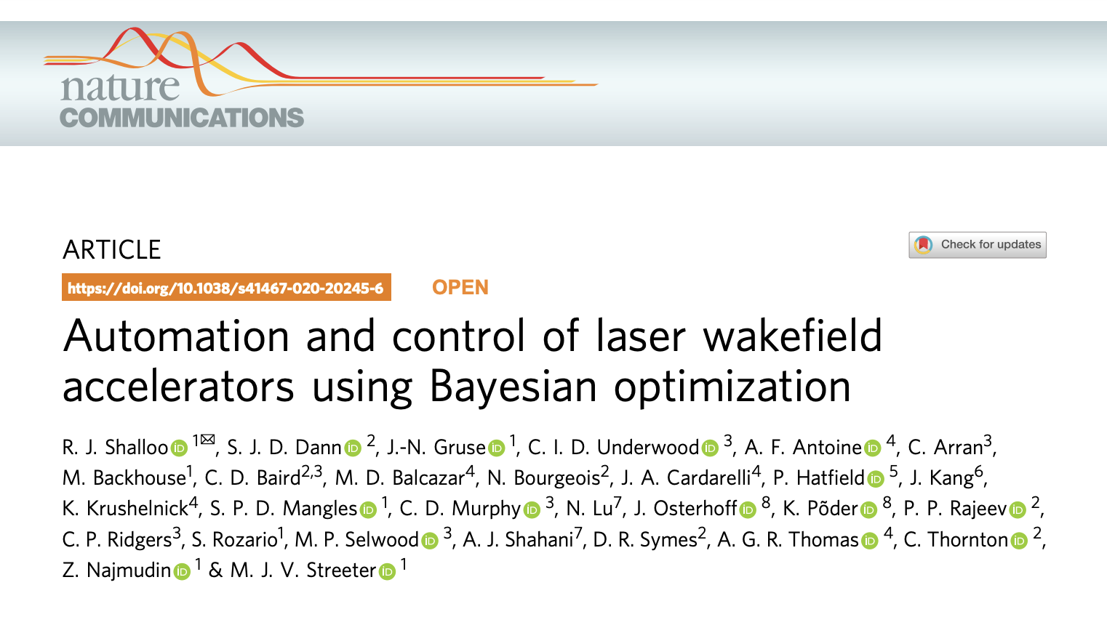
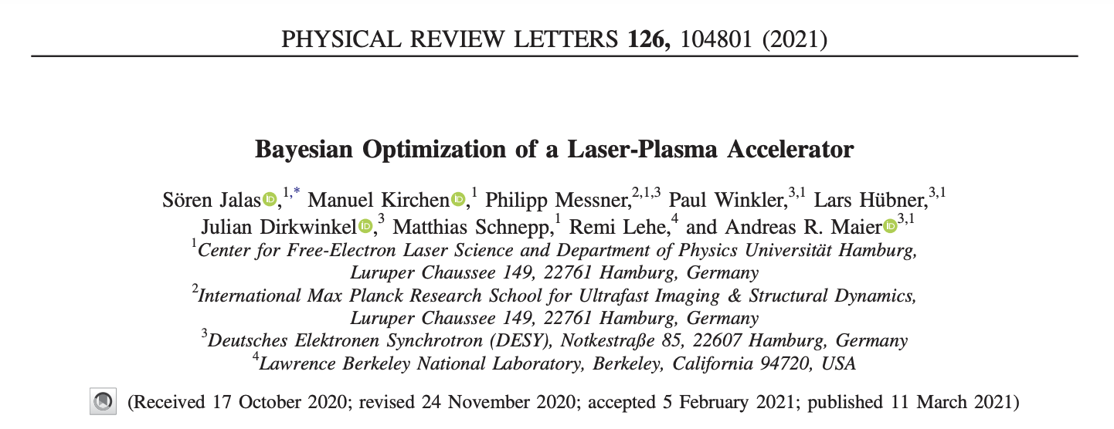
Background and Motivation
R. J. Shalloo et al. (2020)
S. Jalas et al. (2021)

Slide 5
Background and Motivation
Our study:
Can vanilla BO produce low-energy spread, low dark current beams, starting from a very large energy spread?
Can this be done with a simple gas target – no shocks, localised dopant regions, etc.
Can it be done by only varying the input laser?
R. J. Shalloo et al. (2020)
S. Jalas et al. (2021)

Slide 6
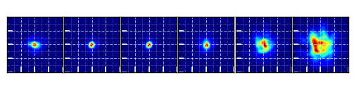
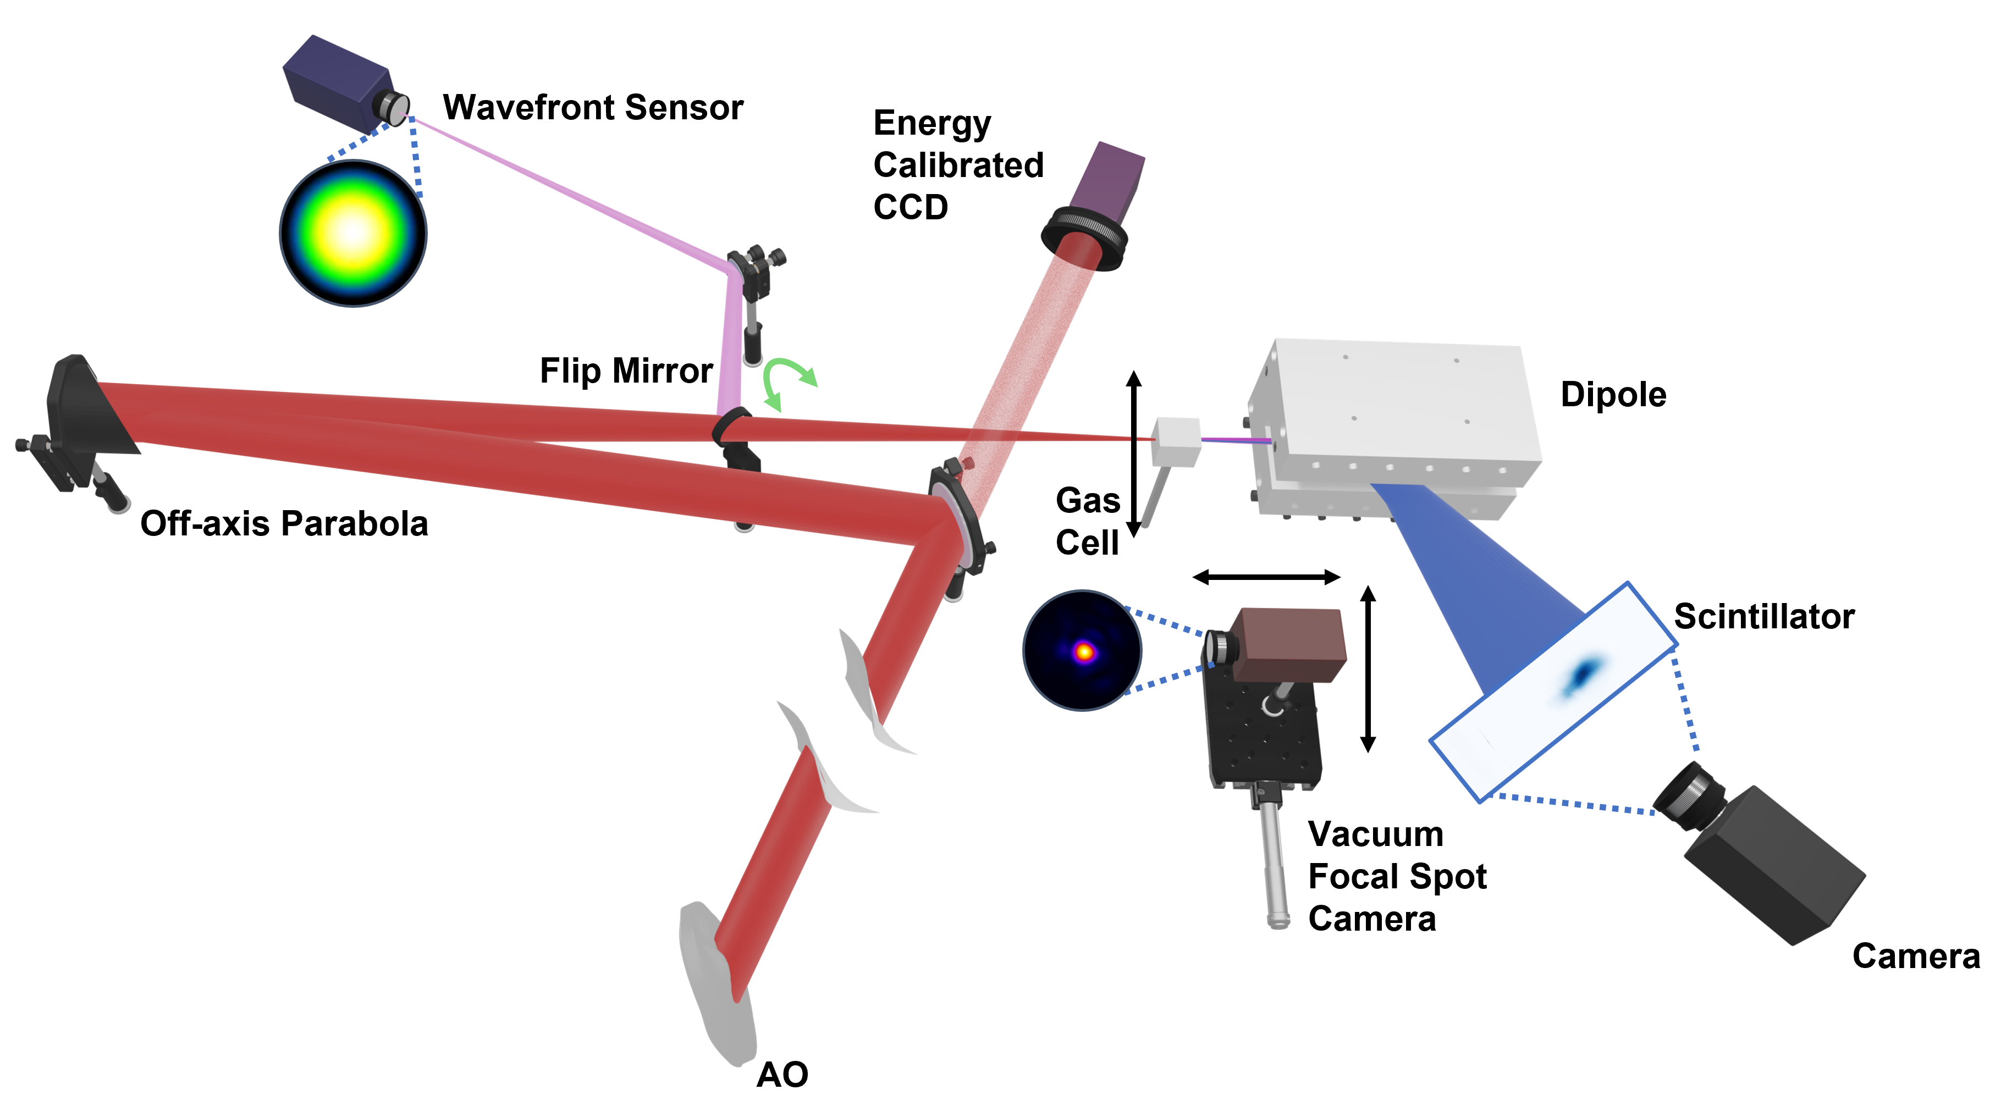

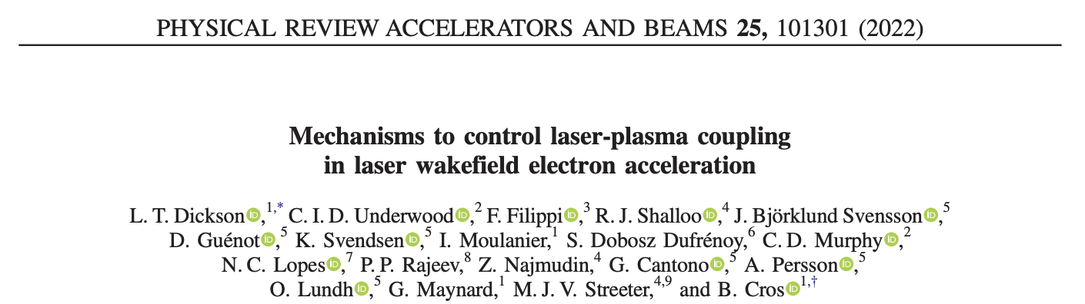
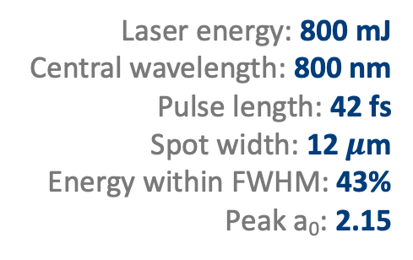
Experiment setup
“Classic” laser wakefield acceleration setup
Laser energy: 800 mJ
Central wavelength: 800 nm
Pulse length: 42 fs
Spot width: 12 $μ$m
Energy within FWHM: 43%
Peak a₀: 2.15
L. T. Dickson et al. (2022)

Slide 7
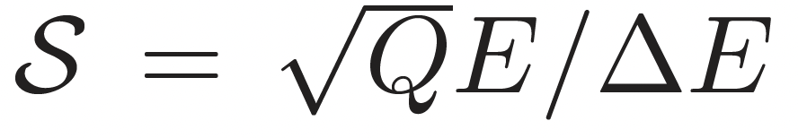
Experimental results

Slide 8
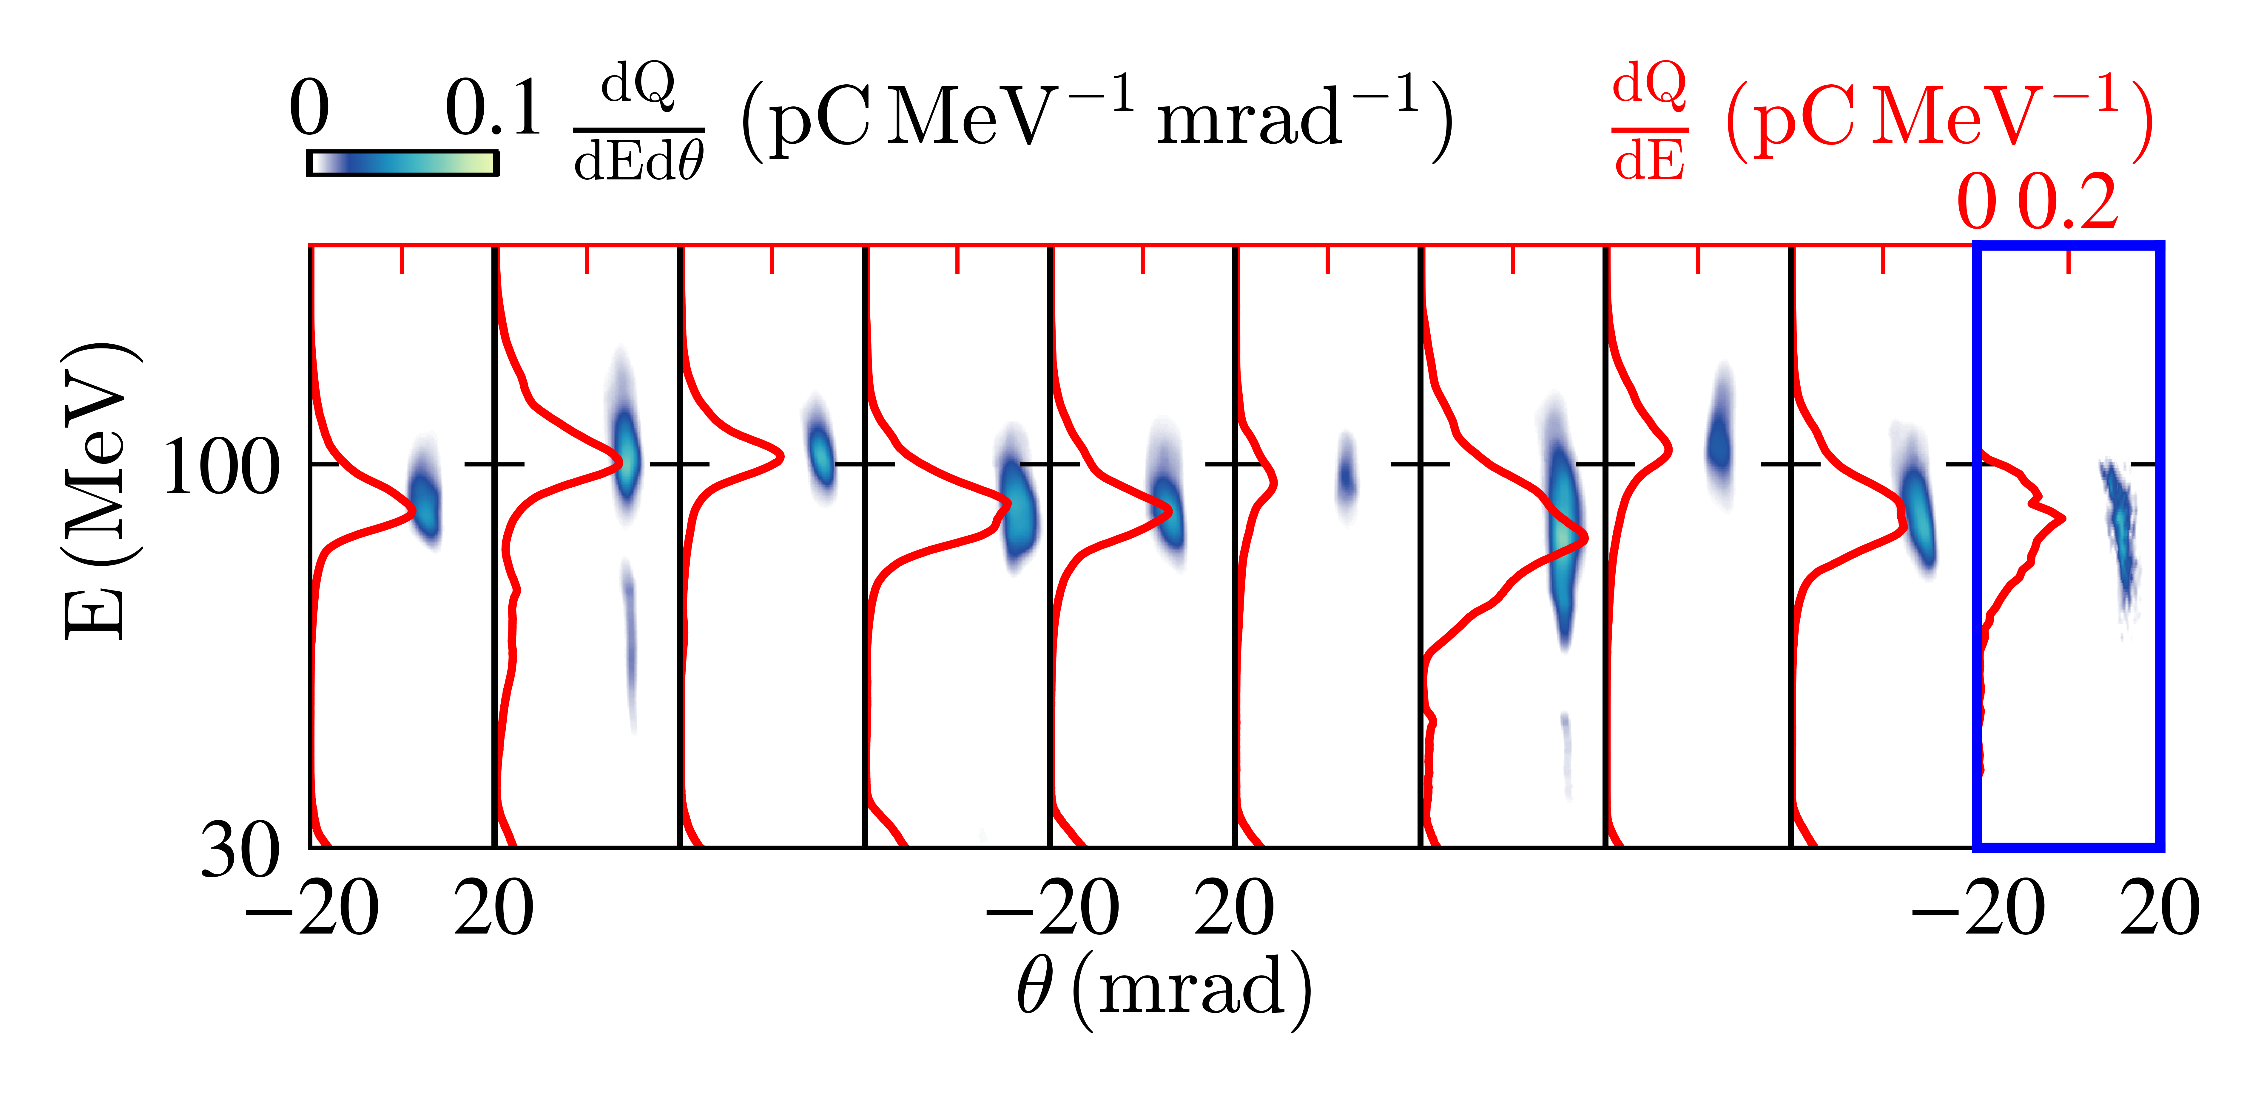
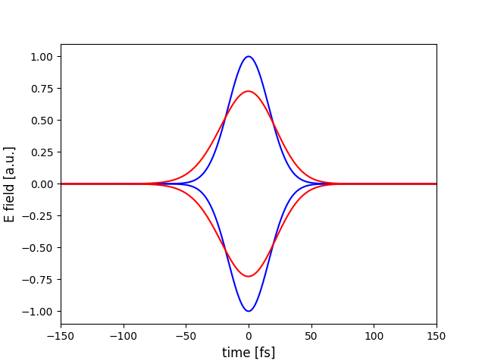
Experimental results
Focus: -0.47mm
(before plateau)
GDD: 500 fs2
TOD: -3300 fs3
FOD: +4485 fs4

Slide 9
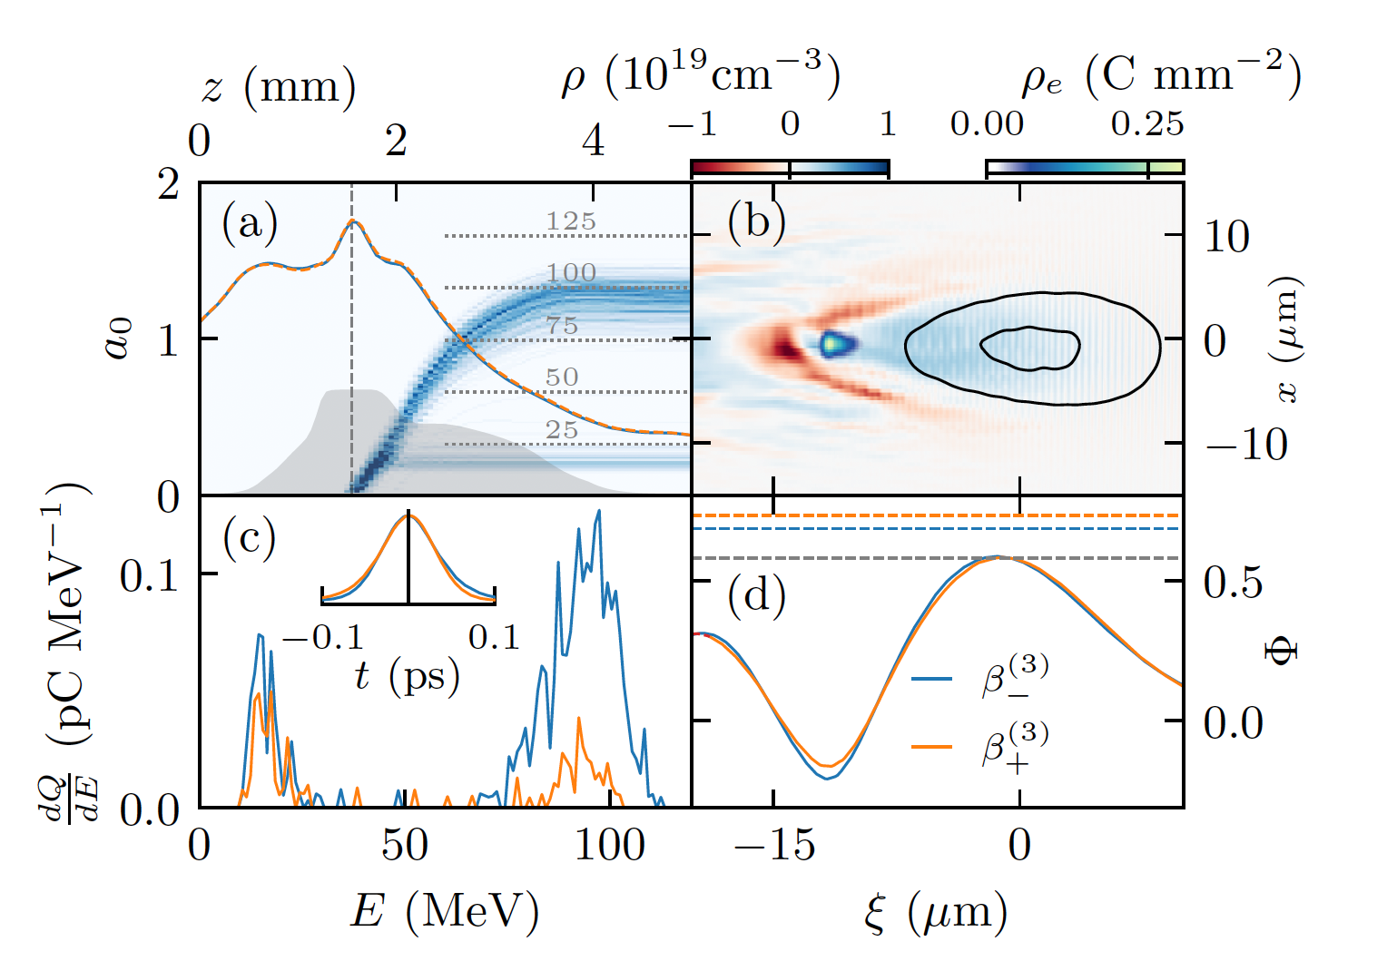
Demonstrating the sensitivity to temporal shape
PIC simulations in FBPIC
Using a realistic reconstructed laser spatial intensity and phase profile
Focal position and chirp work together to localise injection
Optimial TOD matches pulse shape to the wake to deepen the potential

Slide 10
Simulation setting
2

Slide 11
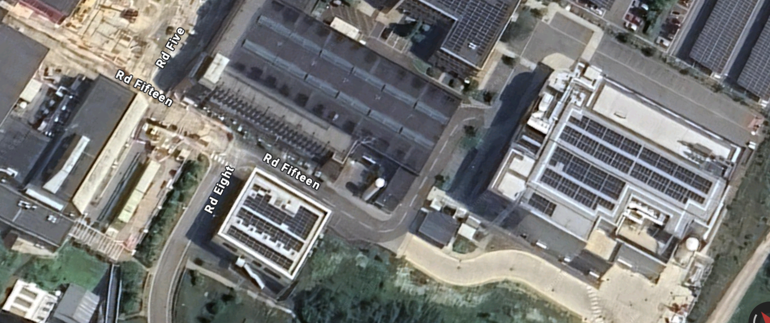
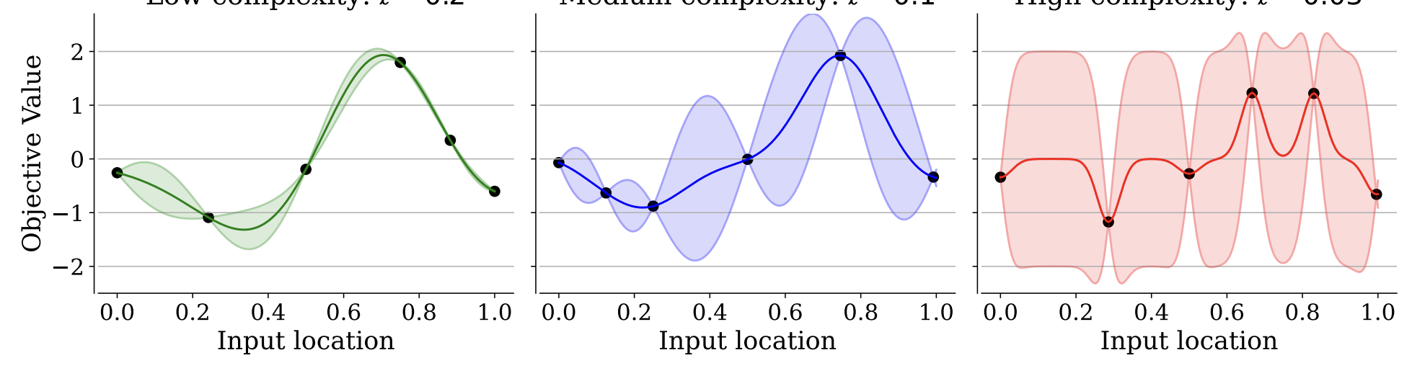
Algorithmic optimisation motivation
Astra-Gemini vs EPAC
Bigger lasers mean more expensive simulations
Greater target flexibility – dimensionality is growing
Domain size/scale length ratio can be much larger
Different users want competing objectives
Increasing complexity
C. Hvarfner et al. (2021)

Slide 12
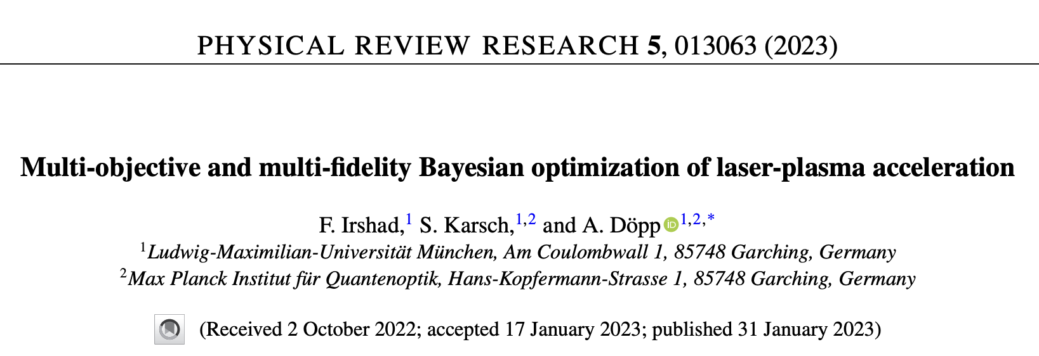
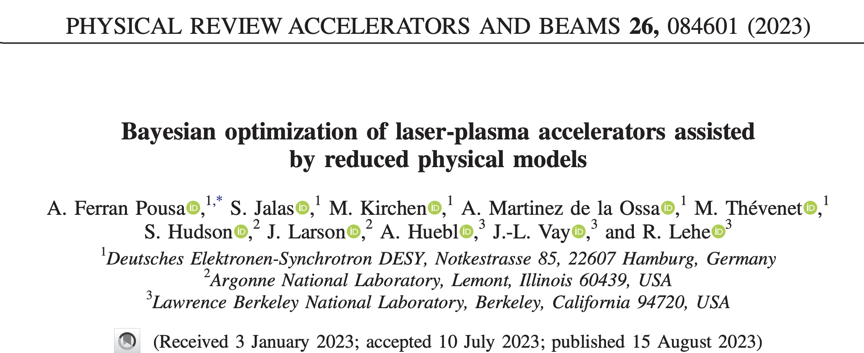
Multi-objective BO and Multi-Task BO
Multi-Objective Bayesian Optimisation
Multi-Task Bayesian Optimisation
Determining optimal tradeoffs between objectives
Attempting to maximise the hypervolume enclosed by the best achieved objectives in the output space
Example: Energy-charge trade-off
Transfer learning between discrete settings
Maximise the objective of the main ‘online’ task
Example: transfer learning between simulation codes
F. Irshad et al. (2023)
A. Ferran Pousa et al. (2023)

Slide 13
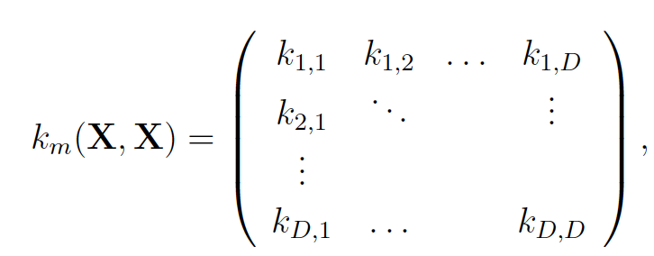
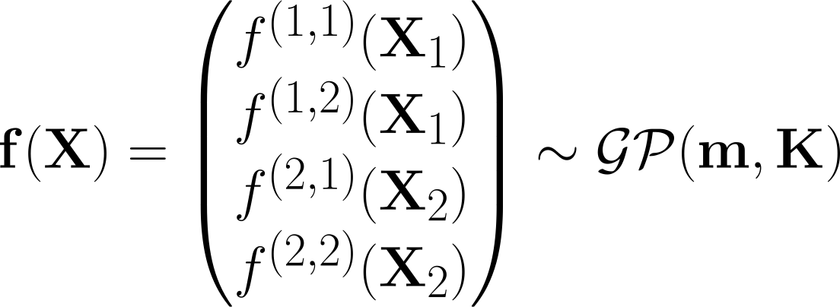




MT-MOBO for inter-task Parato front optimisation
MT-MOBO schematic for two tasks and two objectives
Kenel mixes task and spatial information for restricted transfer learning
Objective 1
Objective 2
Expected hypervolume improvement
Task 1:
$$f^{1,1}(X_{1})$$
$$f^{1,2}(X_{1})$$
Inter-task knowledge transfer
Task 2:
$$f^{2,1}(X_{2})$$
$$f^{2,2}(X_{2})$$
Outperforms regular MOBO on benchmark problems
Surrogate model maps from inputs to a vector with one entry for each objective-task pair.
M. P. Backhouse et al. (2025) (submitted)

Slide 14



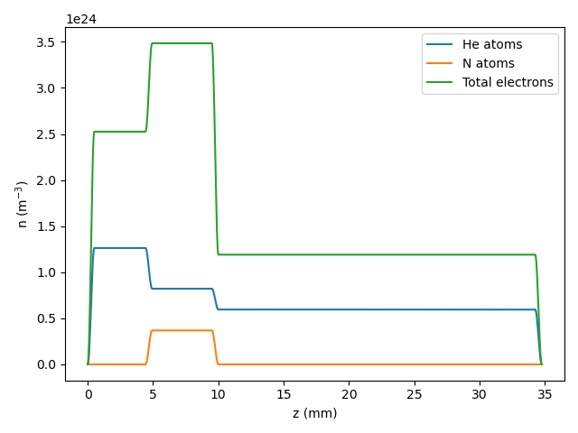
Example – FEL injector from EPAC
Toy problem: explore possible gas targets for an LWFA based FEL injector
FEL parameter:
Total Power
Lasing wavelength
Optimisation metric 1: Peak energy (E)
Optimisation metric 2: Brightness (B)
 | Online | Offline
Resolution (z) | 1/20 | 1/10
PPC | 32 | 16
Radius | 120um | 100um
Speedup |  | >5x
L₁
L₂
L₃
n_{e,2}
n_{e,1}
n_{e,3}
N₂%
25 September 2025

Slide 15
Results – FEL ready beams located after only 10 iterations
M. P. Backhouse et al. (2025) (submitted)
Ionisation injection optimised by a density up ramp to rephase the electron beam
Brightnesses of > 10¹⁶ A m⁻² generated after fewer than 10 optimisation epochs.

Slide 16
Summary
Demonstrated Bayesian optimisation in a “classic” LWFA setup
  Starting from a broadband spectrum
  Maximised spectral density with only laser parameters
Identified the key role pulse shape plays in maximising performance
  Positive skew required for maximising beam charge
Introduced Multi-Task, Multi-Objective Bayesian Optimisation
  Well-suited to large complex parameter spaces with multiple competing objectives.
Used to explore the energy-brightness frontier for FEL applications
  - Configurations that could generate brightnesses > 10¹⁶ A m⁻² were found.

Slide 17






Thanks for listening!
Acknowledgements
L. T. Dickson, I. Moulanier, F. Massimo,
C. C. Cobo, F. Filippi, C. Gustafsson,
E. Lofquist, K. Svendsen, M. J. V. Streeter,
R. J. Shalloo, O. Vasilovici, C. Ballage,
S. J. D. Dann, C. D. Murphy, Z. Najmudin,
S. Dobosz Dufrénoy, O. Lundh, B. Cros

Slide 18
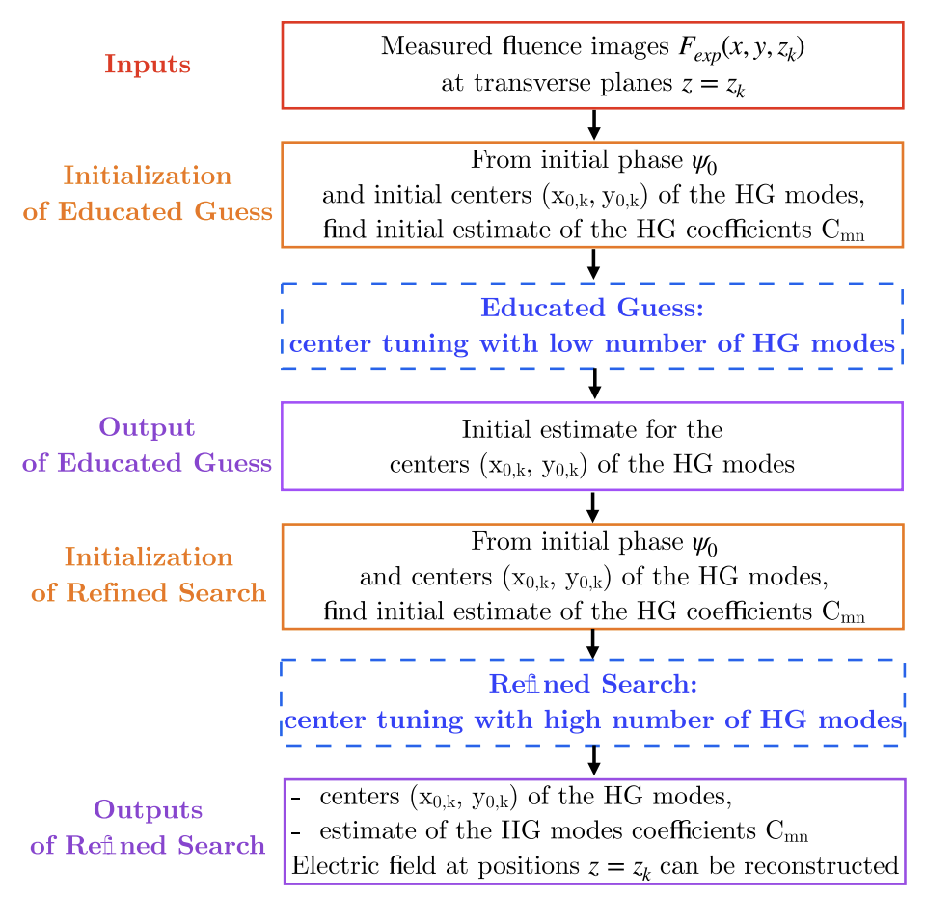
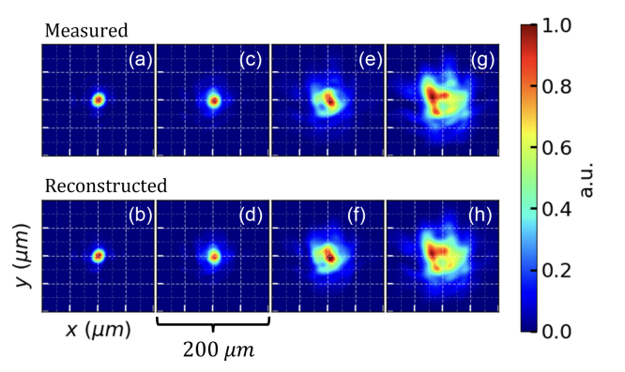
Modelling spatial and spectral phase

Slide 19
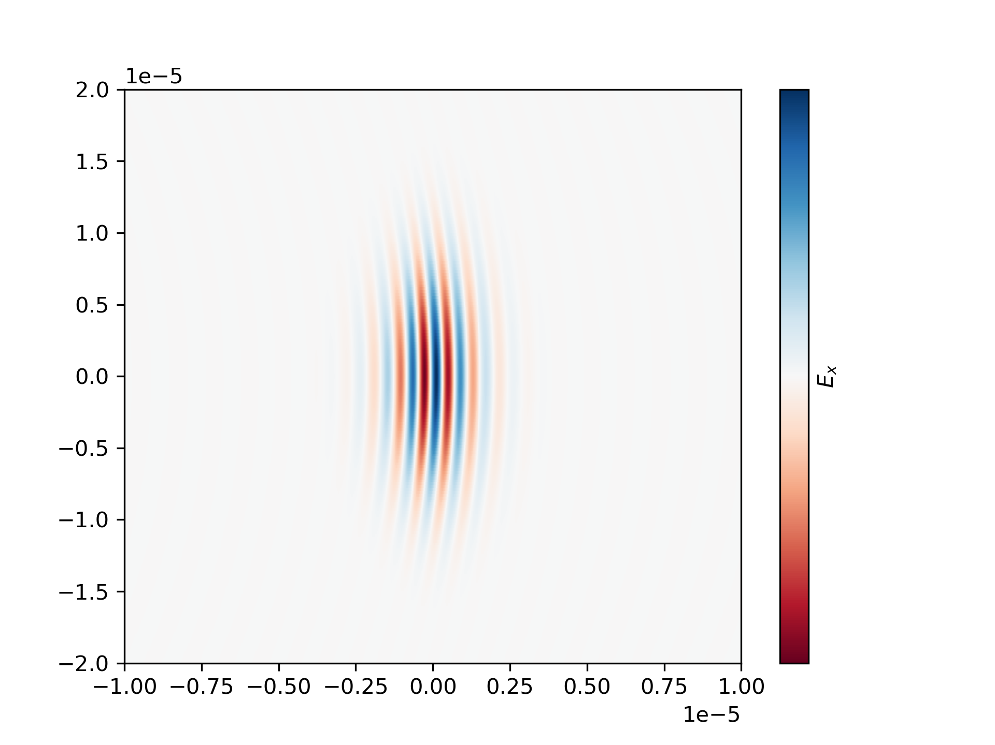
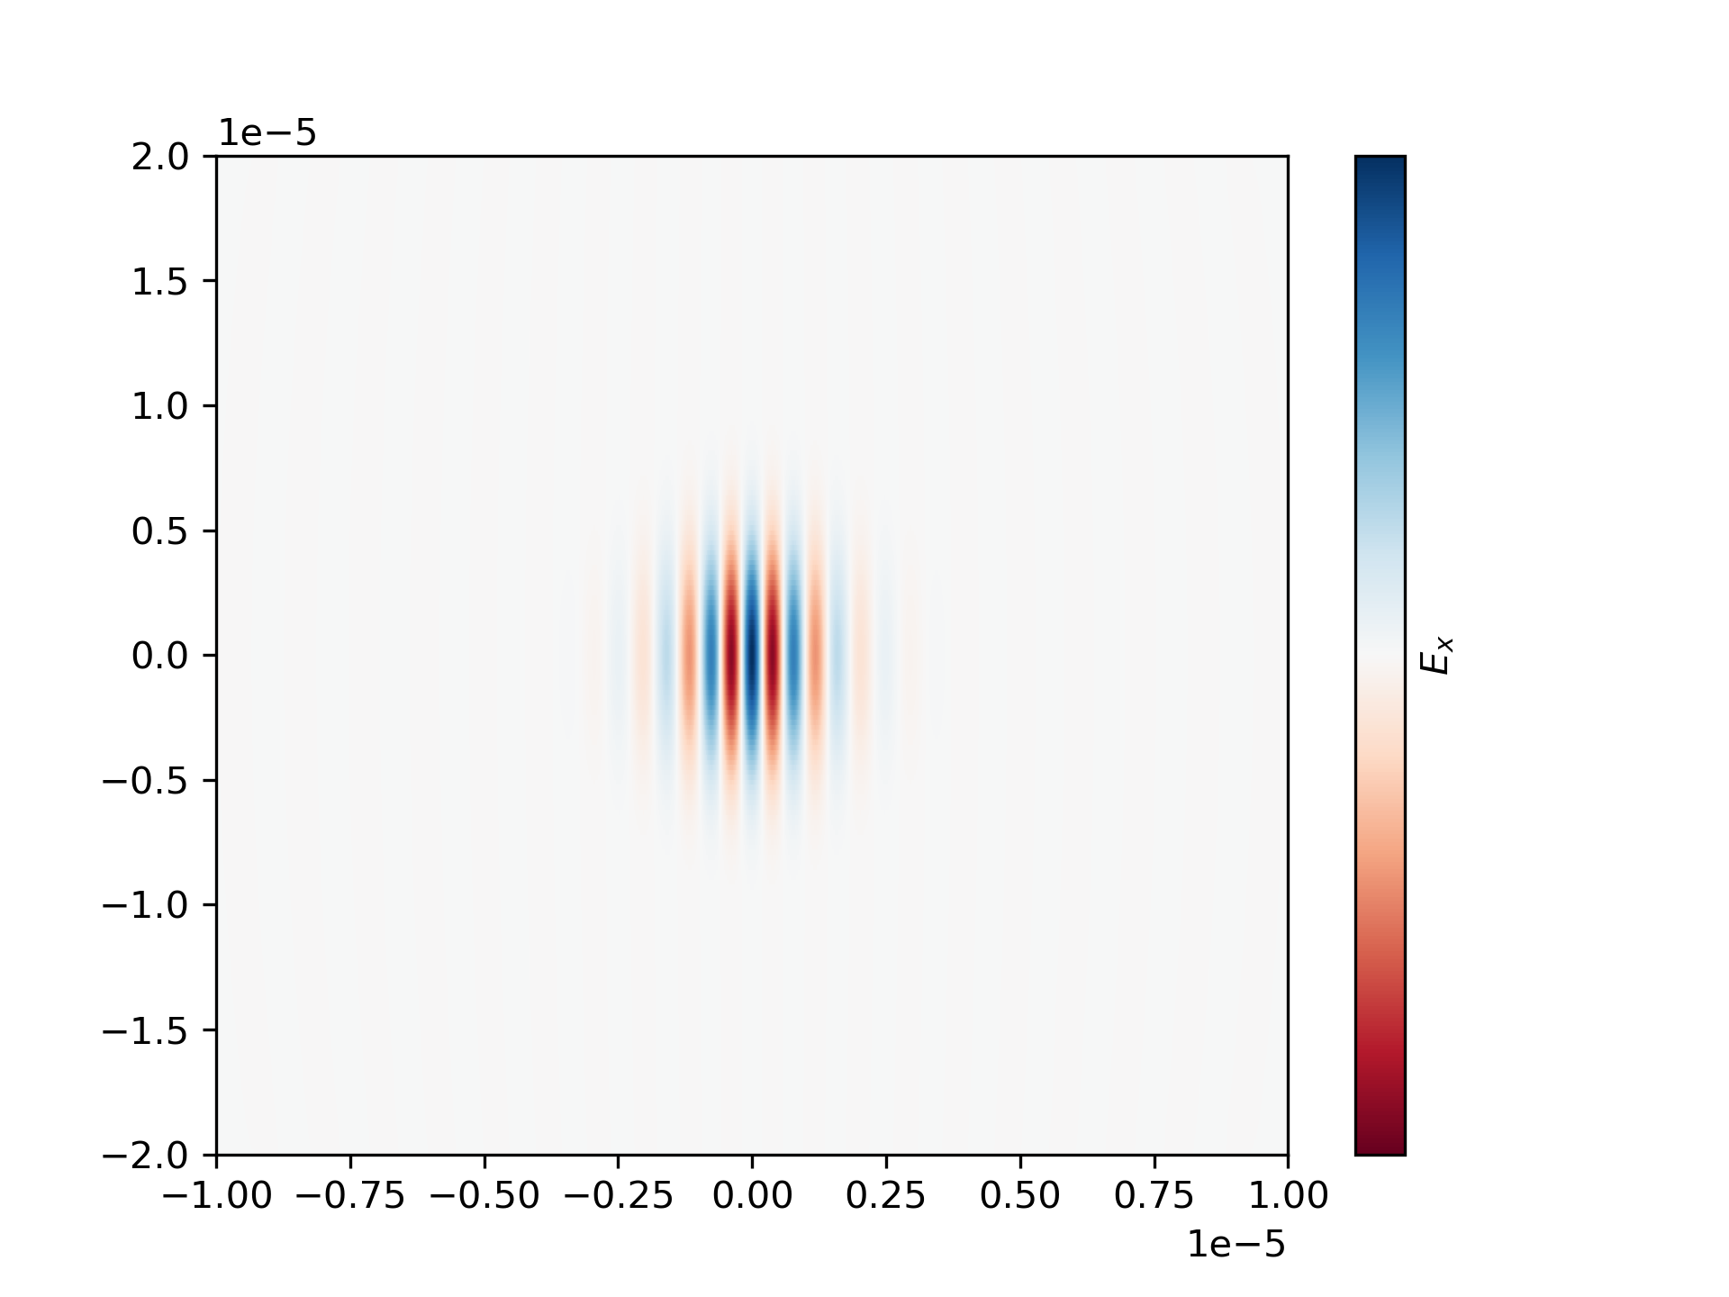
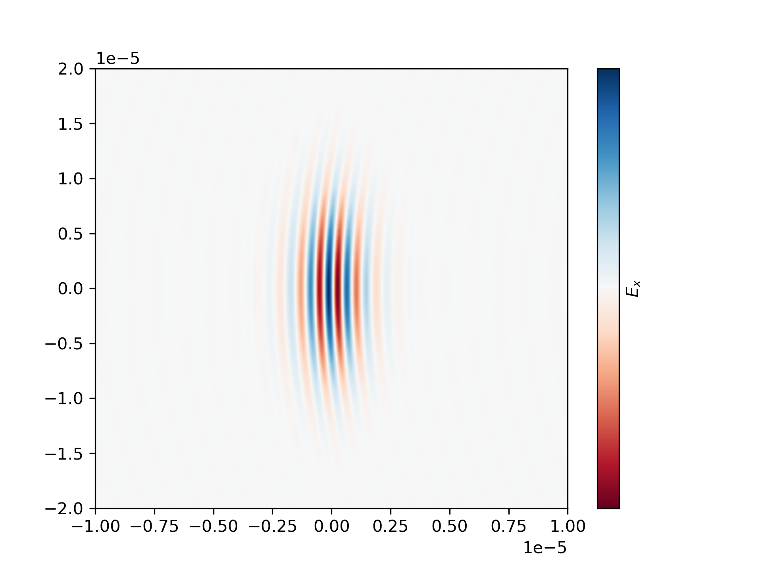

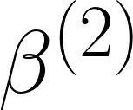
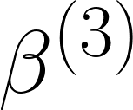
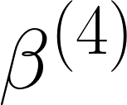
Input and output
Negative
0
Positive
Focus
Propagation
Chirp
TOD
FOD

Slide 20
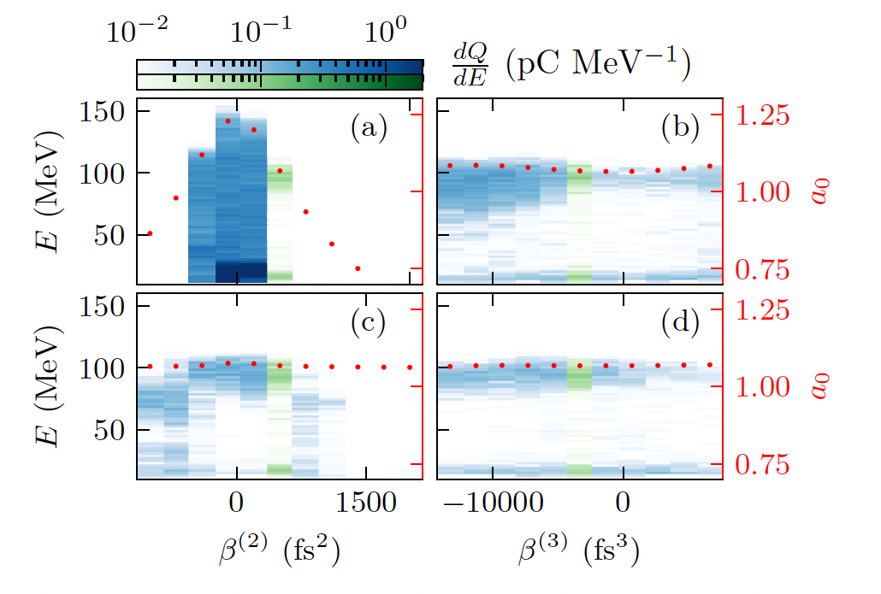
Demonstrating the sensitivity to temporal shape
Parameter scans around the optimum
Injection mechanism
  Highly sensitive to pulse shape independently of intensity
  Relies on carefully matching the longitudinal laser profile to the wake at injection

