Slide 1



Start-to-End Simulations for the Extreme Photonics Application Centre (EPAC)
Oliver Finlay
Central Laser Facility
Rutherford Appleton Laboratory

Slide 2
Talk Outline
EPAC Overview.
Design of vEPAC simulation toolkit.
The Galaxy project.
First results.

Slide 3
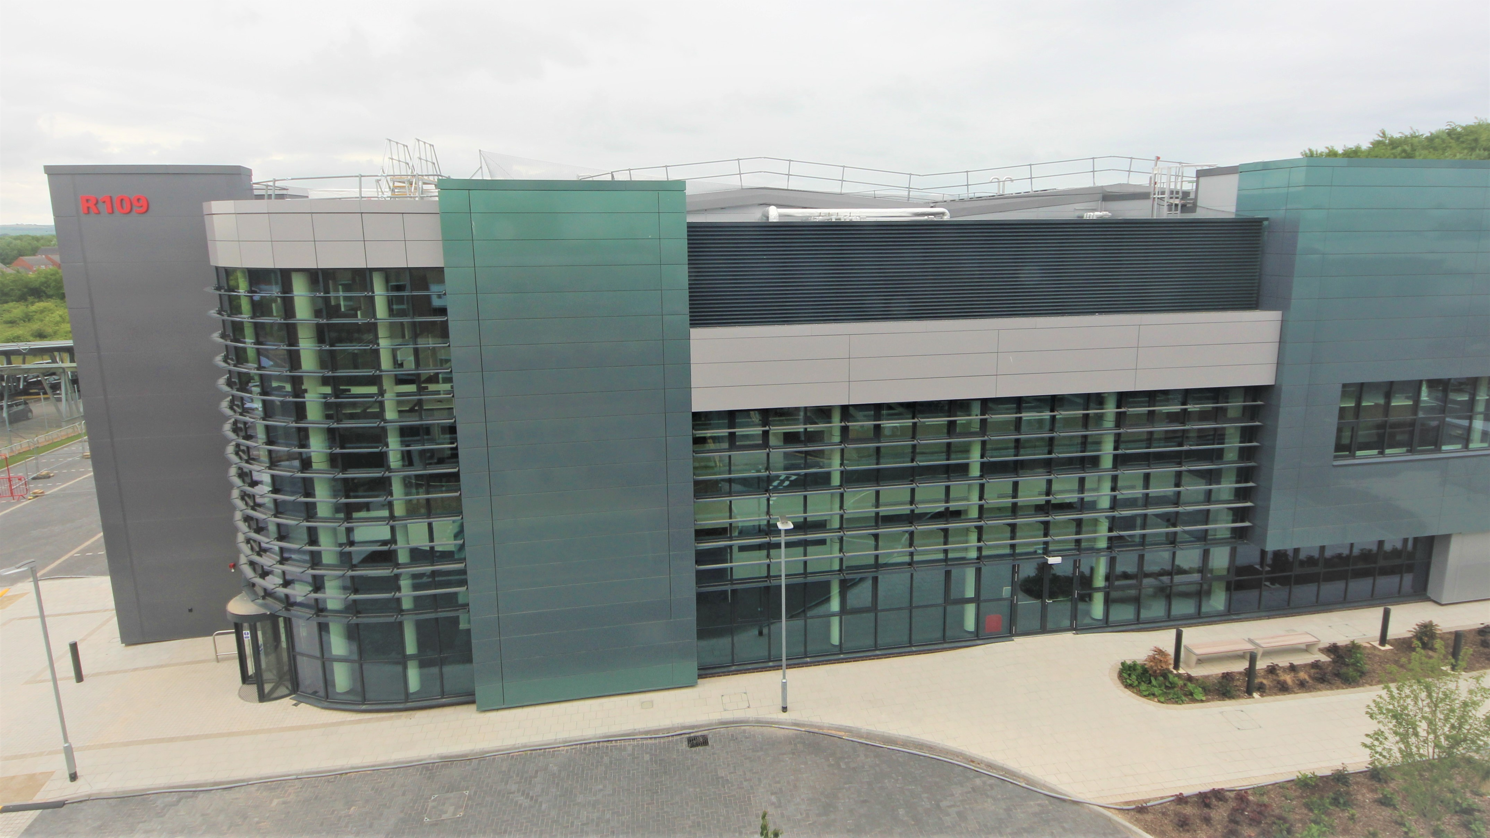
Extreme Photonics Applications Centre
State-of-the-art 10 Hz, 1 PW laser with two independent experimental areas.
Funded with a focus on industrial applications.
Operational in 2026/2027.
clf.stfc.ac.uk/Pages/EPAC-introduction-page.aspx

Slide 4
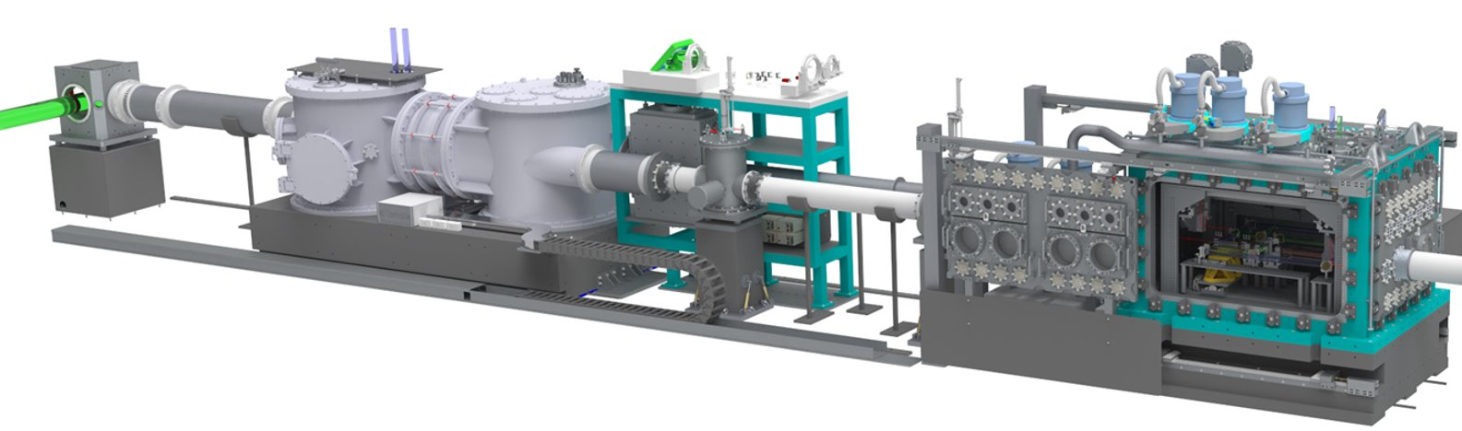
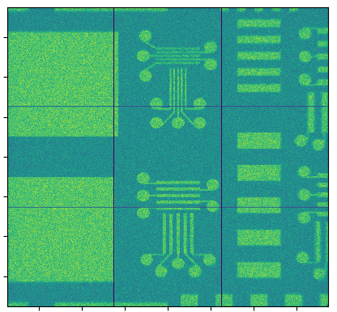
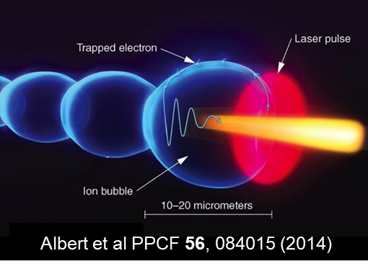
EPAC Experimental Area 1
Final turning mirror
Adaptive optics and parabola
Target chamber
LASER pulse
Object
source
Applications
X-ray imaging
X-ray absorption spectroscopy
FEL driver
Activation analysis
Radiation damage
Radiographs
Image © STFC Alan Ford

Slide 5
vEPAC design
vEPAC
Composition
Density
Gas Target
Feedback
Feedback
Plasma
Radiation
Transport
Spatial
Temporal
Spectra
Radiation
generation
Laser
Object CAD
Detector
Fields

Slide 6
vEPAC Future Functionality
Interferometry
Target Density Profile
Radiation Generation
Radiography/Tomography
CFD Simulation
PIC
Diagnostics
Experimental Measurement
E-Beam
Transport
Laser
Laser front end, amplifier, compressor, transport modelling
FEL

Slide 7
vEPAC Purpose
vEPAC aims to allow a non-specialist to simulate of a variety of EPAC configurations.
It will use existing open-source tools throughout, with tools initially chosen based on experience among the development team.
Code will be open-source, accessible via Github and our scientific computing department web page.
oliver.finlay@stfc.ac.uk

Slide 8
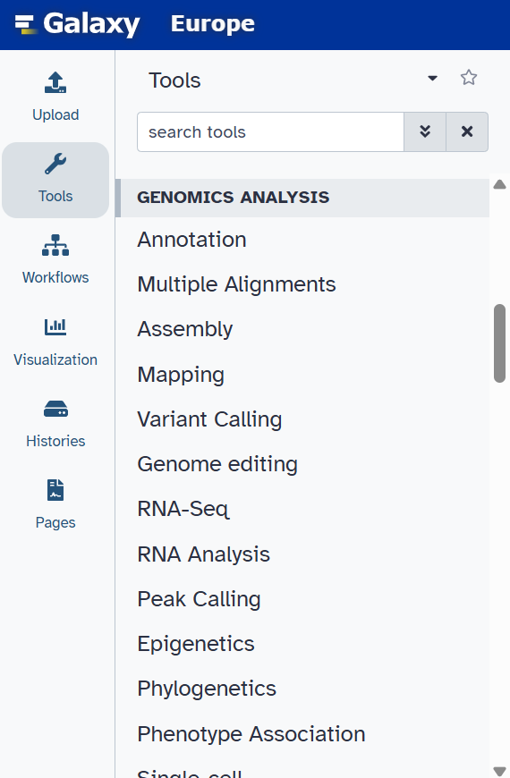
Galaxy Project
Web based data analysis platform with an active, international user community.
User base is predominantly in biomedical science.
Tools can be added by Galaxy project admins.
https://galaxyproject.org/

Slide 9
vEPAC Simplified Workflow
Target Profile Library
PIC
(FBPIC)
E-Beam
Transport
(Geant4)
Bremsstrahlung Generation
(Geant4)
Radiography
(Geant4)
Laser Definition
(LASY)
https://github.com/LASY-org/lasy
A spectral, quasi-cylindrical and dispersion-free Particle-In-Cell algorithm, R.Lehe et al., Computer Physics Communications, 203 (2026) 66-82
Geant4 - A Simulation Toolkit, S. Agostinelli et al., Nucl. Instrum. Meth. A 506 (2003) 250-303

Slide 10
vEPAC Simplified Workflow
Optimas-based Orchestrator
Target Profile Library
PIC
(FBPIC)
E-Beam
Transport
(Geant4)
Bremsstrahlung Generation
(Geant4)
Radiography
(Geant4)
Laser Definition
(LASY)
https://github.com/LASY-org/lasy
A spectral, quasi-cylindrical and dispersion-free Particle-In-Cell algorithm, R.Lehe et al., Computer Physics Communications, 203 (2026) 66-82
Geant4 - A Simulation Toolkit, S. Agostinelli et al., Nucl. Instrum. Meth. A 506 (2003) 250-303
Bayesian optimization of laser-plasma accelerators assisted by reduced physical models, A. Ferran Pousa et al, Phys. Rev. Accel. Beams 26 (2023) 084601

Slide 11
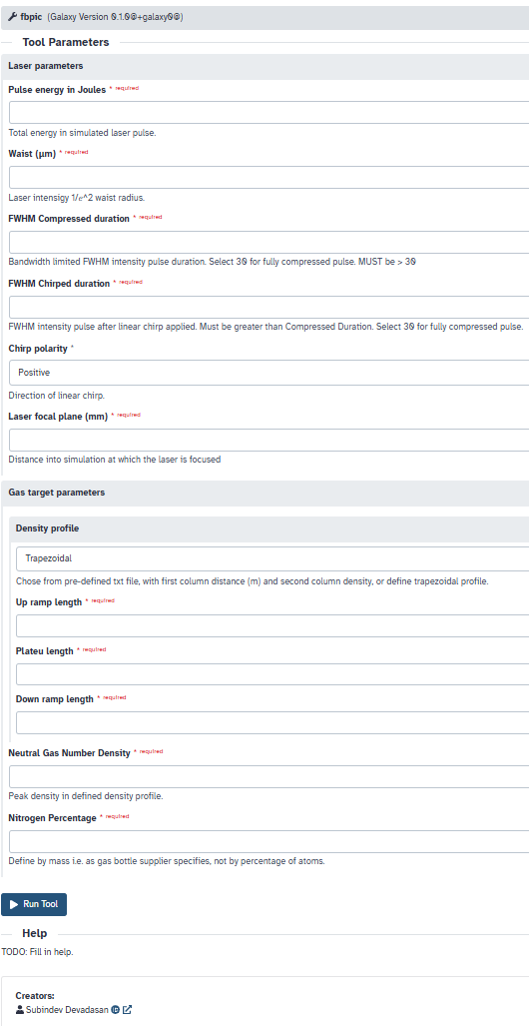
FBPIC Tool

Slide 12
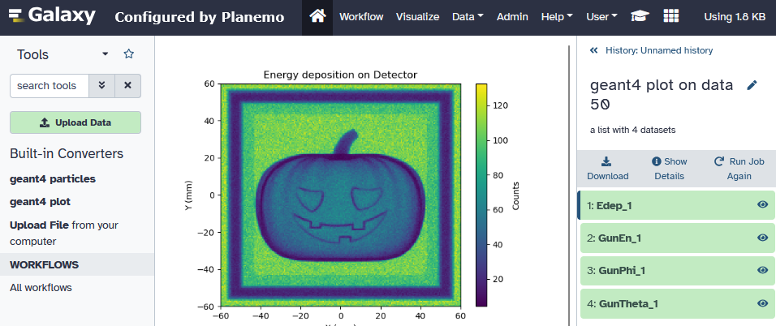
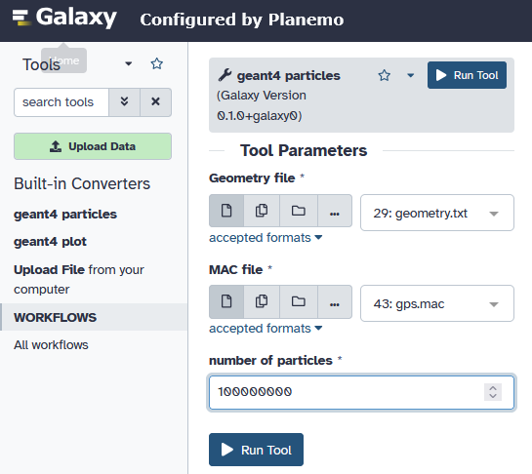
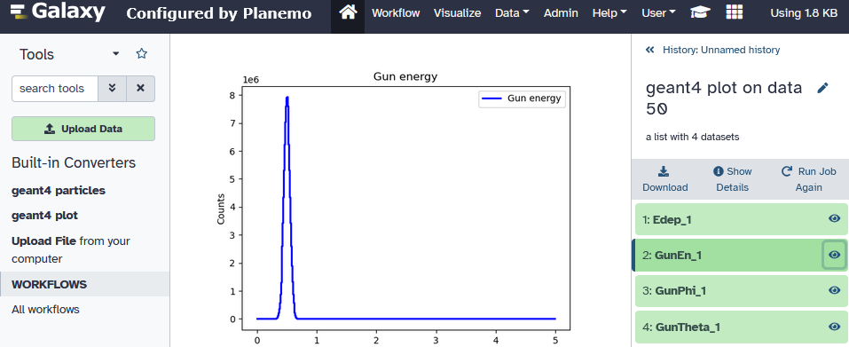
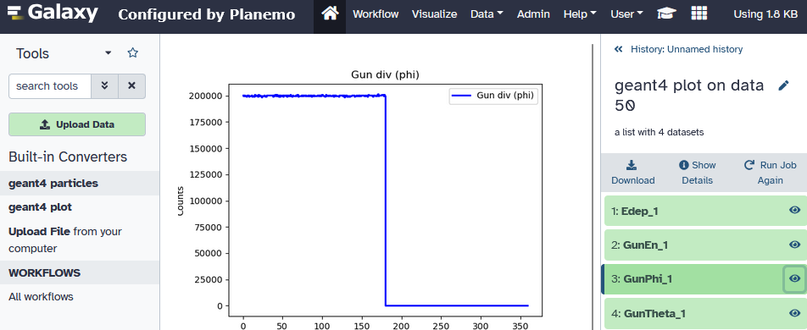
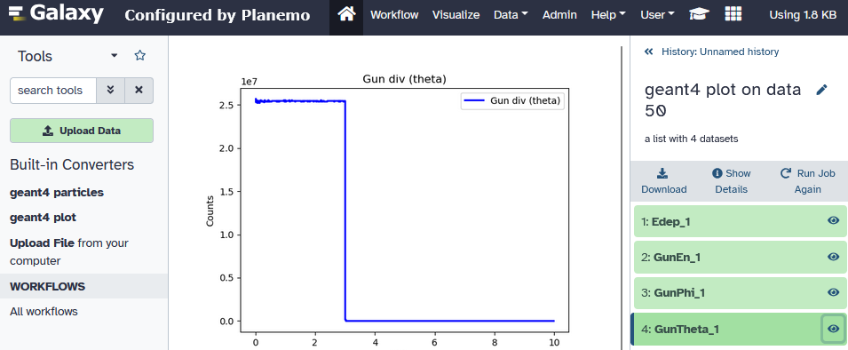
Geant4 Tools
Radiograph
Energy spectra
Creating G4 tool
Output
Phi
Angular variation
Theta

Slide 13
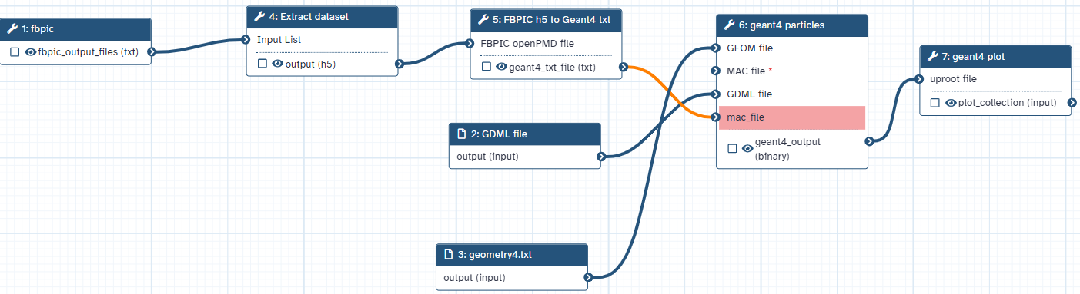
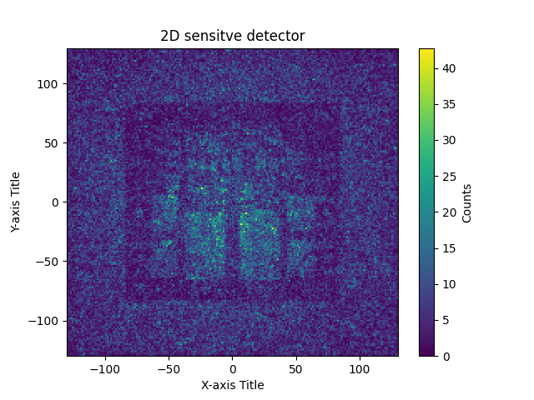
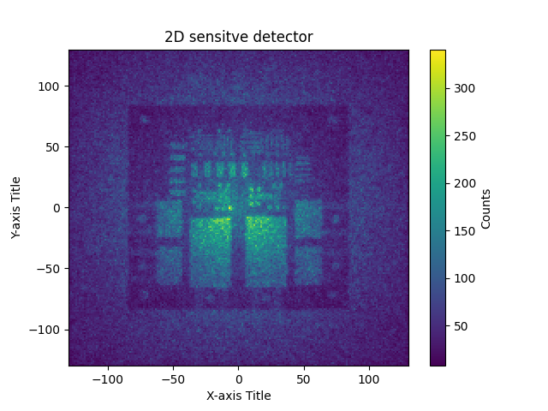
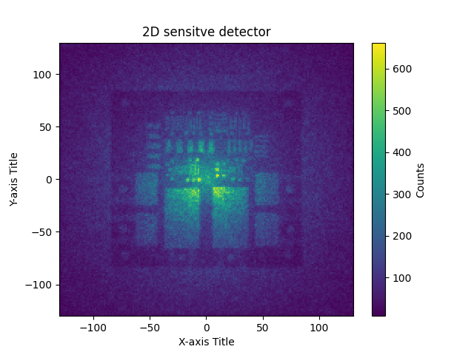
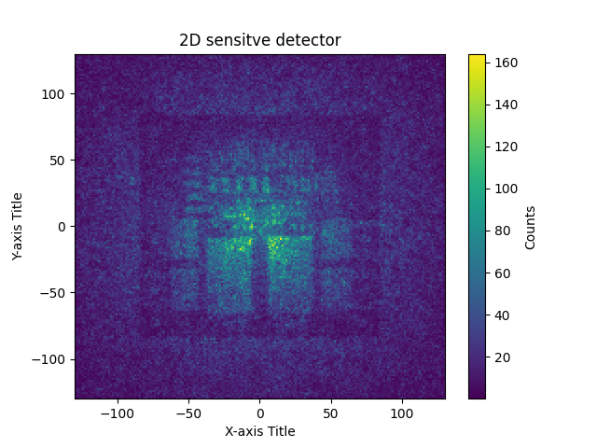
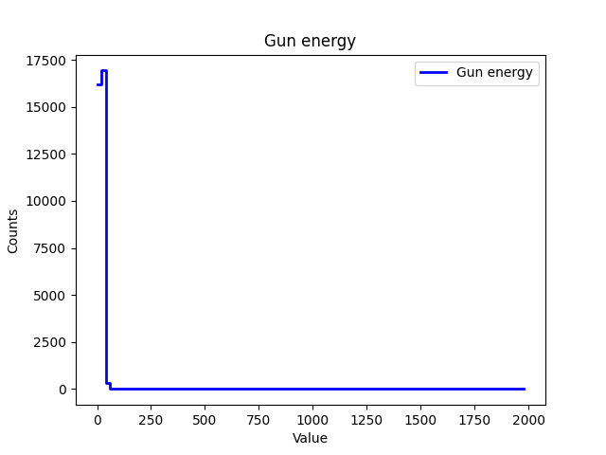
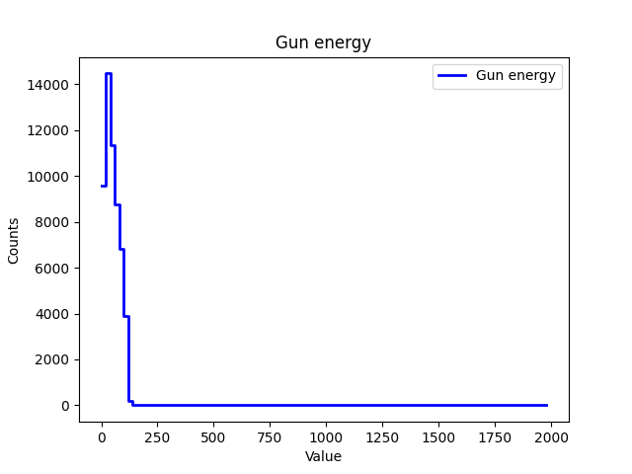
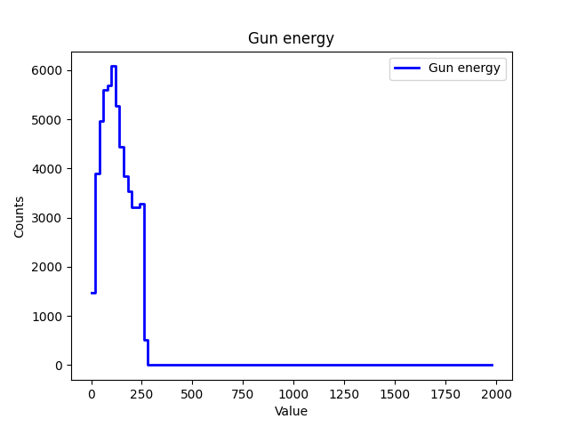
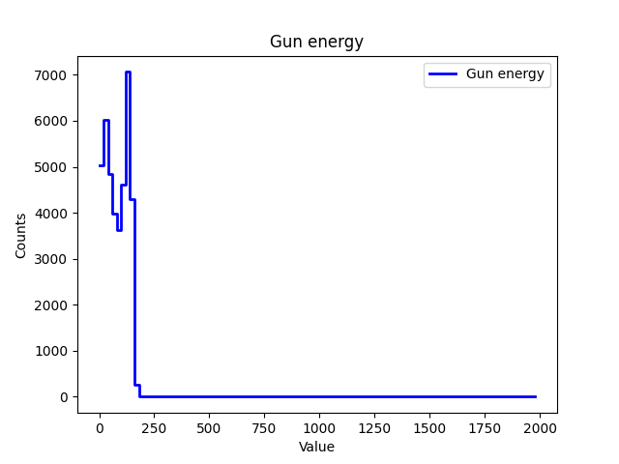
Workflow + results of parameter scans
gas cell length →
0.5mm
1mm
2mm
5mm
Energy deposited
in scintillator after target
In Geant4 →
Electron beam
imported from FBPIC →

Slide 14
Next Steps
Adding “Workflow” scanning and optimisation procedures.
Increasing number of tools and improving tool functionality.
Use of ML techniques on stored data.
Adding experimental data analysis tools as well.

Slide 15



Summary
Team
Framework for start-to-end simulations for EPAC (vEPAC) has been designed.
Implementation has begun using the Galaxy platform.
Improvement and expansion of this project will continue over the coming years.
Kirill Fedorov, Archit Bhardwaj, Chris Armstrong, Meg Savage, Rajeev Pattathil, Dan Symes
Subindev Devadasan, Patrick Austin, Milan Kumar, Ify Igu, Leandro Liberio

Slide 16






Science and Technology Facilities Council
@STFC_matters
Science and Technology Facilities Council

