Slide 1



Exascale Plasma Accelerator Simulations with PIConGPU
Finn-Ole Carstens^{1,2}, Michael Bussmann¹, Alexander Debus¹, Arthur Hirsch-Passicos¹,
Brian Marré^{1,2}, Franz Pöschel^{1,3}, Jeffrey Kelling^{1,4}, Jessica Tiebel^{1,2}, Julian Lenz^{1,3},
Klaus Steiniger^{1,3}, Paweł Ordyna^{1,2}, René Widera¹, Richard Pausch¹, Tapisch Narwal^{1,3}, Thomas Kluge¹, Ulrich Schramm^{1,2}
1) Helmholtz-Zentrum Dresden-Rossendorf (HZDR)
2) Technical University Dresden
3) Center for Advanced Systems Understanding (CASUS)
4) Technical University Chemnitz
Institute of Radiation Physics · Laser Particle Acceleration · Finn-Ole Carstens · f.carstens@hzdr.de · www.hzdr.de

Slide 2
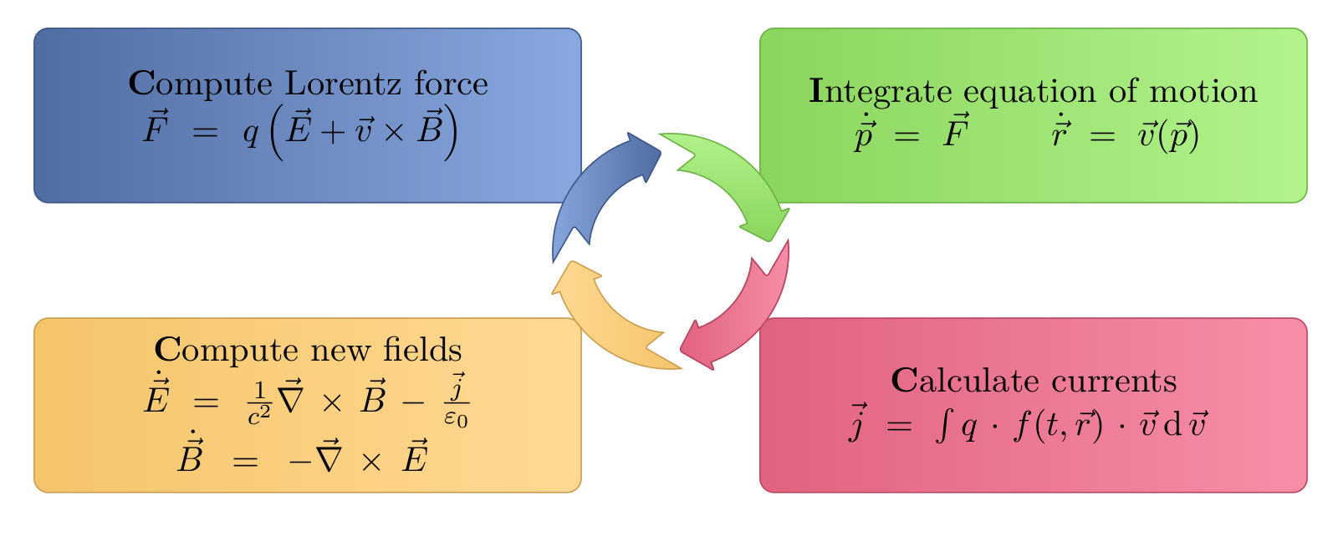
PIConGPU is a Scalable Open Source Particle-in-Cell Code
Solving plasma dynamics on high performance computers
-
-
+
+
-
+
+
-

Slide 3

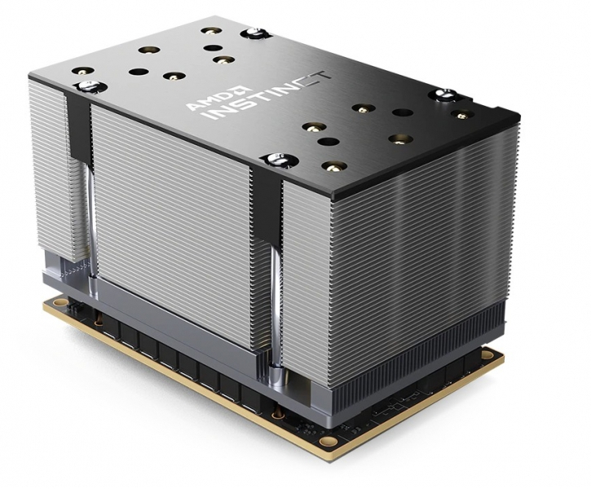
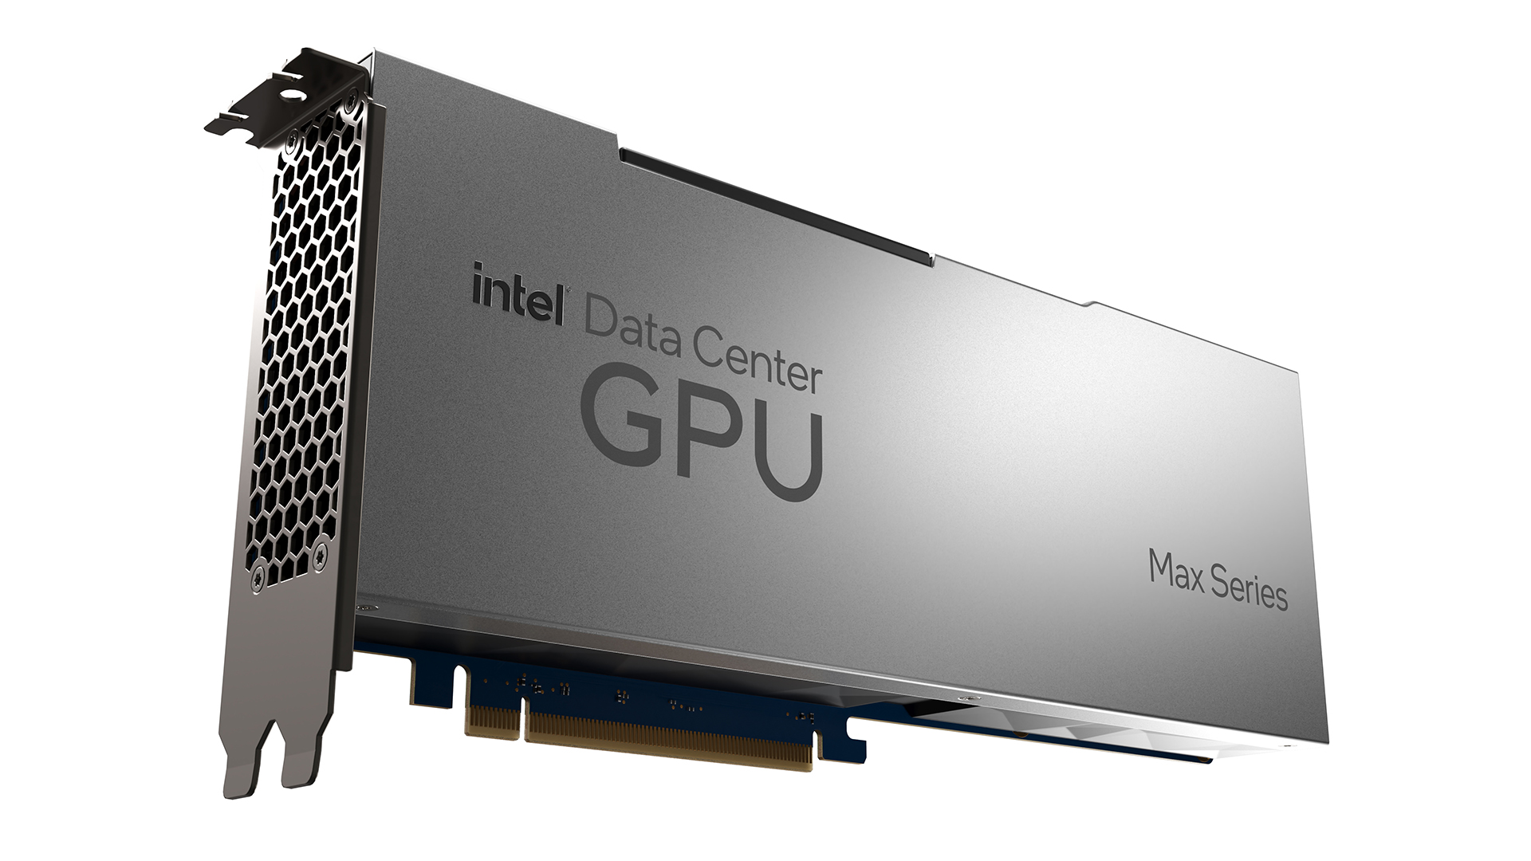
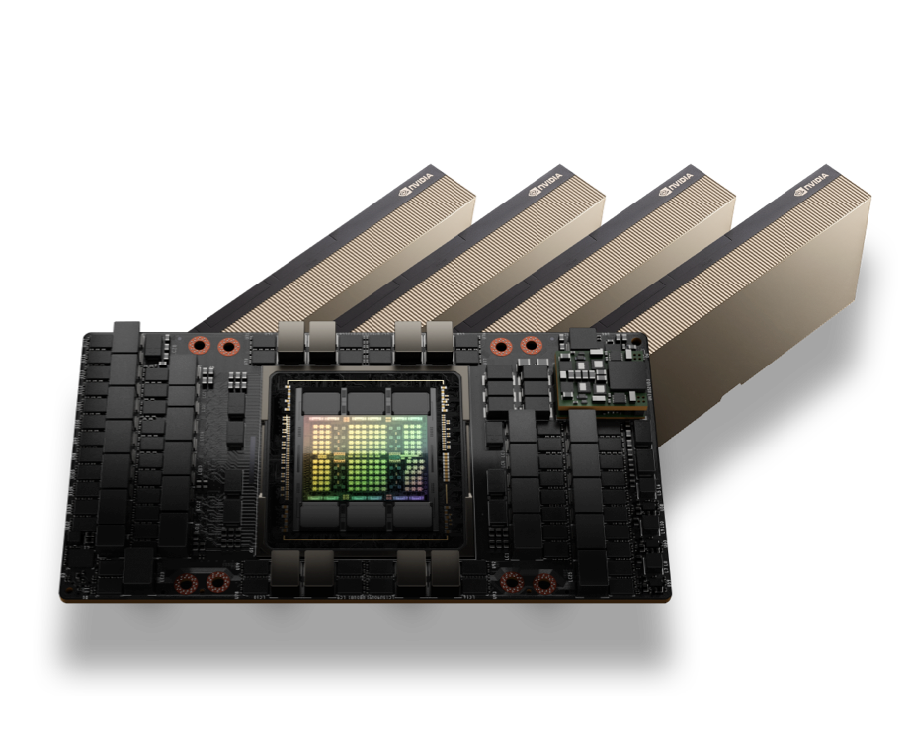
Running on Diverse Modern Hardware Accelerators
enables exascale plasma simulations on all HPCs with no overhead
Rank | Rmax Rpeak | Name | Accelerator (e.g. GPU) cores | Site country
1 | 1,742.00 2,746.38 | El Capitan | 9,988,224 (43,808 × 228 AMD Instinct MI300A) | Lawrence Livermore NL, United States
2 | 1,353.00 2,055.72 | Frontier | 8,451,520 (38,416 × 220 AMD Instinct MI250X) | Oak Ridge NL, United States
3 | 1,012.00 1,980.01 | Aurora | 8,159,232 (63,744 × 128 Intel Max 1550) | Argonne NL, United States
4 | 793.40 930.00 | JUPITER | 3,106,752 (23,536 × 132 Nvidia Hopper H100) | EuroHPC JU, Germany
5 | 561.20 846.84 | Eagle | 1,900,800 (14,400 × 132 Nvidia Hopper H100) | Microsoft, United States
6 | 477.90 606.97 | HPC6 | 2,930,400 (13,320 × 220 AMD Instinct MI250X) | Eni S.p.A, Italy
7 | 442.01 537.21 | Fugaku | 7,630,848 (158,976 x 48 Fujitsu A64FX (ARM)) | Riken Center for Computer Sciene, Japan
8 | 434.90 574.84 | Alps | 1,372,800 (10,400 × 132 Nvidia Hopper H100) | CSCS Swiss, Switzerland
9 | 379.70 531.51 | LUMI | 2,566,080 (11,664 × 220 AMD Instinct MI250X) | EuroHPC JU, Finland
10 | 241.20 306.31 | Leonardo | 1,714,176 (15,872 × 108 Nvidia Ampere A100) | EuroHPC JU, Italy

Slide 4
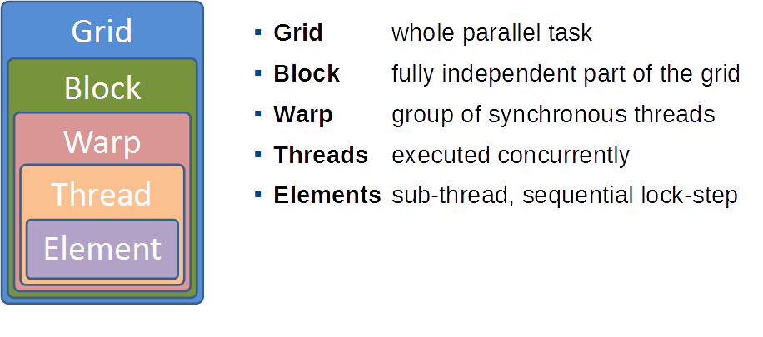
How does PIConGPU Reach Hardware Portability?
How does the alpaka hardware abstraction layer work?
Data parallelism in modern hardware:
Zenker E. et al. (2016) IEEE Xpress DOI:10.1109/IPDPSW.2016.50
Zenker E. et al. ISC (2016) ISC High Performance DOI:10.1007/978-3-319-46079-6_21
Matthes A. et al., (2017) ISC High Performance (pp 496-514) DOI: 10.1007/978-3-319-67630-2_2

Slide 5
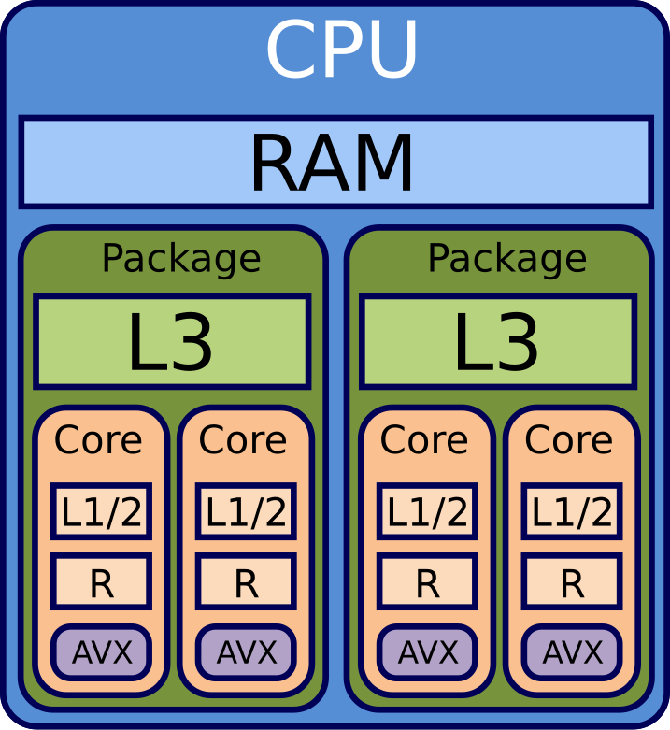
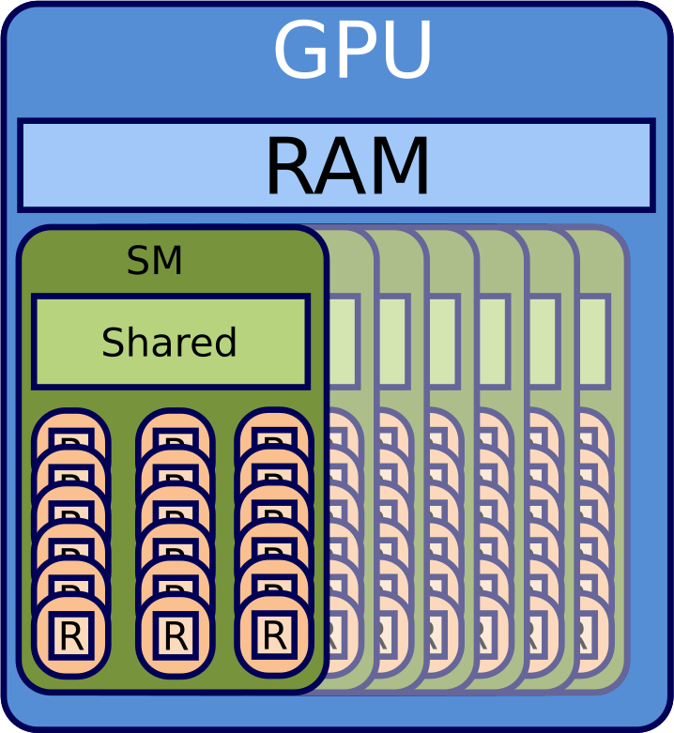
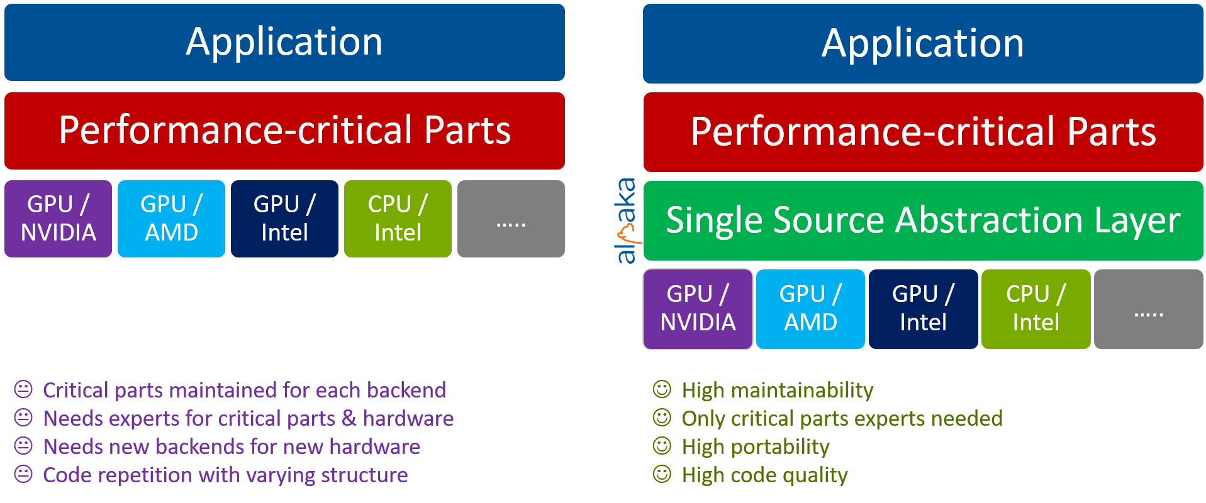
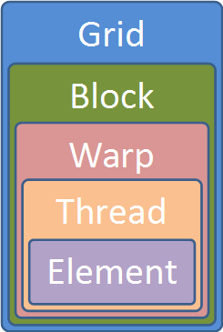
How does PIConGPU Reach Hardware Portability?
One C++ interface to rule them all: Mapping abstract alpaka to all hardware
Zenker E. et al. (2016) IEEE Xpress DOI:10.1109/IPDPSW.2016.50
Zenker E. et al. ISC (2016) ISC High Performance DOI:10.1007/978-3-319-46079-6_21
Matthes A. et al., (2017) ISC High Performance (pp 496-514) DOI: 10.1007/978-3-319-67630-2_2

Slide 6

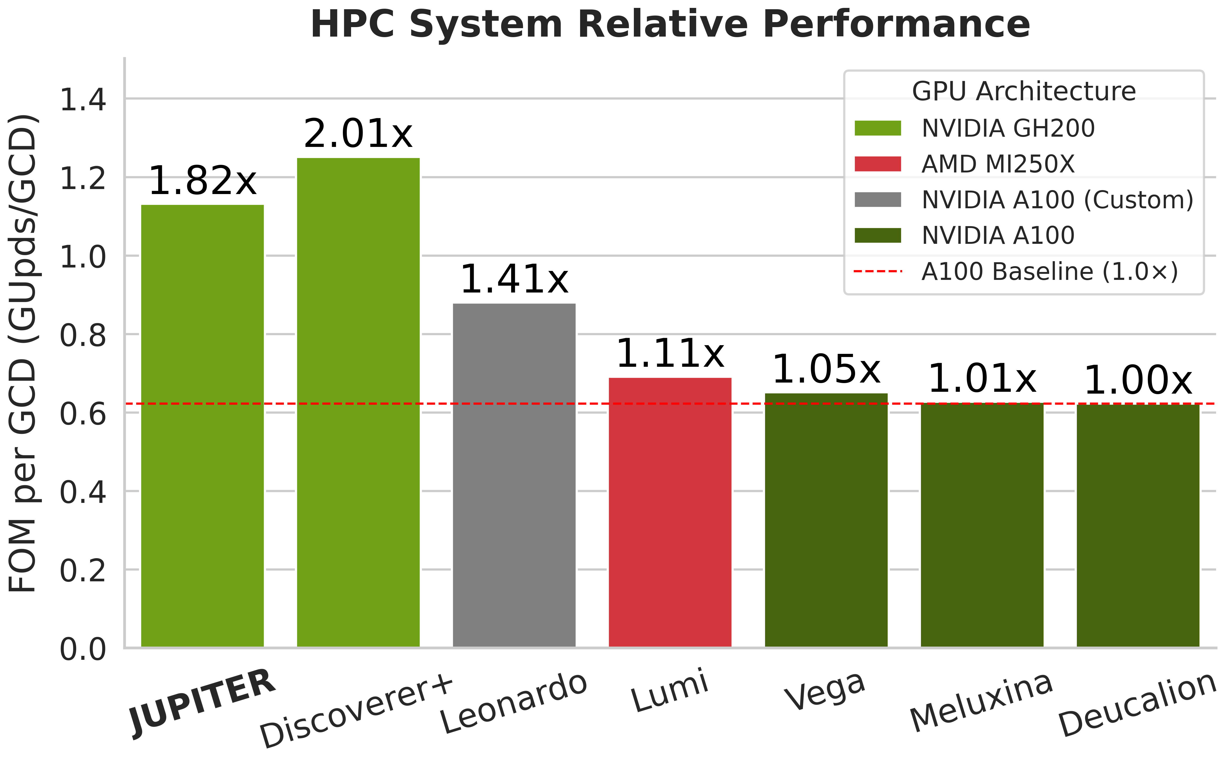
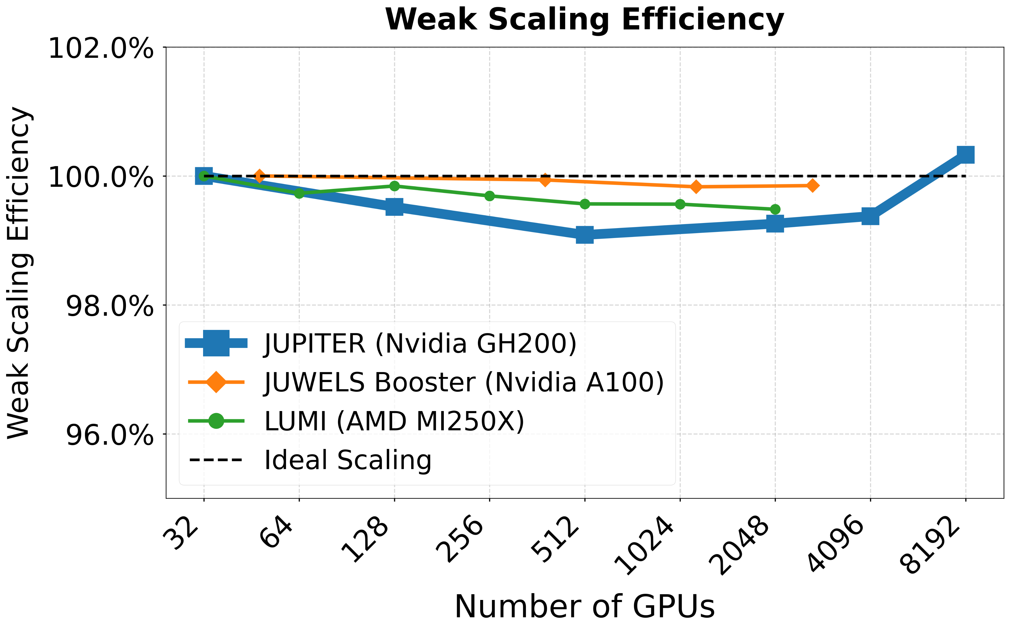

Performance Portability on Different Systems
Maintaining code performance independent of hardware
As a part of this EU project, we share knowledge with other codes from the plasma physics community and run on EuroHPC machines.

Slide 7
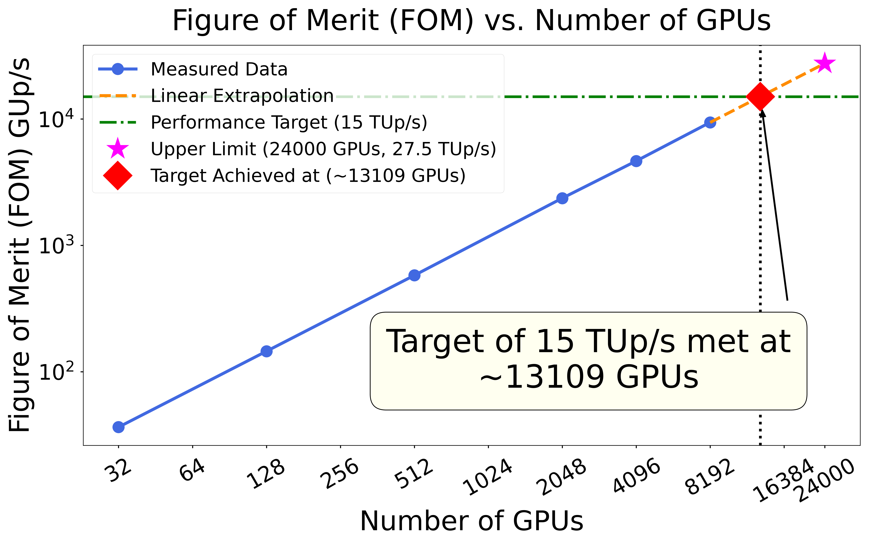
Scaling PIConGPU up to Exascale
JUREAP - PIConGPU is lighthouse application on Europe’s first exascale machine JUPITER!
We are ready to run our large science cases!

Slide 8
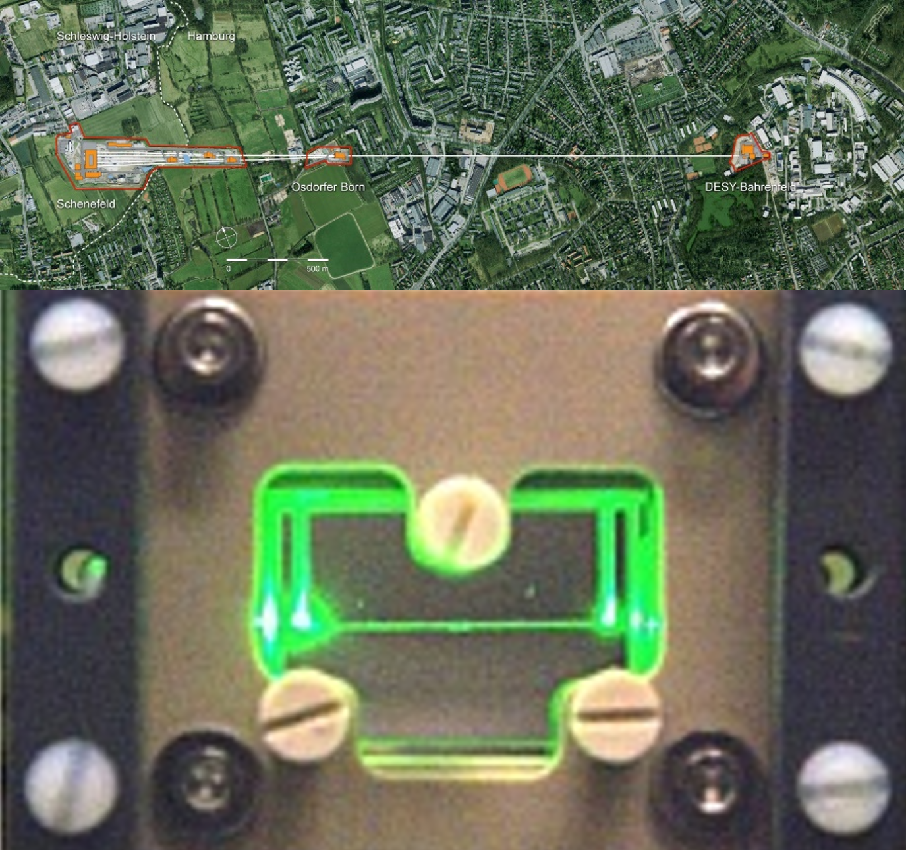
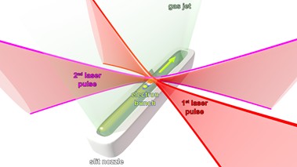
Why Do You Need HPC-Scale Laser Plasma Simulations?
Developing digital twins for modern ultra-compact plasma-based accelerators
Conventional accelerators:
10GeV in 1km
Laser driven
Travelling Wave
Electron Accelerator
Beyond 10GeV
High-order schemes for accuracy beyond 10 million time steps
Realistic system size of 50 trillion particles and 2 trillion cells
Laser-driven accelerators:
10GeV in 10cm
Monday PS 4 5:40
Beyond Dephasing: Scalable laser-plasma accelerators via Traveling-wave electron acceleration
(Alexander Debus)

Slide 9

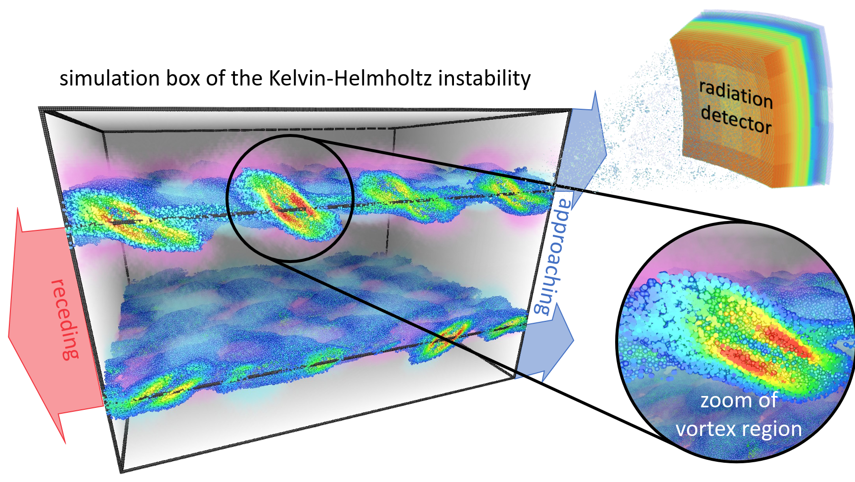
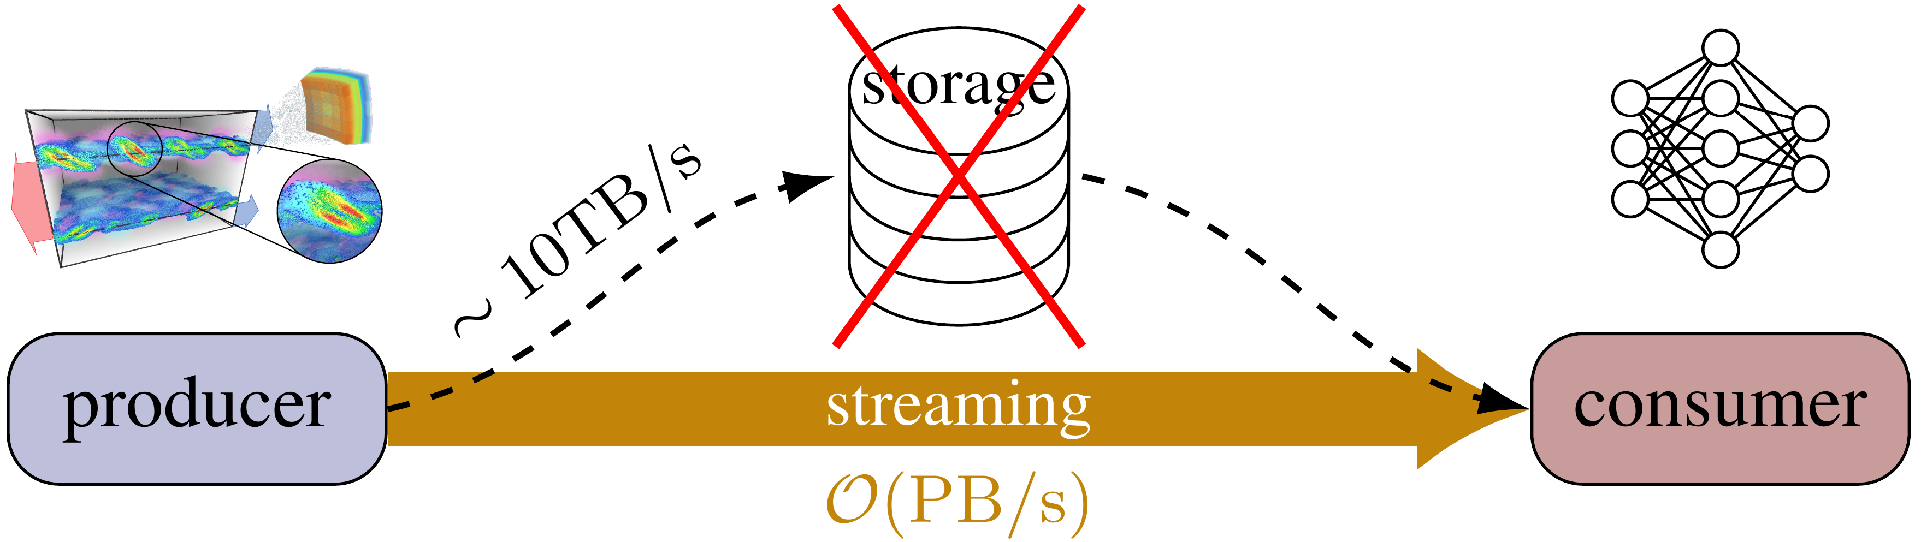



AI Scientist: Exascale in-transit Machine Learning
Connecting particle dynamics with emitted radiation in an AI surrogate model
AI model training from
PIConGPU simulation
data by streaming PB/s
The AI-Scientist combines work from all 3 tasks:
Compression:
We compress knowledge and do not only store compressed data!
I/O: Streaming via openPMD/ADIOS2
In-situ: in-transit selection and reduction
Inverting the model to predict plasma properties from radiation observed on earth
J. Kelling et al., 2025 IPDPS, doi: 10.1109/IPDPS64566.2025.00043.

Slide 10
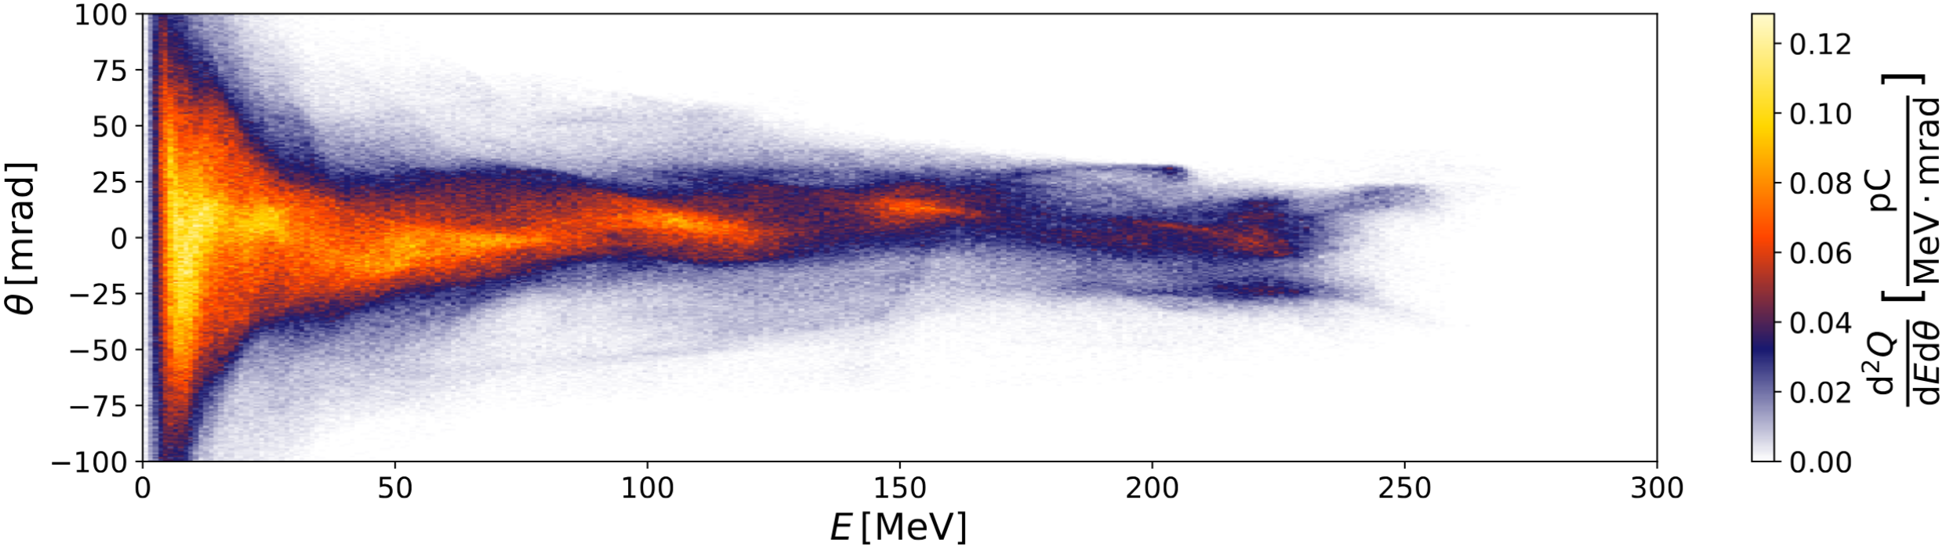
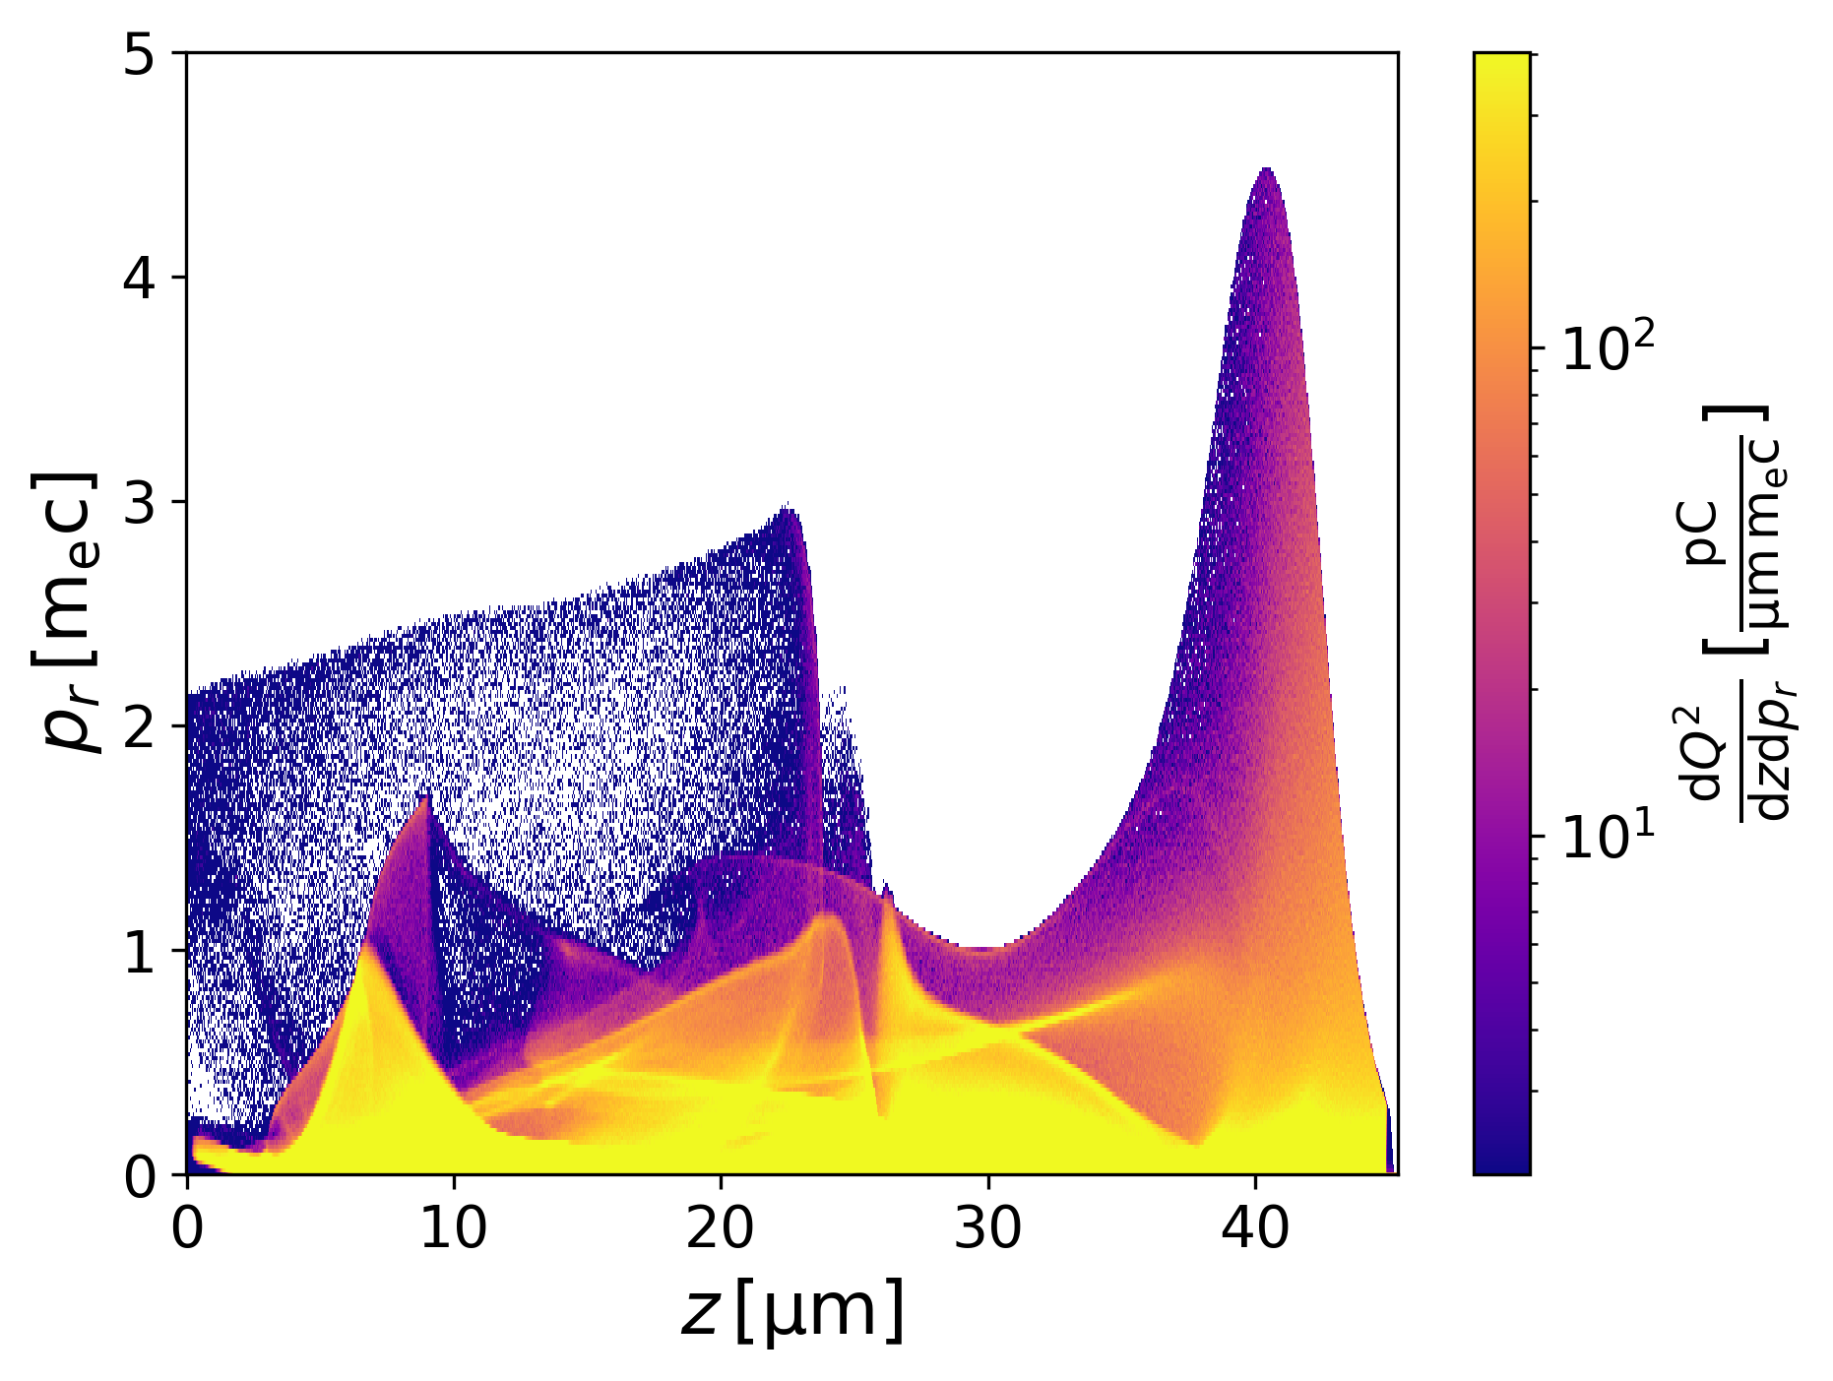
Novel Everyday Features of PIConGPU
Reducing data output, improving physical accuracy, and rendering post-processing redundant
Binning Plugin
Atomic Physics Model
Synthetic Optical Imaging

Slide 11
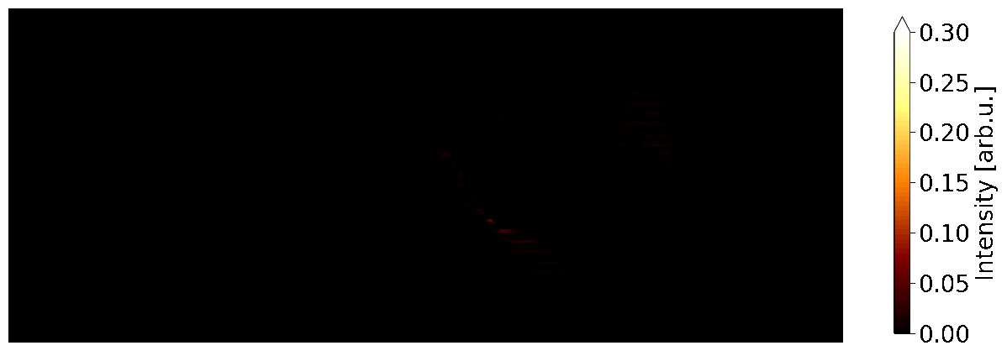

Revolutionizing PIConGPU Workflows with Binning Plugin
Bin all physical quantities with all possible axes to reduce data drastically
Wednesday PS4:
Synthetic Radiation Diagnostic in Hybrid LPWFA
(Finn-Ole Carstens)

Slide 12

Improved Physical Accuracy in Atomic Physics with FLYonPIC
Modelling all sorts of energy deposition on the (sub-)atomic scale
Ionization of electron
Barrier suppression
Tunnel ionization
Collisional ionization
Ionization potential depression
Excitation of electron
X-ray emission
X-ray absorption
...and more!

Slide 13
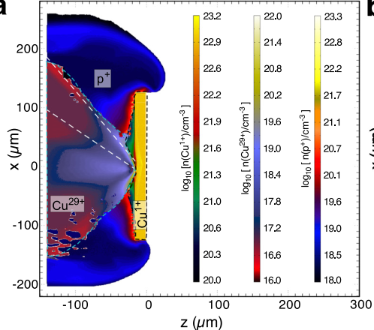
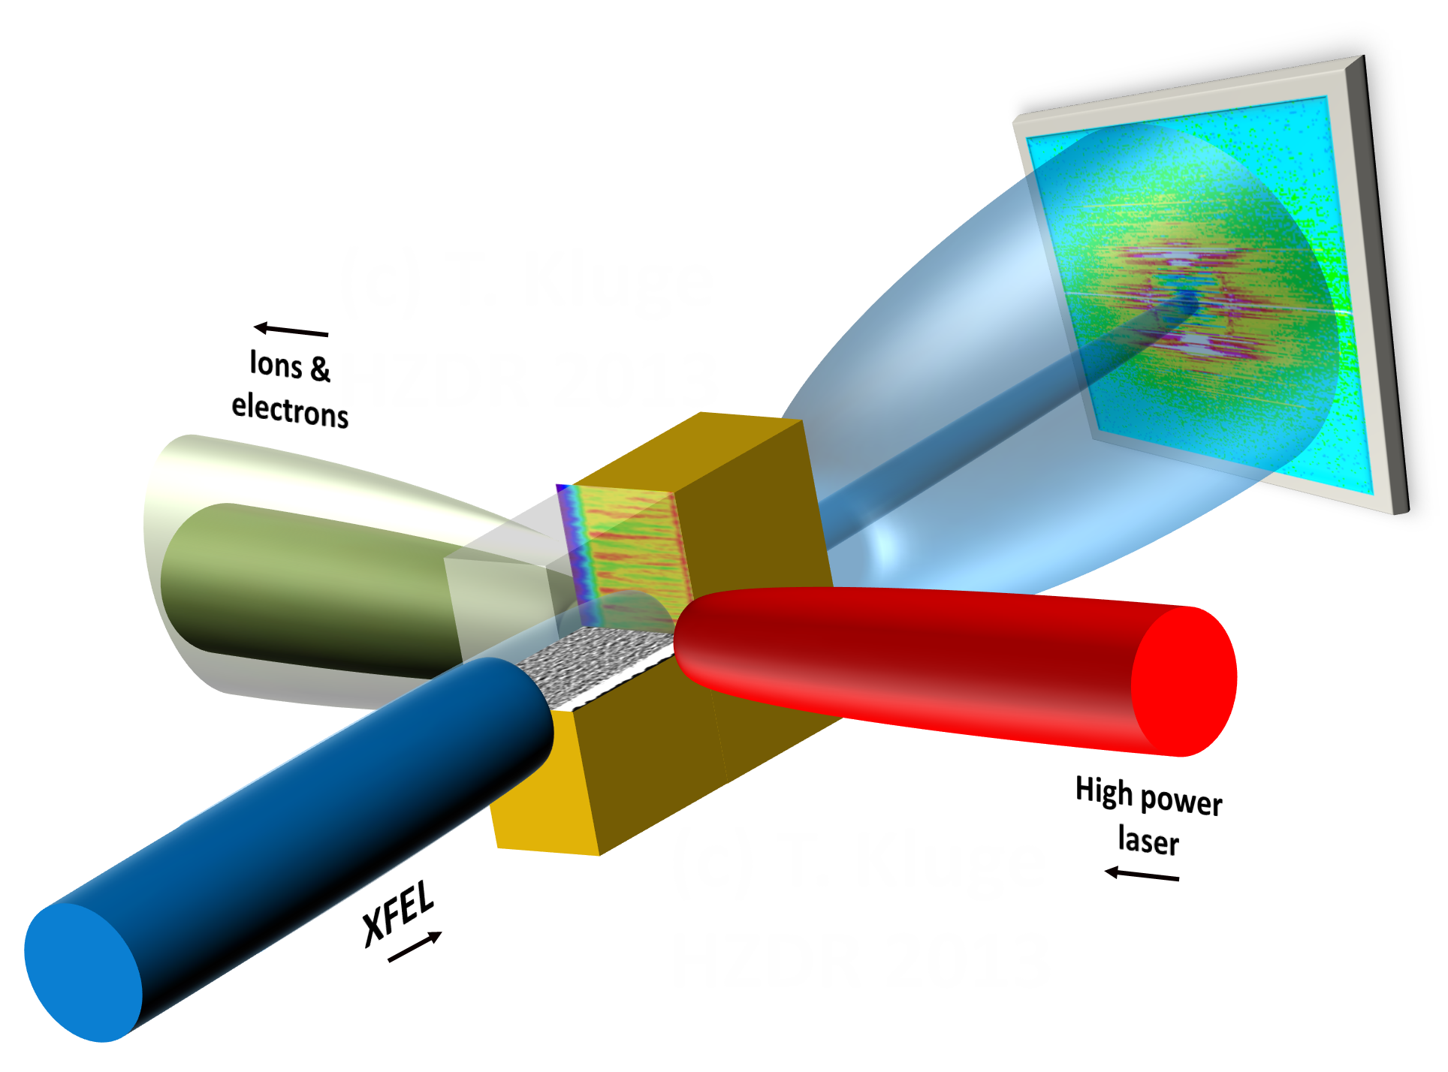

Improved Physical Accuracy in Atomic Physics with FLYonPIC
Modelling all sorts of energy deposition on the (sub-)atomic scale
Ionization of electron
Barrier suppression
Tunnel ionization
Collisional ionization
select group of transition
roll specific transition
over subscription?
no
(Schollmeier et al. Phys. Plasmas 22, 043116 (2015))
Ionization potential depression
X-ray emission
X-ray absorption
Excitation of electron
yes
randomly reject transitions
over subscription?
yes
no

Slide 14
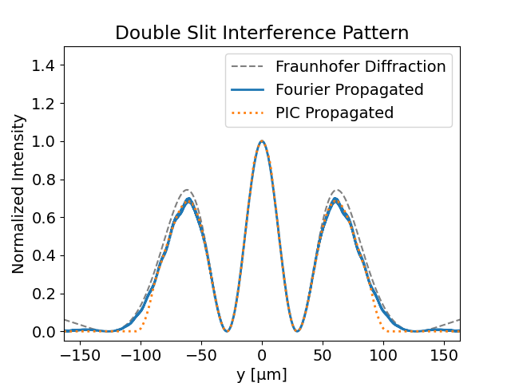
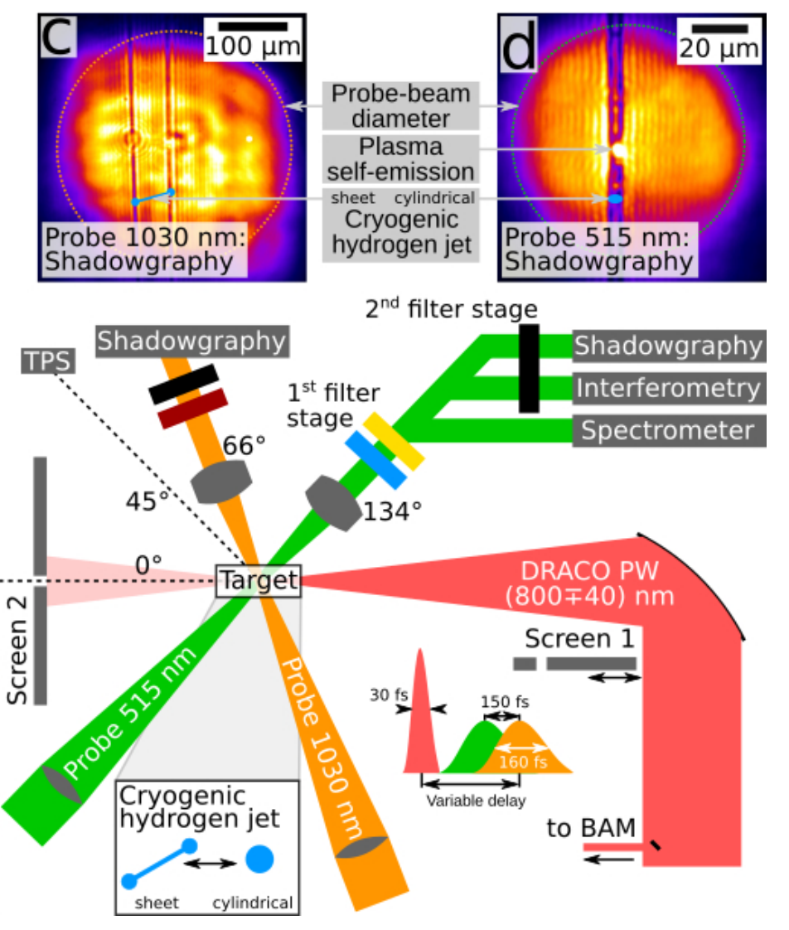
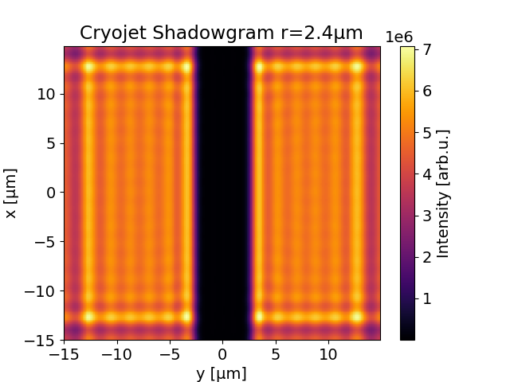
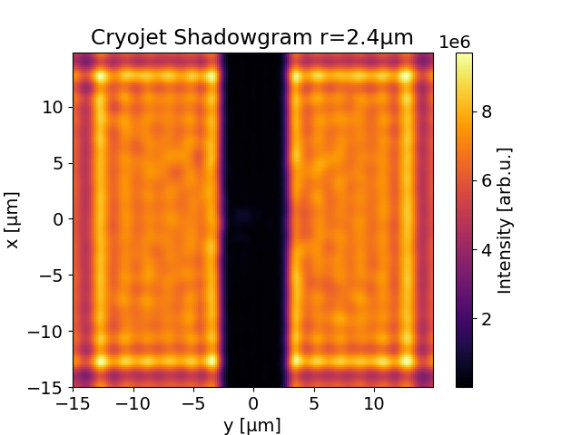
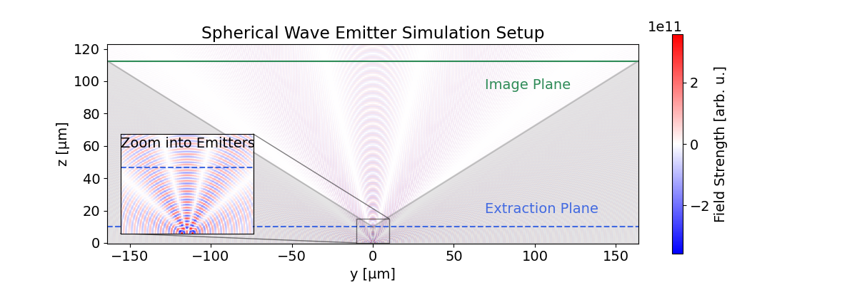
Extending Simulation Box into Far Field
First Synthetic Shadowgrams of Cylindrical Cryojets with PIC
Fully ionized jet without pump
Start of jet expansion
From Constantin Bernert PhD Thesis
2025-09-25

Slide 15

Thank you for your attention!
Feel free to check out PIConGPU, it’s open source!
https://github.com/ComputationalRadiationPhysics/picongpu

