Slide 1
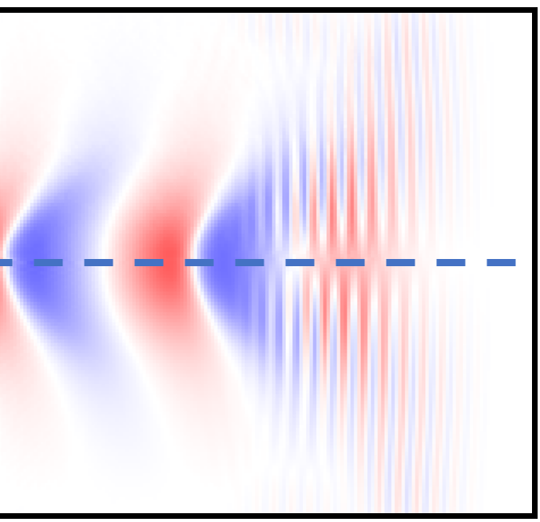
Galilean ElectroMagnetic
GEM PIC code for highly efficient simulations of LWFA and PWFA
EAAC, Elba 2025
http://arxiv.org/abs/2509.16793
Full PIC
Alexander Pukhov & Nina Elkina
Heinrich-Heine-University Dusseldorf
GEM PIC

Slide 2
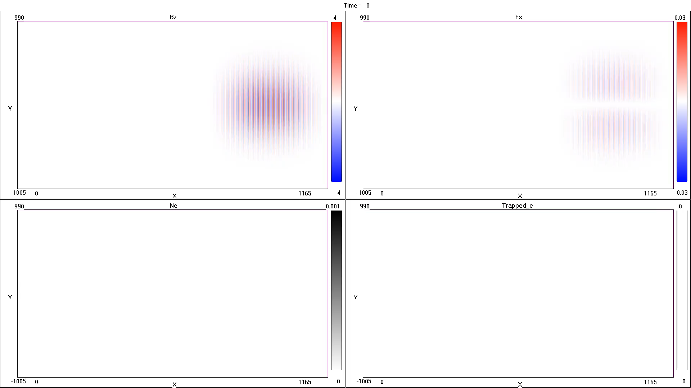
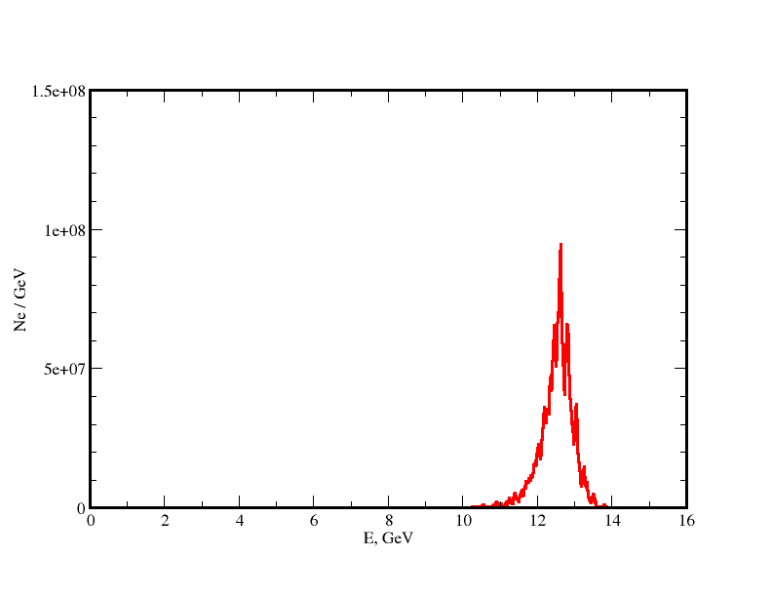
Goal: Make LWFA Simulations Affordable
20J laser in 30cm plasma channel: a full 3D simulation takes ~1h time
any resemblance is purely coincidental
Ionization injection from nitrogen doping. Final electron energies up to 13 GeV

Slide 3
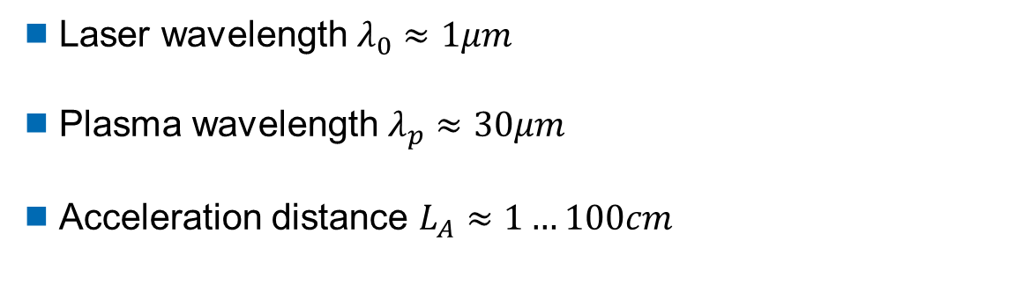
LWFA: multi-scale problem
LWFA simulations are expensive because it is a multiscale problem
Laser wavelength $λ_{0}≈1μm$
Plasma wavelength $λ_{p}≈30μm$
Acceleration distance $L_{A}≈1…100cm$
Huge scale disparity $L_{A}/λ_{0}$ $\sim {10}^{4}…{10}^{6}$

Slide 4
Existing classes of PIC codes
Full PIC codes: OSIRIS, WARP-X, SMILEY, EPOCH, PIConGPU, VLPL, etc.
these codes include all the relevant physics, but are computationally expensive!
Quasi-3D EM codes in cylindrical geometry like FBPIC
more efficient due to the reduced geometry
Quasistatic PIC codes: QuickPIC, HiPACE, WAKE-T, LCODE, QV3D, etc.
- very efficient for PWFA simulations due to the Galilean transformation
- only static field response to the driver
- the laser only can be described in envelope/ponderomotive approximation
- no particle self-trapping
Lorentz-boost in full PIC codes: WARP-X

Slide 5
GEM-PIC properties
Galilean coordinate transform decouples “slow” and “fast” dynamics
Huge steps along the “slow” coordinate: huge performance boost
Radiation terms included: the laser wave structure is correctly simulated
Self-trapping is naturally simulated
Numerical steps are flexible and allow for local fine resolution:
even X-rays can be simulated

Slide 6


We solve the Vlasov system
the kinetic equation
and the full set of self-consistent Maxwell Eqs.

Slide 7
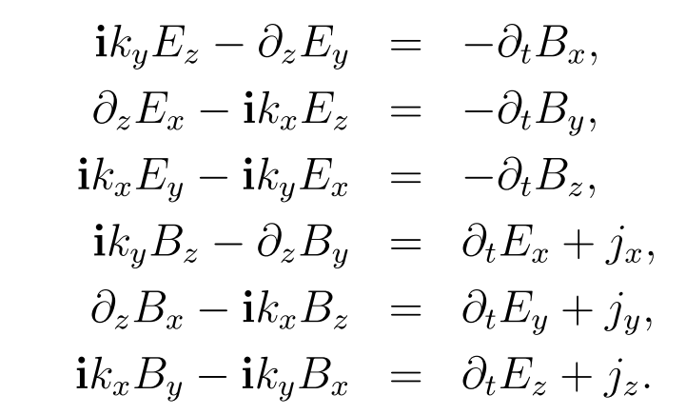


Maxwell: 2D FFT in transverse plane
$$∂_{x}→ik_{x}$$
$$∂_{y}→ik_{y}$$

Slide 8
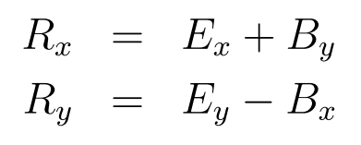
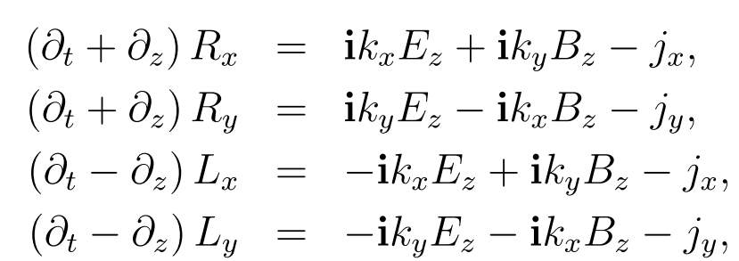
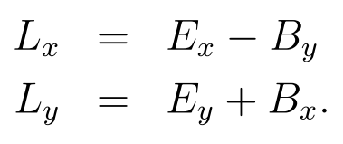
Right- and Left-running field combinations
Run to the right
Run to the left
8

Slide 9
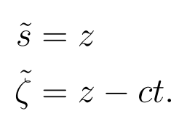
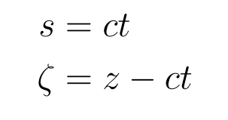
Galilean ElectroMagnetic PIC basics
Two possible Galilean transformations
„spatial“ GT1 „temporal“ GT2

Slide 10
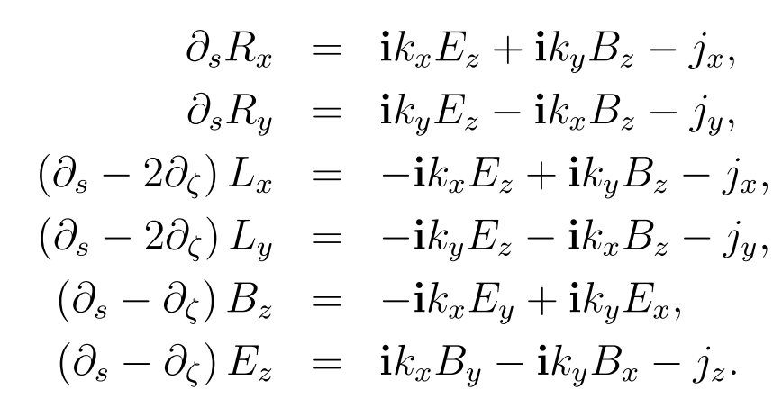
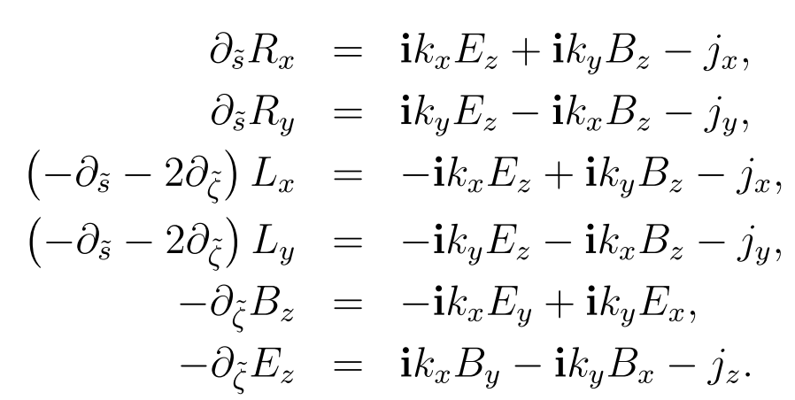

Galilean transformations of Maxwell Eqs
„spatial“ GT1 „temporal“ GT2
$$∂_{s}≪∂_{ζ}$$

Slide 11
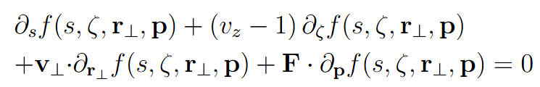
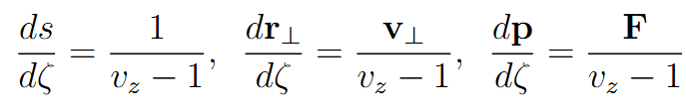
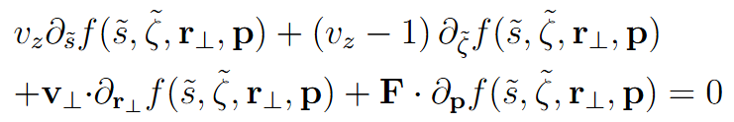
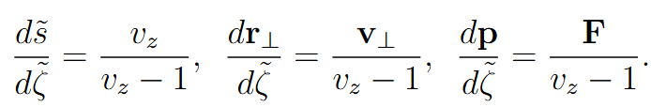
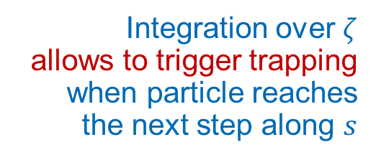
Kinetic equation and self-trapping
„spatial“ GT1
„temporal“ GT2
Integration over $ζ$
allows to trigger trapping
when particle reaches
the next step along $s$

Slide 12
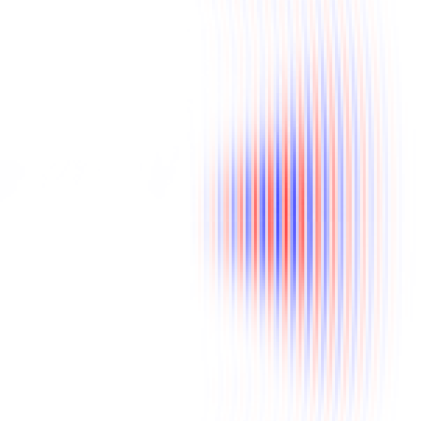
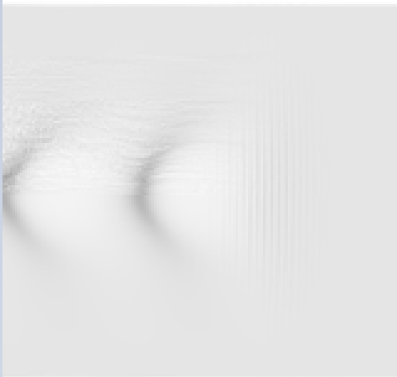
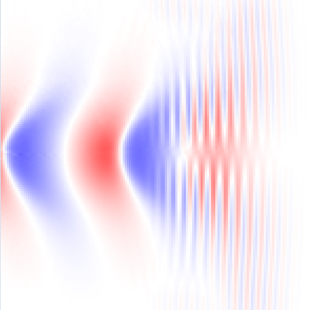
Simulation Example of Laser WakeField
$$a_{0}=2, { σ}_{⊥}=σ_{∥}=4λ, n_{e}=0.01 n_{c}$$
B_{y}
n_{e}
E_{z}
-2.0
2.0
0.0
0.1
-0.1
0.1
100
(a)
(b)
(c)
x
Full PIC
GEM PIC
-100
1100
1200
1100
1200
1100
1200
k₀z

Slide 13
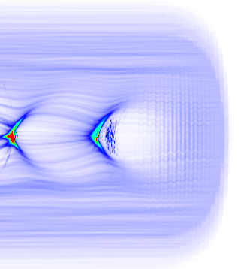
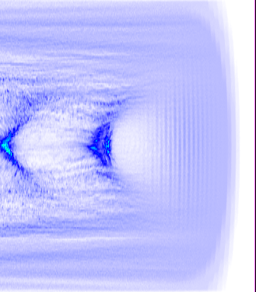
Ionization Injection into Laser WakeField
$a_{0}=2, { σ}_{⊥}=σ_{∥}=4λ, n_{e}=0.01 n_{c},$ add nitrogen at $n_{N}=0.0001 n_{e}$
Trapped electrons
0.01
100
(a)
(b)
n_{e}
x
Full PIC
GEM PIC
-100
800
900
800
900
0
z

Slide 14
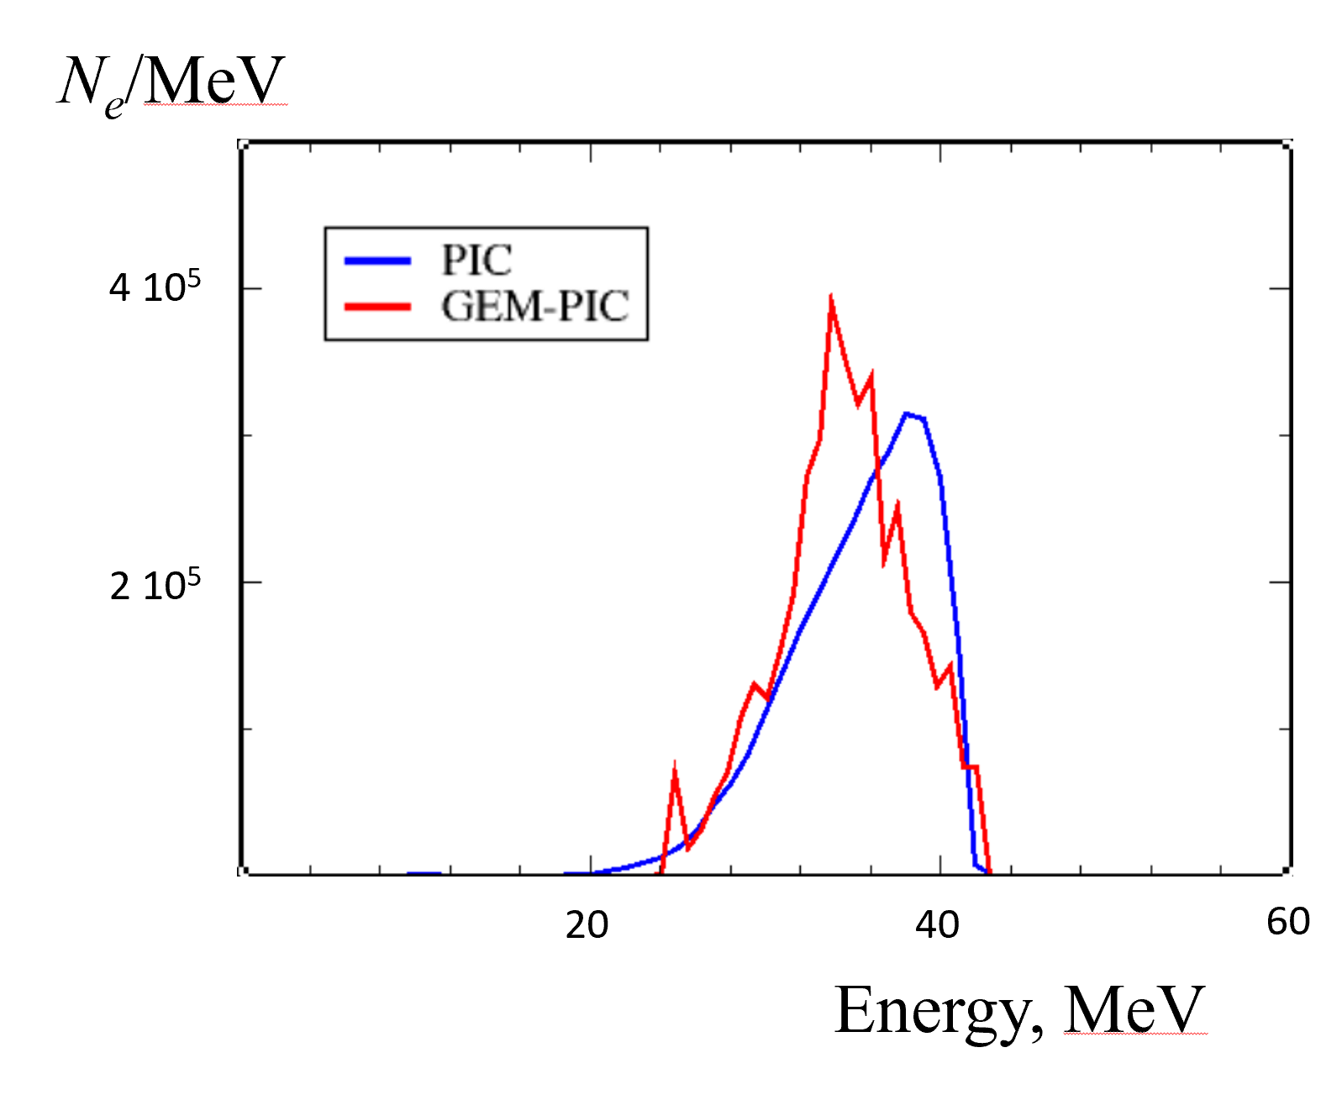
Spectrum of trapped electrons
$a_{0}=2, { σ}_{⊥}=σ_{∥}=4λ, n_{e}=0.01 n_{c},$ add nitrogen at $n_{N}=0.0001 n_{e}$
Full PIC
GEM PIC

Slide 15
Make LWFA simulations affordable
20J laser in 30cm plasma channel: a simulation in full 3D takes ~1h
Ionization injection from nitrogen doping. Final electron energies up to 9 GeV

Slide 16
Outlook
http://arxiv.org/abs/2509.16793
GEM-PIC closes the multi-scale gap in LWFA simulations
Flexible numerical step in the “slow” and “fast” coordinate
Steps as short as Ångström can be locally afforded
Plasma-based XFEL may become simulatable
1 cm LWFA takes a few minutes to simulate in full 3D

