Slide 1
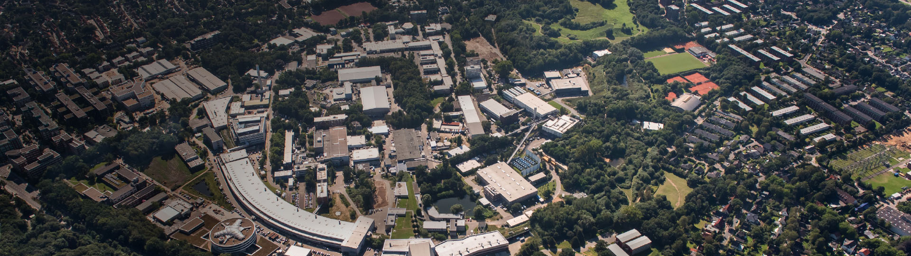

All-optical In-plasma Staging of Laser-Wakefield Accelerators Using Density Tailoring
Xingjian Hui, Alberto Martinez de la Ossa, Alexander Sinn, Ángel Ferran Pousa, Mathis Mewes, Rob Shalloo, Maxence Thévenet
Deutsches Elektronen-Synchrotron (DESY), Hamburg, Germany
Presenter: Xingjian Hui
PhD student at DESY/UHH
(Prof.Dr. Wim Leemans and Dr. Maxence Thévenet)
Elba 09.2025
Notes:
Hi I'm going to present the current status of my PHD study.
The goal of the work

Slide 2
Single stage or multistage toward higher energy?
Single stage plasma channel
>1kJ Laser needed to reach ~100 GeV
Fresh laser in
LPA stage
LPA stage
Staging
……
Depleted laser out
C. B. Schroeder et al. PRAB 13, 101301 (2010)
Notes:
I would like to begin by addressing a central challenge in laser–wakefield acceleration: how can we achieve higher beam energies?
well , the first intuition would be we can use a sufficient long plasma guiding channel to guid a super powerfull laser through extended distance
however such superpowerfull laser is really hard to build and regardless of energy depletion and diffraction, there are other obstacles like dephasing
OTS, another alternative would be replace one long channel with multiple consectutive LPA stages, meanwhile we keep injecting the fresh lasers and couple out the dissipated ones so as to keep the witnesss in the accelerating phase.
and this concept is known as staging

Slide 3
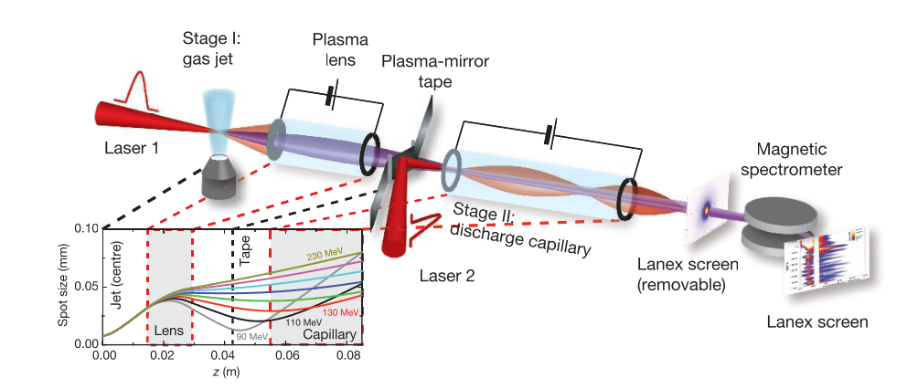
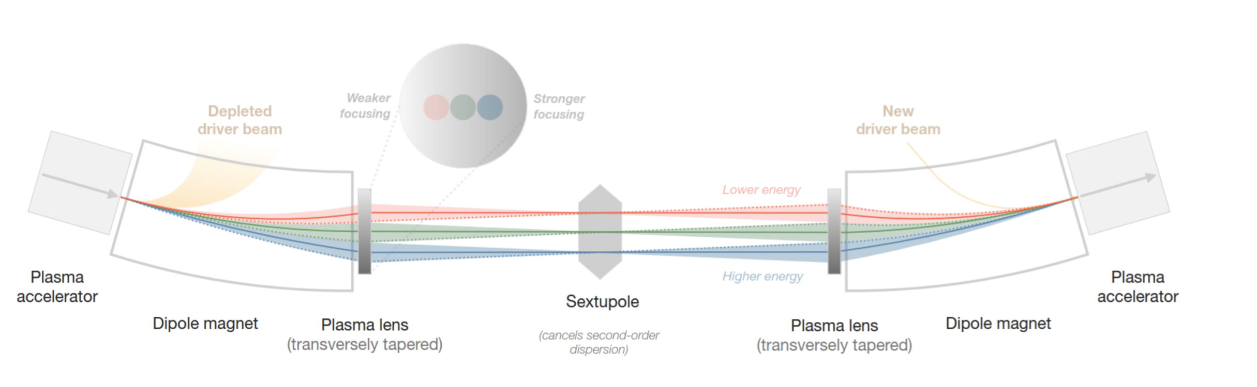
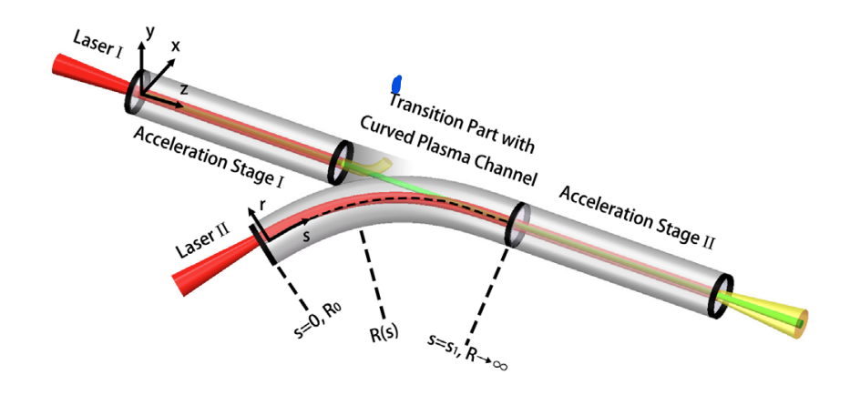
Efforts have been made on multistage coupling for LPA
Tape-based plasma mirror
Non-linear achromatic plasma lens
S. Steinke, et al. Nature 530, 190–193 (2016]
P. Drobniak et al. arXiv:2411.00925 [physics.acc-ph]
Curved Plasma Laser Guiding
Staging comes with the challenges like:
Laser in&out coupling -- All-optical
Beam capturing -- In-plasma
…
X. Zhu et al. PRL 130,215001(2023)
Notes:
Staging is not a new concept, and several creative approaches have already been proposed:
The tape-based plasma mirror at Berkeley,
The nonlinear achromatic plasma lens by Karl Lindström,
And curved plasma guiding channels at Shanghai Jiao Tong University.
while each of them still has some room of improvement, staging is still a open question for new ideas. facing the major obstacles like how do we achieve laser coupling ,
we intend to propose a new concept which
all optic: uses no extra beam and laser optics during coupling
in-plasma: and let the witness stays in plasma front start to end

Slide 4

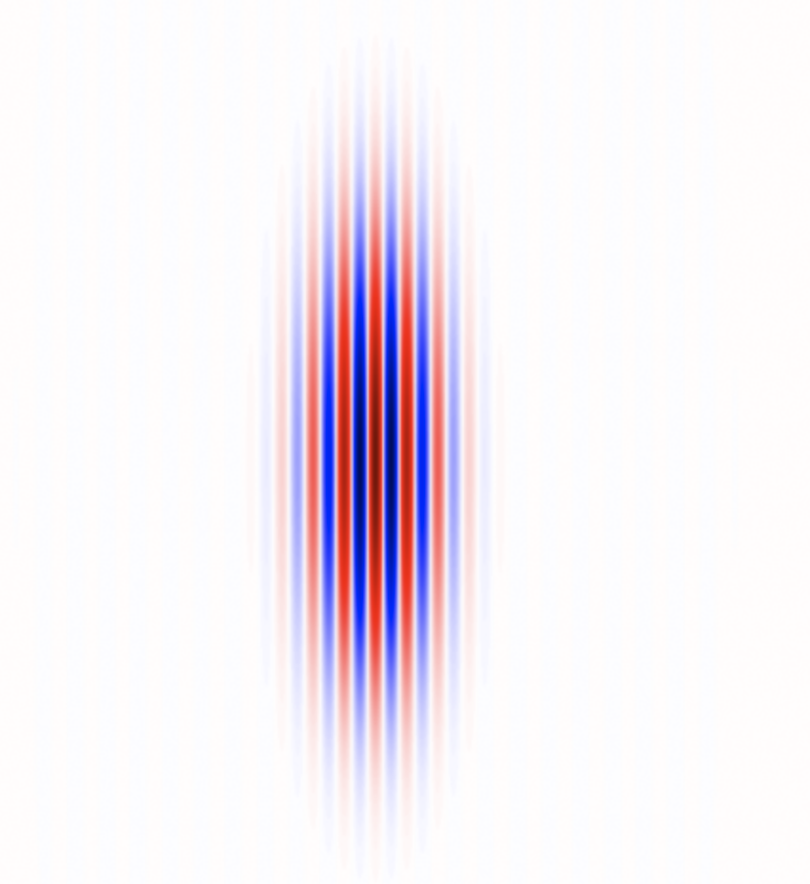
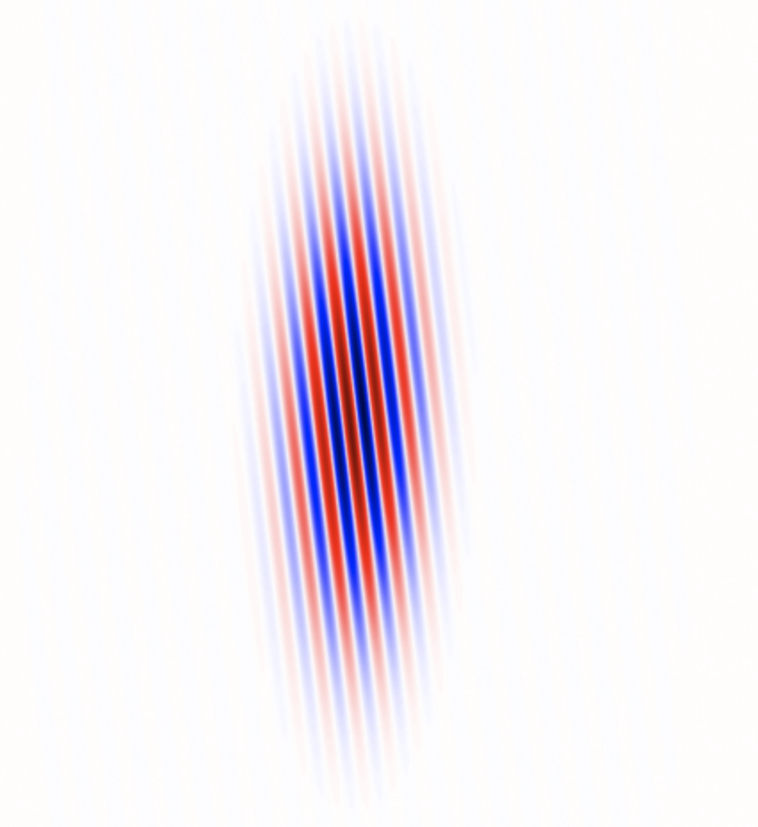
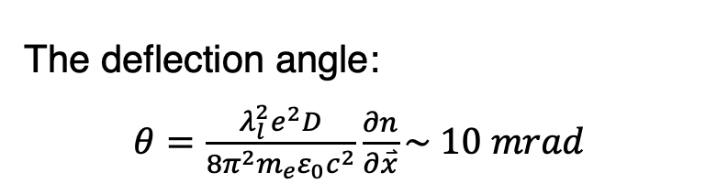
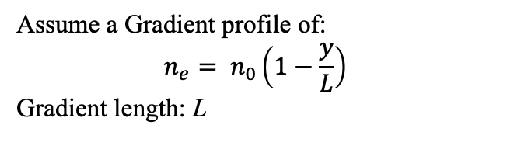




In-plasma laser coupling is possible by refraction
$$Δφ=\frac{v_{∅}D}{c}=(1+\frac{ω_{p}2}{{2ω}_{l}2})$$
The deflection angle:
$θ=\frac{λ_{l}^{2}e^{2}D}{8π^{2}m_{e}ε_{0}c^{2}}\frac{∂n}{∂\overset{⃑}{x}}\sim 10 mrad$
Spatio-temporal coupling derived as:
Group Delayed Dispersion (s²)$=\frac{dt_{0}}{dω}=\frac{ω_{p}2}{ω_{l}3}t$
Angular Dispersion (s)$\text{=}\frac{dθ_{0}}{dω}=\frac{e^{2}n_{0}D}{m_{e}ε_{0}ω^{3}L}$
Spatial Dispersion (m$∙$s)$=\frac{dx_{0}}{dω}=\frac{e^{2}n_{0}D^{2}}{m_{e}ε_{0}ω^{3}L}$
Pulse Front Tilt (s)$=\frac{dt_{0}}{dx}$
$$\vec{k}$$
$$\vec{k}$$
Assume a Gradient profile of:
$$n_{e}= n_{0}\left(1−\frac{y}{L}\right)$$
Gradient length: L
Selcuk Akturk et al. OPTICS EXPRESS 12(19), 4401(2004)/D. E. Mittelberger et al. PRE 100, 063208 (2019)
Notes:
Our approach is to use refraction to achieve laser coupling.
The principle is straightforward. A Gaussian laser pulse enters a plasma with a transverse density gradient. Different parts of the pulse experience different phase and group velocities, tilting the phase front after some propagation. This tilt corresponds to a refraction angle of tens of milliradians.
Beyond this tilt, additional space–time coupling (STC) effects emerge:
Group delay dispersion,
Angular dispersion, where the deflection depends on frequency,
And the associated spatial dispersion.
Together, these effects create a tilted pulse front, which we can exploit for controlled in–out coupling of the driver.

Slide 5
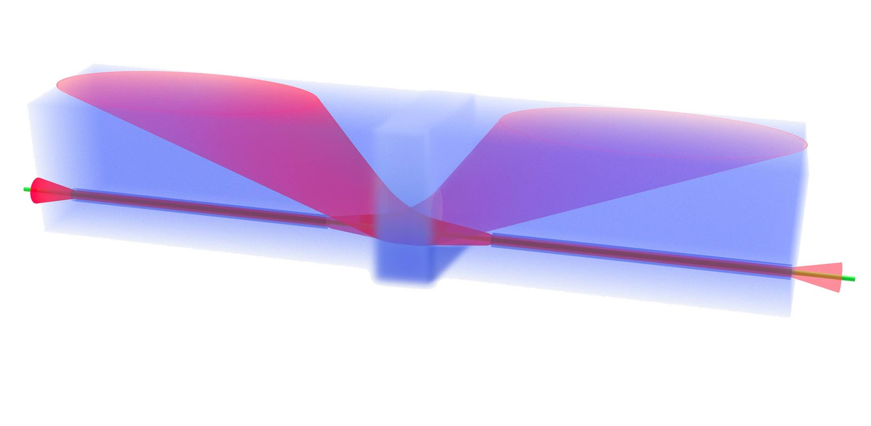
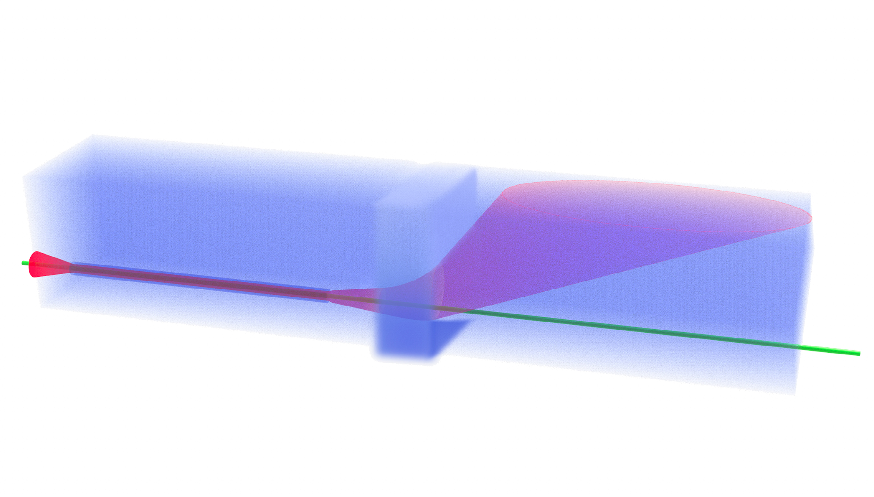
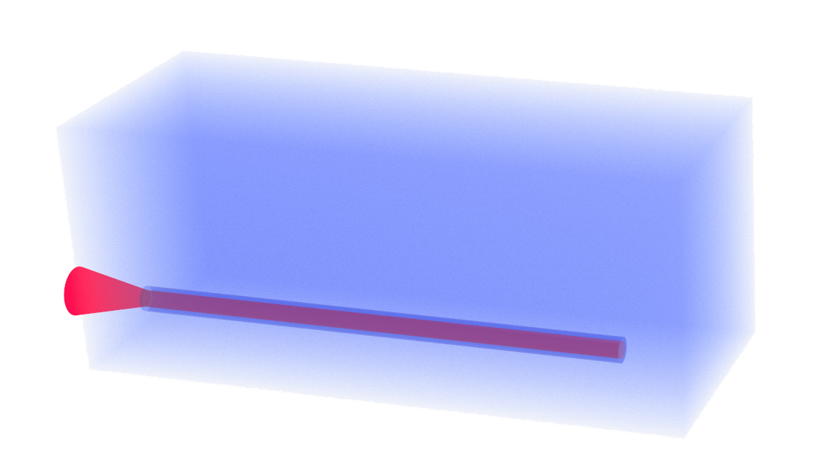
A design of plasma density profile is proposed to realize staging
Laser II inlet
Laser I outlet
Laser I inlet
HOFI stage I
Electron Beam
Diffraction
HOFI stage II
Laser II outlet
Refraction
Capture
Coupling Region
Laser in-&out-coupling using transverse density gradient without solid structures
Witness stays in plasma in coupling region, confined by self-driven wakefield
Notes:
To realize this, we use hydrodynamic optical-field-ionizer (HOFI) channels as the acceleration stages. HOFI technology generates a parabolic plasma density profile via ionization shock waves.
The coupling region consists of three parts:
A uniform density section, where the outgoing driver diffracts and releases energy.
A gradient section, which refracts the spent driver outward.
A focusing section, where the fresh laser is coupled in, focused, and begins accelerating the witness again.

Slide 6
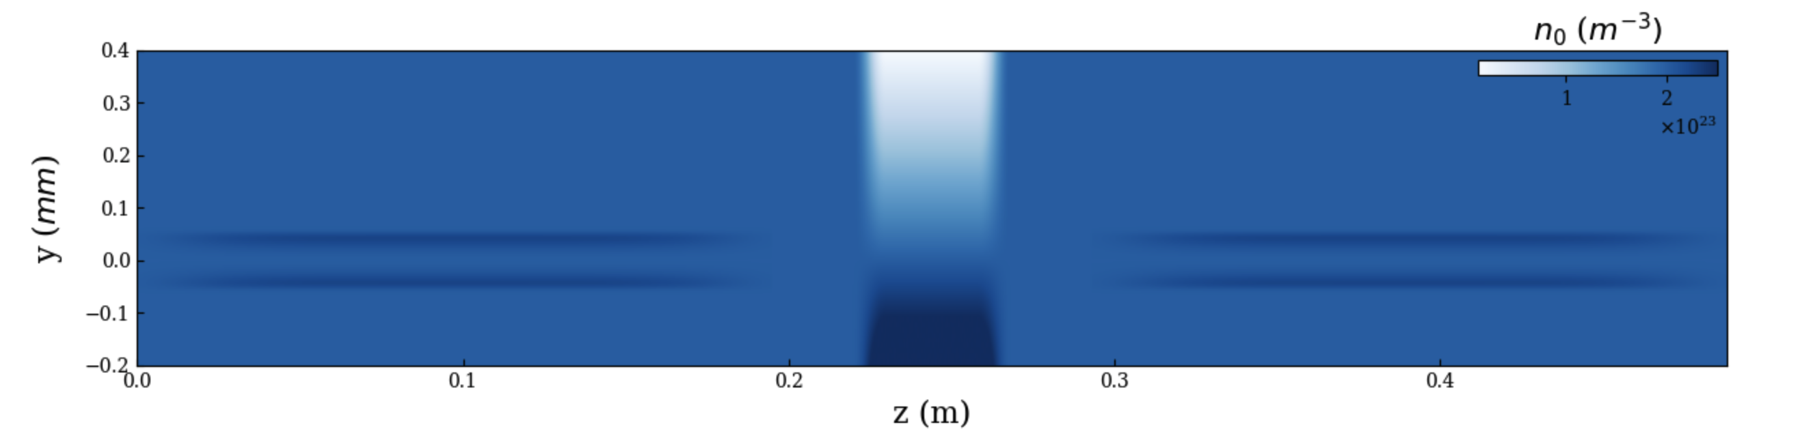
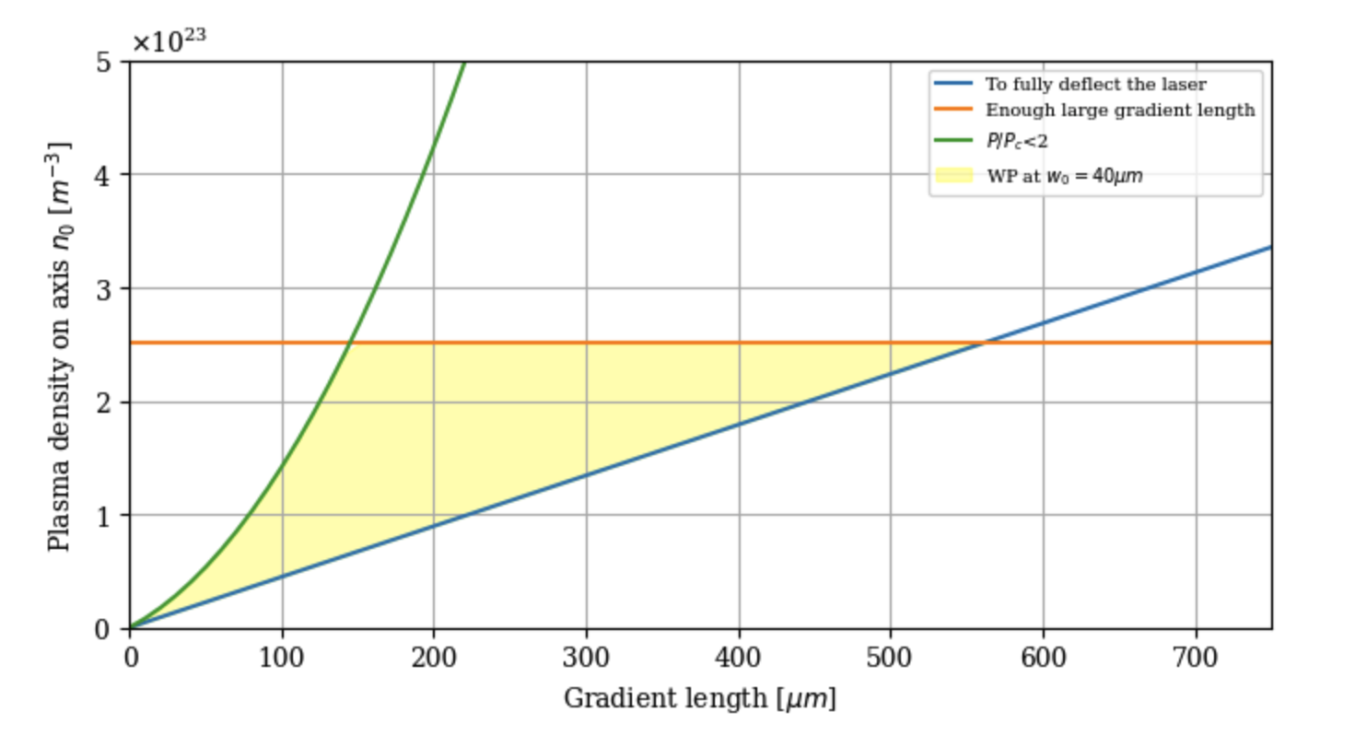
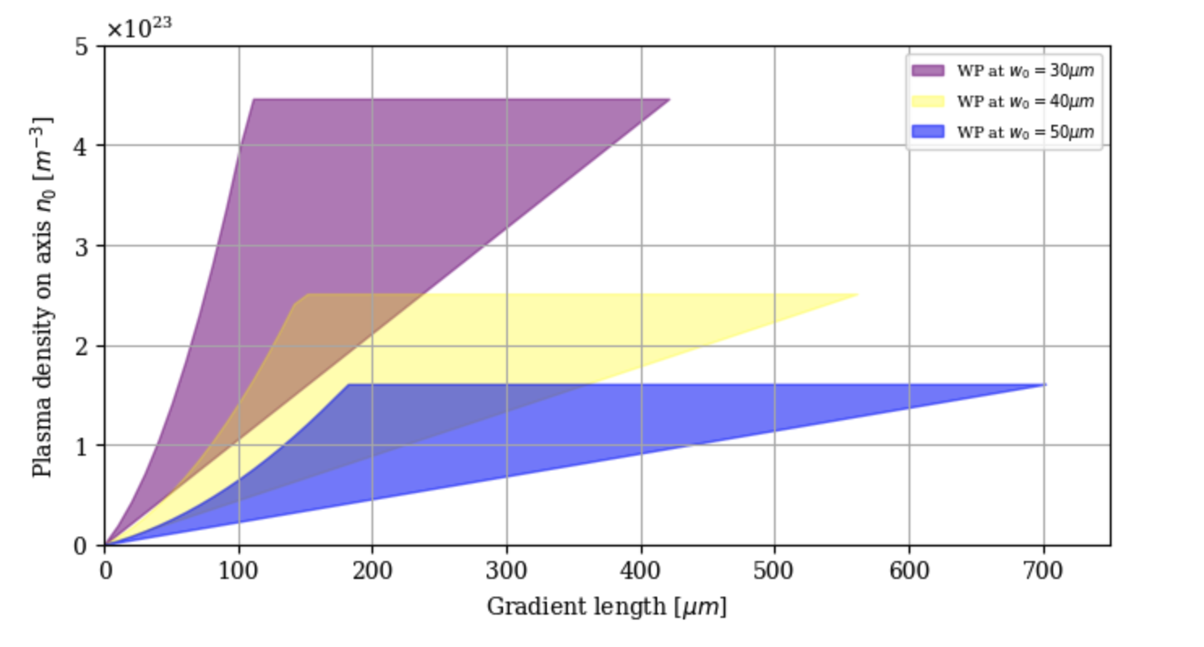
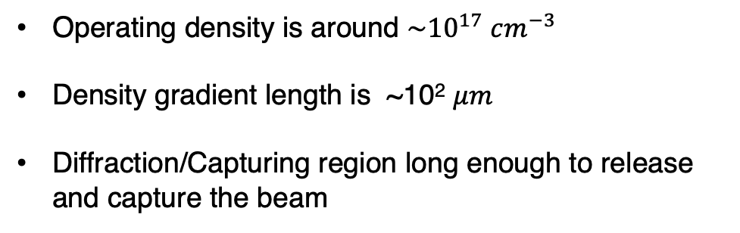


The density profile is refined to couple the driver and witness
D
R
C
Enough Gradient Length
Operating density is around $\sim {10}^{17} cm^{−3}$
Density gradient length is ~10² $μm$
Diffraction/Capturing region long enough to release and capture the beam
$$P/{P_{Critical}}<2$$
$$θ_{refraction }> θ_{diffraction}$$
Notes:
Design Rules – Feasible Working Window
We refine the design with three criteria:
Sufficient gradient strength – enough to fully refract the spent driver out and bring the new driver in.
Weak self-guiding – keep P/Pc<2P/Pc​<2. Excessive self-guiding makes propagation nonlinear and prevents the driver from releasing the witness.
Minimum gradient length – long enough to capture and bend the incoming driver.
From these constraints, we identify a working window:
Gradient lengths on the order of hundreds of microns,
Background densities below 1017 cm−31017cm−3,
Scaling naturally with the laser spot size at focus.
The uniform “release” section is sized to about five Rayleigh lengths, ensuring the wakefield weakens enough to release the witness cleanly.

Slide 7


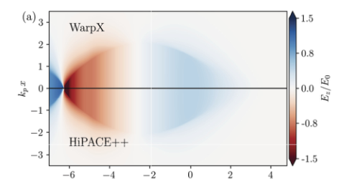
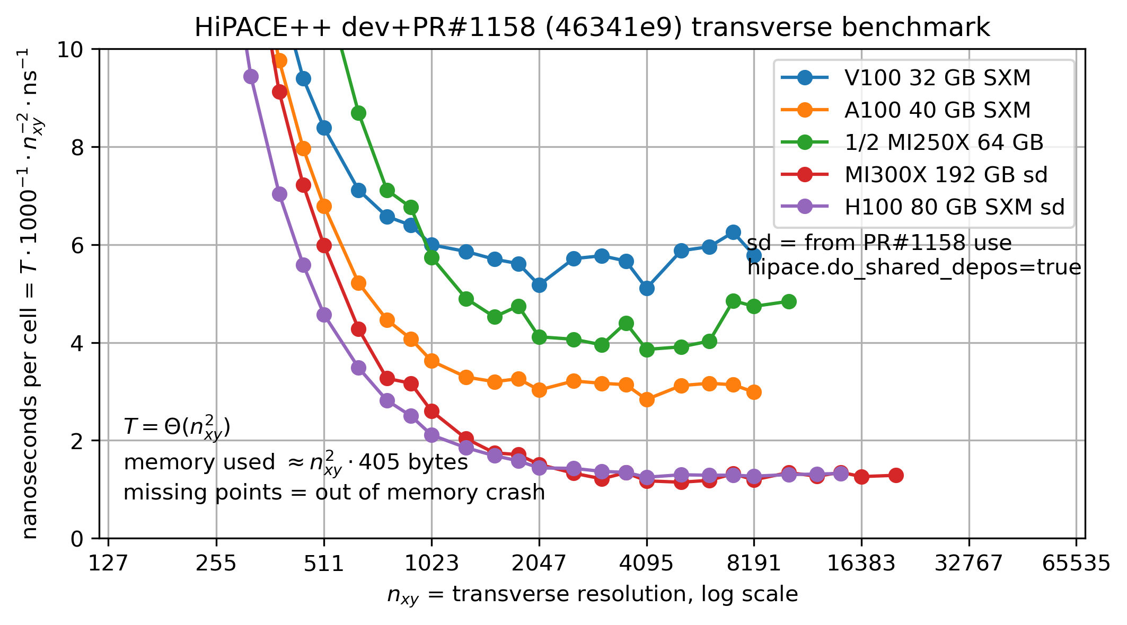

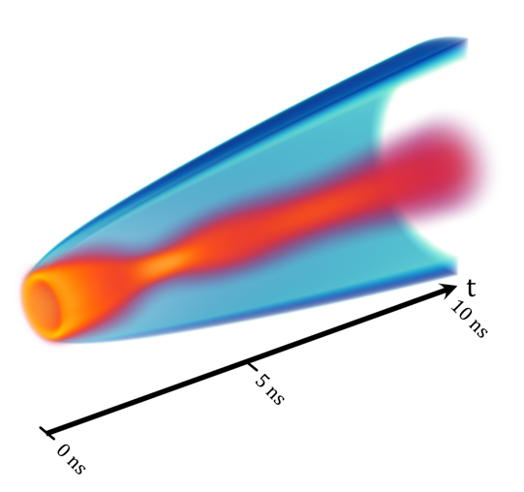




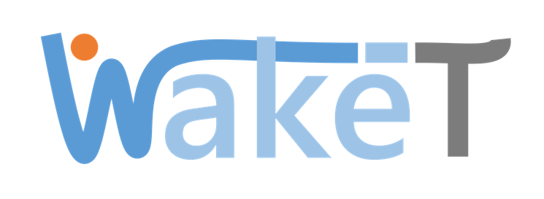
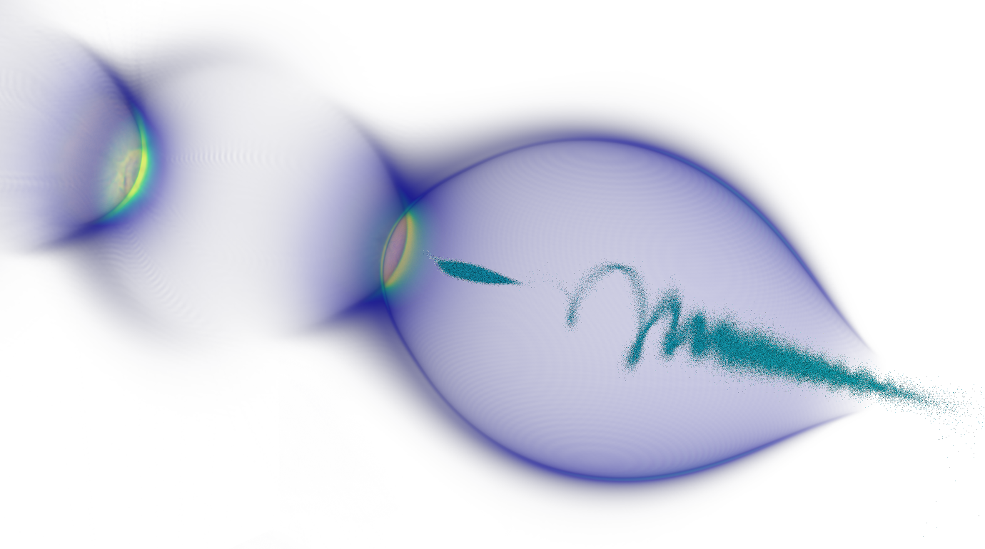




Self developed code ecology forms up a complete workflow
Simulate wakefield acceleration and more…
HIPACE++: a 3D Quasi-static GPU-portable, open-sourced PIC code
Open-Source
Open-Source
  Source: S. Diederich et al. Computer Physics Communications 278 (2022) 108421
  Source: Alexacnder Sinn
Open-Source
Open-Source
Numerics highlights
  Super fast: Less than 2 min for one 30 cm 3D LPA stage simulation
  Advanced algorithms, parallel and mesh refinement
  Multiphysics
  Portable laptops, gaming GPUs, JUWELS Booster, LUMI, Perlmutter, etc.
  Builds on Linux, Windows, MacOS
HiPACE++
Real combination of simulation tools in past or present studies
Open-Source
All simulations are 3D, start-to-end and realistic
More contributors are welcome!
Notes:
So far, these are theoretical estimations. To refine the design, we rely on numerical simulations.
This work builds on a open-source ecosystem developed by an international collaborative community: These codes are open, scalable, and open to contributors worldwide.
For this project, the backbone is HiPACE++:
A 3D, quasi-static, parallelized, GPU-portable PIC code,
Open-source, highly scalable, and efficient,
Enabling realistic, start-to-end 3D simulations.
All results I present today are fully 3D and based on realistic parameters.

Slide 8
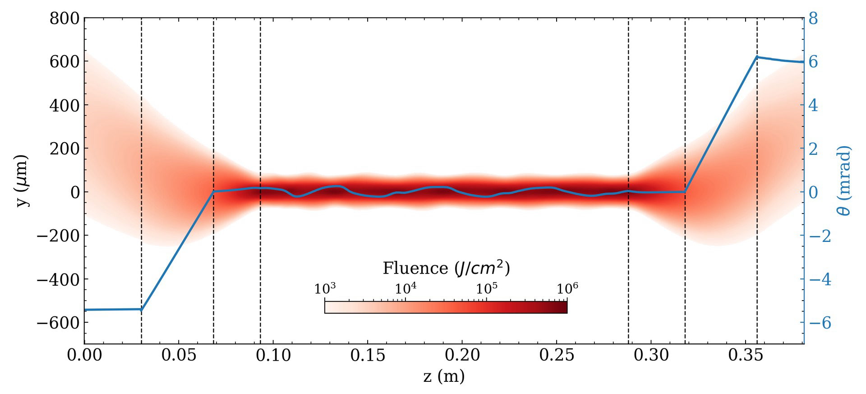
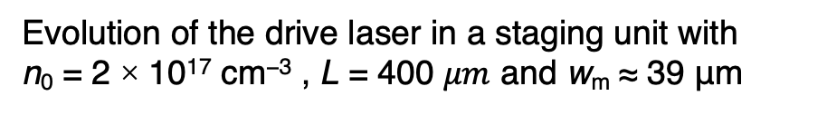
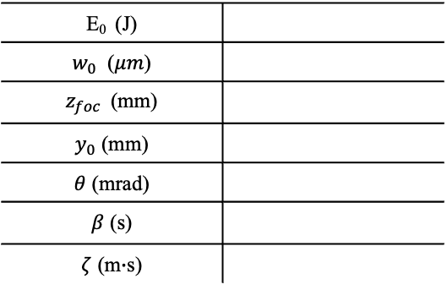
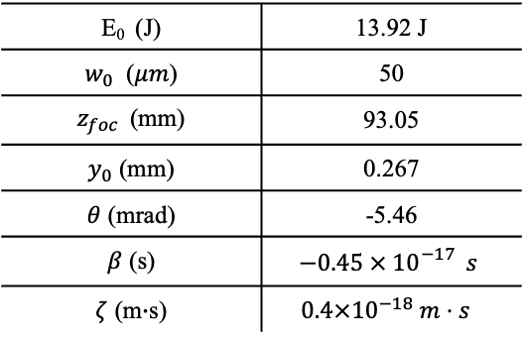
Bayesian optimization with PIC provides a good laser guiding
What laser should we initialize?
Evolution of the drive laser in a staging unit with
n₀ = 2 × 10¹⁷ cm⁻³ , L = 400 $μm$ and w_{m} ≈ 39 μm
Laser diagnostics
3D PIC simulation
HiPACE++
D
R
C
D
R
C
Optimize the parameters
Laser parameters at this WP
E₀ (J) | 13.92 J
$w_{0}$ ($μm$) | 50
$z_{foc}$(mm) | 93.05
$y_{0}$ (mm) | 0.267
$θ$ (mrad) | -5.46
$β$ (s) | $$−0.45 × 10{}_{}^{−17}{ s}$$
$ζ$ (m$∙$s) | $$0.4×{10}^{−18} m⋅s$$
E₀ (J)
$w_{0}$ ($μm$)
$z_{foc}$(mm)
$y_{0}$ (mm)
$θ$ (mrad)
$β$ (s)
$ζ$ (m$∙$s)
Bayesian optimisation helps align and guide the laser
Small oscillation comes from slight pulse front tilt
Notes:
To find the optimal laser initialization, we combine 3D PIC simulations with HiPACE++ and Bayesian optimization.
The optimizer varies:
Launch geometry: initial offset and angle,
STC parameters: pulse-front tilt, angular dispersion, group delay dispersion,
Phase-front curvature: effective focusing on both transverse axes,
Deflection requirement: sufficient to release the spent driver.
Each iteration runs a 3D PIC simulation, diagnostics are performed with LASY, and the optimizer updates.
The optimized working point shows the laser:
Coupling in from the side,
Refracting onto axis,
Capturing the witness,
Guiding through the acceleration stage,
And then diffracting out.
Due to STC, the pulse exhibits some truncation—still under optimization—but the results are already strong:
Centroid oscillation < 0.2 mrad,
Deflection ~5 mrad,
Laser energy ~14 J with a waist of about 15 μm.

Slide 9
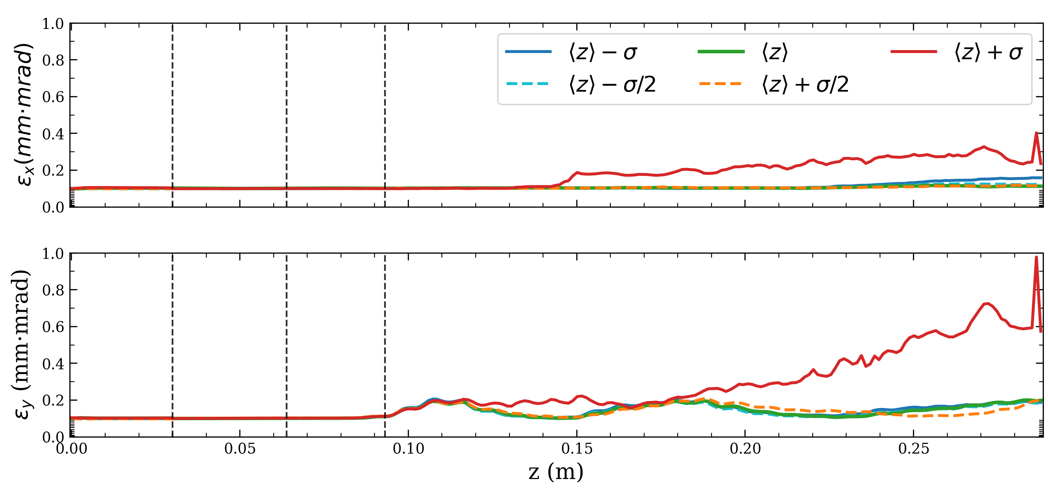
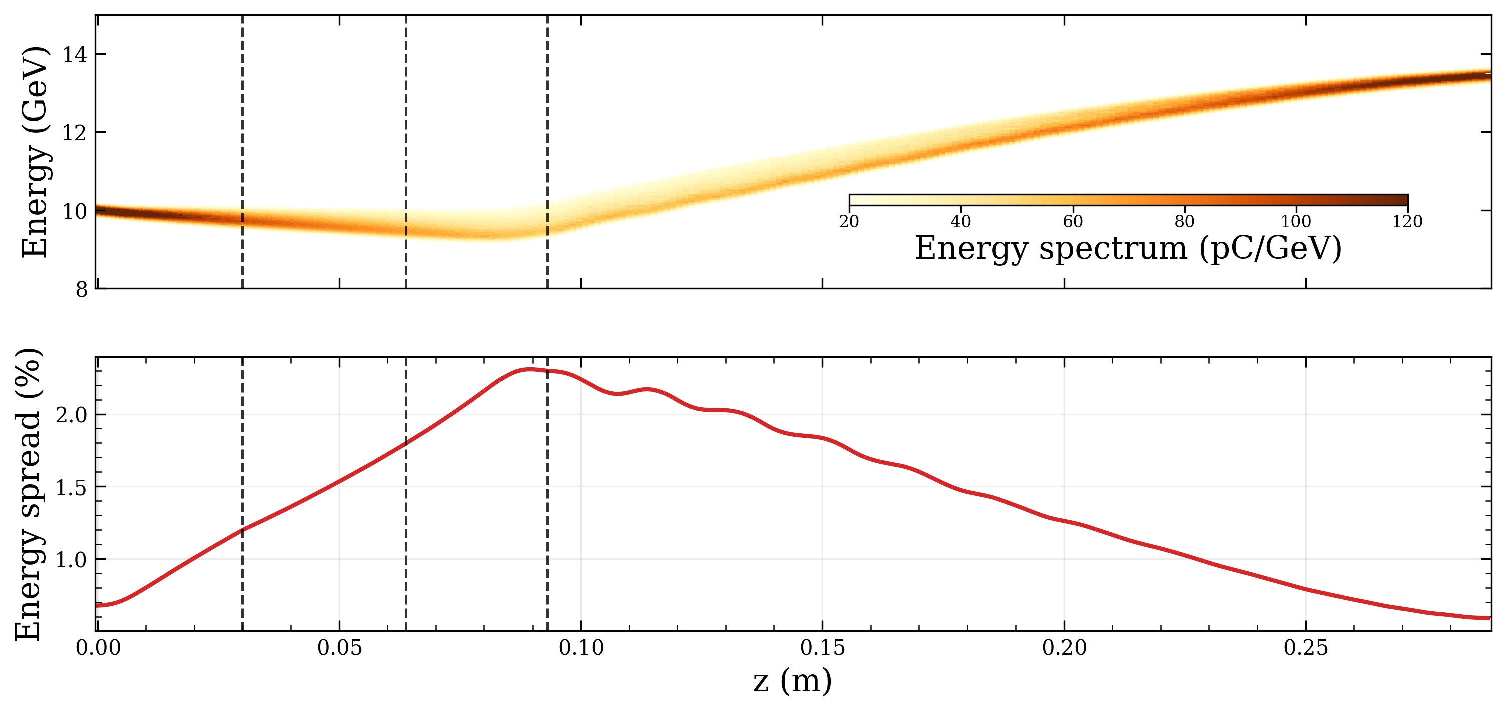
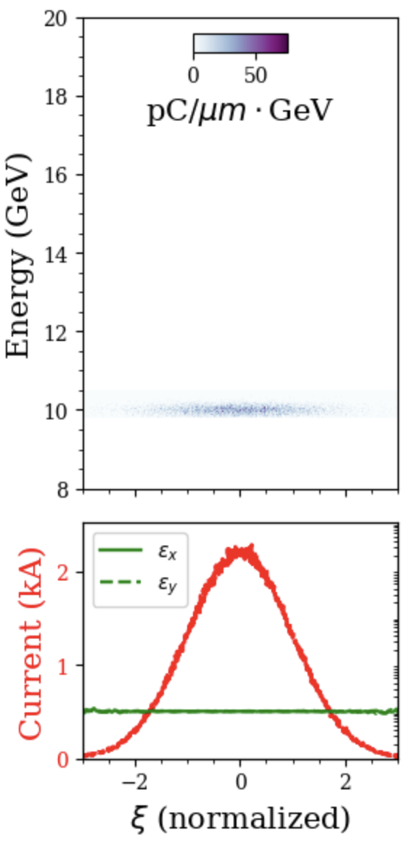
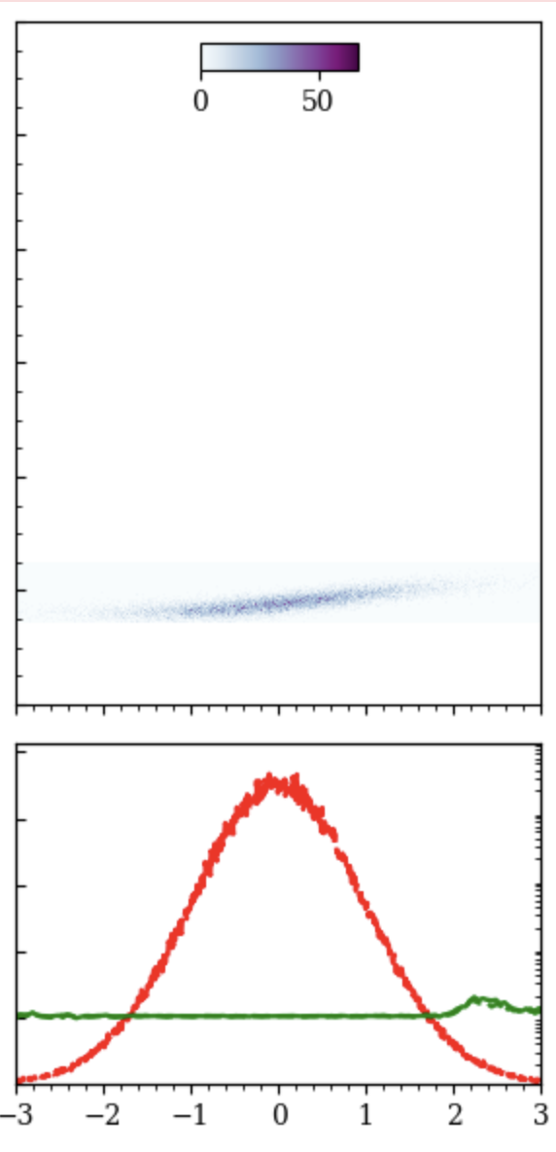
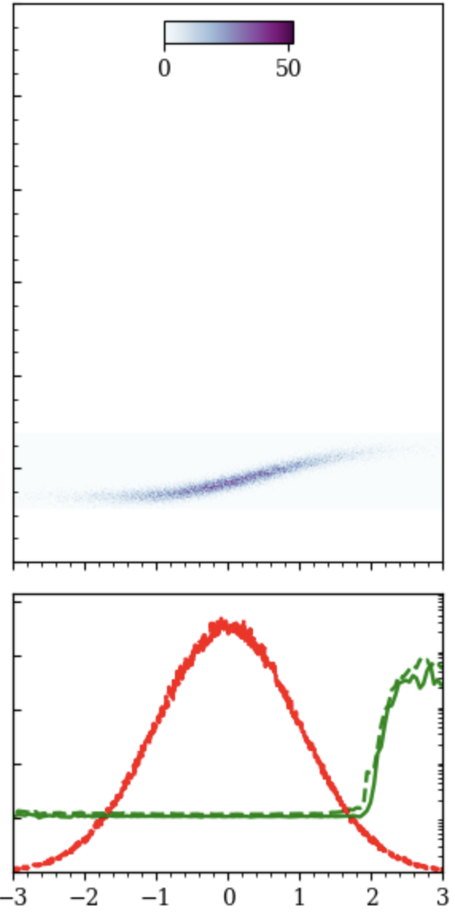
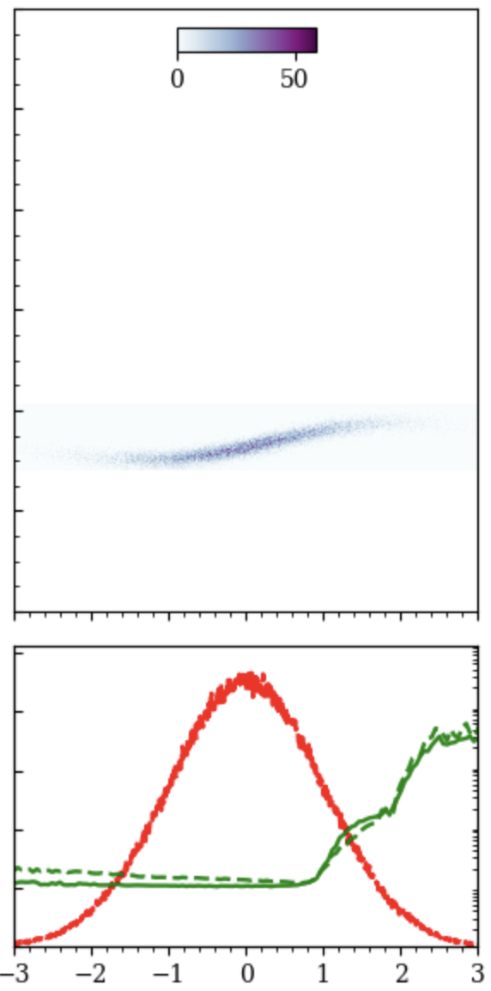
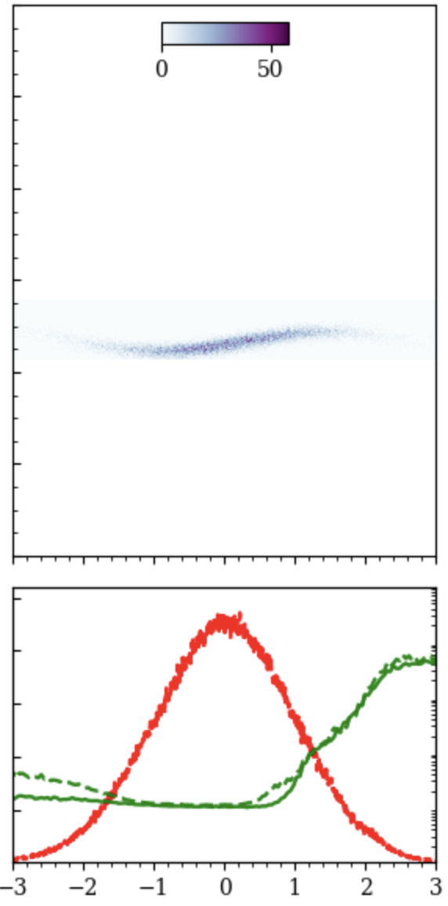
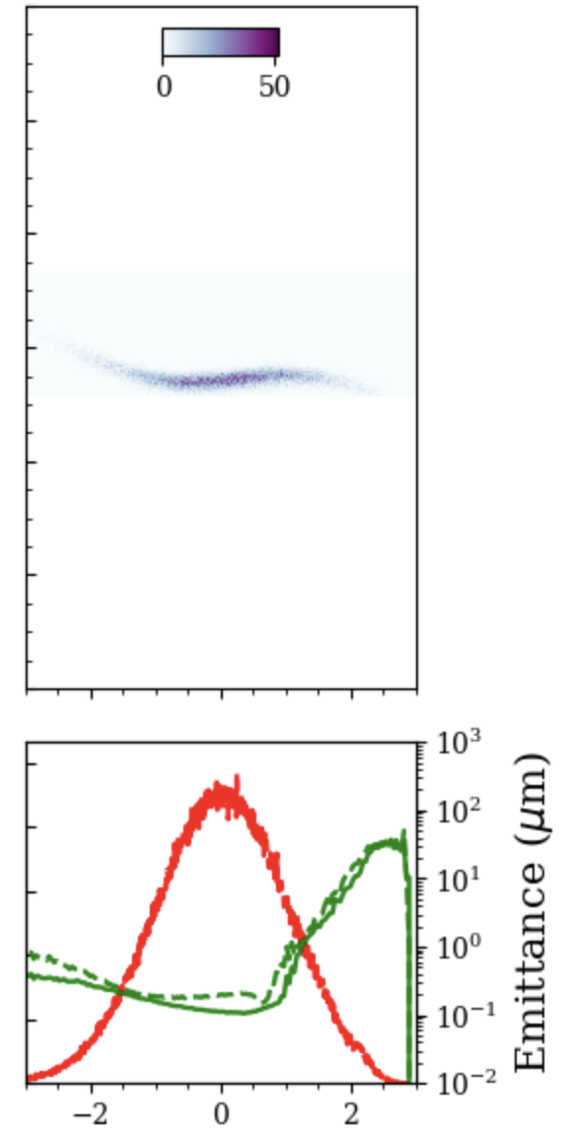
Working point for the second stage from 10 GeV
D
R
C
D
R
C
Head erosion
D
R
C
D
R
C
Laser oscillation
z = 0 cm
z = 3 cm
z = 9 cm
z = 16 cm
z = 22 cm
z = 29 cm
100% beam are captured and accelerated!
4(-0.5) GeV energy gain
Beam loading is handled by adjusting the chirp
Emittance is mostly preserved
Notes:
With this optimized laser, we simulate a two-stage system.
We start with a 10 GeV, 40 pC witness beam, motivated by results from Berkeley.
The results are very promising:
100% of the beam is captured and transmitted.
In the coupling region, the beam is briefly decelerated by its own wakefield, acting as a de-chirper. This introduces a small positive chirp, which can be corrected in the following stage. As a result, the energy spread is preserved.
The slice emittance is largely maintained. Some degradation arises from head erosion and residual laser oscillations, but the central slice emittance remains excellent.
Take-home message: our plasma-only scheme not only achieves effective laser coupling, but also preserves witness beam quality across stages.
字体，强调结果，标出coupling stage，why 3.5GeV

Slide 10
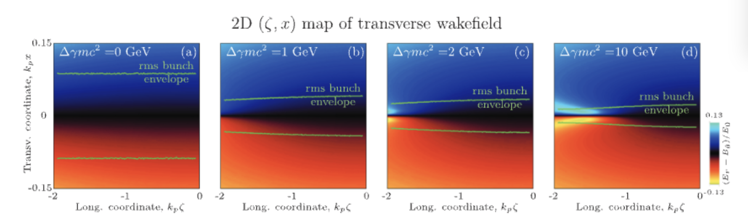
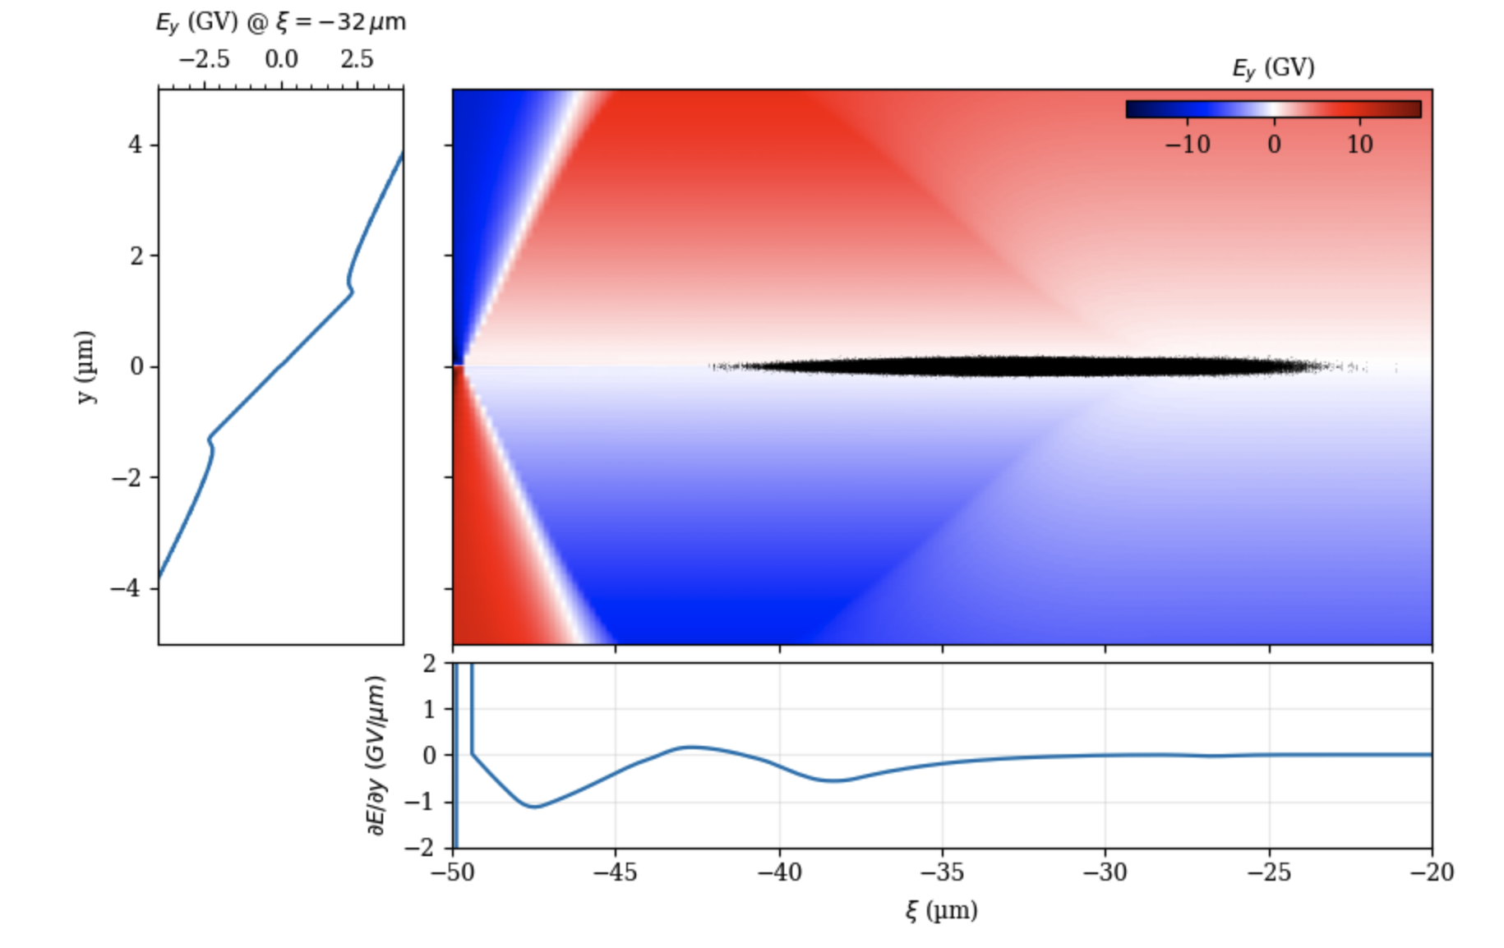
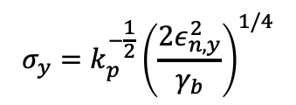

The concept is inherently compatible with ion motion
Mached rms bunch size:
$$σ_{y}=k_{p}^{−\frac{1}{2}}{\left(\frac{2ε_{n,y}^{2}}{γ_{b}}\right)}^{1/4}$$
Coupled area between stages
Longitudinal tailored matched beam can be produced as witness stays in plasma
Assuming ion are stationary and full blow-out
$$γmc^{2}=500 GeV$$
$$Q=30 pC$$
[C. Benedetti et al. Physics of Plasmas 28, 053102 (2021)]
Electron motion due to partial blow-out
Ion motion due to increase of charge density
T. J. Mehrling et al. PRL 121, 264802 (2018)/C. Benedetti et al. Physics of Plasmas 28, 053102 (2021)/C. Benedetti et al. PRAB 20, 111301 (2017)
Notes:
Finally, this concept has an inherent advantage: it is naturally compatible with beam matching in nonlinear fields.
To suppress emittance growth, the beam must stay matched to the focusing field. This is trivial when ions are stationary and the bubble is fully evacuated.
But at higher energies, assumptions fail:
Electrons are not fully expelled, leaving residual fields,
The beam size shrinks, charge density increases, and ion motion becomes important,
The focusing force becomes transversely nonlinear, making matching very difficult if the beam exits plasma.
With conventional staging, re-matching outside plasma is nearly impossible. But in our concept, the witness never leaves the plasma. The evolution is gradual and adiabatic, so the beam naturally adjusts to the matched condition.
This principle is confirmed in the work of Carlo Benedetti, showing that properly tapered beams maintain emittance even at 10 GeV, whereas untapered beams degrade severely.
Thus, in-plasma staging is inherently compatible with ion motion and nonlinear beam dynamics.

Slide 11
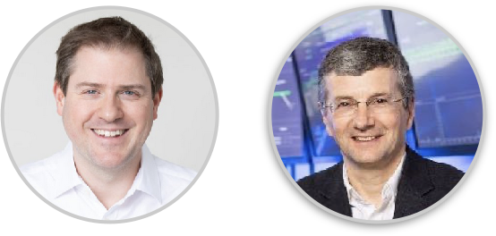
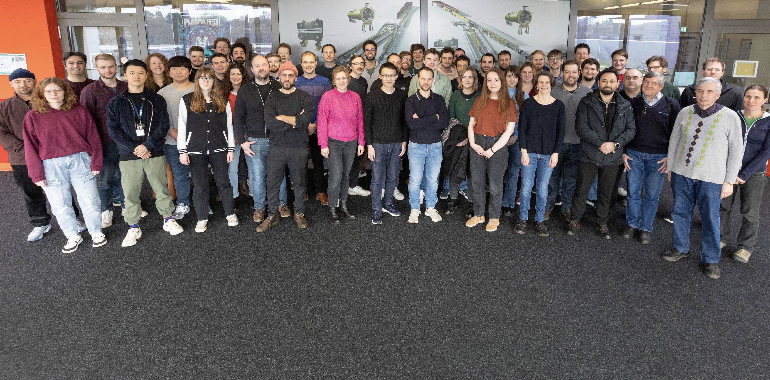
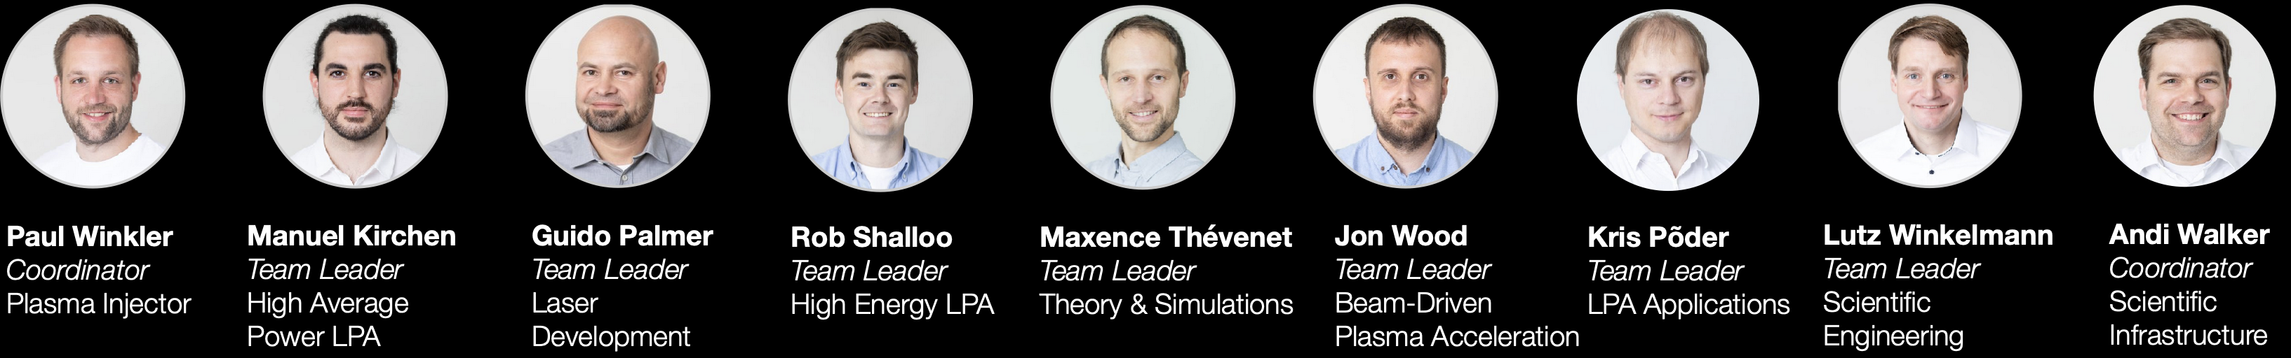
The DESY plasma group MPL
Wim Leemans
division director
Andi Maier
group leader
XFEL 1.7 km

Slide 12
Perspectives
Conclusion
With realistic s2e 3D simulations we demonstrate in-plasma staging
3.5 GeV gain from second HOFI LPA stage with capturing ratio of 100%
Beam loaded, emittance preserved in most of the beam
Compatible with strong ion motion and adiabatic matching
Open-Source
Open-Source
Open-Source
Open-Source
Real combination of simulation tools in past or present studies
HiPACE++
Open-Sourcee
Main challenges are head erosion and laser coupling
Later stages are easier, even with strong ion motion
Still working on laser coupling, emittance preservation, etc.
Being wrapped up for publication, to be submitted next weeks.

