Slide 1

Nonlinear interaction-point dynamics for plasma-accelerated beams
T. C. Wilson, J. Farmer, F. Wileke, N. Lopes,
A. Pukhov, A. Caldwell

Slide 2
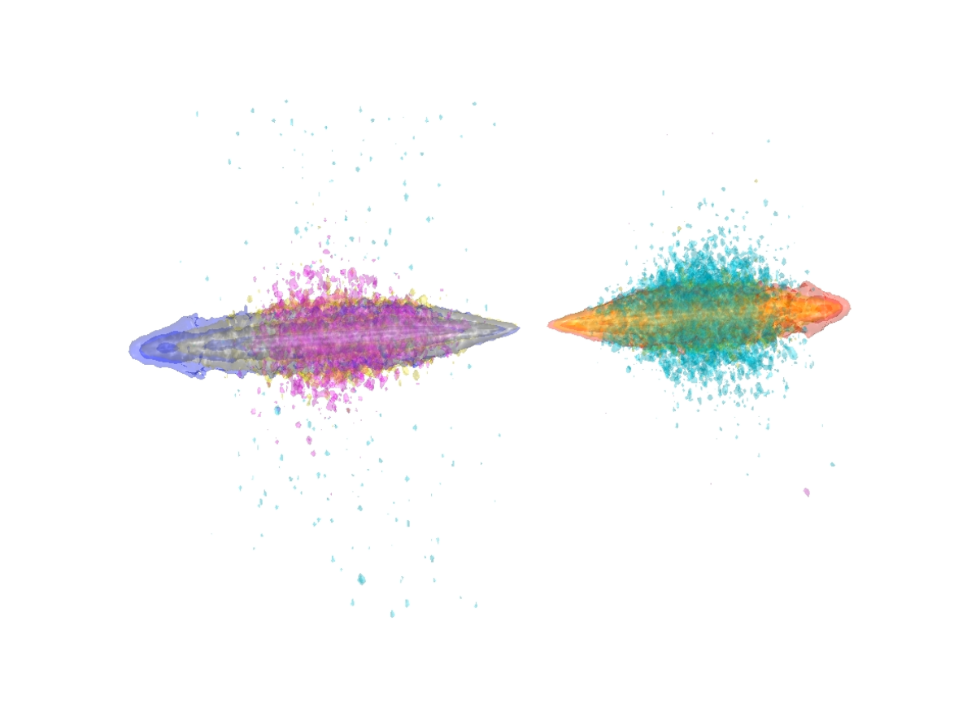
Talk Structure
Introduction
  Luminosity and disruption
  Plasma accelerators
Plasma-accelerated beams
  Angled beams
  Hourglass effect
  Plasma-relevant beam profiles
Summary and Further work

Slide 3
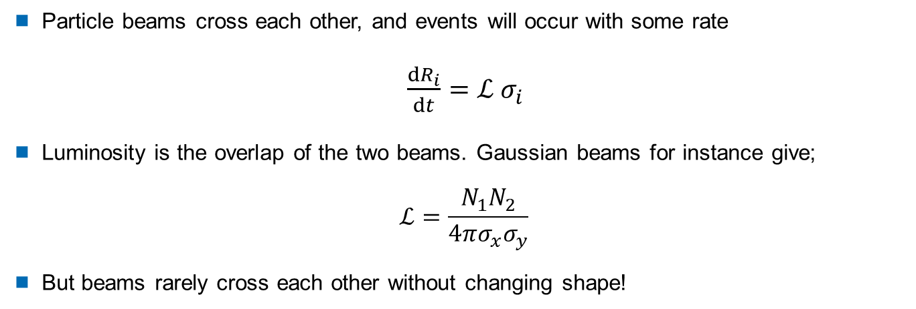
Luminosity
e⁻
e⁺
Particle beams cross each other, and events will occur with some rate
$\frac{dR_{i}}{dt}=ℒ σ_{i}$
Luminosity is the overlap of the two beams. Gaussian beams for instance give;
$$ℒ=\frac{N_{1}N_{2}}{4πσ_{x}σ_{y}}$$
But beams rarely cross each other without changing shape!

Slide 4
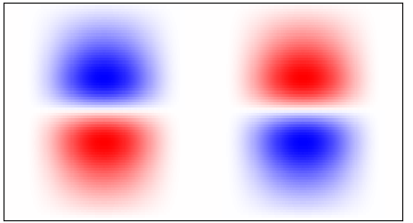
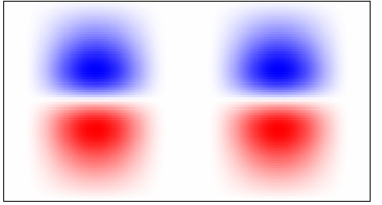
Pinch & disruption
e⁻e⁺ colliders exhibit pinching at the IP, the reason for this is easy to see
As the bunches collide, the defocussing E-field is neutralised, and the focussing B-field is enhanced
The amount that the beam pinches is summarised as disruption
Conventional colliders mitigate this by making beams flat
Repelling E_{y}
Attracting B_{z}
e⁻
e⁺
e⁻
e⁺

Slide 5
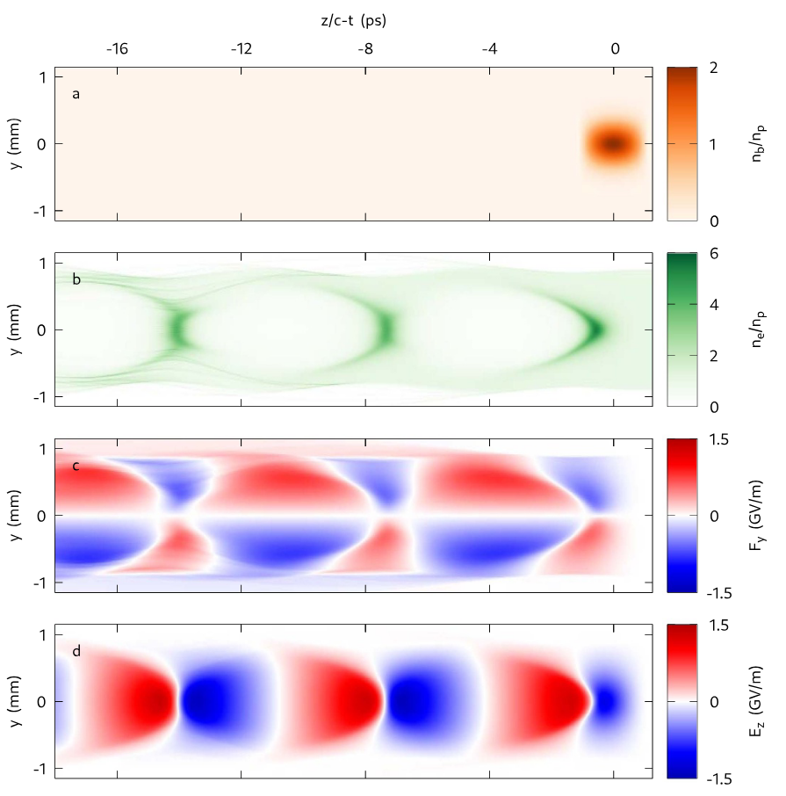
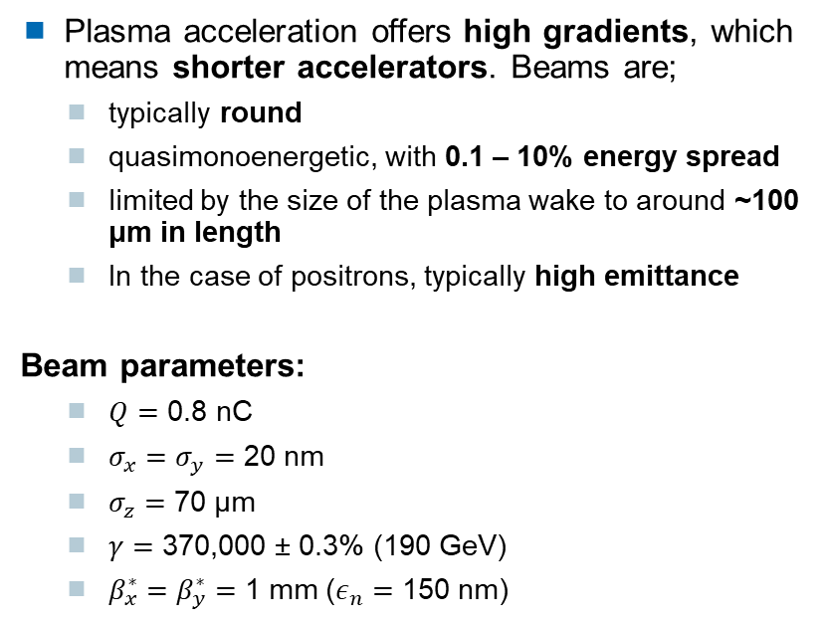
Plasma accelerated beams
Plasma acceleration offers high gradients, which means shorter accelerators. Beams are;
  typically round
  quasimonoenergetic, with 0.1 – 10% energy spread
  limited by the size of the plasma wake to around ~100 μm in length
  In the case of positrons, typically high emittance
Beam parameters:
  $Q=$ 0.8 nC
  $σ_{x}=σ_{y}=$ 20 nm
  $σ_{z}=$ 70 μm
  $γ=$ 370,000 ± 0.3% (190 GeV)
  $β_{x}^{∗}=β_{y}^{∗}=$ 1 mm ($ε_{n}=$ 150 nm)
Based on CLIC,
adapted to round beams
short-bunch proton-driven wakefield structure
J Farmer et al 2024 New J. Phys. 26 113011

Slide 6
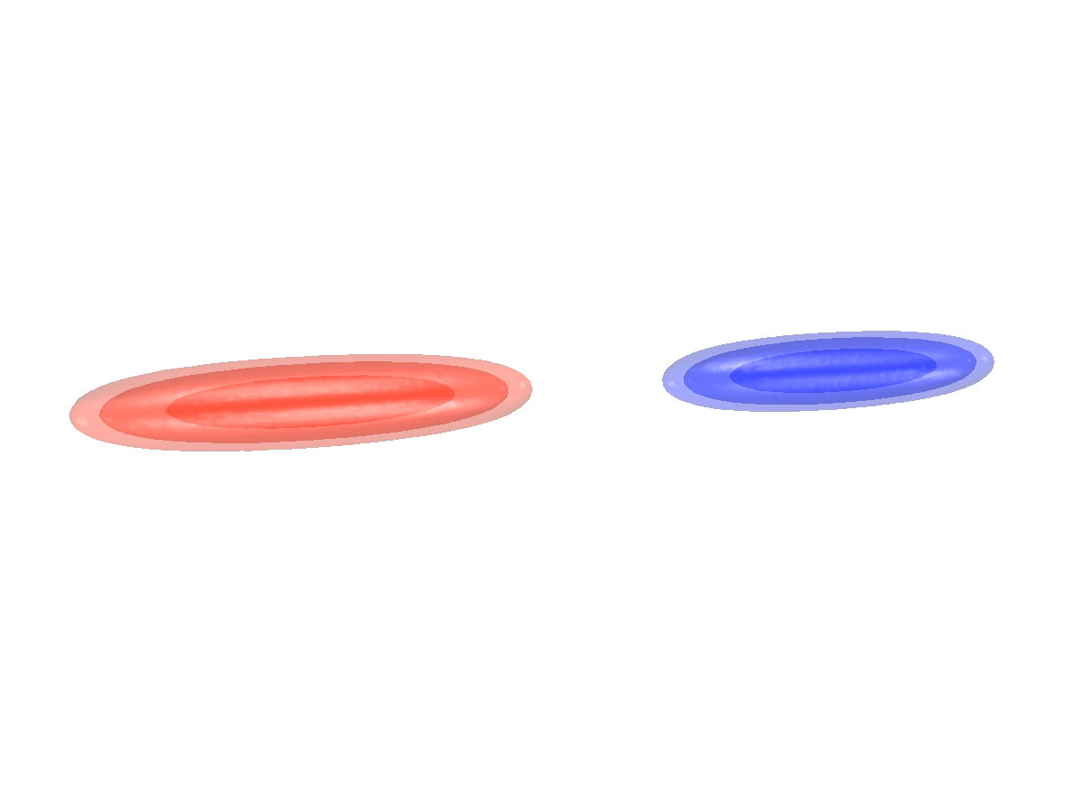

Quantum Complications
VLPL 3D-QED Simulation
As the beams pinch, the fields increase in turn, which can lead to strong-field QED effects
high-energy photons are produced, and in the case of very high disruption, e⁻e⁺ pairs
As these secondary particles are produced, the beams lose energy – so called 'beamsstrahlung'
Pair-production in particular is tricky to model, because new charged particles create fields of their own, which can dramatically affect the interaction
We need simulations!
e⁻
e⁺
Breit-Wheeler e⁻
Briet-Wheeler e⁺
$γ$

Slide 7
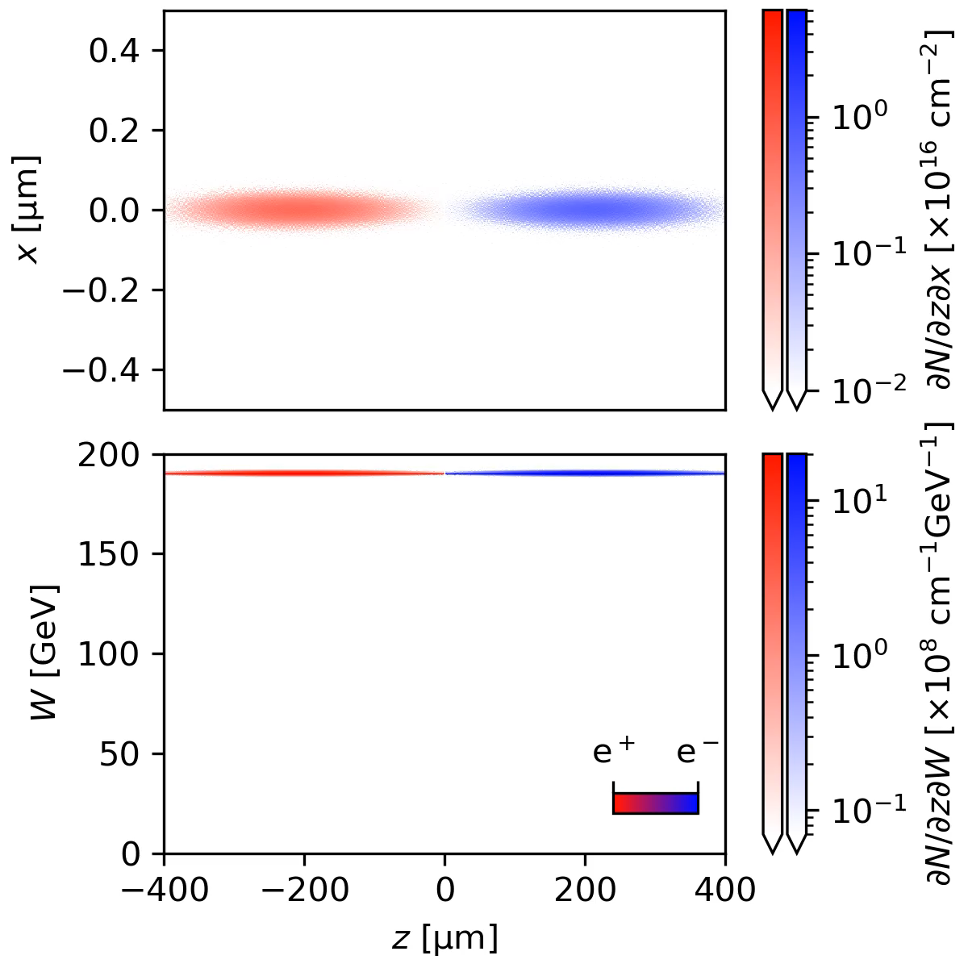
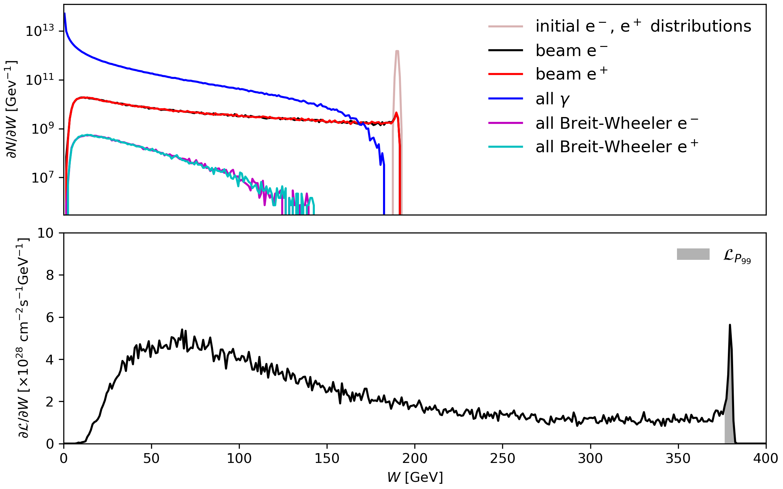
Plasma-accelerated beams
Colliding two of these beams gives us a starting point
Total luminosity ~8x10³⁰ cm⁻²
Of which ~3% is in the top 1% of energy
GuineaPig++ simulation
Positional distributions are integrated over any missing axes

Slide 8
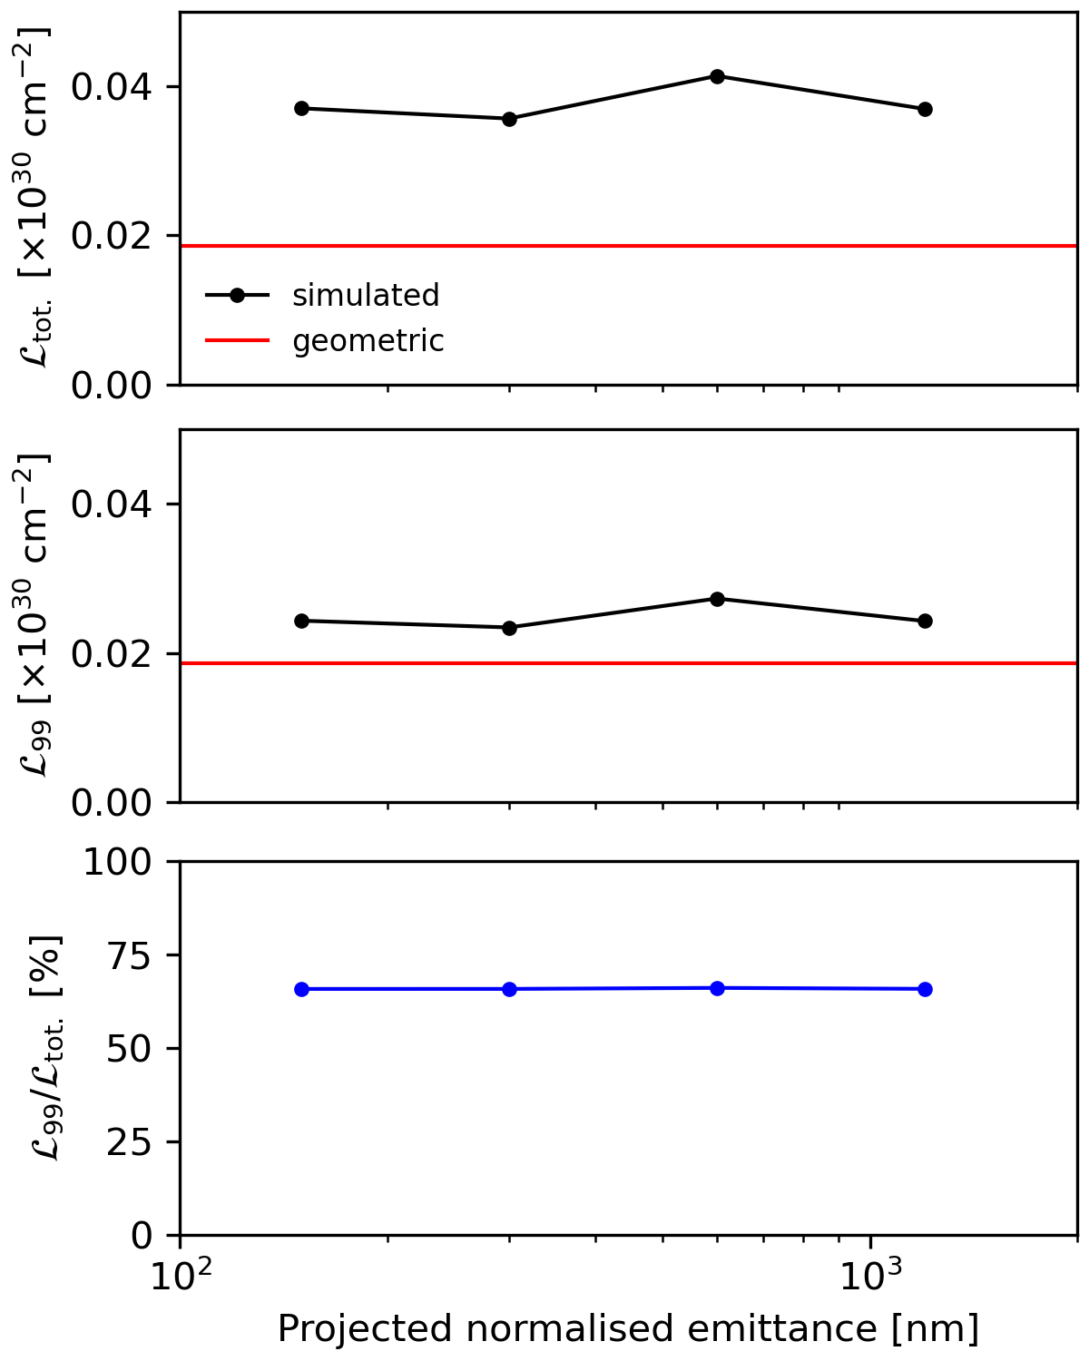
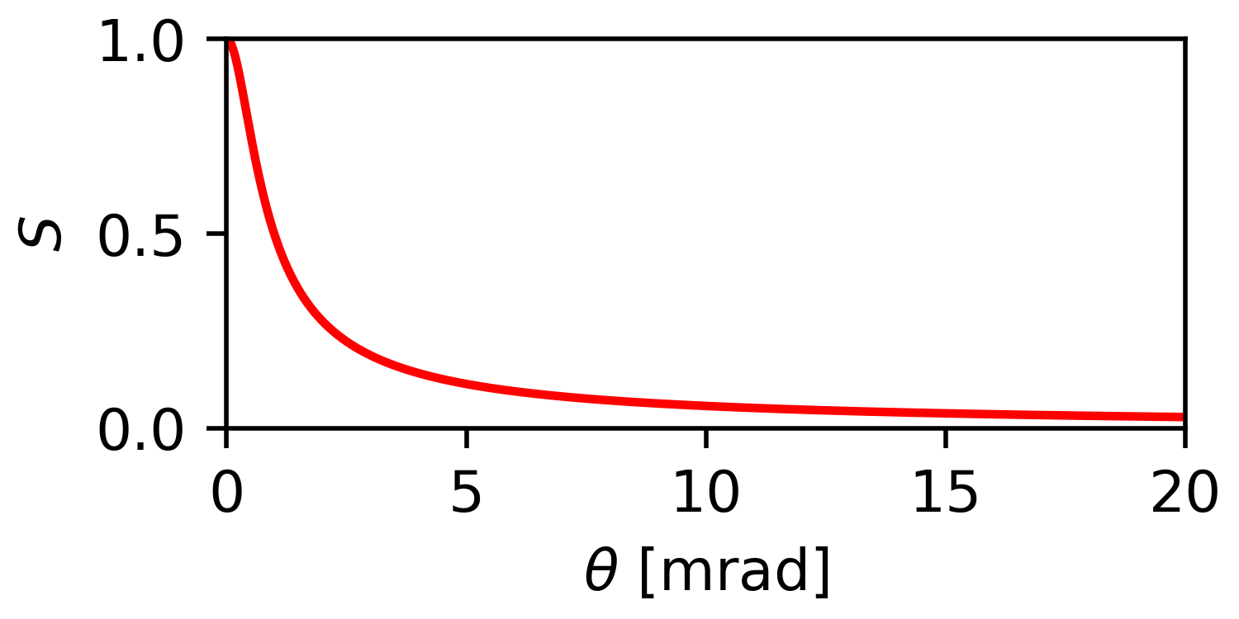

Crossing Angles
no crossing angle
with crossing angle
θ = 16.5 mrad
Crossing angles modify the luminosity by a factor
$$S={\left[1+{\left(\frac{σ_{z}}{σ_{x}}\tan{\frac{θ}{2}}\right)}^{2}\right]}^{−\frac{1}{2}}$$
Directly reducing the overlap between the two beams reduces both disruption and the attainable luminosity, but the interaction becomes insensitive to beam quality
complete overlap
partial overlap

Slide 9
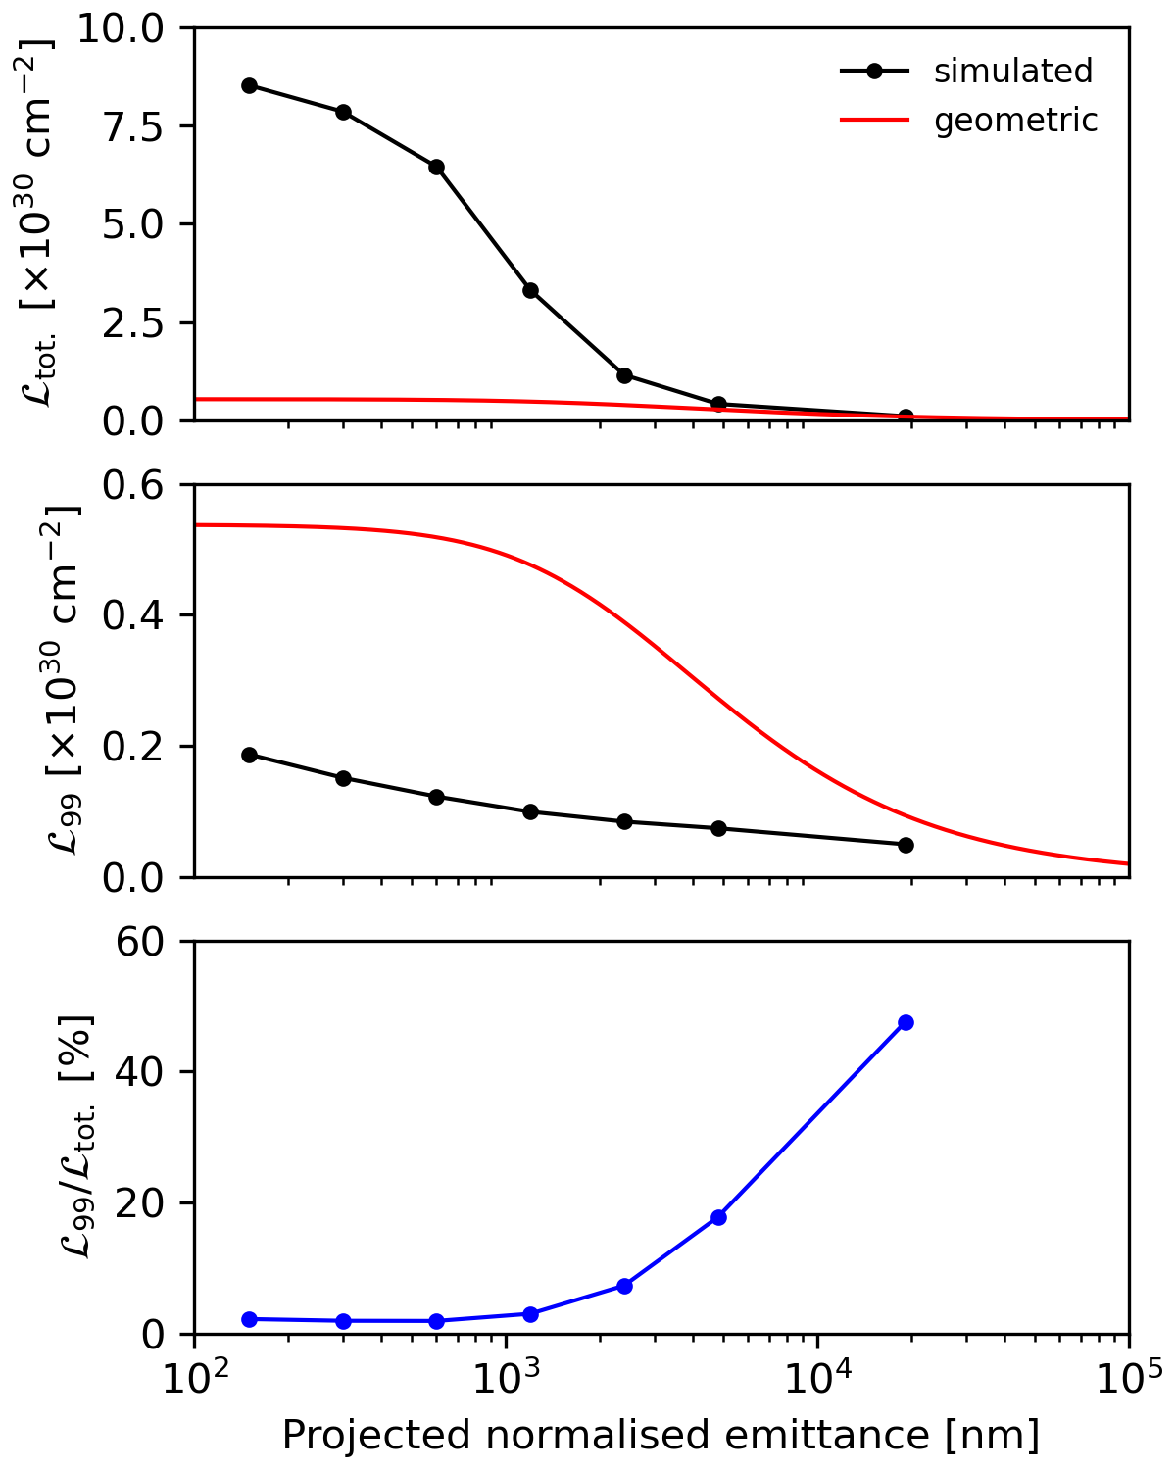
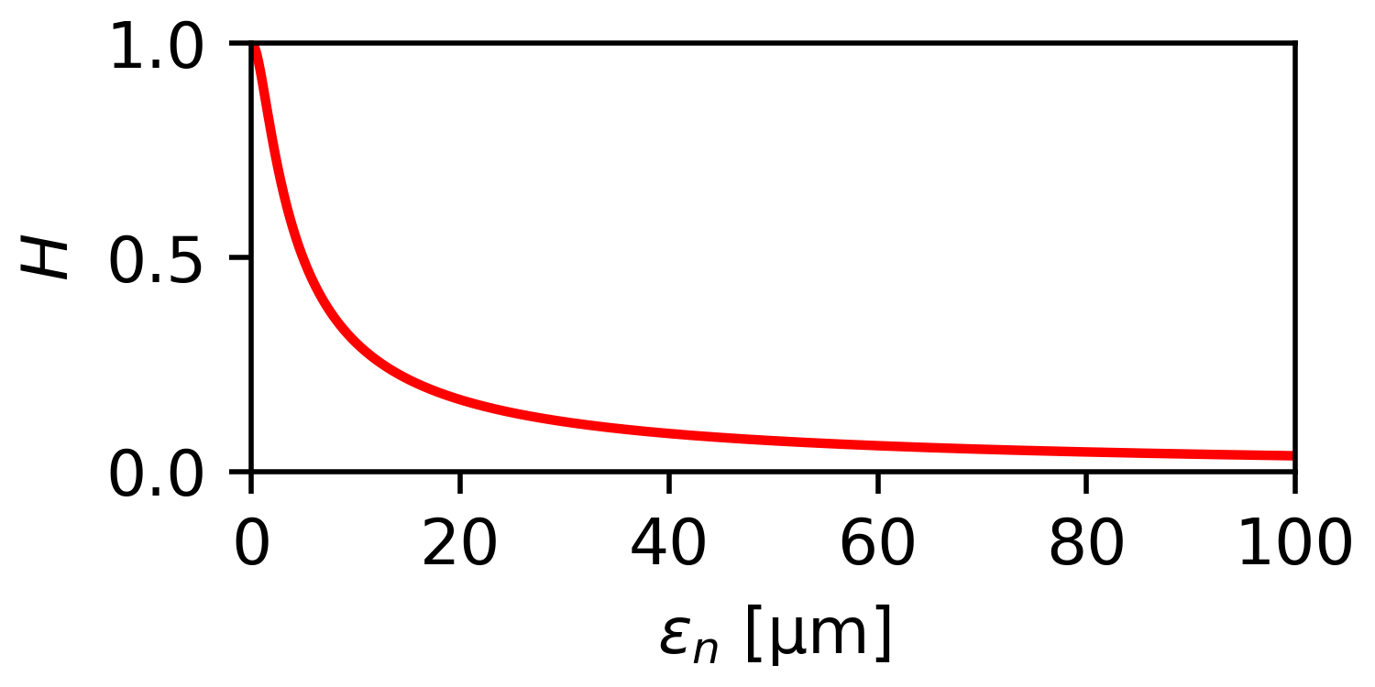


The hourglass effect
The emittance of a beam cause the size of the beam to vary with distance from its focus, much like a laser. This effect also causes a reduction in crossover and hence luminosity
The reduction in disruption causes a large drop in total luminosity, but quality of the signal improves as beam quality degrades, leaving the top 1% fraction relatively insensitive
$$H=\sqrt{π}{ u}_{x}\exp\left(u_{x}^{2}\right)\operatorname{erfc}\left(u_{x}\right)$$
$$u_{x}=\frac{β_{x}^{∗}}{σ_{z}}$$

Slide 10
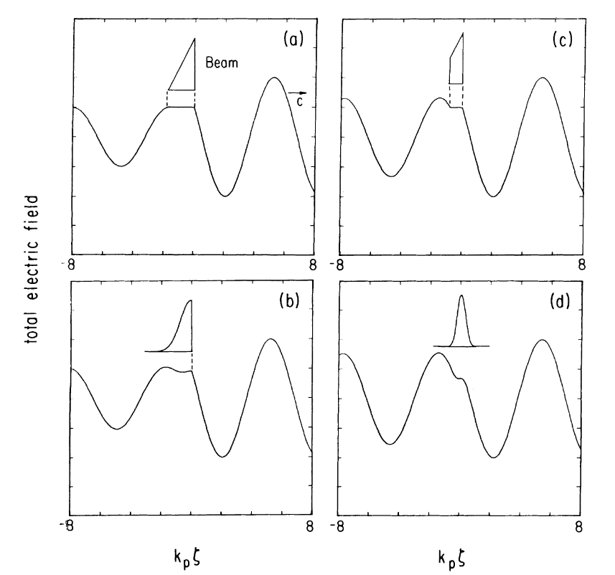
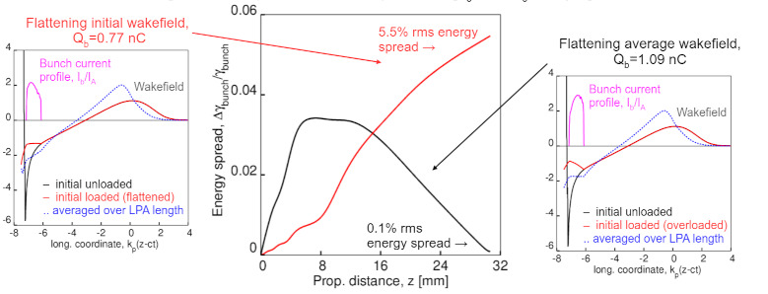
What might we be colliding?
Beamloading in plasma accelerators traditionally calls for downramp (fat-end first) bunches
Optimal profiles for acceleration over very long distances take on weird and wonderful shapes
If the beams require focussing after leaving the plasma, the eventual shape may be different again
https://indico.slac.stanford.edu/event/9734/
T. Katsouleas et al., Particle Accelerators, 22, 81-99, 1987

Slide 11
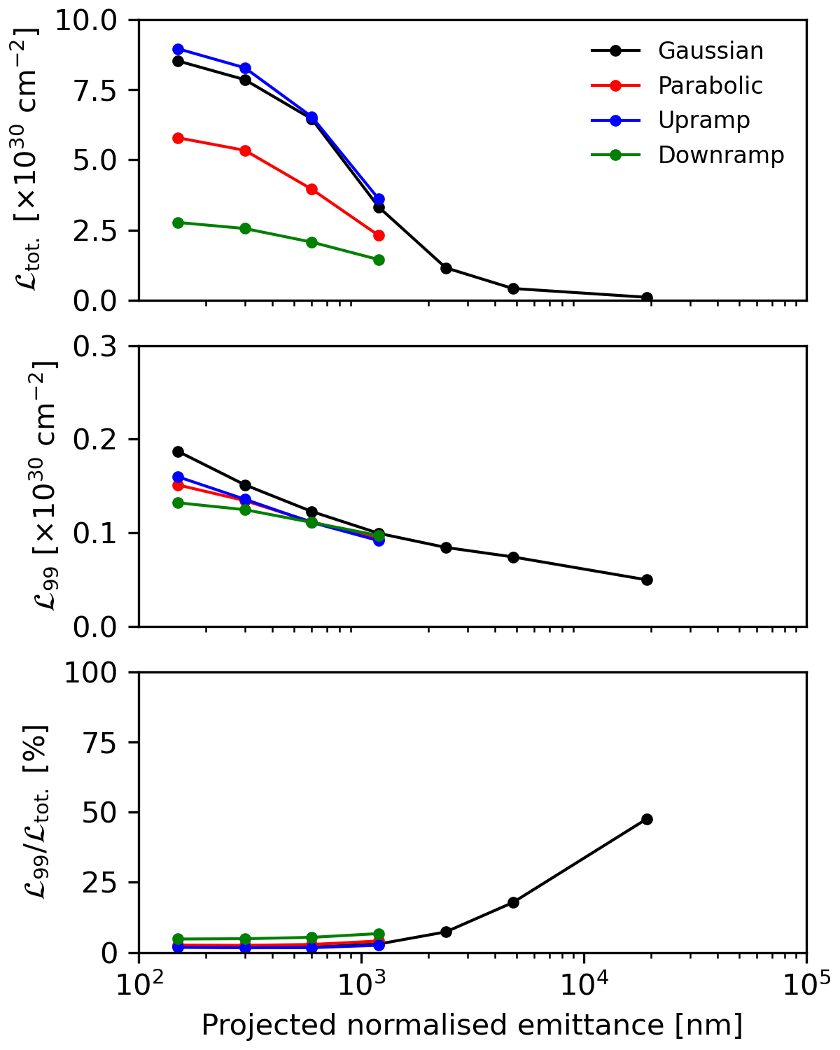
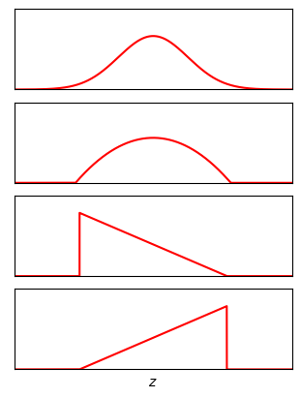
Longitudinal shape factors
It makes sense to scan several different shapes to see how different the results are
Bunch motion
Large variations in the total luminosity are all smoothed out when looking at the top 1%
The overwhelming factor for the high-energy fraction is the projected emittance
All profiles converge towards similar values at high emittance
Gaussian
Universal default
Parabolic
From RF accelerators
Upramp
From (e.g.) Ionisation injection
Downramp
Optimal for beamloading over short distances

Slide 12
Summary
The kinds of bunch profiles typical of plasma accelerators offer similar performance to those of conventional accelerators
The high disruption of round beams can be mitigated with increased emittance, trading off absolute luminosity for quality of signal
The effect of signal to noise ratio should be evaluated with start-to-end (system) codes and detector simulation
As we move towards higher-energy colliders, scanning broad range of collision energies becomes a useful property, so figures of merit may change
Thank you for your attention

