Slide 1
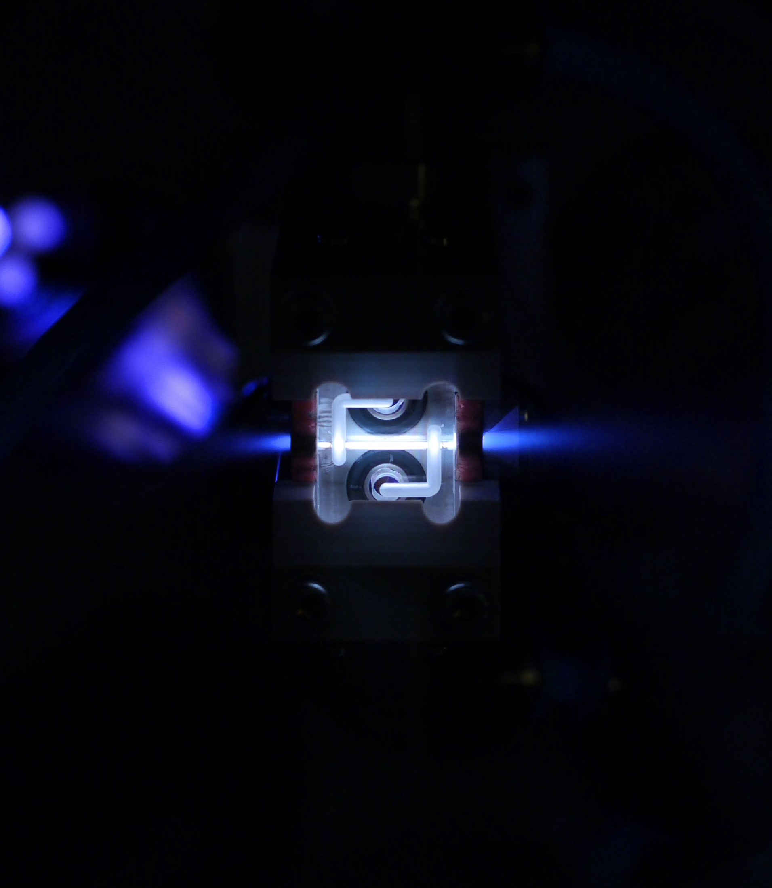



Parametric mapping of the instability—efficiency relation in plasma wakefield accelerators.
Probing the beam-breakup instability (BBU) with HiPACE++.
Ole Gunnar Finnerud
Department of Physics, University of Oslo
24/09/2025

Slide 2
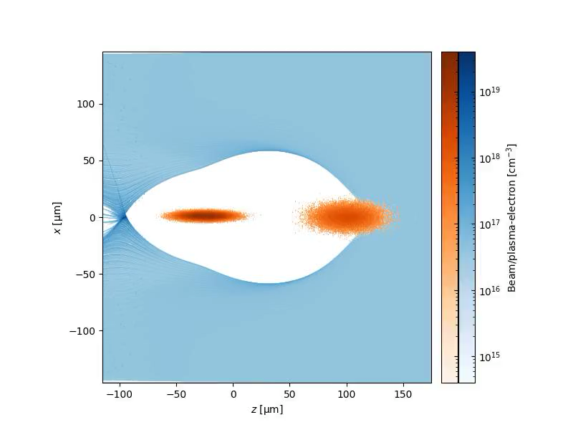
Theory and simulation
A transverse offset of the witness beam relative to the driver seeds the BBU instability.
Offset trailing electrons couple with the blowout sheath inducing a resonant behaviour.
The oscillation—amplitude of the beam electrons grows exponentially in time.
The oscillation—amplitude of the beam electrons grows rapidly towards the tail of the bunch.
24/09/2025 | Ole Gunnar Finnerud | EAAC 2025
Page

Slide 3
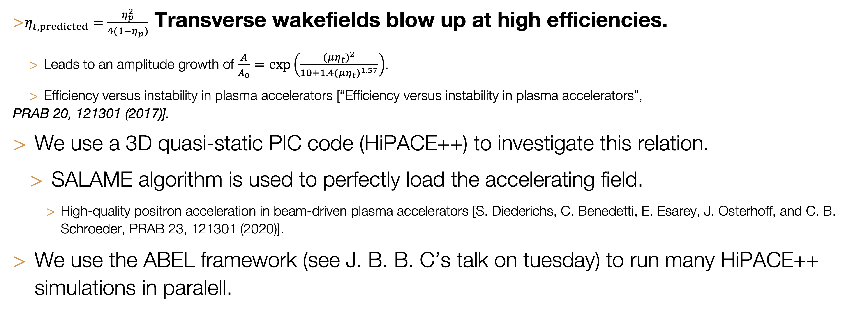
Theory and simulation
Power-transfer efficiency from the driver to the trailing bunch is related to the strength of BBU instability.
$η_{t,predicted}=\frac{η_{p}^{2}}{4(1−η_{p})}$ Transverse wakefields blow up at high efficiencies.
  Leads to an amplitude growth of $\frac{A}{A_{0}}=exp\left(\frac{(μη_{t})^{2}}{10+1.4(μη_{t})^{1.57}}\right)$.
  Efficiency versus instability in plasma accelerators [“Efficiency versus instability in plasma accelerators”,
PRAB 20, 121301 (2017)].
We use a 3D quasi-static PIC code (HiPACE++) to investigate this relation.
  SALAME algorithm is used to perfectly load the accelerating field.
    High-quality positron acceleration in beam-driven plasma accelerators [S. Diederichs, C. Benedetti, E. Esarey, J. Osterhoff, and C. B. Schroeder, PRAB 23, 121301 (2020)].
We use the ABEL framework (see J. B. B. C’s talk on tuesday) to run many HiPACE++ simulations in paralell.
24/09/2025 | Ole Gunnar Finnerud | EAAC 2025
Page

Slide 4
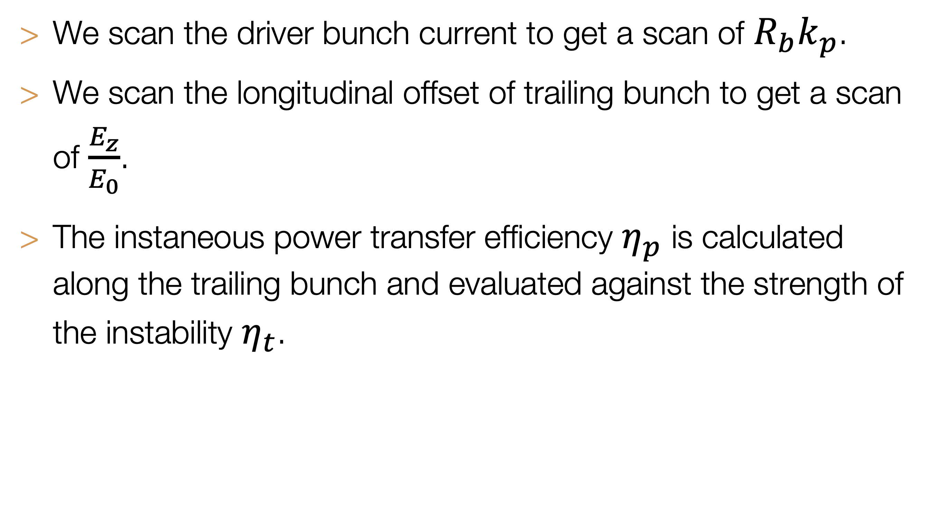
Parameter scan
We scan the field loaded by the trailing bunch and the normalised wake size $R_{b}k_{p}$.
We scan the driver bunch current to get a scan of $R_{b}k_{p}$.
We scan the longitudinal offset of trailing bunch to get a scan of $\frac{E_{z}}{E_{0}}$.
The instaneous power transfer efficiency $η_{p}$ is calculated along the trailing bunch and evaluated against the strength of the instability $η_{t}$.
24/09/2025 | Ole Gunnar Finnerud | EAAC 2025
Page
Source: O. G. Finnerud, Carl A. Lindstrøm and E. Adli, PRAB 28, 071301 (2025).

Slide 5
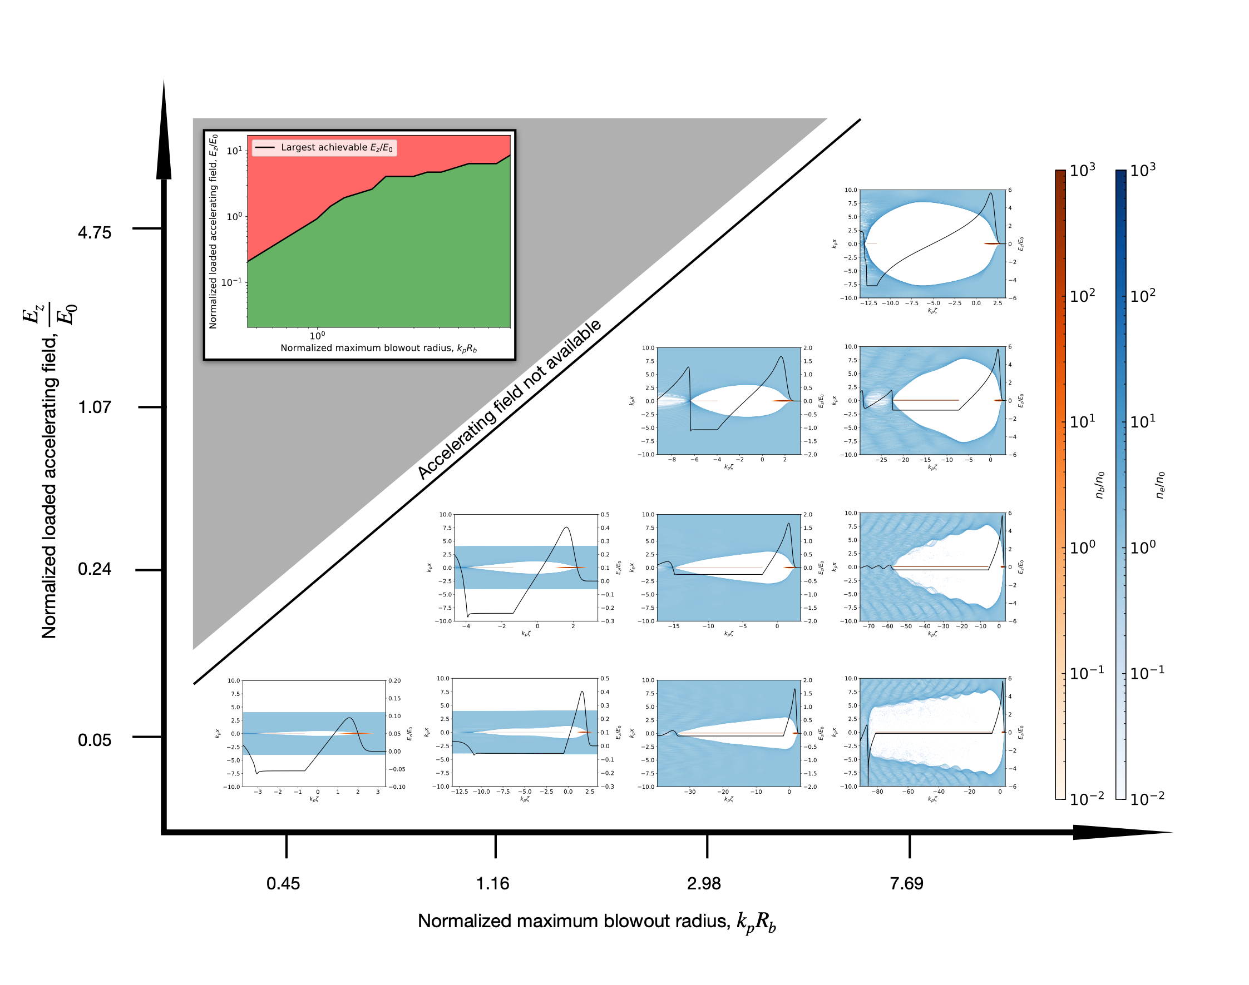
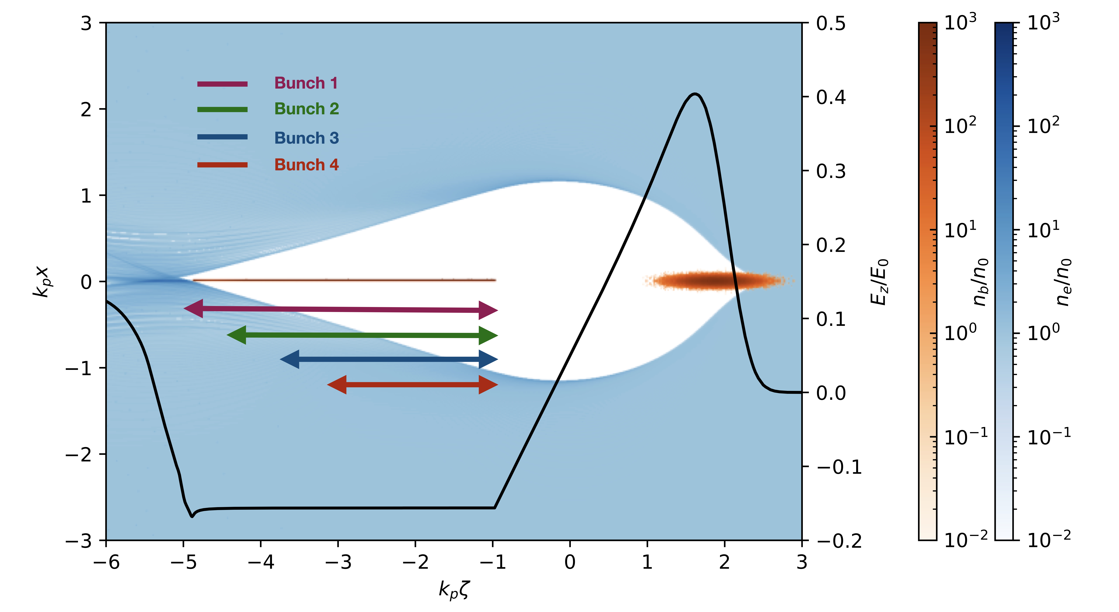
Parameter scan
We scan the field loaded by the trailing bunch and the normalised wake size $R_{b}k_{p}$.
Source: O. G. Finnerud, Carl A. Lindstrøm and E. Adli, PRAB 28, 071301 (2025).
Source: O. G. Finnerud, Carl A. Lindstrøm and E. Adli, PRAB 28, 071301 (2025).
24/09/2025 | Ole Gunnar Finnerud | EAAC 2025
Page

Slide 6
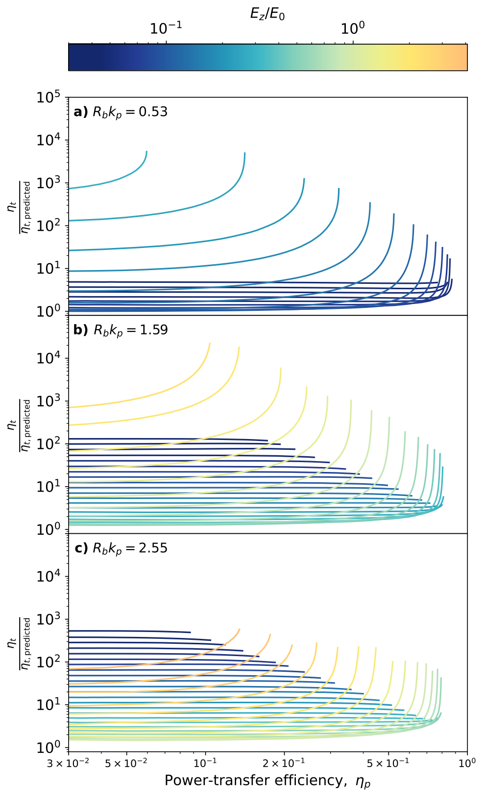
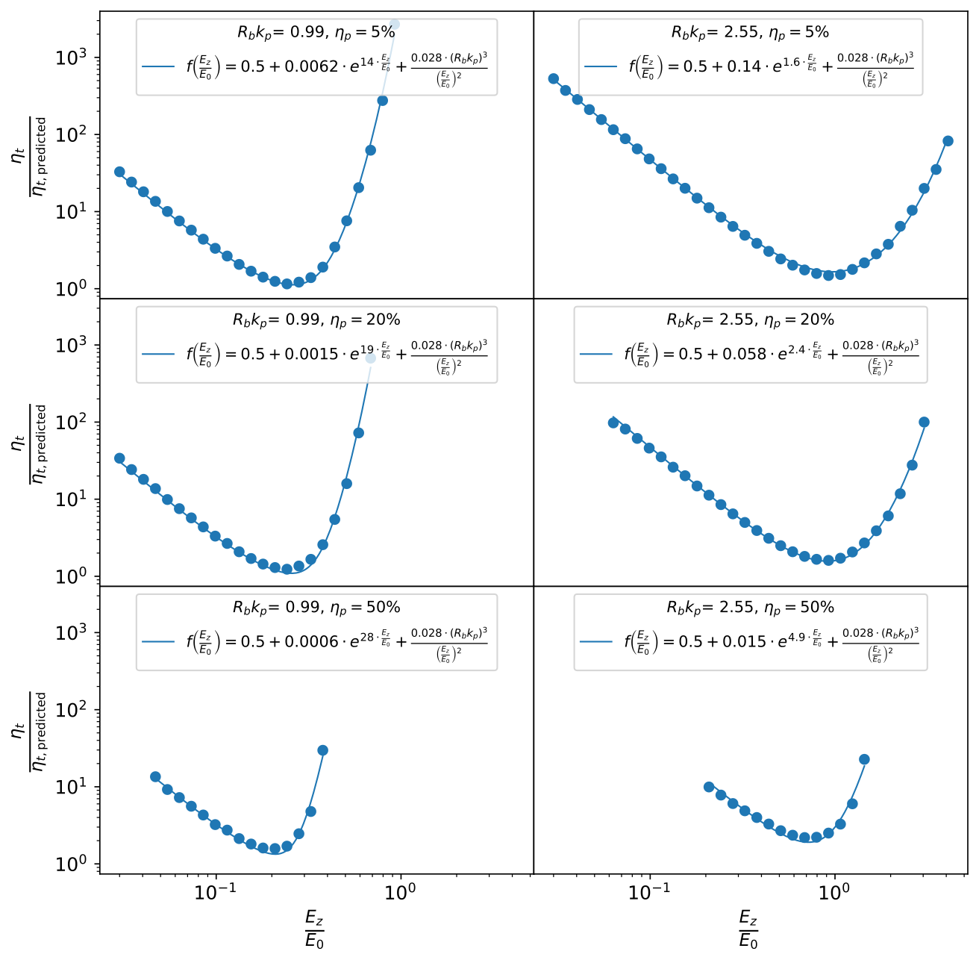
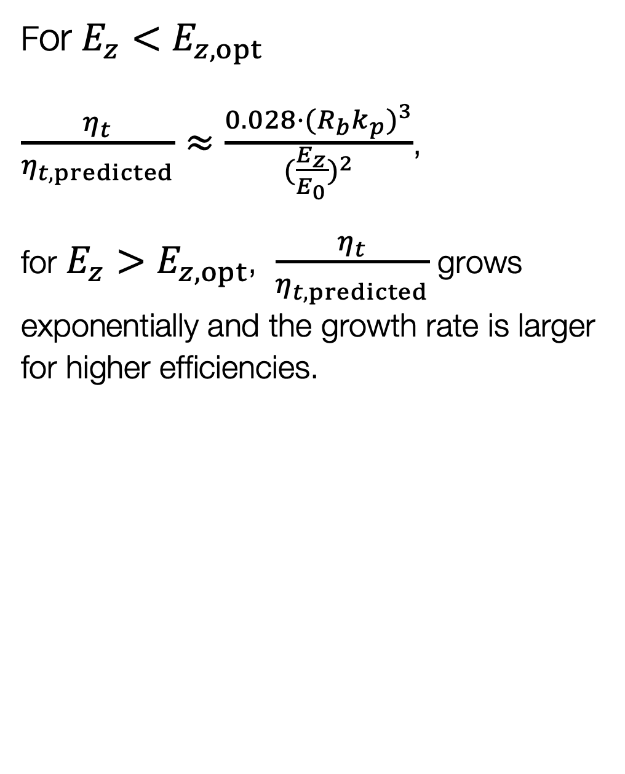
Results
Strength of the instability is in general larger than predicted and varies with $\frac{E_{z}}{E_{0}}$.
For $E_{z}<E_{z,opt}$
$\frac{η_{t}}{η_{t,predicted}}≈\frac{0.028⋅(R_{b}k_{p})^{3}}{(\frac{E_{z}}{E_{0}})^{2}}$,
for $E_{z}>E_{z,opt}$, $\frac{η_{t}}{η_{t,predicted}}$ grows exponentially and the growth rate is larger for higher efficiencies.
Source: O. G. Finnerud, Carl A. Lindstrøm and E. Adli, PRAB 28, 071301 (2025).
Source: O. G. Finnerud, Carl A. Lindstrøm and E. Adli, PRAB 28, 071301 (2025).
24/09/2025 | Ole Gunnar Finnerud | EAAC 2025
Page

Slide 7
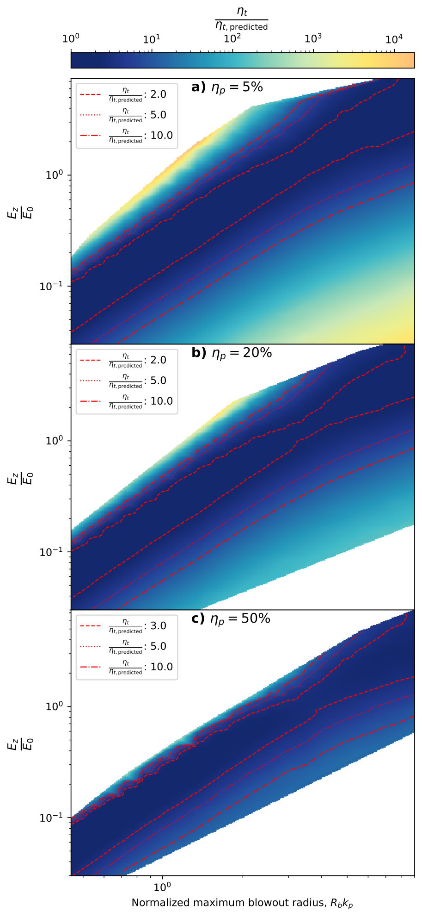
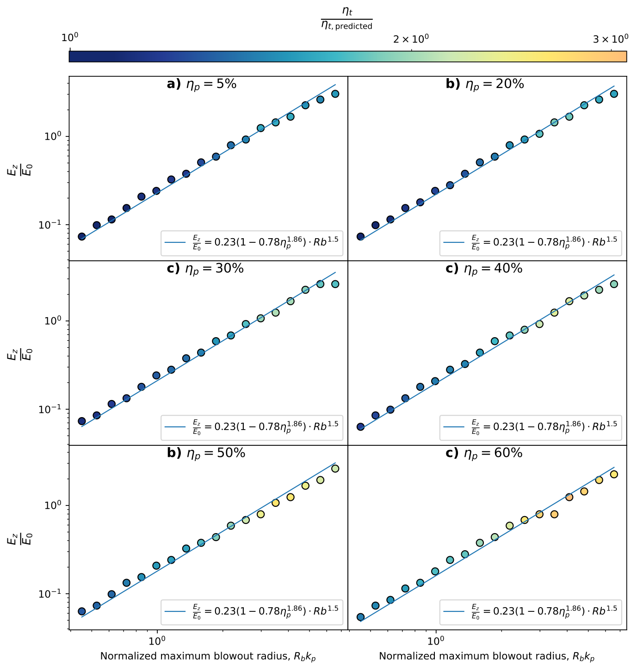
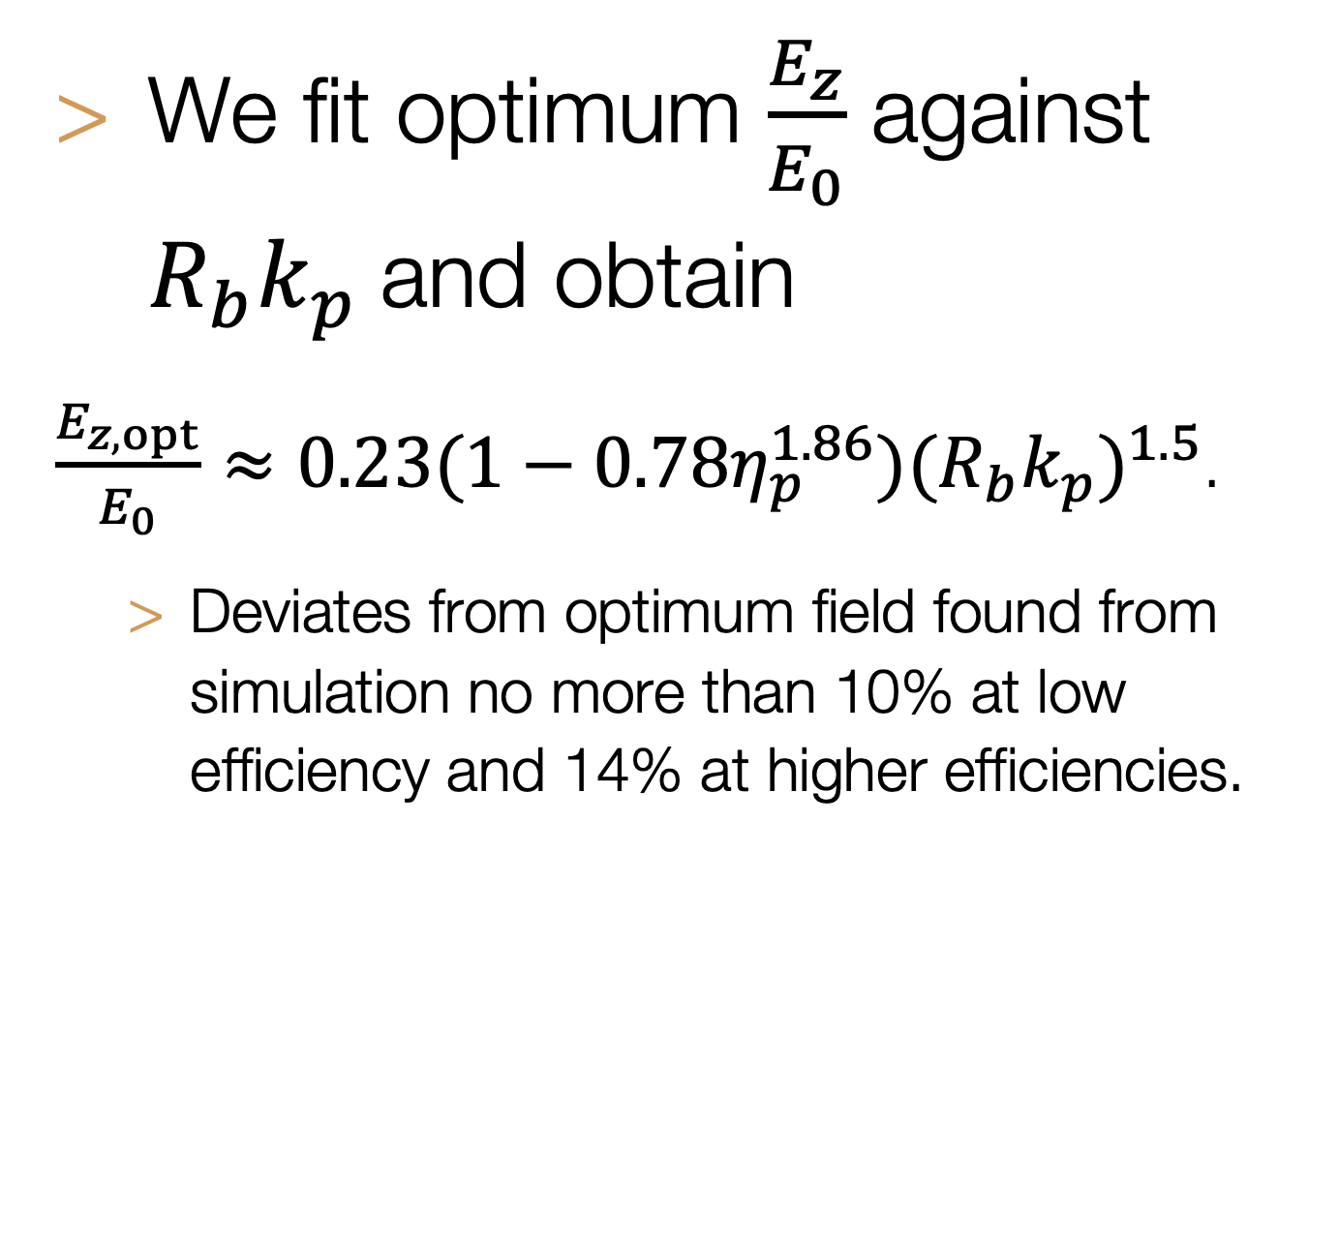
Results
There is an optimum value of $\frac{E_{z}}{E_{0}}$ for each $R_{b}k_{p}$.
We fit optimum $\frac{E_{z}}{E_{0}}$ against $R_{b}k_{p}$and obtain
$\frac{E_{z,opt}}{E_{0}}≈0.23(1−0.78η_{p}^{1.86})(R_{b}k_{p})^{1.5}$.
  Deviates from optimum field found from simulation no more than 10% at low efficiency and 14% at higher efficiencies.
Source: O. G. Finnerud, Carl A. Lindstrøm and E. Adli, PRAB 28, 071301 (2025).
Source: O. G. Finnerud, Carl A. Lindstrøm and E. Adli, PRAB 28, 071301 (2025).
24/09/2025 | Ole Gunnar Finnerud | EAAC 2025
Page

Slide 8
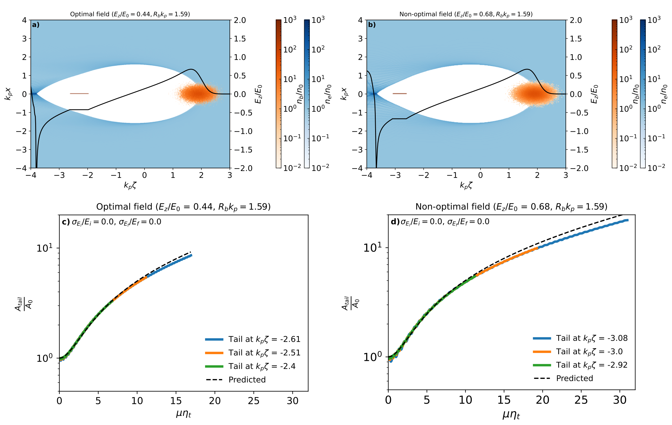
Results
Comparing amplitude growths at different points in the parameter space.
Source: O. G. Finnerud, Carl A. Lindstrøm and E. Adli, PRAB 28, 071301 (2025).
24/09/2025 | Ole Gunnar Finnerud | EAAC 2025
Page

Slide 9
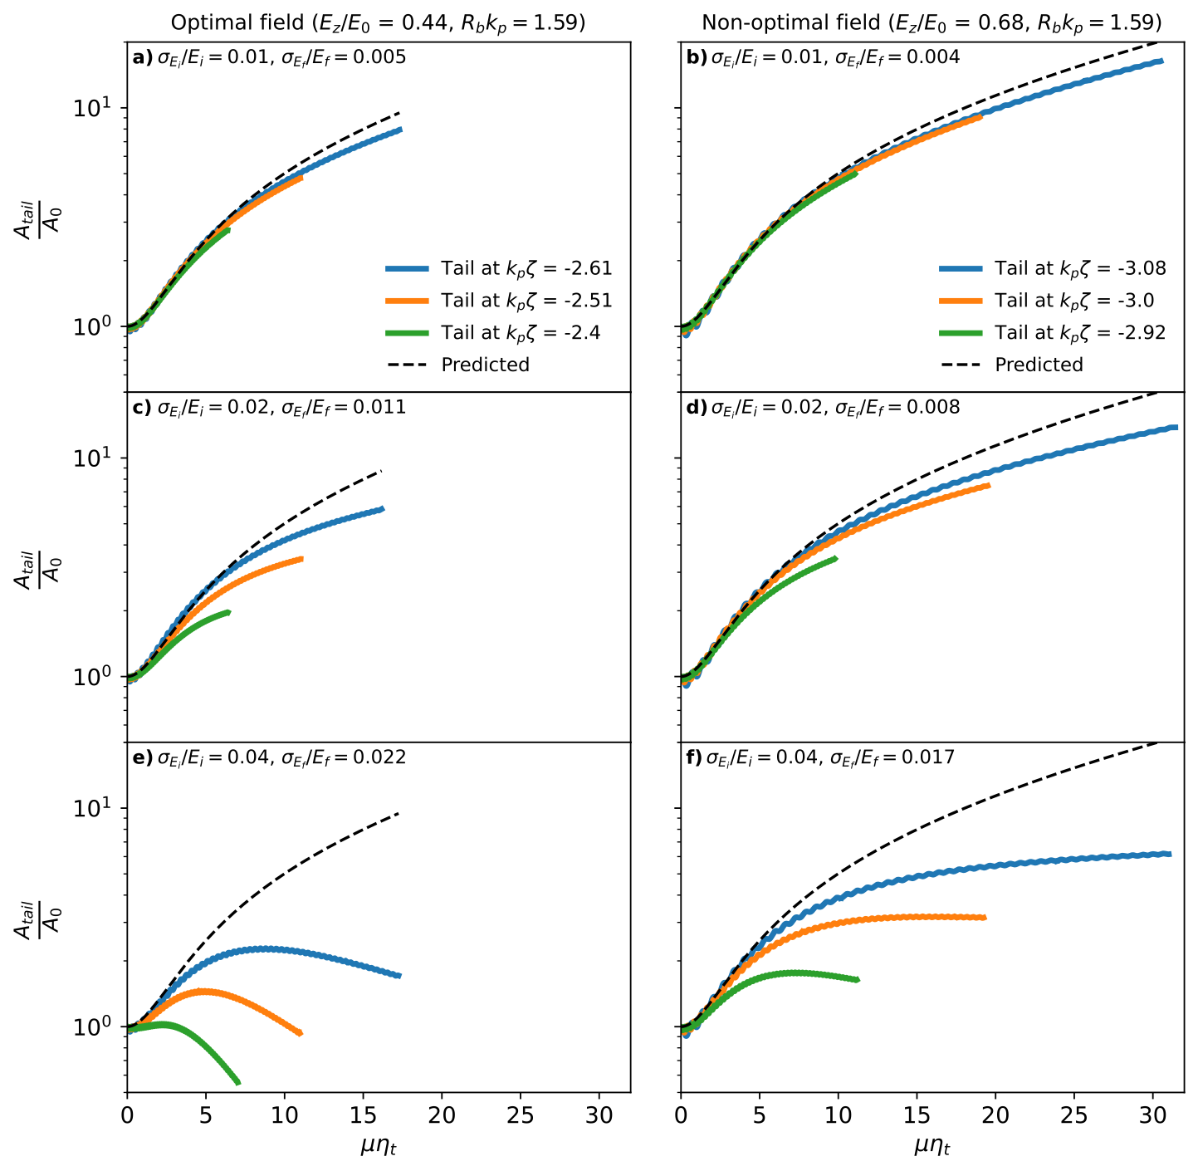
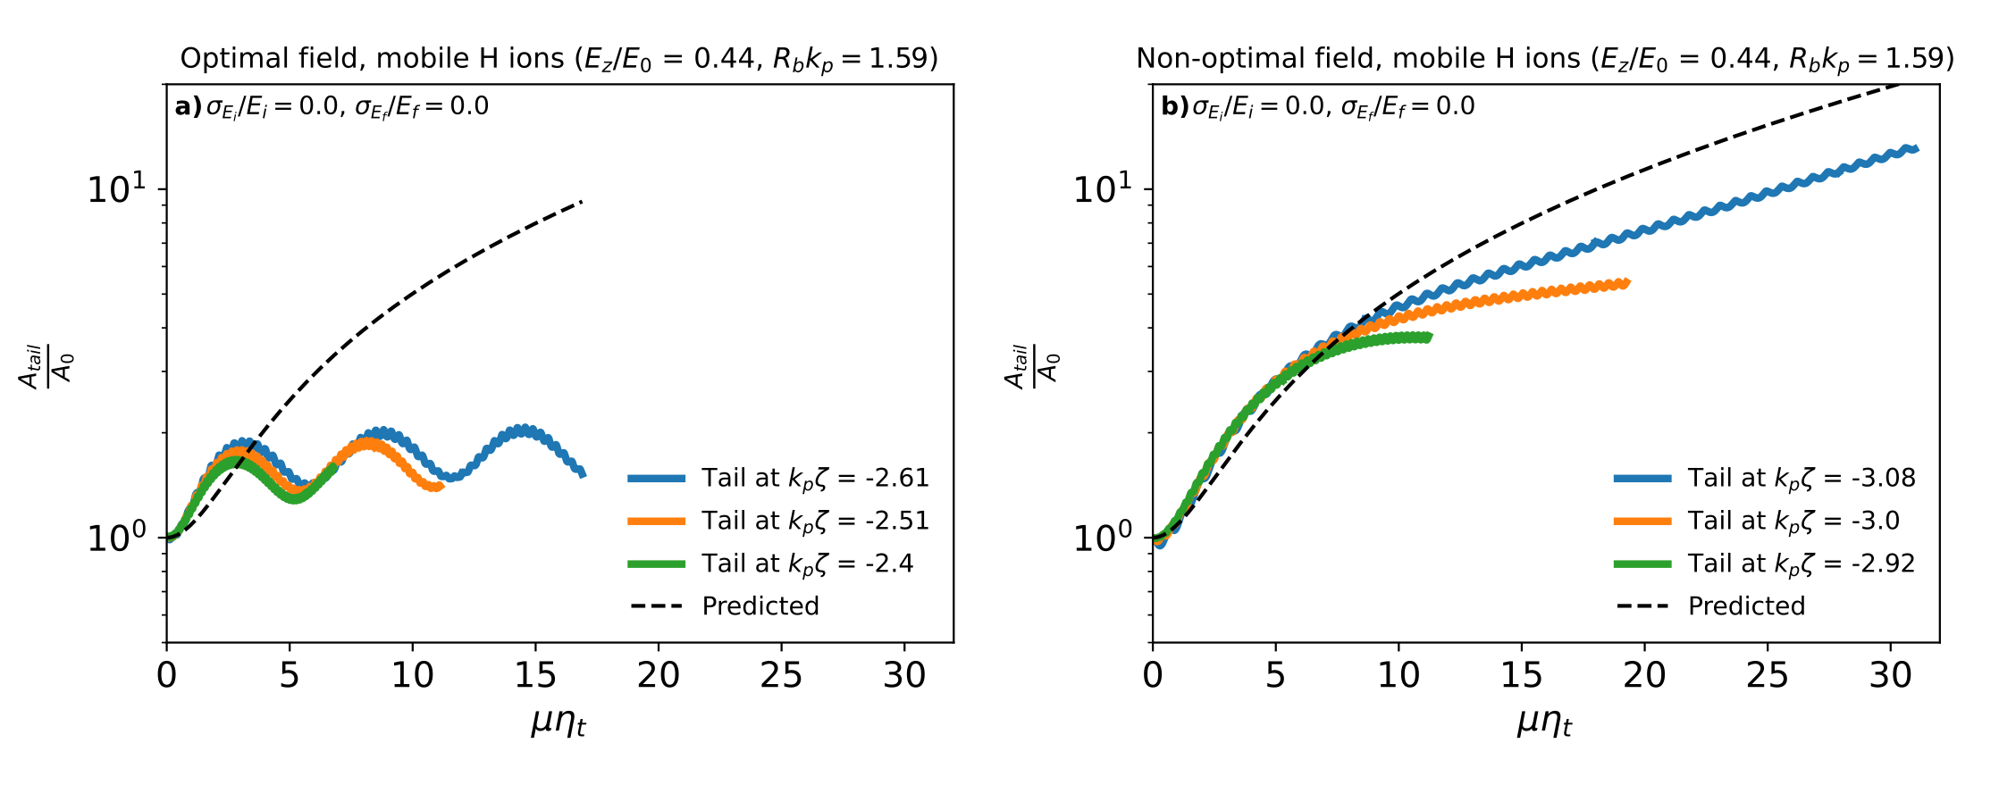
Results
Mitigation with intial uncorrelated energy spread and ion motion.
Source: O. G. Finnerud, Carl A. Lindstrøm and E. Adli, PRAB 28, 071301 (2025).
Source: O. G. Finnerud, Carl A. Lindstrøm and E. Adli, PRAB 28, 071301 (2025).
24/09/2025 | Ole Gunnar Finnerud | EAAC 2025
Page

Slide 10
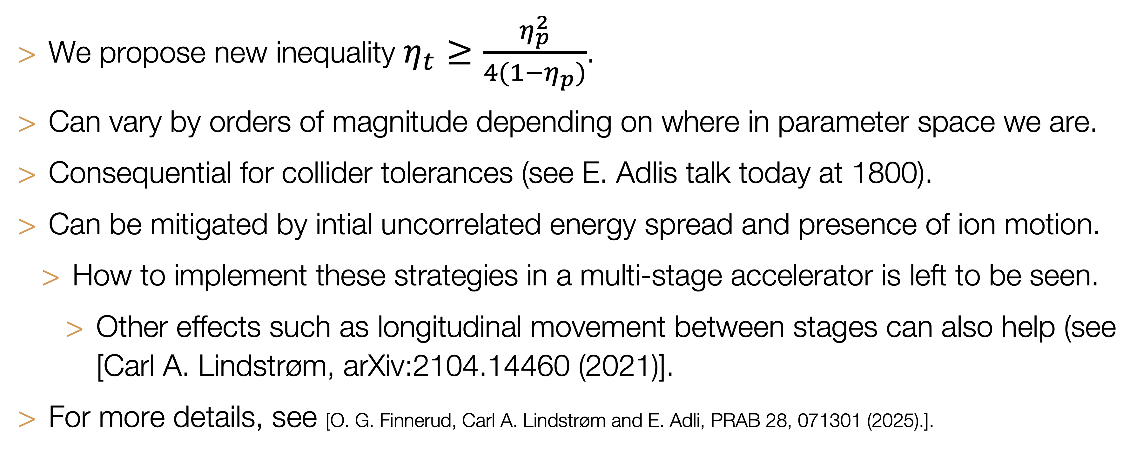
Conclusions
Strength of instability depends strongly on point chosen in parameter space and can be mitigated.
We propose new inequality $η_{t}≥\frac{η_{p}^{2}}{4(1−η_{p})}$.
Can vary by orders of magnitude depending on where in parameter space we are.
Consequential for collider tolerances (see E. Adlis talk today at 1800).
Can be mitigated by intial uncorrelated energy spread and presence of ion motion.
  How to implement these strategies in a multi-stage accelerator is left to be seen.
    Other effects such as longitudinal movement between stages can also help (see [Carl A. Lindstrøm, arXiv:2104.14460 (2021)].
For more details, see [O. G. Finnerud, Carl A. Lindstrøm and E. Adli, PRAB 28, 071301 (2025).].
24/09/2025 | Ole Gunnar Finnerud | EAAC 2025
Page

