Slide 1



Acceleration-Induced Self-Interactions of Ultra-Short Electron Bunches
Ryan J. McGuigan
Supervisor: Prof. Steven P. Jamison

Slide 2
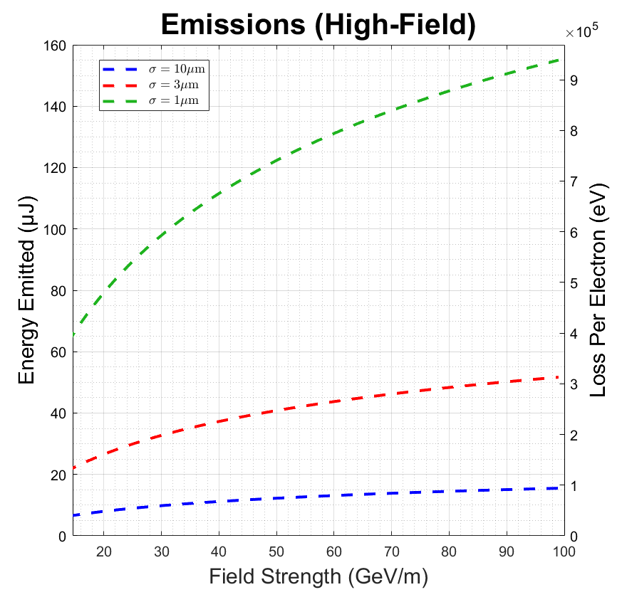

Background
PhD project exploring fundamental performance limitations of high-field gradient acceleration.
Previously calculated the coherent emissions of linearly accelerated bunches
Under the right conditions, bunches may lose a significant amount of energy due to coherent emission
Figure: Predicted scaling of coherent emission losses with external accelerating gradient for different values of bunch length $σ$.
Accelerator length $L=3$cm, $N=6.25×{10}^{8}$
Acceleration-Induced Self-Interactions of Ultra-Short Electron Bunches
Speaker Name: Ryan McGuigan email: r.mcguigan1@lancaster.ac.uk
1

Slide 3
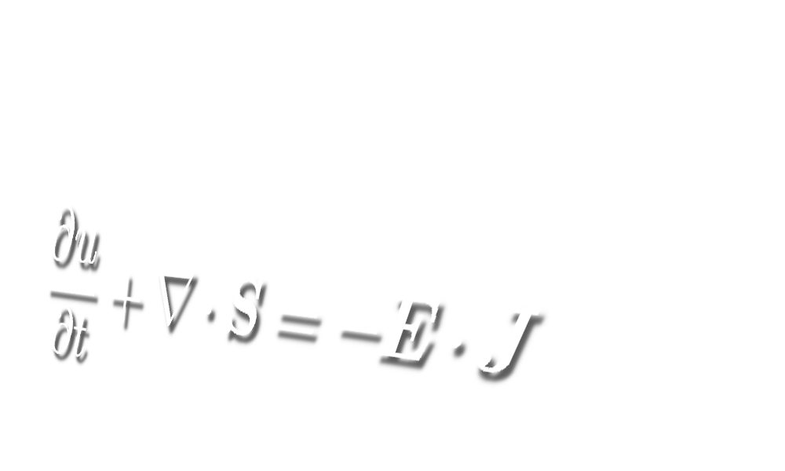
Emission of coherent radiation into Far-Field motivates the question:
How does the bunch interact with itself during high-field gradient acceleration processes?
Acceleration-Induced Self-Interactions of Ultra-Short Electron Bunches
Speaker Name: Ryan McGuigan email: r.mcguigan1@lancaster.ac.uk
2

Slide 4
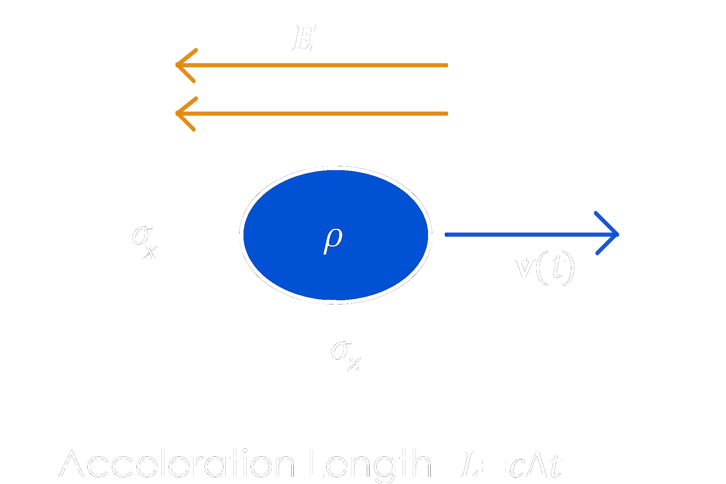


The near field MODEL
3D Charge Density in vacuum, $ρ\left(x, t\right)$with transverse and longitudinal length scales${ σ}_{x}$, $σ_{z}$
Applied uniform field $E_{ext}$ accelerates charge
Field switches off after time $∆t$
Assume self-interaction is sufficiently small such that charge is effectively rigid*
$$ρ\left(x, t\right)=ρ(x−r(t))$$
Charge motion $r(t)$ is hyperbolic in $t$ (hyperbolic motion) during acceleration
$$ext$$
*in more formal terms we can expand in a perturbation series about the rigid charge solution
Acceleration-Induced Self-Interactions of Ultra-Short Electron Bunches
Speaker Name: Ryan McGuigan email: r.mcguigan1@lancaster.ac.uk
3

Slide 5
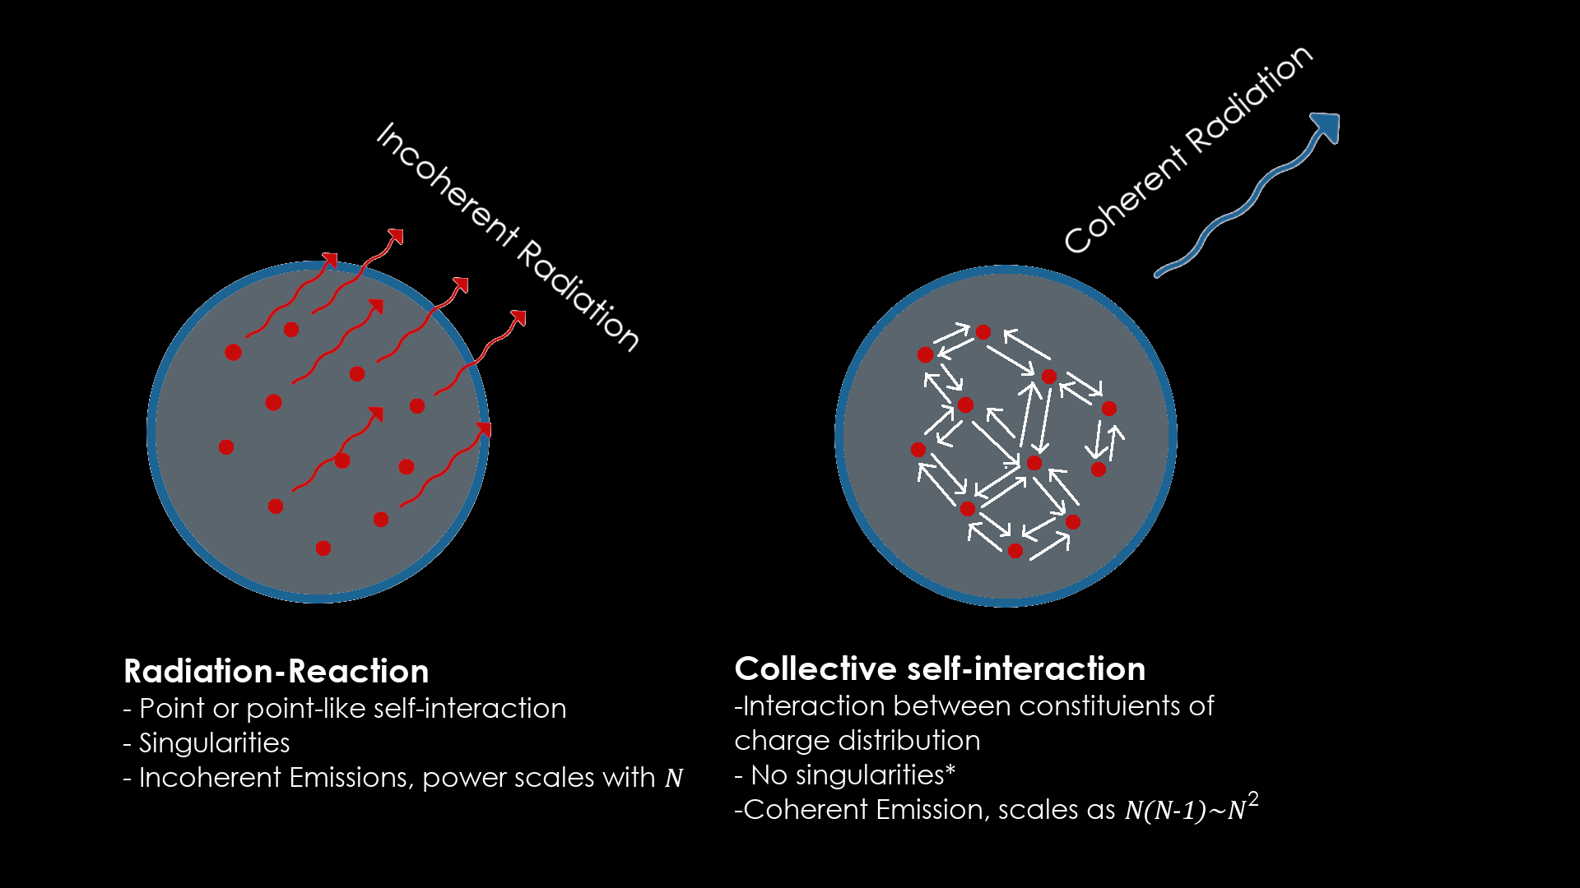

WHAT ABOUT RADIATION-REACTION?
We are keen to clarify that when we talk of self-interaction, we are NOT referring to Radiation Reaction
We are investigating the collective self-interaction of the entire distribution on itself.
(sorry Dirac!)
Acceleration-Induced Self-Interactions of Ultra-Short Electron Bunches
Speaker Name: Ryan McGuigan email: r.mcguigan1@lancaster.ac.uk
4

Slide 6
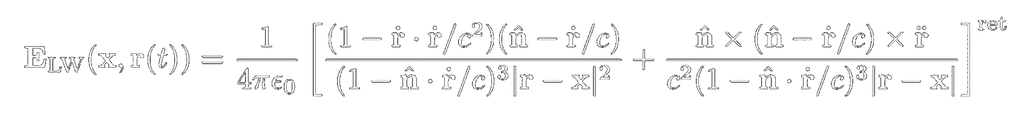
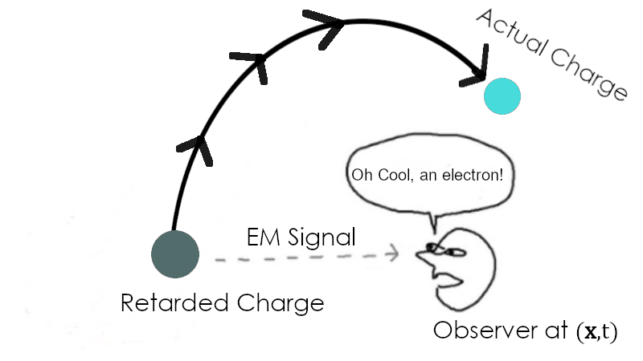

The Lienard Weichert FIELDS
Fields are retarded (appear to arise from a source in the past, ($r(t^{ret})$) ). Made up of a “velocity” term and an “acceleration” term
($r\left(t\right)$ is trajectory of source , $\hat{n}$ is a unit vector from source to observer c is the speed of light and $ε_{0}$ is vacuum permittivity)
In the far-field: Velocity term ignored, acceleration term used to calculate radiation
In the near-field: Both terms are important, no way to distinguish a “radiation field” from the coulomb field of the charge.
Acceleration-Induced Self-Interactions of Ultra-Short Electron Bunches
Speaker Name: Ryan McGuigan email: r.mcguigan1@lancaster.ac.uk
5

Slide 7
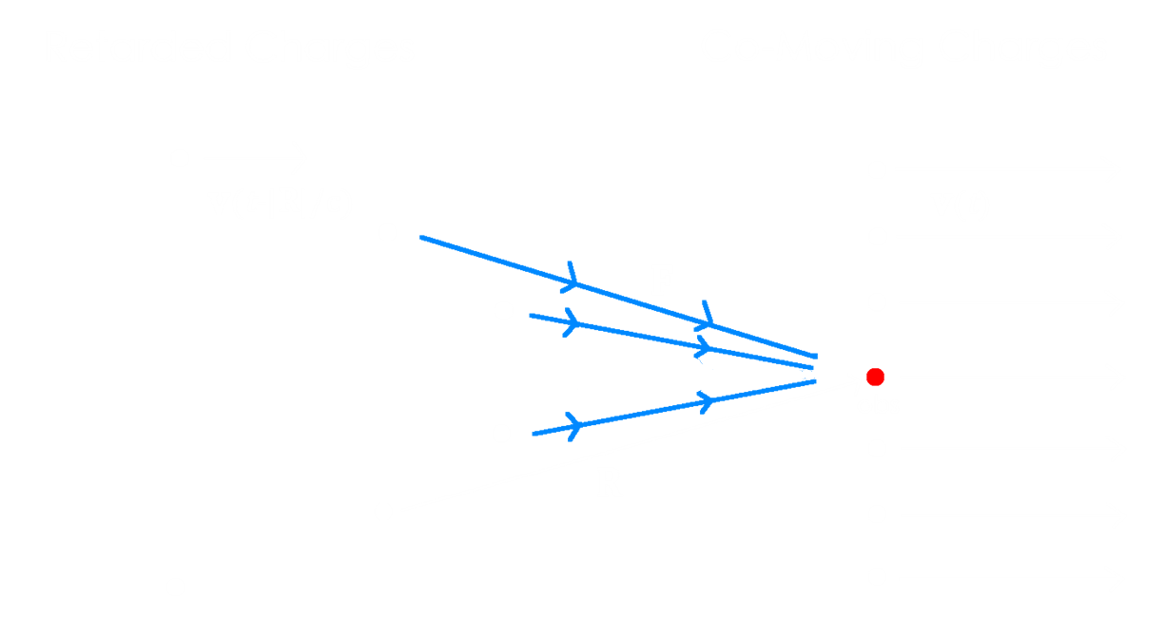

Transverse retardation effects
Transversely offset charges on the RHS are co-accelerating in the same plane. Test charge in red, forces in blue.
Surrounding charge is observed at an earlier retarded time $t^{ret}=t−|R|/c$.
Observer experiences longitudinal velocity and acceleration fields despite lying in transverse plane wrt. to sources
Acceleration-Induced Self-Interactions of Ultra-Short Electron Bunches
Speaker Name: Ryan McGuigan email: r.mcguigan1@lancaster.ac.uk
6

Slide 8
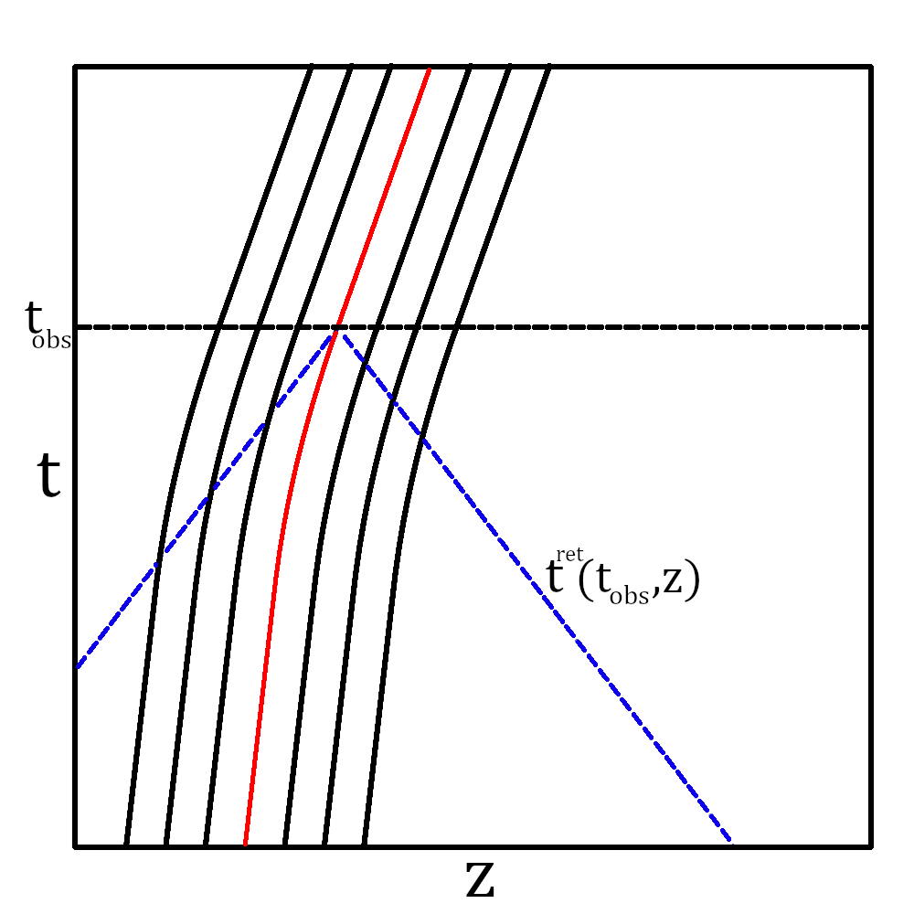

LONGITUDINAL RETARDATION EFFECTS
Space-time diagram of longitudinally off-set charge about a test charge.
Retarded time given by reading off intersection of the light-like curves with the charged source trajectories.
Sources in-front of the observer appear closer,
$t^{ret}$~$t_{obs}$
Sources behind the observer appear to lag behind
Acceleration-Induced Self-Interactions of Ultra-Short Electron Bunches
Speaker Name: Ryan McGuigan email: r.mcguigan1@lancaster.ac.uk
7

Slide 9
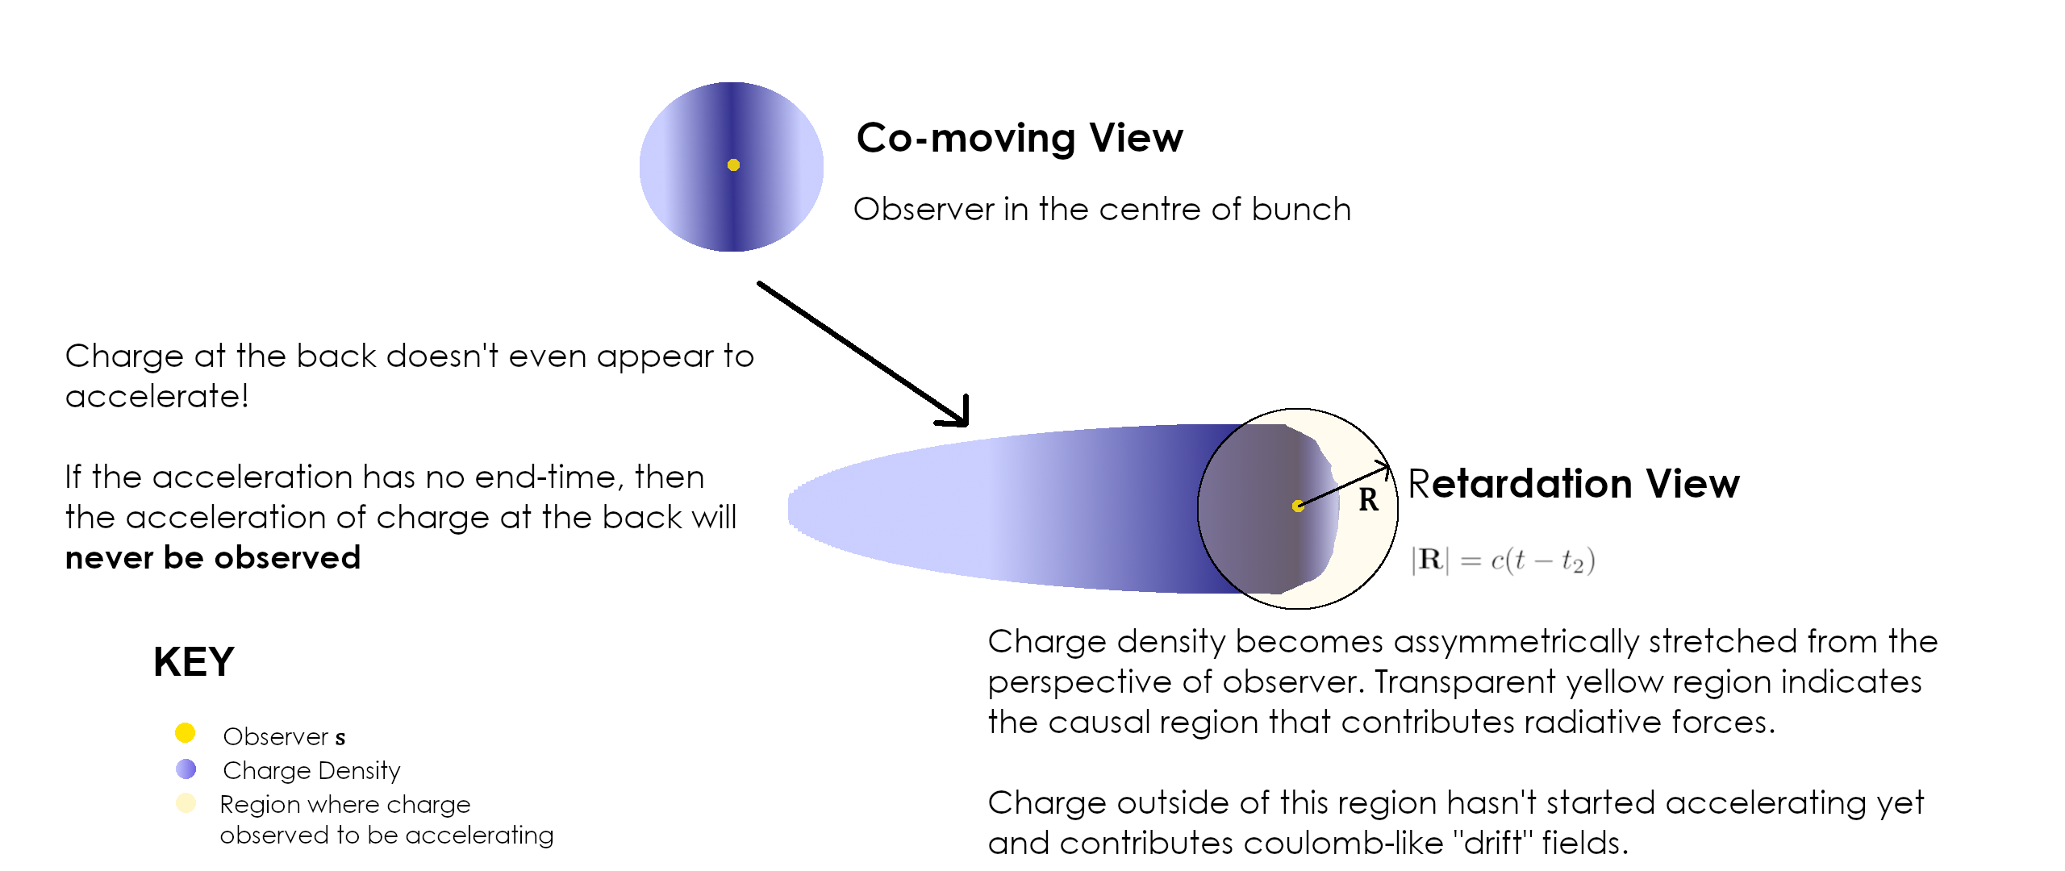
Retardation of a relativistic, accelerated bunch
Acceleration-Induced Self-Interactions of Ultra-Short Electron Bunches
Speaker Name: Ryan McGuigan email: r.mcguigan1@lancaster.ac.uk
8

Slide 10
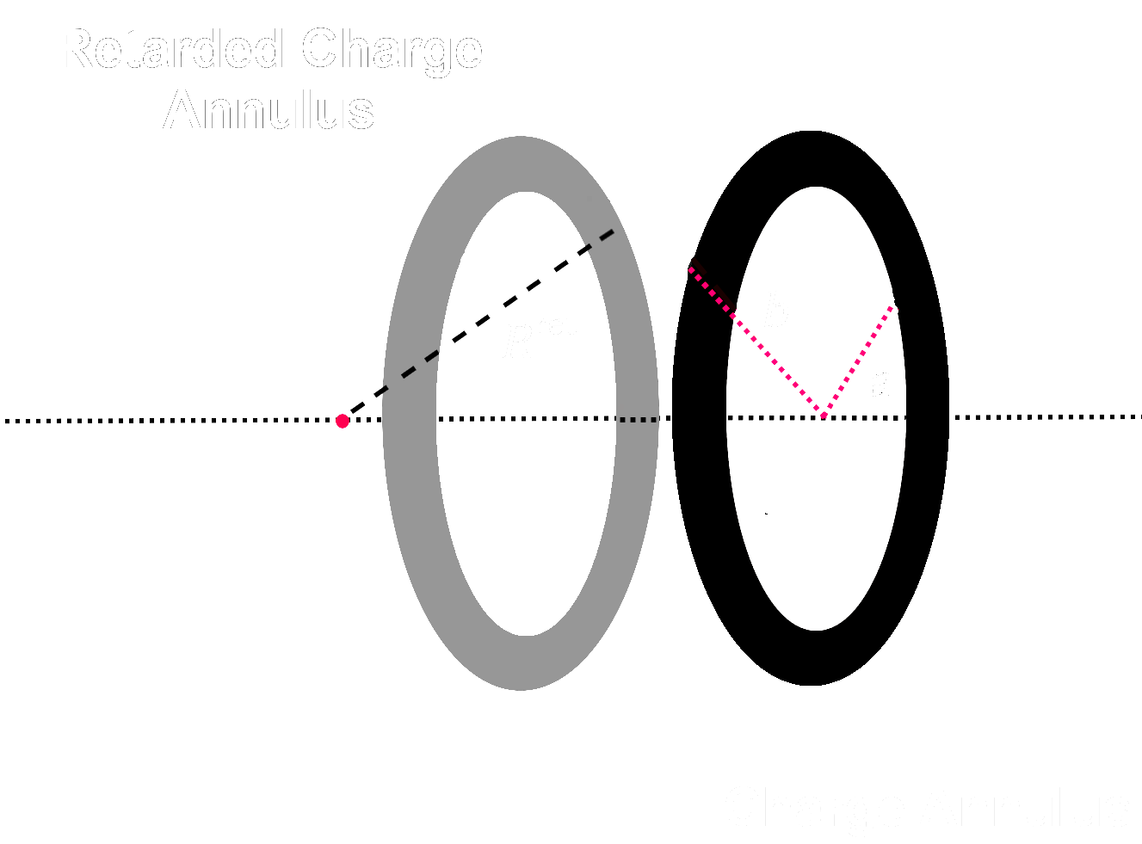
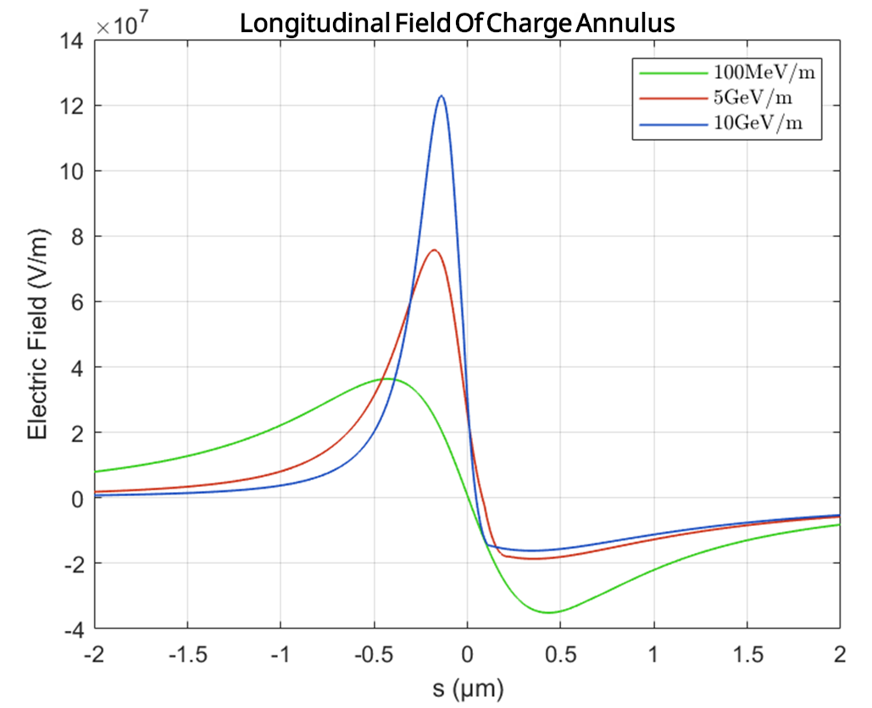

EXAMPLE: Charge annulus
Integrate over contributions from individual charges for the case of a charge annulus (ring)
Figure 7: Electric field for a charge annulus of initial energy 50MeV, a=50 μm b=80μm, surface charge density $3.5×{10}^{−3}$C/$m^{2}$,at time $∆t$ =50ps for different values of acceleration. Field becomes asymmetric at higher field strengths, such that the energy gain is comparable to energy at injection $∆γmc^{2}≳γ_{1}{mc}^{2}$
Acceleration-Induced Self-Interactions of Ultra-Short Electron Bunches
Speaker Name: Ryan McGuigan email: r.mcguigan1@lancaster.ac.uk
9

Slide 11
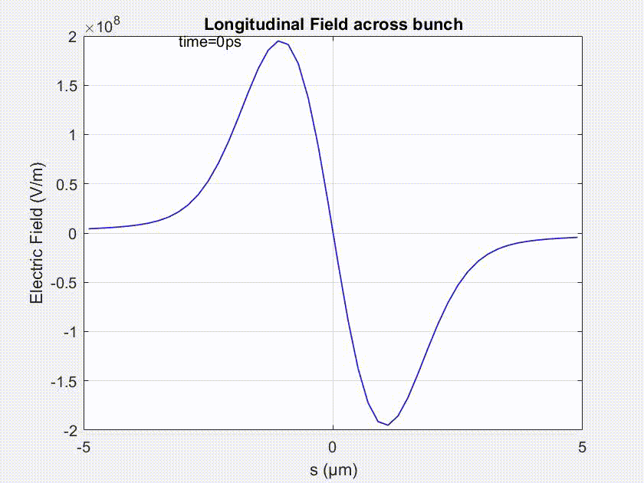
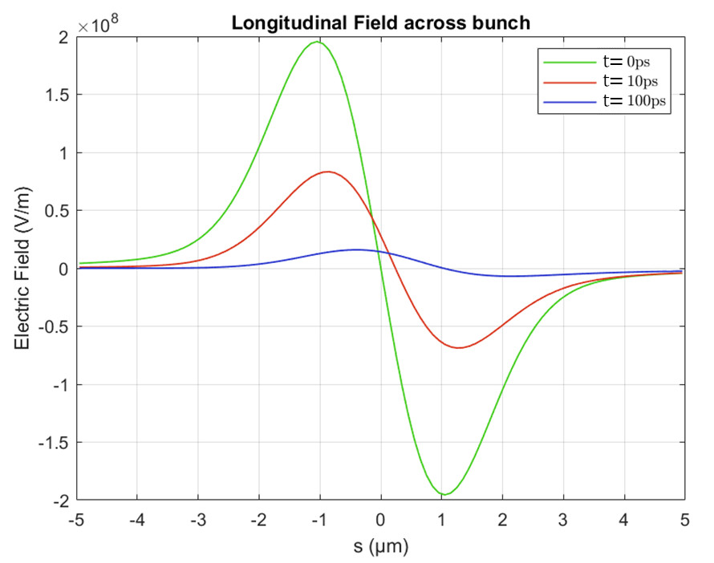


Fields of a Gaussian Bunch (During acceleration)
Charge: Q=100pC ($N=6.25×{10}^{8}$)
Bunch Dimensions: $σ_{x,z}=1μm$
External Field: $E_{ext}=20$GeV/m
Accelerator Length: $∆t=100$ps (3cm)
Initial Energy: $γ=100$ (50MeV)
Longitudinal electric field of an accelerated bunch in vacuum up-to 100ps.
Initial symmetric dipole
Asymmetric dipole field for $t>0$
Gradually reduces in magnitude as energy of the bunch increases
Does work against the motion of the bunch!
Acceleration-Induced Self-Interactions of Ultra-Short Electron Bunches
Speaker Name: Ryan McGuigan email: r.mcguigan1@lancaster.ac.uk
10

Slide 12
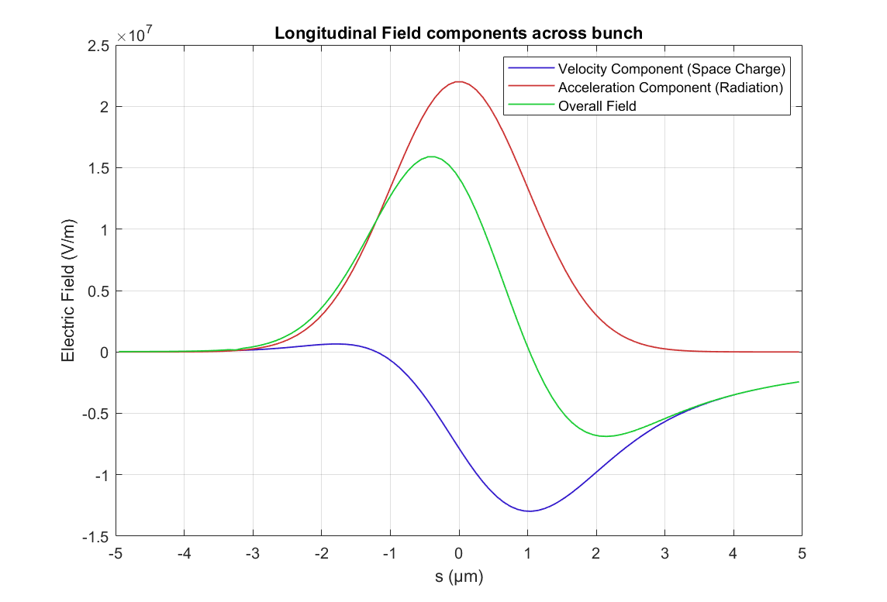
Fields of a Gaussian Bunch
Contributions from the Velocity term and the Acceleration term to the overall field.
Velocity term is dominated by space-charge fields from charge behind the observer, which does not appear to accelerate.
The negative, velocity field is compensated for by the positive acceleration field.
Acceleration-Induced Self-Interactions of Ultra-Short Electron Bunches
Speaker Name: Ryan McGuigan email: r.mcguigan1@lancaster.ac.uk
11

Slide 13
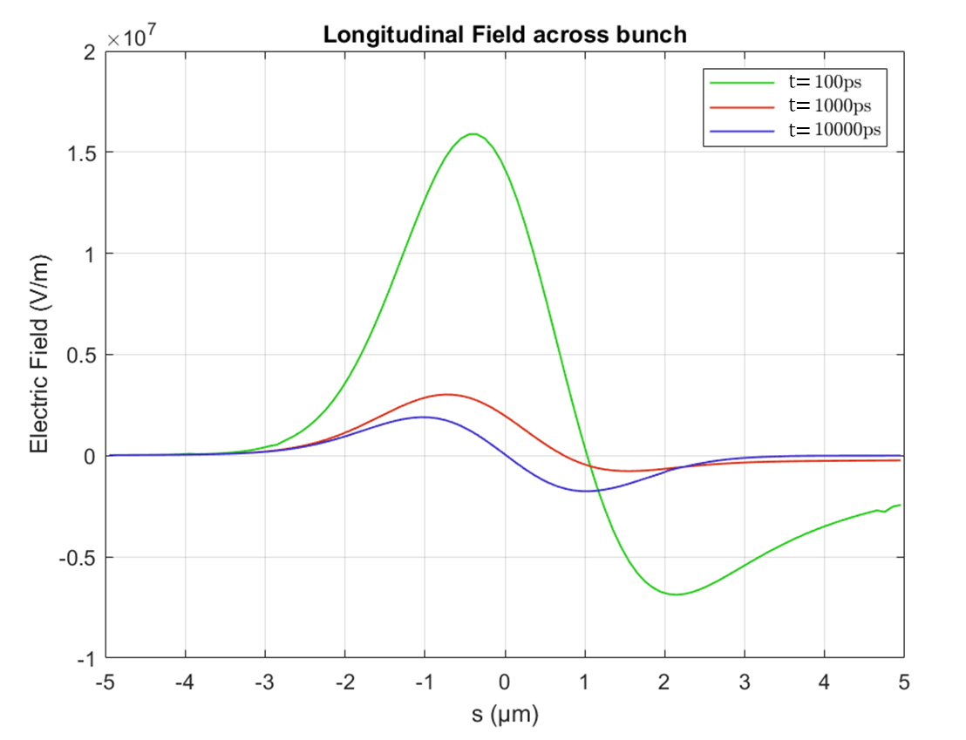

Fields of a Gaussian Bunch (Post-Acceleration)
Even after the acceleration, the induced field continues to propagate up-to the radiation formation length, $2σ_{z}γ_{fin}^{2}$
Remarked upon by Geloni et. al.
(The authors calculated the longitudinal wake for an “instantaneous” acceleration, neglecting contributions from during the acceleration itself)
We account for additional contributions from the acceleration region
1
1. G. Geloni, E. Saldin, E. Schneidmiller, M. Yurkov, Longitudinal wake field for an electron beam accelerated through an ultrahigh field gradient, Nuc. Instr. and Methods Sec. A:, Vol. 578, Iss. 1, (2007), pgs 34-46,
Evolution of transient longitudinal field after the acceleration process
Acceleration-Induced Self-Interactions of Ultra-Short Electron Bunches
Speaker Name: Ryan McGuigan email: r.mcguigan1@lancaster.ac.uk
2
12

Slide 14
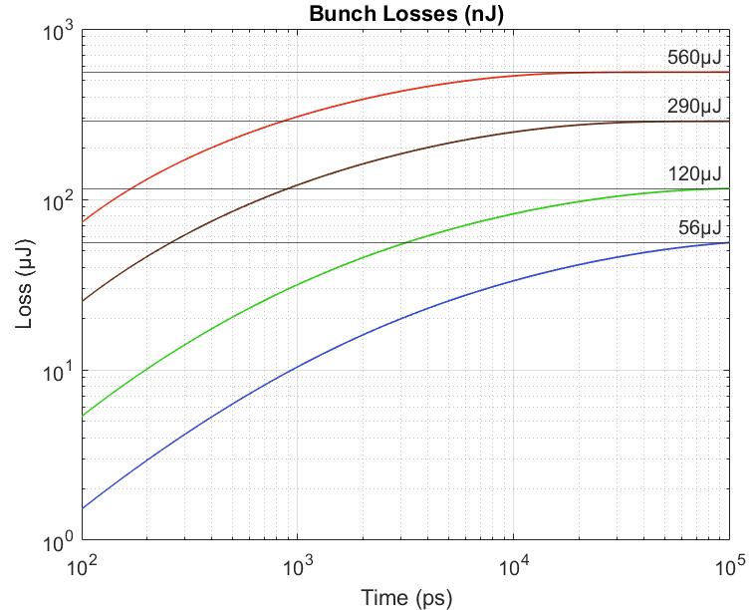
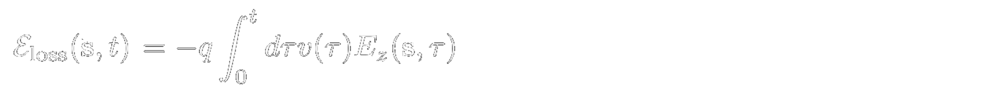
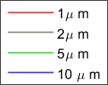
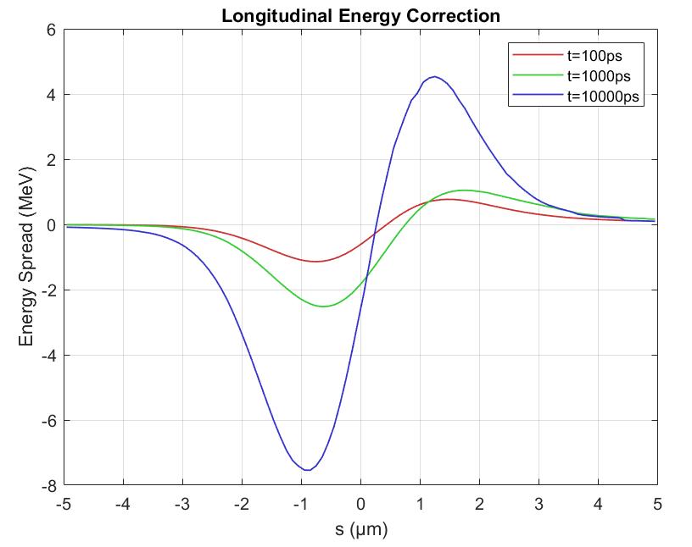


Gaussian Bunch (LOSSES)
Integrate over the fields to obtain the longitudinal chirp
Acceleration induced chirp is asymmetric wrt. to the bunch centroid, with energy spread $O(1\%)$
Losses per electron as a ratio of final energy at different times up to 10ns.
Losses continue long after acceleration has ceased.
Shorter, denser bunches experience dramatically greater losses in less time.
Gain $\sim 60000 μJ$, ~1% energy loss for 1μm
Overall loss scales $\sim {N^{2}}/{σ_{z}}$
Acceleration-Induced Self-Interactions of Ultra-Short Electron Bunches
Speaker Name: Ryan McGuigan email: r.mcguigan1@lancaster.ac.uk
13

Slide 15
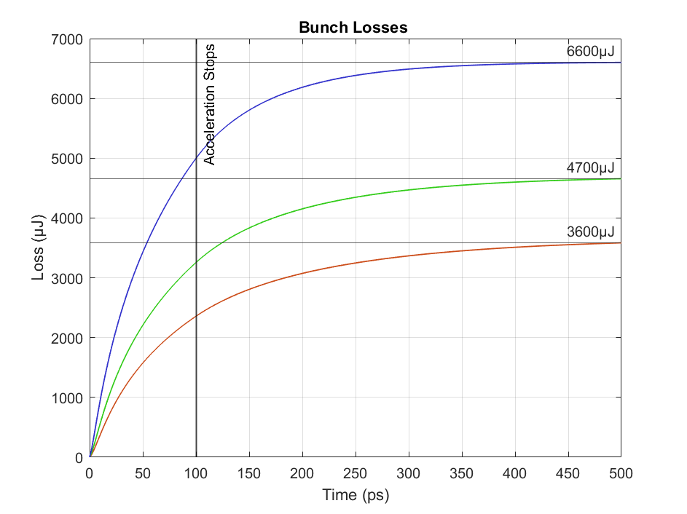

Gaussian Bunch (LOSSES)
A more extreme case for bunches of lengths 0.1μm, 0.075μm, 0.05μm
Increasingly significant bunch losses arise during the acceleration as formation length shrinks
For especially short bunches losses approach O($10\%$) of the total energy of the bunch.
Breakdown of rigidity condition when self-interaction is strong enough and losses are large enough.
Acceleration-Induced Self-Interactions of Ultra-Short Electron Bunches
Speaker Name: Ryan McGuigan email: r.mcguigan1@lancaster.ac.uk
14

Slide 16

Summary
What have we shown
High-field acceleration induces asymmetric longitudinal self-fields
Self-fields degrade the bunch inducing losses and chirp ($O(1\%)$for $Q=100pC, σ_{z}=1μ$m charge)
Losses scale ~${N^{2}}/{σ_{z}}$, effects magnified for shorter bunches
Field contributions during the acceleration process are important especially for short bunches/formation length
Key Takeaway
This model points to an inherent vacuum beam-loading process that is exacerbated rather than compensated by higher-gradient accelerating fields
Acceleration-Induced Self-Interactions of Ultra-Short Electron Bunches
Speaker Name: Ryan McGuigan email: r.mcguigan1@lancaster.ac.uk
15

Slide 17
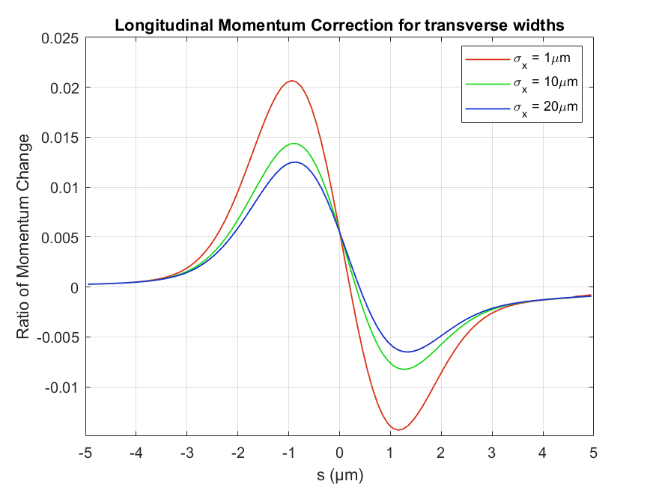
Transverse Scaling
Longitudinal momentum chirp for various transverse bunch lengths
The scaling with the transverse bunch length appears to be quite weak
A bunch only needs to be “compact” in the longitudinal dimension to experience these self-effects.

Slide 18
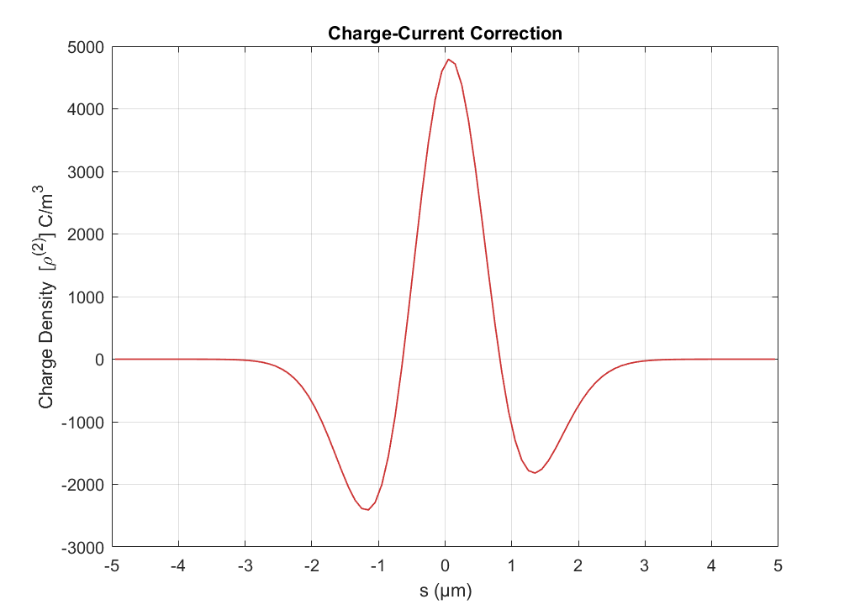

Correction to charge density induced by self fields
A second order (in $N$) effect
Charge vacates the middle of the bunch (hence “positive” charge) and is pushed towards the head and tail
Overall loss of momentum hence tail acquires additional charge
This charge-correction will generate its own EM fields that also interact with the bunch . . .

Slide 19
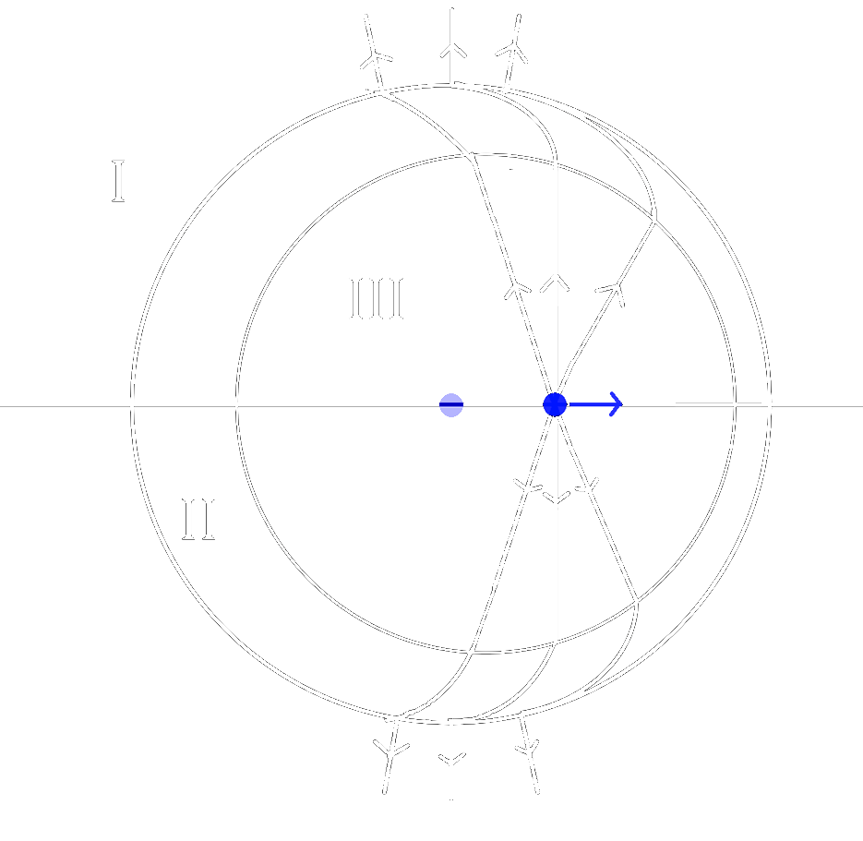
The Lienard Weichert FIELDS
Lienard Weichert Fields of point charge accelerated for finite time.
Retarded charge velocity field observed in region I.
Acceleration Field observed in II.
Velocity of charge at present time observed in III

Slide 20
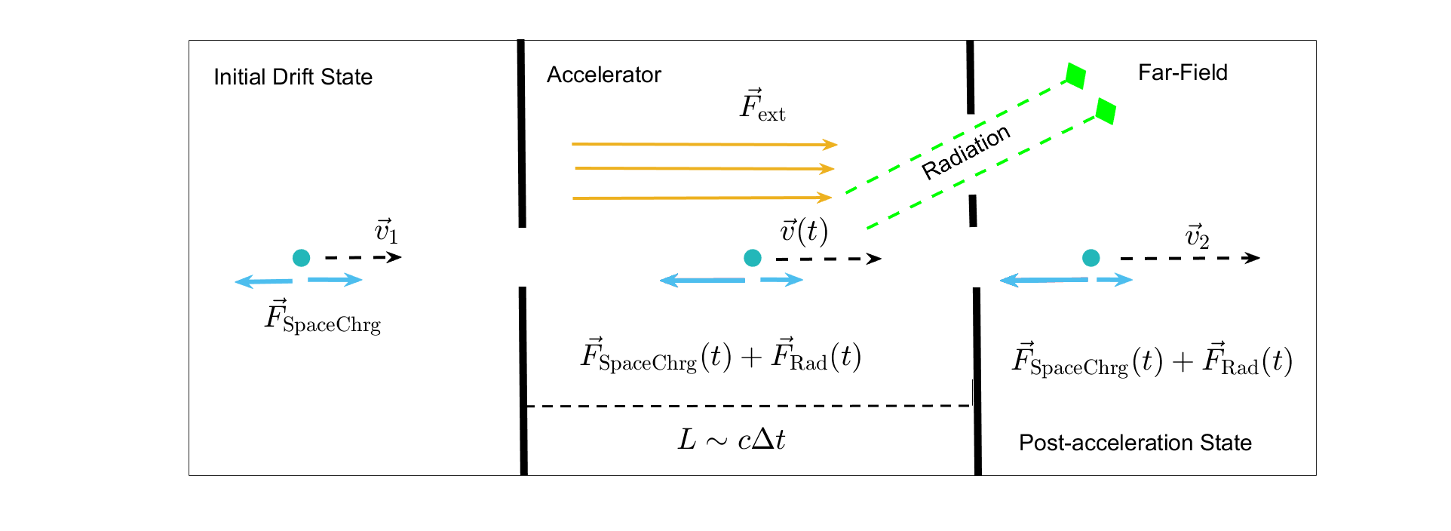

Model
Relativistic, “compact” electron bunch (longitudinal/transverse length scales ($σ_{z,x}<1$μm)
Constant field $E_{ext}$ is applied for a finite duration $∆t$; acceleration across a distance $L$
Acceleration of radiating charge (forces view)

