Slide 1





Physics of transverse dynamics in a laser-plasma accelerator
L. Batista, S. Marini, N. Chauvin, D. Uriot, A. Chancé, P.A.P. Nghiem

Slide 2
Using the accelerated electron beam
        Extracting the accelerated beam from the plasma
        Sending this beam to the next user or plasma
        Plasma - transport line coupling
        Transverse beam physics through the plasma
Plasma
Cell
Transport line
End user
Plasma
Cell
Transport line
Plasma
Cell

Slide 3
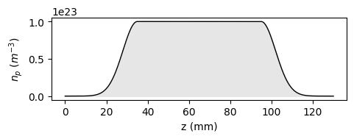
Outline
Context & Background
Transport through the plasma density plateau
Transport through the density down ramp & up ramp
Example of coupling and conclusion
Up ramp
Down ramp

Slide 4
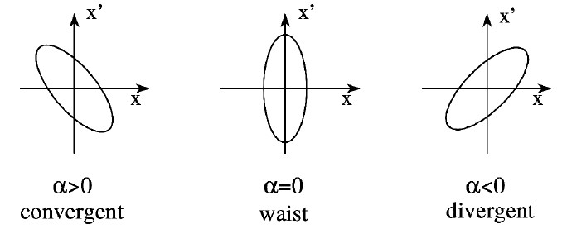

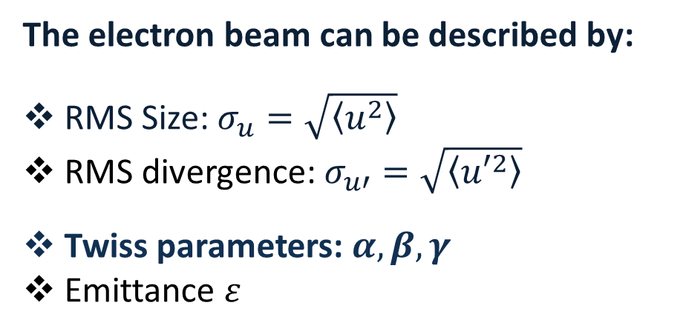
RMS quantities and Twiss parameters
The electron beam can be described by:
RMS Size: $σ_{u}=\sqrt{\left\langle u^{2}\right\rangle }$
RMS divergence: $σ_{u′}=\sqrt{\left\langle {u′}^{2}\right\rangle }$
Twiss parameters: $α, β, γ$
Emittance $ε$
Twiss $β$ $→$ Related to the RMS size : $β= \frac{σ_{u}^{2}}{ε}$
Twiss $γ$ $→$ Related to the RMS divergence : $γ= \frac{σ_{u′}^{2}}{ε}$
Twiss $α$ $→$
Convergent beam
Waist
Divergent beam

Slide 5
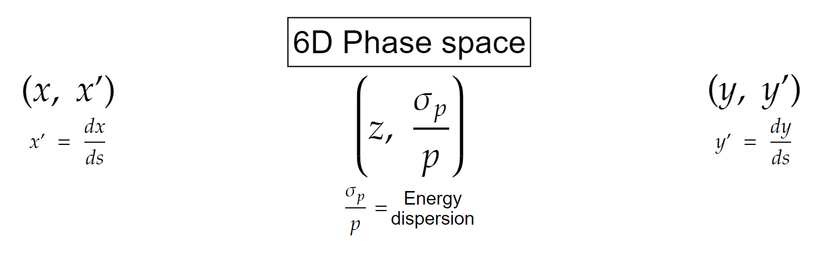
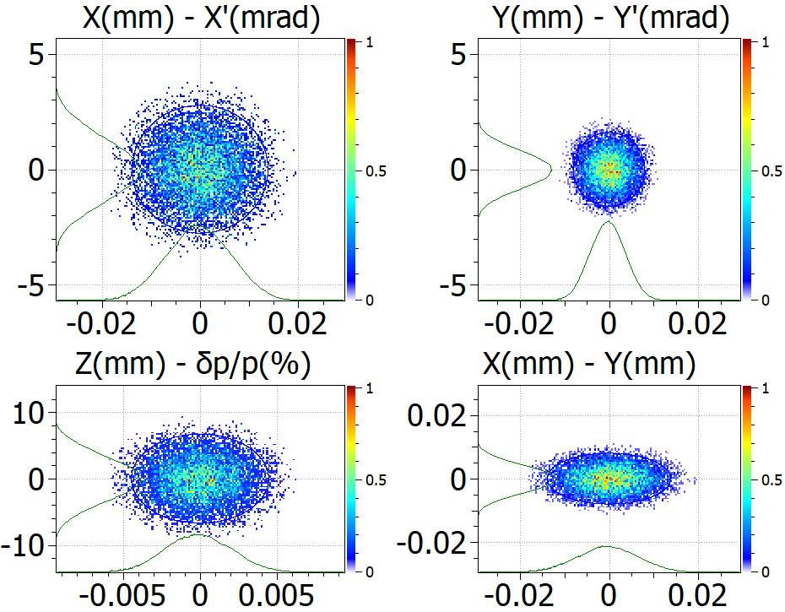
Beam distribution (6D) and emittance
Transverse
Longitudinal
X’(mrad)
Y’(mrad)
X(mm)
Y(mm)
Z(mm)
Emittance $ε$ $→$ Surface occupied by the beam in the phase space

Slide 6
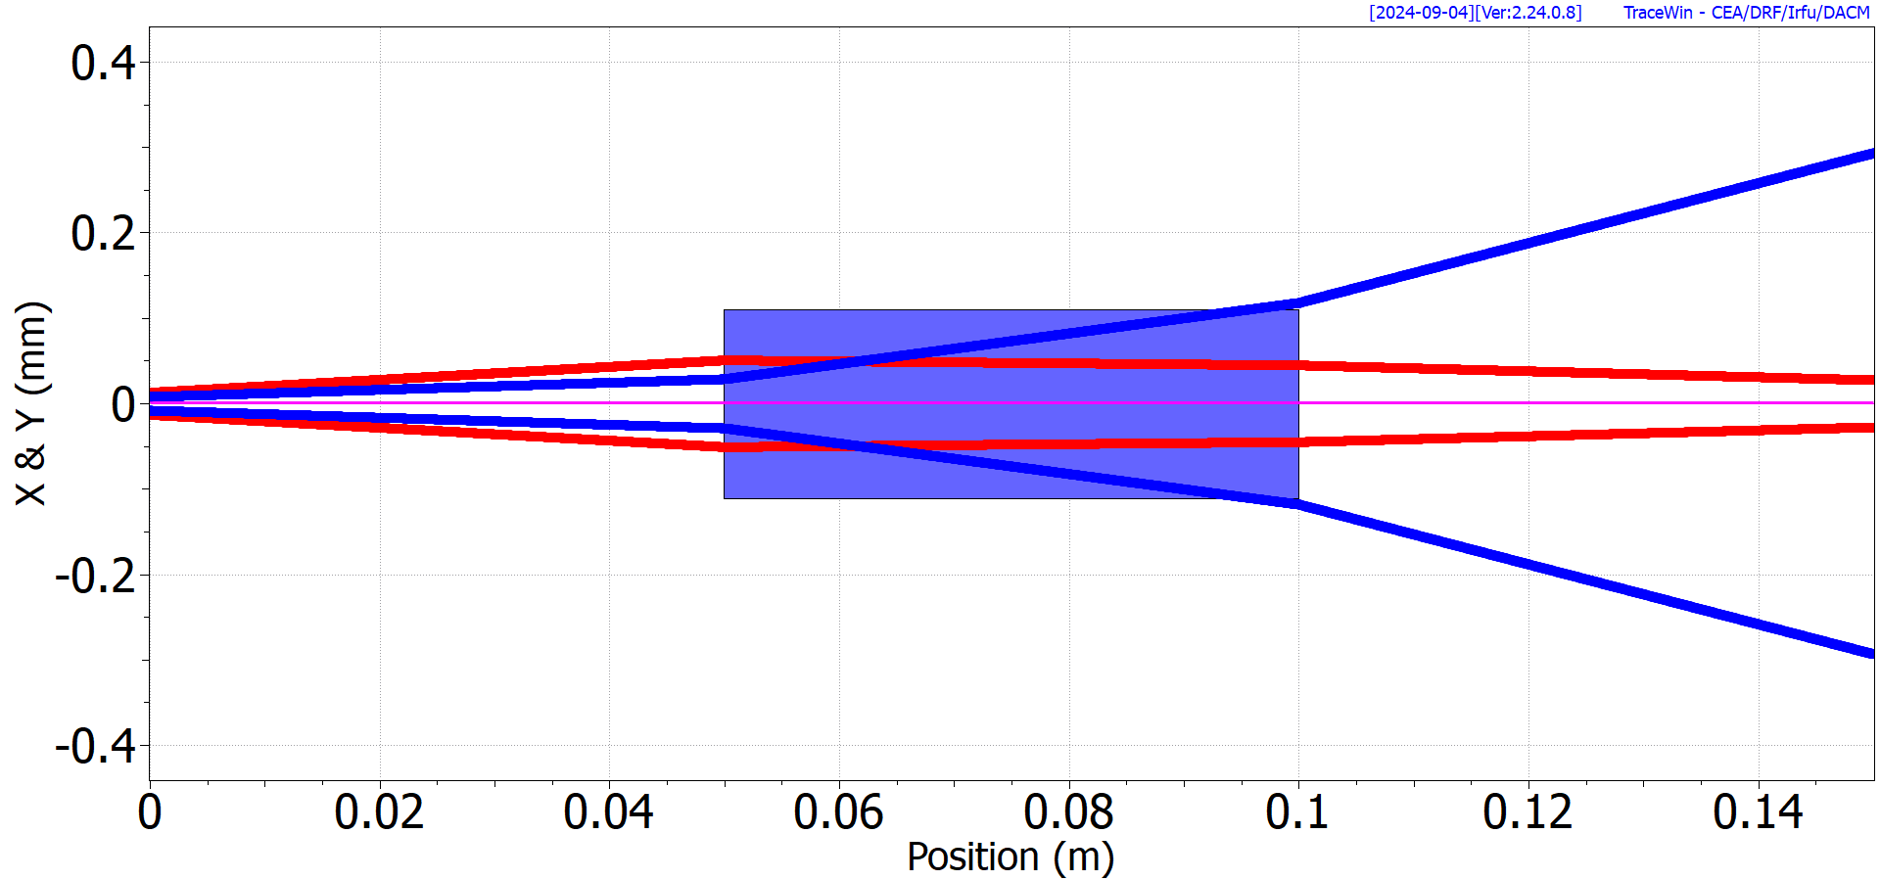
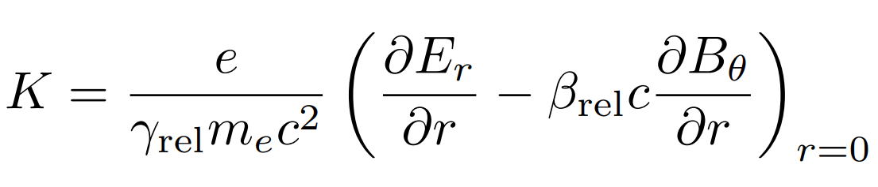
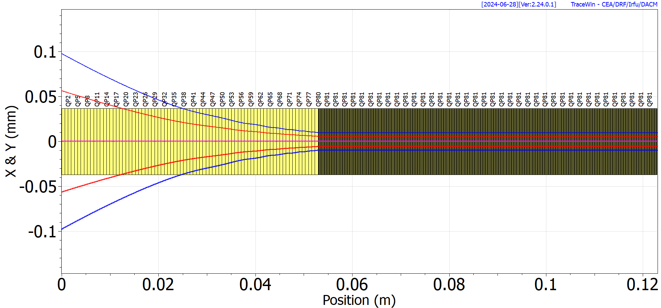
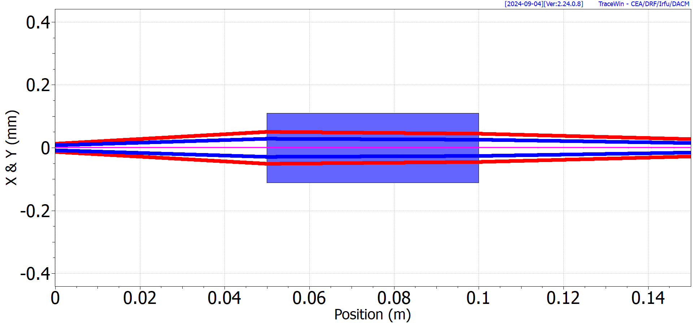

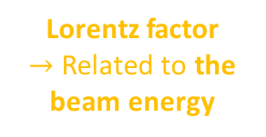
New approach : Transverse beam focusing model
Focusing gradient K ($m^{−2}$):
USUAL QUADRUPOLES IN TRANSPORT LINES
Lorentz factor
$→$ Related to the beam energy
Gradient of the radial electric field
Gradient of
the azimuthal magnetic field
SPECIAL QUADRUPOLES
Up-ramp
Plateau
Model with a sequence of “special” quadrupoles
{up-ramp + plateau}
CPU time: a few seconds

Slide 7
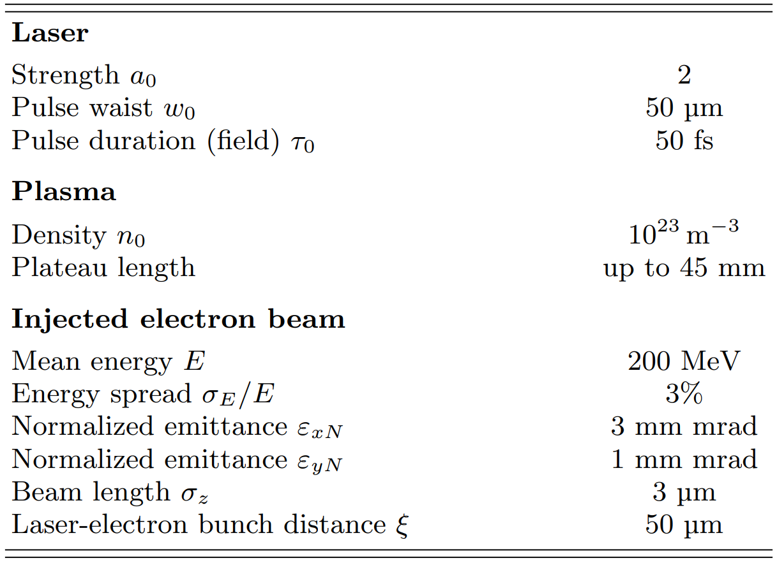
Nominal parameters
Use of:
FBPIC: A laser-plasma PIC code
Wake-T: A laser-plasma tracking code (quasistatic approach)
TraceWin: Beam Dynamics tracking code

Slide 8
Outline
Context & Background
Transport through the plasma density plateau
Transport through the density down ramp & up ramp
Example of coupling and conclusion
Up ramp
Down ramp

Slide 9
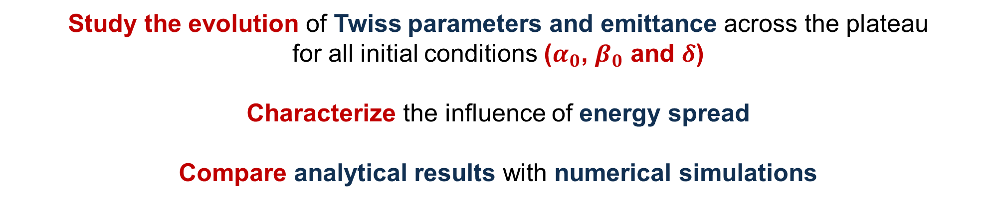
Transport through the plasma density plateau
Objectives
Study the evolution of Twiss parameters and emittance across the plateau
for all initial conditions ($α_{0}$, $β_{0}$ and $δ$)
Characterize the influence of energy spread
Compare analytical results with numerical simulations

Slide 10
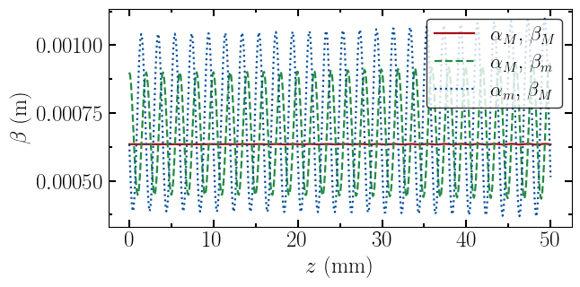

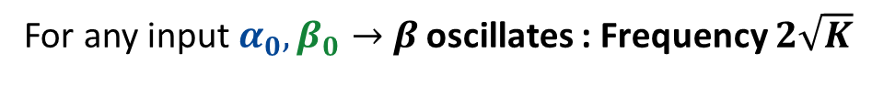


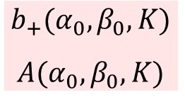

Transport through the plasma density plateau ($δ=0$)
$α$ & $β$ matched
$β$ unmatched
$α$ unmatched
K constant
For any input $α_{0}, β_{0}→$ $β$ oscillates : Frequency $2\sqrt{K}$
$$b_{+}(α_{0}, β_{0}, K)$$
$$A(α_{0}, β_{0}, K)$$
For $α_{0}=0, β_{0}=1/\sqrt{K}$ $→β$ does not oscillate $\overset{⇔}{ }{ β}_{min}=β_{max}=β_{0}$ The Twiss parameters are matched

Slide 11
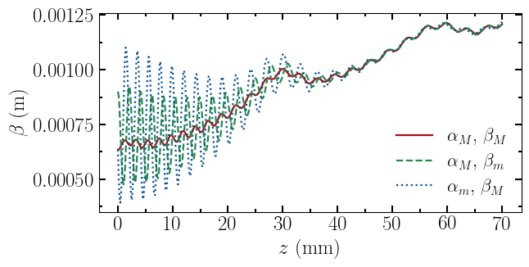
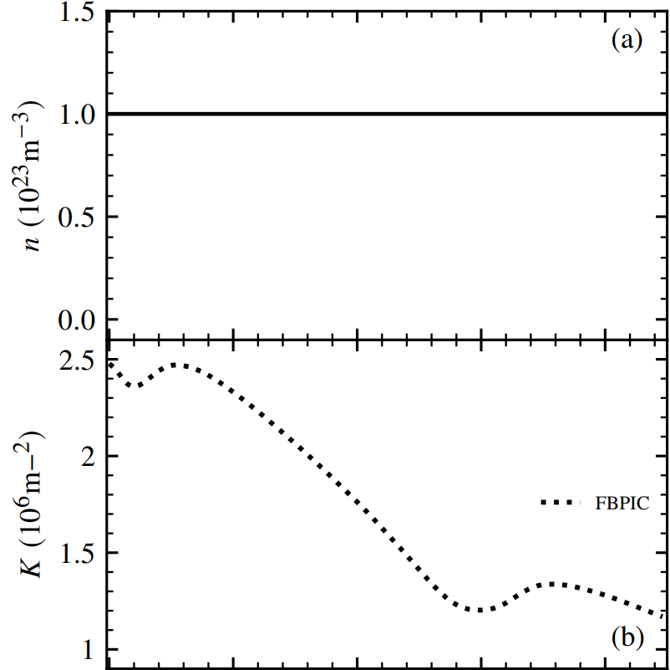
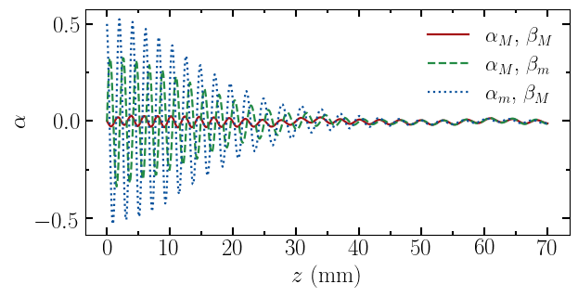
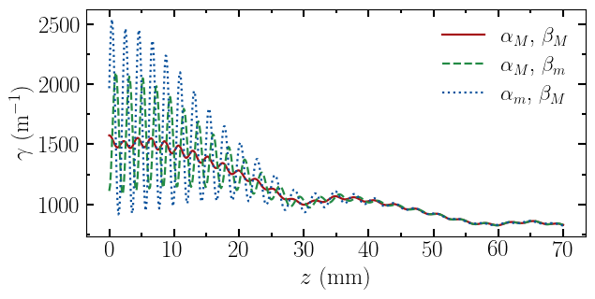


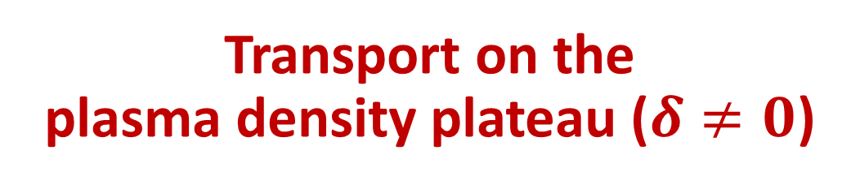
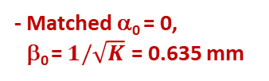

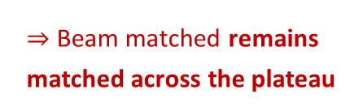
Transport on the
plasma density plateau ($δ≠0$)
Energy spread : $σ_{δ}=5\%$
- Unmatched α₀ = 0.5
- Unmatched β₀ = 0.9 mm
- Matched α₀ = 0,
β₀ = $1/\sqrt{K}$ = 0.635 mm
Constant plasma density
Beam matched remains matched across the plateau
$$K∝1/γ_{rel}$$
𝜶, 𝜷, 𝜸 oscillate
until they saturate towards the matched value
𝜶, 𝜷, 𝜸 oscillate
until they saturate towards the matched value
K without abrupt discontinuity
K varying

Slide 12
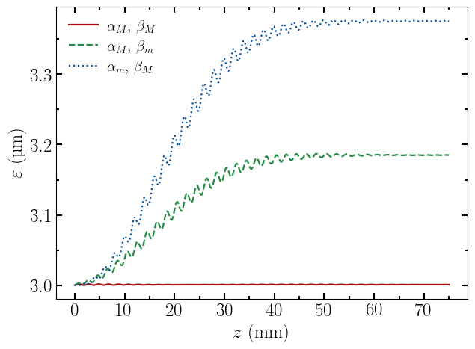
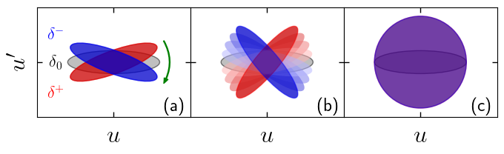
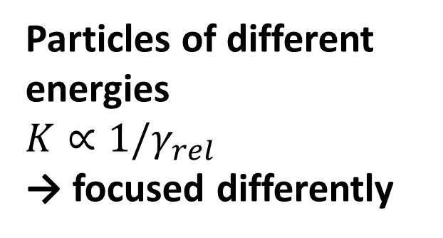
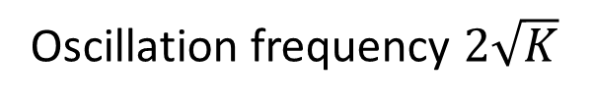
Transport through the plasma density plateau ($δ≠0$)
Particles of different energies
$$K∝1/γ_{rel}$$
→ focused differently
Betatron phase mixing mechanism
Valid for constant or variable K
Unmatched α₀
Unmatched β₀
Mehrling, T et. al. (2012). PRSTAB,15(11), 111303.
Ariniello, R, et.al. (2019). PRAB, 22(4), 041304.
Oscillation frequency $2\sqrt{K}$
→ Oscillate at different frequencies
Matched, α₀ , β₀
Growth and oscillation of emittance
Saturated emittance value

Slide 13
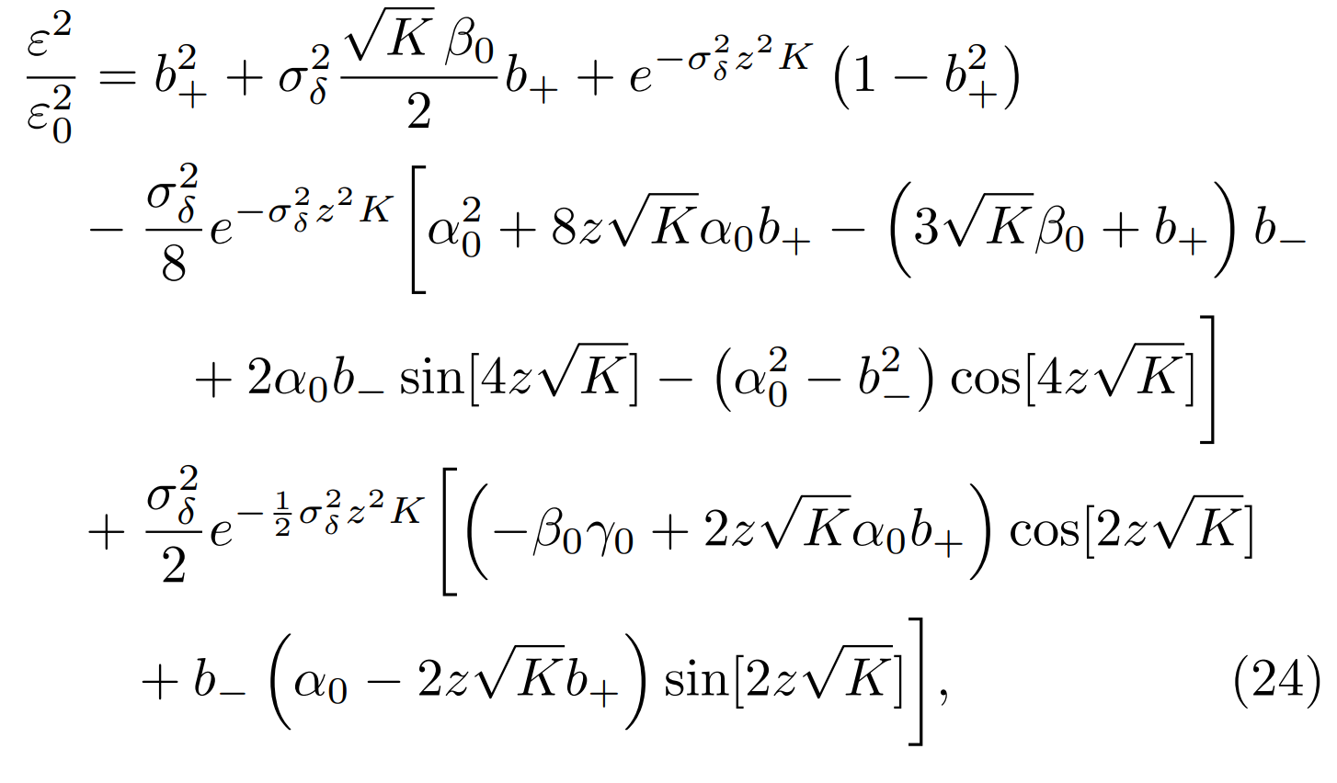
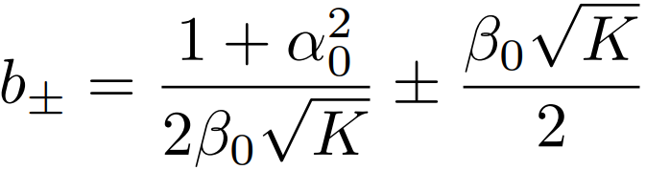
Transport through the plasma density plateau ($δ≠0$)
Emittance evolution
from TraceWin
with plasma modeled by special quadrupoles
Analytical model
Static
term
Chromatic
offset
Term of decoherence
and oscillations
Unmatched α₀
Unmatched β₀
Matched, α₀ , β₀
With :

Slide 14
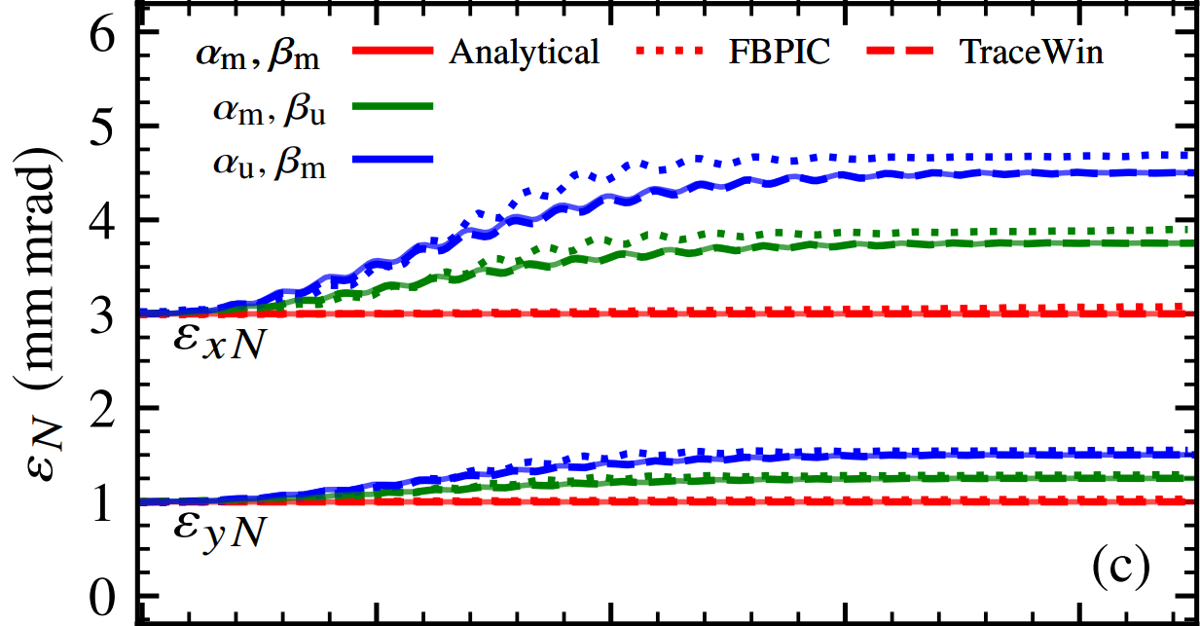
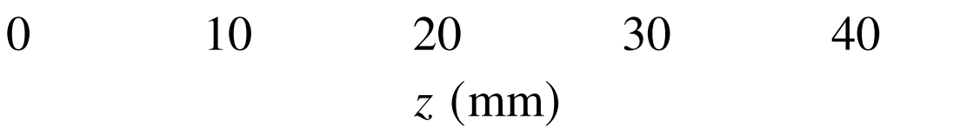



Comparison of the three approaches
Transport through the plasma density plateau ($δ≠0$)
$α, β$ matched
$β$ unmatched
$α$ unmatched
To be compared with the semi-analytical approach of :
Aschikhin et. al. J. (2018). NIMA, 909, 414-418.

Slide 15
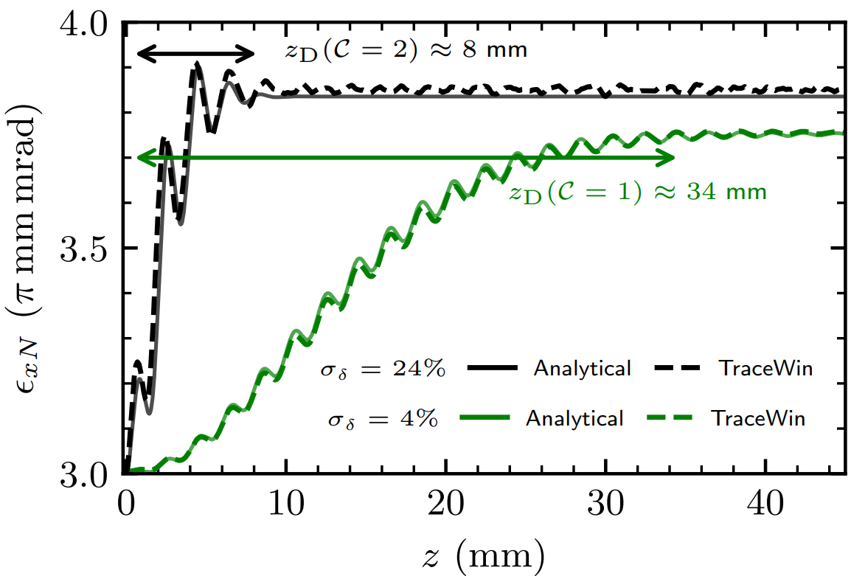
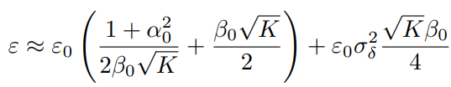



Impact of the energy spread
Impact of the energy spread
Expression of
the decoherence length
Expression of
the decoherence length
z_{D} = 8 mm (C = 2, r = 1%)
z_{D} = 8 mm (C = 2, r = 1%)
$$z_{D}∝\frac{1}{σ_{δ}\sqrt{K}}$$
$$z_{D}∝\frac{1}{σ_{δ}\sqrt{K}}$$
z_{D} = 34 mm (C = 1, r = 1%)
z_{D} = 34 mm (C = 1, r = 1%)
σ_{δ} = 24%
Expression of the emittance saturation value $(z≫z_{D})$
σ_{δ} = 24%
Expression of the emittance saturation value $(z≫z_{D})$
σ_{δ} = 4%
σ_{δ} = 4%
Second order term
Consistent with:
Mehrling, T., et. al. (2012). PRSTAB, 15(11), 111303.
EAAC 2025 - Laury Batista - Physics of transverse dynamics in a laser-plasma accelerator
15

Slide 16
Outline
Context & Background
Transport through the plasma density plateau
Transport through the density down ramp & up ramp
Example of coupling and conclusion
Up ramp
Down ramp

Slide 17
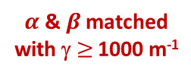


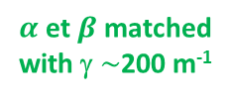
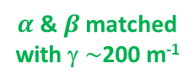
Use of a density ramp
K $\sim {10}^{6}m^{−2}$ $β \sim$ few mm
$α$ & $β$ matched
with γ $≥$ 1000 m⁻¹
Upstream
Transport line
$α$ & $β$ matched
with γ $\sim$200 m⁻¹
$α$ et $β$ matched
with γ $\sim$200 m⁻¹
Downstream
Transport line
n₀ $\sim$ ${10}^{17}{cm}^{−3}$
Upramp
Density plateau
Downramp
Symmetrical behavior upstream and downstream of the density plateau
Our approach:
Any ramp profile can be used if the length is sufficient to reduce γ sufficiently.
Otherwise, the emittance will increase considerably in the upstream or downstream transport line.
Li, X. et. al. (2019) PRAB, 22(2), 021304.

Slide 18
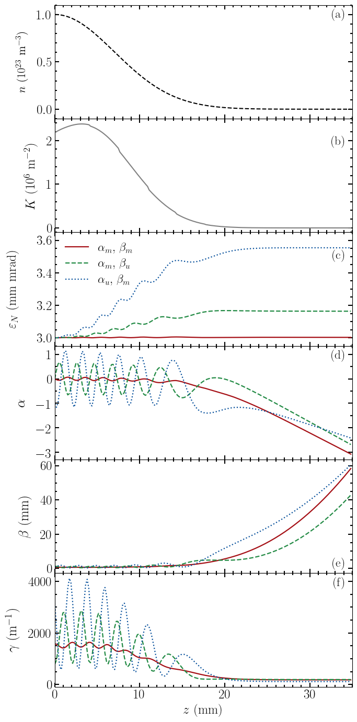




Example : Down ramp of Gaussian profile (L = 7 mm)
$$n= n_{0} exp\left(−\frac{z^{2}}{2L^{2}}\right)$$
-- Matched $α$ & $β$
-- Unmatched $β$
-- Unmatched $α$
Downramp
Upramp

Slide 19
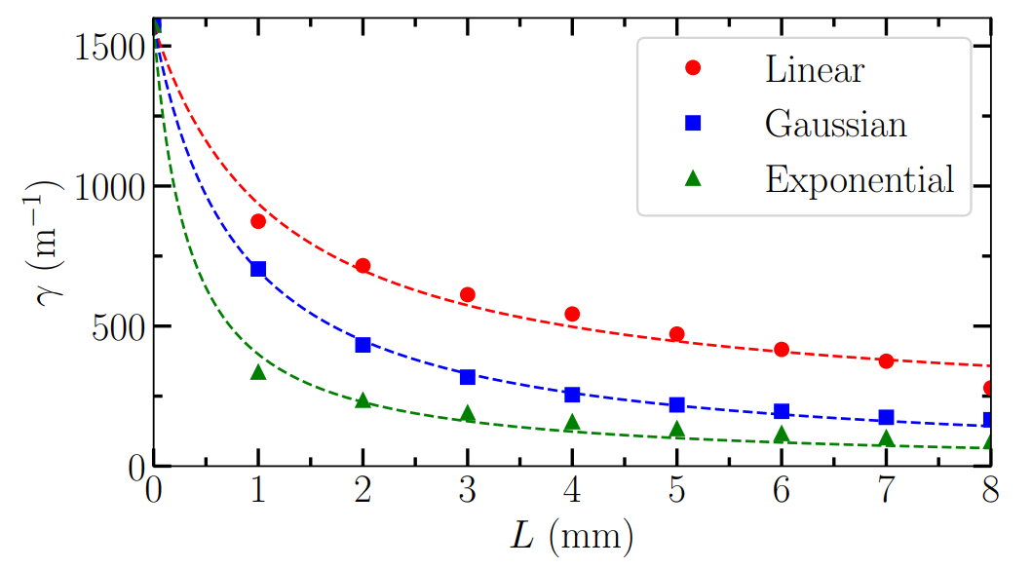
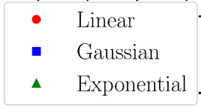



Study of linear, exponential, and Gaussian ramps
For each characteristic length L
→ Ramp simulation
→ Twiss 𝛾 at output
Key parameter = Ramp length
Whatever the ramp shape,
the greater L is, the lower 𝛾 is
$$n∝\left(1 −z/3L\right)$$
$$n∝exp (−z^{2}/2L^{2})$$
$$n∝exp (−z/L)$$

Slide 20
Outline
Context & Background
Transport through the plasma density plateau
Transport through the density down ramp & up ramp
Example of coupling and conclusion
Up ramp
Down ramp

Slide 21
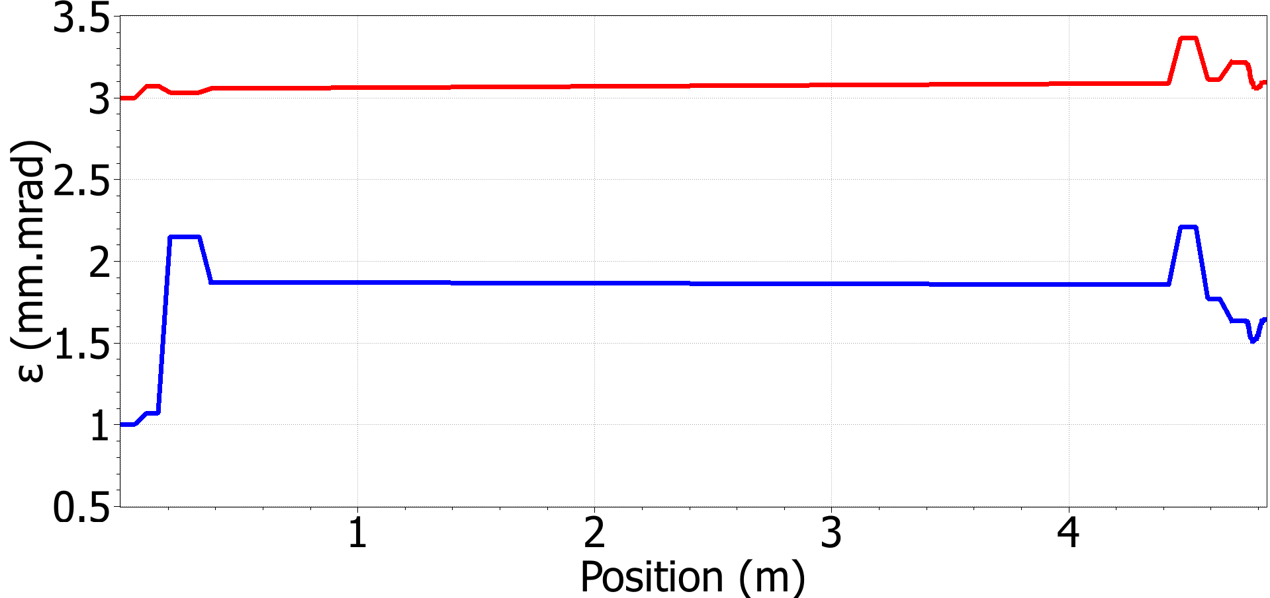


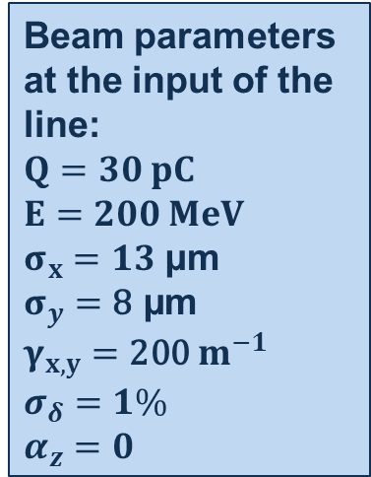
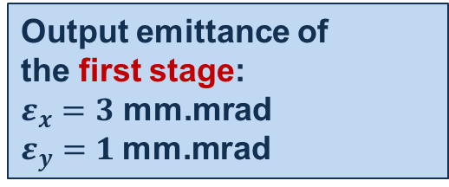


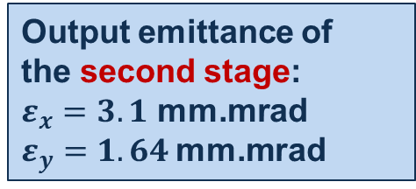
Example 2-stage design
laser pulse
$$e^{−}$$
laser pulse
$$user$$
'
Beam parameters at the input of the line:
$$Q=30 pC$$
$$E=200 MeV$$
$σ_{x}=13$ µm
$$σ_{y}=\text{8}\text{ µ}\text{m}$$
$$γ_{x,y}=\text{200} m^{−1}$$
$$σ_{δ}=1\%$$
$$α_{z}=0$$
Plasma
stage
Plasma
stage
$$Q_{1,2,3}$$
$$Q_{4,5,6}$$
Quadrupoles
Quadrupoles
Injector
second stage
Transport line
Optimized with TraceWin
Output emittance of
the first stage:
$ε_{x}=3$ mm.mrad
$ε_{y}=1$mm.mrad
Output emittance of
the second stage:
$ε_{x}=3.1$ mm.mrad
$ε_{y}=1.64$mm.mrad
Transport line
Plasma stage

Slide 22
Conclusion
Key parameters:
Twiss gamma parameter
The focusing gradient K
The ramp length
Modeling the plasma with equivalent transverse magnetic elements
proved to be an efficient method for
optimizing the coupling between the transport line and the plasma stage
2025 IPAC Proceeding : Batista, L., et. al (2025, September). Simulations of transverse dynamics in a laser-plasma accelerator. In Journal of Physics: Conference Series (Vol. 3094, No. 1, p. 012018). IOP Publishing.
Thank you for your attention!

Slide 23
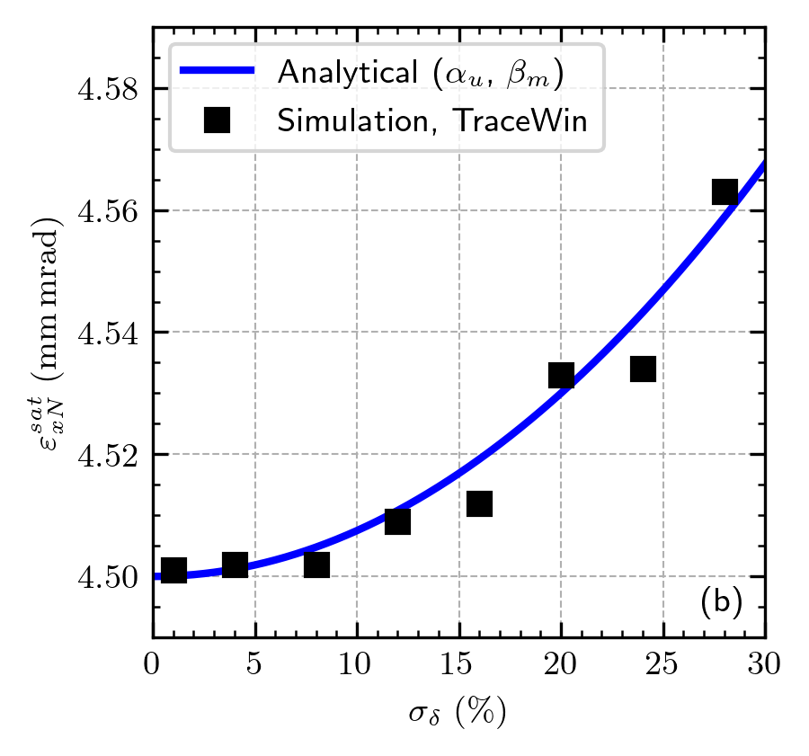
Emittance saturation value for different energy dispersion

Slide 24
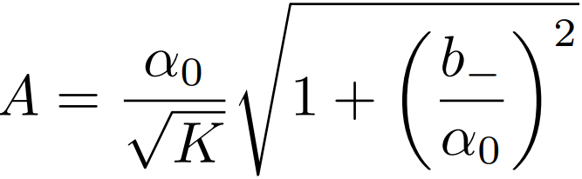


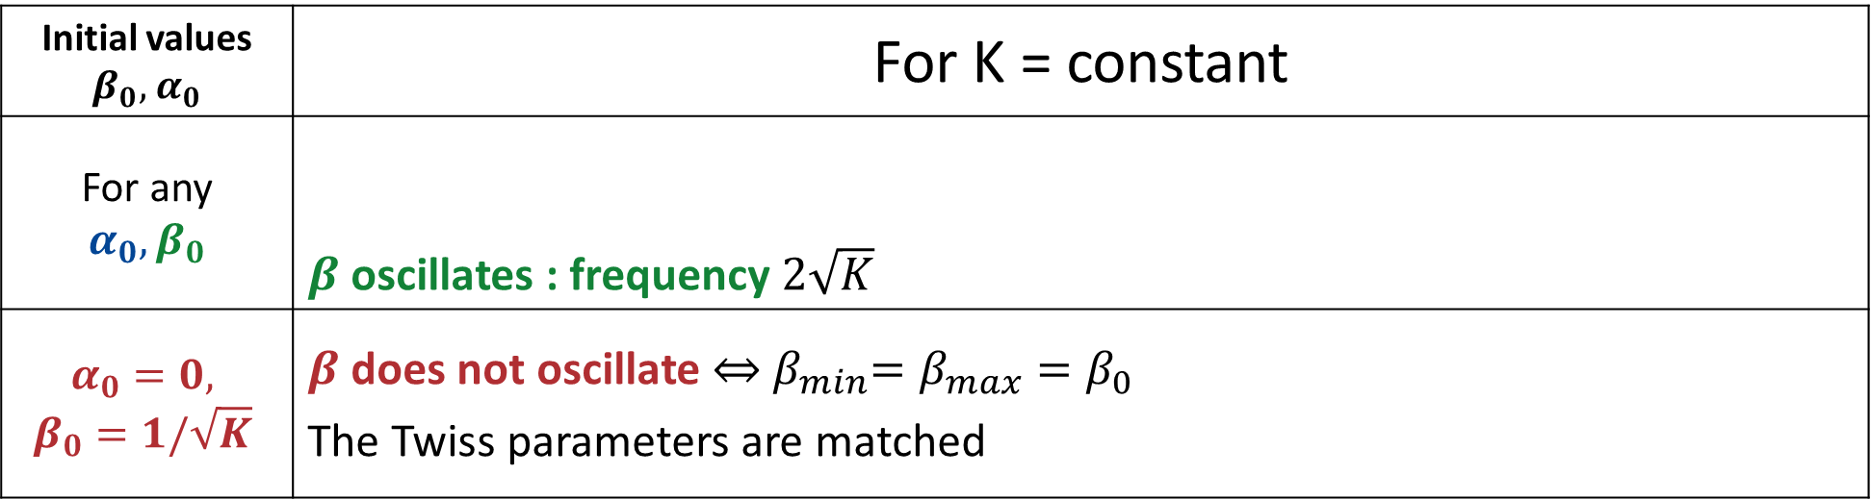

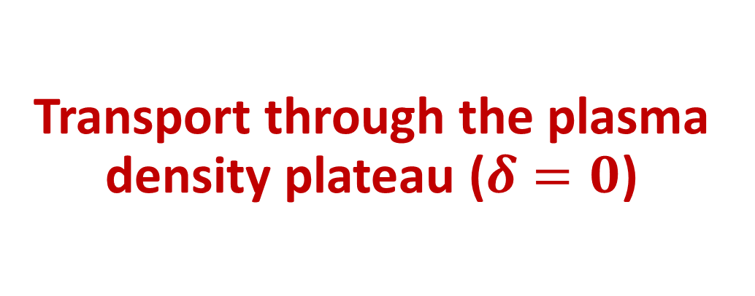

Transport through the plasma density plateau ($δ=0$)
$α$ & $β$ matched
$β$ unmatched
$α$ unmatched
Initial values $β_{0},$ $α_{0}$ | For K = constant
For any $$α_{0}, β_{0}$$ | $β$ oscillates : frequency $2\sqrt{K}$
$$α_{0}=0,$$ $$β_{0}=1/\sqrt{K}$$ | $β$ does not oscillate $\overset{⇔}{ }{ β}_{min}=β_{max}=β_{0}$ The Twiss parameters are matched

Slide 25



Comparison of the three approaches
Transport through the plasma density plateau ($δ≠0$)
Analytical model
Calculation of $\left\langle u\right\rangle$, $\left\langle u′\right\rangle$ & $\left\langle uu′\right\rangle$ over a normalized Gaussian distribution
Assumption : No correlation between the longitudinal and transverse plans
$α, β$ matched
$β$ unmatched
Use of the emittance definition : $ε^{2}=\left\langle u^{2}\right\rangle \left\langle u^{′2}\right\rangle −{\left\langle uu′\right\rangle }^{2}$
$α$ unmatched
Static
term
Chromatic offset
Term of decoherence and oscillations
To be compared with the semi-analytical approach of :
Aschikhin et. al. J. (2018). NIMA, 909, 414-418.

