Slide 1
Research opportunities at Brookhaven's Accelerator Test Facility supported by multi-wavelength lasers combined with an electron beam
William Li
Brookhaven National Laboratory

Slide 2
Content
Introduction to Accelerator Test Facility (ATF)
Accelerator research at ATF
Long-wave infrared (LWIR) upgrade plans
Prospects for future colliders with LWIR-driven LWFA

Slide 3
Introduction to ATF
Notes:
No notes

Slide 4
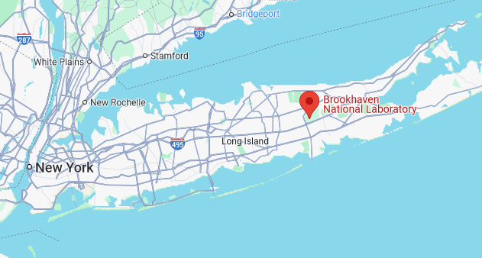
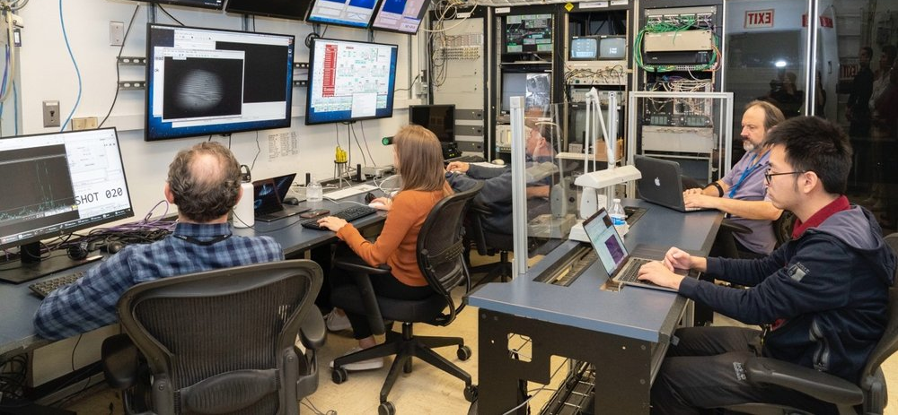
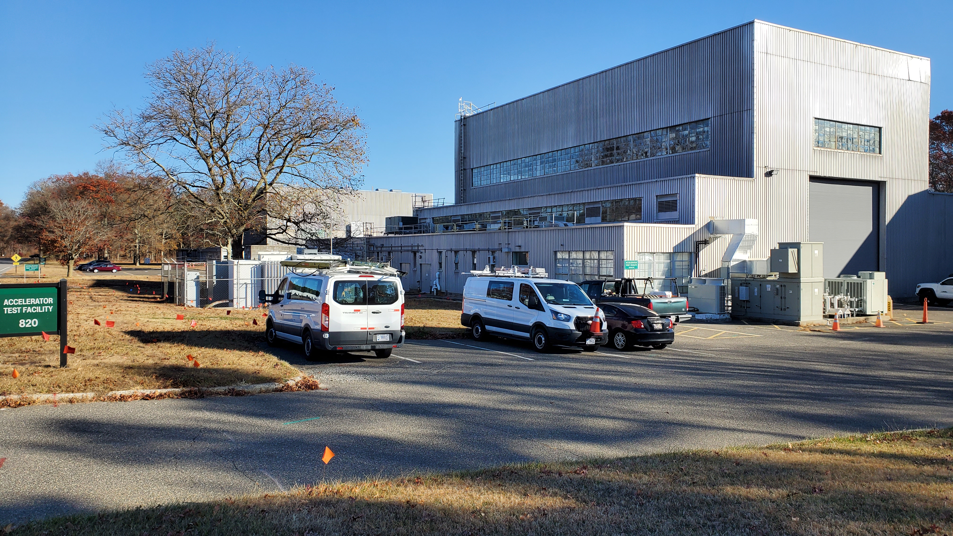
ATF overview
Department of Energy Office of Science User Facility for the Accelerator Stewardship program
Proposal-driven, peer reviewed
Over 30 years of operation for user experiments
Over 130 user experiments completed
40 PhDs defended
20 experiments are currently active

Slide 5
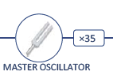
ATF capabilities
81.6 MHz
2.86 GHz
LINAC
high-brightness photocathode
20-75 MeV
energy spread 0.1%
norm. emittance 1μm
  Nd:YAG Laser
single bunch 10 ps – 200 fs
charge ~1 nC
multi-bunch trains
0.266 µm
  Experimental Area
  TiS Laser
1.06 µm
Last year, ~40% of experiments used all 3 capabilities!
hν
0.8 µm
LWIR Laser
high-pressure, isotopic, CPA, λ = 9.2 μm CO₂ laser
peak power 5 TW
pulse energy 5-15 J
NIR lasers
Ti:S λ = 0.8 μm and Nd:YAG λ = 1.06 μm
energy 80 mJ 100 mJ
pulse width: 75 fs 14 ps
9.2 µm
e⁻
75 MeV
pulse FWHM 2.0 ps
repetition rate 0.05 Hz
  Linac
  LWIR Laser
  OPA
Unique combination of synchronized high-peak-power lasers and a high-brightness electron linac.

Slide 6


State of the art ATF laser system
String of innovations:
Solid-state OPA front end
High-pressure isotopic CO₂ amplifiers
First CPA CO₂ laser system
OPA seed pulse generator
Stretcher
CO₂
CO₂
Compressor
5 TW
2 ps
High-pressure, isotopic
gas amplifiers

Slide 7
Accelerator research at ATF

Slide 8
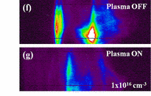
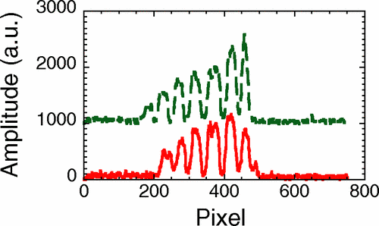
A brief (incomplete) history of accelerator research at ATF
First high-brightness beams from photocathode RF gun:
X. J. Wang et al., NIMPR A 356, 159-166 (1996)
First seeded FEL high-gain harmonic generation
A. Doyuran et al., PRL 86, 5902-5906 (2001)
First staged laser acceleration (IFEL)
W. D. Kimura et al., PRL 86, 4041 (2001)
Demonstration of SASE at visible wavelengths
A. Murokh et al., Phys. Rev. E 67, 066501 (2003)
First high-gradient, controlled PWFA
E. Kallos et al., PRL 100, 074802 (2008)
Development of masking technique for electron microbunches
P. Muggli et al., PRL 101, 054801 (2008)
First demonstration of seeding of self-modulation instability in plasma
Y. Fang et al., PRL 112, 045001 (2014)

Slide 9
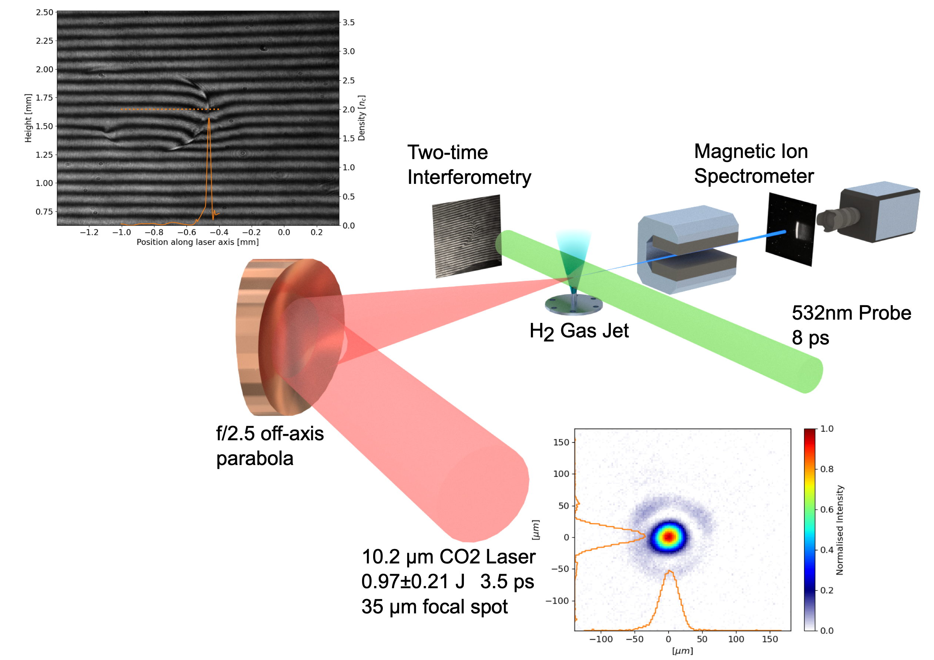
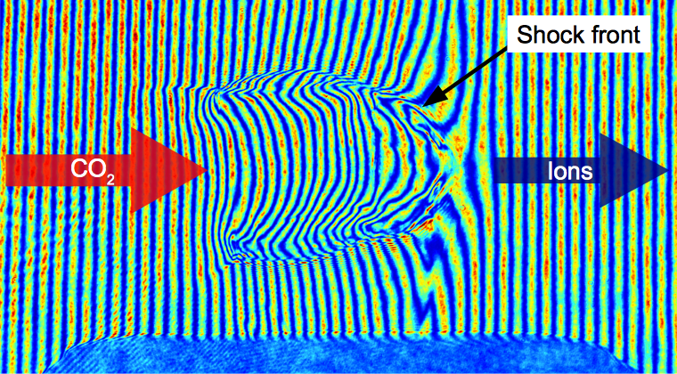
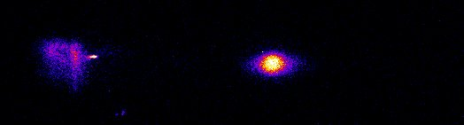
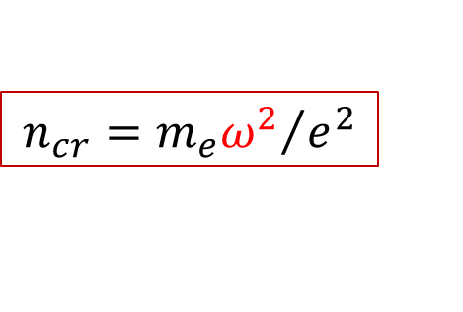
Proton acceleration from H₂ jet
Shock wave mechanism of monoenergetic acceleration.
1.7 MeV protons
Energy spread 4% (record-narrow for laser acceleration)
Spectral brightness 10¹² proton/MeV/str
Proton energy up to 3.2 MeV
532 nm probe
$$n_{cr}={m_{e}ω^{2}}/{e^{2}}$$
Low critical plasma density (10¹⁹cm⁻³) allows driving ions out of gas target.
1TW CO₂
C. A. J. Palmer et al., PRL 106, 014801 (2011)
C. A. J. Palmer et al., J. Plasma Phys. 81, 365810103 (2016)

Slide 10
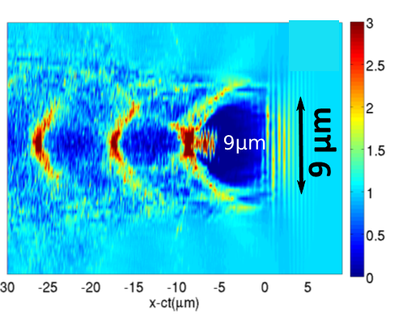
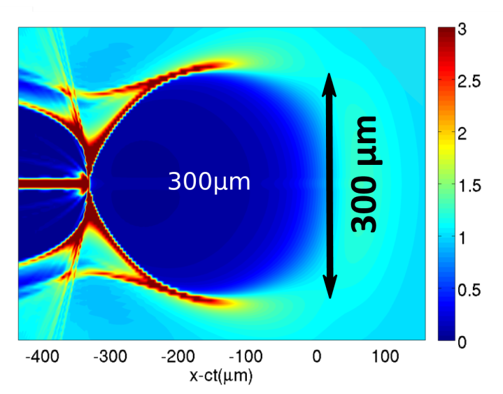


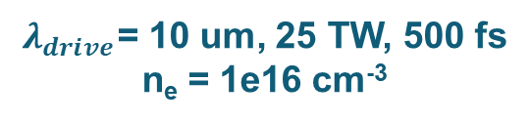
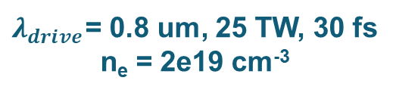
Wavelength scaling for LWFA
$$a_{0}∝\sqrt{Iλ^{2}}$$
$$n_{cr}∝1/λ^{2}$$
$$λ×10$$
$λ_{drive}$= 0.8 um, 25 TW, 30 fs
n_{e} = 2e19 cm⁻³
$λ_{drive}$= 10 um, 25 TW, 500 fs
n_{e} = 1e16 cm⁻³
Simulations courtesy of G. Shvets
Equivalent bubble with Ti:sapph would require PW peak powers

Slide 11
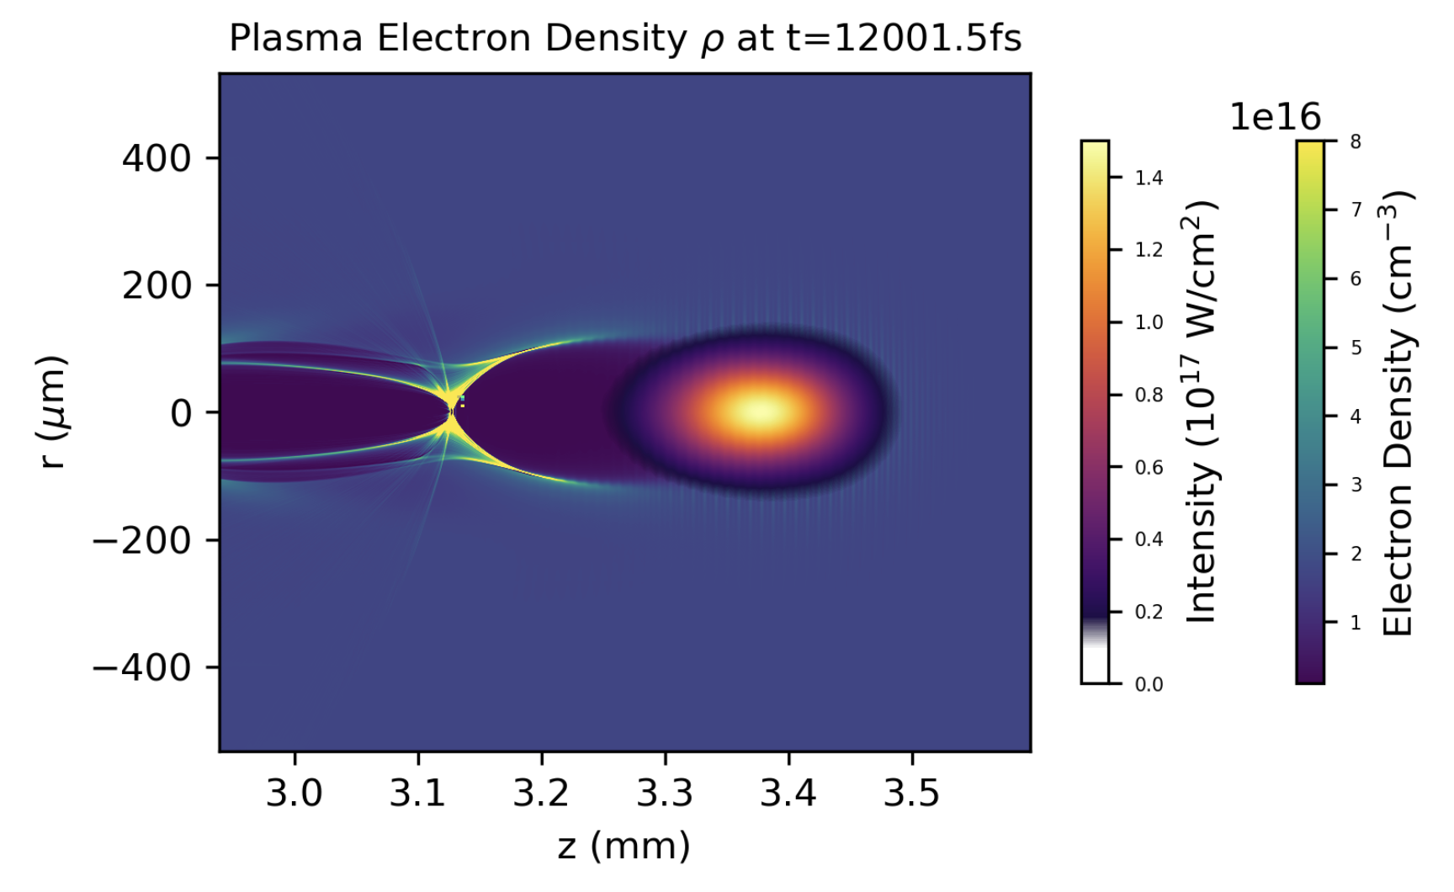
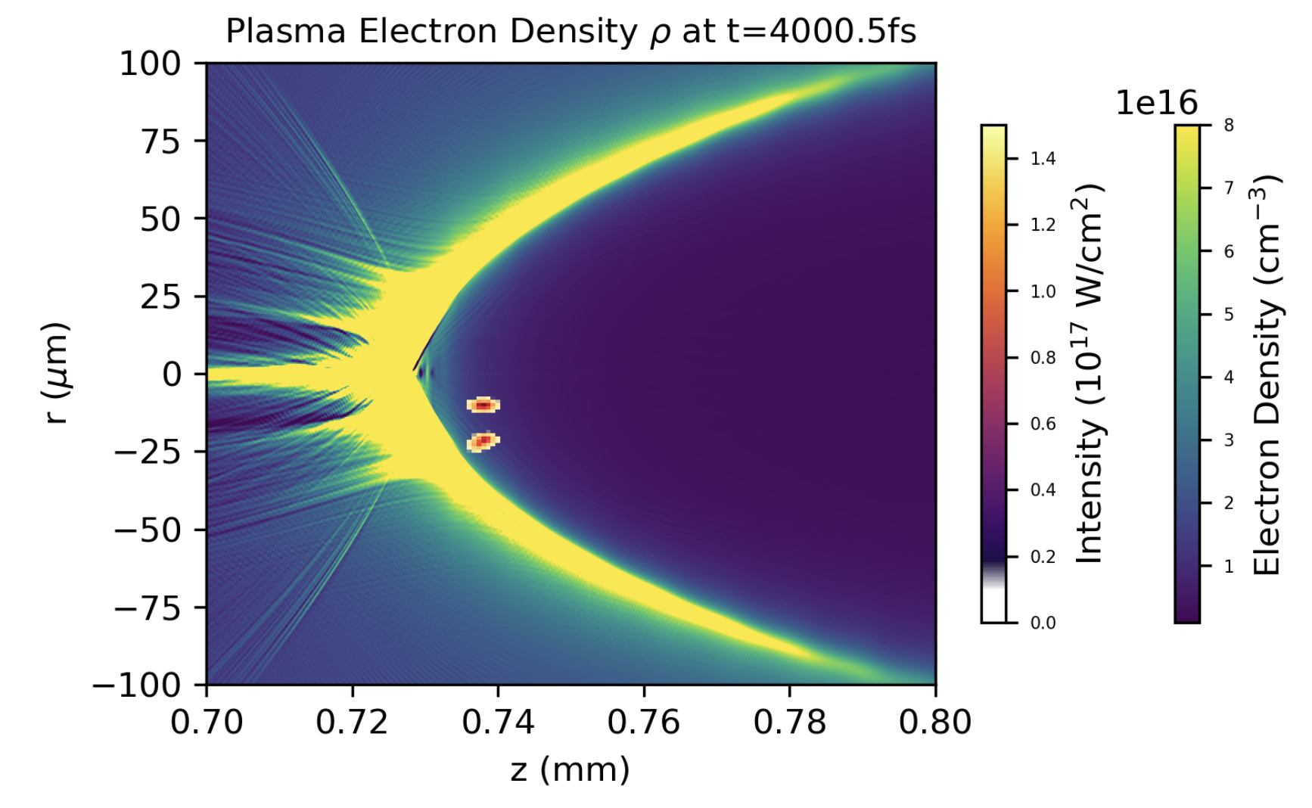
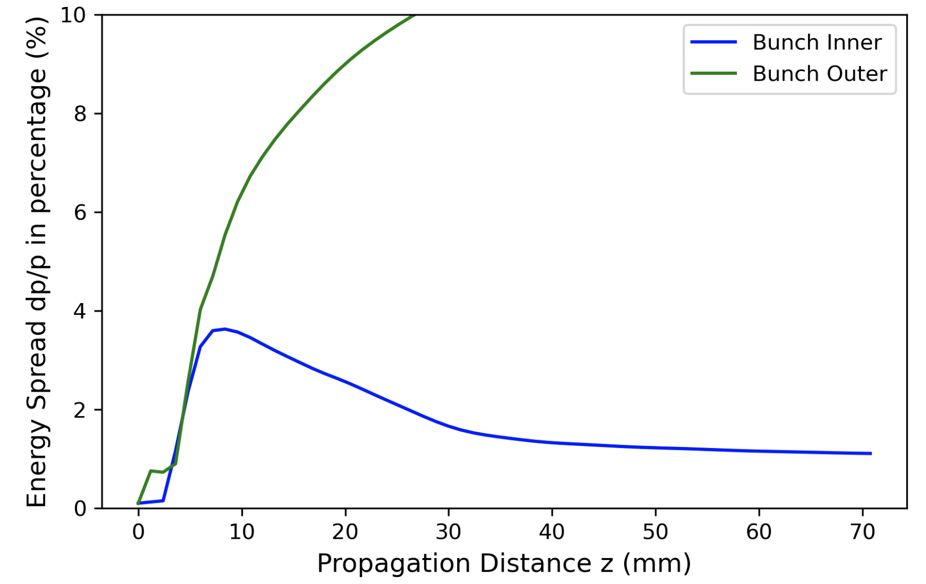
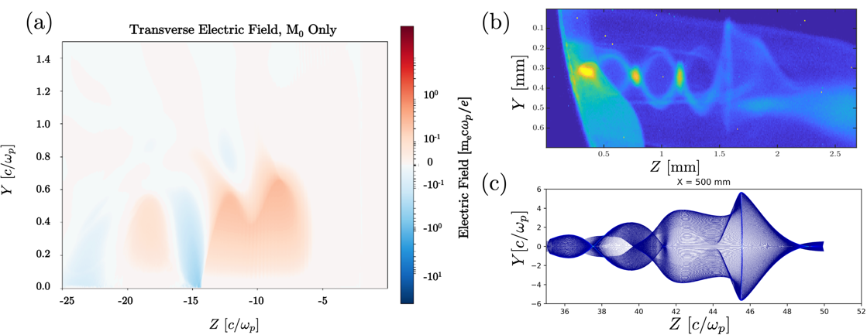
Adding e-beam to laser plasma research
Combination of high-power lasers and electron linac allows pioneering studies of electron injection into laser wakefields as well as detailed wakefield visualization.
500 fs CO₂ laser, a_{o}=4, n_{o}=10¹⁶cm⁻³, $ΔE$=800 MeV
e-beam
laser
Injected
electron
bunches
Seeding electrons into acceleration stages
CO₂ pulse
Courtesy of M. Downer (UT Austin)
Model
Experiment
e-beam
laser
Wake field tomography
A. Gaikward et al., Proc. of 66th Annual Meeting of APS Div. of Plasma Phys. (2024)

Slide 12
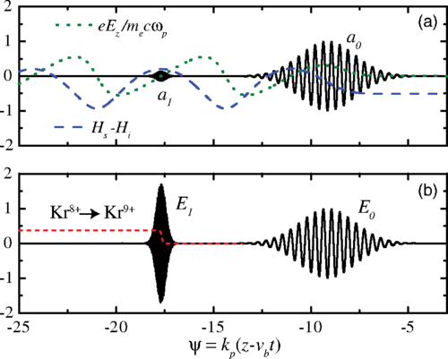
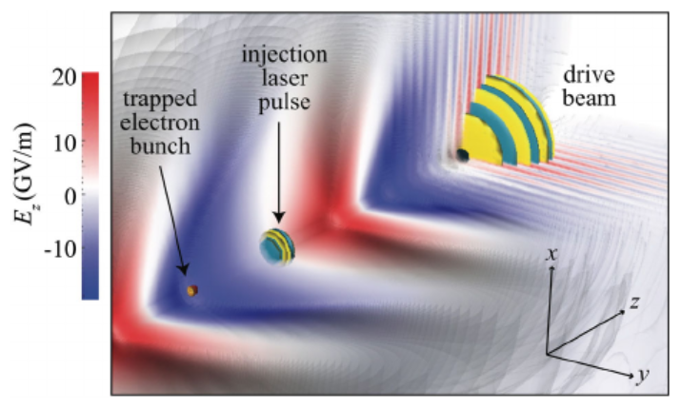
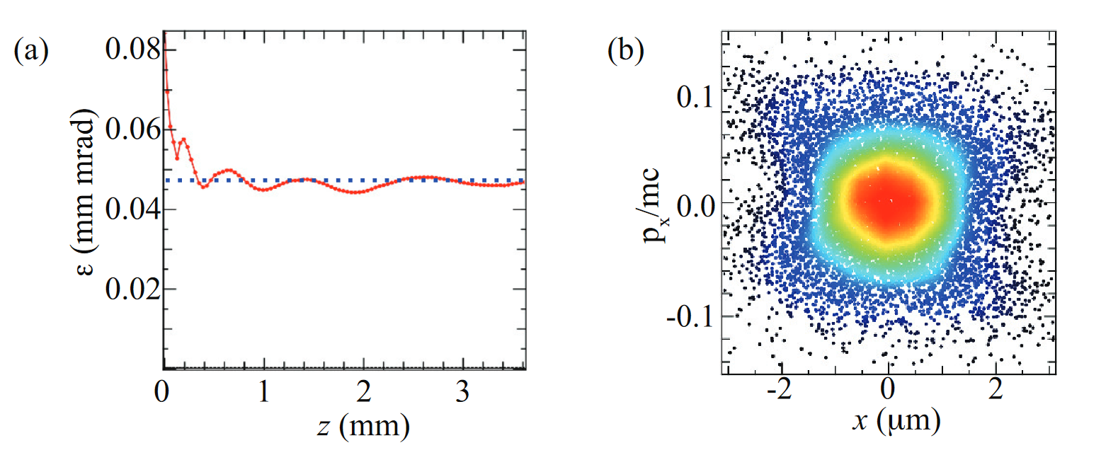


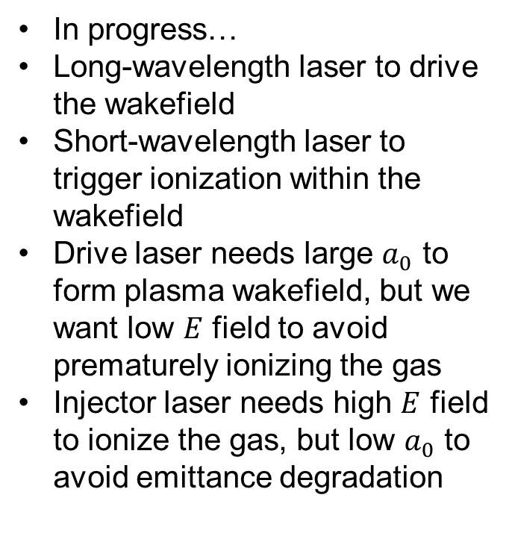
Two-color ionization injection
Less intense, large $a_{0}$
Very intense, small $a_{0}$
In progress…
Long-wavelength laser to drive the wakefield
Short-wavelength laser to trigger ionization within the wakefield
Drive laser needs large $a_{0}$ to form plasma wakefield, but we want low $E$ field to avoid prematurely ionizing the gas
Injector laser needs high $E$ field to ionize the gas, but low $a_{0}$ to avoid emittance degradation
Schroeder, PRSTAB 17, 101301 (2014)
Yu, PRL 112, 125001 (2014)
Excellent phase space
Low emittance
Schroeder, European Conference on Lasers and Electro-Optics (2015)
See also Xu, PRSTAB, 17, 061301 (2014)

Slide 13
LWIR laser roadmap

Slide 14
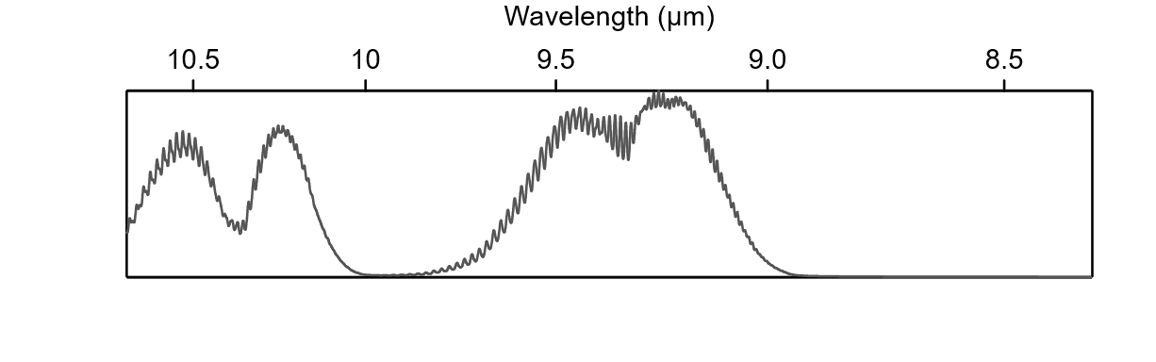
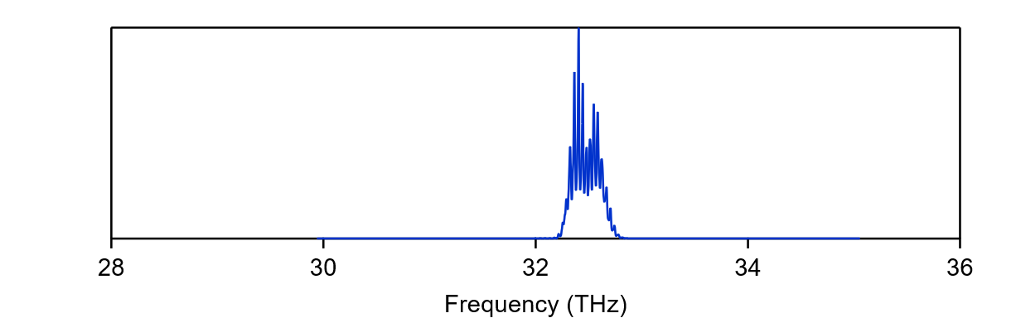
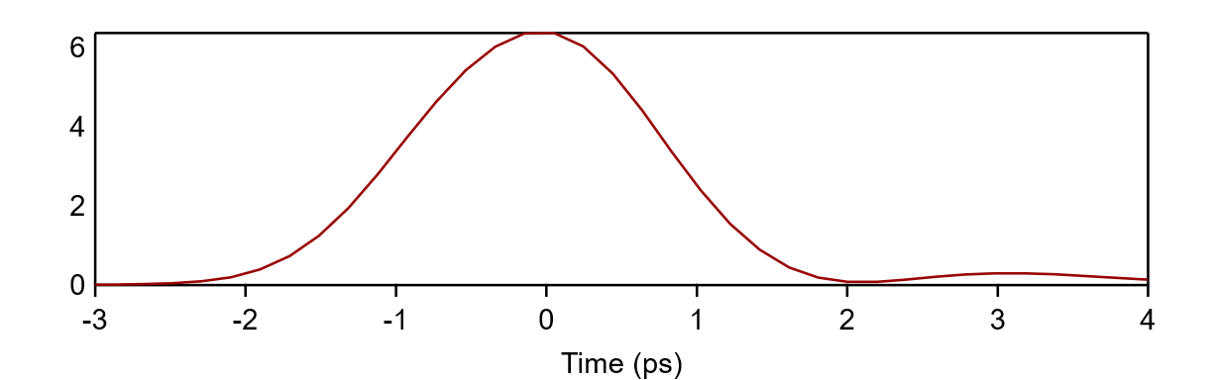
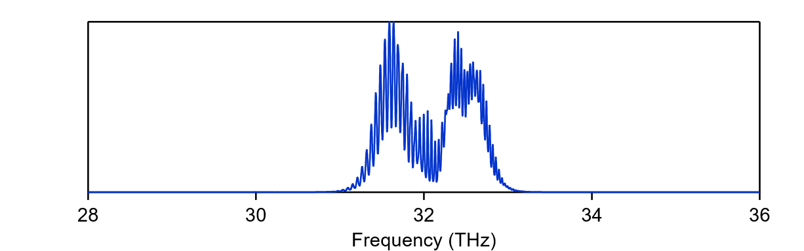
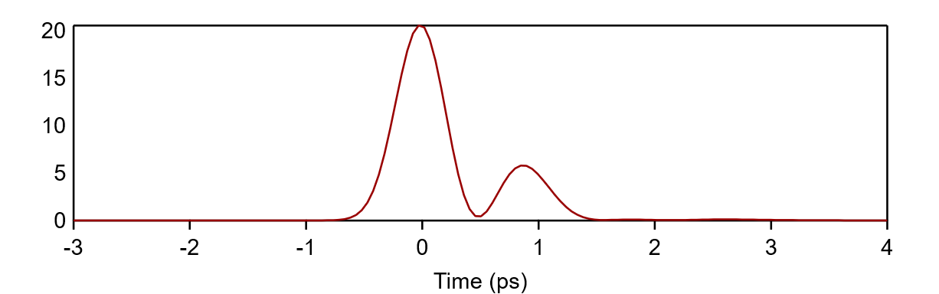
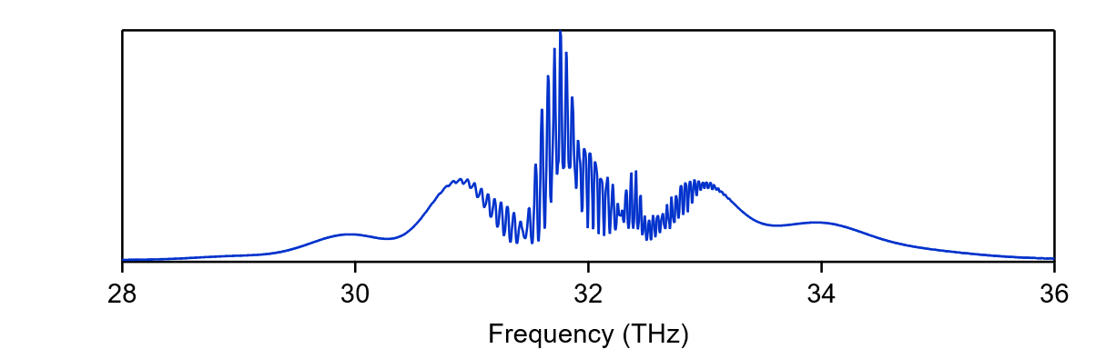
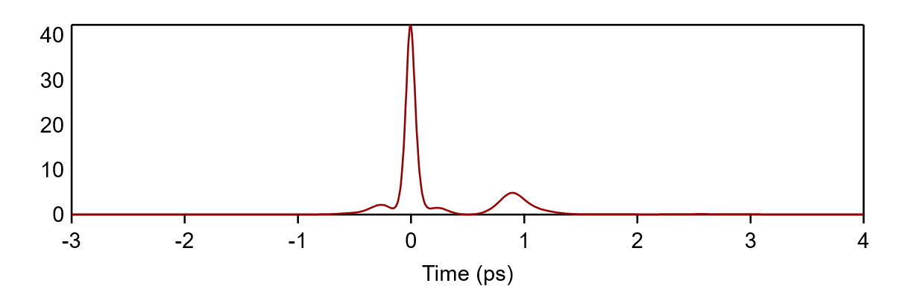
Roadmap to multi-petawatt femtosecond LWIR
Now
(10 µJ seed)
2 ps
6 TW
Gain spectrum
10 mJ seed
500 fs
20 TW
Power (TW)
Post-compression
100 fs
40 TW
1 optical cycle = 31 fs
14

Slide 15
Optical pumping
Future
- Yb:YAG + OPA
- Cr:YAG
Present
(Er,Cr):YSGG
1.44 µm
3ν₃
Past
No viable solid-state option
2.8 µm
2ν₃
4.3 µm
ν₃+ν₁
ν₃
ν₃
ν₃
ν₁
T

Slide 16
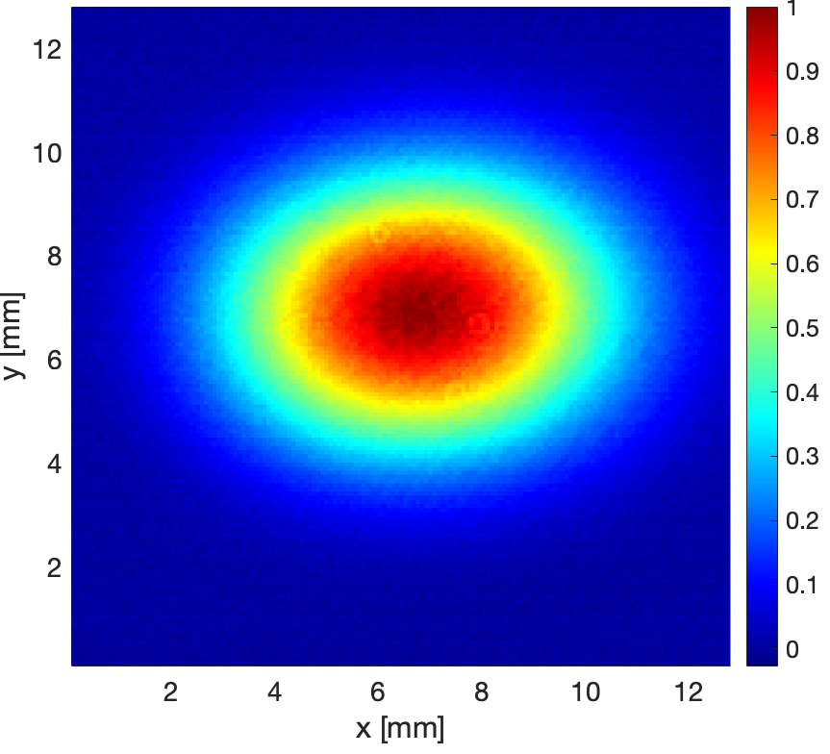
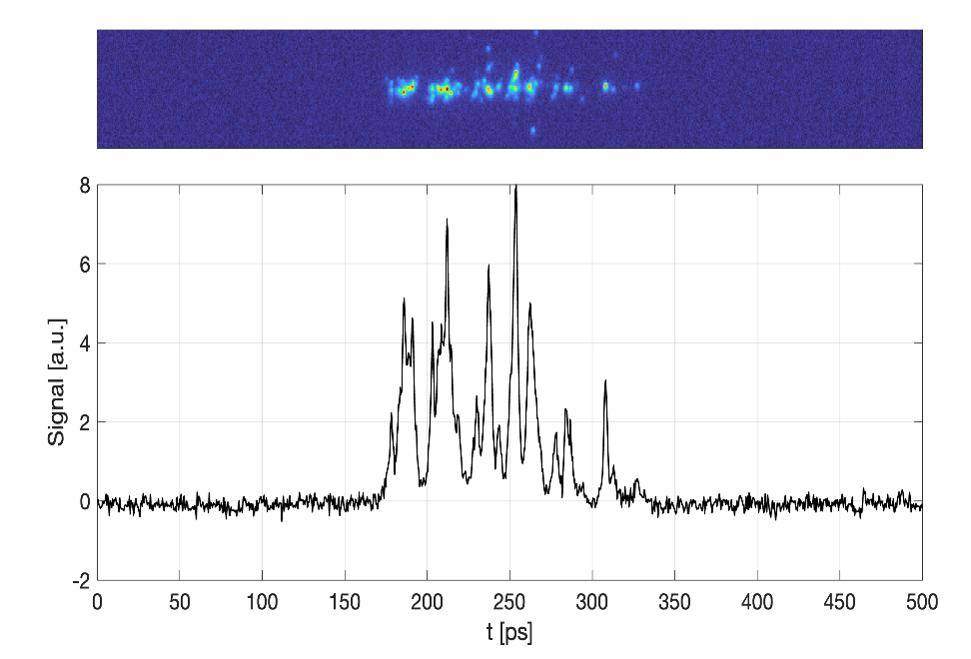
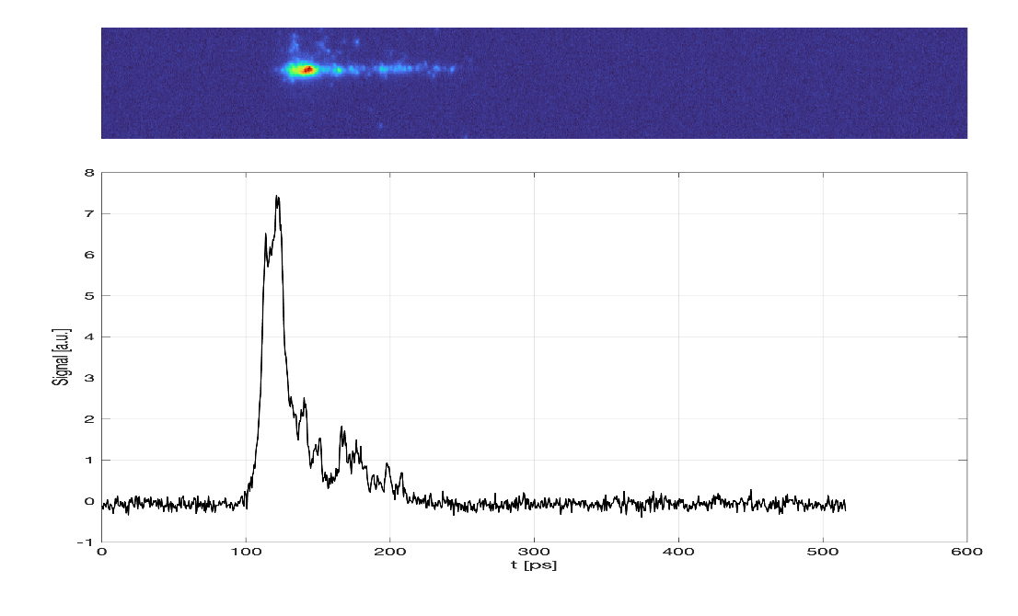

Demonstration of compact 15 atm CO₂ amplifier pumped at 2.8 um
Amplified 10.3 μm beam
MCT detector
10 Atm CO₂-He
0.4 μm Ti:saph. >1.6 mJ, 50 fs
1/40 GHz=25 ps
Output pulse:
~10 μm ≤2 mJ, 3-5 ps
Lens
10 μm filter
F=0.7 meters
R10.6=0.5%
R2.8=1.5%
2.8 μm pump: 100 mJ, 90 ns
Optically pumped 12 cm CO₂ cell
NaCl
wedge
DM
DM
Er:YSGG
Q-switched
laser
SS
10 μm regen
TOPAS/DFG System 10.3 (10.6) μm seed >10 μJ, 500 fs
15 Atm CO₂-He
Calorimeter
With ~60 mJ absorbed in the multiatmosphere CO₂ cell, we generated a single picosecond pulse with an energy ≥2 mJ.
Neptune Laboratory
S. Tochitsky, D. Mateo, E. Geske et al.
Amplification of 10 μm picosecond pulses in a compact optically pumped multiatmosphere CO₂ laser
Under per review Opt. Express (2025)

Slide 17
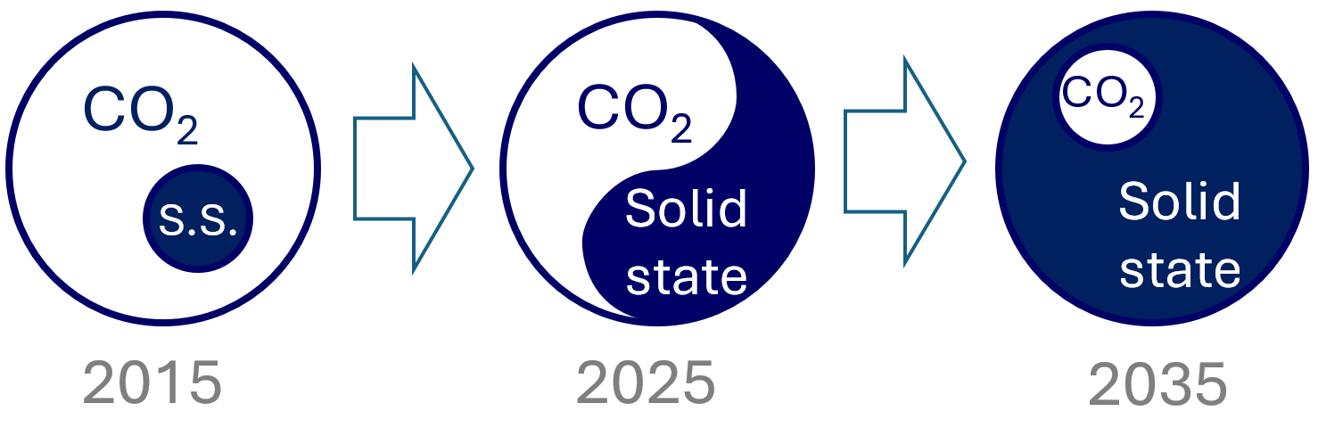
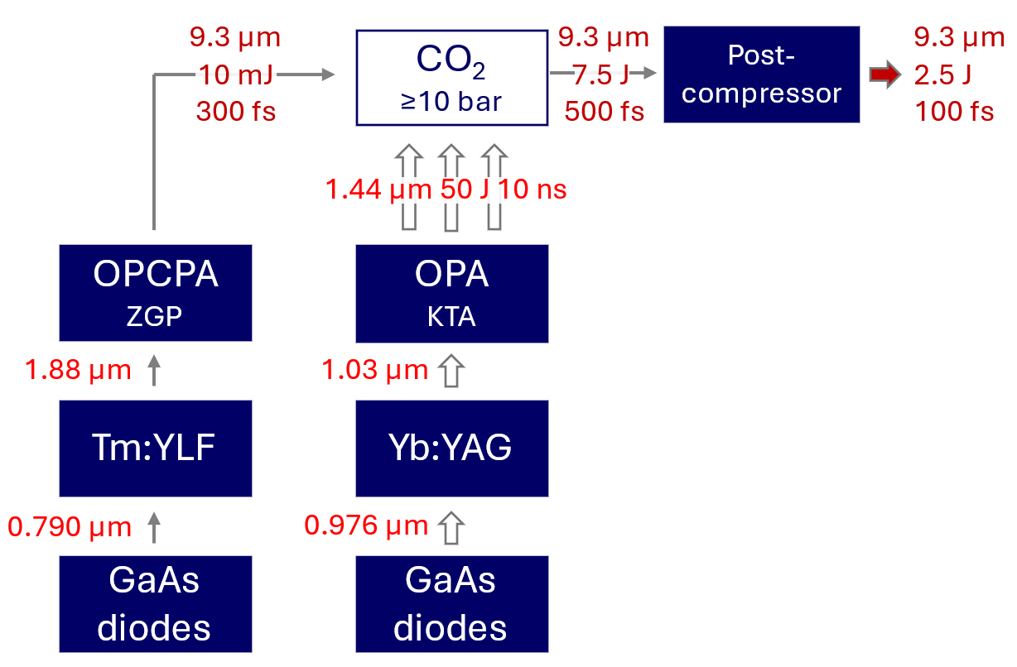
Next-generation LWIR laser architecture (≥25 TW, ≥10 Hz)
~3-cycle
DiPOLE laser architecture
(CLF RAL, UK)
100 J, 10 ns, 10 Hz
systems exist:
- CLF, UK
- HiLASE, Czech Republic
- European XFEL, Germany
BAT laser architecture
(LLNL)
1.5 J, 270 fs, 1 Hz
operation demonstrated
ALL CRITICAL TECHNOLOGIES ARE WITHIN REACH

Slide 18
Prospects for future colliders with LWIR-driven LWFA

Slide 19
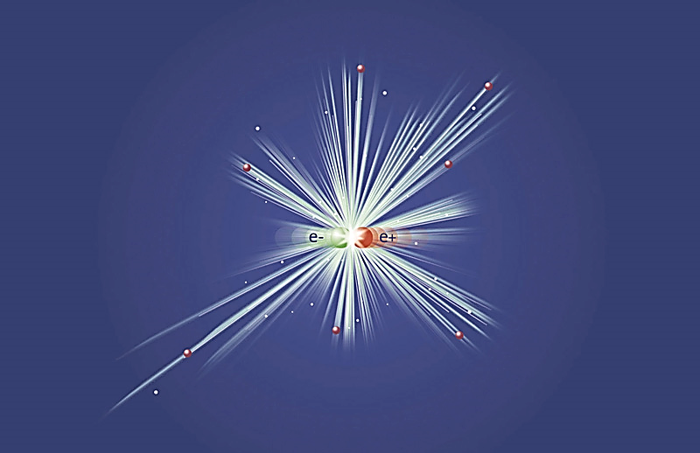
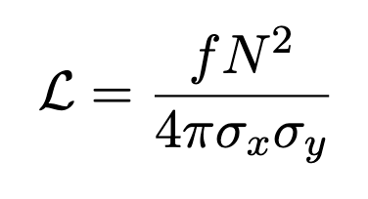
Prospective 10 TeV e⁻e⁺ Collider
5TeV
P5 recommendation
Advanced accelerators could provide the necessary cost savings to make it feasible
Plasma-based accelerator with demonstrated 100 GeV/m gradient is a possible solution.
~3 km 500 stages
5 TeV
Geometric Luminosity
5 TeV
= 10³⁵ cm⁻² s⁻¹
~3 km 500 stages
Higher bunch charges and smaller emittance are favored
19

Slide 20

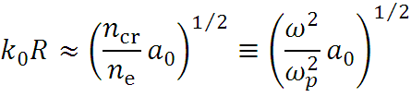




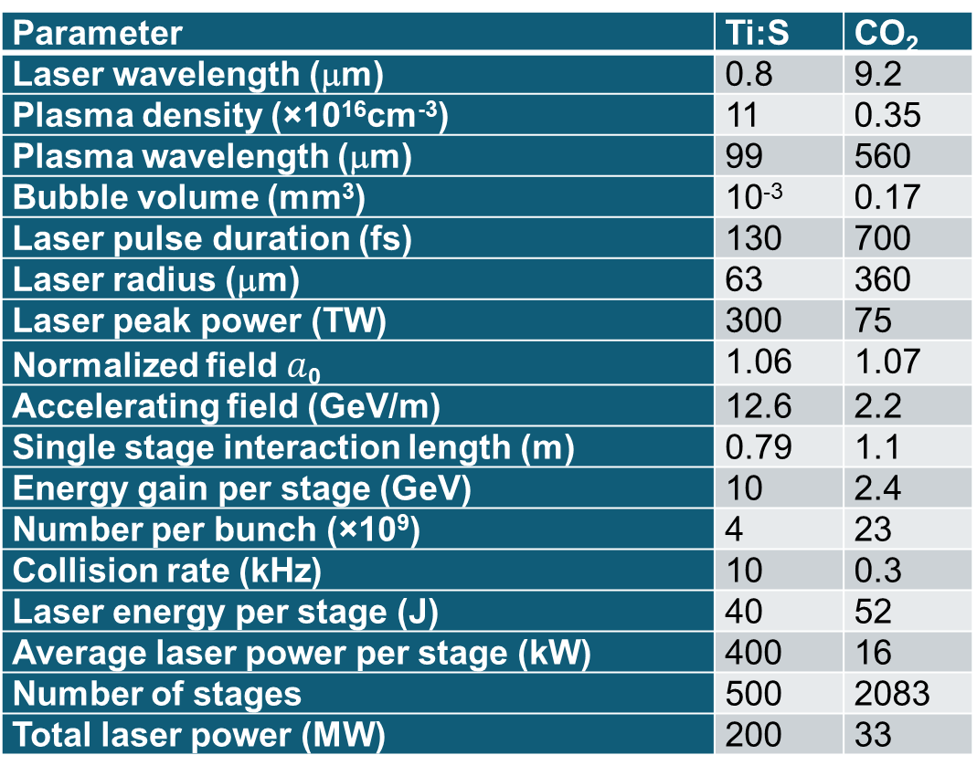
Two optimized examples
Parameter | Ti:S | CO₂
Laser wavelength (μm) | 0.8 | 9.2
Plasma density (×10¹⁶cm⁻³) | 11 | 0.35
Plasma wavelength (μm) | 99 | 560
Bubble volume (mm³) | 10⁻³ | 0.17
Laser pulse duration (fs) | 130 | 700
Laser radius (μm) | 63 | 360
Laser peak power (TW) | 300 | 75
Normalized field $a$₀ | 1.06 | 1.07
Accelerating field (GeV/m) | 12.6 | 2.2
Single stage interaction length (m) | 0.79 | 1.1
Energy gain per stage (GeV) | 10 | 2.4
Number per bunch (×10⁹) | 4 | 23
Collision rate (kHz) | 10 | 0.3
Laser energy per stage (J) | 40 | 52
Average laser power per stage (kW) | 400 | 16
Number of stages | 500 | 2083
Total laser power (MW) | 200 | 33
Factors affecting collider luminosity:
Bigger sized bubble facilitates low-emittance beams
where
0.3×
Higher charge
reduces quadratically repetition rate
resulting in relaxed average laser power
and total power
Following “Physical considerations for a laser-plasma linear collider” C. B. Schroeder et al, 2010
20

Slide 21

Conclusions
The Brookhaven Accelerator Test Facility operates three capabilities: electron beam, NIR lasers, and LWIR laser
Long history of pioneering accelerator science
Unique multi-beam multi-wavelength experiments
Roadmap established for 25 TW+ LWIR with high repetition rate
Get in touch if you have interesting ideas to test!
Point of contact: ATF director, Igor Pogorelsky igor@bnl.gov

Slide 22
Thank you!

Slide 23
Backup slides

Slide 24
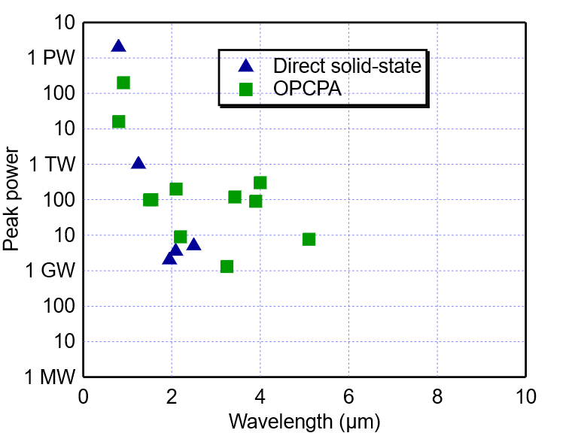
CO₂ lasers are the only choice for delivering TW power in LWIR
NIR
SWIR
MWIR
LWIR
CO₂ amplifiers
Compilation: Sara Bucht (LLE) ~2018

Slide 25
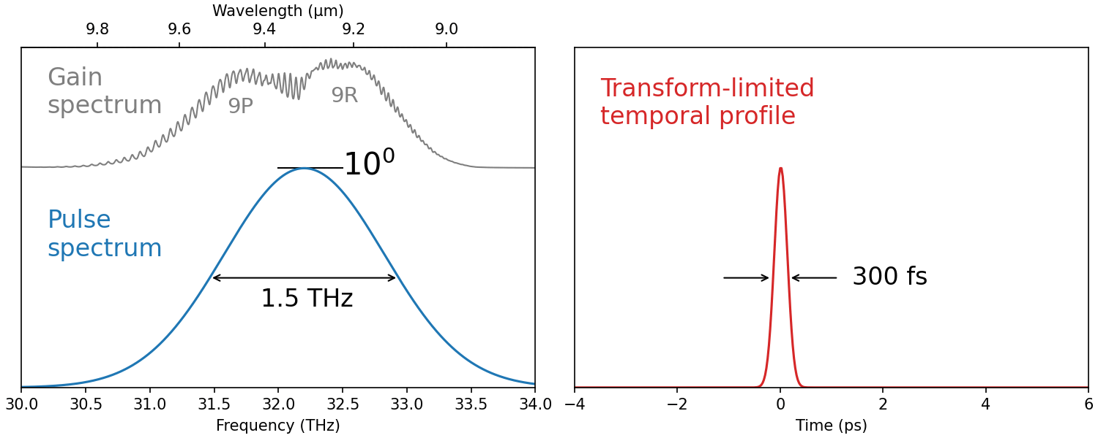
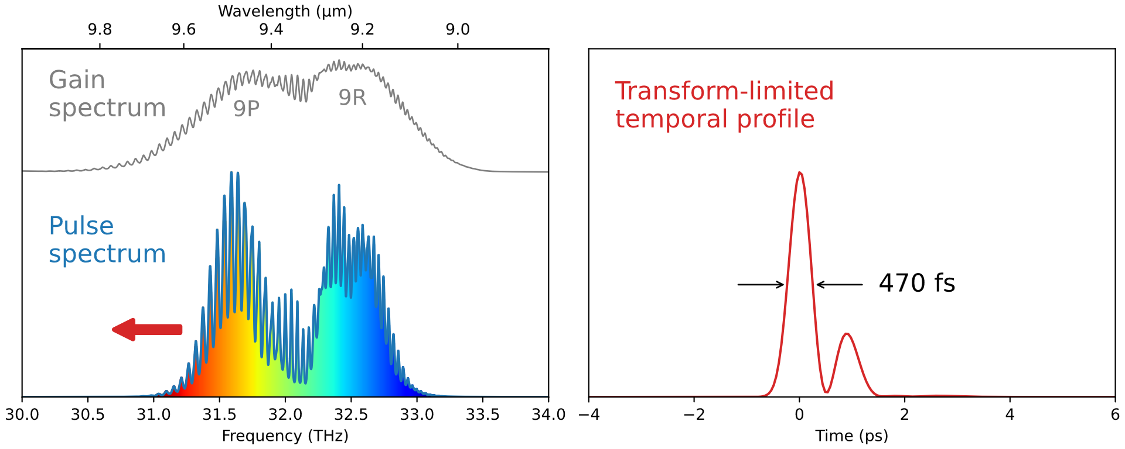
Can we do better than 2 picoseconds?
Possible routes to
ultra-fast CO₂ lasers:
Strong, broadband seed pulse
Nonlinear post-compression (NLPC)
Seed: 10 µJ
Two CO₂ amplifiers
x10⁴
x10⁸
Seed: 10 mJ
Single CO₂ amplifier
20 J
140 ps
14 J, 0.5 ps
20 TW
@ 9.3 μm
7 mJ
140 ps
x10⁴
10 mJ
300 fs
Seed
Generator

Slide 26
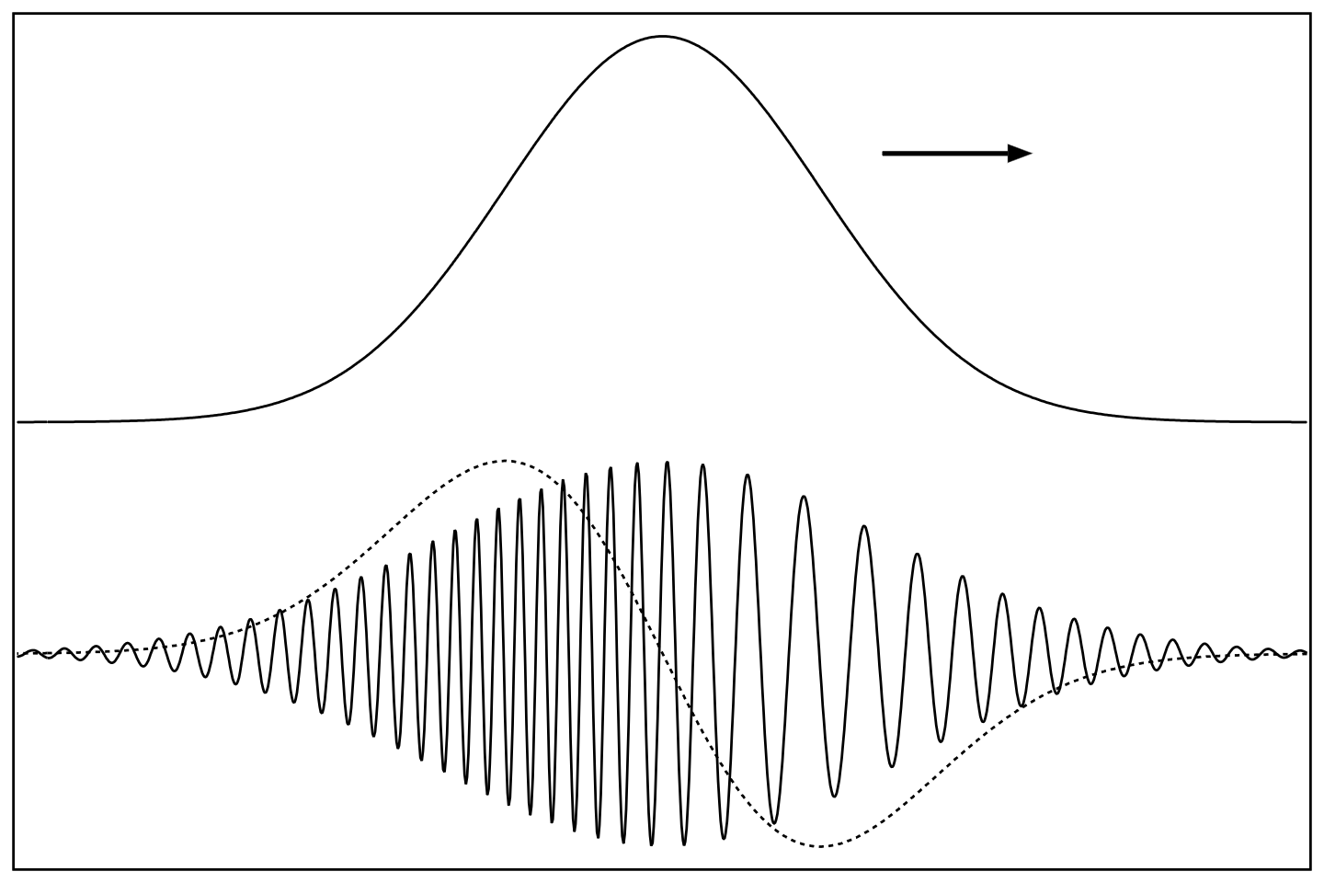

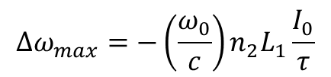


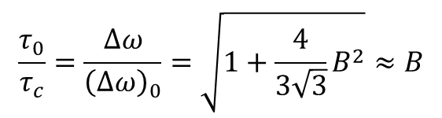
Can we do better than 2 picoseconds?
Strong, broadband seed pulse
Possible routes to
ultra-fast CO₂ lasers:
Nonlinear post-compression (NLPC)
  Self-phase modulation due to Kerr effect in a nonlinear material results in a quasi-linear frequency chirp.
  A chirped pulse gets compressed in a material with a negative group dispersion.
,
n(t) = n₀ + n₂I(t)
$$τ_{0} =∆ω_{max}(GVD) L_{2}$$
Self-phase
modulation
Dispersive compression
compressible linear chirp
$$∆ω_{max}$$
$$\frac{τ_{0}}{τ_{c}}=\frac{∆ω}{{\left(∆ω\right)}_{0}}=\sqrt{1+\frac{4}{3\sqrt{3}}B^{2}}≈B$$
$$∆ω_{max}=−\left(\frac{ω_{0}}{c}\right)n_{2}L_{1}\frac{I_{0}}{τ}$$
= $B$

Slide 27
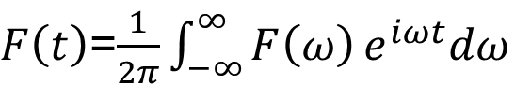

Gain spectrum affects the pulse time envelope
Δν ~50 GHz
~20 ps
Periodical line structure of the CO₂ gain spectrum splits a single picosecond pulse into a train.
High-pressure collisional broadening, combined with mixing different CO₂ isotopes, overlaps individual rotational lines into continuum, and pulses as short as 0.5 ps can be amplified without distortion.
$$F\left(ω\right)$$
$F\left(t\right)$=$\frac{1}{2π}\int_{−∞}^{∞}{F\left(ω\right)}e^{iωt}dω$
Inverse Fourier transform

Slide 28
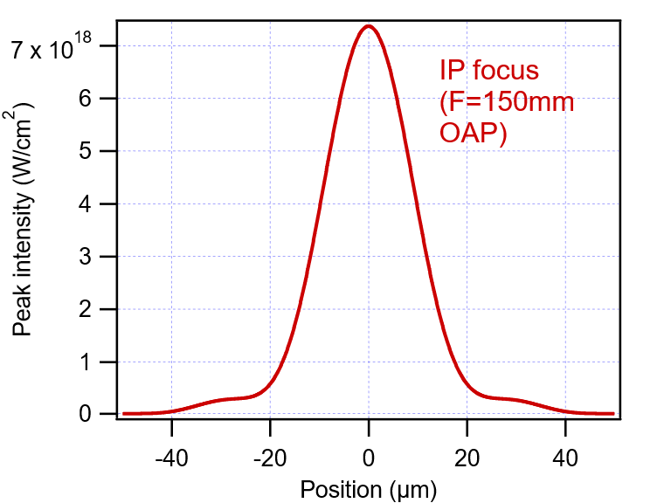
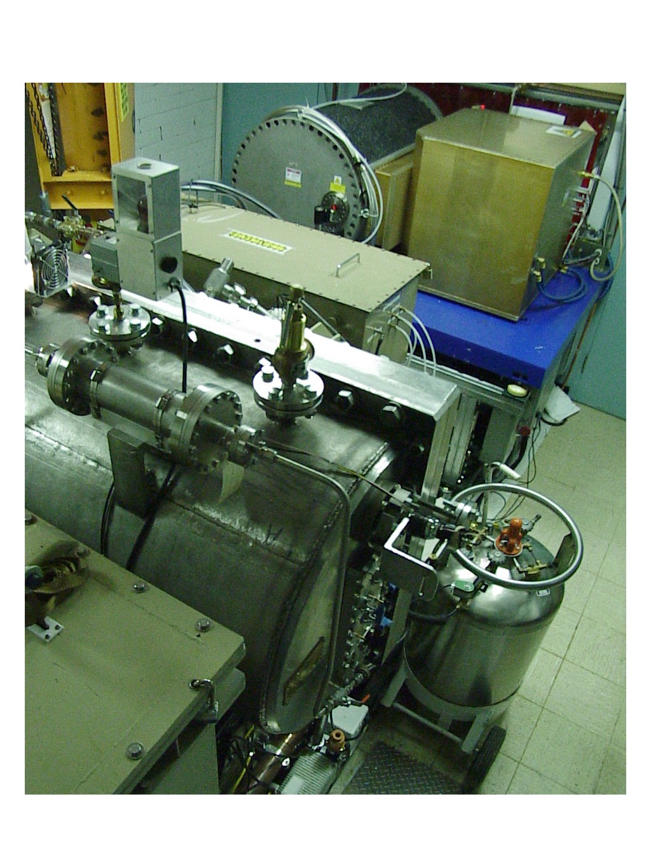
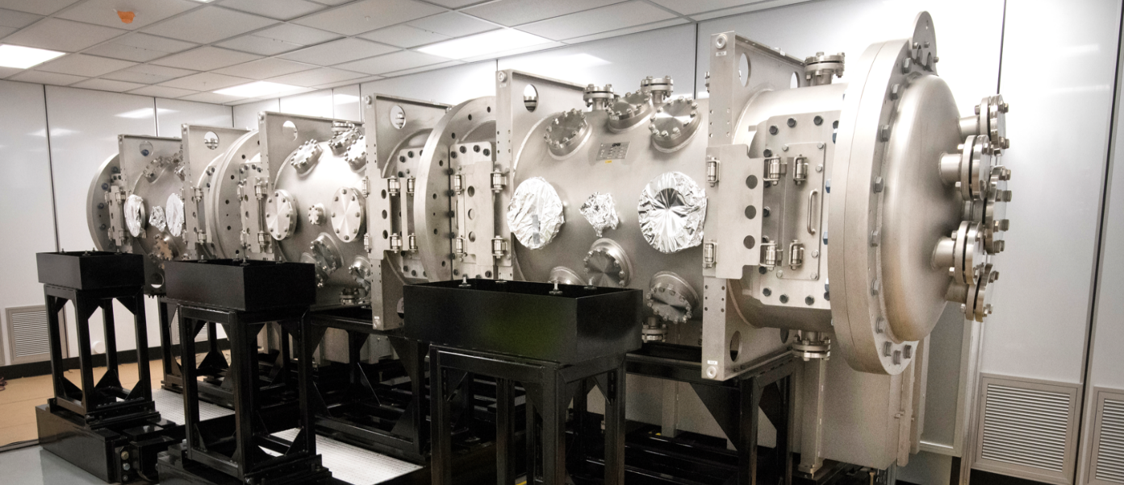
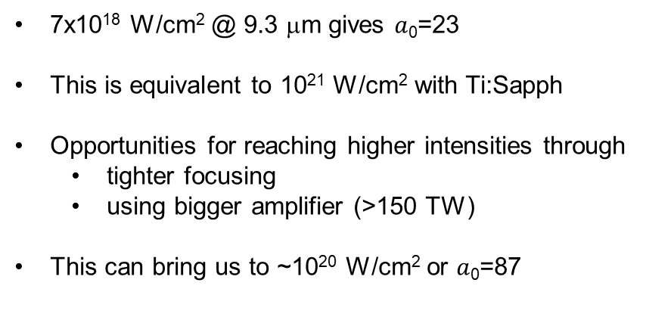
Reaching strong field regime
7x10¹⁸ W/cm² @ 9.3 μm gives $a$₀=23
This is equivalent to 10²¹ W/cm² with Ti:Sapph
Opportunities for reaching higher intensities through
  tighter focusing
  using bigger amplifier (>150 TW)
This can bring us to ~10²⁰ W/cm² or $a$₀=87
Simulated focus of 40-TW
9.3 μm laser
Radius (μm)
At equal power, CO₂ laser provides the same ponderomotive action within ~λ² (100 times ) bigger area
~λ³ (1000 times) bigger volume.
Present final amplifier
Bigger amplifier available at BNL
150 TW CO₂ laser could be equivalent to 15-150 PW solid state laser!
(not taking into account typically 10x longer pulse)

Slide 29
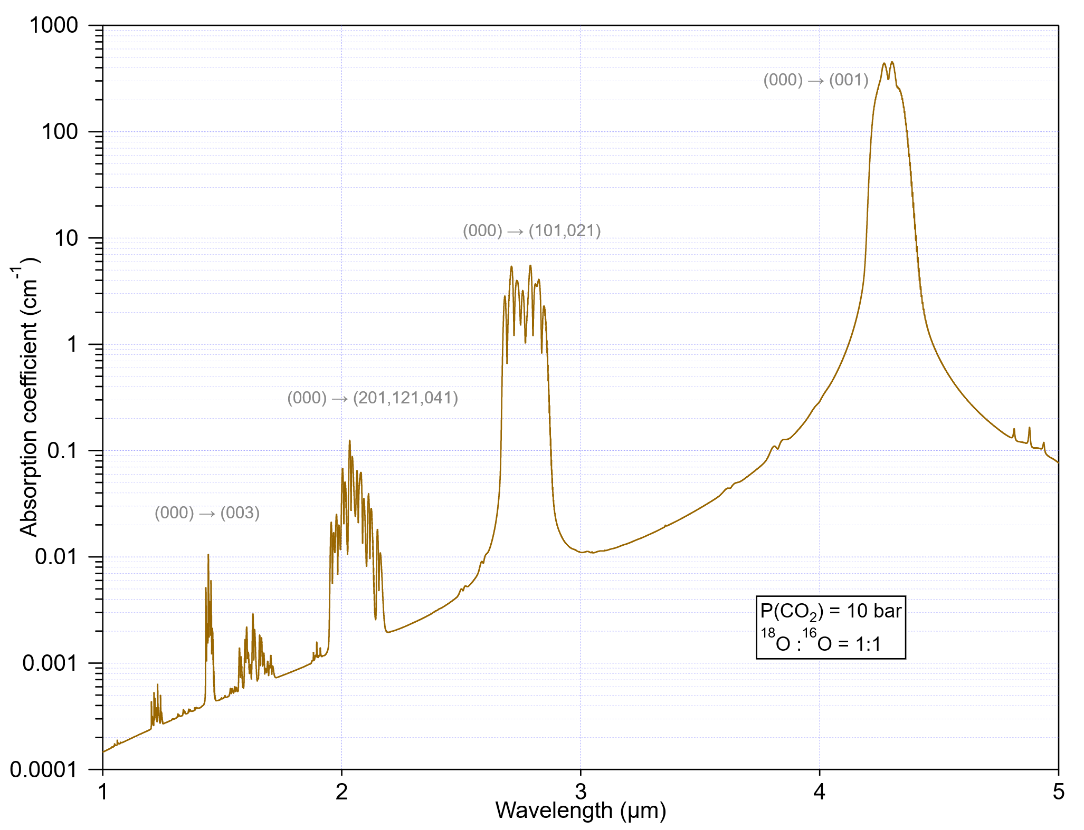
Optical pumping
4.3 µm
2.8 µm
2 µm
1.44 µm

Slide 30



LWIR single stage LWFA
3D PIC simulations performed for a 400 fs, 60 TW CO₂ laser focused to w₀=262.5 μm at the entrance to a 3.2x10¹⁵cm⁻³, matched, parabolic plasma channel.
3
600
2
400
Electron Energy [GeV]
Laser Spot Size [μm]
1
200
0
0
0 20 40 60 80
Distance [cm]
Simulations by Wei Lu, Tsinghua Un.

Slide 31


Custom high-pressure x-ray ionized CO₂ amplifier operated at BNL/ATF
ATF high-pressure laser amplifier
X-ray pre-ionized electric discharge
Discharge volume 10x10x100 cm³
Pressure 10 atm
Amplified ps pulse 20 J

Slide 32




Submit proposal get approved safety review get beam time
Approval of user experiments
www.bnl.gov/atf/
User’s and Proposal Steering Committee meetings
Your experiment

Slide 33

Representative sets of laser and plasma parameters for LWFA 10-TeV c.m. e⁻e⁺ collider
Parameter | #1 | #2 | #3 | #4 | #5 | PIC* | #6
Laser wavelength (μm) | 0.8 | 9.2 | 9.2 | 0.8 | 9.2 | 10 | 9.2
Plasma density (×10¹⁶cm⁻³) | 11 | 11 | 1.1 | 1.1 | 0.35 | 0.32 | 0.11
Plasma wavelength (μm) | 99 | 99 | 313 | 313 | 560 | 585 | 990
Laser pulse duration (fs) | 130 | 130 | 390 | 390 | 700 | 400 | 1300
Laser radius (μm) | 63 | 63 | 200 | 200 | 360 | 262 | 630
Laser peak power (TW) | 300 | 2.3 | 23 | 3000 | 75 | 60 | 230
Laser energy per stage (J) | 40 | 0.3 | 9 | 1200 | 52 | 24 | 300
Number per bunch (×10⁹) | 4 | 4 | 13 | 13 | 23 | 12 | 40
Single stage interaction length (m) | 0.79 | 0.006 | 0.19 | 25 | 1.1 | 0.6 | 6
Accelerating field (GeV/m) | 12.6 | 12.6 | 4.3 | 4.3 | 2.2 | 3.8 | 1.25
Energy gain per stage (GeV) | 10 | 0.075 | 0.75 | 100 | 2.4 | 2.3 | 7.5
Number of stages | 500 | 66660 | 6660 | 50 | 2080 | 2170 | 660
Collision rate (kHz) | 10 | 10 | 1 | 1 | 0.3 | 1.2 | 0.1
Average laser power per stage (kW) | 400 | 3 | 9 | 1200 | 16 | 30 | 30
Linac length (stages 0.5m apart) (km) | 0.65 | 3.3 | 4.66 | 1.25 | 4.48 | 2.4 | 4.3
Total laser power (MW) | 20 | 20 | 6 | 6 | 2.6 | 6.5 | 2
PRAB 19, 091001 (2016)
33
Notes:
Someone may ask: How we know that case is optimum? Why not to let TiS laser to operate at low plasma density if it is so beneficial?
We check what happening if we reduced the plasma density for TiS 10x, which is still 3x above the optimum CO2 case.
We see that the regime is becoming hardly affordable due to huge individual laser and stage length.
Then we do similar exercise for CO2 laser trying to use it under conditions optimum for Ti:Sapph laser.
We see that stage length is extremely short due to 100 times smaller depletion length. This results in small acceleration per stage and huge number of stages.
If anyone wants to take deeper dive into this problem and a table, I can address you to this reference.

Slide 34









Experimentally accessing physics relevant to plasma research
Time
Length
Density
EM Field
~3 fs
~1 μm
~10²¹ cm⁻³
$$a_{0}=1$$
Near-IR
Too short
Too small
Too dense
$$@ 1018 W/{{cm}^{2}}$$
☹️
Laser-plasma interactions can be normalized to reference frequency:
$$a_{0}∝\frac{\sqrt{I}}{ω_{L}}$$
$$\tilde{x}=\frac{ω_{L}}{c}x$$
$\tilde{n}=\frac{n}{n_{cr}}∝\frac{1}{ω_{L}^{2}}$ $n$
$$\tilde{t}=ω_{L}t$$
~30 fs
~10 μm
~10¹⁹ cm⁻³
$$a_{0}=1$$
LongWave-IR
$$@ 1016W/{{cm}^{2}}$$
😃
Easier to resolve experimentally
Same process at less density
Same effect at less power

Slide 35









Relativistic Oscillating Mirror (ROM)
Specular reflection of an incident laser beam.
At high intensities (>10¹⁶ W/cm² @ 10μm), laser field drives relativistic oscillation of the plasma surface.
This induces a Doppler effect on the reflected beam, resulting in a periodically distorted reflected waveform, the spectrum of which consists of a comb of high-order harmonics.
Potential ATF advantages:
Better control of plasma thickness <λ.
Optical plasma diagnostic.
Availability of e-beam to analyze the focused field via electron deflection or Compton scattering.
$$ω_{m}=4a_{0}^{2}ω_{L}$$
Possibility of using a blast wave in plasma for a target.
Broad spectrum
Intensity boost
Ultra-short pulses
Spot size ~ ${λ_{L}}/{a_{0}^{2}}$
$$T=$$
$${2π}/{ω_{L}}$$
$$τ={2π}/{ω_{L}a_{0}}$$
      after High Power Laser Sci. Eng. 9, e6 (2021)
Notes:
However, there are other opportunities for entering relativistic regime of high harmonic generation from target.
In this case plasma oscillations induce Doppler effect on the reflected beam, resulting in a periodically radiated bursts, the spectrum of which consists of a comb of high-order harmonics.
LWIR laser might allow better control over plasma thickness which needs to be less than lambda.
We can also use optical plasma diagnostic φορ βεττερ χοντρολ οφ τηε προχεσσ.
Availability of e-beam will allow to analyze focused field via electron deflection or Compton scattering. Note that focused fields in vacuum is difficult to measure otherwise.
Also, interesting possibility could be using blast wave in plasma as a target

Slide 36


Scaling proton acceleration
with CO₂ lasers
Proton acceleration from foil
10-μm laser with the intensity of 10¹⁶ W/cm² performs like 1-μm laser of the 10¹⁸ W/cm² intensity.
Production of hot electrons is the key.
Their energy strongly depends upon the laser wavelength
$$Φ\sim Iλ^{2}$$
This was confirmed by ATF TNSA experiment.
Nucl. Instrum. Meth. Phys. Res. A620, 67 (2010)
36
Notes:
Turning to user experiments on ion acceleration, we notice again the importance of favorable scaling of electron energy that forces electrons to escape target and pull protons and heavier ions along.
Here we explicitly demonstrated that 10-υm laser with intensity of 10¹⁶ W/cm² produces the same proton spectrum as 1-υm laser of 10¹⁸ W/cm² in the so-called Target Normal Sheaf acceleration.

Slide 37


Scaling shock wave acceleration
Proton energy scales ~$a_{0}^{3/2}$
$a_{0}$=87 might give 4.5 GeV protons
Nat. Phys. 8, 95 (2011),
37

Slide 38


Relativistic mirror
Basic idea of a relativistic mirror
$$v=βc$$
Upon reflection on such a mirror, the laser pulse wavelength is Doppler shifted by 1/4γ² and compressed in time by the same factor.
Assuming perfect reflection, the light beam energy then gets boosted by 4γ² and intensity by 16γ⁴ (in strongly relativistic case).
Assuming perfect focusing total intensity enhancement 64γ⁶ covering a gap to a Schwinger limit.
      after High Power Laser Sci. Eng. 9, e6 (2021)

Slide 39







Plasma wake as relativistic mirror
Possible implementation with plasma wake at wave breaking
Wave breaking leads to singularity in the electron density distribution.
Reflection $R$ from singularity is typically very low ($R$~0.1% @ $γ$=10) when driver and signal wavelengths are equal.
$R=(nelλsre/γ)2$ implying $R$≈10% for CO₂ laser.
Focusing by such parabolic singularity adds to the overall intensity boost reaching ~$400 γ^{6}R\frac{D^{2}}{λ^{2}}$ .
Gain in $R$ is canceled by diffraction.
plasma
drive
signal
${RI_{s}}/c≪$ $γn_{e}mc^{2}$
$$I_{s}[W{cm}^{−2}]≪2.4×{10}^{−3}\frac{γ}{R}n_{e}\left[{cm}^{−3}\right]$$
The reflected intensity is limited by recoil effect: or
        - condition where energy density in reflected pulse is much less than energy in electron layer.
        Example: 4 PW, ~1 kJ TiS laser drives a wake in 10¹⁸ cm⁻³ plasma that reflects $I_{s}$=1.8x10¹⁵ W/cm² ($a_{0}$=0.3) of 10-μm light to $I_{R}$=4x10²⁵ W/cm² @ λ=2.5 nm compared to 4x10²⁷ W/cm² @ λ=0.25 nm for 1-μm laser.
        Note that $a_{0}$parameters are equivalent while the focus area for 10-μm laser case is 100x bigger!
        after T.M. Jeong, S.V. Bulanov et al, Rev. Modern Plasma Phys. (2024)
Notes:
.

Slide 40






Directed energy applications
TW power can be transmitted in a single cm-thick filament over km distance
Nat. Photon. 13, 41 (2019)
$$P_{cr}=3.77\frac{λ^{2}}{8πn_{0}n_{2}}$$
Δ$n_{plasma}=−\frac{n_{e}e^{2}λ^{2}}{8π^{2}ε_{0}m_{e}c^{2}}$
$${Δn}_{Kerr}=n_{2}​ I$$
Detection of a radioactive source
Wavelength scaling of laser filaments and secondary processes have been explored in recent ATF user experiments.
2 cm
Po-210
Phys. Rev. Applied 23, 034004 (2025)

Slide 41


Nonlinear Compton scattering
Angle distribution of high harmonics (simulation)
Laser acts as a virtual wiggler
$$Φ\sim Iλ^{2}$$
Energy of the electron quiver motion in laser field
Need 10¹⁶ W/cm² to reach relativistic energy with CO₂ laser
Also, bigger number of laser photons per Joule.
With a stronger laser the ICS spectrum turns into a super-continuum with the maximum shifted to high harmonics.
Can be used for measuring peak laser intensity.
First observation of nonlinear component in ICS at $a_{0}$=0.3
3rd harmonic and red shift at $a_{0}$=0.6 PRST-AB 18, 060702 (2015)

Slide 42

Other novel radiation mechanisms
Relativistic Instability Modulated Emission (RIME)
Burst Intensification by Singularity Emitting Radiation (BISER)
Can produce EUV order of magnitude more intense than reflected harmonics
Strong x-ray radiation from near-critical singularities in a plasma wave envelope
M. Lamac et al. PRL 131, 205001 (2023)
A.S. Pirozhkov et al. Sci. Rep. 7, 17968 (2017)

Slide 43

Probing B-fields generated by plasma instabilities
Pioneering studies of dense plasma instabilities lead to better understanding of Universe and fast ignition.
LWIR driver is ideal because it strongly affects plasma temperature, T_{e}~ $Iλ^{2}$, and has a low critical plasma density, n_{cr}~λ⁻², allowing optical diagnostic in gas plasma.
Phys. Plasmas 31, 072108 (2024)

