Slide 1
Target Area Fraunhofer project @HI Jena: Synchronized High Power Laser Experiments
Alexander Sävert, Marco Hornung, Dominik Hollatz, Peter Hilz, Andreas Winnefeld, Hendrik Wöhl, Marcus Ostermann,
Thomas Köhler, Frank Schorcht, Dirk Hieronymous, Malte C. Kaluza, Matt Zepf, Thomas Stöhlker
EAAC 2025, 25.09.2025

Slide 2
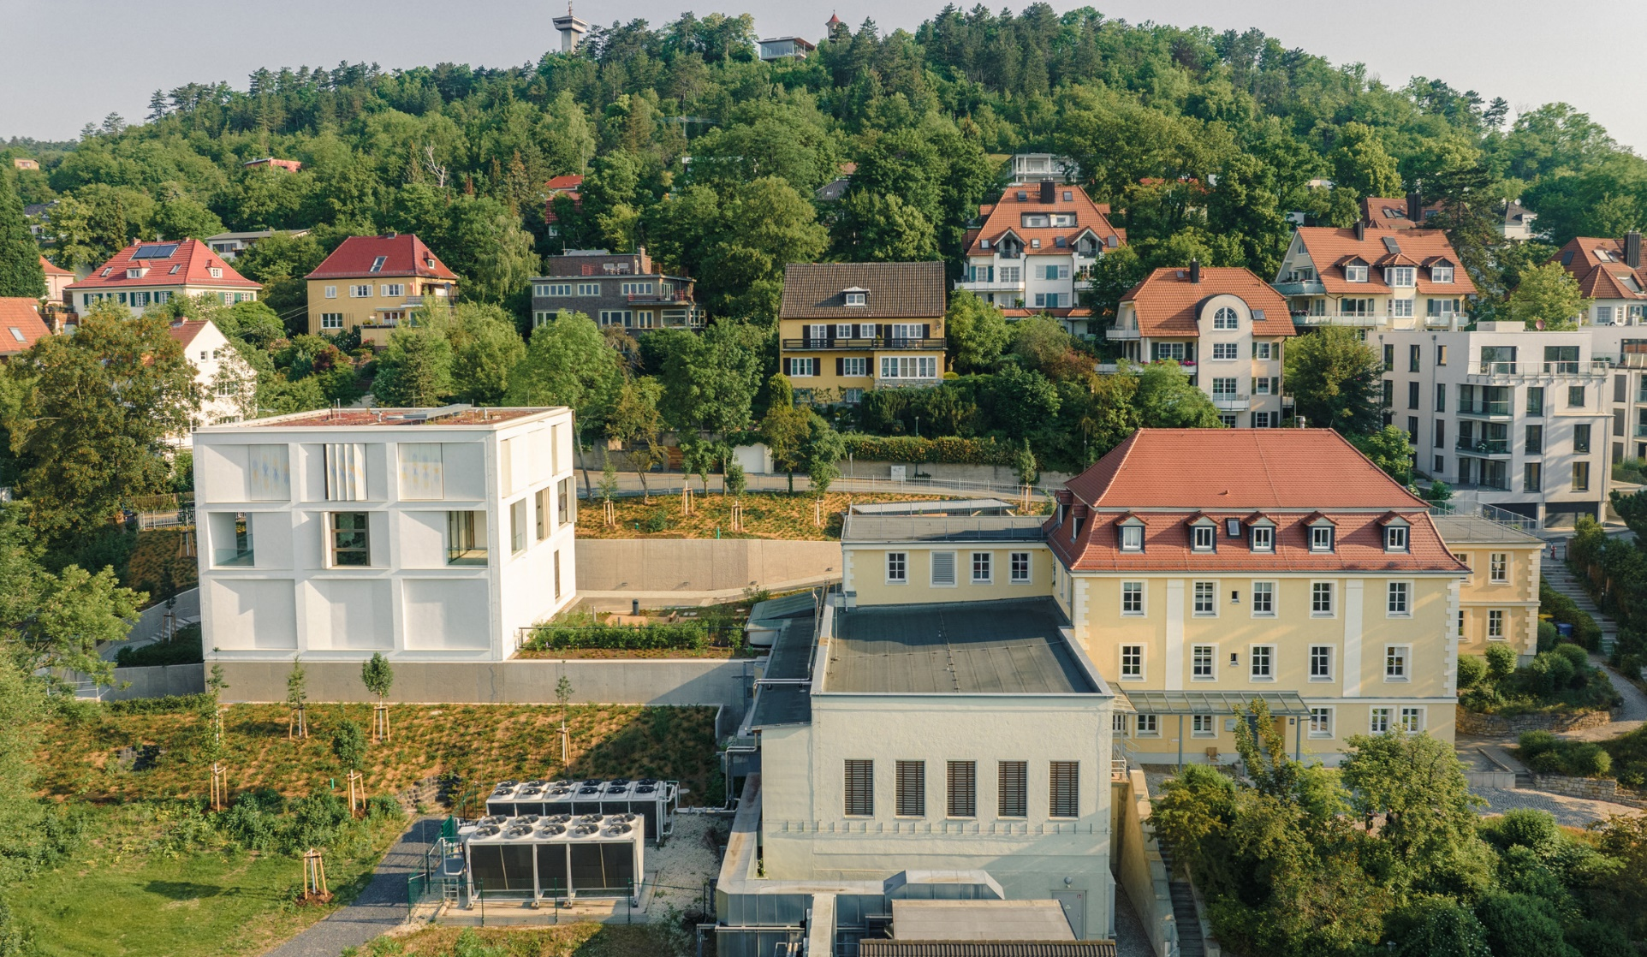
HI Jena extension (2022) & TAF project
Fraunhoferstraße
New 140 m² Target Area Fraunhofer (TAF)

Slide 3

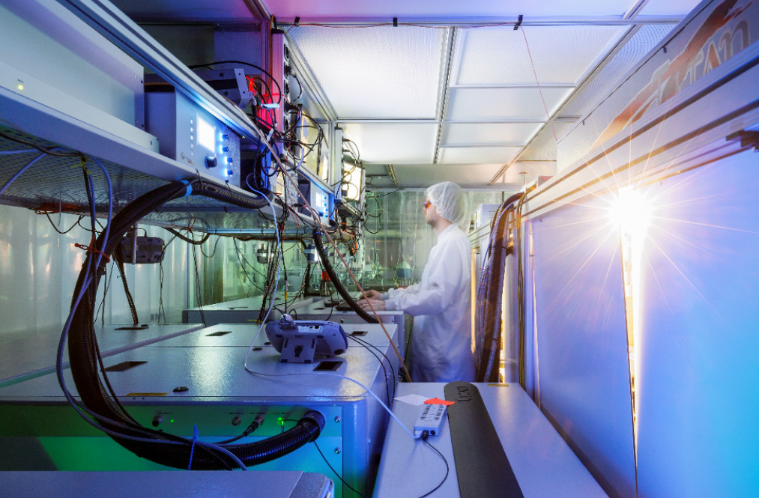
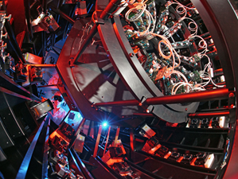
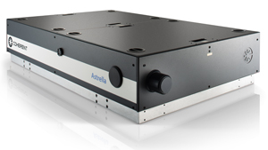
High intensity lasers @ HI Jena
JETi ONE
JETi200
POLARIS
NIR option
Wavelength: 800 nm
Energy: 2 mJ
Pulse duration: 3 fs - 30 fs
SWIR option via OPA + NDFG
Wavelength: 1.1 µm – 7 µm
Energy: 1 mJ – 5 µJ
Pulse duration: few-cycle
Wavelength: 800 nm
Energy on target: 5 J
Pulse duration: 17 fs
Peak power: 300 TW
Short pulse NIR probing system
Wavelength: 750 nm
Energy: 200 µJ
Pulse duration: < 5 fs
Wavelength: 1030 nm
Energy on target: 16 J (54 J)
Pulse duration: 100 fs
Peak power: 160 TW (500 TW)
Short pulse probing system
Wavelength: 800 nm
Energy: 20 µJ
Pulse duration: 11 fs

Slide 4
Major tasks for TAF project
Synchronisation of all beams in space (< 3 µrad (rms)) and time (< 20 fs (rms))
Increase the peak power of POLARIS for novel experiments & applications
Readiness of the laser systems for joined experiments and autonomous control for machine learning to optimize these

Slide 5
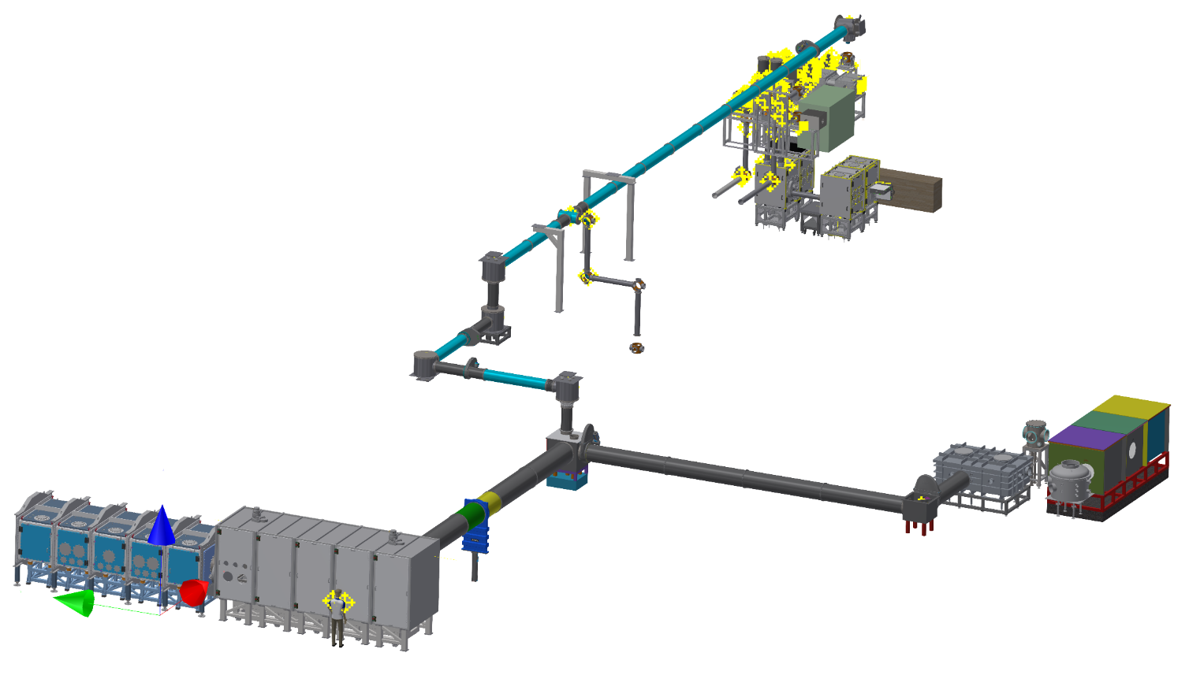
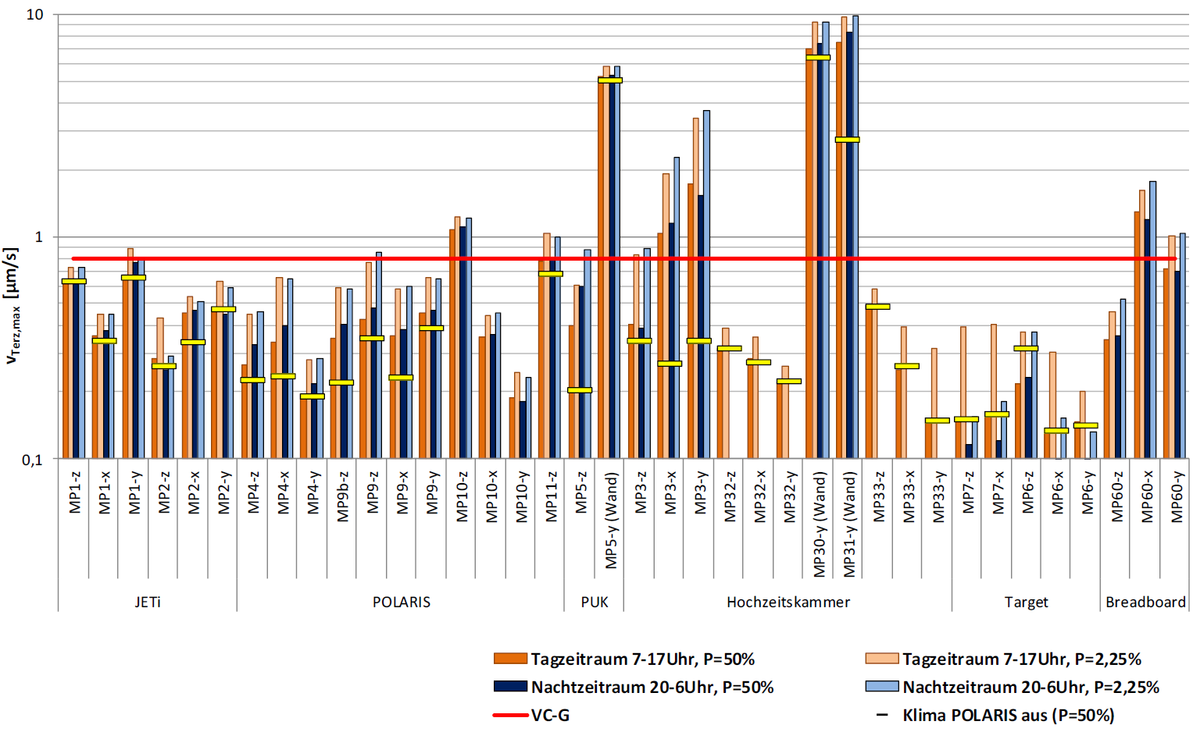
Beam Transport Towers & Frames, stablity analysis
JETi200 & JETiONE
2
TAF layout & beamline
3
1
25 m
4
15 m
POLARIS
1
2
10 m
3
4
VC-G: strongest criteria for REM und TEM with sub-Ångström resolution.
JETi200 Periscope (~ 3m)
JETi200 turning chamber above wedding chamber (~ 3 m)
POLARIS turning chamber (~ 5 m above ground)
Beam shaping chamber (~ 6 m x 2m x 1.5 m)

Slide 6
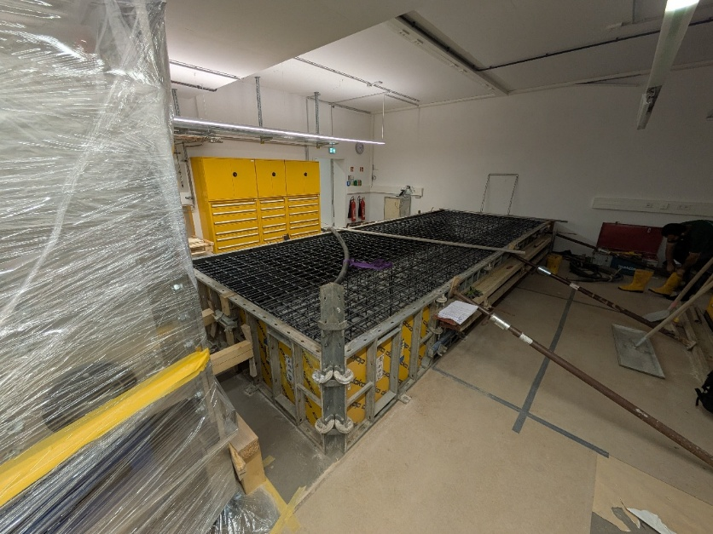
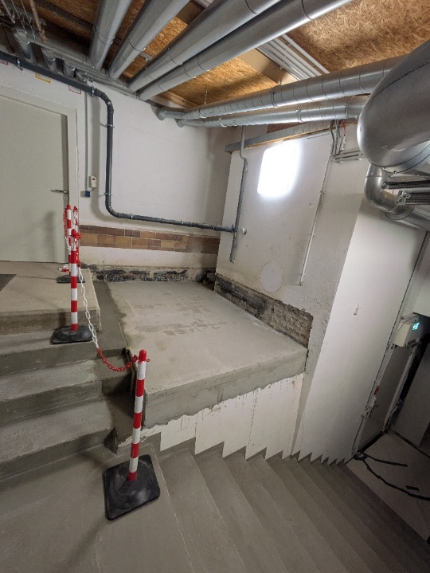
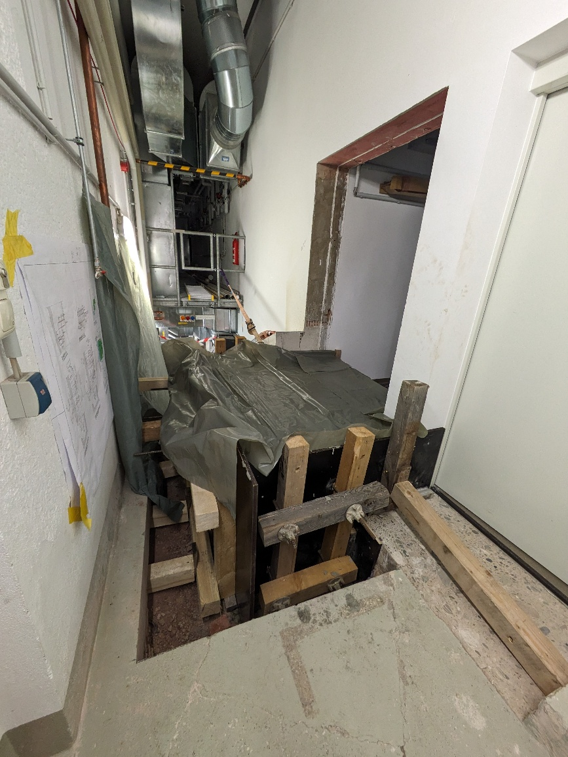
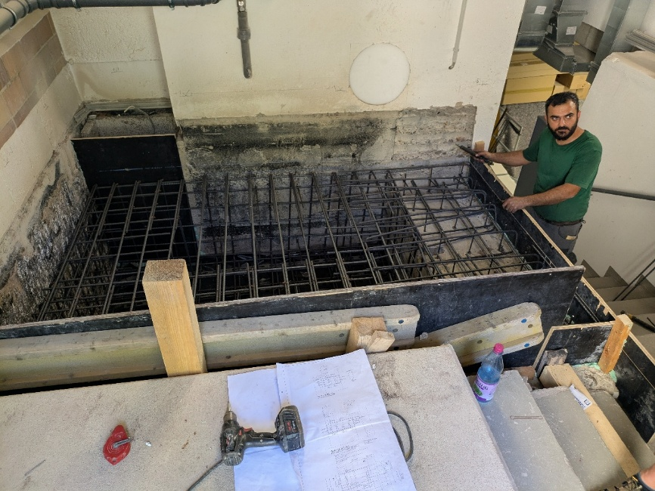
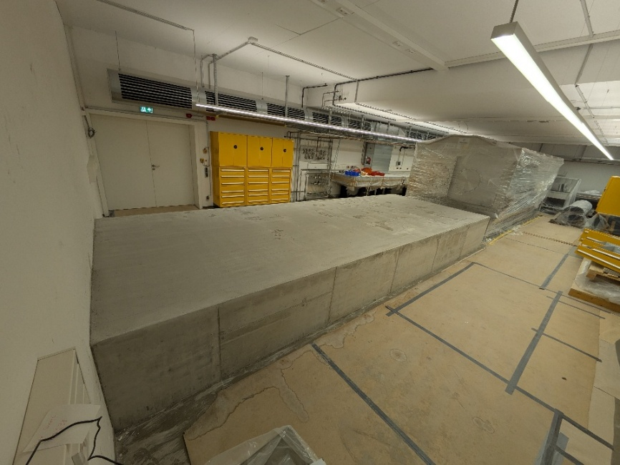
Foundation Work for JETi-Beamline and Beam-Shaping Chamber
JETi200 Periscope
Beam Shaping Chamber
Wedding Chamber

Slide 7
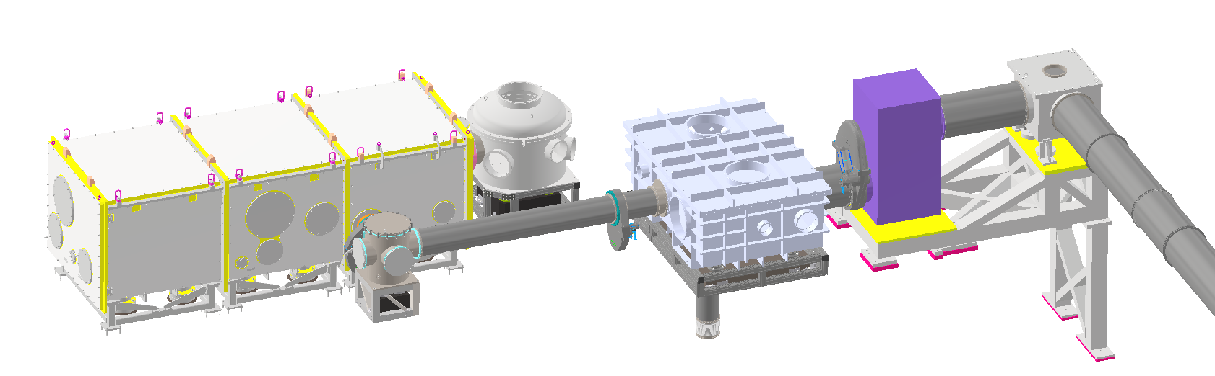
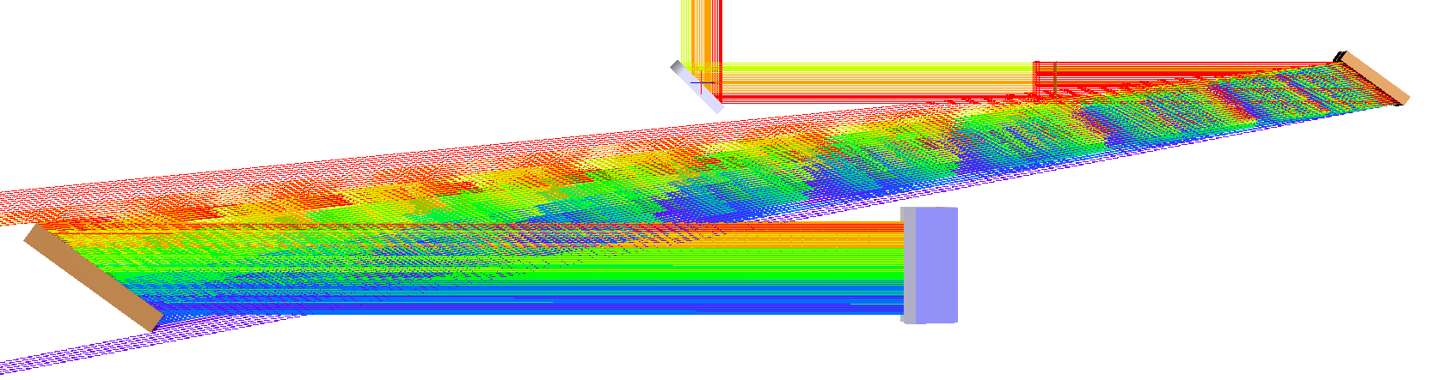
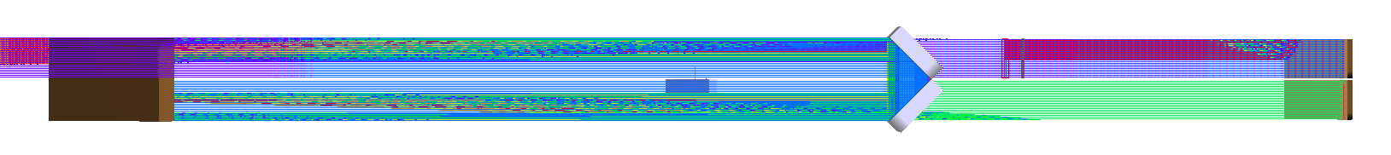
New 54°- AOI Pulse Compressor
Existing (old) chambers
Turning
chamber
Grating compressor
Periscope
6.5 m
Switchyard
TAF
Turning
chamber
Key features
54° AOI, 5.8 m separation length
500 TW peak performance
190 mm circular aperture
Monolithic compressor
MLD design possible
1480 l/mm gold gratings
Optical design:
500 TW peak performance with 190 mm aperture
24.09.2025
7

Slide 8
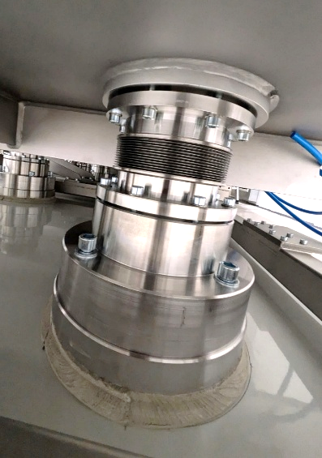
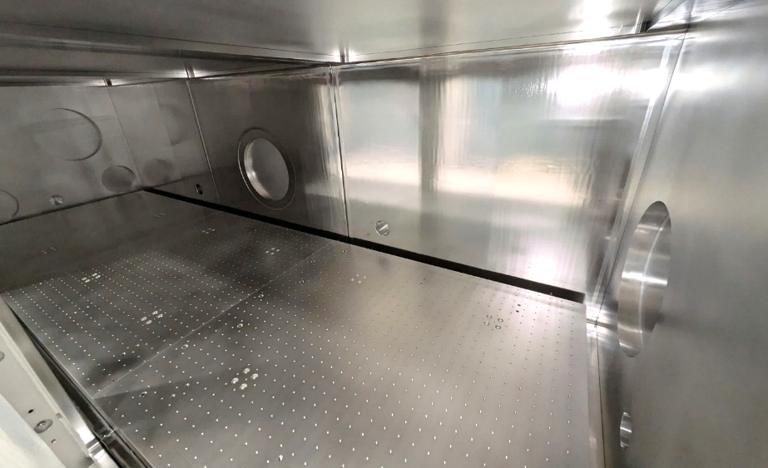
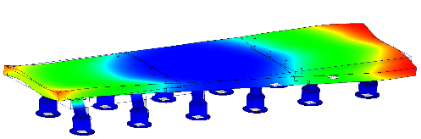
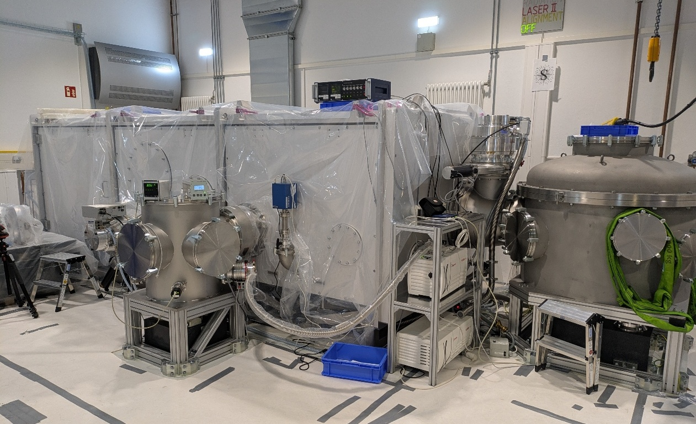

Pulse Compressor Vacuum System
12 x breadboard-base
View into the compression chamber
First eigenfrequency > 200 Hz
P_{end} < 1x10⁻⁷ mbar

Slide 9
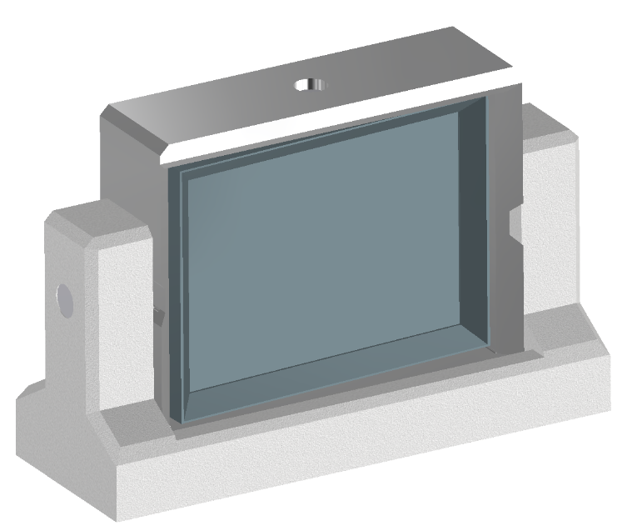
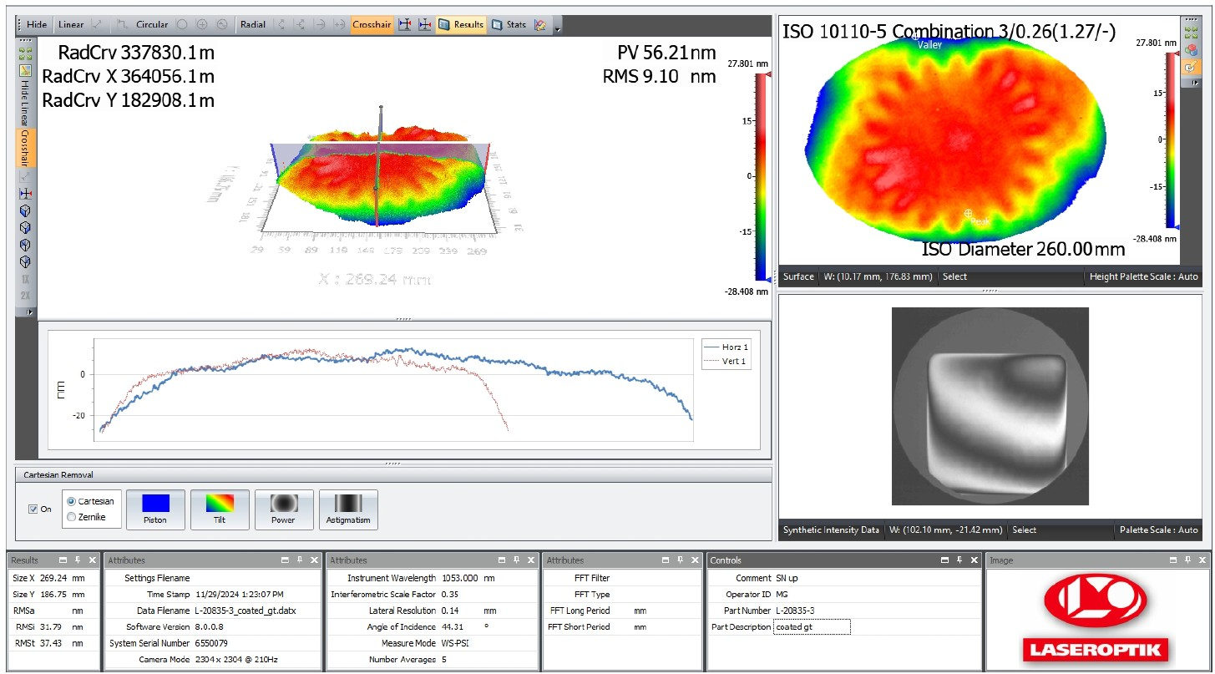
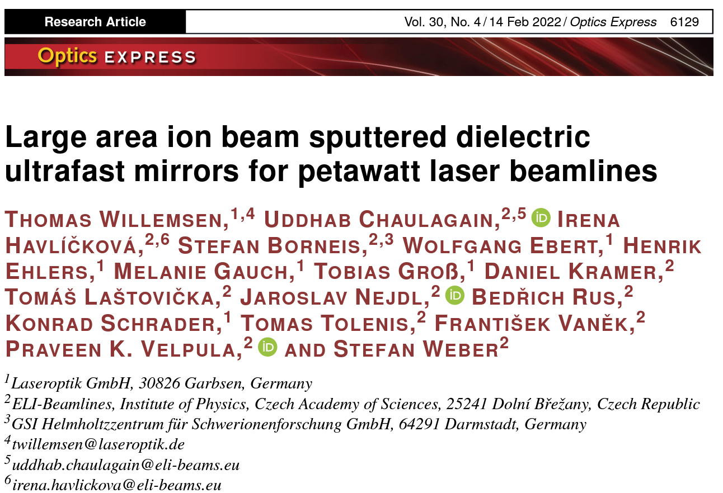

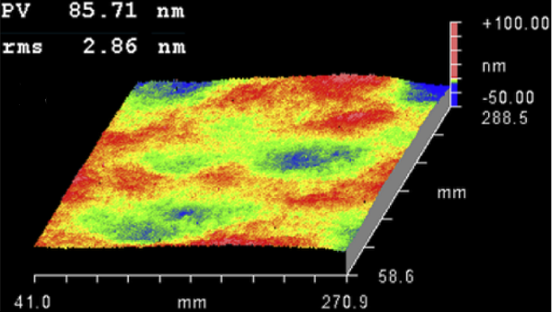
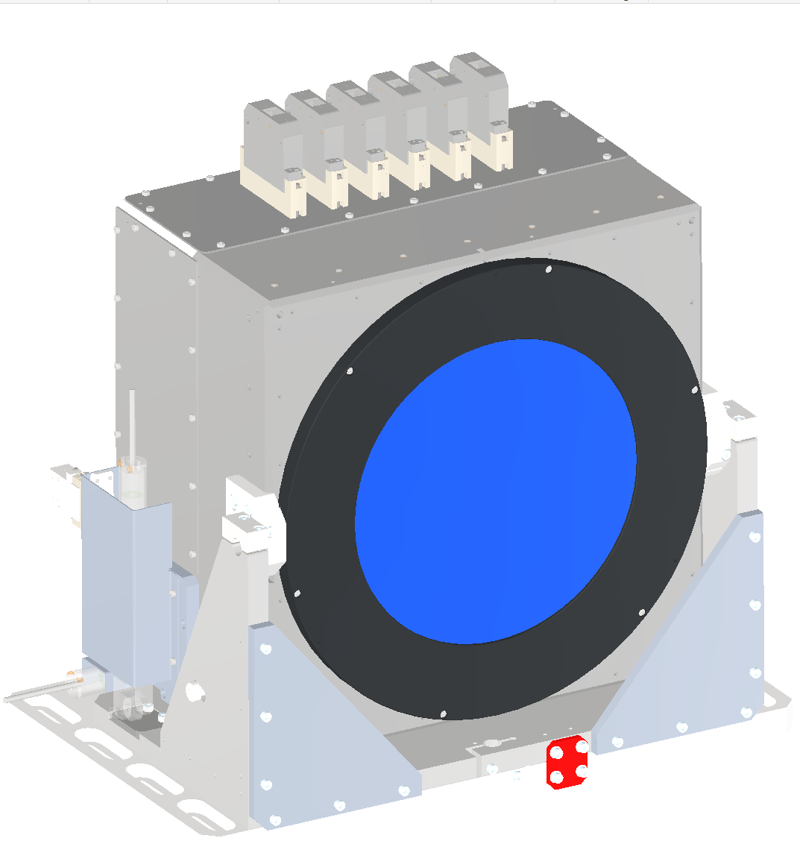
Large Aperture Mirrors, Adaptive Optics and Mounts
2023 FGI 0023
8 large aperture mirrors POLARIS
2 pieces: 440 x 320 x 80 mm³
12 pieces: 320 x 230 x 50 mm³
Surface < λ/10 measured @ 1053 nm
Damage threshold > 1 J/cm² @ 100 fs
6 large aperture mirrors JETi200
6 pieces: 320 x 230 x 50 mm³
Damage threshold > 0.1 J/cm² @ 20 fs
Surface < λ/30 measured @ 800 nm
Ultra-Stable Mirror Mount
Prototype in development
Monolithic basement
Ultra-stable bearing
High-precise Adjustment
+- 3° adjustment range
370 mm
560 mm
Mechanical RMS pointing stability < 50 nrad is envisioned
Deformable mirror systems for JETi200 & POLARIS
170 mm & 220 mm clear aperture
53 actuators
Closed loop with HR WFS
45° single pass reflected wavefront w/o PWR and AST, PV = 86 nm, 3 nm RMS, 230 x 230 mm²

Slide 10
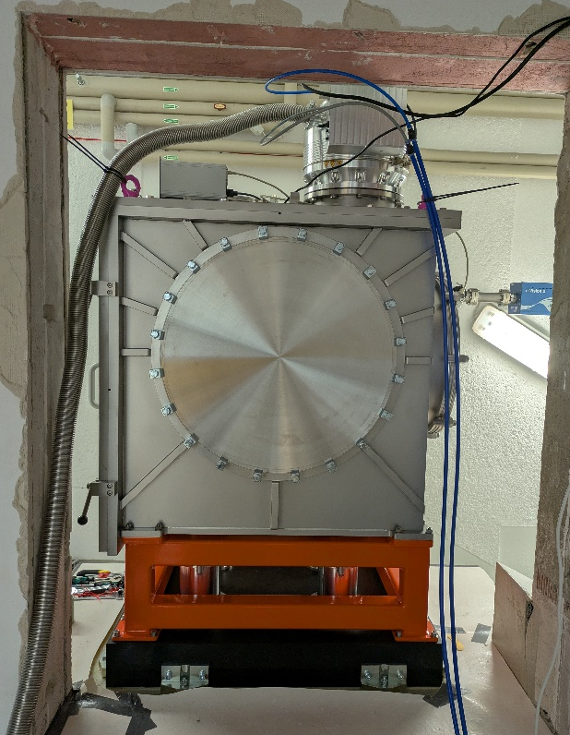
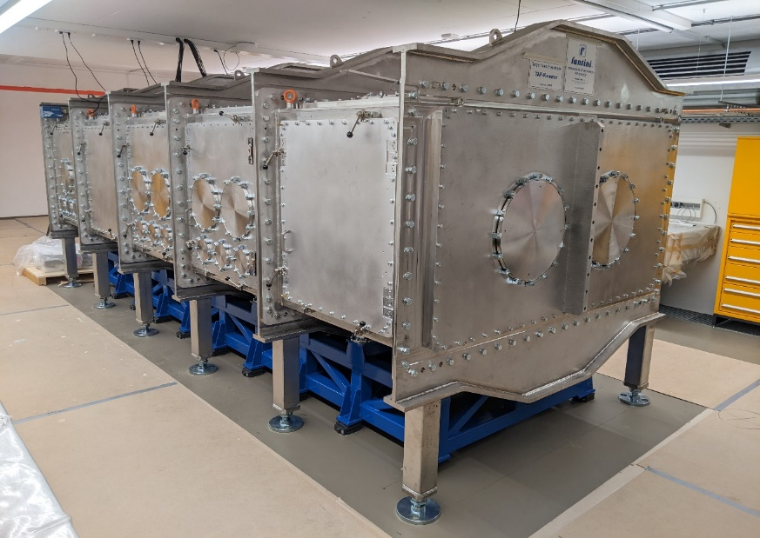

Wedding chamber & TAF experimental chamber
JETi200 & JETiONE
25 m
combining JETI200, JETiONE and POLARIS
6.3 x 2.3 x 1.5 m³
Breadboard: 5.8 x 2.1 x 0.08 m³
1 m free height above breadboard
Decoupled breadboard
POLARIS
15 m
10 m

Slide 11
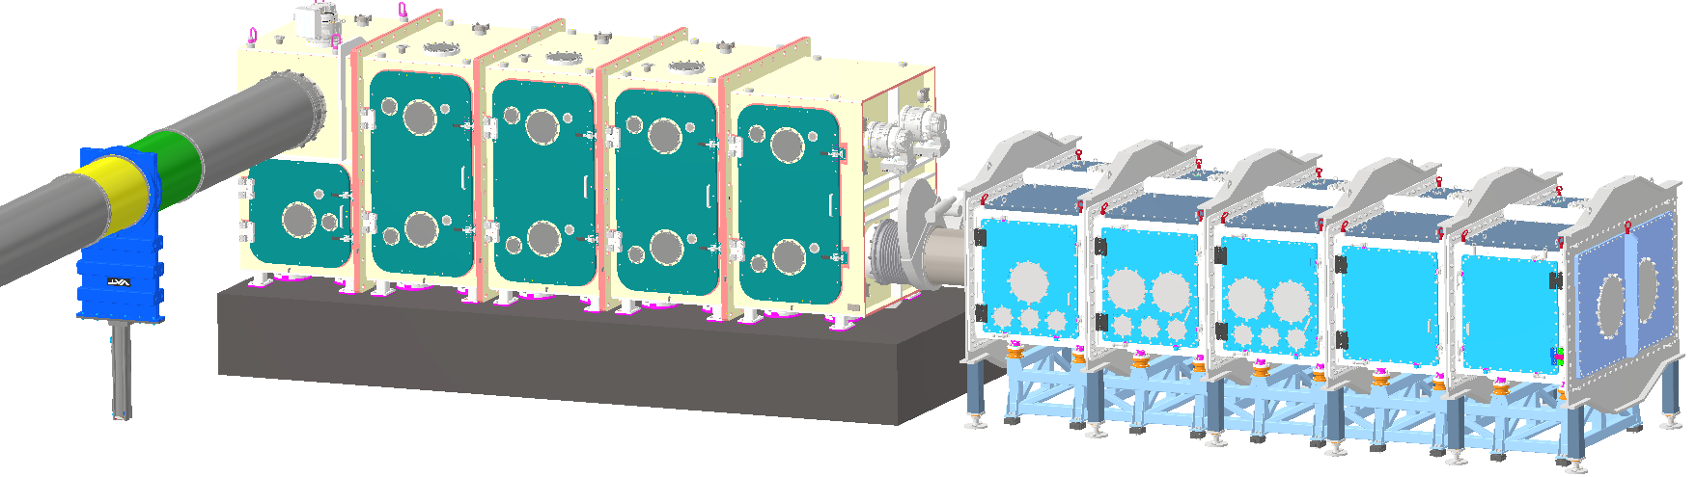
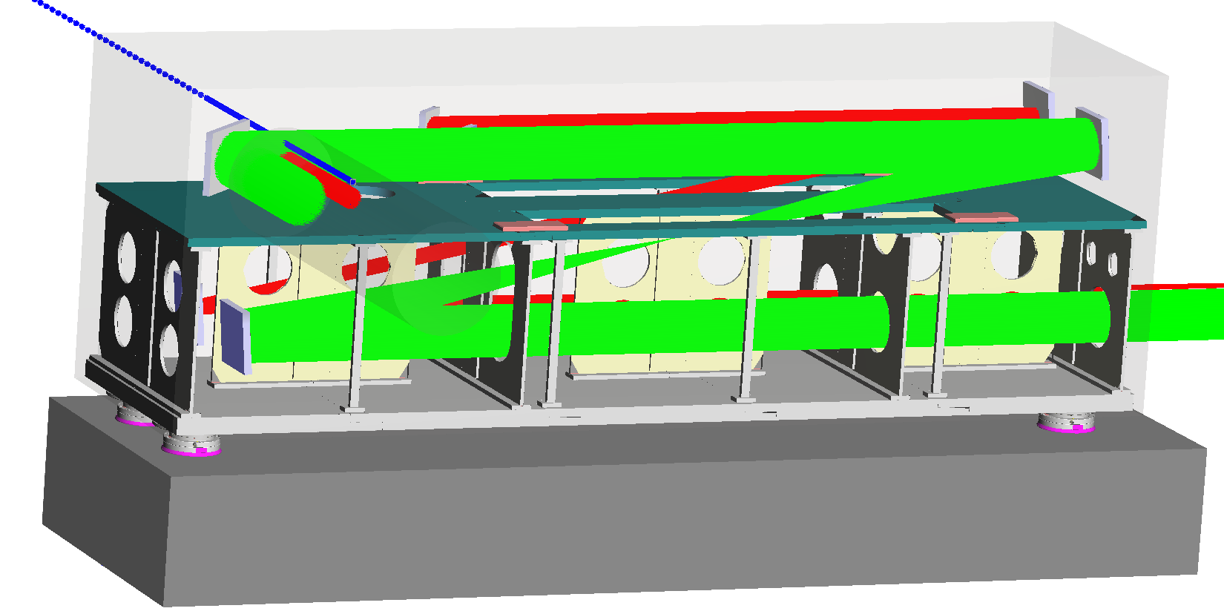
Beam Shaping Chamber – Pulse compression to PW level
Key parameters:
switch yard for POLARIS and JETi200
support for double plasma mirror
long focal length focusing mirror (f = 8 m & f = 17 m)
Pulse compression with gas or solid targets
POLARIS: < 30 fs, JETI200: < 10 fs
delivery in Q4/2025

Slide 12

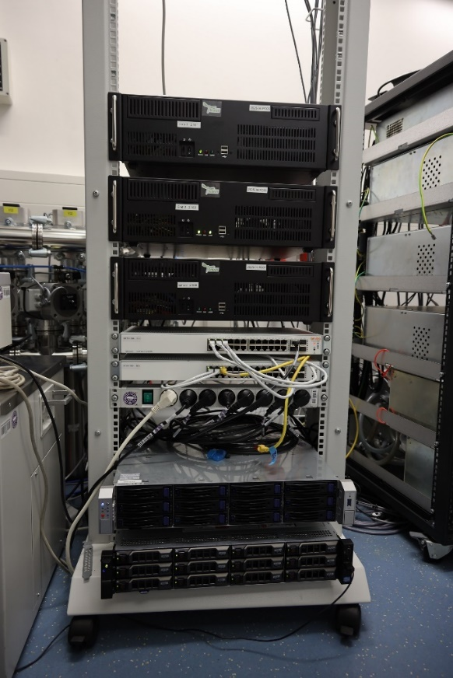
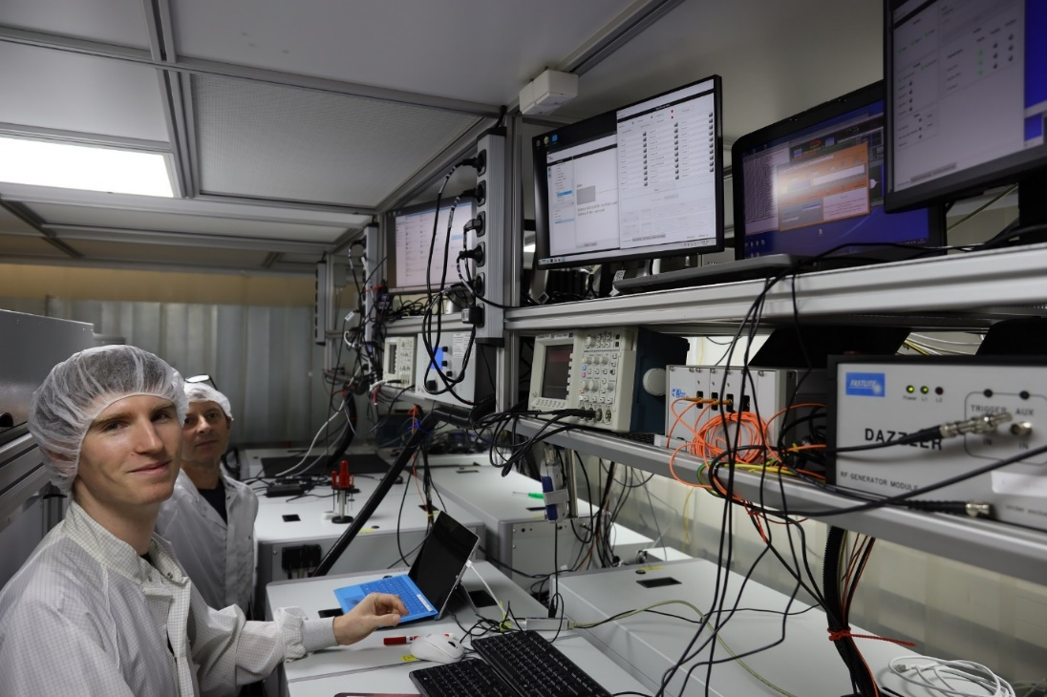


New control systems for JETi200 and POLARIS
old system was installed in 2013 and running since then
active control for optimization experiments requires access to the laser control system
new control system installed in 09/2025
Hardware upgrade
Software update
open source device driver for cameras and gas control systems developed
smaller work packages for our implementation
Vision package for cameras

Slide 13
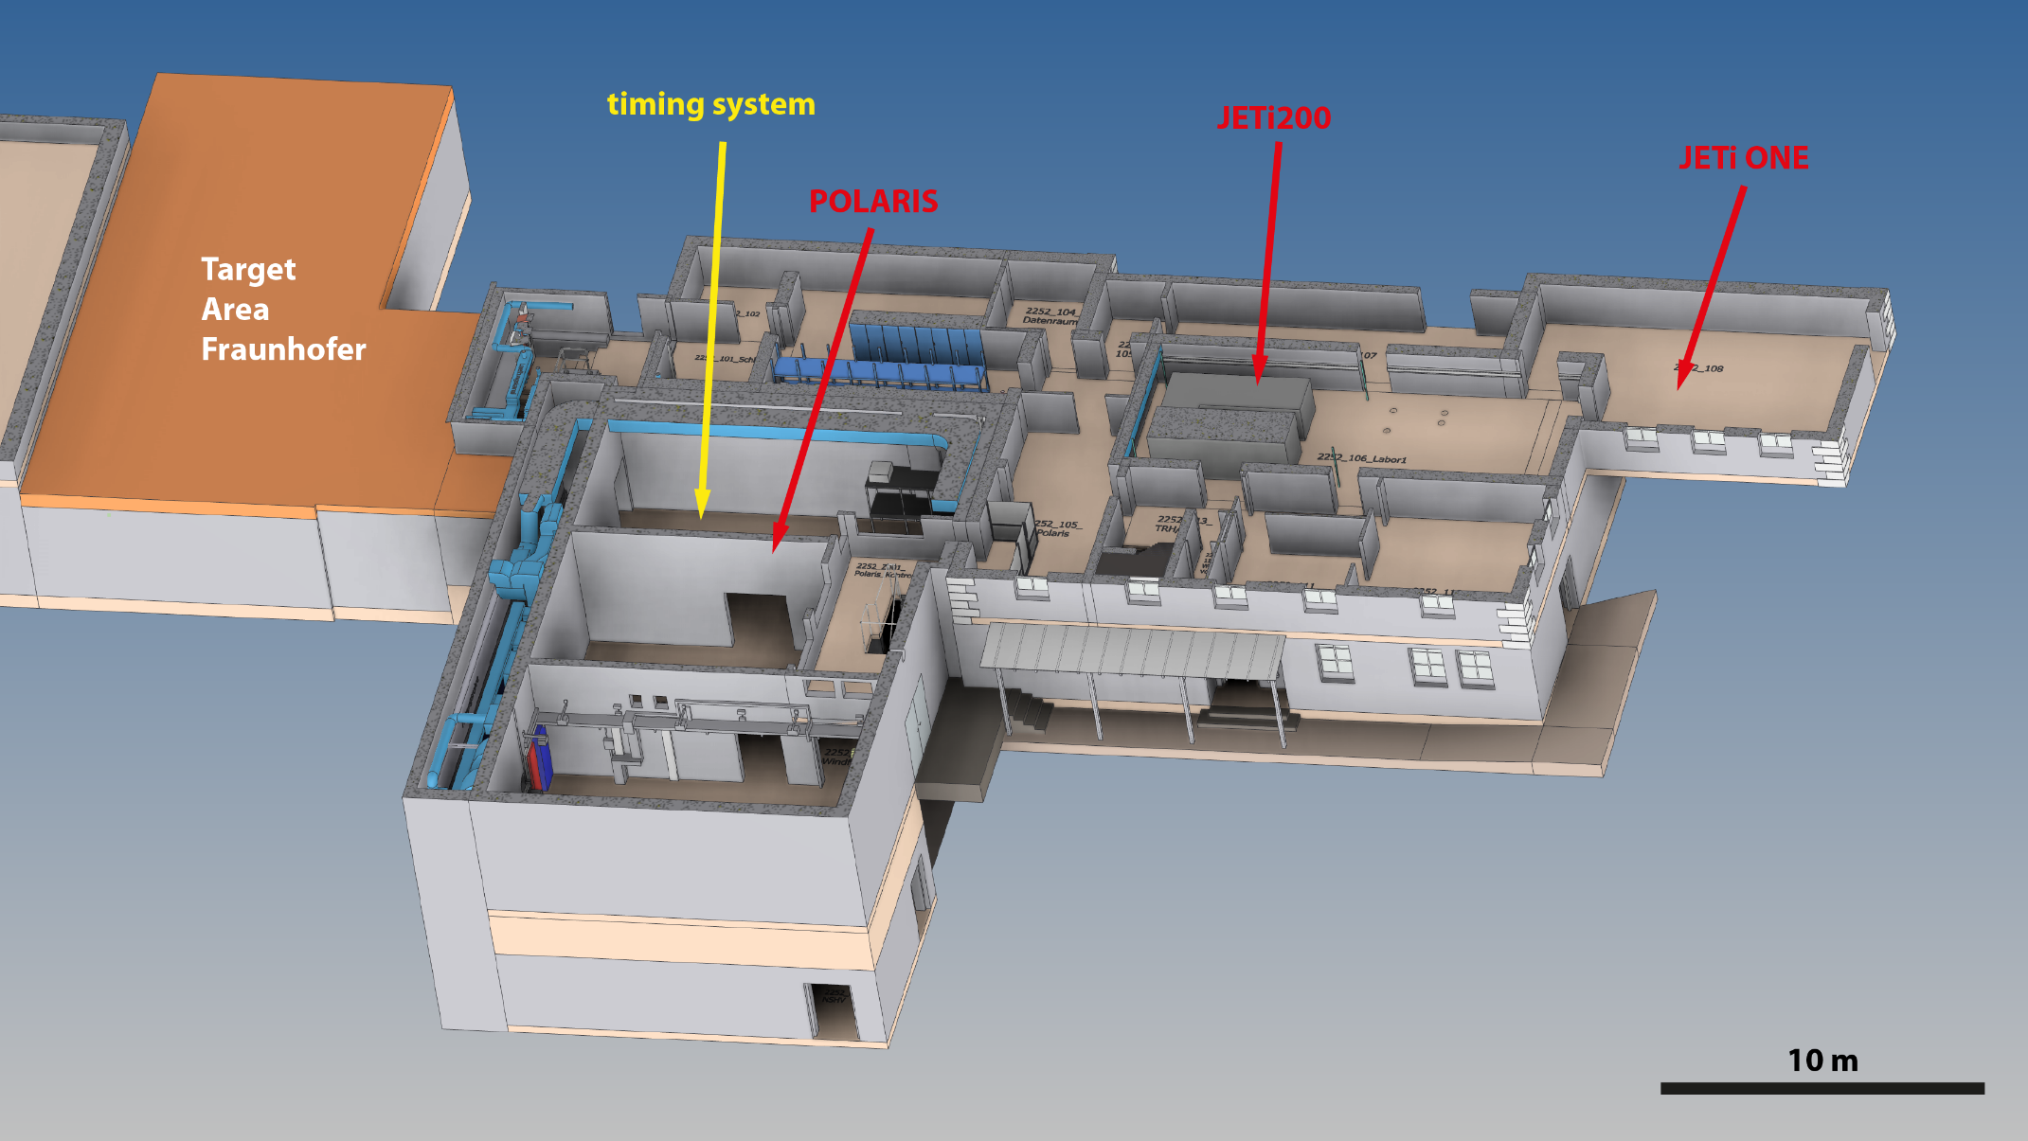
State of the art synchronisation - locations

Slide 14
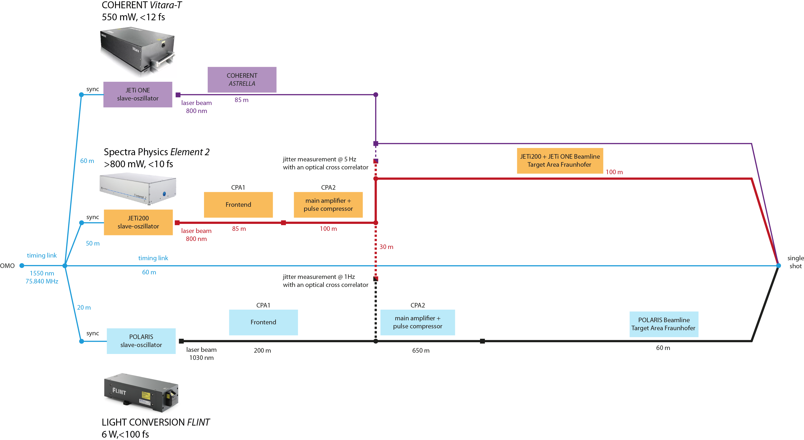

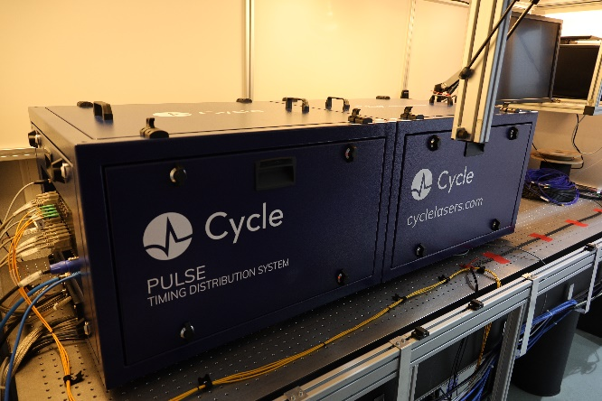
TAF timing system at HI Jena
2022 FGI 0008
2023 FGI 0022
Temperature stabilized platform for low noise optical master oscillator.
OSAT: December 2024

Slide 15
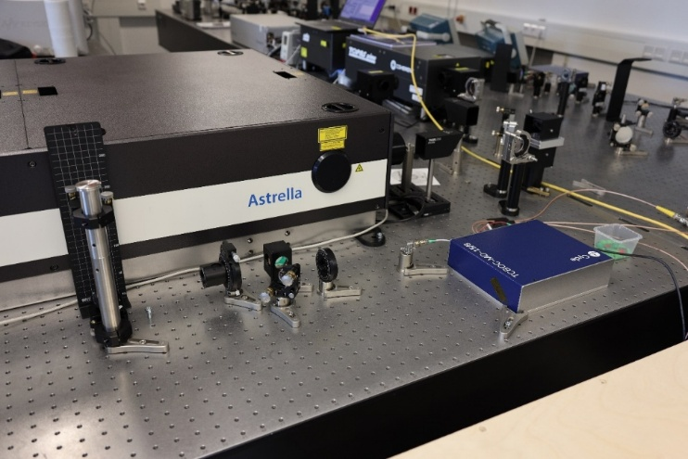
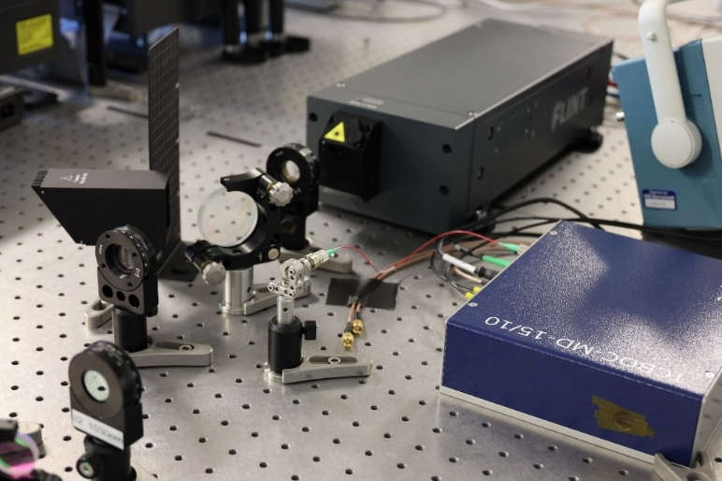
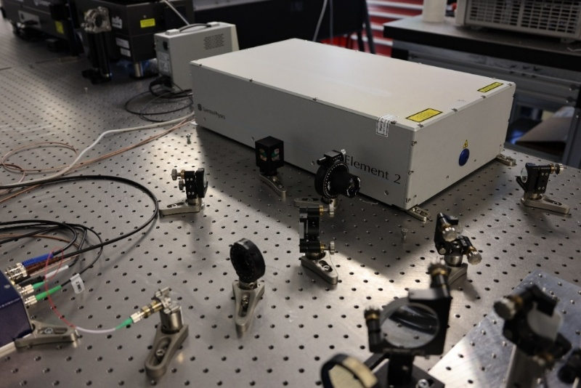
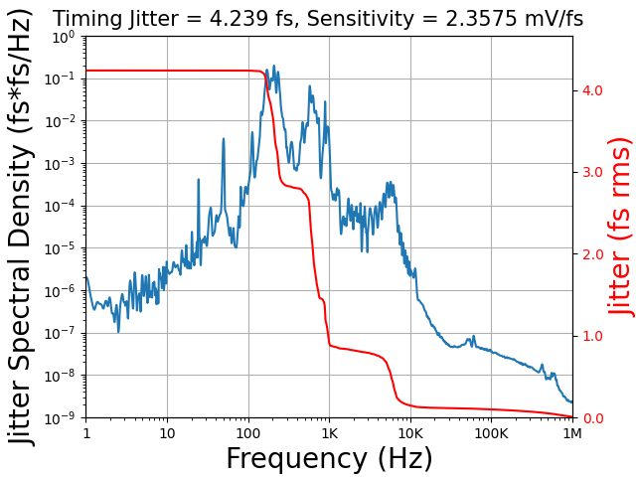
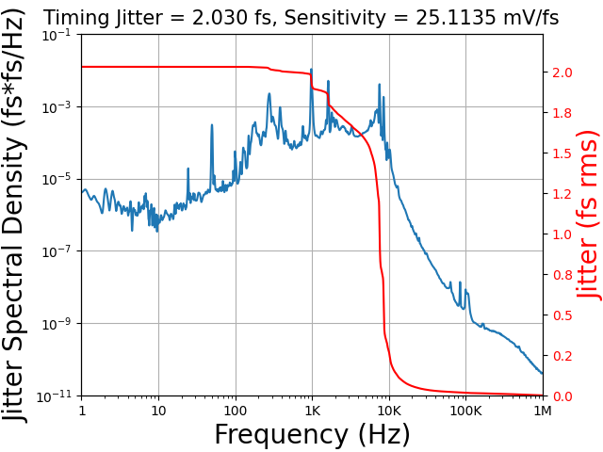
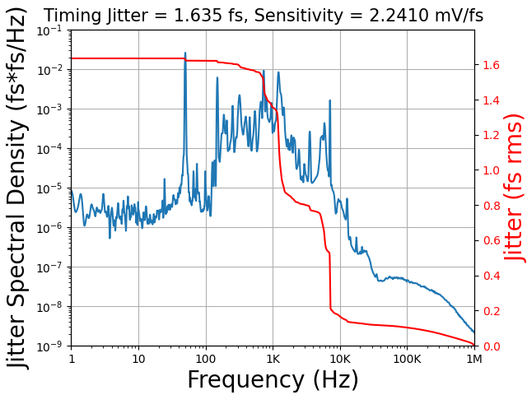
Phase Noise Measurement
JETi ONE (VITARA)
POLARIS (FLINT)
JETi200 (ELEMENT 2)
rms jitter = 4.2 fs
rms jitter = 2.0 fs
rms jitter = 1.6 fs

Slide 16
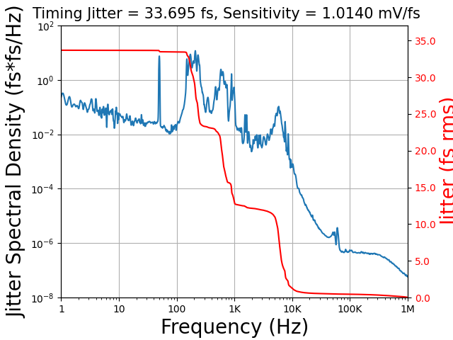
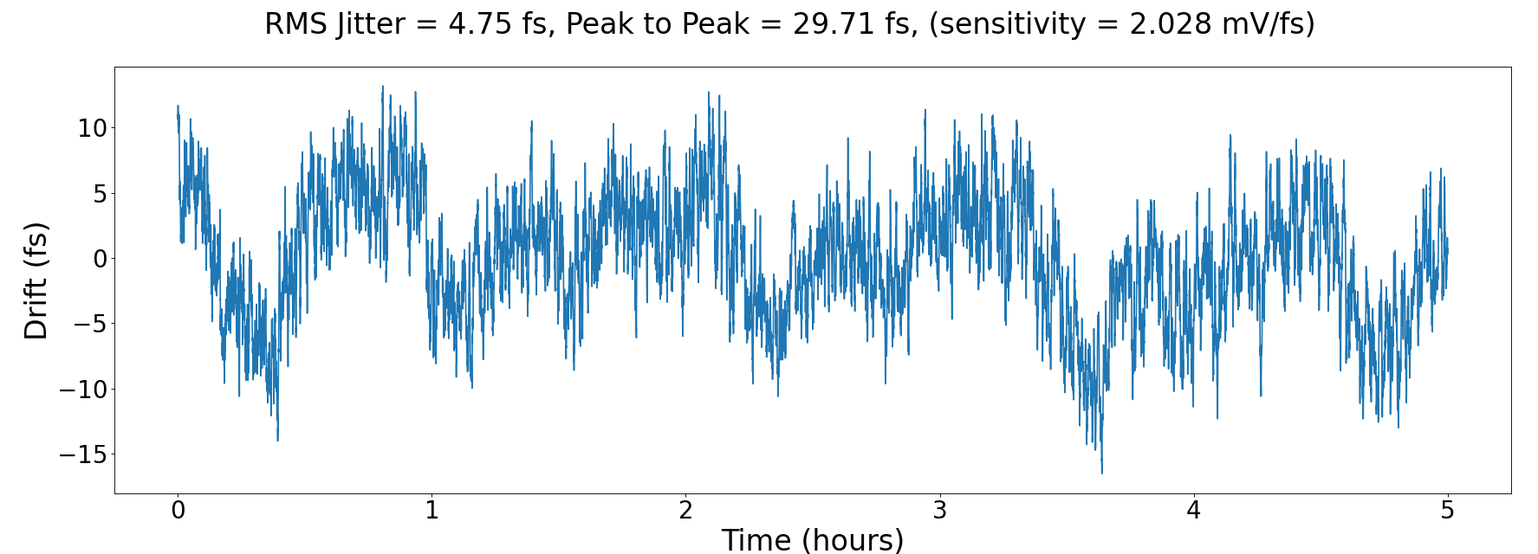
Jitter measurement (Out-Of-Loop) FLINT-Vitara
Timing drift: 4.8 fs rms (5 hours)
Total integrated jitter (1 MHz – 60 µHz): 34 fs (rms)

Slide 17
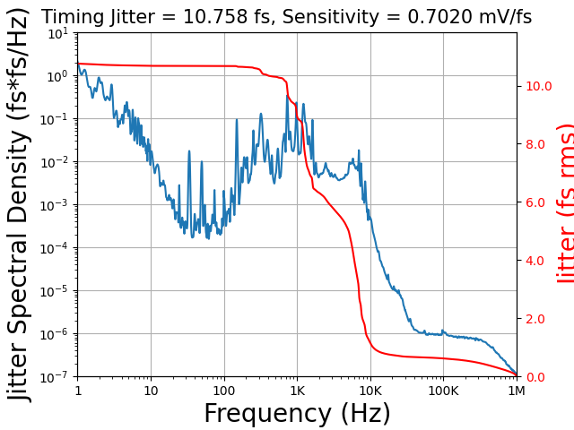
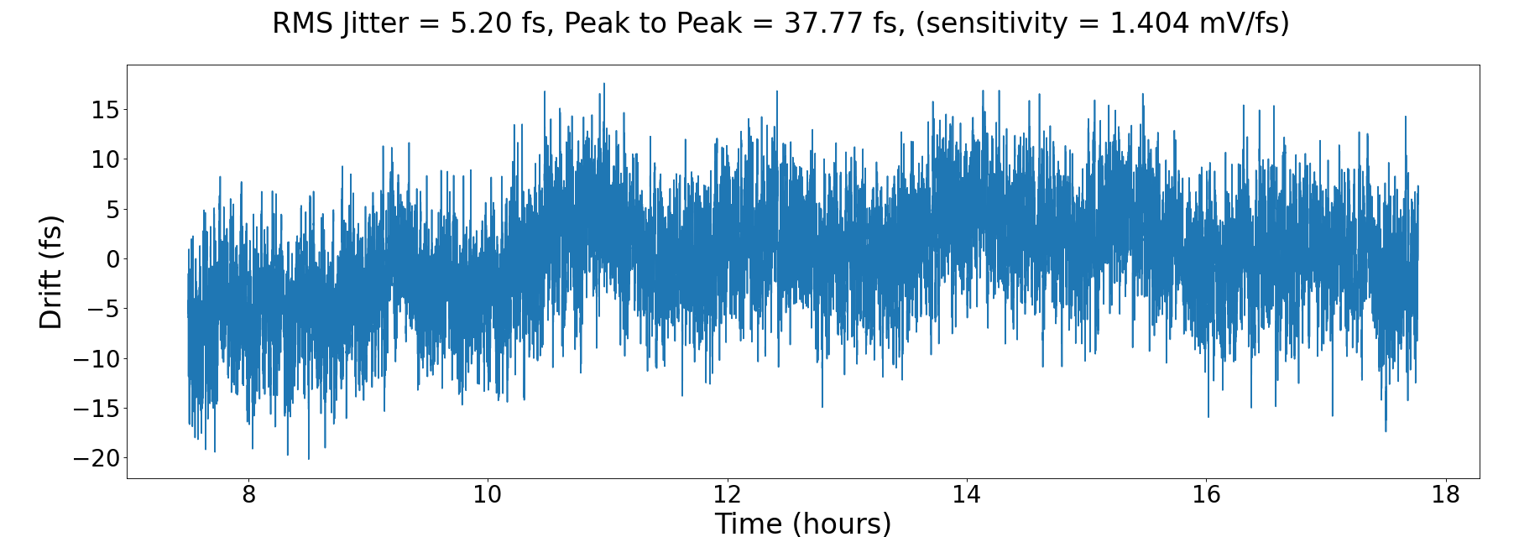
Jitter measurement (Out-Of-Loop) FLINT-Element2
Timing drift: 5.2 fs rms (10 hours)
Total integrated jitter (1 MHz – 30 µHz): 12 fs (rms)

Slide 18
Conclusion and Outlook for 2026
Major vacuum chambers are installed.
Timing system performing quite well .
Bringing POLARIS back online
Finish vacuum installation in TAF (pumps, …)
Manufacturing of optomechanics
Post-compression schemes for few-cycle pulse generation
First experiments in 2027

Slide 19

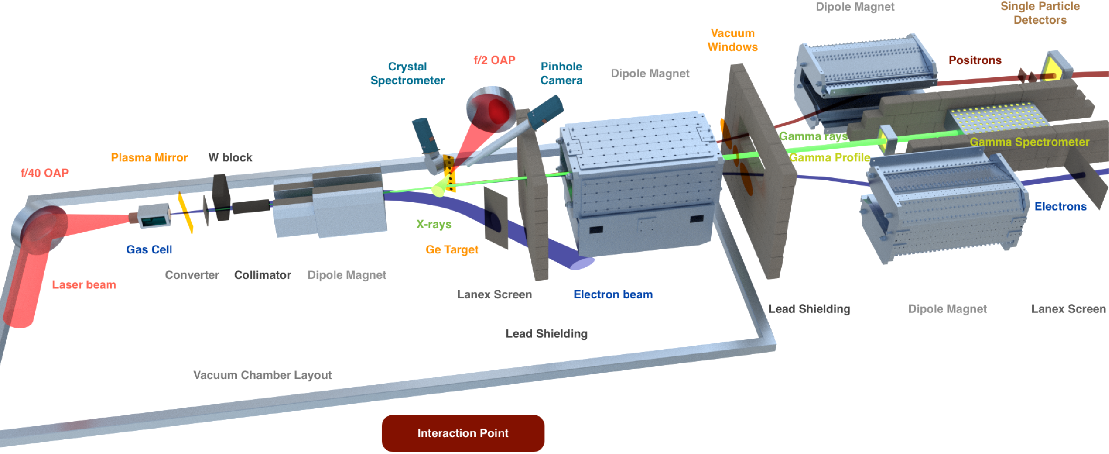
First flagship experiments @ TAF (2027 and beyond)
Linear/non-linear Breit-Wheeler experiments
Light by light scattering
Radiation Reaction
JETi200
JETi ONE
Dissertation D. Hollatz
Few-cycle option for probing from 800 nm up to 7 µm wavelength.
Temporal (~10s fs) and spatial overlap (< 3 µrad) crucial.

Slide 20








Acknowledgements
A. Winnefeld
M. Ostermann
T. Köhler
H. Wöhl
D. Hieronymous
F. Schorcht
M. Hornung
A. Sävert,
D. Hollatz
P. Hilz
M. Hellwing
G. A. Becker
M. B. Schwab
Y. Azamoum
A. Kessler
J. Hein
M. C. Kaluza
M. Zepf
T. Stöhlker
S. Hundack
A. Hahn
D. Marx
R. Pattathil
D. Symes
A. Stallwood
S. Borneis
20

