Slide 1
High Gradient Electron Injector for external injection for AWAKE Run 2C
Introduction to AWAKE Run 2C
New electron injector and high-power RF systems
High gradient developments
Outlook
EAAC2025, ELBA, Italy, September 21st-27th
Steffen Doebert, CERN

Slide 2
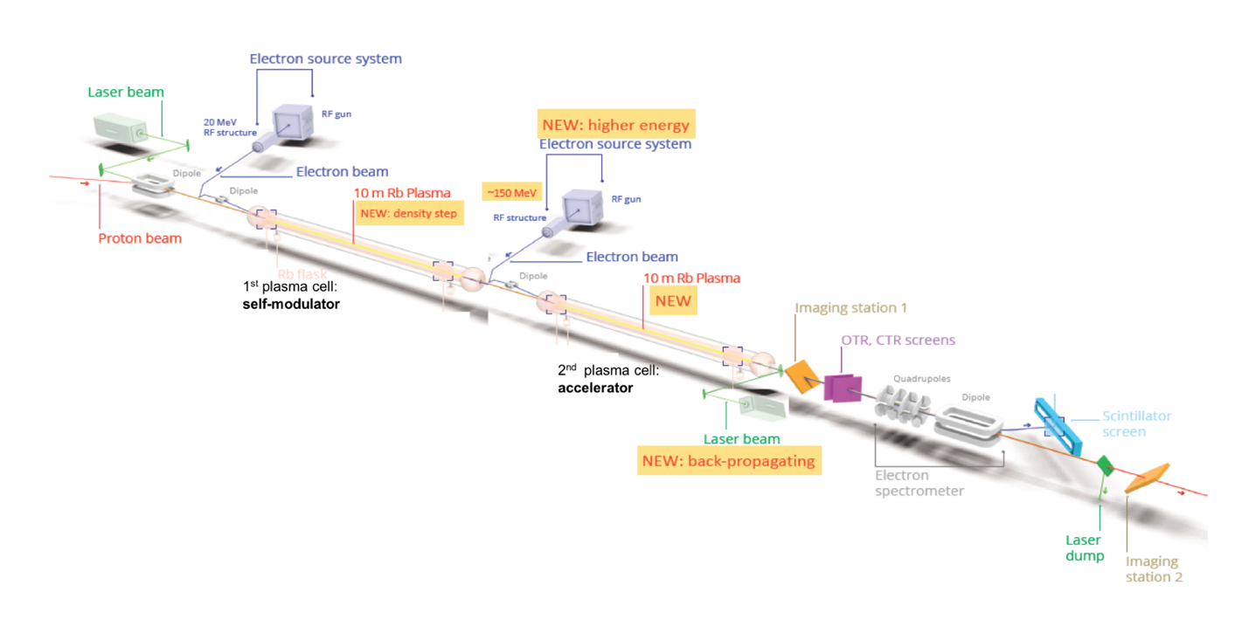
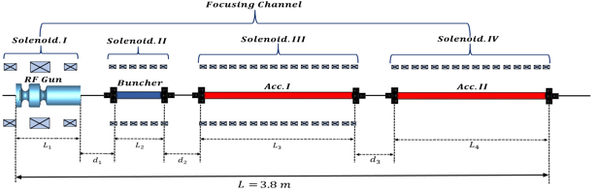
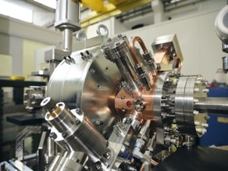
AWAKE Run 2, from acceleration to accelerator
Demonstrate possibility to use AWAKE scheme for high energy physics applications in mid-term future!
Start 2021! Staged program for ~ 10 years
  Need to work in blow-out regime and do beam-loading
  New electron beam based on x-band:
  150 MeV, 200 fs, 100 pC, σ = 5.75 µm
Goals:
Accelerate an electron beam to high energy (gradient of 0.5-1GV/m)
Preserve electron beam quality as well as possible (emittance preservation at 10 mm mrad level)
Demonstrate scalable plasma source technology (e.g. helicon prototype)

Slide 3
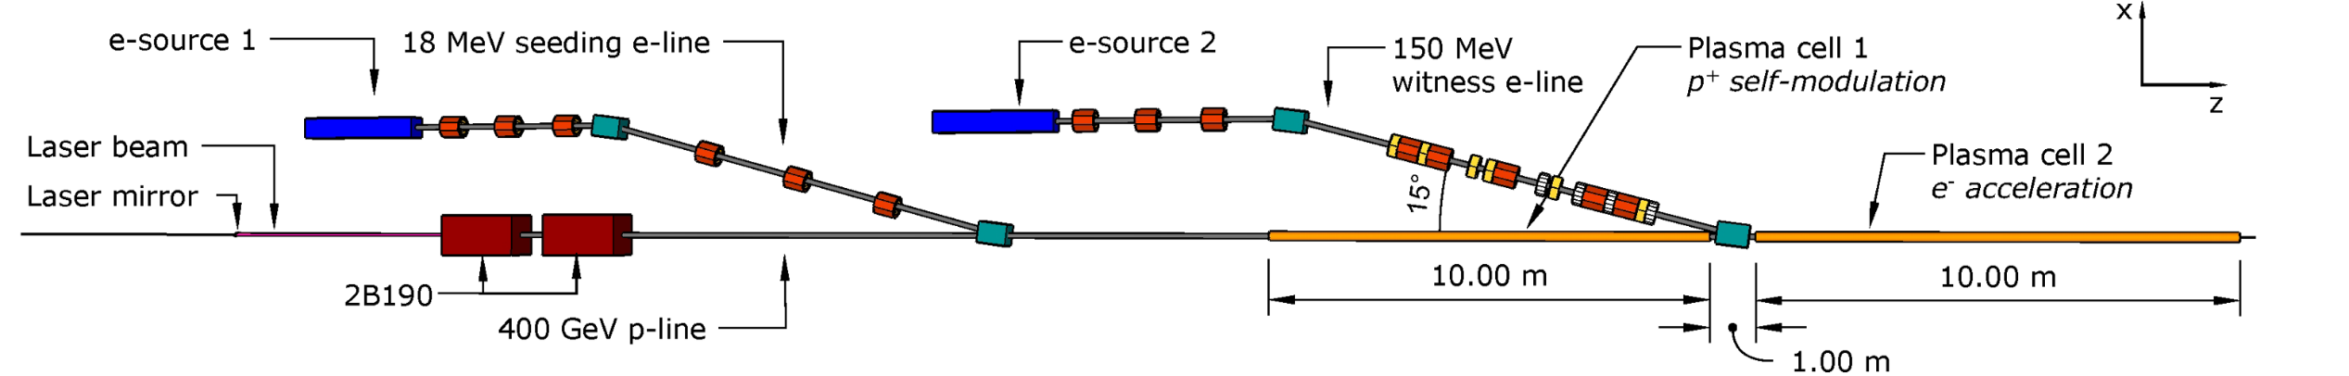
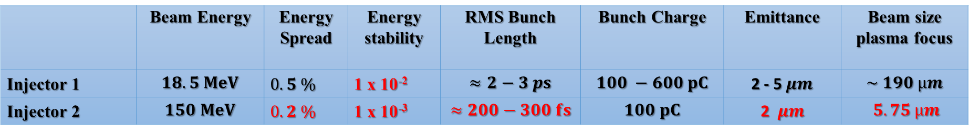
Run 2C, parameters for both injectors
 | Beam Energy | Energy Spread | Energy stability | RMS Bunch Length | Bunch Charge | Emittance | Beam size plasma focus
Injector 1 | $$18.5 MeV$$ | $0.5 \%$ | 1 x 10⁻² | $$≈2−3 ps$$ | $$100 −600 pC$$ | 2 - 5$μm$ | $$\sim 190 µm$$
Injector 2 | $$150 MeV$$ | $0.2 \%$ | 1 x 10⁻³ | $$≈200−300 fs$$ | $$100 pC$$ | 2 $μm$ | $$5.75 µm$$
Flexibility in the beam parameters which can be delivered keeping good energy spread and emittance
Energy: +- 10%, Charge: up to 400 pC, Bunch length: 0.2-1 ps, beam size
Constraint space for hardware
Excellent timing stability and synchronisation with laser and self-modulation device; ~ 30 fs stability

Slide 4

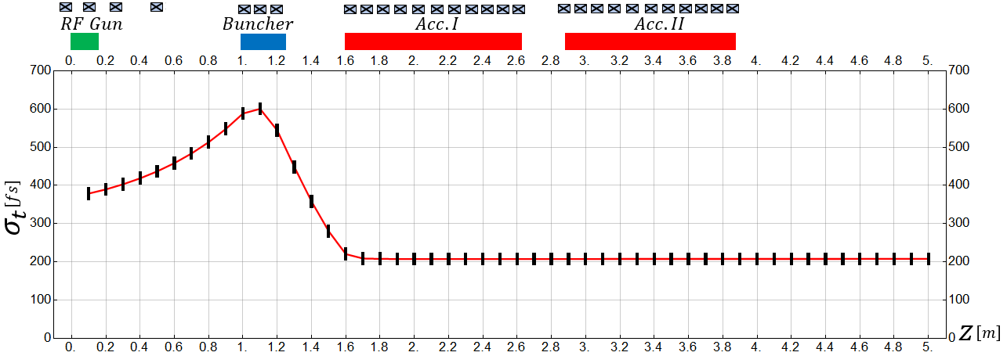
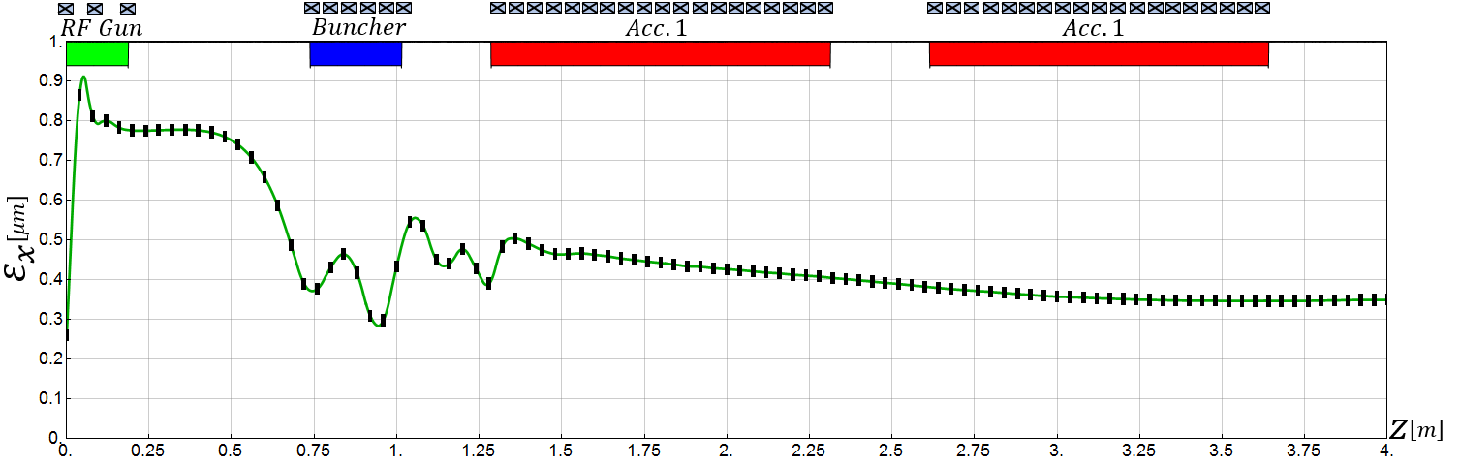
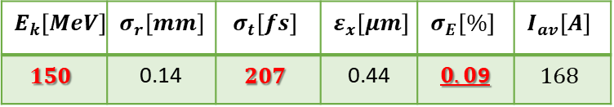
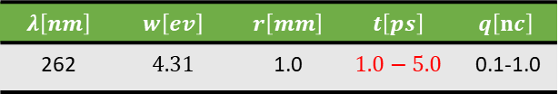
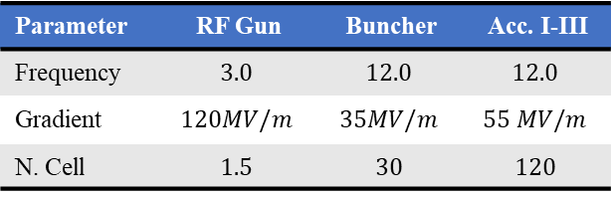
150 MeV injector – beam dynamics design
Very compact electron injector
Simulated parameters within specifications
$$E_{k}\left[MeV\right]$$ | $$σ_{r}\left[mm\right]$$ | $$σ_{t}\left[fs\right]$$ | $$ε_{x}\left[μm\right]$$ | $$σ_{E}\left[\%\right]$$ | $$I_{av}\left[A\right]$$
$$150$$ | 0.14 | $$207$$ | 0.44 | $0.0$9 | $$168$$
Length ~ 5 m
Laser parameters
$$λ\left[nm\right]$$ | $$w\left[ev\right]$$ | $$r\left[mm\right]$$ | $$t\left[ps\right]$$ | $$q\left[nc\right]$$
262 | $$4.31$$ | 1.0 | $$1.0−5.0$$ | 0.1-1.0
RF parameters
Parameter | RF Gun | Buncher | Acc. I-III
Frequency | $$3.0$$ | $$12.0$$ | $$12.0$$
Gradient | $$120MV/m$$ | $$35MV/m$$ | $$55 MV/m$$
N. Cell | $$1.5$$ | $$30$$ | $$120$$

Slide 5
S-Band RF System Layout
S-band, 45 MW
We will use a single high-power klystron to power all 3 GHz cavities
less waveguides
same rf source and timing jitter
easier to maintain
coupling of the operation of the two injectors
circulator
A
ϕ
ϕ
15 MW, SW, 120 MV/m
10 MW, SW,
100 MV/m
10 MW, TW, 18 MV/m
~ 20 m difference for injection points = 67 ns

Slide 6
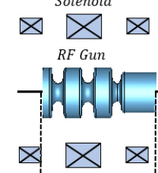

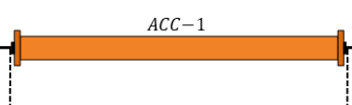
150 MeV injector – X-band RF layout
25 MW, x-band
50 MW, x-band
ϕ
15 MW, S-band
A, ϕ
PC, 120-130 MW
PC, 90 MW
Long waveguides 40-50 m
Round or double height WG needed
Solenoid
Solenoid
X
X
X
X
X
X
X
X
X
X
X
X
X
X
3 structures at 55 MV/m
This solution gives a bit more margin in 12 GHz power and makes optimal use of contributed equipment from CLIC (cost savings)

Slide 7
Electron Source Integration status
Quite challenging integration due to space constraints and equipment density in the area

Slide 8
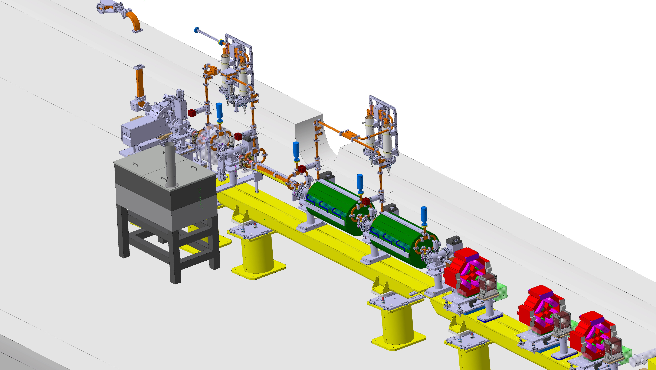
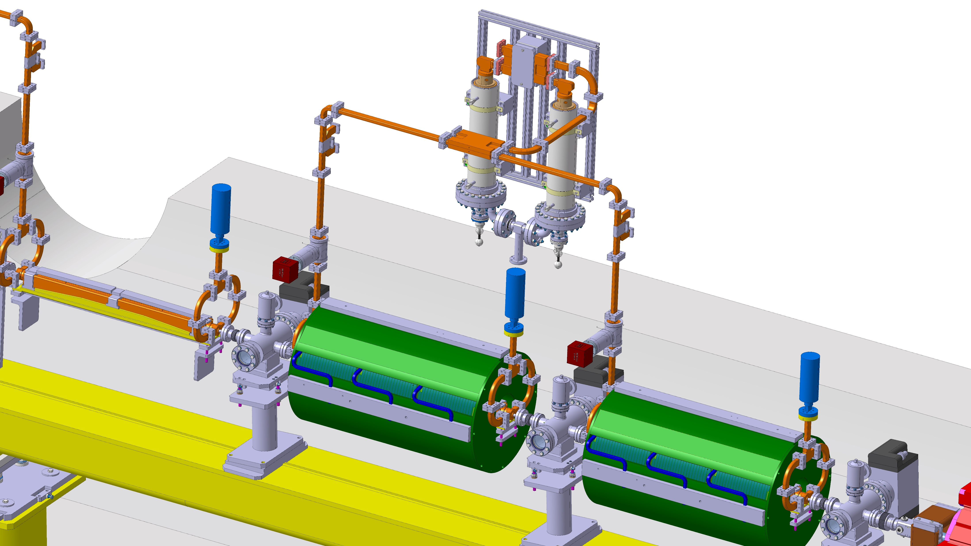
Current 3D model of Injector 2

Slide 9
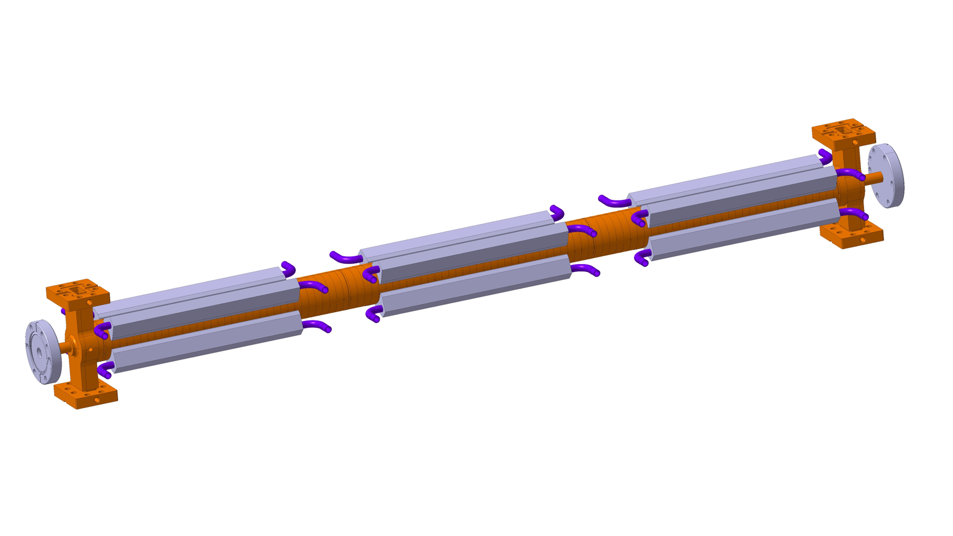
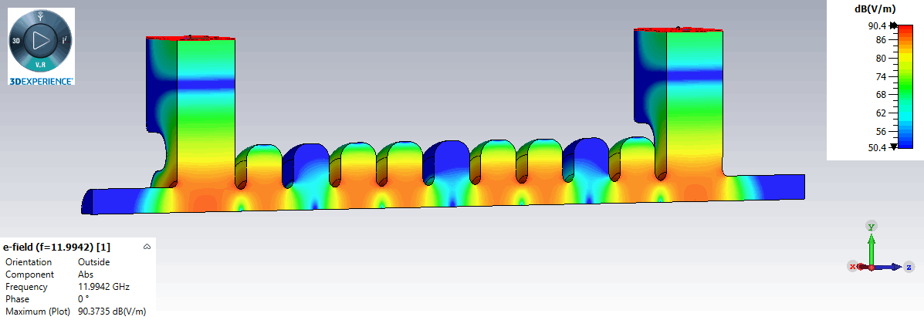
X-band structure developments
Travelling wave Constant Impedance
Shunt Impedance [MΩ/m] | 100
Group Velocity vg/c [%] | 2.4
Q-Factor | 7061
Attenuation [1/m] | 0.7
Length [m] | 0.9
Mechanical design made at CERN
CLIC style tolerances
Vacuum brazing design
Structure to be inserted in a solenoid of 150 mm diameter bore radius
Buncher structure has 30 cells and the accelerator 105 regular cells
Designed by INFN Frascati, D. Alesini, M. Diomede,
for CompactLight and EuPraxia

Slide 10
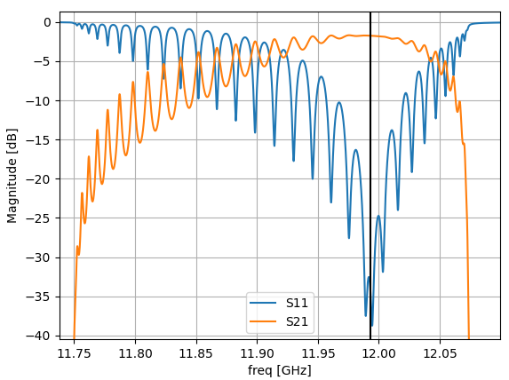
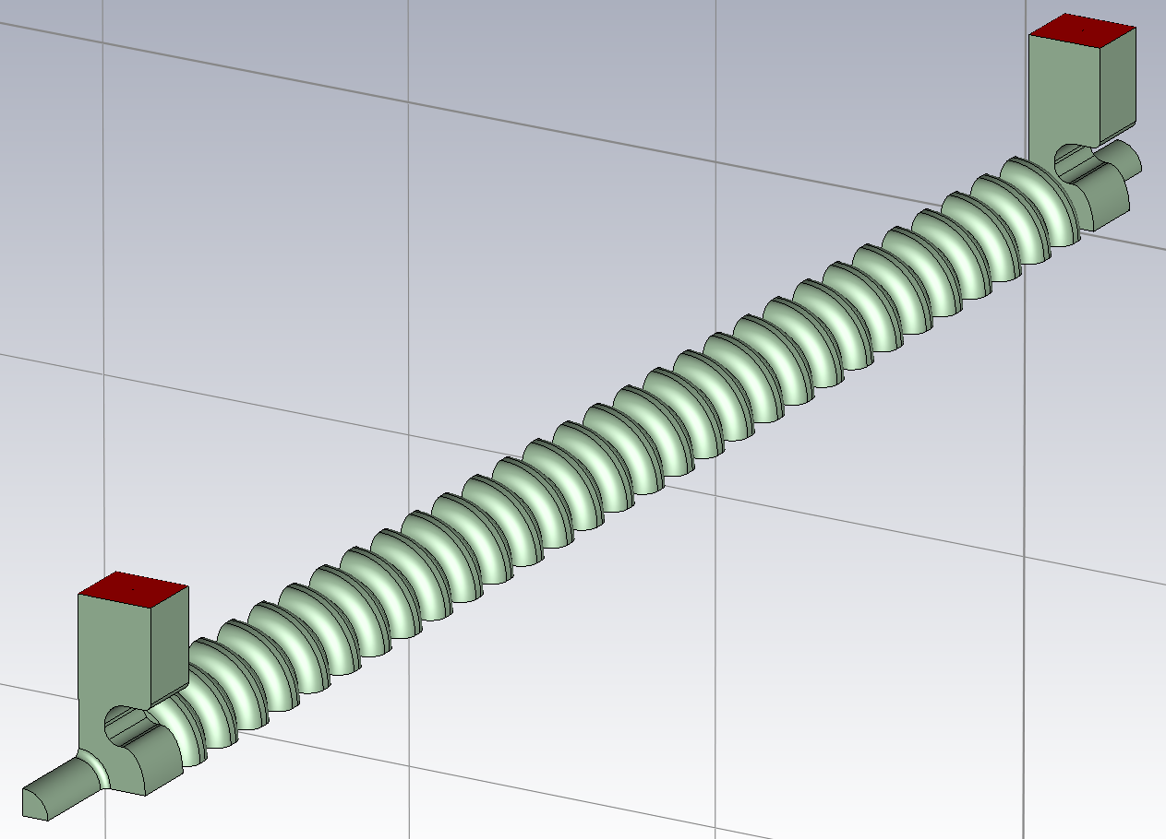
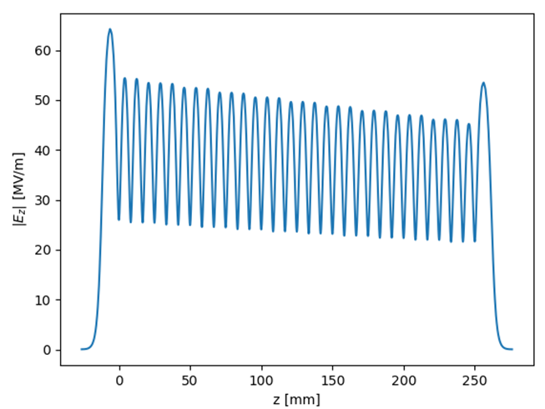
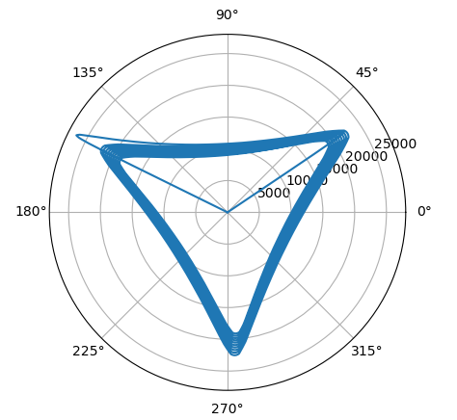
Buncher: E-field simulations
30 regular cells + 2 coupler cells

Slide 11
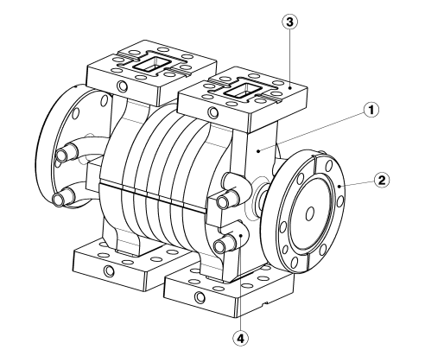
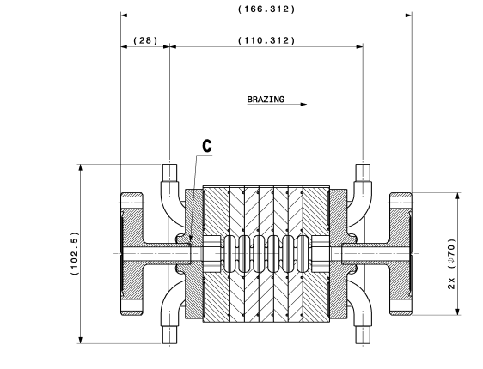
First short prototype build at CERN
C. Capelli, N. Chritin
Verify mechanical design, brazing assembly and tolerances needed.
Low power RF measurements

Slide 12
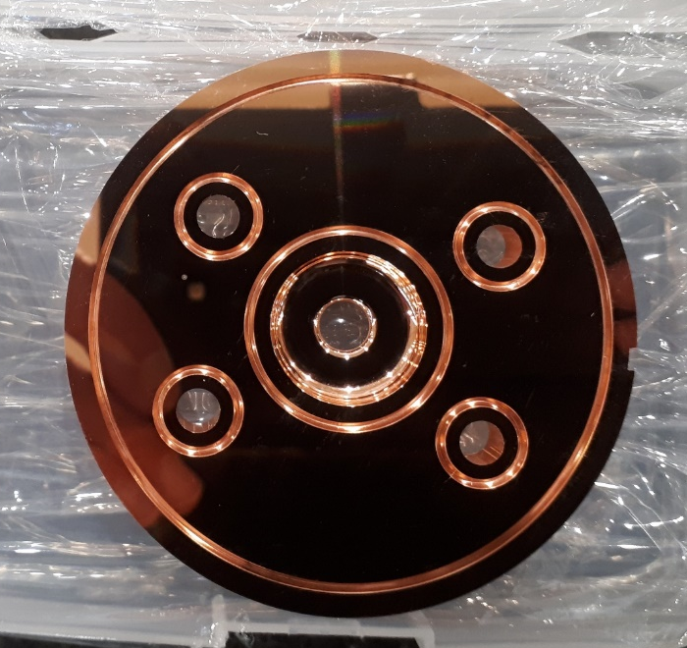
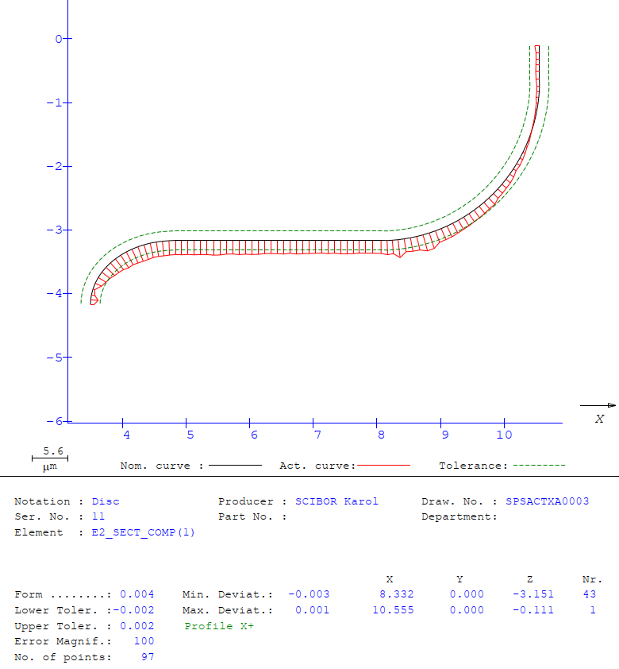
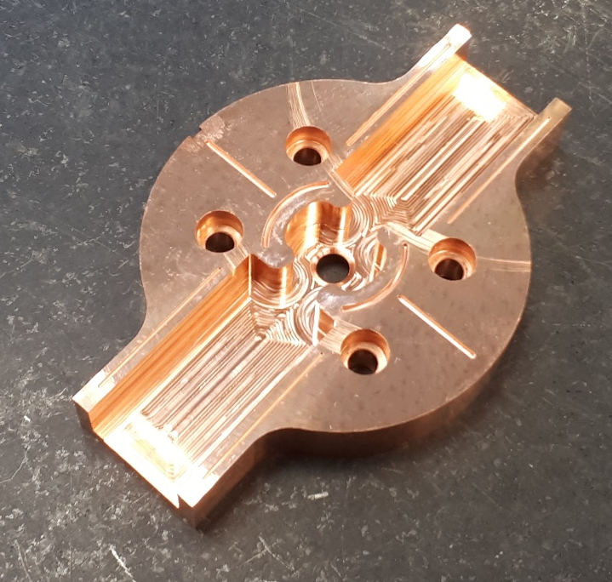
First short prototype with cells made at CERN

Slide 13
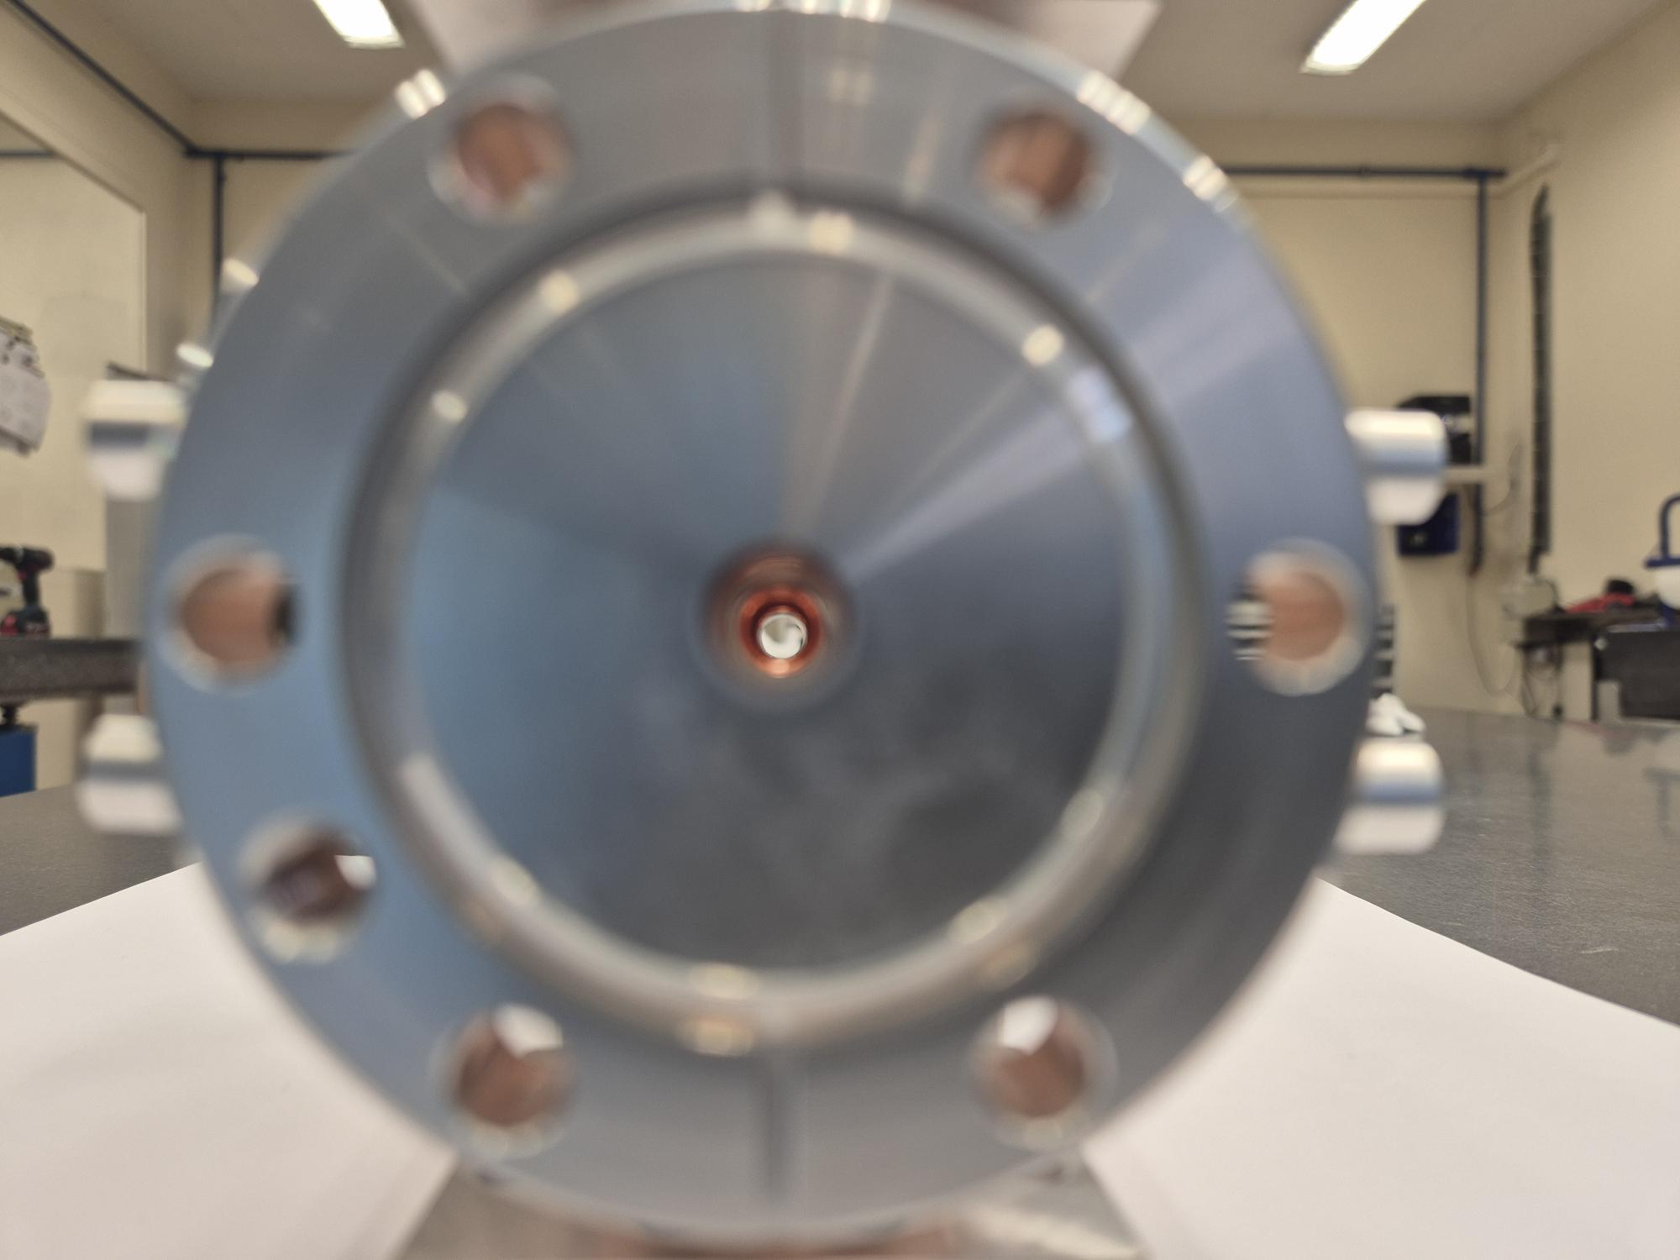
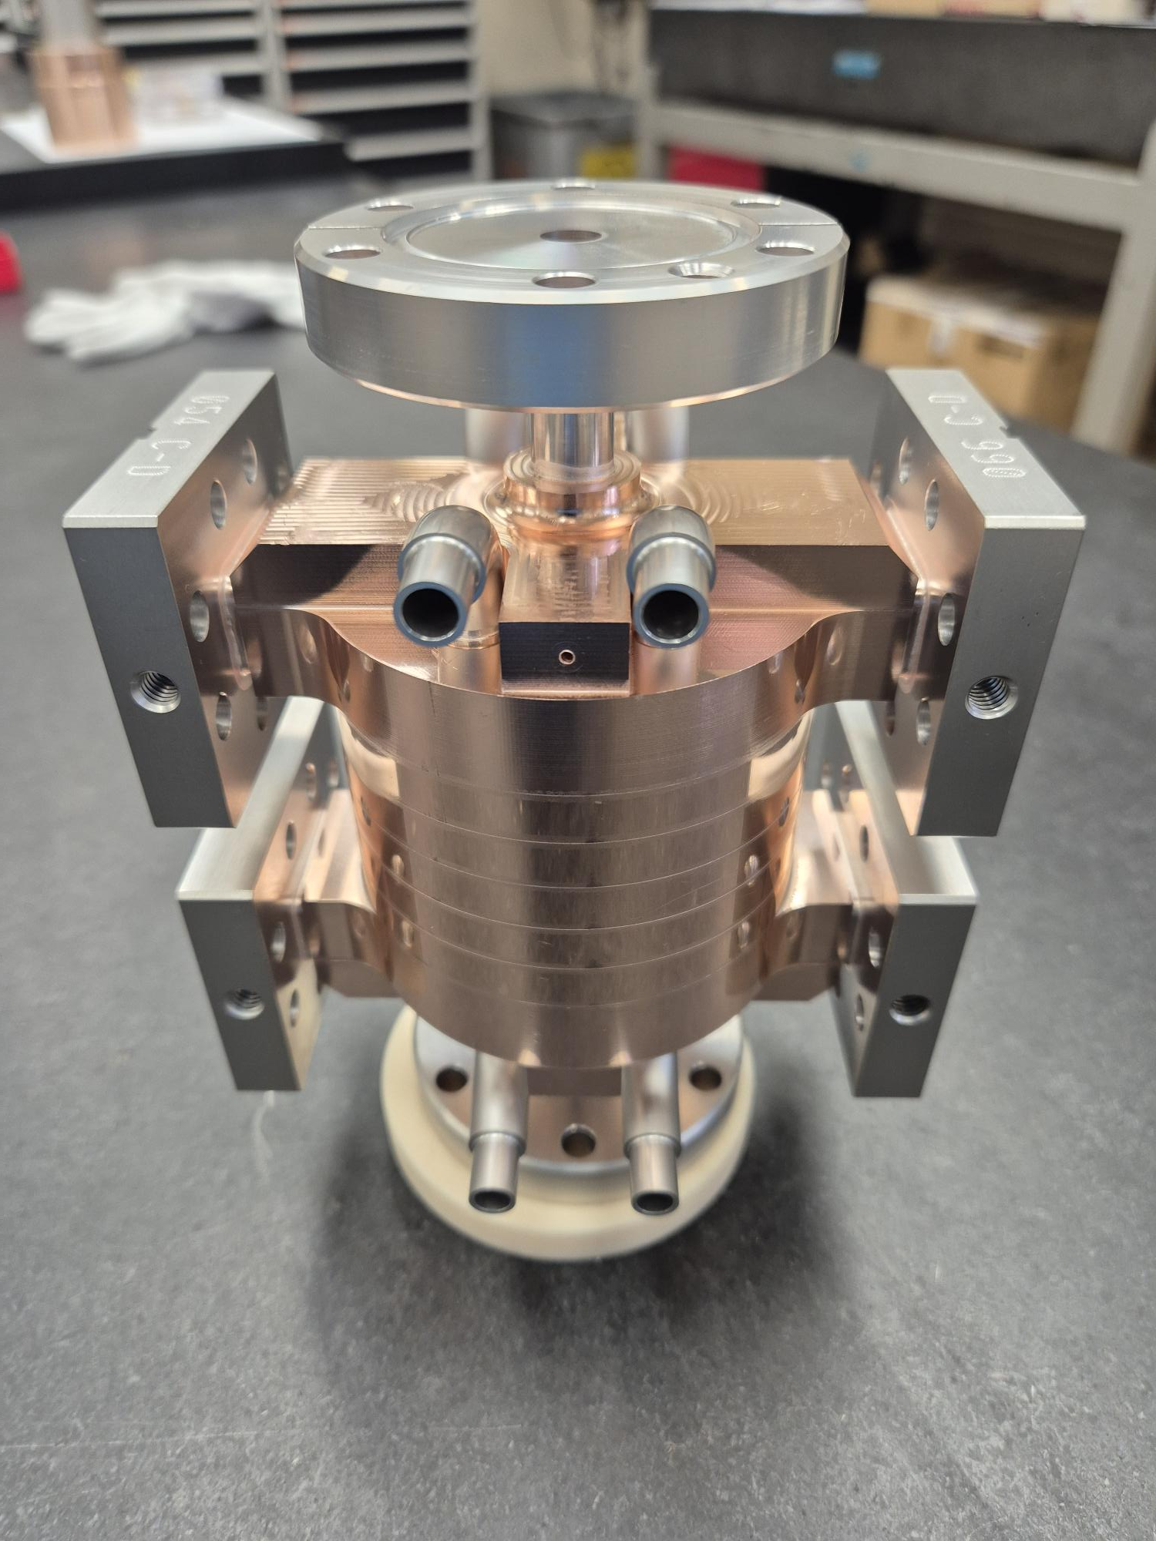
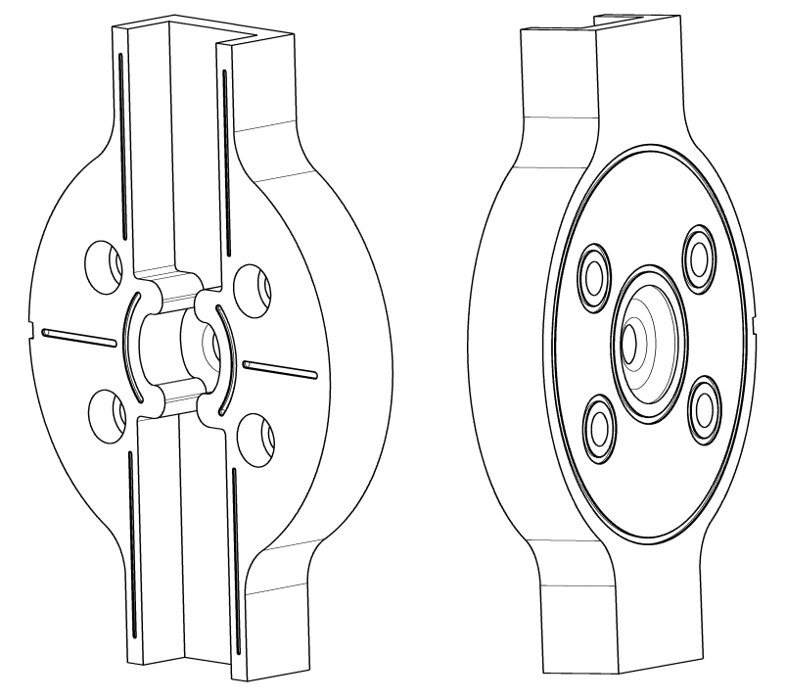
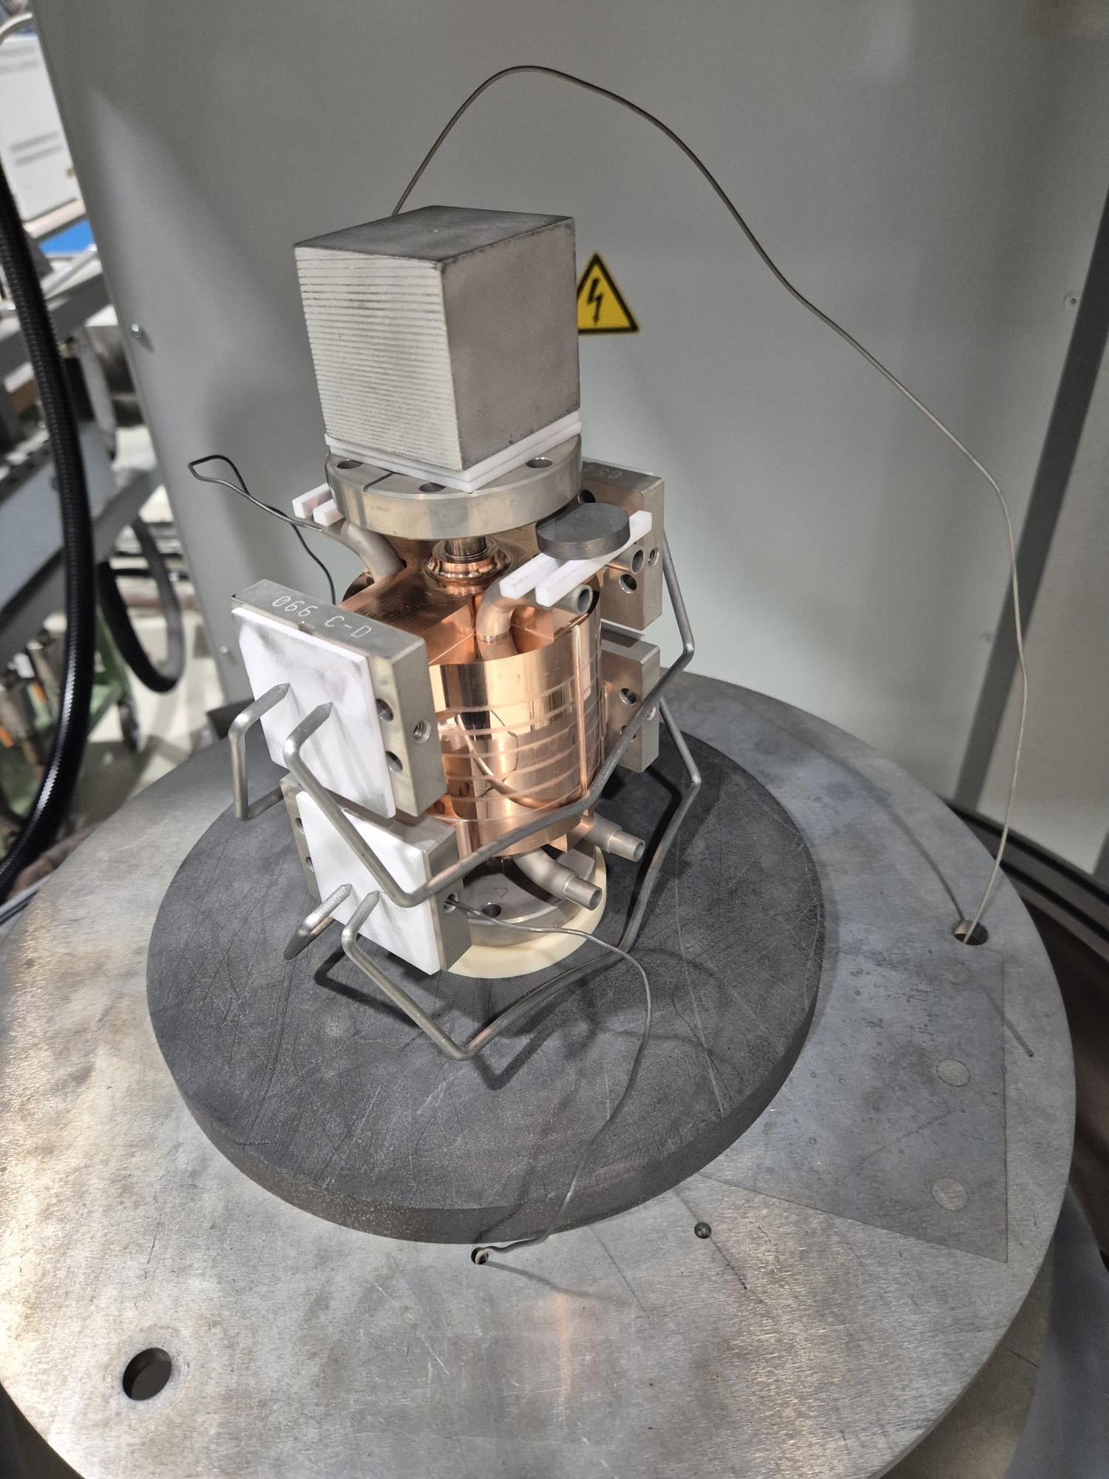
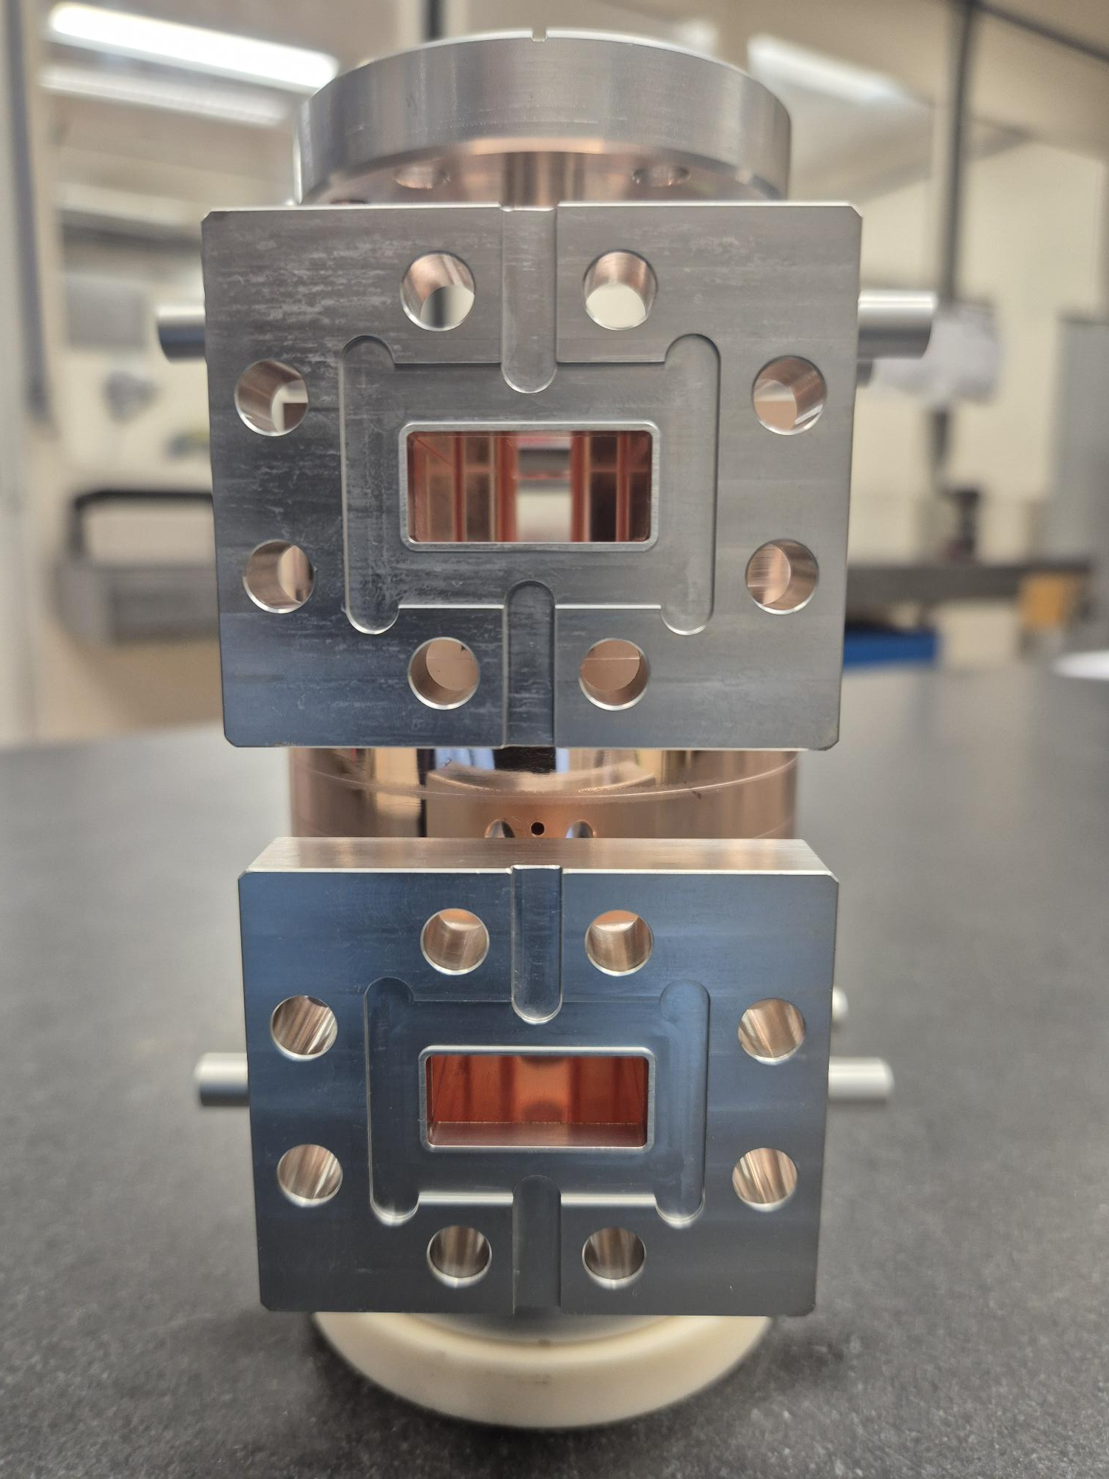
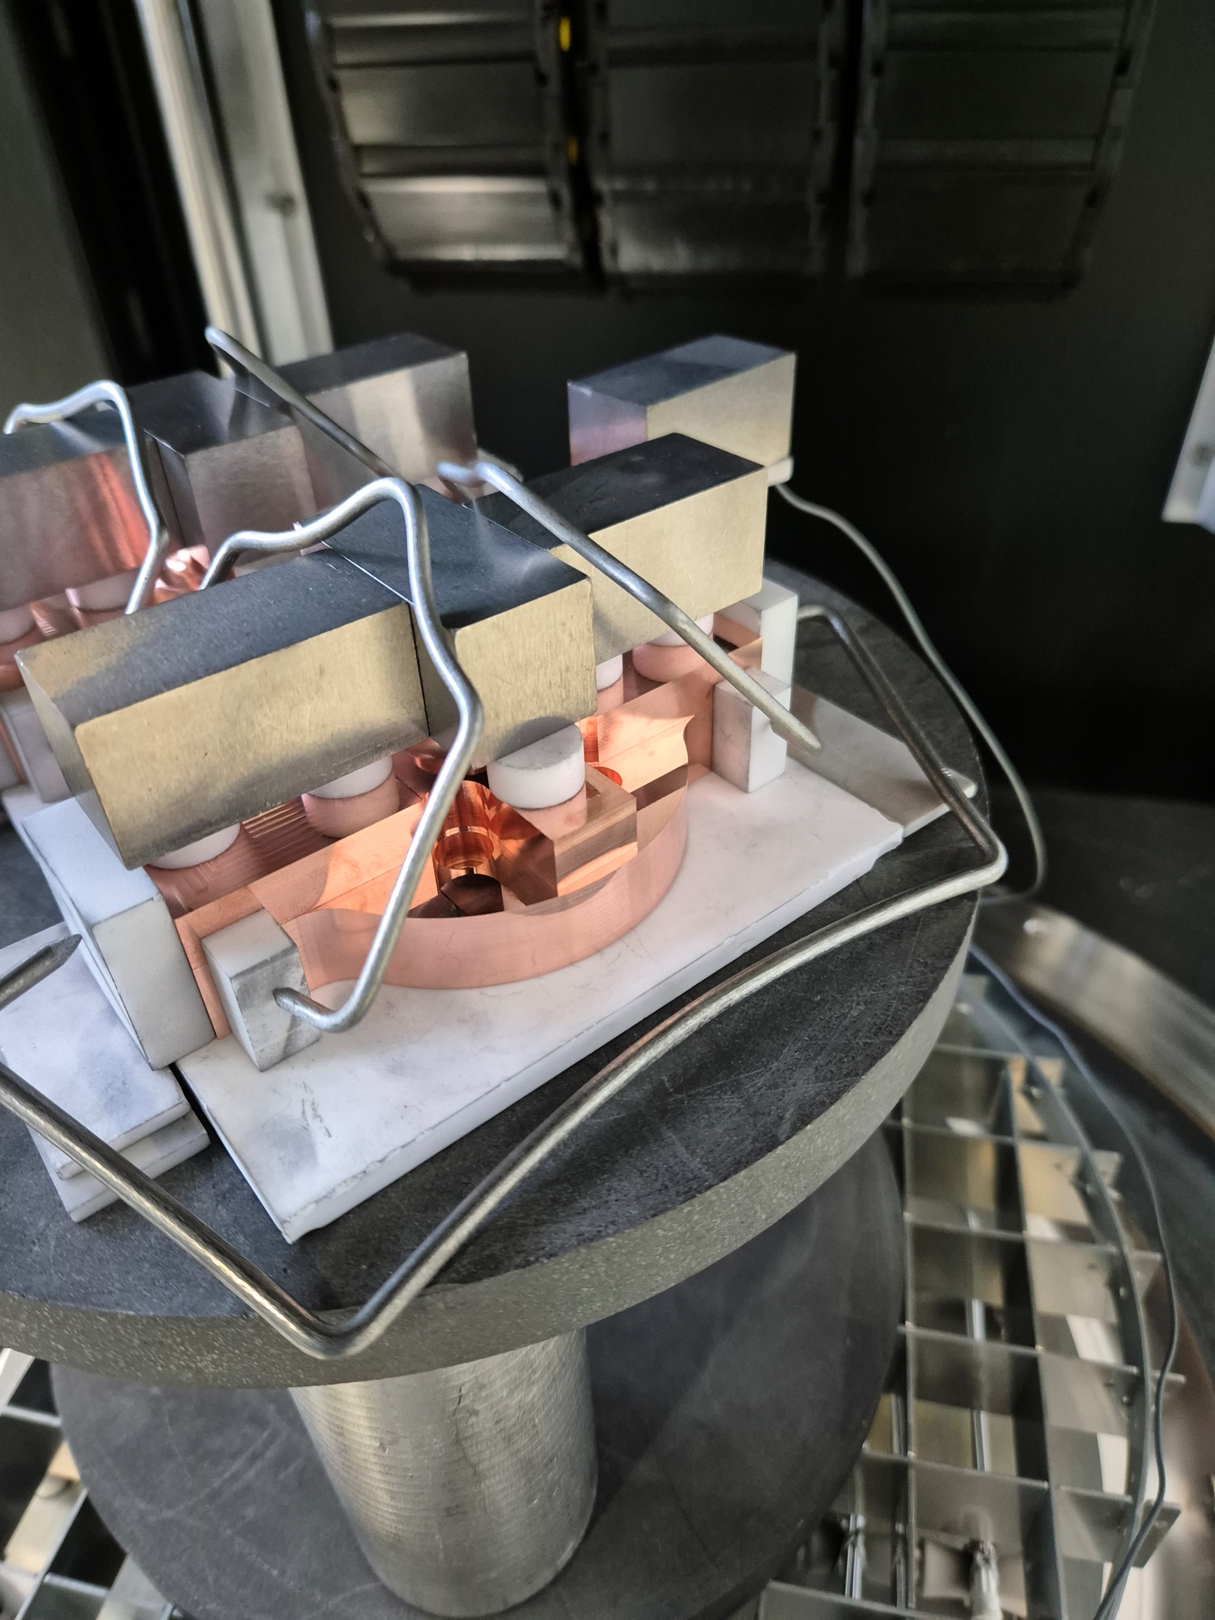
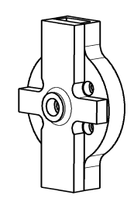
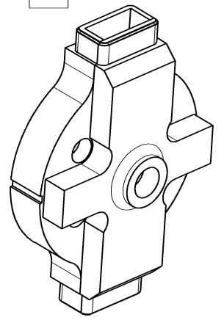
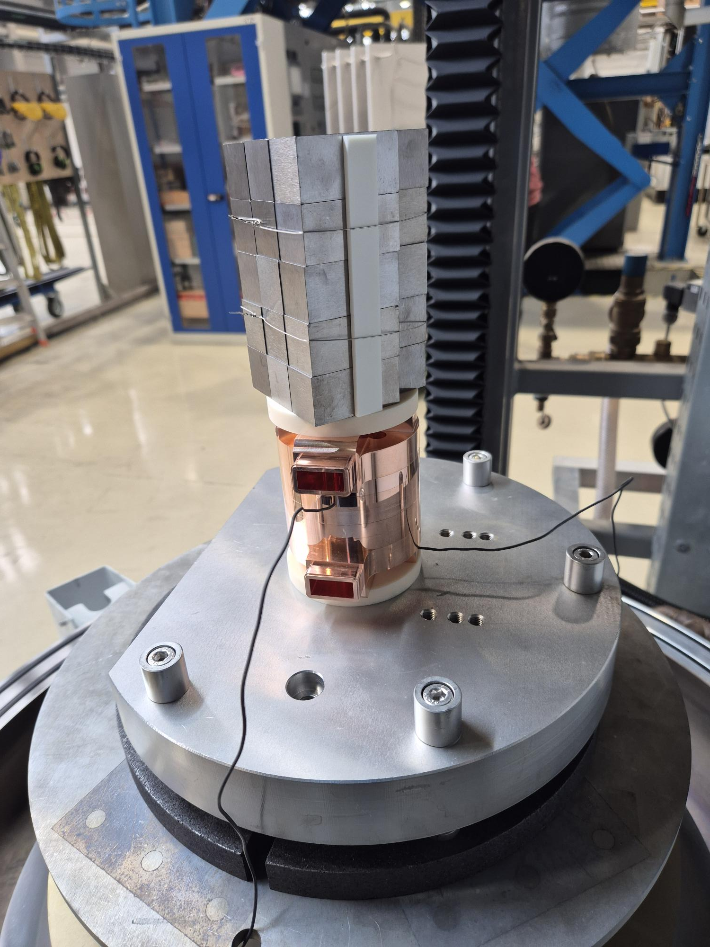
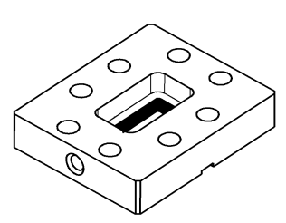
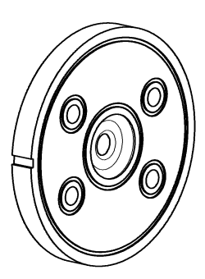
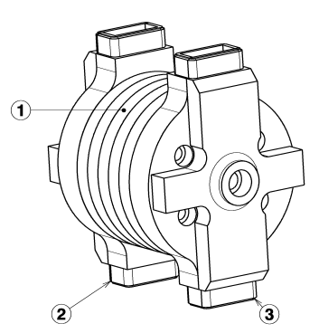
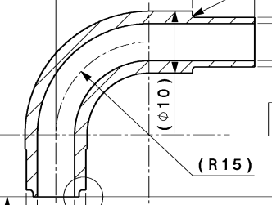
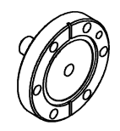
Structure Awake - 3 brazing steps
AgCu : 780°C
AgCuPb10 : 850°C
Brazing
AgCuPb5 : 810°C
Machining
+
x4
x2
+
x5
x8
x2

Slide 14
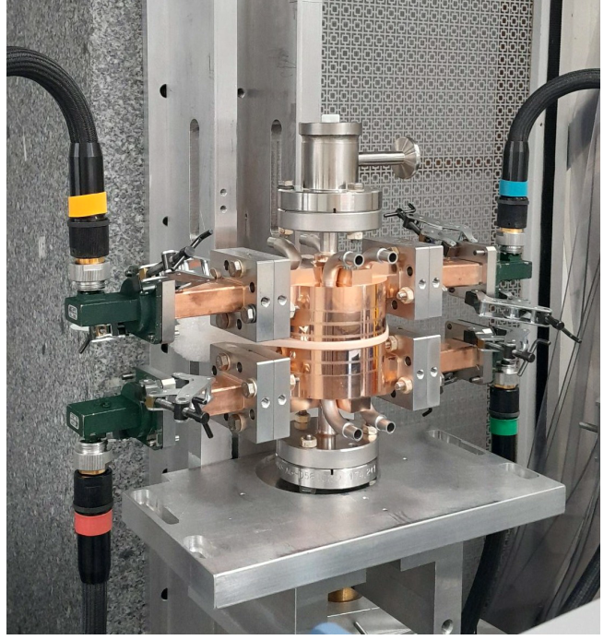
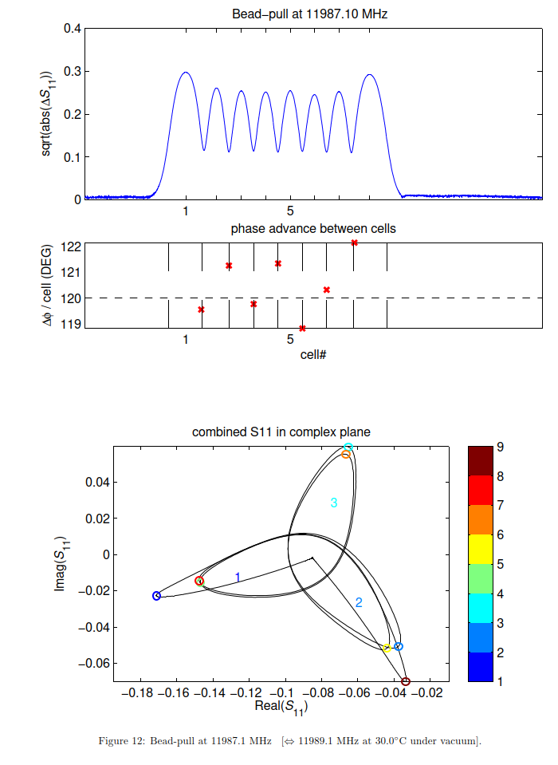
AWAKE 12 GHz accelerating structure prototype
Rolf Wegner
Mechanical, vacuum and RF measurements done to evaluate prototype, finally being cut for further analysis

Slide 15
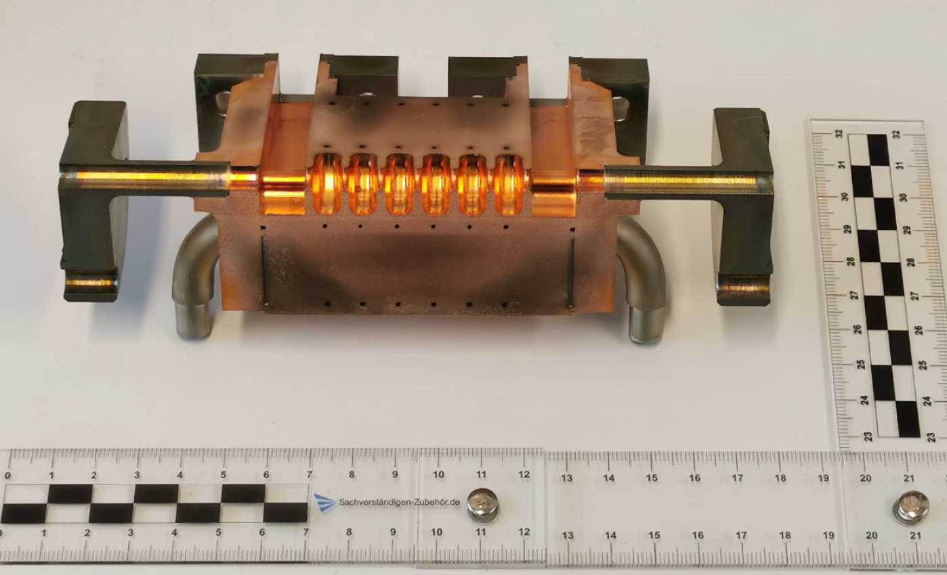
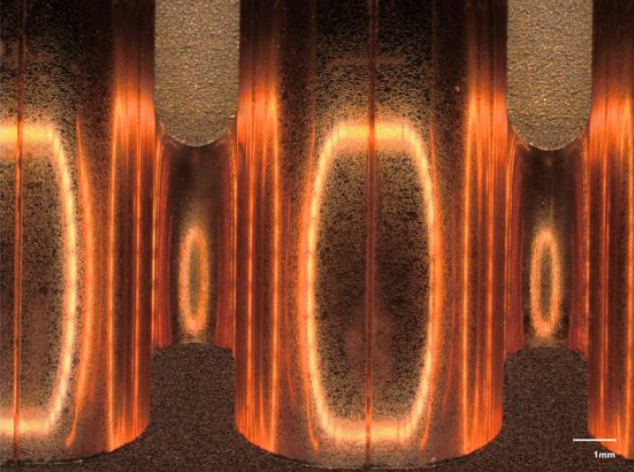
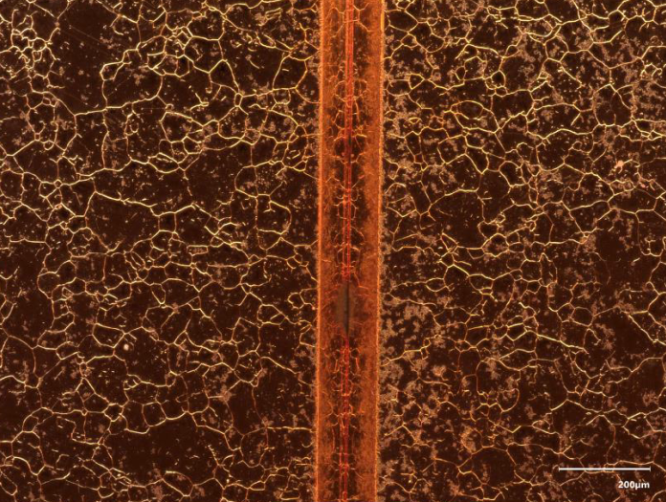
AWAKE 12 GHz accelerating structure prototype

Slide 16
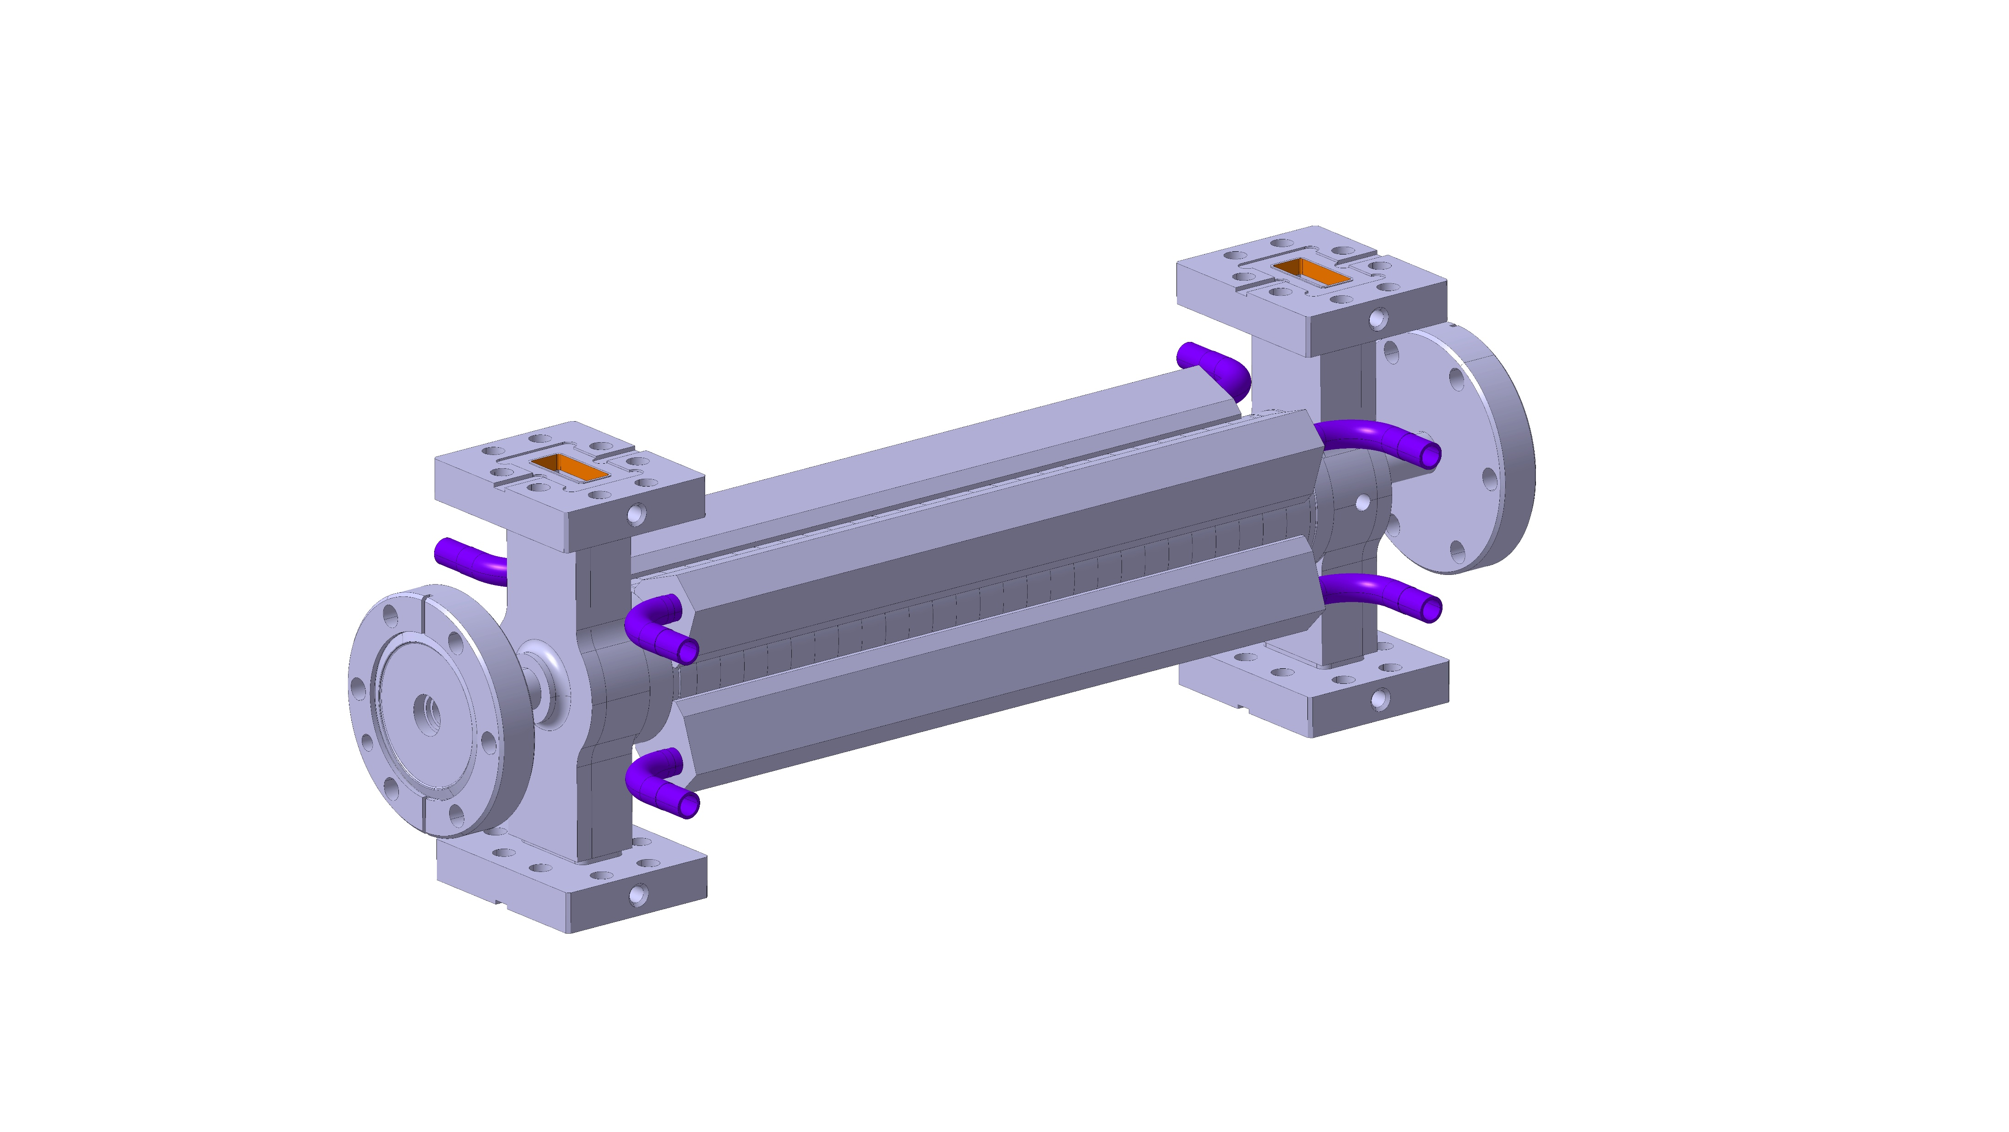
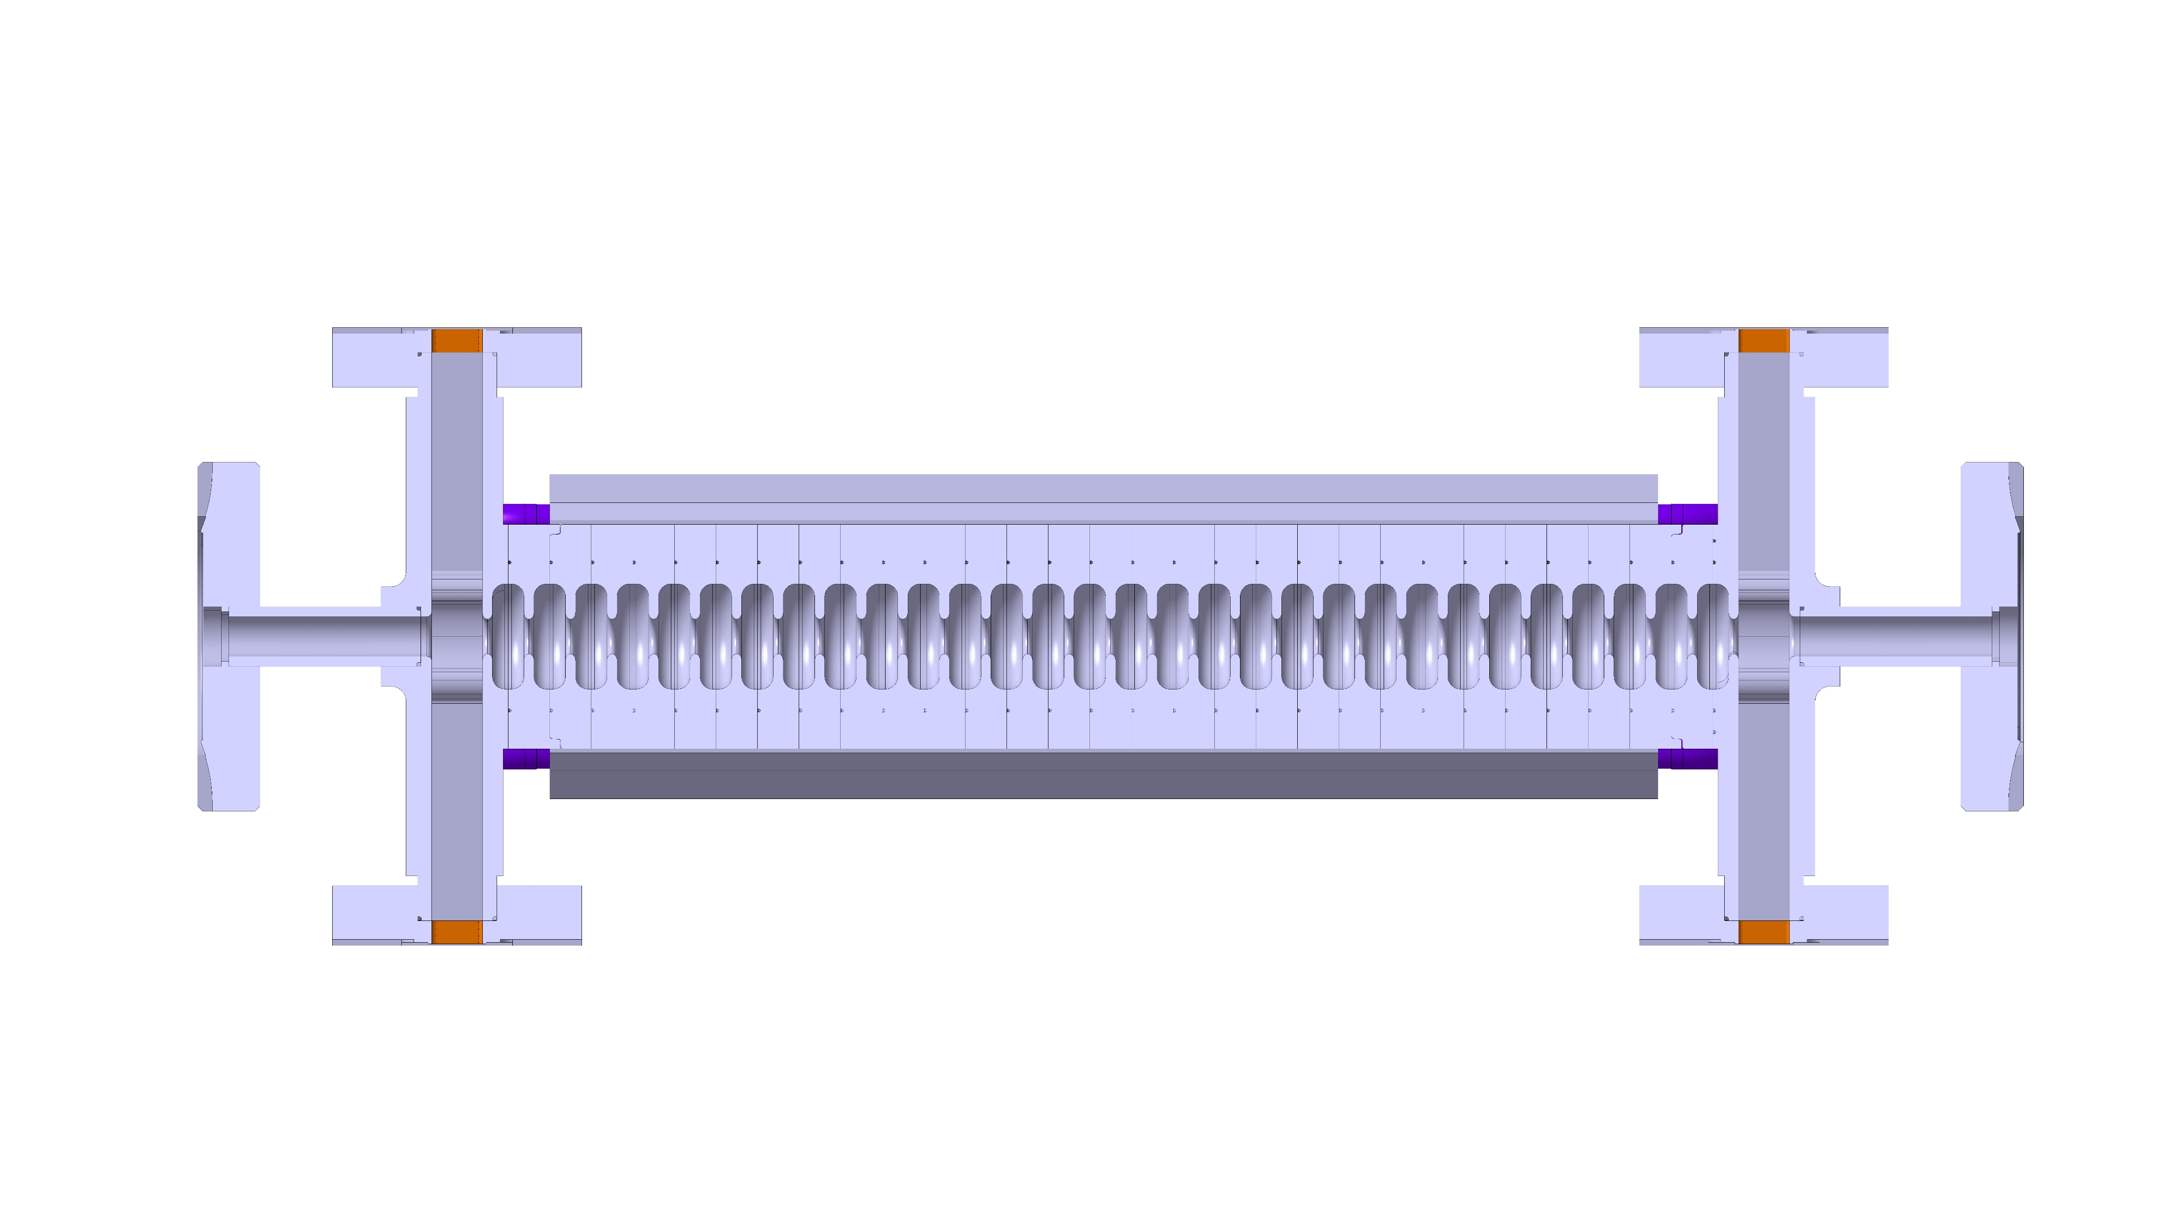

Next prototype and final structure
External cooling to simplify
30 cm
90 cm
C. Capelli, N. Chritin
C. Capelli, N. Chritin

Slide 17
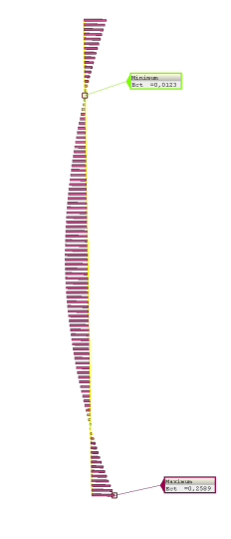
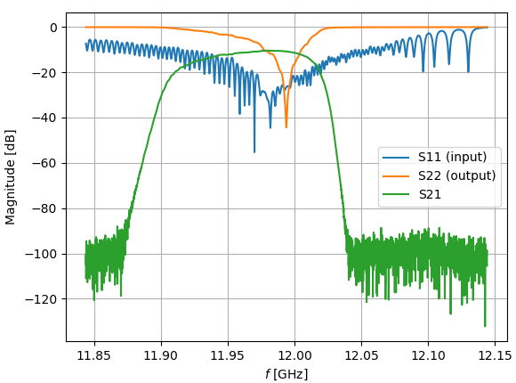
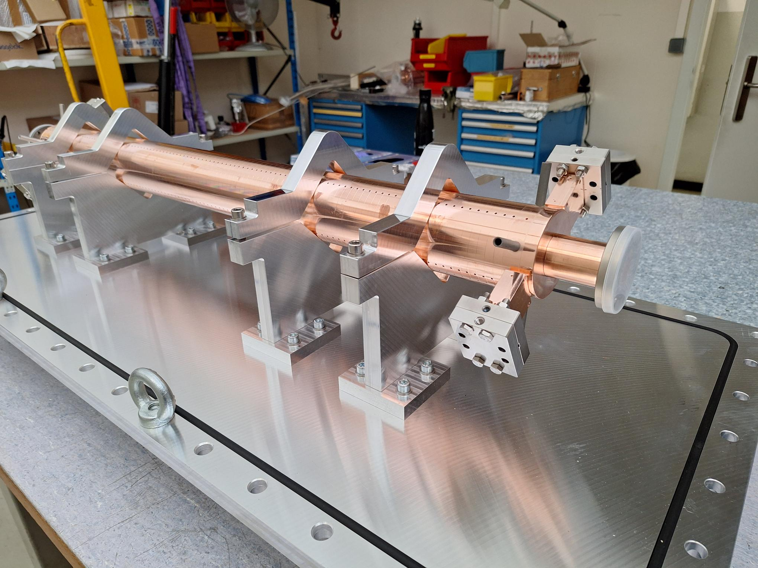
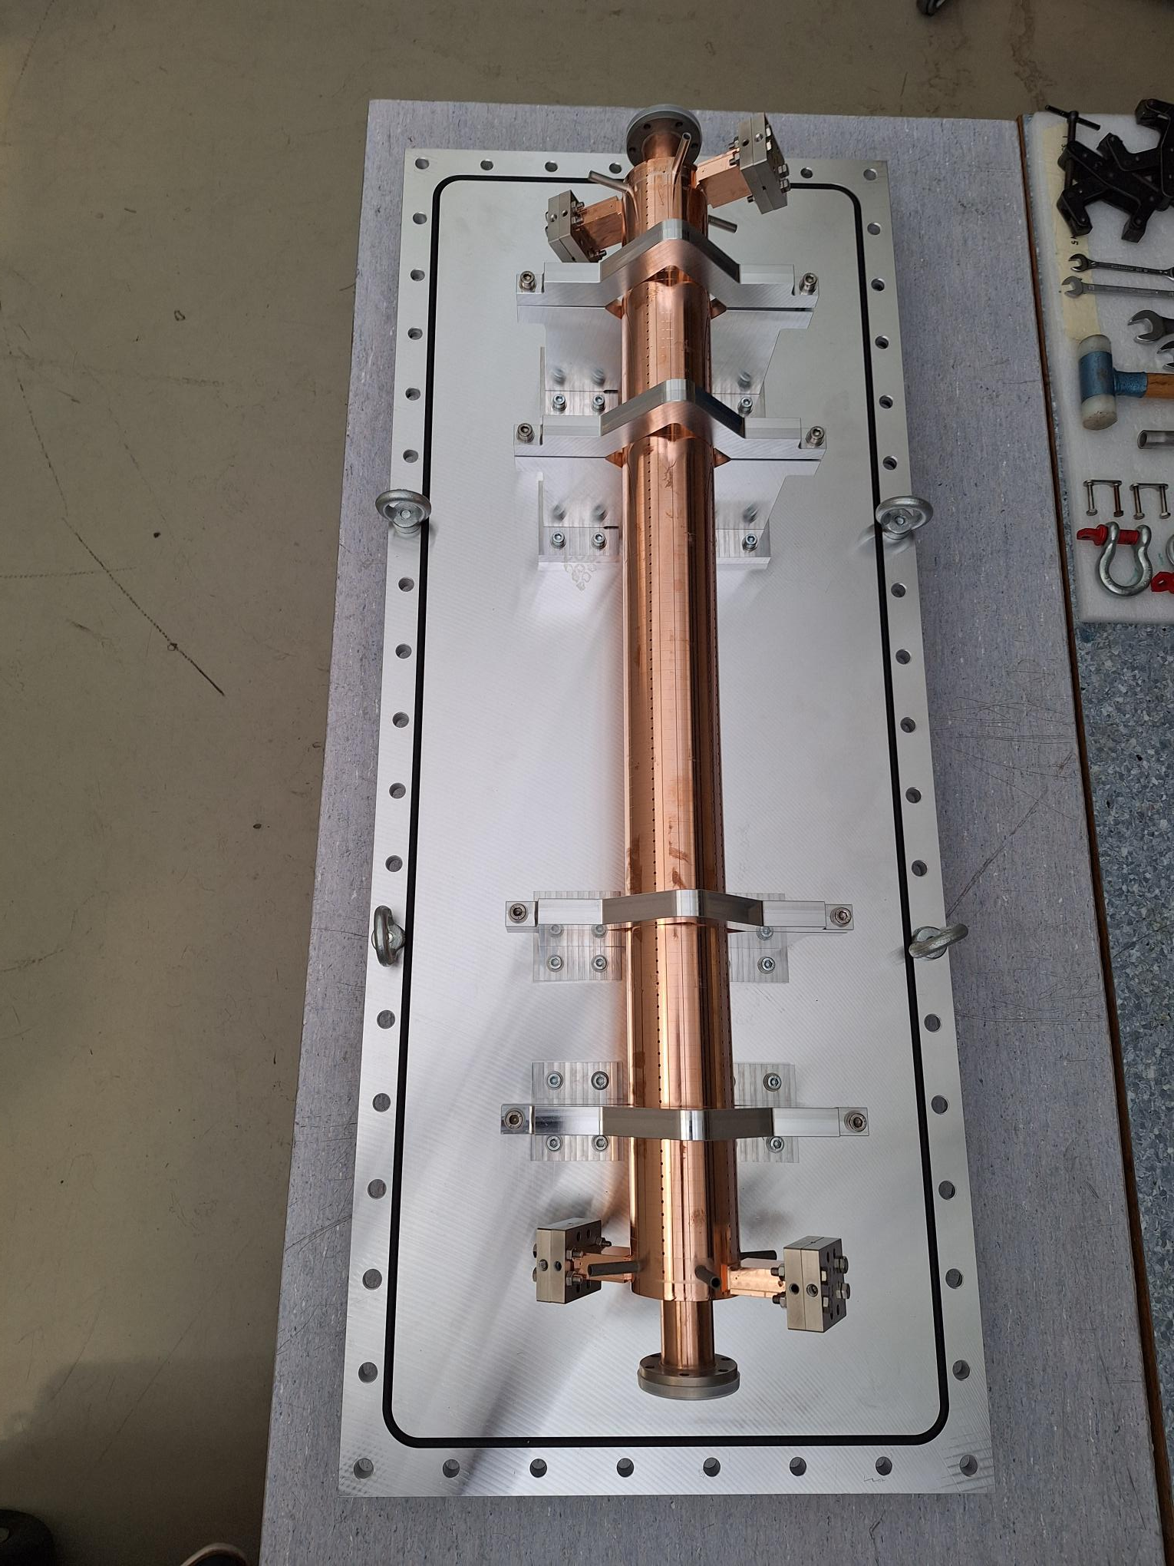
I-FAST structure
Unfortunately, not leak tight
Straightness measurement showed cell alignment problems
RF measurements show large losses

Slide 18






Pulse Compressor Optimization Process
r, Q, vg, τ_{s}
“Classical” SLED at
CERN- Xboxes
Barrel Open cavity for CLIC
Q₀, β
+
R_{s}: Effective Shunt Impedance
To optimize:
L=0,9 m
τ_{s} =125 ns
For each value of the filling time of the accelerating Structure there is a value of β and Q of the storage cavities wich maximizes Rs*
Jordan Arnesano

Slide 19



Waveguide distribution and pulse compressor
SLED:
  $Q_{0}=170000$
  $β=5.8$
Losses:
49 m circular waveguide (ø50mm)
10 mode converters
Power | MW
Klystron output | 21
PC input | 16.6
Input structure | 8.3
Attenuation | %
Circular WG | 11.23
WR90 | 5.69
MC | 5.59
Total | 20.96

Slide 20

F-Cup
ARTI in CTF2
Screen BTV1
RF-GUN
Brazing free RF-Gun from INFN
RF-gun conditioned to 120 MV/m on the cathode
200 ns
400 ns
600 ns
800 ns
1 us
Spectrometer
GUN contributed by INFN, D. Alesini
Notes:
.

Slide 21


RF-Gun operation with beam
Solenoid scan
Qe-measurements of copper cathode
QE ≈ 1.34 x 10⁻⁴
Miguel Martinez Calderon and Anton Eager

Slide 22
Summary
AWAKE needs a challenging injector for external injection
Design well established, procurement for high-power RF-system started
Development program at CERN for the high-gradient x-band structures ongoing
Test set-up for the electron source is operating with good results
Installation of the injector is planned for the second half of 2027

Slide 23

CTF2 QE measurements
Fluence calculated with the FWHM spot sizes measured by Anton, taking the lowest values (“x” beam size) to be in the worst-case scenario
Even at the highest Fluence tested in the last tests, we still do not reach the ablation threshold.
Single-pulse ablation threshold for Copper using fs-pulses and UV wavelength should be well above 100 mJ/cm²
Exact data for ablation threshold with UV fs-pulses is hard to find but there are many references using different wavelengths (please note that also ablation threshold data is normally calculated using the 1/e² spot size and here we are plotting FWHM) [1-3].
[1] Jan Winter, et. al. "Ultrashort single-pulse laser ablation of stainless steel, aluminium, copper and its dependence on the pulse duration," Opt. Express 29, 14561-14581 (2021)
[2] Byskov-Nielsen, J., et al. Ultra-short pulse laser ablation of metals: threshold fluence, incubation coefficient and ablation rates. Appl. Phys. A 101, 97–101 (2010).
[3] Ultrafast laser ablation of copper with GHz bursts: A numerical study on the effects of repetition rate, pulse number and burst fluence on ablation efficiency and heat-affected zone. Optics & Laser Technology 158, Part A, February 2023, 108803
Miguel Martinez Calderon and Anton Eager

Slide 24



Timeline & Milestone Overview
2021
2017
Run 2a: Control of
Self-Modulation
Run 2b: Stabilization of
Wakefield Amplitude
Run2d:
Demonstration of
Scalability
Run 1a: Successful
Self-Modulation
2018
Run 2c:
Acceleration with
Quality Control
2023
Run 1b: First
Electron Acceleration
DPS Operation
in AWAKE
Start of experiments
Now

Slide 25
Electron Source Integration status
Waveguide routing study
PROPOSAL C
Length: 46 and 49m
This version is currently our preferred one → base line
we will study this one in more detail
90°
90°
90°
Length: 34m

Slide 26




Seeding with an Electron Bunch
To build an accelerator, the wakefield phase and amplitude must be reproducible.
→ Wakefields driven by an electron bunch also allow for seeding in pre-ionized plasmas
SMI: Self-Modulation instability
Process starts from noise
SSM: Seeded Self-Modulation
Process starts from seed
Electron bunch drives
Seed wakefields
PhD Student
e-

Slide 27






Single cell
E-field
H-field
$$S_{c}$$
Parameter | Value
$f$ [GHz] | 11.9932
$$Q_{0}$$ | 7054
${Z_{eff}/Q}_{0} [Ω/m]$ | 14028
$$v_{g} [\%c]$$ | 2.41
$$E_{max}/E_{a}$$ | 1.94
$H_{max}/E_{a}$ [mA/V] | 2.91
${S_{c}}_{max}/E_{a}^{2}$ [mA/V] | 0.45

Slide 28




Linac: E-field
105 regular cells + 2 coupler cells

Slide 29



Reference design
Mohsen Dayyani Kelisani

