Slide 1

The Ultracold Electron Source as an Injector for High Bunch Charge Dielectric Laser Acceleration
25th September 2025
Ameya Patwardhan, Simona Borrelli, Bas van der Geer, Jom Luiten, Julius Huijts

Slide 2
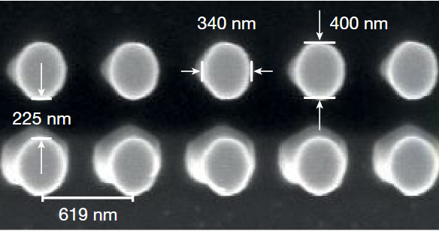
Injection into Dielectric Laser Accelerators: The Challenge
Micron scale input aperture makes it difficult to inject beam into the accelerator
Low geometric emittance source is needed
    Use compact linac of length ≈ 10-100 m
    Use electron microscope as source
Shiloh, R. et al. Electron phase-space control in photonic chip-based particle acceleration, Nature 597, 498–502 (2021)

Slide 3
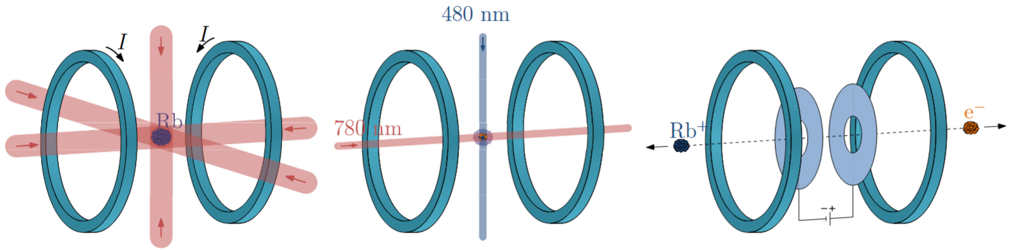
Better Solution: Ultracold Electron Source
Low transverse temperature by laser cooling ≈ 10 K
Bunched beam ≈ 1 ps
Bunch charge ≈ 1 fC
Low normalized emittance ≈ 1 nm-rad
Franssen, J. G. H. et al. Energy spread of ultracold electron bunches extracted from a laser cooled gas, J. Phys. B: At. Mol. Opt. Phys. 51, 035007 (2018)

Slide 4
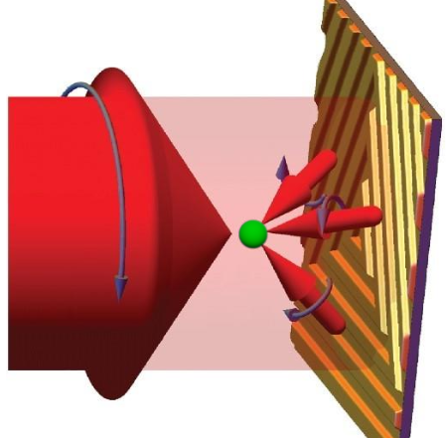
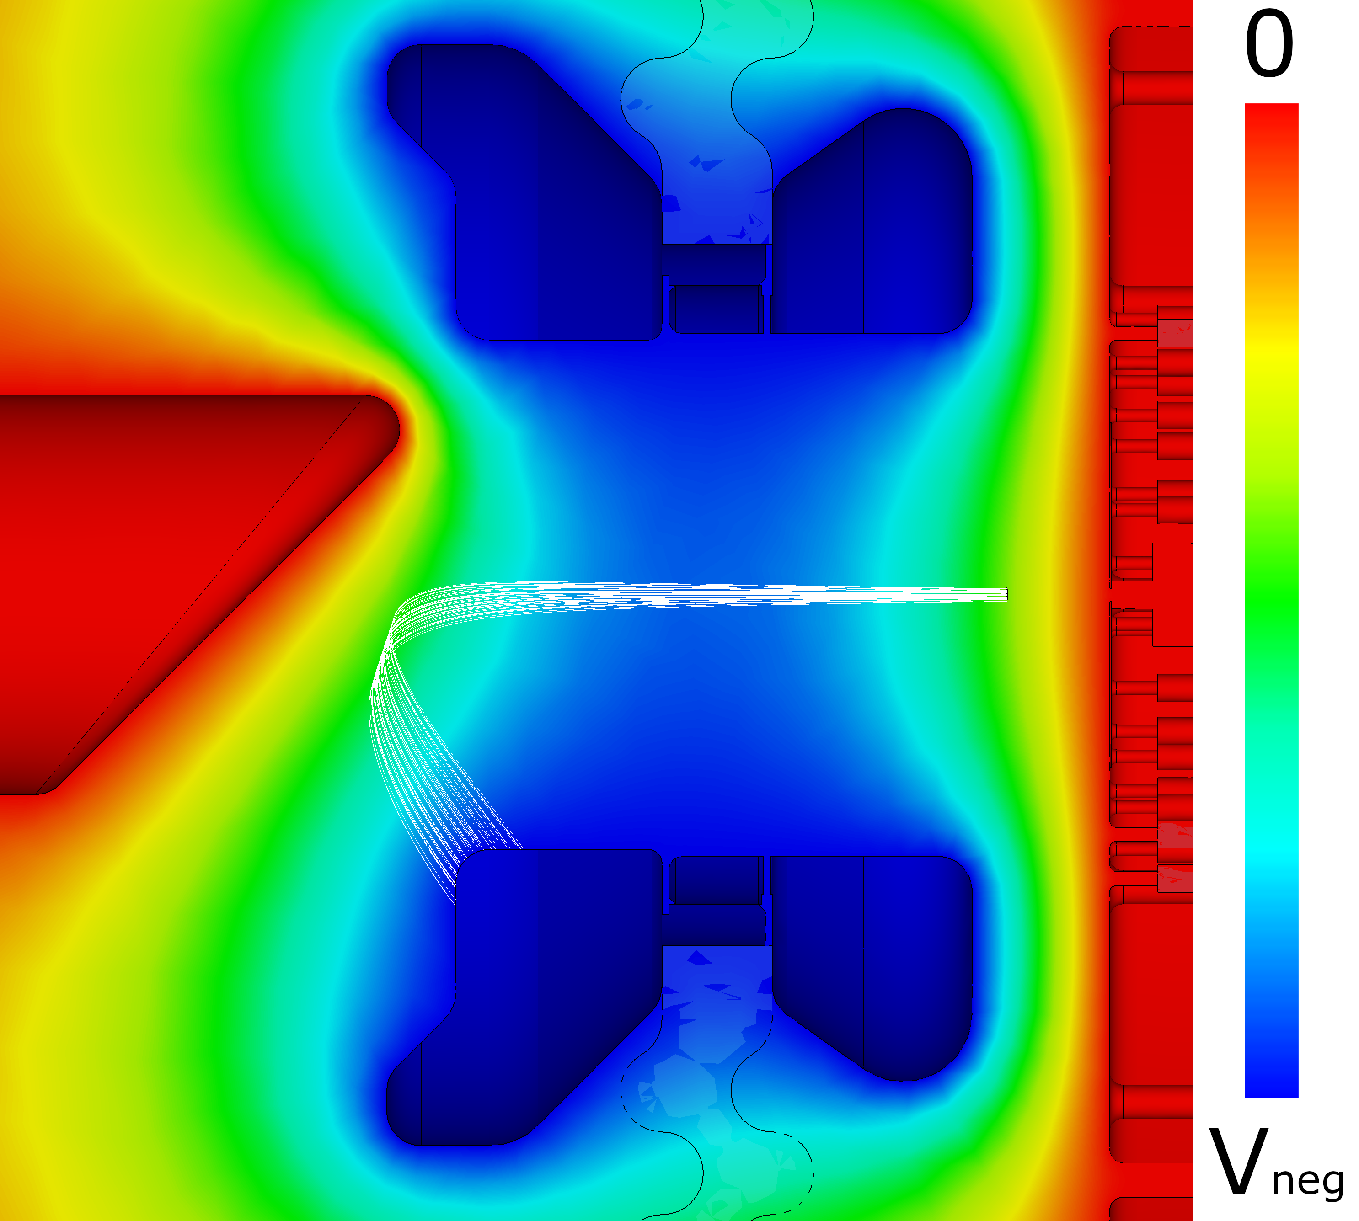
Ultracold Electron Source: Accelerator
Grating Magneto-Optical Trap: Tetrahedron of trapping beams generated from a single laser beam
Electrode design that enables dumping of Rb⁺ beam away from insulators
Rb⁺
e⁻
MOT
de Raadt, T. C. H. The ultracold electron source: from experiment to instrument (Eindhoven University of Technology, Eindhoven, 2024)

Slide 5
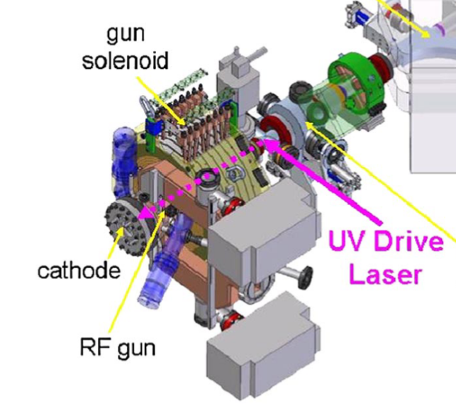
Electron Photo-injectors: The Bucking Solenoid
Bucking Solenoid is used to compensate the axial magnetic field of the gun solenoid
Zero axial magnetic field at the source avoids apparent emittance growth, though not the limiting factor in our design
Akre, R. et al. Commissioning the Linac Coherent Light Source injector, Phys. Rev. ST Accel. Beams 11, 030703 (2008)

Slide 6
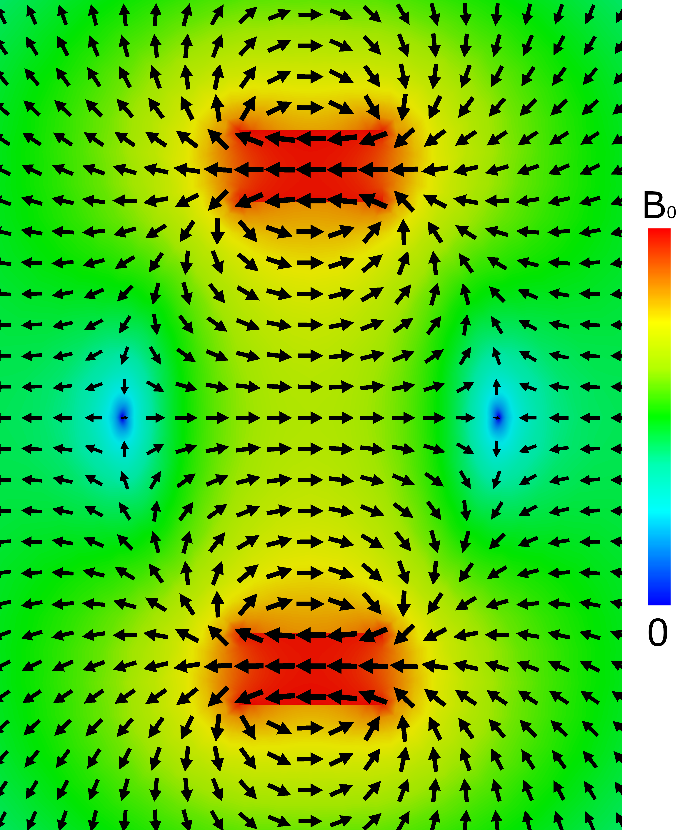
Permanent Magnet: Zeros of the Magnetic Field
Axially Magnetized Permanent Magnet produces zeros of the magnetic field.
Magnetic field necessary for atom trapping and also focusses the beam
N
S

Slide 7
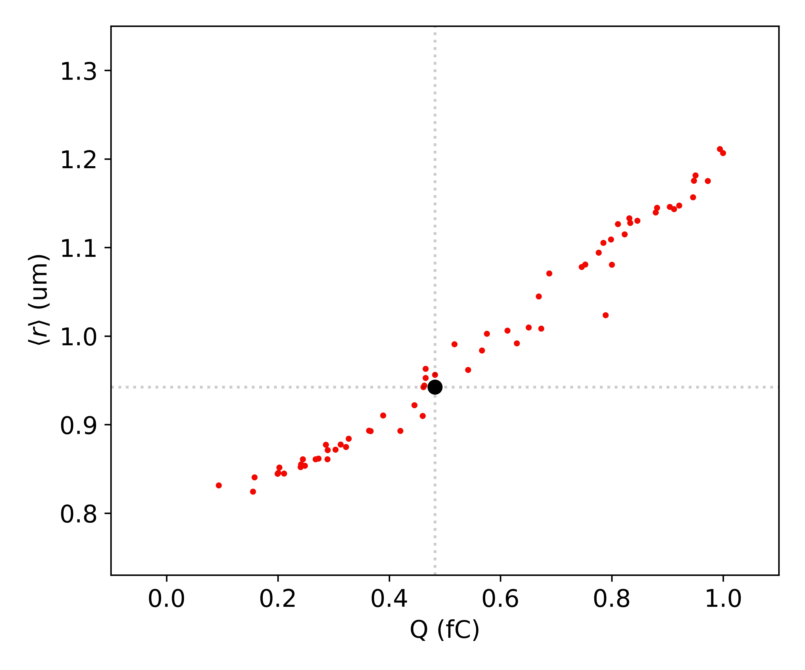
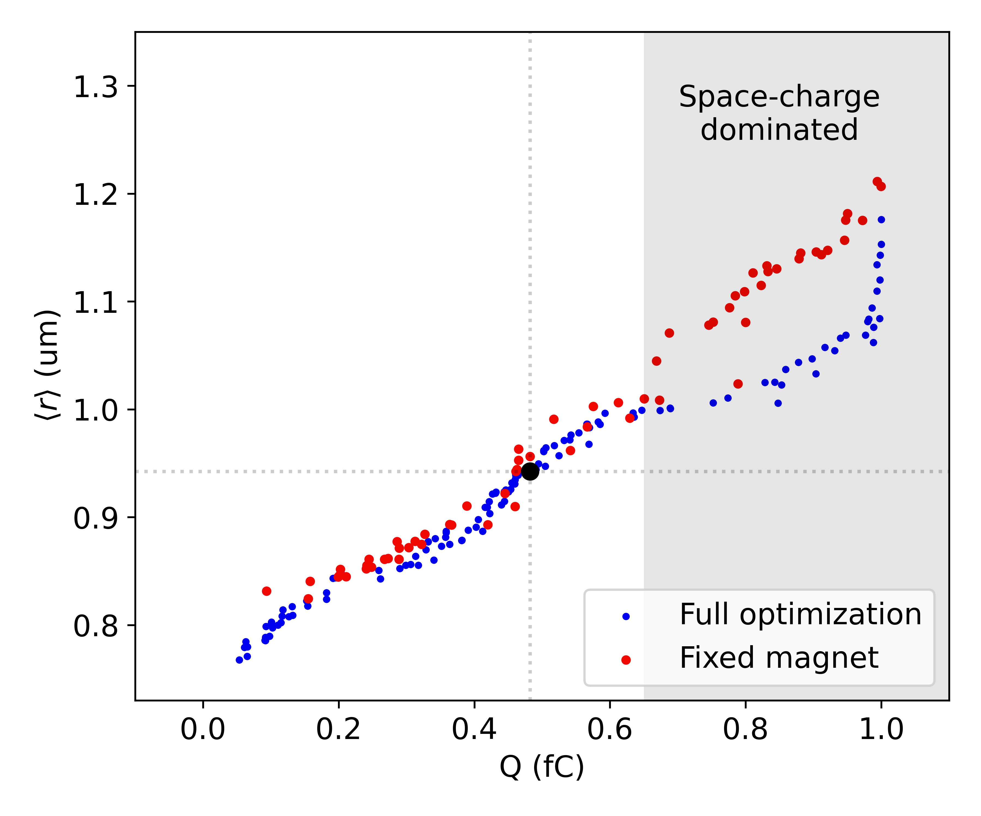
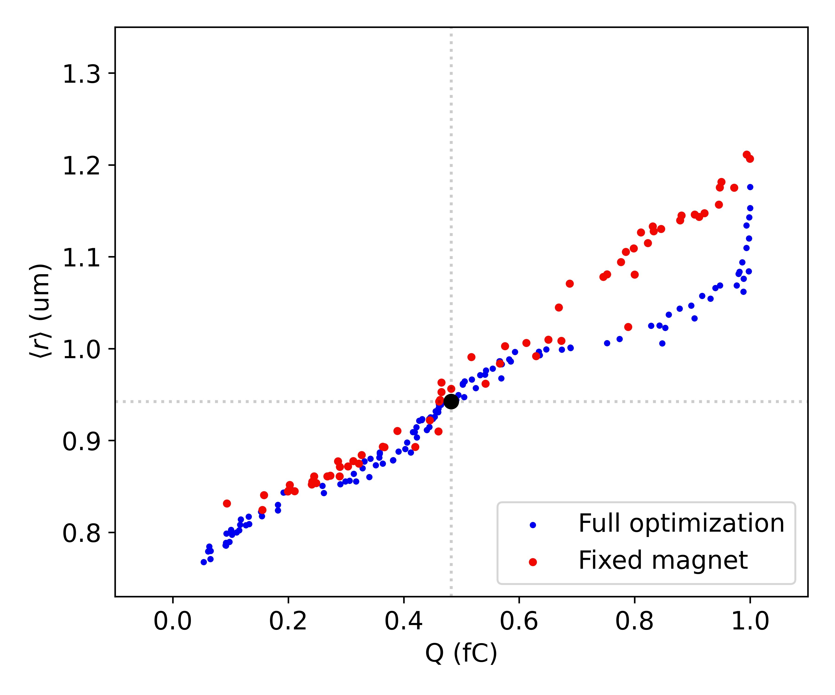
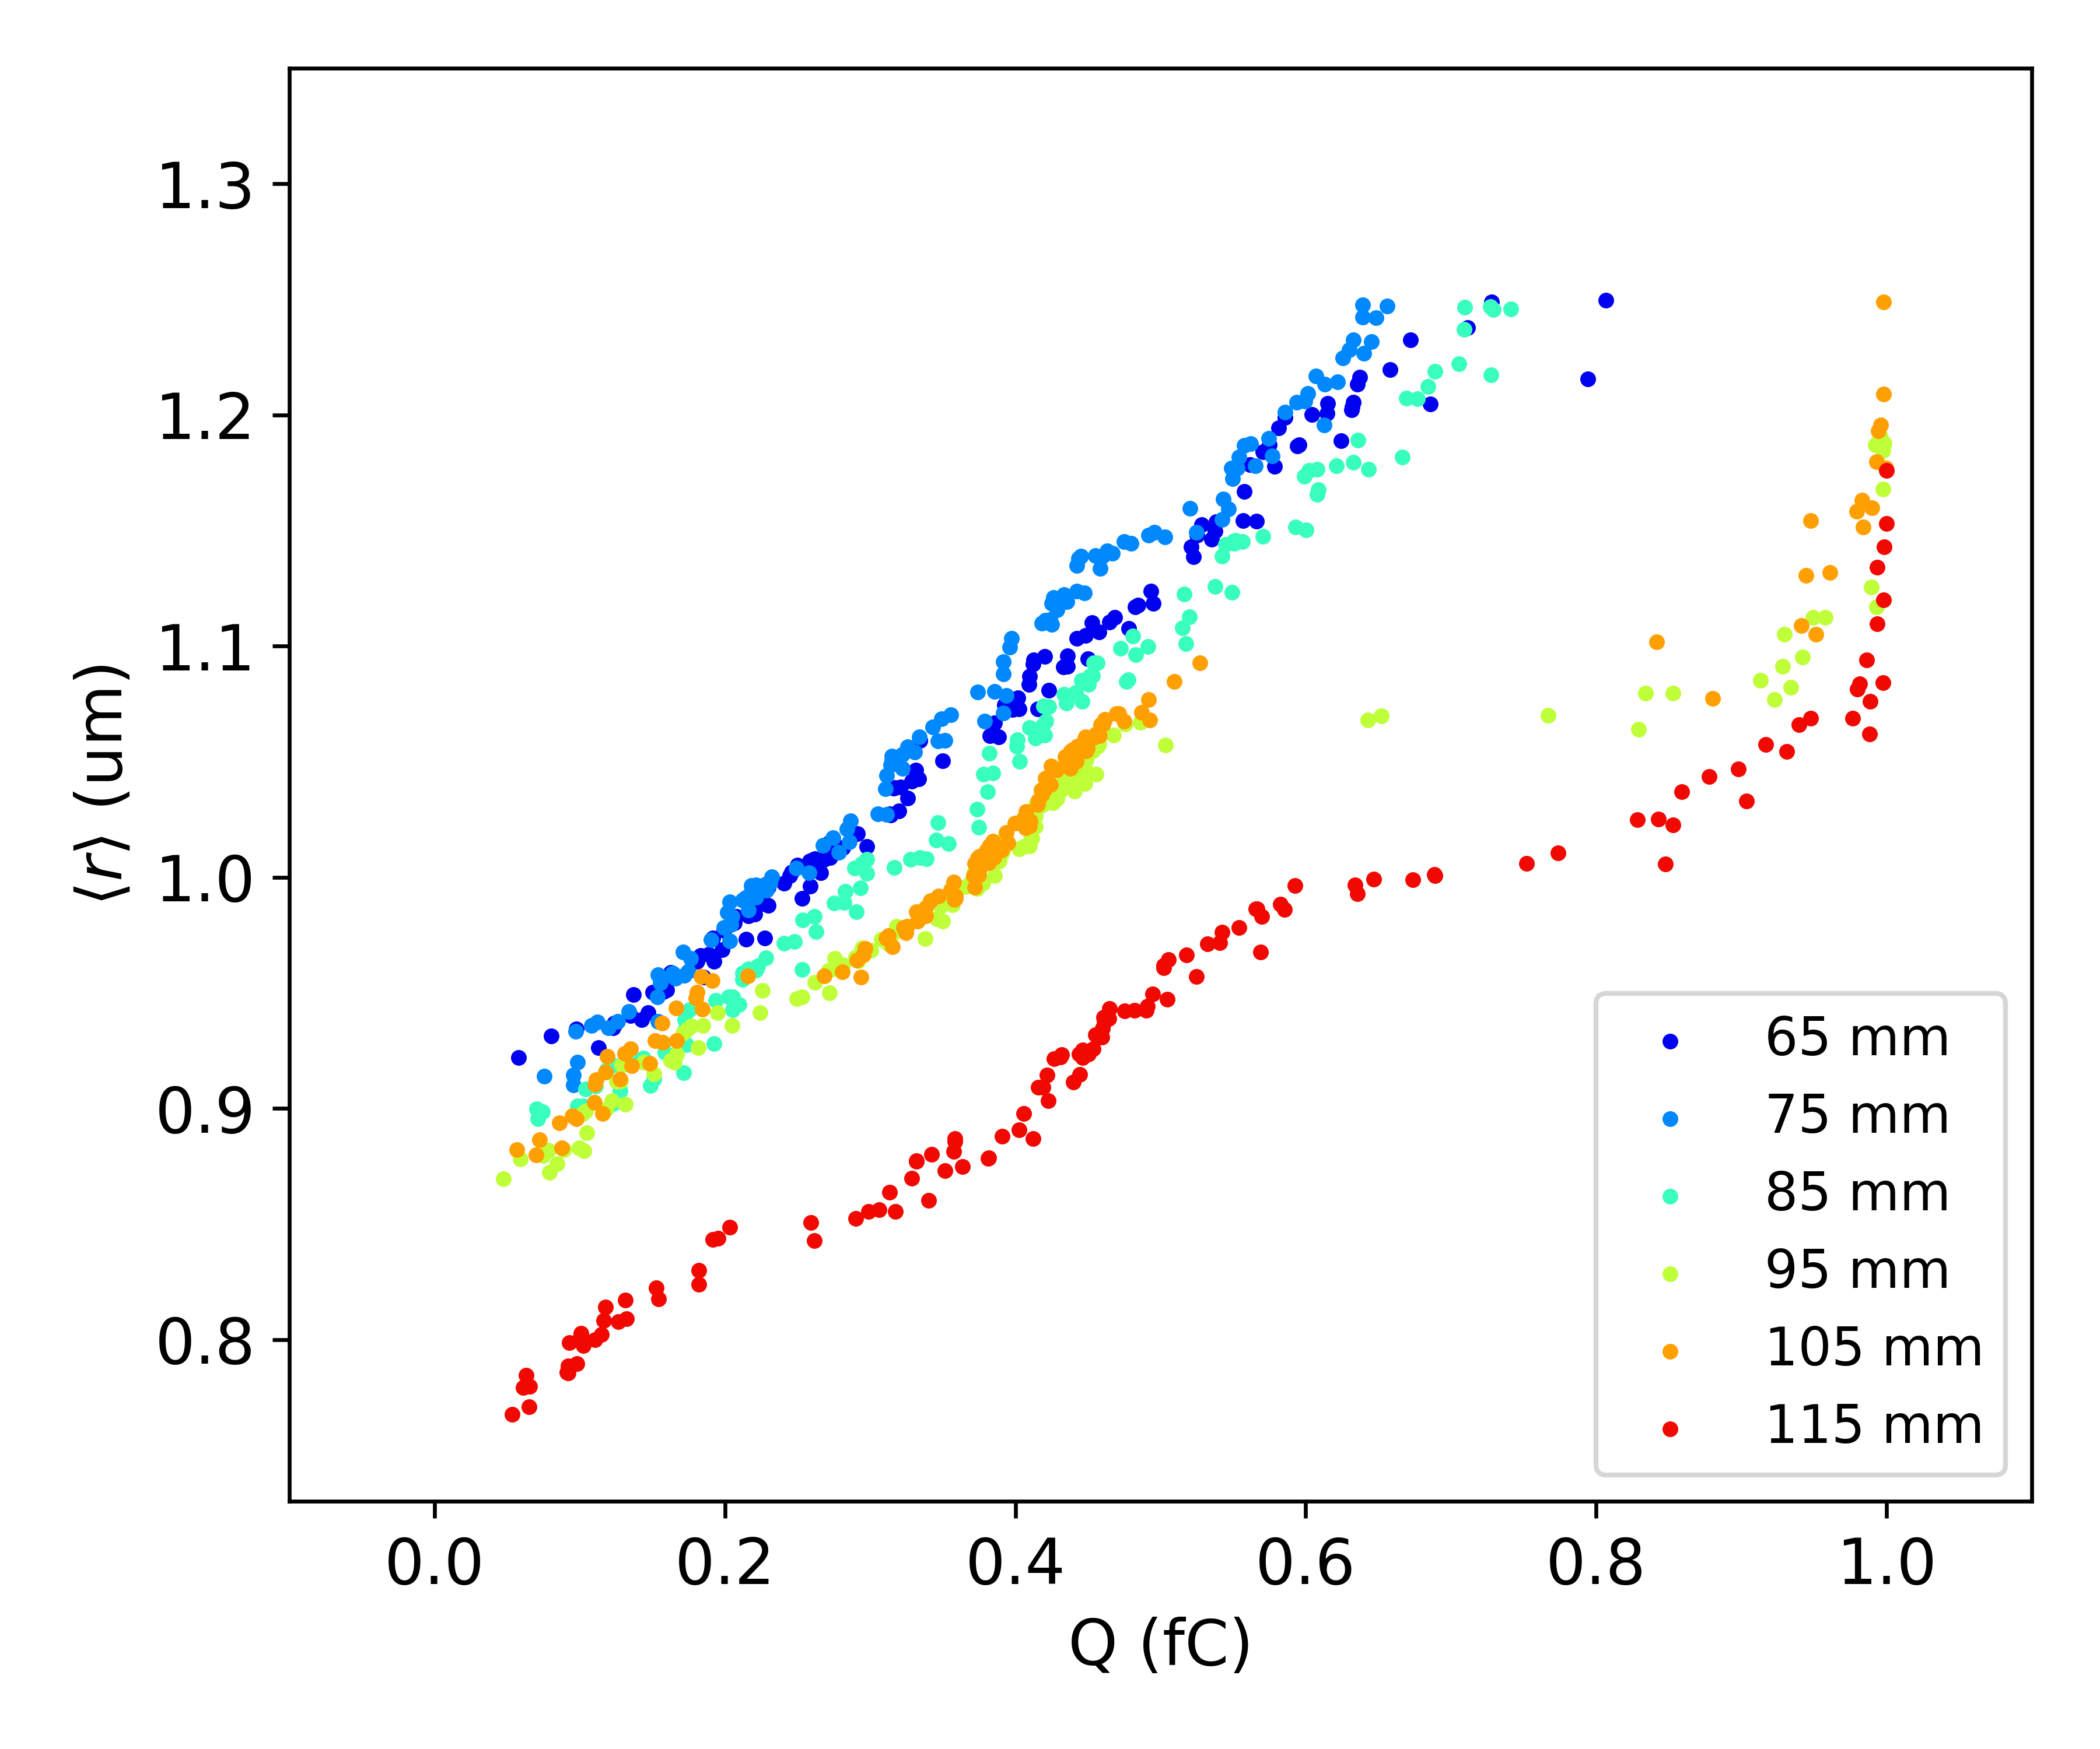
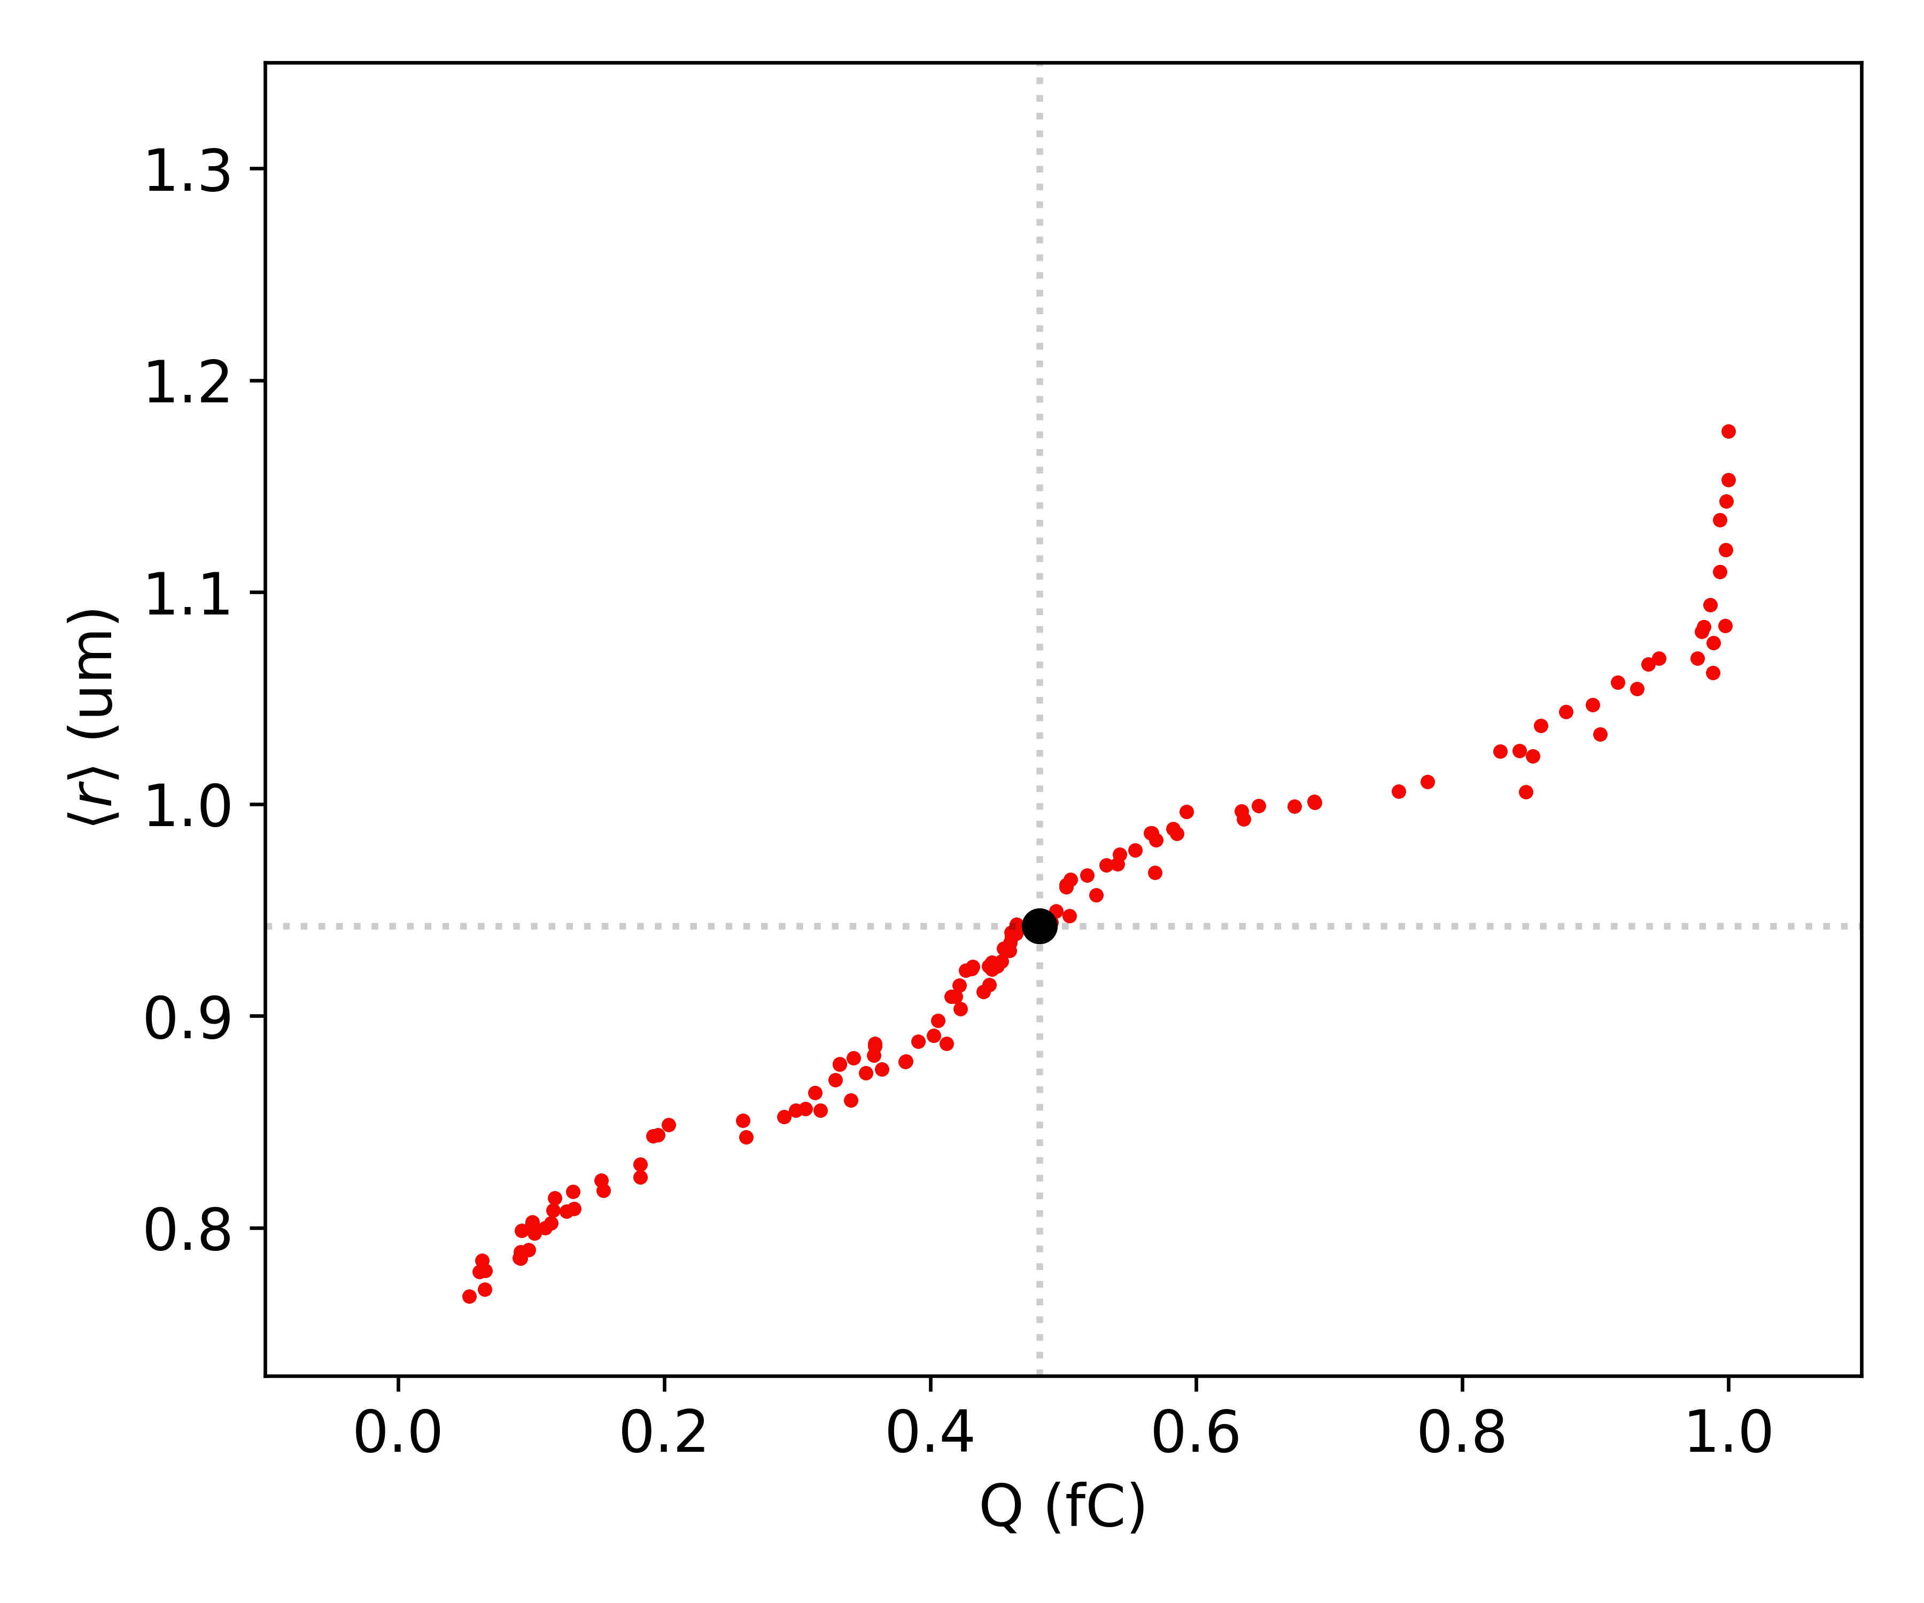
Magnet Optimization: Pareto Fronts
Different Choices of focal positions lead to different Pareto fronts
Magnet Configuration based on a chosen bunch charge
For a fixed magnet configuration, a different Pareto Front is obtained.

Slide 8
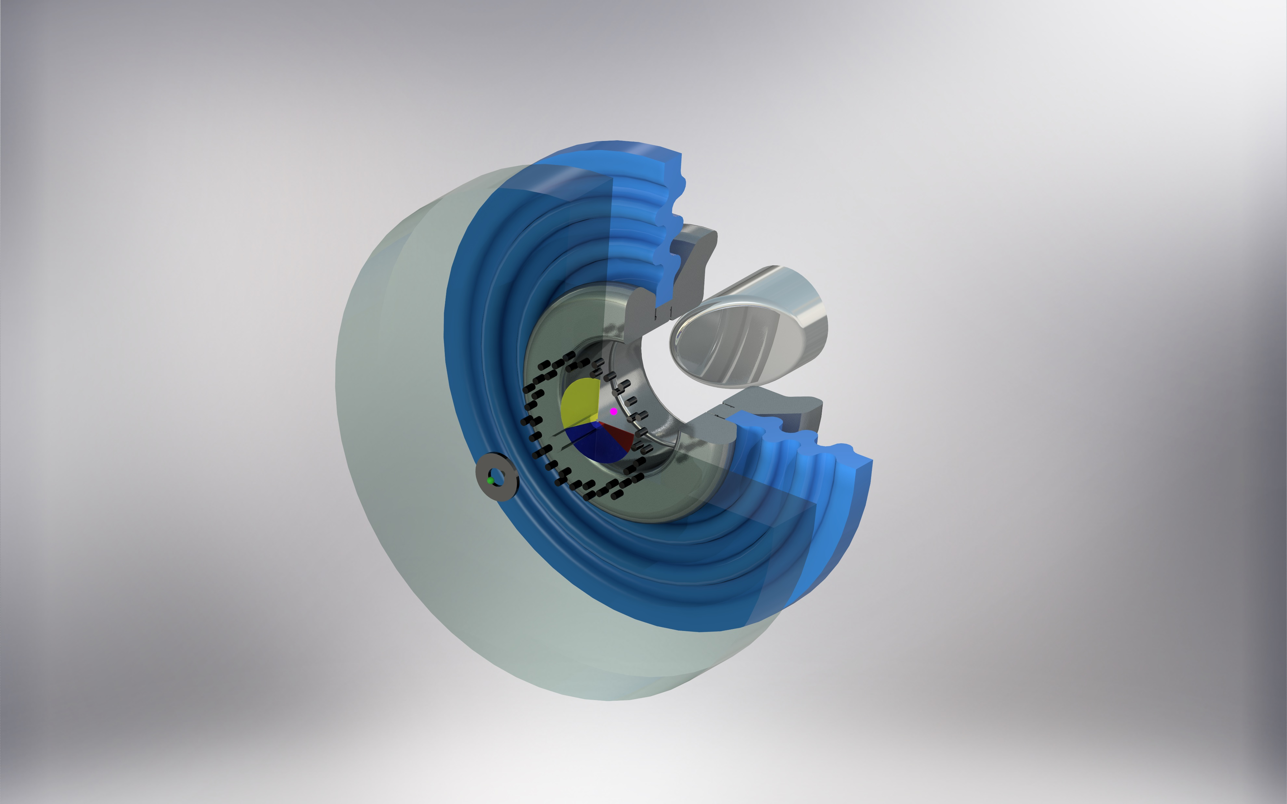
Accelerator Assembly
Mirror
Magnet 1
(tiled)
Rb Atoms
(Source)
Negative Electrode
Grating
HV Insulator
Focus
Ground Electrode
Magnet 2

Slide 9
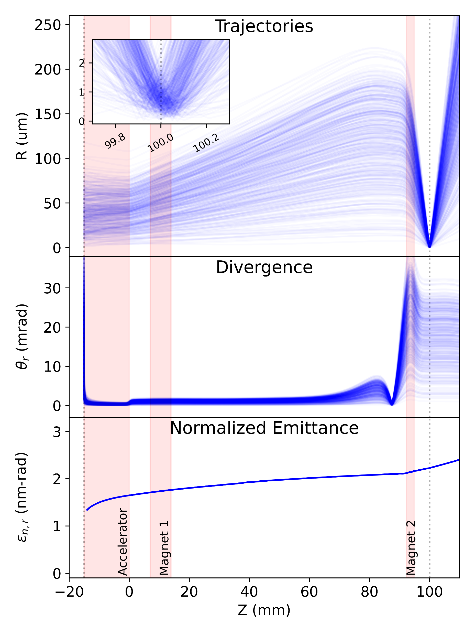
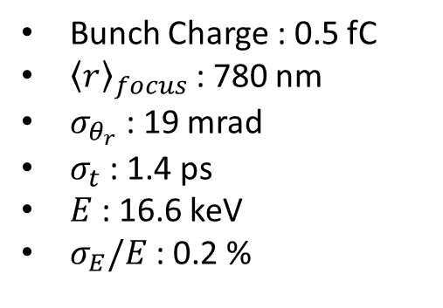
Injector Performance
Bunch Charge : 0.5 fC
${\left\langle r\right\rangle }_{focus}$ : 780 nm
$σ_{θ_{r}}$ : 19 mrad
$σ_{t}$ : 1.4 ps
$E$ : 16.6 keV
$σ_{E}/E$ : 0.2 %

Slide 10
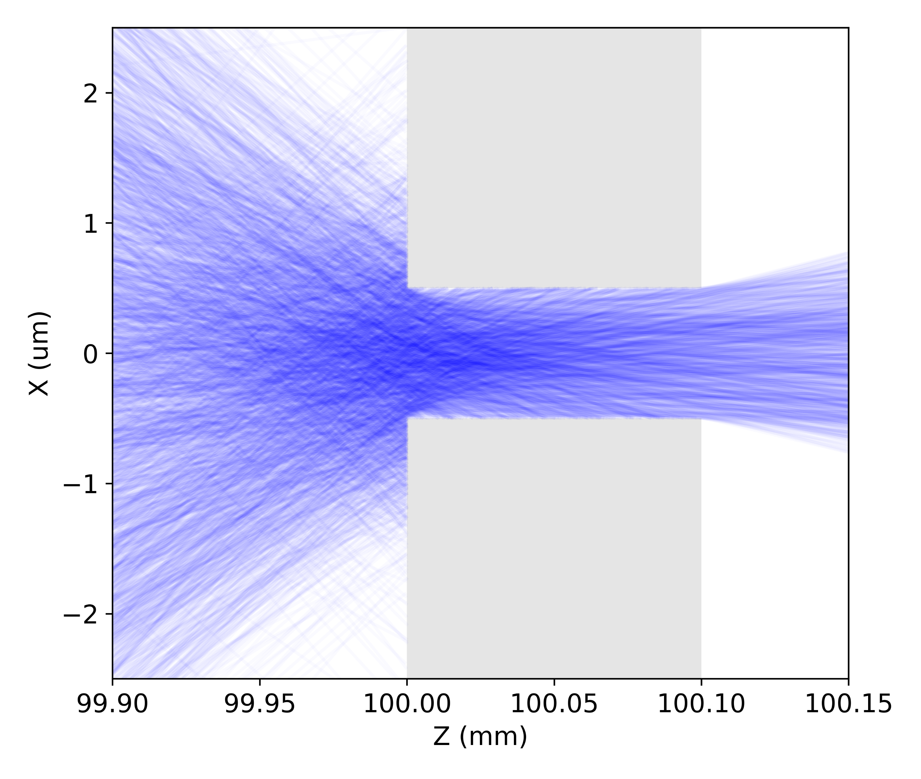
Estimate of Injection into $λ$=10um DLA structure
90 (60) electrons per bunch for 1 GV/m (100 MV/m) gradient for an aperture of 5 um x 1 um
Significant Improvement over typical sub-relativistic injection of 0.005 electrons per bunch
Shiloh, R. et al. Electron phase-space control in photonic chip-based particle acceleration, Nature 597, 498–502 (2021)

Slide 11





Acknowledgements
Funded by
Huijts, J.
Luiten, O. J.
Borrelli, S.
van der Geer, S. B.

Slide 12
Questions?

Slide 13
Estimate of Injection into $λ$=10um DLA structure
90 (60) electrons per bunch for 1 GV/m (100 MV/m) gradient for an aperture of 5 um x 1 um
Significant Improvement over typical sub-relativistic injection of 0.005 electrons per bunch
Shiloh, R. et al. Electron phase-space control in photonic chip-based particle acceleration, Nature 597, 498–502 (2021)

