Slide 1




Isola d'Elba, Italy, 21st - 27th September 2022
Terahertz-driven compression for femtosecond bunching and laser-electron temporal locking of relativistic electron beams.
Christopher T. Shaw (PDRA)
The Cockcroft Institute & Lancaster University
Representing the Terahertz Acceleration Group

Slide 2
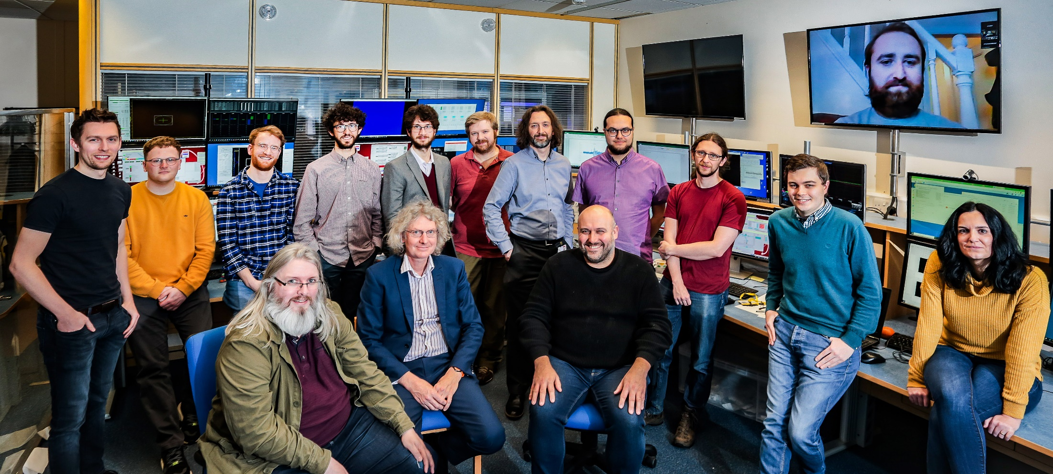


Terahertz acceleration group @ The Cockcroft Institute
Connor Mosley
Morgan Hibberd
Joseph Bradbury
Sergey Siaber
Dave
Walsh
Darren Graham
Laurence Nix
Matt
King
Tom
Pacey
Dan Lake
Christopher Shaw
Beatriz
Higuera Gonzalez
Graeme Burt
Steven Jamison
Rob Appleby
+ STFC staff
THzAG.uk
25th September 2025

Slide 3
Introduction: Why Terahertz?
High quality femtosecond relativistic electron beams desired for applications such as:
  Free electron laser pump probe experiments
  Ultrafast electron diffraction
  Future high-energy physics colliders
Few-femtosecond bunches achieved by existing accelerators such as:
  Advanced free electron laser facilities
  Laser plasma accelerators
The problems:
  Fine femtosecond level control
  Stability and synchronisation to external laser
The solution:
Terahertz!
RF
>2 GV/m
to match
THz
20 MV/m
f_{RF} = 3 GHz
T_{RF} > 300 ps
Energy gain
Electron bunch
<1 ps
Energy loss
Multi-cycle
THz pulse
f_{THz} = 0.39 THz
T_{THz} = 2.56 ps
25th September 2025

Slide 4
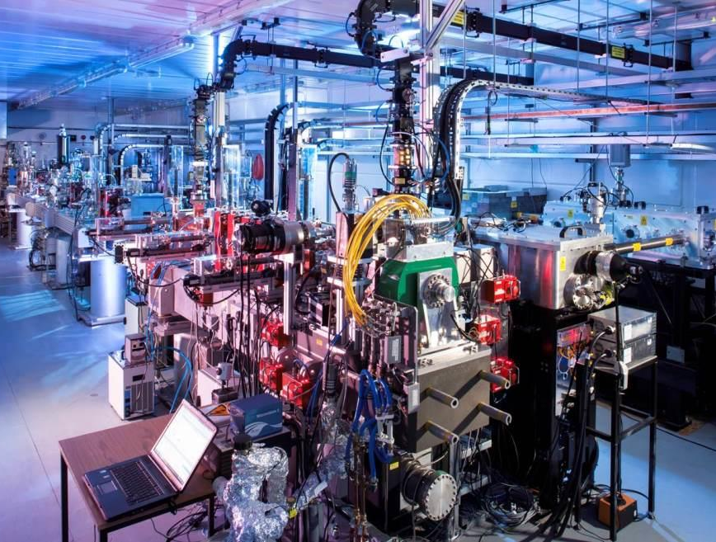
Experimental Setup Overview
Compact Linear Accelerator for Research and Applications
Terahertz dielectric lined waveguide
Magnetic chicane compressor
3 GHz RF linac
35.5 MeV
Magnetic dogleg
PPLN wafer stack terahertz source
Electron bunch
<1 ps
Energy gain
5.5 MeV
1 m
Short bunch:
400 fs rms
2 pC charge
Long bunch:
2.5 ps rms
30 pC charge
Energy loss
Multi-cycle
THz pulse
f_{THz} = 0.39 THz
T_{THz} = 2.56 ps
25th September 2025

Slide 5
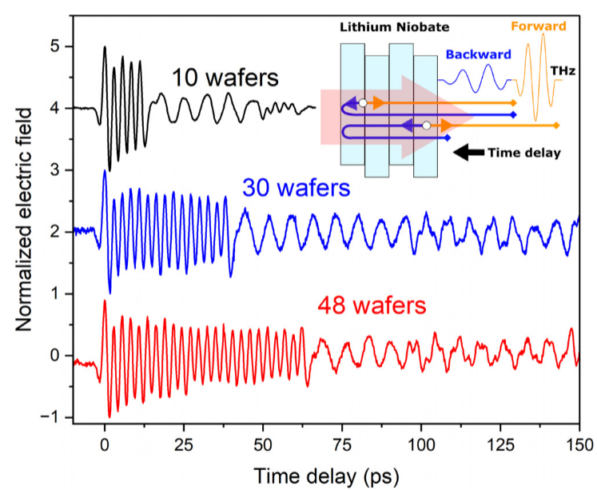
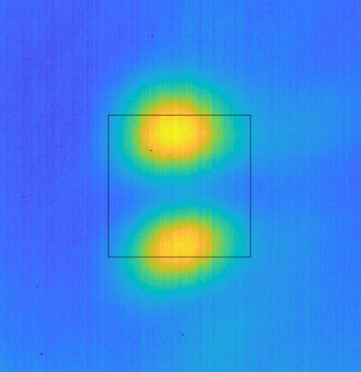

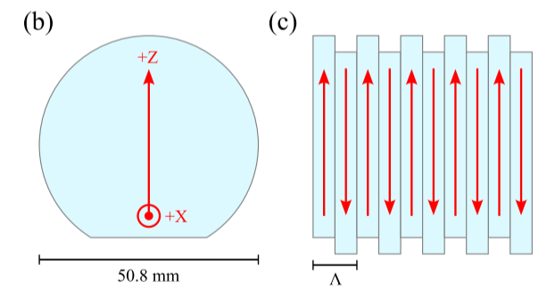
Experimental Setup: The Terahertz source
Drive Laser:
Up to 600 mJ pulses
800 nm central wavelength
50 fs transform limited duration → 750 fs chirped in use
500 mJ·cm⁻² fluence at stack
THz source:
10 Cycle (20 wafer) pulse
120uJ pulse energy
0.03-0.1% conversion efficiency
Converted to free space quasi-TEM₀₁ mode
THz beam profile
F. Lemery et. al. Commun. Phys. 3, 150 (2020)
THz frequency
Domain period (2x wafer thickness)
THz phase shear plate
PPLN wafer stack
THz pulse
Drive laser
P. J. Dalton et. al. Appl. Phys. Lett. 125, 141101 (2024)
C. D. W. Mosley et al. Optics Express. 3, 4041-4054 (2023)
25th September 2025

Slide 6
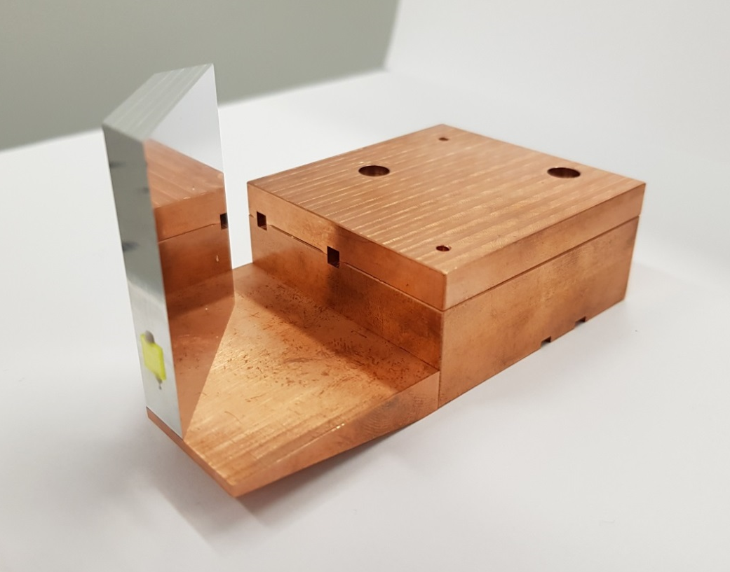
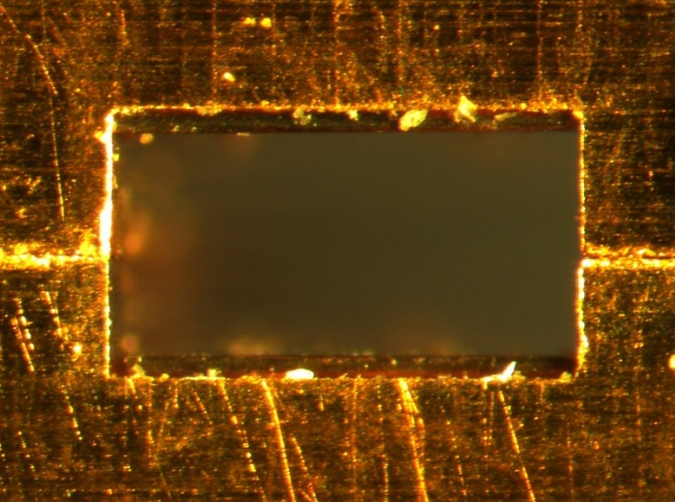
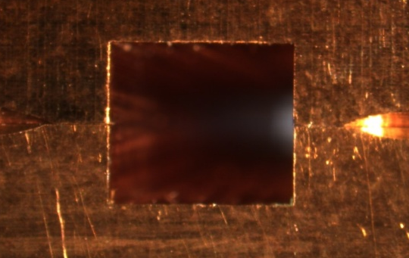
Experimental Setup: Dielectric lined waveguide
Dielectric lining results in: Longitudinal Section Magnetic modes (LSM)
LSM₁₁ for acceleration
Dimensions matched to give the LSM₁₁ THz the same phase velocity as the electron beam velocity v_{e} = c (1 - 10⁻⁴)
Single bunch compression
Sub-cycle chirping
Short injected bunch
DLW assembly
Energy
Energy
Time
THz DLW
Time
30 mm
Long injected bunch
Multi-cycle modulation
DLW exit
Energy
Energy
460μm
600 μm
Coupler entrance
Time
Time
Multi Bunch Train
3.25 mm
3.18 mm
L. J. R. Nix et. al. Phys. Rev. Accel. Beams 27, 041302 (2024)
25th September 2025

Slide 7
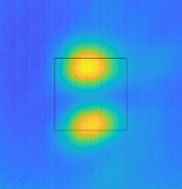
Experimental Setup: The Terahertz interaction extrapolated
Short injected bunch
Sub-cycle chirping
Single compressed
bunch
Single bunch compression
Energy
Energy
THz beam profile
Energy
Time
Magnetic chicane compressor
Time
THz DLW
Time
30 mm
CLARA
3 GHz RF linac
35.5 MeV
THz phase shear plate
Micro-bunch
train
PPLN wafer stack
5.5 MeV
Magnetic dogleg
THz pulse
Drive laser
Long injected bunch
Multi-cycle modulation
1 m
Energy
Multi Bunch Train
Energy
Energy
Time
Time
Time
25th September 2025

Slide 8
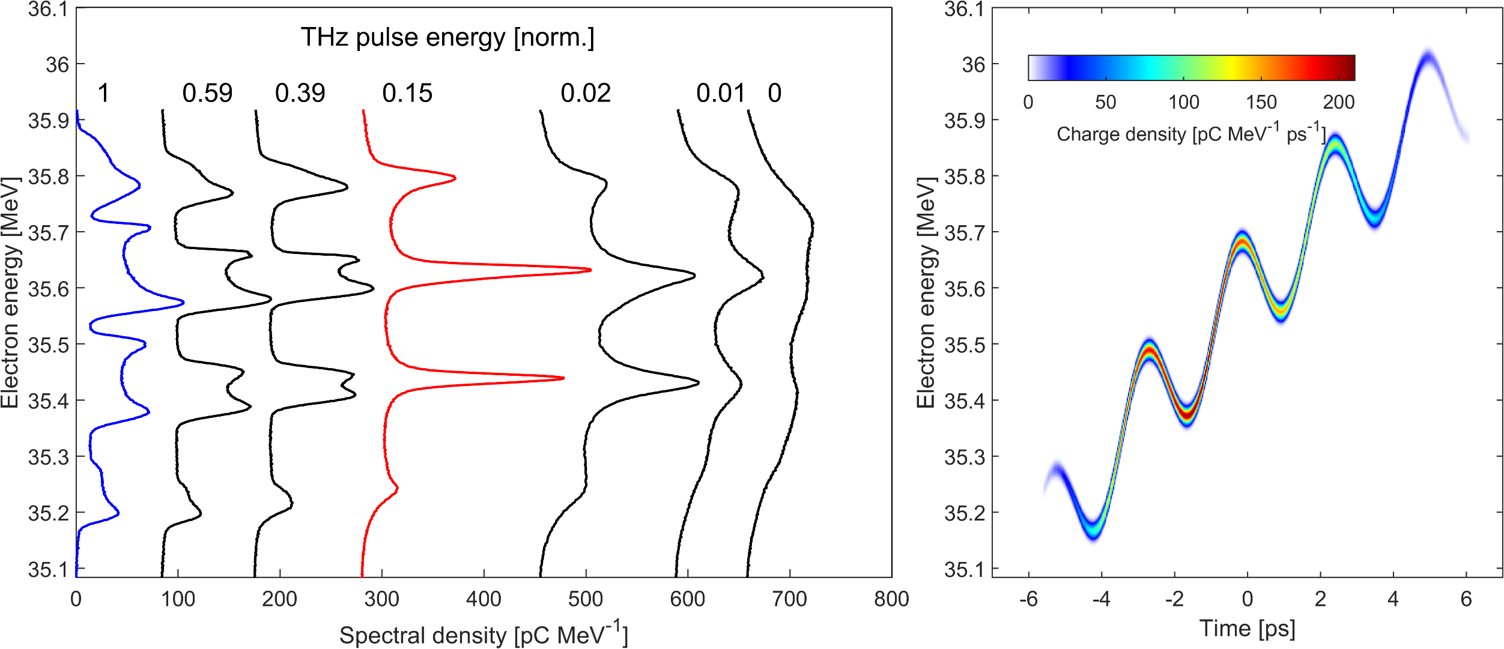
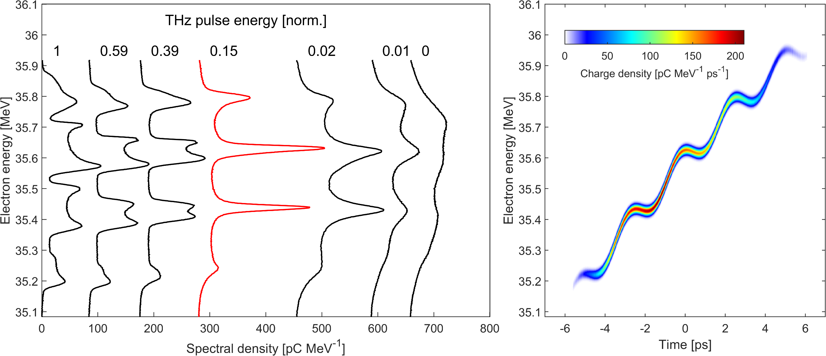
Multi Bunch Train
Measured
Simulated Phase Space
25th September 2025

Slide 9
Multi Bunch Train
Measured
Simulated Phase Space
25th September 2025

Slide 10
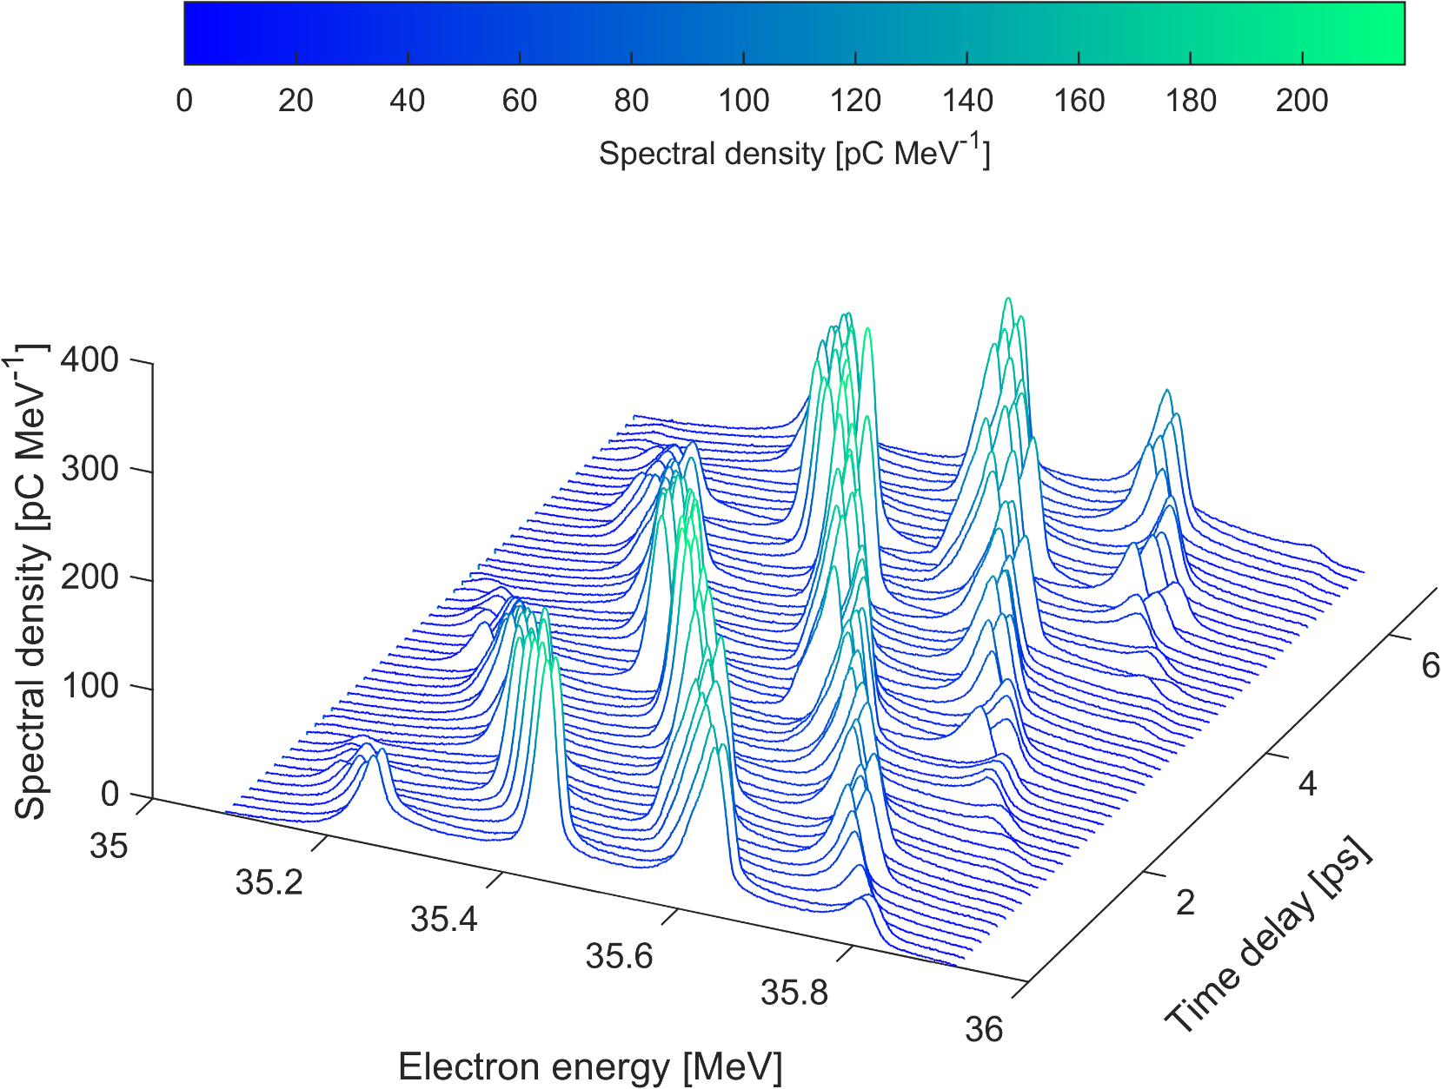
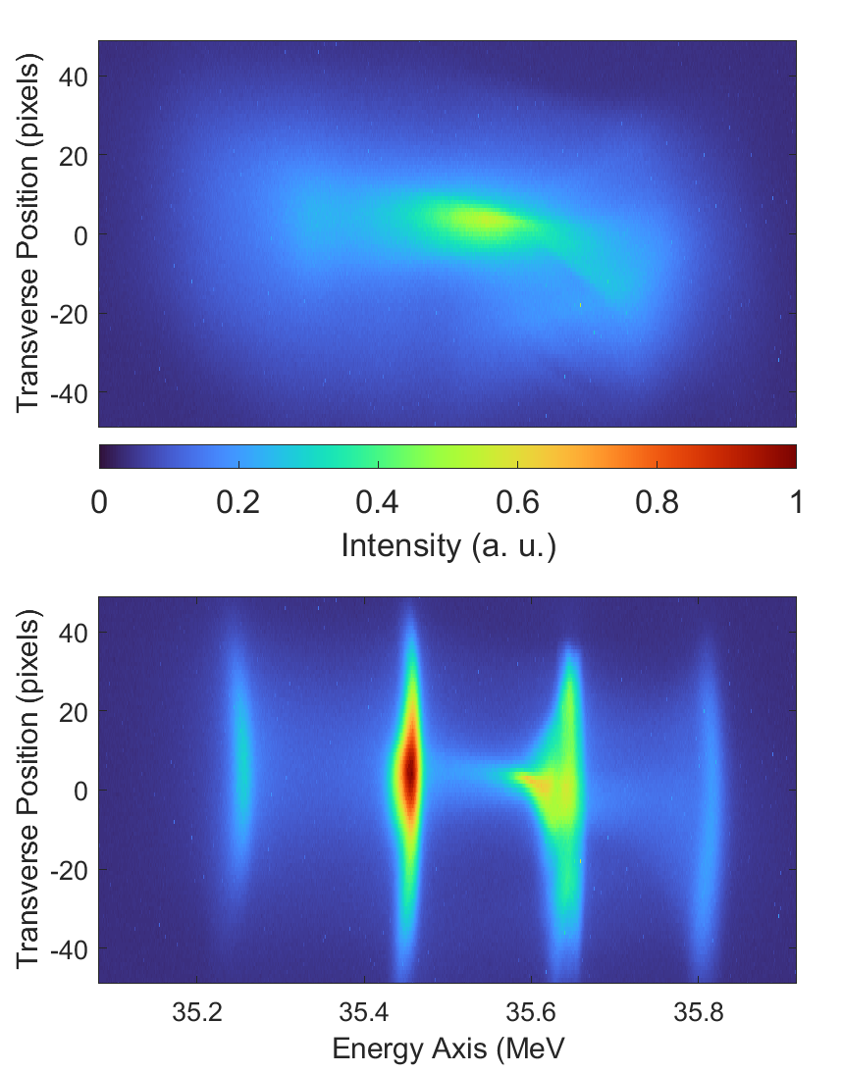
Multi Bunch Train
Energy Spectrometer Images
No THz
THz on
Long bunch:
2.5 ps rms
30 pC charge
450 keV FWHM
25th September 2025

Slide 11
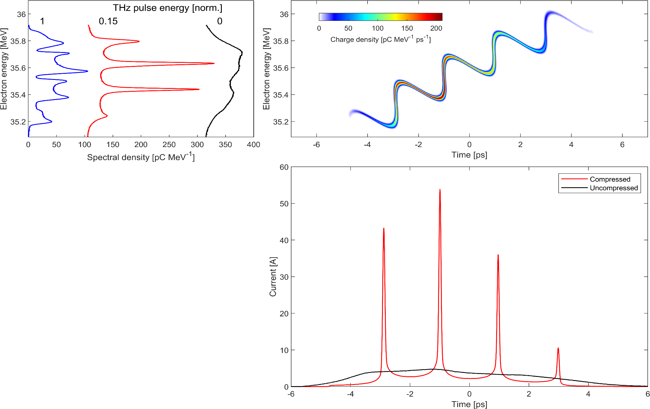
Multi Bunch Train
Long bunch:
2.5 ps rms
30 pC charge
450 keV FWHM
Multi-cycle modulation
2 ps spacing
Magnetic chicane compressor
Micro-bunch train
Energy
Energy
Time
37 fs rms
Time
25th September 2025

Slide 12
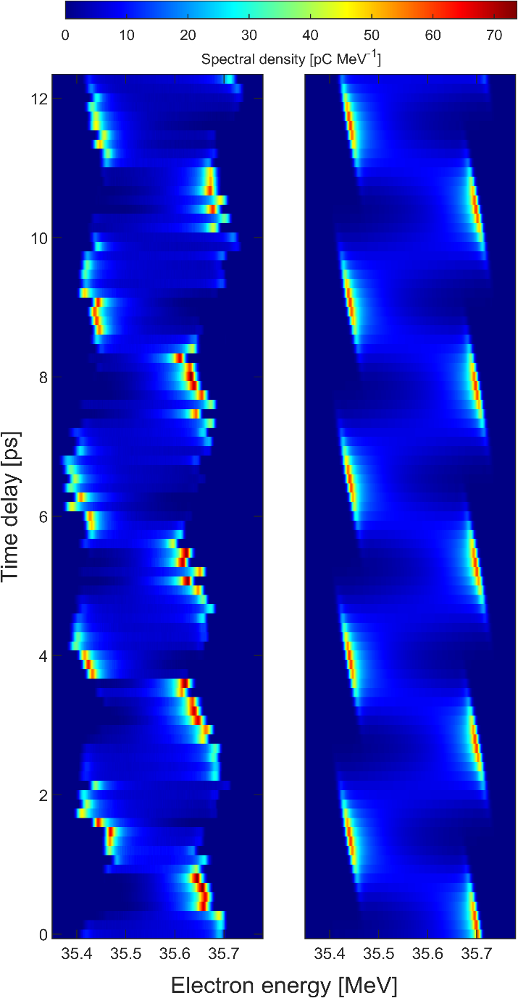
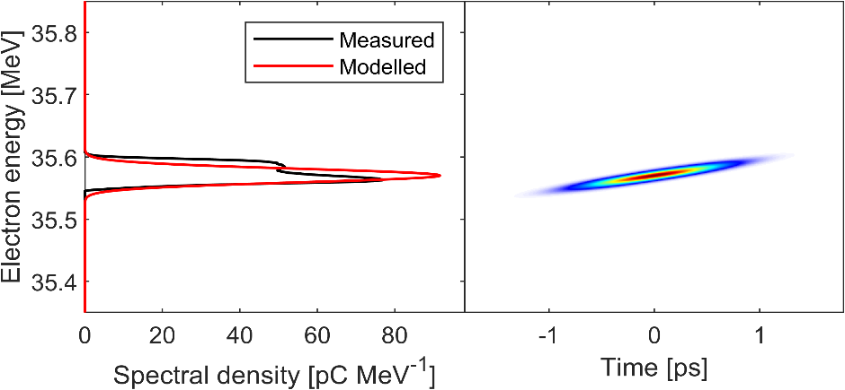
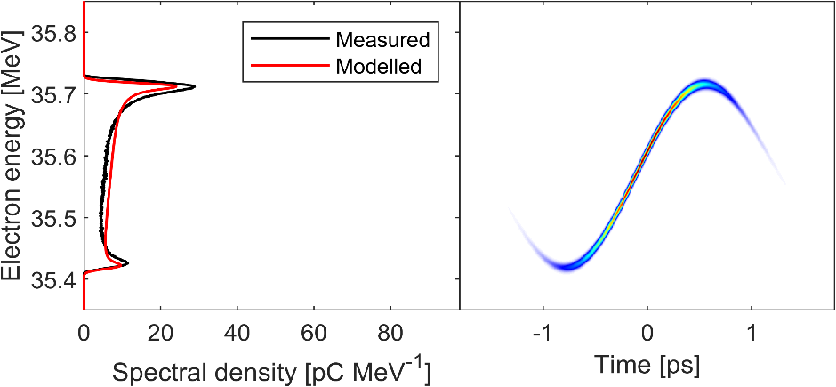
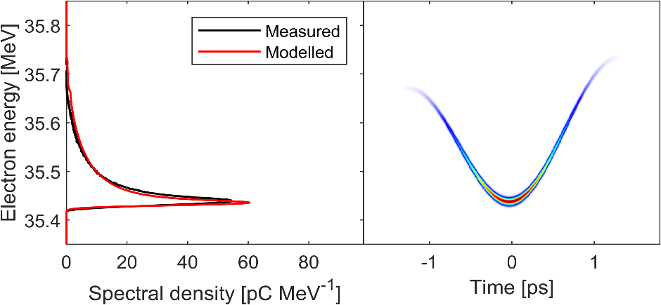
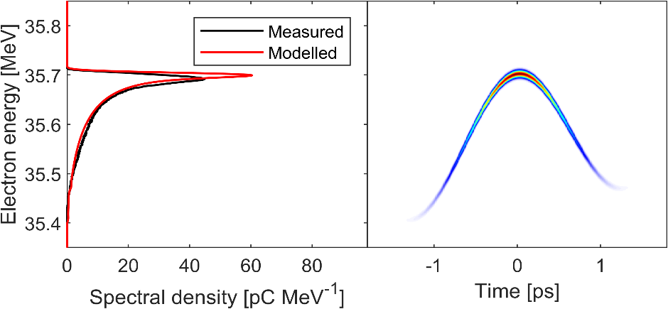
Single bunch compression
THz off
Chirping
Acceleration
Deceleration
25th September 2025

Slide 13
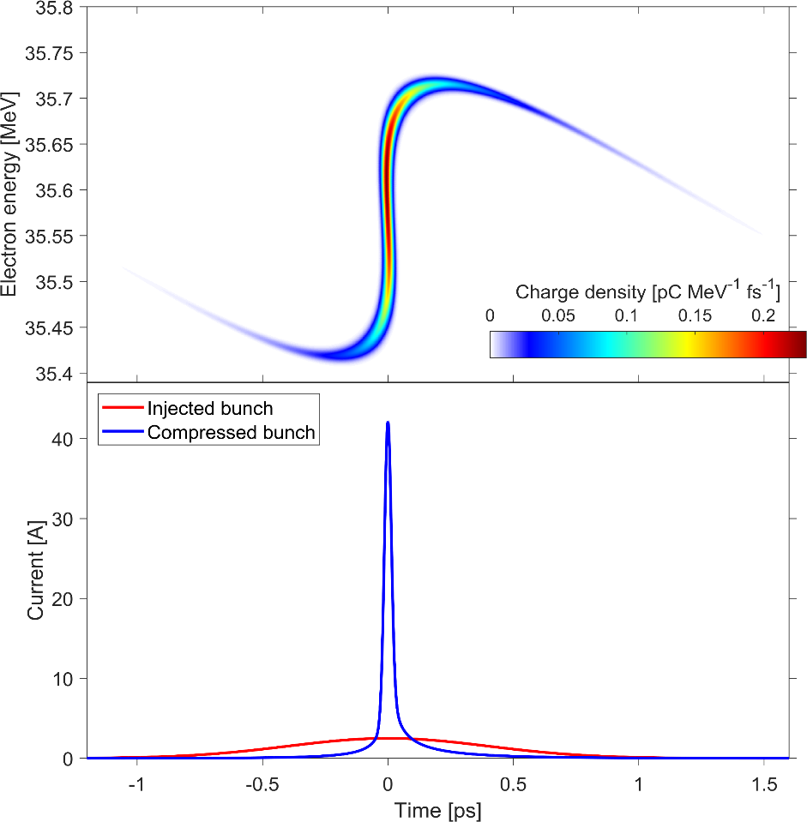
Single bunch compression
Sub-cycle chirping
Single compressed
bunch
Magnetic chicane compressor
Energy
Energy
15 fs rms
Time
Time
400 fs rms
25th September 2025

Slide 14










Temporal Locking: Modelling elements
RF
THz
$$U_{i}=U_{inj}+U_{RF}\cos\left(ω_{RF}t_{inj}+φ_{RF}\right)$$
Drift + Dogleg
$$U_{iii}=U_{ii}+U_{THz}\sin\left(ω_{THz}\left(t_{ii}+t_{THz}\right)\right)$$
Drift + chicane
$$t_{i}=t_{inj}$$
$$t_{iii}=t_{ii}$$
$${∆φ}_{RF}$$
Greatest change in electron bunch chirp at THz zero cross phase
$$∆t_{THz}$$
$$∆U_{RF}$$
Energy
$$∆U_{THz}$$
Magnetic chicane compressor
Energy
$$U_{RF}$$
$$∆t_{inj}$$
Time
THz DLW
Energy
$$∆U_{inj}$$
Time
CLARA
3 GHz RF linac
Converts electron bunch chirp to compression around THz zero cross phase
Time
35.5 MeV
THz source
5.5 MeV
Magnetic dogleg
1 m
25th September 2025

Slide 15
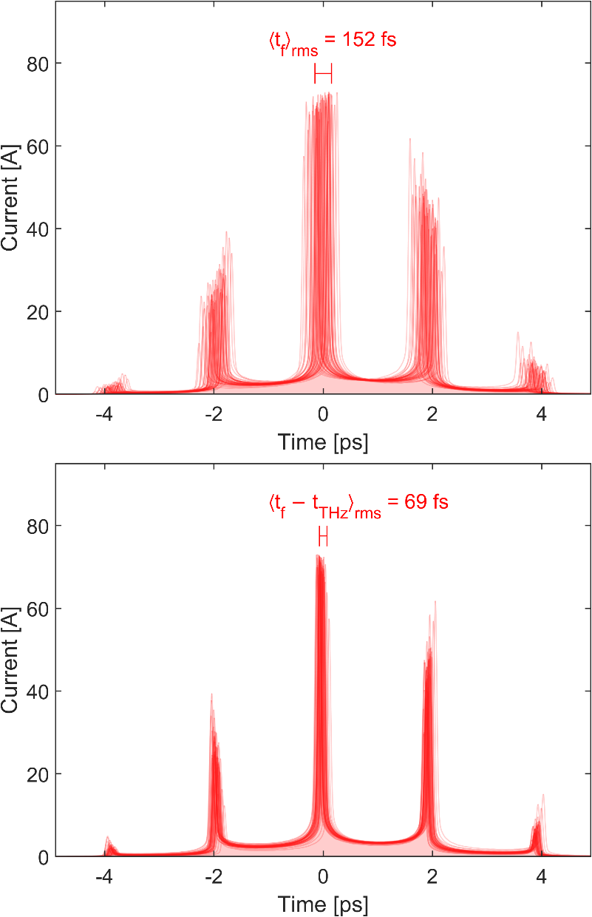
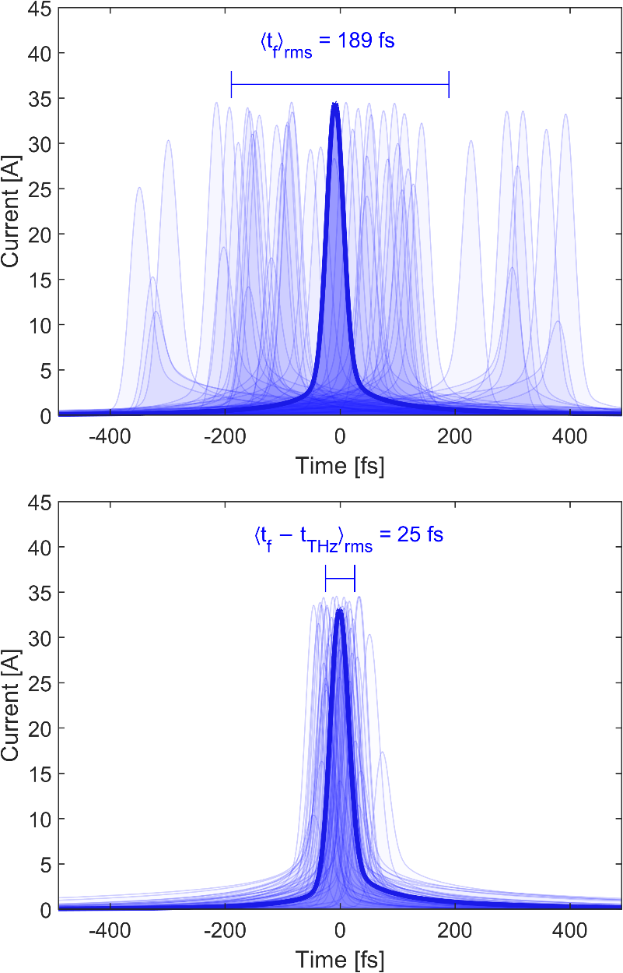
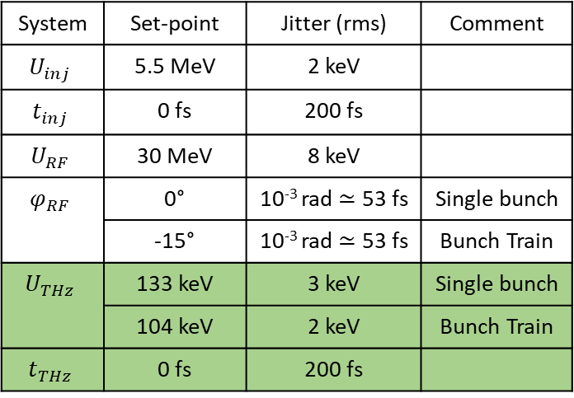
Jitter suppression
Laboratory Reference Frame:
System | Set-point | Jitter (rms) | Comment
$$U_{inj}$$ | 5.5 MeV | 2 keV
$$t_{inj}$$ | 0 fs | 200 fs
$$U_{RF}$$ | 30 MeV | 8 keV
$$φ_{RF}$$ | 0° | 10⁻³ rad $≃$ 53 fs | Single bunch
 | -15° | 10⁻³ rad $≃$ 53 fs | Bunch Train
$$U_{THz}$$ | 133 keV | 3 keV | Single bunch
 | 104 keV | 2 keV | Bunch Train
$$t_{THz}$$ | 0 fs | 200 fs
Long Bunch
Terahertz Drive Laser Reference Frame:
Short Bunch
New laser locked reference point
25th September 2025

Slide 16


Summary
Long Bunch Initial:
2.5 ps rms
30 pC charge
2 ps spacing
Long Bunch Final:
37 fs duration electron bunches
RF phase controlled ps spacing
69 fs timing jitter to laser
Ideal for plasma wakefield applications
37 fs rms
15 fs rms
400 fs rms
Short Bunch Initial:
400 fs rms
2 pC charge
Short Bunch Final:
15 fs duration electron bunches
25 fs timing jitter to laser
High peak current for charge of bunch
Extremely stable ultrashort bunch for further experimentation
25th September 2025

Slide 17

Thank You Any Questions?
Connor Mosley
Morgan Hibberd
Joseph Bradbury
Sergey Siaber
Dave
Walsh
Darren Graham
Laurence Nix
Matt
King
Tom
Pacey
Dan Lake
Christopher Shaw
Beatriz
Higuera Gonzalez
Graeme Burt
Steven Jamison
Rob Appleby
THzAG.uk
+ STFC staff
M. Hibberd et. al. arXiv:2508.20685 [physics.acc-ph]
25th September 2025

