Slide 1



Proposal to control BBU instability in SWFA by using adjustable rectangular DLWs
B. Higuera González, T. Overton, T. Pacey, Y. Saveliev, G. Xia

Slide 2
Overview
WHAT
  Beam Break Up (BBU) instability
WHY
  Dielectric Wakefield Acceleration (DWA)
HOW
  BBU compensation schemes
  Destreaker for BBU compensation
Simulations
  Parameters
  Results
Conclusions

Slide 3
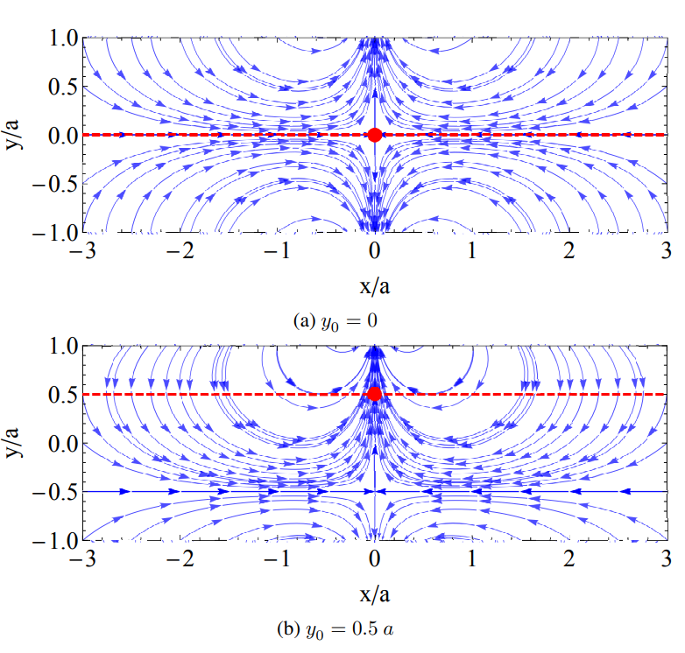
WHAT – Beam Break Up (BBU) instability
Wakefields are generated by Cherenkov radiation when charged particles travel faster than the speed of light inside the structure.
Transverse wakefields can induce BBU instability and lead to charge losses.
Beam offsets produce dipole-like fields, deflecting the bunch towards the closer dielectric, developing BBU.
Image courtesy of T. Overton. Available at University of Manchester thesis (2023).

Slide 4
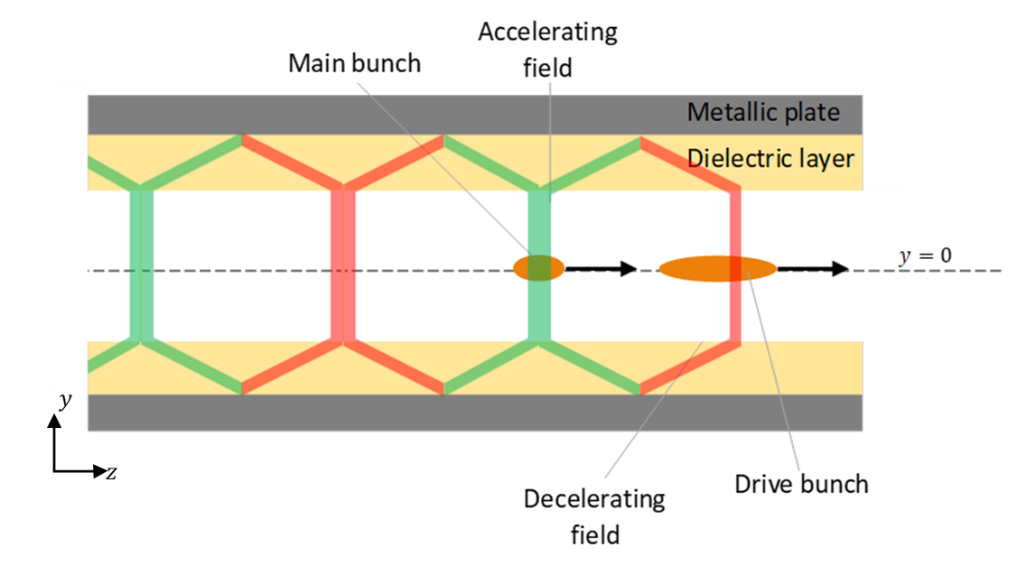
WHY – Dielectric Wakefield Acceleration (DWA)
The speed of light is reduced by dielectric layers.
A high-charge drive bunch generates longitudinal wakefields (decelerating and accelerating).
This wakefield can be used to accelerate a low-charge main bunch.
BBU limits the acceleration length and so the achievable energy gain.

Slide 5
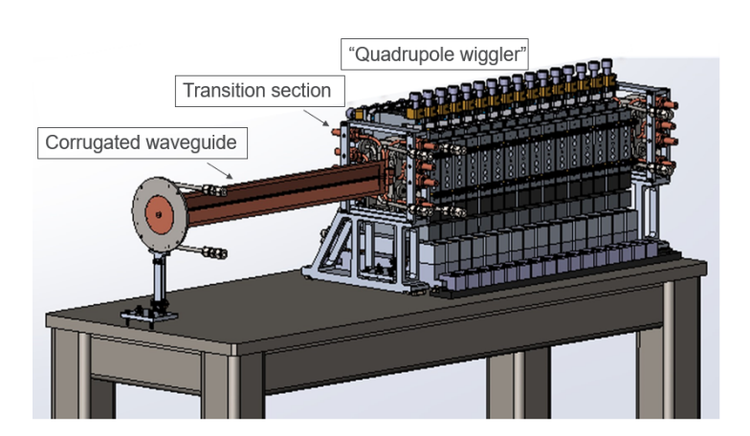
HOW – BBU compensation schemes
Lynn et al (2021). Available at Strong Quadrupole Wakefield Based Focusing in Dielectric Wakefield Accelerators
Zholents et al (2025). Available at A high repetition rate millimeter wavelength accelerator for an X-ray free-electron laser - IOPscience
H+V configuration controls quadrupole fields which could lead to beam losses.
Dipole-like transverse fields remain uncontrolled.
Quadrupole wiggler applies BNS damping to minimise BBU instability.
Set up is complex and costly

Slide 6
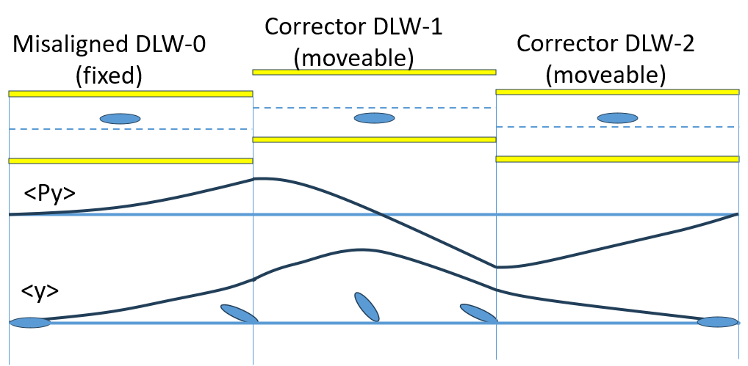
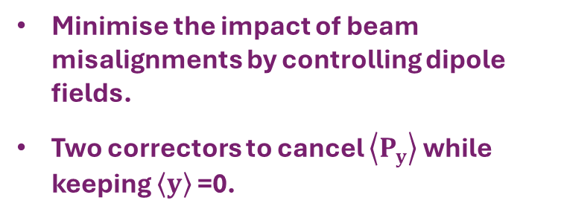
HOW –Destreaker for BBU compensation
Minimise the impact of beam misalignments by controlling dipole fields.
Two correctors to cancel $\left\langle P_{y}\right\rangle$ while keeping $\left\langle y\right\rangle$ =0.
Control transverse quadrupole fields with H+V configuration.
Simple and cost-effective.

Slide 7
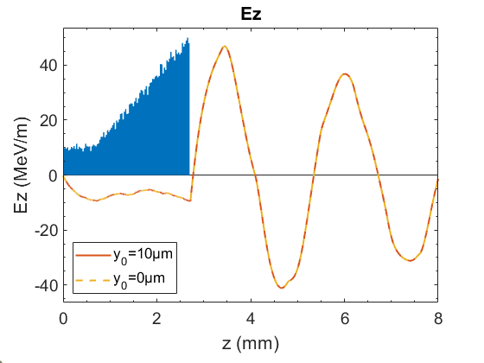
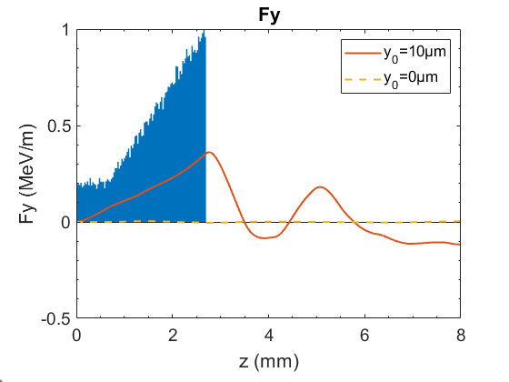
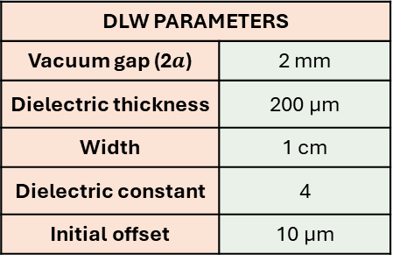
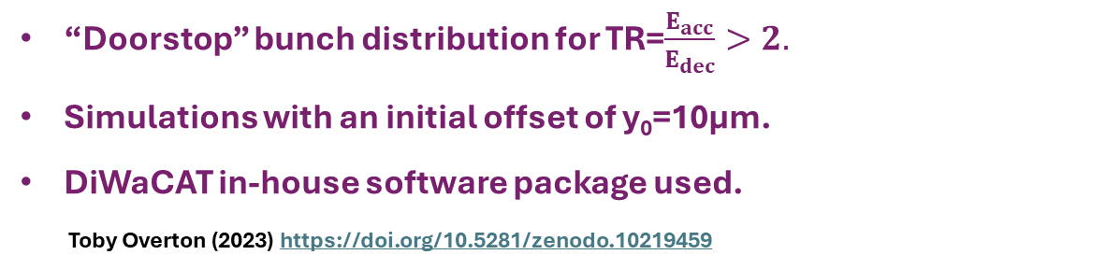
Simulations Parameters
DLW PARAMETERS
Vacuum gap (2$a$) | 2 mm
Dielectric thickness | 200 μm
Width | 1 cm
Dielectric constant | 4
Initial offset | 10 µm
BUNCH PARAMETERS
Length | 9 ps (z = λ)
Transverse Size | 20 µm RMS
Average Energy | 1 GeV
Total Charge | 10 nC
Normalised Emittance | 1 µm rad
“Doorstop” bunch distribution for TR=$\frac{E_{acc}}{E_{dec}}>2.$
Simulations with an initial offset of y₀=10μm.
DiWaCAT in-house software package used.
Toby Overton (2023) https://doi.org/10.5281/zenodo.10219459
Length (m)
DLW | 0.05 | 0.1 | 0.1 | 0.1 | 0.1 | 0.1 | 0.05 | Total
0 | H | V | H | V | H | V | H | 0.6
1 | V | H | V | H | V | H | V | 0.6
2 | H | V | H | V | H | V | H | 0.6

Slide 8
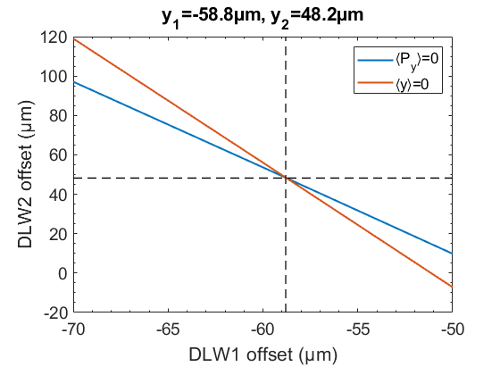

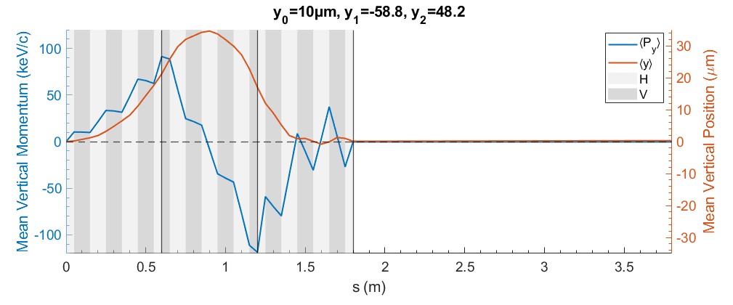
Simulations Results (9ps “Doorstop” bunch)
Confirmed both mean vertical momentum and mean vertical displacement are cancelled.
Succes?
Optimal offset chosen to cancel both mean vertical momentum and displacement.
Not quite!

Slide 9
Simulations Results (9ps “Doorstop” bunch)
Comparison of emittance growth between optimal offset combination and perfect aligned beam.
Vertical emittance grows exponentially along the bunch.

Slide 10
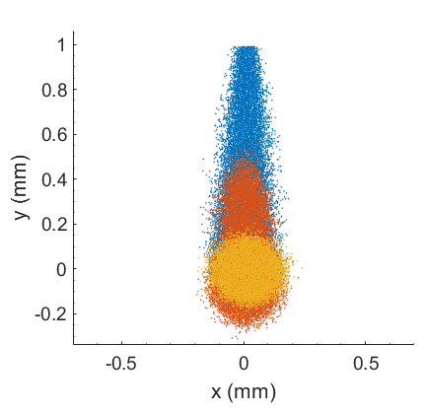
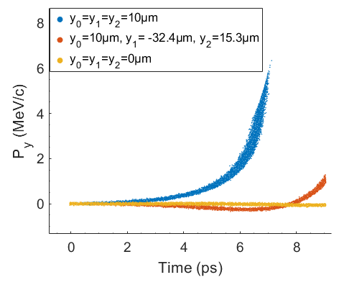
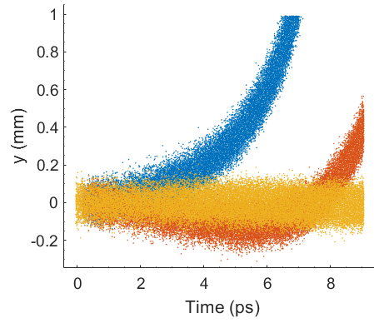
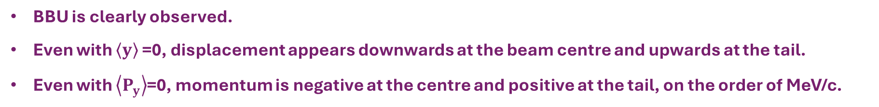
Simulations Results (9ps “Doorstop” bunch)
EXIT
BBU is clearly observed.
Even with $\left\langle y\right\rangle$ =0, displacement appears downwards at the beam centre and upwards at the tail.
Even with $\left\langle P_{y}\right\rangle$=0, momentum is negative at the centre and positive at the tail, on the order of MeV/c.

Slide 11
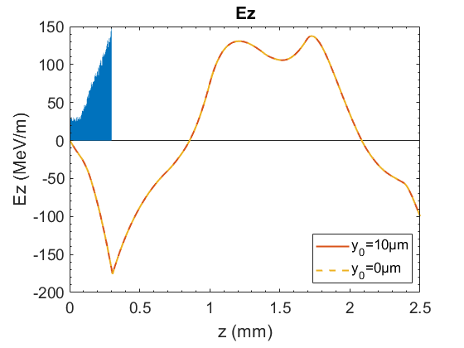
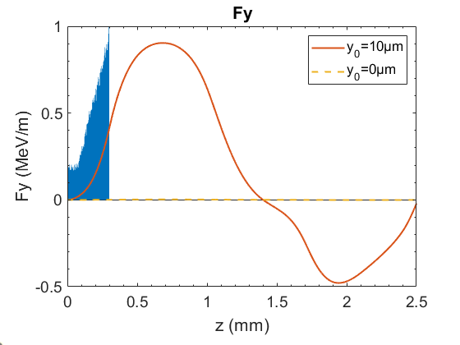
Simulations Results (1ps “Doorstop” bunch)
Simulations were repeated with a shorter bunch.
TR is reduced.
Vertical wakefields generated by the 10μm offset are similar to those of the 9 ps bunch.

Slide 12
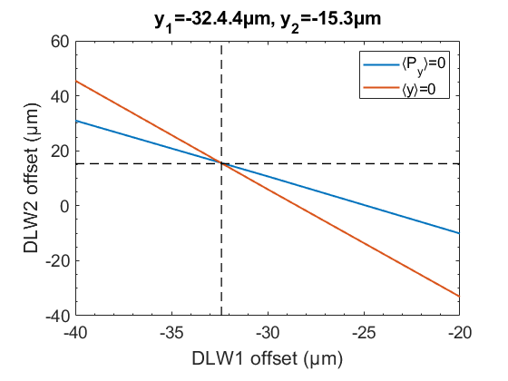
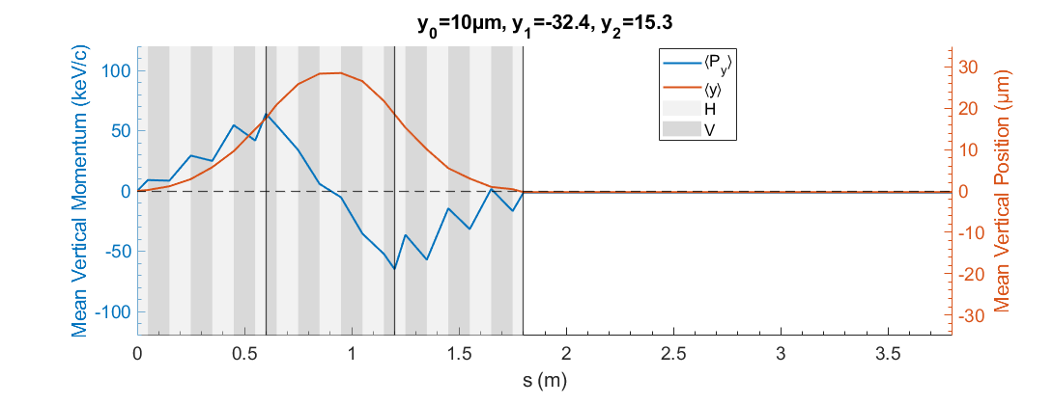
Simulations Results (1ps “Doorstop” bunch)
Cancellation of both mean vertical momentum and displacement confirmed.
Optimal offset chosen to cancel both mean vertical momentum and displacement.

Slide 13
Simulations Results (1ps “Doorstop” bunch)
Minimal difference in horizontal emittance between perfect aligned and offset bunch.
Vertical emittance grows along the structure but is almost fully compensated at the exit (1.9 vs 1.7 mm mrad).

Slide 14
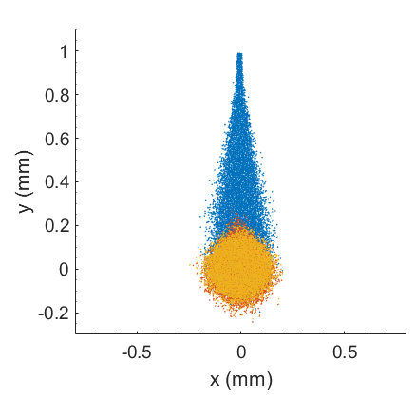
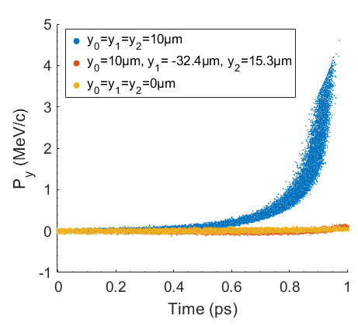
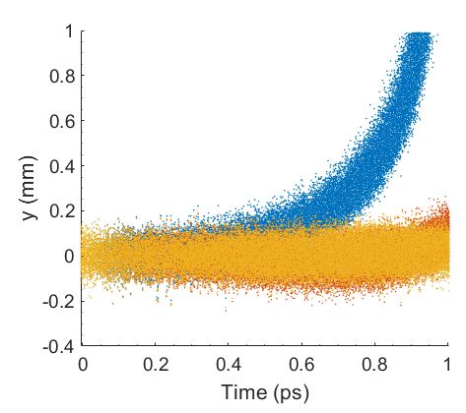
Simulations Results (1ps “Doorstop” bunch)
EXIT
Minimal BBU observed compared to aligned bunch and the bunch without offset compensation.
The bunch without vertical compensation shows charge losses in the tail.
The tail still has positive vertical momentum, although ~10 times weaker than in the longer bunch.

Slide 15
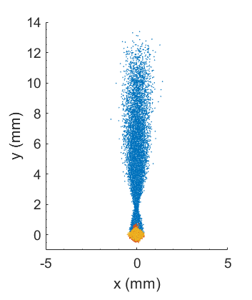
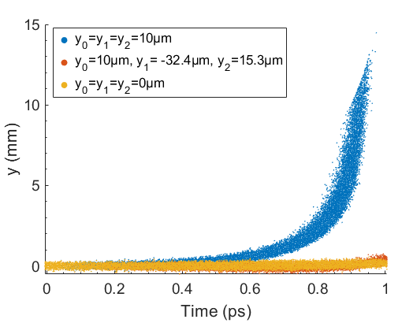
Simulations Results (1ps “Doorstop” bunch)
2m DRIFT
Minimal difference in bunch shape on screen between perfectly aligned bunch and the bunch with an initial offset using destreaker.
BBU develops with a 10μm misalignment along the entire structure.

Slide 16
CONCLUSIONS
Destreaker: novel approach to address misalignment sensitivity in SWFA.
Shown to be effective for 1ps “doorstop” bunch.
Effectiveness reduced for optimal bunch length for high TR.
Balance required between achieving high TR and controlling BBU instability.
Further study needed to better understand transverse dynamics.

Slide 17

Thank you!
beatriz.higueragonzalez@postgrad.manchester.ac.uk
beatriz.higuera-gonzalez@cockcroft.ac.uk

Slide 18
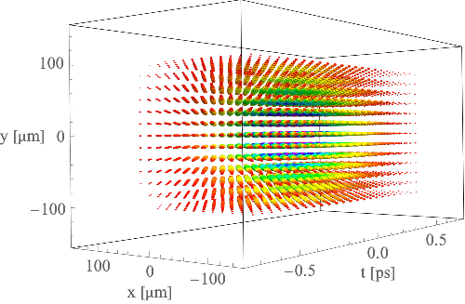
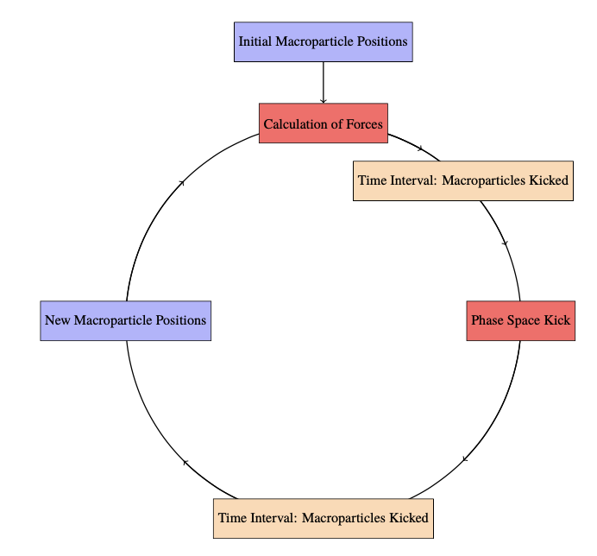

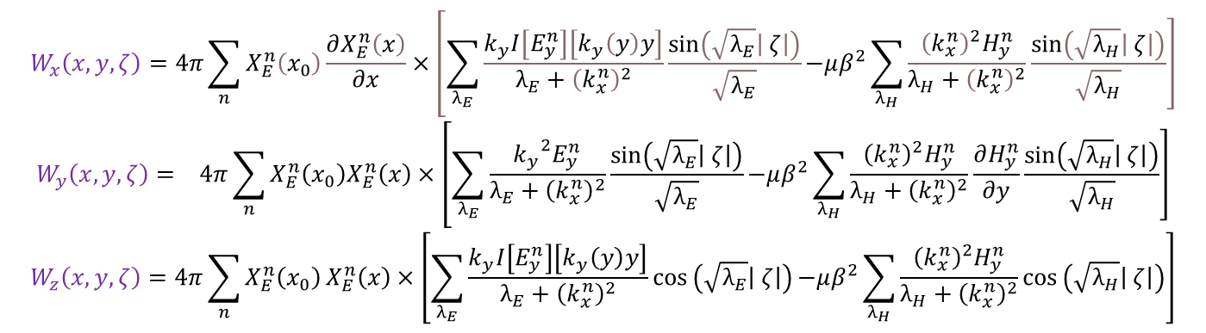
SIMULATIONS METHOD: DiWaCAT
Dielectric Wakefield Calculator And Tracker
Toby Overton (2023) https://doi.org/10.5281/zenodo.10219459
Mixture of Python and C++
Benchmarked against CST
“Beam Dynamics and Applications of Dielectric Wakefield Accelerator Structures” Overton, T. (thesis). 31 Dec 2023
Make a beam with mesh point charges (beam distribution)
Calculate wake potentials
$$W_{x}\left(x, y, ζ\right)=4π\sum_{n}{X_{E}^{n}\left(x_{0}\right)\frac{∂X_{E}^{n}\left(x\right)}{∂x}}×\left[\sum_{λ_{E}}{\frac{k_{y}I\left[E_{y}^{n}\right]\left[k_{y}\left(y\right)y\right]}{λ_{E}+{\left(k_{x}^{n}\right)}^{2}}\frac{sin\left(\sqrt{λ_{E}}\left| ζ\right|\right)}{\sqrt{λ_{E}}}}\right.\left.−μβ^{2}\sum_{λ_{H}}{\frac{{\left(k_{x}^{n}\right)}^{2}H_{y}^{n}}{λ_{H}+{\left(k_{x}^{n}\right)}^{2}}\frac{sin\left(\sqrt{λ_{H}}\left| ζ\right|\right)}{\sqrt{λ_{H}}}}\right]$$
$$W_{y}\left(x, y, ζ\right)= 4π\sum_{n}{X_{E}^{n}\left(x_{0}\right)X_{E}^{n}\left(x\right)}×\left[\sum_{λ_{E}}{\frac{{k_{y}}^{2}E_{y}^{n}}{λ_{E}+{\left(k_{x}^{n}\right)}^{2}}\frac{sin\left(\sqrt{λ_{E}}\left| ζ\right|\right)}{\sqrt{λ_{E}}}}\right.\left.−μβ^{2}\sum_{λ_{H}}{\frac{{\left(k_{x}^{n}\right)}^{2}H_{y}^{n}}{λ_{H}+{\left(k_{x}^{n}\right)}^{2}}\frac{∂H_{y}^{n}}{∂y}\frac{sin\left(\sqrt{λ_{H}}\left| ζ\right|\right)}{\sqrt{λ_{H}}}}\right]$$
$$W_{z}\left(x, y, ζ\right)=4π\sum_{n}{X_{E}^{n}\left(x_{0}\right)}X_{E}^{n}\left(x\right)×\left[\sum_{λ_{E}}{\frac{k_{y}I\left[E_{y}^{n}\right]\left[k_{y}\left(y\right)y\right]}{λ_{E}+{\left(k_{x}^{n}\right)}^{2}}cos}\left(\sqrt{λ_{E}}\left| ζ\right|\right)\right.\left.−μβ^{2}\sum_{λ_{H}}{\frac{{\left(k_{x}^{n}\right)}^{2}H_{y}^{n}}{λ_{H}+{\left(k_{x}^{n}\right)}^{2}}cos}\left(\sqrt{λ_{H}}\left| ζ\right|\right)\right]$$
Create 3D wakefields with a convolution of wakes and beam distribution
Track beam through 3D wakefields
$\left(\begin{matrix}F_{x} \\ F_{y} \\ E_{z}\end{matrix}\right)$ $=$ $q\left(\begin{matrix}W_{x} \\ W_{y} \\ W_{z}\end{matrix}\right)$

Slide 19
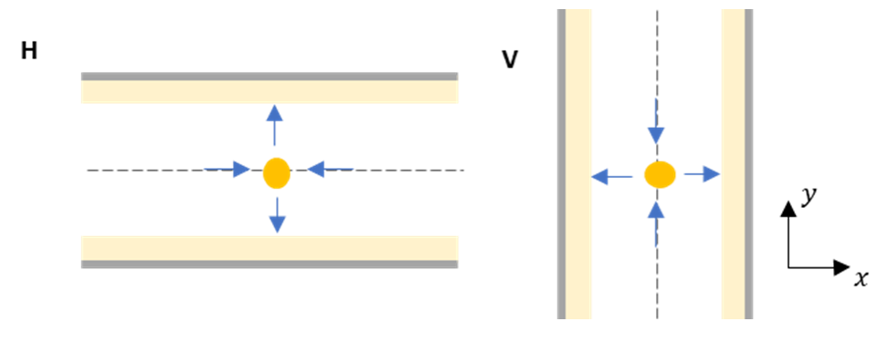

Slide 20
