Slide 1
This slide was intentionally left blank

Slide 2
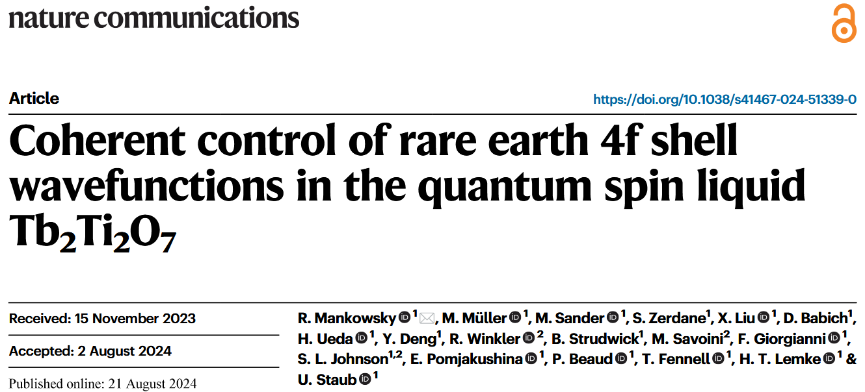
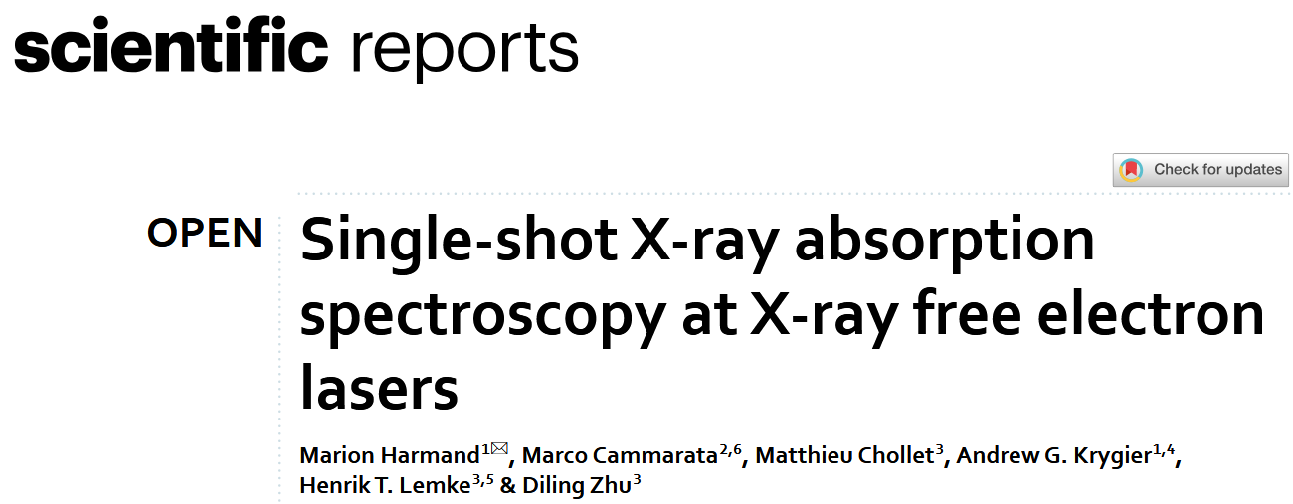
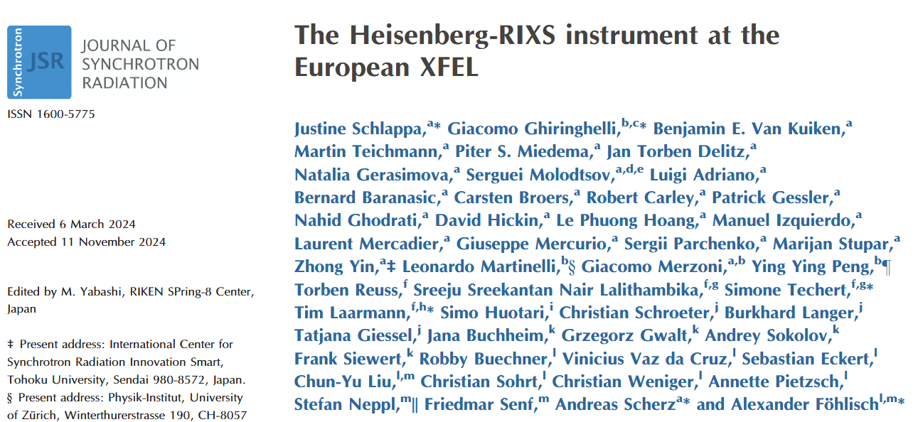
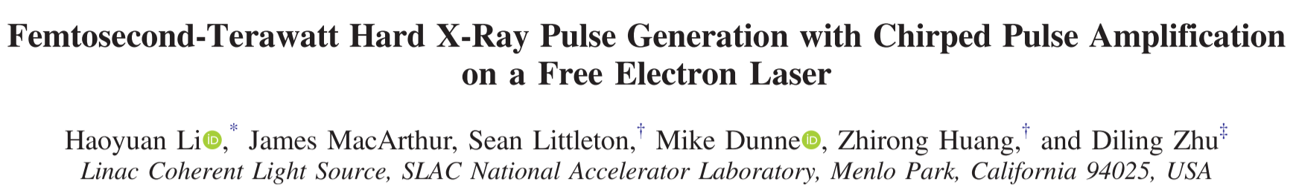
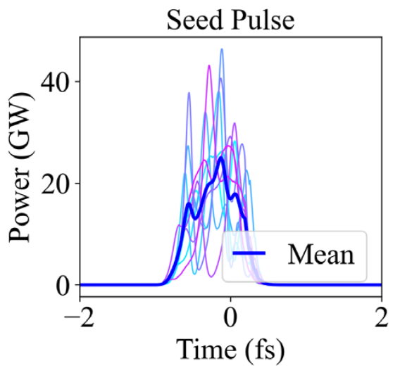
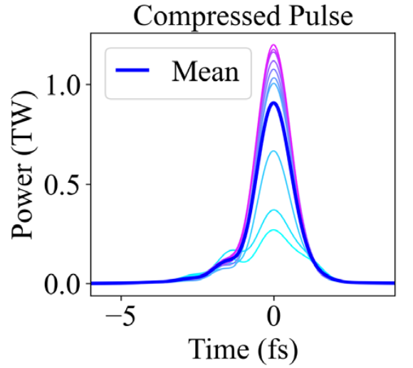
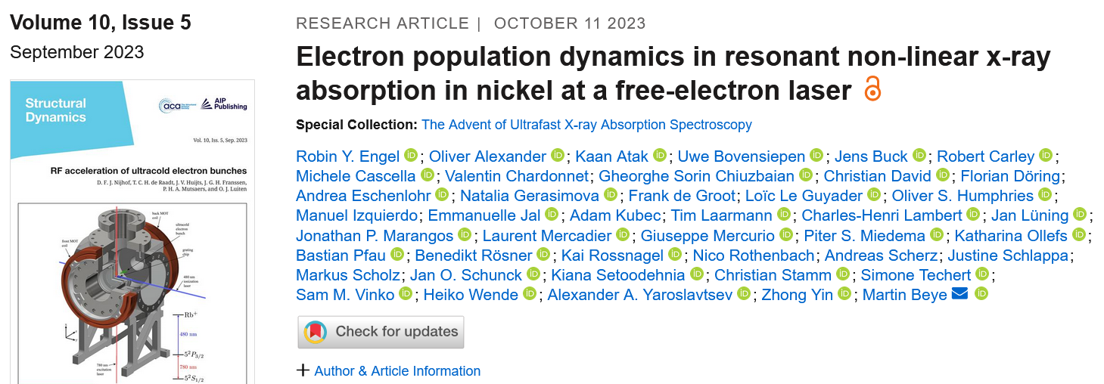
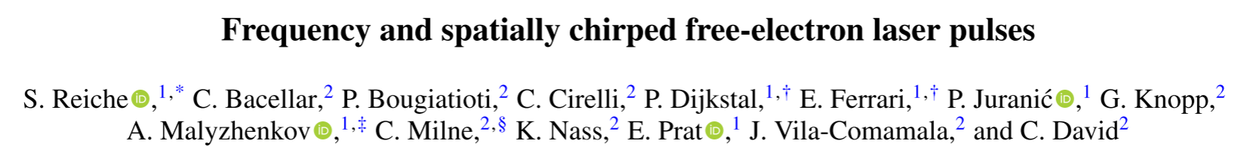
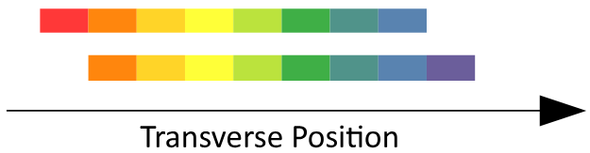
Small Bandwidth
Large Bandwidth
X-ray Diffraction
1 eV bandwidth
X-ray absorption near edge structure
100 eV bandwidth
Resonant inelastic X-ray scattering
40 meV
Nonlinear X-ray absorption
420 meV
Notes:
Something I find interesting about accelerators is the number of big things required to do very small, very short experiments. The variety of experiments and analysis done at beamline endstations is impressive for sure. This very short, very selective summary of experiments highlights the need to control FEL bandwidth. The first column includes diffraction, scattering and absorption experiments that require small bandwidth. The second column list some applications that benefit from large FEL bandwidths. The first is an X-ray absorption spectroscopy experiment that benefitted from a large bandwidth. The second publication used a large bandwidth FEL pulse and X-ray optics to shape an FEL pulse. The last experiment produced a large bandwidth FEL pulse and managed to arrange the transverse position of the photons according to their energy.

Slide 3
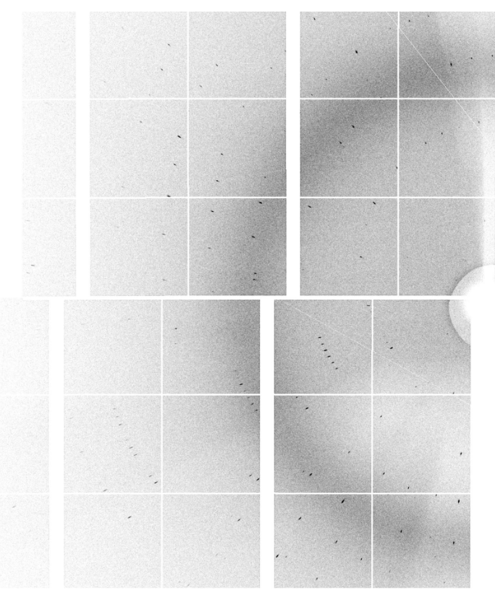
“We found that the minimal number of images needed for a good quality data set could be reduced by a factor of four when using X-ray pulses with a large BW of 2.2% when compared with X-ray pulses with a nominal SASE BW of 0.17% and similar experimental conditions.”
Nass, et al. Pink-beam serial femtosecond crystallography for accurate structure-factor determination at an X-ray free-electron laser
Notes:
A last impressive result using a large bandwidth FEL came from a crystallography group. They said:
*quote*
From the examples we’ve seen we can say there is a need to control the bandwidth of FELs.

Slide 4



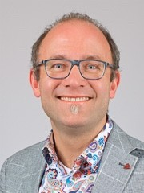

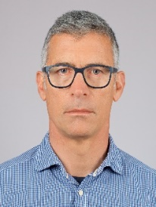
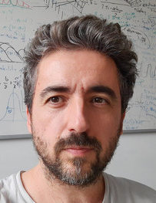
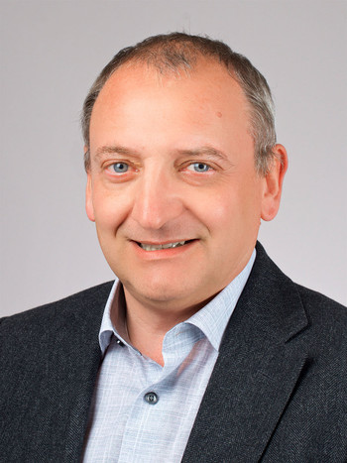

Rasmus
Ischebeck
Paolo
Craievich
Fabio
Marcellini
Sven
Reiche
Eduard
Prat
Mike
Seidel
Diagnostics & Instrumentation
Radio Frequency Systems
Beam Dynamics
Accelerator Science & Engineering
This project has received funding from the European Union’s Horizon Europe research and innovation programme under grant agreement No. 101079773
Notes:
My name is Evan Ericson. I am an EPFL PhD student based at the Paul Scherrer Institute where I do research for the EuPRAXIA collaboration. I have been doing wakefield simulations for accelerators since 2018 and have prepared the simulations and measurements I will show you today. PSI hosts the SwissFEL facility and the experts who develop it. I study methods of manipulating and measuring the energy spread of particle beams because it impacts the performance of free electron lasers. Specifically, the correlated energy spread of the determines the bandwidth of X-rays produced by free electron lasers.

Slide 5
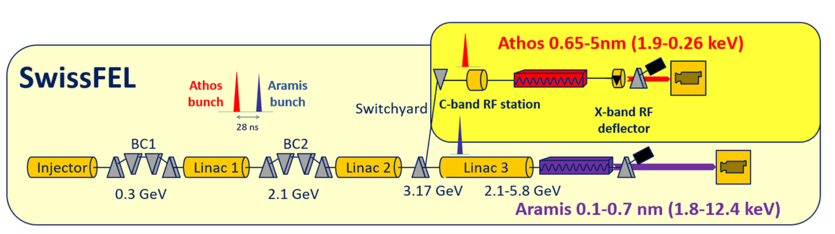
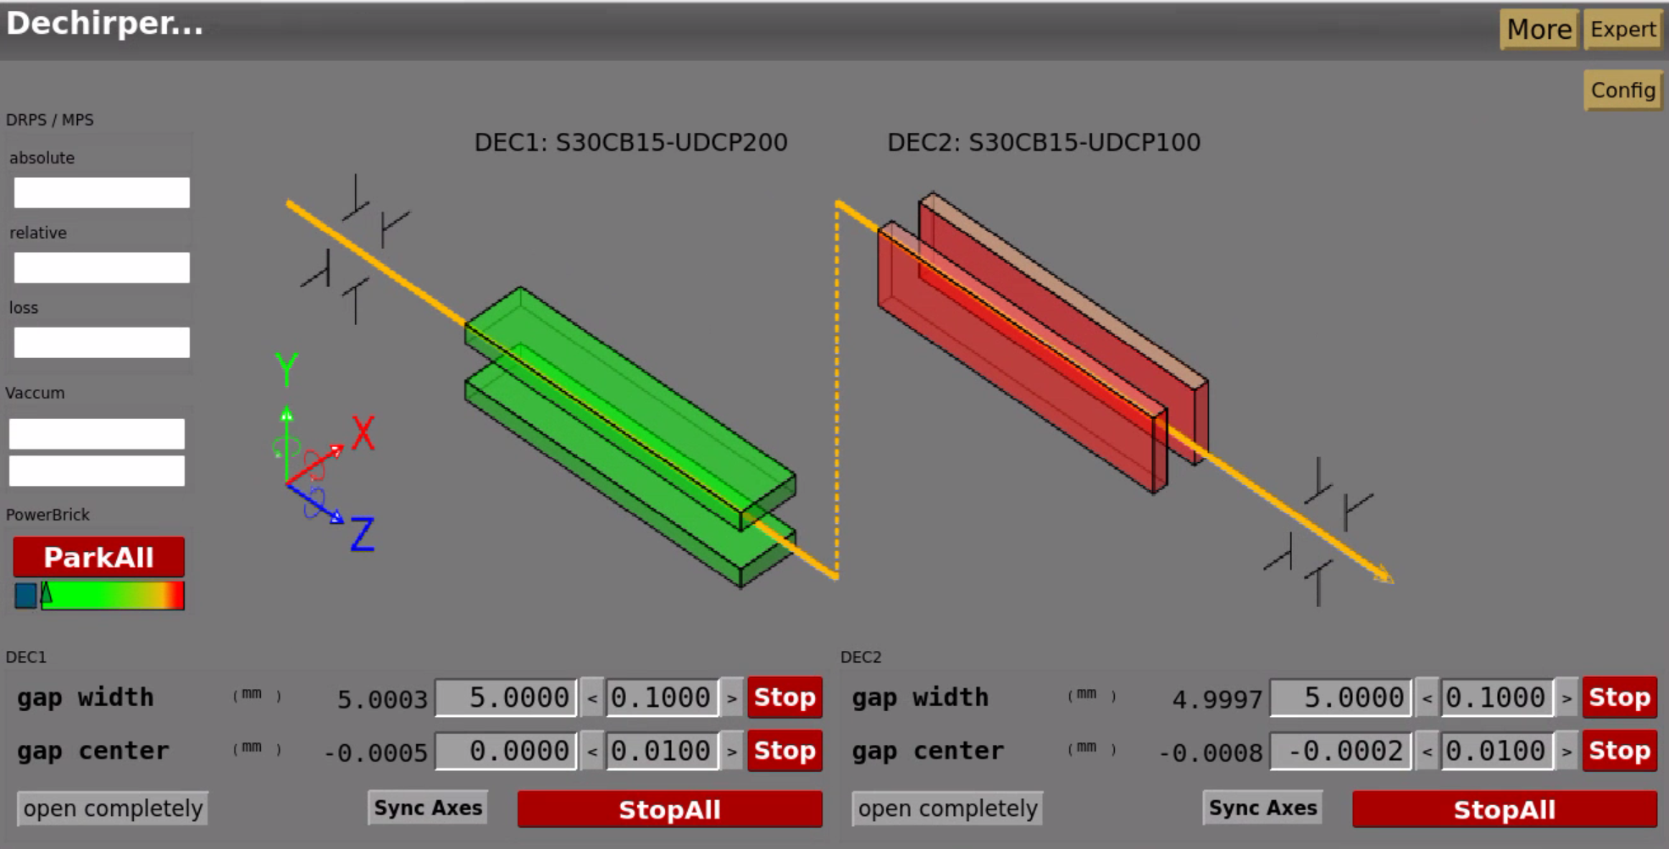
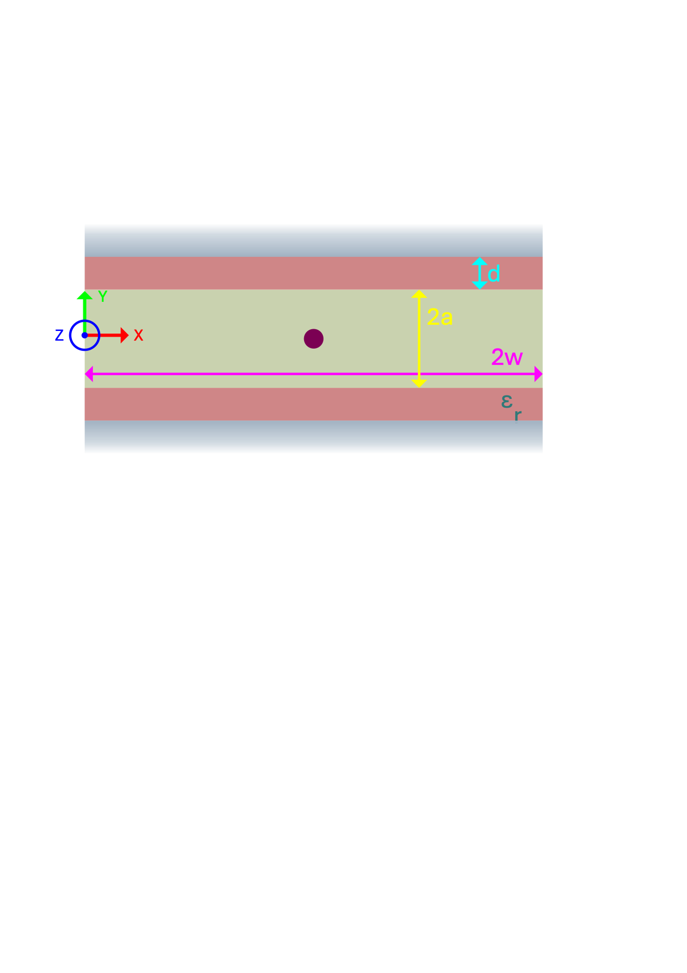
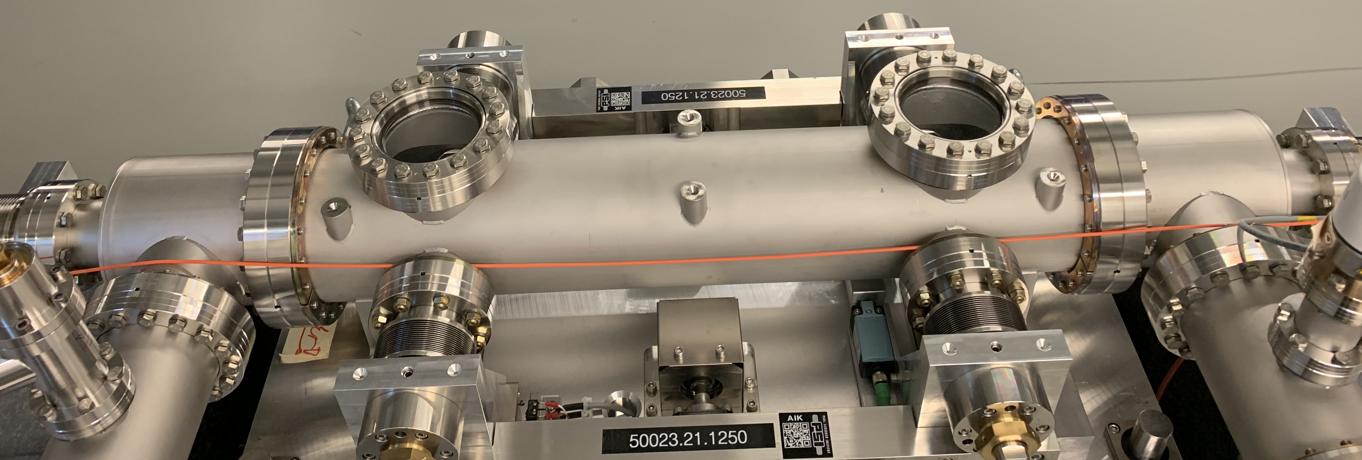
Notes:
SwissFEL has two beamlines: Aramis and Athos. The two bunches that feed the beamlines are produced in an injector before traveling through two bunch compressors and LINACs before being separated. The Athos beam goes through the switchyard and then undulators. The Aramis beam goes through a final LINAC and then its undulators. A common way of manipulating the energy spread of beams is by changing the LINAC phase and compression settings. However, changing the machine settings in the first half of the accelerator, affects both the Athos and Aramis beams. To fine change the bandwidth of the Aramis beamline, two flat dielectric structures have been installed upstream of the Aramis undulators. Each structure consists of two metal plates coated with a thin layer of dielectric. The separation between the plates is adjustable. Each structure is 1 meter long. They are oriented orthogonally relative to each other to compensate the effect of the quadrupole wakefields generated in each structure.

Slide 6
Dechirping
E
E
tail
head
tail
head
t
t
Chirping
E
E
tail
head
tail
head
t
t
E
E
tail
head
tail
head
t
t
Notes:
The dielectric wakefield structures are used to modify the energy spread of the beam that passes through it. The wakes generated by the head of the beam are used to modify the energy of the tail of the beam. The wakes can be used to reduce or increase the energy spread of the beam. We did three experiments to demonstrate the energy manipulations that can be done with the structures. In the first experiment, we used the structure to reduce the energy spread of the beam to reduce the FEL bandwidth. In the second experiment, we took a relatively long beams with low energy spread and used the structure to increase the energy spread of the beam. In the third experiment we increased the energy spread of a beam with an already large energy spread to increase the FEL bandwidth.

Slide 7
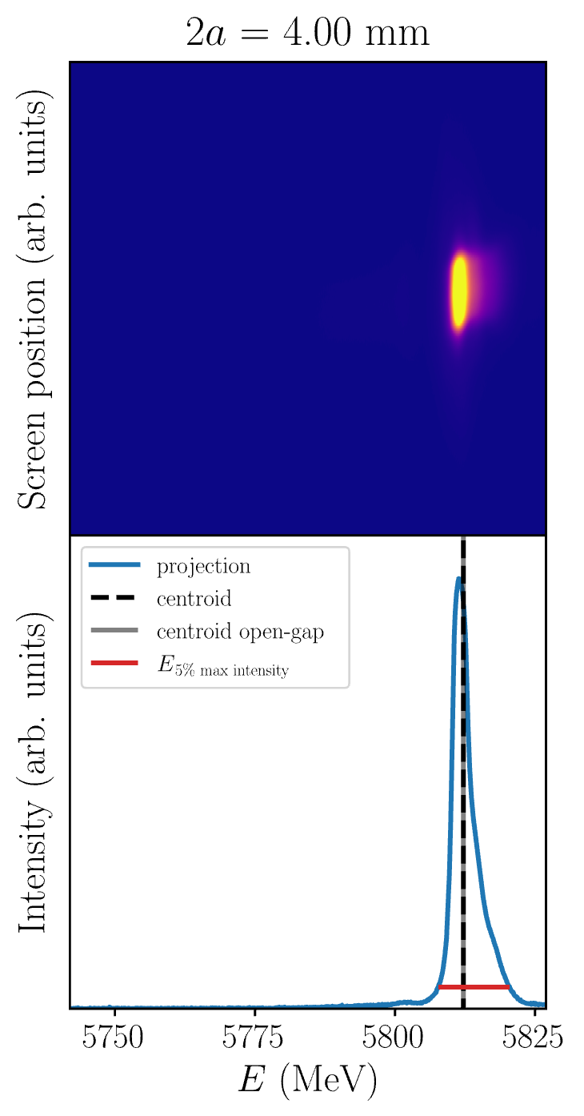
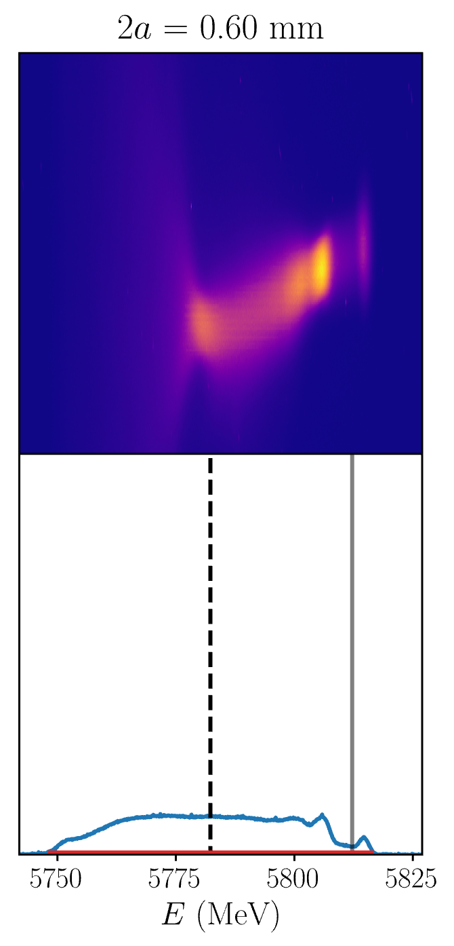
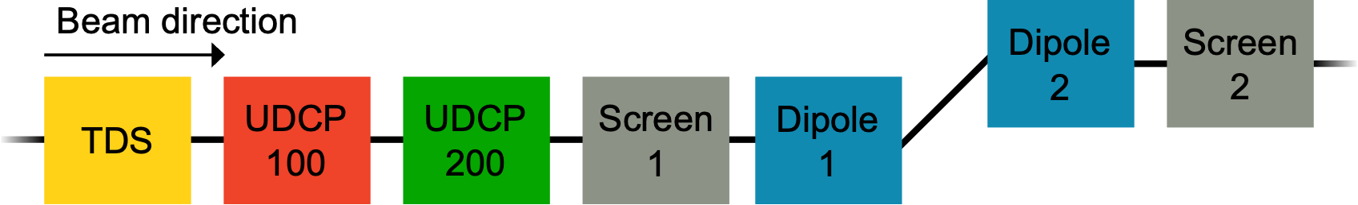
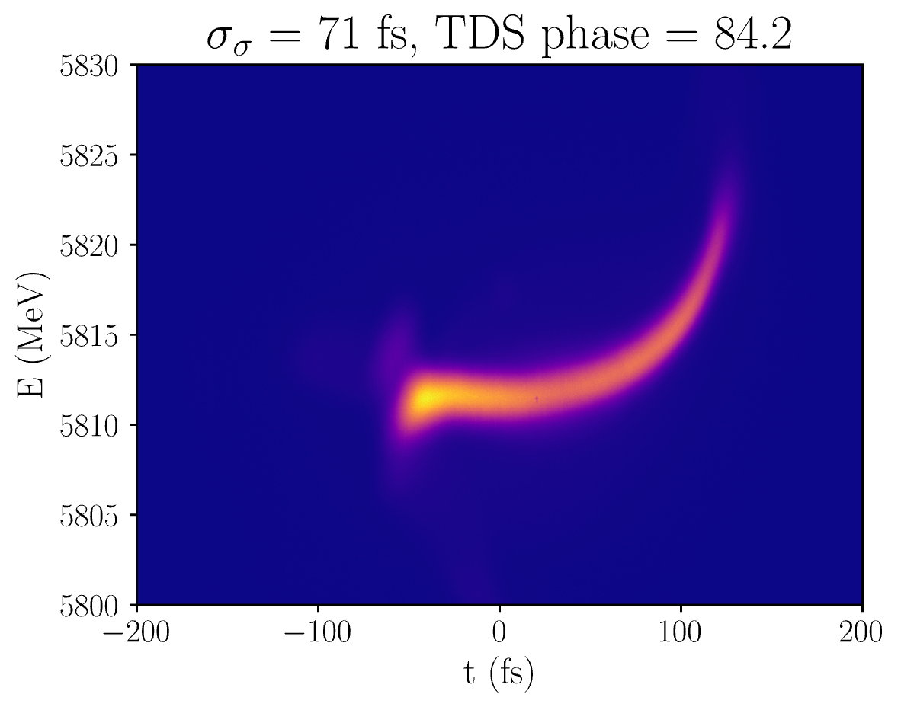
Notes:
To measure the effect of the structures on the beam. We used the following portion of the Aramis beamline. First, we moved the structures such that their centers corresponded with the beam axis. We did this two ways. The first way was to look at the transverse distribution on Screen 1. We iteratively closed the structure gaps while changing the structure’s center to maintain a constant transverse profile. If the transverse profile did not change when we changed the structure’s center, we looked at downstream BPM readings and chose the structure center that minimized orbit perturbations downstream. After this was complete, we imaged the longitudinal phase space of the beam using a C-Band transverse deflecting structure. Then we deactivated the TDS and measured the energy spread of the beam as the structure gaps were varied. The top row corresponds to images on the screen that, once calibrated, correspond to screen position versus energy. The projection of these images gives the energy distribution of the beam. We used two numbers to quantify the performance of the structures. The first is the loss factor which represents the shift the central energy of the distribution. The second quantity is the energy spread, the width of the distribution.

Slide 8
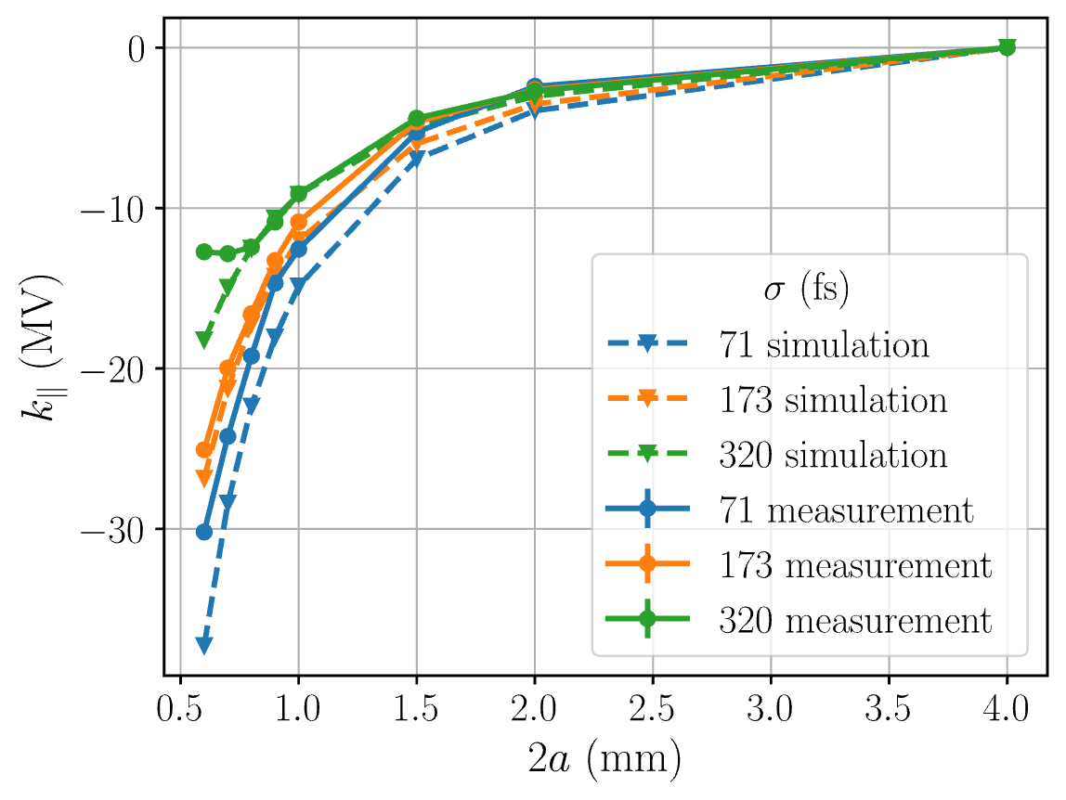
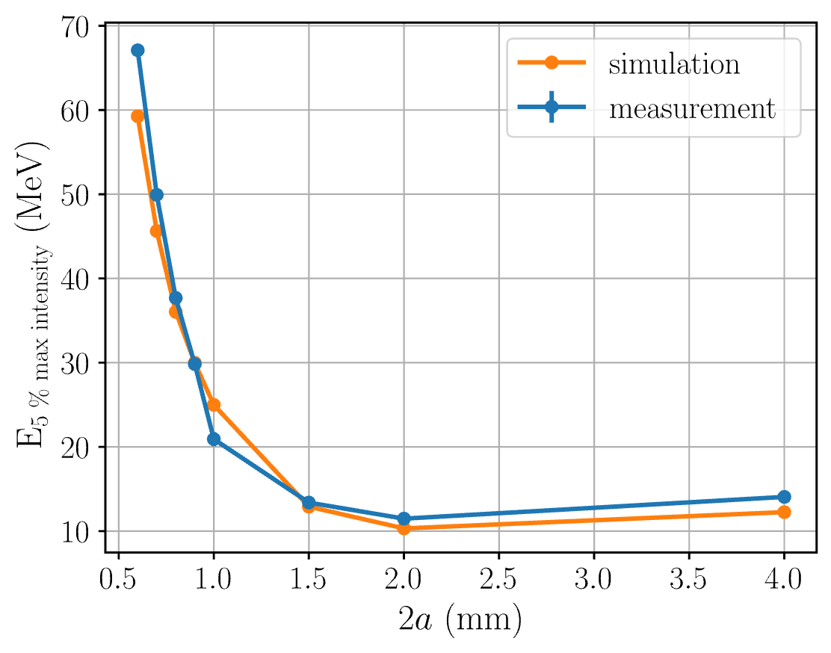
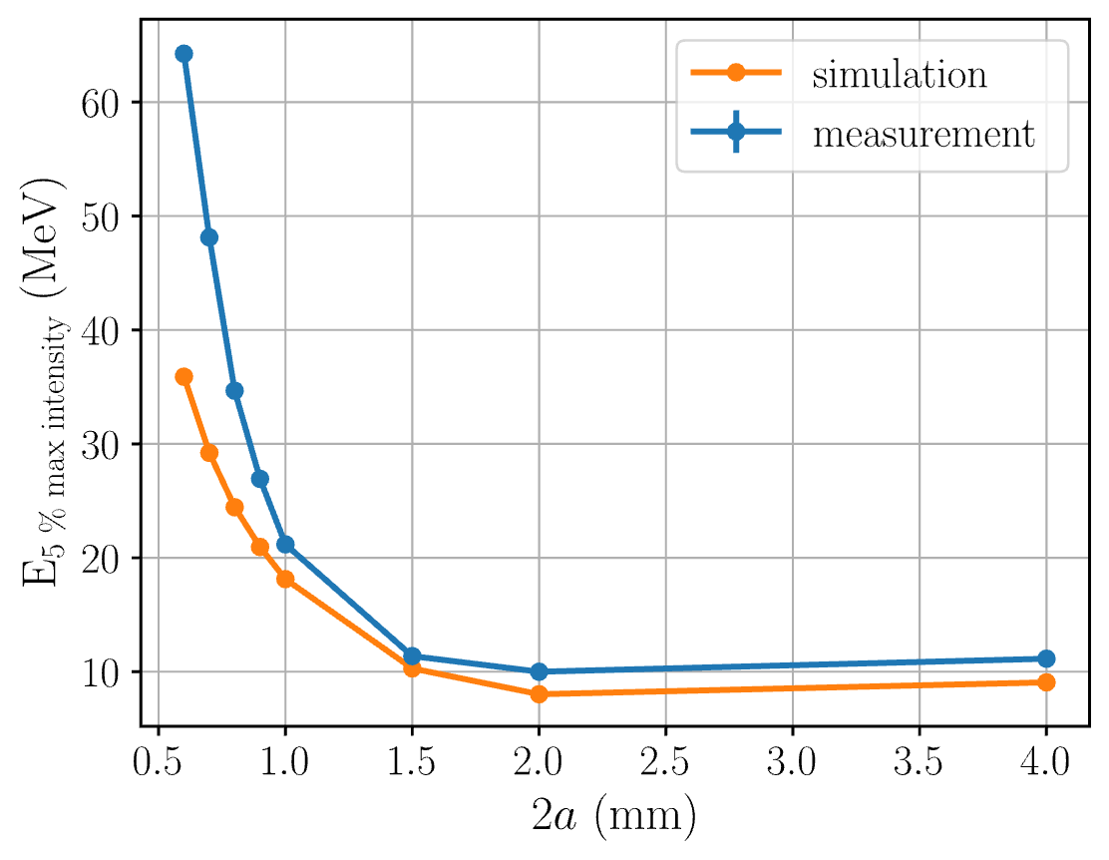
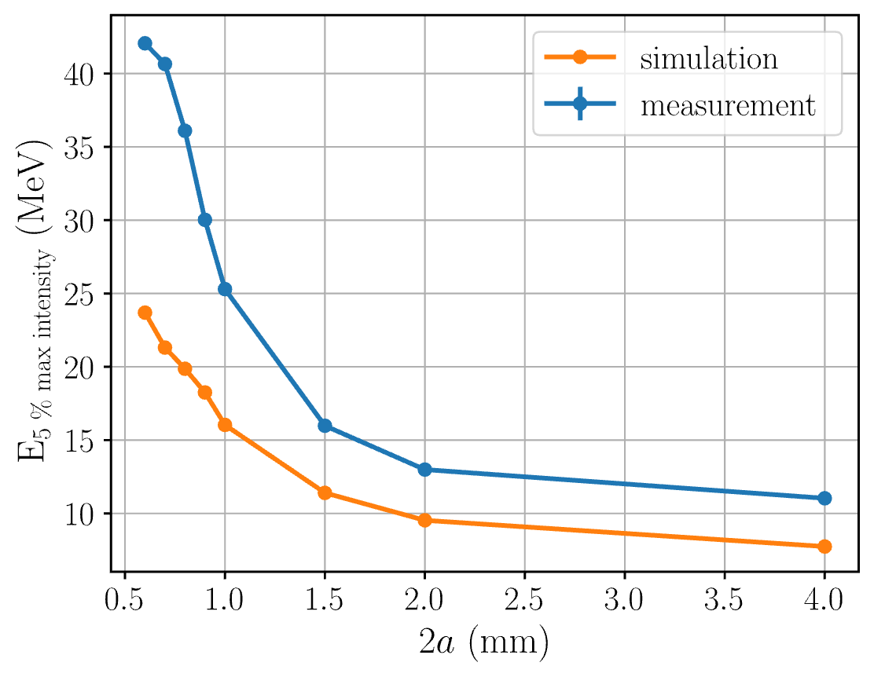
E
E
tail
head
tail
head
t
t
σ = 320 fs
σ = 71 fs
σ = 173 fs
Notes:
The first measurements we did used relatively long beams with low energy spread and we used the structures to increase the energy spread of the beams. The measured loss factors agreed with those predicted by simulations and started having some differences at very small gaps. The energy spreads had the expected behavior but different amplitude than what we expected, particularly for small structure gaps. We looked at the energy distributions themselves for more information.

Slide 9
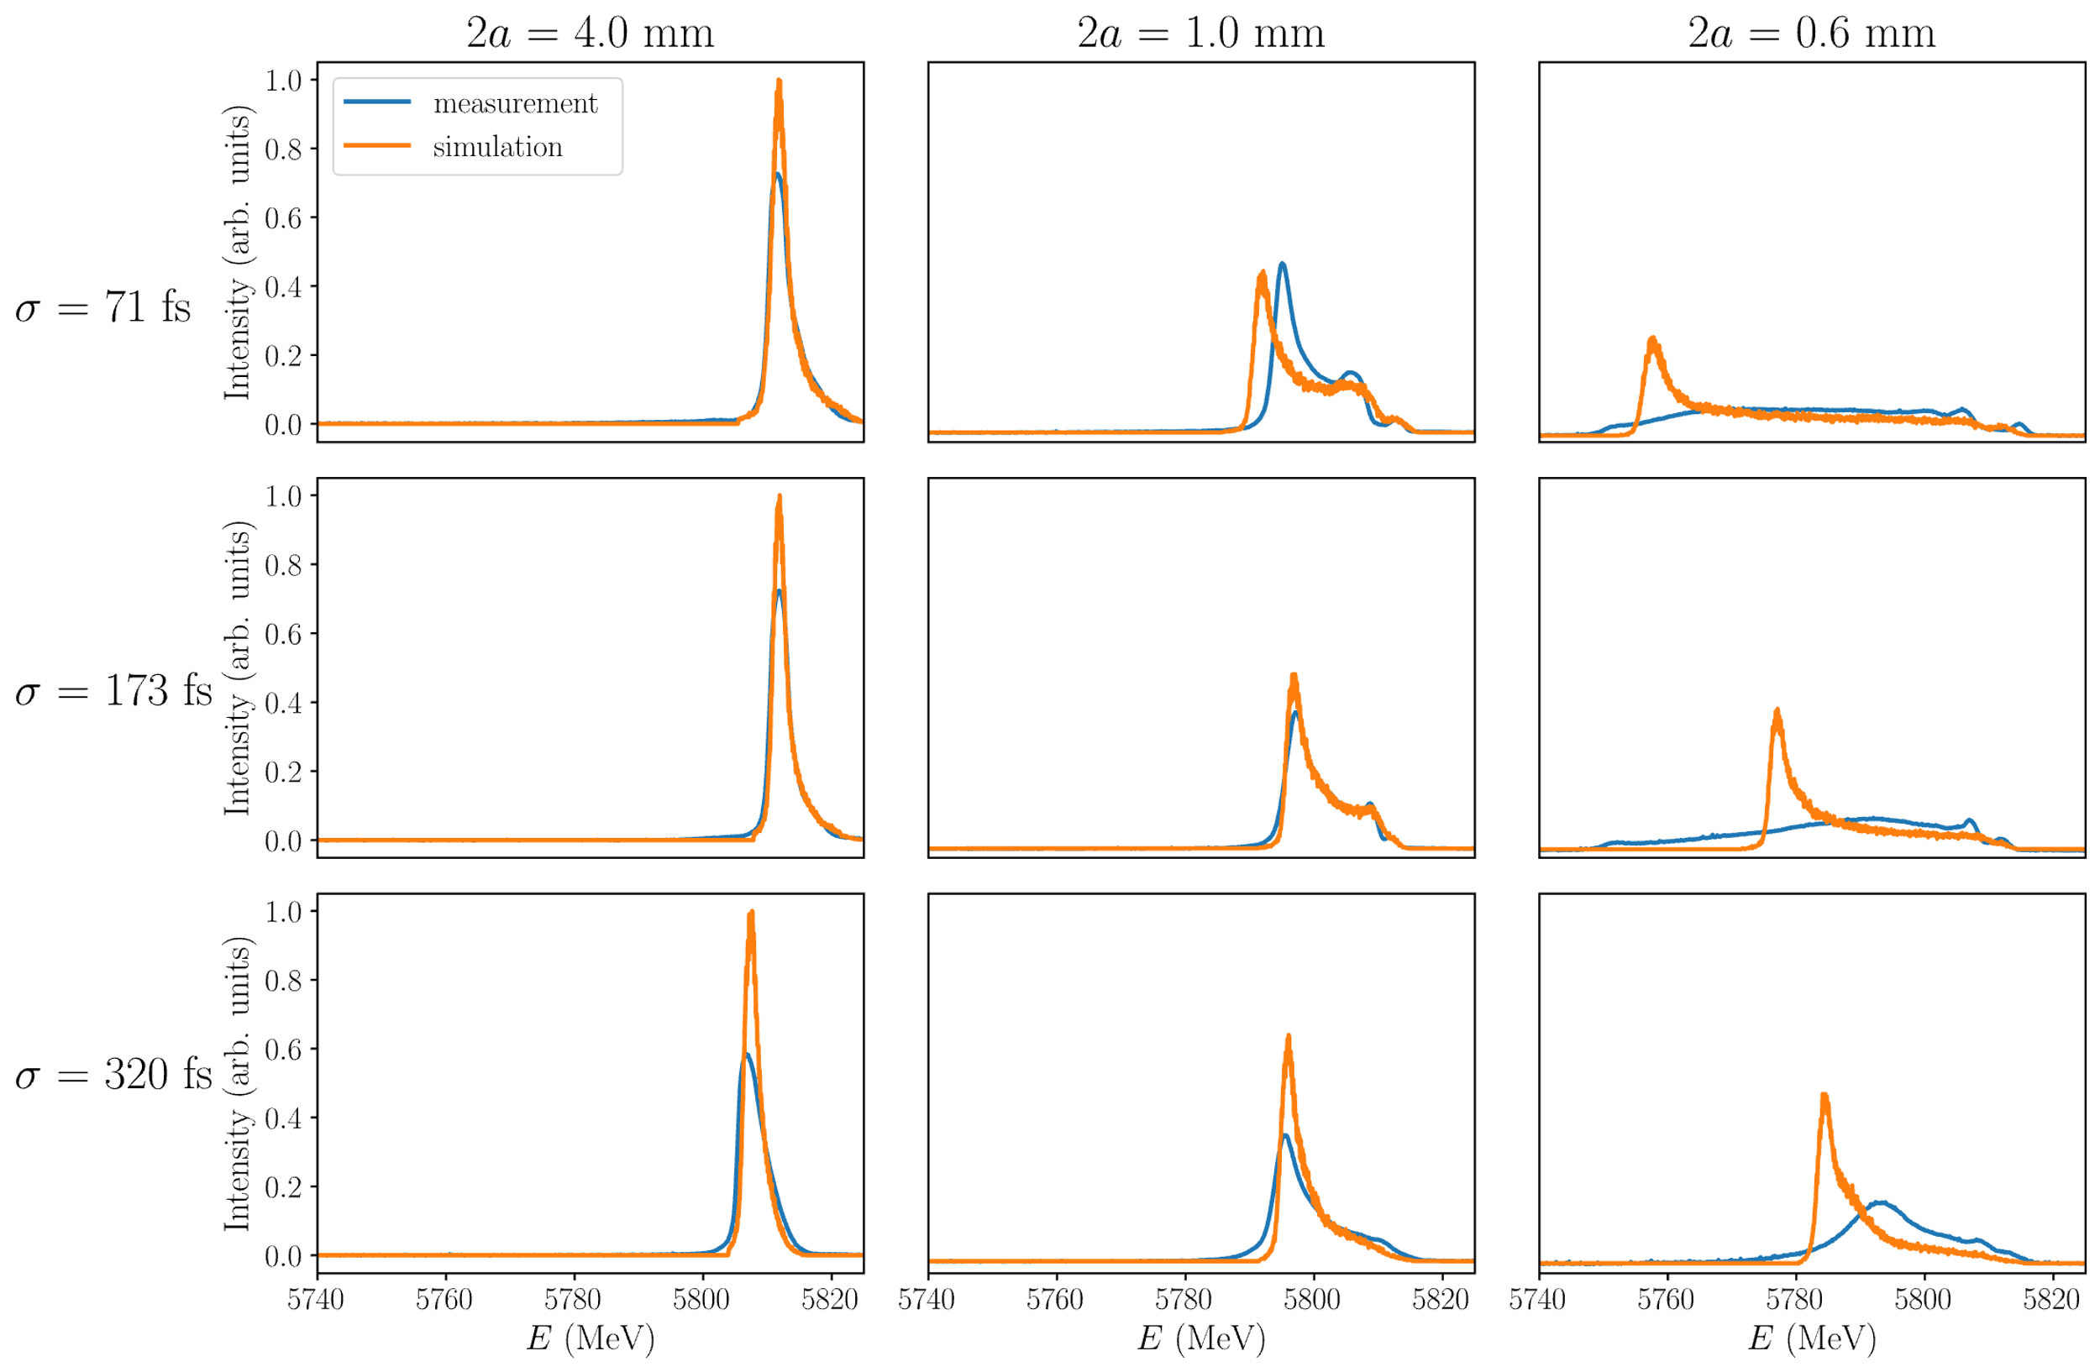
Notes:
The energy distributions showed that at very small gaps, simulations predicted an accumulation of low energy particles that was not seen during our measurements. Instead, we observed a blurring of the energy tails. This suggests that at very small gaps, when the gap is similar to the transverse size of the beam, the slab model used in the simulations is not suitable. With this experience, we proceeded explore different beam configurations.

Slide 10
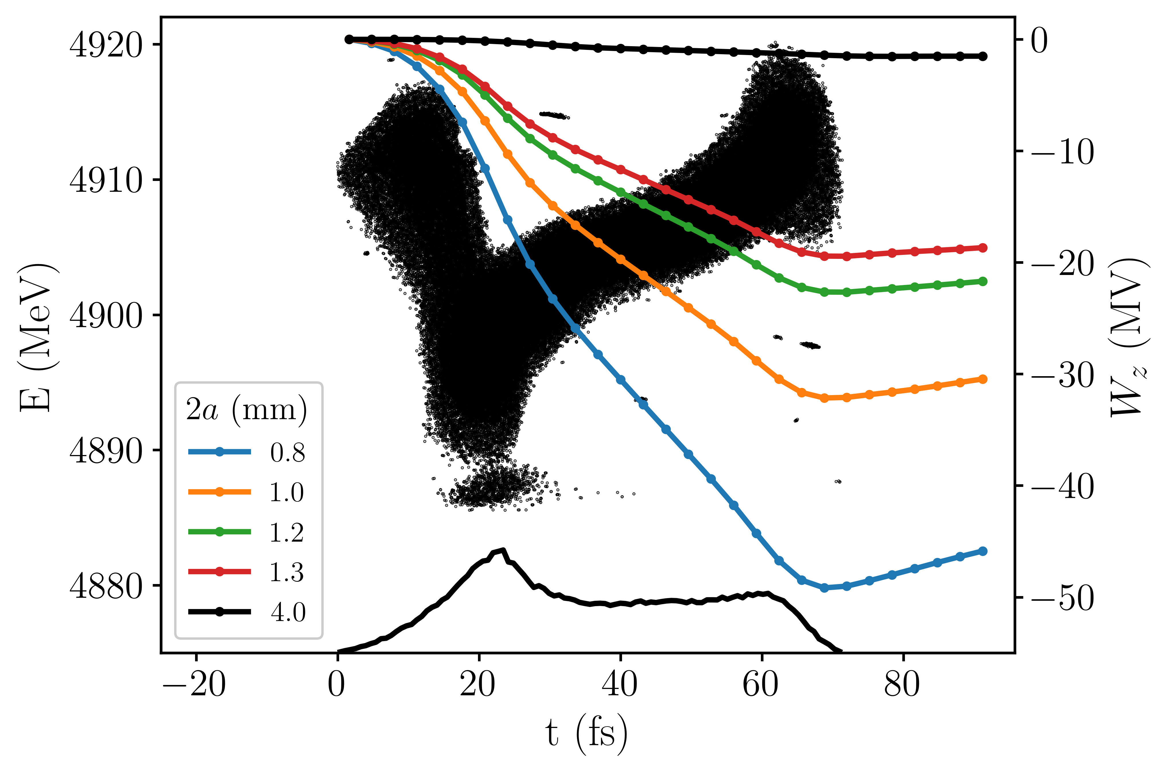
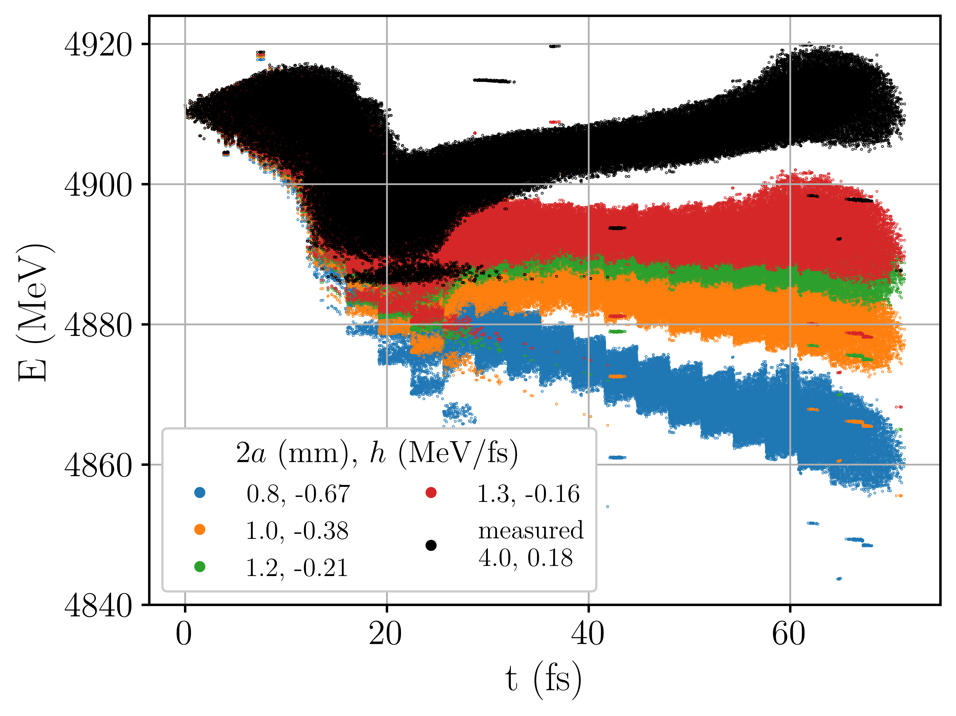
E
E
tail
head
tail
head
t
t
head
tail
head
tail
Notes:
Next we generated a short beam where the tail had higher energy than the head and sent it through the dielectric structures. Our simulations used the measured current distribution as an input to predict the wakes generated in the structures. The results of the simulations predicted the longitudinal phase space should rotate because of the wakes and the energy spread should be reduced when the gap is near 1.3 mm, before growing again.

Slide 11
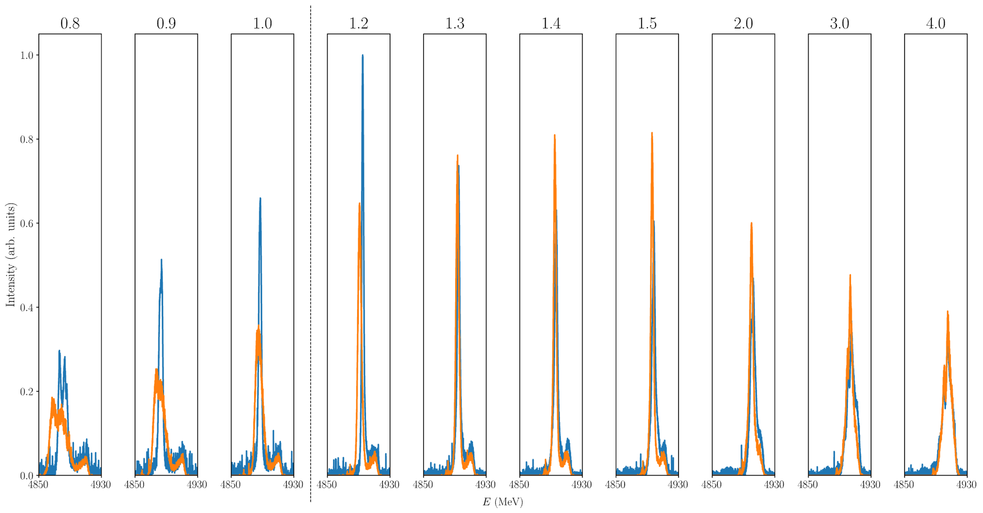
Measurement
Simulation
Notes:
The following plot shows the measured and predicted energy distributions of the beam for many structure gaps. At first, when the gap is open, the energy distribution is relatively broad. Then at a certain gap, near 1.3 mm, the distribution is narrow. As we closed the gap further the distribution starts to widen again. In many of these distributions, we see a small peak at high energies. This peak is the head of the beam whose energy is unchanged by the wakes.

Slide 12
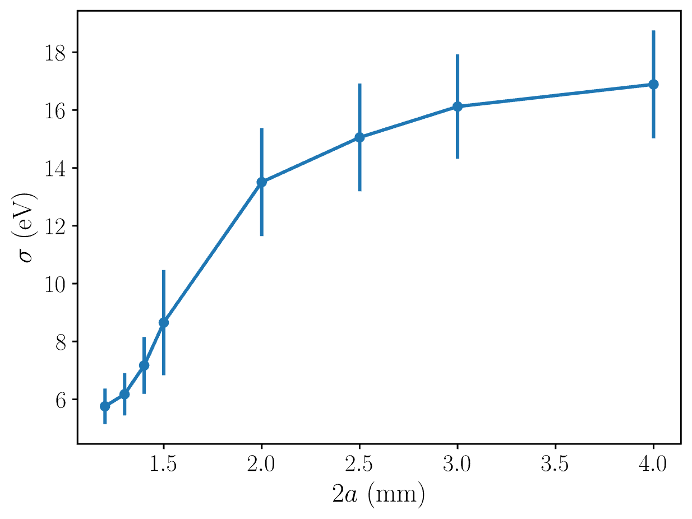
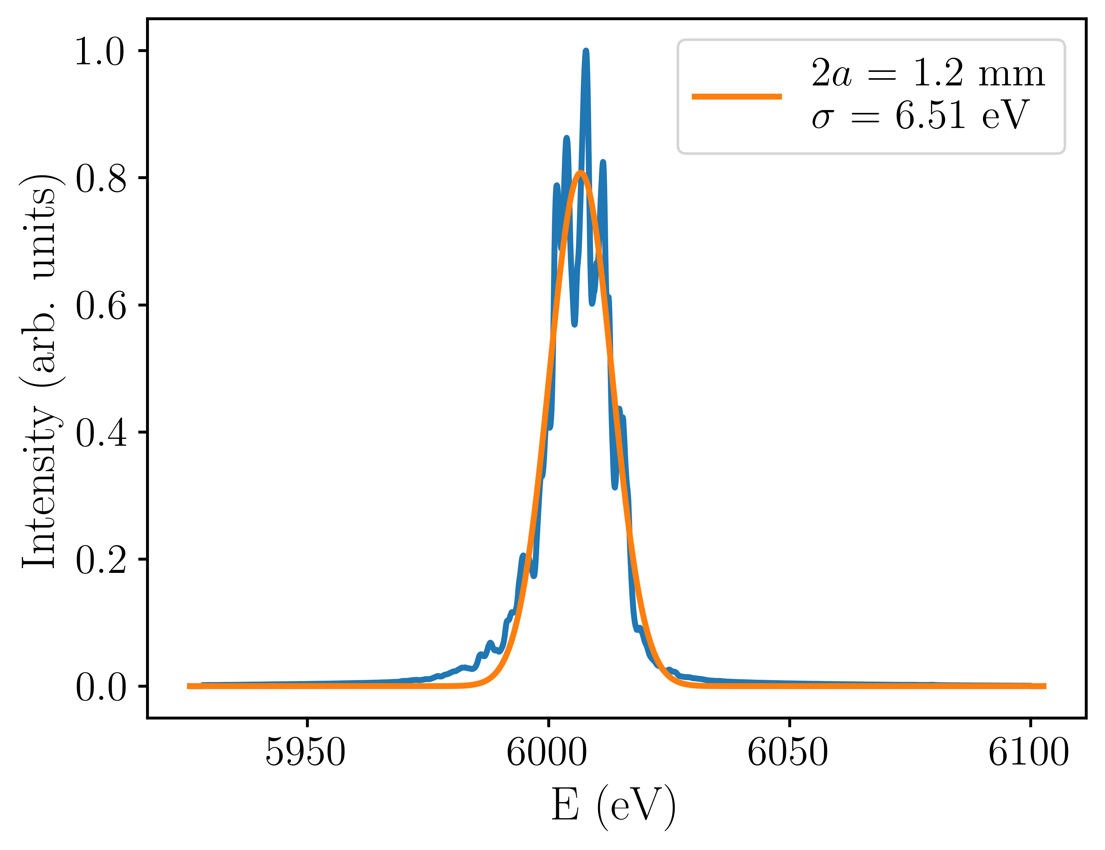
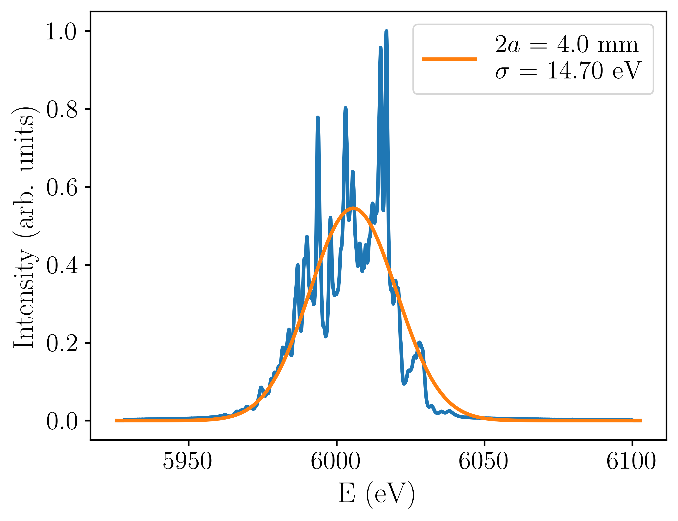
The wakefield structure can reduce FEL bandwidth
Notes:
Using the same beam, we measured the FEL spectrum while varying the structure gap. We observed that the width of the FEL spectrum decreased as the structure gap was decreased. Because our machine time was limited and we did not observe the broadening of the spectrum for gaps below 1.2 mm.

Slide 13
Increasing FEL bandwidth
E
E
E
E
tail
head
tail
head
tail
head
tail
head
t
t
t
t
Notes:
In the most recent experiments, we used the structures to enhance the energy chirp of a beam with large energy spread. We generated the input beam by over compressing the beam in SwissFEL’s second bunch compressor. The longitudinal wakefields in LINAC 3 caused the tail of the beam to lose energy. This beam was sent through the dielectric structures.

Slide 14
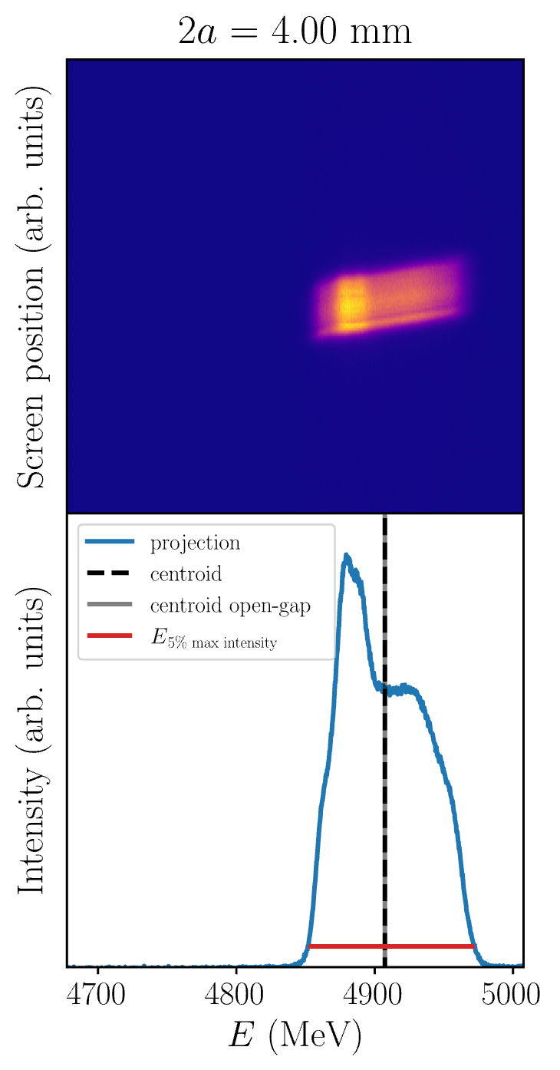
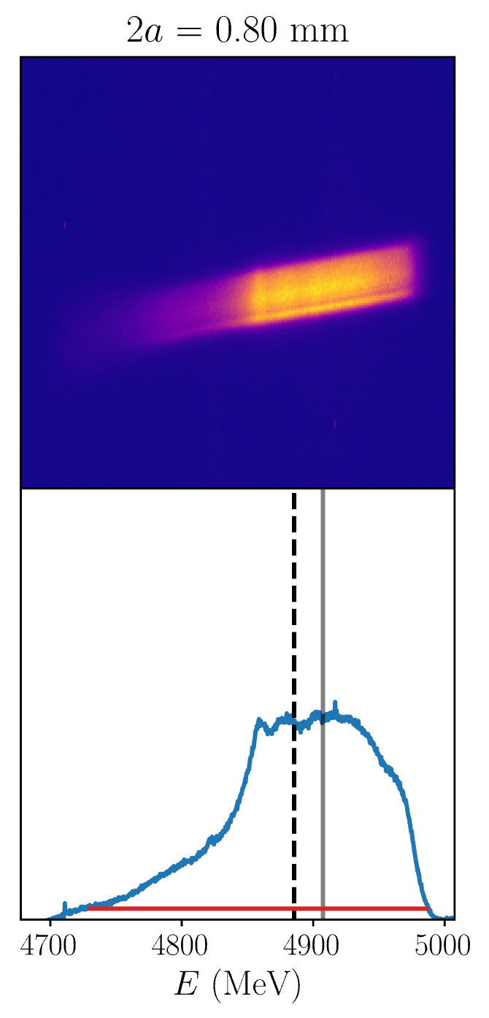
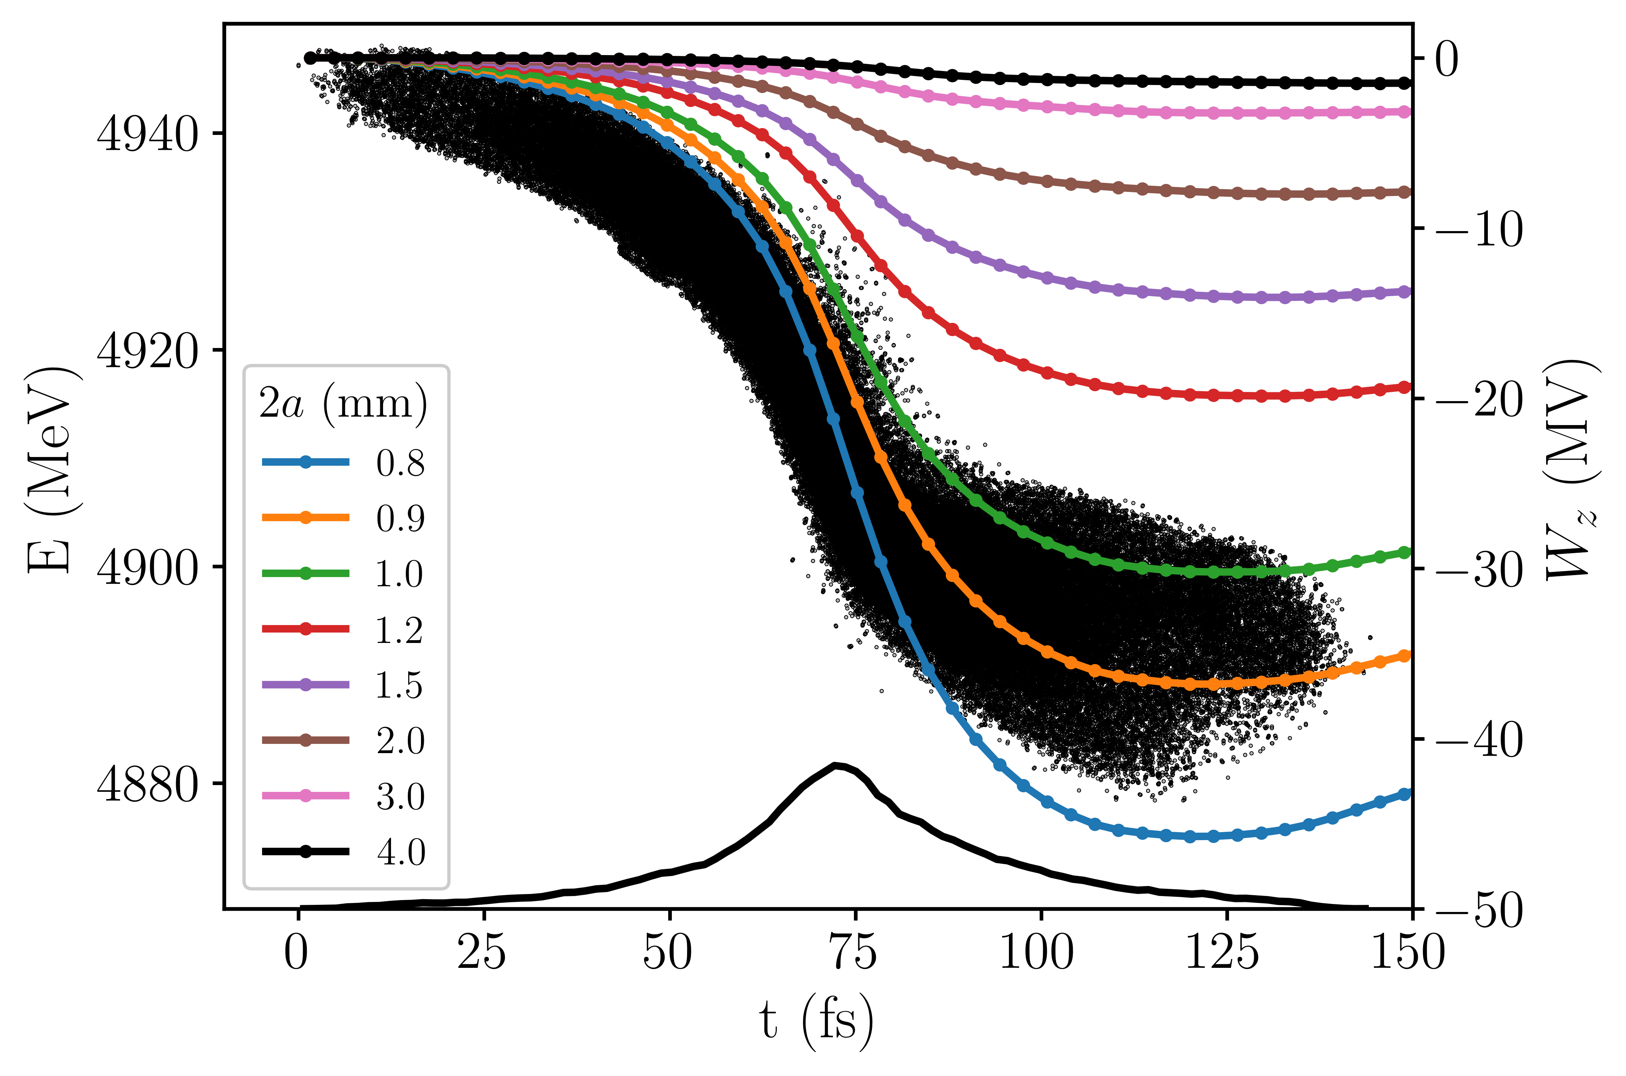
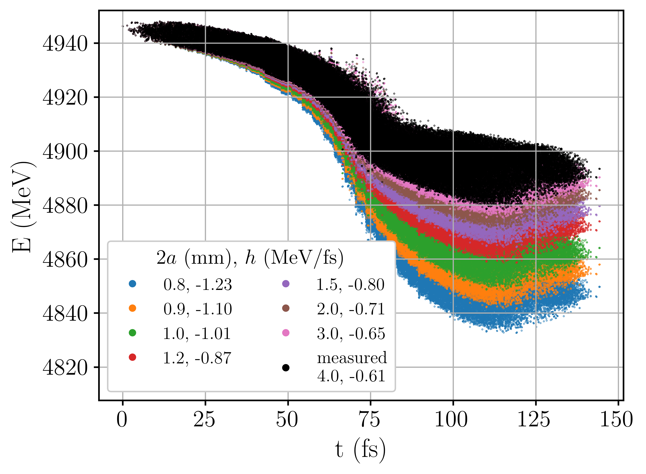
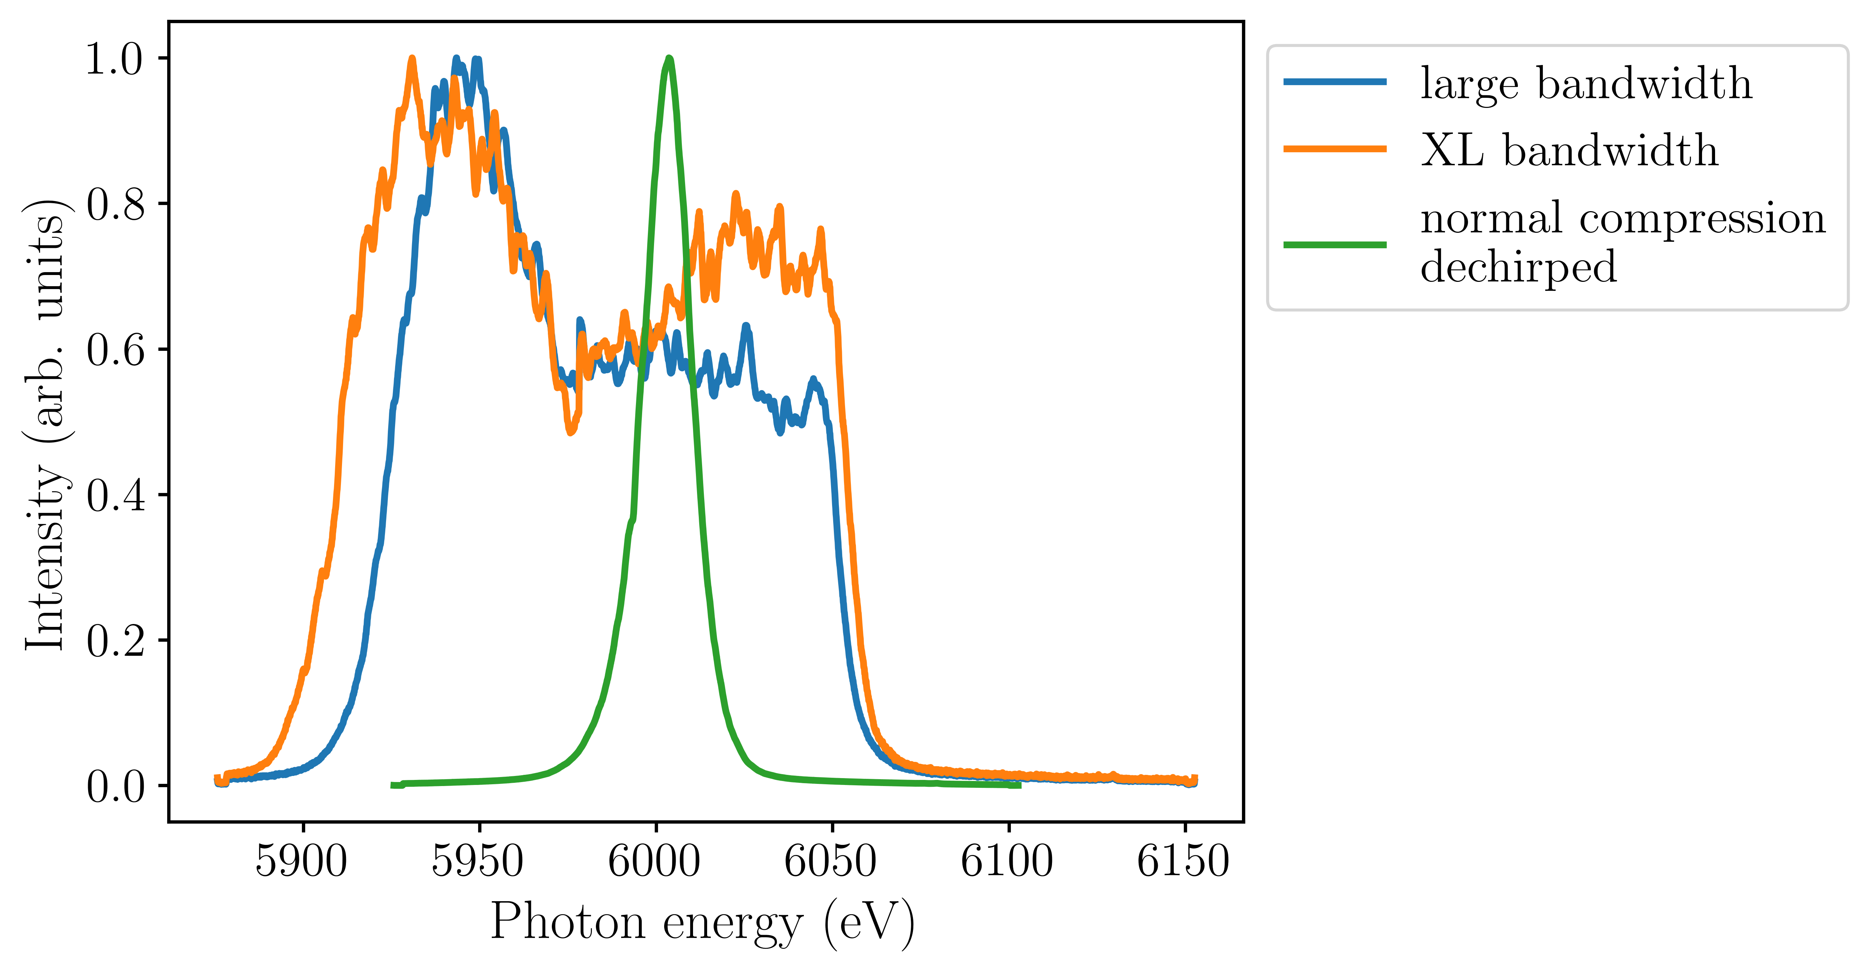
head
tail
head
tail
Notes:
We simulated the wakes generated in the structures and saw the enhancement of the chirp and then saw the same effect in measurements. The bandwidth of the beam in this case is much larger than before. The plot on the bottom shows the average photon spectra for different machine configurations. The green curve is the dechirped beam we saw earlier. The orange curve is the spectrum when the chirp of the beam is enhanced.

Slide 15
Dielectric wakefield structures can increase or reduce the electron beam’s energy spread without adjusting the rest of the accelerator settings
Wakefield structure simulations and measurements agree except for very small gaps
Dielectric structures can be used to adjust the FEL bandwidth

Slide 16
Controlling FEL bandwidth at SwissFEL using a dielectric wakefield structure
Evan Ericson, Paolo Craievich, Rasmus Ischebeck, Fabio Marcellini, Eduard Prat, Sven Reiche, Mike Seidel
European Advanced Accelerator Conference, 22 September 2025

Slide 17
EXTRA SLIDES

Slide 18
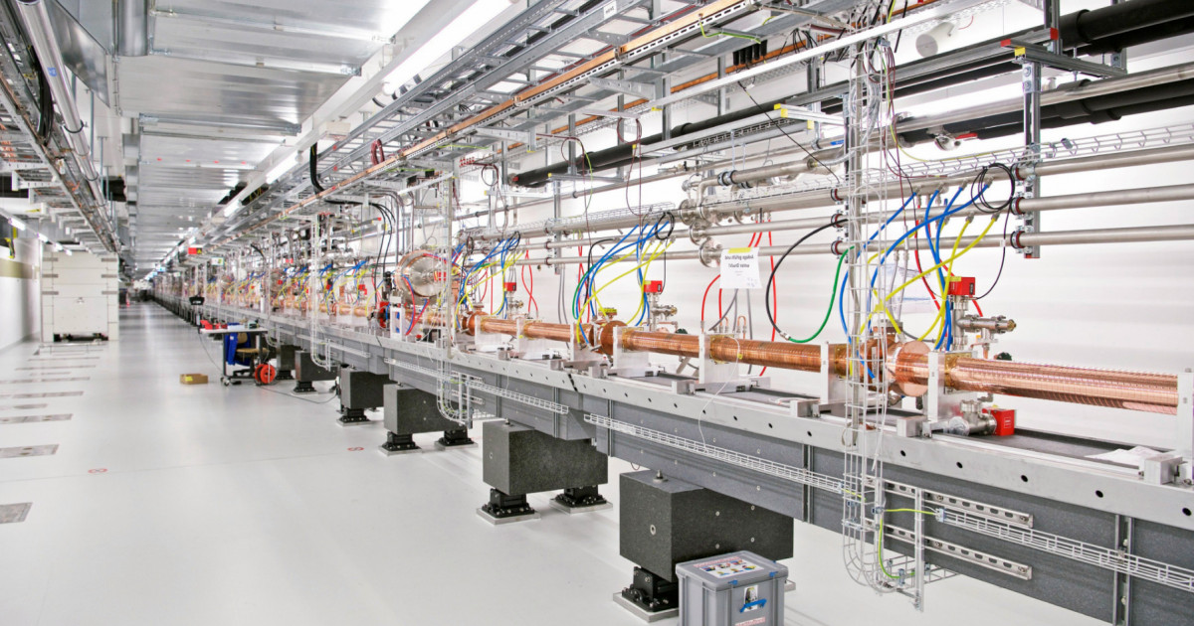
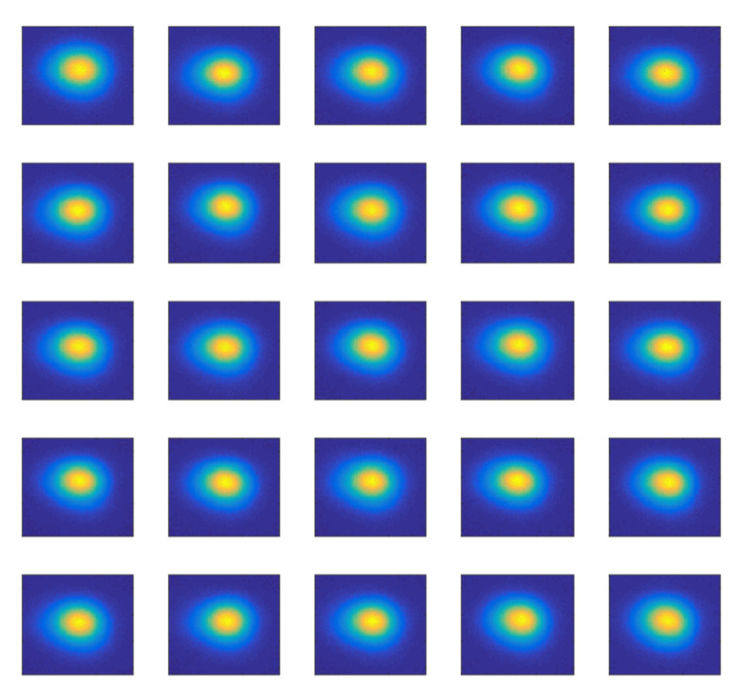
Parameter | SwissFEL
Length | 740 m
LINAC frequency | 5.7 GHz (C-band)
Repetition rate | 100 Hz
Energy | up to 6.1 GeV
Bunch charge | 10 – 200 pC
Trajectory jitter | < 10% of beam size
Relative energy jitter | ~ 10⁻⁴
Arrival time jitter | < 10 fs
Slice emittance | 200 nm (for 200 pC)
Bunch length | < 1 fs – 50 fs
Courtesy: Eduard Prat

Slide 19
Structure parameters
Parameter | Value
Length, L | 1 m
gap, 2a | 500 μm – 4000 μm
Width, 2w | 42 mm
Dielectric thickness, d | 400 μm
Alumina permittivity, ε_{r} | ~ 10

Slide 20
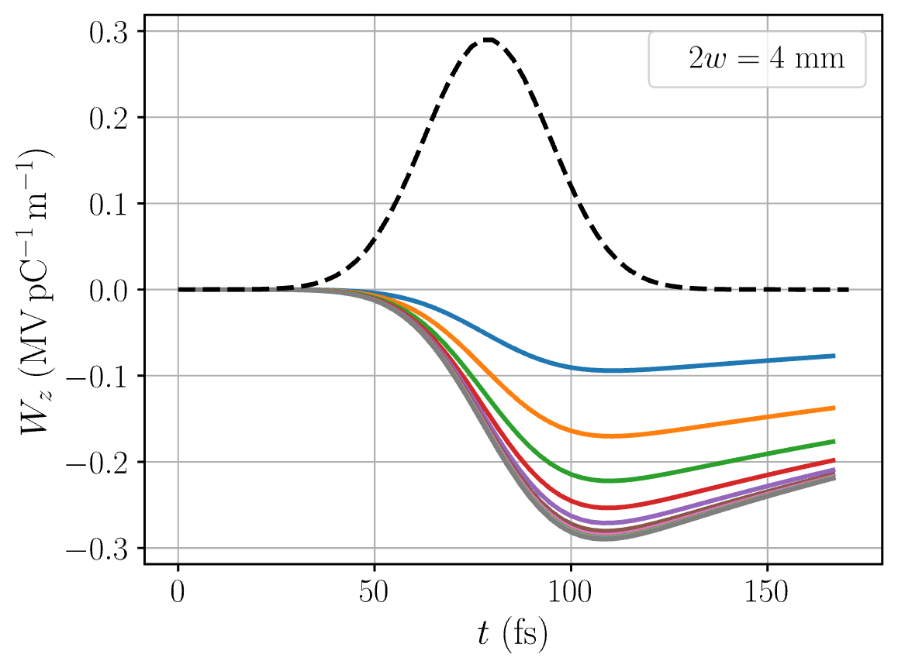
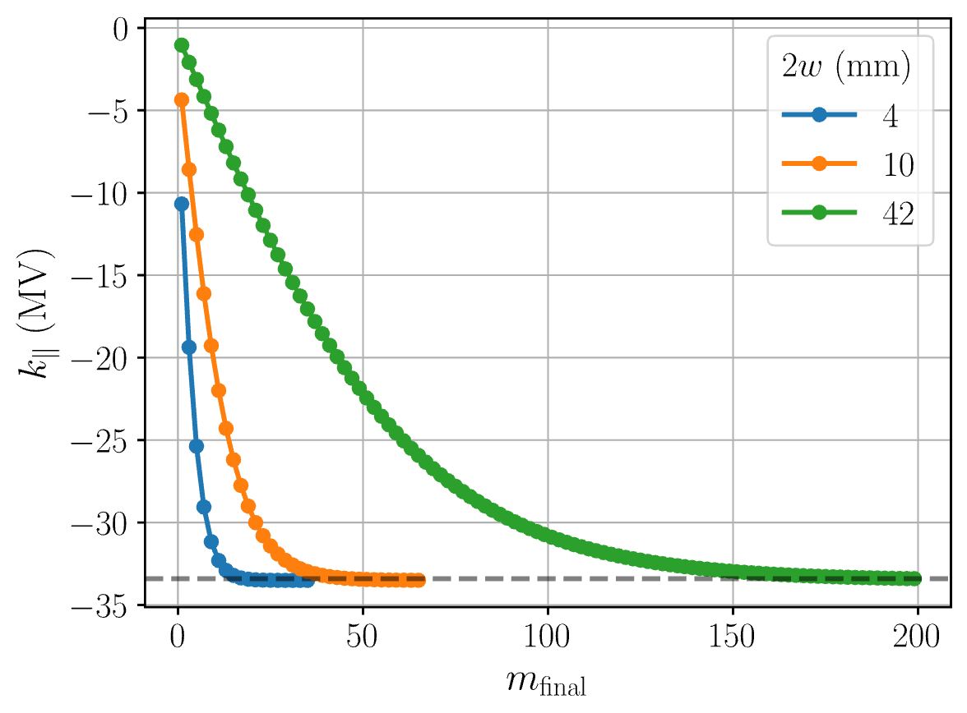
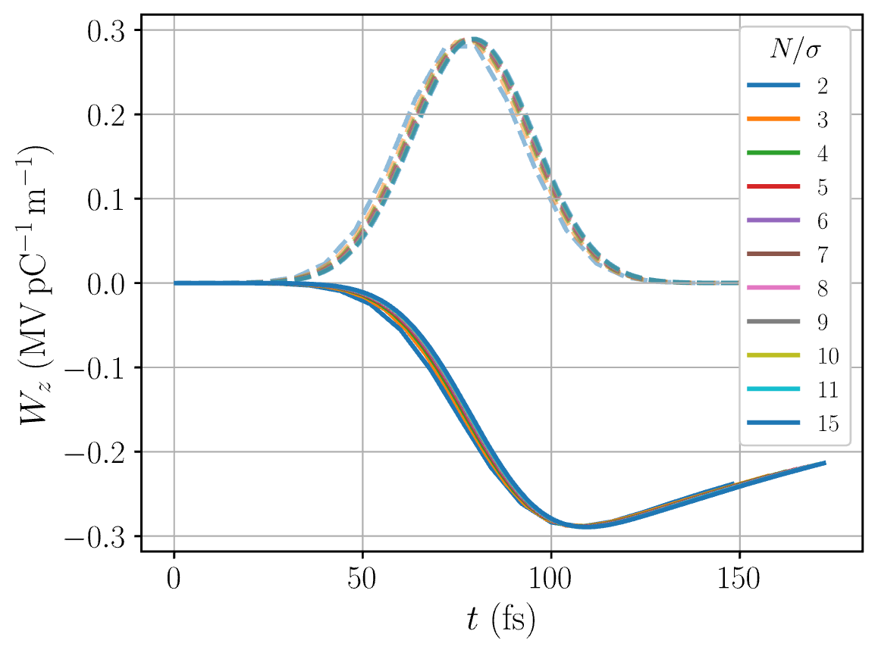
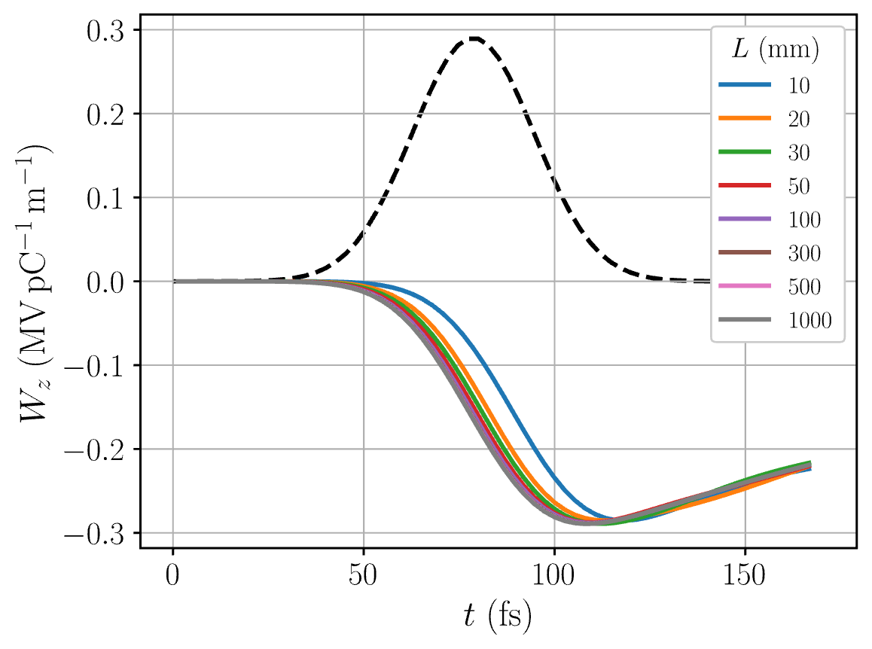
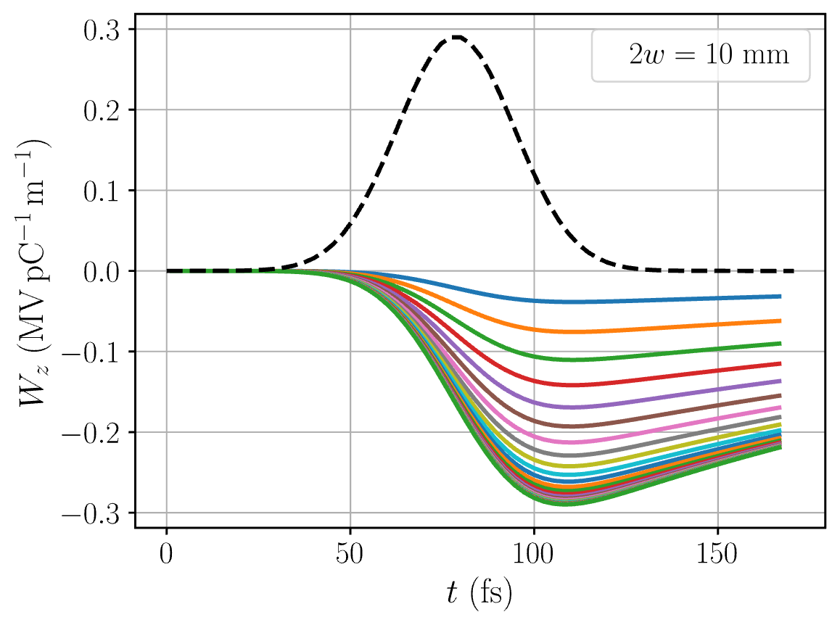
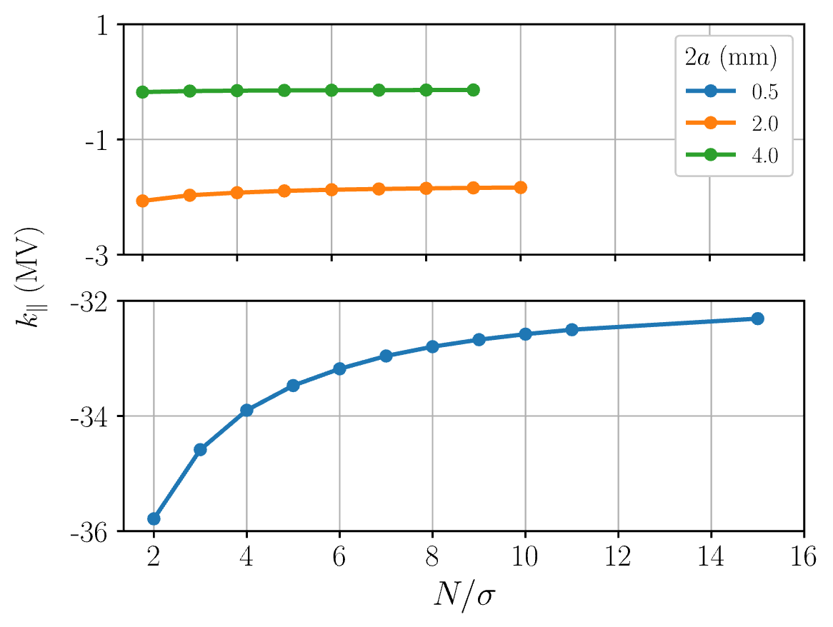
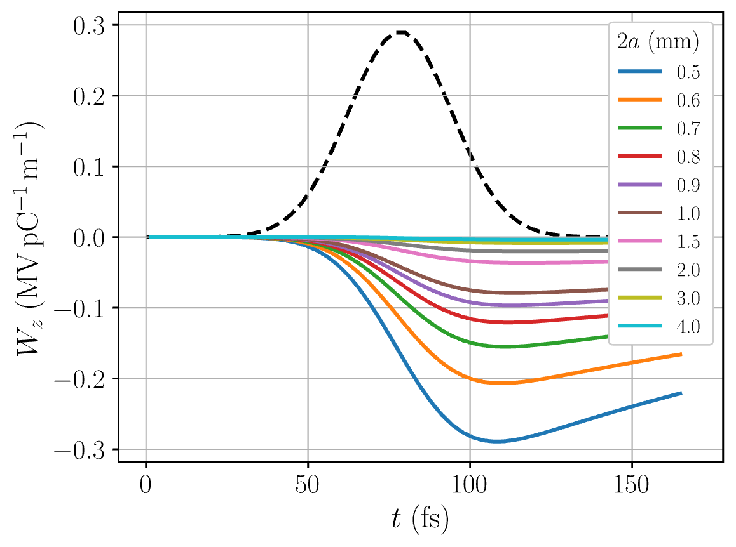
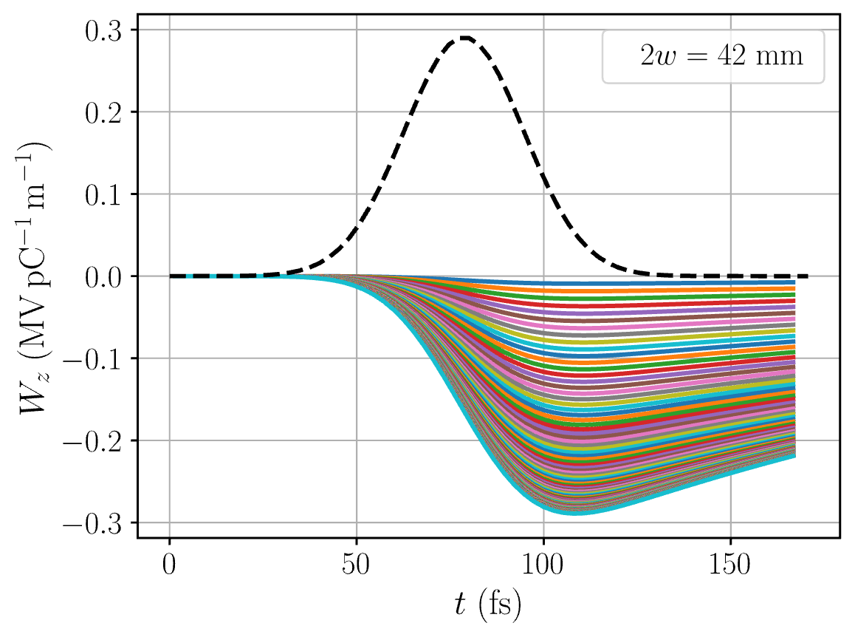
ECHO2D simulations
Coarser mesh overestimates amplitude of loss factor for small gaps

Slide 21
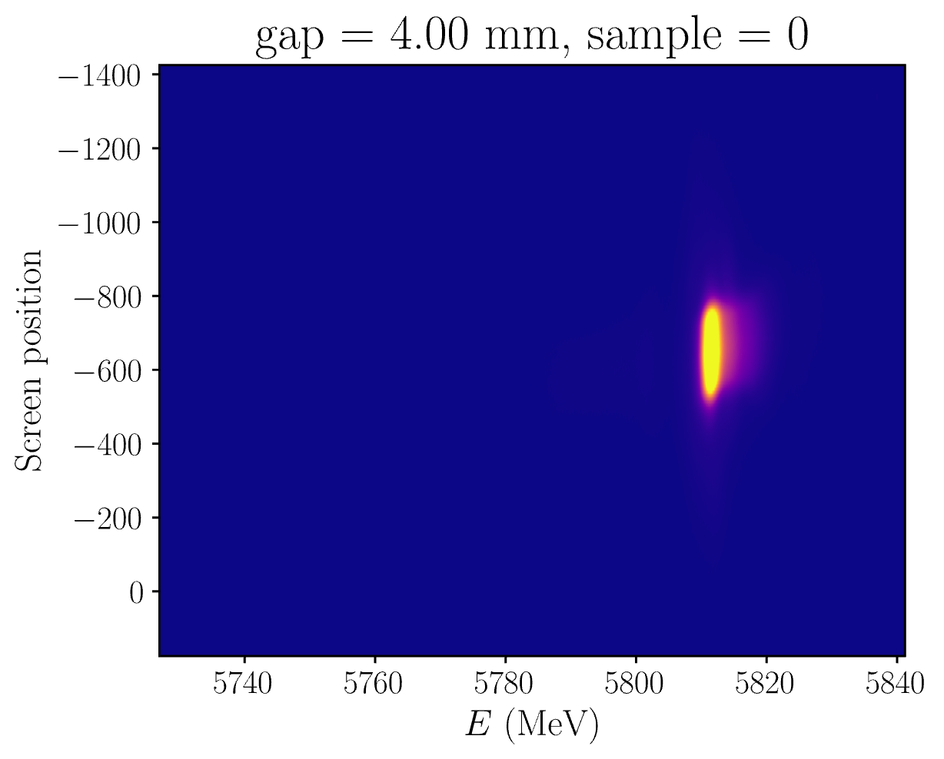
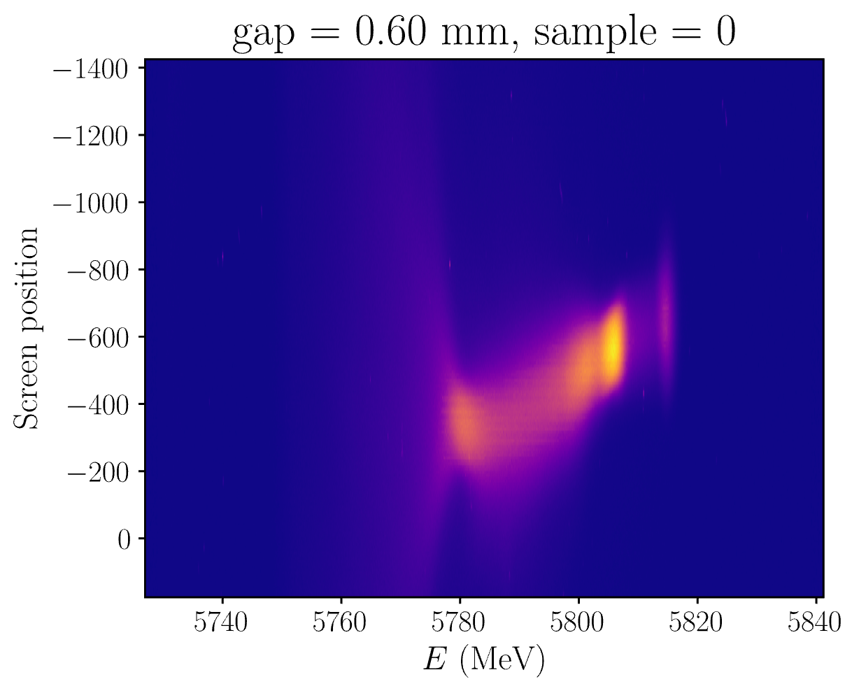
Measurement
Record LPS using TDS
Extract current profile from TDS
Simulate current profile passing through wakefield structure in ECHO2D
Track LPS through wake
Derive energy projection
Extract loss factor & energy spread
Vary wakefield structure gap while measuring
energy projection
Extract loss factor & energy spread
0.8 m dispersion at Screen 2 → 58 keV resolution

Slide 22
Measurement
Both structures centered using:
Transverse profile on Screen 1
Downstream BPM measurements
0.8 m dispersion at Screen 2 → 58 keV resolution

Slide 23




Slide 24






Transverse wakefields

Slide 25







