Slide 1
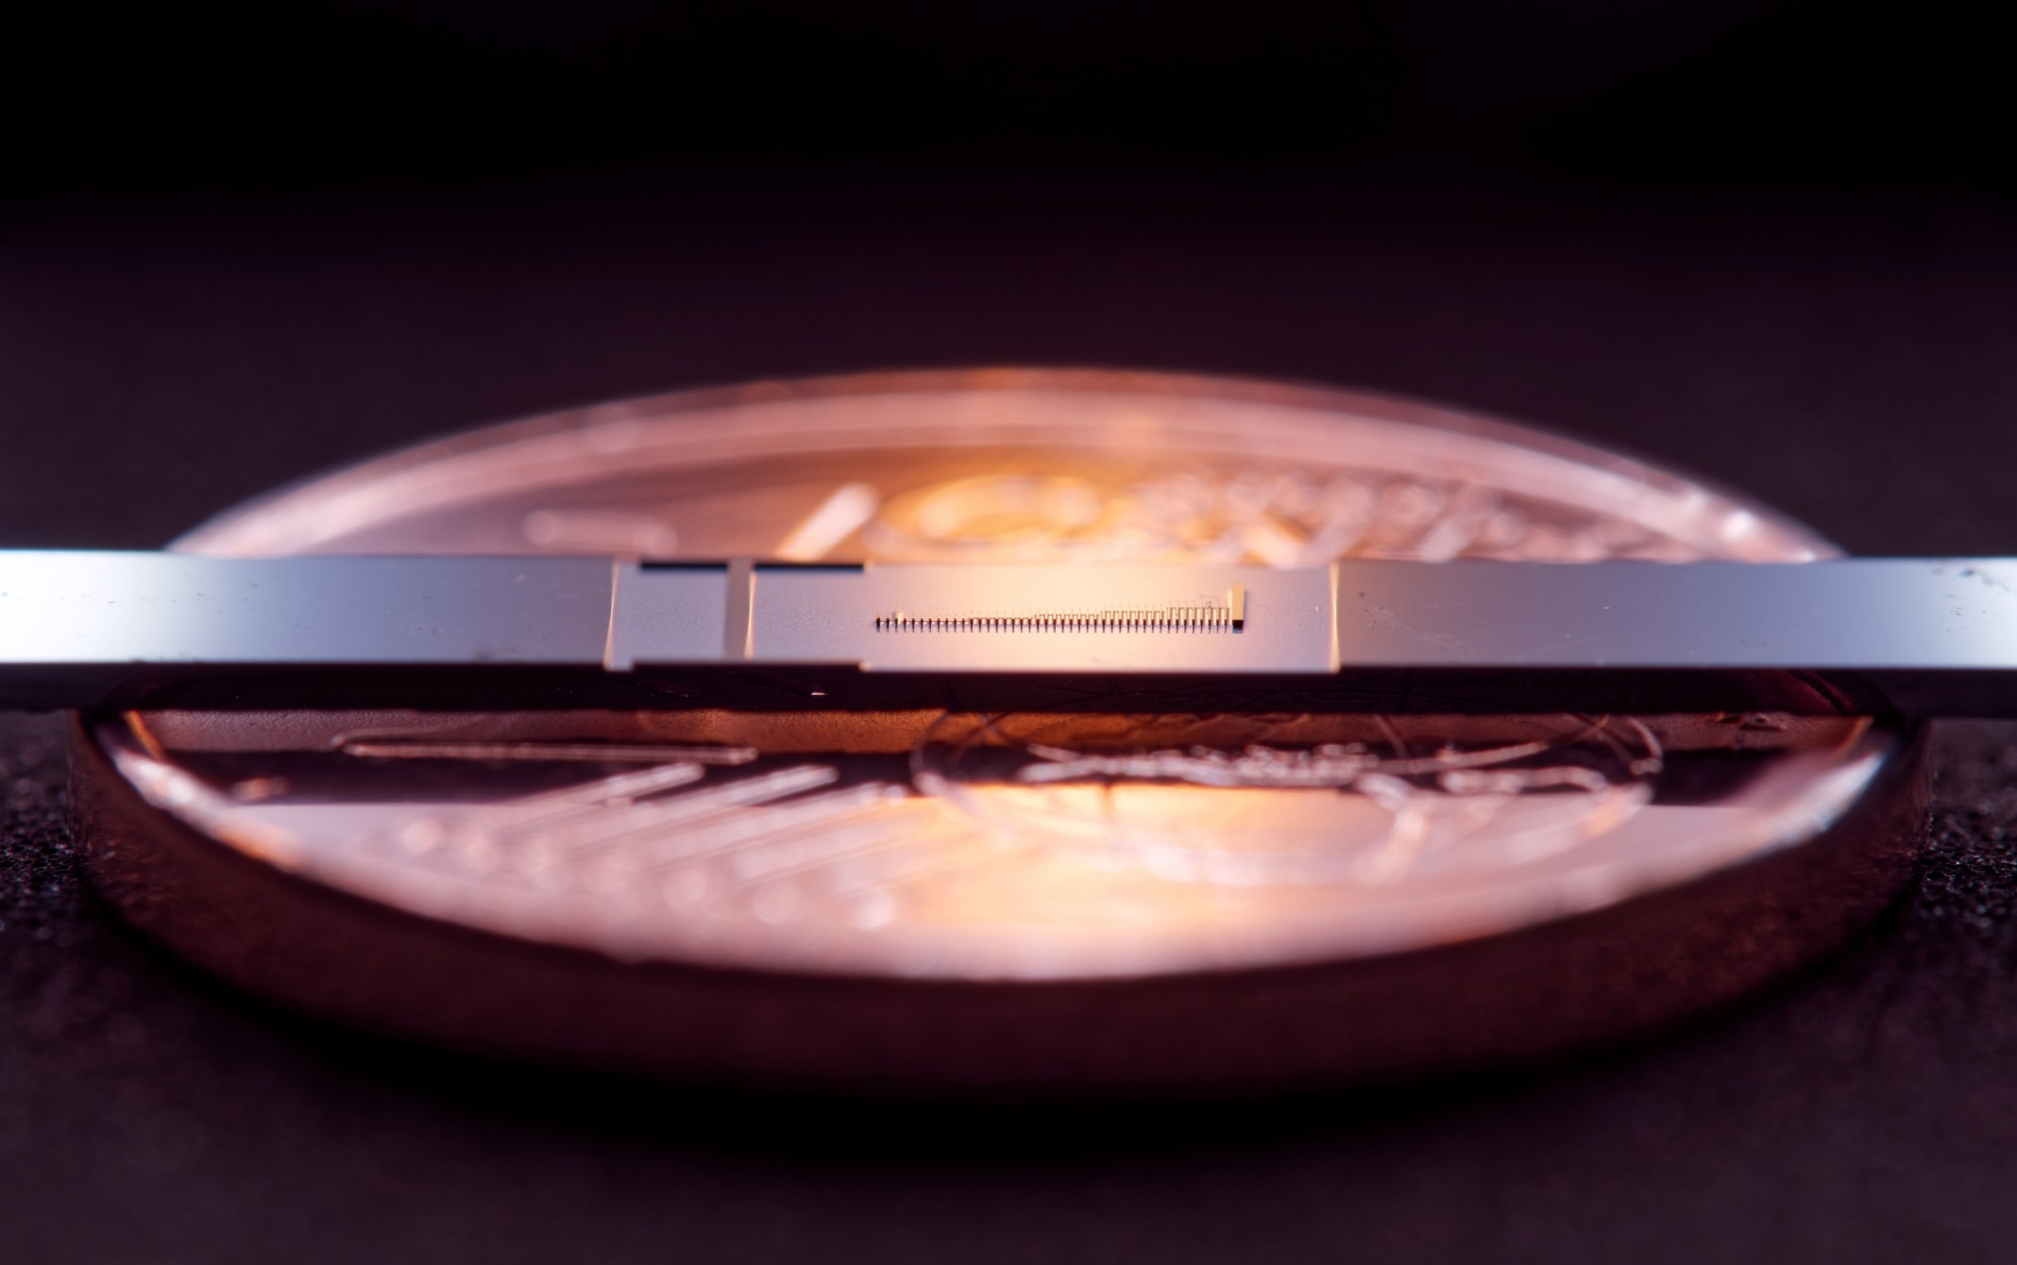
Towards three-dimensional confinement of the electron beam inside dielectric laser accelerators
Manuel Konrad, Stefanie Kraus, Julian Litzel, Leon Brückner, Zhexin Zhao,
Roy Shiloh*, Tomas Chlouba**, Peter Hommelhoff***
Friedrich-Alexander-Universität Erlangen-Nürnberg (FAU), Erlangen, Germany
* Now with Hebrew University, Jerusalem, Israel
** Now with AMOLF, Amsterdan, Netherlands
*** Now with Ludwig-Maximilian University München (LMU) and FAU

Slide 2
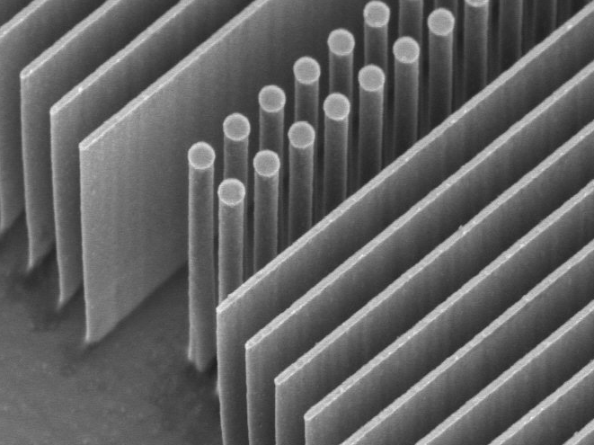
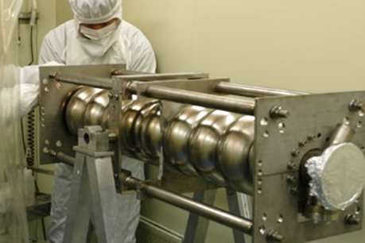
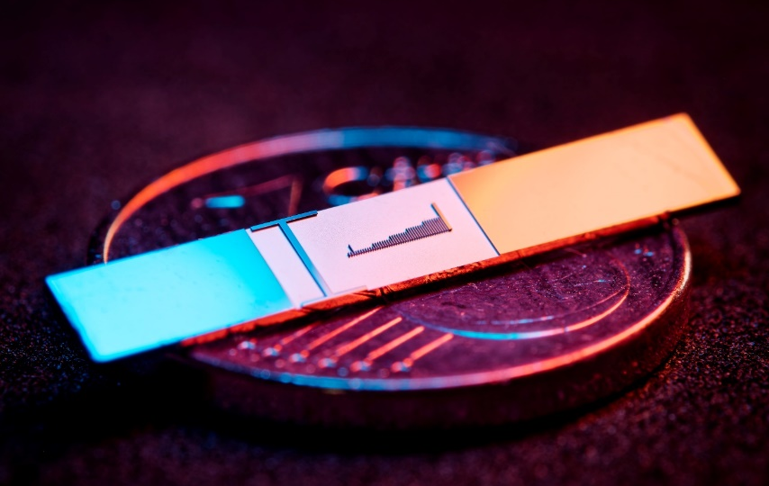
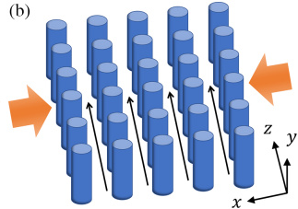

Why dielectric-based laser accelerators?
$$\text{1 }\text{μm}$$
Fermilab
Dielectric materials and optical frequencies
Higher damage threshold than metallic cavities
Higher gradients and smaller, minituarized structures
Much stricter requirements on beam properties
Lower current
per channel
Laser
Laser
DLA
f=150 THz (λ=2 μm)
τ=6.6 fs
RR ~ kHz-MHz
>3 GV/m fields
Gradient >1 GeV/m
Physical aperture: ~200 nm
Emittance <100 pm rad (norm)
fA-pA
(in single channel, many are possible soon)
RF
f=3 GHz
τ=333 ps
RR ~ Hz-kHz
<200 MV/m
25-50 MeV/m
~1cm
1 μm ~ 1 mm rad
nA-μA and larger
Multi-channel DLA:
Zhao et al., Photonics Research 8 10,
1586-1598 (2020)

Slide 3
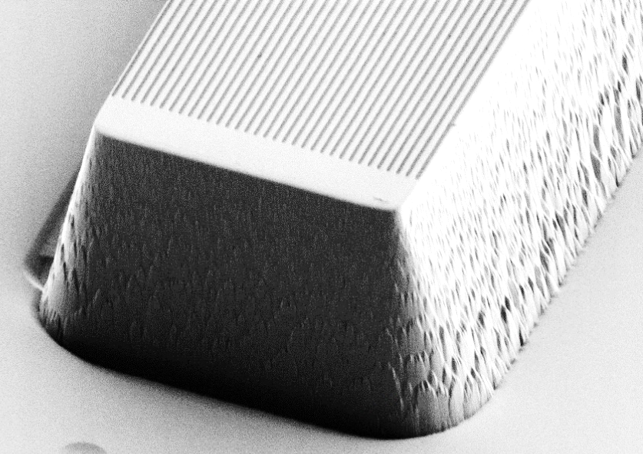







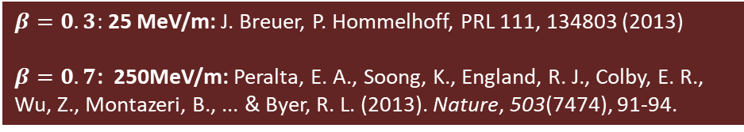
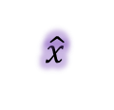


Operation principle
Synchronicity condition:
$$β=Λ_{p}/λm$$
Depending on particles position:
Acceleration
Deceleration
Deflection
1
2
3
4
1
2
$$Λ_{p}$$
3
4
$$\hat{y}$$
TM-polarized
$$\hat{x}$$
$$\hat{y}$$
Goal: generate a mode that allows momentum transfer from laser field to electrons
Use first order effect, so m=1 (efficient!)
Second order effects too already too inefficient
$$\hat{z}$$
$$\hat{x}$$
4
~620nm
$$\hat{z}$$
1
2
3
$$Λ_{p}$$
First spatial harmonic
$$λ$$
Proof of concept:
0
$β=0.3:$ 25 MeV/m: J. Breuer, P. Hommelhoff, PRL 111, 134803 (2013)
$β=0.7$: 250MeV/m: Peralta, E. A., Soong, K., England, R. J., Colby, E. R., Wu, Z., Montazeri, B., ... & Byer, R. L. (2013). Nature, 503(7474), 91-94.
Deceleration
Acceleration

Slide 4
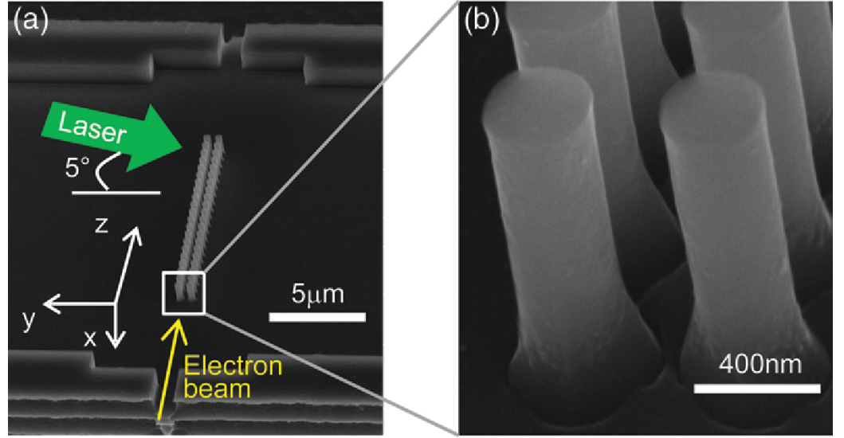
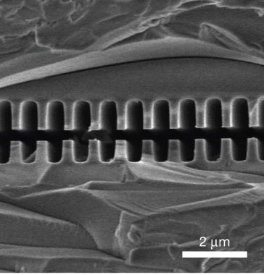
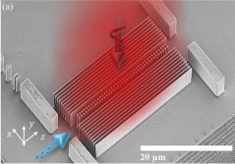
2015
Silicon pillar structures
2021
2013
Top illumination
Bonded silica gratings
Leedle, et al. CLEO, pp. FM3M-7 (2018)
Leedle, et al. Opt. Lett. 40, 4344-4347 (2018)
Yousefi et al., Opt. Lett. 44, 1520-1523 (2019)
Fishman et al., Nature Comm 14, 3687 (2023)
Black et al., PRAB 23, 114001 (2020)
Peralta et al. Nature 503, 91–94 (2013)
Koyama, K., et al. IPAC (2014)
Wei et al., Appl. Optics 56(29) (2017)
Wie et al., Physics of Plasmas 24.7 (2017)
Cesar et al., NIMA 909, 252-256 (2018)
Cesar et al., Optics Expr., 26(22), (2018)
Crisp et al., arXiv:2310.12384 (2023)
Chen et al., Proposal (1989)
Shiloh, et al., Opt. Express 29, 14403-14411 (2021)

Slide 5
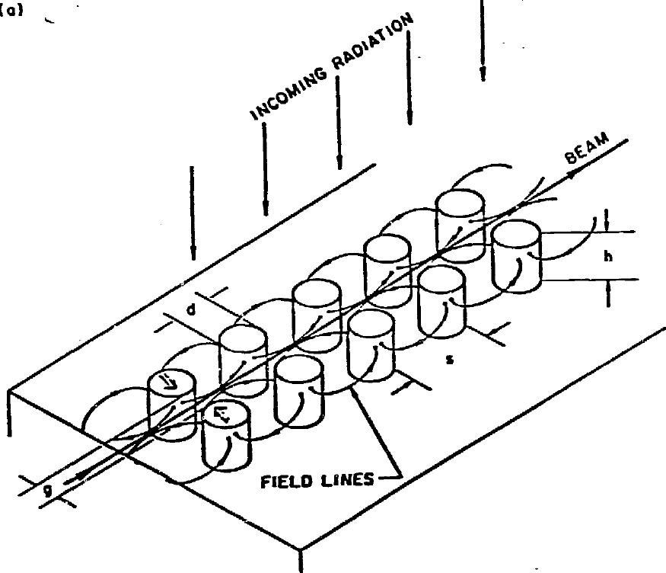
2015
Silicon pillar structures
2021
2013
Top illumination
Bonded silica gratings
Leedle, et al. CLEO, pp. FM3M-7 (2018)
Leedle, et al. Opt. Lett. 40, 4344-4347 (2018)
Yousefi et al., Opt. Lett. 44, 1520-1523 (2019)
Fishman et al., Nature Comm 14, 3687 (2023)
Black et al., PRAB 23, 114001 (2020)
Peralta et al. Nature 503, 91–94 (2013)
Koyama, K., et al. IPAC (2014)
Wei et al., Appl. Optics 56(29) (2017)
Wie et al., Physics of Plasmas 24.7 (2017)
Cesar et al., NIMA 909, 252-256 (2018)
Cesar et al., Optics Expr., 26(22), (2018)
Crisp et al., arXiv:2310.12384 (2023)
Chen et al., Proposal (1989)
Shiloh, et al., Opt. Express 29, 14403-14411 (2021)

Slide 6
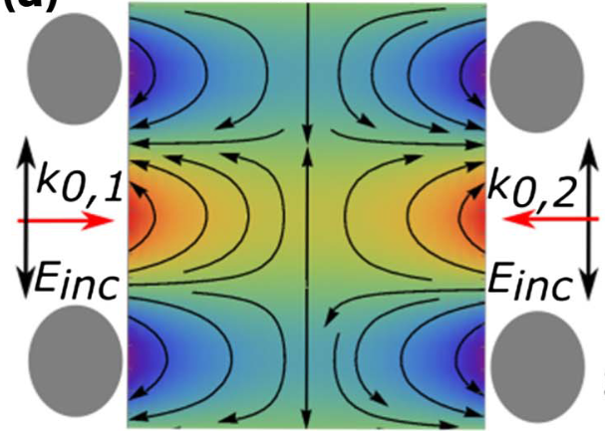

Red (accelerating) and blue (decelerating)
2015
e⁻
E_{z}
x
Silicon pillar structures
2021
2013
Top illumination
y
z
Bonded silica gratings
Laser
Laser
Laser
Laser
Side illumination
Leedle, et al. CLEO, pp. FM3M-7 (2018)
Leedle, et al. Opt. Lett. 40, 4344-4347 (2018)
Yousefi et al., Opt. Lett. 44, 1520-1523 (2019)
Fishman et al., Nature Comm 14, 3687 (2023)
Black et al., PRAB 23, 114001 (2020)
Peralta et al. Nature 503, 91–94 (2013)
Koyama, K., et al. IPAC (2014)
Wei et al., Appl. Optics 56(29) (2017)
Wie et al., Physics of Plasmas 24.7 (2017)
Cesar et al., NIMA 909, 252-256 (2018)
Cesar et al., Optics Expr., 26(22), (2018)
Crisp et al., arXiv:2310.12384 (2023)

Slide 7
Guiding in 2D
(plane parallel to substrate)

Slide 8
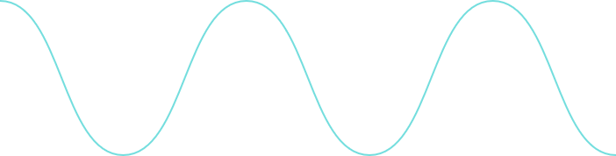
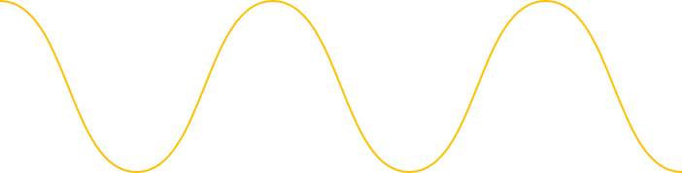
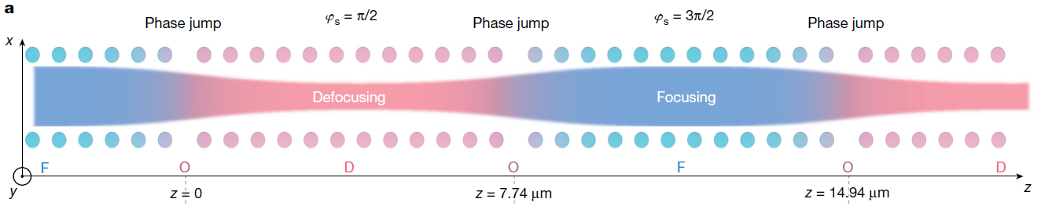










Guiding with Alternating Phase Focusing
(without acceleration)
e⁻
x
$$π/2$$
$$π$$
$$3π/2$$
$$2π$$
z
Force acting on electrons:
$${\text{F}}_{\text{z}}\text{= }−\frac{\text{e}\text{c}}{\text{βγ}}{\text{C}}_{\text{C}}\text{cosh}\left({\text{k}}_{\text{z}}\text{x}\right)\text{cos}\left({\text{φ}}_{\text{s}}\right)$$
$${\text{F}}_{\text{x}}\text{=} \frac{\text{e}\text{c}}{\text{βγ}}{\text{C}}_{\text{C}}\frac{\text{1}}{\text{γ}}\text{sinh}\left({\text{k}}_{\text{z}}x\right)\text{sin}\left({\text{φ}}_{\text{s}}\right)$$
y
$${\text{F}}_{\text{z}}$$
$${\text{φ}}_{\text{s}}$$
z<0
${\text{φ}}_{\text{s}}$: Phase between laser and electron
$${\text{F}}_{X}$$
$$Δφ_{s}=180°$$
Niedermayer, U., Egenolf, T., Boine-Frankenheim, O., Hommelhoff P., Phys. Rev. Lett. 121, 214801 (2018)
Shiloh, R., Illmer, J., Chlouba, T., Yousefi, P., Schönenberger, N., Niedermayer, U., Mittelbach, A., & Hommelhoff, P. Nature 597, 498 (2021)

Slide 9
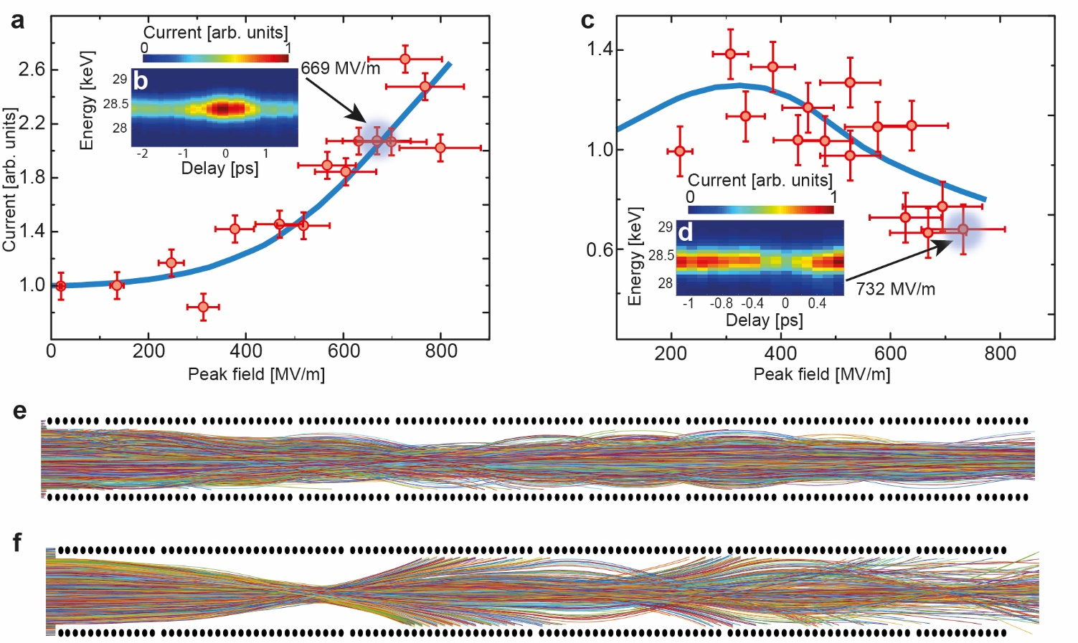

Alternating phase focusing effect: proof of principle
Overfocusing
Guiding
2.7 times larger electron current at optimal transport field strength (~700 MV/m)
Overfocusing effect (>400 MV/m)
Different structure geometry with larger macrocells
R. Shiloh, J. Illmer, T. Chlouba, P. Yousefi, N. Schönenberger, U. Niedermayer, A. Mittelbach, P. Hommelhoff, Nature 597, 498 (2021)
For Linacs: Lauber, S., Barth, W., Basten, M., Dziuba, F. D., List, J., Miski-Oglu, M., ... & Yaramyshev, S., EPJ Techniques & Instrumentation, 11(1), 5 (2024)

Slide 10
Acceleration + Guiding in 2D
(guiding in plane parallel to substrate)

Slide 11
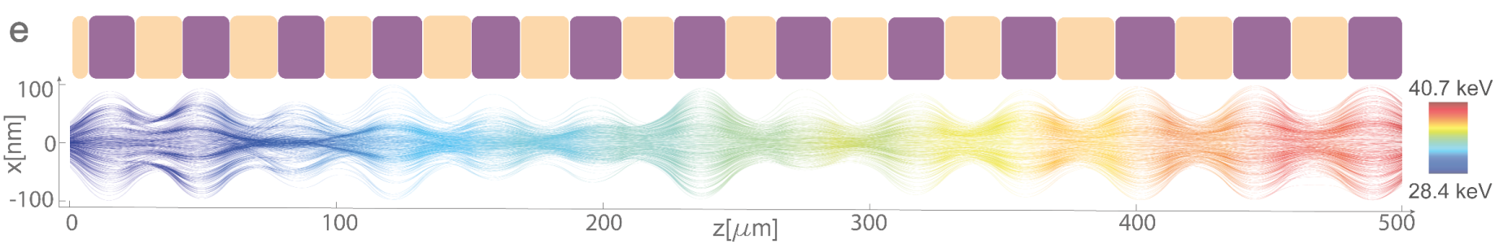


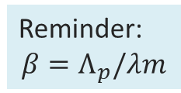







Coherent laser acceleration of electrons
So far only guiding, now: acceleration
$$π/2$$
$$π$$
$$3π/2$$
$$2π$$
Phase jumps + Tapering
=
Guiding + Acceleration
Reminder:
$$β=Λ_{p}/λm$$
$${\text{F}}_{Z}$$
$${\text{φ}}_{\text{s}}$$
$${\text{F}}_{X}$$
$$Δφ_{s}=180°$$
$$Δφ_{s}=120°$$
D: Defocusing
F: Focusing
T. Chlouba*, R. Shiloh*, S. Kraus*, L. Brückner*, J. Litzel, P. Hommelhoff, Nature, 622, 476 (2023)

Slide 12
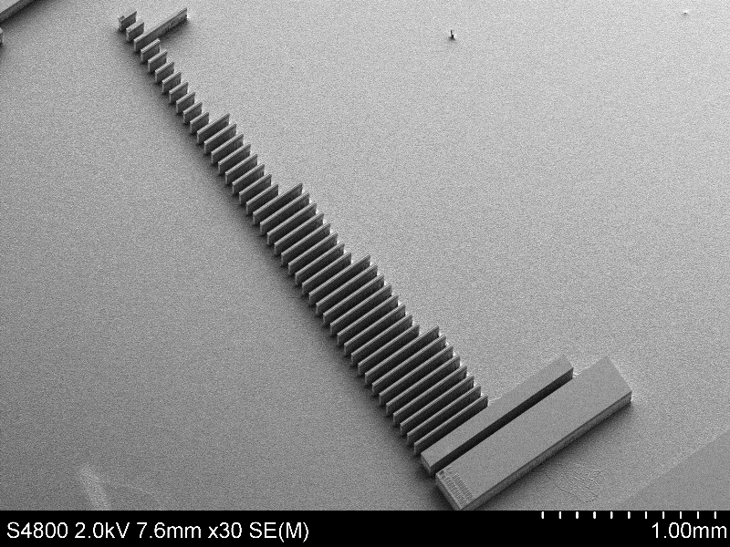
1mm

Slide 13
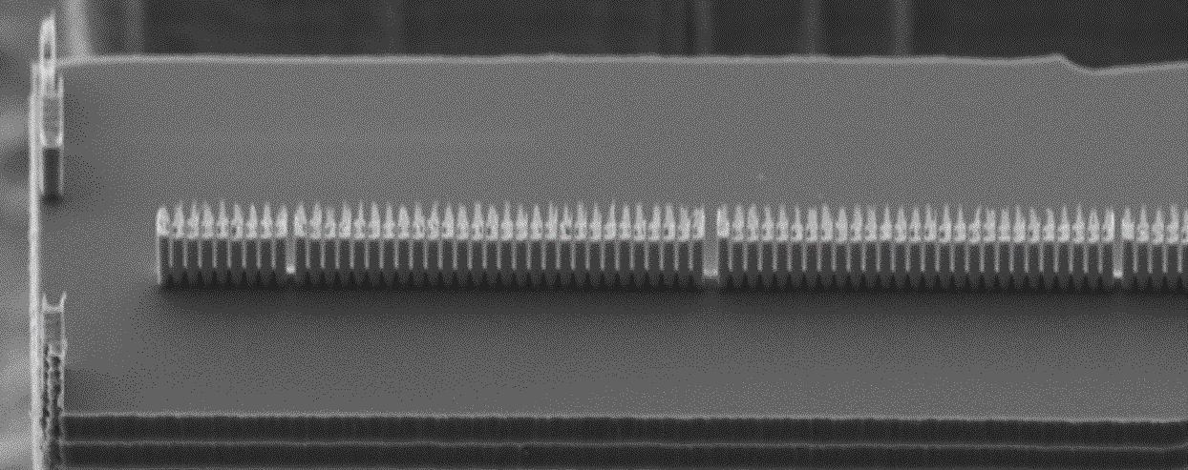




Laser
e-
Previous generation accelerating structure
2µm
200 $μm$
300 $μm$
400 $μm$
E_{Peak} = 600MV/m - 700MV/m
Design gradient: 22.7MeV/m
500 $μm$
1mm
12

Slide 14
Laser
e-
Previous generation accelerating structure
2µm
200 $μm$
300 $μm$
400 $μm$
E_{Peak} = 600MV/m - 700MV/m
Design gradient: 22.7MeV/m
500 $μm$
1mm
13

Slide 15
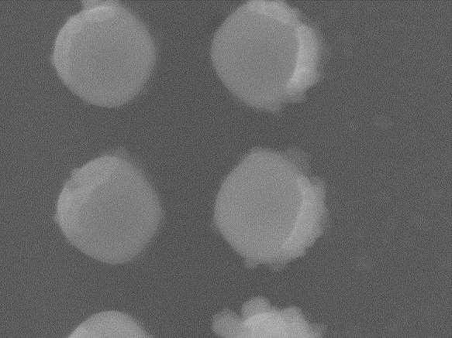



Acceleration structures
Top view
225nm
139 – 237nm
500 µm long, made of 733 pillar pairs
Tapered periodicity: from 619 nm to 717 nm
Pillar radii: 240nm x 225nm, 225nm wide channel
Macro-cells: from 5 µm to 22.5 µm (total of 26 segments)
Average design gradient: 22.7 MeV/m
Peak electric optical field: 600 MV/m (2.2 µJ pulse energy and 360 mW average power)
Laser pulse front tilting required in experiment
480nm
450nm
$$\text{20}\text{0}\text{n}\text{m}$$
2$μm$ pillar height
$$\text{50 }\text{μm}$$

Slide 16
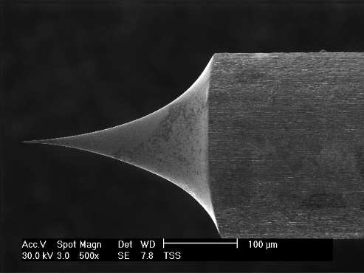
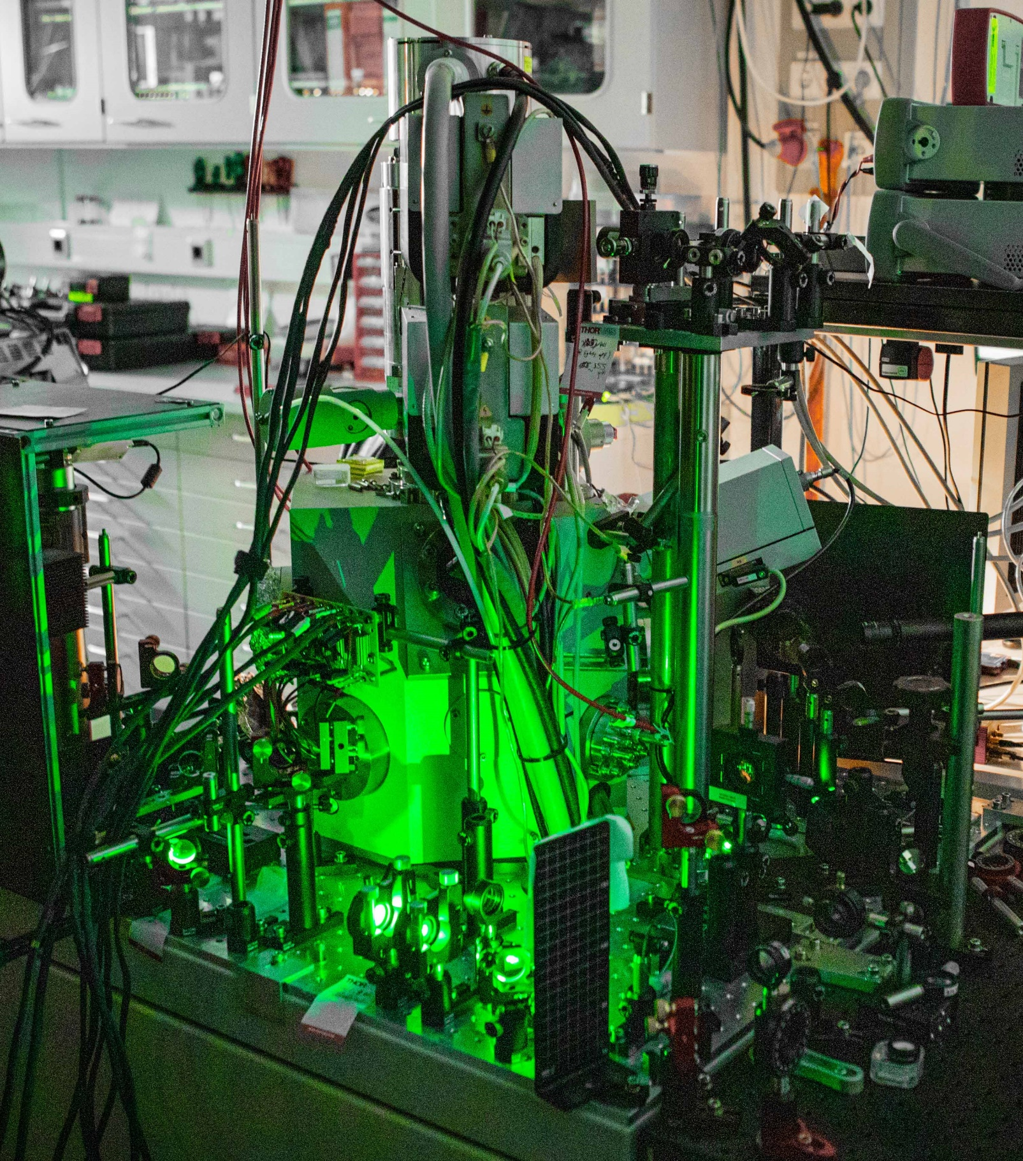
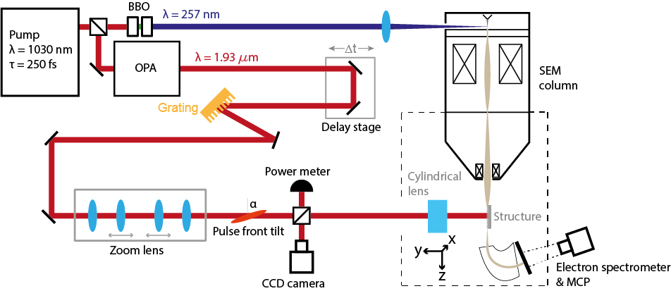
Experimental setup at FAU
Electron sources
XL30
More about electron sources for DLA in Ameya Patwardhan’s talk

Slide 17
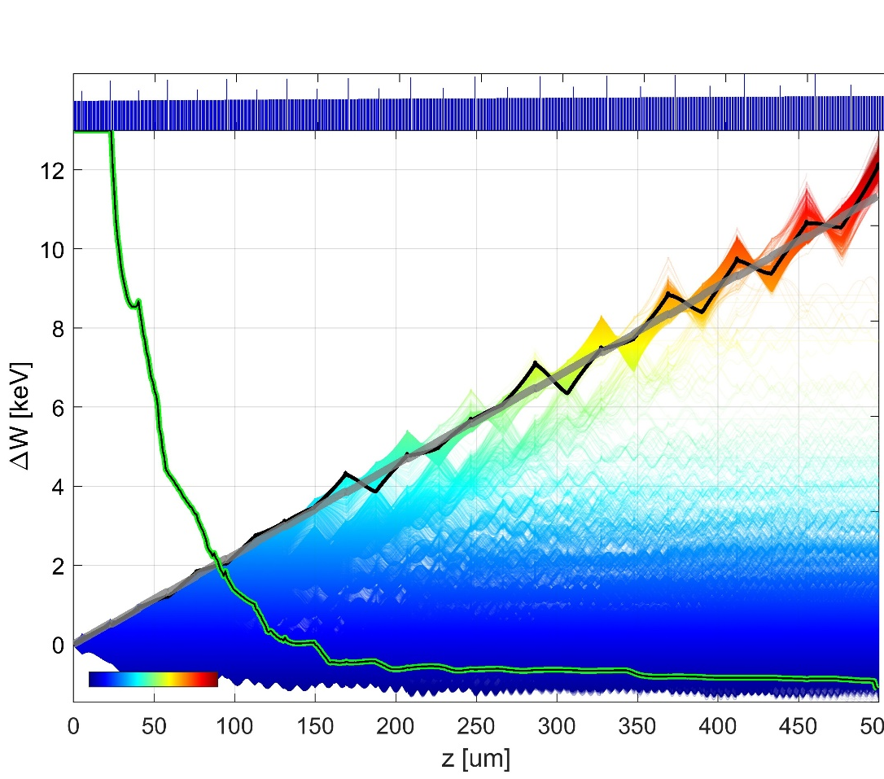
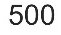



Simulation
Pillar distance
1
The design curve
Energy gain (keV)
% of survived particles
0.5
300$μ$m
Laser on
Laser off
Simulation
Energy
0
400$μ$m
500$μ$m
T. Chlouba*, R. Shiloh*, S. Kraus*, L. Brückner*, J. Litzel, P. Hommelhoff, Nature, 622, 476 (2023)

Slide 18
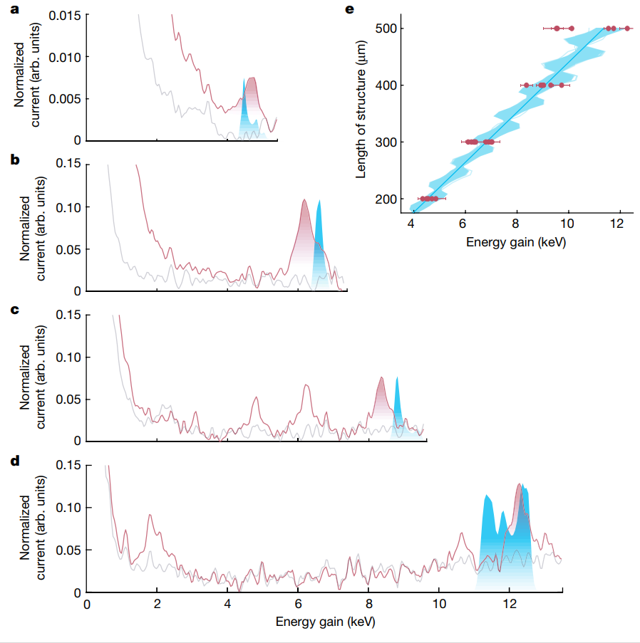

Simulation
Pillar distance
200$μ$m
1
2
4
Energy gain (keV)
Energy gain (keV)
% of survived particles
0.5
4.5 keV
Laser on
Laser off
Simulation
Energy
0
Similar results from Stanford/Darmstadt team:
Broaddus, Egenolf, …, Byer, Leedle, Solgaard, Phys. Rev. Lett. 132, 085001 (2024)
T. Chlouba*, R. Shiloh*, S. Kraus*, L. Brückner*, J. Litzel, P. Hommelhoff, Nature, 622, 476 (2023)

Slide 19
Simulation
Pillar distance
200$μ$m
1
Energy gain (keV)
6.6 keV
% of survived particles
0.5
300$μ$m
4.5 keV
Laser on
Laser off
Simulation
2
4
6
Energy
Energy gain (keV)
0
Similar results from Stanford/Darmstadt team:
Broaddus, Egenolf, …, Byer, Leedle, Solgaard, Phys. Rev. Lett. 132, 085001 (2024)
T. Chlouba*, R. Shiloh*, S. Kraus*, L. Brückner*, J. Litzel, P. Hommelhoff, Nature, 622, 476 (2023)

Slide 20
Simulation
Pillar distance
200$μ$m
1
8.8 keV
Energy gain (keV)
6.6 keV
% of survived particles
0.5
300$μ$m
4.5 keV
Laser on
Laser off
Simulation
Energy
0
400$μ$m
2
4
6
8
Energy gain (keV)
Similar results from Stanford/Darmstadt team:
Broaddus, Egenolf, …, Byer, Leedle, Solgaard, Phys. Rev. Lett. 132, 085001 (2024)
T. Chlouba*, R. Shiloh*, S. Kraus*, L. Brückner*, J. Litzel, P. Hommelhoff, Nature, 622, 476 (2023)

Slide 21
Simulation
Pillar distance
200$μ$m
1
11.9 keV
8.8 keV
Energy gain (keV)
6.6 keV
% of survived particles
0.5
300$μ$m
4.5 keV
Laser on
Laser off
Simulation
Energy
0
400$μ$m
Maximum energy gain 12.3 keV
Total energy of 40.7 keV
43% energy gain
500$μ$m
Similar results from Stanford/Darmstadt team:
Broaddus, Egenolf, …, Byer, Leedle, Solgaard, Phys. Rev. Lett. 132, 085001 (2024)
T. Chlouba*, R. Shiloh*, S. Kraus*, L. Brückner*, J. Litzel, P. Hommelhoff, Nature, 622, 476 (2023)

Slide 22
Guiding in 3D?
(including out of plane direction)

Slide 23
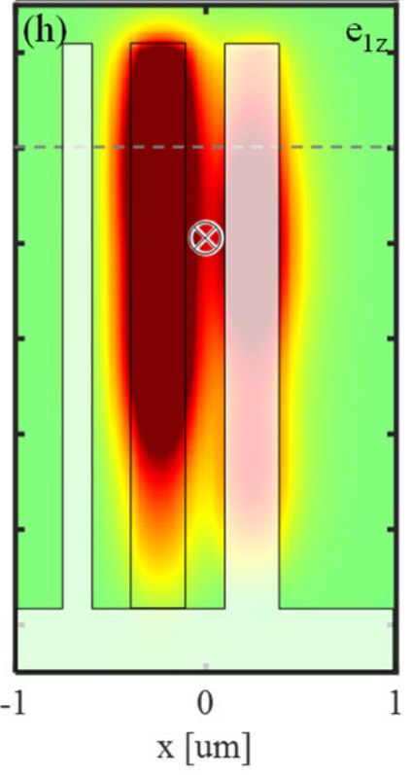
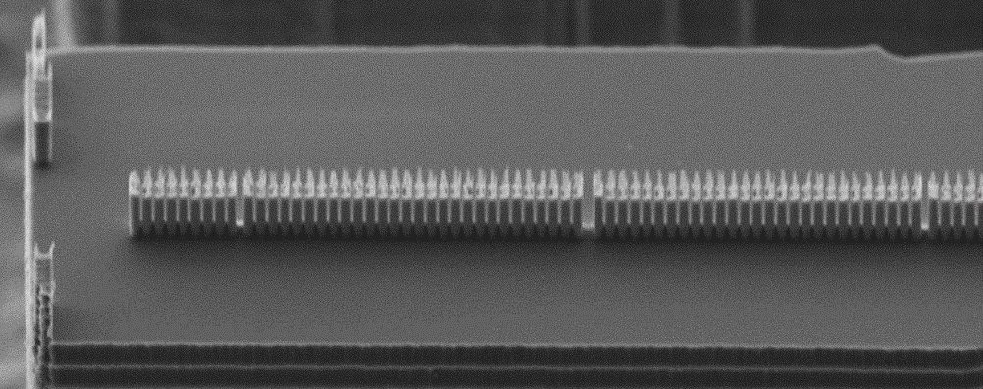
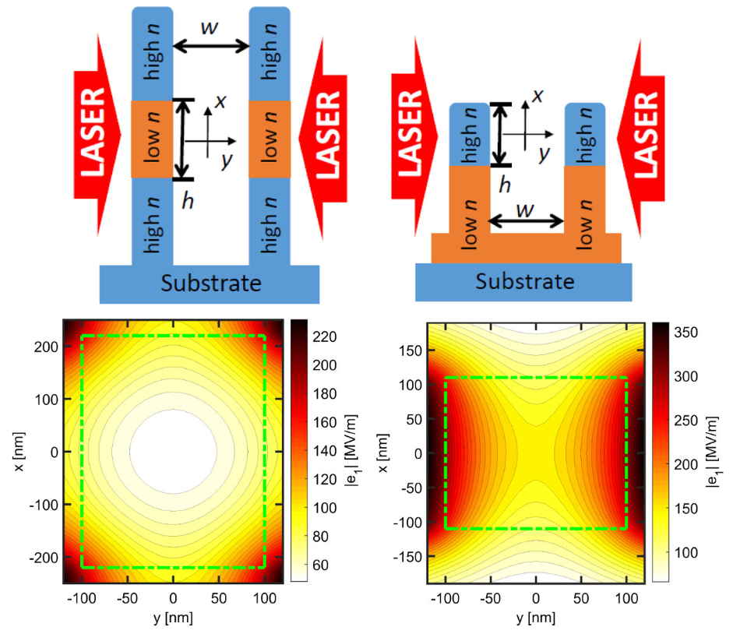
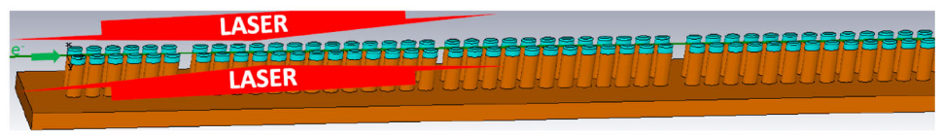
Guiding in 3D - The concept
Problem: structures etched from silicon
-> field roughly invariant perpendicular
to substrate
-> No field component in that direction
Possible Solution proposed by Uwe Niedermayer et al.:
Stacked layers of different dielectrics
-> Contrast of refractive index breaks invariance
Niedermayer, et al., Phys. Rev. Lett. 125, 164801 (2020)

Slide 24
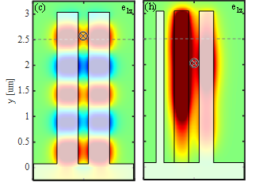
Guiding in 3D - The concept
Two questions arise:
Do we need the stacked structure or is top-illumination sufficient
If so, did we already have 3D confinement in previous measurements?
Another way to break invariance: Top illumination!
-> Reflection from substrate breaks invariance
-> Similar field profiles to stacked structure
Niedermayer, et al., Phys. Rev. Lett. 125, 164801 (2020)
Shiloh, et al., Opt. Express 29, 14403-14411 (2021)
For top-illumination:
  Field invariance is broken -> field nodes form along channel
  Transversal forces now in both directions

Slide 25
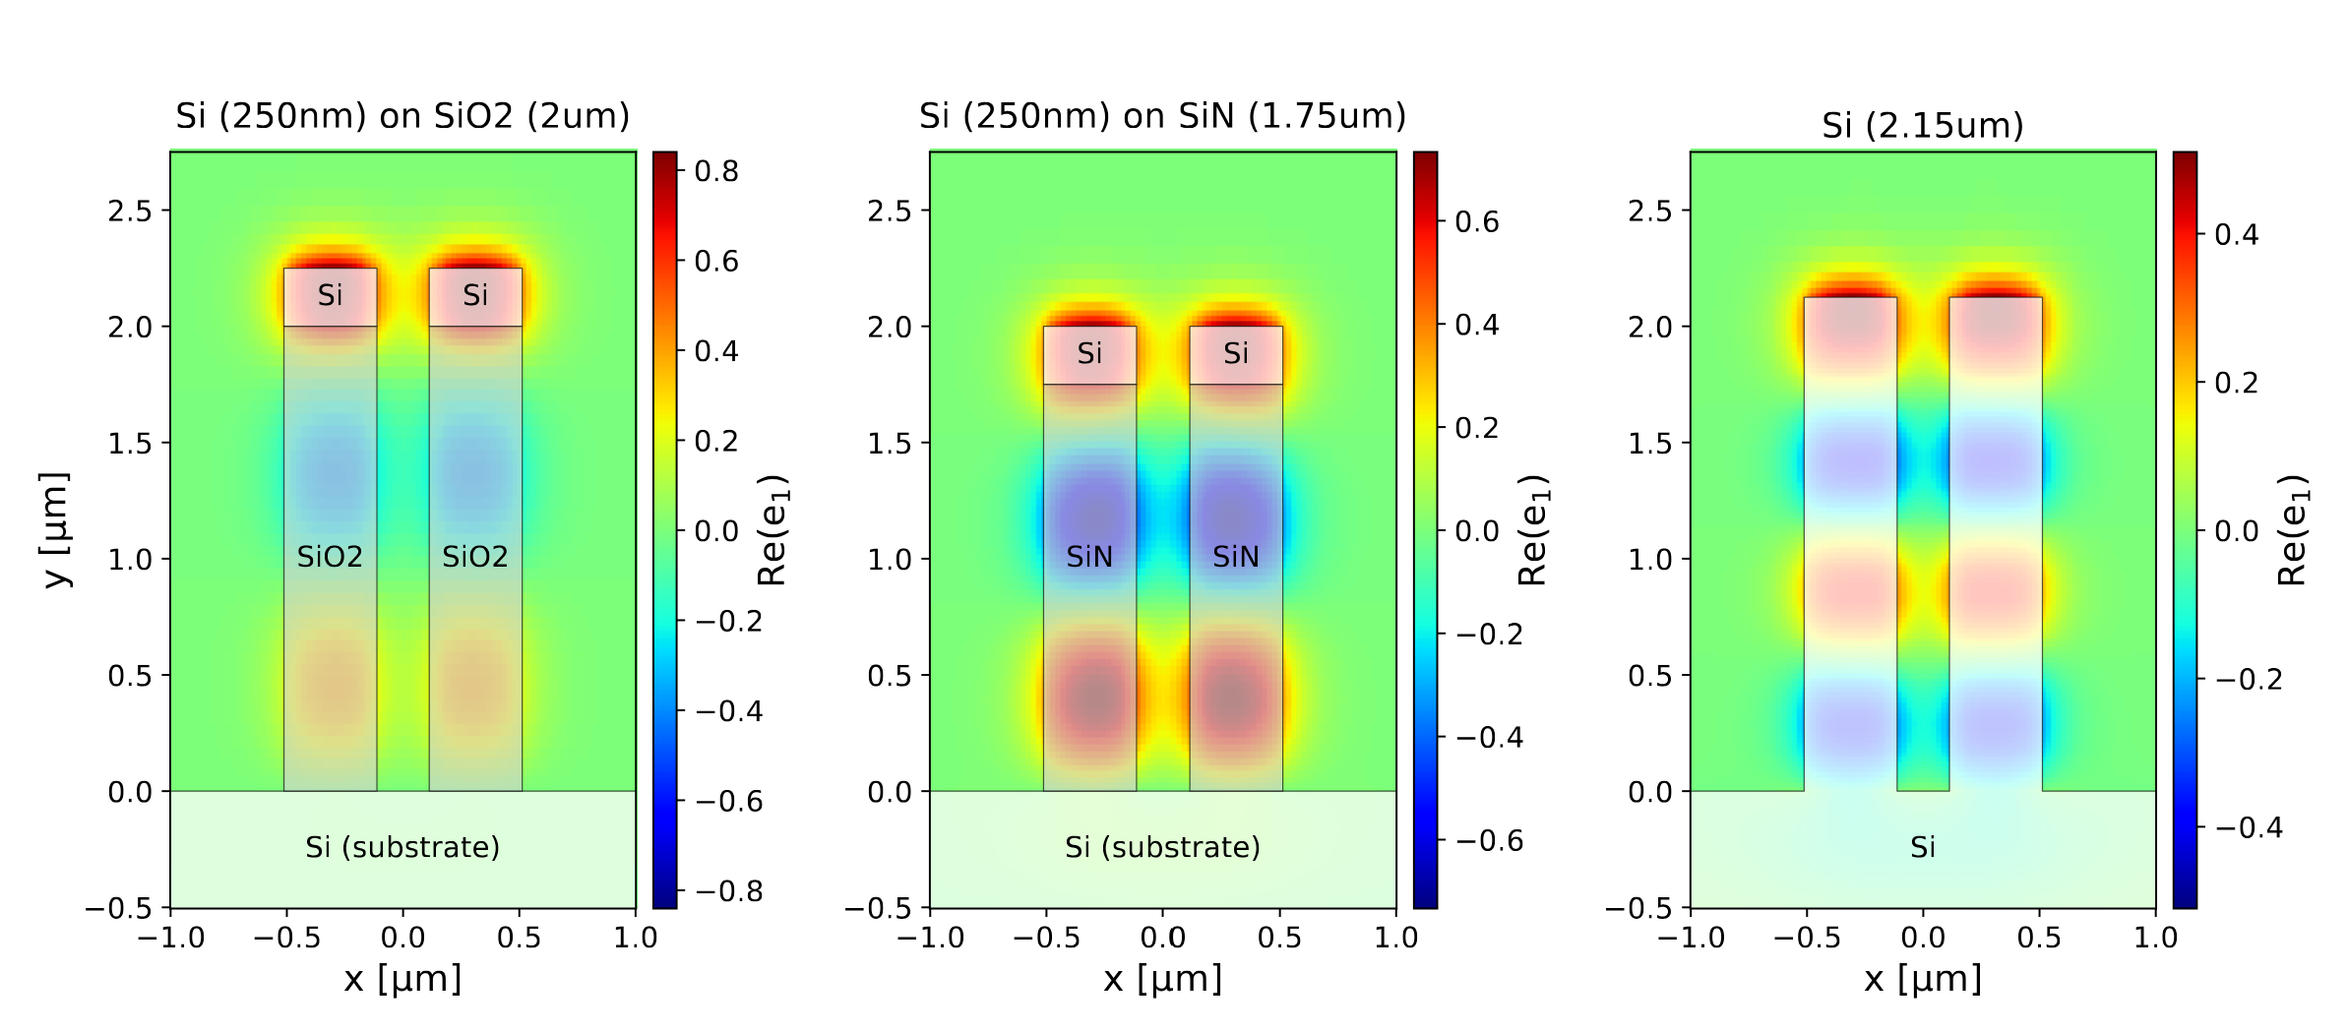
Guiding in 3D – Material combinations
How does the material influence 3D APF?
-> Nodes less pronounced for lower contrast
Only Silicon: Nodes forming as well
-> due to top-illumination

Slide 26
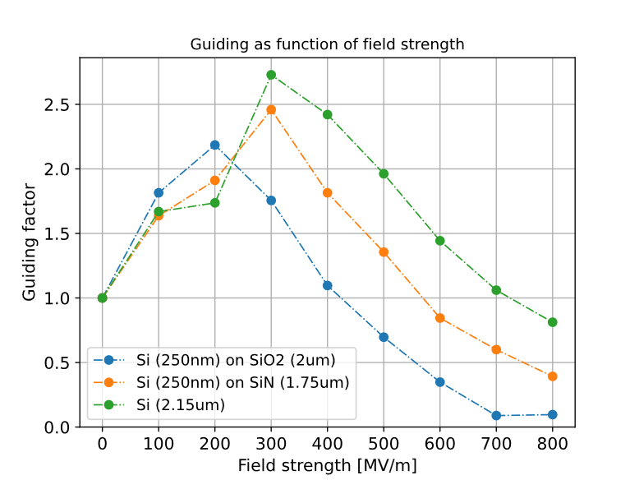
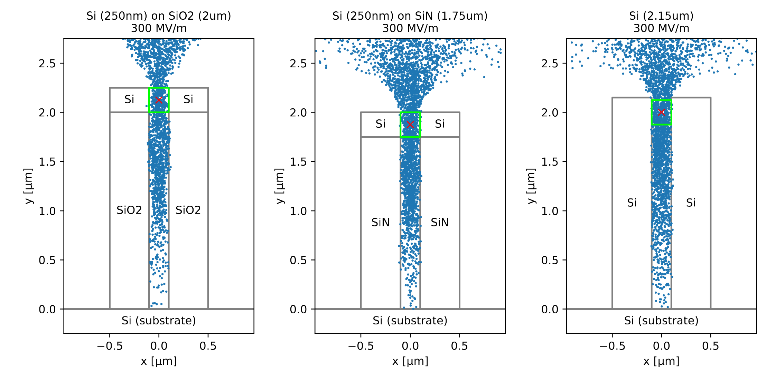
Guiding in 3D – First preliminary simulation results
Preliminary!
2D APF
All structures show guiding, but is it 3D APF?
-> Need to find a way to distinguish between
2D and 3D guiding
Note: Pure silicon shows strongest guiding
-> Structures not yet optimized
First measurements incoming!
Shiloh, R., et al., Nature 597, 498 (2021)

Slide 27
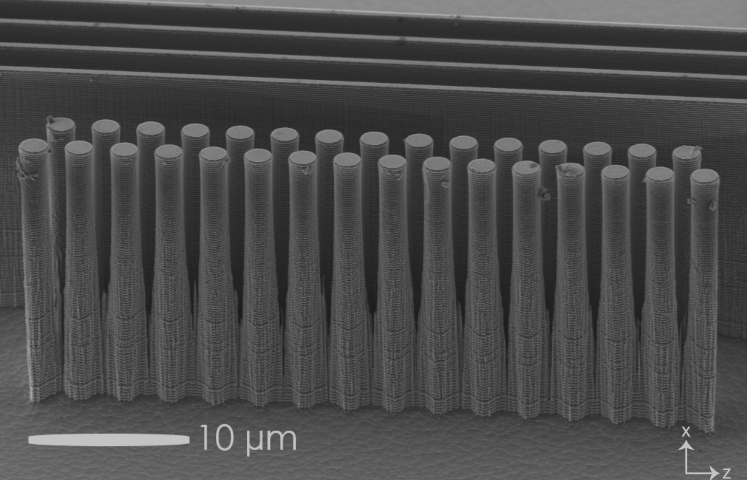
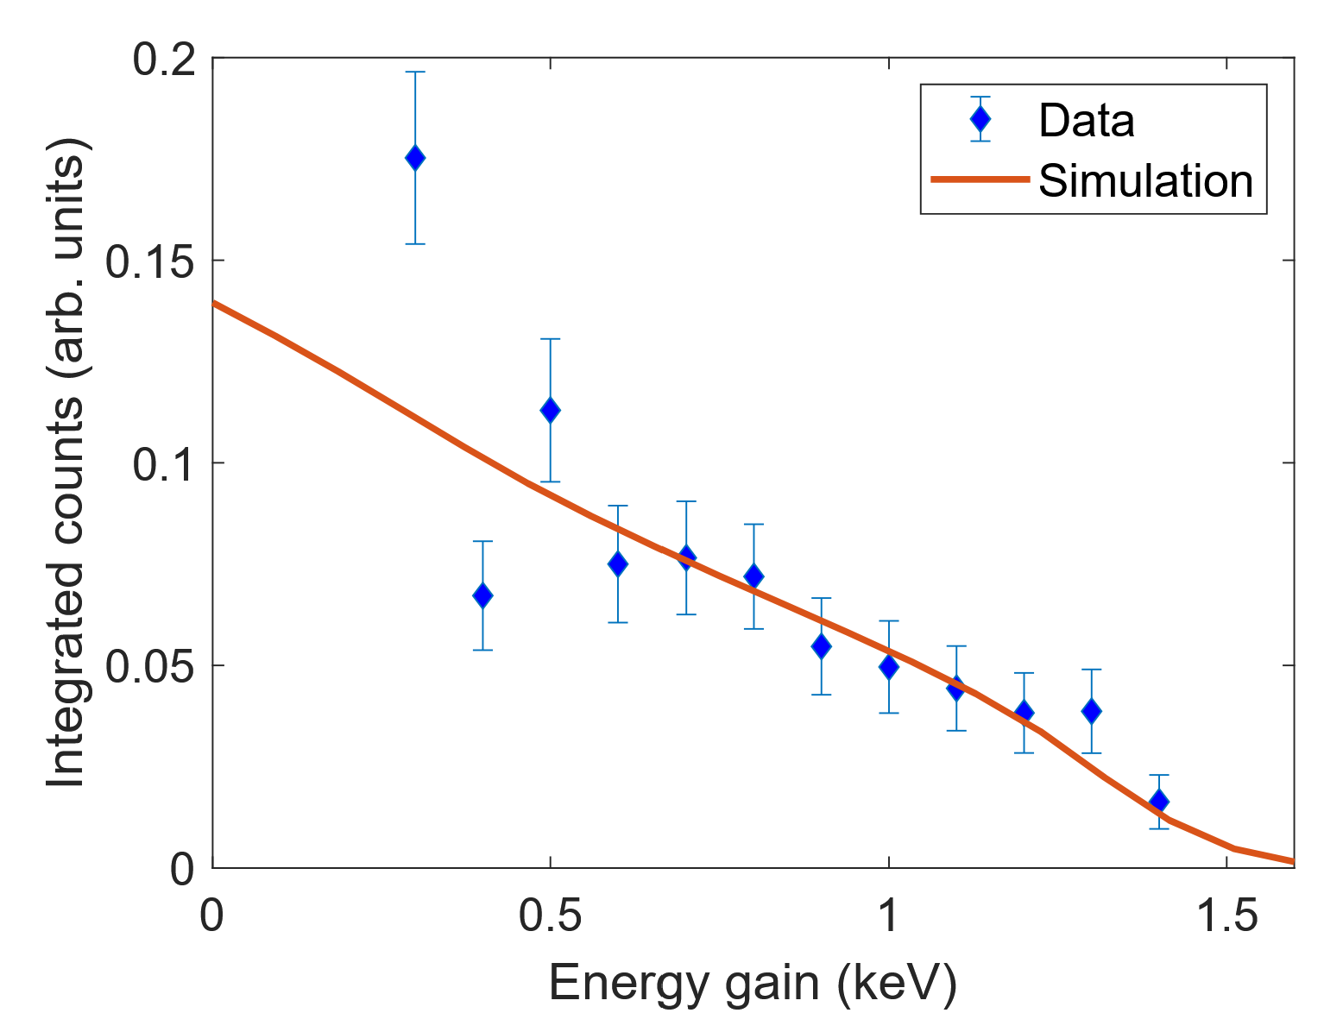
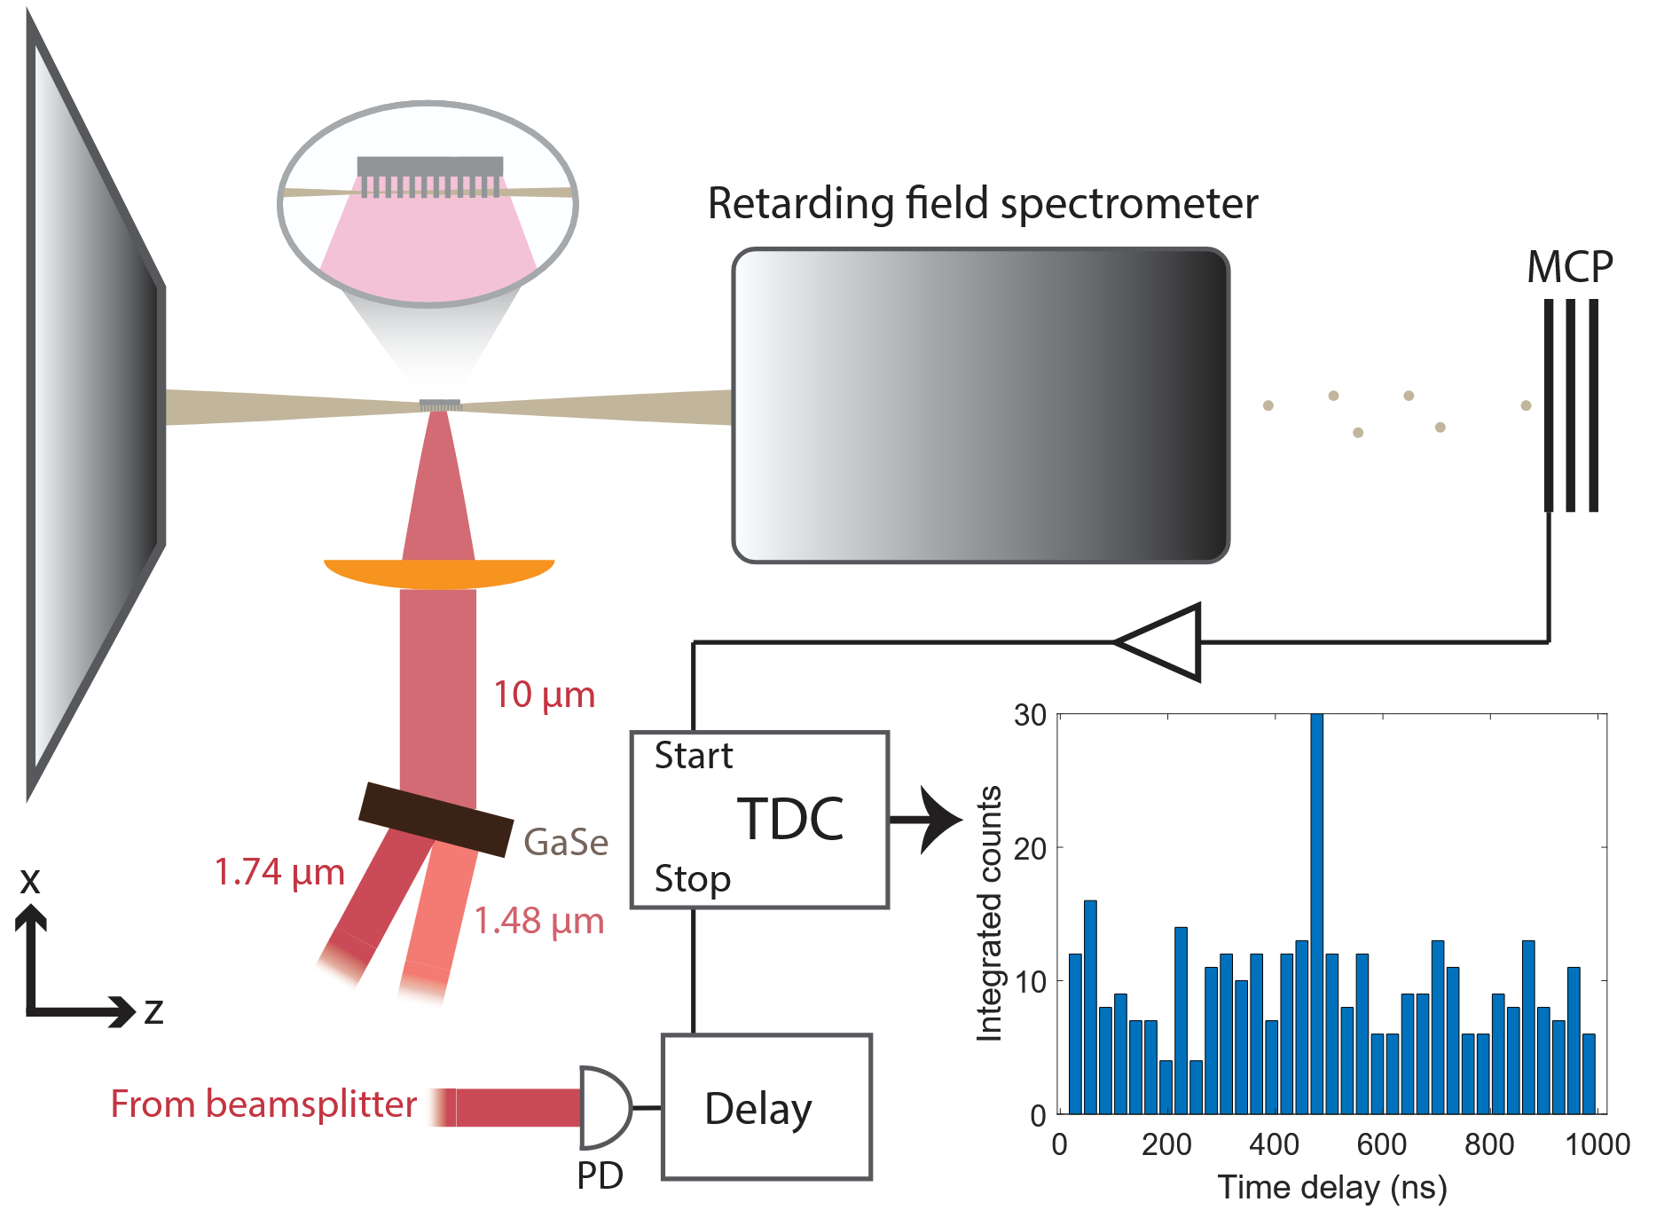
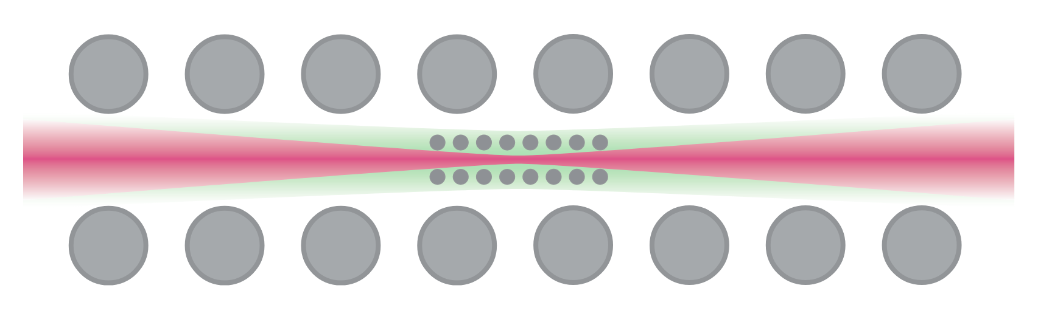
DLA @ 10 µm
Advantage of longer wavelengths:
Higher damage threshold
→ Higher accelerating fields
Much wider channel (factor 5 for 10 µm vs. 2 µm)
→ Larger acceptance / less strict requirements
on input beam
→ Larger currents possible
Easier fabrication
→ Additive fabrication? → More possibilities for 3D structures
L. Brückner, dissertation
L. Brückner, et al., Opt. Express 32, 28348 (2024)

Slide 28
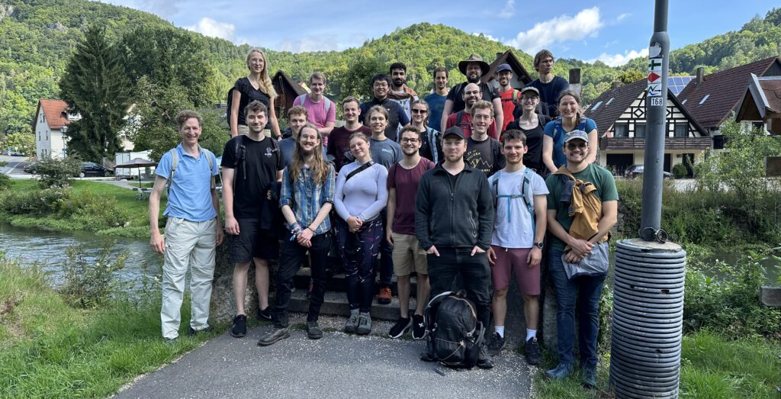











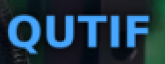
Fabian Bammes
Nils Bode
Leon Brückner
Yiqi Fang
Julian Freier
Jonas Heimerl
Celina Hüttner
Johannes Illmer
Patrick Käferlein
Manuel Konrad
Viacheslav Korolev
Stefanie Kraus
Daniel Lesko
Weizhe Li
Julian Litzel
Felix López Hoffmann
Matthias Meier
Stefan Meier
Selina Nöcker
Jonathan Pölloth
Tamara Pröbster
Martin Reh
Franz Schmidt-Kaler
Fabian Sochor
Frederic Voggel
Tobias Volk
Timo Wirth
Maria Würth
Zhexin Zhao
Partners:
iQCE collaboration
ACHIP collaboration
M. Chekhova, MPL
Y. Morimoto, RIKEN
I. Kaminer, Technion
O. Neufeld, Technion
J. Rosenzweig, UCLA
I. Franco, Rochester
F. Tani, Ph. Russell, MPL
Th. Fennel, Rostock
C. Lemell, J. Burgdörfer, TU Vienna
A. Leitensdorfer, Konstanz
FAU Applied Physics: H. Weber
M. Kling, LMU/MPQ
R. L. Byer + coll., Stanford / SLAC
M. Stockman^{Ϯ}, Georgia State
G. G. Paulus, Jena
Recent alumni:
PhDs: T. Weitz (né Boolakee) Ph. Dienstbier C. Gerner C. Heide Ang Li M. Seidling T. Paschen A. Tafel N. Schönenberger R. Zimmermann (M. Sirotin)
Postdocs: T. Chlouba M. Knipfer F. Mooshammer Y. Morimoto R. Shiloh T. Shibuya
Master students: S. Hillmann M. Knauft B. Löhrl A. Michalak
I. Probst S. Wittigschlager

Slide 29
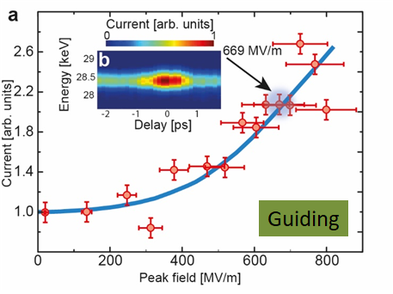
Summary
2D APF
(guiding in plane)
3D APF
(full guiding)
Preliminary!
Shiloh, R., et al., Nature 597, 498 (2021)
2D APF +
Acceleration
Long term goal:
3D APF + Acceleration
T. Chlouba*, R. Shiloh*, S. Kraus*, L. Brückner*, J. Litzel, P. Hommelhoff, Nature, 622, 476 (2023)

