Slide 1

Progress on the Flat beam PWFA experiment at AWA
Pratik Manwani¹, Alex Ody², Yunbo Kang¹, Joshua Mann¹, Nathan Majernik², Kai Huang¹, Gerard Andonian¹, B. Naranjo¹, Phillipe Piot², Doran Scott², Eric Wisniewski², Wahming Liu, John Power², and James Rosenzweig¹
1: University of California, Los Angeles
2. ANL, Lemont, Illinois
3: Stanford Linear Accelerator Center (SLAC)

Slide 2
Outline
Motivation
Theory - General formalism
  Beam and plasma blowout ellipticity
  Matching conditions
  Features and Insights
Experiment at Argonne Wakefield Accelerator(AWA)
  Plasma source development
  Simulations – Beam plasma interaction
  Experimental runs : Flat beam generation and final focus
Conclusion and future steps

Slide 3
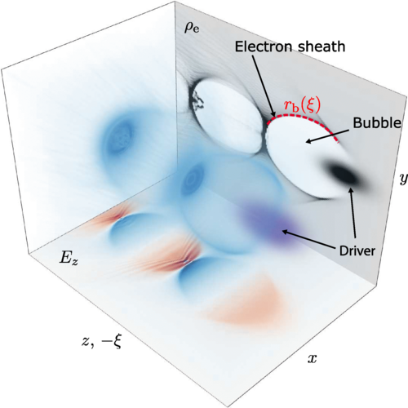
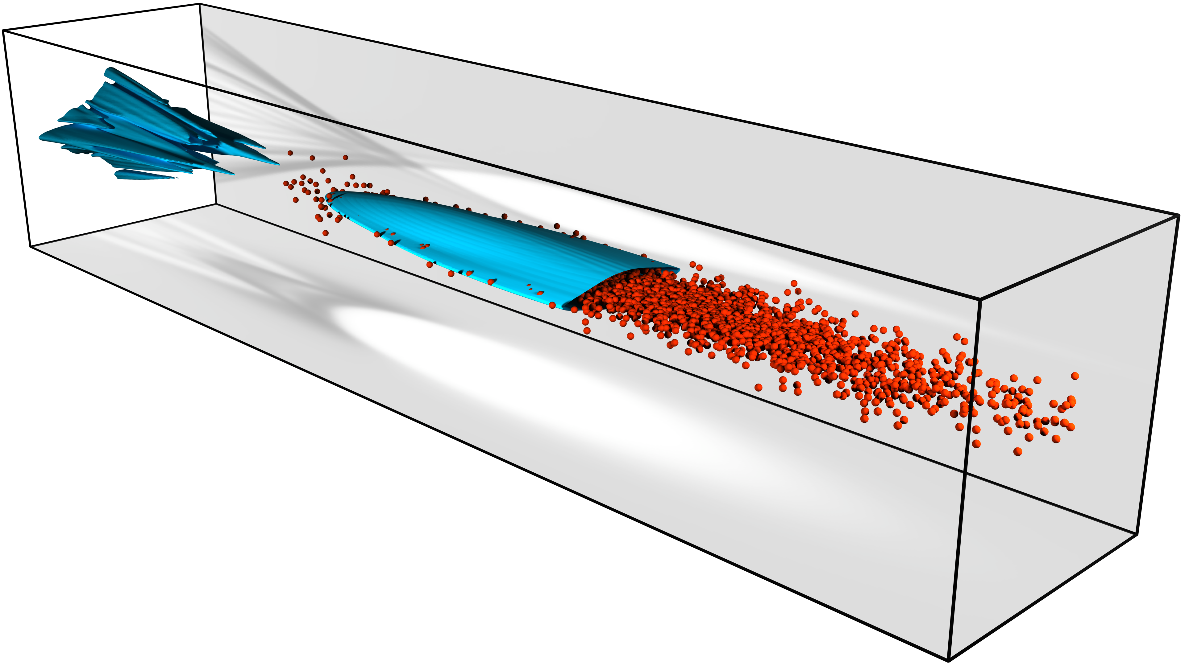
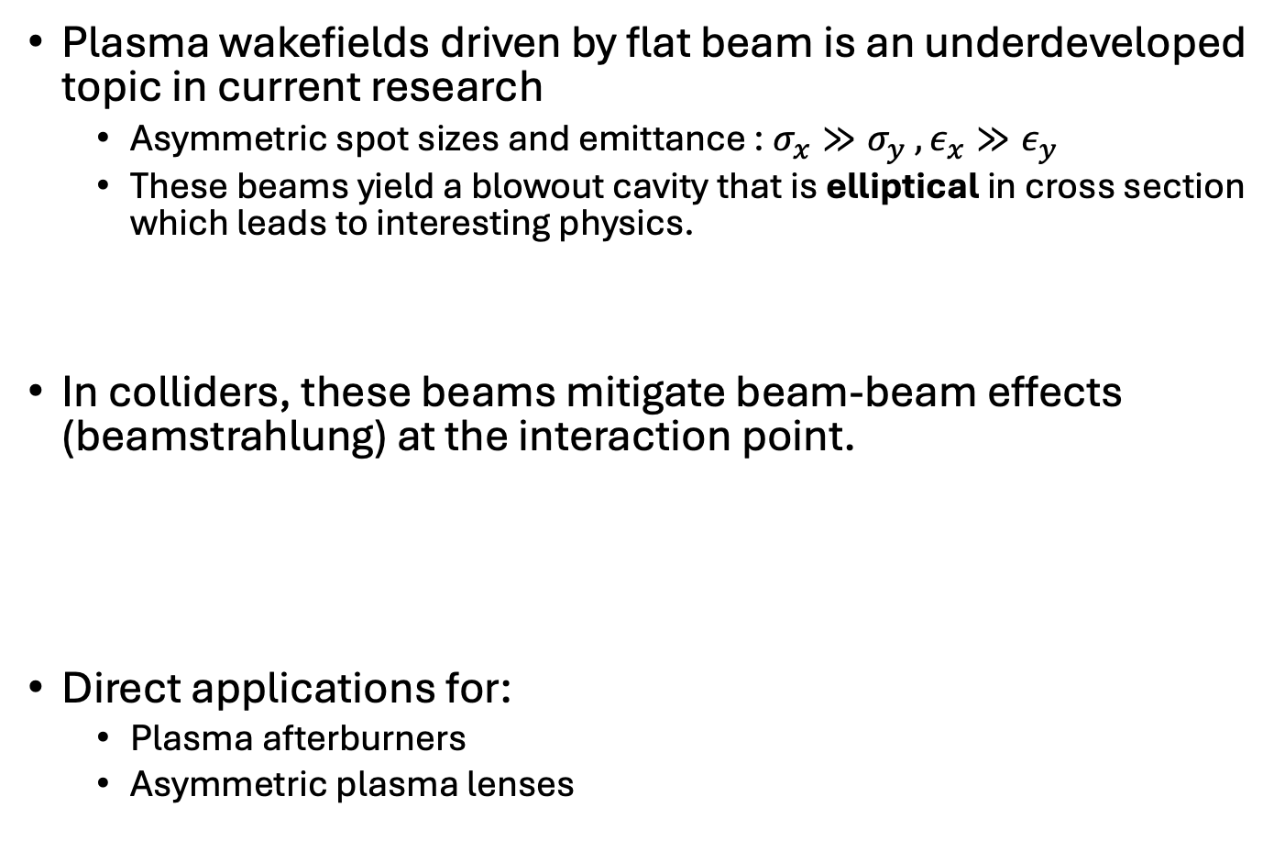
Motivation
Plasma wakefields driven by flat beam is an underdeveloped topic in current research
  Asymmetric spot sizes and emittance : $σ_{x}≫σ_{y} ,ε_{x}≫ε_{y}$
  These beams yield a blowout cavity that is elliptical in cross section which leads to interesting physics.
In colliders, these beams mitigate beam-beam effects (beamstrahlung) at the interaction point.
Direct applications for:
  Plasma afterburners
  Asymmetric plasma lenses
A. Golovanov et al,
PRL (2023)
Beamstrahlung $∝\frac{1}{σ_{x}+σ_{y}}$ , Luminosity $∝\frac{1}{σ_{x}σ_{y}}$

Slide 4
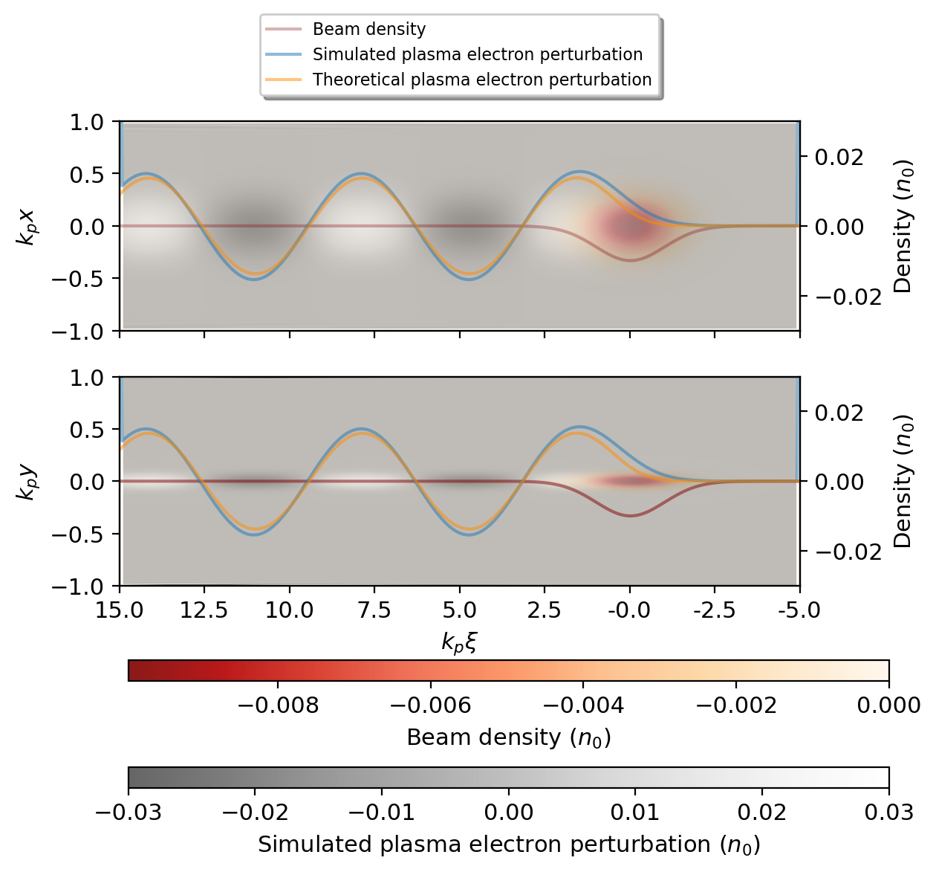
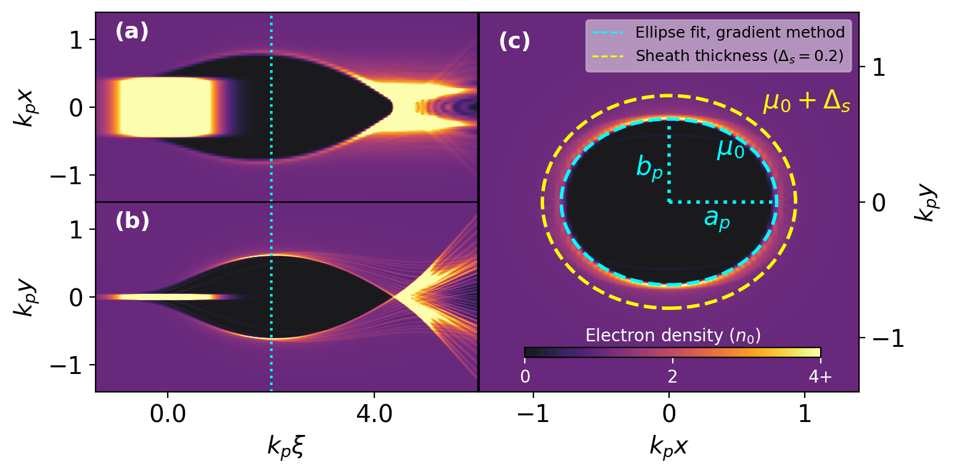
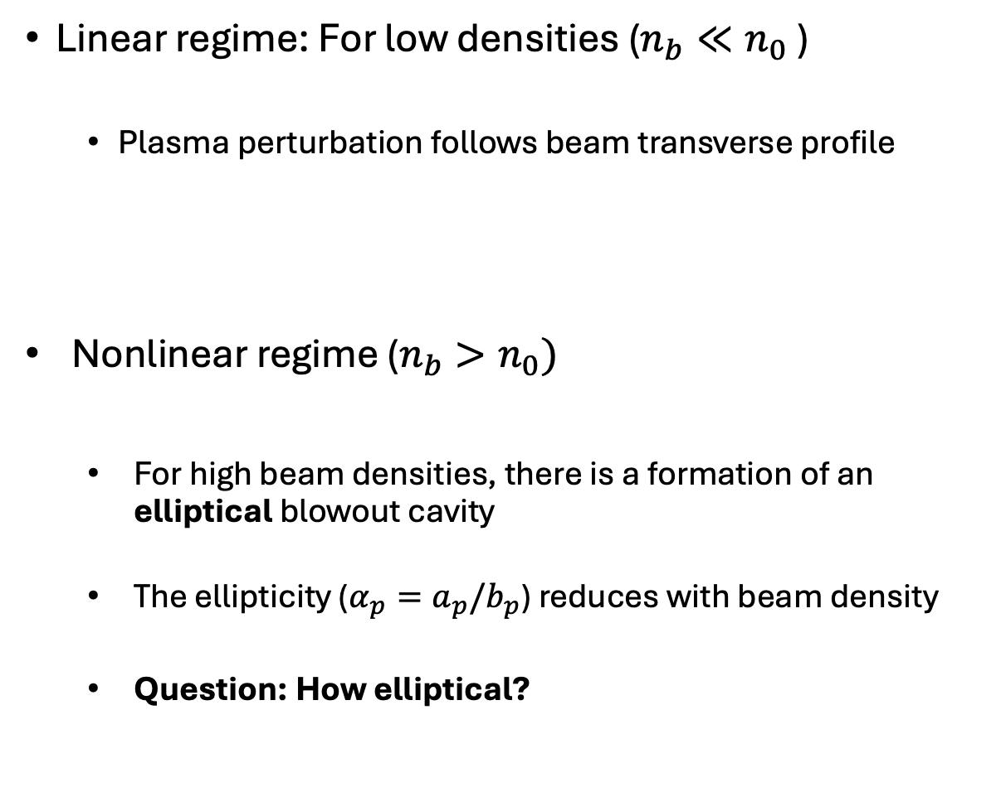


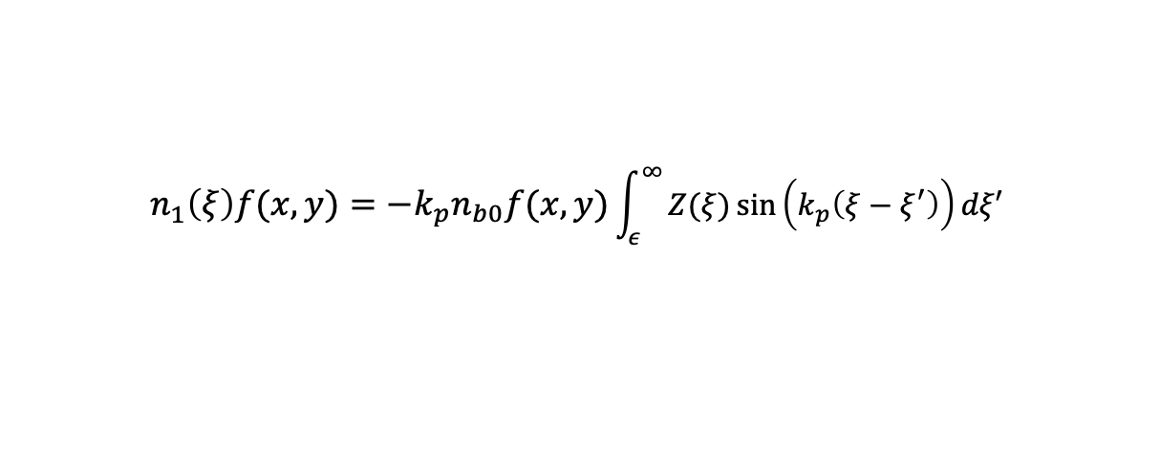
Asymmetric wakes
Linear regime: For low densities ($n_{b}≪n_{0}$)
  Plasma perturbation follows beam transverse profile
Nonlinear regime ($n_{b}>n_{0})$
  For high beam densities, there is a formation of an elliptical blowout cavity
  The ellipticity ($α_{p}=a_{p}/b_{p}$) reduces with beam density
  Question: How elliptical?
$$n_{1}^{ }\left(ξ\right)f(x,y)=−k_{p}n_{b0}f(x,y)\int_{ε}^{∞}{Z(ξ)\sin\left(k_{p}\left(ξ−ξ^{′}\right)\right)dξ′ }$$
J. Rosenzweig et al, PRA (1991)
W. Lu et al, PRL (2006)
A. Golovanov et al, PRL (2023)
  Linear wake ($σ_{x}=10 σ_{y})$
  Weak blowout ($σ_{x}=10 σ_{y})$

Slide 5
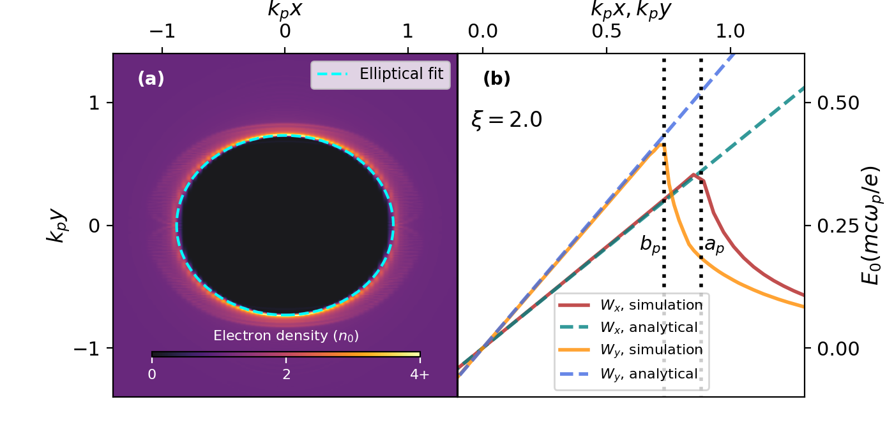
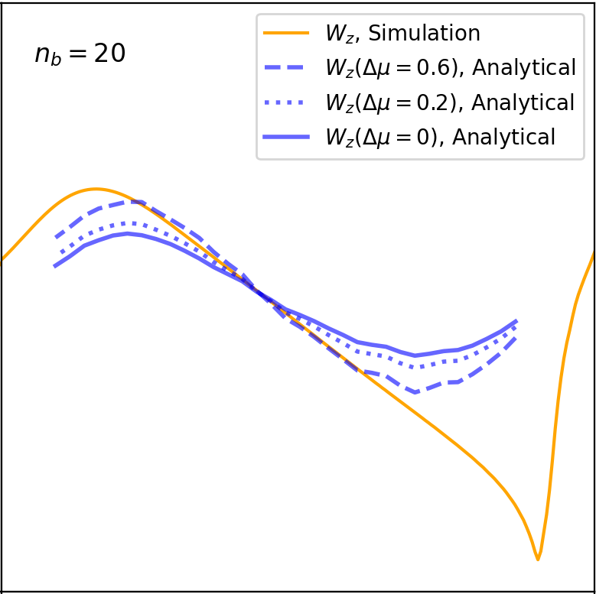
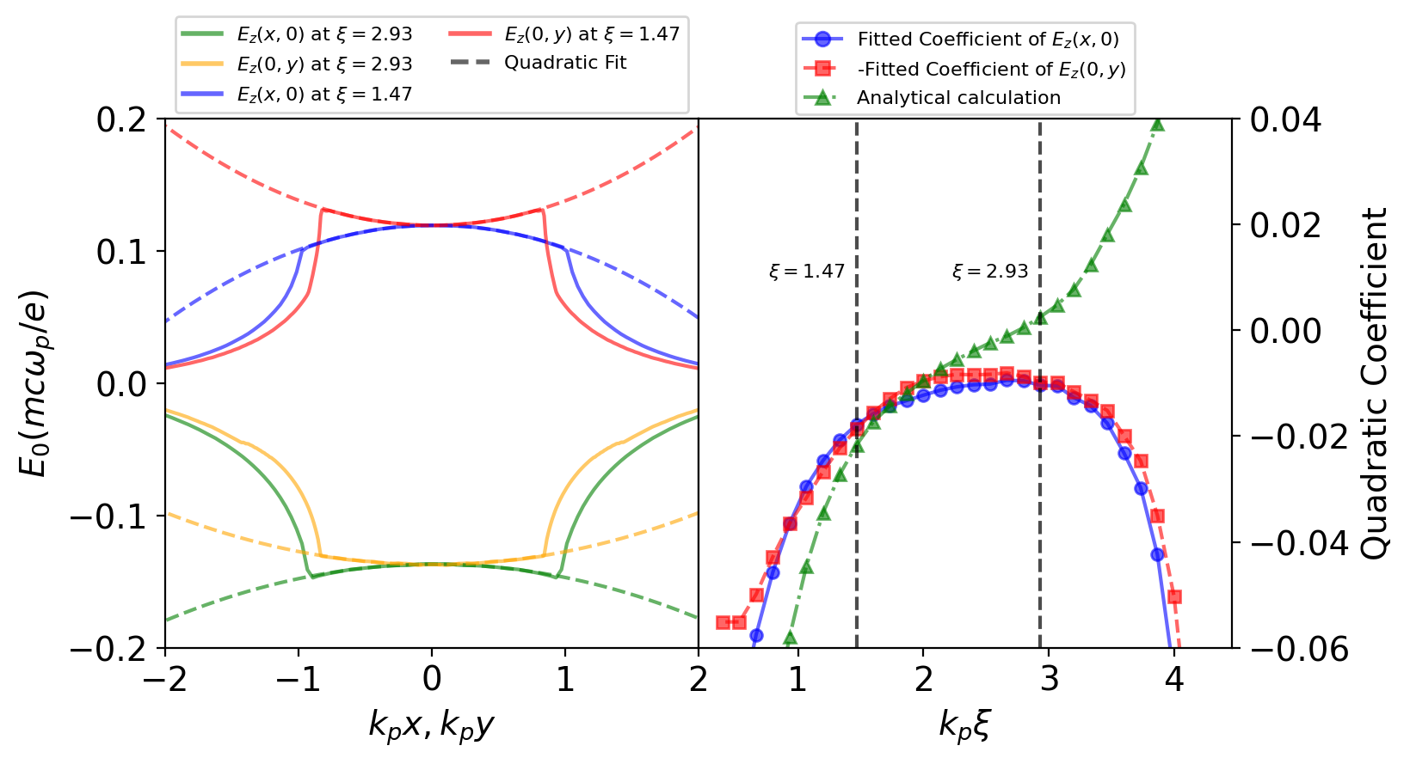


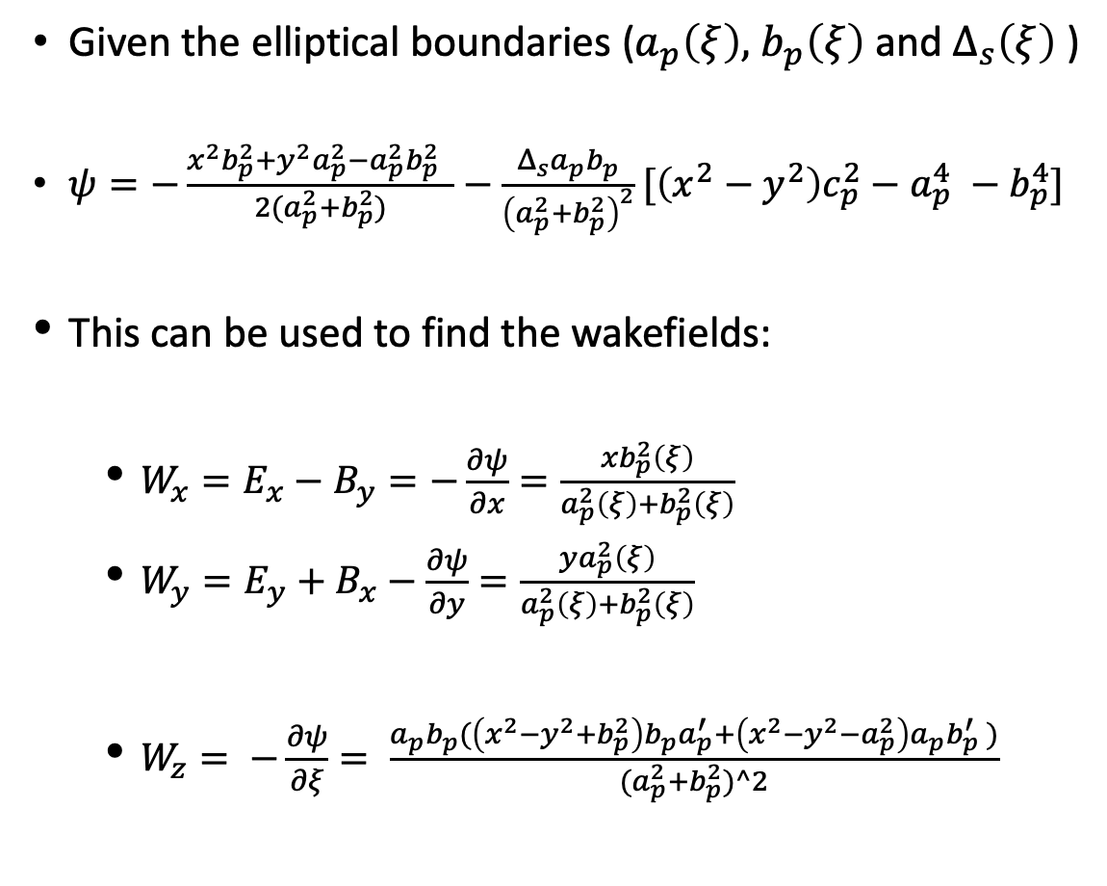
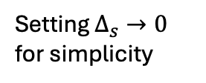
Potential and wakefields
$$b_{p}$$
Given the elliptical boundaries ($a_{p}\left(ξ\right),$ $b_{p}\left(ξ\right)$ and $Δ_{s}\left(ξ\right)$ )
$ψ=−\frac{x^{2}b_{p}^{2}+y^{2}a_{p}^{2}−a_{p}^{2}b_{p}^{2} }{2(a_{p}^{2}+b_{p}^{2})}−\frac{Δ_{s}a_{p}b_{p}}{{\left(a_{p}^{2}+b_{p}^{2}\right)}^{2}}[\left(x^{2}−y^{2}\right)c_{p}^{2}−a_{p}^{4} −b_{p}^{4}]$
This can be used to find the wakefields:
  $W_{x}=E_{x}−B_{y}=−\frac{∂ψ}{∂x}=\frac{xb_{p}^{2}\left(ξ\right)}{a_{p}^{2}\left(ξ\right)+b_{p}^{2}\left(ξ\right)}$
  $W_{y}=E_{y}+B_{x}−\frac{∂ψ}{∂y}=\frac{ya_{p}^{2}\left(ξ\right)}{a_{p}^{2}\left(ξ\right)+b_{p}^{2}\left(ξ\right)}$
  $W_{z}= −\frac{∂ψ}{∂ξ}= \frac{a_{p}b_{p}^{ }(\left(x^{2}−y^{2}+b_{p}^{2}\right)b_{p}a_{p}^{′}+\left(x^{2}−y^{2}−a_{p}^{2}\right)a_{p}b_{p}^{′} )}{{(a}_{p}^{2}+b_{p}^{2})^2}$
$$a_{p}$$
Wake potential
Need sheath distribution!
Setting $Δ_{s}→0$ for simplicity
Plasma current reversal
Asymmetric and linear!
No longer uniform

Slide 6
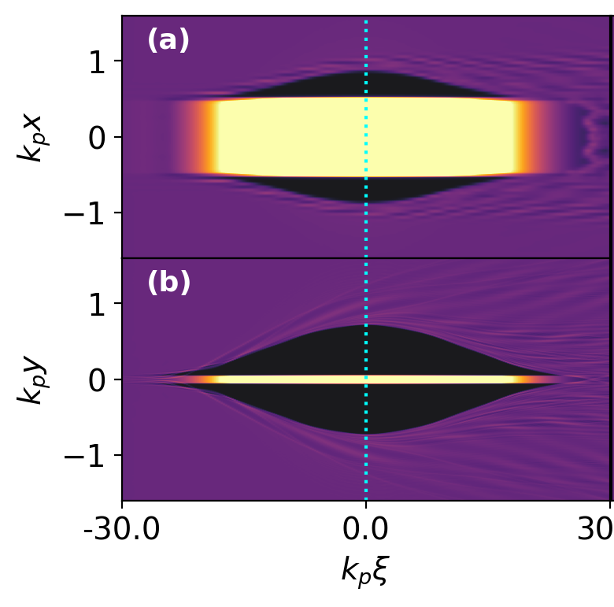
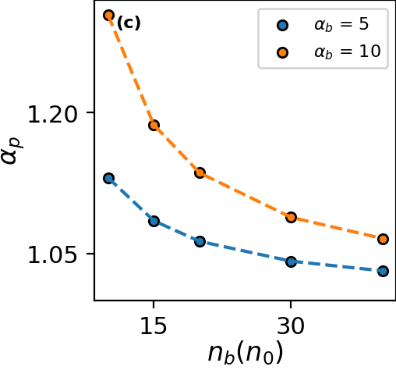
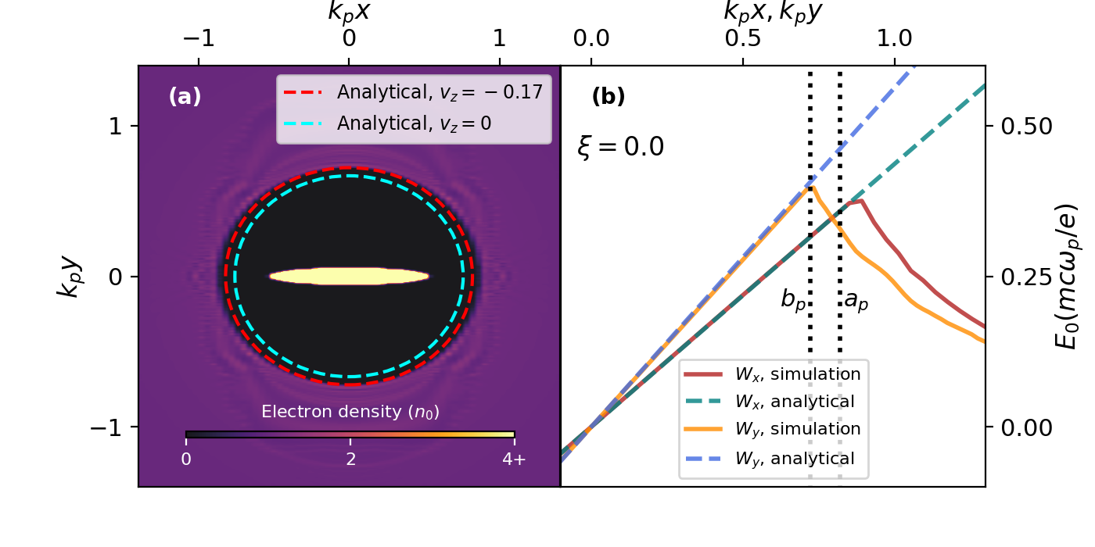
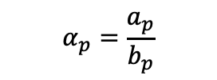
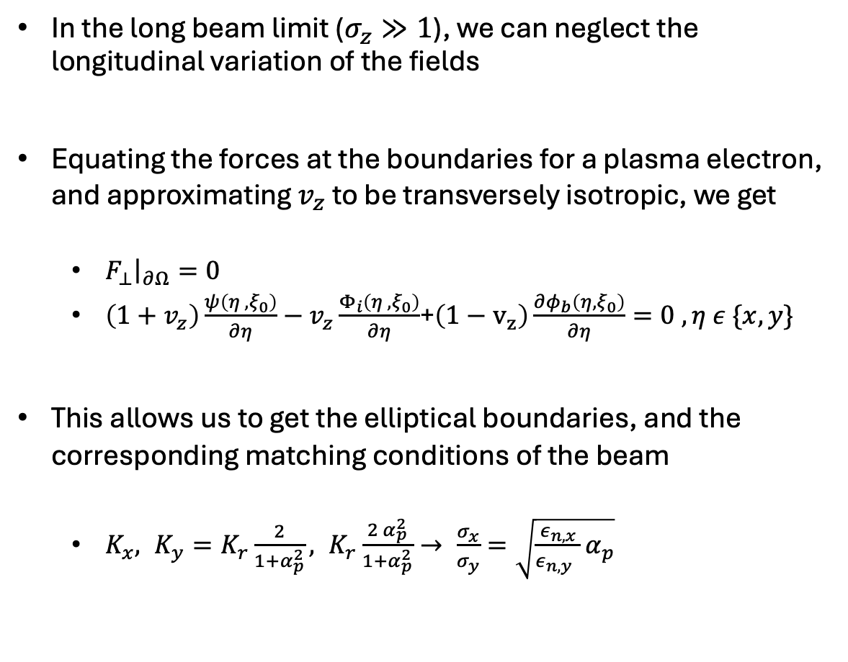

Finding the blowout boundaries
Long beam ($n_{b}=20$)
$$α_{p}=\frac{a_{p}}{b_{p}}$$
In the long beam limit ($σ_{z}≫1$), we can neglect the longitudinal variation of the fields
Equating the forces at the boundaries for a plasma electron, and approximating $v_{z}$ to be transversely isotropic, we get
  $F_{⊥}{\left.​\right|}_{∂Ω}=0$
  $\left(1+v_{z}\right)\frac{ψ\left(η_{ },ξ_{0}\right)}{∂η}−v_{z}\frac{Φ_{i}\left(η_{ },ξ_{0}\right)}{∂η}$+$\left(1−v_{z}\right)\frac{{∂φ}_{b}\left(η,ξ_{0}\right)}{∂η}=0 ,η ε \{x,y\}$
This allows us to get the elliptical boundaries, and the corresponding matching conditions of the beam
  $K_{x}, K_{y}=K_{r}\frac{2}{1+α_{p}^{2}}, K_{r}\frac{2 α_{p}^{2}}{1+α_{p}^{2}}→ \frac{σ_{x}}{σ_{y}}=\sqrt{\frac{ε_{n,x}}{ε_{n,y} }α_{p}}$
Ellipticity vs beam density
Wake potential
Ion potential
Beam potential
Center slice (XY)

Slide 7
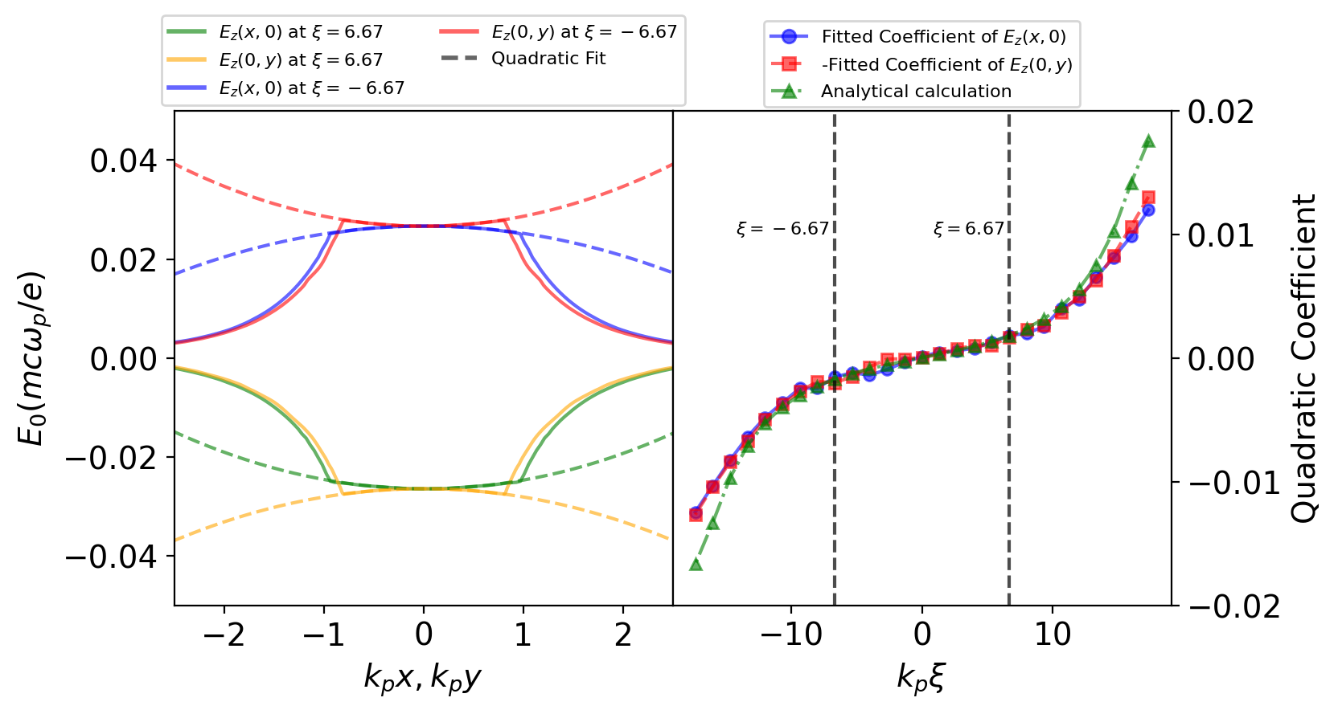
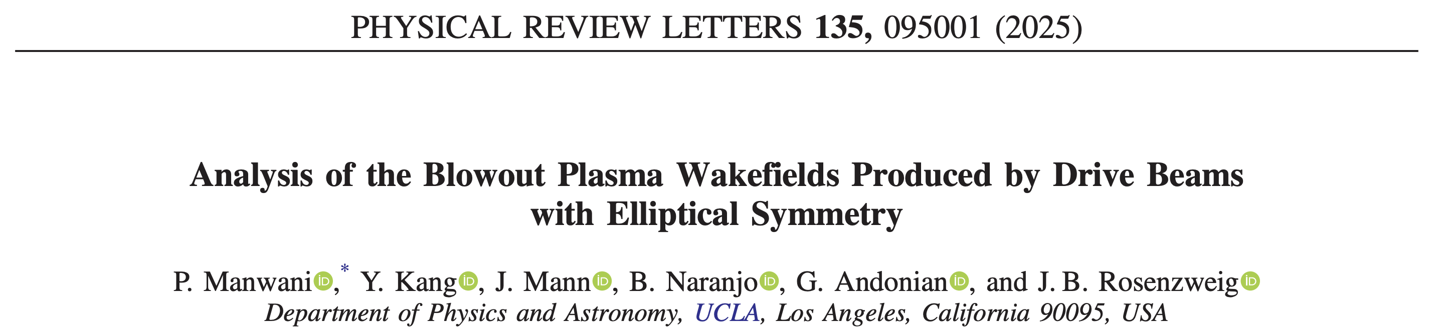
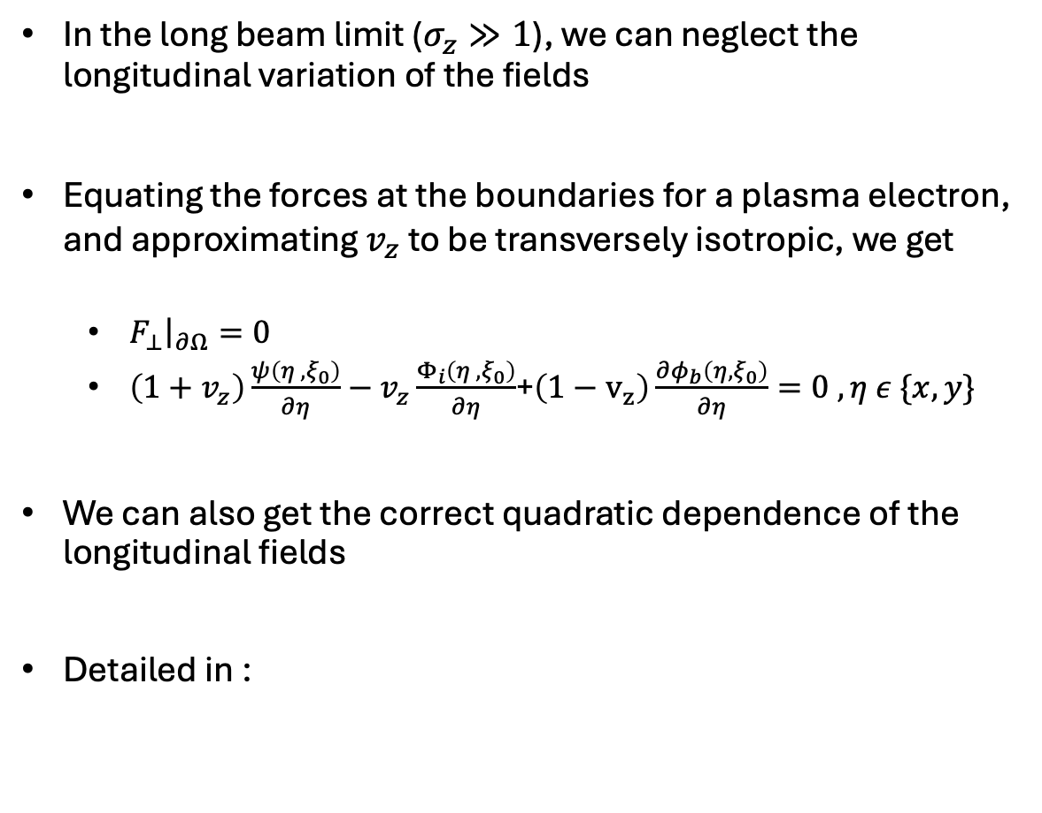
Finding the blowout boundaries
Long beam ($n_{b}=20$)
In the long beam limit ($σ_{z}≫1$), we can neglect the longitudinal variation of the fields
Equating the forces at the boundaries for a plasma electron, and approximating $v_{z}$ to be transversely isotropic, we get
  $F_{⊥}{\left.​\right|}_{∂Ω}=0$
  $\left(1+v_{z}\right)\frac{ψ\left(η_{ },ξ_{0}\right)}{∂η}−v_{z}\frac{Φ_{i}\left(η_{ },ξ_{0}\right)}{∂η}$+$\left(1−v_{z}\right)\frac{{∂φ}_{b}\left(η,ξ_{0}\right)}{∂η}=0 ,η ε \{x,y\}$
We can also get the correct quadratic dependence of the longitudinal fields
Detailed in :
Wake potential
Ion potential
Beam potential
Correct quadratic dependence! No plasma current reversal

Slide 8
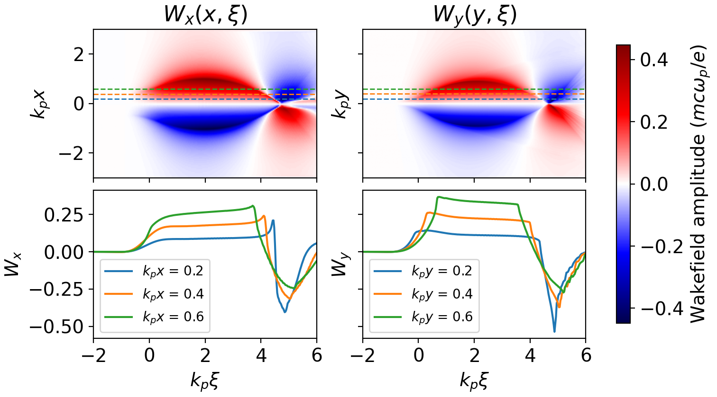
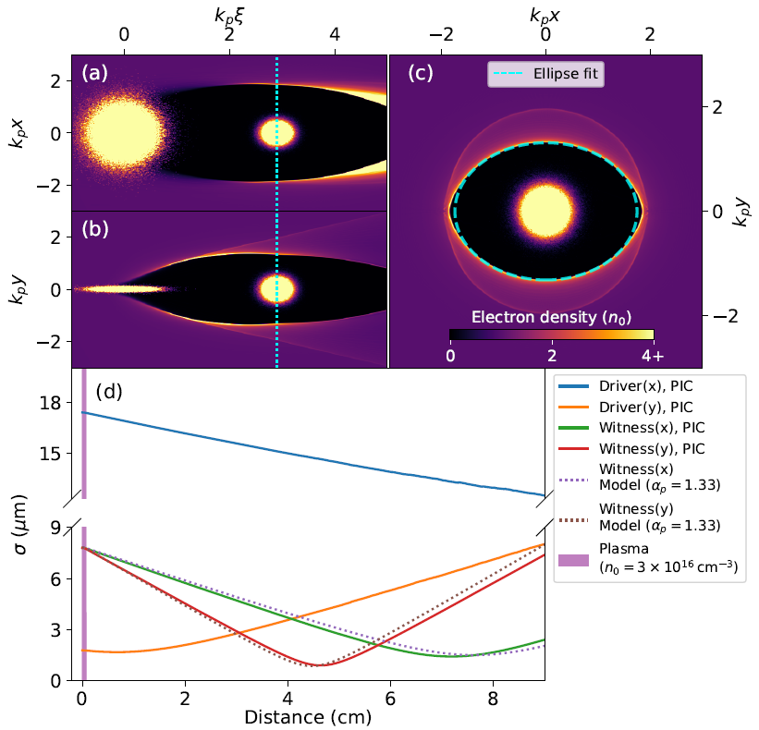

Features and Insights
Longitudinally varying focusing
  Can mitigate hosing instability (resonance between head and tail)
Asymmetric linear fields
  Can be slice-by-slice emittance matched
  Leads naturally to asymmetric plasma lenses
  Asymmetry can break resonant x-y emittance mixing in presence of nonlinearities. Flat beam ion motion breaks it too
Modified Quadrupole instability – Blowout keeps getting asymmetric if mismatched
  $Kx,Ky= K_{r}\left(1±\frac{α_{p}^{2}−1}{α_{p}^{2}+1}\right)$
  Significant head erosion in one dimension
Energy spread due to quadratic transverse dependence
DH. Whittum et al, PRL (1991)
C. Huang et al, PRL(2007)
S. Diederichs et al,
PRL(2024)
Solid: PIC
Dotted: Equations

Slide 9
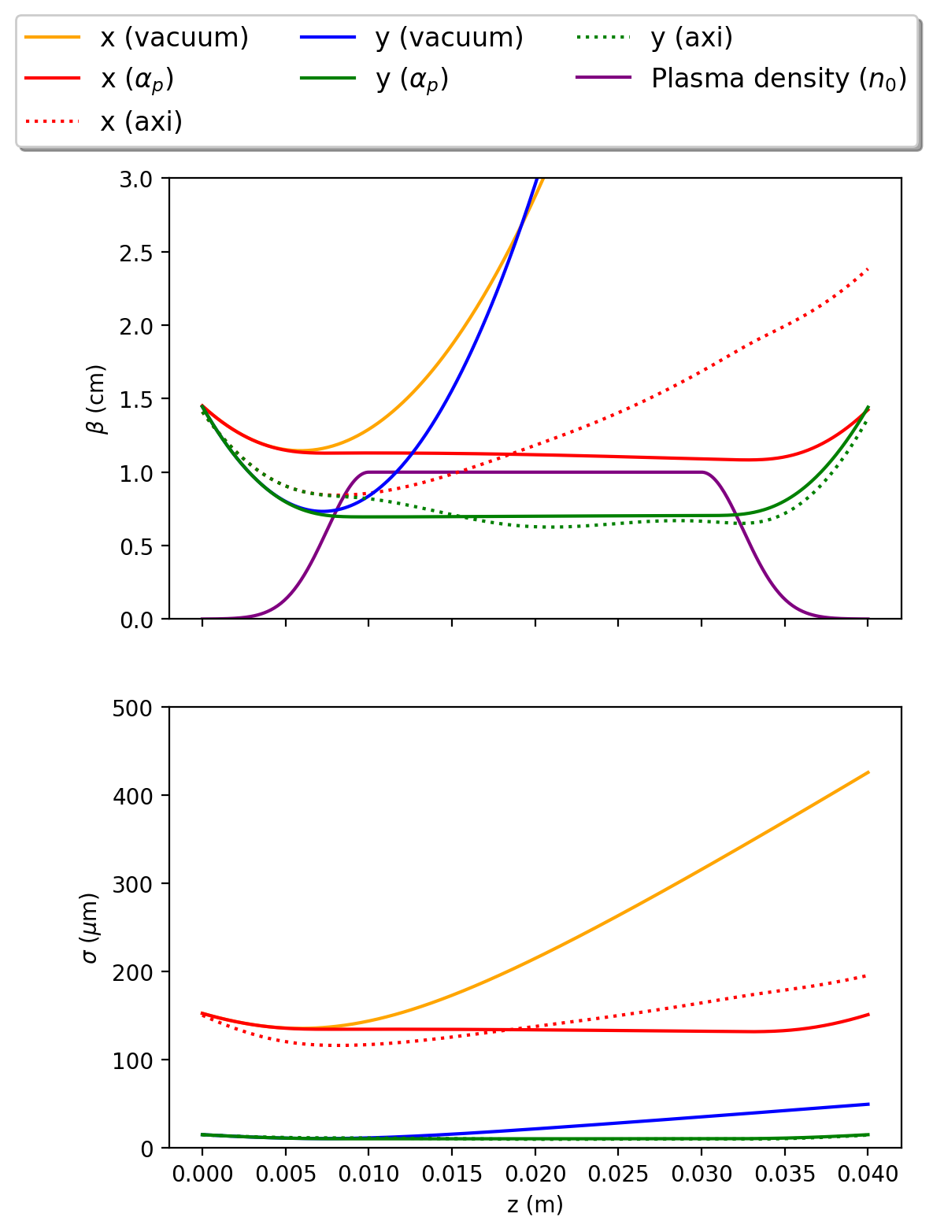
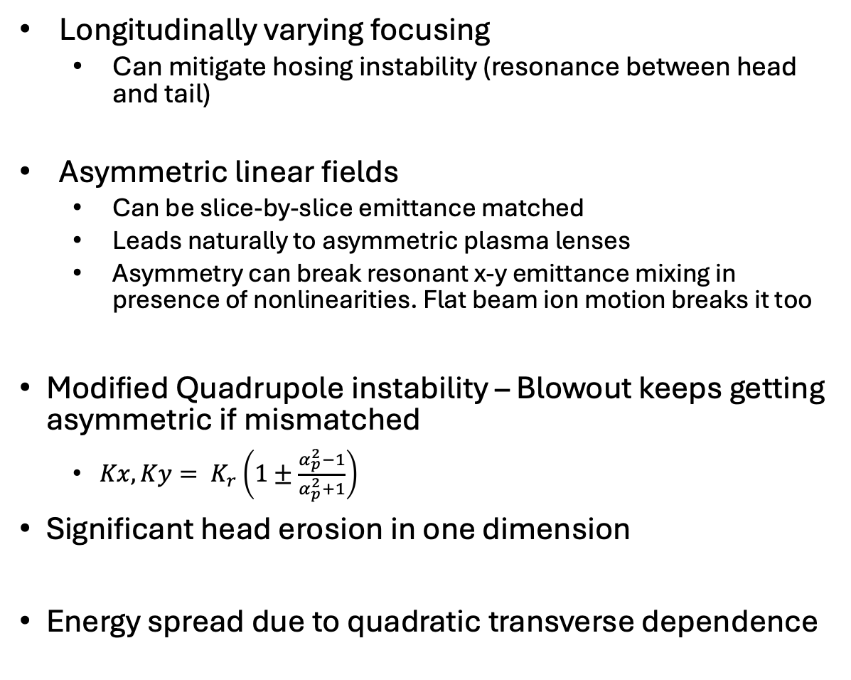
Features and Insights
Longitudinally varying focusing
  Can mitigate hosing instability (resonance between head and tail)
Asymmetric linear fields
  Can be slice-by-slice emittance matched
  Leads naturally to asymmetric plasma lenses
  Asymmetry can break resonant x-y emittance mixing in presence of nonlinearities. Flat beam ion motion breaks it too
Modified Quadrupole instability – Blowout keeps getting asymmetric if mismatched
  $Kx,Ky= K_{r}\left(1±\frac{α_{p}^{2}−1}{α_{p}^{2}+1}\right)$
Significant head erosion in one dimension
Energy spread due to quadratic transverse dependence
DH. Whittum et al, PRL (1991)
C. Huang et al, PRL(2007)
S. Diederichs et al,
PRL(2024)
Using long beam model

Slide 10
Flat beam PWFA Experiment at the AWA facility

Slide 11
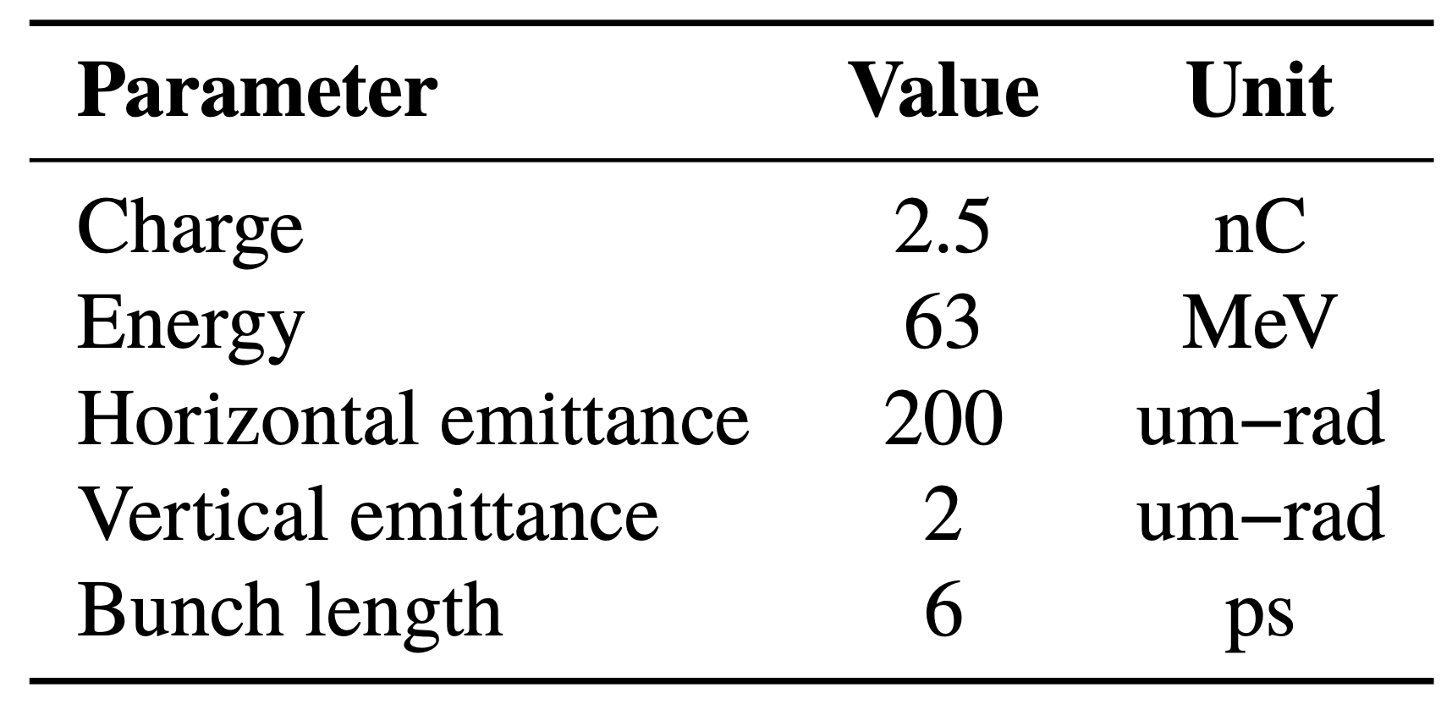
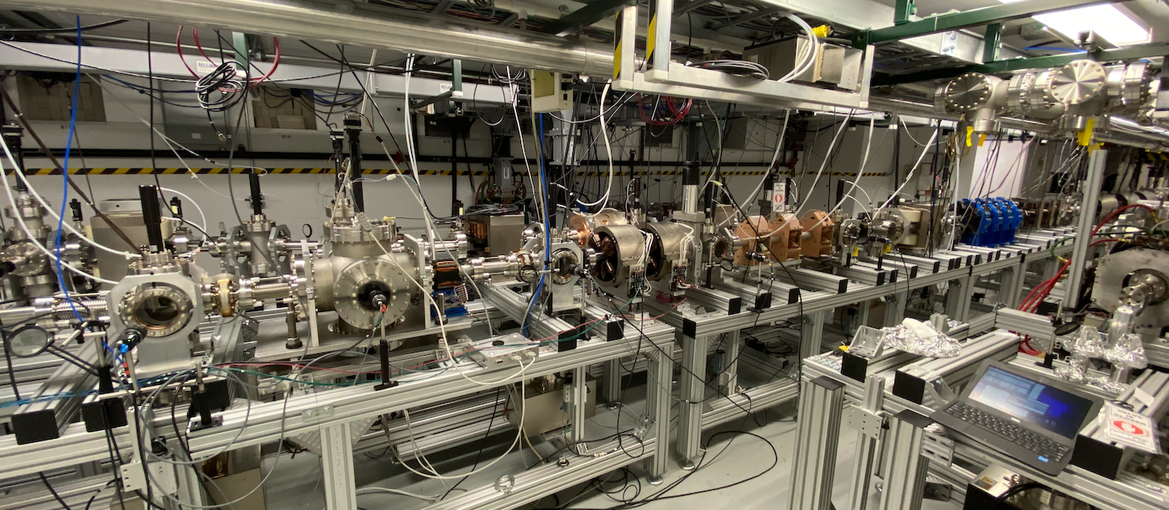
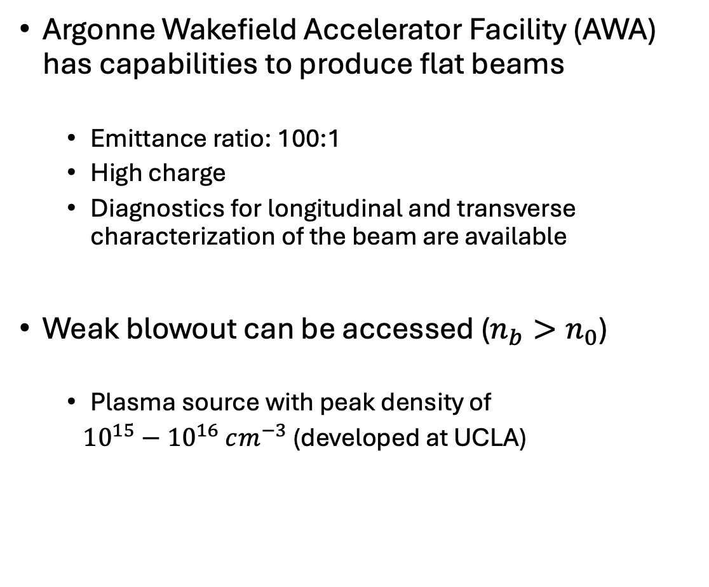
Flat beam PWFA experiment at AWA
Argonne Wakefield Accelerator Facility (AWA) has capabilities to produce flat beams
  Emittance ratio: 100:1
  High charge
  Diagnostics for longitudinal and transverse characterization of the beam are available
Weak blowout can be accessed ($n_{b}>n_{0}$)
  Plasma source with peak density of
  ${10}^{15}−{10}^{16} cm^{−3}$ (developed at UCLA)
Flat beam parameters at AWA
AWA facility

Slide 12
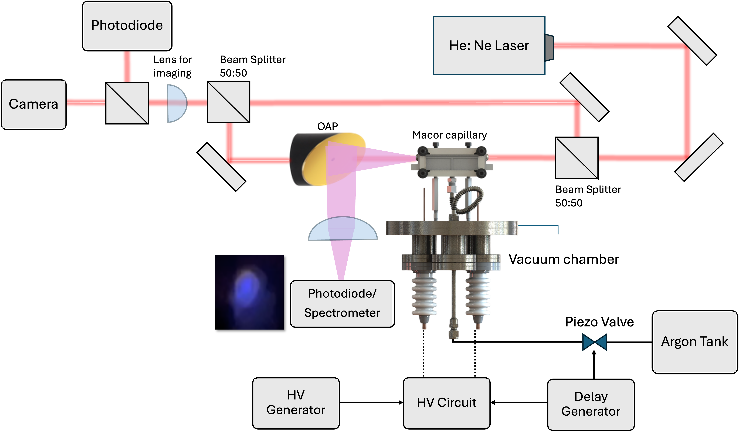
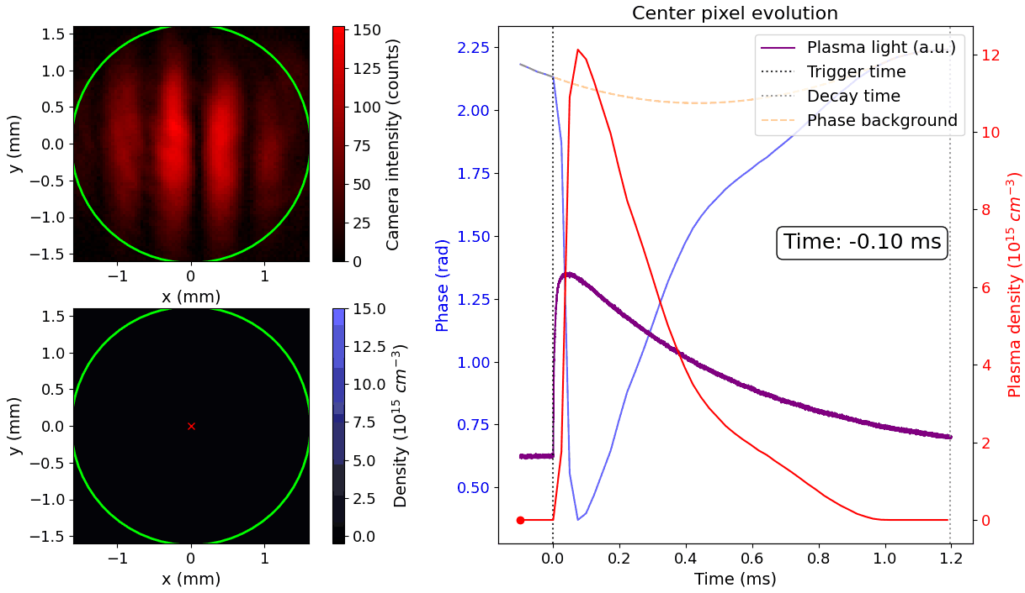
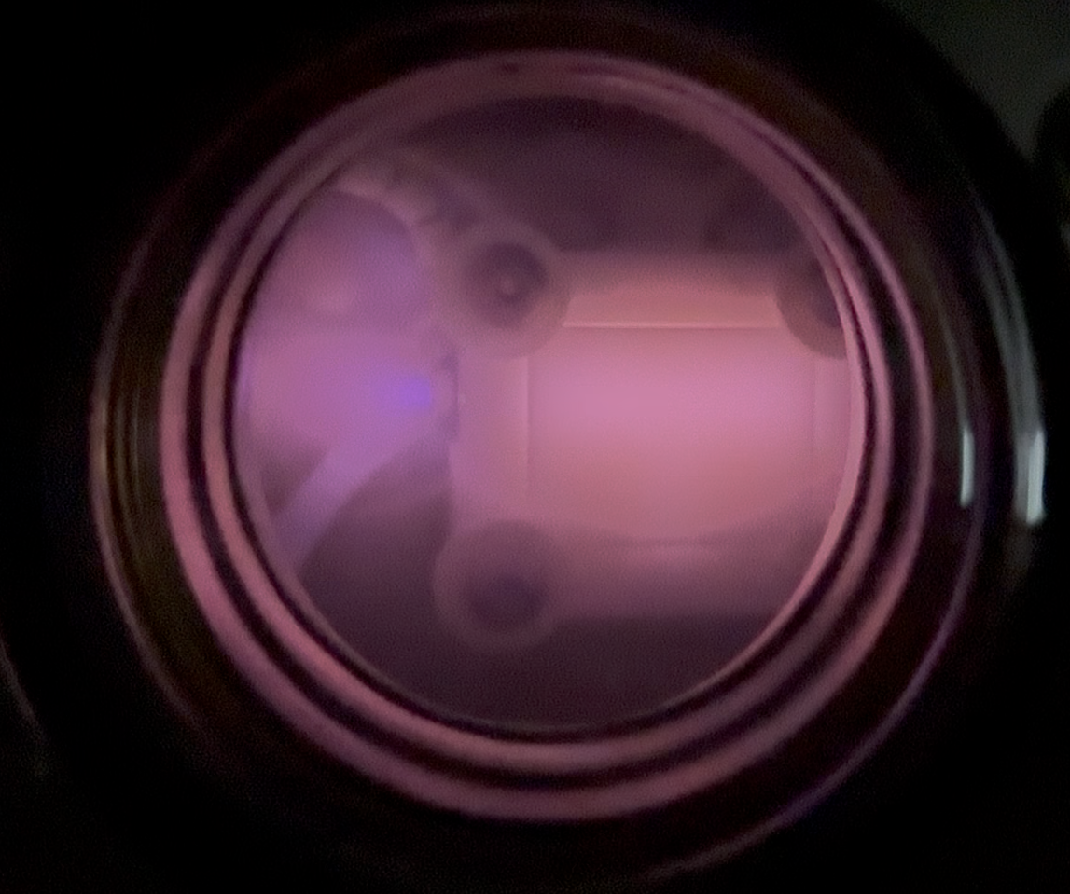

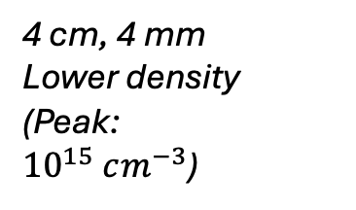
Capillary discharge-based plasma source @UCLA
Macor - 4 mm diameter, 8 cm length
10 kV, 100 A (1 $μ$s) peak current
Argon gas, Backing pressure 100 psi
Valve opening time : 5 ms
Peak density increases with voltage
Mach Zehnder based HeNe interferometer
4 cm, 4 mm
Lower density (Peak:
${10}^{15} cm^{−3}$)

Slide 13
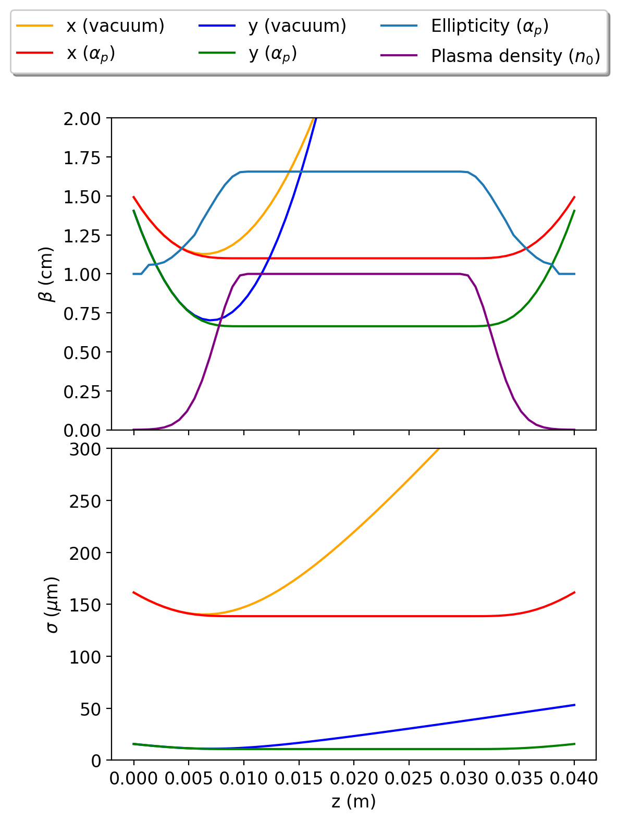
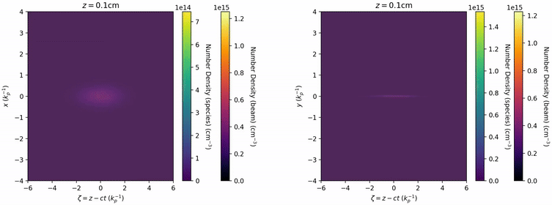


Beam-plasma interaction
We can use our long beam model for the vacuum-plasma transport
The ellipticity ($α_{p}$) increases with increase in plasma density
Note: Matched beta functions depend on $α_{p}\left(\frac{a_{p}}{b_{p}}\right)$
Peak $α_{p}$ = 1.7
Using long beam model
AWA beam parameters at $n_{0}$ of ${1×10}^{14}$ $cm^{−3}$(QuickPIC)

Slide 14
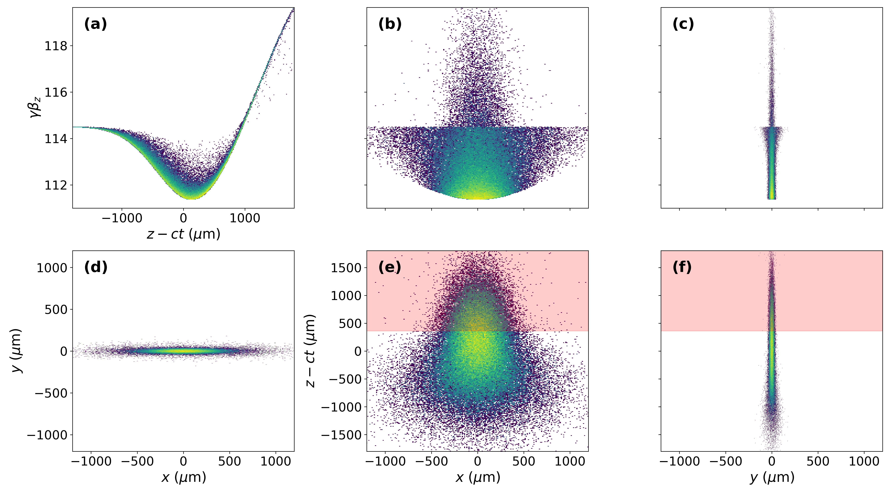
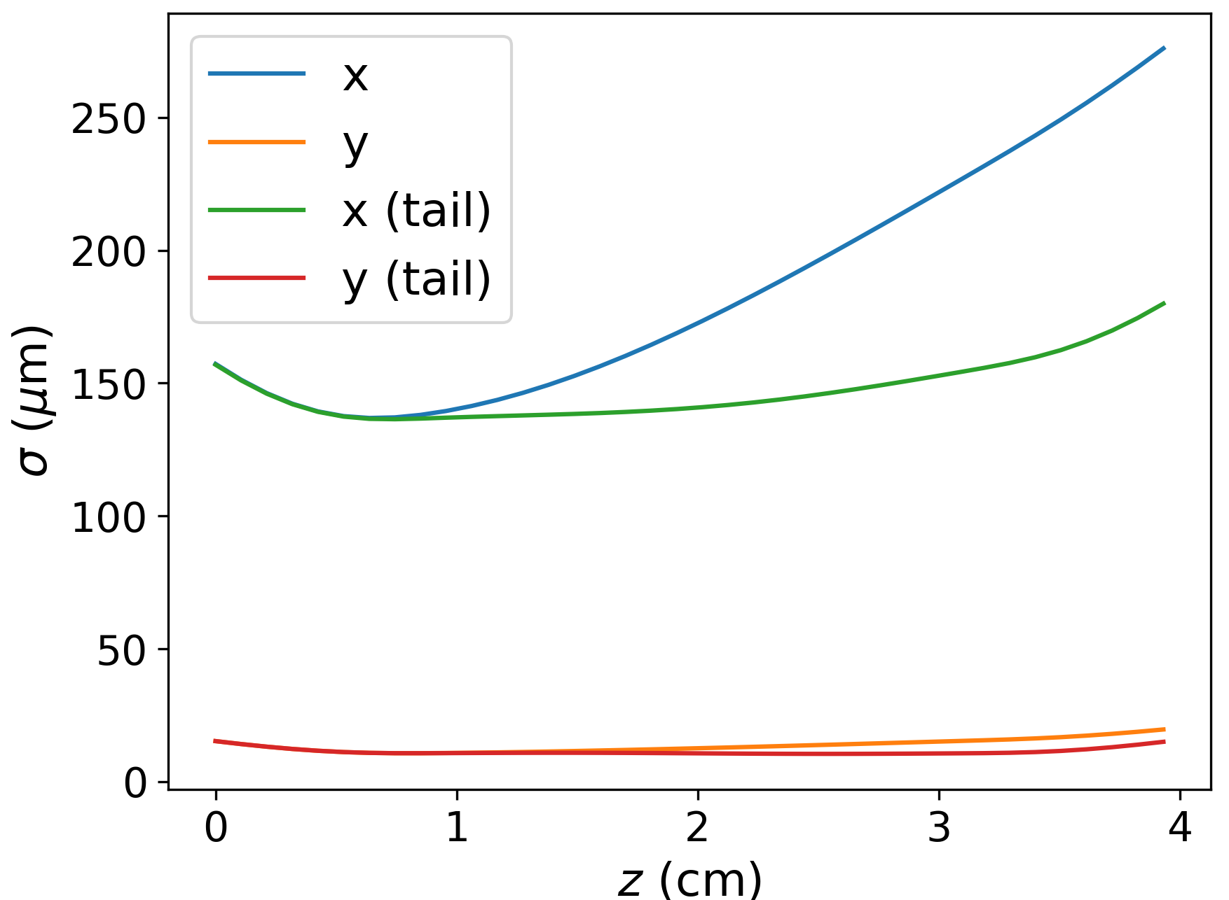






Experiment observables
Longitudinally varying focusing
  OTR foil at entrance and exit of capillary viewed by streak camera
  Two screens downstream for angle and emittance measurements
Energy spread will be measured using a transverse deflecting cavity and a dipole spectrometer
z-$p_{z}$
x-$p_{z}$
y-$p_{z}$
x-$y$
x-$z$
y-$z$
Spot size evolution(QuickPIC)
After beam – plasma interaction (QuickPIC)

Slide 15
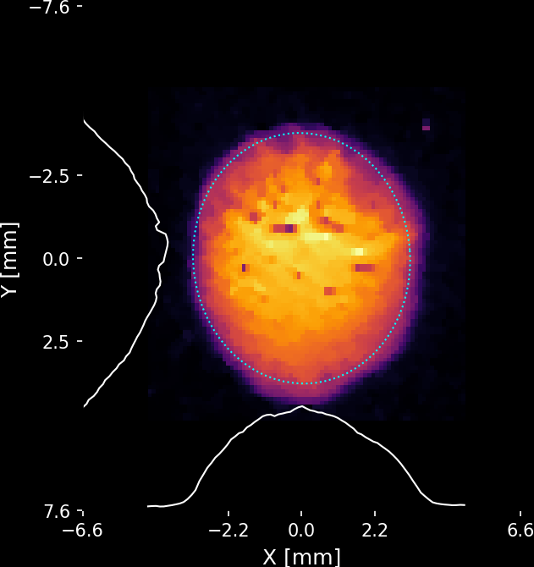
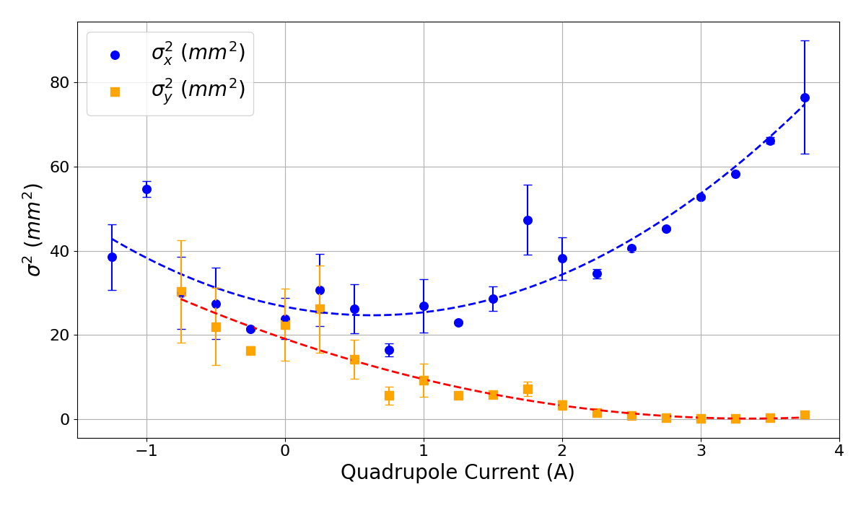
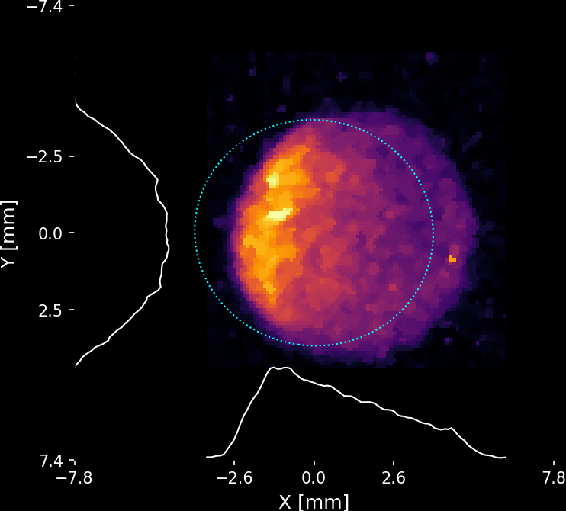
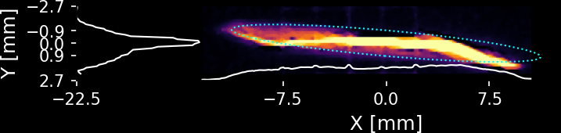
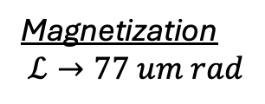
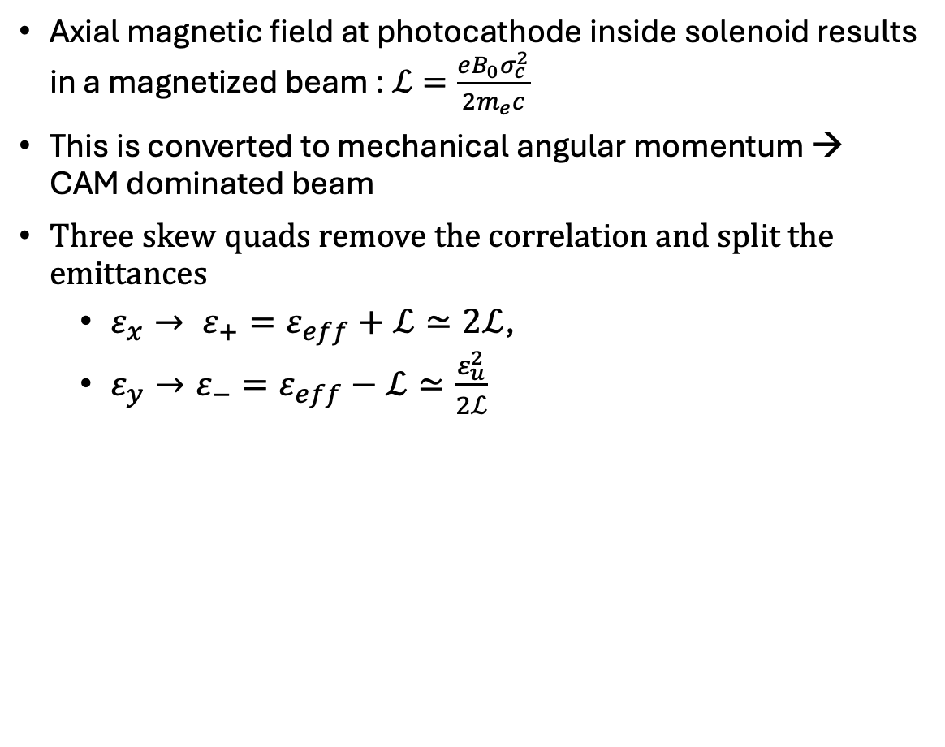
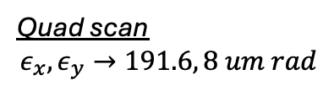
CAM dominated beam
Experimental runs-Flat beam generation
Axial magnetic field at photocathode inside solenoid results in a magnetized beam : $ℒ=\frac{eB_{0}σ_{c}^{2}}{2m_{e}c}$
This is converted to mechanical angular momentum → CAM dominated beam
Three skew quads remove the correlation and split the emittances
  $ε_{x}→ ε_{+}=ε_{eff}+ℒ≃2ℒ$,
  $ε_{y}→ε_{−}=ε_{eff}−ℒ≃\frac{ε_{u}^{2}}{2ℒ}$
Magnetization
$$ℒ→77 um rad$$
Quad scan
$$ε_{x},ε_{y}→191.6, 8 um rad$$
Y. Sun et al,
PRSTAB (2004)
YAG4
Skew quadrupoles
YAG5
SQ1
SQ2
SQ3

Slide 16
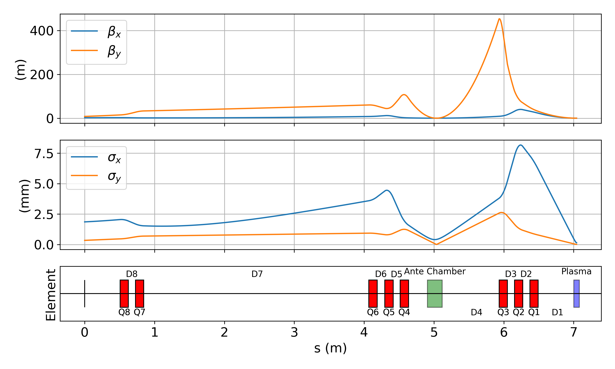
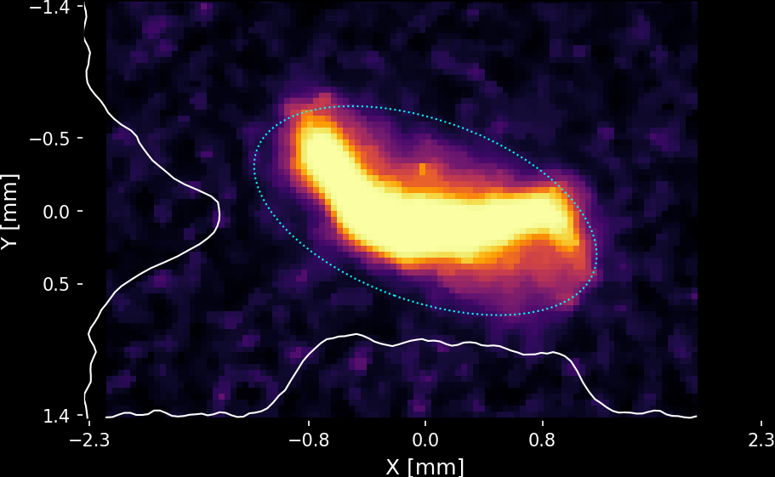
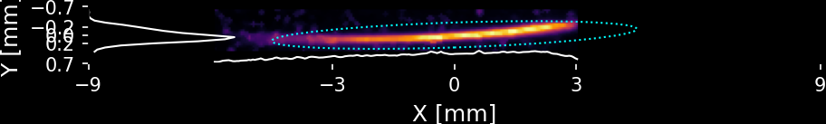
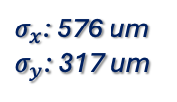
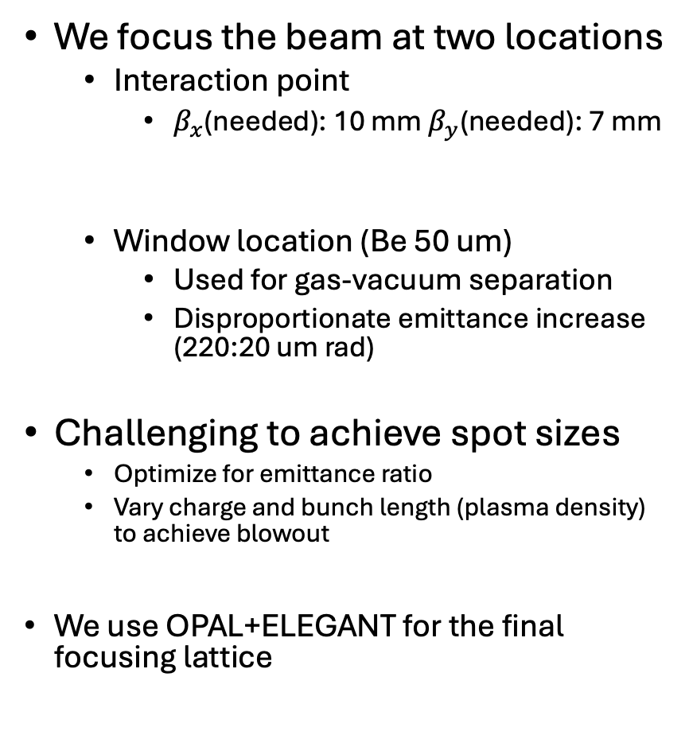

Two foci – Window and plasma chamber
We focus the beam at two locations
  Interaction point
    $β_{x}$(needed): 10 mm $β_{y}$(needed): 7 mm
  Window location (Be 50 um)
    Used for gas-vacuum separation
    Disproportionate emittance increase (220:20 um rad)
Challenging to achieve spot sizes
  Optimize for emittance ratio
  Vary charge and bunch length (plasma density) to achieve blowout
We use OPAL+ELEGANT for the final focusing lattice
Be Window
IP
$σ_{x}$: 576 um
$σ_{y}$: 317 um
$σ_{x}\text{:}$ 2.04 mm
$σ_{y}$ : 171 um
Recent experimental runs
(Final focusing lattice
will be modified)
Notes:
9 T/m

Slide 17
Conclusion and Future steps
Flat beam PWFA has unique features – advantages as well as challenges
We developed a simplified theoretical model that has been successfully validated with PIC simulations
Used this model to design experiments:
  AWA propagation experiment
    Plasma source commissioned at UCLA
    Propagated flat beam to IP
    Need to optimize for emittance ratio after window – Early 2026
    Integration of plasma source to AWA beamline – Early 2026
  FACET-II : Asymmetric plasma lens
    Collaborating with the E-308 group to use asymmetric driver for passive plasma lens

Slide 18





References and Acknowledgements
Manwani, P., Kang, Y., Mann, J., Naranjo, B., Andonian, G., & Rosenzweig, J. B. (2025, August 26). Analysis of the blowout plasma Wakefields produced by drive beams with elliptical symmetry. PRL doi: https://doi.org/10.1103/28c4-blhg
W. Lu, C. Huang, M. Zhou, W. B. Mori, and T. Katsouleas, Nonlinear theory for relativistic plasma wakefields in the blowout regime, Phys. Rev. Lett. 96, 165002 (2006).
Golovanov, A., Kostyukov, I. Yu., Pukhov, A., & Malka, V. (2023). Energy-conserving theory of the blowout regime of Plasma wakefield. Physical Review Letters, 130(10). https://doi.org/10.1103/physrevlett.130.105001
Barov, N., Rosenzweig, J., Conde, M., Gai, W., & Power, J. (2000). Observation of plasma wakefield acceleration in the underdense regime. Phys. Rev. ST Accel. Beams, 3, 011301.
W.Kellog, Foundations of Potential Theory, (Dover Publications,New York,1953), p. 192
Xu, T., Conde, M., Ha, G., Kuriki, M., Piot, P., Power, J., & Wisniewski, E. (2019). Generation High-Charge of Flat Beams at the Argonne Wakefield Accelerator. In 10th International Particle Accelerator Conference. 10.18429/JACoW-IPAC2019-WEPTS094
https://link.aps.org/doi/10.1103/PhysRevSTAB.3.011301
Mihalcea, Daniel & Piot, P. & Stoltz, P.. (2012). Three-Dimensional Analysis of Wakefields Generated by Flat Electron Beams in Planar Dielectric-Loaded Structures. Physical Review Special Topics - Accelerators and Beams. 15. https://doi.org/10.1103/PhysRevSTAB.15.081304
Funded by DOE Grant No. DE-SC0017648
Acknowledgements
Alex Ody², Yunbo Kang¹, Joshua Mann¹, Nathan Majernik², Kai Huang¹, Gerard Andonian¹, B. Naranjo¹, Phillipe Piot², Doran Scott², Eric Wisniewski², Wahming Liu, John Power², and James Rosenzweig¹
Thank you for your time!

Slide 19
Backup Slides

Slide 20




Elliptical wake potential ($δ$ sheath)
We have Poisson’s equation with boundary condition
  ${−∇_{⊥}}^{2}ψ_{ }=ρ−J_{z}≡S$
  ${−∇_{⊥}}^{2}ψ_{μ<μ_{0}}=1; ψ{\left.​\right|}_{∂Ω}=0$
  $ψ=−\frac{c_{p}^{2}}{8}\left( \cosh\left(2μ\right)−\cosh\left(2μ_{0}\right)+\left(1−\frac{\cosh\left(2μ\right)}{\cosh\left(2μ_{0}\right)}\right)cos⁡(2ν)\right)$
    Elliptical coordinates ($μ,ν$)
    Elliptical blowout boundary : $μ_{0}$
    Focal length of ellipse: $c_{p}=\sqrt{a_{p}^{2}−b_{p}^{2}}$
Converting back to Cartesian coordinates:
$$ψ\left(x,y,ξ\right)=−\frac{x^{2}b_{p}^{2}+y^{2}a_{p}^{2}−a_{p}^{2}b_{p}^{2} }{2\left(a_{p}^{2}+b_{p}^{2}\right)}$$
  Weak blowout ($σ_{x}=10 σ_{y})$

Slide 21



Elliptical wake potential ($Δ_{s}$ sheath)
For simplicity, we assume an angle independent confocal elliptical sheath having thickness $Δ_{s}$
Conservation of S in each $ξ$ slice:
$${−∇_{⊥}}^{2}ψ_{ }=\left\{\begin{aligned} 1 μ_{ }<μ_{0} \\ −\frac{\sinh\left(2μ_{0}\right)}{\sinh\left(2μ_{0}+2Δ_{s}\right)−\sinh\left(2μ_{0}\right)} μ_{0}<μ<μ_{0}+Δ_{s} \\ 0 μ>μ_{0}+Δ_{s}\end{aligned}\right.$$
To first order:
$$ψ\left(x,y,ξ\right)=−\frac{x^{2}b_{p}^{2}+y^{2}a_{p}^{2}−a_{p}^{2}b_{p}^{2} }{2\left(a_{p}^{2}+b_{p}^{2}\right)}−\frac{Δ_{s}a_{p}b_{p}}{{\left(a_{p}^{2}+b_{p}^{2}\right)}^{2}}[\left(x^{2}−y^{2}\right)c_{p}^{2}−a_{p}^{4} −b_{p}^{4}]$$
Extendable to more arbitrary distributions

Slide 22

Gaussian and flattop beams
Gaussian beam leads to a broadening of the plasma sheath
Studied in detail for transport
Y. Kang et al,
IPAC (2024)

Slide 23








Observables – Elliptical blowout
Asymmetric case ($ε_{x} :200,ε_{y} :2 um rad$)
Axisymmetric case ($ε_{x,y} :20 um rad$)
x-$p_{z}$
y-$p_{z}$
(x,y)-$p_{z}$
Transverse dependence of the longitudinal field
Curvature is observed
Signature of elliptical blowout
Difficult measurement – Slit?
No transverse dependence
No curvature is observed

Slide 24


Longitudinal profile – Plasma light (Preliminary)
Opening time : 1 ms
Opening time : 3 ms

