Slide 1



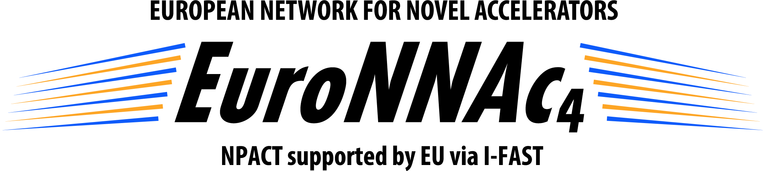

Laser wakefield acceleration in carbon nanotube-based plasmas
— on behalf of NanoAc Collaboration
Jiaqi Zhang^{1,2,*}, Alexandre Bonatto³, Cristian Bontoiu⁴, Bifeng Lei^{4,2}, Javier Resta-López^{5,6}, Hossein Saberi^{1,2}, and Guoxing Xia^{1,2}
¹Department of Physics and Astronomy, University of Manchester, UK
²Cockcroft Institute, UK
³Graduate Program in Information Technology and Healthcare Management, and the Beam Physics Group, Federal University of Health Sciences of Porto Alegre, Brazil
⁴Department of Physics, University of Liverpool, UK
⁵Departamento de Física Aplicada y Electromagnetismo, Universidad de Valencia, Spain
⁶Instituto de Ciencia de los Materiales (ICMUV), Universidad de Valencia, Spain
European Advanced Accelerator Conference
21–27 Sept. 2025, Isola d'Elba, Italy
Notes:
Hello, everyone. It’s my pleasure to show our recent results on behalf of Nanostructured Acceleration Collaboration. I am Jackie, a PhD student based on the University of Manchester and Cockcroft Institute at the Daresbury Lab in the UK. My topic is laser wakefield acceleration in carbon nanotube-based plasmas.

Slide 2
Contents
Background & Motivation
Our Collaborative Team
Recent Developments
LWFA with a CNT Bulk
LWFA with CNT Bundles
Conclusions
Notes:
Which mainly includes simulation study of LWFA using a uniform CNT bulk and non-uniform bundles. Just kindly remember that the CNT bulk is an ideal material.

Slide 3
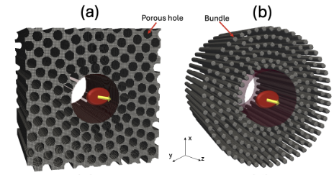
Background & Motivation
Background:
  Since in LWFA the wakefield amplitude scales with the plasma density, ^{[1]}, fields of TV/m may be achievable if solid targets are adopted ^{[2]}.
  CNT bundles: density tailoring and laser propagation ^{[3]}.
Issues:
  Optimum parameters for beam quality.
Research objectives:
  TV/m-scale acceleration for CNT bundles, E > 100 MeV, nC scale, σ_{E} < 5 %, and ε_{N} < 10 mm mrad.
Applications:
  Compact radiation sources
  Beam radiotherapy
  Free electron lasers (FELs) with further optimisation
[1] E. Esarey et al., Rev. Mod. Phys. 81, 1229 (2009).
[2] C. Bontoiu et al., Sci. Rep. 1 (2023).
[3] A. Bonatto et al., Phys. Plasmas 033105, (2023).
Notes:
We know LWFA with gaseous plasma has achieved GV/m-scale acceleration, both in simulations and experiments, since Toshi Tajima proposed the concept in 1979. According to the wave-breaking theory, the maximum achievable wakefield is proportional to the square root of plasma electron density, so gradients of TV/m-scale can be achieved if we have a density of 10^20 cm-3, which means a solid target. Typically, 2D carbon-based materials, like Graphene, CNTs, were selected as the plasma media due to their good thermo-mechanical properties. It’s less complicated to tailor the plasma density of CNT bundles, which have a bunch of CNTs packed together. Typically for an 800nm laser, the critical density is 1.7*10^21. But the intrinsic density of CNTs is from 10^22 to 10^23 /cm3. But CNT bundles have empty spaces to allow the laser to penetrate the target. The condition depends on the plasma frequency and laser frequency. If the plasma one is less than laser one, then problem resolved. That’s why we are using the CNT bundles.
There’s an issue that previous studies were focusing on gradients, like tens of TV/m or even 100s of TV/m. With a low beam quality, it really limits the applications in this field.
As such, we tried to do parameter scans to achieve TV/m-scale acceleration for CNT bundles, with energy over 100 MeV, nC-scale charge, energy spread below 5%, and emittance below 10 mm.
This work can facilitate applications in compact radiation sources and beam radiotherapy. Particularly for FELs, we need further optimization.

Slide 4
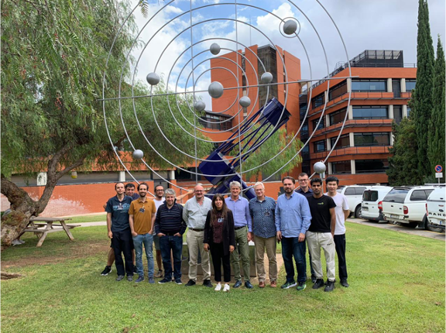
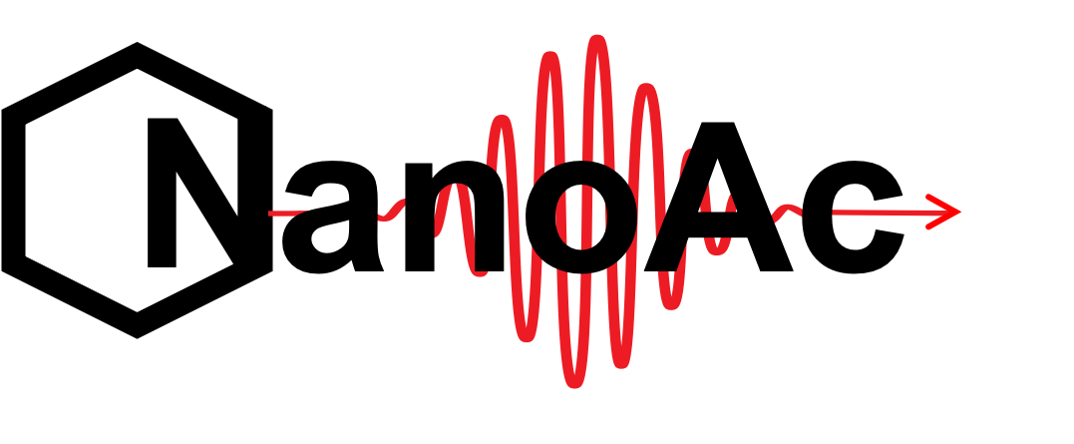
Our Collaborative Team
Javier Resta-López,
Guoxing Xia,
Alexandre Bonatto,
Cristian Bontoiu,
Bifeng Lei
INFN: L. Bandiera, A. Sytov, G. Cavoto (UNIROMA1), I. Rago, I. Drebot, P. Cirrone, G. Petringa
The Institute for Plasma Physics and Lasers at Hellenic Mediterranean University (IPPL/HMU), Greece: N. Papadogiannis, M. Tatariakis, G. Andrianaki
The National Technical University of Athens (NTUA): C. Valagiannopoulos
Sphere Ultrafast Photonics, S.A. (SPH), Portugal: R. Romero
The Pulsed Lasers Centre (CLPU): G. Gatti
European funding through the PATHFINDER-OPEN scheme
@ Workshop on Applications of Nanostructures in the field of Accelerator Physics (NanoAc 2024)
Notes:
This is main members in our collaborative team. Javier is from University of Valencia. Guoxing is from UoM and CI. Alex comes from University of Health Sciences in Brazil. Cristian graduated from the University of Liverpool, and Bifeng is a postdoc in Liverpool. For proof-of-principle experiments, we also have close connections with INFN, Greek institutions, a industrial laser equipment supplier, and Salamanca’s laser facility in Spain. We held an Nano Acceleration workshop last September. Besides, We have recently applied for European funding through the PATHFINDER-OPEN scheme.

Slide 5
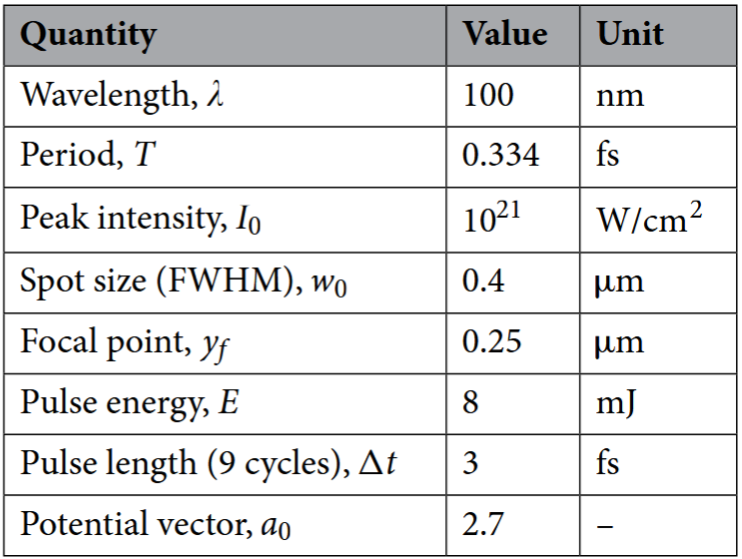
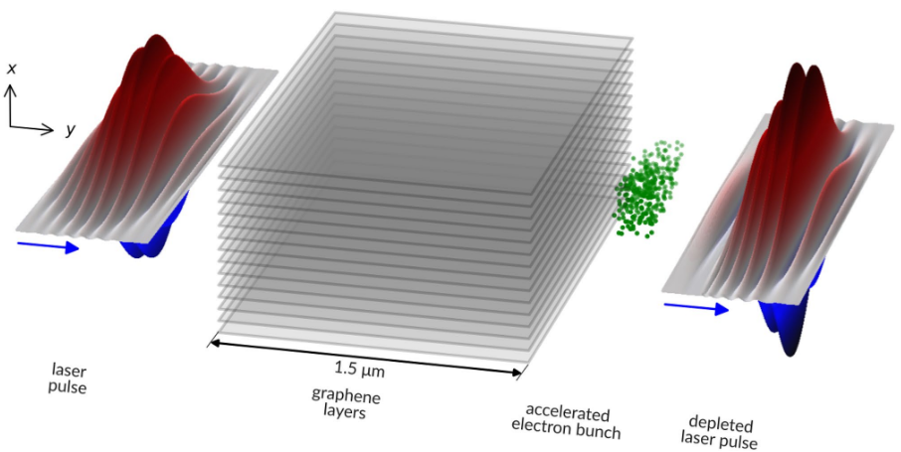
Recent Developments
TeV/m catapult acceleration of electrons in graphene layers
  Numerical work based on the PIConGPU code
  Catapult self-injection driven by the edge plasma oscillations
  Acceleration then proceeds in the blowout regime at a gradient of 4.79 TeV/m
  0.4 fs‑long self-injected bunch with a total charge > 2.5 pC and average energy of 6.94 MeV
[1] C. Bontoiu et al., Sci. Rep. 1 (2023).
Notes:
Some recent publications from our team are listed here. In 2023, Cristian simulated LWFA with a graphene plasma. We achieved a gradient of 4.79 TeV/m in the blowout regime. With a quite short distance, we gained a self-injected bunch with a total charge 2.5 pC and average energy of 6.94 MeV.

Slide 6
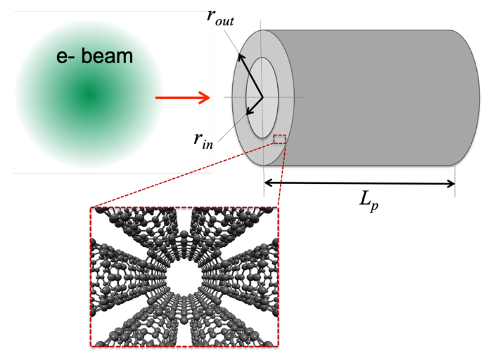
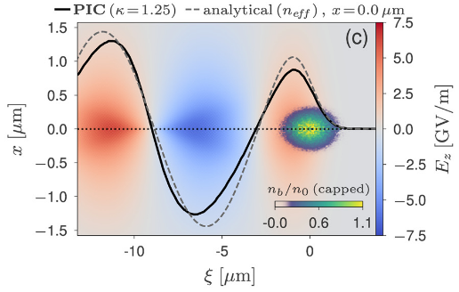
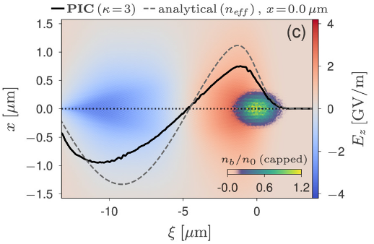
Recent Developments
Exploring ultra-high-intensity wakefields in carbon nanotube arrays: An effective plasma-density approach.
  Effective density method: Replaces the actual non-uniform density with an effective average density and allows analytically describe wakefields in inhomogeneous targets.
  Conditions for Validity﻿: 1) Periodic plasma (e.g., wall + gap); 2) Periodic unit << laser waist / beam radius;
  3) Linear to quasi-linear regime; 4) Gap ≤ wall thickness
  Benefits: 1) Uses existing analytical expressions; 2) Estimates wakefield amplitudes quickly and accurately;
  3) Scales wakefield properties with density and structure parameters for complex periodic plasmas.
[1] A. Bonatto et al., Phys. Plasmas 033105, (2023).
Notes:
Also 2 years ago, Alex published a paper that we proposed the effective density method. Effective density means that replace the actual non-uniform plasma density with an average one. But we need to notice that the plasma should be periodic. Periodic size should be much less than laser waist or beam radius. No3, the acceleration shouldn’t happen in the bubble regime. The last one, the gap shouldn’t be too high, compared with the wall thickness.
Anyway, what’s the benefits of the effective density? We can use existing analytical expressions to estimate wakefield, rather than using the particle-in-cell code. And we can simplify complex periodic plasmas by capturing the wakefield with just two key parameters: density and geometry.

Slide 7
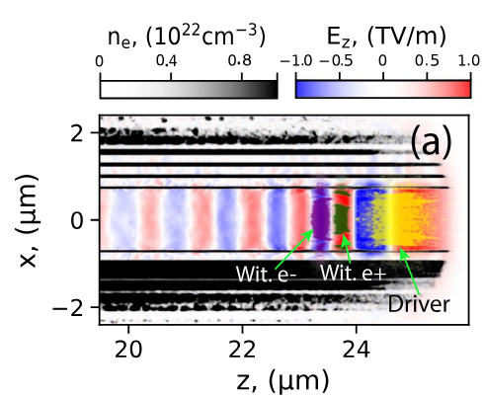
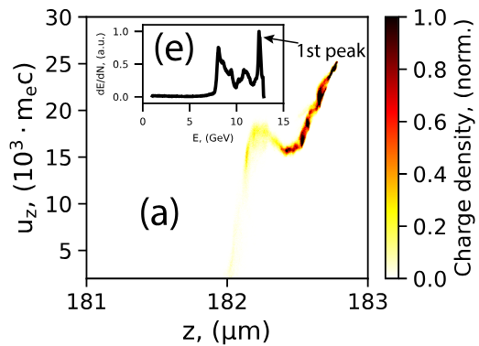
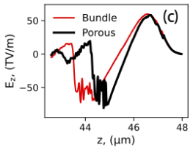
Recent Developments
100s TeV/m-level particle accelerators driven by high-density electron beams in micro structured carbon nanotube forest channel
  Ultra-high accelerating gradients: hundreds of TV/m at n_{p} = 10²⁴ cm⁻³.
  Surface plasmon leakage fields: sub-TV/m, phase-matched acceleration for electrons and positrons.
  Bubble wakefields: reach 50 – 400 TV/m with up to 67% efficiency and quasi-monoenergetic GeV beams with nC-level charge.
[1] B. Lei et al., New J. Phys. 27, (2025).
Notes:
This year we achieved 100s of TeV/m driven by high-density electron beams with the plasma density is 10^24. We discovered the surface plasmon leakage fields, which can provide sub-TV/m and proper plasma phase match for both electrons and positrons as shown in the middle figure. Besides, the bubble wakefield is exactly what we want to accelerate the electrons with the gradient of 400 TV/m at most. It is possible to achieve quasi-monoenergetic GeV beams with high efficiency and nC-scale charge in 100s of um, even though the energy spread is basically around 30%.

Slide 8
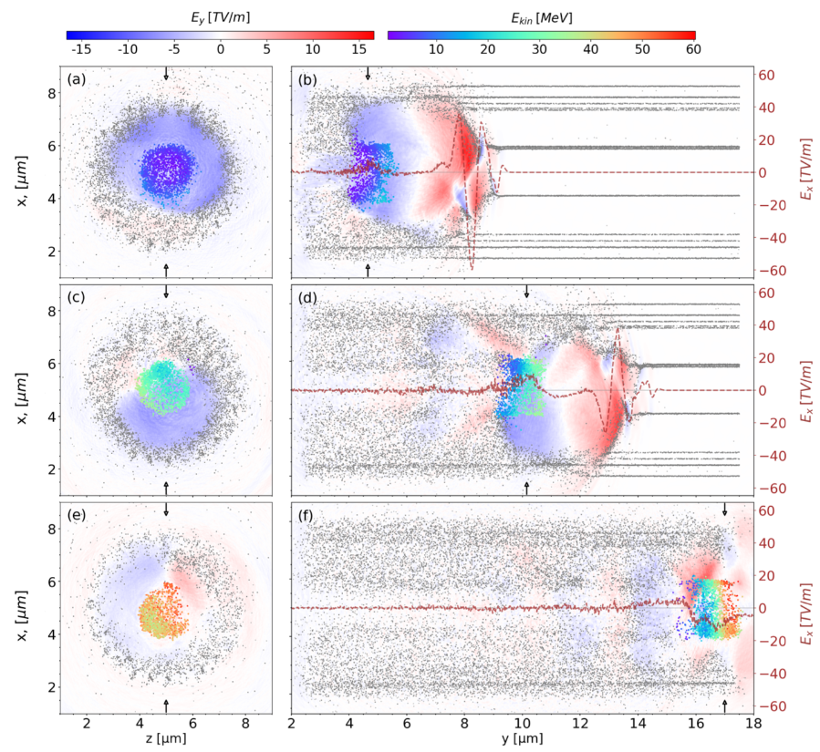
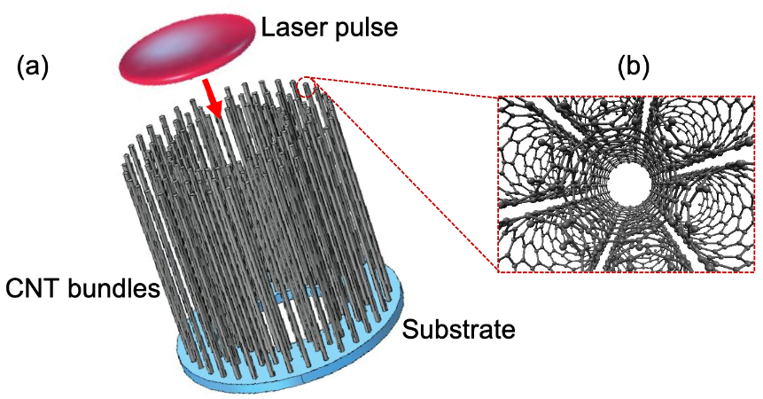
Recent Developments
Numerical study of electron acceleration in structured CNT targets via self-injection in a wakefield bubble driven by an 800 nm laser, Sci. Rep. (Under review after revision) 2025
  Structured CNT bundles reduce effective plasma density to ~10²⁰ cm⁻³, enabling 800 nm lasers to drive wakefield bubbles.
  Self-injected electron bunches reach tens of MeV, with ~0.9 nC charge, TeV/m gradients, but a broad ~100% energy spread over 15 µm.
  Simulations also reveal ~50 kT azimuthal magnetic fields, which provide a focusing effect and highlight the robustness of CNT solid targets.
Notes:
A couple of months ago, we numerically reported that the 800 nm lasers can propagate through the structured CNT bundles and drive wakefield bubbles. With a 15-um-long solid-state plasma channel, self-injected electron bunches with a TeV/m scale gradient, tens of MeV, 0.9 nC charge were achieved. But the limitation would be the impressive energy spread. Related work has been submitted to Scientific Report and is under review for now.

Slide 9
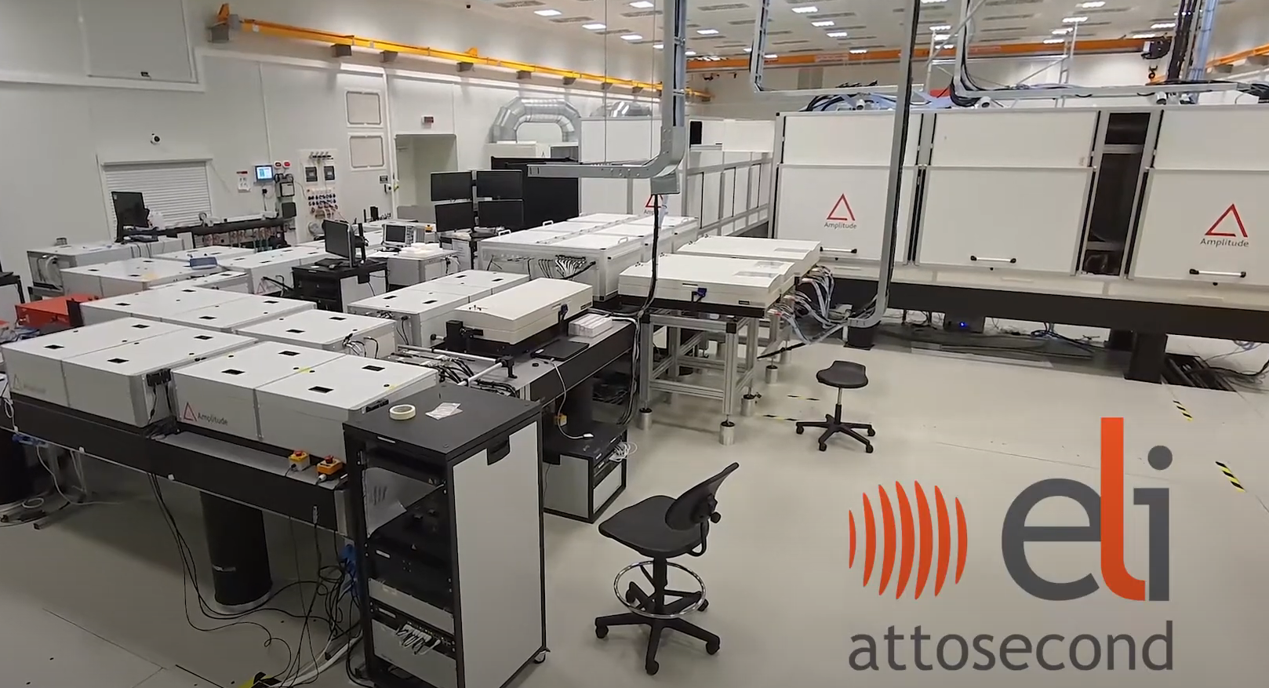
LWFA with a CNT Bulk
Laser Facility—ELI-ALPS 2 PW High Field Laser ^{[1,2]}
Parameters |  | Values
Laser pulse | Peak power | 2 PW
 | Energy stability | 1.5 %
 | Peak intensity | 10²¹ – 10²² W/cm²
 | FWHM spot size (1/e² waist) | 2 – 4.5 μm (1.7 – 3.8 μm)
 | Central wavelength | 800 nm
 | Duration | 17 fs
 | Repetition rate | 10 Hz
[1] ELI-ALPS Science & Technology, ELI-ALPS, n.d., https://www.eli-alps.hu/en/Science-Technology/Secondary-Sources-Division-1. Accessed 18 Sept. 2025.
[2] R. S. Nagymihály et al., 2023 Conf. Lasers Electro-Optics Eur. Eur. Quantum Electron. Conf. CLEO/Europe-EQEC 2023 4599 (2023).
Notes:
For my recent work, I used the ELI-ALPS 2PW High field laser. The peak intensity reaches 10^22 W/cm2, with the duration of 17 fs and repetition rate of 10HZ.

Slide 10
LWFA with a CNT Bulk
Particle-in-cell Simulation Code: WarpX^{[1]}
LBNL, open-source, developed in 2018
Full 3D Cartesian coordinate
GPU support
Running on STFC SCARF and CSF3
Simulation settings | Values
dx | 200 nm
dy | 200 nm
dz | 97 nm
Ion macroparticles per x | 4
Ion macroparticles per y | 4
Ion macroparticles per z | 4
dt | 0.27 fs
Field ionisation | ADK
Initialised particle | Carbon atoms
Particle pusher | Boris
Field solver | Yee (FDTD)
Field boundary conditions | Absorbing
Particle boundary conditions | Absorbing
[1] J. Vay et al., Nucl. Inst . Methods Phys. Res. A 909, 476 (2018).
Notes:
For PIC code, I used WarpX which was developped by Berkeley Group. ADK model was employed as the field ionisation.

Slide 11
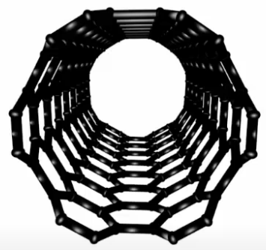
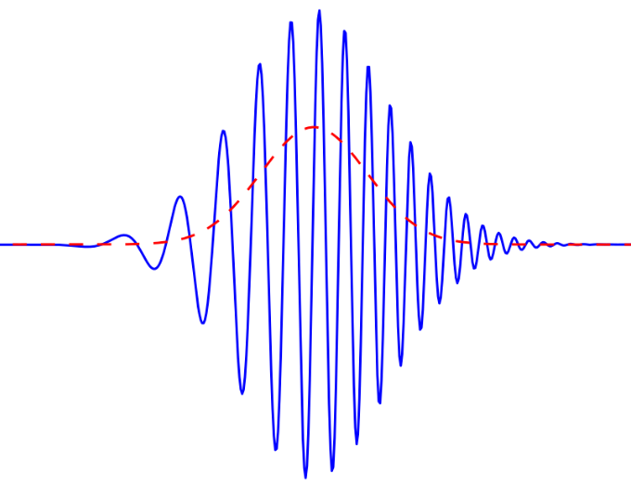
LWFA with a CNT Bulk
Simulation Settings & Parameters
Parameters |  | Ranges / Values
Plasma | Density (cm⁻³) Inner radius (μm) Outer radius (μm) Initial atoms | 1.0×10¹⁹ – 2.0×10²⁰ 0.5 – 5.0 10 Carbon
Laser pulse | Peak power (PW) Peak intensity (W/cm²) Vector potential Peak electric field (TV/m) Wavelength (nm) Waist (μm) Duration (fs) Focal position Rayleigh length (μm) Polarisation | 2 8.82 – 16.2 ×10²¹ 63.9 – 86.7 258 – 349 800 2.8 – 3.8 17 z = 0 30.8 – 56.7 Linear
Laser pulse
Single/Multi-walled CNTs
r_{out}
r_{in}
c
LWFA with a CNT bulk
Notes:
The CNT is shaped like a cylindrical thing with a hole in the middle. The uniform bulk is just used for effective density determination. Parameter scanning on plasma density, Inner radius, and laser waist has beed done, and I’m gonna show you some preliminary results.

Slide 12
LWFA with a CNT Bulk
Parameter Scanning on Plasma Density
Parameters & results | Values
Inner radius (μm) | 0.5
Laser waist (μm) | 3.5
Plasma density (cm⁻³) | 1×10¹⁹ | 3×10¹⁹ | 5×10¹⁹ | 7×10¹⁹ | 1×10²⁰ | 2×10²⁰
Particle cut ^{[1]} (MeV) | E > 190 | E > 220 | E > 210 | E > 180 | E > 120 | E > 100
Mean energy (MeV) | 204 | 248 | 276 | 256 | 234.6 | 184
Charge (nC) | 1.3 | 6.7 | 7.6 | 8.5 | 9.3 | 9.9
Energy spread (%) | 3.9 | 6.2 | 13.4 | 20.9 | 45.3 | 35.7
Emittance (mm mrad) | 8.7 | 19.3 | 25.5 | 30.3 | 59.9 | 75.3
Accelerating length (μm) | 169 | 85 | 85 | 85 | 85 | 85
Gradient (TeV/m) | 1.2 | 2.9 | 3.3 | 3.0 | 2.8 | 2.2
Beam quality factor | 0.03801 | 0.05587 | 0.02229 | 0.01349 | 0.00342 | 0.00368
Beam quality factor ^{[2]}:
[1] S. Romeo et al., Nucl. Instruments Methods Phys. Res. Sect. A 909, 71 (2018).
[2] A. Giribono et al., Phys. Rev. Accel. Beams 26, 83402 (2023).
Notes:
We found that the energy spread and emittance become worse and worse, in terms of the plasma density of 10^20 /cm3 scale. To give a standard optimising the parameter, we defined the beam quality factor, which is charge divided by energy spread and emittance, quite similar as the 5D brightness. So the plasma density of 10^19 looks better.

Slide 13
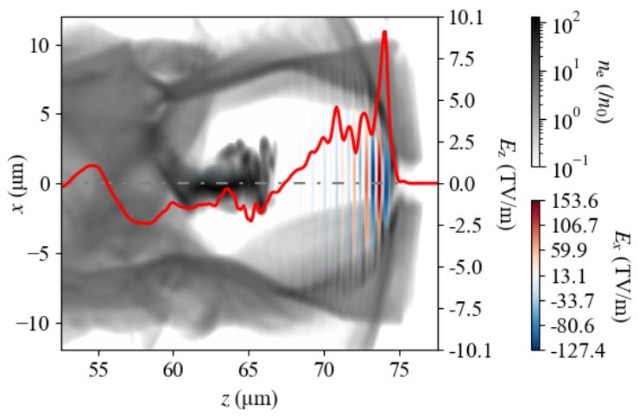
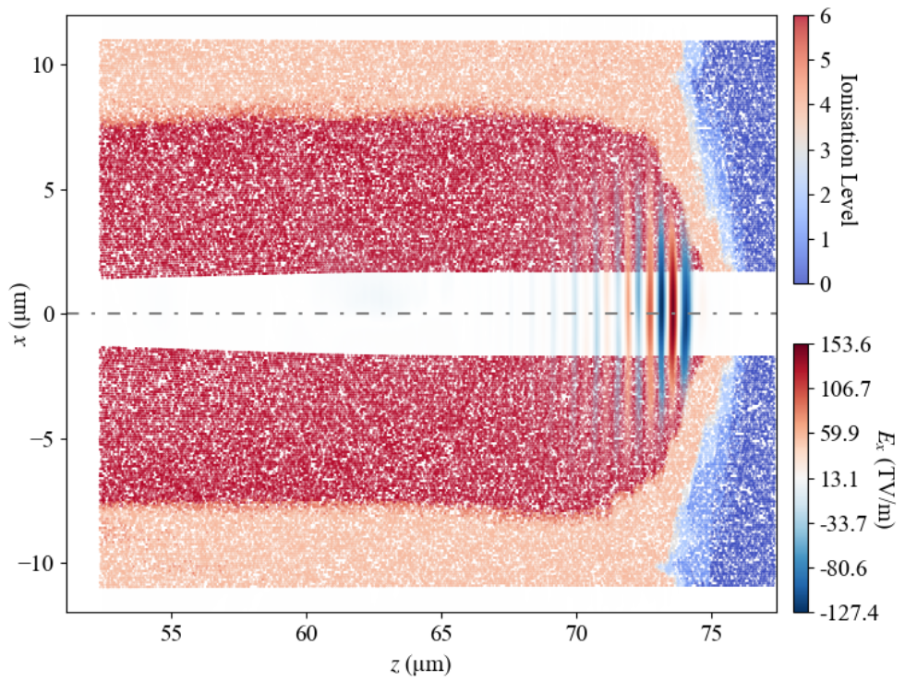
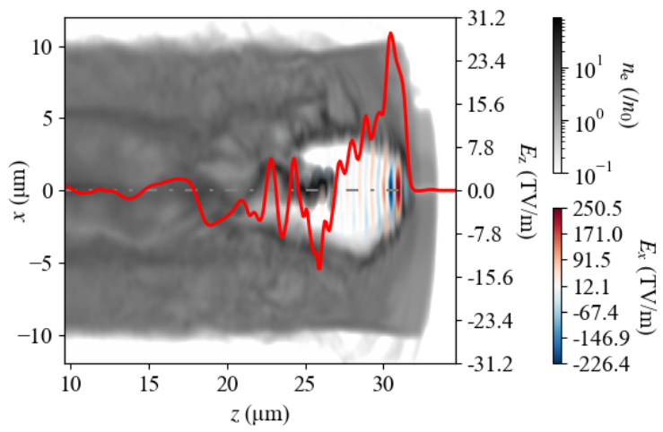
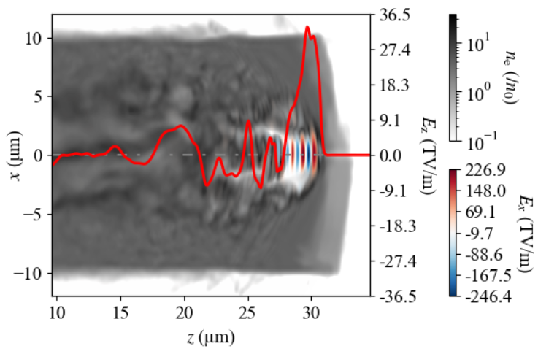
LWFA with a CNT Bulk
Wakefield & Ionisation
1.8×10¹⁹ cm⁻³
n_{p} = 1.0×10²⁰ cm⁻³
2.0×10²⁰ cm⁻³
Full ionisation radius: ~7.5 μm ≈ 2 w₀
Wakefield Fluctuates at 10²⁰ cm⁻³ scale
Notes:
As the plasma density grows, the wakefield fluctuates much more, and eventually quite strongly at 10^20. Besides, with such a powerful laser, Carbon atoms can be fully ionised with the radius of 7.5um, which is double than laser waist approximately.

Slide 14
LWFA with a CNT Bulk
Parameter Scanning on Inner Radius & Laser Pulse
Parameters |  | Values
Plasma | Density (cm⁻³) Inner radius (μm) Outer radius (μm) Initial atoms | 1.8×10¹⁹ 1.7 10 Carbon
Laser pulse | Peak power (PW) Peak intensity (W/cm²) Vector potential Peak electric field (TV/m) Wavelength (nm) Waist (μm) Duration (fs) Focal position Rayleigh length (μm) Polarisation | 2 9.34 ×10²¹ 65.6 266 800 3.7 17 z = 0 53.8 Linear
Quantity | Values
Particle cut (MeV) Mean energy (MeV) Charge (nC) Energy spread (%) Emittance (mm mrad) Accelerating length (μm) Gradient (TeV/m) Beam quality factor | > 130 142 3.6 5.0 6.5 74.0 1.9 0.111
Laser propagation condition:
Notes:
As soon as we get the ionisation level, we can check the laser propagation condition, plasma frequency is lower than the laser frequency. Eventually we’ve got the best result so far. Mean energy? 142MeV, Charge? 3.6 pC, energy spread? 5.0%, emittance 6.5 mm.

Slide 15
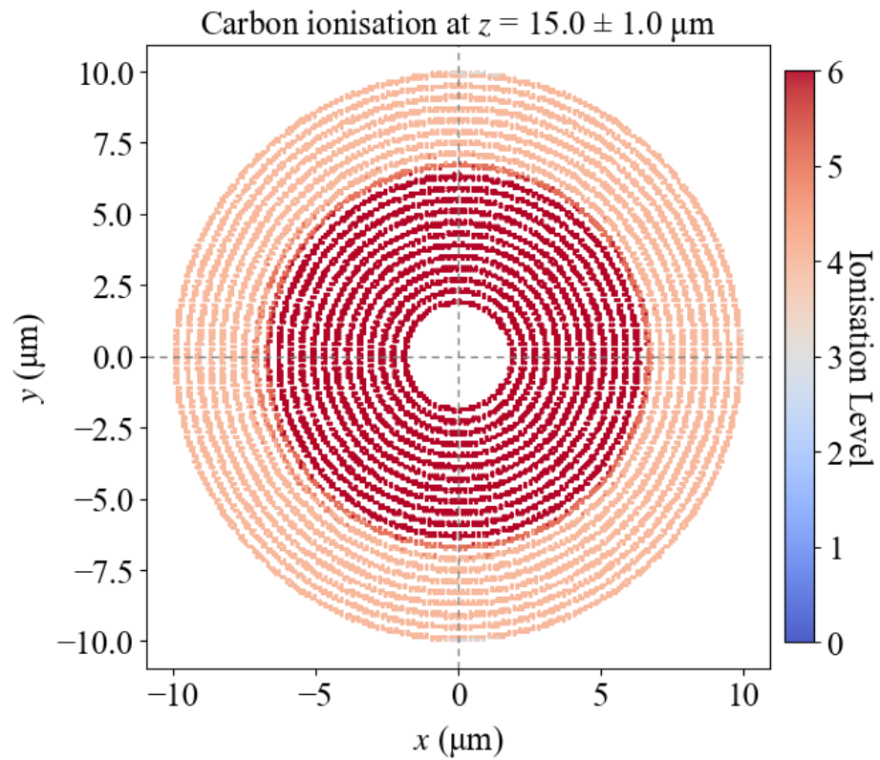
LWFA with CNT Bundles
Simulation Parameters
Quantity | Values
Particle cut (MeV) Mean energy (MeV) Charge (nC) Energy spread (%) Emittance (mm mrad) Accelerating length (μm) Gradient (TeV/m) Beam quality factor | > 80 104 3.3 14.4 8.7 99.4 1.0 0.027
Parameters |  | Values
Grids | dx | 96 nm
 | dy | 96 nm
 | dz | 97 nm
Plasma | Effective density | 1.8×10¹⁹ cm⁻³
 | Bundle density | 3.9×10¹⁹ cm⁻³
 | Bundle diameter | 200 nm
 | Gap | 200 nm
 | Inner radius | 1.7 μm
 | Outer radius | 9.9 μm
 | Initial atoms | Carbon
 | Filling factor | 90%
Number of bundles | Shell 1 | 53
 | Shell 2 | 65
 | Shell 3 | 76
 | … | …
 | Shell 20 | 268
 | Shell 21 | 280
CNT bundles
Notes:
Then we moved the work to CNT bundles. Here the geometry of CNT bundles it is! One thing is the filling factor, which represent a fraction of the total volume that is physically occupied by the CNTs. 90% of it means a densely packed the CNT bundles are. So the energy spread? 14%, emittance? 8.7.

Slide 16
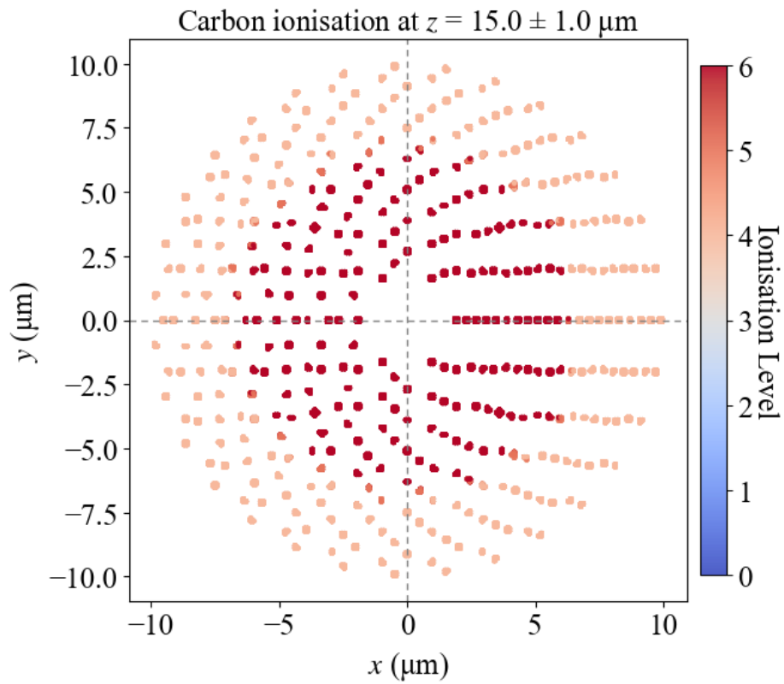
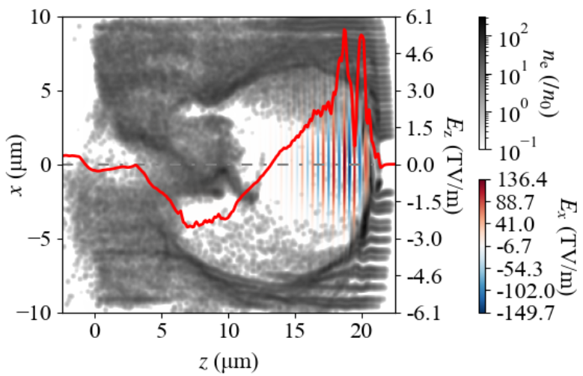
LWFA with CNT Bundles
Case 2—Low Filling Factor
Parameters |  | Values
Grids | dx | 96 nm
 | dy | 96 nm
 | dz | 97 nm
Plasma | Effective density | 1.8×10¹⁹ cm⁻³
 | Bundle density | 3.5×10²⁰ cm⁻³
 | Bundle diameter | 200 nm
 | Gap | 200 nm
 | Filling factor | 10%
Quantity | Values
Particle cut (MeV) Mean energy (MeV) Charge (nC) Energy spread (%) Emittance (mm mrad) Accelerating length (μm) Gradient (TeV/m) Beam quality factor | > 130 138 2.1 ↓ 3.9 ↓ 8.7 ↑ 105.0 1.3 ↑ 0.062 ↑
Notes:
Then we reduced the filling factor down to 10%, describing that most of the volume is empty space, as shown in the figure on bottom right. The wakefield shows a good flatten effect at the rear of the bubble. So the energy spread? 3.9%. Emittance? 8.7, which satisfies our research objectives.

Slide 17
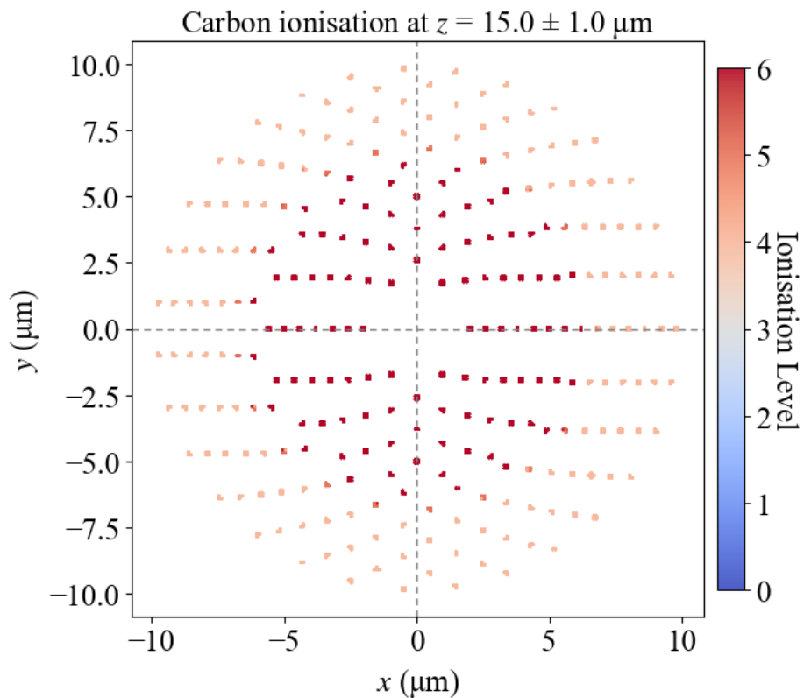
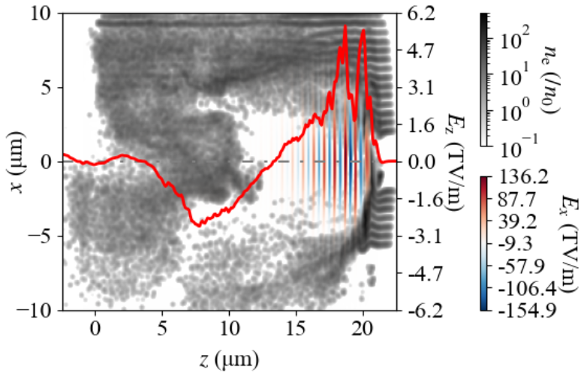
LWFA with CNT Bundles
Case 3—Larger Gap
Parameters |  | Values
Grids | dx | 96 nm
 | dy | 96 nm
 | dz | 97 nm
Plasma | Effective density | 1.8×10¹⁹ cm⁻³
 | Bundle density | 5.14×10²⁰ cm⁻³
 | Bundle diameter | 200 nm
 | Gap | 400 nm
 | Filling factor | 10%
Quantity | Values
Particle cut (MeV) Mean energy (MeV) Charge (nC) Energy spread (%) Emittance (mm mrad) Accelerating length (μm) Gradient (TeV/m) Beam quality factor | > 120 129 2.1 4.6 ↑ 10.2 ↑ 105.0 1.2 ↓ 0.045 ↓
Notes:
One more case is ready for a larger gap of 400 nm. The difference seems to be more empty space, but the bundle density is still higher all the same. So the energy spread? 4.6. emiitance? more than 10.

Slide 18
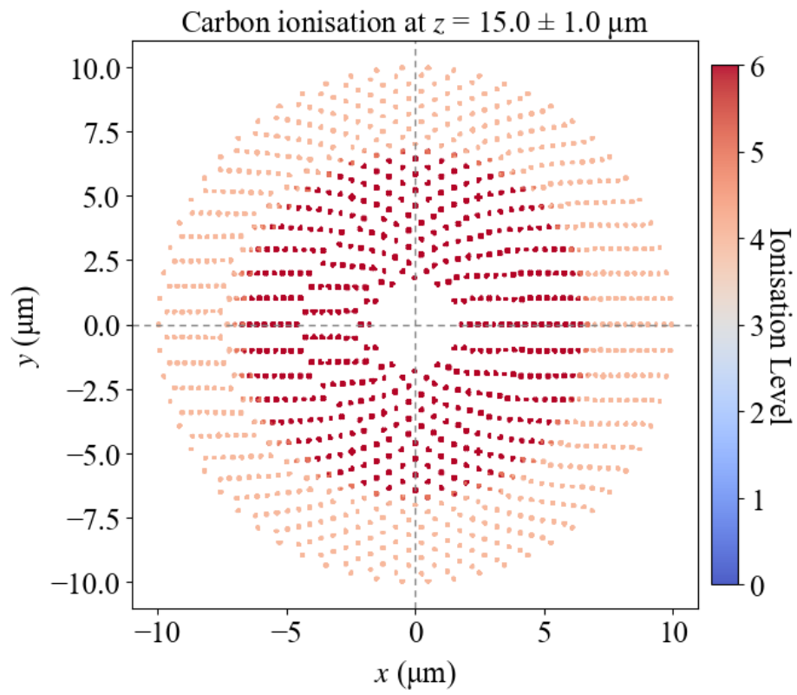
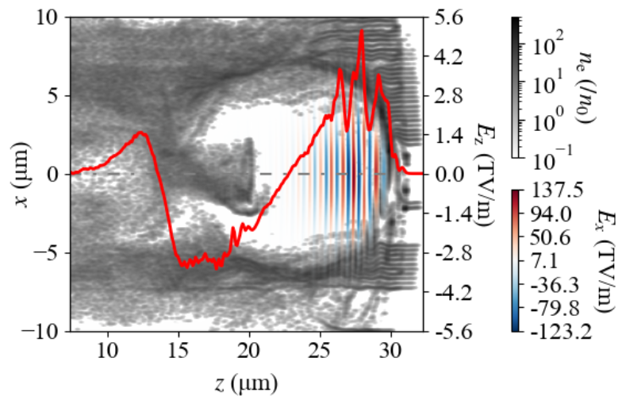
LWFA with CNT Bundles
Case 4—Smaller Bundle Diameter
Parameters |  | Values
Grids | dx | 48 nm
 | dy | 48 nm
 | dz | 97 nm
Plasma | Effective density | 1.8×10¹⁹ cm⁻³
 | Bundle density | 5.27×10²⁰ cm⁻³
 | Bundle diameter | 100 nm
 | Gap | 200 nm
 | Filling factor | 10%
Quantity | Values
Particle cut (MeV) Mean energy (MeV) Charge (nC) Energy spread (%) Emittance (mm mrad) Accelerating length (μm) Gradient (TeV/m) Beam quality factor | > 80 89 ↓ 2.1 7.2 ↑ 6.5 ↓ 69.7 0.9 ↓ 0.045
Notes:
The last case is ready for a smaller bundle diameter of 100 nm. Unfortunately, the laser cannot give a sufficient accleration before it is depleted significantly. As such, the energy reached 89 MeV only.

Slide 19
An Answer to Target Damage
Two potential damage pathways:
Cold ablation:
The ionic response develops on slower timescales, typically ≥100 fs, due to ion inertia ^{[1]}.
A quenching-revival of the Coulomb explosive process was observed in the graphite during 100 – 200 fs ^{[2]}.
Hot ablation:
Ultrafast electron diffraction on graphite finds electron → phonon energy transfer at ~259 fs ^{[3]}.
Phonon-phonon/lattice thermalization at ~6.5 ps ^{[3]}.
Diffusive thermal-mechanical responses driven by heat conduction evolve even more slowly (≳ns) ^{[1]}.
Literature ^{[4]} shows that wakefields in solid-state nanomaterials remain virtually unaffected by the ion dynamics.
Our simulations indicate that ion displacement is negligible.
[1] T. Fennel et al., Rev. Mod. Phys. 82, 1793 (2010).
[2] M. Lenner et al., Phys. Rev. B 79, 1 (2009).
[3] R. P. Chatelain et al., Phys. Rev. Lett. 113, 1 (2014).
[4] S. Hakimi et al., Phys. Plasmas 25, (2018).
Notes:
Before the question session, I guess some of you are interested in the target damage, as every time when we delivered a presentation or submitted a manuscript, we would receive this concerns. Basically the target can be damaged by two pathways, but all the mechanisms, such as Coulomb explosive, electron-phonon energy transfer, and thermal-mechanical responses happen in a slower period, compared with our electron acceleration. Our simulations indicate that ion displacement is negligible.

Slide 20
Conclusions & Outlook
Laser-induced full ionisation covers 2 times laser waist, which can be estimated as C⁶⁺ for initialisation.
We achieved TV/m-scale acceleration, E > 100 MeV, nC-scale charge, σ_{E} < 5 %, ε_{N} < 10 mm mrad, using CNT bundles.
Bundle diameter, gap, and filling factor significantly affect the beam quality.
Further work:
Machine-learning based beam quality optimisation for CNT bundles
Proof-of-principle experiments based on ELI-UoM Collaboration Scheme
Acknowledgements:
This project has received funding from the European Union’s Horizon 2020 Research and Innovation programme under Grant Agreement No 101004730 'I.FAST’.
We acknowledge the support from the Cockcroft Institute Core Grant No. ST/V001612/1.
Computing resources are provided by STFC Scientific Computing Department’s SCARF cluster.
Notes:
For a quick summary, we numerically proved the TV/m scale acceleration is achievable using graphene and CNTs. In my recent work, we obtained a highly improved beam quality, by performing the parameter scanning of plasma, laser and CNT geometry.

Slide 21
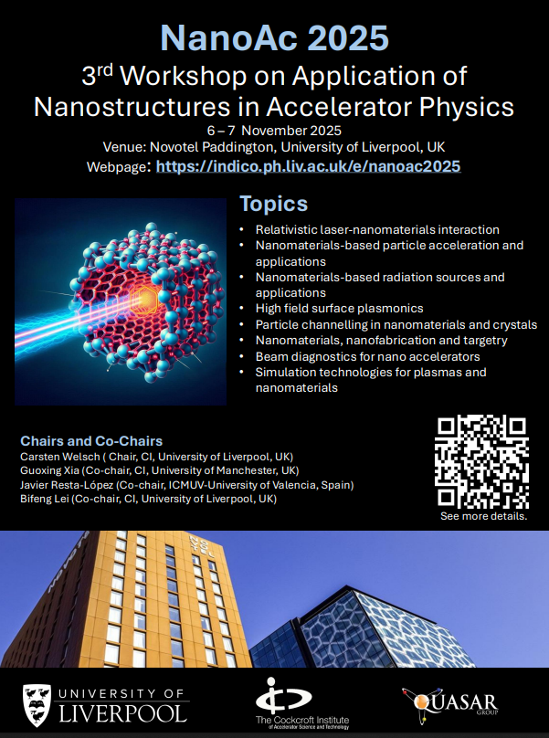
点击添加文本
Thanks for your attention!
Thanks for your attention!
Thanks for your attention!
Thanks for your attention!
Thanks for your attention!
Thanks for your attention!
Thanks for your attention!
Thanks for your attention!
Thanks for your attention!
Thanks for your attention!
Thanks for your attention!
Thanks for your attention!
Thanks for your attention!
点击添加文本
点击添加文本
点击添加文本

Slide 22
点击添加文本
Thanks for your attention!
Thanks for your attention!
Thanks for your attention!
Thanks for your attention!
Thanks for your attention!
Thanks for your attention!
Thanks for your attention!
Thanks for your attention!
Thanks for your attention!
Thanks for your attention!
Thanks for your attention!
Thanks for your attention!
Thanks for your attention!
Thanks for your attention!
Thanks for your attention!
点击添加文本
点击添加文本
点击添加文本

