Slide 1









Collider-quality electron bunches from an all-optical plasma photoinjector
Marcus Babzien, Michael Downer, Arohi Jain, Chandrashekhar Joshi, William Li, Warren Mori, John Palastro, Mark Palmer, Jacob Pierce, Mikhail Polyanskiy, Roman Samulyak, Tanner Simpson, Navid Vafaei-Najafabadi, Jiayang Yan
Stony Brook University, University of Rochester, UCLA, BNL

Slide 2
Synthesis
Plasma accelerators create accelerating gradients that are hundreds of times higher than conventional accelerators
A “plasma photoinjector” for a collider application needs to create
  Low emittance (<100 nm)
  High charge (order of nC)
  Trapezoidal shape for low energy spread in subsequent accelerating plasma stages
Such plasma photoinjector can be generated by applying the spatiotemporal pulse shaping to two-color ionization injection.

Slide 3
Synthesis
Plasma accelerators create accelerating gradients that are hundreds of times higher than conventional accelerators
A “plasma photoinjector” for a collider application needs to create
  Low emittance (<100 nm)
  High charge (order of nC)
  Trapezoidal shape for low energy spread in subsequent accelerating plasma stages
Such plasma photoinjector can be generated by applying the spatiotemporal pulse shaping to two-color ionization injection.

Slide 4
Synthesis
Plasma accelerators create accelerating gradients that are hundreds of times higher than conventional accelerators
A “plasma photoinjector” for a collider application needs to create
  Low emittance (<100 nm)
  High charge (order of nC)
  Trapezoidal shape for low energy spread in subsequent accelerating plasma stages
Such plasma photoinjector can be generated by applying the spatiotemporal pulse shaping to two-color ionization injection

Slide 5


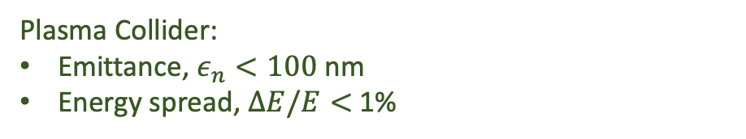


Collider quality electron beam
In addition to energy, beam quality is a critical consideration
In colliders, quality is measured by Luminosity
$$L\sim \frac{fN_{1}N_{2}}{4πσ^{2}}$$
Beam collision rate $⟹$High rate
Beam charge $⟹$High charge
Plasma Collider: $f\sim 50$kHz
Plasma Collider:$Q\sim 200$ pC , ${10}^{9} e^{−}$
Focusability $⟹$ low emittance and energy spread
Plasma Collider:
Emittance, $ε_{n}<100$ nm
Energy spread, $ΔE/E<$ 1%
$L↑ ⟹ε_{n}↓$ & $ΔE/E↓$ & Q $↑$
C.B. Schroeder et al 2023 JINST 18 T06001
DOI 10.1088/1748-0221/18/06/T06001
Notes:
Having a high acceleration gradient is not enough, you also need a high quality beam
Luminosity determines number of events (collisions) per second

Slide 6
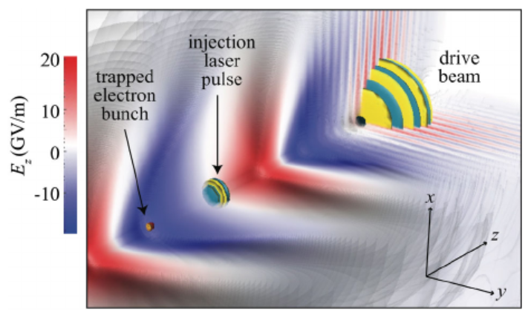
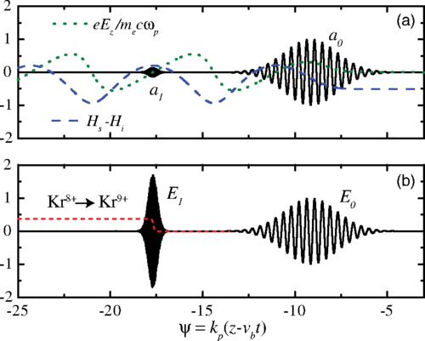
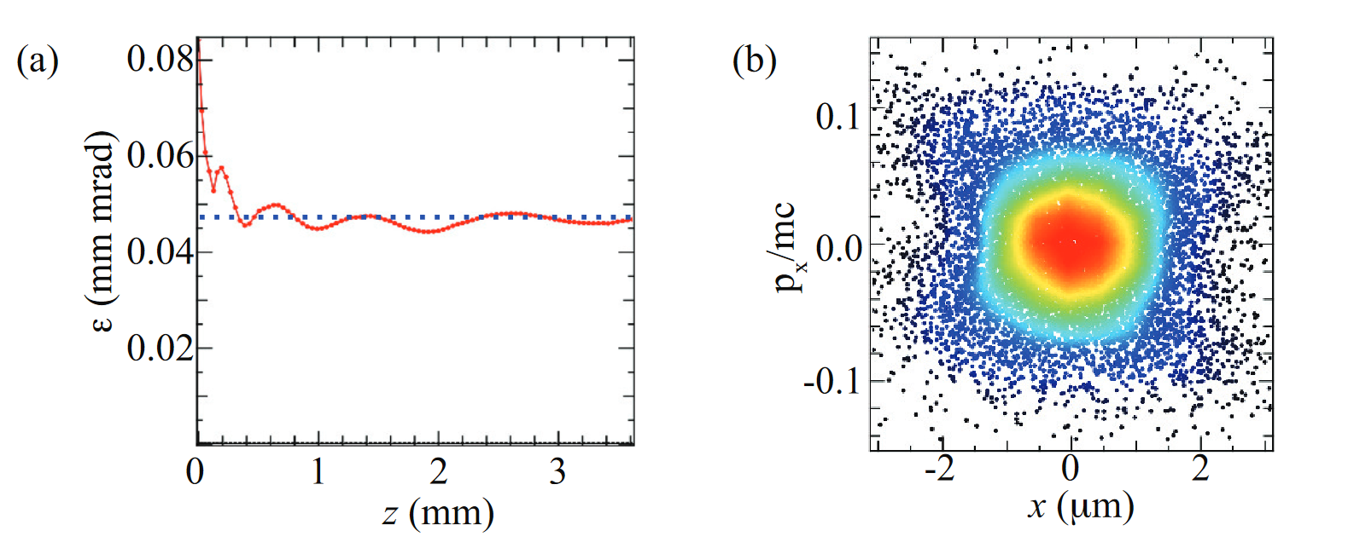


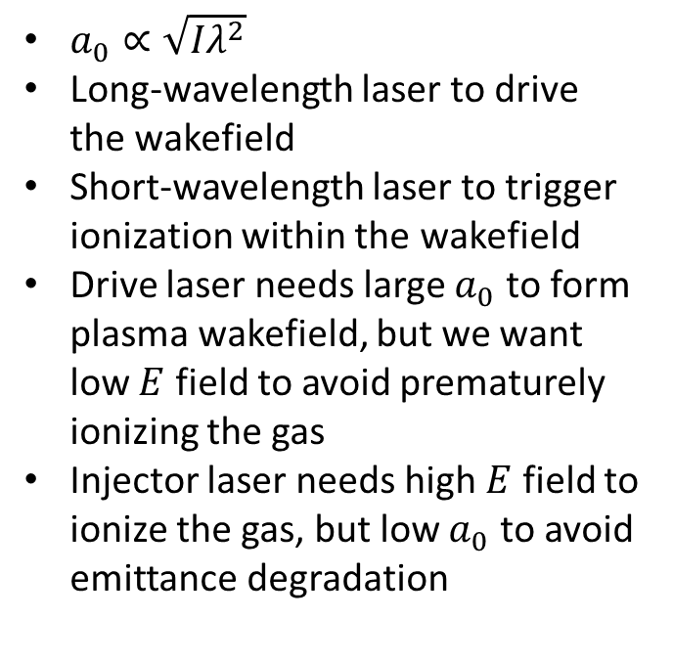
Two-color ionization injection
Very intense, small $a_{0}$
Less intense, large $a_{0}$
$a_{0}∝\sqrt{Iλ^{2}}$
Long-wavelength laser to drive the wakefield
Short-wavelength laser to trigger ionization within the wakefield
Drive laser needs large $a_{0}$ to form plasma wakefield, but we want low $E$ field to avoid prematurely ionizing the gas
Injector laser needs high $E$ field to ionize the gas, but low $a_{0}$ to avoid emittance degradation
Schroeder, PRSTAB 17, 101301 (2014)
Yu, PRL 112, 125001 (2014)
Excellent phase space
Low emittance
Schroeder, European Conference on Lasers and Electro-Optics (2015)
See also Xu, PRSTAB, 17, 061301 (2014)

Slide 7
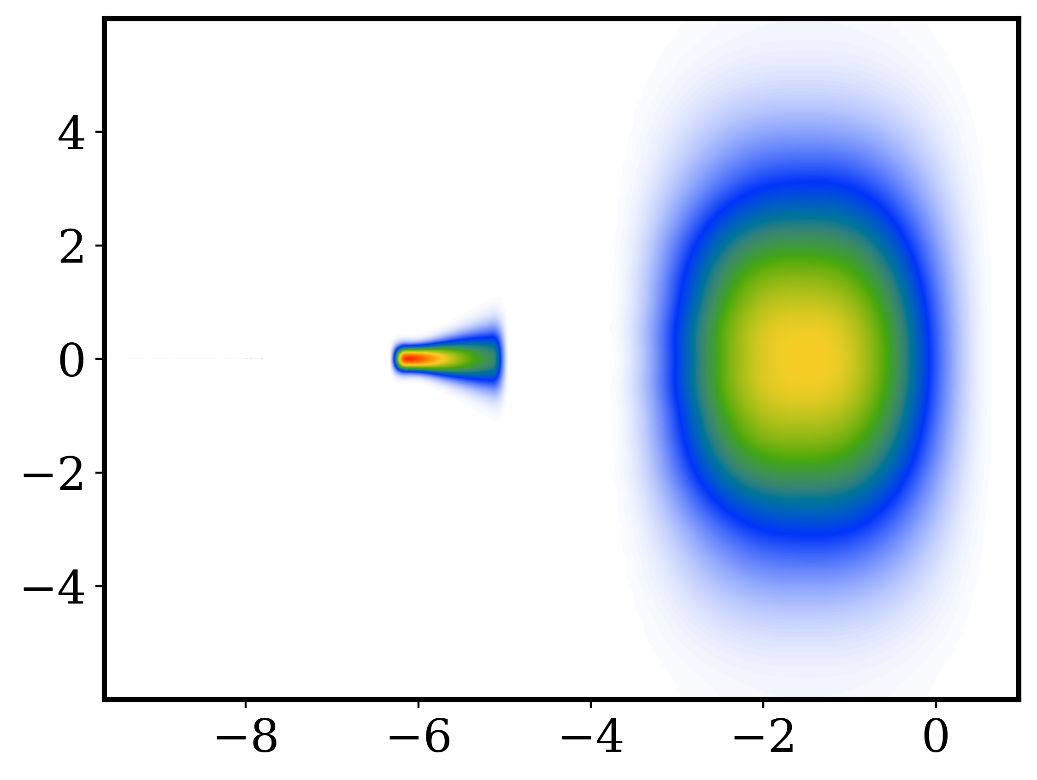
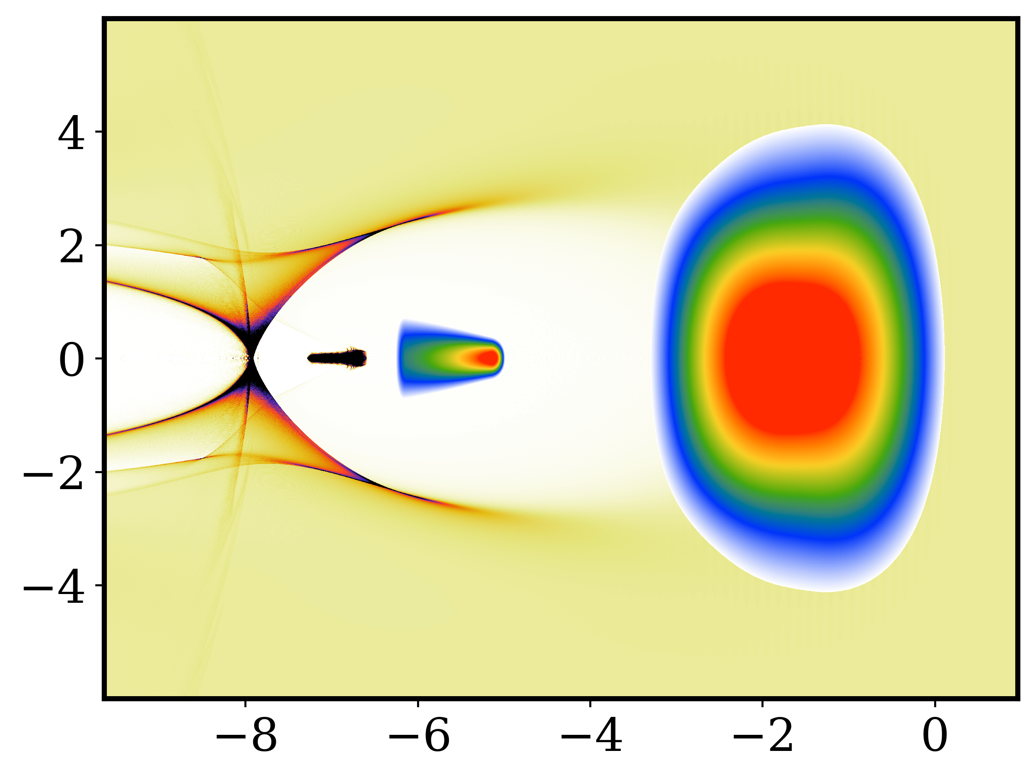
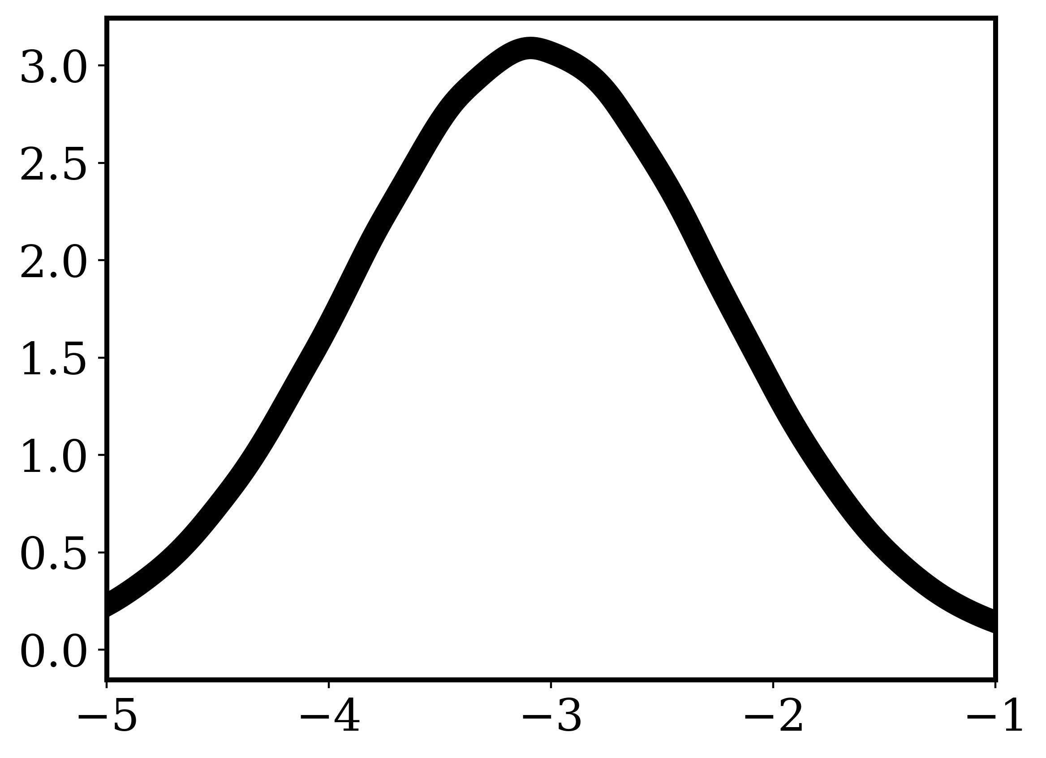
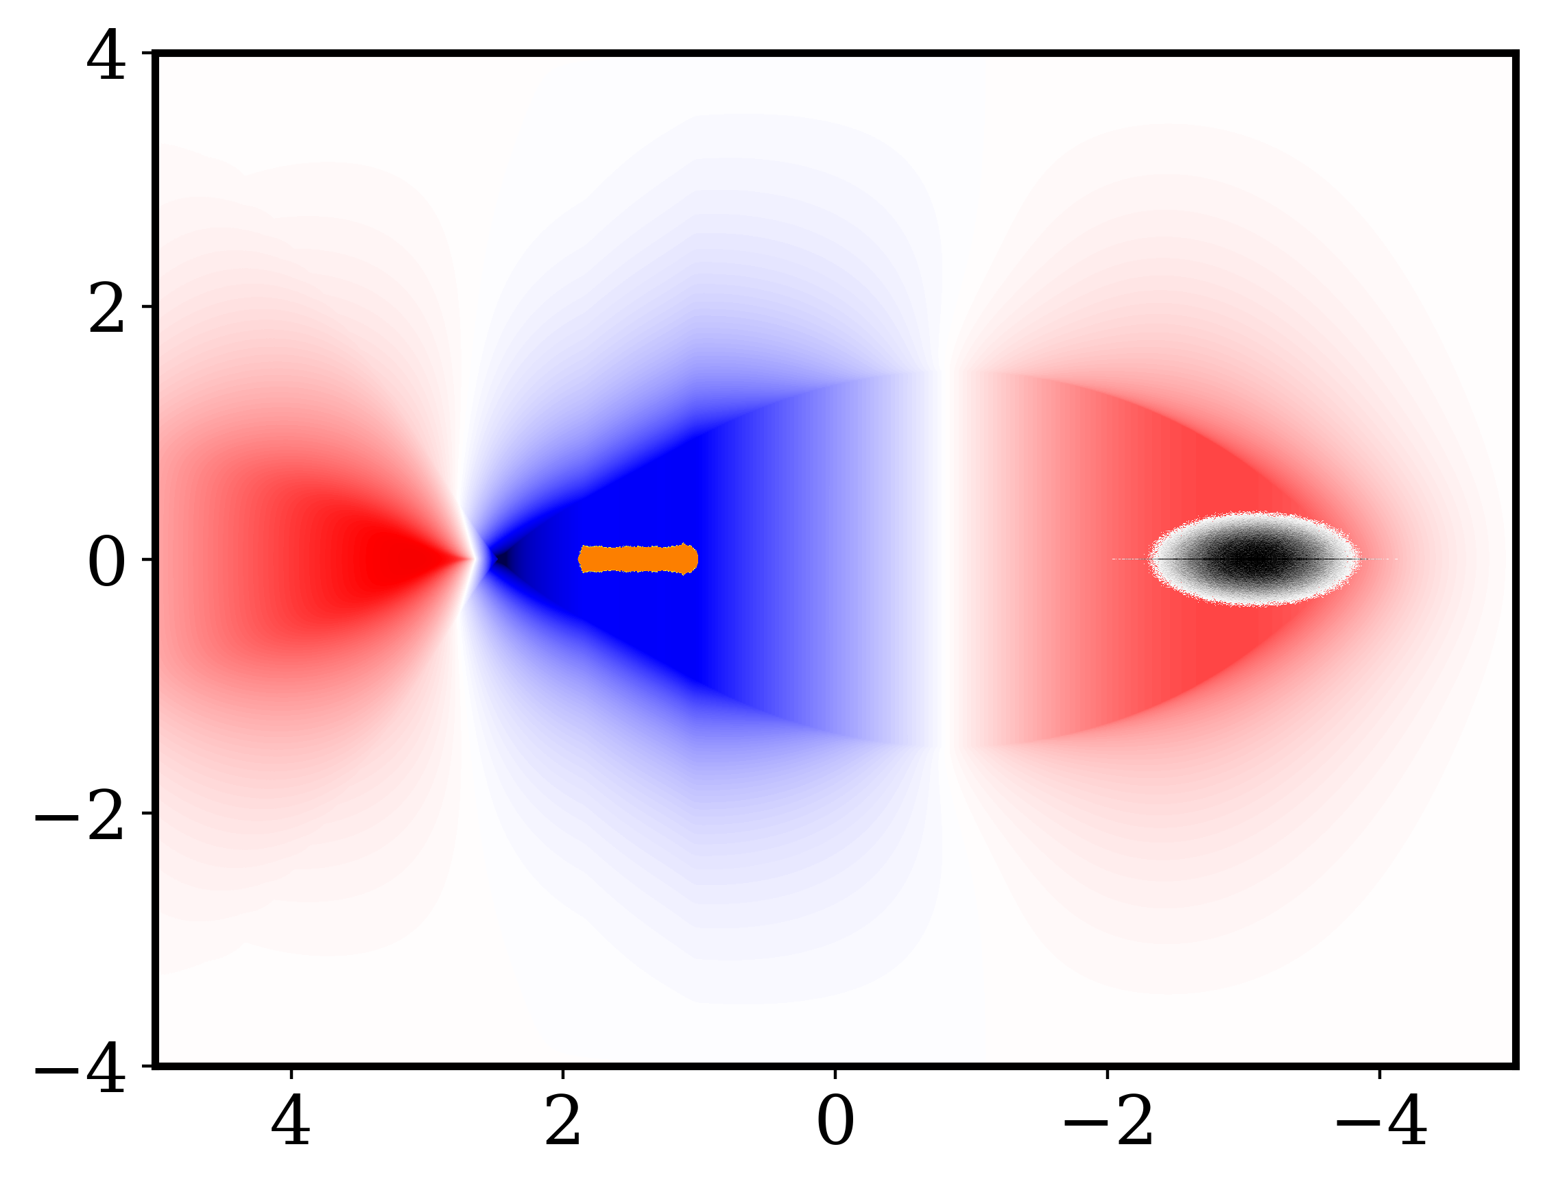

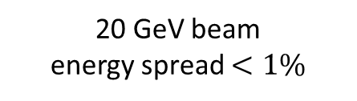


We propose a method for generating collider quality electron beam
Injection stage
Ionization laser
Flying focus laser
CO₂ laser
Trapezoidal electron bunch
Plasma cell $\sim 6$ mm
Acceleration stage
Trapezoidal electron bunch
Driver
Beam
20 GeV beam
energy spread $<1\%$
Plasma cell $\sim 2$ m

Slide 8

Injection stage
Ionization laser
Flying focus laser
CO₂ laser
Trapezoidal electron bunch
Plasma cell $\sim 6$ mm
Injection Stage

Slide 9
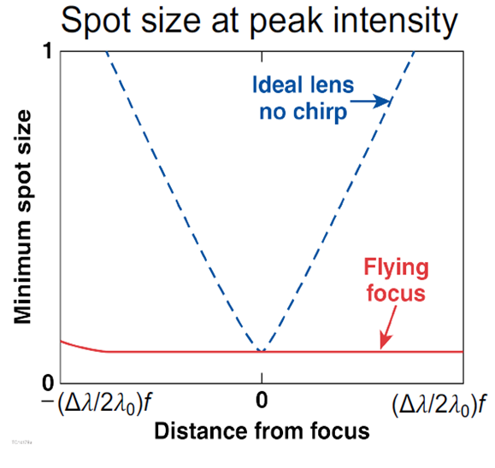
Varying the location of ionization is possible through spatiotemporal control of the ionizing laser
A chirped laser pulse focused by a chromatic lens exhibits a dynamic, or “flying”, focus
By varying the chirp, the region of peak intensity (focus) can be made to travel at any velocity
While maintaining the same spot size, the focus region can be extended to be much longer than the Rayleigh length
D. H. Froula, Nature Photon 12, 262–265 (2018)

Slide 10

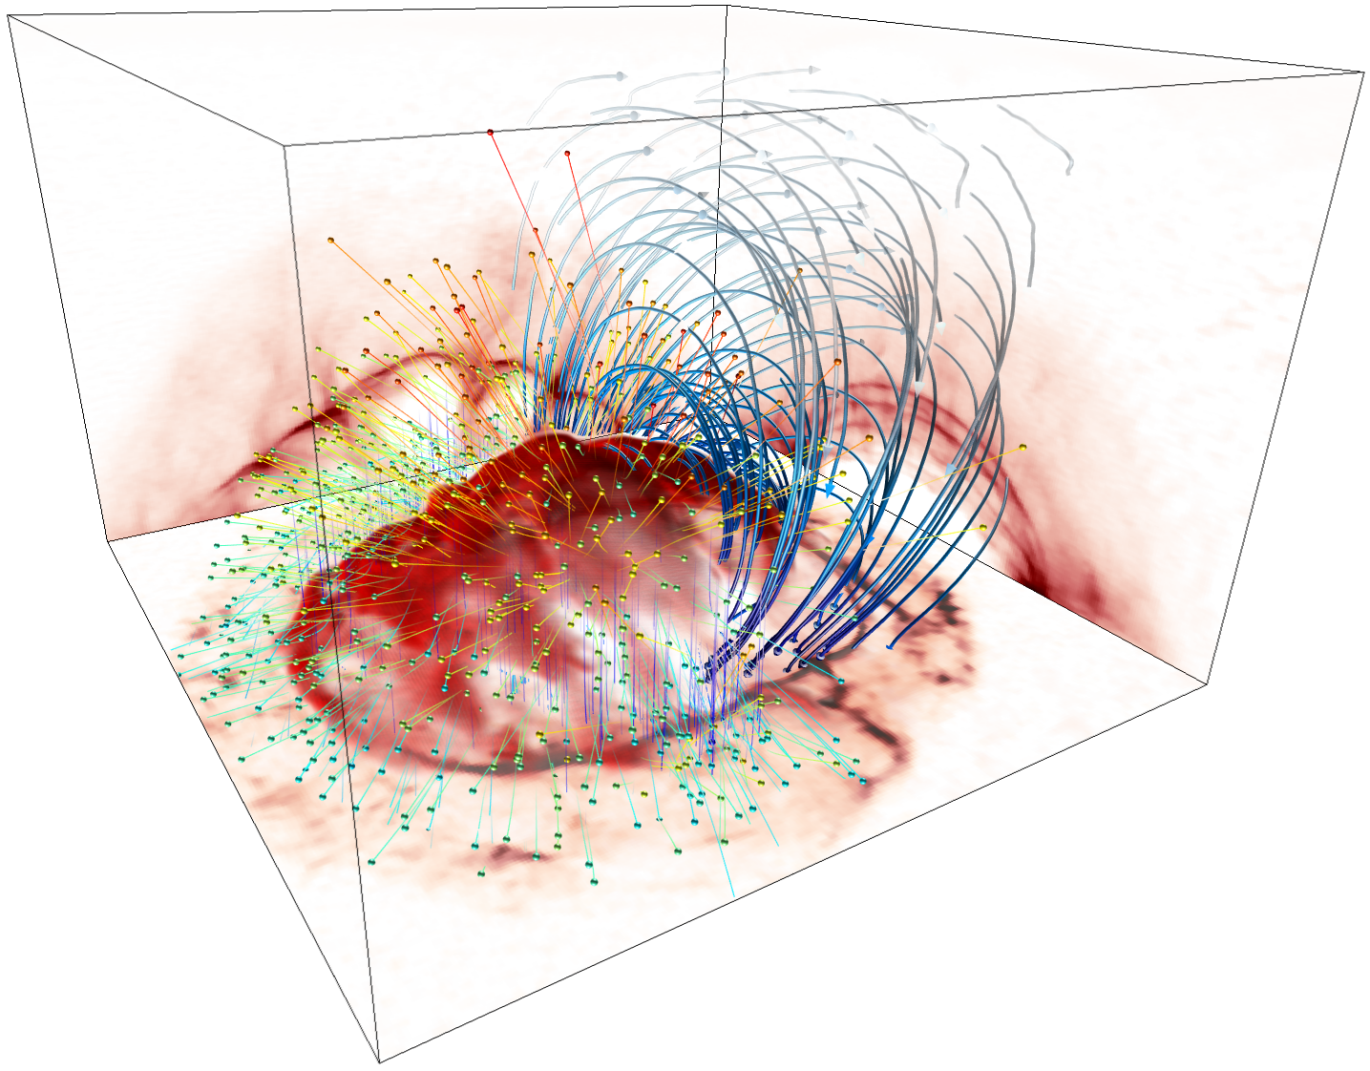
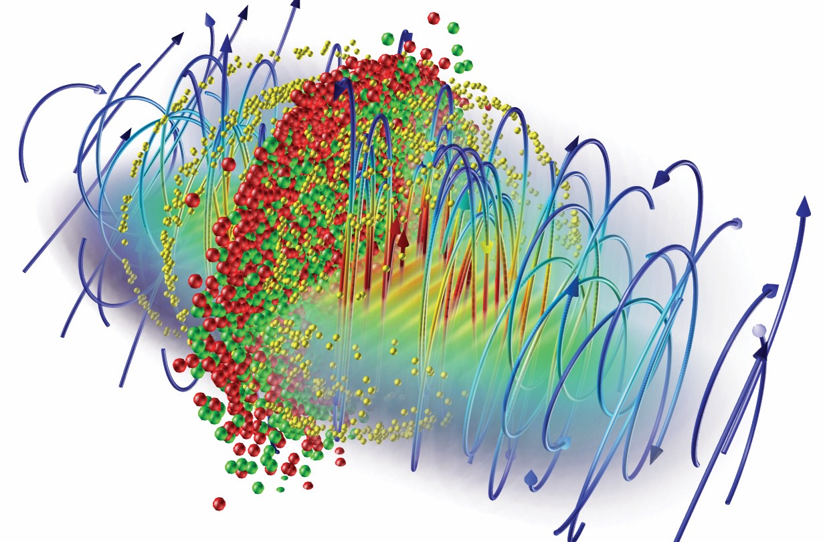




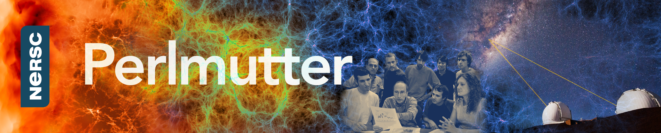
Osiris simulations performed on Perlmutter@Nersc and SEAWULF@SBU
osiris framework
Massivelly Parallel, Fully Relativistic
Particle-in-Cell (PIC) Code
Visualization and Data Analysis Infrastructure
Developed by the osiris.consortium
UCLA + IST
code features
Scalability to ~ 1.6 M cores
SIMD hardware optimized
Parallel I/O
Dynamic Load Balancing
QED module
Particle merging
GPGPU support
Xeon Phi Support
Ricardo Fonseca: ricardo.fonseca@tecnico.ulisboa.pt
Frank Tsung: tsung@physics.ucla.edu
Jacob Pierce: jacobpierce@physics.ucla.edu
http://epp.tecnico.ulisboa.pt/
http://plasmasim.physics.ucla.edu/

Slide 11
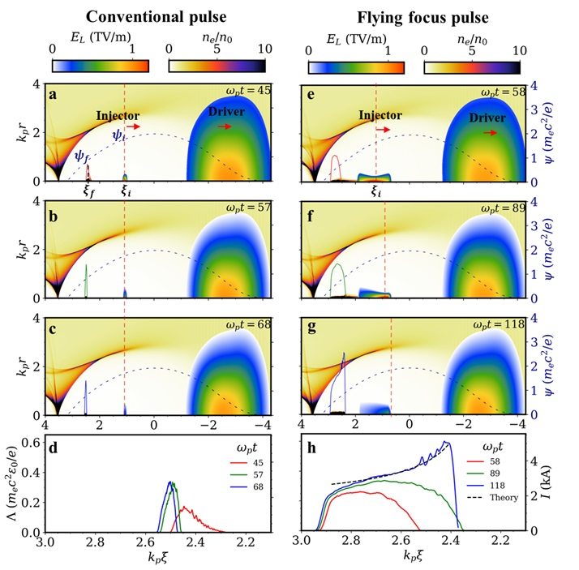
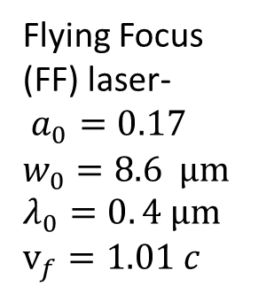
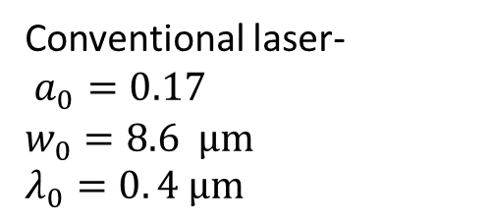
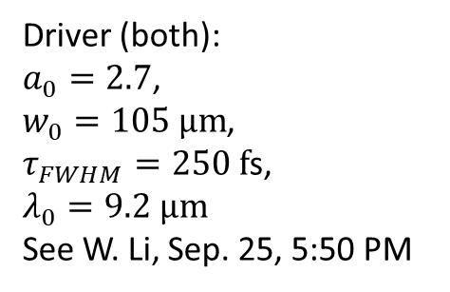
Varying the location of ionization is possible through spatiotemporal control of the ionizing laser
Driver (both):
$a_{0}=2.7$,
$w_{0}=105 μm$,
$τ_{FWHM}=250 f$s,
$$λ_{0}=9.2 μm$$
See W. Li, Sep. 25, 5:50 PM
Flying Focus (FF) laser-
$a_{0}=0.17$ $w_{0}=8.6 μm$
$$λ_{0}=0. 4 μm$$
$$v_{f}=1.01 c$$
Conventional laser-
$a_{0}=0.17$
$$w_{0}=8.6 μm$$
$$λ_{0}=0. 4 μm$$

Slide 12
The injected beam is gradually assembled with the motion of the ionization front
Charge= 17 pC
Charge= 220 pC

Slide 13
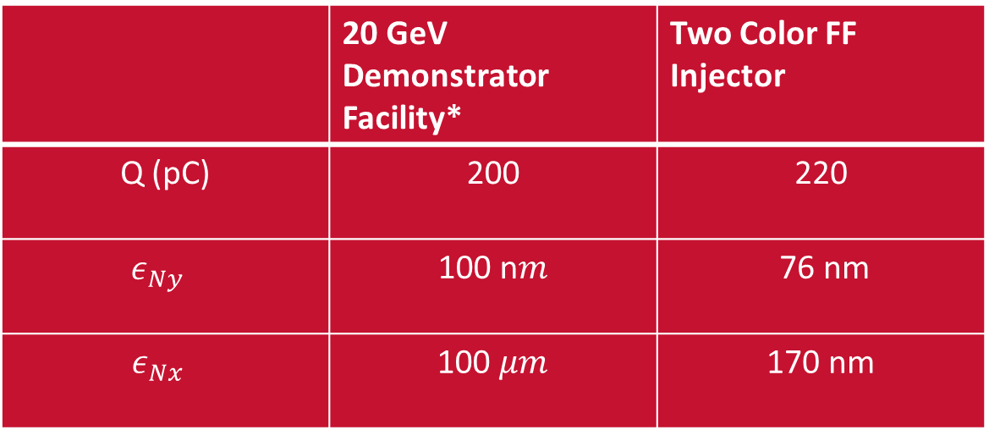
Charge and emittance are consistent with collider requirements
 | 20 GeV Demonstrator Facility* | Two Color FF Injector
Q (pC) | 200 | 220
$$ε_{Ny}$$ | 100 n$m$ | 76 nm
$$ε_{Nx}$$ | 100 $μm$ | 170 nm
*C.B. Schroeder et al 2023 JINST 18 T06001

Slide 14

Injection stage
Ionization laser
Flying focus laser
CO₂ laser
Trapezoidal electron bunch
Plasma cell $\sim 4$ mm
Acceleration stage
Trapezoidal electron bunch
Driver
Beam
20 GeV beam
energy spread $<1\%$
Plasma cell $\sim 2$ m

Slide 15
Acceleration Stage

Slide 16
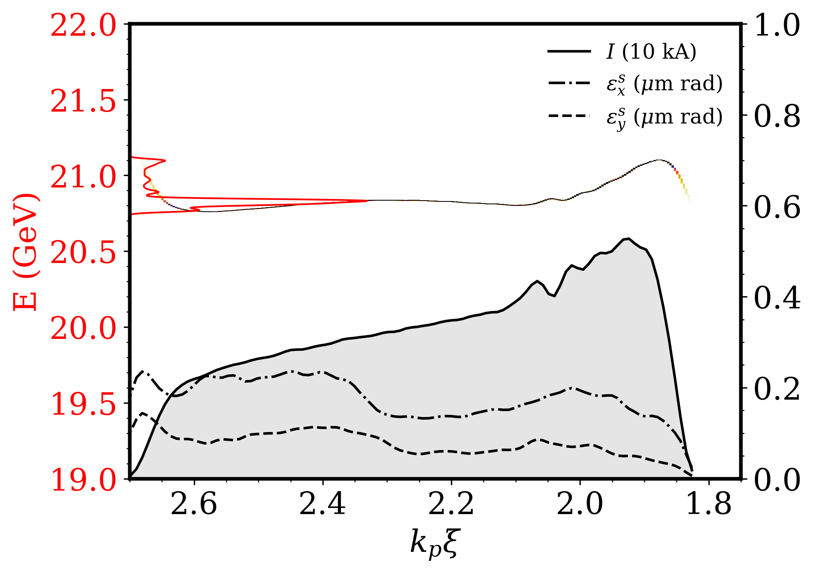
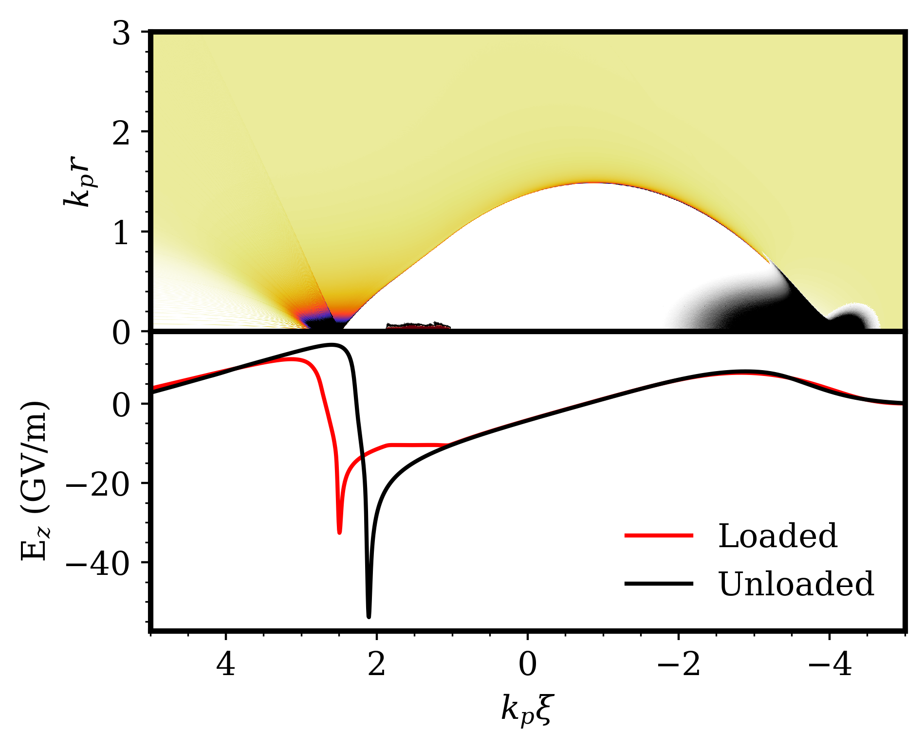
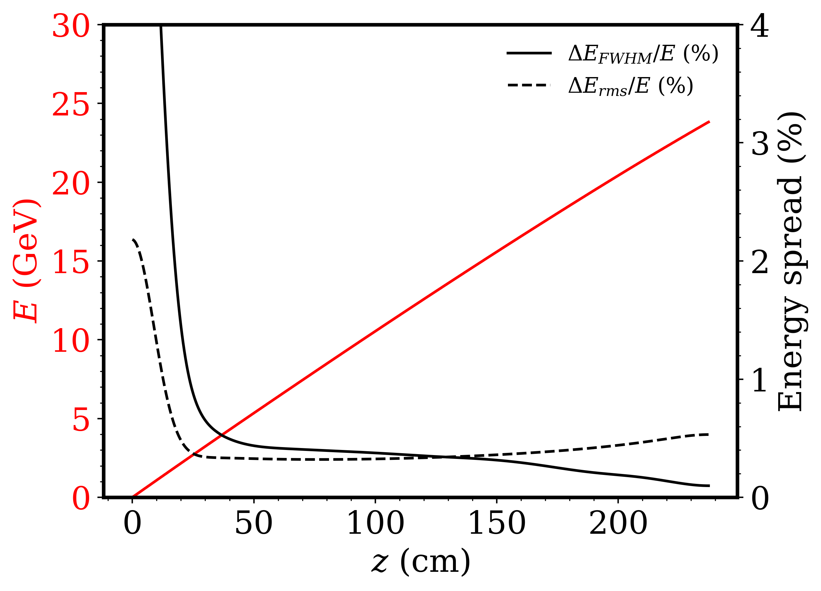
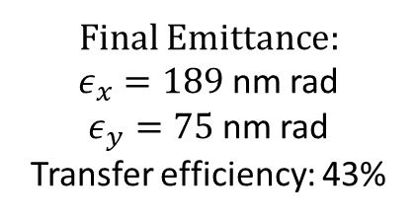
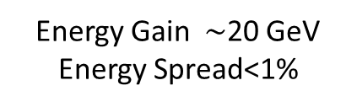
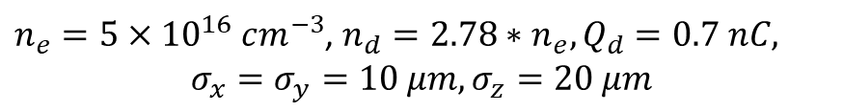
Beam generated in this photo injector can be accelerated in subsequent stages at 10 GeV/m and at high efficiency
c
a
Final Emittance:
$ε_{x}=189$ nm rad
$ε_{y}=75$nm rad
Transfer efficiency: 43%
b
d
Energy Gain $\sim$20 GeV
Energy Spread<1%
$n_{e}=5×{10}^{16} cm^{−3}$, $n_{d}=2.78∗n_{e}, Q_{d}=0.7 nC,$
$$σ_{x}=σ_{y}=10 μm, σ_{z}=20 μm$$

Slide 17
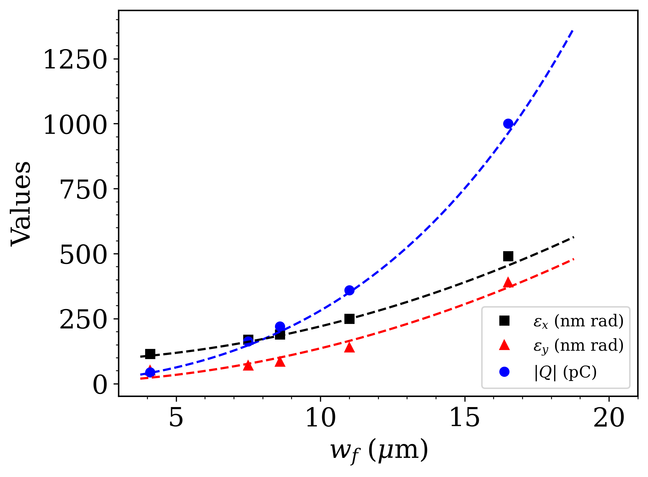
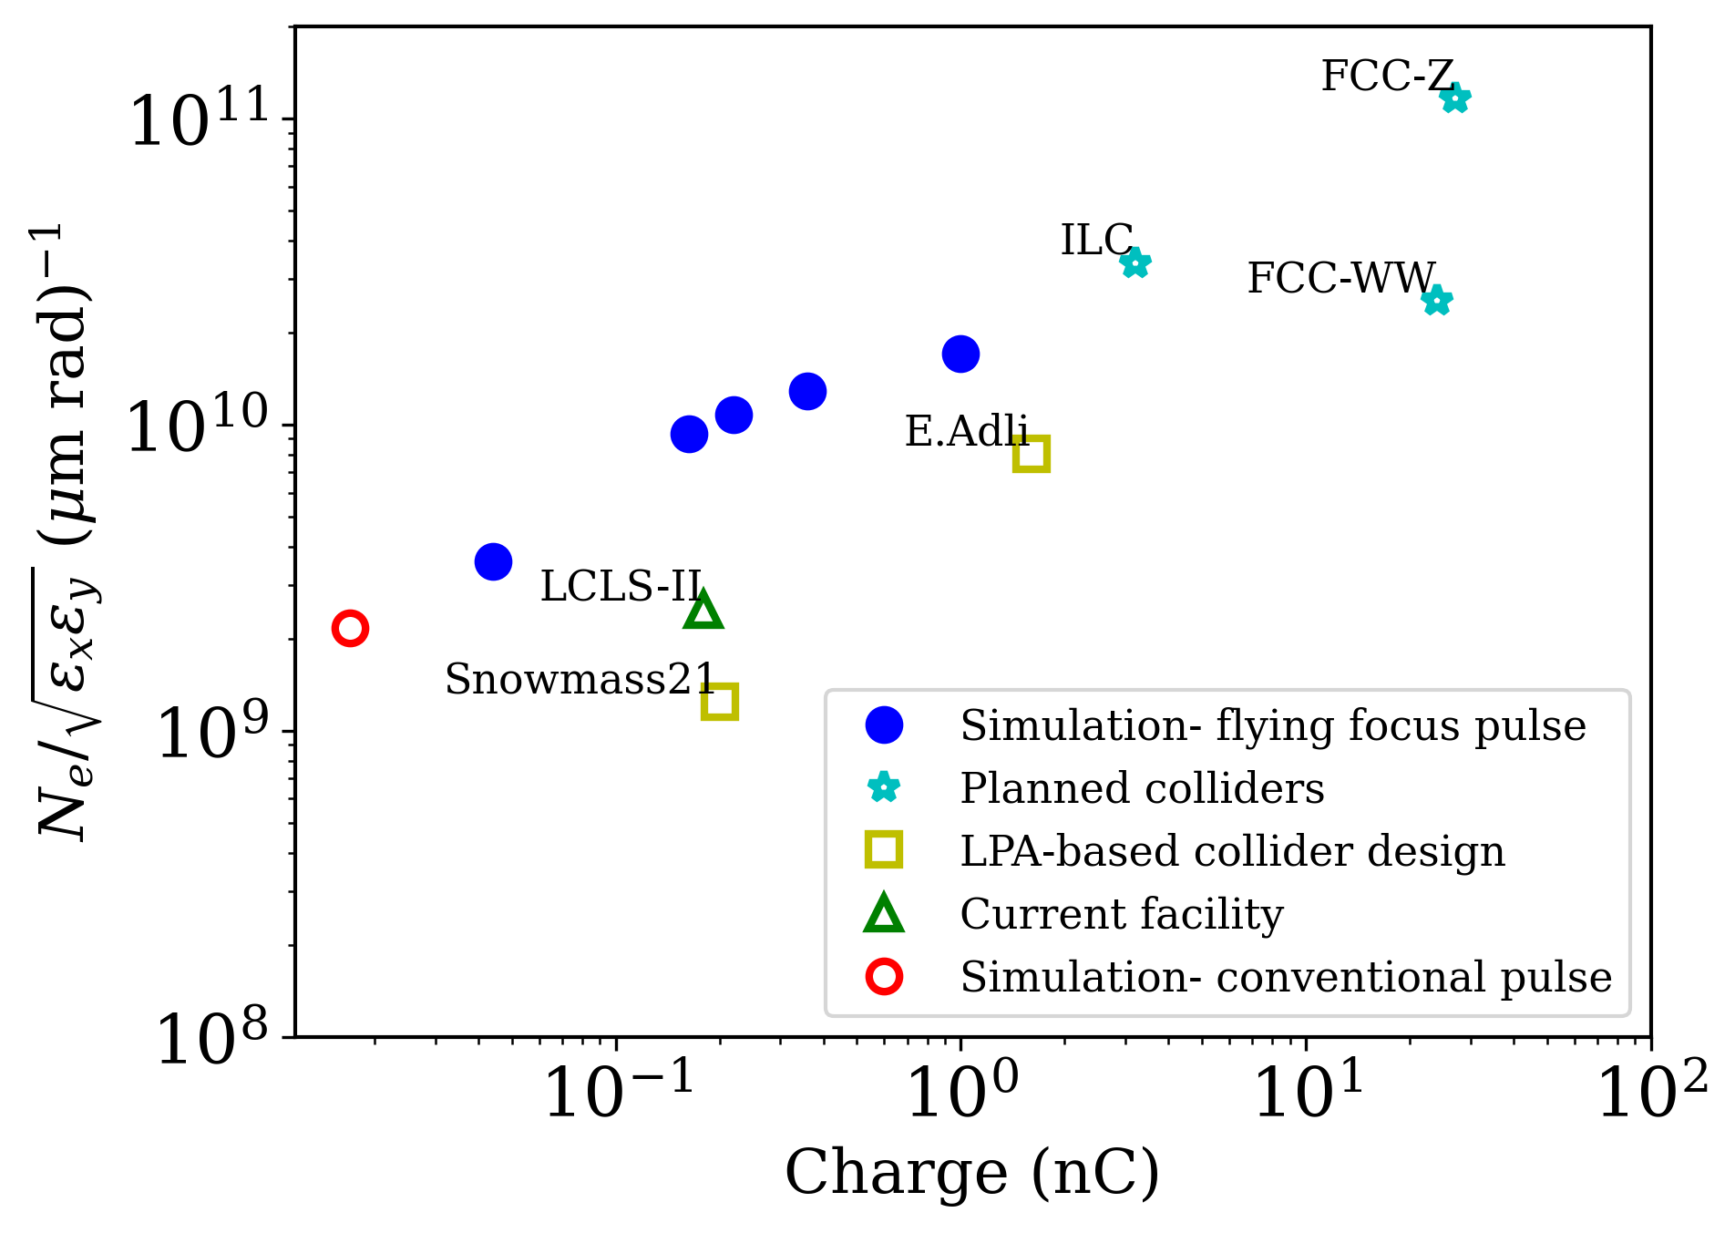
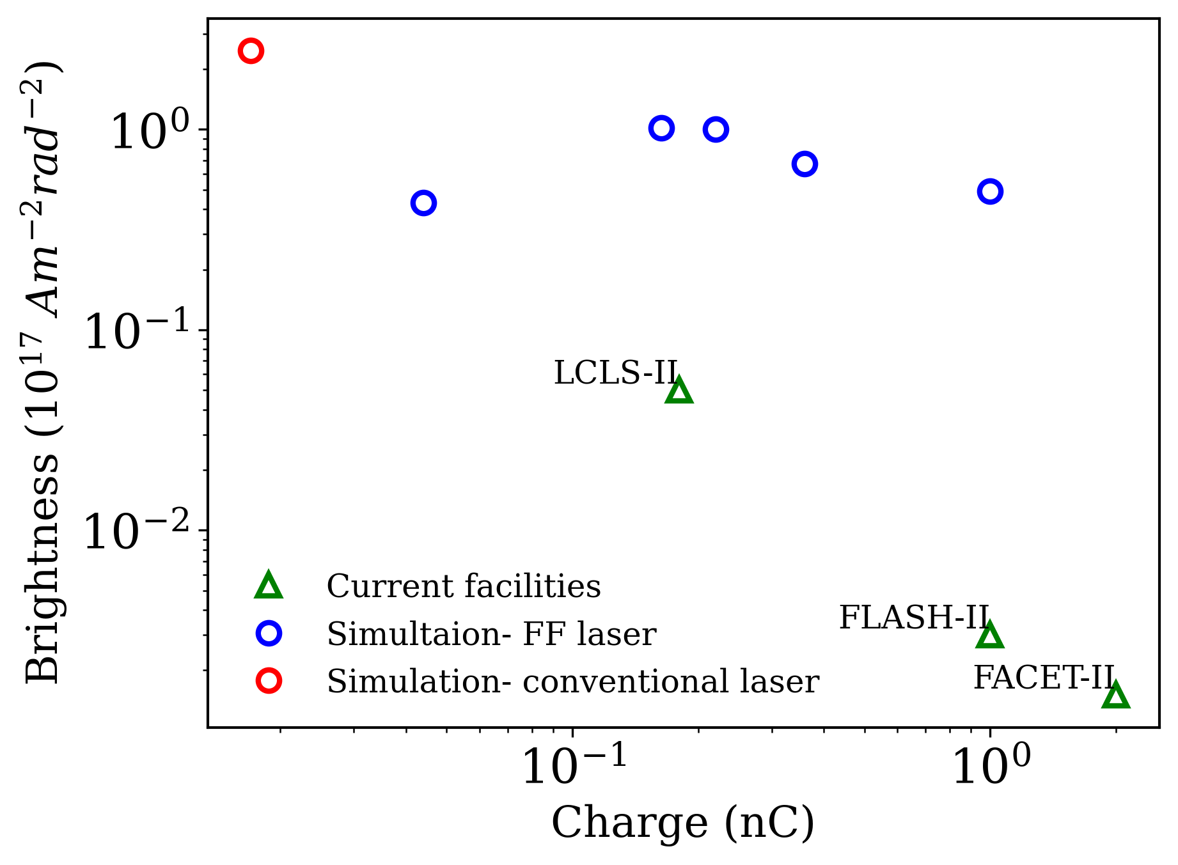
This method can easily be scaled to higher charge, albeit with higher emittance
a
b
c

Slide 18
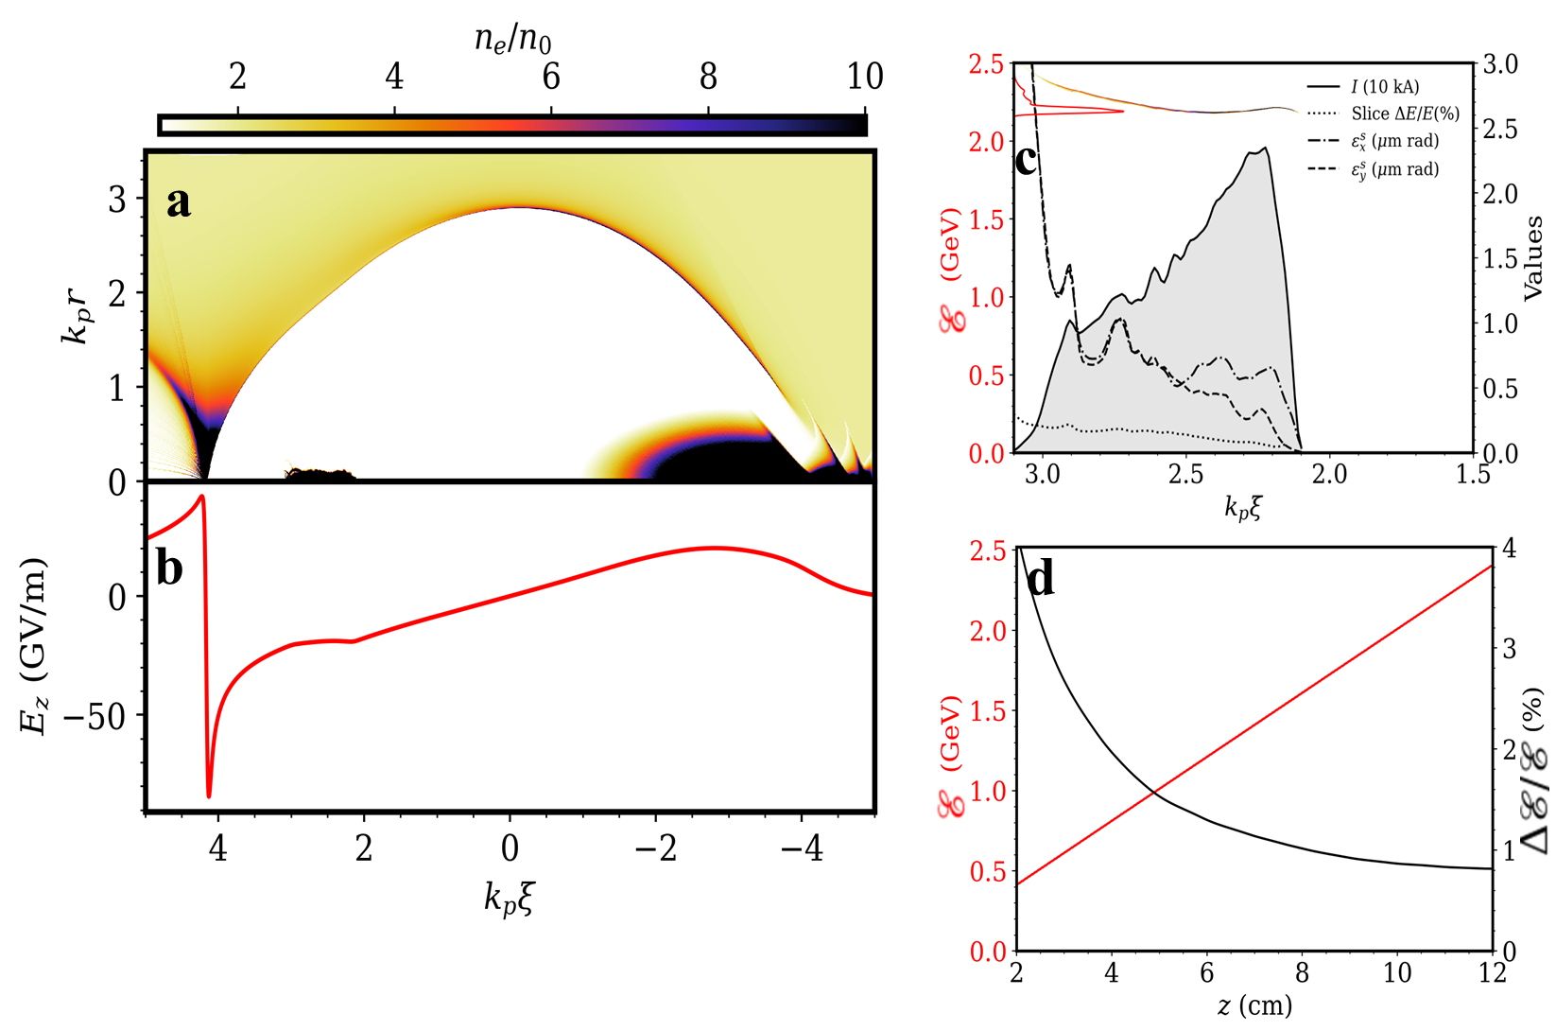
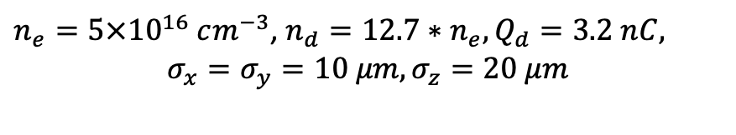
Beam loading of the nC beam
$n_{e}=5×{10}^{16} cm^{−3}$, $n_{d}=12.7∗n_{e}, Q_{d}=3.2 nC,$
$$σ_{x}=σ_{y}=10 μm, σ_{z}=20 μm$$

Slide 19
Conclusions
Introduced novel plasma photoinjector approach for collider-quality electron beams
Flying focus laser pulse creates a moving ionization front for efficient electron injection
Produced trapezoidal-shaped electron bunches with 220 pC charge and low emittance
Efficiently accelerated the shaped bunch to 20 GeV in a 2-meter acceleration stage.
Beam parameters align with Snowmass requirements, showcasing the feasibility for future compact accelerators.

Slide 20
Thank you!

Slide 21
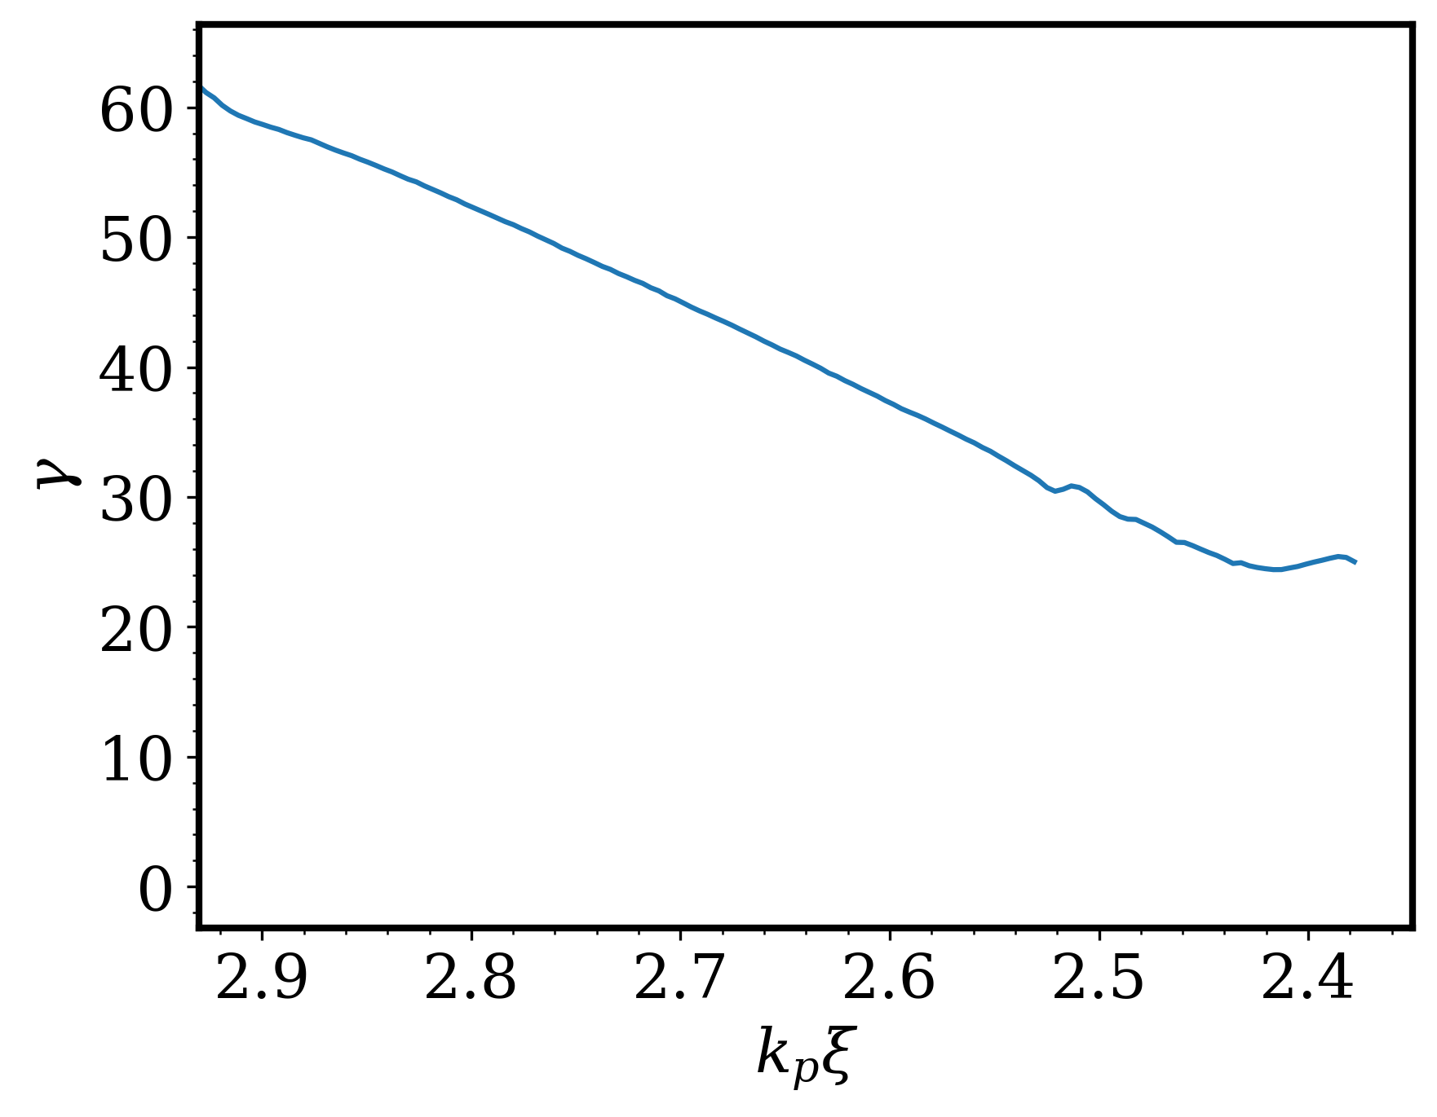
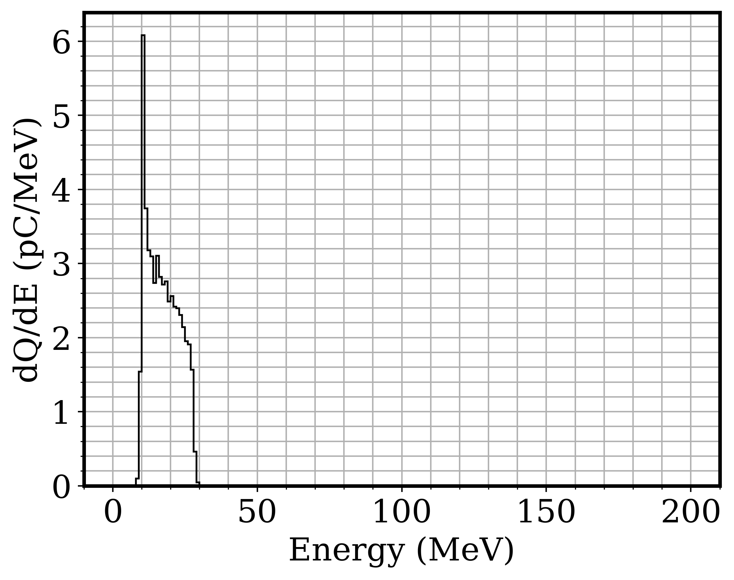
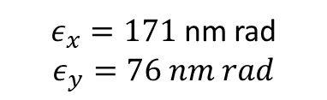
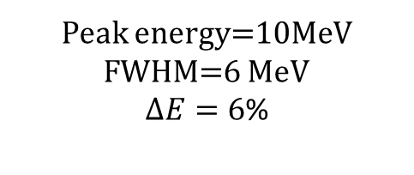
Beam energy after injection stage
$ε_{x}=171$ nm rad
$$ε_{y}=76 nm rad$$
Peak energy=10MeV
FWHM=6 MeV
$ΔE=6$%

Slide 22
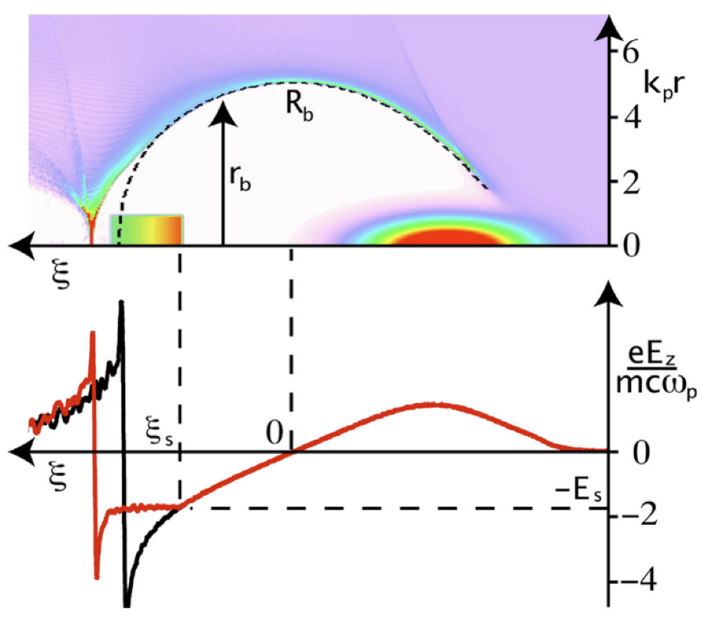
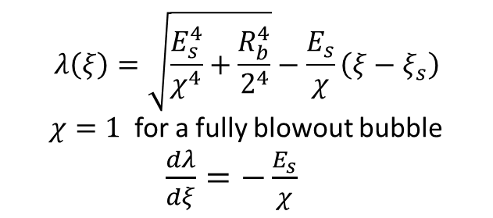
Beam loading
How to maintain low energy spread during acceleration?
Ideal beam loading
A trailing beam with a particular density profile result in flattening of the wakefield [1]
$$λ\left(ξ\right)=\sqrt{\frac{E_{s}^{4}}{χ^{4}}+\frac{R_{b}^{4}}{2^{4}}}−\frac{E_{s}}{χ}\left(ξ−ξ_{s}\right)$$
$χ=1$ for a fully blowout bubble
$\frac{dλ}{dξ}=−\frac{E_{s}}{χ}$
M. Tzoufras, Phys. Rev. Lett. 101, 145002 (2008)

Slide 23
Integration of Ti:Saph at ATF
Parameter | Value | Comments
Energy (compressed) | >15 mJ (@1.5 Hz) | Compressed on target. <5% std long-term variation To be increased to 100 mJ @ 12 Hz
Energy (stretched) | >200 mJ | Out of 4-pass amplifier <8% std long-term variaiton
Duration | <70 fs | FWHM
Focused spot size | <4 µm FWHM | With F/1.5 OAP <1µm std pointing stability (~25µrad std)
Polarization | Vertical | Horizontal available upon request
Synchronization | Synchronized to the facility 81.6 MHz master clock | Rough timing (ns) by SRS delay generators. Fine adjustments (~10fs) by phase tuning the oscillator (Coherent Vitara+Synchrolock)
Transport line+ compressor transmission | 60%
Peak intensity | >10¹⁸ W/cm²
Beam size in transport | <1.5” | Limited by aperture of vacuum line between Nd:YAG and Gun Hutch rooms
Addition of Ti:Saph represents an important upgrade in the capabilities of ATF

Slide 24
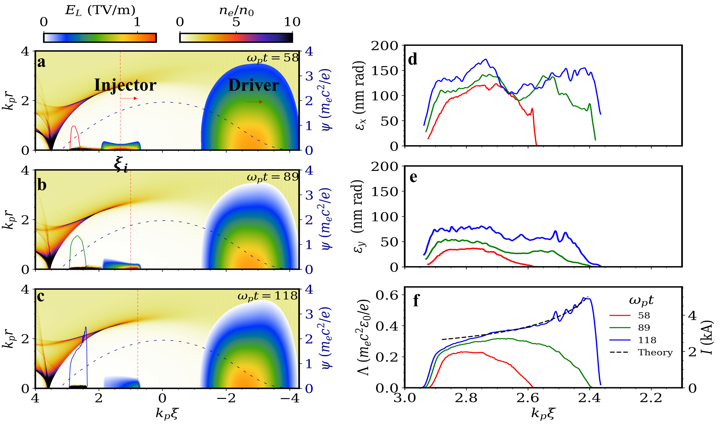
The injected beam is gradually assembled with the motion of the ionization front

Slide 25
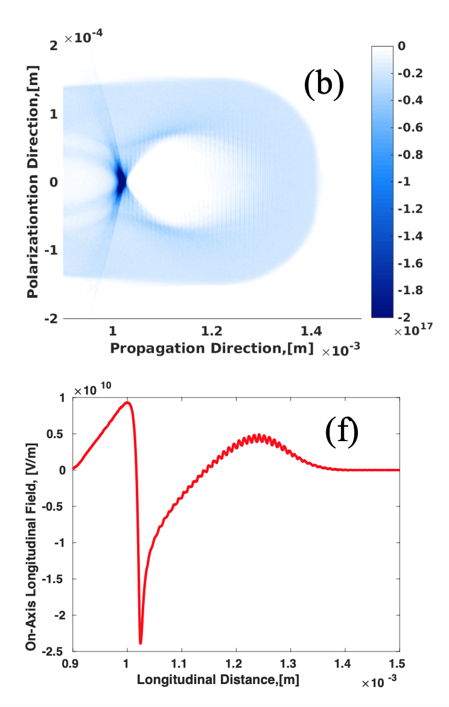
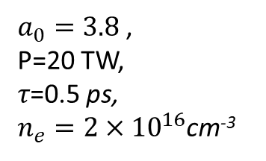
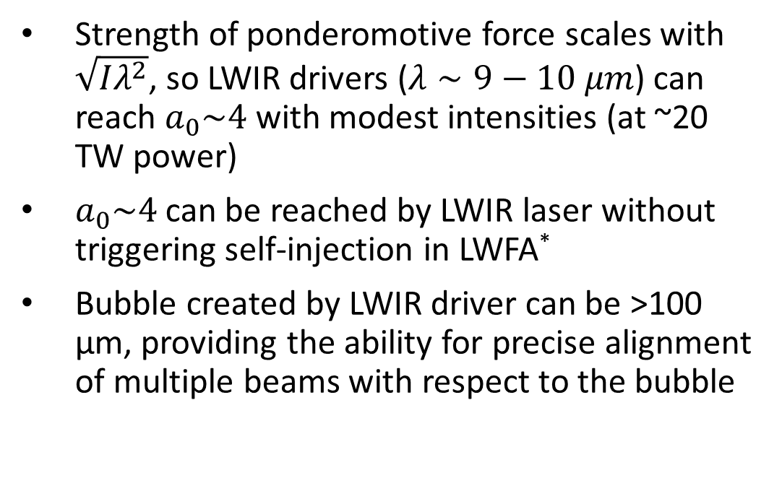
A relatively low-power LWIR laser generates a clean, highly nonlinear wakefield
P. Kumar, Physics of Plasmas, 28, 013102 (2021)
Strength of ponderomotive force scales with $\sqrt{Iλ^{2}}$, so LWIR drivers ($λ∼9−10 μm$) can reach $a_{0}\sim 4$ with modest intensities (at ~20 TW power)
$a_{0}\sim 4$ can be reached by LWIR laser without triggering self-injection in LWFA*
Bubble created by LWIR driver can be >100 µm, providing the ability for precise alignment of multiple beams with respect to the bubble
$a_{0}=3.8$,
P=20 TW,
𝜏=0.5 ps,
$n_{e}=2×{10}^{16}$cm⁻³
* See A. Jain, Proceedings of AAC 2022
Notes:
LWIR drives clean wakefield

Slide 26
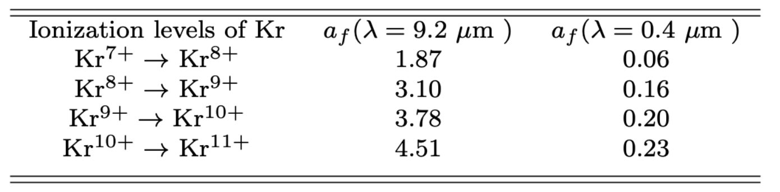


CO₂ and flying focus (FF) laser intensities are chosen based on Kr⁸⁺ $−>$ Kr⁹⁺ ionization rates
Simulation Parameters
CO₂ laser- $a_{0}=2.7$, $w_{0}=105 μm$, $τ_{FWHM}=250 f$s, $λ_{0}=9.2 μm$
FF laser- $v_{f}=1.01 c$, $w_{0f}=8.6 μm$, $λ_{0}=0. 4 μm, a_{0f}=0.17$
Plasma: $n_{0}=2×{10}^{16} cm^{−3}$, $\frac{1}{k_{p}}=37.6 μm, L=6$mm
Notes:
Also below the level of self injection

Slide 27
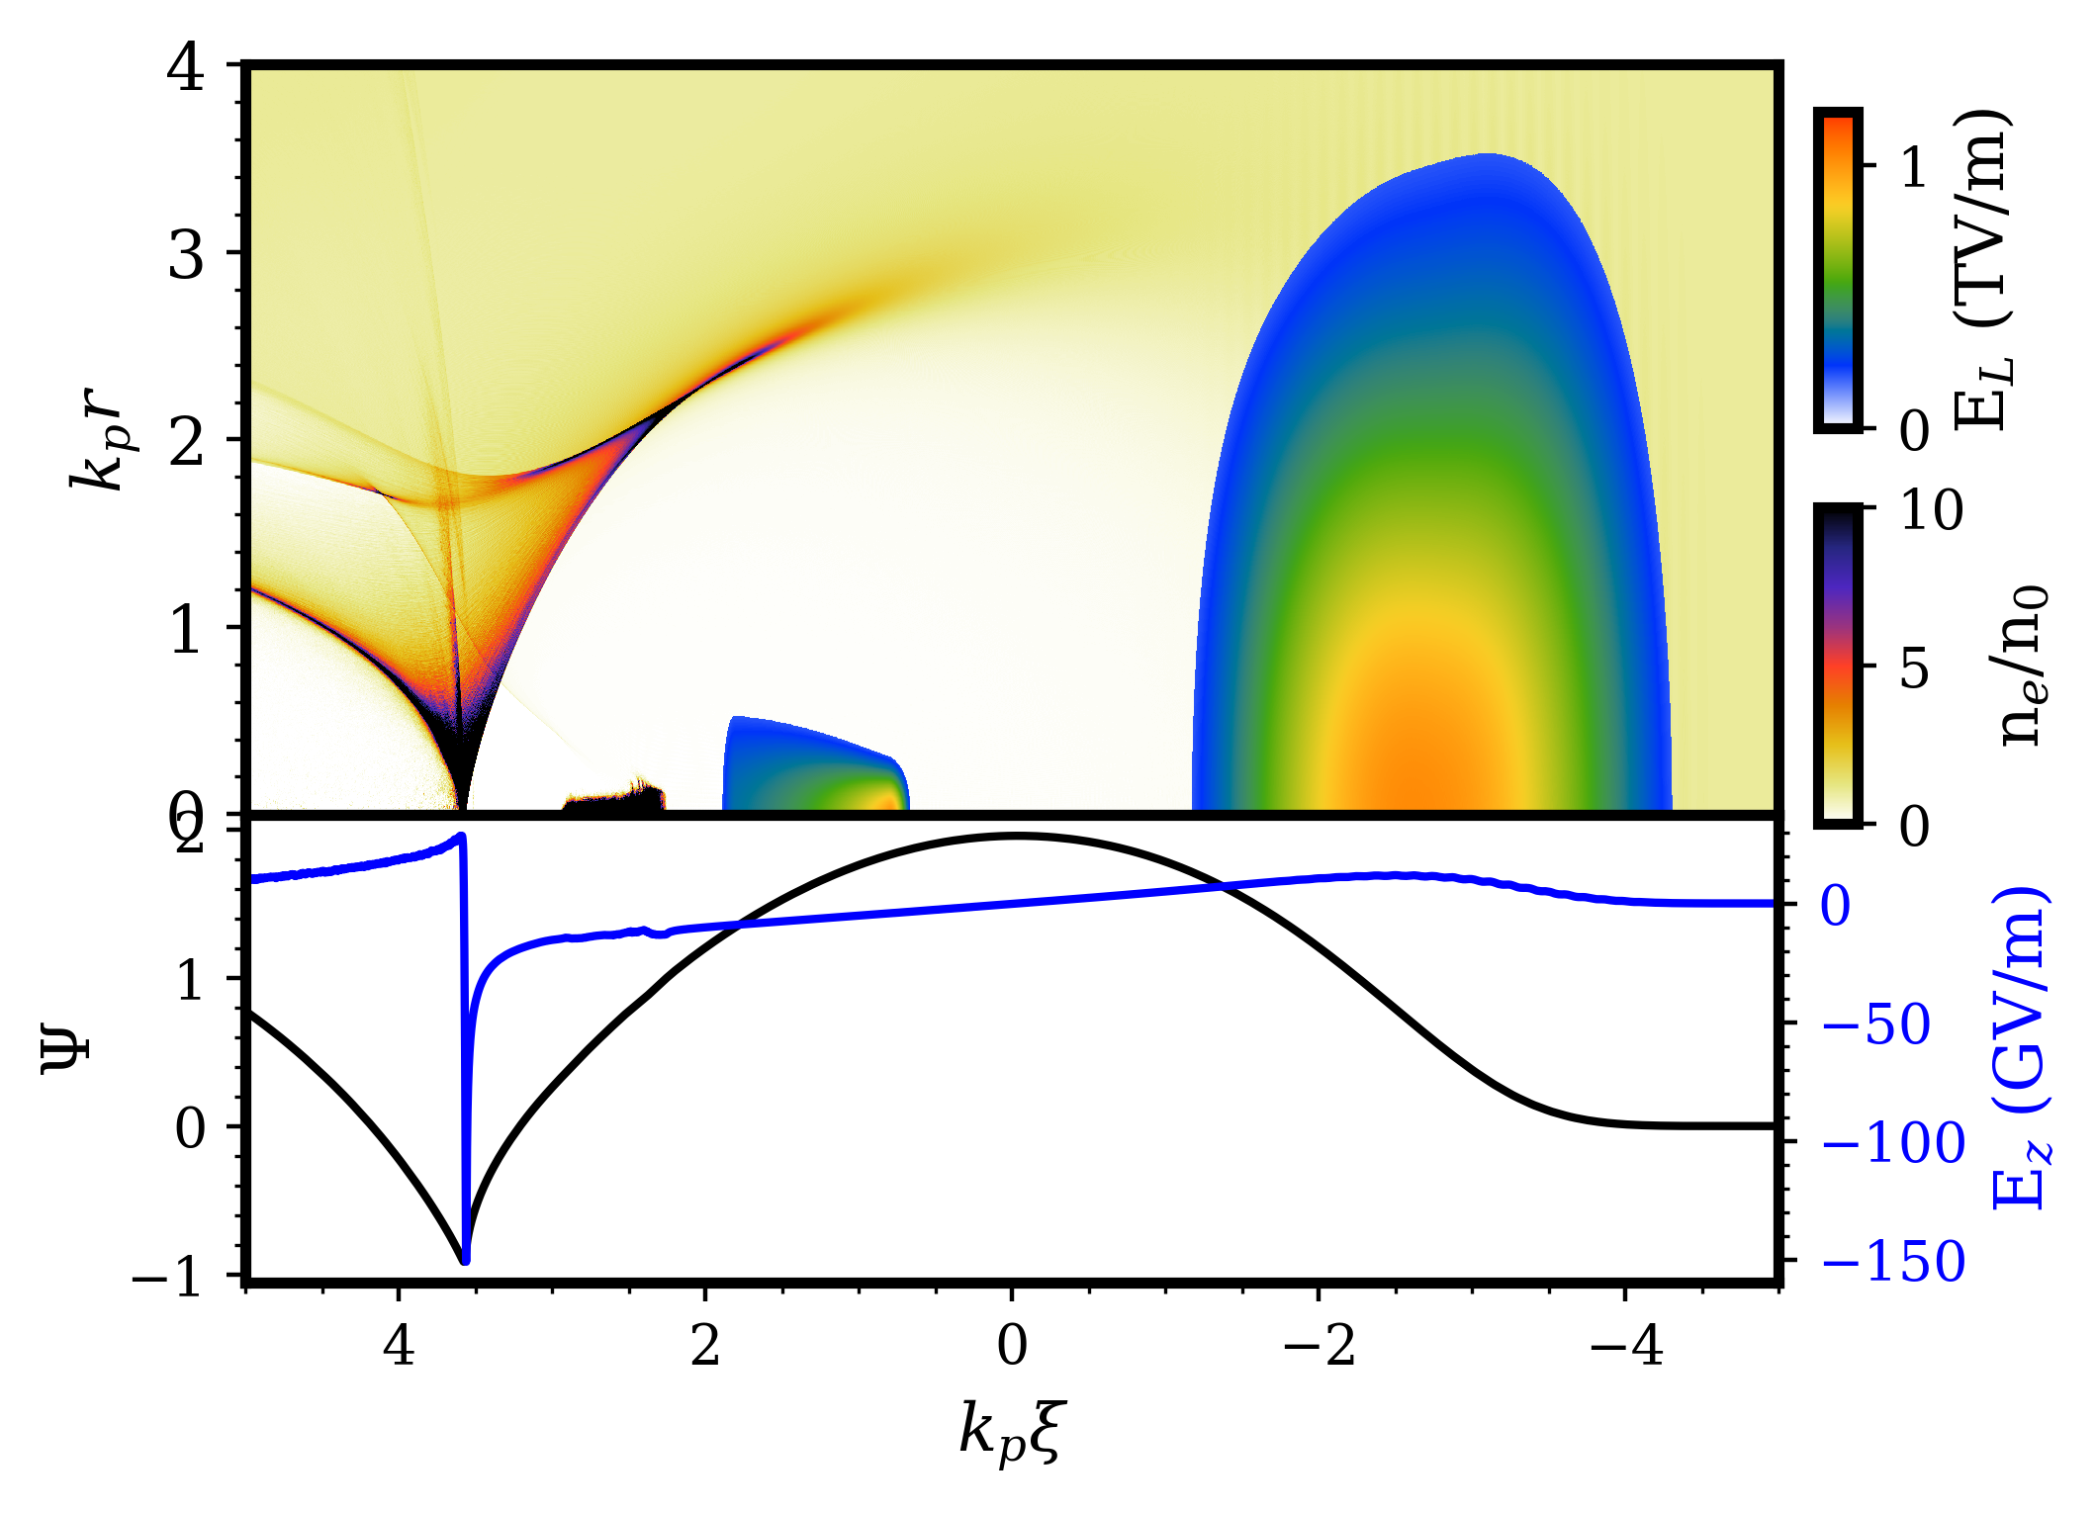
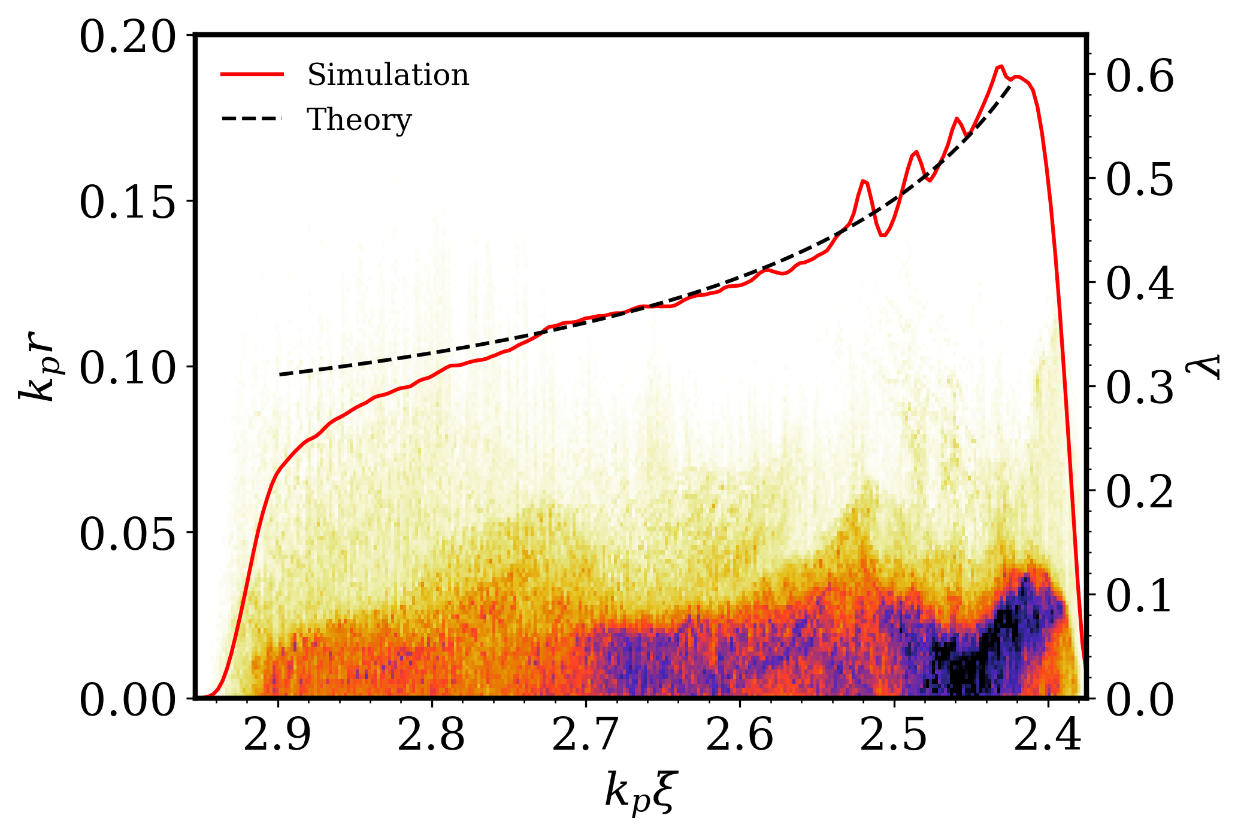



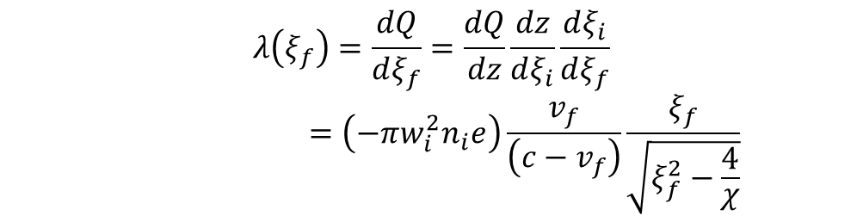





Motion of the ionization location and the shape of the $ψ$ function result in injection of a trapezoidal profile
$$λ\left(ξ_{f}\right)=\frac{dQ}{dξ_{f}}=\frac{dQ}{dz}\frac{dz}{dξ_{i}}\frac{dξ_{i}}{dξ_{f}}$$
$$=\left(−πw_{i}^{2}n_{i}e\right)\frac{v_{f}}{\left(c−v_{f}\right)}\frac{ξ_{f}}{\sqrt{ξ_{f}^{2}−\frac{4}{χ}}}$$
Plasma formed by ionization of Krypton gas
(a)
Plasma wake driven by CO₂ laser pulse
CO₂
laser
$$r_{b}(ξ)$$
(c)
FF laser
$$r_{m}$$
$$25 μm$$
(b)
$$Ψ_{i}$$
$$Ψ_{f}$$
$$ξ_{f}$$
$$ξ_{i}$$
A. Jain, in preparation

Slide 28
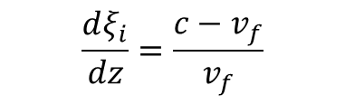



Flying Focus Injection Theory
Plasma formed by ionization of Krypton gas
(a)
Plasma wake driven by CO₂ laser pulse
CO₂
laser
  $$λ\left(ξ_{f}\right)=\frac{dQ}{dξ_{f}}=\frac{dQ}{dz}\frac{dz}{dξ_{i}}\frac{dξ_{i}}{dξ_{f}}$$
$$r_{b}(ξ)$$
FF laser
$$r_{m}$$
$$\frac{dξ_{i}}{dz}=\frac{c−v_{f}}{v_{f}}$$
(b)
$$Ψ_{i}$$
$$\frac{dQ}{dz}=− πw_{i}^{2}n_{i}e$$
$$Ψ_{f}$$
$$ξ_{f}$$
$$ξ_{i}$$
$$\frac{dQ}{dξ_{f}}=\left(−πw_{i}^{2}n_{i}e\right)\frac{v_{f}}{\left(c−v_{f}\right)}\frac{dξ_{i}}{dξ_{f}}$$

Slide 29

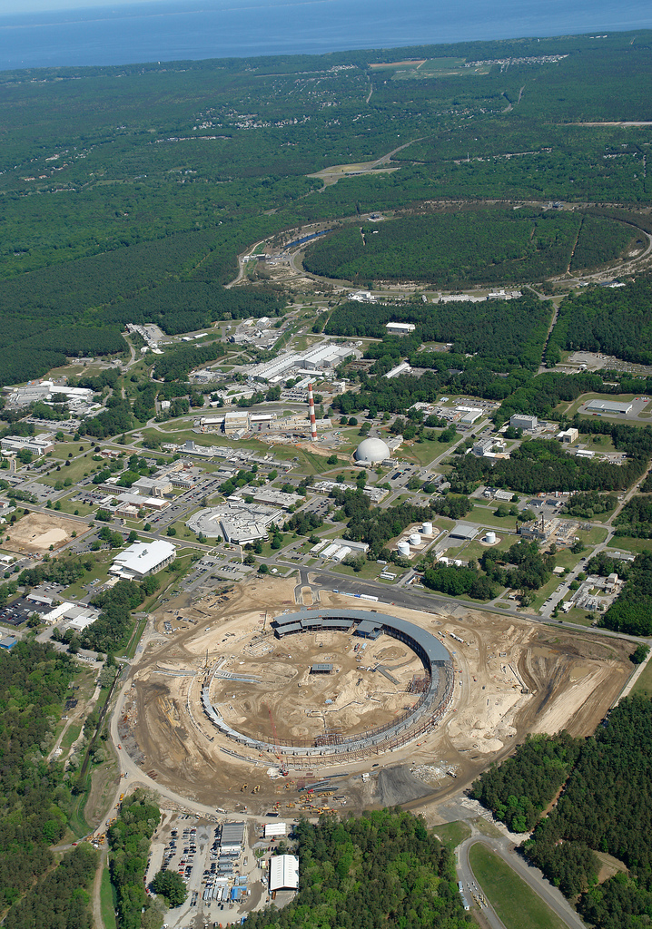
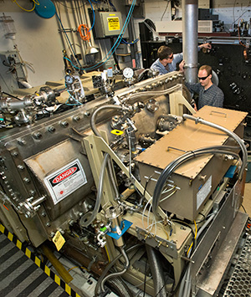
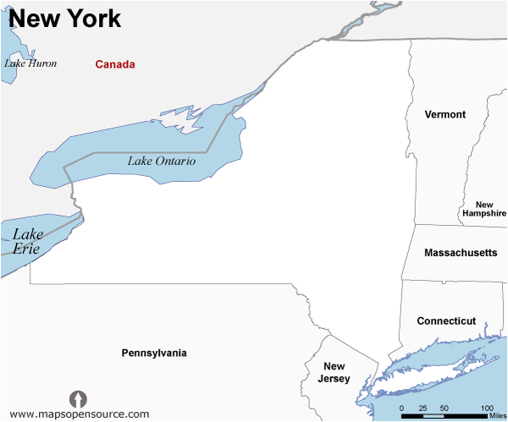
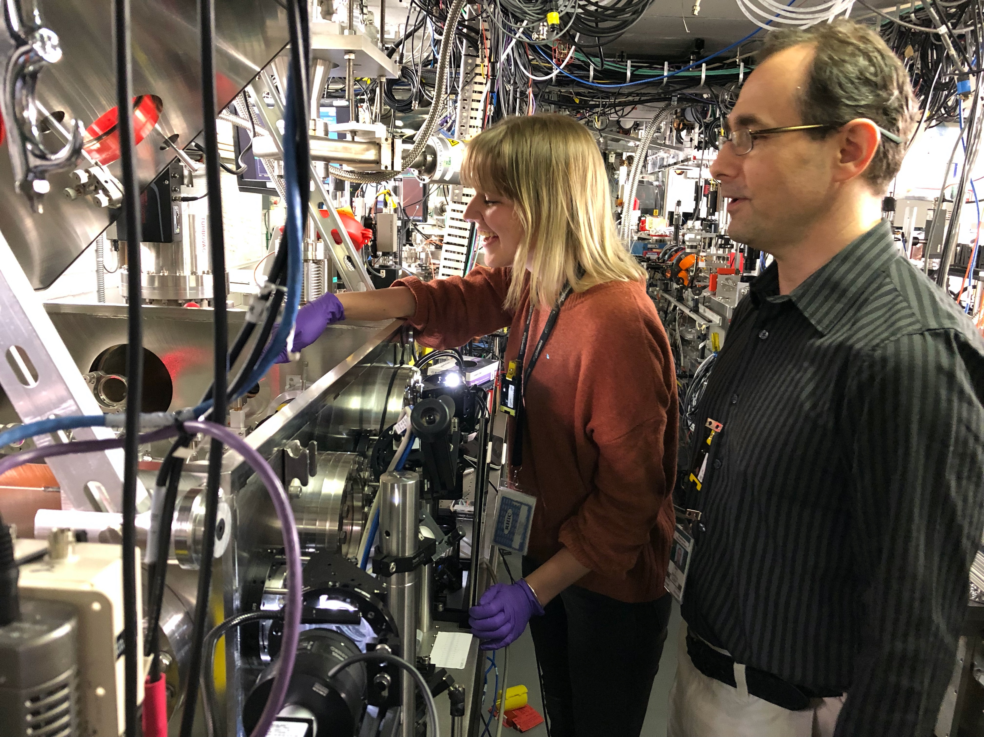
BNL’s Accelerator Test Facility (ATF) has unique infrastructure
for developing such photoinjector.
New York
RHIC
ATF
NSLS
Dr. Irina
Petrushina
Multi-TW discharge-pumped CO₂ laser
• 8J, 2 ps (2024)
• 10 J, 0.5 ps (projected 2027)
TW – class Ti:Sapphire Laser
Dr. Rafal
Zgadzaj
Synched S-band
linac (50 MeV, 100 fs)

Slide 30

Shortcomings:
The charge produced is low (3-30 pC)
Lack of beam loading results in relatively large energy spread (few %)
Key constraint is a very localized injection of high-quality electrons
Solution:
Inject a trapezoidal beam and flatten the plasma wakefield through beamloading
M. Tzoufras, Phys. Rev. Lett. 101, 145002 (2008)

Slide 31

Summary
A “plasma photoinjector” for a collider application needs to create
  Low emittance ($≤$ 100 nm)
  High charge (order of nC)
  Trapezoidal shape for low energy spread in subsequent accelerating plasma stages
By applying the spatiotemporal pulse shaping to two-color ionization injection, such plasma photoinjector can be demonstrated at ATF, BNL

