Slide 1
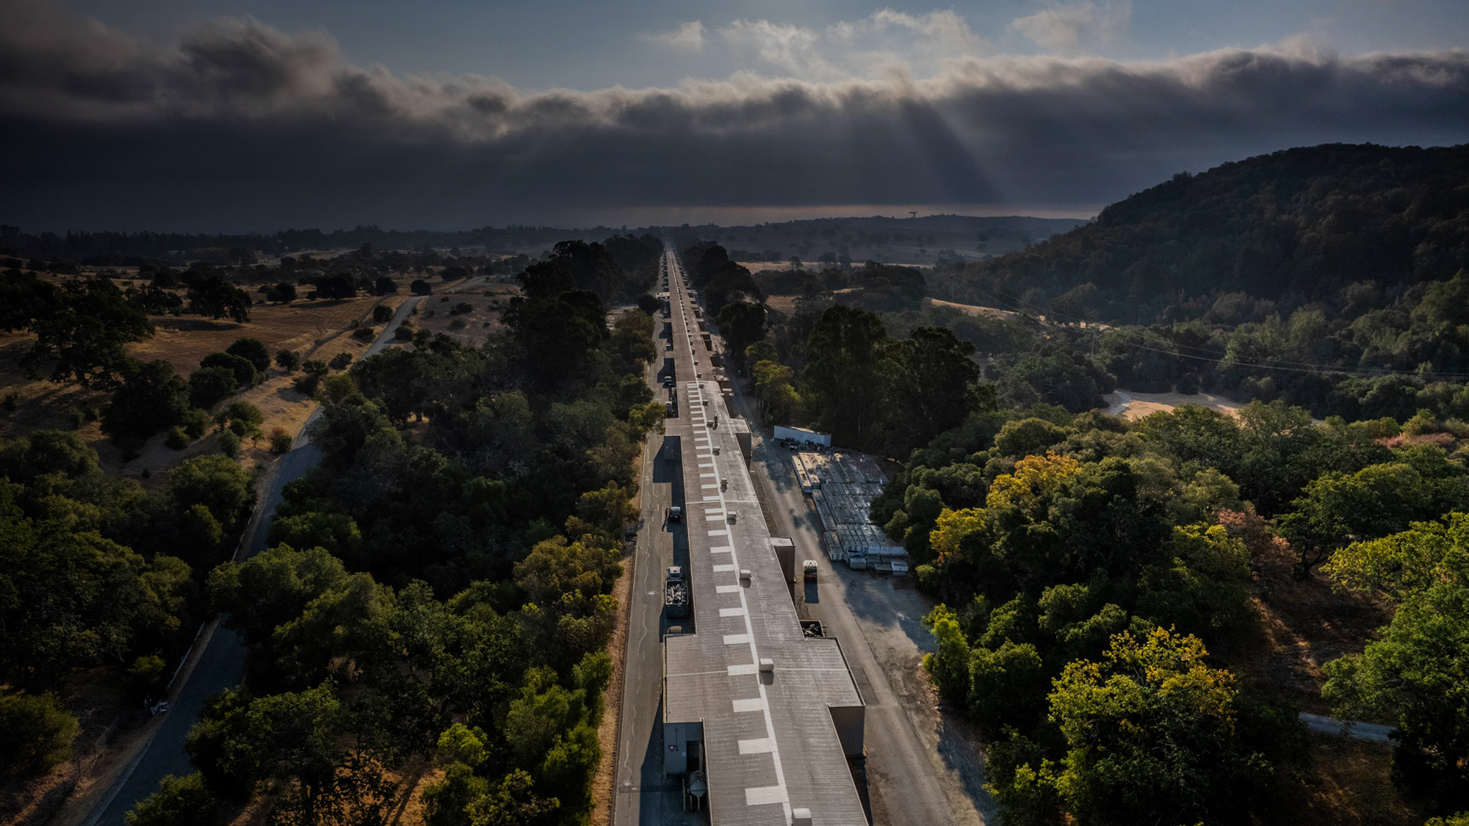
Facility for Advanced
Accelerator Experimental Tests
Multi-GeV Witness Acceleration with High Field Uniformity at FACET-II
7th European Advanced Accelerator Conference
Doug Storey | FACET-II | SLAC National Accelerator Laboratory
September 24, 2025

Slide 2










E300 collaboration – PI’s C. Joshi (UCLA) and M. Hogan (SLAC)
SLAC Advanced Acceleration Research Department team:
  R. Ariniello, S. Corde (Ecole Polytechnique), T. Dalichaouch (UCLA), A. Edelen, C. Emma, S. Gessner, A. Knetsch, N. Majernik, B. O’Shea, S. Perez, I. Rajkovic, D. Storey, K. Swanson, Y. Ye, M. Hogan
  Z. Buschmann, S. Kalsi, R. Loney, M. Parker, G. Yocky
Joined for on-site efforts:
  S. Rego, V. Zakharova (Ecole Polytechnique), O. Finnerud, D. Kavli, E. Adli (University of Oslo), C. Hansel, V. Lee, M. Litos (CU Boulder)
    FACET-II is supported in part by the U.S. Department of Energy under contract number DE-AC02-76SF00515

Slide 3
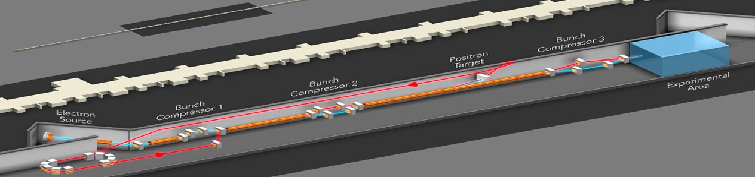
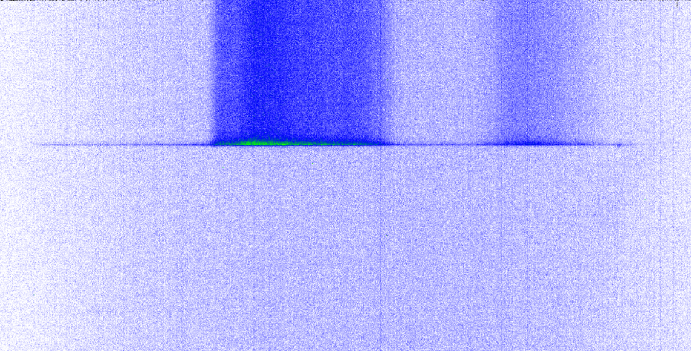
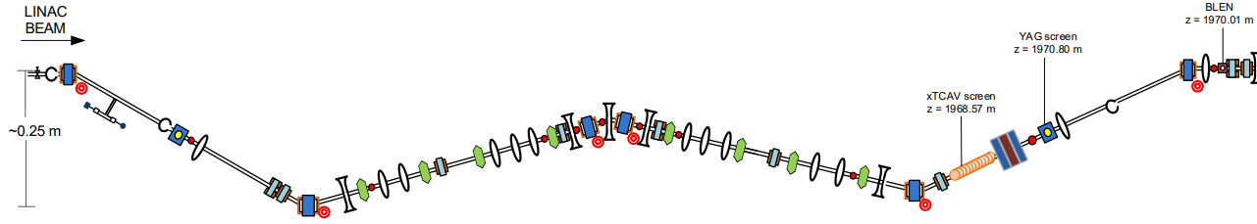
FACET-II provides 10 GeV beams for PWFA studies
FACET-II Technical Design Report SLAC-R-1072
Positron Damping Ring (not installed)
Two ways to produce 2 bunches at the experimental area for PWFA studies:
Single chirped long bunch, collimated to produce lower current drive and witness
Notch Collimator
SYAG
Witness
Drive
To PWFA
FINAL FOCUS
Jaw Collimators

Slide 4
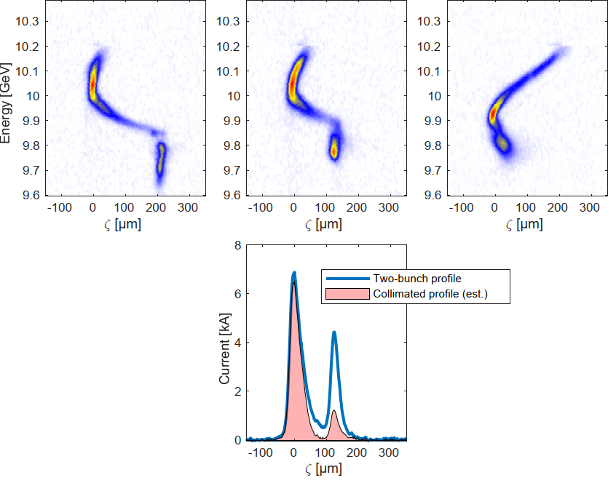
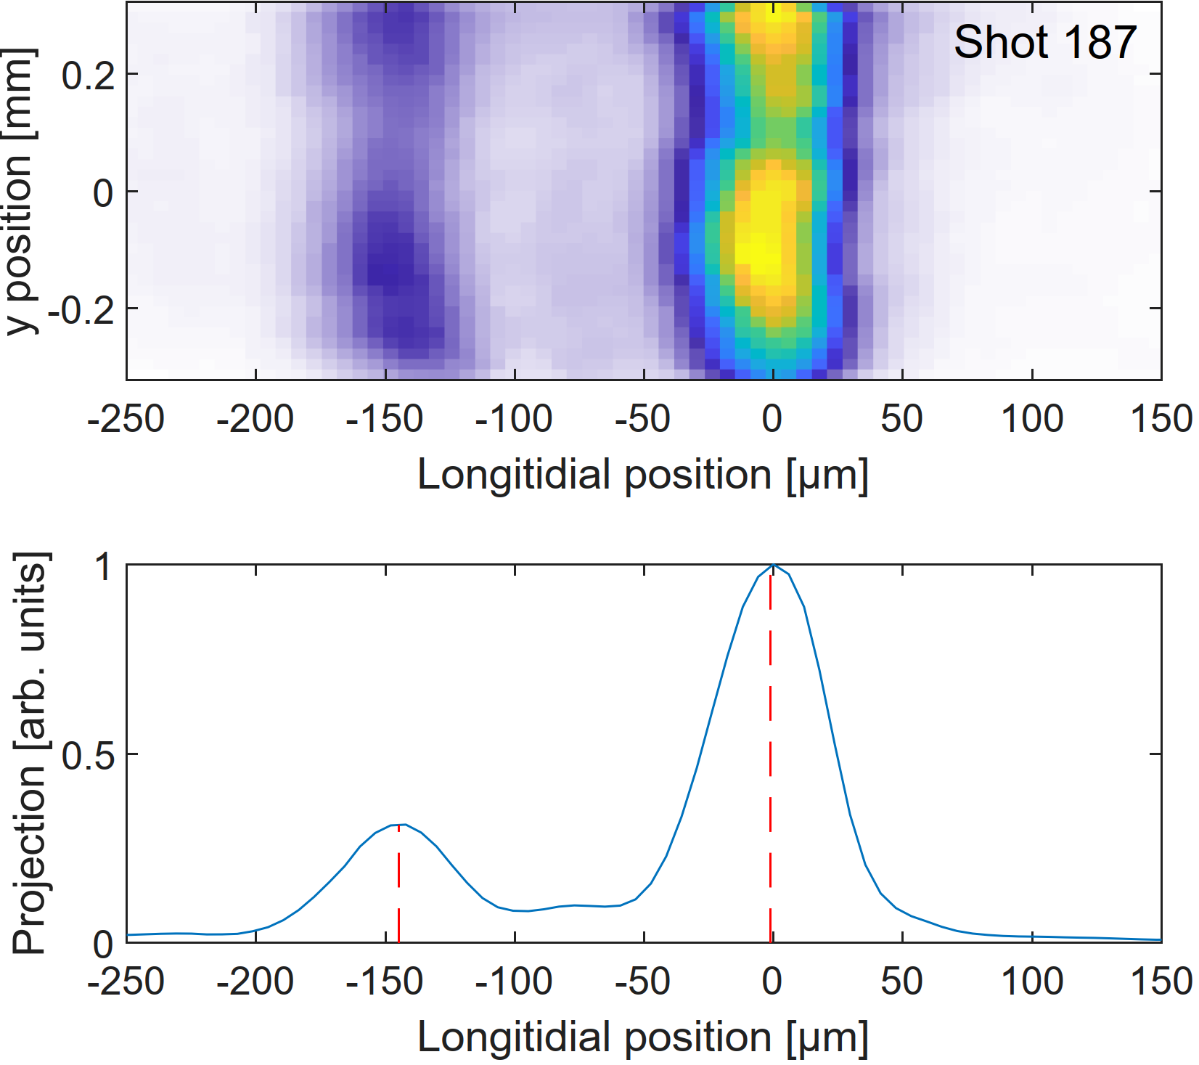
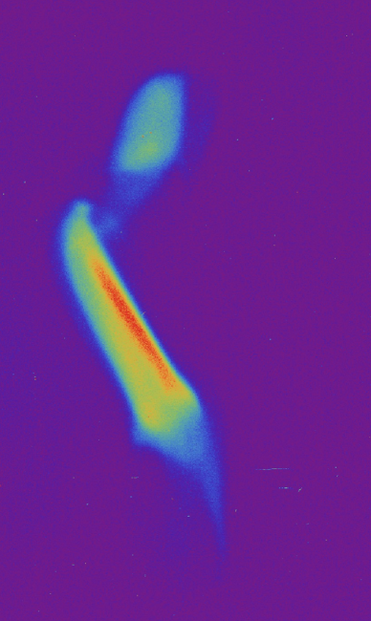
FACET-II provides 10 GeV beams for PWFA studies
FACET-II Technical Design Report SLAC-R-1072
Positron Damping Ring (not installed)
Two ways to produce 2 bunches at the experimental area for PWFA studies:
TCAV Long. Phase Space
EOS Temporal Profile
Two bunches off the photo cathode, co-accelerated through the linac
Witness
Drive
Time
Drive
Energy [GeV]
Witness
Drive
Witness
Energy

Slide 5
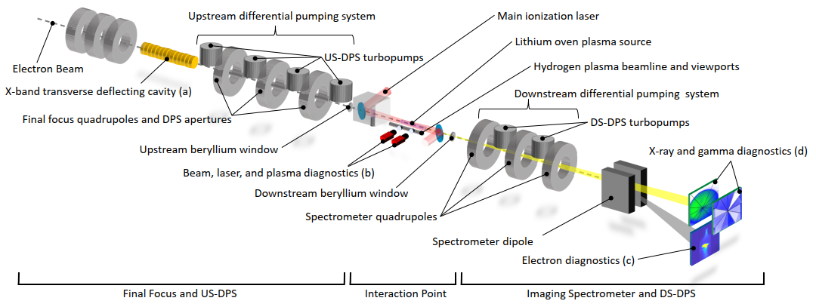
FACET-II experimental area overview

Slide 6
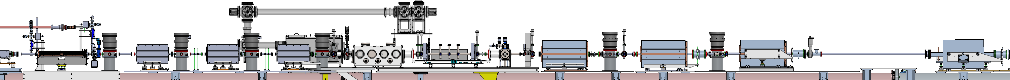
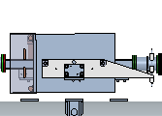
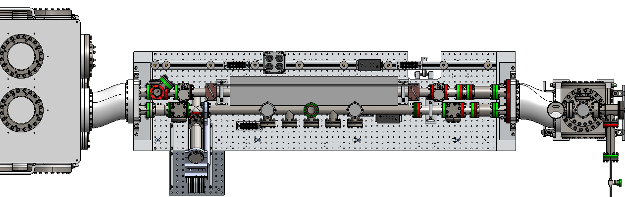
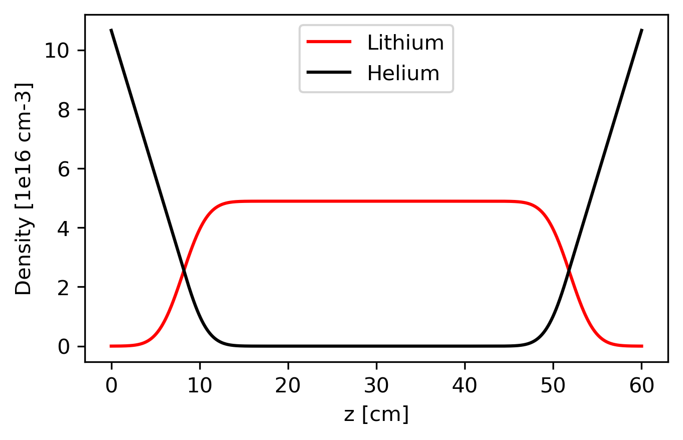
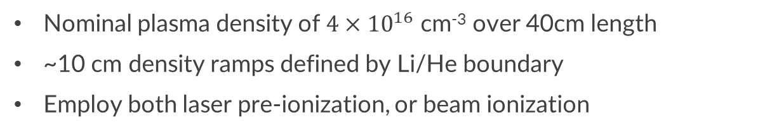
Lithium oven plasma source
DS Be
window
Upstream DPS and final focus quads
US Be
window
Li Oven /
Bypass line
Downstream DPS and reimaging quads
XTCAV
Spectrometer Bend
Picnic Basket
Li Oven
Laser Extraction
Lithium Oven Density Profile
Bypass line
Nominal plasma density of $4×{10}^{16}$ cm⁻³ over 40cm length
~10 cm density ramps defined by Li/He boundary
Employ both laser pre-ionization, or beam ionization
Notes:
Challenges:
buffer ionization
Long time to reach eqbm
Radiation robustness

Slide 7
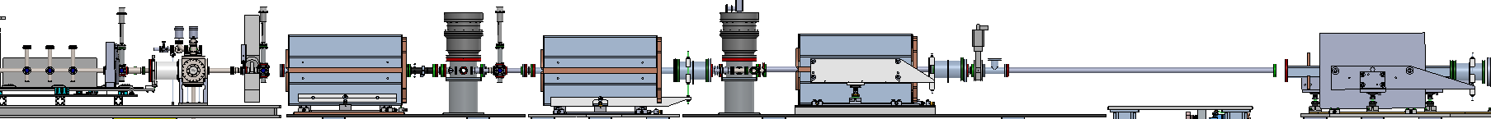
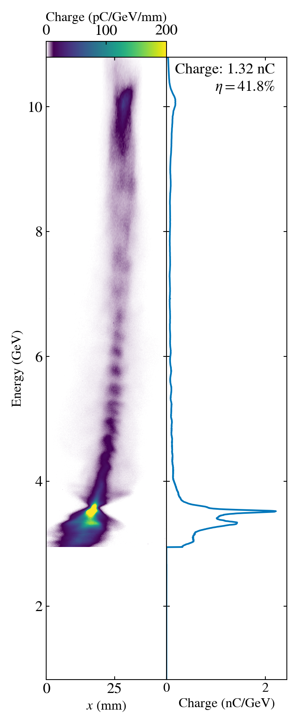
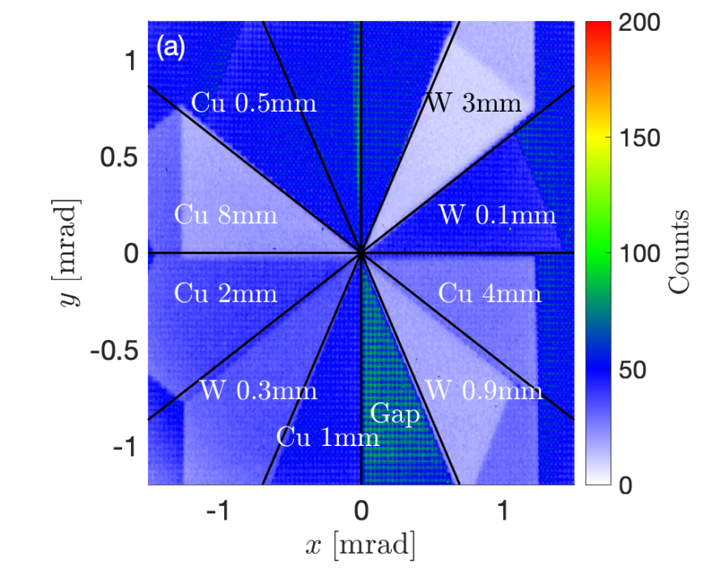
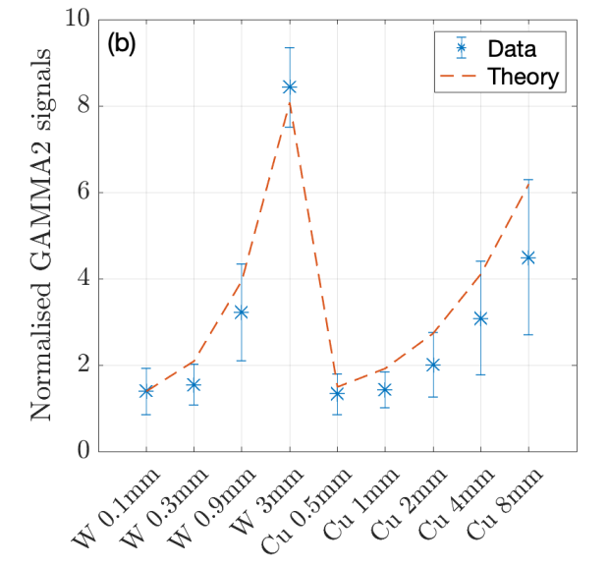
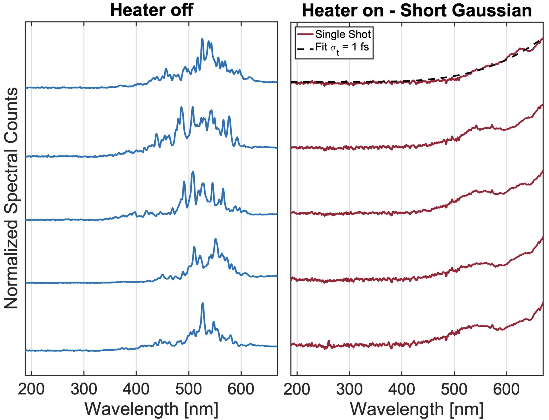
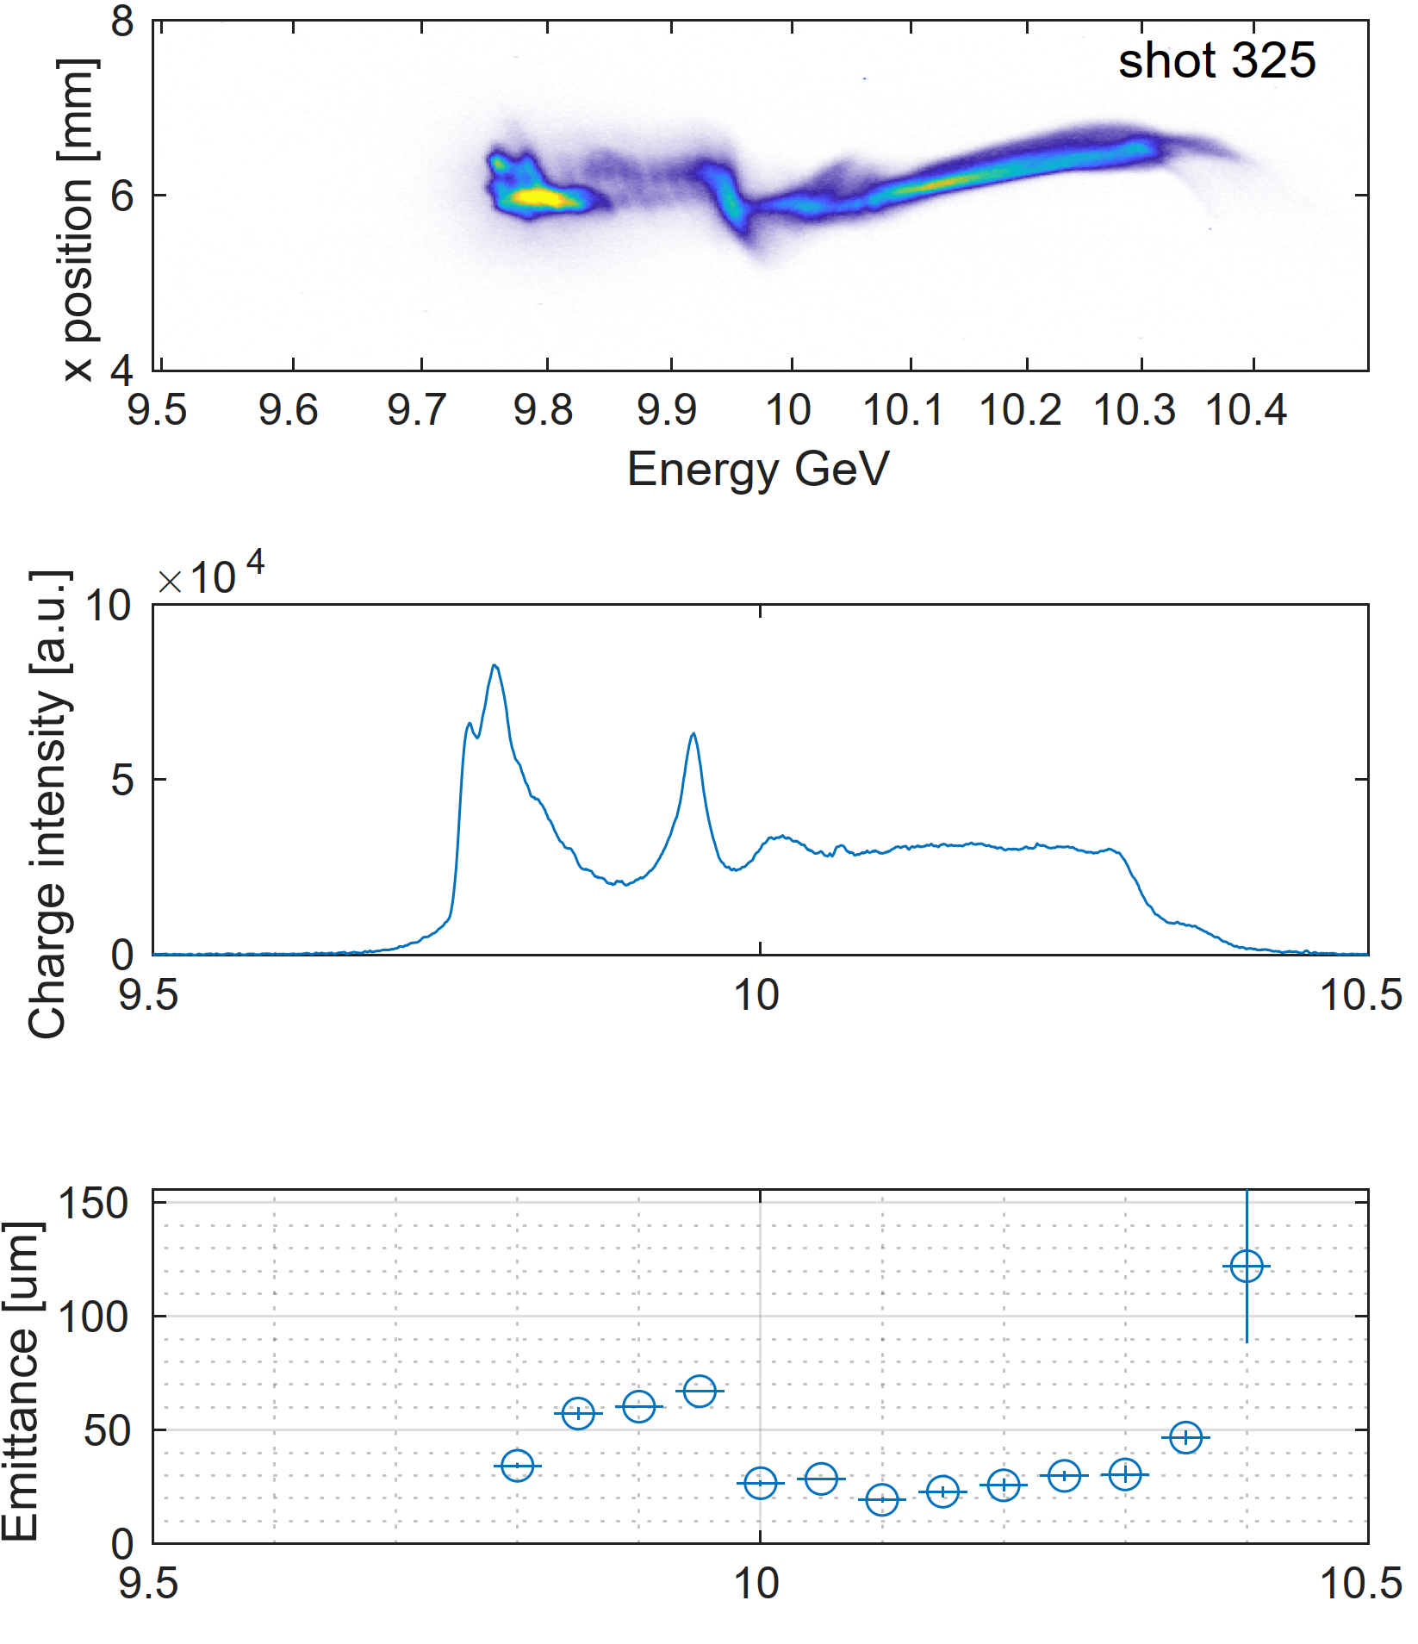
Post plasma diagnostics
Plasma
sources
Spectrometer
Dipole
Electron and Gamma Screens
Spectrometer Quadrupoles
UV Spectrometers
gammas
e-
Imaging electron spectrometer
Betatron radiation diagnostics
UV and XUV spectrometers
P. San Miguel Claveria et al., AAC (2022)
  Compton Spectrometer upcoming, covering a range of 180 keV-28 MeV
C. Emma et al., PRL 134, 085001 (2025)
D. Storey et al., PRAB 27 051302 (2024)

Slide 8
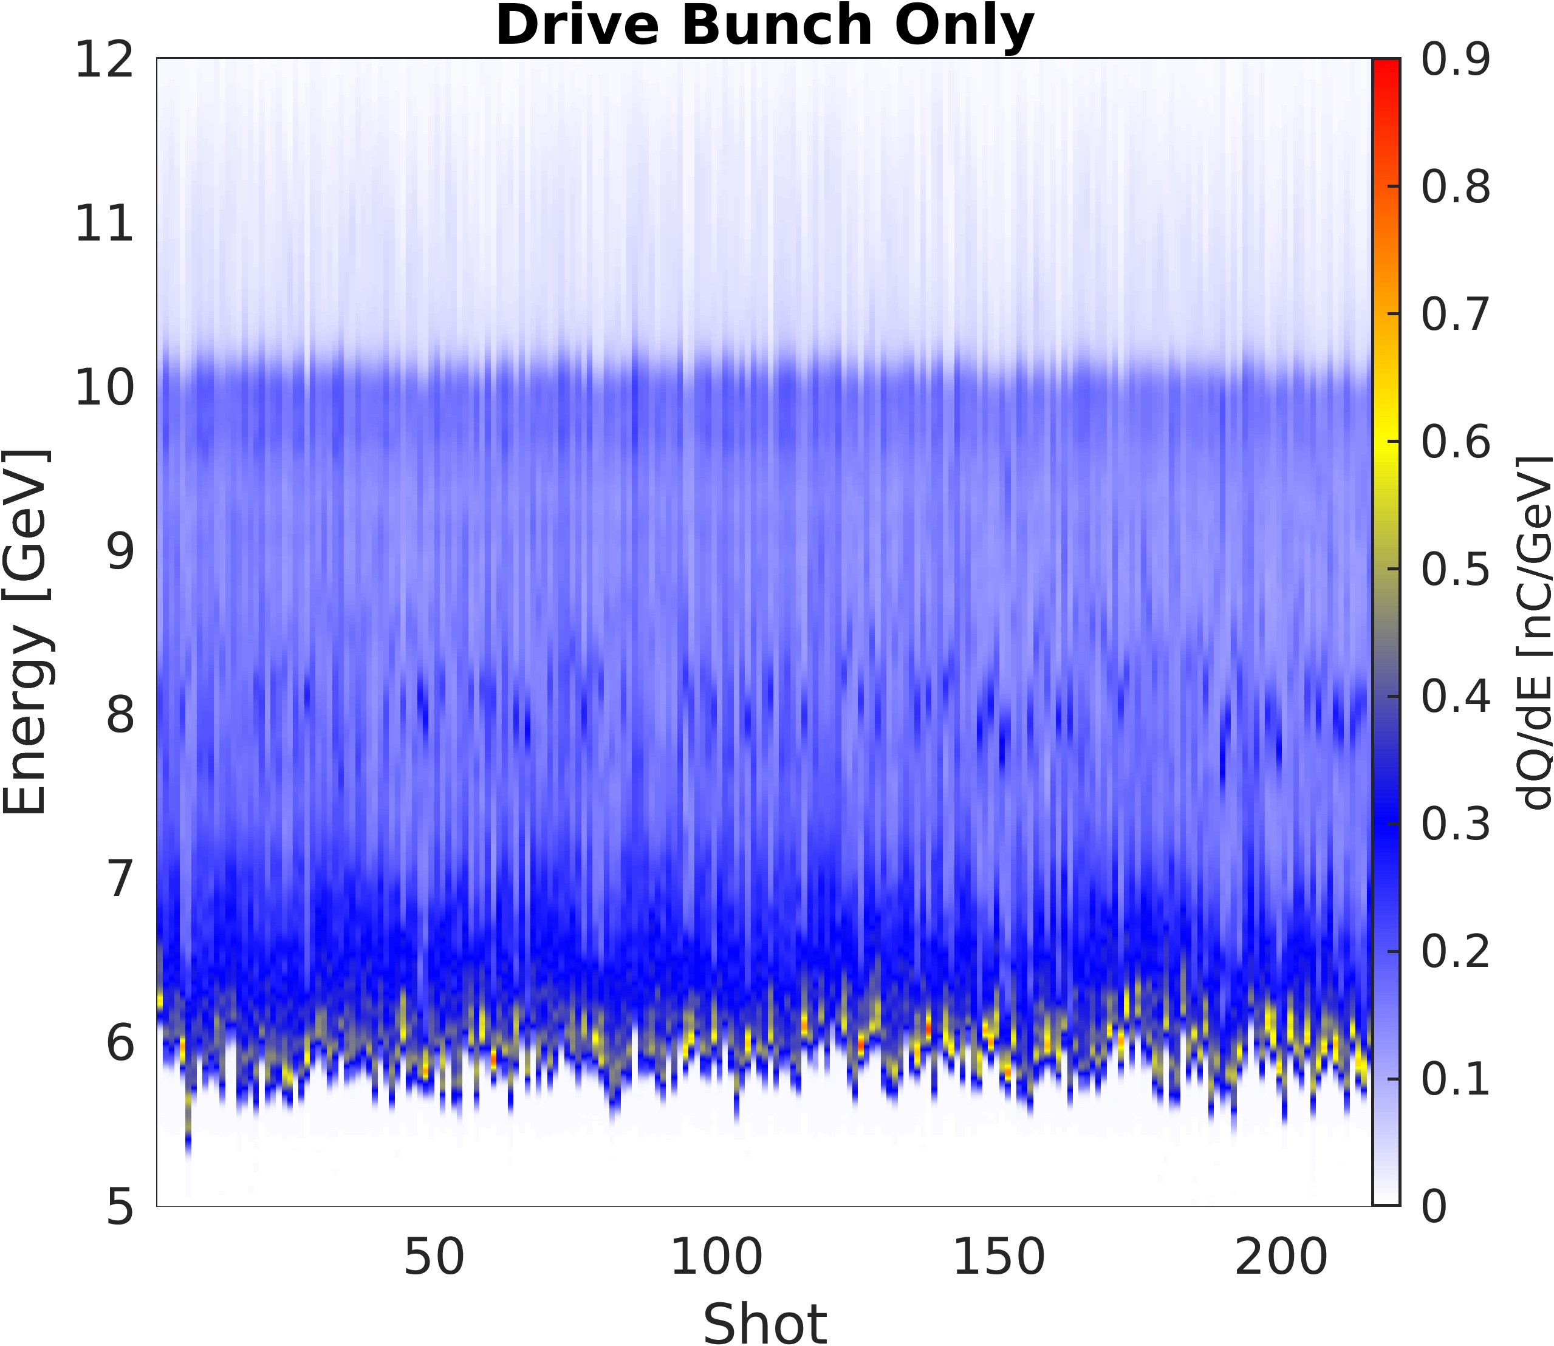
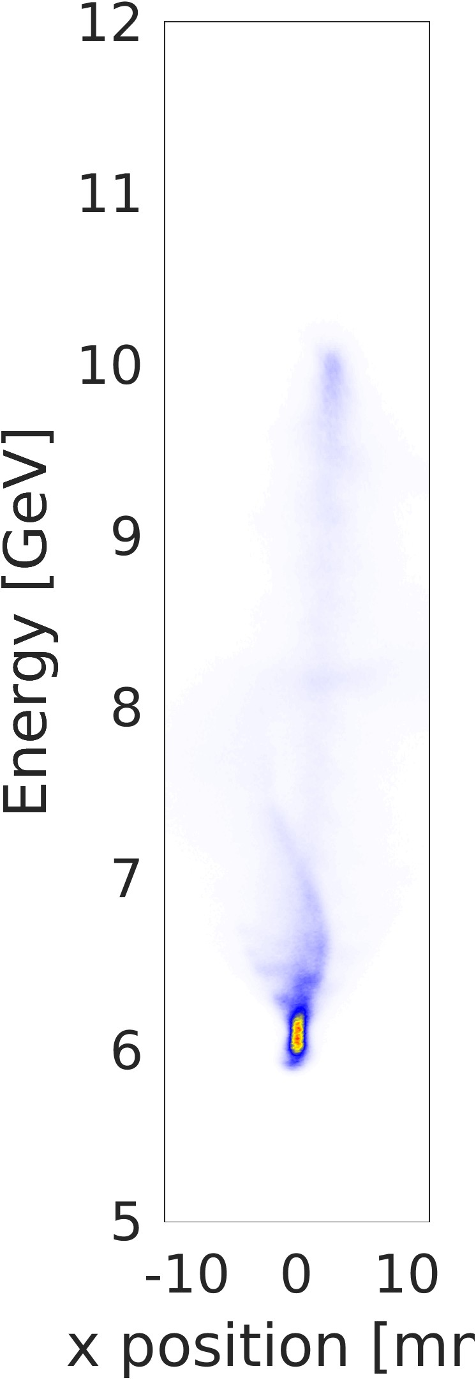
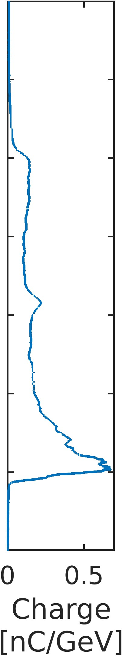
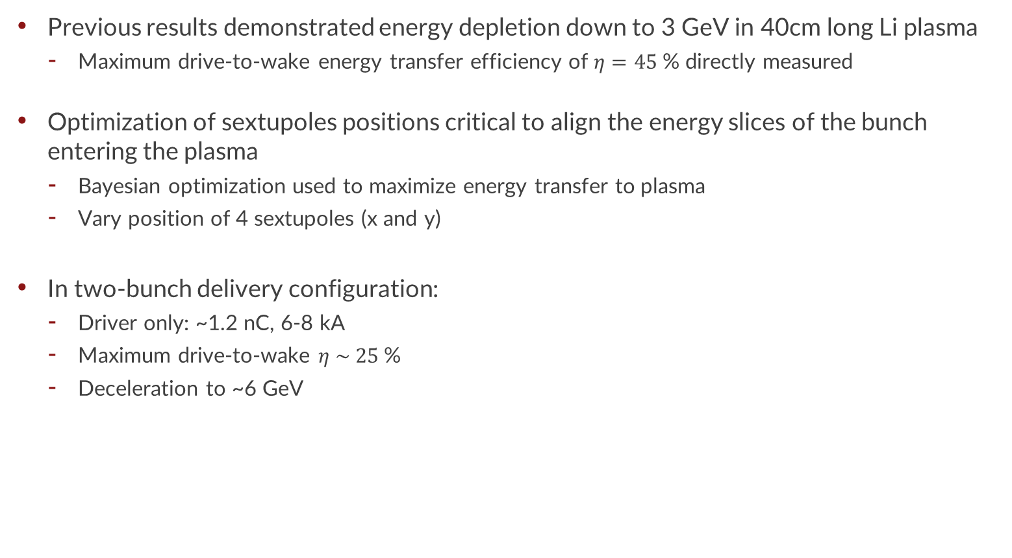
Maximizing drive-to-wake transfer efficiency
Single Bunch
Previous results demonstrated energy depletion down to 3 GeV in 40cm long Li plasma
  Maximum drive-to-wake energy transfer efficiency of $η=45$% directly measured
Optimization of sextupoles positions critical to align the energy slices of the bunch entering the plasma
  Bayesian optimization used to maximize energy transfer to plasma
  Vary position of 4 sextupoles (x and y)
In two-bunch delivery configuration:
  Driver only: ~1.2 nC, 6-8 kA
  Maximum drive-to-wake $η \sim 25$%
  Deceleration to ~6 GeV

Slide 9
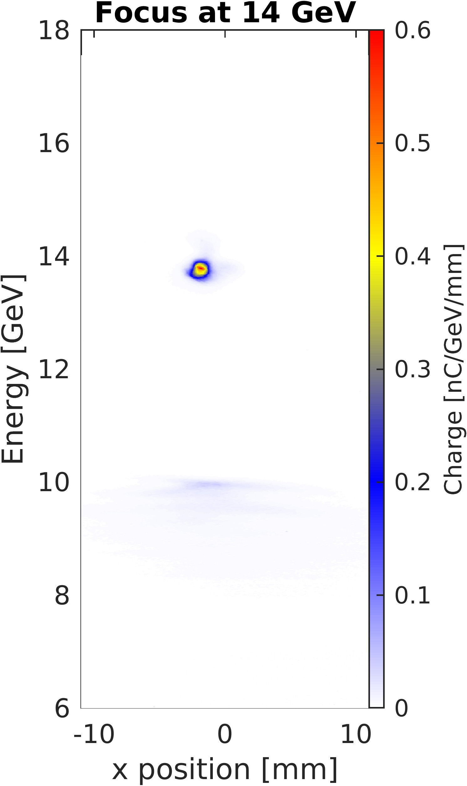
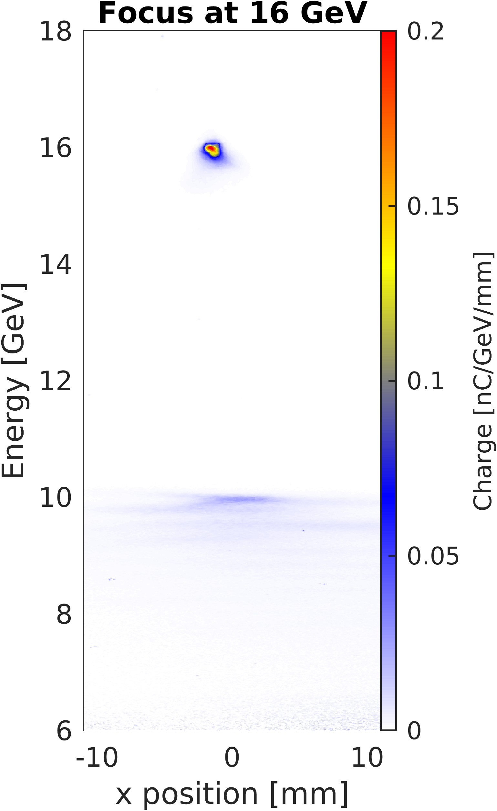
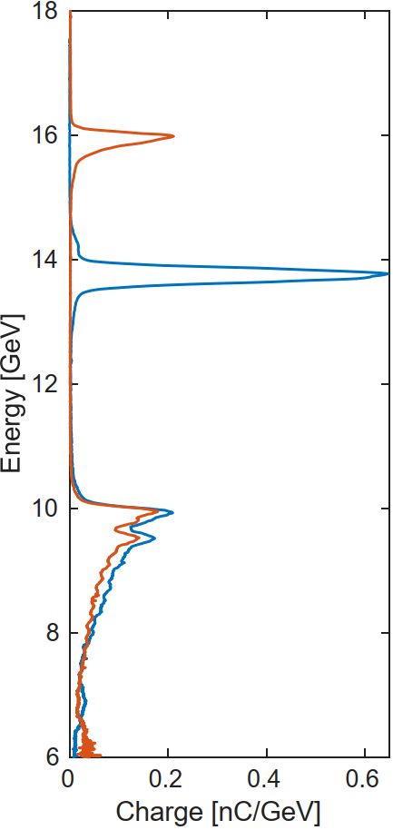
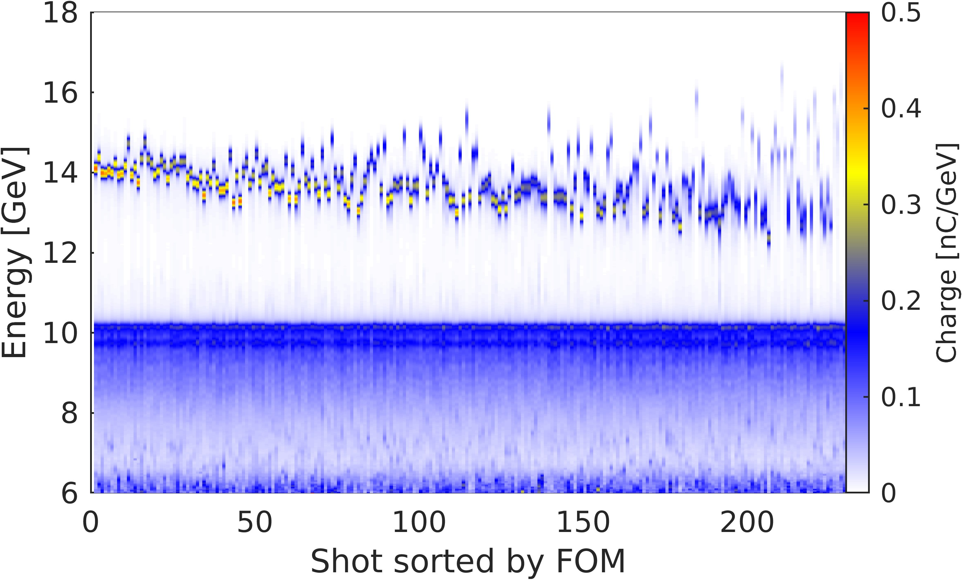
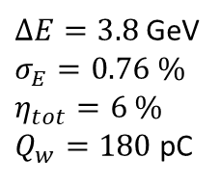
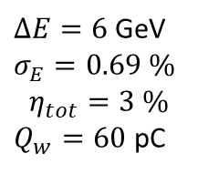

Multi-GeV witness acceleration
Two-bunch configuration
  Driver: ~1.2 nC, 6-8 kA
  Witness: 150-250 pC incoming charge
  Plasma: 40cm long lithium plasma, 4e16 cm⁻³
Sorted by figure of merit:
$$Ω=\frac{\left(\frac{σ_{E_{W}}}{ΔE_{W}}\right)}{η_{tot}\left(\frac{ΔE_{W}}{10 GeV}\right)}$$
Focus at 14 GeV
$ΔE=3.8$ GeV
$σ_{E}=0.76 \%$
$η_{tot}=6 \%$
$Q_{w}=180$ pC
$ΔE=6$ GeV
$σ_{E}=0.69 \%$
$$η_{tot}=3 \%$$
$Q_{w}=60$ pC
Field uniformity (energy spread over energy gained) ~2%

Slide 10
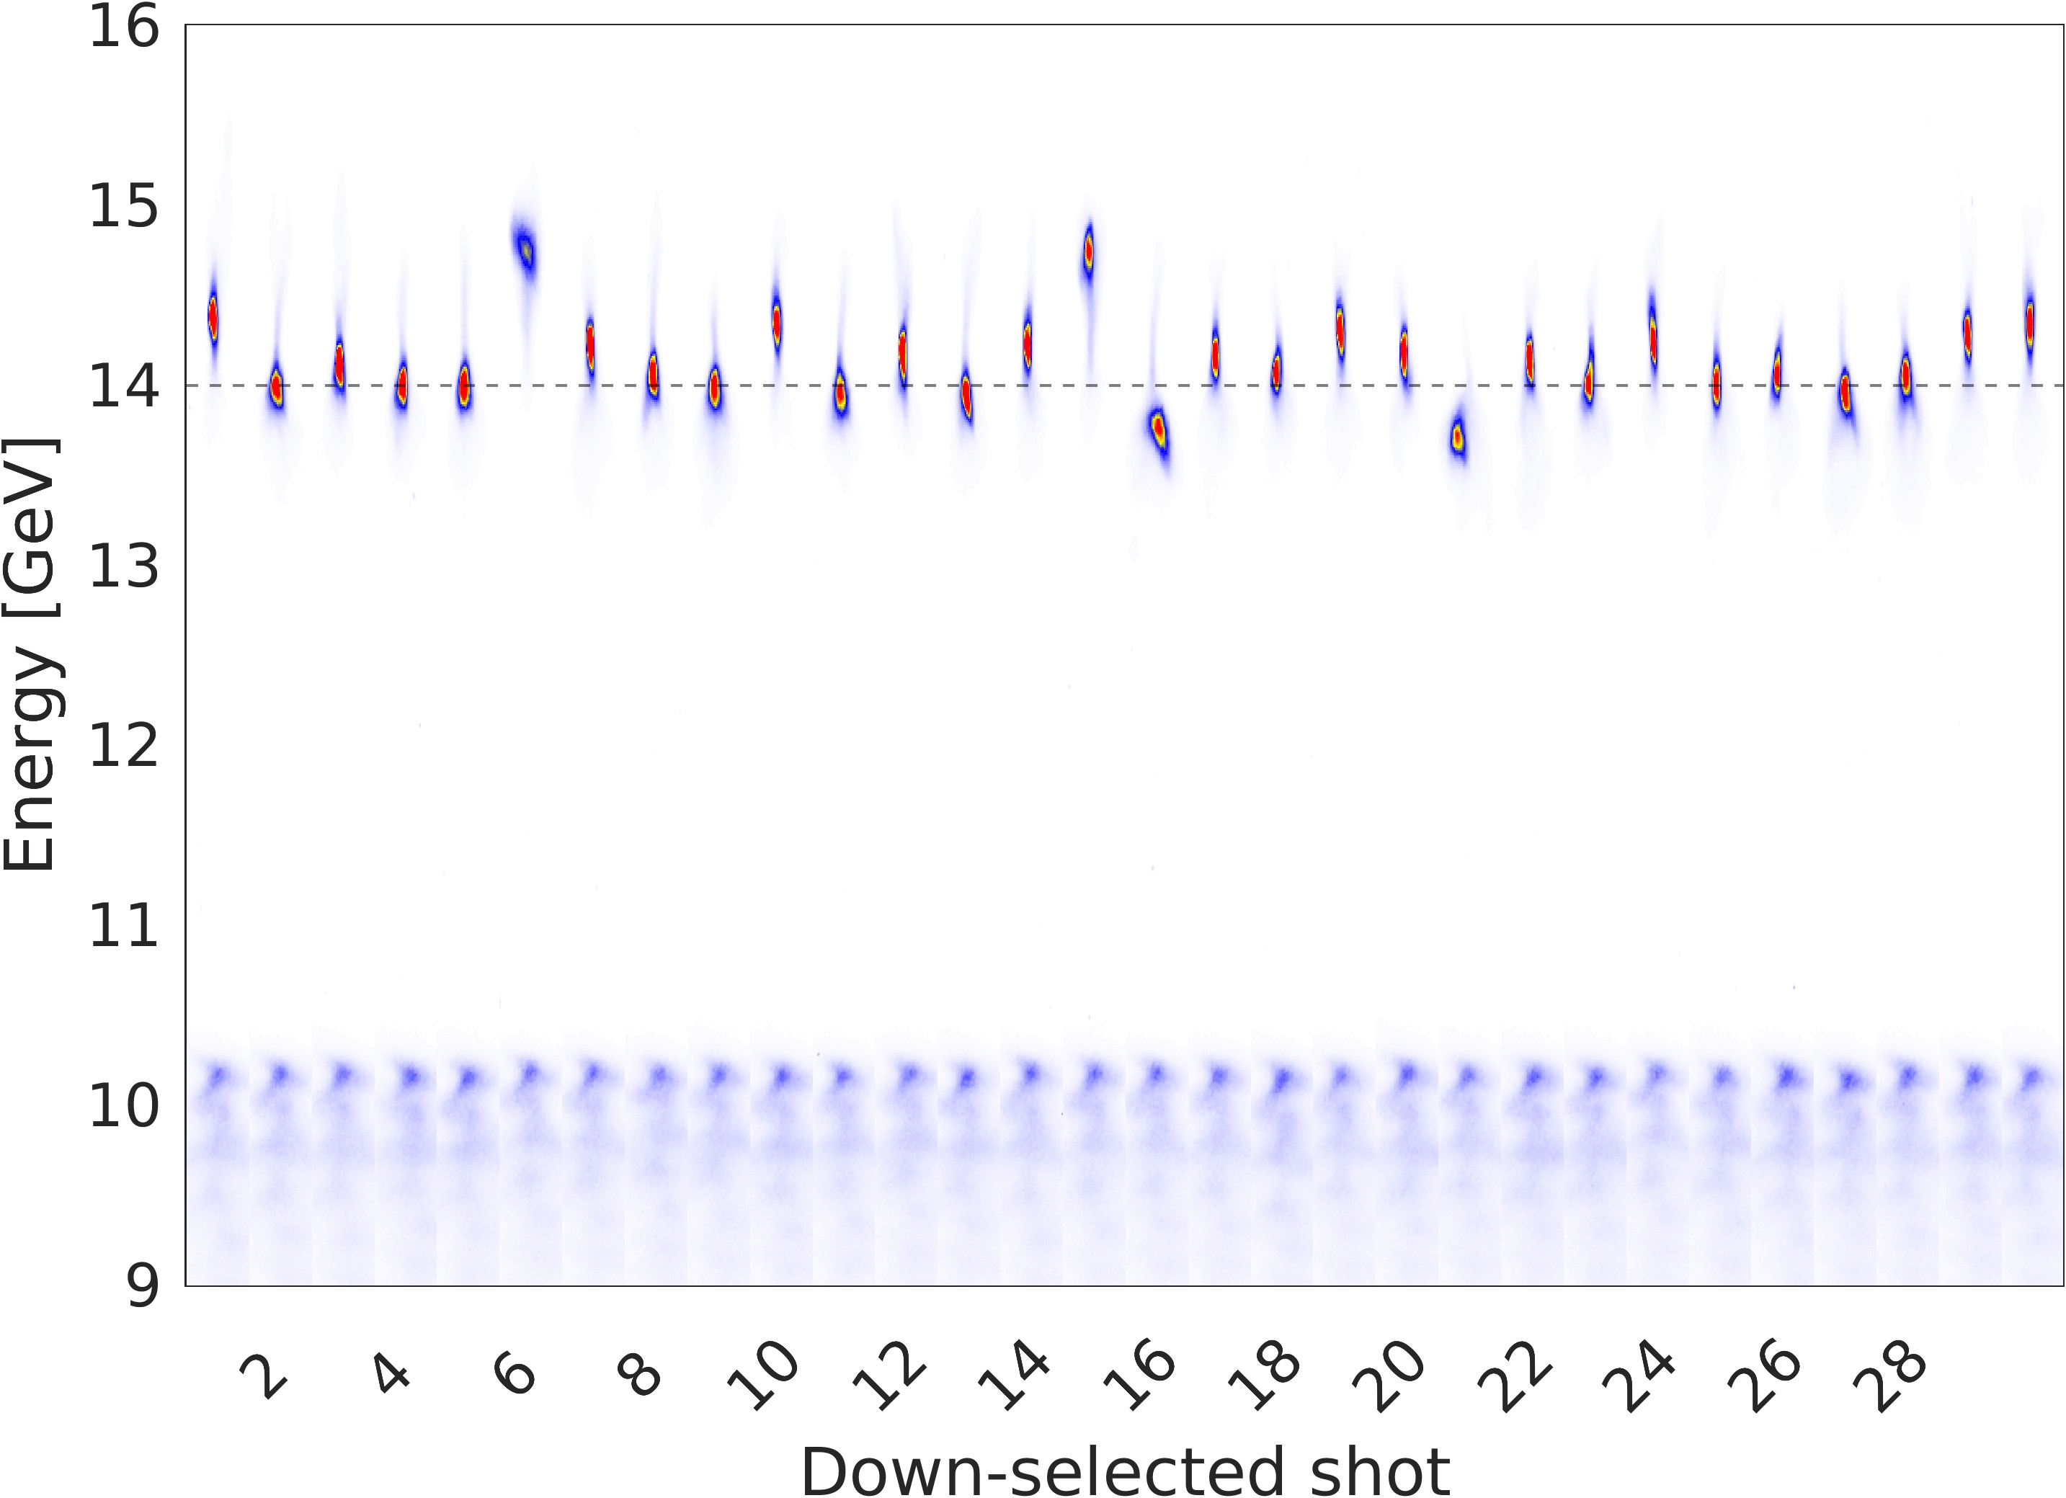
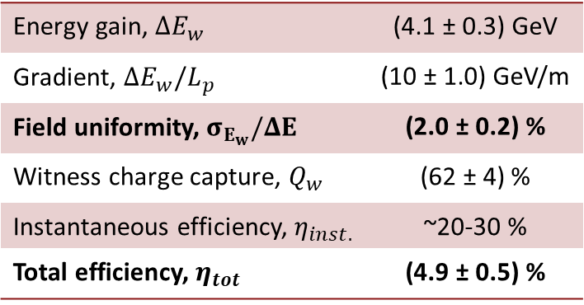
High field uniformity and total efficiency at the GeV scale
Linac instabilities are the main driver of shot-to-shot fluctuations in PWFA performance
Down-select to the highest performing 10% of shots
Shots have comparable linac parameters:
  Bunch length measurement in linac
  Energy measurements in linac (x2)
  Bunch separation at plasma
  BPM measurements just prior to plasma
Performance:
14 GeV Focus
Energy gain, $ΔE_{w}$ | (4.1 ± 0.3) GeV
Gradient, $ΔE_{w}/L_{p}$ | (10 ± 1.0) GeV/m
Field uniformity, $σ_{E_{w}}/ΔE$ | (2.0 ± 0.2) %
Witness charge capture, $Q_{w}$ | (62 ± 4) %
Instantaneous efficiency, $η_{inst.}$ | ~20-30 %
Total efficiency, $η_{tot}$ | (4.9 ± 0.5) %
Shot # (sorted)

Slide 11
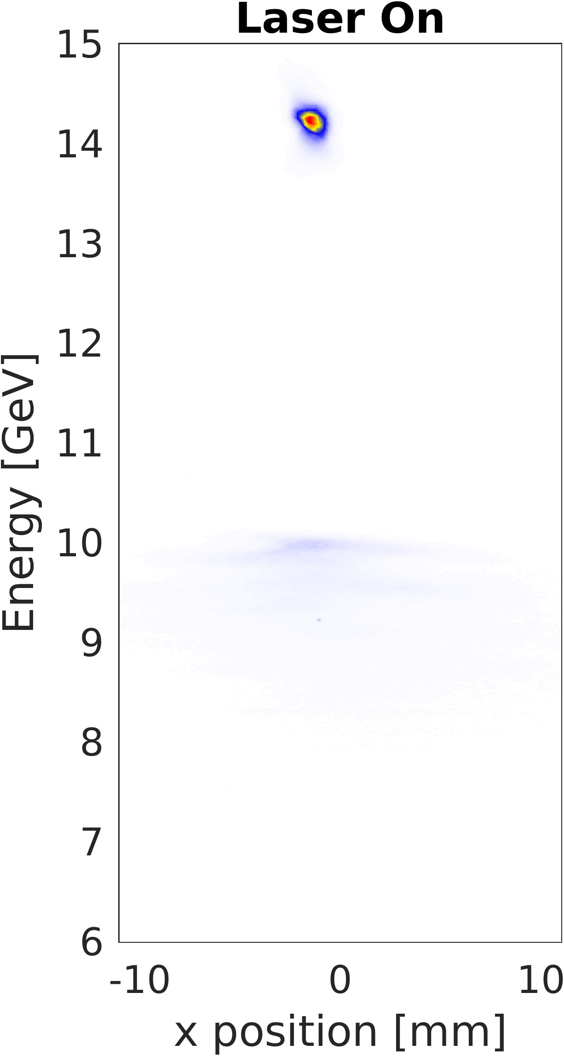
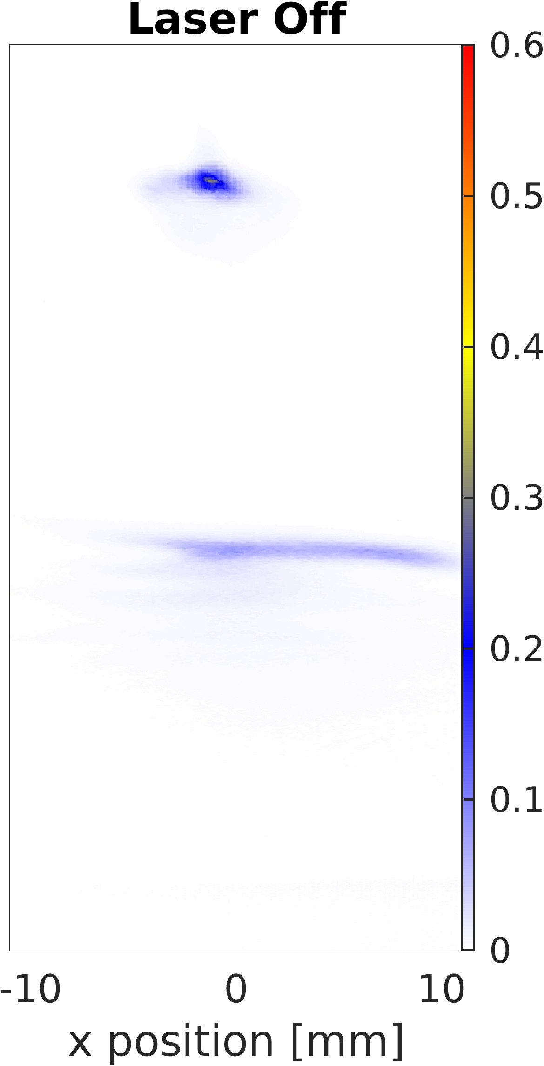
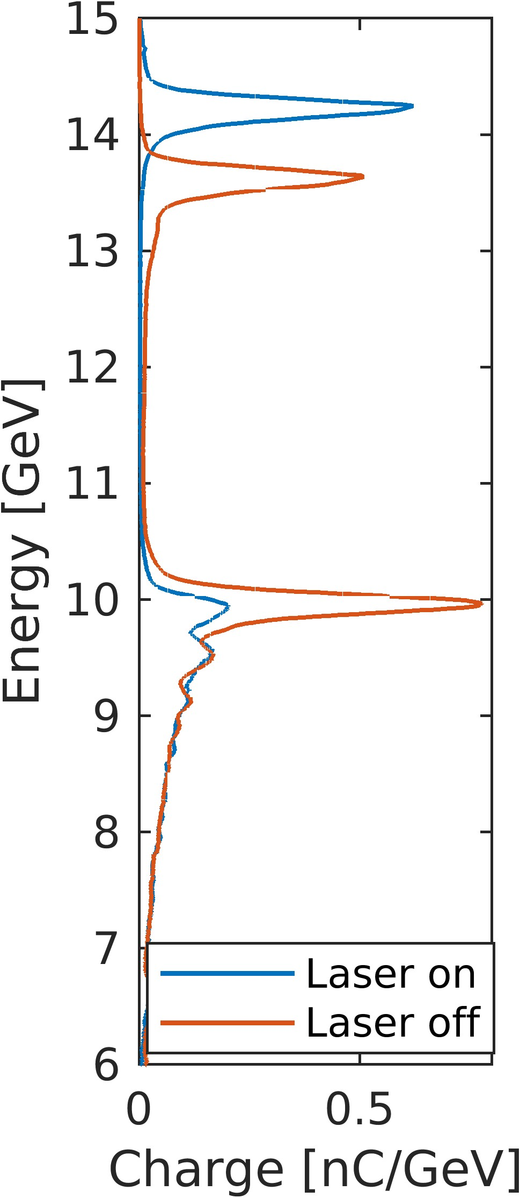
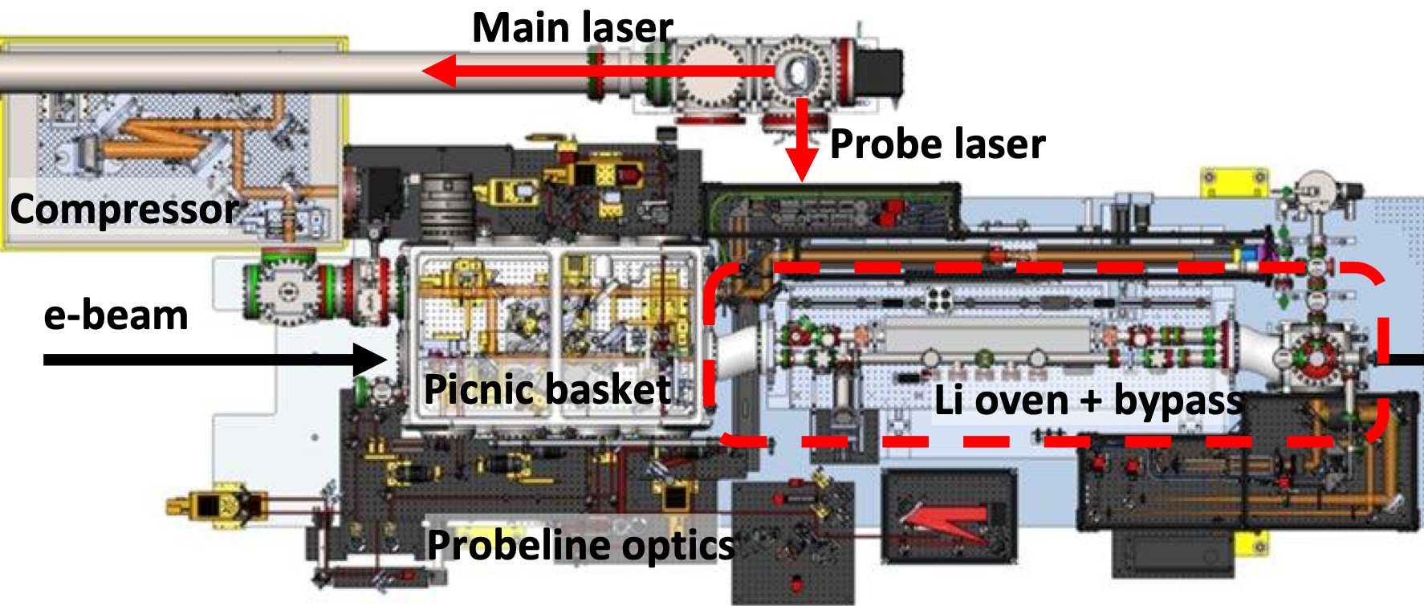
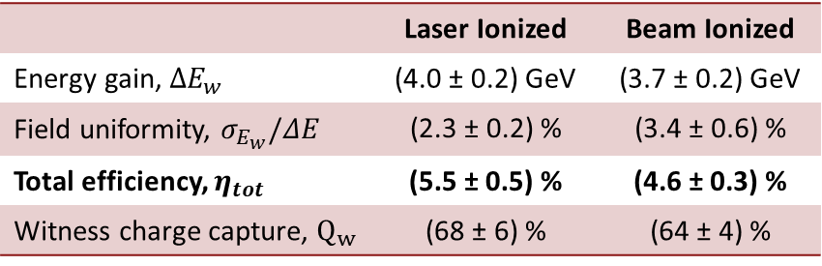
Laser pre-ionization of Lithium plasma
Pre-ionization increases PWFA performance over relying on beam ionization
  ~1 mm wide plasma channel
  Increased participating drive charge
  Increased witness acceleration and total efficiency
 | Laser Ionized | Beam Ionized
Energy gain, $ΔE_{w}$ | (4.0 ± 0.2) GeV | (3.7 ± 0.2) GeV
Field uniformity, $σ_{E_{w}}/ΔE$ | (2.3 ± 0.2) % | (3.4 ± 0.6) %
Total efficiency, $η_{tot}$ | (5.5 ± 0.5) % | (4.6 ± 0.3) %
Witness charge capture, $Q_{w}$ | (68 ± 6) % | (64 ± 4) %

Slide 12
Longitudinal Phase Space delivered to the plasma
Range of Longitudinal Phase Space Profiles
Control of the LPS is critical for:
  Ensuring proper bunch spacing
  Optimizing driver intensity for efficient energy transfer
  Beam loading of the wake for minimizing witness energy spread
Achieved through combination of RF phases, collimators, cathode laser pulse separation
LPS measured via transverse deflecting cavity before the plasma
Drive
Witness
Collimation
Drive
Witness

Slide 13
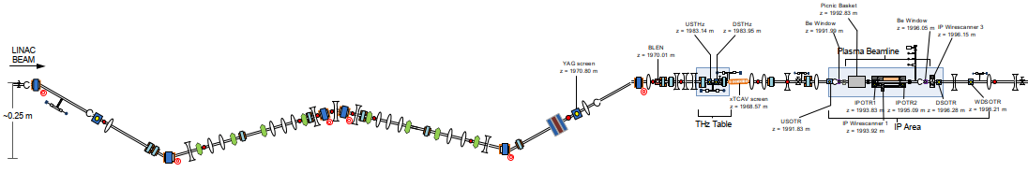
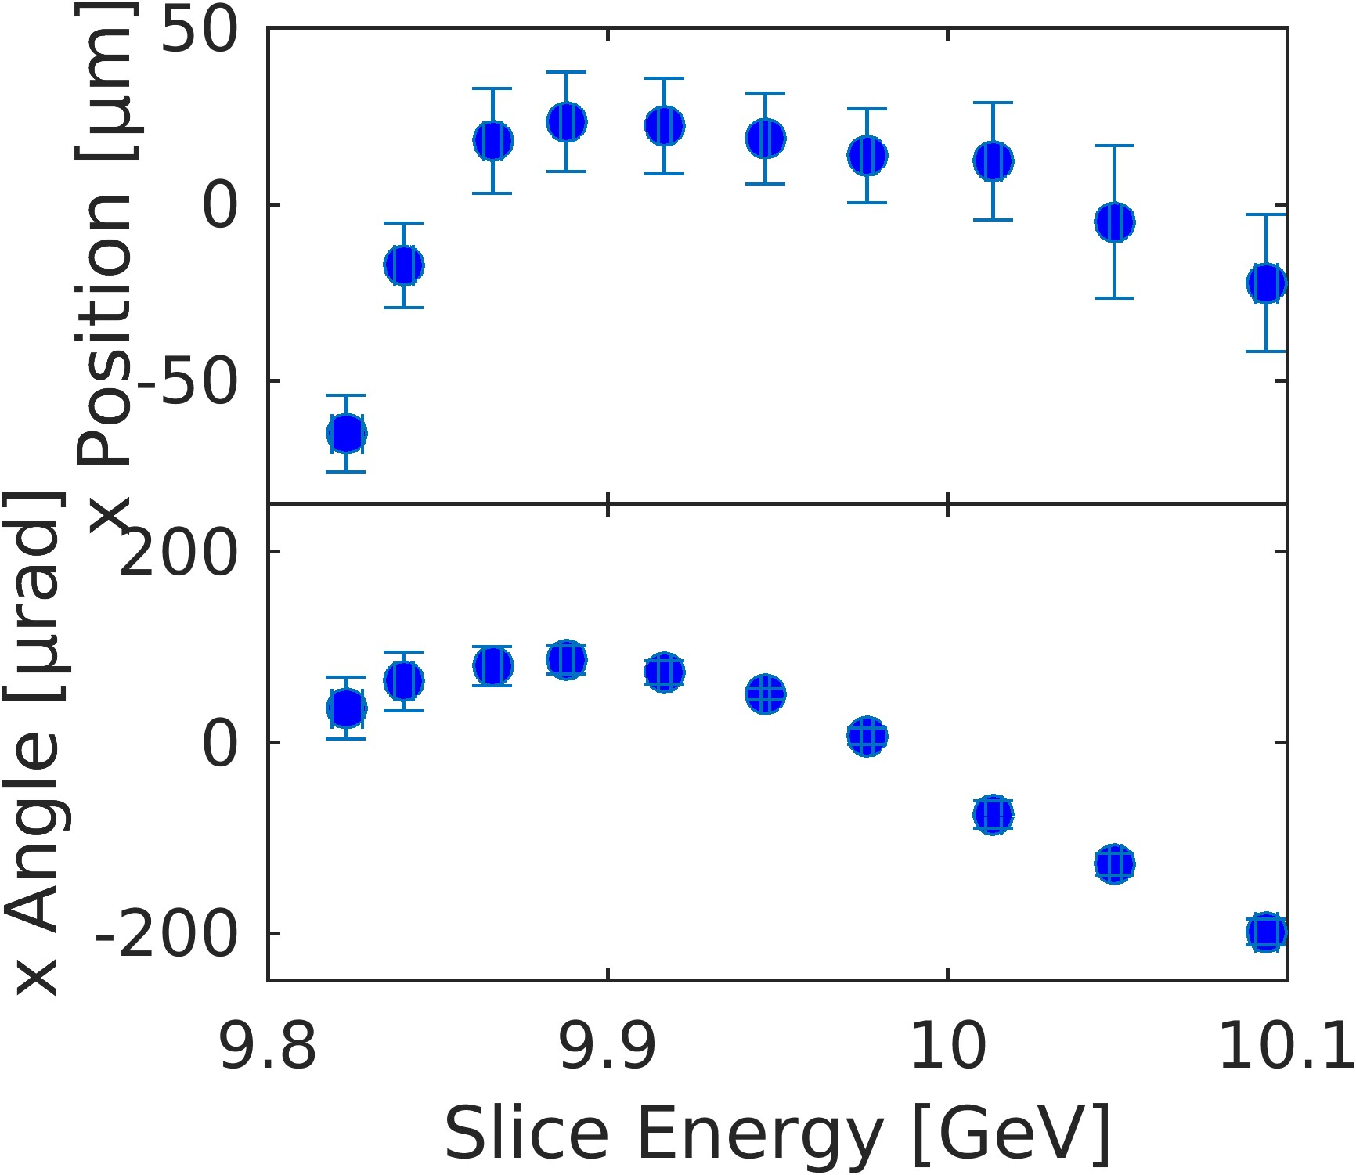
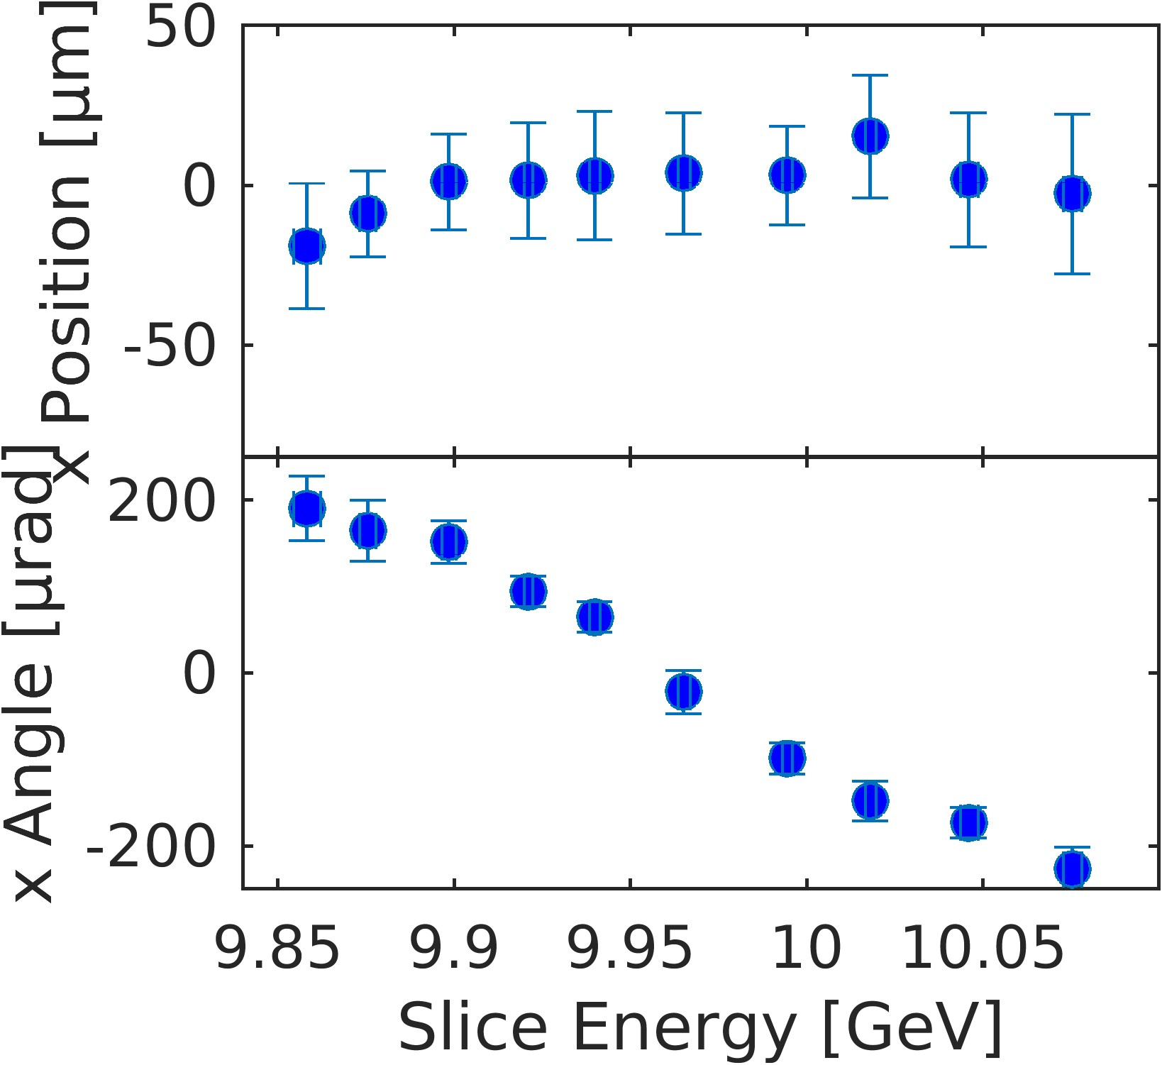
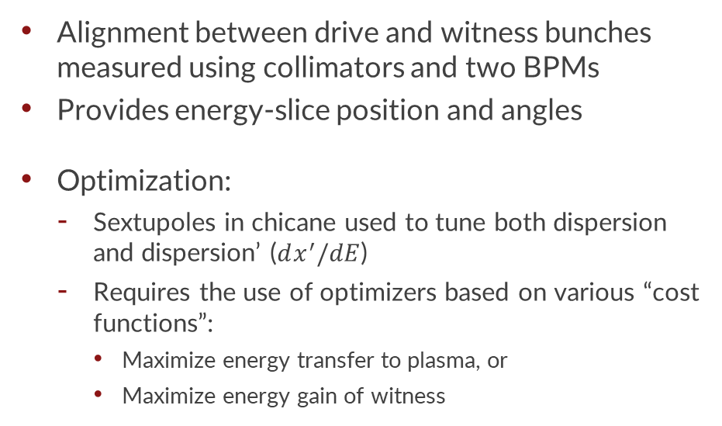
Optimization of the transverse phase space
W-Chicane
Final Focus
Sextupoles
BPM1
BPM2
Plasma Source
Alignment between drive and witness bunches measured using collimators and two BPMs
Provides energy-slice position and angles
Optimization:
  Sextupoles in chicane used to tune both dispersion and dispersion’ ($dx^{′}/dE$)
  Requires the use of optimizers based on various “cost functions”:
    Maximize energy transfer to plasma, or
    Maximize energy gain of witness
Witness
Drive
Drive
Witness
Drive
Plasma
Drive
Plasma
Witness
Witness

Slide 14
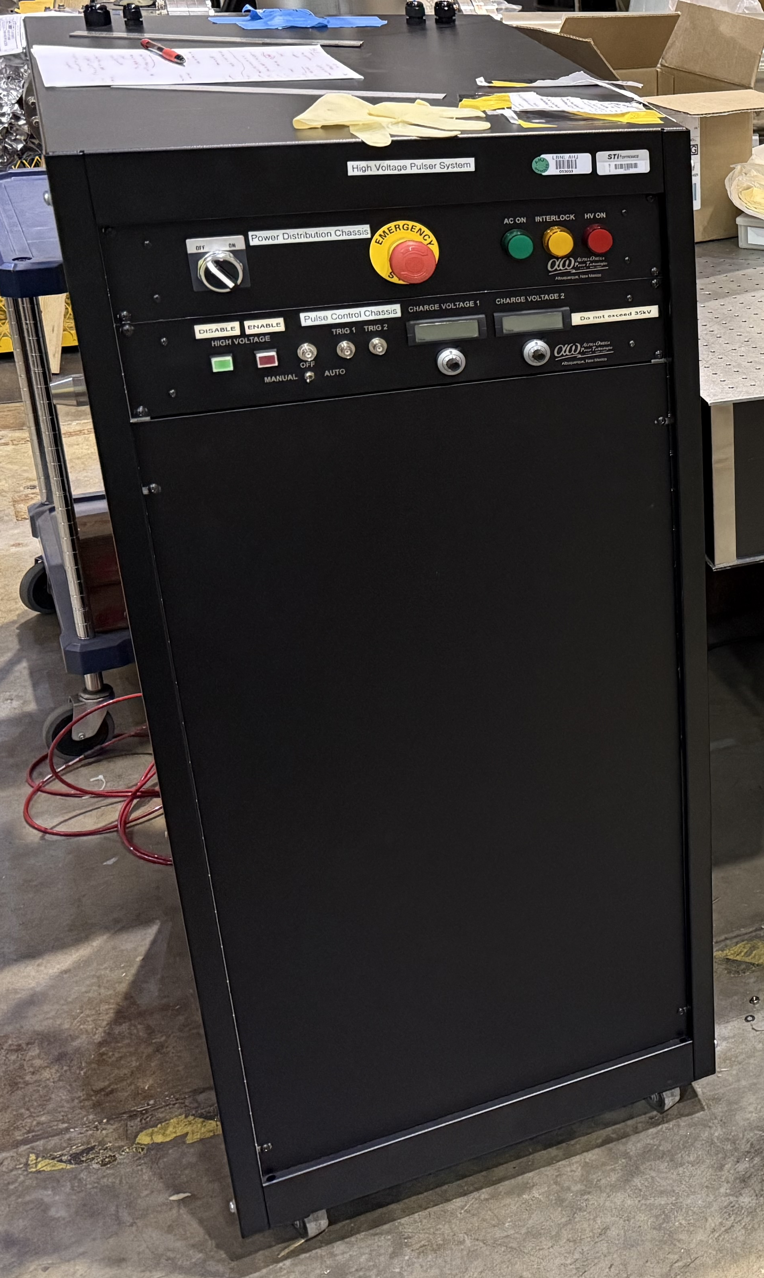
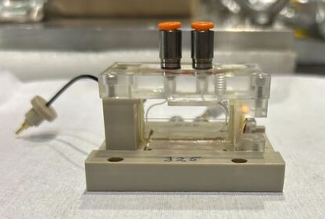
Outlook for the FY26 Experimental Run
Continue to improve both longitudinal and transverse properties of two-bunch delivery
  Improve witness charge capture, total efficiency, and beam quality of accelerated witness bunches
Further implementation of Bayesian optimization of sextupoles for improved dispersion control
Plasma sources:
  Lithium oven – continued use of 40cm oven
    Can accommodate up to 60cm long plasma oven, but not planned for this year
  Laser ionized hydrogen plasma source (see the next talk for more details)
  Plasma discharge source – in collaboration with LBNL
    Yiheng Ye (Stanford), Muhammad Saeed (San Jose State
    University), and D. Storey, S. Gessner
    Discharge capillaries and pulsed power unit on loan for
    development studies

Slide 15
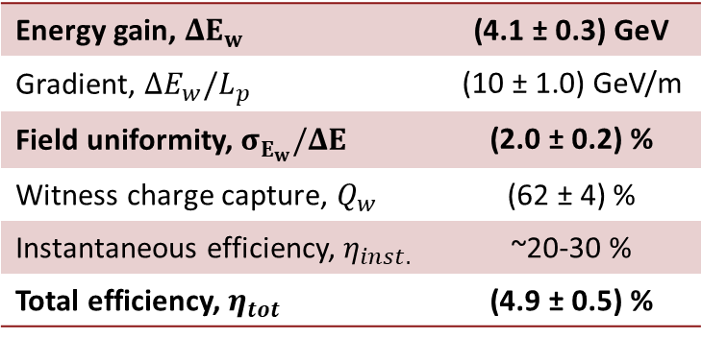
Conclusions
Multi-GeV witness acceleration with high field uniformity and total efficiency
4-6 GeV energy gain of 150-200 pC witness bunches
Energy spread over energy gain ~2%
Total efficiency ~5%
Many new tools developed to optimize the incoming beam:
Improved linac stability
Transverse tuning tools
Higher resolution LPS measurements
Working towards matching and emittance preservation
Thank you! Questions?
Shot # (sorted)
Energy gain, $ΔE_{w}$ | (4.1 ± 0.3) GeV
Gradient, $ΔE_{w}/L_{p}$ | (10 ± 1.0) GeV/m
Field uniformity, $σ_{E_{w}}/ΔE$ | (2.0 ± 0.2) %
Witness charge capture, $Q_{w}$ | (62 ± 4) %
Instantaneous efficiency, $η_{inst.}$ | ~20-30 %
Total efficiency, $η_{tot}$ | (4.9 ± 0.5) %

Slide 16
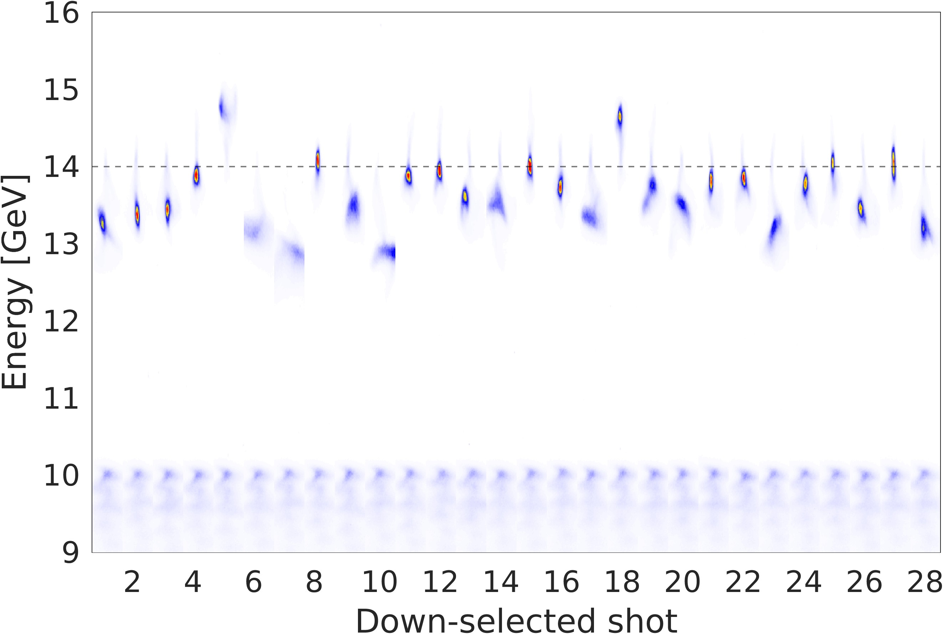
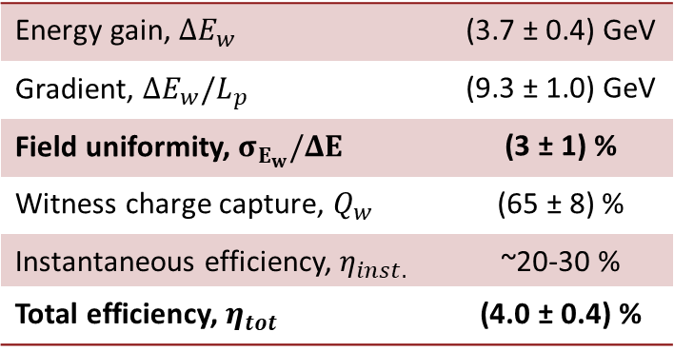
Statistics: High field uniformity and total efficiency at GeV scale
Linac instabilities are the main driver of shot-to-shot fluctuations in PWFA performance
Down-select the shots to only include those
with similar linac parameters:
  Bunch length measurement in linac
  Energy measurements in linac (x2)
  Bunch separation at plasma
  BPM measurements just prior to plasma
Performance:
14 GeV Focus
Energy gain, $ΔE_{w}$ | (3.7 ± 0.4) GeV
Gradient, $ΔE_{w}/L_{p}$ | (9.3 ± 1.0) GeV
Field uniformity, $σ_{E_{w}}/ΔE$ | (3 ± 1) %
Witness charge capture, $Q_{w}$ | (65 ± 8) %
Instantaneous efficiency, $η_{inst.}$ | ~20-30 %
Total efficiency, $η_{tot}$ | (4.0 ± 0.4) %

