Slide 1


Experimental Progress of PWFA in a Laser-Ionized Plasma Source FACET-II
EAAC 2025
Sep. 24, 2025
Elba, Italy
Authors: Michael Litos (speaker, CU Boulder),
Valentina Lee (CU Boulder), Robert Ariniello (SLAC Nat’l Lab)
On behalf of E-301 and E-333 collaborations

Slide 2
Co-Authors
Alexander Knetsch (SLAC National Accelerator Laboratory) Brendan O'Shea (SLAC National Accelerator Laboratory) Chandrashekhar Joshi (UCLA) Dr Chaojie Zhang (University of California Los Angeles) Christine Clarke (SLAC National Accelerator Laboratory) Dr Christopher Doss (Lawrence Berkeley National Laboratory) Ms Claire Hansel (University of Colorado Boulder) Claudio Emma (SLAC National Accelerator Laboratory) Doug Storey (SLAC National Accelerator Laboratory) Ms Elena Ros (University of Colorado Boulder) Elias Gerstmayr (Queen's University Belfast) Erik Adli (University of Oslo, Norway) Fei Li (Tsinghua University) Jiawei Cao (UiO) Dr Kenneth Marsh (University of California Los Angeles) Mark Hogan (SLAC National Accelerator Laboratory) Nathan Majernik (SLAC National Accelerator Laboratory) Pablo San Miguel (Ecole Polytechnique) Prof. Sebastien Corde (Laboratoire d'Optique Appliquée) Mr Shutang Meng (University of Colorado Boulder) Spencer Gessner (SLAC) Thamine Dalichaouch (University of California Los Angeles) Viktoriia Zakharova Warren Mori (Department of Physics and Astronomy, University of California, Los Angeles, CA 90095, USA) Weiming An (Beijing Normal University)
(Apologies if incomplete!)

Slide 3

Research Funding and Facility Credit
U.S. Department of Energy, Office of Science, Office of High Energy Physics, under Award Number DE-SC001796.
This research used resources of the Facility for Advanced Accelerator Experimental Tests II (FACET-II), which is a DOE Office of Science User Facility.

Slide 4
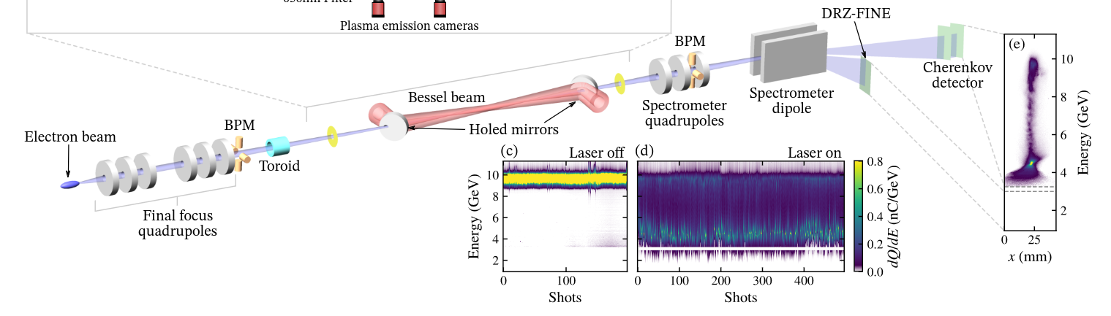
E-301 Experiment at FACET-II
PWFA in a laser-ionized, unconfined H₂ plasma source
Unique features:
Semi-arbitrary density profile controlled by laser focusing
Rapid tunability of plasma density and length
Permits localized gas jets of different species along main filament
Highly accessible to diagnostics
Science Goals:
Optimal performance PWFA stage at 10 GeV scale
  High energy gain, efficiency, and low energy spread
  Full charge transmission and emittance preservation
Platform for other experiments
  High brightness beam injection (E304, E307, E31X)
  Narrow channel electron and positron PWFA (E333)
  Ion channel laser (E306)

Slide 5
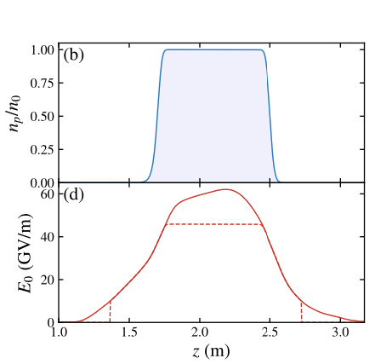
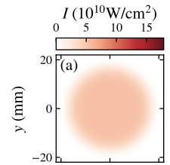

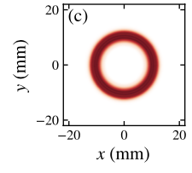

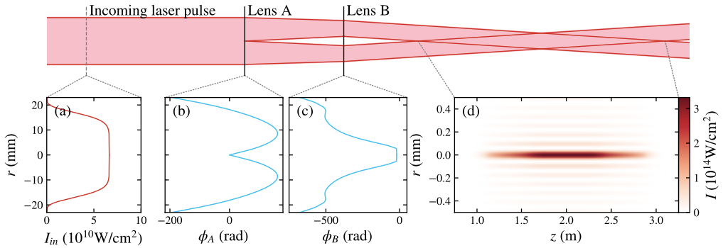
Tandem Lens Focusing of Ionization Laser
A pair of diffractive optics acts in tandem to shape the laser intensity profile.
Lens A controls initial intensity profile at Lens B.
Lens B produces axicon-like Bessel focusing.
Shape of donut profile at Lens B determines axial intensity profile downstream.
Plasma refraction helps to broaden plasma filament.
R. Ariniello, V. Lee, M. Litos, “Demonstration of a tandem lens for producing shaped laser-ionized plasmas for plasma wakefield acceleration”, arXiv:2509.01747 (2025)

Slide 6
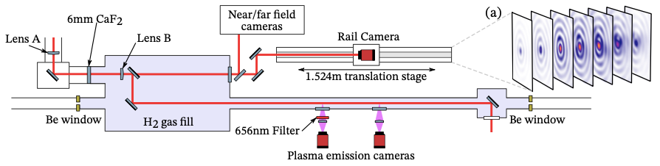
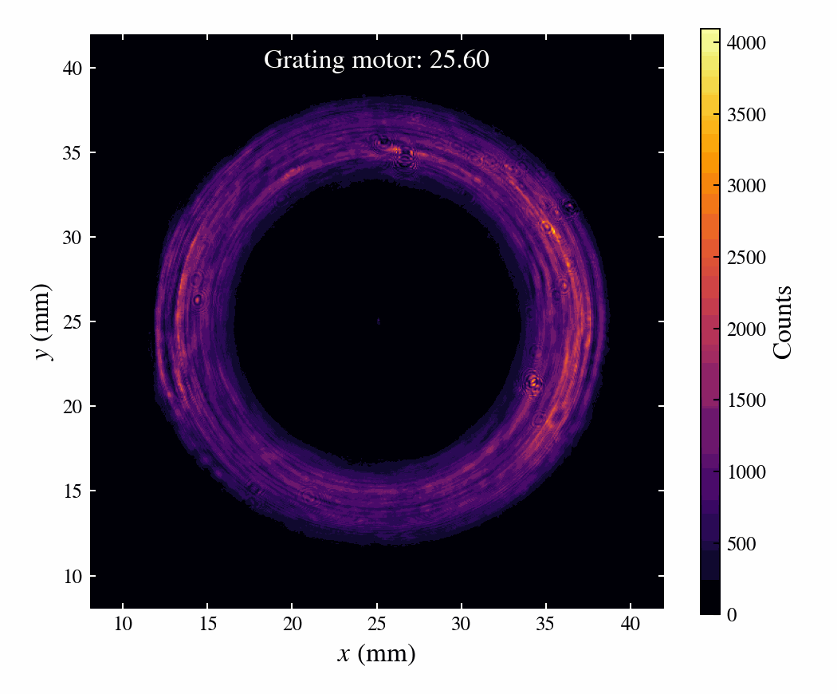
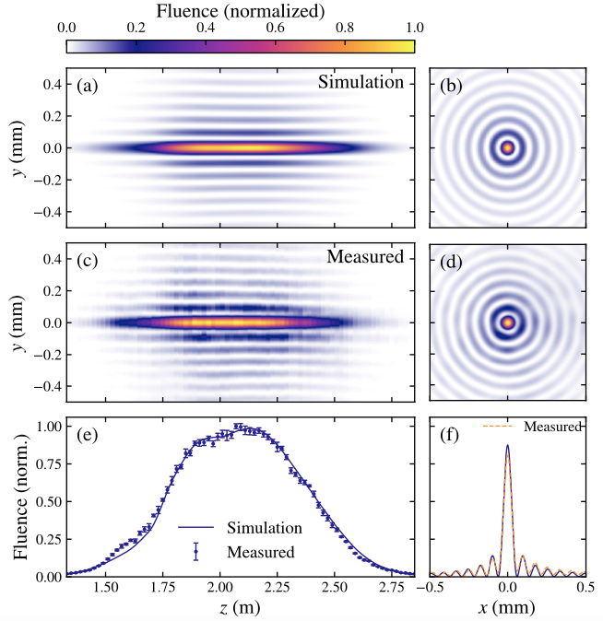
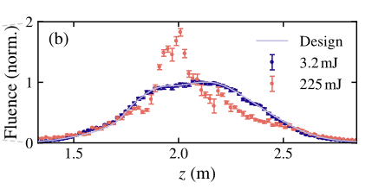
Axial Intensity Profile
Left: At low intensity, laser profile matches prediction with excellent accuracy.
Right: At high intensity, nonlinear effects in a window between Lens A and Lens B produce aberrations in the wave front leading to distortion of the axial intensity profile.
~85 cm x 250 µm, 4x10¹⁶ cm⁻³ plasma filament.
Not ideal, but useable.
Window has been removed for upcoming run.

Slide 7
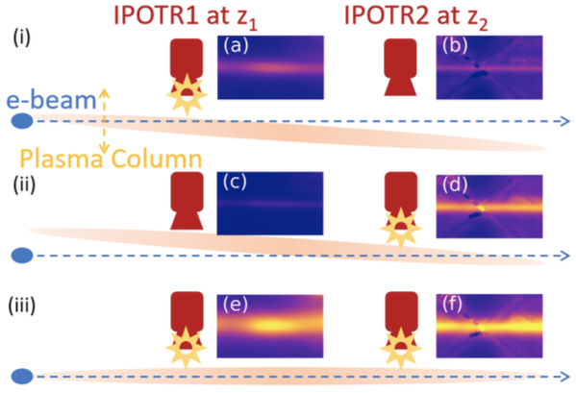
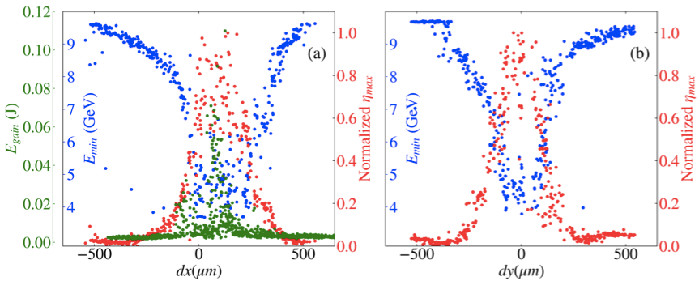
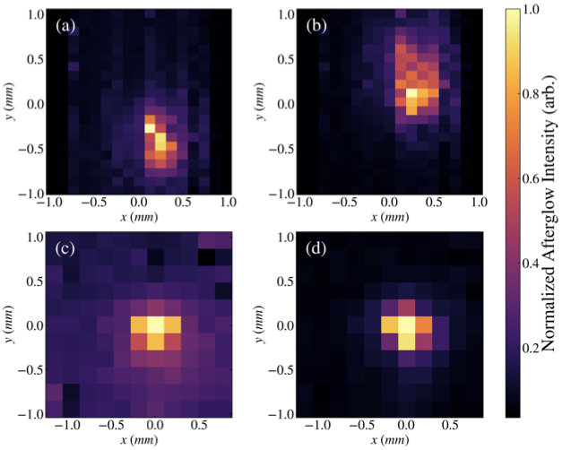
Alignment of Plasma Source to e-Beam
A method was developed for rapid alignment of plasma source to e-beam.
Initial coarse alignment achieved using OTR foils.
Fine alignment achieved using plasma glow after interaction with e-beam. Brighter light = better alignment.
Measurement of drive and witness beam interaction confirmed simple geometric alignment constraint:
Δr: radial offset, Δθ: angular offset
L: length of plasma, R_{p}: radius of plasma, R_{b} radius of blowout
misaligned
aligned
V. Lee, et al., “Precision alignment and tolerance of a plasma wakefield accelerator in a laser-ionized plasma source”, arXiv:2508.16864 (2025)

Slide 8
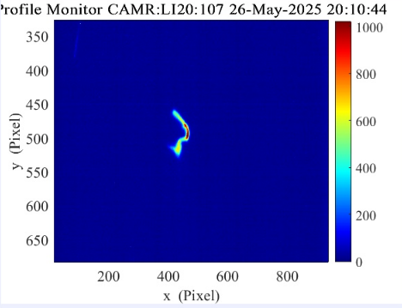
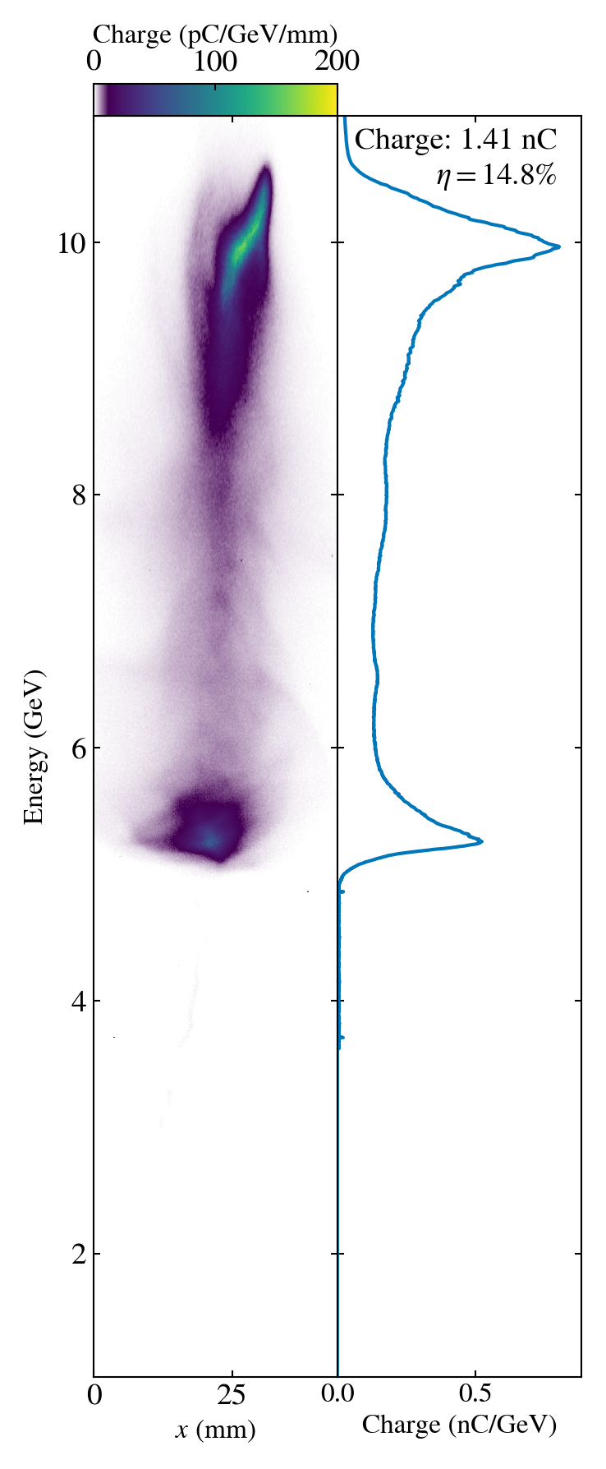
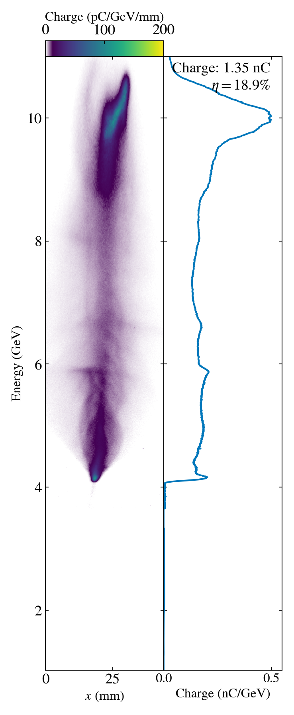
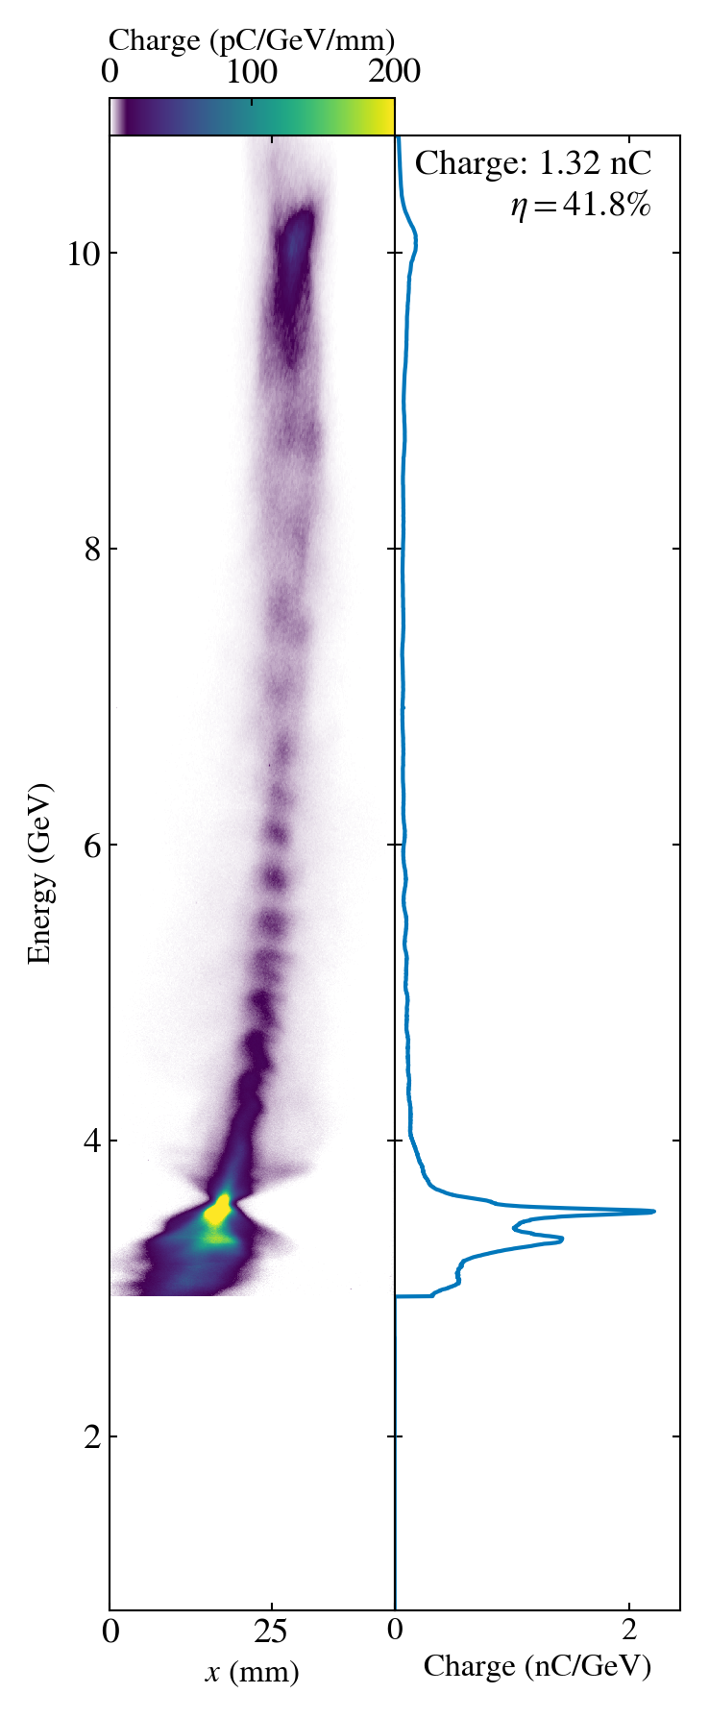
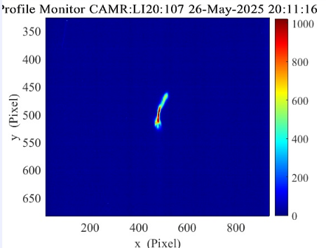
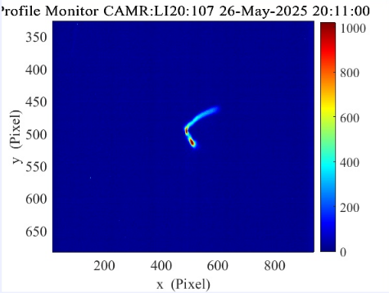
Plasma Interaction Optimization Process
Step 1: Overlap drive and witness in time – both will lose energy driving wake
Step 2: Send into plasma and observe energy loss
Step 3: optimize longitudinal waist location
Step 4: Optimize sextupole tuning to minimize dispersion
TCAV: -90º
TCAV Off
TCAV: +90º
time

Slide 9
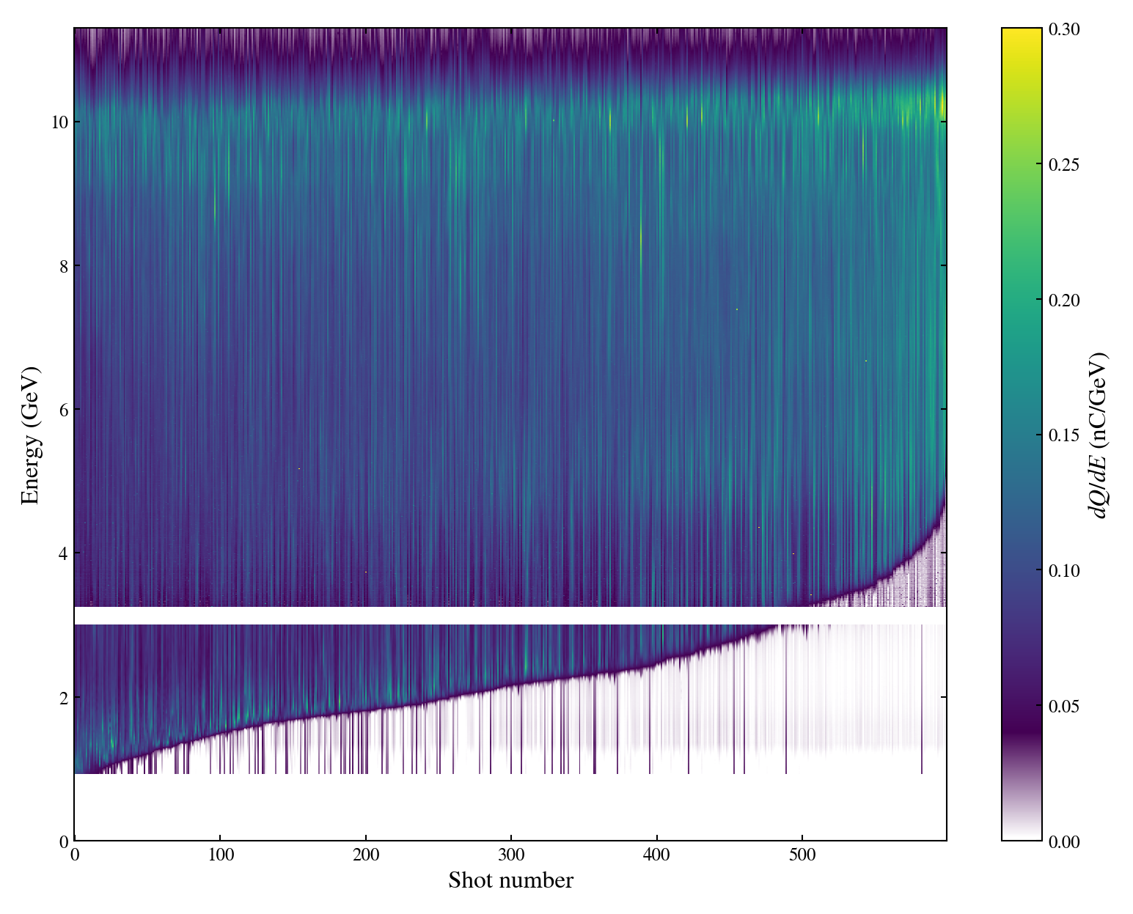
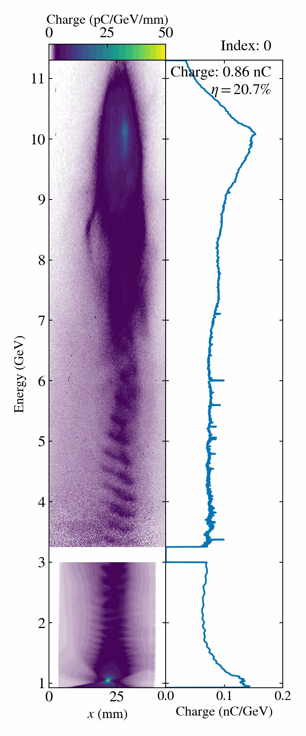
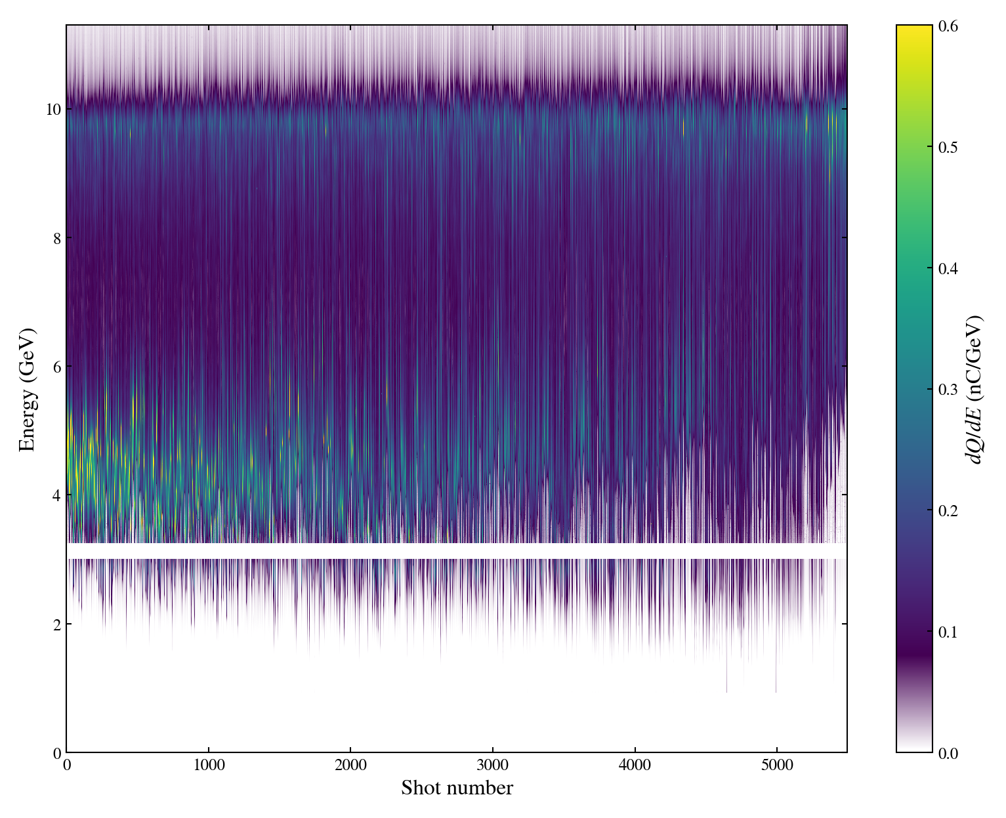
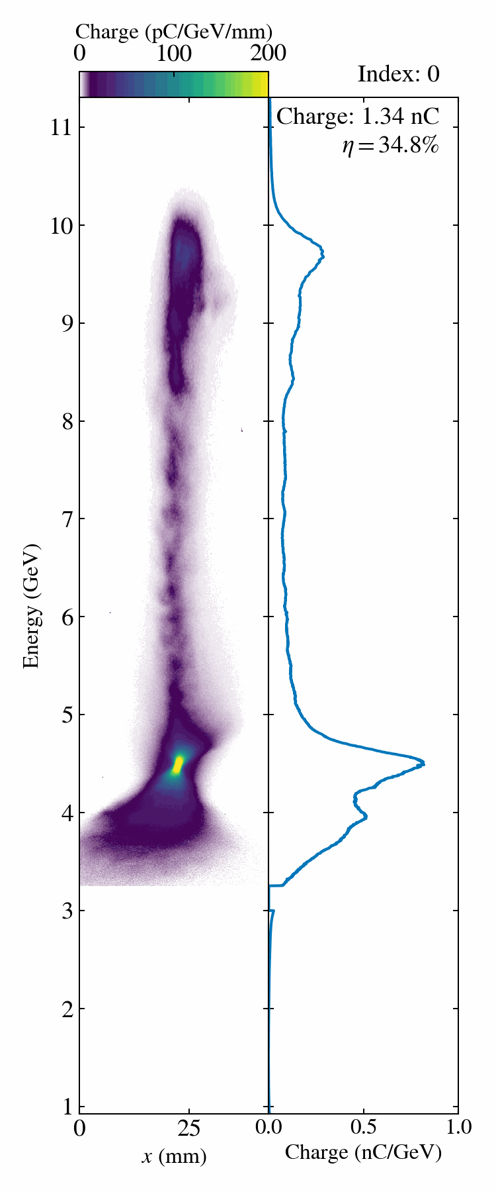
Drive Bunch Depletion and High Efficiency
Drive Beam Depletion
Spectrometer was set to image charge at ≤1 GeV
Many shots show deceleration below 1 GeV
In this data, >200 pC did not participate strongly in the beam-plasma interaction.
High Drive-to-Wake Efficiency
Spectrometer set to image charge at 3.5 GeV
>30% of drive beam energy transferred plasma wake
Best shot achieving 37% → 5.6 Joules of energy deposited in the plasma.

Slide 10
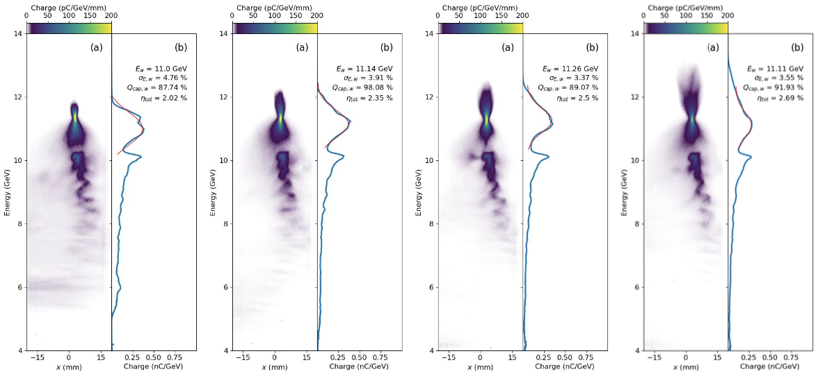
High Charge Capture and Transmission
98% charge capture
Total Charge Capture
Two-bunch data from FACET-II
~1 GeV gain, ~3.5% spread
>90% charge capture of the witness bunch with multi-GeV energy gain
~2.5% total efficiency:
energy gained / init. drive energy
High charge capture enabled by long plasma density ramps
At start of ramp, density is low, and wake bubble is large
Density then increases adiabatically, gradually focusing down beam with wake bubble

Slide 11
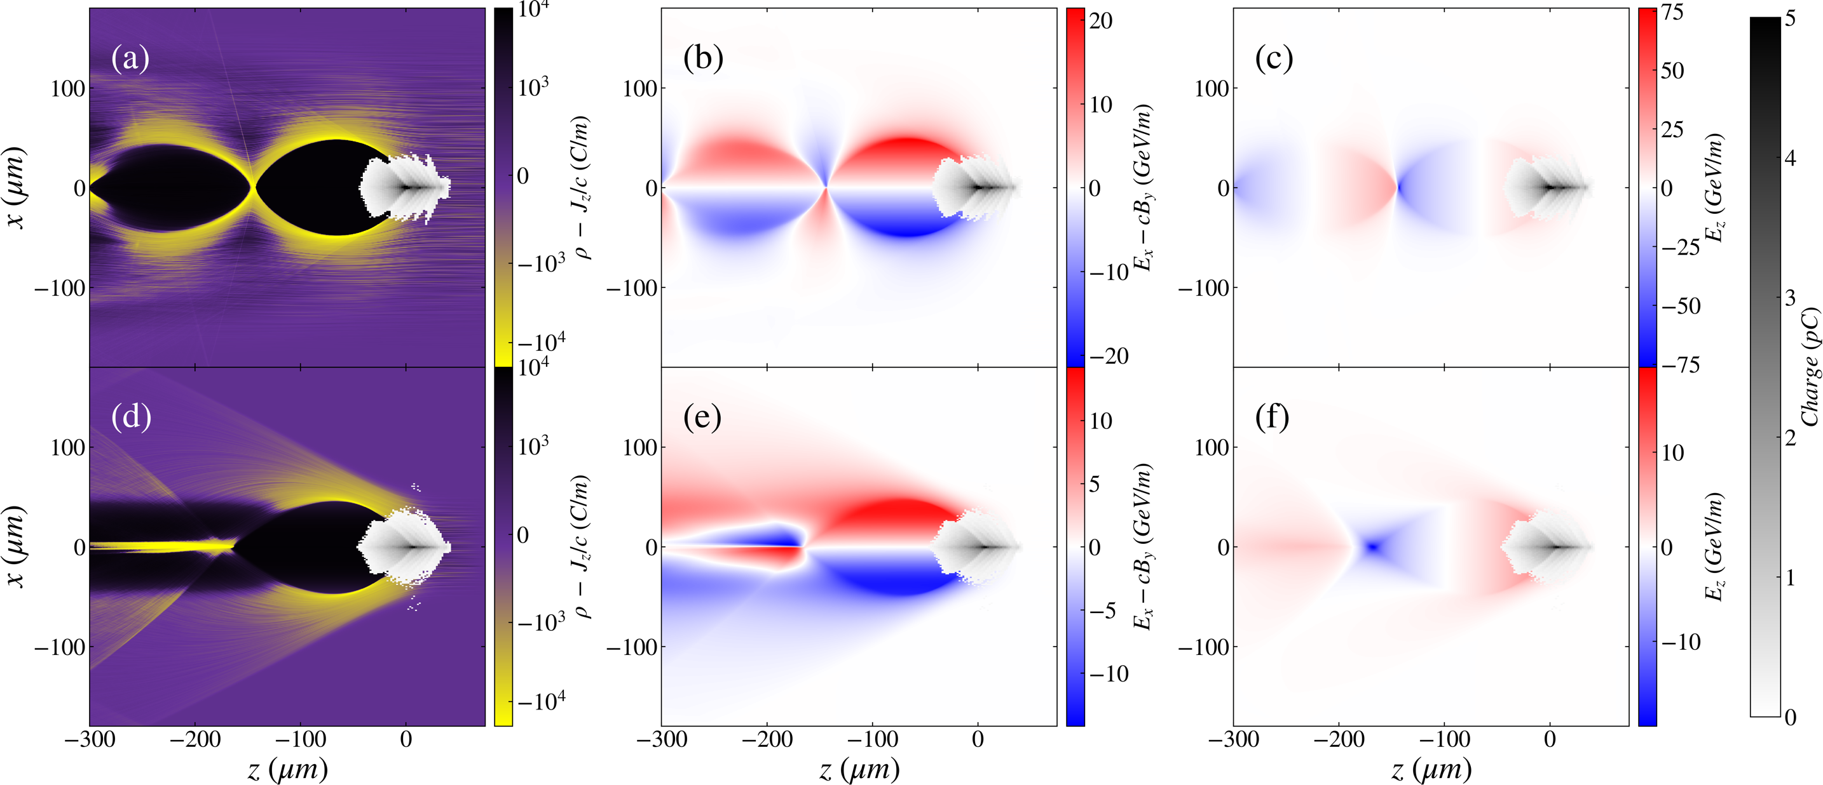
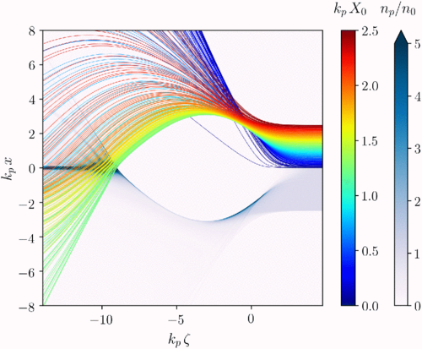
E-333 Experiment at FACET-II
PWFA in a narrow plasma channel → toward positron PWFA
S. Diederichs, et al., Phys. Rev. Accel. Beams 22, 081301 (2019)
e⁻ driver
Wide Channel
e⁺ goes here
Narrow Channel
Science Goals:
Demonstrate ability to control plasma channel radius
Measure PWFA response to narrowing of plasma channel
  Guiding of e-beams along channel
  Elongation of plasma wake bubble
Focusing for Positrons
Accelerating for Positrons

Slide 12
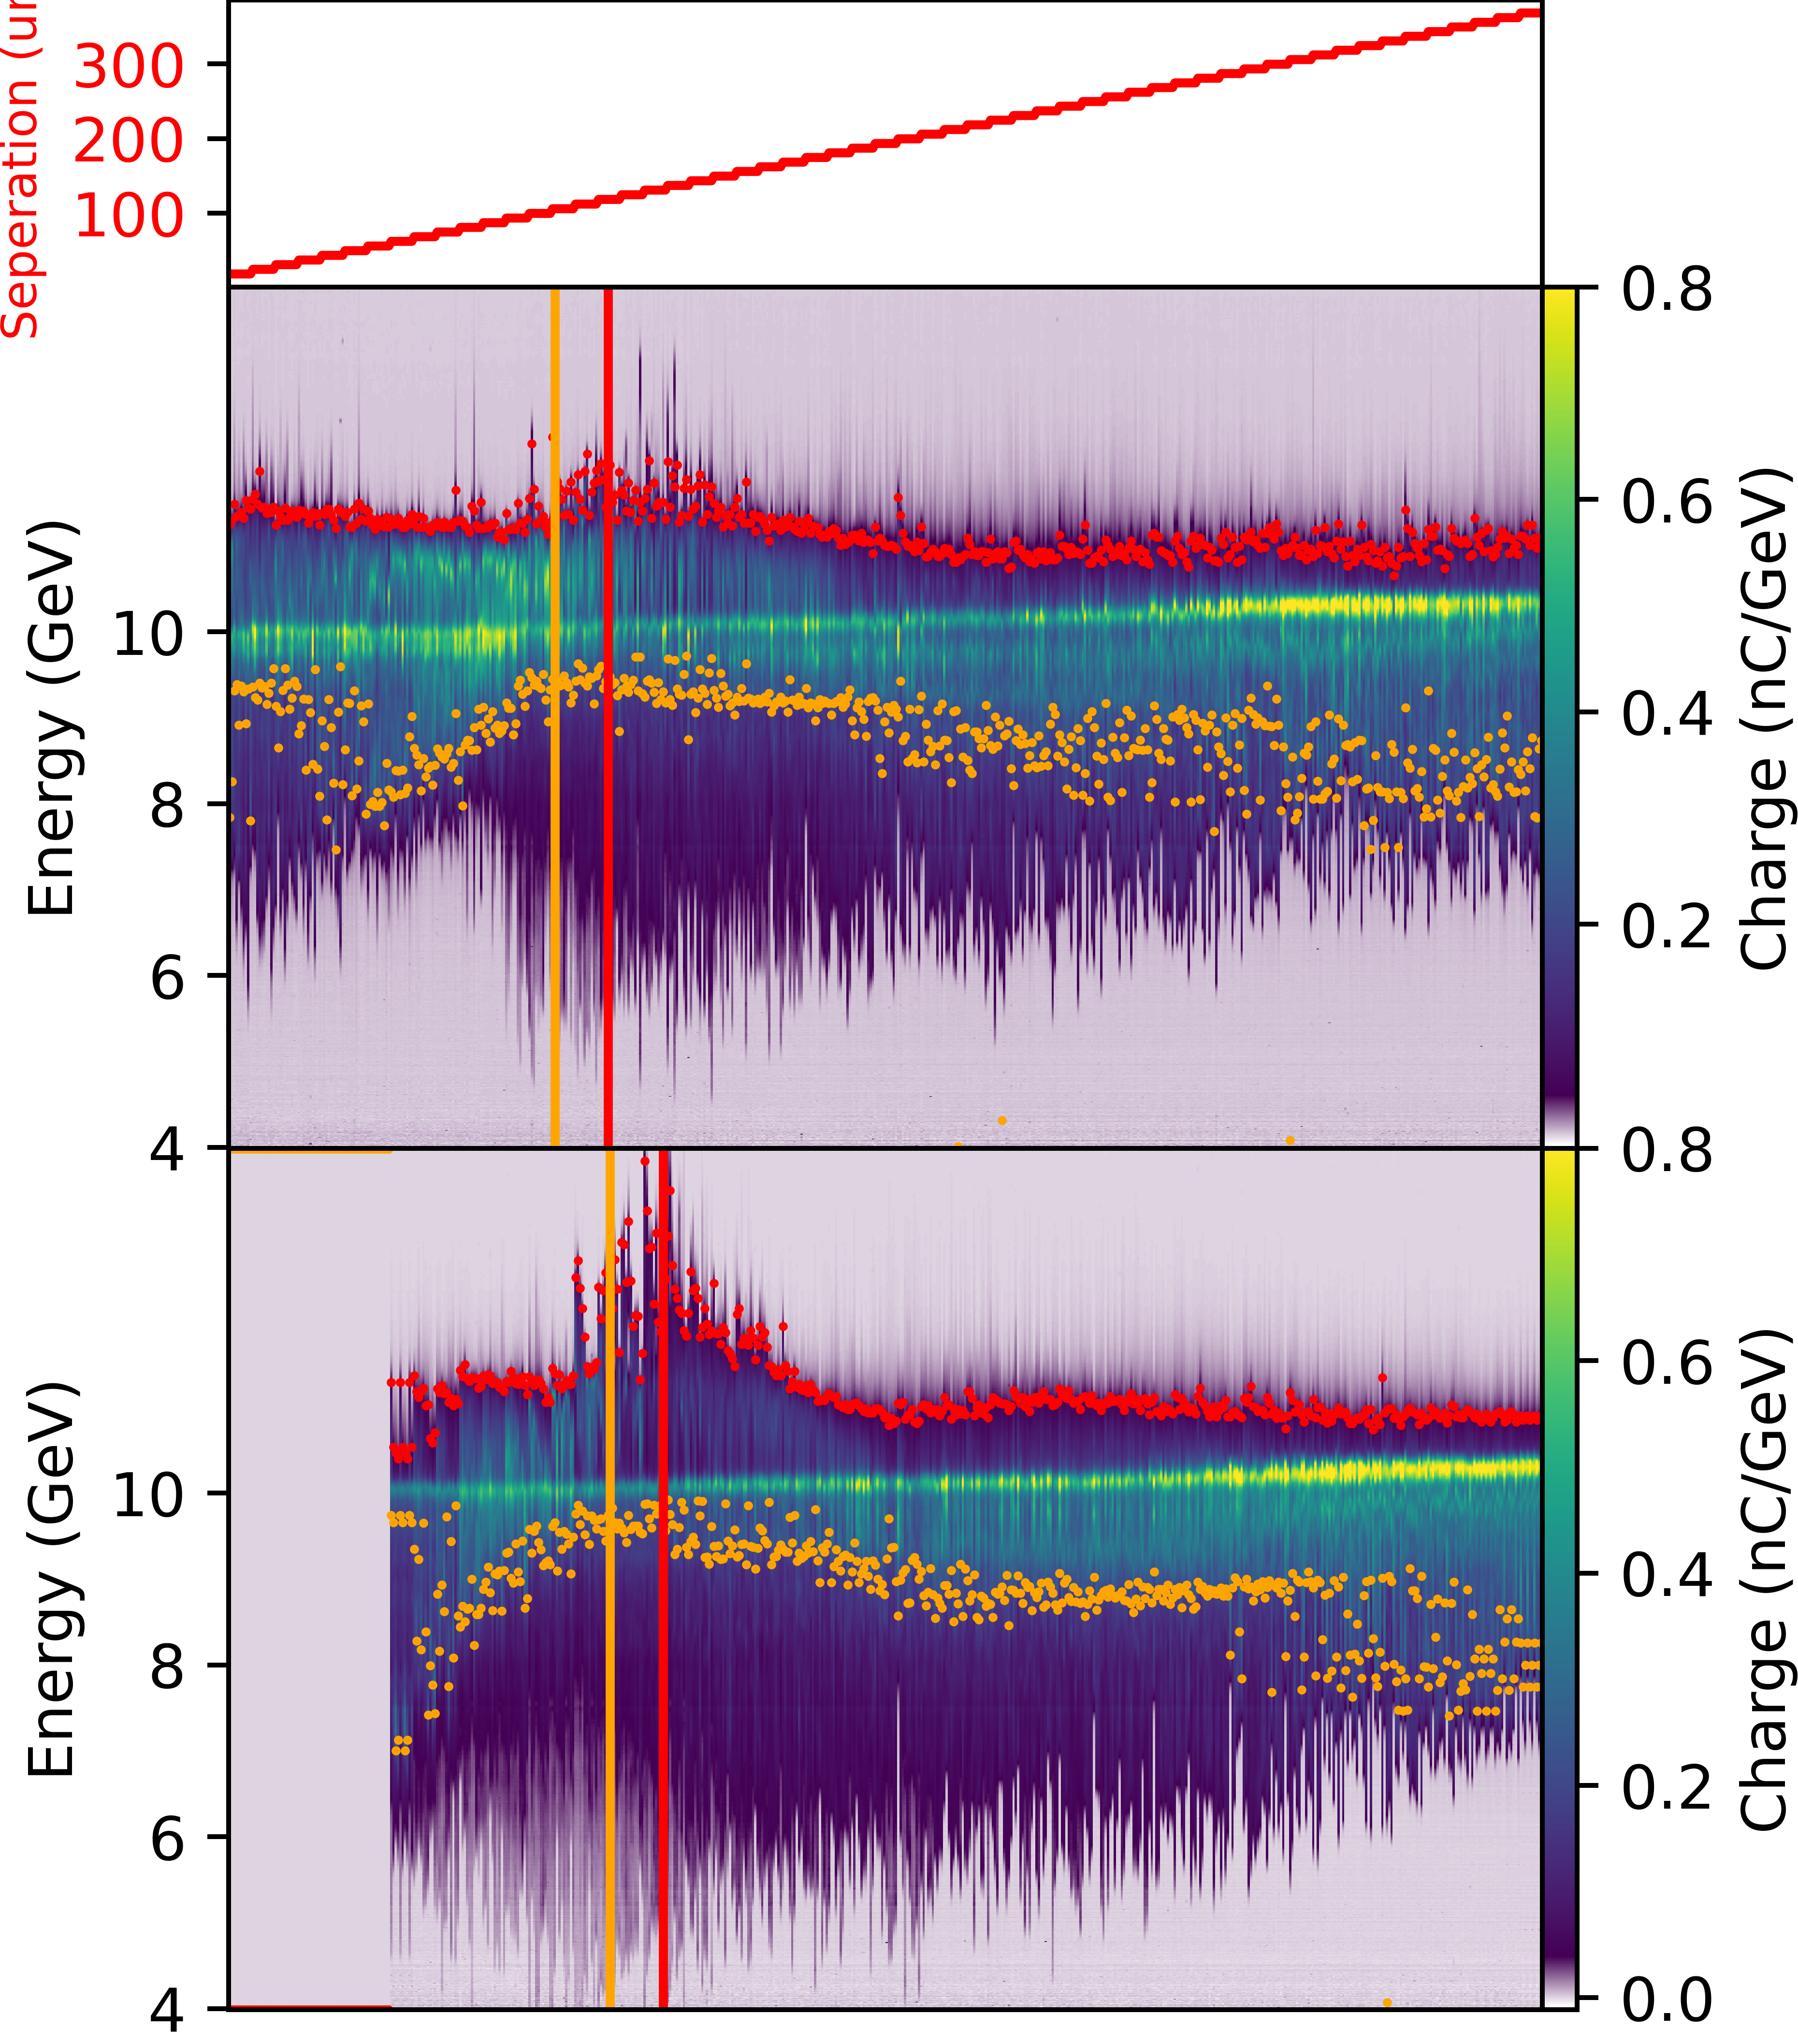
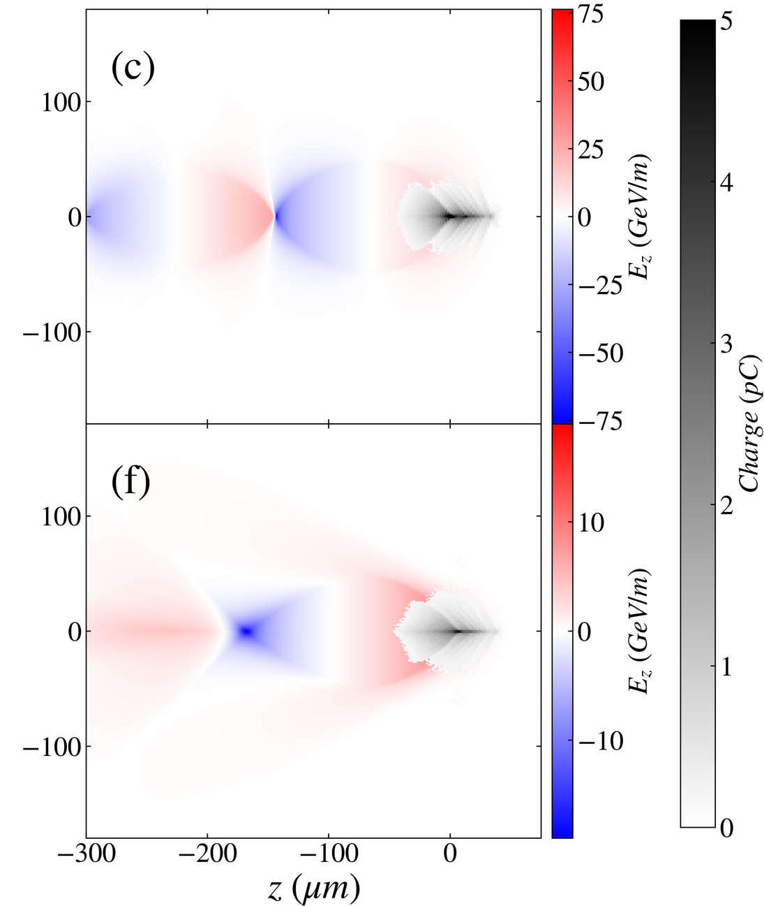
Elongated Wake Measurement
Drive-Witness Separation Scan
Reduced plasma width by reducing laser energy
Scanned drive/witness separation from 0 to 400 µm
Observed shift of max acceleration and min deceleration location by ~20 µm in narrow plasma
Qualitative agreement with expectations
Detailed simulation campaign ongoing
Wide Channel
Narrow Channel
[no data]
orange: min. decel.
red: max accel.

Slide 13
Summary
E-301: PWFA in laser-ionized gas plasma
Performed PWFA in meter-scale laser-ionized unconfined H₂ plasma source
Achieved drive beam depletion: ~35% drive-to-wake efficiency, ~5 J energy deposition
Achieved total charge capture: >90% charge capture, 1 GeV gain, 2.5% total efficiency
Demonstrated importance of long plasma ramps for charge capture
E-333: PWFA in narrow-channel plasma
Generated plasma channel with width smaller than blowout radius
Compared wide channel and narrow channel PWFA
Observed expected elongation of wake in narrow channel

Slide 14
Publications
R. Ariniello, V. Lee, M. Litos, “Demonstration of a tandem lens for producing shaped laser-ionized plasmas for plasma wakefield acceleration”, arXiv:2509.01747 (2025) [submitted for publication]
R. Ariniello, et al., [PWFA in a laser-ionized gas, in preparation]
V. Lee, et al., “Precision alignment and tolerance of a plasma wakefield accelerator in a laser-ionized plasma source”, arXiv:2508.16864 (2025) [submitted for publication]
V. Lee, et al., [PWFA in a narrow plasma channel, in preparation]

