Slide 1
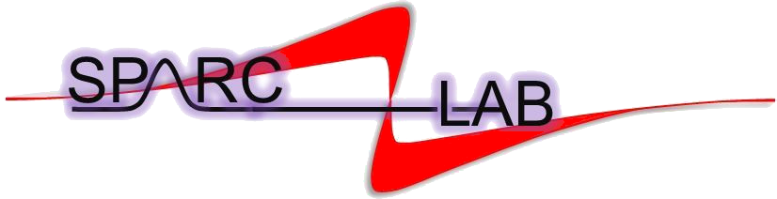

Experimental Validation of the EuPRAXIA@SPARC_LAB Nominal Working Point via RF Compression at SPARC_LAB
G. J. Silvi and A. Giribono
INFN-LNF
On behalf of the SPARC_LAB collaboration
*silvigil@lnf.infn.it
This project has received funding from the European Union´s Horizon Europe research and innovation program under grant agreement No. 101079773
7th European Advanced Accelerator Conference (EAAC2025) September 21-27, 2025

Slide 2


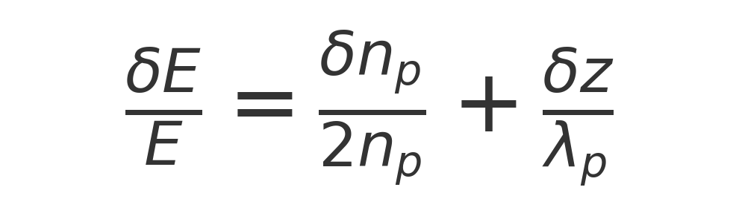
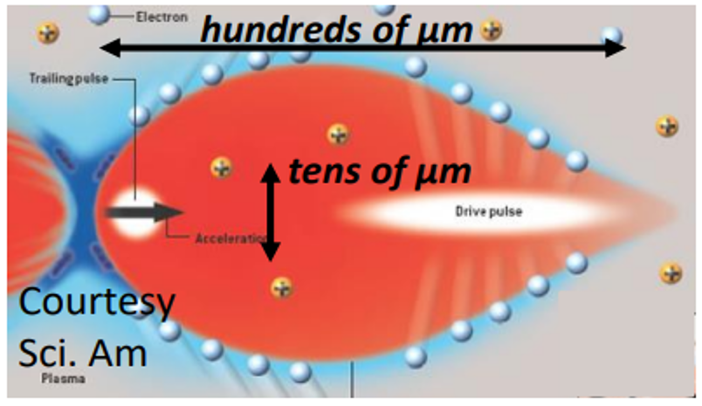
Outlook of the experiment
Advanced Photoinjector → PWFA Matching Requirements
Beam quality requirements for plasma injection:
High brightness
  µm-scale bunch length & transverse size → good accelerated beam quality
  fs-scale precision in bunch spacing → low energy jitter
  Controlled bunch shape & peak current → minimized energy spread
How they are achieved:
RF compression stage in velocity bunching configuration
  Plasma–based experiment @SPARC_LAB
Innovative RF compression: performed in two accelerating sections of the photoinjector:
  Strong bunch length reduction
  Mitigation of emittance growth
Laser comb with velocity bunching: Preliminary results at SPARC”, M. Ferrario et al., NIMA vol 637 (2011)
Beam manipulation with velocity bunching for PWFA applications”, R. Pompili et al., NIMA vol. 829 (2016)
Focusing of High-Brightness Electron Beams with Active-Plasma Lenses”, R. Pompili et al., Phys. Rev. Lett. vol. 121 (2018) Energy spread minimization in a beam-driven plasma wakefield accelerator”, R. Pompili et al., Nature Phys. vol. 17 (2021)
First emittance measurement of the beam-driven plasma wakefield accelerated electron beam”, V. Shpakov et al., PRAB
Free-electron lasing with compact beam-driven plasma wakefield accelerator”, R. Pompili et al., Nature vol. 605 (2022
Stable Operation of a Free-Electron Laser Driven by a Plasma Accelerator”, M. Galletti et al., PRL vol. 129 (2022
Acceleration and focusing of relativistic electron beams in a compact plasma device”, R. Pompili et al., PR E vol. 109 (2024)
Nominal working point:
30+200 pC comb beam optimized for plasma
injection and versus static and dynamic errors

Slide 3
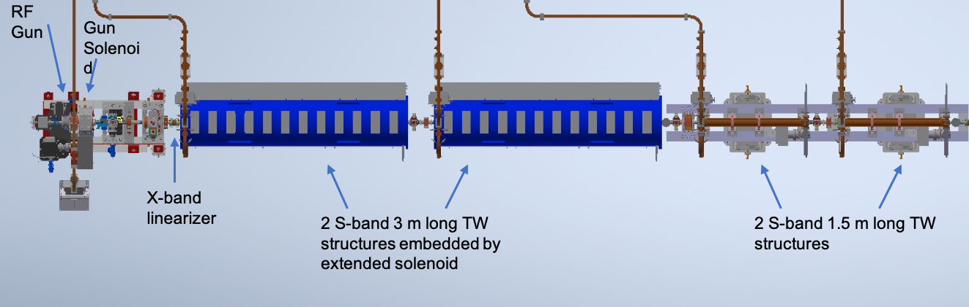
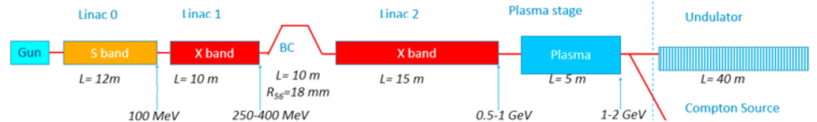
EuPRAXIA@SPARC_LAB RF injector
A. Giribono et al. EuPRAXIA@SPARC_LAB, The high brightness RF photo injector layout proposal, NIMA (2018)
G.J Silvi et al. "Beam dynamics optimization of Eu-PRAXIA@SPARC_LAB RF injector" IPAC’23, paper WEPA040
G.J Silvi et al., Optimizing beam dynamics in the EuPRAXIA@SPARC_LAB RF injector, SIF Congress 2023

Slide 4
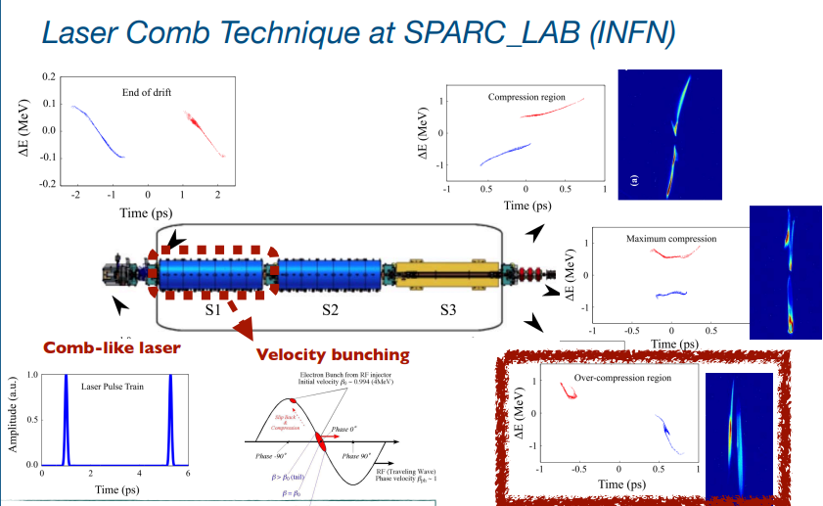
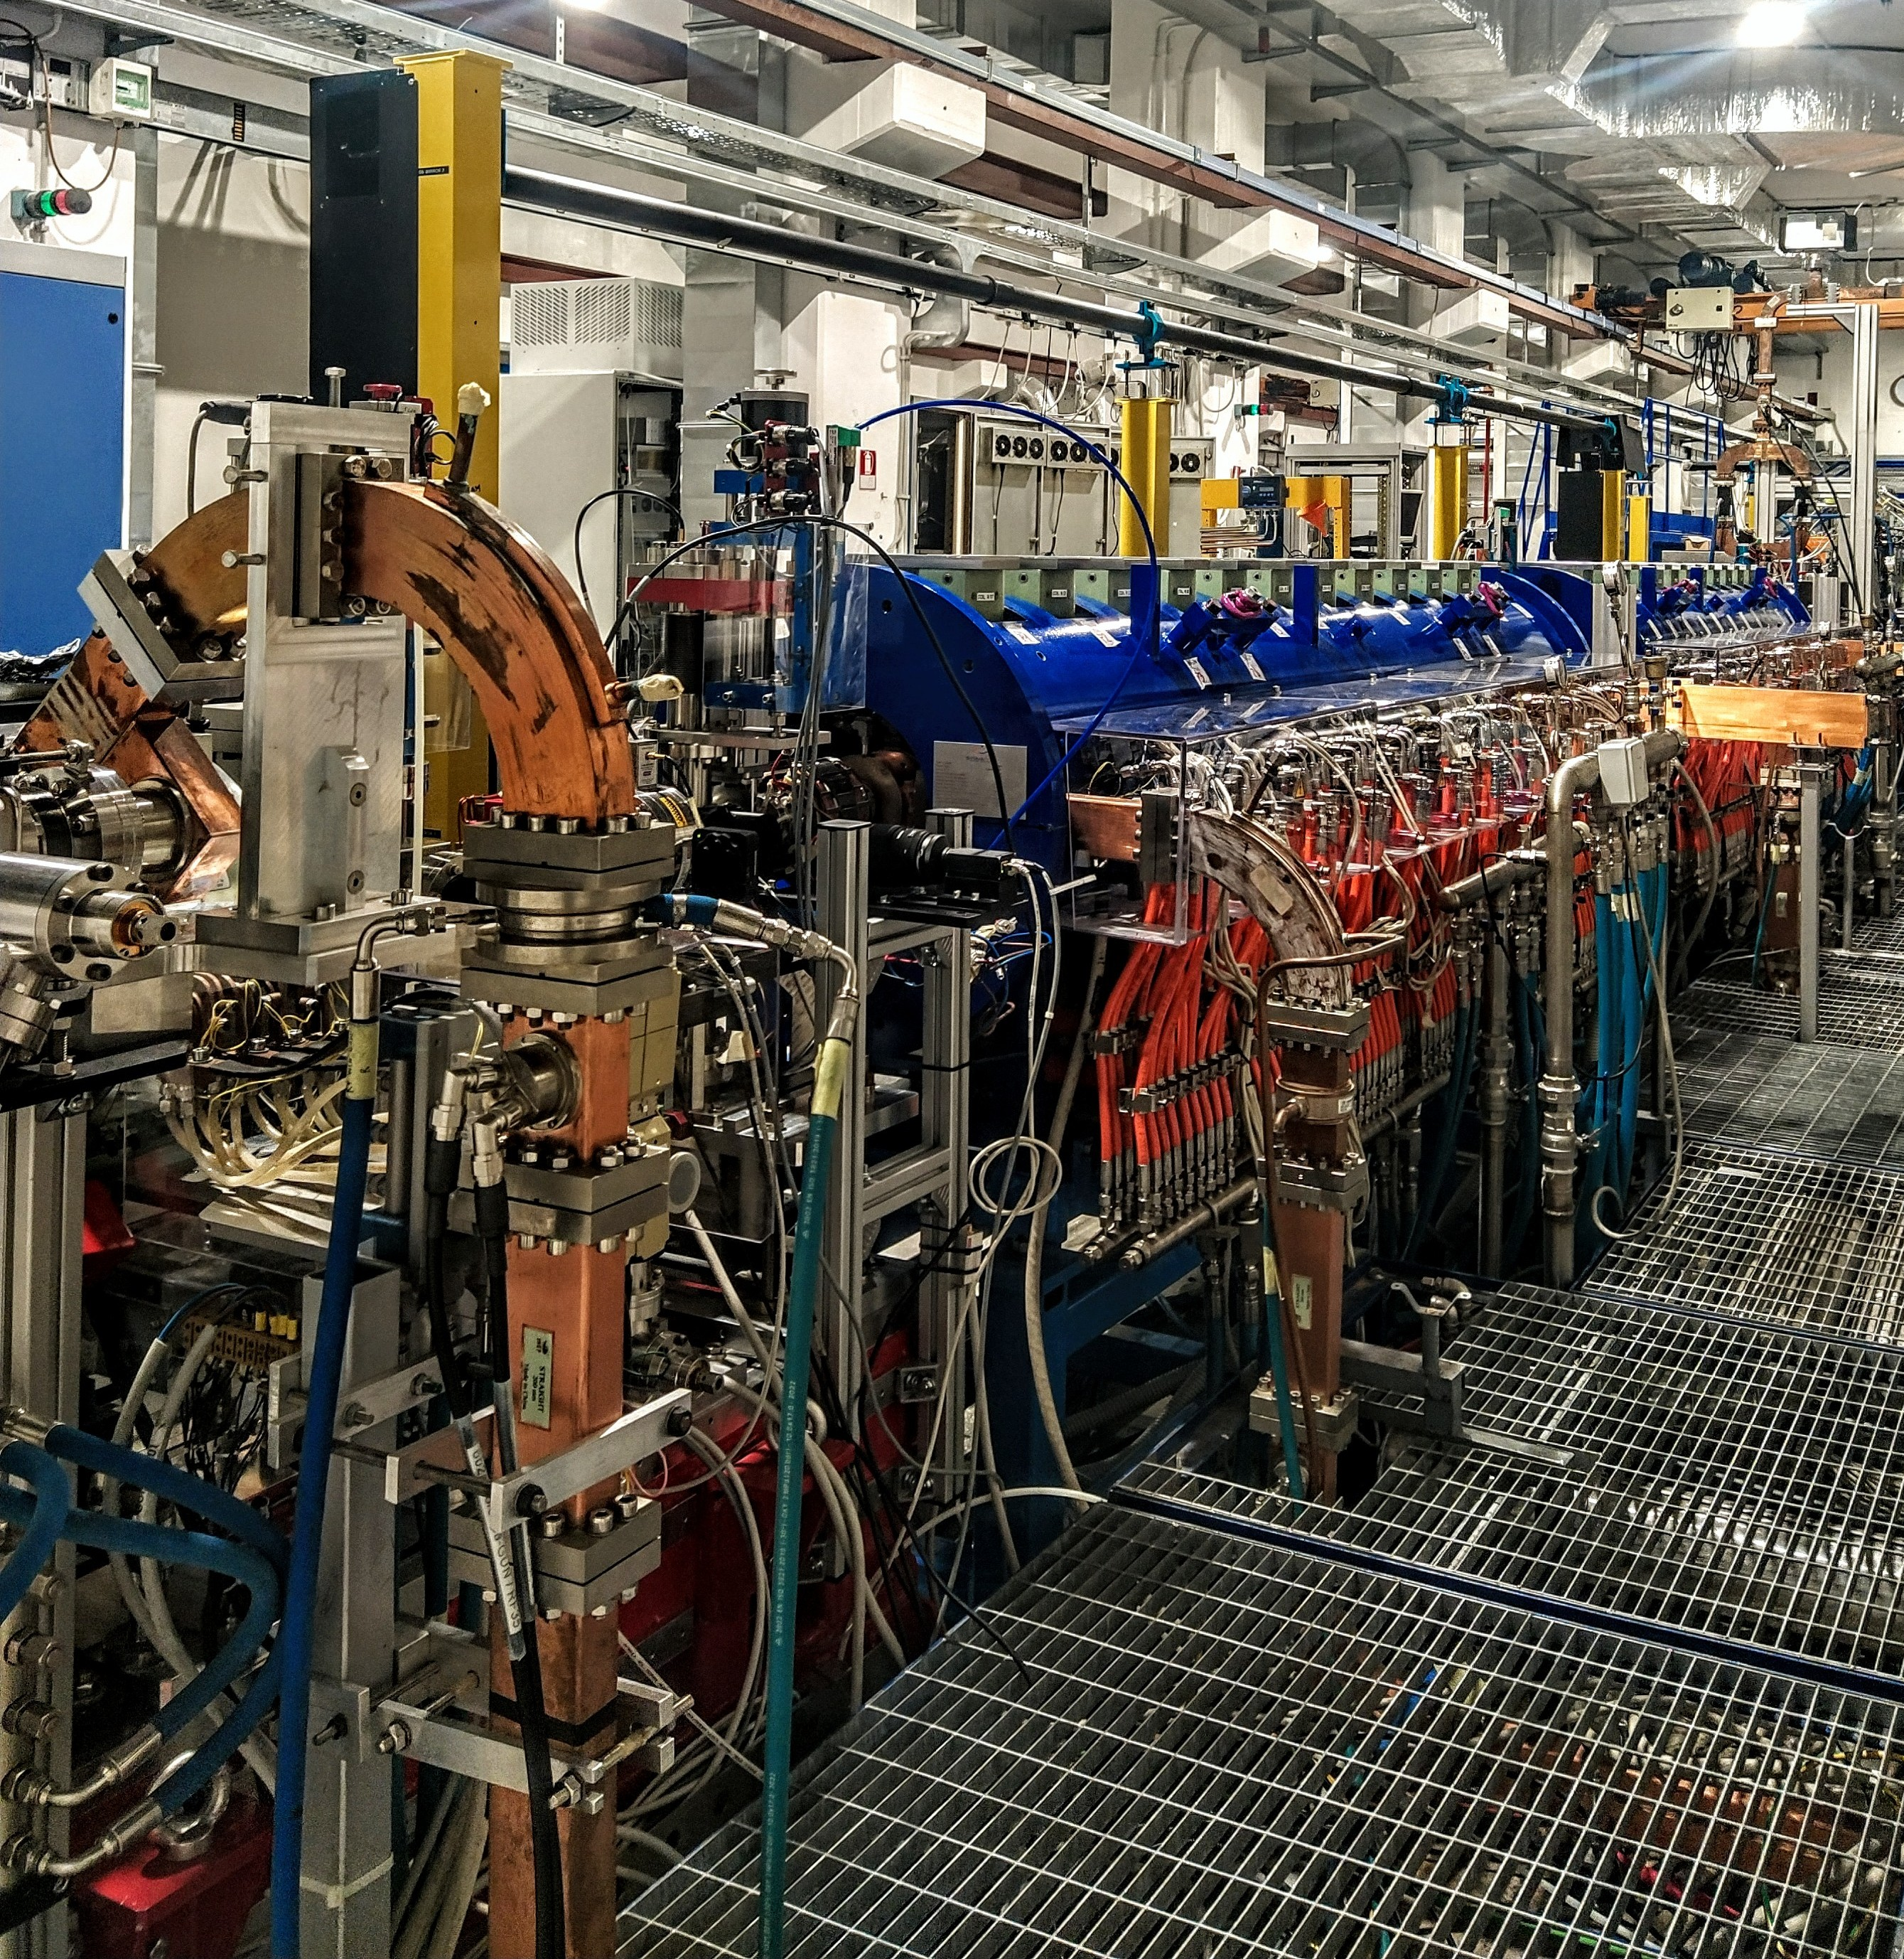
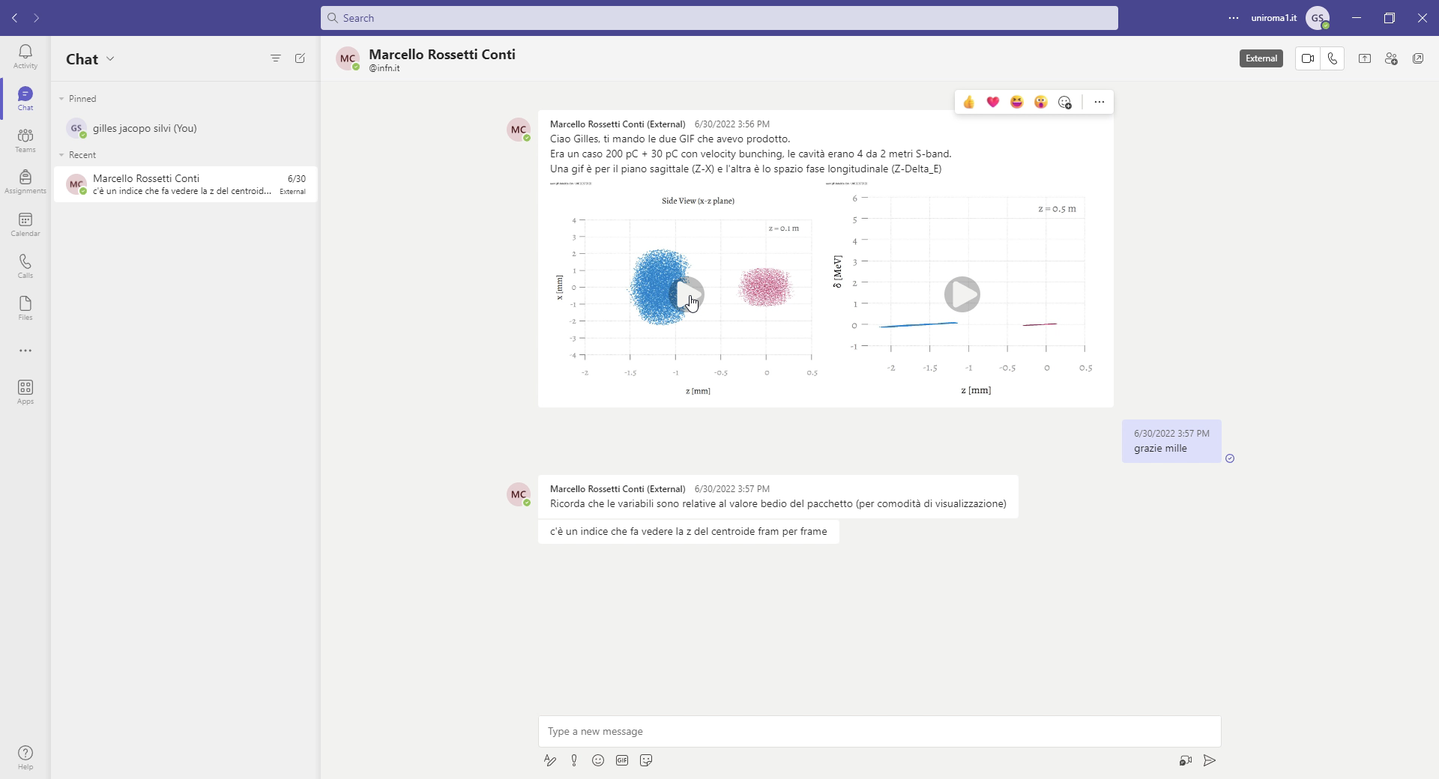
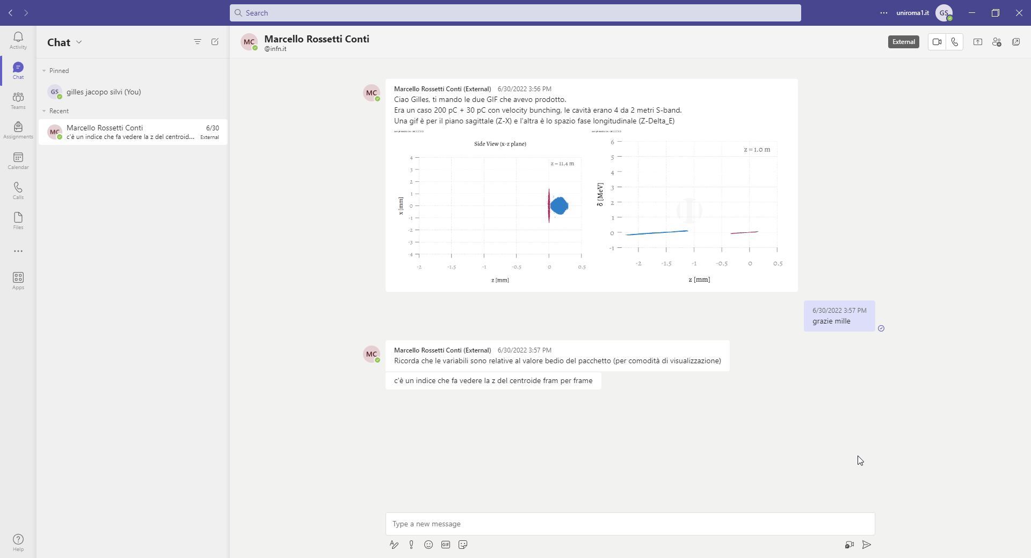
SPARC_LAB RF Linac
Courtesy of E.Chiadroni
L. Serafini and M. Ferrario, AIP Conf. Proc. No. 581 (AIP, New York, 2001), p. 87.
M. Ferrario et al., Phys. Rev. Lett. 104, 054801 (2010) 3.
S. G. Anderson et al., Phys. Rev. ST Accel. Beams 8, 014401 (2005)
M. Ferrario et al. Laser comb with velocity bunching: Preliminary results at SPARC, Nuclear Instruments and Methods in Physics Research Section A: Accelerators, Spectrometers, Detectors and Associated Equipment, Volume 637, 2011.

Slide 5
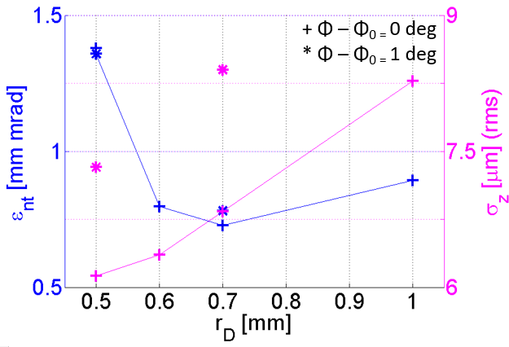
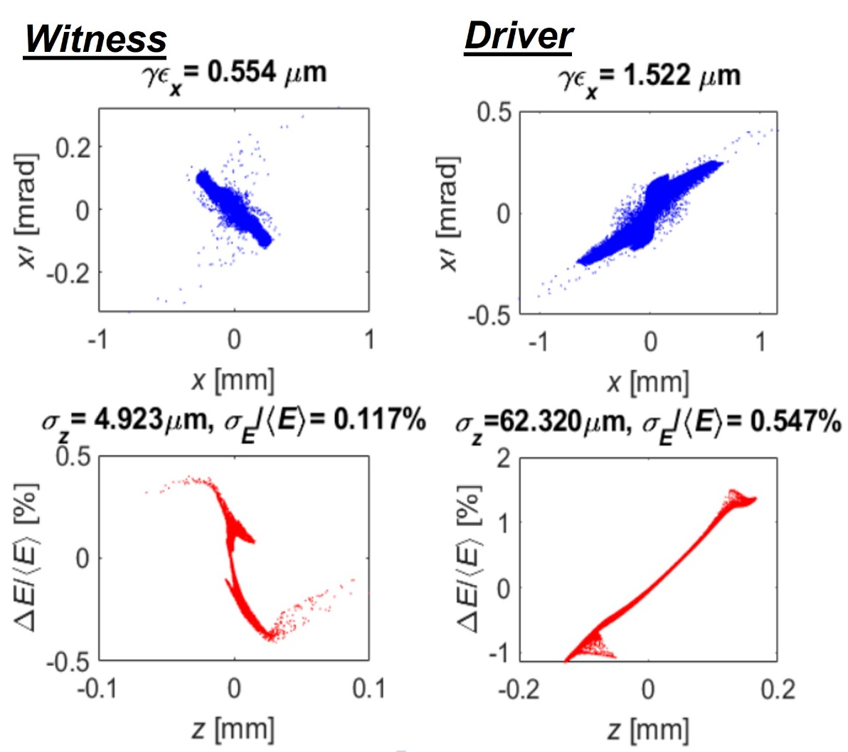
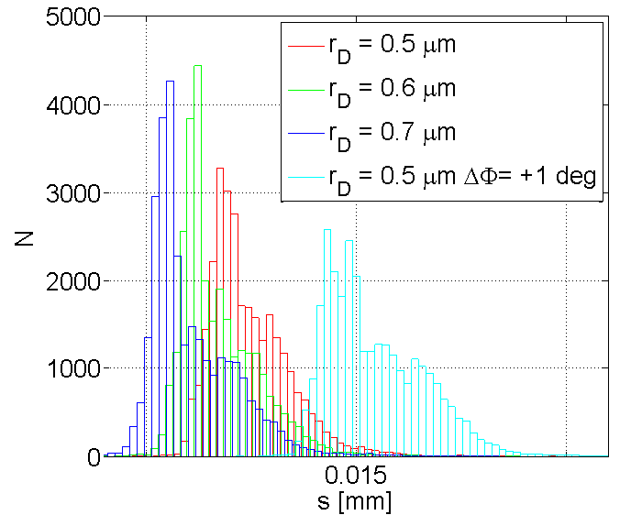
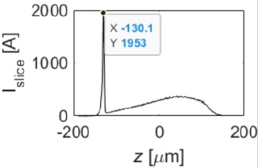
  Beam dynamics studies for the design of the EuPRAXIA@SPARC_LAB accelerator: the photo-injector
The beam dynamics has been studied by means of simulations with the TStep
  The witness and driver distribution on the cathode has been chosen looking at the witness quality that depends on the density of the beams at the overlapping point
  Double-VB is applied in the first and second S-band acc. structures → this scheme ensures at same time up to 2 kA peak current and separation lower than 0.6 ps at plasma entrance (up to 3 kAmps at FEL entrance)
A. Giribono et al, Electron beam analysis and sensitivity studies for the EuPRAXIA@SPARC_LAB RF injector, J.Phys.Conf.Ser. 2687 (2024) 3,
G.J. Silvi et al. "Beam dynamics optimization of Eu-PRAXIA@SPARC_LAB RF injector" J.Phys.Conf.Ser. 2687 (2024) 6, 062024
A. Giribono et al. EuPRAXIA@SPARC_LAB: The high-brightness RF photo-injector layout proposal, https://doi.org/10.1016/j.nima.2018.03.0

Slide 6
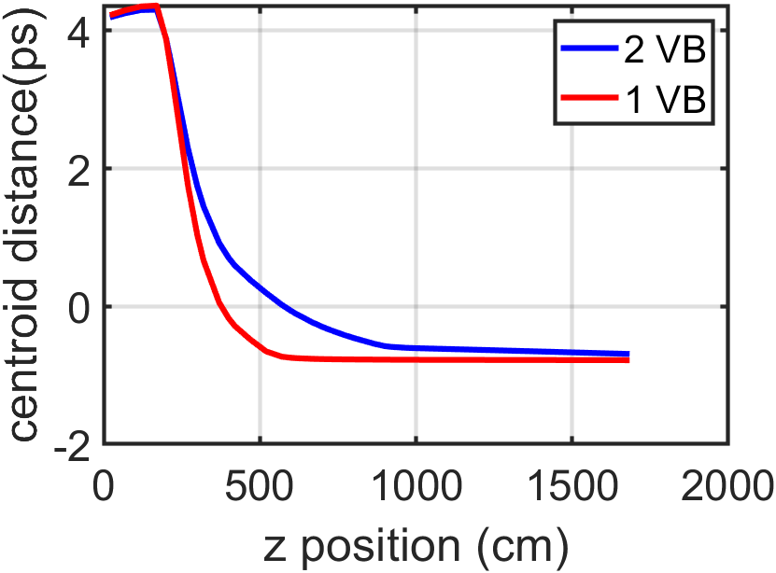
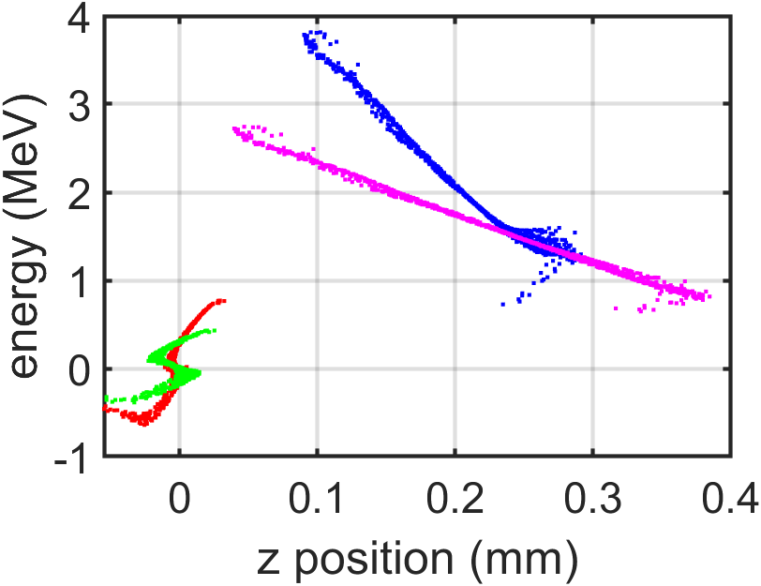
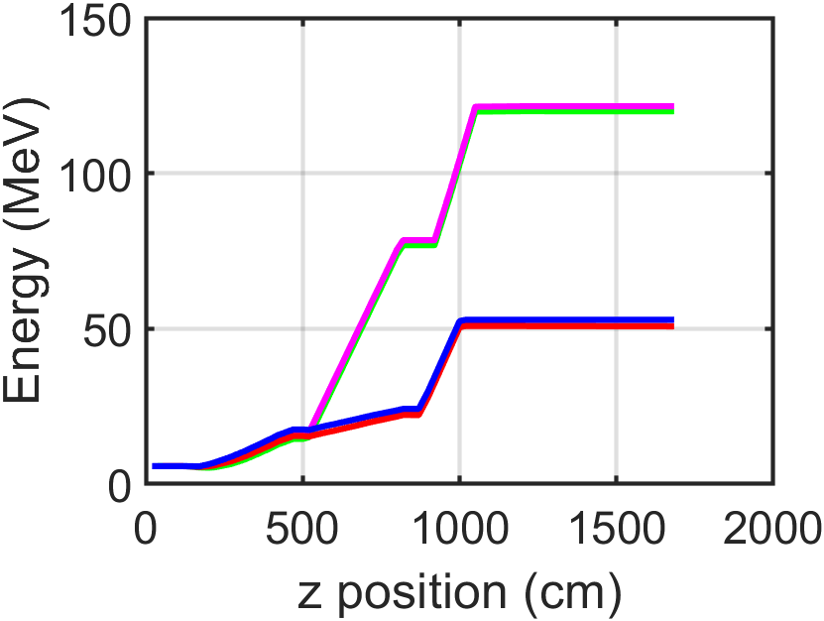
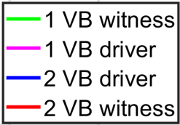
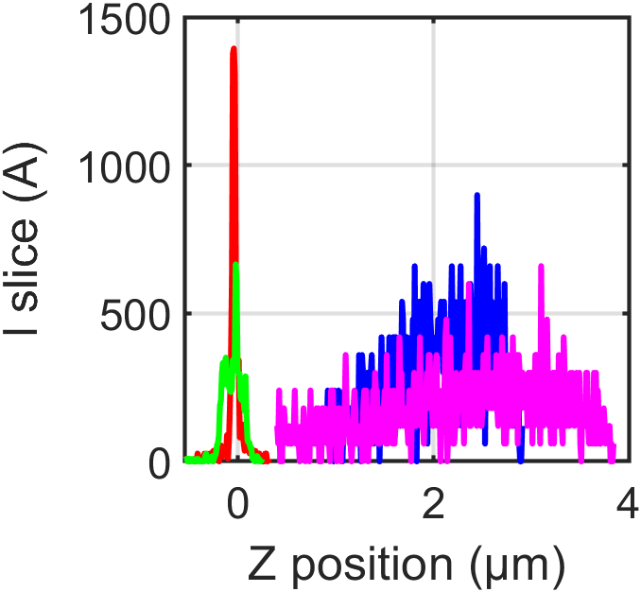
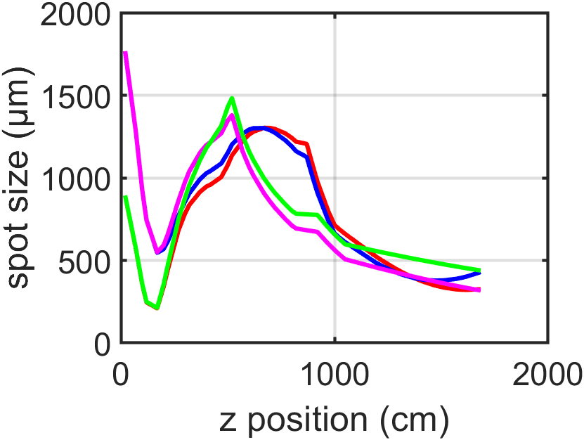
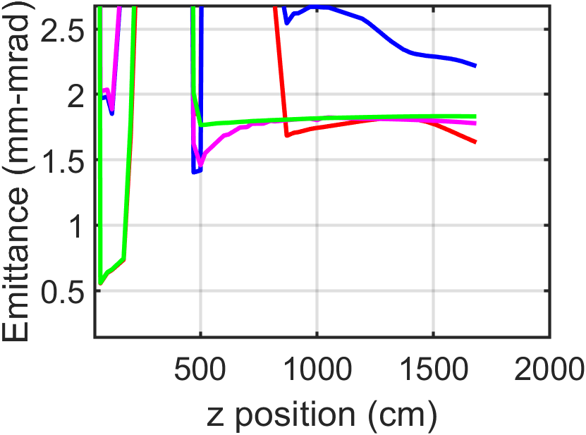




Experiment preparation @SPARC: beam dynamics simulations
$$σ_{T}=52 um$$
$$σ_{T}=9,2 um$$
$$σ_{T}=9,4 um$$
$$σ_{T}=88 um$$
Witness/driver emittance Eu (mm-mrad) | Witness/driver emittance SPARC 2 VB (mm-mrad) | Witness/driver emittance SPARC 1 VB (mm-mrad)
0,55 @120 MeV | 1,6 @51MeV 1,6*51/120=0,68 | 1,70 @120MeV 1,7*120/120=1,7
1,6 @ 120MeV | 2,2 @ 51MeV 2,2*51/120=1,12 | 1,83@120 MeV 1,83*120/120=1,83

Slide 7
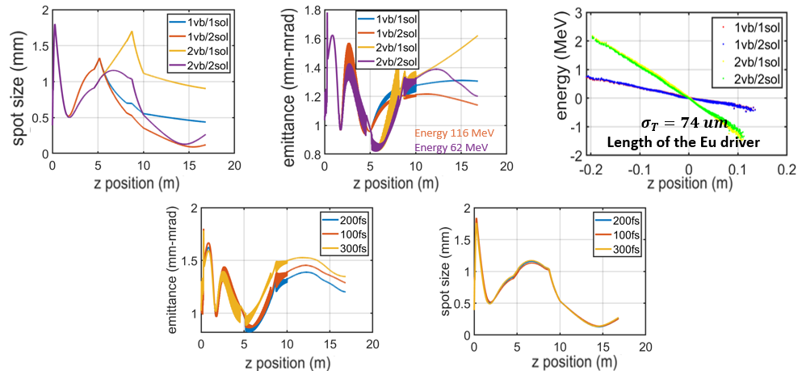
Experiment preparation @SPARC: beam dynamics simulations
Due to a laser pump failure, we could no longer generate the comb and therefore switched to a single bunch

Slide 8
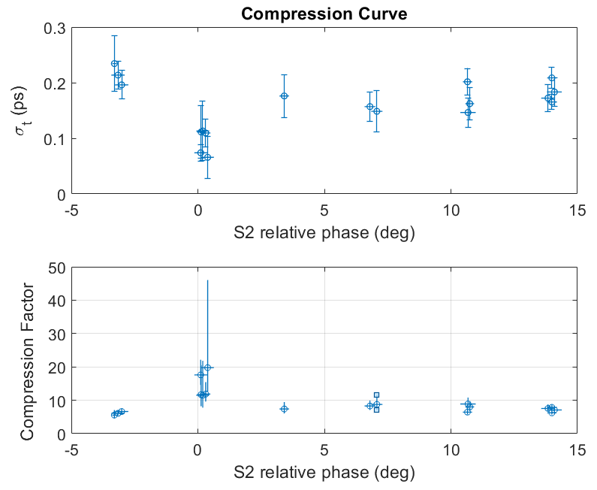
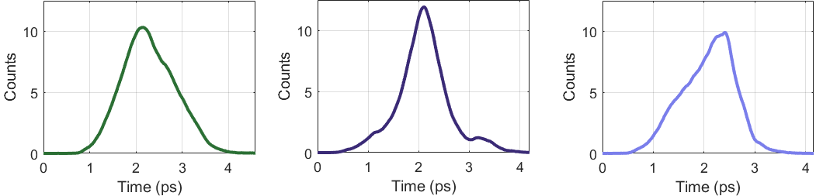
Compression curve
Recent Experimental Results from two-week dedicated shift (including machine failures) in March 2025
Single bunch mode, with ~300 pC charge
The compression curve has been characterised in terms of bunch length, energy, emittance and envelope through the machine
Minimum measured bunch length of ~65 fs (rms) with normalized emittance: 4 mm·mrad at 65 MeV
RF voltage and phase jitter of the photoinjector strongly impact on the beam temporal stability. Measured jitters are compliant with numerical studies. Notice that RF voltage and phase jitter are respectively one order of magnitude and doubled with respect to the ones foreseen at EuPRAXIA@SPARC_LAB and that, in this range values and mode of operation, bunch temporal jitters are linear with RF jitter
📌 Target beam parameters for the driver beam for EuPRAXIA@SPARC_LAB WP (@120 MeV)
Charge | 200-400 pC
Bunch length | ~ 160 fs (rms)
Normalised Emittance | ≤4 mm·mrad @120MeV
σ_{t} = 65 fs
ϵ_{n} = 4.0 mm-mrad @65 MeV
Measured compression curve as a function of the phase of the second accelerating cavity around the zero crossing

Slide 9
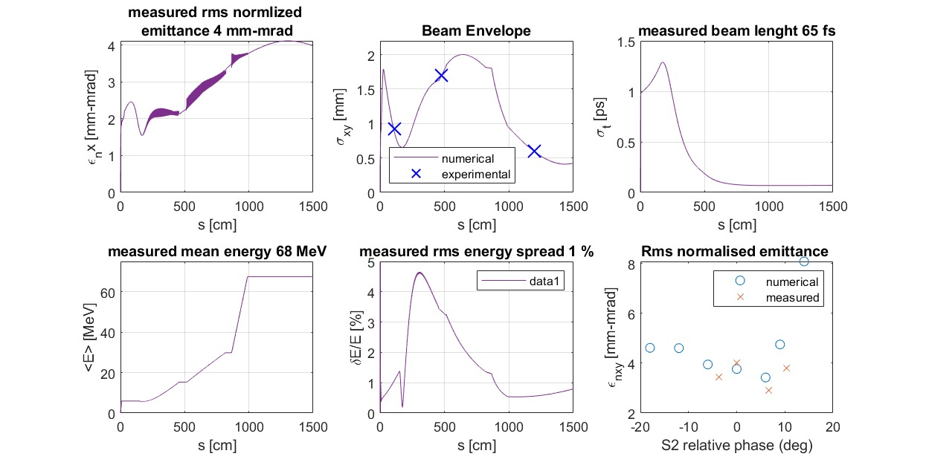
Comparison with numerical results

Slide 10
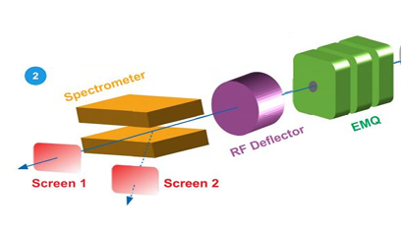

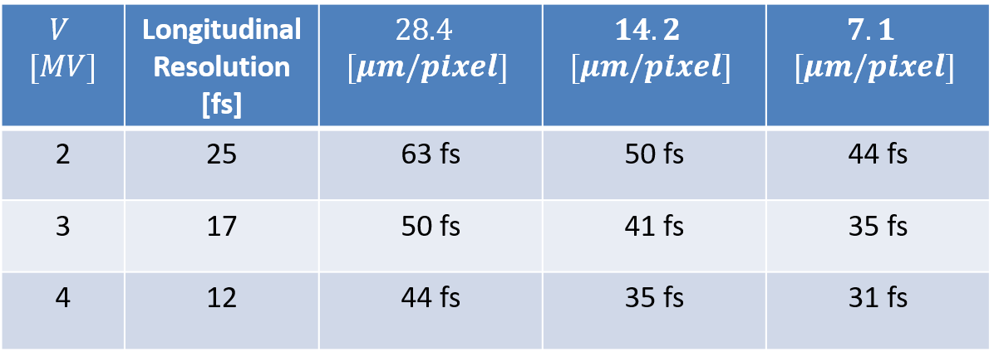
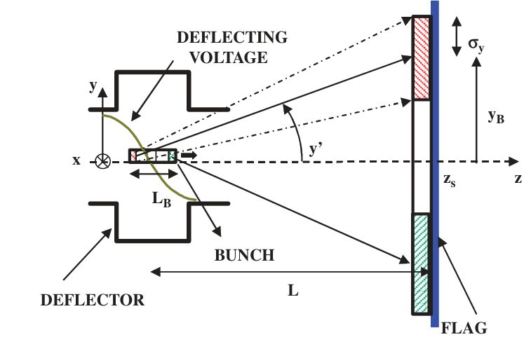
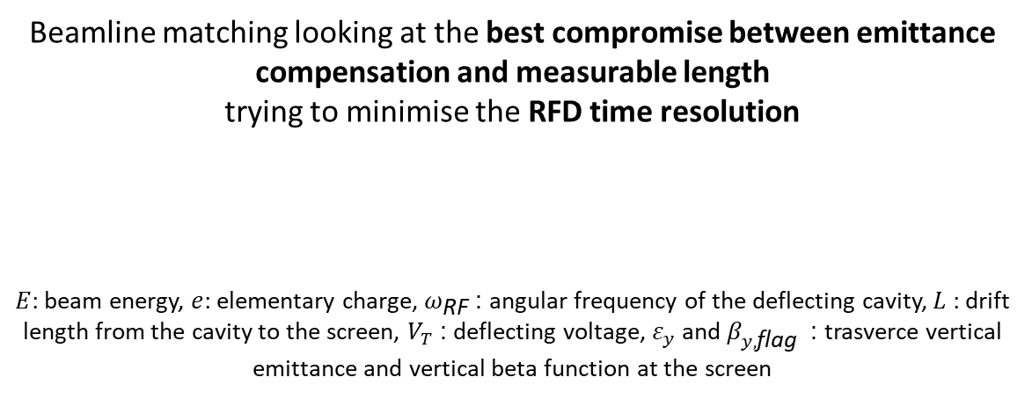
Beam Length Measurement with RFD
Beamline matching looking at the best compromise between emittance compensation and measurable length
trying to minimise the RFD time resolution
$E$: beam energy, $e$: elementary charge, $ω_{\text{RF}}$: angular frequency of the deflecting cavity, $L$: drift length from the cavity to the screen, $V_{T}$: deflecting voltage, $ε_{y}$ and $β_{y,\text{flag}}$ : trasverce vertical emittance and vertical beta function at the screen
Diagnostic beamline
Courtesy of F. Demurtas
Alesini et al. RF deflector design and measurements for the longitudinal and transverse phase space characterization at SPARC NIMA vol 568(2) https://doi.org/10.1016/j.nima.2006.07.050

Slide 11
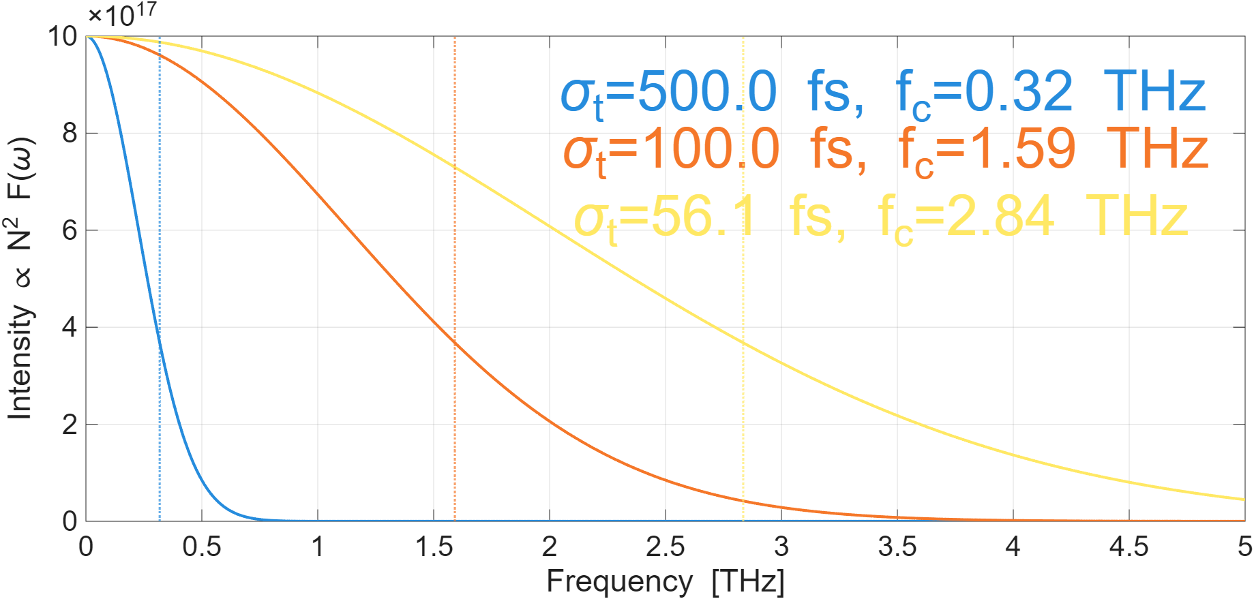

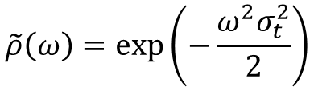


THz as an estimation of the bunch length
The angular spectrum of radiation emitted by a bunch of $N$electrons can be written as:
$$\frac{d^{2}I}{dωdΩ}=\frac{d^{2}I_{sp}}{dωdΩ}\left[N+N\left(N−1\right)F\left(ω\right)\right]$$
The term $∝N$represents the incoherent emission, while the term $∝N^{2}F\left(ω\right)$ describes the coherent radiation and the longitudinal form factor is defined as:
$$F\left(ω\right)={\left|\tilde{ρ}\left(ω\right)\right|}^{2}$$
where $\tilde{ρ}\left(ω\right)$ is the Fourier transform of the normalized temporal distribution of the bunch $ρ\left(t\right)$:
$$\tilde{ρ}\left(ω\right)=\exp\left(−\frac{ω^{2}σ_{t}^{2}}{2}\right)$$
The longitudinal form factor is finally defined as:
$$F\left(ω\right)=\exp\left[−{\left(ωσ_{t}\right)}^{2}\right]$$
Su X., Yan L., Du Y., Zhang Z., Zhou Z., Wang D., Zheng L., Tian Q., Huang W., Tang C. Monitoring of electron bunch length by using terahertz coherent transition radiation, Nucl. Instrum. Methods Phys. Res. A, 402 (2017), pp. 157-161

Slide 12
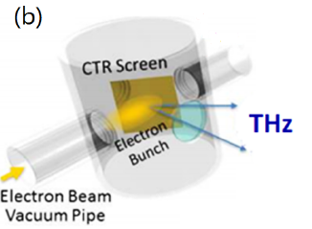
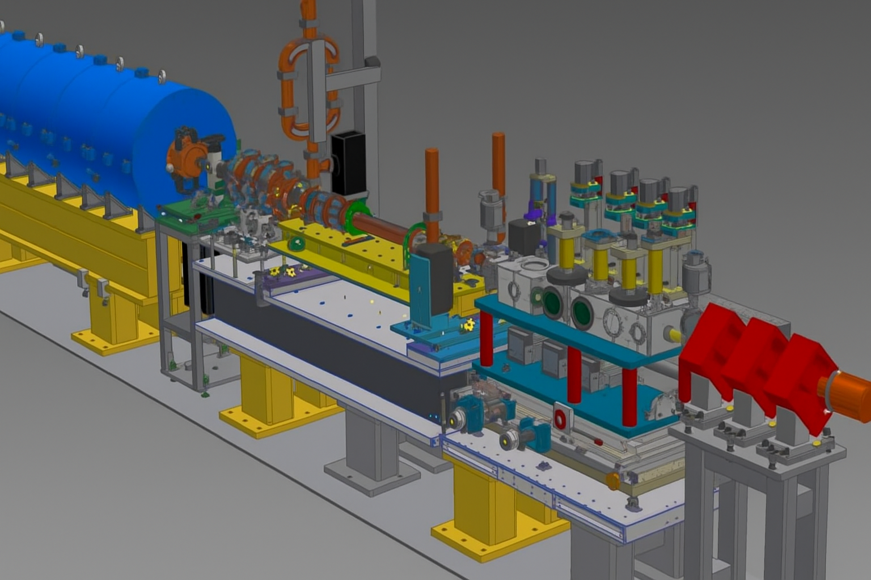
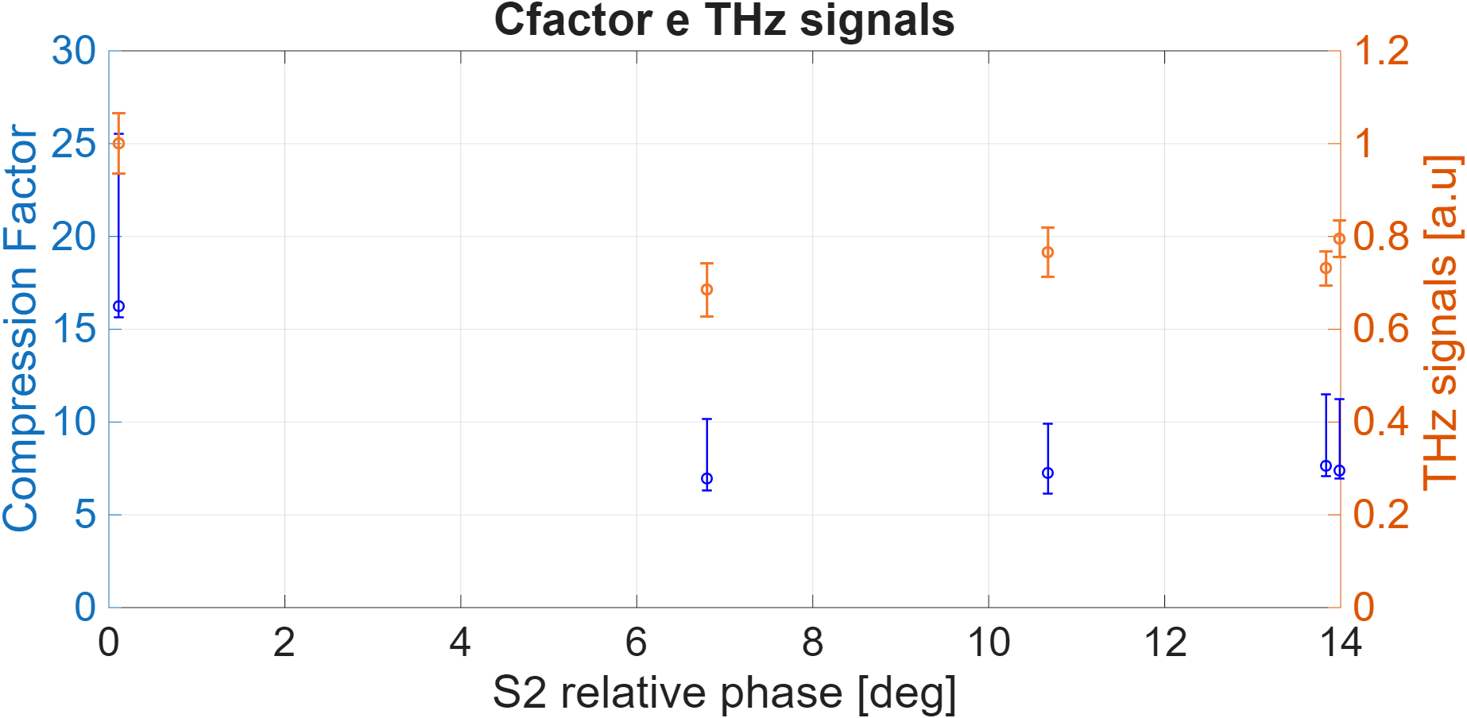
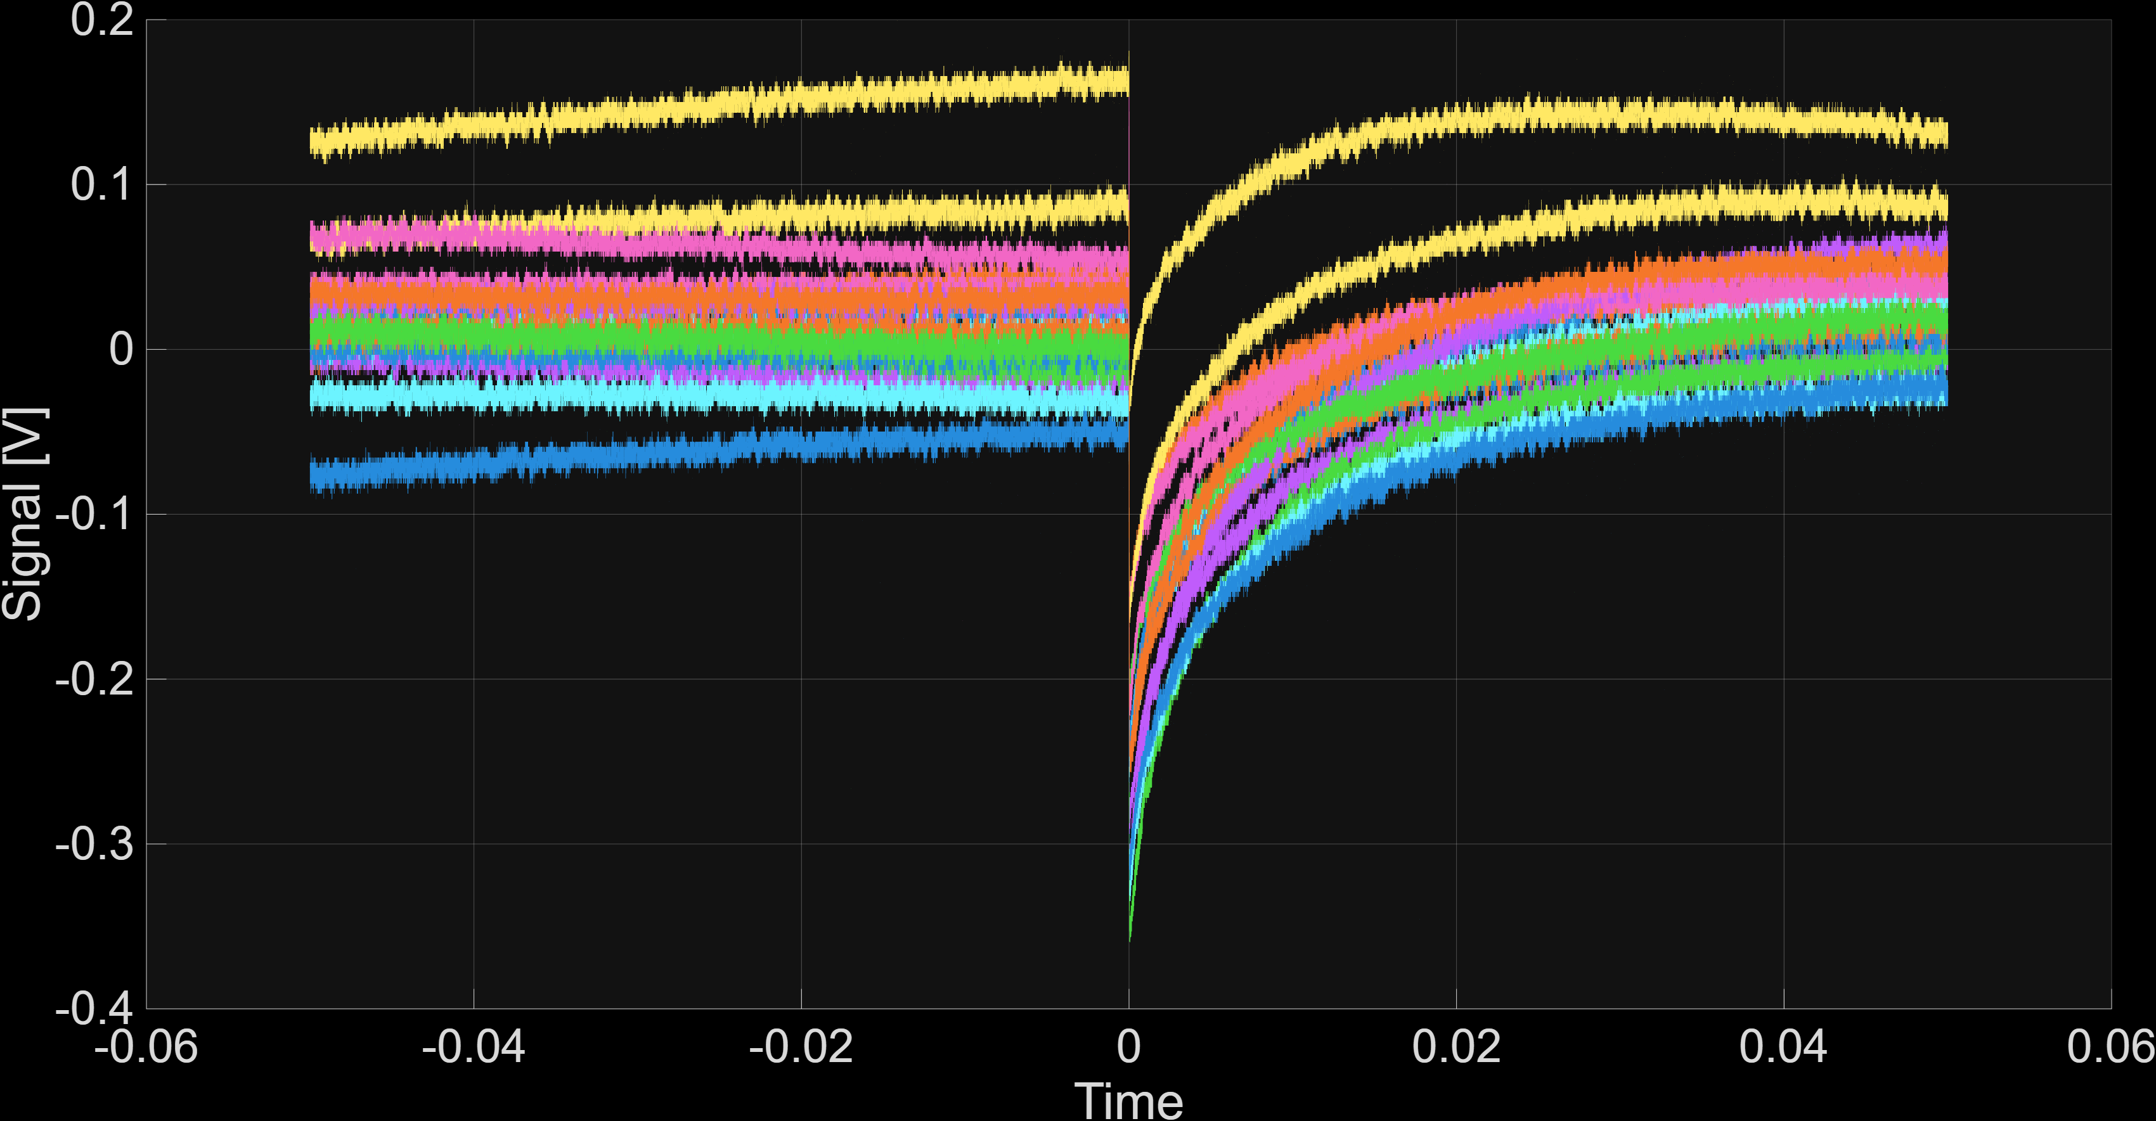
THz emission confirms successful two-stage RF compression
Detector
In this part of the experiment, the electron bunch length was measured using an RF deflector (RFD), while bunch compression was achieved through two RF compression stages. At the same time, the emitted THz radiation was recorded with an oscilloscope. Although the THz signals did not provide a direct measurement of the bunch length, their amplitude followed the same trend as the compression curve obtained with the RFD. Therefore, the agreement between the RFD measurements and the THz signals trend demonstrates that the two-stage RF bunch compression has been successfully achieved.
“The SPARC linear accelerator-based terahertz source”, E. Chiadroni et al., Appl. Phys. Lett. vol. 102 (2013) pag. 094101, doi: 10.1063/1.4794014.
“Tailoring of Highly Intense THz Radiation Through High Brightness Electron Beams Longitudinal Manipulation”, F. Giorgianni et al., Appl. Sci. vol. 6 (2016) pag. 2, doi: 10.3390/app6020056.
“Bunch Length Characterization at the TTF VUV-FEL”, E. Chiadroni, Ph.D. thesis TESLA-FEL 2006-09 (2006). [6] “Strong nonlinear terahertz response induced by Dirac surface states in Bi2Se3 topological insulator”, F. Giorgianni et al., Nature Communications vol. 7 (2016) pag. 11421, doi:10.1038/ncomms11421.

Slide 13
Conclusion and future prospectives
The experimental validation of the EuPRAXIA@SPARC_LAB nominal working point via RF Compression at SPARC_LAB has been performed
We have demonstrated the advantages of the suggested configuration in term of emittance compensation and compression factor
Even though we could only test the single bunch operation because of SPARC machine failures
Further experimental shifts are foreseen by the end of 2025-2026 SPARC_LAB scientific planning. We will explore such configuration with the comb-like beam, with the goal of the validation of the EuPRAXIA@SPARC_LAB RF injector and further tests on diagnostics and machine control tools.
We would like to thank the EuPRAXIA@SPARC_LAB collaboration, the LNF Accelerator Division and the SPARC_LAB team members that contributed to the experimental runs

Slide 14
Thank you for your attention!
G. J. Silvi and A. Giribono
INFN-LNF
On behalf of the SPARC_LAB collaboration
*silvigil@lnf.infn.it
This project has received funding from the European Union´s Horizon Europe research and innovation program under grant agreement No. 101079773
7th European Advanced Accelerator Conference (EAAC2025) September 21-27, 2025

Slide 15
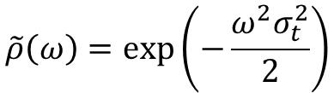

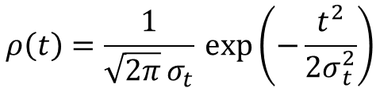
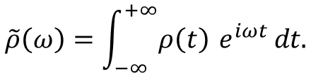


THz as an estimation of the bunch length
The angular spectrum of radiation emitted by a bunch of $N$electrons can be written as:
$$\frac{d^{2}I}{dωdΩ}=\frac{d^{2}I_{sp}}{dωdΩ}\left[N+N\left(N−1\right)F\left(ω\right)\right]$$
The term $∝N$represents the incoherent emission, while the term $∝N^{2}F\left(ω\right)$ describes the coherent radiation and the longitudinal form factor is defined as:
$$F\left(ω\right)={\left|\tilde{ρ}\left(ω\right)\right|}^{2}$$
where $\tilde{ρ}\left(ω\right)$ is the Fourier transform of the normalized temporal distribution of the bunch $ρ\left(t\right)$:
$$\tilde{ρ}\left(ω\right)=\int_{−∞}^{+∞}{ρ\left(t\right)} e^{iωt} dt.$$
For a bunch with a Gaussian distribution, the Fourier transform is again a Gaussian:
$$ρ\left(t\right)=\frac{1}{\sqrt{2π} σ_{t}} \exp\left(−\frac{t^{2}}{2σ_{t}^{2}}\right)$$
$$\tilde{ρ}\left(ω\right)=\exp\left(−\frac{ω^{2}σ_{t}^{2}}{2}\right)$$
The longitudinal form factor is finally defined as:
$$F\left(ω\right)=\exp\left[−{\left(ωσ_{t}\right)}^{2}\right]$$
Su X., Yan L., Du Y., Zhang Z., Zhou Z., Wang D., Zheng L., Tian Q., Huang W., Tang C. Monitoring of electron bunch length by using terahertz coherent transition radiation, Nucl. Instrum. Methods Phys. Res. A, 402 (2017), pp. 157-161

Slide 16
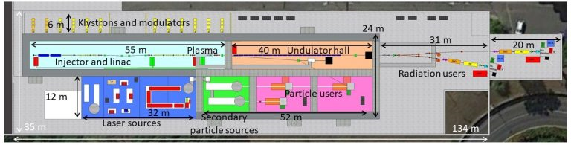


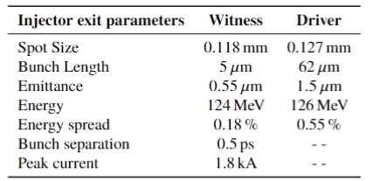
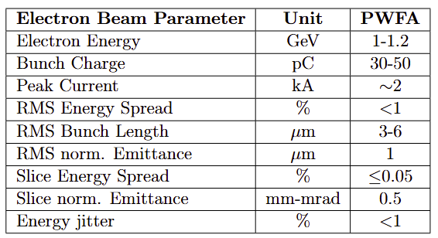
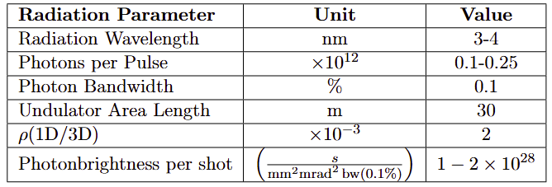
EuPRAXIA@SPARC_LAB
EuPRAXIA@SPARC_LAB is the first European research infrastructure to demonstrate the usability of a plasma accelerator combining a high-brightness GeV–range electron beam generated in a state-of-the-art linac, and a 0.5 PW–class laser system.
EuPRAXIA@SPARC_LAB will be a user facility dedicated for instance to the production of a high-brightness plasma accelerated beam to induce Self Amplified Spontaneous Emission (SASE) in an FEL undulator.
ultra-short, high-quality electron beams
M. Ferrario et al., EuPRAXIA@SPARC_LAB Conceptual Design Report, LNF Technical Note 18-03, 07/05/2018.
Assmann, R.W., Weikum, M.K., Akhter, T. et al. EuPRAXIA Conceptual Design Report. Eur. Phys. J. Spec. Top. 229, 3675–4284 (2020).
S-band RF photo-injector
X-band RF booster linac
Plasma Stage
Undulator

