Slide 1



Structured Light Laser-Wakefield Acceleration
Victor Malka
Aaron Liberman, Sheroy Tata, Anton Golovanov, Anda-Maria Talposi, Santosh Krishnamurthy, Arujash Mohanty, Eitan Levine, Salome Benracassa, and Eyal Kroupp
Slava Smartsev, Igor A. Andriyash, Ronan Lahaye, and Cedric Thaury
1
EAAC 2025, 7th European Advanced Accelerator Conference, Hotel Hermitage, La Biodola Bay, Isola d'Elba, Italy, 21–27 Sept 2025

Slide 2

Laser-Wakefield Acceleration
The Dephasing Limit
Structuring Light: Near Field - STCs
Structuring Light: Far Field - Axiparabola
Axiparabola Velocity Measurement
Femtosecond Relativistic Electron Microscopy (FREM)
EAAC 2025, 7th European Advanced Accelerator Conference, Hotel Hermitage, La Biodola Bay, Isola d'Elba, Italy, 21–27 Sept 2025

Slide 3
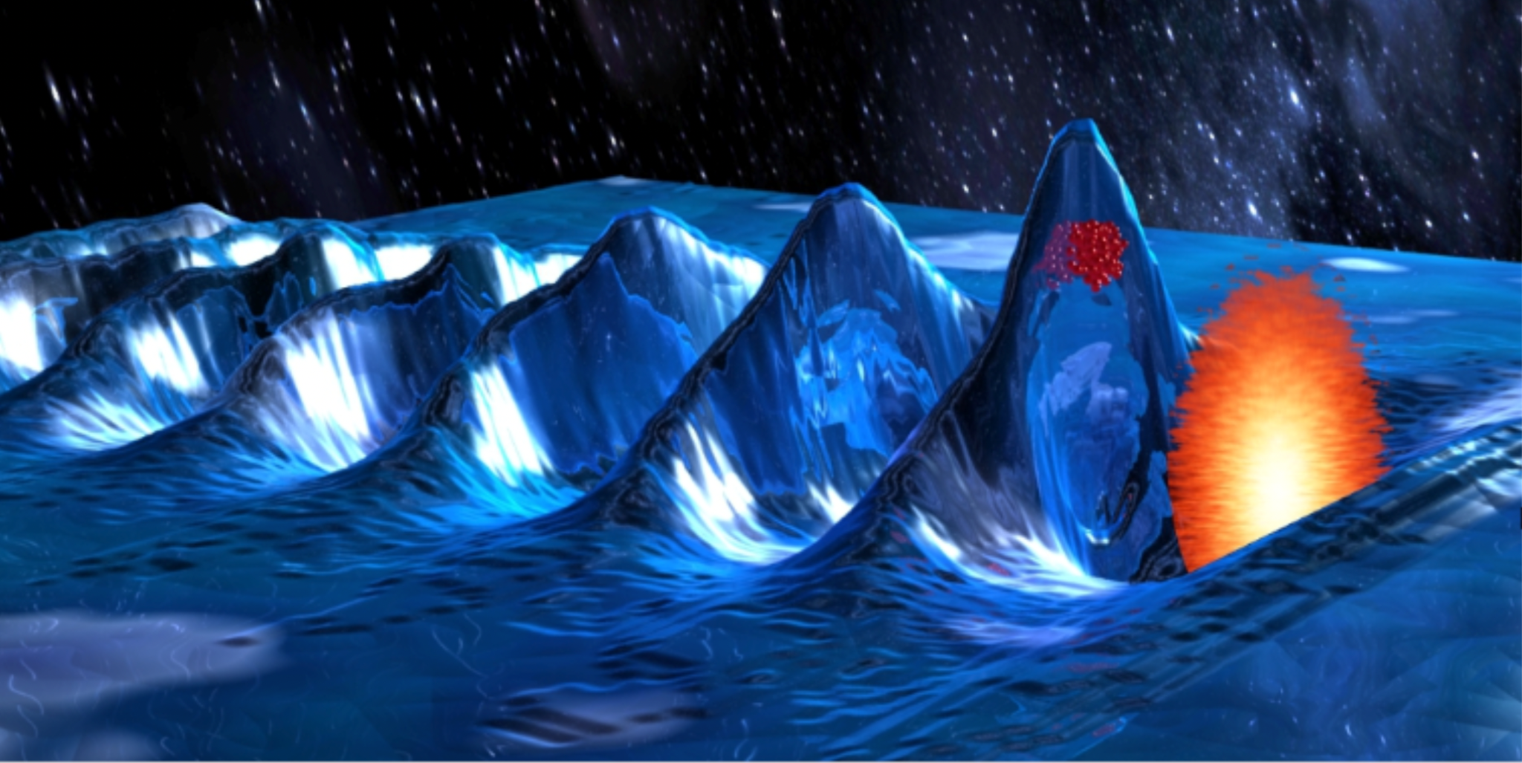
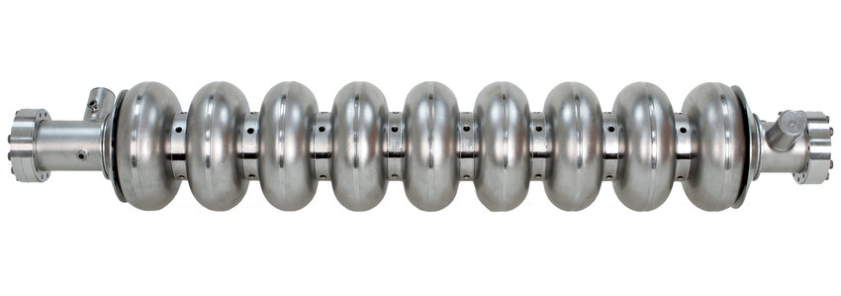

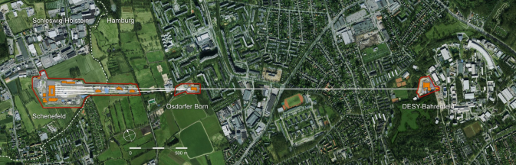
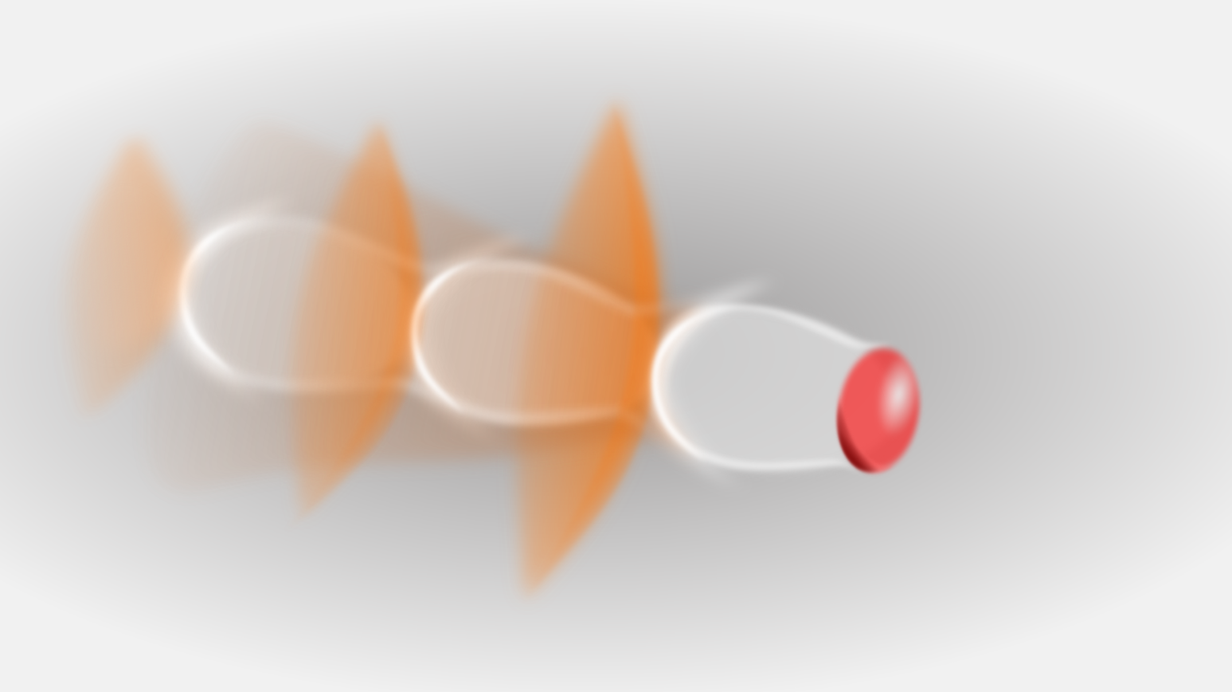

The Breakdown Issue
Laser wakefield acceleration: Limitation
18 GeV electrons $→$2 km
Max Field < 100 MV/m
over kms
Plasma wave
Laser
Max Field > 100 GV/m
over mms-cms
~ tens of microns
EAAC 2025, 7th European Advanced Accelerator Conference, Hotel Hermitage, La Biodola Bay, Isola d'Elba, Italy, 21–27 Sept 2025

Slide 4
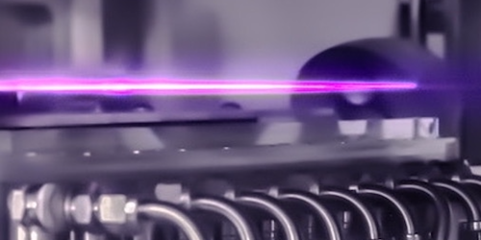
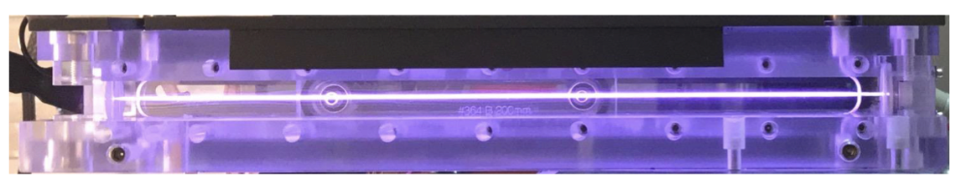
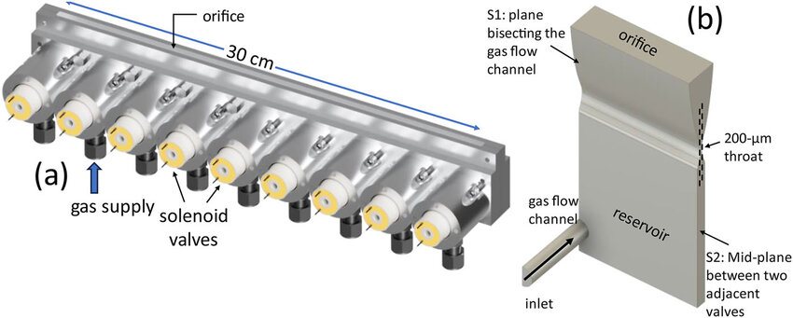
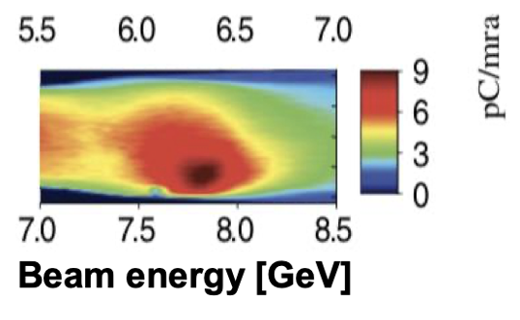
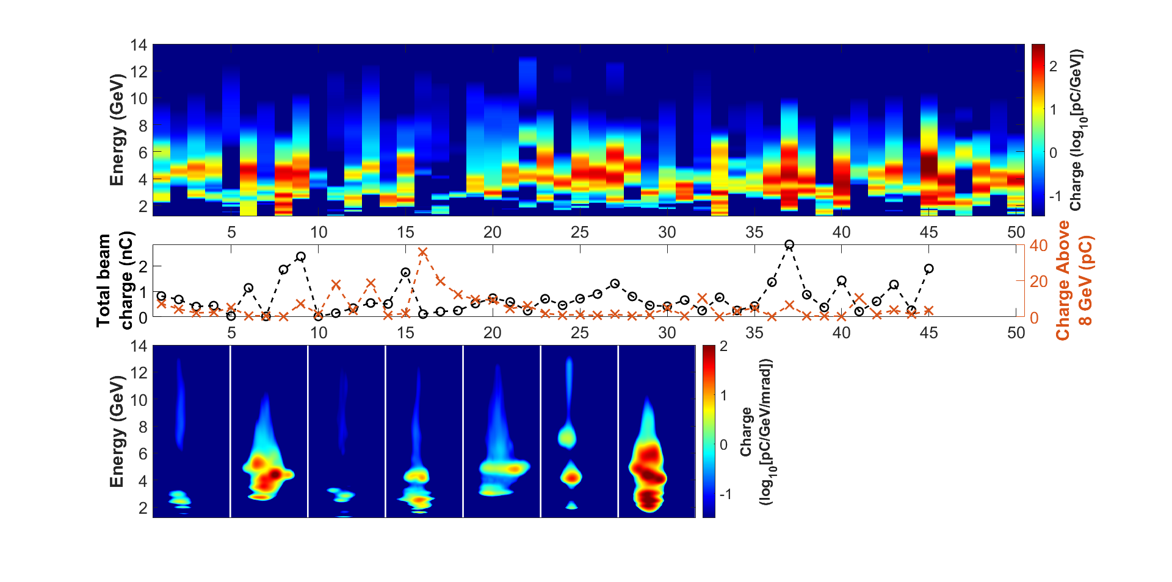
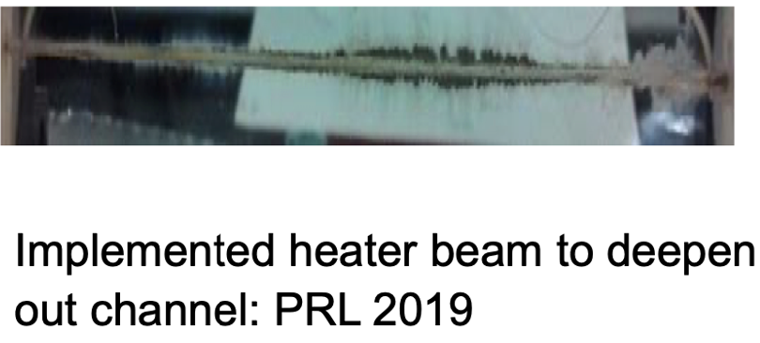
Laser guided wakefield in plasma channels
20 cm-scale plasma discharge
30 cm-scale OFI plasma channel
9
6
1 PW
laser
pC/mrad
3
7.0
7.5
8.0
8.5
0
3
4
Beam energy (GeV)
Gonsalves et al., PRL (2019)
E. Rockafellow et al., PoP (Accepted 2025);
J.E. Shrock et al., in preparation
Fragile, 2 additional laser beams, difficult to
use: no future for real applications
Very promising approach with already excellent results
EAAC 2025, 7th European Advanced Accelerator Conference, Hotel Hermitage, La Biodola Bay, Isola d'Elba, Italy, 21–27 Sept 2025
R. Lehe

Slide 5
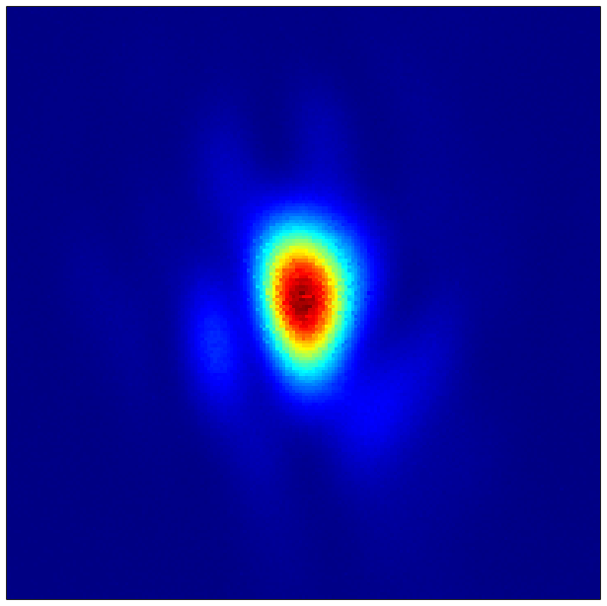
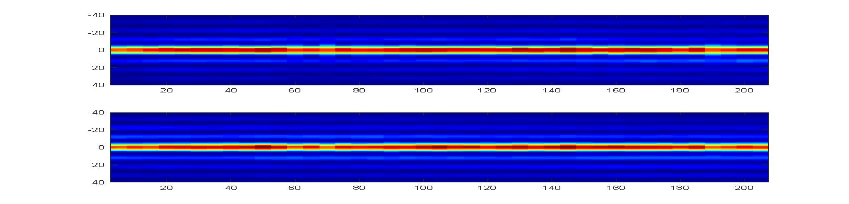

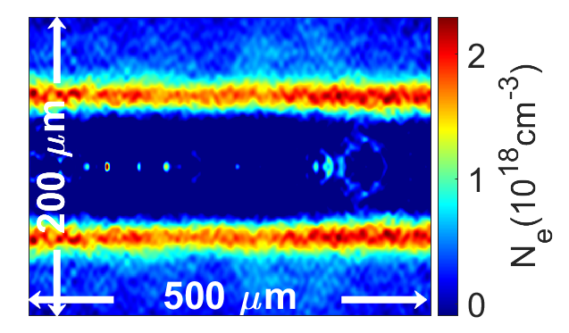
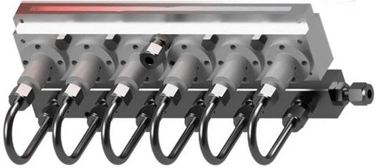

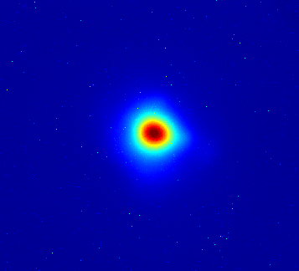

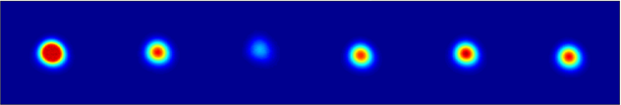
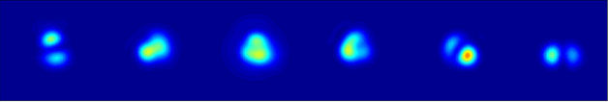


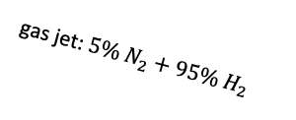
Also 10 GeV with OFI plasma channel
< 15 J, 45 fs
x-y pointing
Fluctuations 9 µm
M1
Extended multi-valve generation VI supersonic gas jet for meter-scale, low density waveguide developed at UMD
200 µm
20 cm
P1
2-color probe
P2
diffractive axicon
gas flow
M2
gas jet: $5\% N_{2}+95\% H_{2}$
LA1
SL
magnets
LA2
(e)
$$N_{e0}=1.3 × {10}^{17} cm^{−3}$$
200 μm
200μm
200 μm
$$N_{e0}=3.2 × 10^{17} cm^{−3}$$
B. Miao et al., Phys. Rev. Lett. 129, 074801 (2020), L. Feder et al., Phys. Rev. Res. 2, 043173 (2020), B. Miao et al., Phys. Rev. Accel. Beams 27, 08132 (2024), E. Rockafellow et al., PoP (Accepted 2025); J.E. Shrock et al., in preparation
EAAC 2025, 7th European Advanced Accelerator Conference, Hotel Hermitage, La Biodola Bay, Isola d'Elba, Italy, 21–27 Sept 2025
R. Lehe

Slide 6
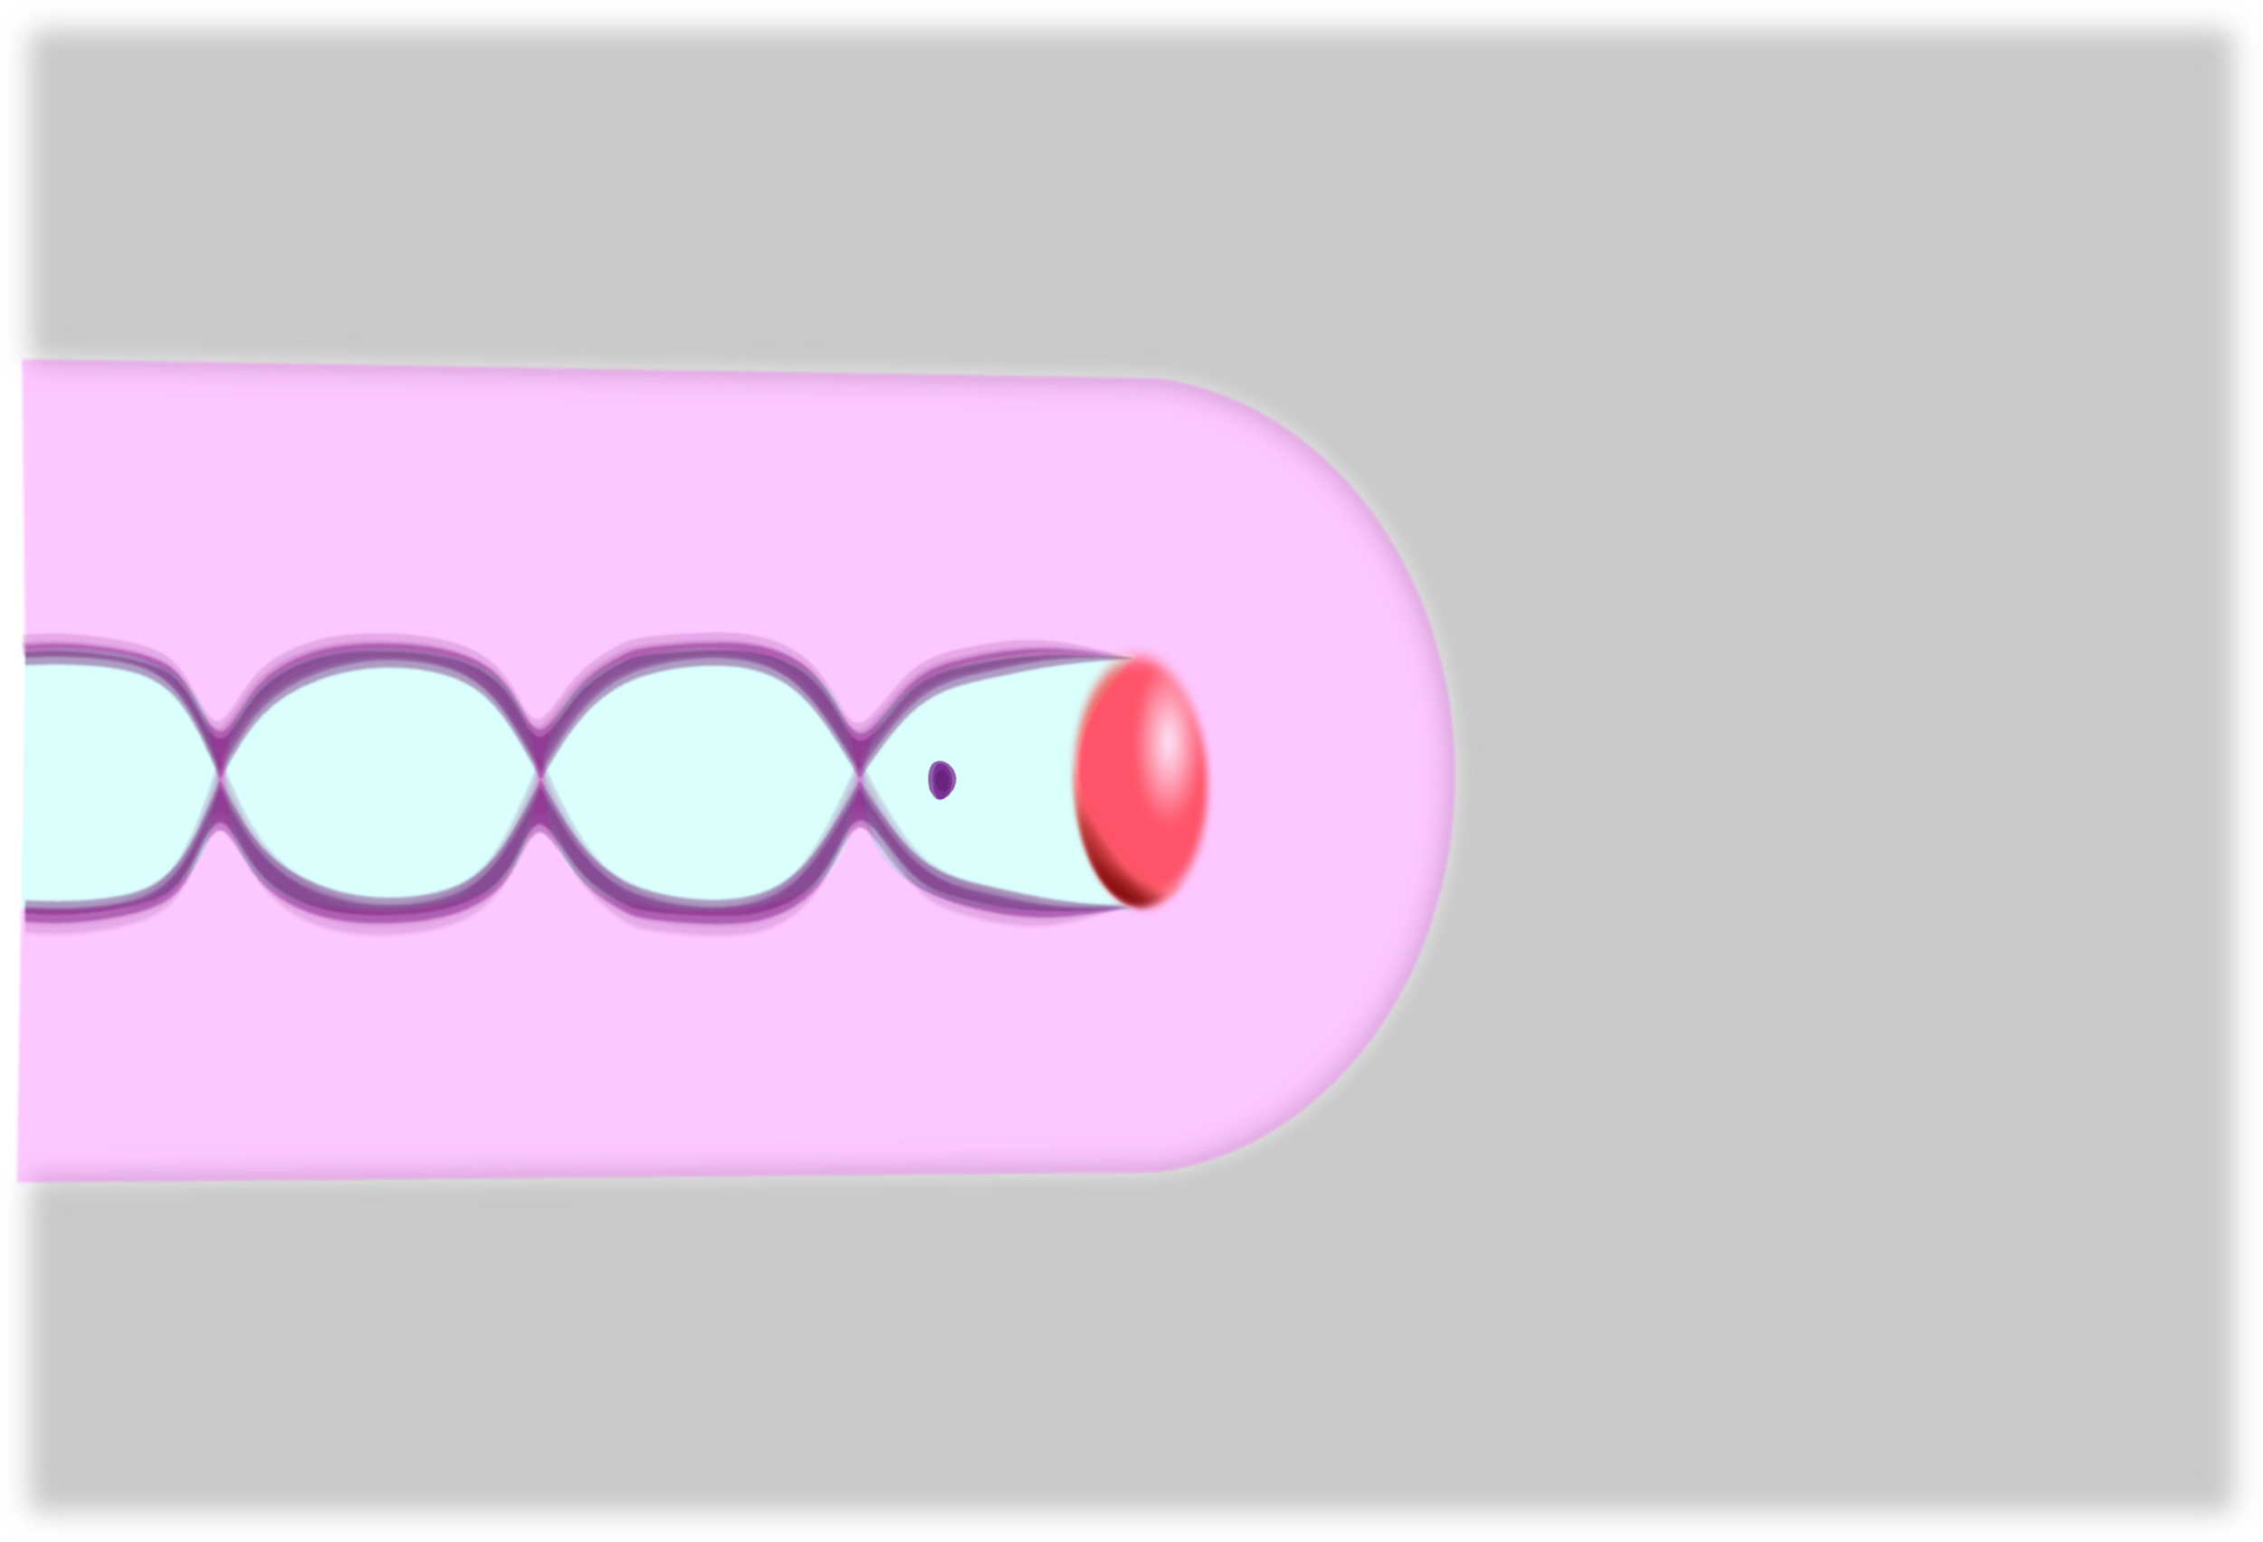
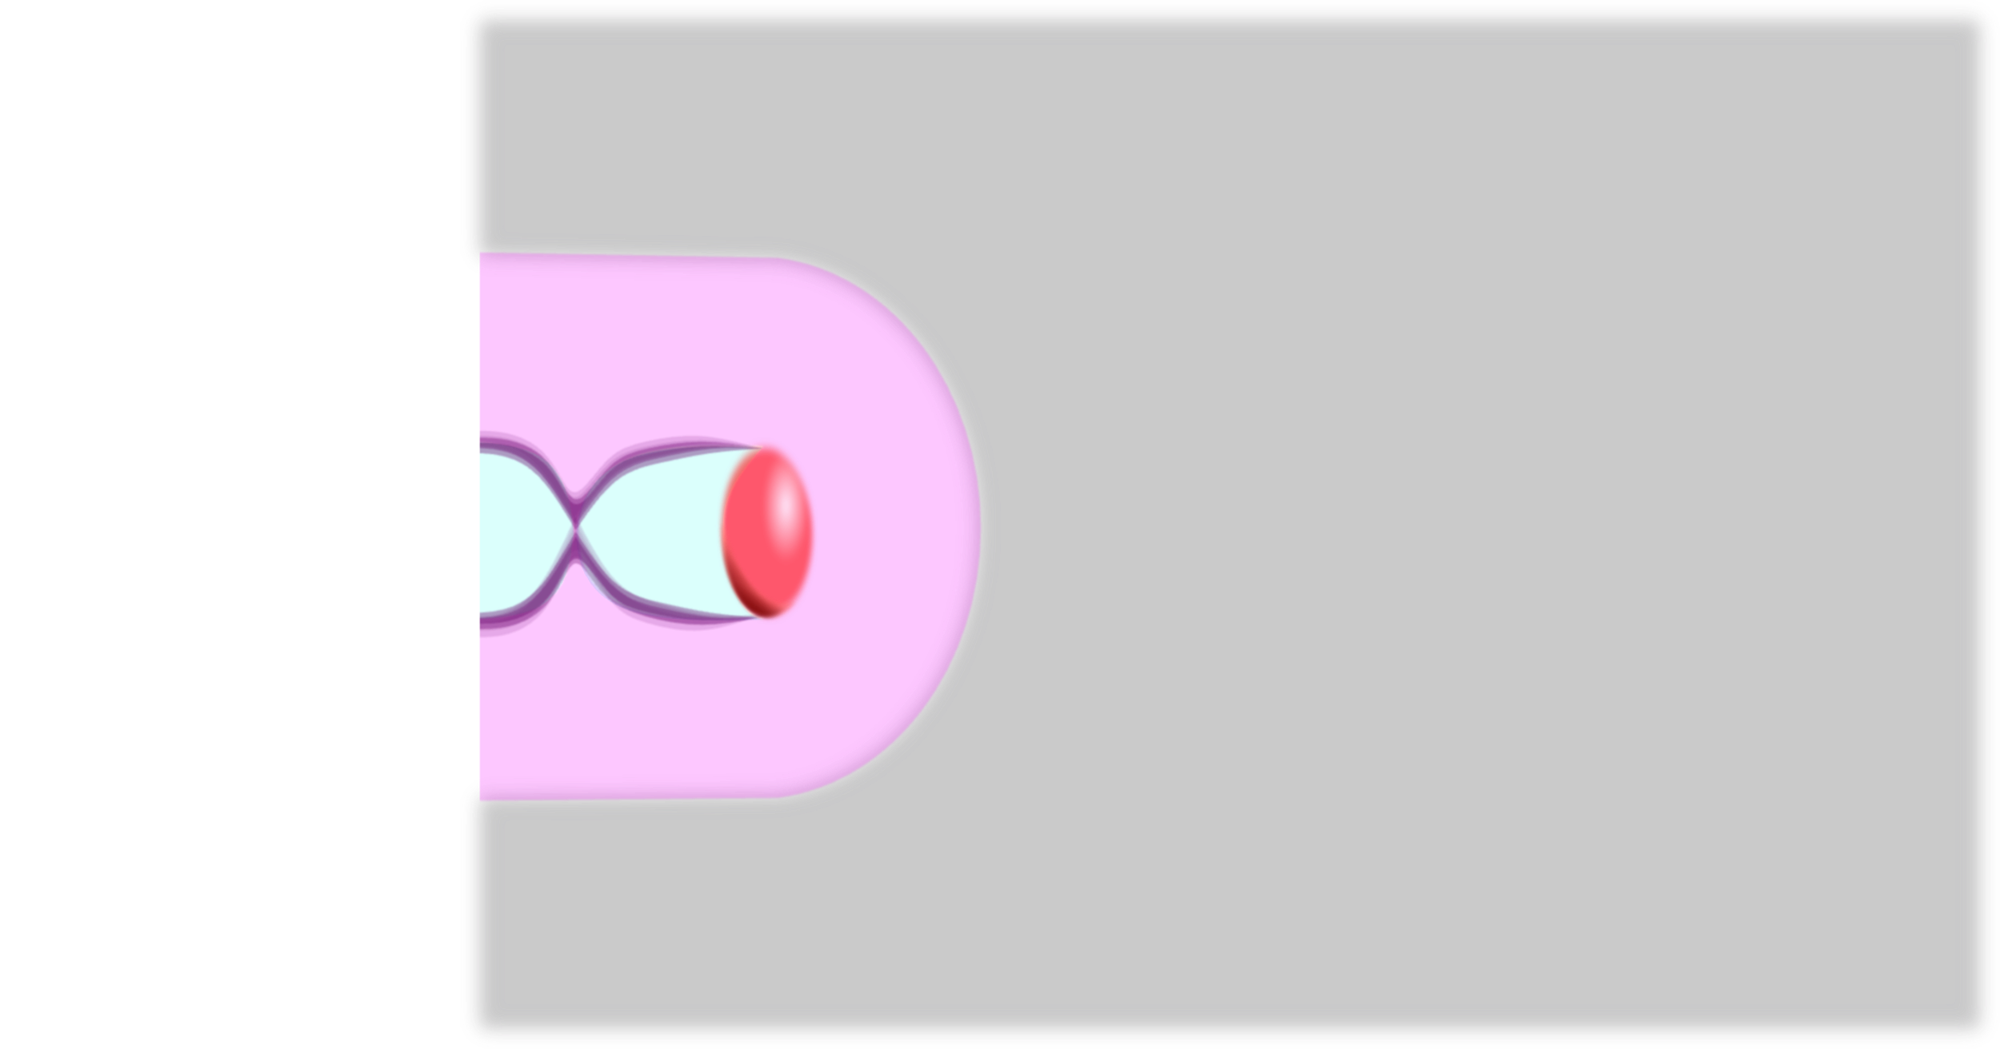
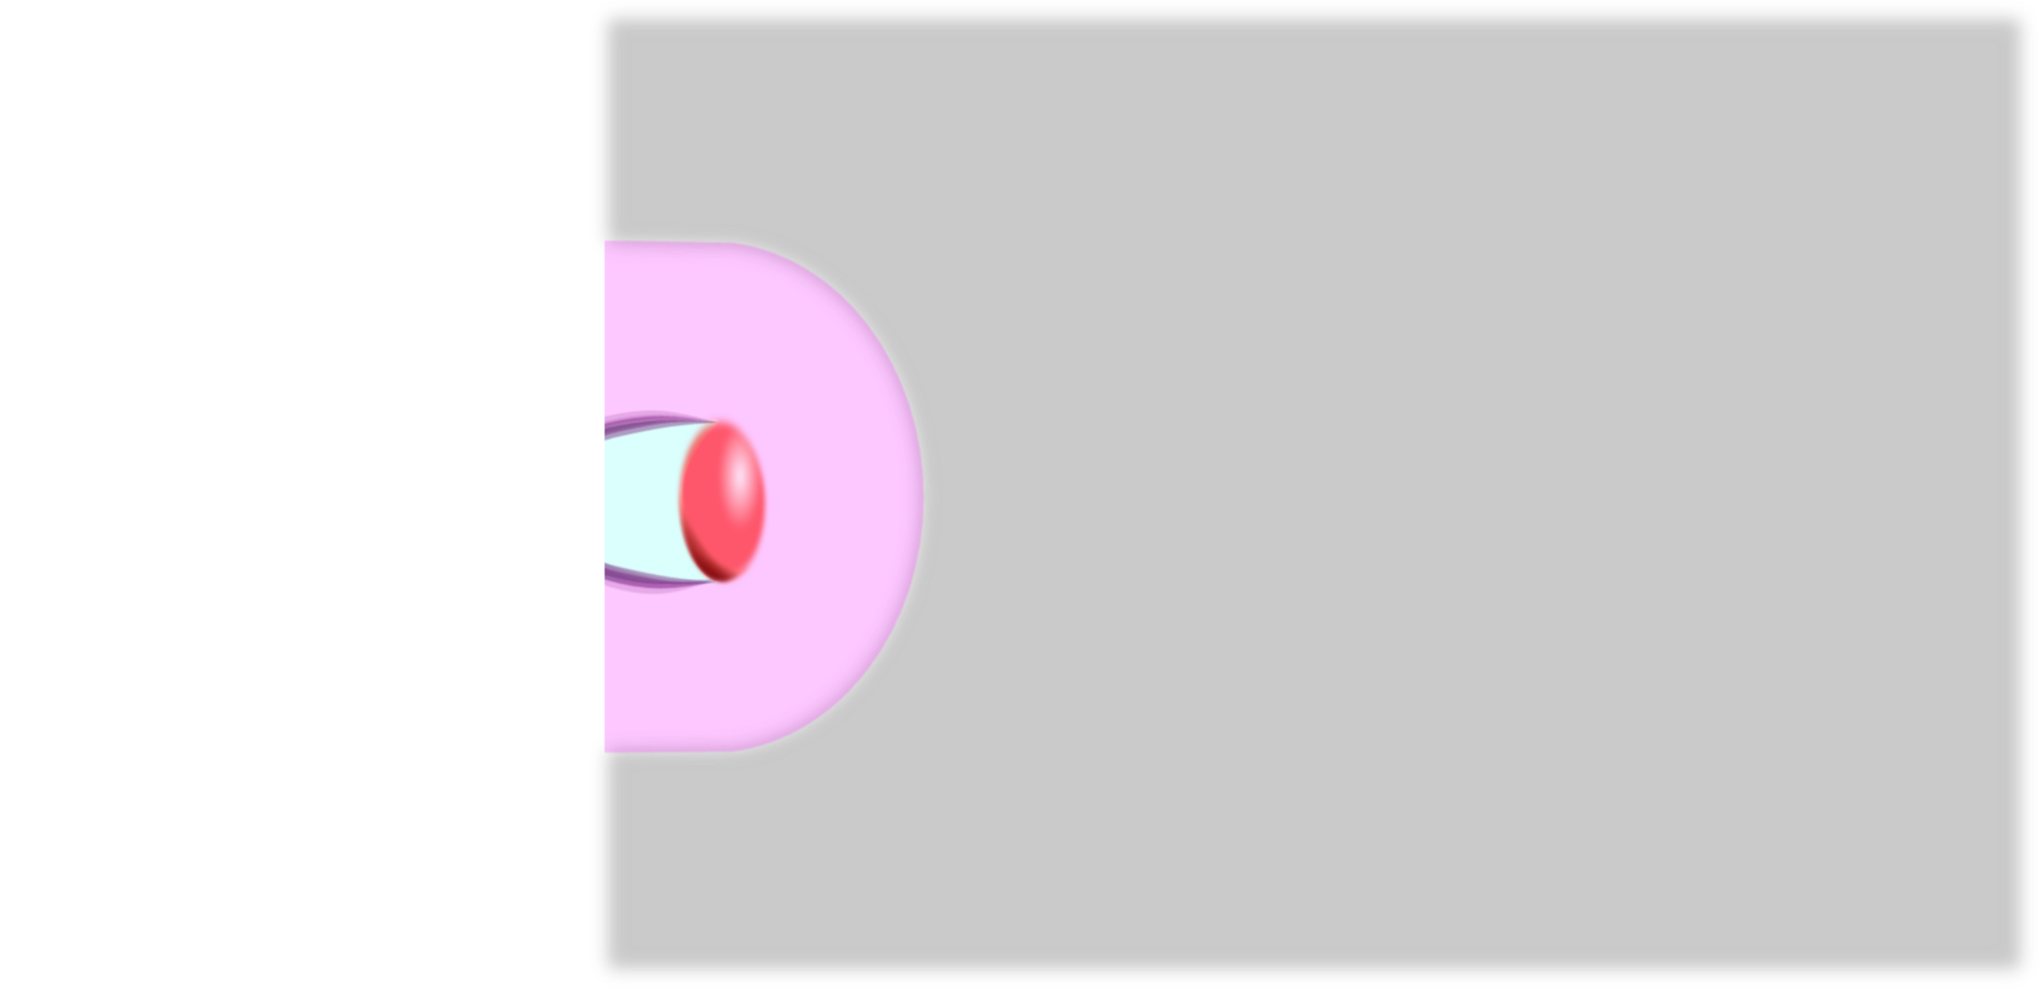
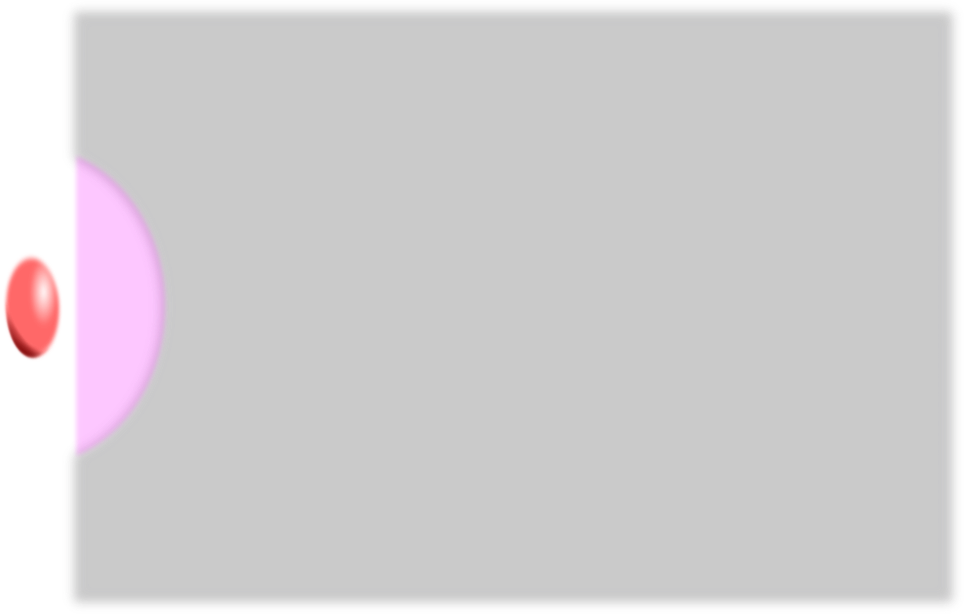
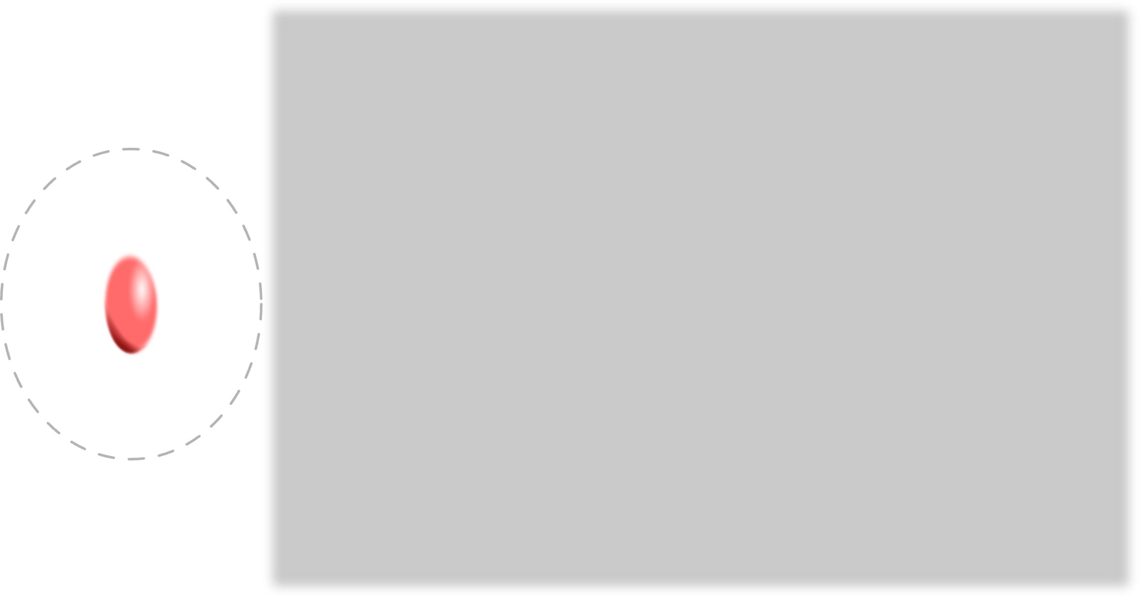



Solution 1: Laser-Waveguide
$$1∙{10}^{15} W∙cm^{−2}$$
$$1∙{10}^{19} W∙cm^{−2}$$
EAAC 2025, 7th European Advanced Accelerator Conference, Hotel Hermitage, La Biodola Bay, Isola d'Elba, Italy, 21–27 Sept 2025

Slide 7
Laser-Wakefield Acceleration
The Dephasing Limit
Structuring Light: Near Field - STCs
Structuring Light: Far Field - Axiparabola
Axiparabola Velocity Measurement
Femtosecond Relativistic Electron Microscopy (FREM)
EAAC 2025, 7th European Advanced Accelerator Conference, Hotel Hermitage, La Biodola Bay, Isola d'Elba, Italy, 21–27 Sept 2025

Slide 8
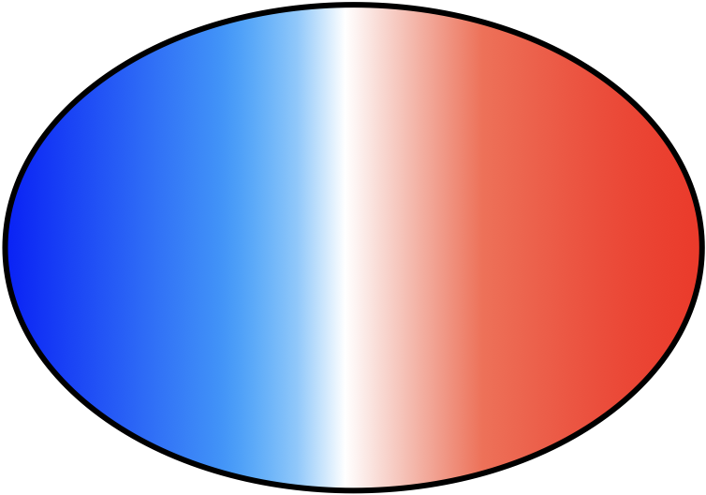
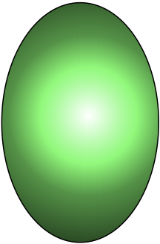

Dephasing in laser wakefield
Since the laser group velocity is < c, when electrons energy is getting ~c they diphase,
electrons reach the center of the cavity and start to be deccelerated
Typical value for 100 TW to PW 30fs laser system at density of 10¹⁸cm⁻³, L_{deph} is of the order of 1 cm (larger than z_{R}.)
L_{deph.}= γ_{p}²λ_{p}/2 = λ₀ (n_{c}/n_{e})^{3/2}
z_{R} = πw₀²/λ₀
EAAC 2025, 7th European Advanced Accelerator Conference, Hotel Hermitage, La Biodola Bay, Isola d'Elba, Italy, 21–27 Sept 2025
R. Lehe

Slide 9
Dephasing in laser wakefield
Since the laser group velocity is < c, when electrons energy is getting ~c they diphase,
electrons reach the center of the cavity and start to be deccelerated
Typical value for 100 TW to PW 30fs laser system at density of 10¹⁸cm⁻³, L_{deph} is of the order of 1 cm (larger than z_{R}.)
L_{deph.}= γ_{p}²λ_{p}/2 = λ₀ (n_{c}/n_{e})^{3/2}
z_{R} = πw₀²/λ₀
EAAC 2025, 7th European Advanced Accelerator Conference, Hotel Hermitage, La Biodola Bay, Isola d'Elba, Italy, 21–27 Sept 2025
R. Lehe

Slide 10
Dephasing in laser wakefield
Since the laser group velocity is < c, when electrons energy is getting ~c they diphase,
electrons reach the center of the cavity and start to be deccelerated
Typical value for 100 TW to PW 30fs laser system at density of 10¹⁸cm⁻³, L_{deph} is of the order of 1 cm (larger than z_{R}.)
L_{deph.}= γ_{p}²λ_{p}/2 = λ₀ (n_{c}/n_{e})^{3/2}
zR = πw0²/λ0
EAAC 2025, 7th European Advanced Accelerator Conference, Hotel Hermitage, La Biodola Bay, Isola d'Elba, Italy, 21–27 Sept 2025
R. Lehe

Slide 11
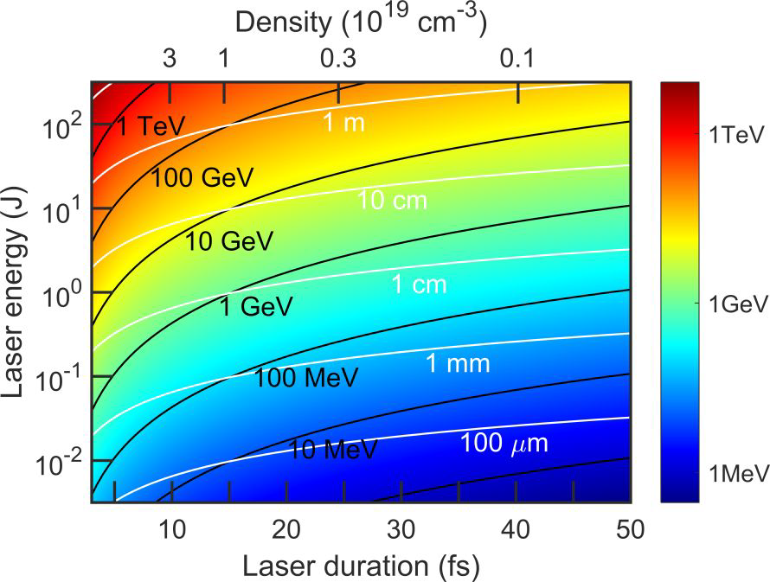
Benefit of luminal wakefield
Up to 50 GeV in 50 cm
with a 1 PW, 15 fs laser
γ ∝ 1/τ²
γ ∝ E_{L}
C. Caizergues et al., Nature Photonics 14, 475–479 (2020), J. Palastro et al.,
Phys. Rev. Lett. 124, 134802 (2020), A. Debus et al., Phys. Rev. X 9, 031044 (2019)
EAAC 2025, 7th European Advanced Accelerator Conference, Hotel Hermitage, La Biodola Bay, Isola d'Elba, Italy, 21–27 Sept 2025

Slide 12

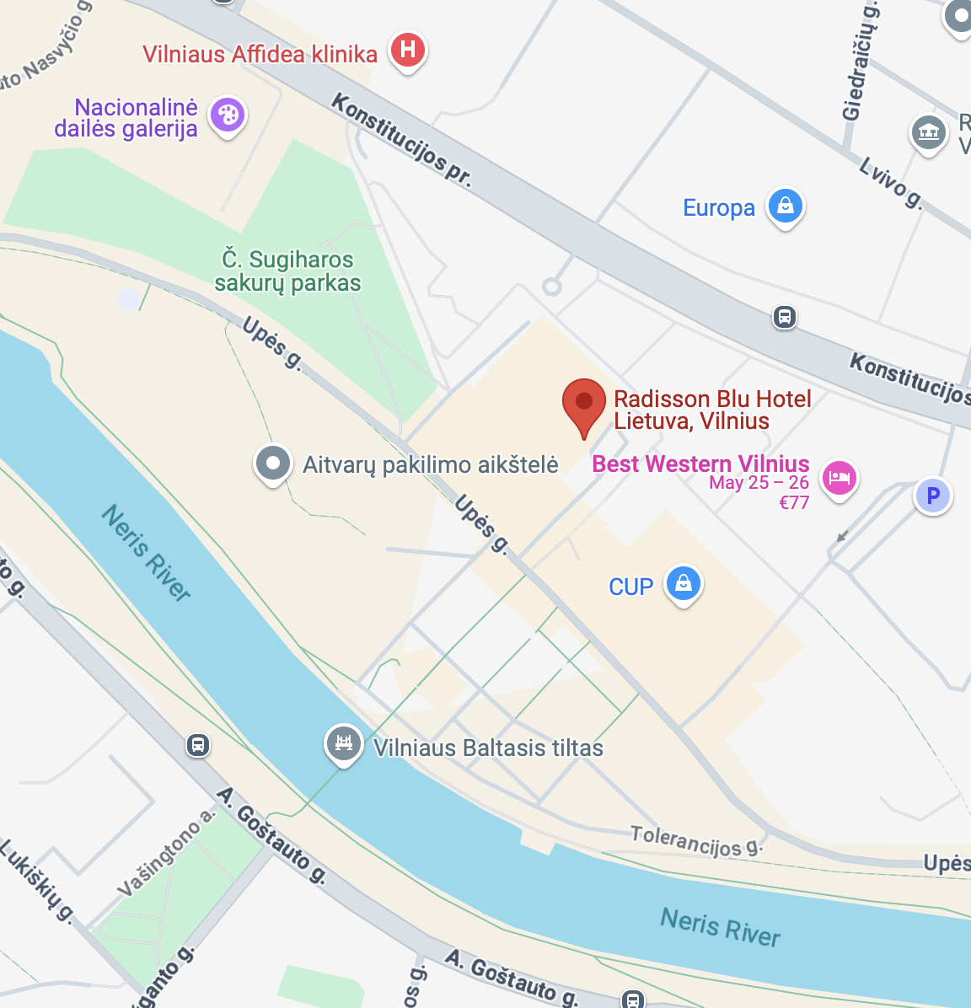
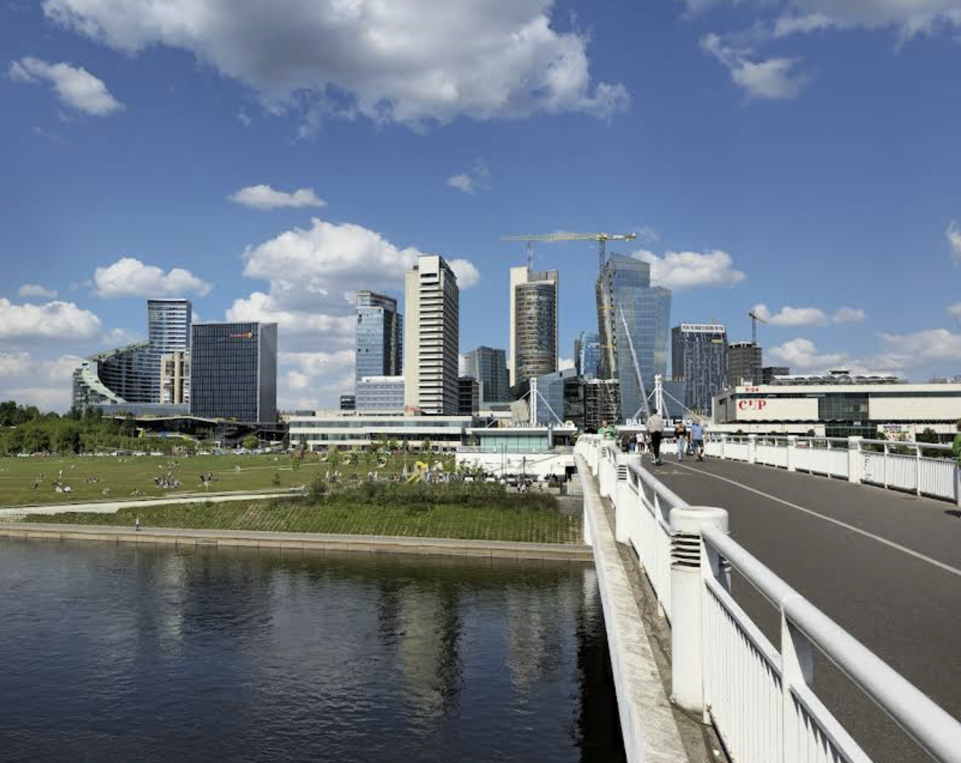
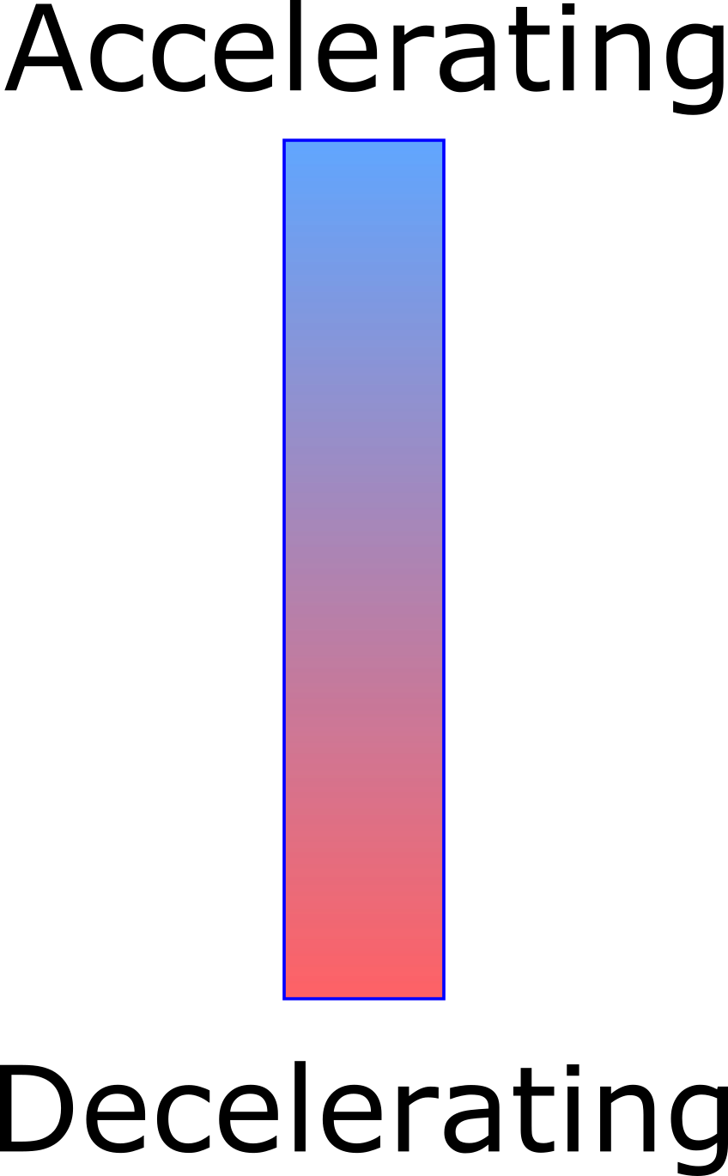
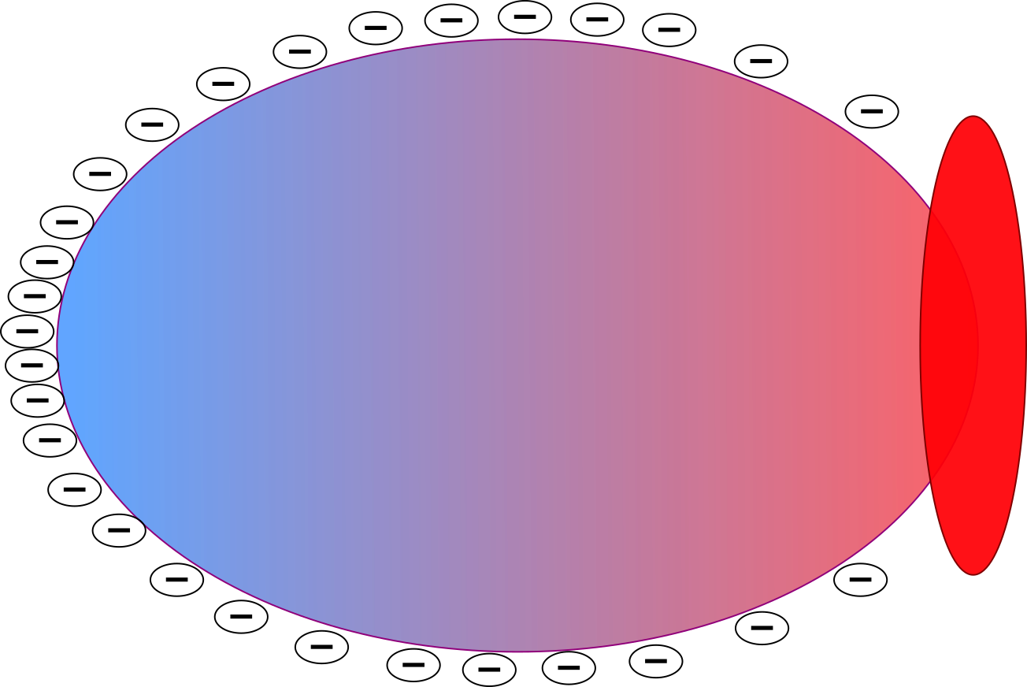
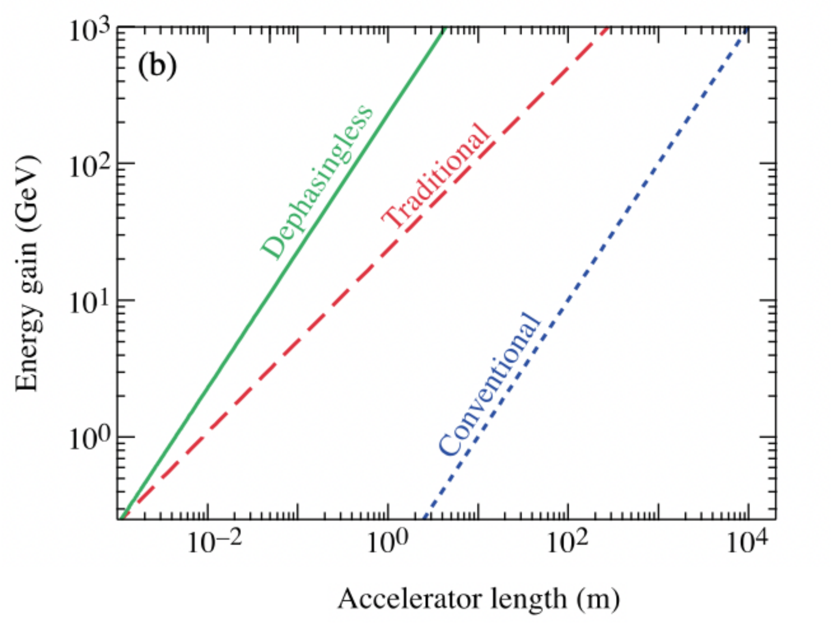
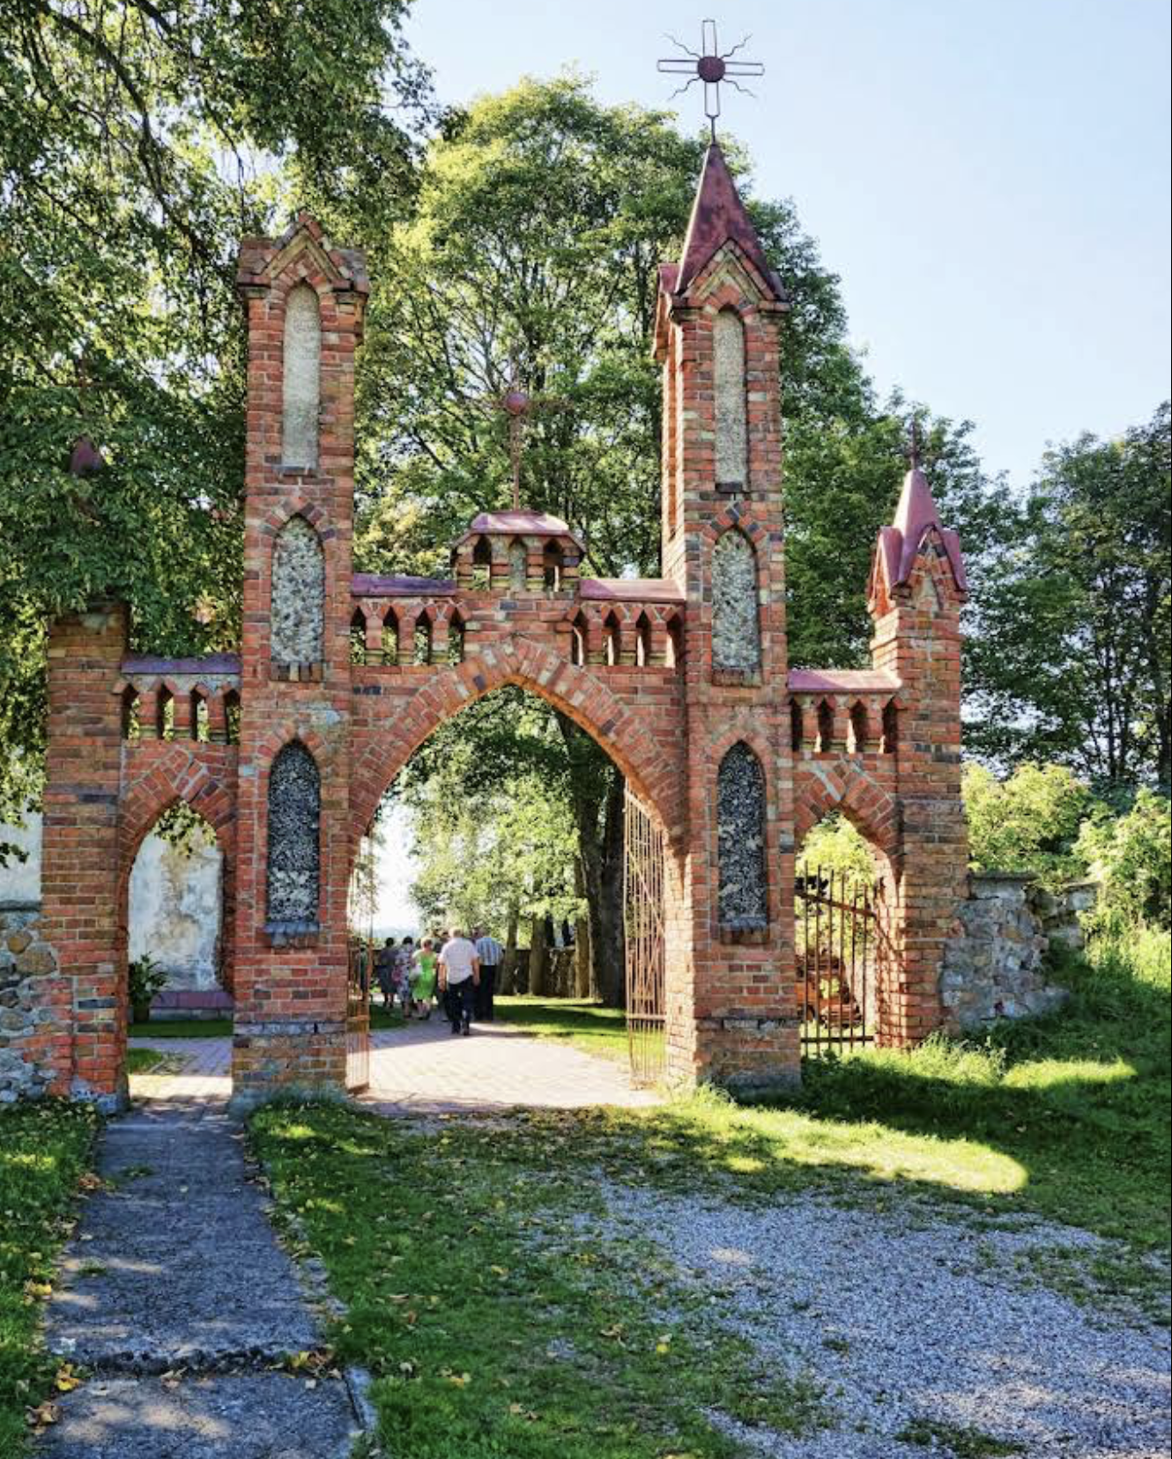
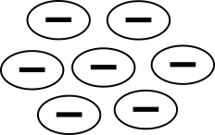
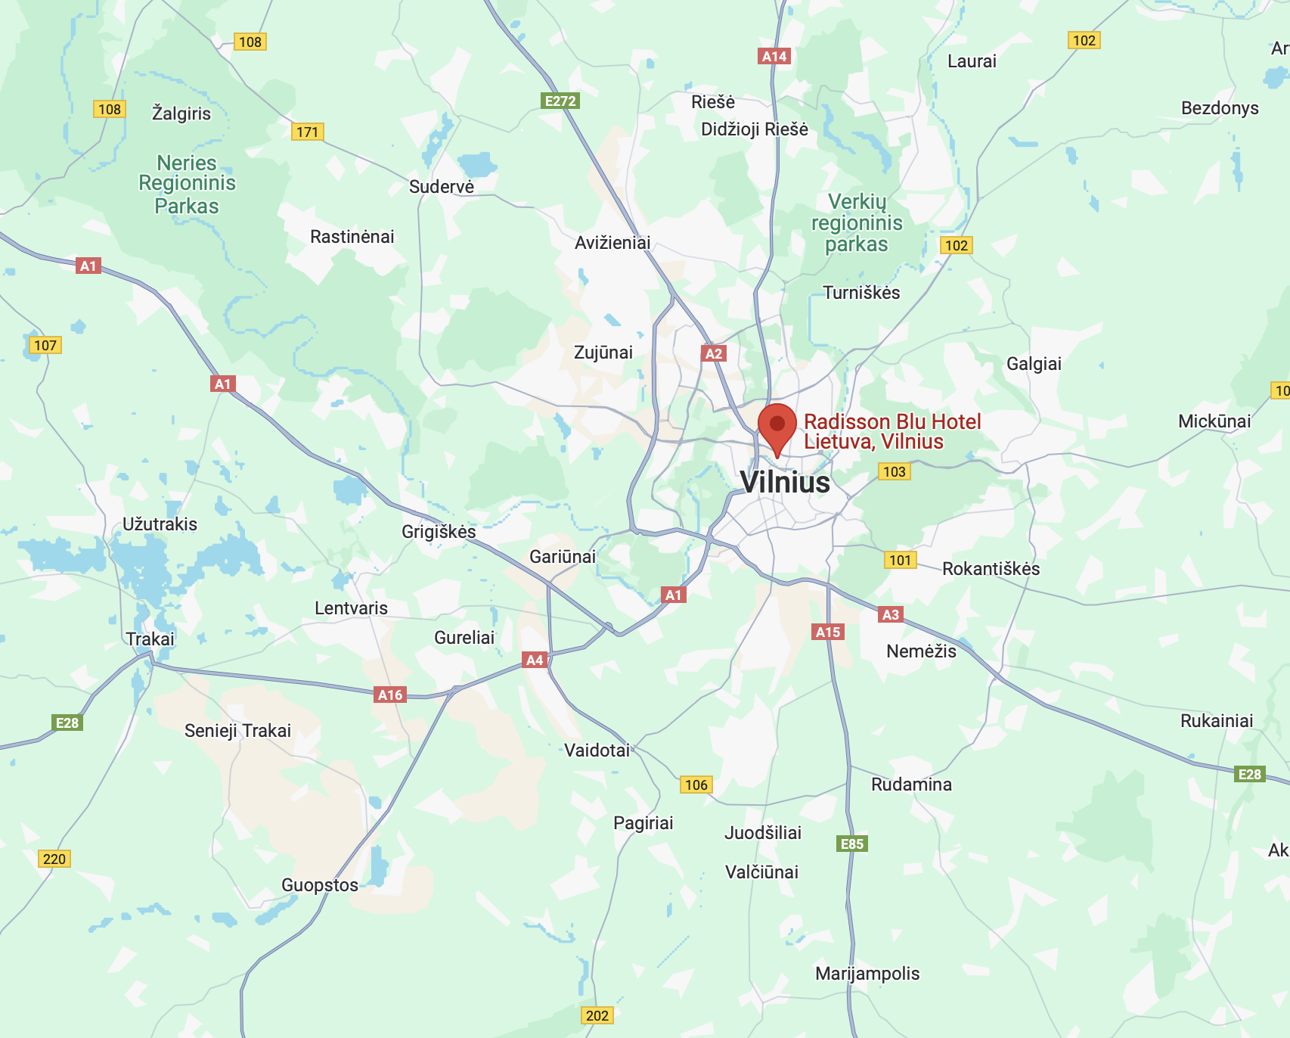
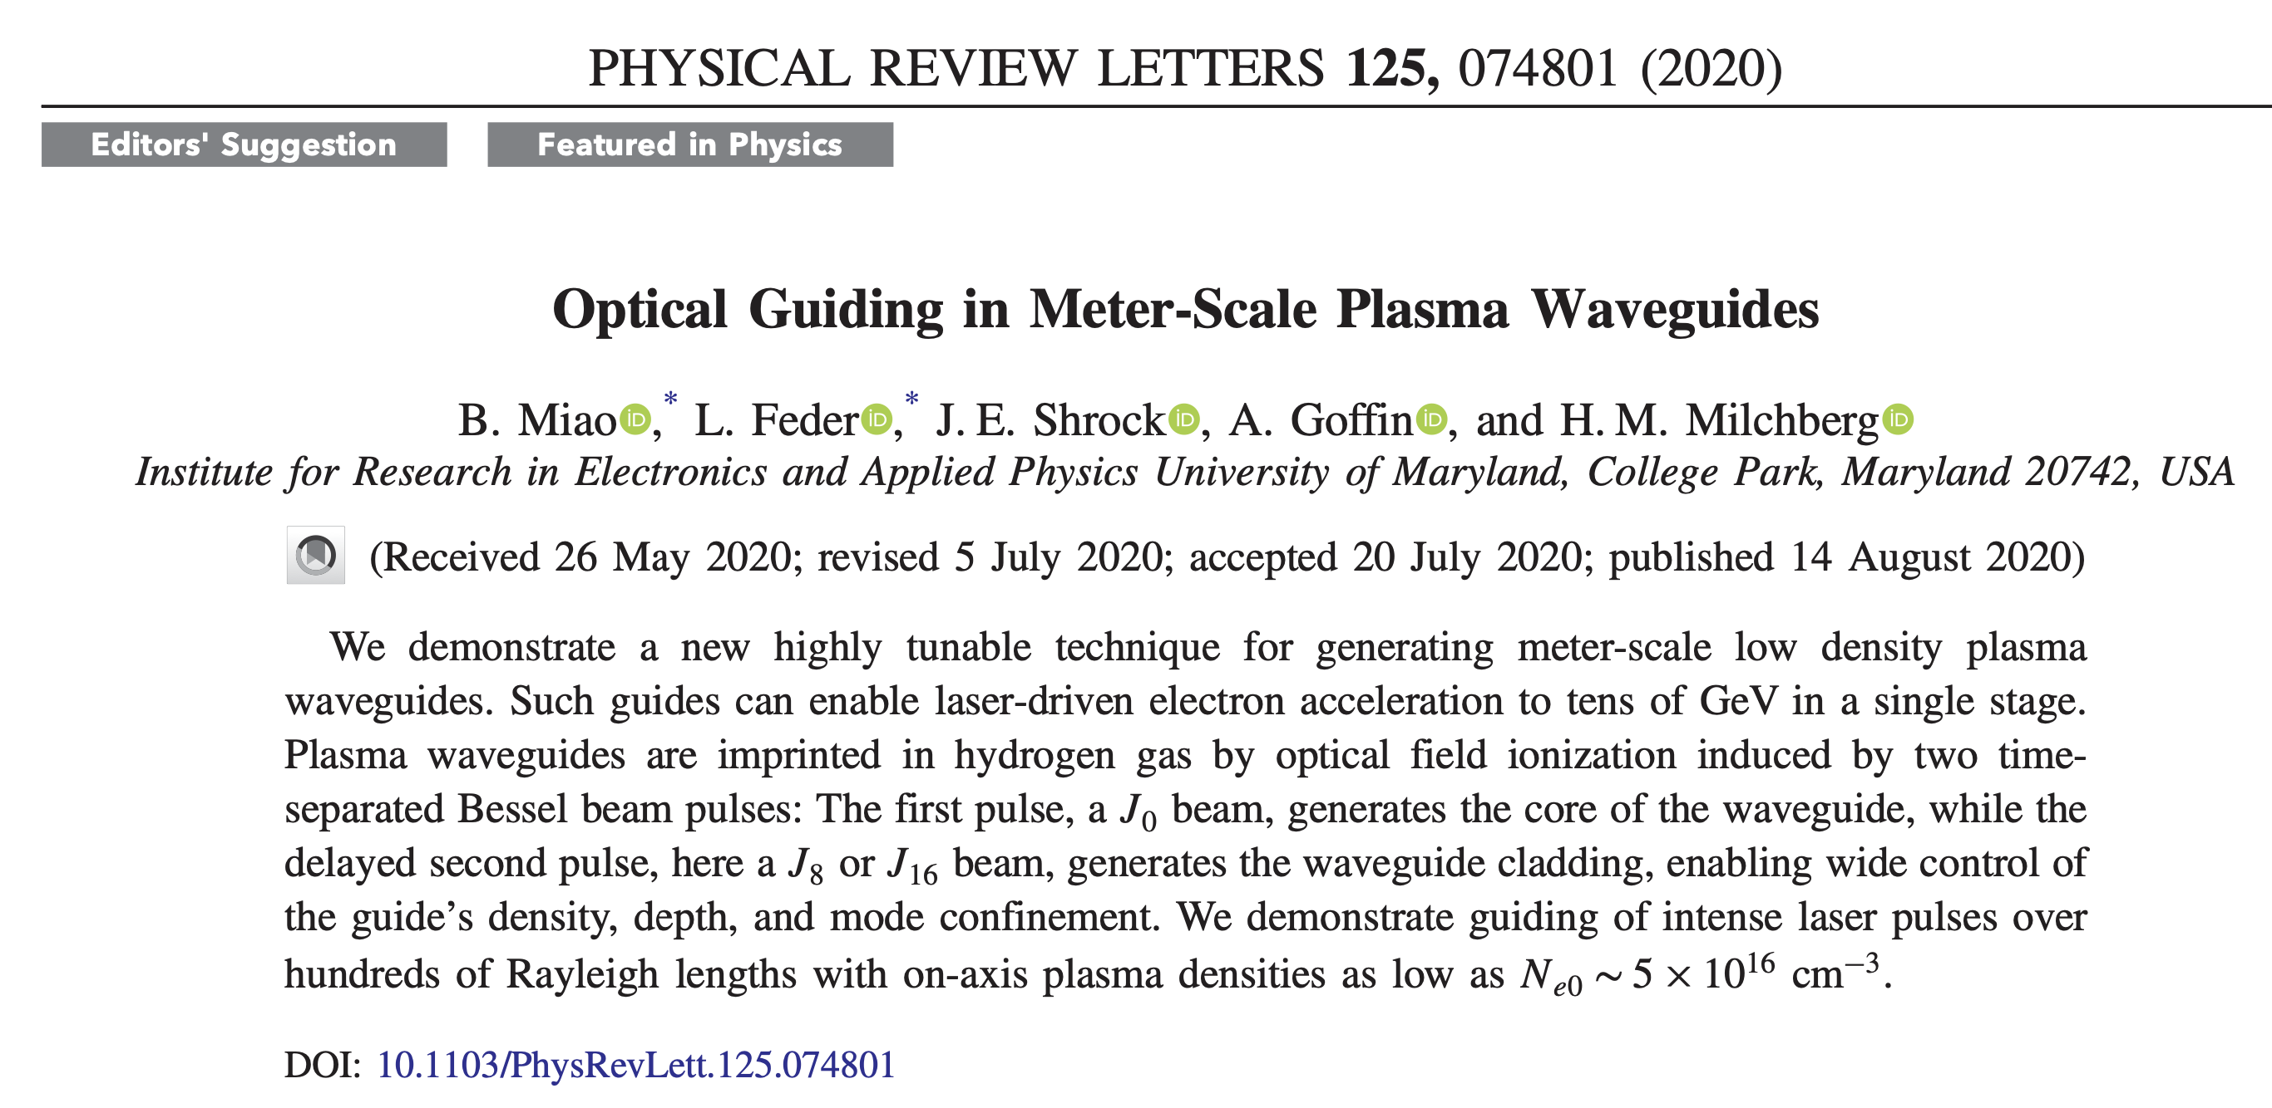
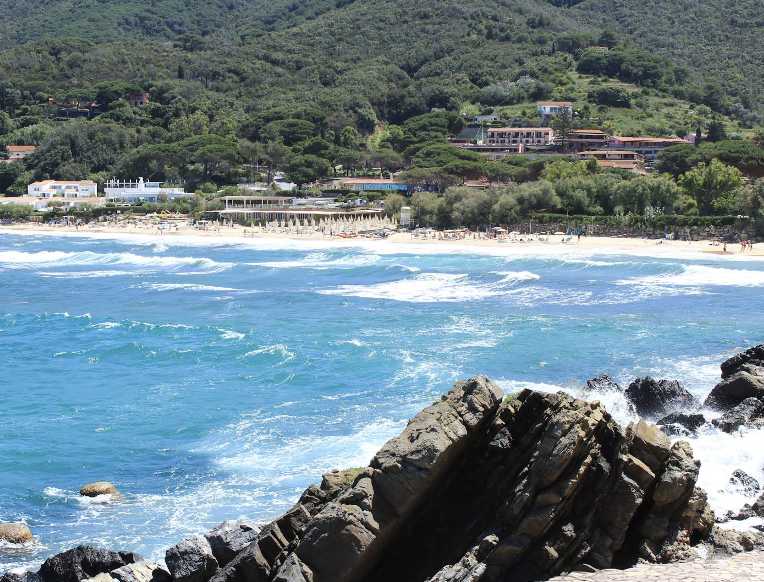
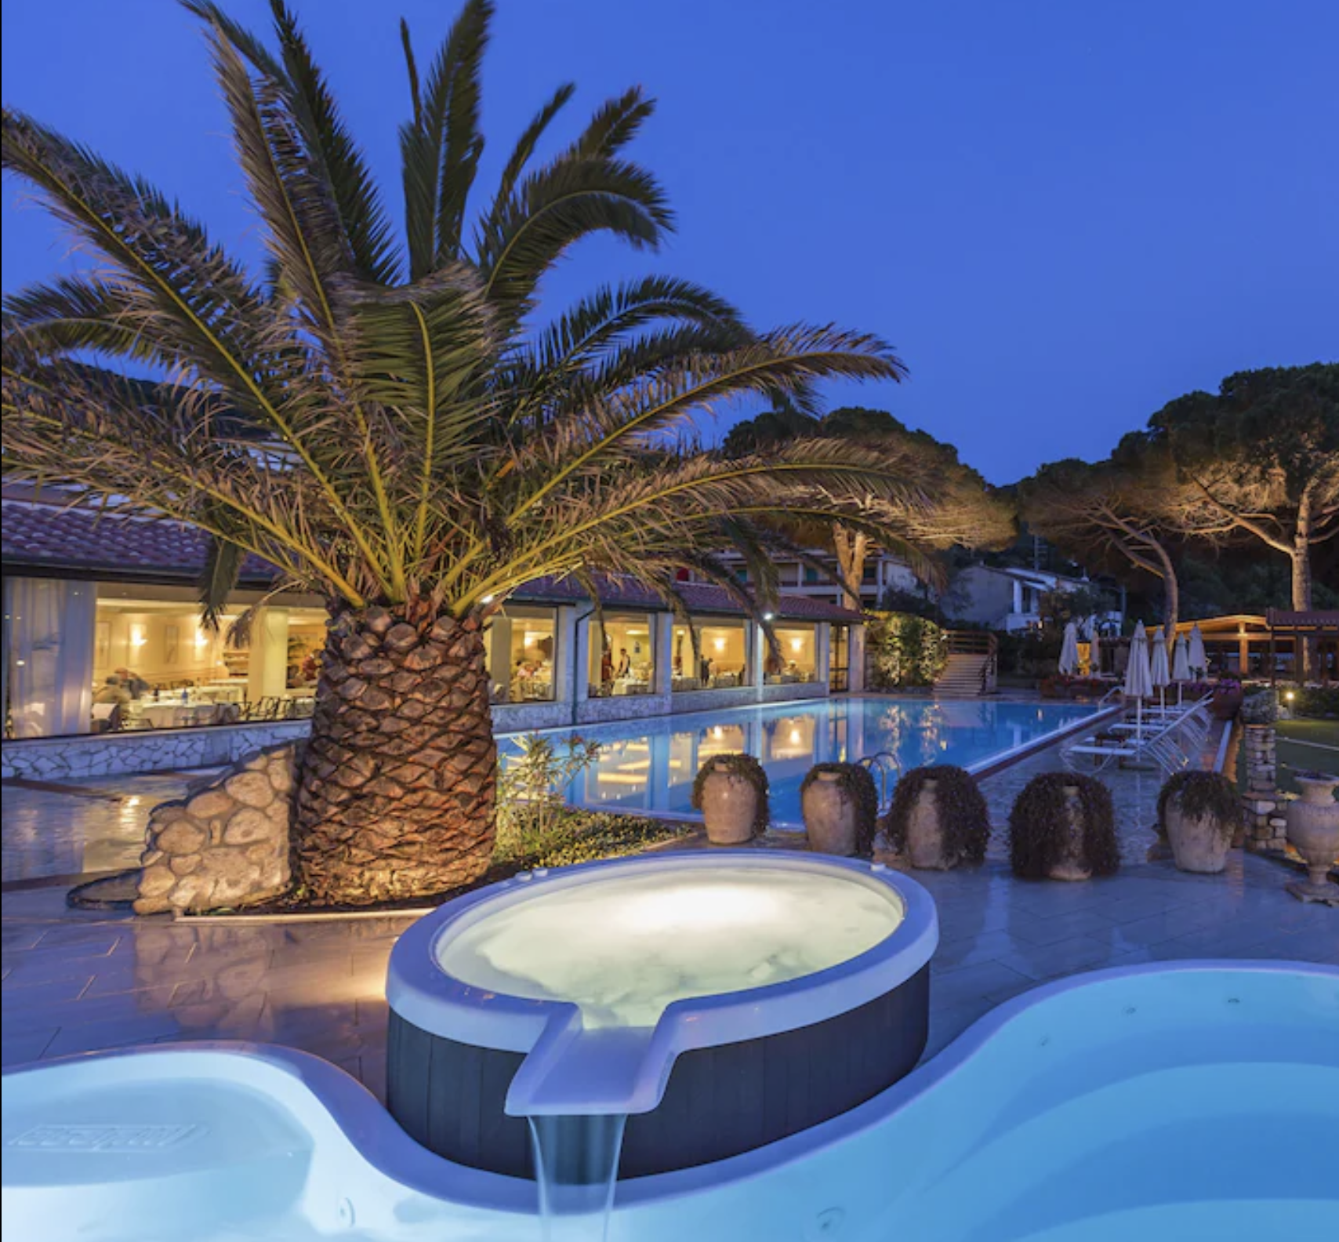
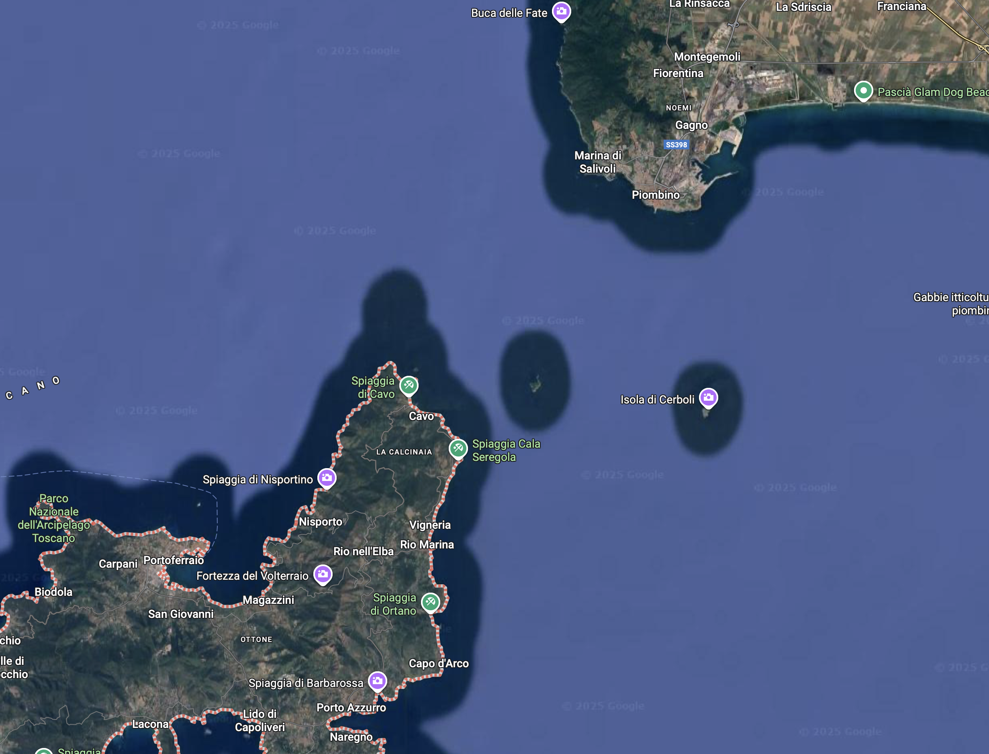
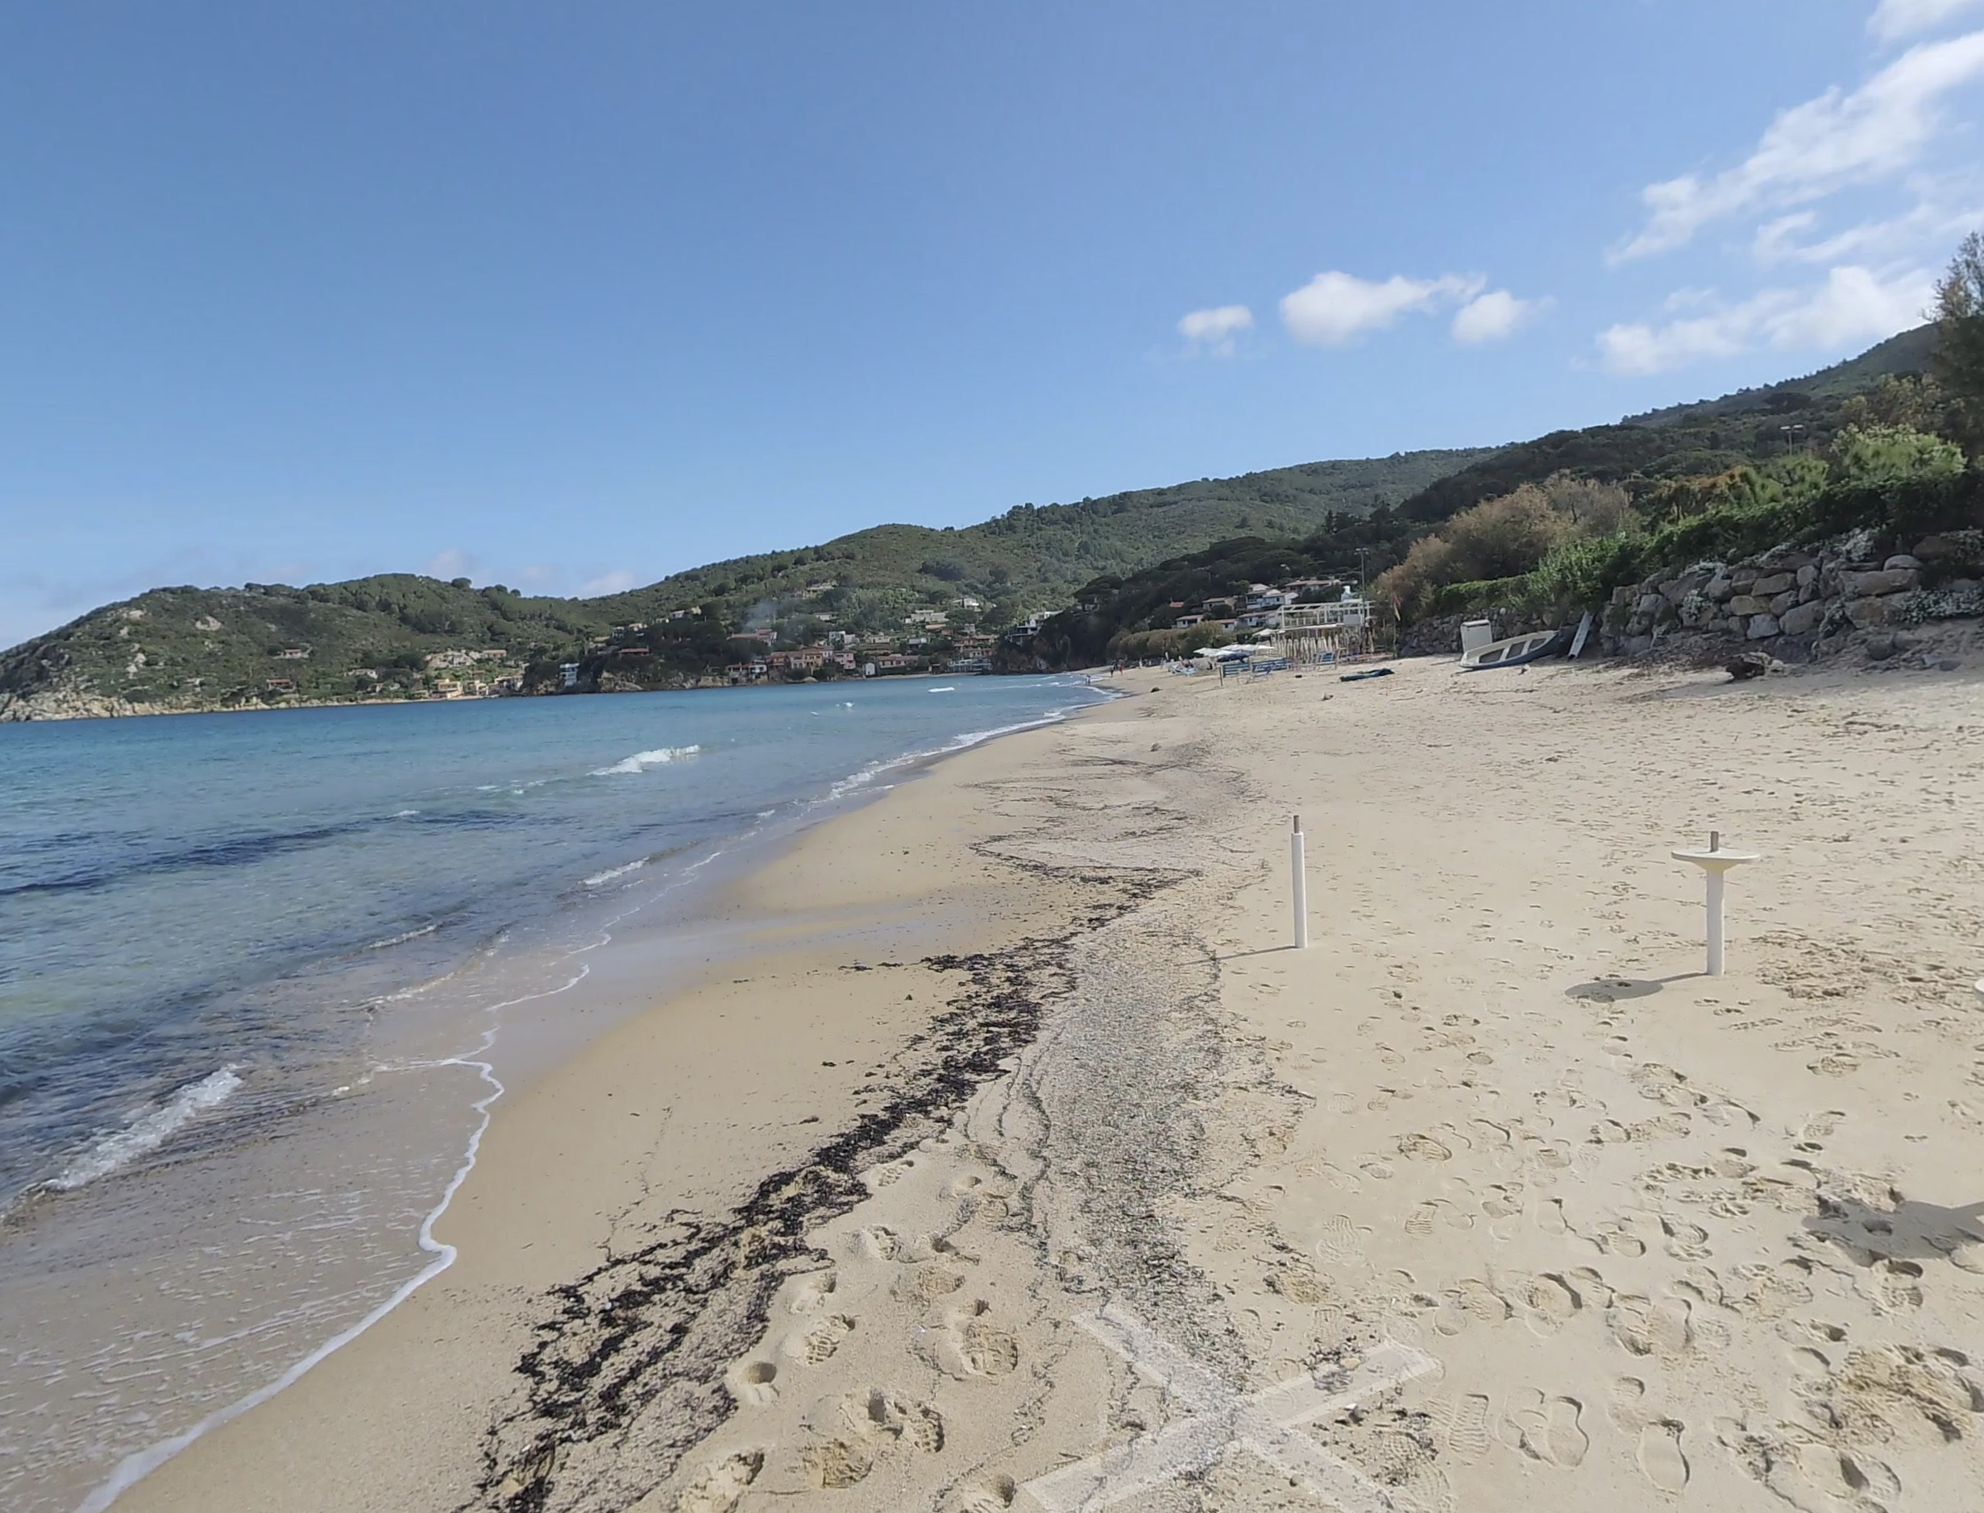
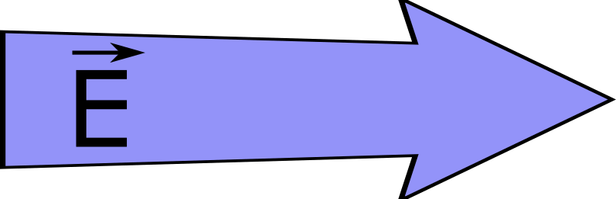
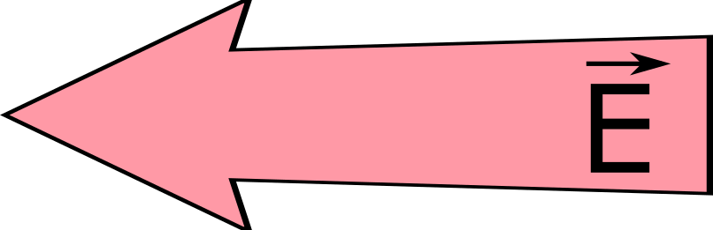
The Dephasing Limit
Problem: Relativistic electrons outpace laser in plasma
4 m
200 m
10,000 m
Solution: Need to speed up the bubble (and therefore the laser driver)
J. P. Palastro et al., 2020.
EAAC 2025, 7th European Advanced Accelerator Conference, Hotel Hermitage, La Biodola Bay, Isola d'Elba, Italy, 21–27 Sept 2025

Slide 13
Laser-Wakefield Acceleration
The Dephasing Limit
Structuring Light: Near Field - STCs
Structuring Light: Far Field - Axiparabola
Axiparabola Velocity Measurement
First Electrons
Femtosecond Relativistic Electron Microscopy (FREM)
EAAC 2025, 7th European Advanced Accelerator Conference, Hotel Hermitage, La Biodola Bay, Isola d'Elba, Italy, 21–27 Sept 2025

Slide 14
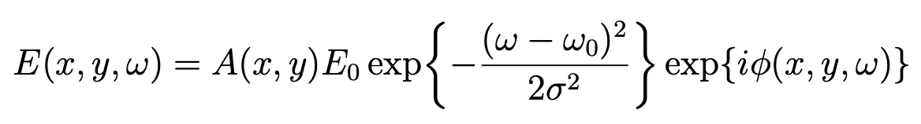

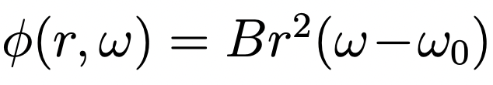
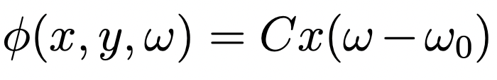
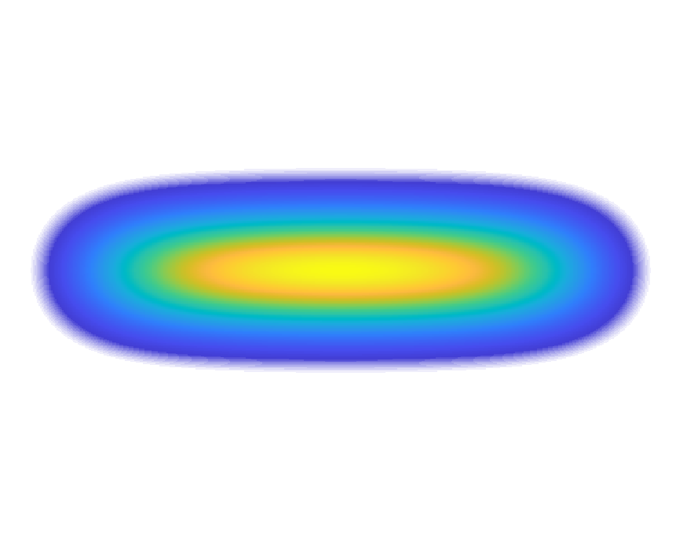
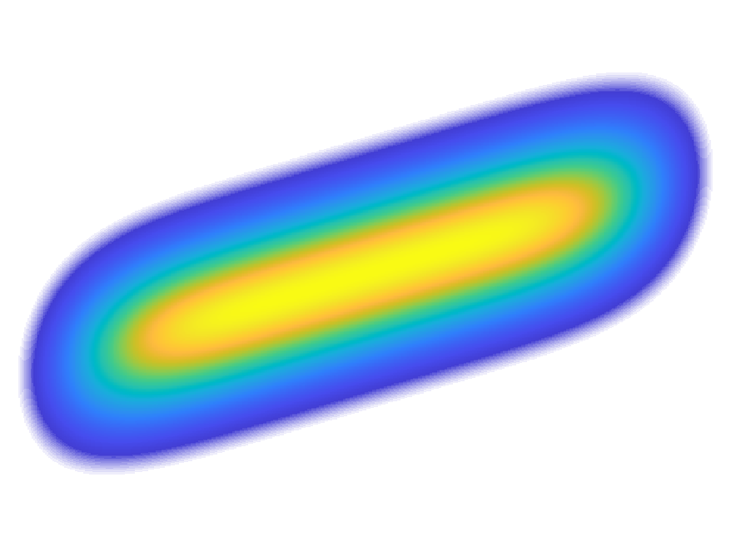
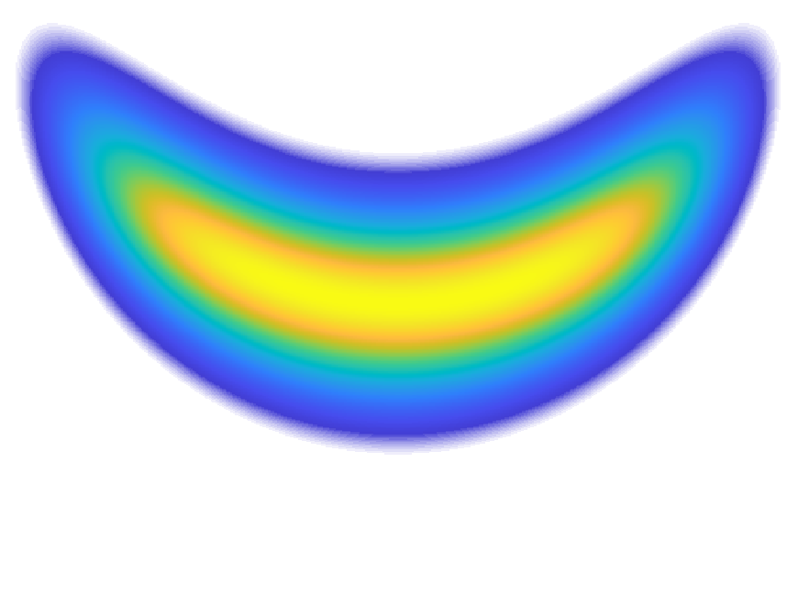
Spatio-Temporal Couplings (STCs)
-
Spatiotemporal couplings spatially-dependent chromatic effects
For Gaussian:
1st order couplings - spatially dependent pulse front delay
No STC Pulse Front Curvature Pulse Front Tilt
Time [fs]
X
EAAC 2025, 7th European Advanced Accelerator Conference, Hotel Hermitage, La Biodola Bay, Isola d'Elba, Italy, 21–27 Sept 2025

Slide 15
Laser-Wakefield Acceleration
The Dephasing Limit
Structuring Light: Near Field - STCs
Structuring Light: Far Field - Axiparabola
Axiparabola Velocity Measurement
First Electrons
Femtosecond Relativistic Electron Microscopy (FREM)
EAAC 2025, 7th European Advanced Accelerator Conference, Hotel Hermitage, La Biodola Bay, Isola d'Elba, Italy, 21–27 Sept 2025

Slide 16
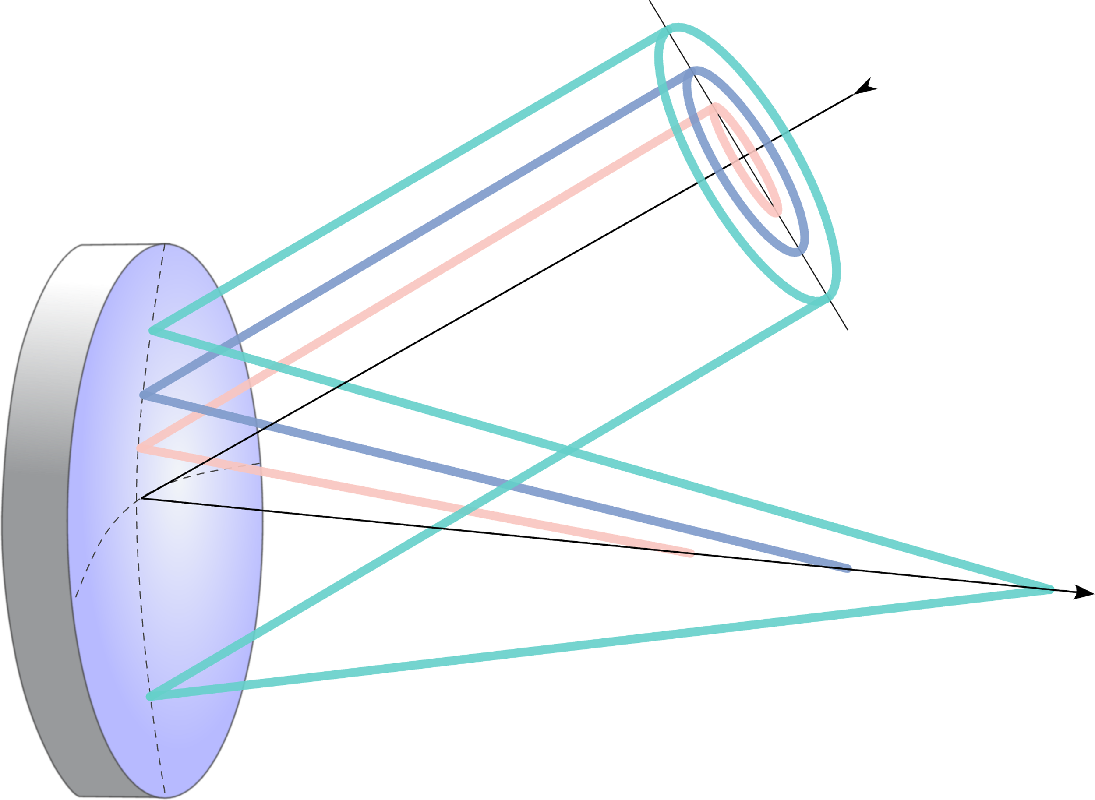
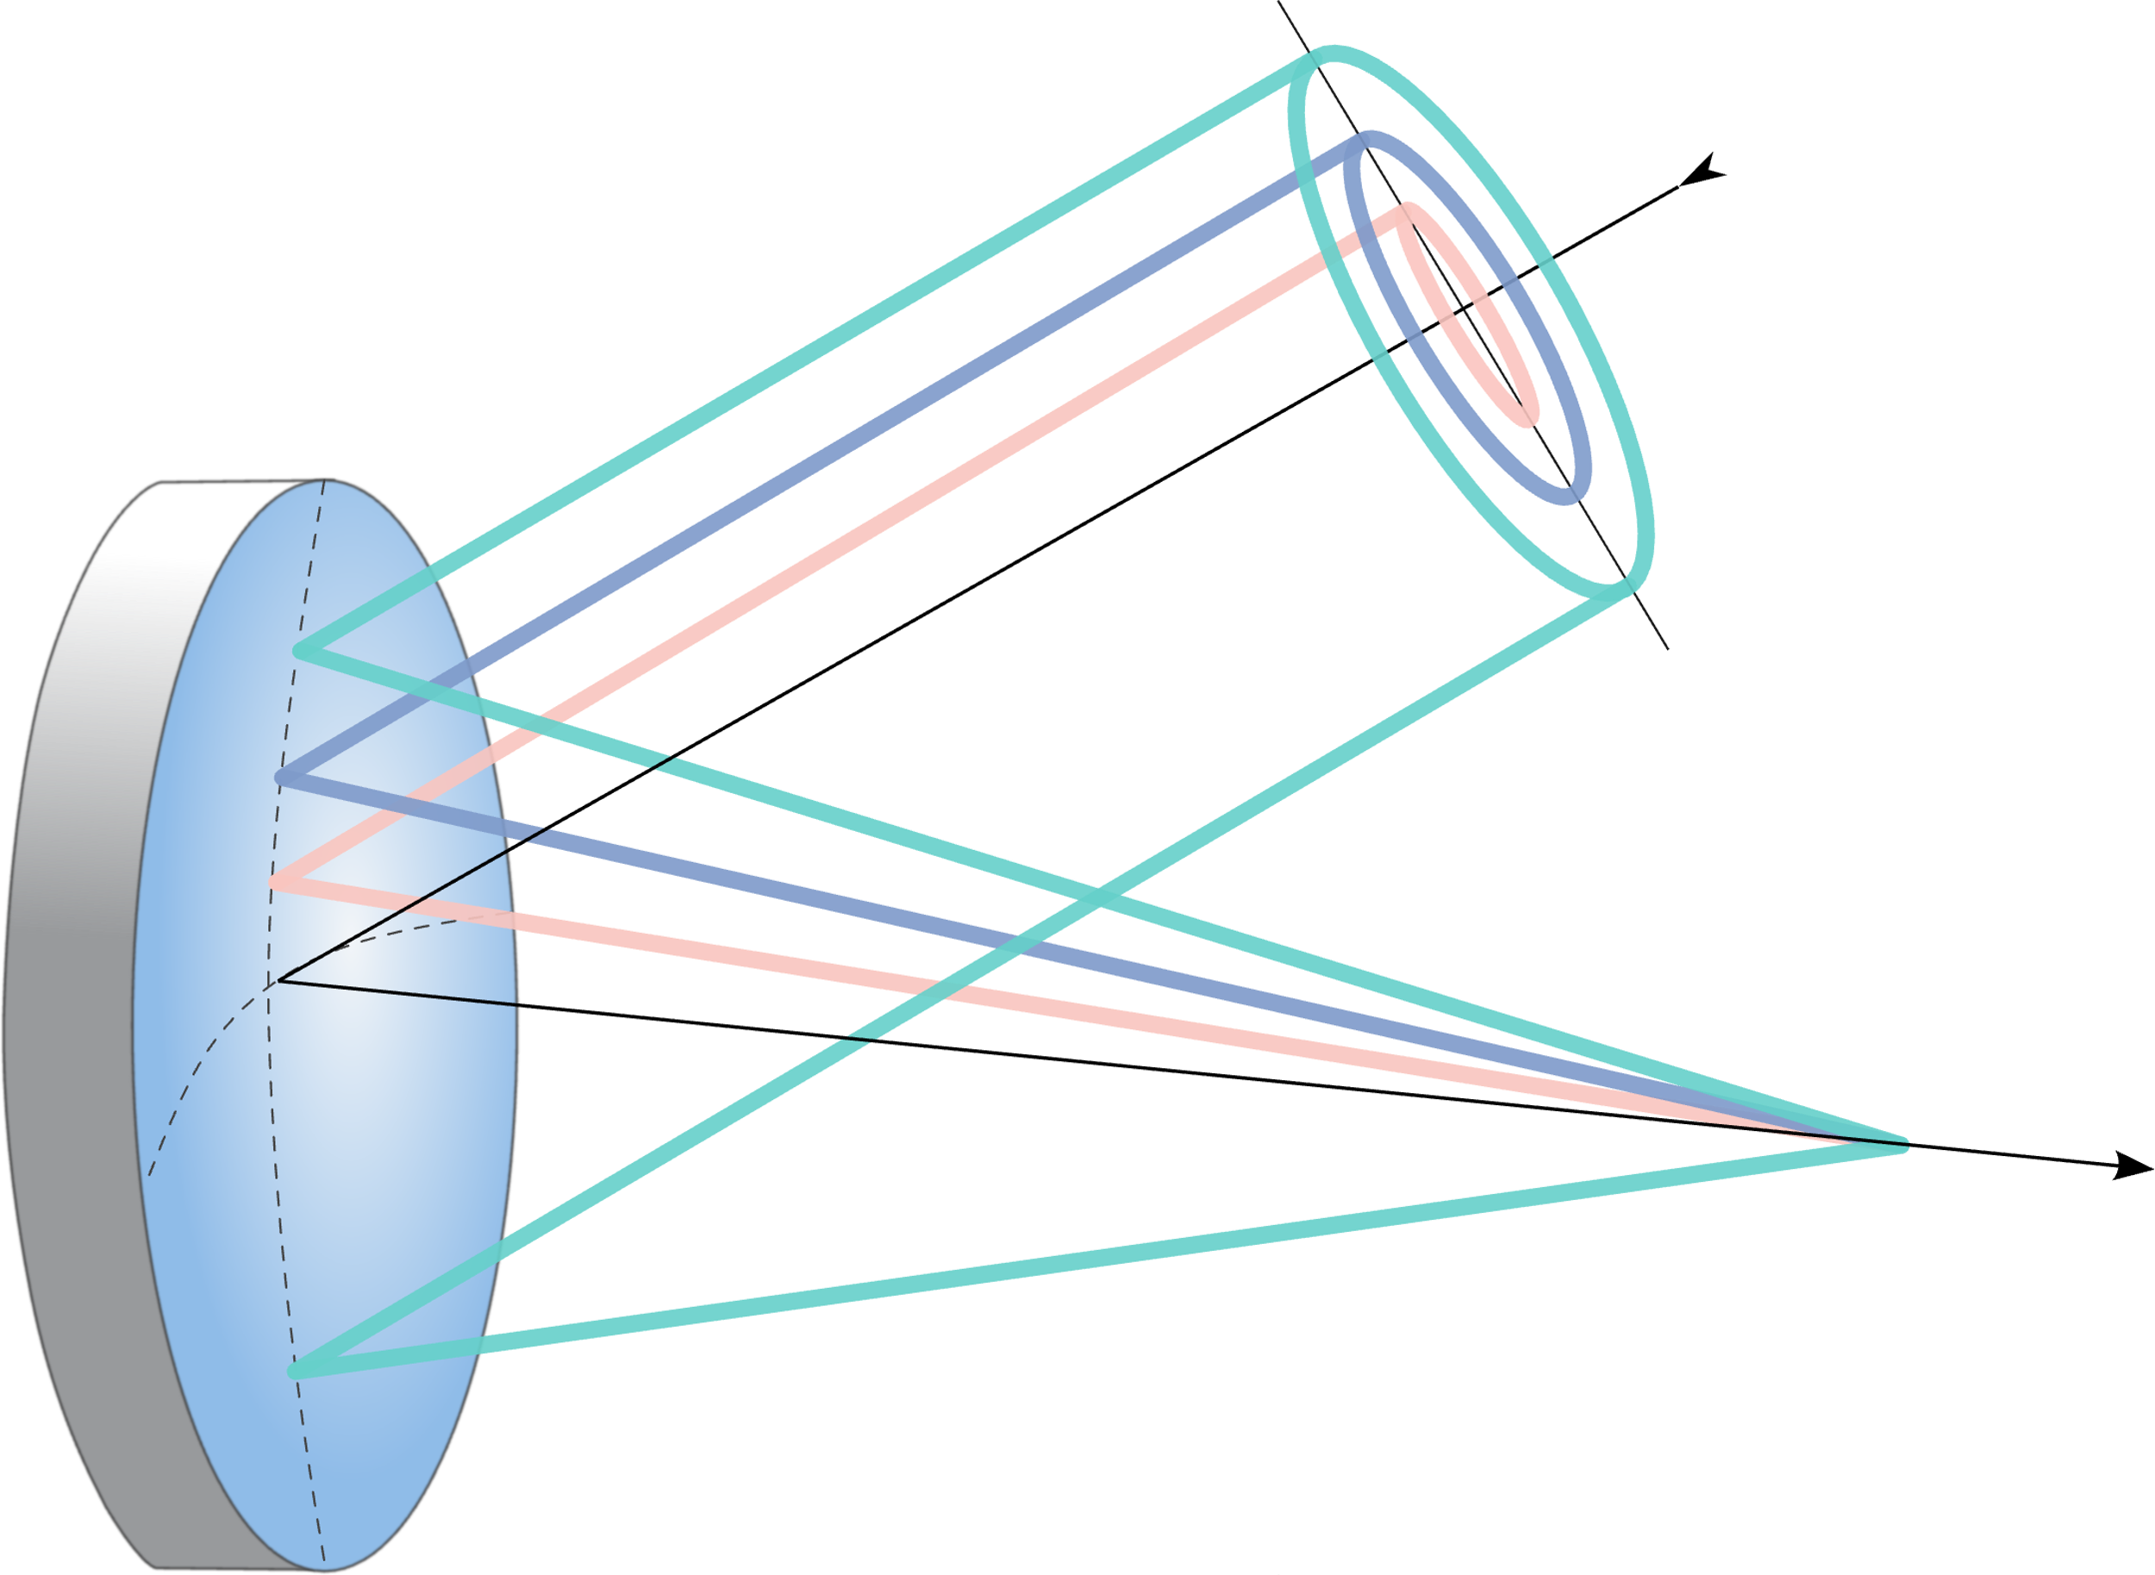

The Axiparabola
parabola
axiparabola
f
δ
f
Smartsev et. al., Opt. Lett. 44, 14 (2019)
EAAC 2025, 7th European Advanced Accelerator Conference, Hotel Hermitage, La Biodola Bay, Isola d'Elba, Italy, 21–27 Sept 2025

Slide 17
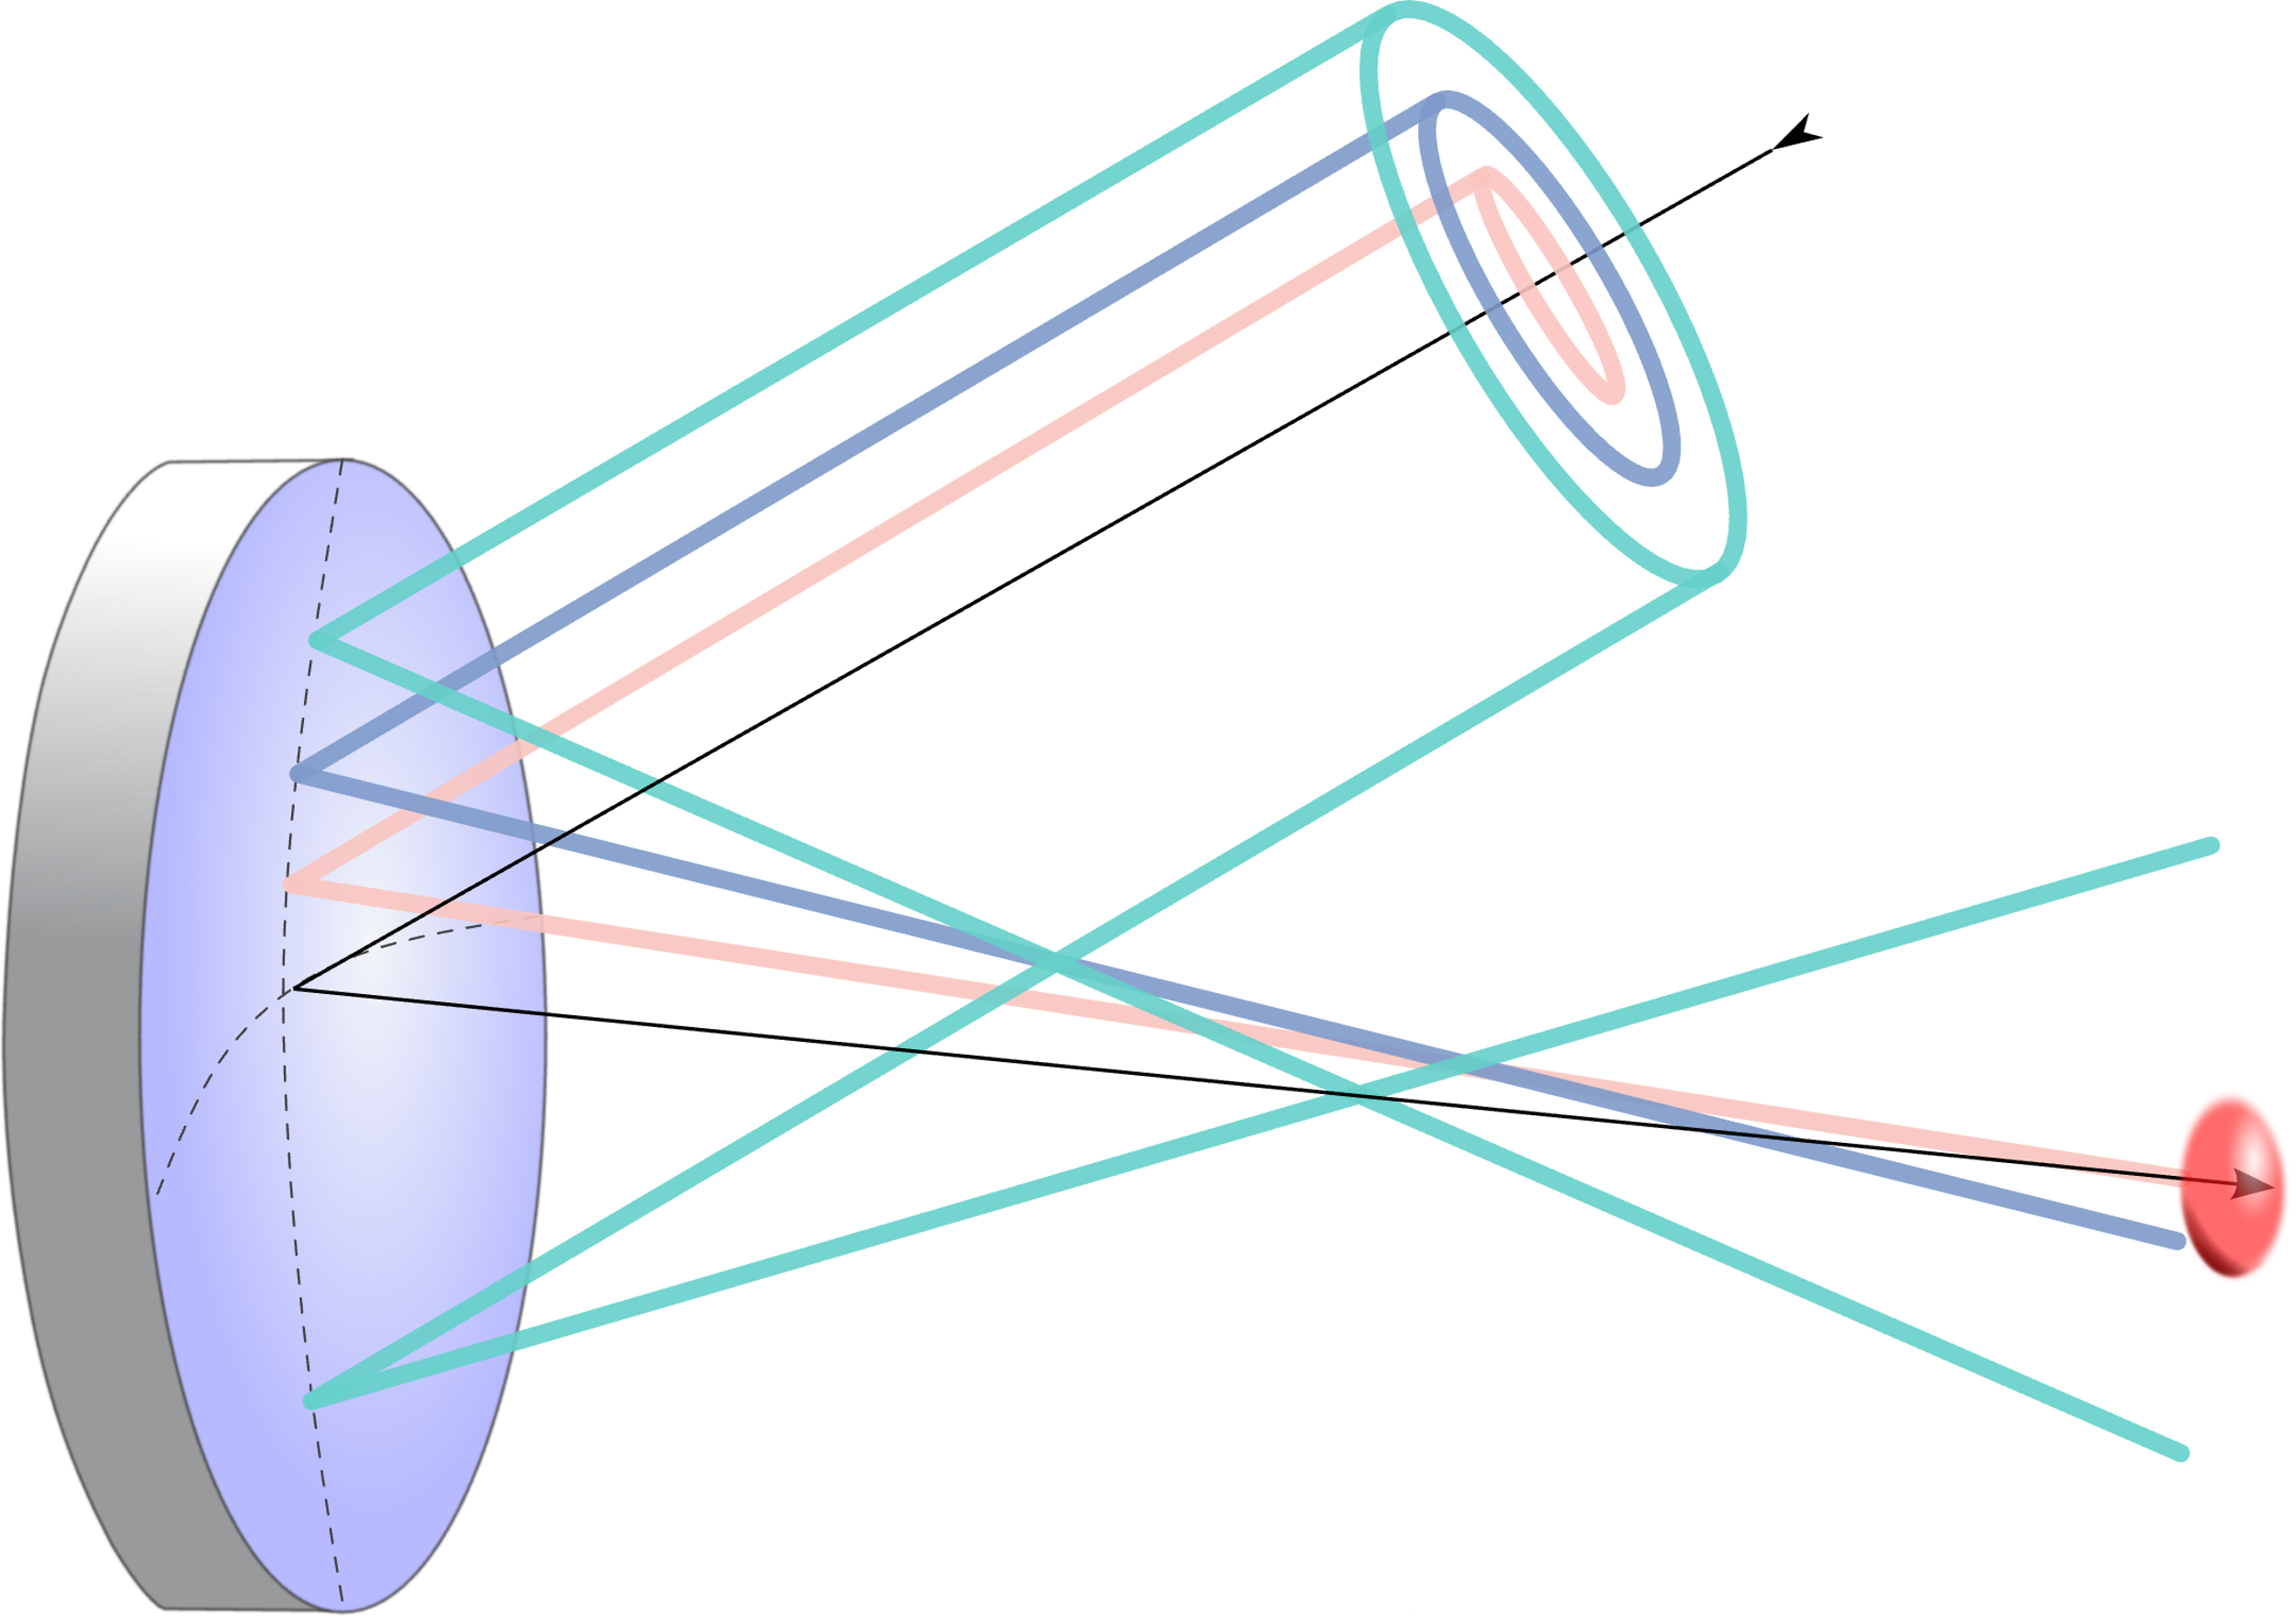



Intensity Propagation Dynamics
“Appearance” velocity is superluminal
axiparabola
Caizergues et. al., Nat. Phot. 14, 475–479 (2020)
EAAC 2025, 7th European Advanced Accelerator Conference, Hotel Hermitage, La Biodola Bay, Isola d'Elba, Italy, 21–27 Sept 2025

Slide 18



Axiparabola + STCs: Phase locked acceleration
Caizergues et. al., Nat. Phot. 14, 475–479 (2020)
EAAC 2025, 7th European Advanced Accelerator Conference, Hotel Hermitage, La Biodola Bay, Isola d'Elba, Italy, 21–27 Sept 2025

Slide 19
Laser-Wakefield Acceleration
The Dephasing Limit
Structuring Light: Near Field - STCs
Structuring Light: Far Field - Axiparabola
Axiparabola Velocity Measurement
First Electrons
Femtosecond Relativistic Electron Microscopy (FREM)
EAAC 2025, 7th European Advanced Accelerator Conference, Hotel Hermitage, La Biodola Bay, Isola d'Elba, Italy, 21–27 Sept 2025

Slide 20



Electron Acceleration
Data
Simulation
High Energy Events
Liberman et al., CLEO Proceedings 2024
Longer Manuscript in Prep.
EAAC 2025, 7th European Advanced Accelerator Conference, Hotel Hermitage, La Biodola Bay, Isola d'Elba, Italy, 21–27 Sept 2025

Slide 21
Laser-Wakefield Acceleration
The Dephasing Limit
Structuring Light: Near Field - STCs
Structuring Light: Far Field - Axiparabola
Axiparabola Velocity Measurement
Femtosecond Relativistic Electron Microscopy (FREM)
EAAC 2025, 7th European Advanced Accelerator Conference, Hotel Hermitage, La Biodola Bay, Isola d'Elba, Italy, 21–27 Sept 2025

Slide 22
Femtosecond Relativistic Electron Microscopy
Liberman et al., ArXiv:2503.01516
EAAC 2025, 7th European Advanced Accelerator Conference, Hotel Hermitage, La Biodola Bay, Isola d'Elba, Italy, 21–27 Sept 2025

Slide 23
FREM Pulse Front Curvature Comparison
PFC = -0.0019 fs/mm²
PFC = 0.02 fs/mm²
Liberman et al., ArXiv:2503.01516
EAAC 2025, 7th European Advanced Accelerator Conference, Hotel Hermitage, La Biodola Bay, Isola d'Elba, Italy, 21–27 Sept 2025

Slide 24
Linear and Nonlinear Fields
Liberman et al., ArXiv:2503.01516
EAAC 2025, 7th European Advanced Accelerator Conference, Hotel Hermitage, La Biodola Bay, Isola d'Elba, Italy, 21–27 Sept 2025

Slide 25
Comparison to Parabola
Parabolic
Axiparabolic
Liberman et al., ArXiv:2503.01516
EAAC 2025, 7th European Advanced Accelerator Conference, Hotel Hermitage, La Biodola Bay, Isola d'Elba, Italy, 21–27 Sept 2025

Slide 26
Summary
LWFA - promising due to unprecedented acceleration gradients
Dephasing limits the achievable electron energy – hurts potential applications
To mitigate dephasing - increase propagation velocity of laser driver
Structuring light using STCs and an axiparabola – possible solution
Experimentally demonstrated ability to tune propagation velocity
Used FREM to probe the structure of this novel wakefield
Provide new insights into this regime
EAAC 2025, 7th European Advanced Accelerator Conference, Hotel Hermitage, La Biodola Bay, Isola d'Elba, Italy, 21–27 Sept 2025

Slide 27























Thank You
ExCoMet
WIS-CNRS (IPR LAMA)

Slide 28


Summary
Axiparabola Velocity Measurement
Refractive doublet for PFC Control:
Effect scales with beam size
Kabacinski et al. J. Opt. 23 (2021), Liberman et al., Opt. Let. 49 (2024)
EAAC 2025, 7th European Advanced Accelerator Conference, Hotel Hermitage, La Biodola Bay, Isola d'Elba, Italy, 21–27 Sept 2025

