Slide 1
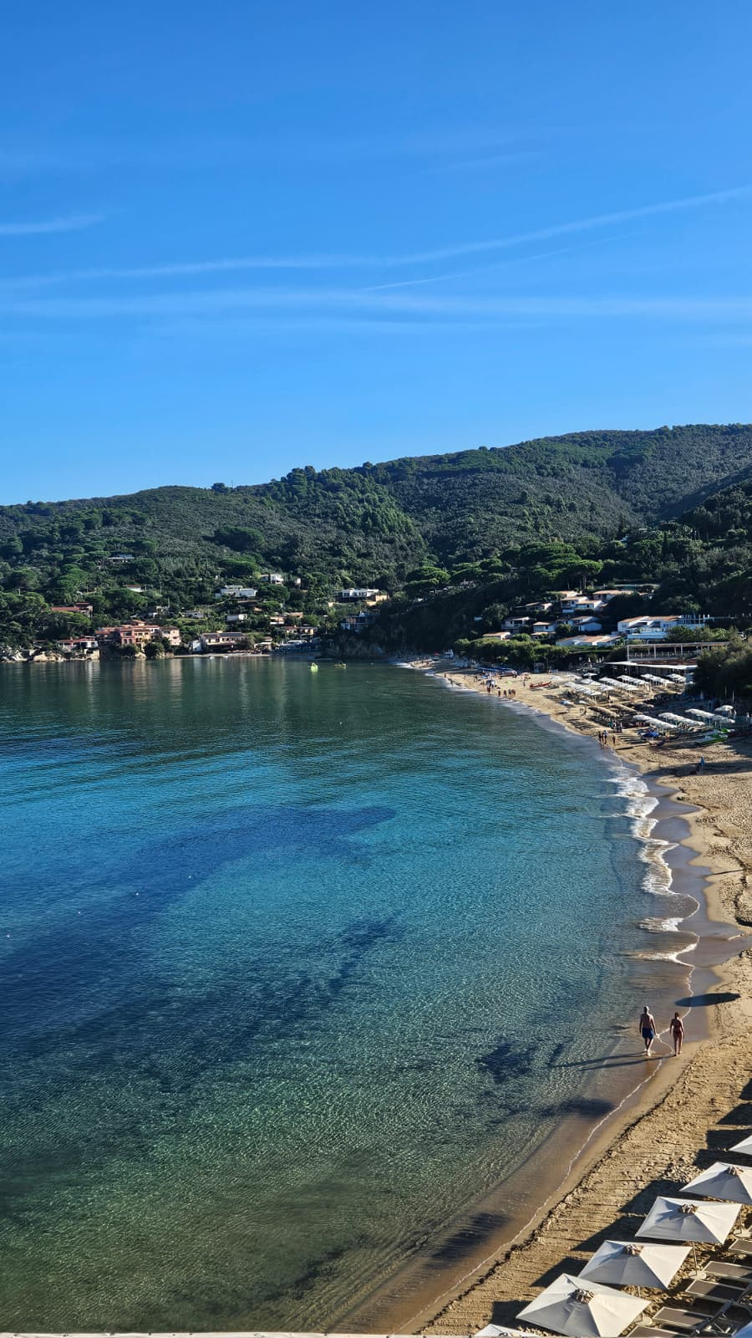
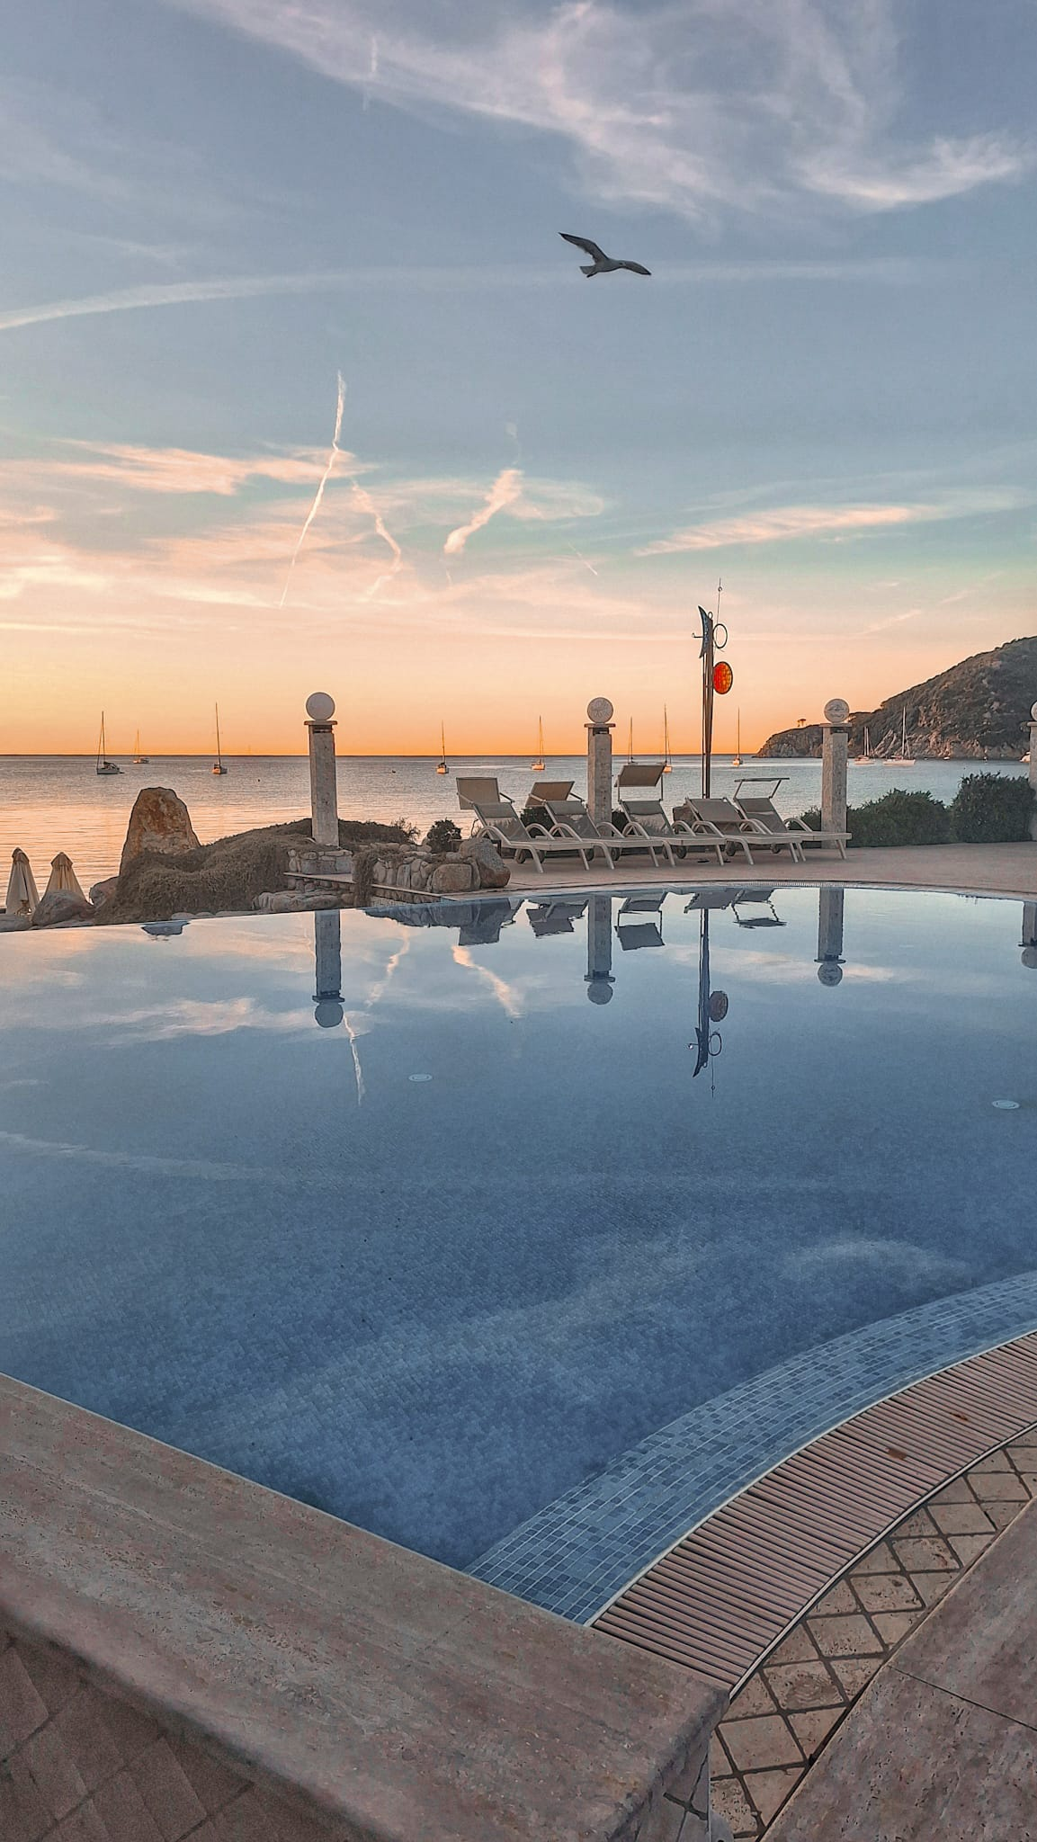





Welcome to:
7th European Advanced Accelerator Conference
21 – 27 September 2025
Hotel Hermitage
Elba Island

Slide 2
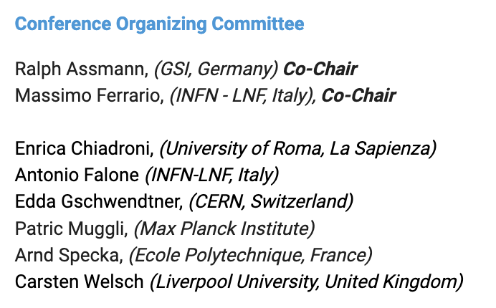
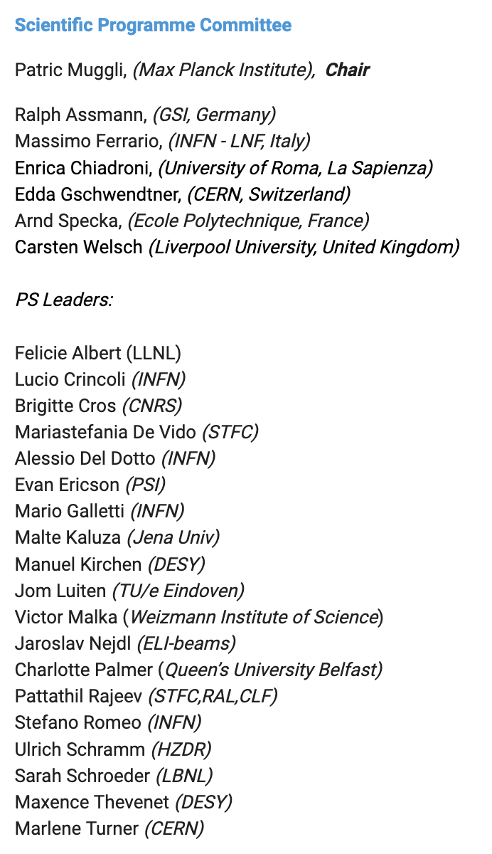
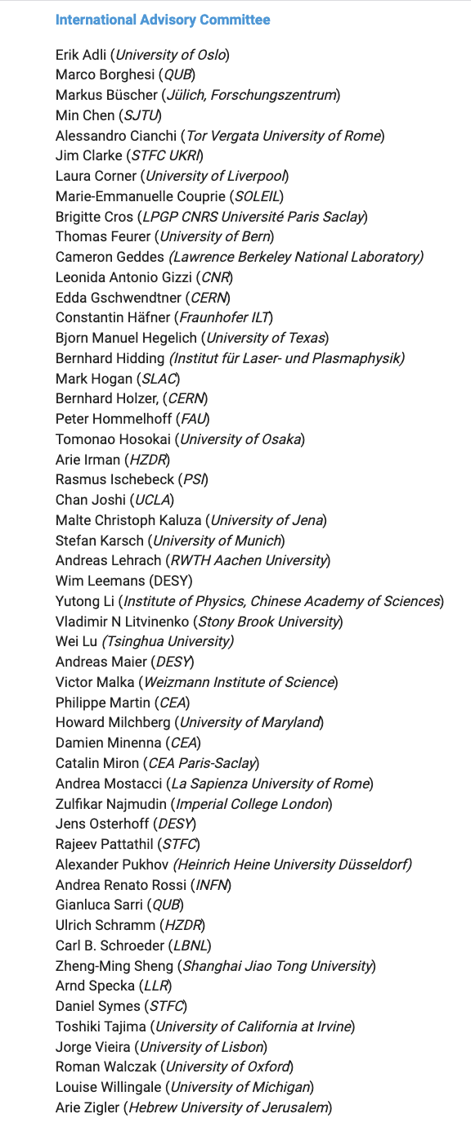
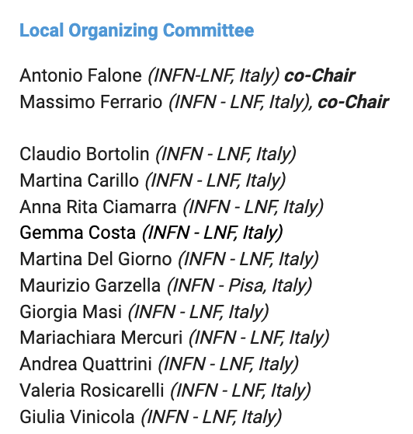

Slide 3
Over the next few days, we will share the latest progress in advanced accelerator science, from plasma- and structure-based concepts to novel applications that may define the future of our field.
Parallel Session | Topic | Co-Leaders
PS1 | Plasma-based accelerators and ancillary components | Sarah Schroeder (LBNL) • Mario Galletti (INFN)
PS2 | High gradient vacuum structures | Evan Ericson (PSI) • Jom Luiten (TU/e)
PS3 | Laser technology | Manuel Kirchen (DESY) • Mariastefania De Vido (STFC)
PS4 | Theory and simulations | Stefano Romeo (INFN) • Maxence Thevenet (DESY)
PS5 | Applications | Victor Malka (Weizmann Institute of Science) • Felicie Albert (LLNL) • Jaroslav Nejdl (ELI Beamlines)
PS6 | Ion acceleration and developments towards fusion | Charlotte Palmer (Queen’s University Belfast) • Ulrich Schramm (HZDR)
PS7 | Beam diagnostics, instrumentation, Machine Learning | Brigitte Cros (CNRS) • Alessio Del Dotto (INFN)
PS8 | Plasma sources and related diagnostics | Malte Kaluza (University of Jena) • Lucio Crincoli (INFN)
PS9 | Particle physics applications: proposals, ESPP input, sustainability | Pattathil Rajeev (STFC RAL CLF) • Marlene Turner (CERN)

Slide 4
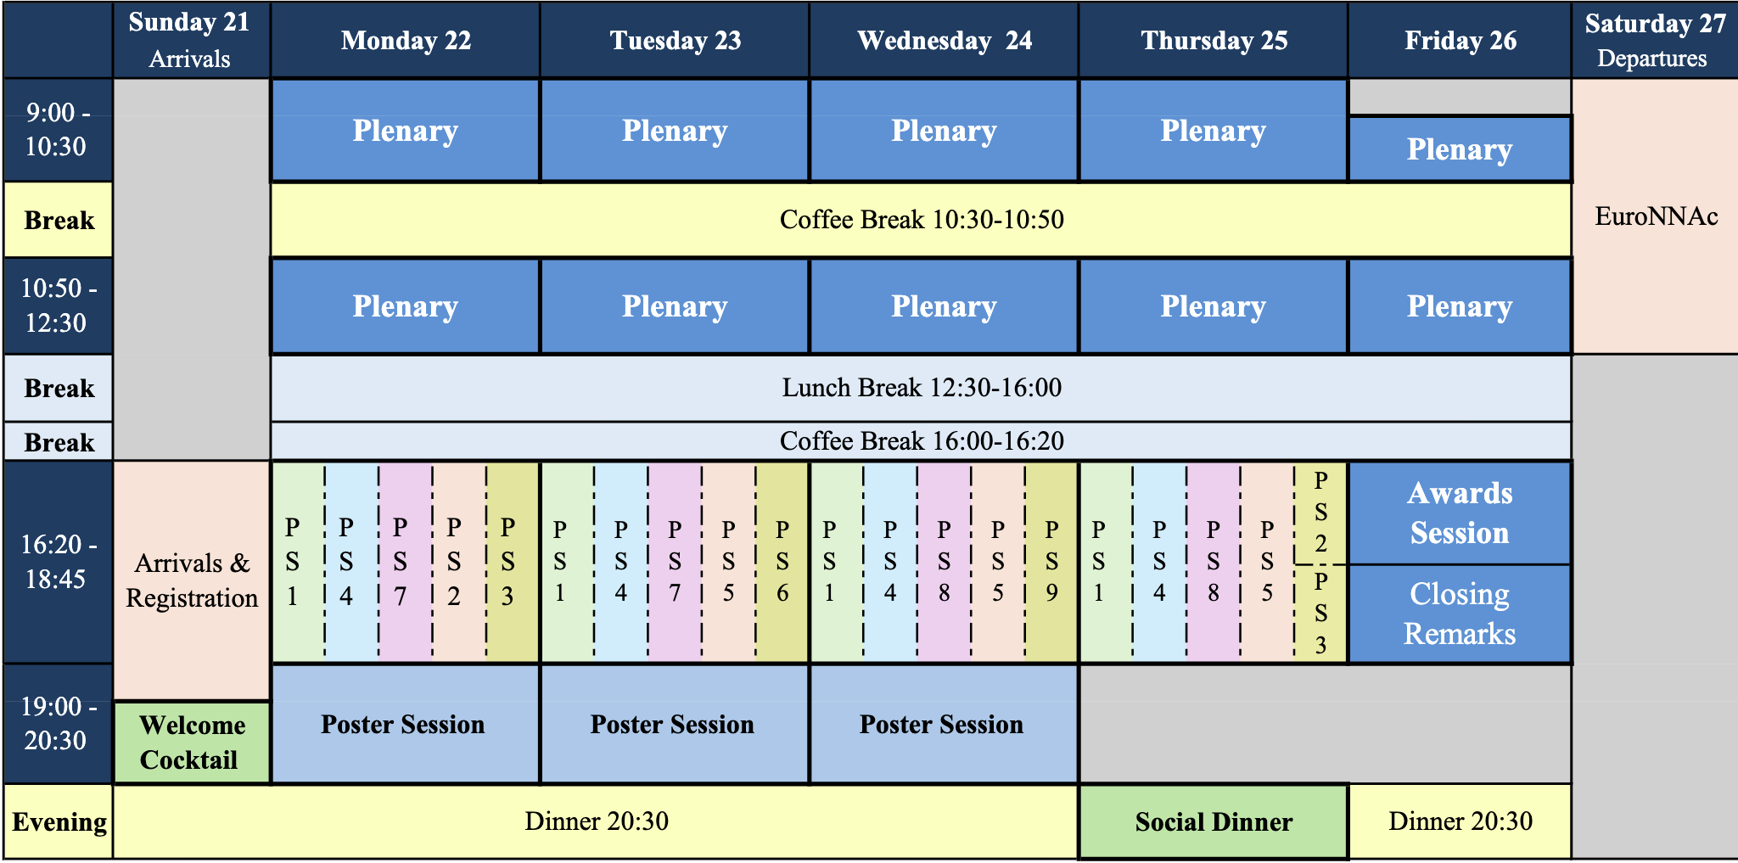

Slide 5
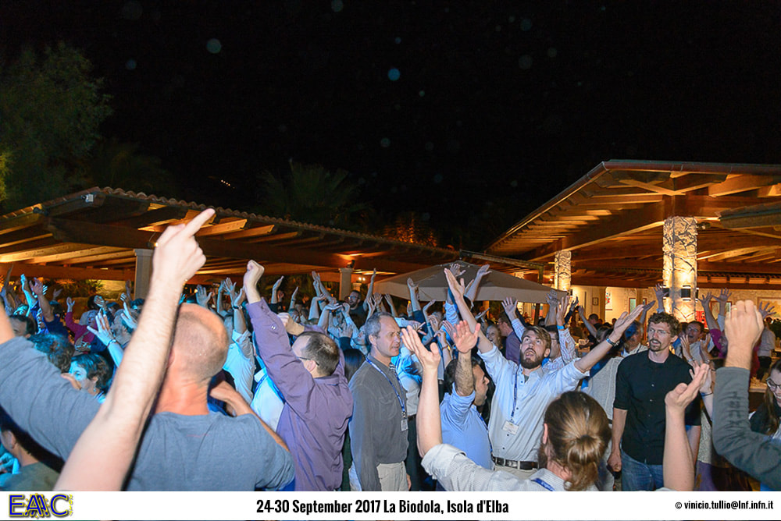
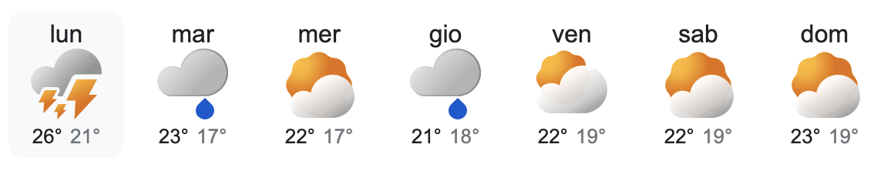
Social Dinner

Slide 6
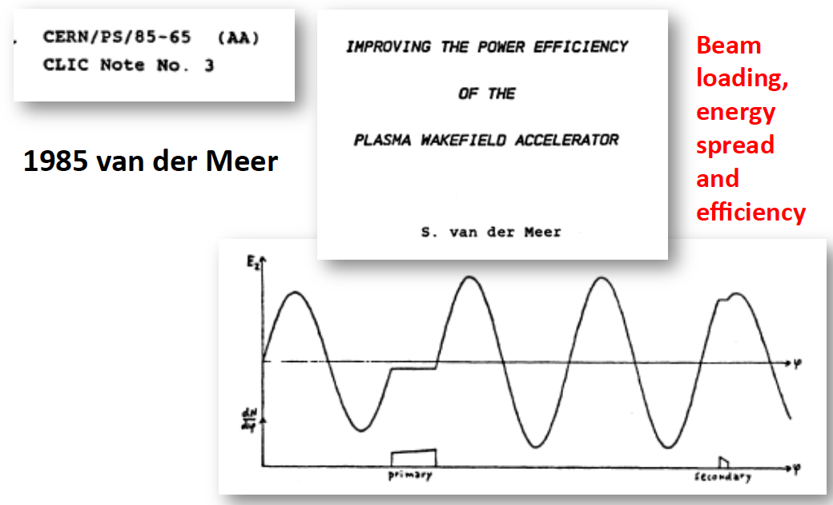
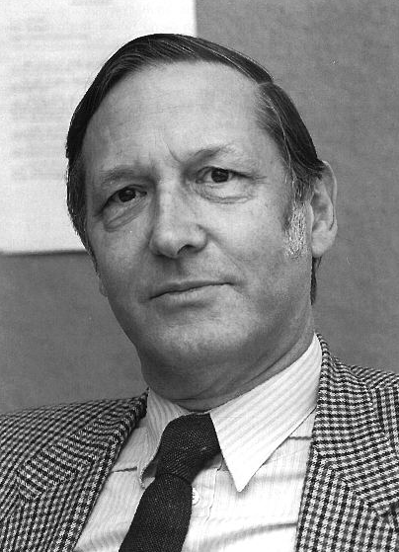
Simon van der Meer Early Career Award
in Novel Accelerators
1984 Nobel Prize in Physics to C. Rubbia and S. van der Meer for their decisive contributions to the large project, which led to the discovery of the field particles W and Z, communicators of weak interaction ➔ Stochastic Cooling.

Slide 7







European Advanced Accelerator Conference
The Simon van der Meer Early Career Award in Novel Accelerators
Sponsored by CERN/GSI/INFN
Is awarded by the European Advanced Accelerator Conference to recognize outstanding early career contributions (theoretical, experimental, computational or technical) in novel accelerator science.
This diploma certifies that the 2025 Award has been presented to
2025
Award
Ralph Aßmann
EAAC2025 Co-Chair
Massimo Ferrario
EAAC2025 Co-Chair
Edda Gschwendtner
Prize Committee Chair
22 September 2025

Slide 8
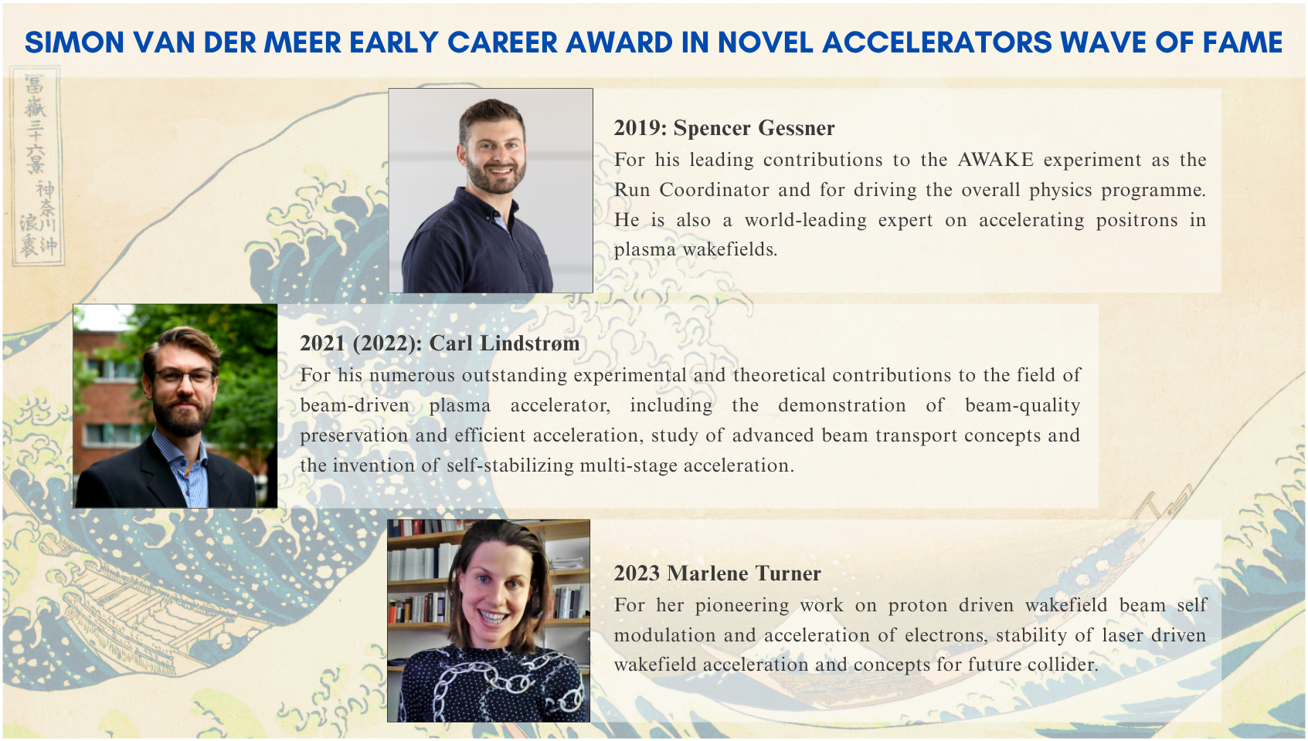

Slide 9

Poster Awards:
All posters presented by students and postdoctoral researchers during the three dedicated Poster Sessions will be eligible for the Poster Awards.
An evaluation committee will select three outstanding contributions to be recognized with a special prize.
The Poster Awards are kindly sponsored by Amplitude Laser Group and consist of a monetary prize of 300€.

Slide 10
Yearly Meeting European Network for Novel Accelerators (EuroNNAc4), 27.9.2025
09:00 Welcome (R. Assmann, M. Ferrario) - includes quick introduction around the table
09:10 EuroNNAc and EAAC - History and Future Options (R. Assmann)
09:40 EuroNNAc and EAAC Funding in IFAST WP6 (M. Ferrario)
10:00 Discussion Future of EuroNNAc Network and EAAC (round-table)
10:30 Decision on EAAC 2027
10:40 Coffee and Group Picture
11:10 Status of EuPRAXIA@SPARCLAB (M. Ferrario)
11:30 Status of EuPRAXIA@ELI-Beamlines (tbd)
11:50 Status and News of Advanced Acceleration Projects (round-table)
12:50 Conclusion (R. Assmann, M. Ferrario)
13:00 Adjourn

Slide 11
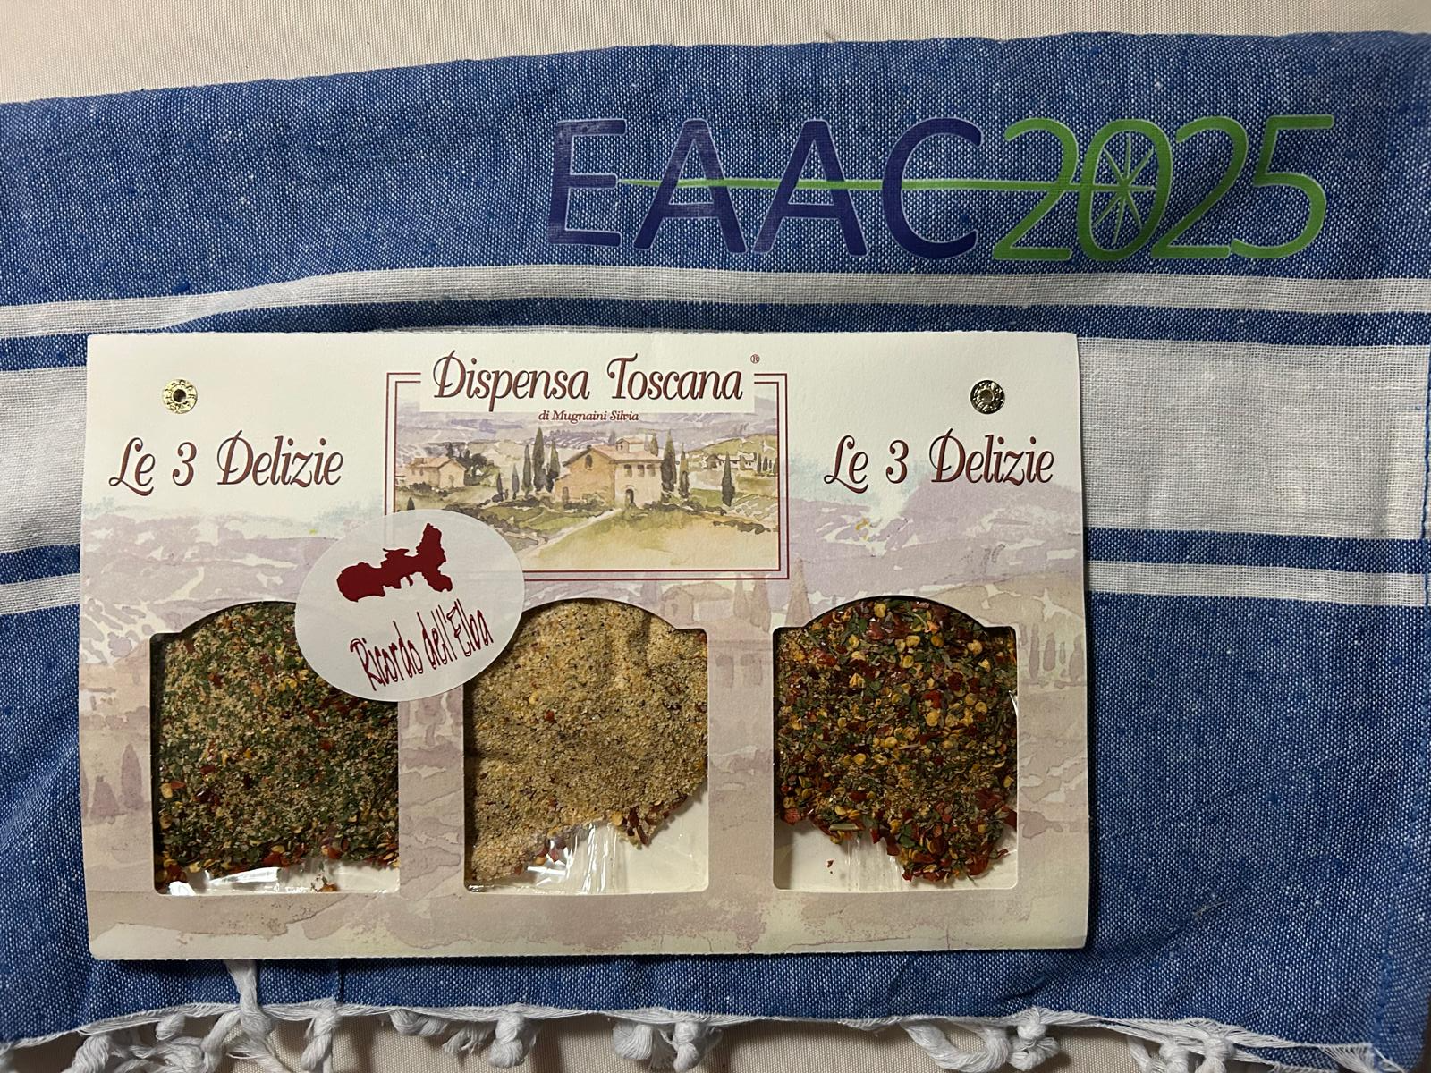
In your welcome kit:
Penne all’Arrabbiata
Bruschetta Tradizionale
Aglio Olio e Peperoncino

Slide 12
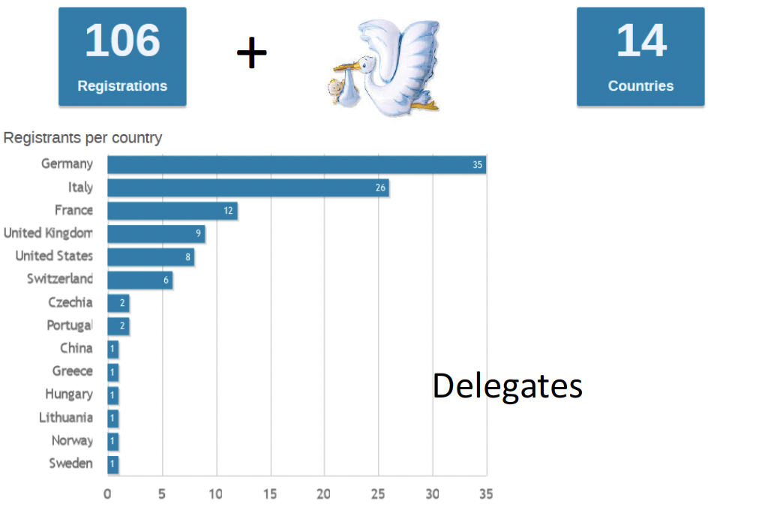
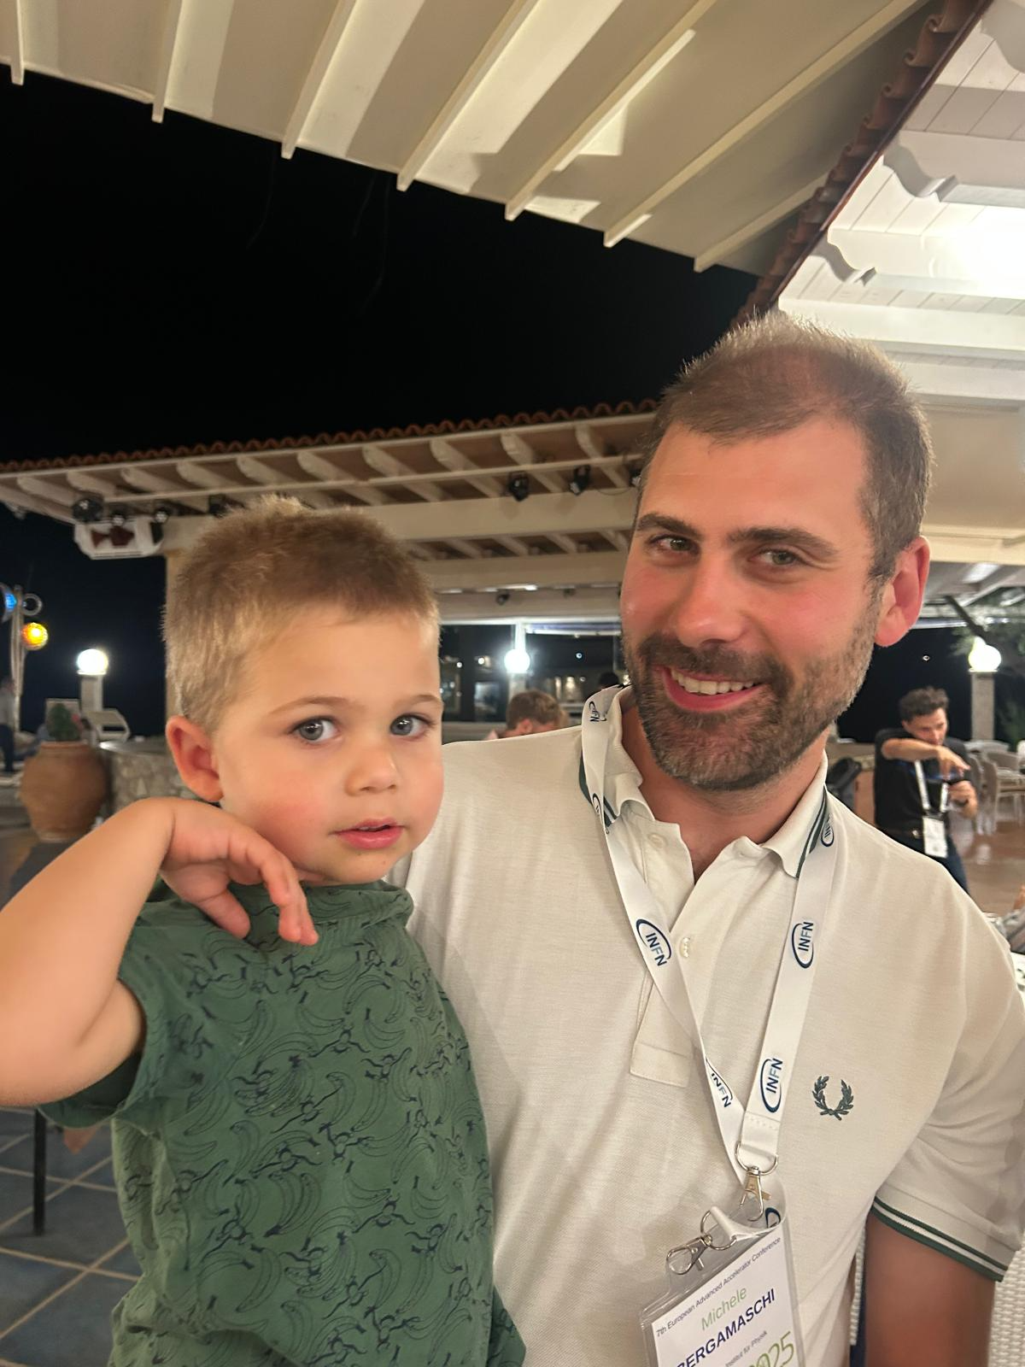
2022 Special Topics Workshop

Slide 13
Useful info:
- For speakers: please make sure to upload your slides on Indico;
- Always wear your badge;
- Guests not staying at Conference Hotels should confirm meals for eventual accompanying persons at Hotel Hermitage reception;
- The group photo will be taken on Tuesday 23rd of September, during the morning coffee break;
- Eduroam wifi network is available.

Slide 14
EAAC has always been more than just a meeting: it is a space for open exchange, for building collaborations across disciplines and generations, and for inspiring each other with new ideas.
Let this workshop be not only a place for science, but also a symbol of our commitment to collaboration across borders, cultures, and generations, for a better world in peace.

Slide 15
have a nice and fruitful conference

