Slide 1



Laboratori Nazionali di Legnaro – INFN
Optimized Protocol for Ag/Pd Separation at LENA
Results and Future Prospects
G. Grosso
March 27th, 2025

Slide 2
Outline
Critical Issues
Optimized Protocol
Tests and Results
Future Efforts
Conclusions
Notes:
2

Slide 3
Critical Issues
Many issues were found after the first experiments on mice, which might also interfere with invitro studies:
          Unaccettable chemical purity
          Poor solubility
          LD50 in mice
          Standardization of the Protocol
The main impurity was deemed to be the presence of remaining Palladium after the separation step, which was confirmed by its yellowish color and a subsequent irradiation step on the separated sample.
Notes:
3

Slide 4
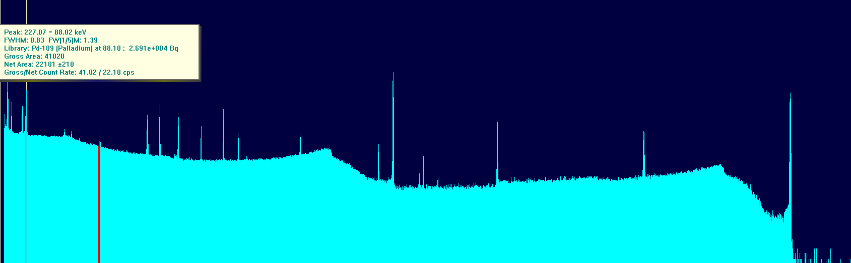
Critical Issues
By irradiating a decayed sample that underwent the first separation step, it was confirmed the suspected presence of Pd.
This step also gave an approximate quantitative idea to be confirmed via ICP-MS, which was deemed due to roughly 100 μg of Pd, meaning that the LN column has the capacity to purify more than 1000 fold.
Notes:
4

Slide 5
Optimized Protocol
Notes:
5

Slide 6
Optimized Protocol
Notes:
6

Slide 7
Optimized Protocol
Notes:
7

Slide 8
Optimized Protocol
Notes:
8

Slide 9
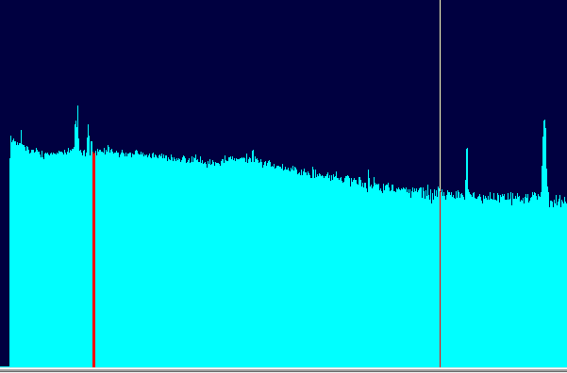
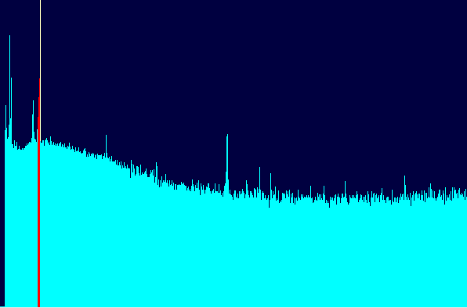
Tests and Rsults
Gamma spectra for decayed samples:
First separation followed by tandem LN First separation followed by TK200
This promising result has to be confirmed via ICP-MS in order to cement the new protocol as eligible for further in-vivo and in vitro studies
Notes:
9

Slide 10
Irradiation tests
In order to gather more data and standardize the whole process:
The process involved the irradiation, the dissolution followed by the first separation on LN resin. Then, it proceeded with an overnight evaporation, and the tandem LN column. Lastly, it preconcentrated the volumes via TK200 polish leading to roughly 91% of silver activity in 6-8 ml of pure water.
Notes:
10

Slide 11
Cold Chemistry Tests and Results
Cold chemistry was aimed only to gather the quantity of the residual palladium in a quick and accurate manner:
To be Determined
To be Determined
The results, which are currently only on the last step of the separation, are promising, both in terms of the reproducibility of the process and the outcome itself, meaning that hopefully no mice will be harmed in the future.
Notes:
11

Slide 12


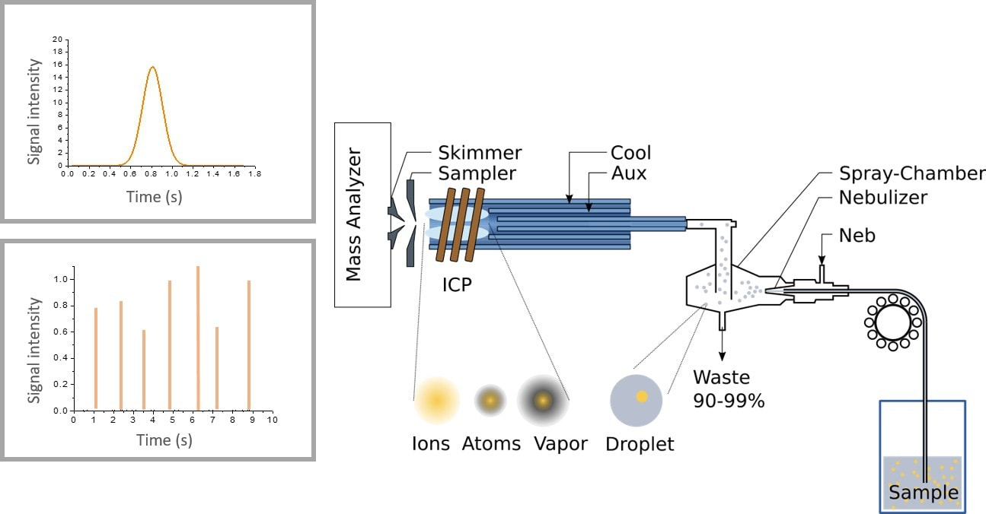

Future efforts
Testing the new protocol on in-vivo and in-vitro experiments
Optimize the implemented protocol by changing one variable at a time in the hope of reducing volumes and time spent on the separation step
ICP-MS Analysis at Gran Sasso Facility on decayed samples
12
Notes:
12

Slide 13
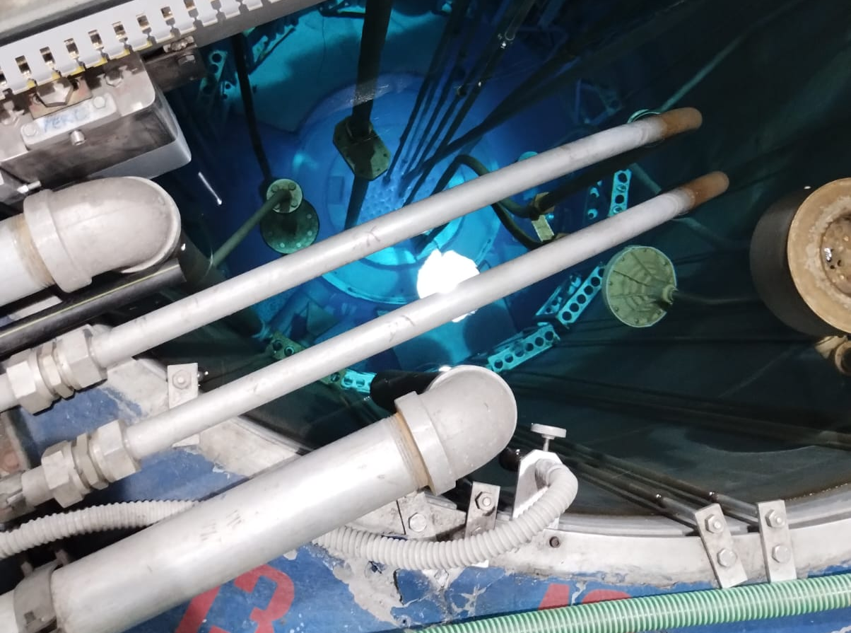
Conclusions
The promising newfound Protocol was optimized via:
Analyzing impurities via various techniques
Repeating the steps leading to fully standardized process
13
Notes:
13

Slide 14
Thank you for your attention!
14
Notes:
14

