Slide 1
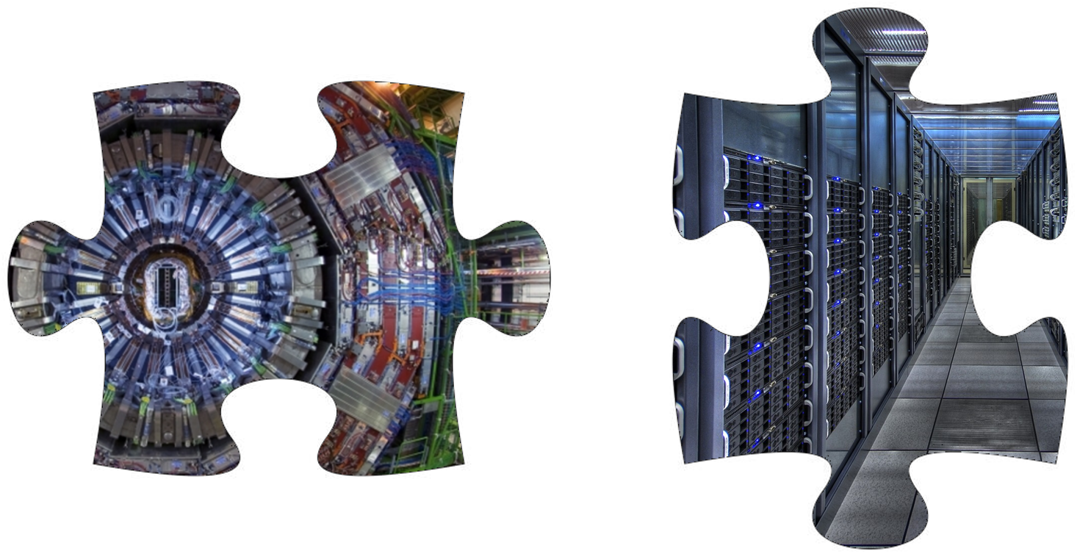
Particle Detectors in the AI Era – part 1
Scuola Bonaudi-Chiavassa
Cogne, 25/6 2023
Tommaso Dorigo
First researcher @ INFN, Sezione di Padova
Guest Professor @ Luleå Techniska Universitet
President @ Universal Scientific Education and Research Network

Slide 2
About me
First Researcher at INFN, Padova
Professor at the Statistical Sciences department, Univ. Padova, 2018-
President of USERN organization, 2022- https://usern.tums.ac.ir
Member of CMS experiment at CERN, 2002-
member of the CMS Statistics Committee, 2009- (and chair, 2012-2015)
Member of SWGO experiment, 2022-
Founder and chair of MODE collaboration (mode-collaboration.github.io ), 2020-
Previously (1992-2010) member of CDF experiment at the Tevatron
Interest in statistics dates back to early analyses in CDF, but becoming sapient in statistical matters is a lifelong task
Physics outreach in a blog since 2005. The blog is now at http://www.science20.com/quantum_diaries_survivor
The blog contains over 1500 articles on science outreach

Slide 3
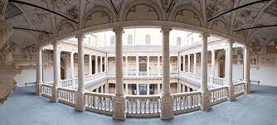
About me
First Researcher at INFN, Padova
Professor at the Statistical Sciences department, Univ. Padova, 2018-
President of USERN organization, 2022- https://usern.tums.ac.ir
Member of CMS experiment at CERN, 2002-
member of the CMS Statistics Committee, 2009- (and chair, 2012-2015)
Member of SWGO experiment, 2022-
Founder and chair of MODE collaboration (mode-collaboration.github.io ), 2020-
Previously (1992-2010) member of CDF experiment at the Tevatron
Interest in statistics dates back to early analyses in CDF, but becoming sapient in statistical matters is a lifelong task
Physics outreach in a blog since 2005. The blog is now at http://www.science20.com/quantum_diaries_survivor
The blog contains over 1500 articles on science outreach

Slide 4
About me
First Researcher at INFN, Padova
Professor at the Statistical Sciences department, Univ. Padova, 2018-
President of USERN organization, 2022- https://usern.ORG
Member of CMS experiment at CERN, 2002-
member of the CMS Statistics Committee, 2009- (and chair, 2012-2015)
Member of SWGO experiment, 2022-
Founder and chair of MODE collaboration (mode-collaboration.github.io ), 2020-
Previously (1992-2010) member of CDF experiment at the Tevatron
Interest in statistics dates back to early analyses in CDF, but becoming sapient in statistical matters is a lifelong task
Physics outreach in a blog since 2005. The blog is now at http://www.science20.com/quantum_diaries_survivor
The blog contains over 1500 articles on science outreach

Slide 5
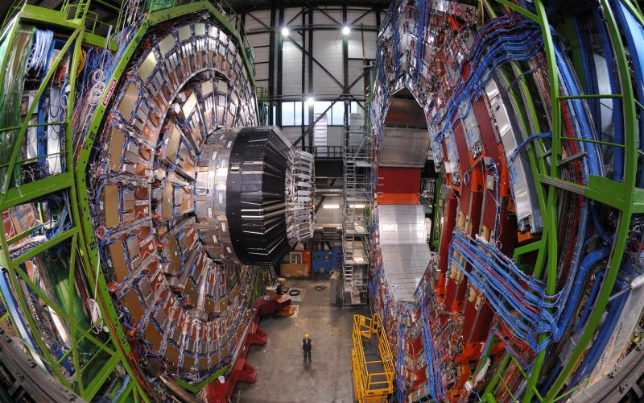
About me
First Researcher at INFN, Padova
Professor at the Statistical Sciences department, Univ. Padova, 2018-
President of USERN organization, 2022- https://usern.tums.ac.ir
Member of CMS experiment at CERN, 2002-
member of the CMS Statistics Committee, 2009- (and chair, 2012-2015)
Member of SWGO experiment, 2022-
Founder and chair of MODE collaboration (mode-collaboration.github.io ), 2020-
Previously (1992-2010) member of CDF experiment at the Tevatron
Interest in statistics dates back to early analyses in CDF, but becoming sapient in statistical matters is a lifelong task
Physics outreach in a blog since 2005. The blog is now at http://www.science20.com/quantum_diaries_survivor
The blog contains over 1500 articles on science outreach

Slide 6
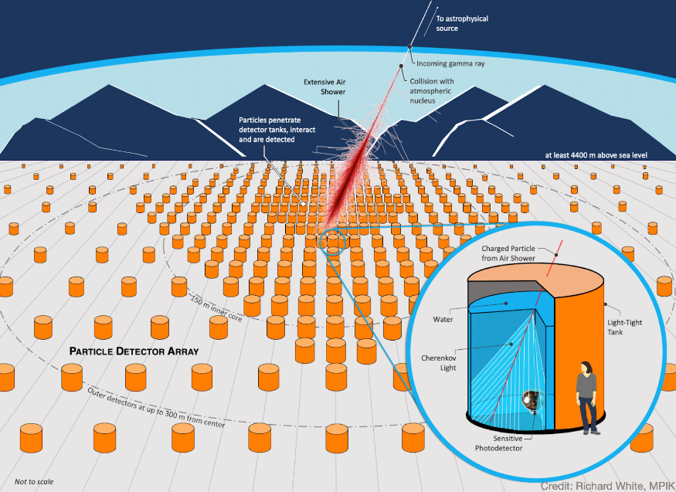
About me
First Researcher at INFN, Padova
Professor at the Statistical Sciences department, Univ. Padova, 2018-
President of USERN organization, 2022- https://usern.tums.ac.ir
Member of CMS experiment at CERN, 2002-
member of the CMS Statistics Committee, 2009- (and chair, 2012-2015)
Member of SWGO experiment, 2022-
Founder and chair of MODE collaboration (mode-collaboration.github.io ), 2020-
Previously (1992-2010) member of CDF experiment at the Tevatron
Interest in statistics dates back to early analyses in CDF, but becoming sapient in statistical matters is a lifelong task
Physics outreach in a blog since 2005. The blog is now at http://www.science20.com/quantum_diaries_survivor
The blog contains over 1500 articles on science outreach

Slide 7
About me
First Researcher at INFN, Padova
Professor at the Statistical Sciences department, Univ. Padova, 2018-
President of USERN organization, 2022- https://usern.tums.ac.ir
Member of CMS experiment at CERN, 2002-
member of the CMS Statistics Committee, 2009- (and chair, 2012-2015)
Member of SWGO experiment, 2022-
Founder of MODE collaboration (mode-collaboration.github.io ), 2020-
Previously (1992-2010) member of CDF experiment at the Tevatron
Interest in statistics dates back to early analyses in CDF, but becoming sapient in statistical matters is a lifelong task
Physics outreach in a blog since 2005. The blog is now at http://www.science20.com/quantum_diaries_survivor
The blog contains over 1500 articles on science outreach

Slide 8
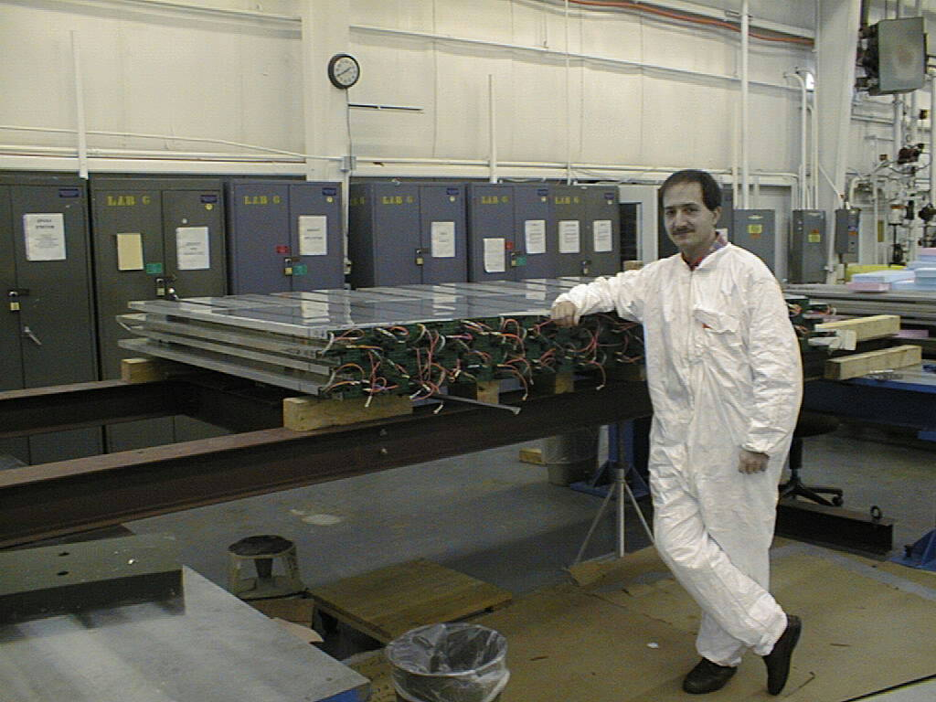
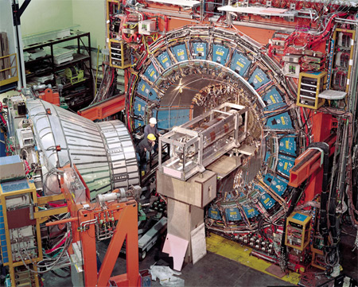
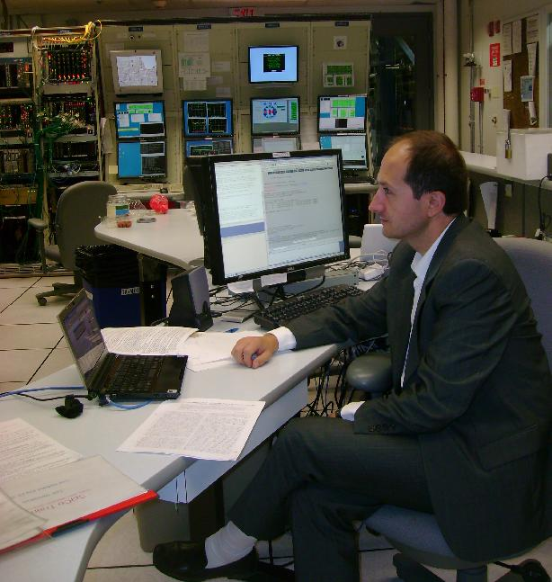
About me
First Researcher at INFN, Padova
Professor at the Statistical Sciences department, Univ. Padova, 2018-
President of USERN organization, 2022- https://usern.tums.ac.ir
Member of CMS experiment at CERN, 2002-
member of the CMS Statistics Committee, 2009- (and chair, 2012-2015)
Member of SWGO experiment, 2022-
Founder and chair of MODE collaboration (mode-collaboration.github.io ), 2020-
Previously (1992-2010) member of CDF experiment at the Tevatron
Interest in Machine learning dates back to early analyses in CDF
Physics outreach in a blog since 2005. The blog is now at http://www.science20.com/quantum_diaries_survivor
The blog contains over 1500 articles on science outreach

Slide 9
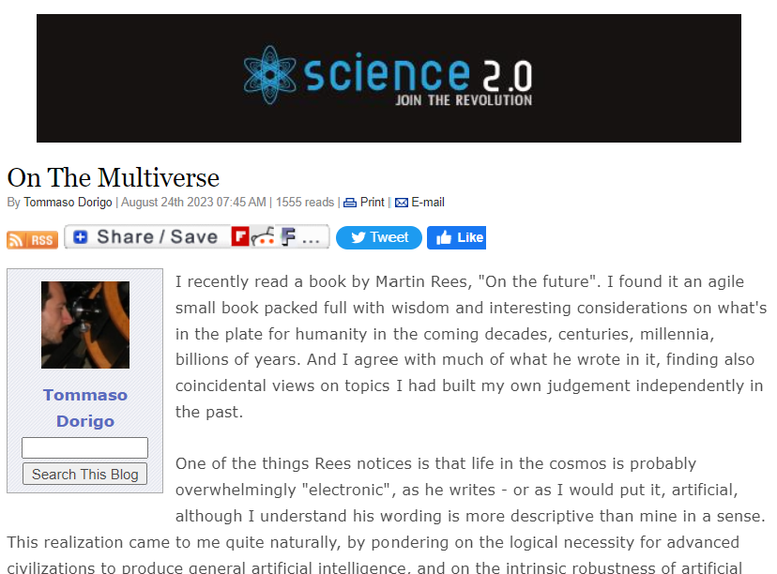
About me
First Researcher at INFN, Padova
Professor at the Statistical Sciences department, Univ. Padova, 2018-
President of USERN organization, 2022- https://usern.tums.ac.ir
Member of CMS experiment at CERN, 2002-
member of the CMS Statistics Committee, 2009- (and chair, 2012-2015)
Member of SWGO experiment, 2022-
Founder and chair of MODE collaboration (mode-collaboration.github.io ), 2020-
Previously (1992-2010) member of CDF experiment at the Tevatron
Interest in statistics dates back to early analyses in CDF, but becoming sapient in statistical matters is a lifelong task
DOING Physics outreach in a blog since 2005. The blog is now at http://www.science20.com/quantum_diaries_survivor
The blog contains over 1500 articles on science outreach

Slide 10
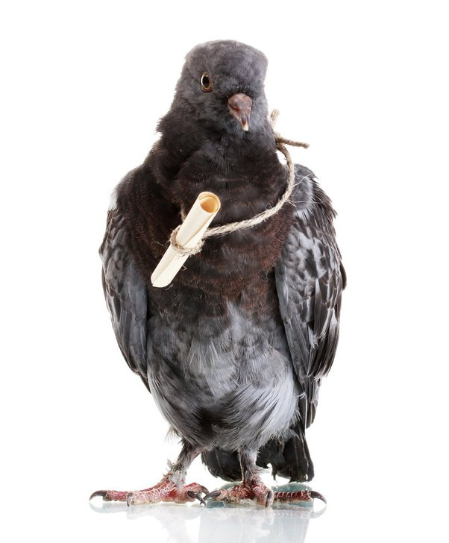
Ways to contact me
Email: tommaso.dorigo@gmail.com (preferred way, quick to answer)
Phone: +39 / 3666995594
Office phone: +39 / 0499677230

Slide 11
Contents
The context: deep learning for fundamental physics today
A challenging future
Steps forward: Optimization of experimental design
How to pull it off: early examples
Ongoing studies: an astro-physics example
Future applications in calorimetry

Slide 12
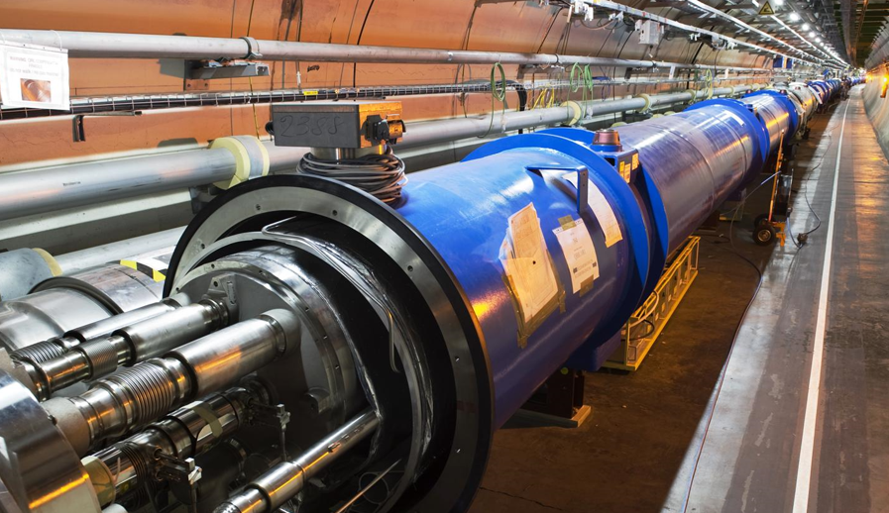
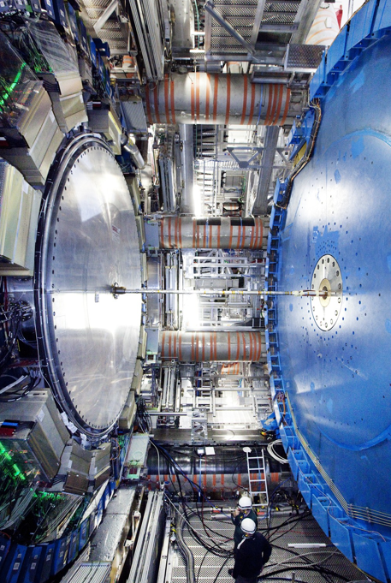
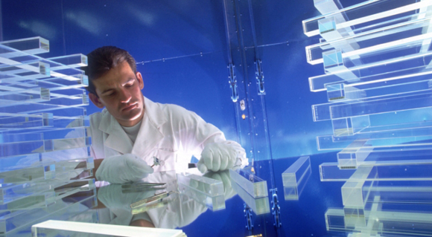
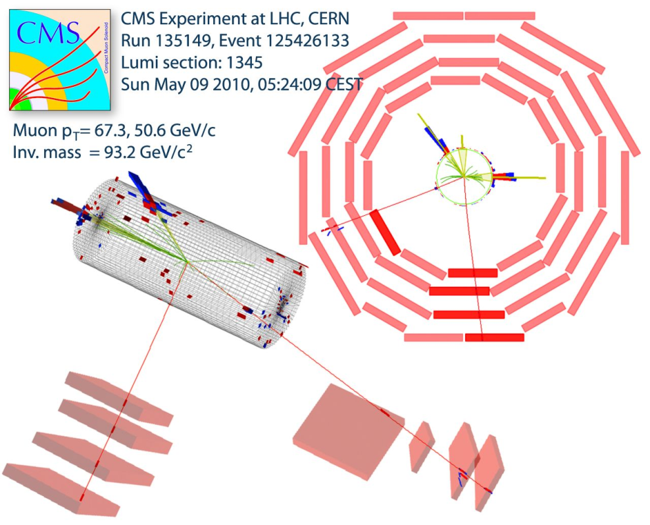
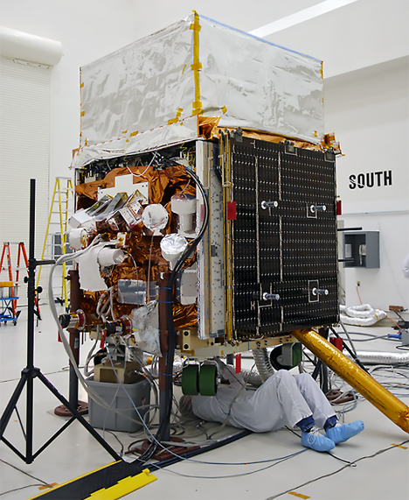
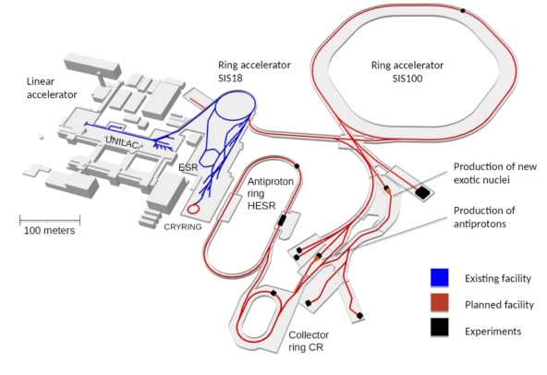
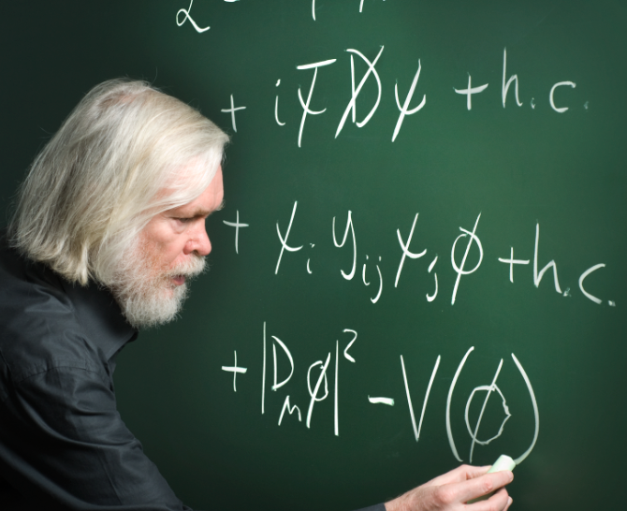
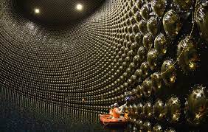
The Context

Slide 13
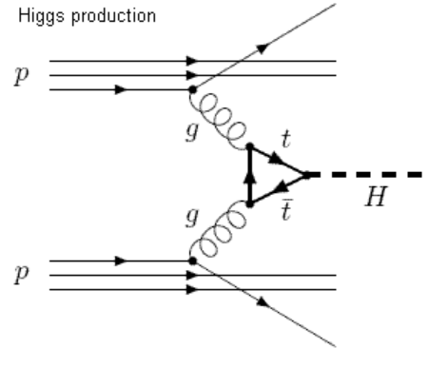
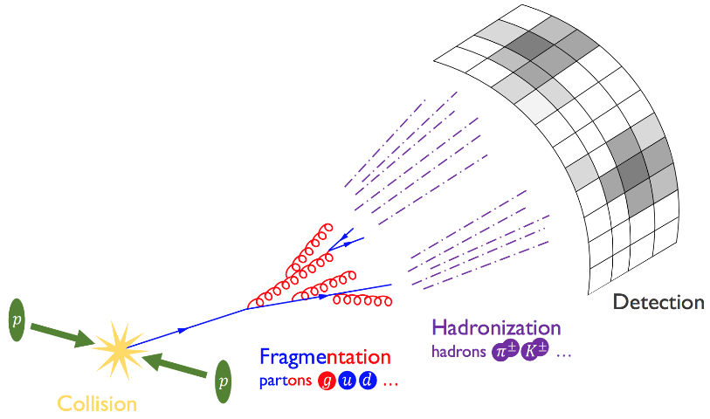
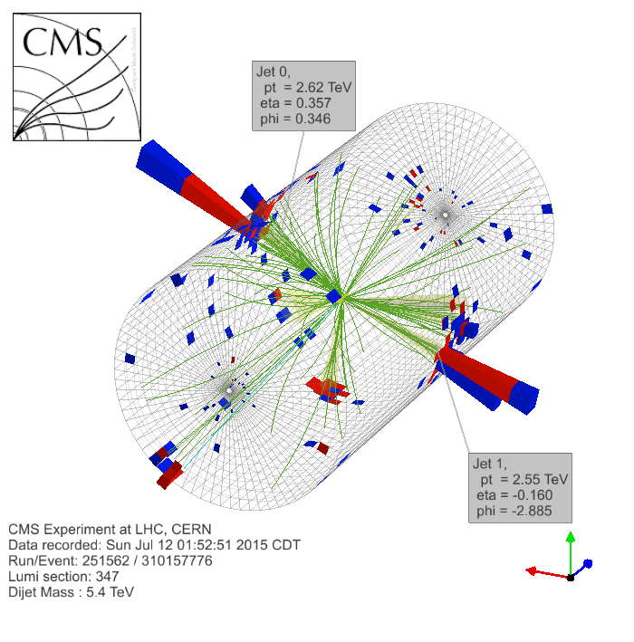
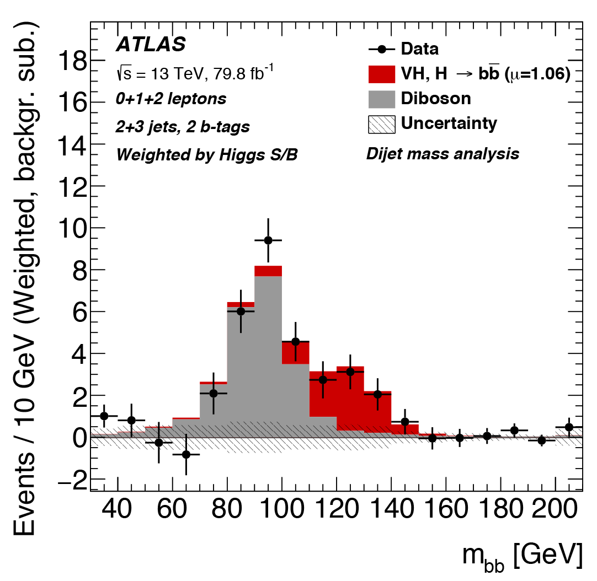
From Collisions to Observable Features
A proton-proton collision may produce a Higgs particle, together with hundreds of others
The Higgs boson decays immediately to, e.g., a pair of quarks
Quarks fragment into streams of quarks and gluons...
which create unstable hadrons
Hadrons decay into «stable» particles: protons, electrons, photons, neutrons, muons, pions, kaons...
which reach the detectors, leaving information on their energy and direction
From detected signals one may try to infer the nature of the original process, on a statistical basis
q
(5)
(1)
(2)
H
(4)
q
(3)
(6)
(7)

Slide 14
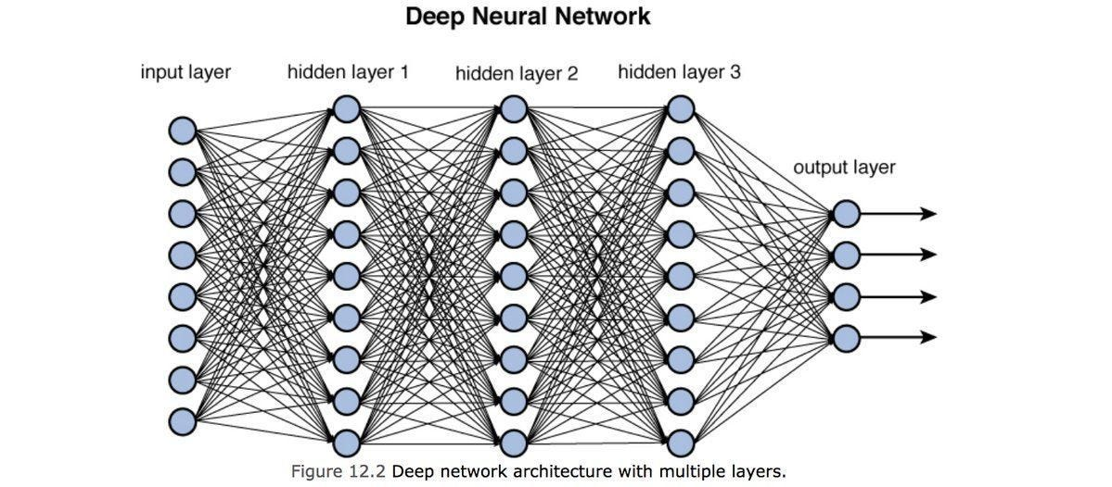
The Rise of Deep Learning in HEP
DNNs use skyrocketed in HEP after 2012, when ML tools were used for the Higgs discovery. A true paradigm change!
Further evidence of the benefit of ML tools for HEP: Kaggle Higgs challenge [Kaggle 2014]
→ 1800 teams (physicists, statisticians, computer scientists), 13k euro prize
→ Task: separate H→ττ decays from backgrounds in LHC simulated data
Solution | Pseudo-significance
Gabor Melis (DNN pooling) | 3.806
MultiBoost | 3.405
TMVA boosted trees | 3.200
Naive Bayesian classifier | 2.060
1D cut-based selection | 1.535
Most effective solution was based on pool of DNNs, with emphasis on cross-validation
Alternative methods commonly used in HEP (xgboost, Bayesian NN, etc.) were beaten soundly
equiv. to 6 times more data!

Slide 15
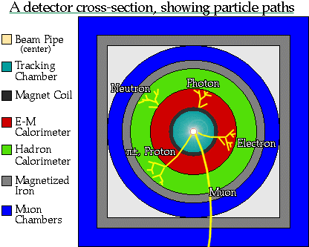
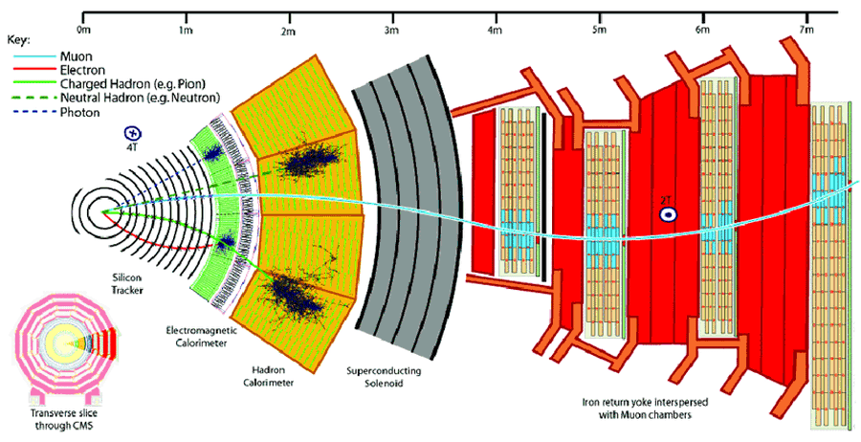
1989
We Are Successful Detector Builders…
In the past 60+ years our community established robust design paradigms, while pushing technologies to their bleeding edge
Some of those deeply ingrained paradigms are not necessarily as motivated today as they once were
- track first, destroy later (dichotomic!)
- redundancy (the opposite of optimality!)
- symmetric layouts (but the relevant physics is not!)
The design space of the biggest projects has grown to transcend our understanding – we cannot think in 10⁵ dimensions
Our demands (luminosity, resolution) are also on the rise, as is the size of the viable technological solutions space (e.g. 3D printing)
2010
2050?
?

Slide 16
We Are Successful Detector Builders…
1989
In the past 60+ years our community established robust design paradigms, while pushing technologies to their bleeding edge
Some of those deeply ingrained paradigms are not necessarily as motivated today as they once were
- track first, destroy later
- redundancy
- symmetric layouts
The design space of the biggest projects has grown to transcend our understanding – we cannot think in 10⁴ dimensions
Our demands (luminosity, resolution) are also on the rise, as is the size of the viable technological solutions space (e.g. 3D printing)
2010
2050?
?

Slide 17
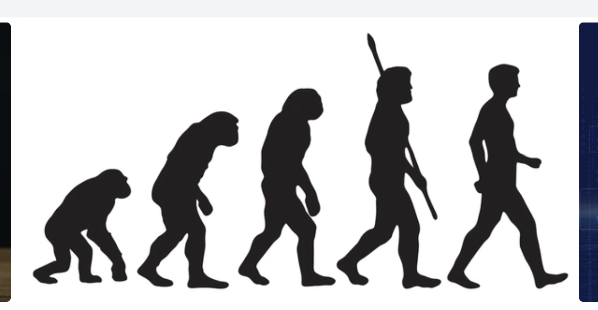
The (non-)Evolution of Design
1989
2010
2050?
DO’H!
Who’re you gonna call?

Slide 18
Research Directions in Fundamental Science
Explore higher energy / higher intensity frontier, ensuring we do not miss new physics
Explore the universe with multiple messengers, seeking answers to cosmology riddles
Study matter at extreme densities
Understand neutrinos
Formulate new theories of Nature
Improve calculational tools and prediction power of our theories
Extract sufficient statistics from high-D data
Ensure complete control of uncertainties and type-1 error rates
Application of deep learning to software optimization problems has caused a true revolution in fundamental science.
The next customer in line is detector design
In market-driven human activities, co-design of hardware and software is already happening.
Our challenge is to start to do it systematically. If we do not do it, we miss an opportunity, and risk a strong misalignment
Nowadays we are doing all of this and more with deep learning!

Slide 19
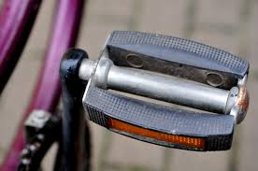
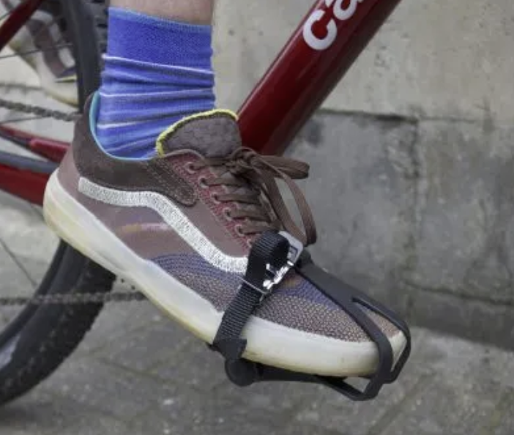
What is Co-Design?
Realizing that the achievement of a goal may require to tailor each part of a system to all others: synergy
Enabling the simultaneous optimization of all parts, to maximize a global utility in a high-dimensional design space: holistic optimization
Bringing together diverse components, technologies, or expertise to create a unified and cohesive system, ensuring seamless interoperability and coordination: integration

Slide 20
What is Co-Design?
Realizing that the achievement of a goal may require to tailor each part of a system to all others: synergy
Enabling the simultaneous optimization of all parts, to maximize a global utility in a high-dimensional design space: holistic optimization
Bringing together diverse components, technologies, or expertise to create a unified and cohesive system, ensuring seamless interoperability and coordination: integration

Slide 21
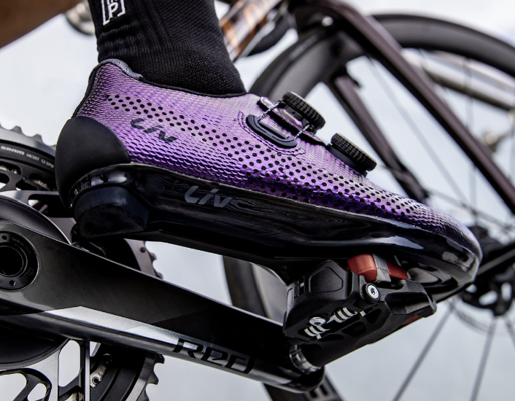
What is Co-Design?
Realizing that the achievement of a goal may require to tailor each part of a system to all others: synergy
Enabling the simultaneous optimization of all parts, to maximize a global utility in a high-dimensional design space: holistic optimization
Bringing together diverse components, technologies, or expertise to create a unified and cohesive system, ensuring seamless interoperability and coordination: integration

Slide 22
On Co-Design of experiments
Despite the flourishing of (very nice!) examples of hardware optimization (and software optimization) in various areas, I have not yet seen a convincing case of co-design carried out in full.
My only proto-example is an old and a bit too simple one: the MuOnE experiment (next slides).
Optimization efforts of the hardware H of an experiment may fix the software producing inference from the collected data, or consider a few possible choices for it
In other efforts the software (pattern reconstruction, dim. Reduction) is optimized end to end by considering a fixed detector, or maybe a few possible configurations
The full space is only accessible if you consider every parameter together
Design space
Software methods and parameters
Note: It can be proven that the optimality of inference is strictly dependent on the exact characteristics of produced data –there is no catch-all test statistic!
Hardware components and parameters

Slide 23
On Co-Design of experiments
Despite the flourishing of (very nice!) examples of hardware optimization (and software optimization) in various areas, I have not yet seen a convincing case of co-design carried out in full.
My only proto-example is an old and a bit too simple one: the MuOnE experiment (next slides).
Optimization efforts of the hardware H of an experiment may fix the software producing inference from the collected data, or consider a few possible choices for it
In other efforts the software (pattern reconstruction, dim. reduction) is optimized end to end by considering a fixed detector, or maybe a few possible configurations
The full space is only accessible if you consider every parameter together
Design space
Software methods and parameters
Hardware components and parameters

Slide 24
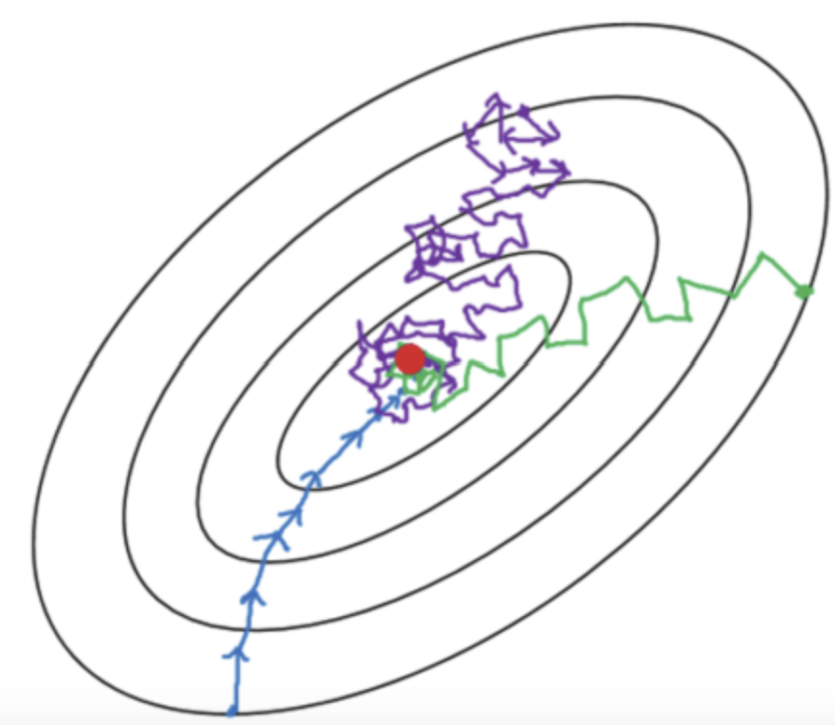
On Co-Design of experiments
Despite the flourishing of (very nice!) examples of hardware optimization (and software optimization) in various areas, I have not yet seen a convincing case of co-design carried out in full.
My only proto-example is an old and a bit too simple one: the MuOnE experiment (next slides).
Optimization efforts of the hardware H of an experiment may fix the software producing inference from the collected data, or consider a few possible choices for it
In other efforts the software (pattern reconstruction, dim. reduction) is optimized end to end by considering a fixed detector, or maybe a few possible configurations
The full space is only accessible if you consider together all parameters. Depending on the breadth of methods and parameter space considered, this scans (a subset of) the full dimensionality available
Design space
Software methods and parameters
Hardware components and parameters

Slide 25
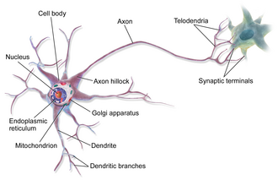
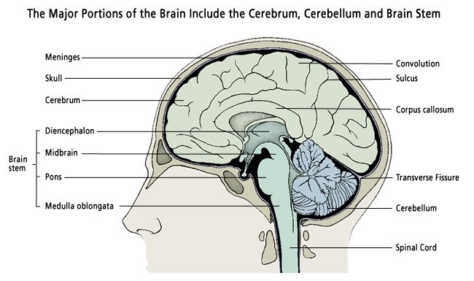
…But what is a Neural Network?
A neural network (NN) is a system of neurons connected by a network communicating signals between them
Each of us owns a phenomenal example of a NN: our brain!

Slide 26
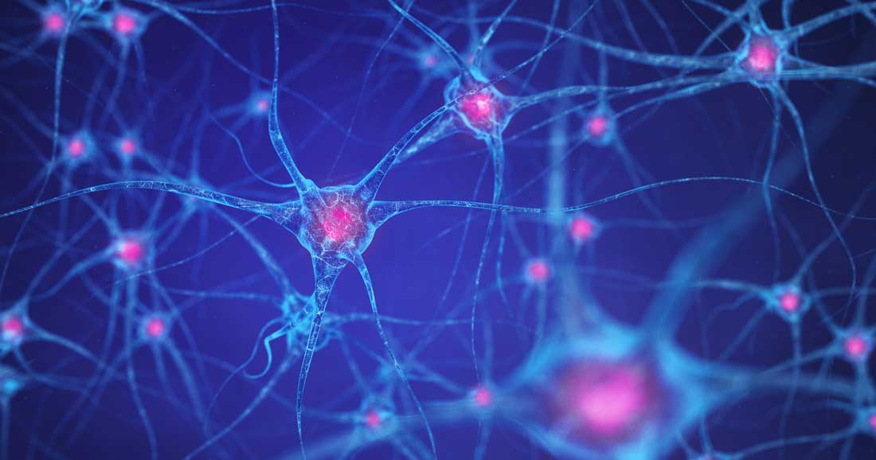
Artificial Neural Networks
The human brain has 80 billion neurons. The complexity and richness of our thought is only the result of the great complexity of our brain’s structure.
… But then, if we simulate faithfully a large enough neural network, can we reproduce human intelligence?
Or go beyond?

Slide 27
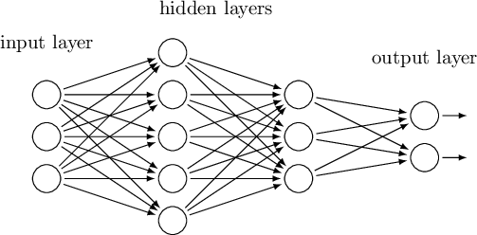
How Does an ANN Work
An Artificial Neural Network (ANN) is a computer program that simulates the behavior of a set of neurons and their interconnections
In the simplest setup (feed-forward ANN), there is an architecture organized in layers. Every neuron from a layer receives input from neurons in the previous layer

Slide 28
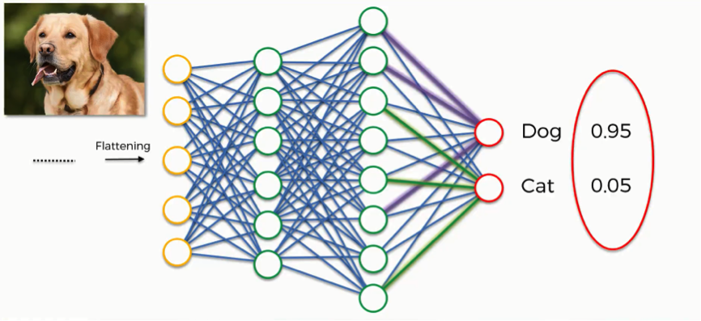
How Does an ANN Work
Input data are usually real numbers, encoding e.g. pixel colours of an image or other information.
The ANN processes the data with a fixed formal rule to produce a numerical output that represents the wanted answers, once it has been trained
→ It is essentially a deterministic function of the inputs

Slide 29
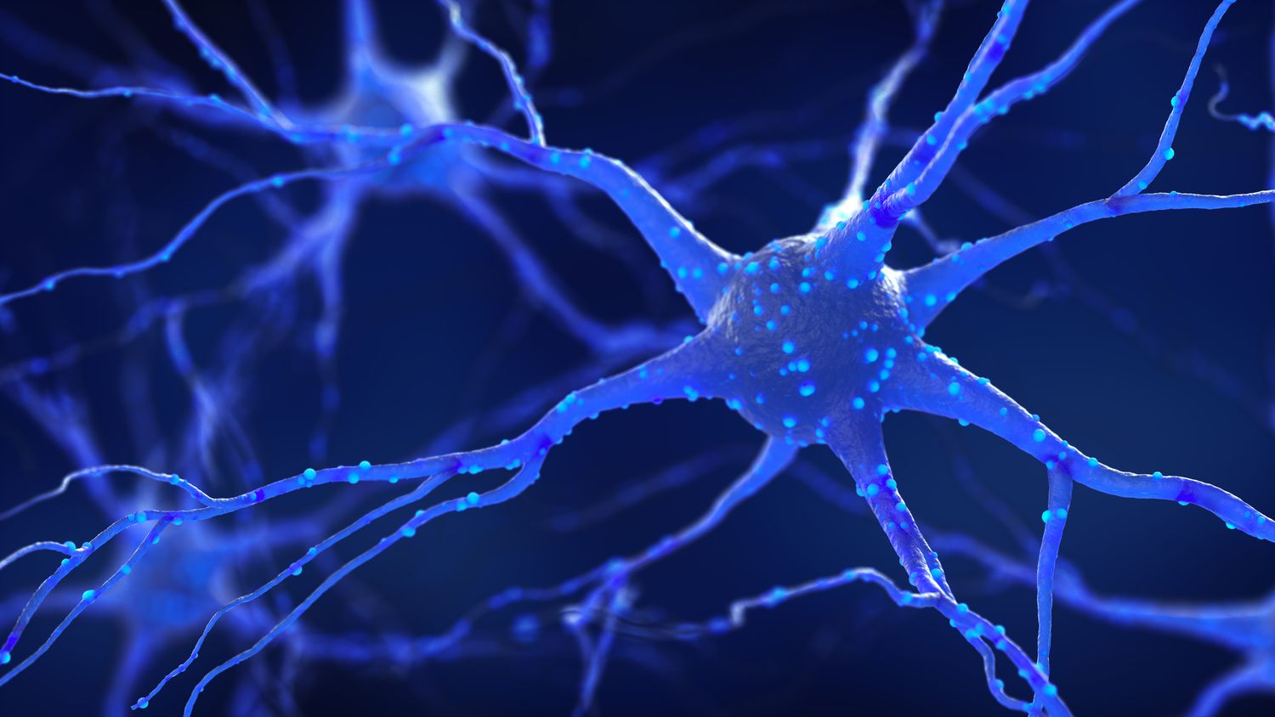
How Does an ANN Work – some detail
Each neuron’s behavior is described by a vector of numbers (some weights w and an overall bias b).
Each weight «scales» the input signal coming into a synapse.
w₆ = -3
w₁ = 5
w₅ = 5
b = -2
w₂ = 4
w₄ = 2
w₃ = 0.5

Slide 30
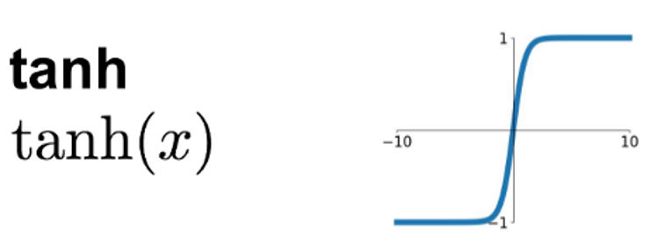
How Does an ANN Work – some detail
Each neuron’s behavior is described by a vector of numbers (some weights w and an overall bias b).
Each weight «scales» the input signal coming into a synapse.
The output is a function of the sum of input times weights plus bias, e.g. $O= \tanh\left[b+\sum{w_{i}s_{i}}\right]$
Input:
(3,0,2,-1,4,8)
3
w₁ = 5
0
w₂ = 4
2
w₃ = 0.5
Output:
O = tanh[-8+3*5
+0*4+2*0.5+(-1)*2
+4*5+8*(-3)]
= tanh(2)
b = -8
-1
w₄ = 2
4
w₅ = 5
8
w₆ = -3

Slide 31
How Does an ANN Work – some detail
Each neuron’s behavior is described by a vector of numbers (some weights w and an overall bias b).
Each weight «scales» the input signal coming into a synapse.
The output is a function of the sum of input times weights plus bias, e.g. $O= \tanh\left[b+\sum{w_{i}s_{i}}\right]$
3
w₁ = 5
0
w₂ = 4
2
w₃ = 0.5
b = -8
O=0.96
-1
w₄ = 2
4
w₅ = 5
8
w₆ = -3
The ANN learning process consists in finding suitable values for weights and biases for all neurons

Slide 32
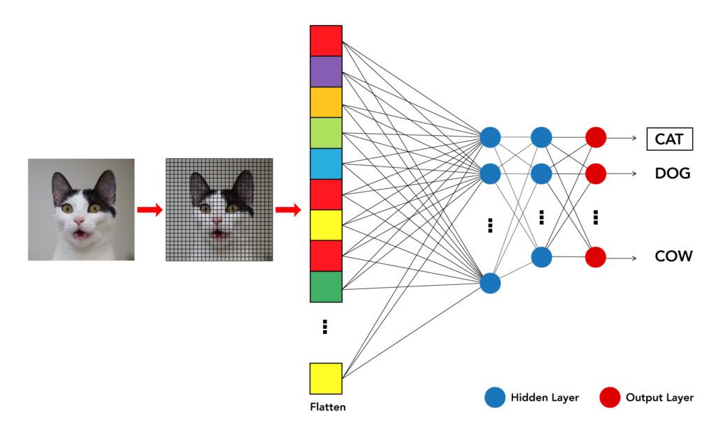
Supervised learning: e.g., image classification
To learn to classify photographs of animals into separate categories, the ANN weights and biases are tuned such that the number of misclassified images in a training set is the smallest possible.
This is called «supervised learning» because training data carry a label (cat / dog / …)

Slide 33
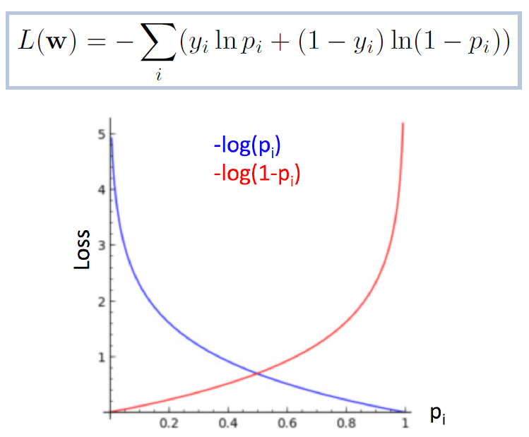
Classification loss: Binary Cross Entropy
For binary classification, class assignment is modeled by a Bernoulli trial probability p following the Binomial distribution:
A commonly used loss function is correspondingly defined as
High loss for events
with low probability
of being in predicted class

Slide 34
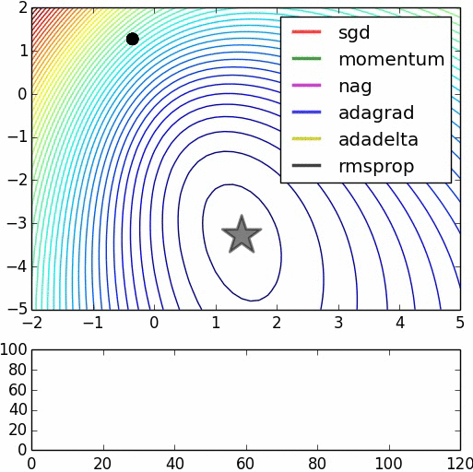
Gradient descent
The crucial part of the learning process is called backpropagation. During this procedure, the weights and the bias of each neuron get modified in order to improve the ANN performance (reduce the number of badly classified images)
Like a ball rolling toward the lowest point of a surface, the ANN evolves to the point where the loss function is minimized
Convergence speed depends on the smoothness of the «landscape» of the loss in the parameter space, and on the algorithm used

Slide 35
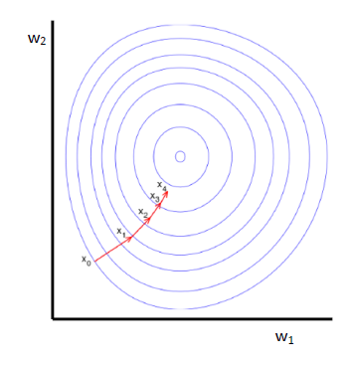
Minimizing the loss
In the absence of an analytical description of the loss function, we "descend" toward the minimum by approximating the shortest route with local information:
find gradient of the loss L w.r.t. parameters w: $\frac{∂L(w)}{∂w}$
update parameters:
$w^{′}←w−η\frac{∂L(w)}{∂w}$
and iterate.
Success depends on how fast you descend, moduled by "learning rate" η.

Slide 36
The Challenging Future of Fundamental Science
The 2020 update of the European Strategy for Particle Physics (EUSUPP) encourages feasibility studies for new large, long-term projects which will once again push our technological skills to their limits.

Slide 37
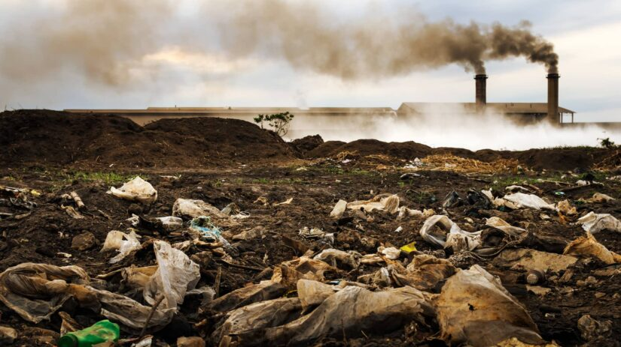
But humanity faces unprecedented global challenges (climate change, pandemics, overpopulation, pollution) which demand resources to seek solutions through applied science innovations, rather than investing in fundamental research.

Slide 38
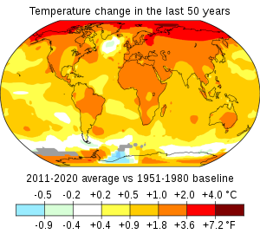
But humanity faces unprecedented global challenges (climate change, pandemics, overpopulation, pollution) which demand resources to seek solutions through applied science innovations, rather than investing in fundamental research.

Slide 39
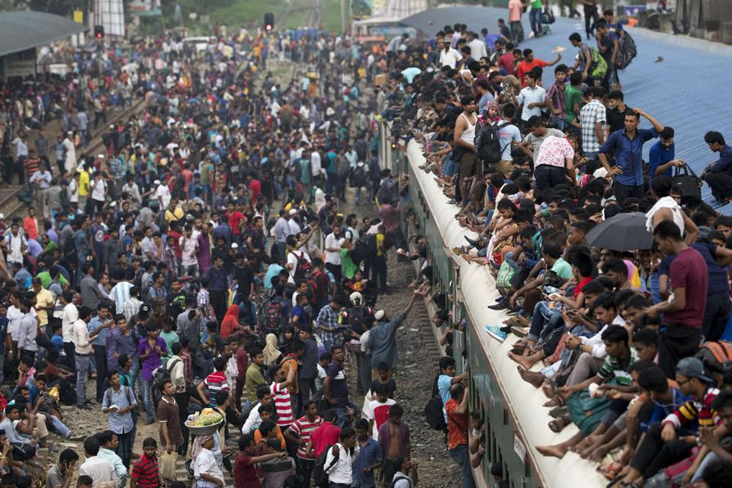
But humanity faces unprecedented global challenges (climate change, pandemics, overpopulation, pollution) which demand resources to seek solutions through applied science innovations, rather than investing in fundamental research.

Slide 40
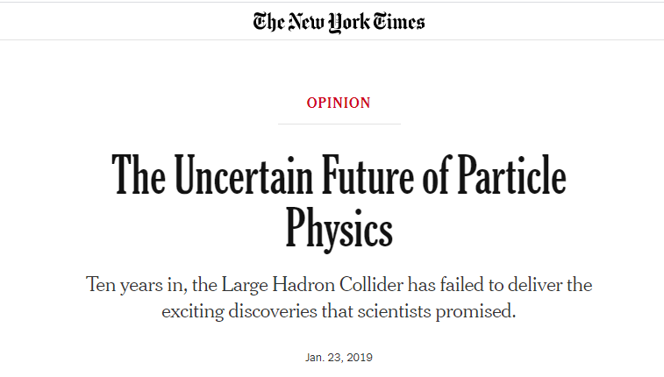
Furthermore, there are indications that wide sectors of society no longer consider the furthering of our understanding of matter at the smallest distance scales a top priority.
In this situation, ensuring the maximum exploitation of any resources spent on fundamental research is a moral imperative, and it may be key to ensure that the long-term projects envisioned by the EUSUPP may be undertaken and sustained.

Slide 41
Ensuring the maximum exploitation of any resources spent on fundamental research is a moral imperative
Ensuring the maximum exploitation of any resources spent on fundamental research is a moral imperative
Optimization!

Slide 42
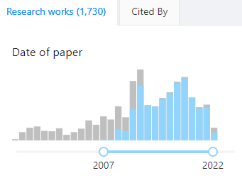
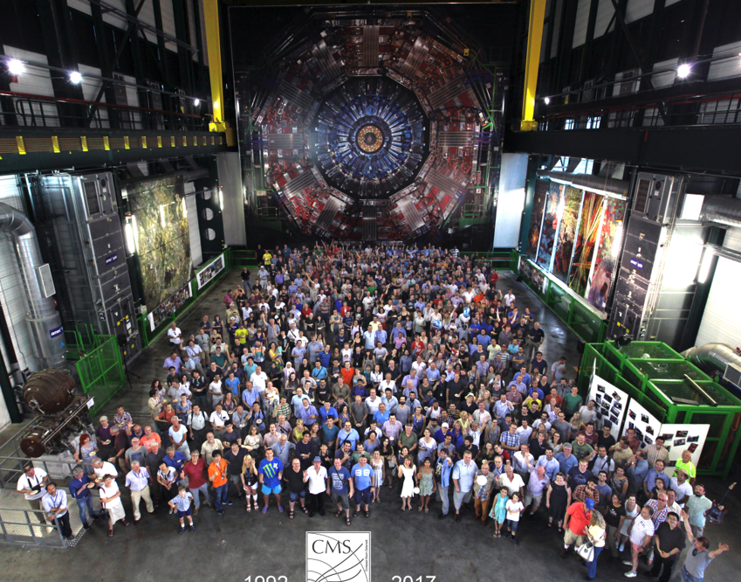
Optimal for What?
Over 1000 publications
The reason why detectors are complex is not only that the studied physics is complex: Science is a demanding job. Physicists want to study everything and do it better than their predecessors
CMS has over 4000 members, who use the data for a LARGE number of different measurements and searches...
So, what does it mean for a detector to be optimal?
What loss function do we aim to minimize?
Does it make sense to speak of an experiment-wide utility function?
Above: publication time of 1125 articles by the CMS collaboration (in blue).
Below: a small fraction of the CMS members

Slide 43
Optimal for What?
Over 1000 publications
The reason why detectors are complex is not only that the studied physics is complex: Science is a demanding job. Physicists want to study everything and do it better than their predecessors
CMS has over 4000 members, who use the data for a LARGE number of different measurements and searches...
So, what does it mean for a detector to be optimal?
What loss function do we aim to minimize?
Does it make sense to speak of an experiment-wide utility function?
Above: publication time of 1125 articles by the CMS collaboration (in blue).
Below: a small fraction of the CMS members

Slide 44
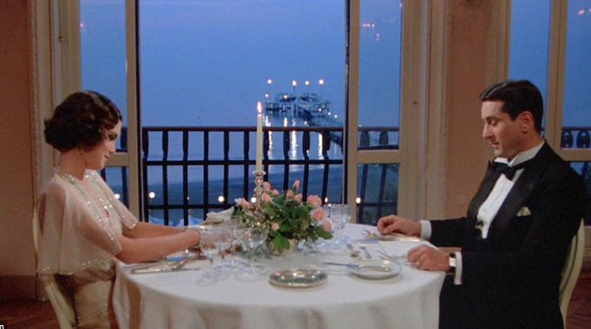
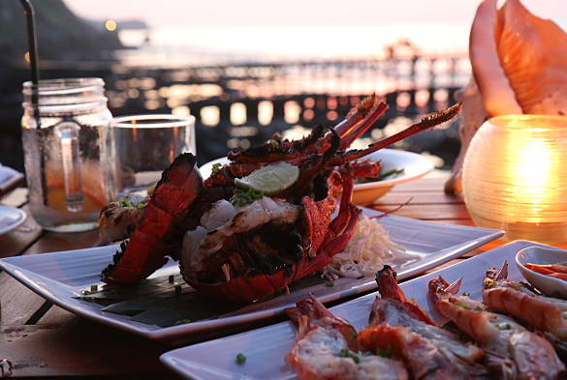
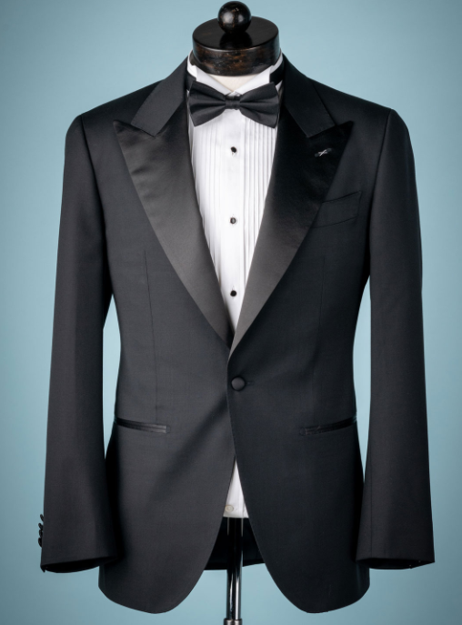
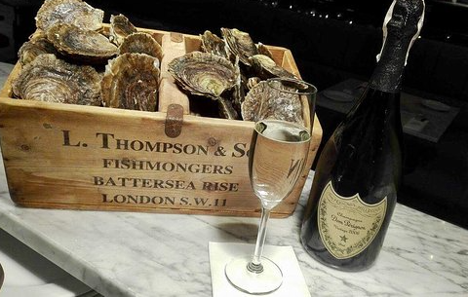
Recipe for a Perfect Dinner
We are not alien to confidently taking complex decisions in a multi-objective space. We actually do it routinely...
Of course, we are not deterred by knowing that the exact form of our optimization target is arbitrary

Slide 45
Recipe for a Perfect Trigger
Similarly, we are actually used to create multi-target optimization strategies, e.g. when we allocate resources for the trigger menu of a collider detector.
Consider CDF, Run 1 (1992-96): taking in
a rate of 300 kHz of proton-antiproton
collisions and having to select 50 Hz
of writable data created some of the
most heated scientifically-driven,
rationally motivated, painfully well
argumented, and littered with 4-letter
words debates I ever listened to.
The top quark had to be discovered, but it was not the only goal
of the experiment...

Slide 46
Recipe for a Perfect Detector
1, 2
Assess your total budget and time-to-completion
Model as a steep function the cost of overriding budget or time
Assess the scientific impact of each achievable scientific results
Create a differentiable model of the geometry, the components, the information-extraction procedures, and the utility function
Construct a pipeline with those modules, enabling backpropagation and gradient descent functionality
Let the chain rule of differential calculus do the hard work for you
3
4
5
We will discuss this in more detail below, with a couple of examples – but will first discuss the scale of our problems
6

Slide 47
Recipe for a Perfect Detector
1, 2
Assess your total budget and time-to-completion
Model as a steep function the cost of overriding budget or time
Assess the scientific impact of each achievable scientific results
Create a differentiable model of the geometry, the components, the information-extraction procedures, and the utility function
Construct a pipeline with those modules, enabling backpropagation and gradient descent functionality
Let the chain rule of differential calculus do the hard work for you
3
4
5
We will discuss this in more detail below, with a couple of examples – but will first discuss the scale of our problems
6

Slide 48
Recipe for a Perfect Detector
1, 2
Assess your total budget and time-to-completion
Model as a steep function the cost of overriding budget or time
Assess the scientific impact of each achievable scientific results
Create a differentiable model of the geometry, the components, the information-extraction procedures, and the utility function
Construct a pipeline with those modules, enabling backpropagation and gradient descent functionality
Let the chain rule of differential calculus do the hard work for you
3
$$\frac{∂}{∂x}$$
4
5
We will discuss this in more detail below, with a couple of examples – but will first discuss the scale of our problems
6

Slide 49
Recipe for a Perfect Detector
1, 2
Assess your total budget and time-to-completion
Model as a steep function the cost of overriding budget or time
Assess the scientific impact of each achievable scientific results
Create a differentiable model of the geometry, the components, the information-extraction procedures, and the utility function
Construct a pipeline with those modules, enabling backpropagation and gradient descent functionality
Let the chain rule of differential calculus do the hard work for you
3
4
5
We will discuss this in more detail below, with a couple of examples – but will first discuss the scale of our problems
6

Slide 50
Recipe for a Perfect Detector
1, 2
Assess your total budget and time-to-completion
Model as a steep function the cost of overriding budget or time
Assess the scientific impact of each achievable scientific results
Create a differentiable model of the geometry, the components, the information-extraction procedures, and the utility function
Construct a pipeline with those modules, enabling backpropagation and gradient descent functionality
Let the chain rule of differential calculus do the hard work for you
3
4
5
We will discuss this in more detail below, but first
let us see what are the typical modi operandi
for experiment design
6

Slide 51
Theory-Driven Experiment Design
In a theory-driven scheme of scientific investigations, we have a theory of the world which produces predictions of observable phenomena A, A’, A’’...
E.g.: Fermi theory, existence of the electron neutrino
e⁺
_
v_{e}
A
p
n
e⁻
v_{e}
A’
n
p
A^{n}

Slide 52
Theory-Driven Experiment Design / 2
We proceed to test a prediction of the theory: the existence of the neutrino. This implies many reactions must exist. We may focus on the lowest-hanging fruit, say A, and devise a means to study it.
e⁺
_
v_{e}
A
p
n
e⁻
v_{e}
A’
n
p
A^{n}

Slide 53
Theory-Driven Experiment Design / 3
Want many neutrinos!
Given the well-defined goal of discovering a specific phenomenon, it is relatively easy to at least sort out what technology and mechanisms we intend to use to produce and evidence it
In thie Reines-Cowan experiment, one early question was how to produce an intense flux of neutrinos
Hanford
Better be repeatable!
σ = 6 * 10⁻⁴⁴ cm⁻²
Savannah river
Backgroundis a concern

Slide 54
Theory-Driven Experiment Design / 4
The remaining job is to connect the killer observables that the process yields to suitable layouts
Importance of optimization here is limited to some aspects of the problem
want a massive, transparent target (to see the photons) → use water
need to find a way to detect neutrons → exploit material with high capture rate of neutrons, emission of photons, delayed → dissolve CdCl₂ in water
Once these basic ideas are sorted out, the rest is not crucial.

Slide 55
Precision Measurements
A connected use case to the previous one is that of measuring some important fundamental parameter with the utmost precision
→ help comparisons with theoretical predictions
→ input to future studies
LEP
LEP is a great example of that modus operandi
There, optimization may have targeted specific metrics (e.g., precision of M_{Z}, δN_{ν}) and an «experiment-wide» loss function may be relatively easy to agree upon.

Slide 56
The Third Way: Fishing Expeditions
DAΦNE
In experiment-driven science, we aim for observing new phenomena, incrementally acquiring information that may later be studied to improve our theories.
We thus focus on exploring Nature as widely as possible. Precision is no longer the single most important bit
→ Our greed for diverse, high-quality data dictates the need for multi-purposedness
LEP

Slide 57
Makeshift Surrogates of Objectives
Earlier we were making the point of the possibility to have multi-target objectives… But the problem is more connected with the high-D of the input, not the output.
When we design sensors and electronics, operate choices on budget allocations, define requirements for the performance of detection elements, or choose composition and layout of a complex instrument, we are implicitly trying to find an optimal working point in a loosely-constrained feature space of hundreds of dimensions.
Such a task is clearly super-human.
Because of the implicit nature of the models (likelihood is intractable), the only way forward until recently has been to set their aim on makeshift surrogates of our real objectives.
Evolving from this modus operandi to directly goal-informed decisions enables potentially enormous performance gains.

Slide 58
The Design Space is Large
New technological advancements are enabling better designs of our instruments by reducing the cost of complex layouts.
3D printing of scintillation detectors is being explored for neutrino physics
Very thin layouts of resistive AC-coupled silicon detector elements provide large gains in spatial and temporal resolution
→ The geometry space has become larger and more complex to explore.
Higher-performance demands are also rising as, e.g.,
Tracking at high collider luminosity requires AI solutions
As we move fundamental physics research to space, payload and power consumption become driving constraints
Higher fluxes and energies, and studies of high-mass particles, demand us to invest in more granular, higher-performance hadron calorimeters (more on this later)
Above: 3D printed scintillation detector
Above: tracks of particles in a simulated
high-luminosity collision
Below: the FERMI satellite is a calorimeter detecting gamma rays

Slide 59
How Large Can Gains of Full Optimization Get?
A good example [Dorigo 2020] of how experimental design as is carried out today leaves ample room for improvement from systematic study of geometry and materials
The chance of doing so was offered by refereeing the detector proposed by the MUonE collaboration [Abbiendi et al. 2018], which aims at determining with high precision the cross section of elastic muon-electron scattering
Through the direct exploration of the parameter space of detector geometry, I could show how large gains are possible by moving away from choices dictated by past experience

Slide 60
One Example of Geometry Optimization: MUonE
MUonE aims to determine with high precision the probability of elastic muon-electron scattering, as this number may reduce the theory systematics of the g-2 muon anomaly
The experiment must be sensitive to the rate of interactions as a function of momentum transfer, with 10⁻⁴ precision
Above: a long-standing anomaly in the Standard Model, the muon g-2 value
Below: a muon-photon interaction, with a hadronic quantum loop
Beam
Above: layout of one of 40 1m-long MUonE stations

Slide 61
MUonE Optimization
To study alternative layouts, I wrote a simulation of muon scatterings and event reconstruction, then optimized the geometry of the apparatus accounting for every part of the problem affecting the precision of the inference
This identified a layout different from the one chosen by detector experts, with a factor of 2 improvement in the relevant metric without increase in detector cost
After some digestive trouble, MUonE adopted most of my proposed improvements

Slide 62
MUonE Optimization
Relevant figure of merit: relative resolution on momentum transfer q²
A factor of 2 in HEP is
Incidentally, a similar improvement was found in a different study [Shirobokov20] when optimizing magnet design for shielding the SHIP experiment (again, a limited complexity use case)
We can only guess how large are the gains possible if a fully differentiable model is used for detectors of significantly higher complexity
HUGE
Above: relative resolution in event q² for different configurations (the higher, black line is the original proposal by the MUonE coll.)
Note: the MUonE optimization was «easy», because there are 3 particles involved and only few Be and Si layers... Discrete optimization scans were sufficient there. How to scale?

Slide 63
Event Reconstruction in MUonE
μe scattering involves an incoming muon and outgoing muon and electron → it seems proficuous to fit the trajectories to a common vertex
However, if one is not thinking about the potential of alternative layouts (read: end-to-end optimization) to the original proposal, the advantage of a full 3D vertex fit looks like a detail worth leaving to final tweaks. It is instead crucial!
Here is a correct «holistic» way of thinking at the matter:
Interactions mostly take place in Be target, which is thick so it does not offer z-position constraints
hence a fit involving the z coordinate is useless Hence we should rethink the layout to exploit the constraint: use thin layers spaced in vacuum or air!
Large systematics on measured angles are lurking, due to relative z positioning errors; hard to position elements with sufficient precision. Hence thin layers layouts are impractical By exploiting vertex fit to many events we should manage to reduce effect of positioning systematics

Slide 64
Reducing Positioning Errors
The MUonE collaboration envisioned a holographic laser system to measure the position along z of modules and targets with 10μm precision (roughly required threshold for wanted q² resolution).
Cost: one 10k euro system per meter-length muon station, 40 stations → 400k euro budget

Slide 65
Effect of Thin Layers and Vertex Fit
Once you realize the benefit of thin layers, a simulation proves that the holographic shebang is useless:
by using 5 minutes worth of beam data, layouts that involve thin target layers allow to fit for the position z of individual hardware elements, as well as for their tilt and bow, to sub-micron accuracy!
Δχ²

Slide 66
What Do We Learn from this Example?
Could an automatic scanning of layouts come to appraise the benefits of thin target layers?
the parametrization of the system needs to have the flexibility of considering the segmenting of targets along z in the first place
→ this is possible but might be overlooked (in fact it was)!
the reconstruction model needs to consider all physical constraints ab initio
→ this is reasonable, but it again highlights the need of optimal reconstruction when searching for optimal geometry
the model of detector-related systematic uncertainties must include provisions for exploiting the data for self-calibration → this is extremely hard to conceive building in the model if we don’t know what we are trying to shoot at!
→ 1: Even in this simple use case, expert insight is required
→ 2: Software and hardware need to be optimized together!

Slide 67
Expert-in-the-Middle Schemes
In today’s way of doing business, we strongly leverage prior experience in conceiving a new detector, and exploit most advanced technologies, but do not explore the parameter space fully:
Expert(s) proposes design → simulation tests it → performance assessed on reachable proxies → possible improvements identified in discrete space → new simulation probes them → evaluation → modification → big simulation campaign, analysis results on valuable end targets (but at that stage there is little that can be tweaked) → Final configuration.
Building a pipeline for end-to-end optimization is thus already a big change of paradigm:
we imply the intention of specifying a loss function for the whole experiment
we force ourselves to specify how cost, timeline, and other factors play in the loss
we take responsibility to model inference extraction already at a design stage
we state the intent of considering how design choices affect the whole chain
Note how the end-to-end approach involves much more than detector experts and post-hoc validation: computer scientists, analysis experts, and a global loss composition are called for.

Slide 68
How to do it

Slide 69
Computer Science to the Rescue
Progress in CS redefined performance standards of our technologies in, e.g.,
language translation
speech recognition
self-driving vehicles
The developed AI tools are application-specific: the AI potential in providing new solutions to old tasks depends on our ability to create the right interfaces.
A new paradigm shift is offered by differentiable programming, which eases the systematic search of minima of arbitrarily complex multi-dimensional functions
→ By casting the whole problem in a differentiable framework a full end-to- end optimization becomes possible.

Slide 70
Note: there are alternatives!
Optimization is a huge topic – going differentiable is not the only option!
If you have a limited number of parameters, depending on the complexity of your problem, there are many alternatives:
Bayesian methods
Genetic algorithms
Reinforcement learning
…
In general, in our problems gradient descent is more appropriate… But many examples of application of these alternatives are flourishing

Slide 71
A table of methods, compared
Method | The good | The bad | Applicability
Genetic Algorithms (GA) | Good for discrete or combinatorial spaces; Global search, avoids local minima; No need for gradients | Slow convergence; Many hyperparameters; May stagnate without diversity | Discrete optimization; Non-differentiable, rugged fitness landscapes
Simulated Annealing (SA) | Escapes local minima; Works with arbitrary cost functions; Simple implementation | Slow convergence; Sensitive to cooling schedule | Combinatorial and discrete problems; Global optimization with unknown gradients
Bayesian Optimization (BO) | Sample-efficient; Models uncertainty; Ideal for expensive functions | Not scalable to >20-30 dimensions; Slow evaluation time | Hyperparameter tuning; Expensive black-box optimization
Random Search | Extremely simple; Effective baseline; No assumptions | Inefficient; No learning from history | High-dimensional but cheap functions
NELDER-MEAD Simplex | No gradient needed; Works in low-dim problems; Adaptive step sizes | Fails in high dimensions; Can stagnate on noisy functions | Parameter tuning; Optimization with few variables
Finite-Difference Methods | Simple way to estimate gradients; Can use standard optimizers | Inaccurate for noisy functions; Scales poorly with dimension | When gradients are unavailable but smoothness is assumed

Slide 72
Automatic Differentiation
The compiler figures out how functions vary depending on parameters, and carries out the complicated task of propagating derivatives around.
Those of us who have done this manually for a long while can’t be happier by seeing the rise of Pytorch, TensorFlow, etc.
Left: different ways of obtaining derivatives of a coded function (Graph courtesy A.G. Baydin)

Slide 73
Four-Slide Description of a Differentiable Model for Design Optimization - 1
An end-to-end detector design optimization task can be briefly formalized in the following way.
(1) We start with a simulation of the physics processes of relevance, which generates a multi-dimensional, stochastic input variable x, distributed with a PDF f(x)
(2) The input is turned by the simulation of the detection apparatus into sensor readouts z distributed with PDF
p(z|x,θ).
z are observed low-level features of the physical process; they depend through p( ) on parameters θ describing physical properties of detector and geometry.
x
z

Slide 74
Four-Slide Description of a Differentiable Model for Design Optimization - 2
z
(3) Detector readouts z are used by a reconstruction model R( ) that produces high-level features
ζ(θ) = R[z,θ,ν(θ)]
(e.g. particle four-momenta), by employing knowledge of detector parameters θ as well as a model of nuisance parameters ν(θ) which affect the pattern recognition task.
(4) In turn, high-level features ζ(θ) constitute the input of a further dimensionality reduction, typically powered by a neural network NN( )
Once trained for the task at hand, the network produces a low-dimensional summary statistic
s = NN[ζ(θ)].
(5) With s, inference can finally be carried out to infer back x. This completes our model of the inference process...
ζ
s
L(s|x)
x

Slide 75
Four-Slide Description of a Differentiable Model for Design Optimization - 3
The problem of detector optimality is that of finding estimators $\hat{θ}$that satisfy
$$\hat{θ}=arg\min_{θ}{\int{L\left[NN\left(ζ\right),c\left(θ\right)\right]p\left(z | x,θ\right)f\left(x\right)dxdz}}$$
c(θ) models the cost of a detector of parameters θ, and the loss function L[NN,c] appraises the result, obeying cost constraints and other limitations.
The PDF p(z|x,θ) is not available in closed form –models are implicit–, so we rely on forward simulation: we approximate $\hat{θ}$ with a sample of n events:
$${\hat{θ}}_{a}=arg\min_{θ}{\frac{1}{n}}\sum_{i=1}^{n}{L\left[NN\left(R\left(z_{i}\right)\right),c\left(θ\right)\right]}$$
where z_{i} is distributed as F(x_{i},θ) to emulate p(z|x,θ) as x_{i} is sampled from its PDF f( ). We thus obtain detector parameters which minimize the loss.

Slide 76
Four-Slide Description of a Differentiable Model for Design Optimization - 4
In some cases we will need to approximate the non-differentiable stochastic simulator F( ) with a local surrogate model:
z = S(y,x,θ),
that depends on a parameter y describing the stochastic variation of the approximated distribution. This allows to descend to the minimum of the approximated loss $\hat{L(z)}$ by following its surrogate gradient
$$∇_{θ}\hat{L(z)}=\frac{1}{n}\sum_{i=1}^{n}{∇_{θ}L[NN\left(R\left(S\left(y_{i},x_{i},θ\right)\right)\right),c(θ)]}.$$
The above recipe requires one to learn the differentiable surrogate S( ): this is a task liable to be carried out independently from the optimization procedure.

Slide 77
Putting It All Together
If the simulation can be bypassed by a differentiable surrogate, we remove the stochasticity of the physics and strongly simplify the problem
θ
c
ν
x
z or S
ζ = R(z)
L=NN(ζ)

Slide 78
Putting It All Together / 2
The model must
include a model of the absolute state-of-the-art (or even extrapolated future performance!) of reconstruction and inference to avoid any misalignment

Slide 79
Putting It All Together / 3
Backpropagation of the gradient of the objective function then allows to find optimal parameters θ → obtain end-to-end optimality of the instrument

Slide 80
A Few Additional Details - 1 / Symmetries
Symmetries are a very significant attribute of systems liable to optimization
A system’s symmetry implies
that there will be degeneracy in the optimal solutions
may be a good thing (allows reduction of phase space)
that some features of the optimal configuration are easy to guess
also good, provides useful starting point
questions the need of wrestling with complex optimization tools!
... but the symmetry must be exact, which is rarely the case!
If you break the symmetry by enforcing detector geometry choices, this may propagate to interesting non-symmetrical solutions elsewhere in the problem
E.g. in MUonE: cylindrical symmetry of Physics along incoming muon axis, but once you place a target somewhere, this automatically implies the existence of optimal placing of silicon planes downstream – NOT equispaced!

Slide 81
2 - Parametrization
Care is required when defining the coordinate system and the parameters describing a detector layout.
In many cases, we already know that advantageous configurations impose functional dependencies between parameters
→ silly to force the system to discover these subspaces by brute force
→ much better: choose parametrization that naturally accounts for interdependence at soft spot
Quick example: should we parametrize a calorimeter depth in meters or in X₀ units?
Tradeoff: easier connection to external constraints vs seamless transfer of optimal solutions as one varies the composition

Slide 82
2 – Parametrization / cont’d
Another example: MUonE tracker. The goal is to minimize q² resolution for high-q² interactions
small angle expected for muon track
soft spot ties staggering length s to transverse tilt θ for near-horizontal tracks (the most important ones); relation changes for changes in pitch/sensor distance p/d ratios
advantageous to study what parameters to describe detector with, e.g. fix p/d = f(θ), thus initially reducing dimensionality of problem; later can release once optimality is found, to fine-tune

Slide 83
How to Deal with Discreteness
Discreteness of design choices requires special handling
E.g., the number of detection elements of a system is something we cannot take derivatives on
Or even the simple translation of a detection element in space is an operation that breaks the differentiability (a particle hits or misses it)
We can address the first issue by keeping “imaginary elements” in the system, but assigning to them zero efficiency – the continuous variable takes charge of allowing for seamless transitions.
We can address the second by modeling efficiency versus x as a Gaussian PDF, or otherwise smoothly varying function. This is only used in the back-propagation step – the true efficiency map can be used in forward mode.
eff.
1
0
position x

Slide 84
How to Deal with Discreteness
Discreteness of design choices requires special handling
E.g., the number of detection elements of a system is something we cannot take derivatives on
Or even the simple translation of a detection element in space is an operation that breaks the differentiability (a particle hits or misses it)
We can address the first issue by keeping “imaginary elements” in the system, but assigning to them zero efficiency – the continuous variable takes charge of allowing for seamless transitions.
We can address the second by modeling efficiency versus x as a Gaussian PDF, or otherwise smoothly varying function. This is only used in the back-propagation step – the true efficiency map can be used in forward mode.
eff.
1
0
position x

Slide 85
How to Deal with Discreteness
Discreteness of design choices requires special handling
E.g., the number of detection elements of a system is something we cannot take derivatives on
Or even the simple translation of a detection element in space is an operation that breaks the differentiability (a particle hits or misses it)
We can address the first issue by keeping “imaginary elements” in the system, assigning to them zero efficiency – the continuous variable takes charge of allowing for seamless transitions.
We can address the second by modeling efficiency versus x as a Gaussian PDF, or otherwise smoothly varying function. This is only used in the back-propagation step – the true efficiency map can be used in forward mode.

Slide 86
How to Deal with Discreteness
Discreteness of design choices requires special handling
E.g., the number of detection elements of a system is something we cannot take derivatives on
Or even the simple translation of a detection element in space is an operation that breaks the differentiability (a particle hits or misses it)
We can address the first issue by keeping “imaginary elements” in the system, but assigning to them zero efficiency – the continuous variable takes charge of allowing for seamless transitions.
We can address the second by modeling efficiency versus x as a Gaussian PDF, or otherwise smoothly varying function. This is only used in the back-propagation step – the true efficiency map can be used in forward mode.
eff.
1
0
position x

Slide 87
How to Deal with Discreteness
Discreteness of design choices requires special handling
E.g., the number of detection elements of a system is something we cannot take derivatives on
Or even the simple translation of a detection element in space is an operation that breaks the differentiability (a particle hits or misses it)
We can address the first issue by keeping “imaginary elements” in the system, but assigning to them zero efficiency – the continuous variable takes charge of allowing for seamless transitions.
We can address the second by modeling efficiency versus x as a Gaussian PDF, or otherwise smoothly varying function. This is only used in the back-propagation step – the true efficiency map can be used in forward mode.

Slide 88
How to Deal with Discreteness
Discreteness of design choices requires special handling
E.g., the number of detection elements of a system is something we cannot take derivatives on
Or even the simple translation of a detection element in space is an operation that breaks the differentiability (a particle hits or misses it)
In relatively simple problems (with only few discrete parameters, taking on few possible values) other solutions involve considering all combinations
+ easy parallelization
- quickly unmanageable as D grows
Evolutionary methods may help, and they could work well if coupled with GD ones → to be explored further

Slide 89
Monetary Cost Considerations
Cost: driving factor in experiment design
Impact in the loss may be modulated by the performance of the apparatus, rather than as a fixed constraint
e.g. we might be happy to discover that with 50% more than the planned budget we would have access to 300% improvements in performance
Subsystem cost in large collaborative projects is usually not negotiable...
Imagine you told the ATLAS Calo people to give 30% of their upgrade moneys to the tracking guys... «it’s for the common good!» – good luck with that
Political/strategic considerations always drivers → human in the middle schemes often the only sensible option.

Slide 90
Monetary Cost Considerations
Cost: driving factor in experiment design
Impact in the loss may be modulated by the performance of the apparatus, rather than as a fixed constraint
e.g. we might be happy to discover that with 50% more than the planned budget we would have access to 300% improvements in performance
Subsystem cost in large collaborative projects is usually not negotiable...
Imagine you told the ATLAS Calo people to give 30% of their upgrade moneys to the tracking guys... «it’s for the common good!» – good luck with that
Political/strategic considerations always drivers → human in the middle schemes often the only sensible option.

Slide 91
Machine-Learning Optimized Design of Experiments
MODE Collaboration
https://mode-collaboration.github.io
M. Aehle¹⁷, A. G. Baydin⁵, A. Belias¹⁰, A. Boldyrev⁴, S.M. Casey³², L. Chen¹⁷, K. Cranmer⁸, P. de Castro Manzano¹, T. Dorigo^{21,1,14,26}, D. Derkach⁴, K. Dimitrova³⁰, J. Donini^{3,26}, P. Elmer¹⁸, F. Fanzago¹, S. Gami²⁷, N.R. Gauger¹⁷, A. Giammanco², C. Glaser¹¹, C. Haack³¹ , L. Heinrich¹², R. Keidel¹⁷, J. Kieseler²², T. Kortus¹⁷, V. Kozhuharov³⁰ , C. Krause²⁸, L. Kusch²⁹, M. Lagrange², A. Lee²⁵, M. Liwicki²¹, G. Louppe⁶, L. Masserano²⁵, F. Nardi^{3,14}, P. Martinez Ruiz del Arbol⁹, M. Pereira Martínez²³, P. Petkov³⁰ , F. Ratnikov⁴, R. Roussel²⁰, T. Samui²⁴, F. Sandin²¹, A. Schilling¹⁷, P. Stowell¹⁵, G. Strong¹, M. Tosi^{1,14}, A. Ustyuzhanin⁴, X.C. Vidal²³, P. Vischia^{13,26}, G. Watts¹⁹, Z. Zaher², H. Zaraket¹⁶
Sponsored by
1 INFN, Italy
2 Université Catholique de Louvain, Belgium
3 Université Clermont Auvergne, France
4 Laboratory for big data analysis of the HSE, Russia
5 University of Oxford, UK
6 Université de Liege, Belgium
7 CERN, Switzerland
8 New York University, USA
9 IFCA, Spain
10 GSI, Germany
11 Uppsala Universitet, Sweden
12 TU Munchen, Germany
13 Universidad de Oviedo and ICTEA, Spain
14 Università di Padova, Italy
15 Sheffield University, UK
16 Lebanese University, Lebanon
17 Kaiserslautern-Landau University, Germany
18 Princeton University, USA
19 University of Washington, USA
20 SLAC, USA
21 Lulea University of Technology, Sweden
22 Karlsruhe Institute of Technology, Germany
23 Universidad de Santiago de Compostela, Spain
24 IISER Kolkata, India
25 Carnegie-Mellon University, USA
26 Universal Scientific Education and Research Network
27 NISER, India
28 HEPHY OeAW, Austria
29 TU Eindhoven, The Netherlands
30 Sofia University, Bulgaria
31 ECAP-FAU Erlangen-Nürnberg, Austria
JENAS

Slide 92
Realigning Design Choices and Ultimate Goals
The target of MODE [Mode 2020] is to design a scalable, versatile architecture that can provide end-to-end optimization of particle detectors, proving it on a number of different applications
Idea: if we “solve” a few problems we may construct a library of solutions and exploit the universality of the architecture and its modularity, re-using modeling efforts
Initial study cases:
LHCb EM calorimeter optimization → preliminary results out
Muon tomography detector optimization → published
Muon collider EM calorimeter → in progress
Hybrid calorimeter design integrating tracking layers → in progress
Optimization of detectors for air Cherenkov showers (SWGO) → published
plus many more envisioned, see [Dorigo 2022]

Slide 93
Muon Tomography Optimization
Perhaps the «simplest» use case with elementary particles: muon tomography.
Exploit flux of cosmic rays impinging on Earth’s surface as a source of data with which to image composition of unknown volumes
Applications are countless:
study core of volcanos
prevent smuggling of dangerous materials in containers
study wear of industrial apparata (e.g. steel pipes), interior of furnaces, plasma in reactors
archaeological prospections
and many more
Above: a proton or light nucleus hits a nucleus of Nitrogen
and produces a shower of unstable hadrons. The latter
decay to muons that reach the ground

Slide 94
Muon Tomography Optimization / 2
Perhaps the «simplest» use case with elementary particles: muon tomography.
Exploit flux of cosmic rays impinging on Earth’s surface as a source of data with which to image composition of unknown volumes
Applications are countless:
study core of volcanos
prevent smuggling of dangerous materials in containers
study wear of industrial apparata (e.g. steel pipes), interior of furnaces, plasma in reactors
archaeological prospections
and many more
Above: exploit dependence of scattering angle
of muons on atomic number of material
Two main methods for inference
Below: use incoming momentum spectrum of muons
and absorption of parts of it to infer thickness in 3D

Slide 95
Muon Tomography Optimization / 3
Scattering tomography is not too hard to model:
need no surrogate of a simulator;
one particle at a time (or even many...)
parametric scattering model
Simple transport mode (next slide)
Still, quite complex to put together simulation, inference, and optimization in one package
→ great testing ground for future, more ambitious projects
Above: exploit dependence of scattering angle
of muons on atomic number of material
Below: Optimization pipeline of TomOpt

Slide 96
BTW: Modeling Coulomb scattering
The PDG offers a model of multiple Coulomb scattering which is good enough for most applications
We define the typical scattering angle in a plane,
for a small traversed width:
A great approximation for this planar deflection is:
Then displacements must also be treated… See the PDG for detail. The
good thing is that this model works quite well, although it does not capture
The occasional large-angle scattering. Corrections exist for those effects, too

Slide 97
We developed an open source code in PyTorch to optimize hardware for scattering tomography Example application: improvement in linearity of metrics and squared error of prediction, for industrial application (measurement of molten iron in furnace)
Muon tomography detector
optimization: TomOpt
Infer location

