Slide 1
Micro Pattern Gaseous Detectors and their space applications
Lesson 2 — The SWEATERS Experience
Federico Pilo — INFN Sezione di Pisa
The XXXIII Bonaudi-Chiavassa International School on Particle Detectors
Cogne, 25 June 2025
Notes:
Title of the presentation
Subtitle: "Experimental Physics Meets Space — Technology and Constraints"
Your name, institution, date

Slide 2
Objectives of the session
Introduce the SWEATERS detector concept and its scientific goals
Examine the impact of space constraints on gas detector design
Present the development of custom electronics for low-energy particle detection
Learn how beam tests and simulations validate performance
Discuss strategies to advance from early prototypes to higher TRLs
Notes:
Understand the transition from lab to space instruments
Identify key experimental challenges (construction, testing, qualification)
Appreciate the unique constraints of designing for space

Slide 3
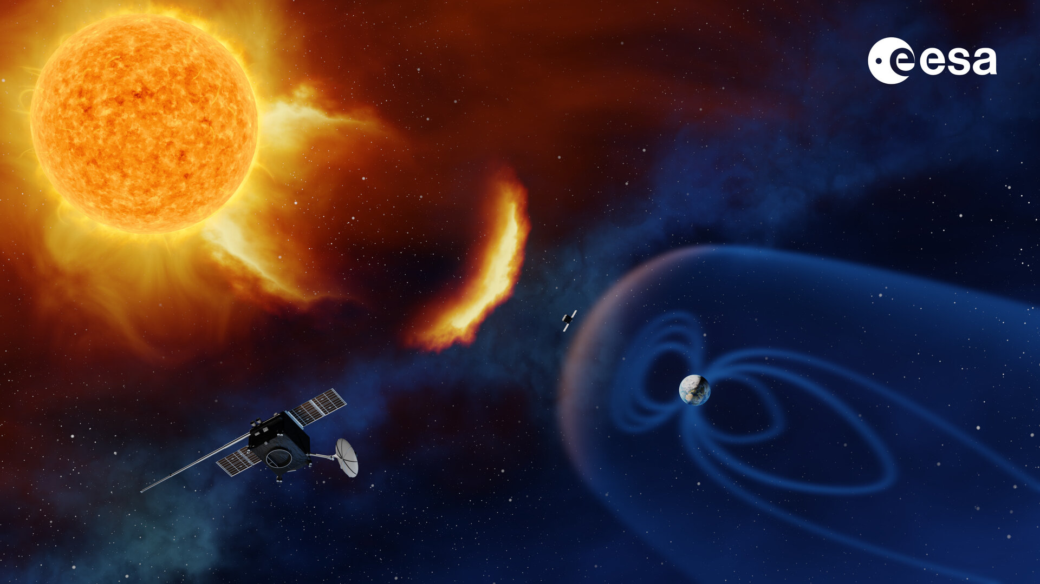
Magnetospheric Dynamics and Space Weather
What is Solar Wind?
A continuous flow of charged particles (mainly electrons and protons) that originates from the Sun’s outer atmosphere (the corona) at ~1 to 2 million K
Speeds range: from 300 to 800 km/s as it travels through space
Particle density near Earth: about 5 particles/cm³
What is the Magnetosphere?
The magnetosphere is the region of space dominated by Earth’s magnetic field, acting as a shield against the solar wind
Why Study Its Dynamics?
The magnetosphere is constantly shaped and disturbed by solar activity
Solar wind compresses the magnetosphere on the dayside
Magnetic reconnection at the magnetopause allows solar wind energy and particles to enter
This leads to geomagnetic storms and substorms
Notes:
Controllare la storia dei milion!!
Campi magnetici: quanto intensi?
Che differenza c’è tra storms e substorms?

Slide 4
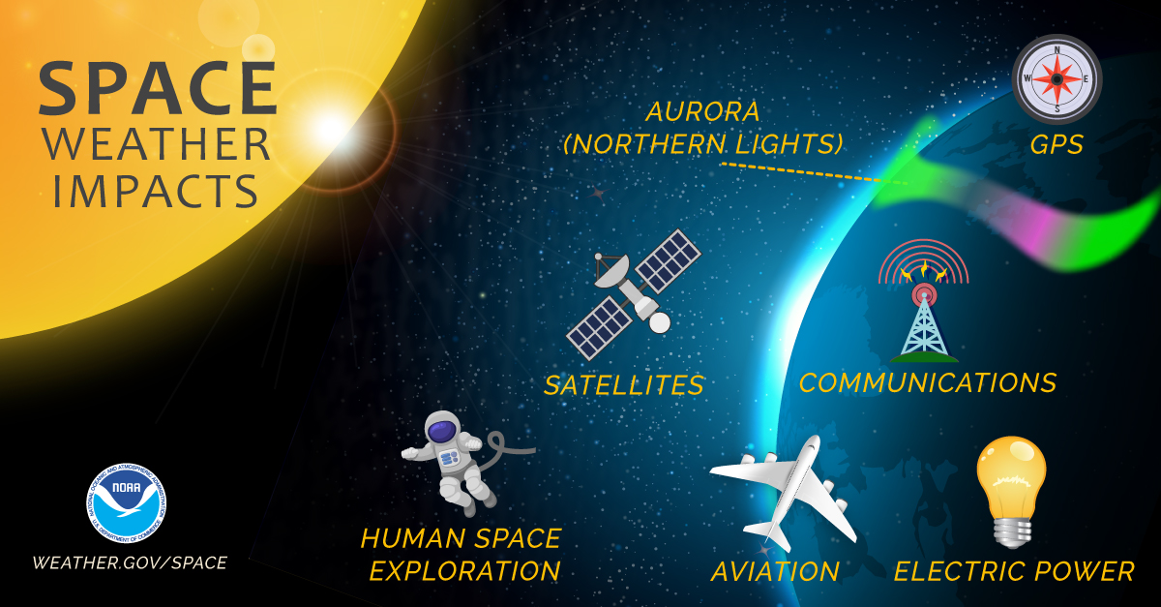
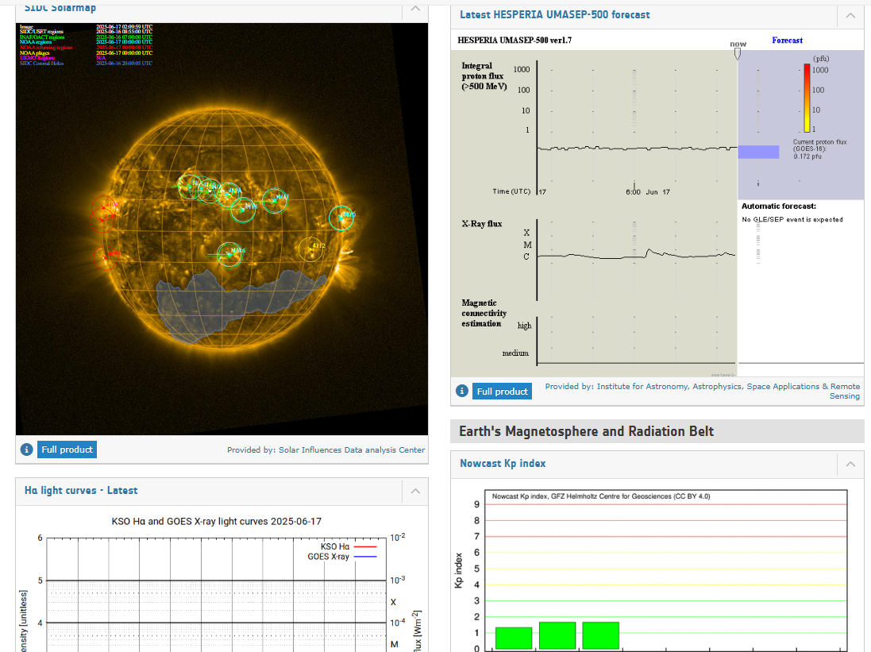
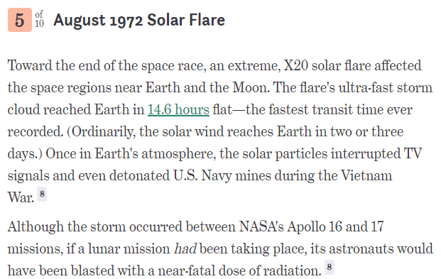
On Space Systems:
Satellite damage (electronics, solar panels, sensors)
Increased satellite drag due to upper atmosphere heating
Disruption of satellite communications and GPS accuracy
Radiation hazards for astronauts and high-altitude flights
On Ground Infrastructure:
Geomagnetically induced currents (GICs) in power grids → blackouts
Interference with radio communications (especially HF/VHF)
Pipeline corrosion from induced currents
Navigation system errors (GNSS/GPS disruptions)
Other Effects:
Auroras (visible at lower latitudes during strong storms)
Disturbances in radar and aviation systems
ESA Space Weather Service Network https://swe.ssa.esa.int/

Slide 5
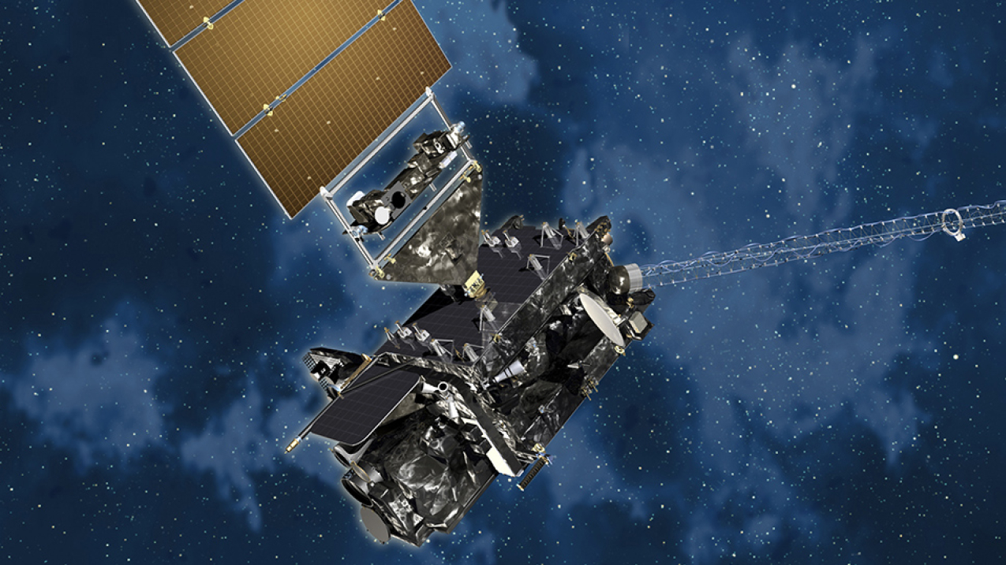
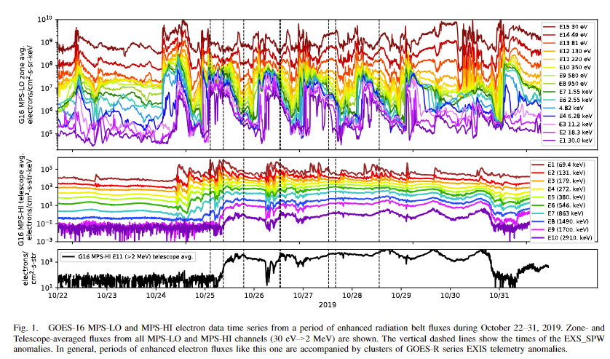
Space Weather Satellites
In Situ measurements – GOES-R
NOAA Operational weather and space weather monitoring
Operated by NOAA, positioned in geostationary* orbit (~35,786 km).
The space weather instruments include:
SEISS (Space Environment In-Situ Suite):
→ Measures energetic particles (electrons, protons).
EXIS (Extreme Ultraviolet and X-ray Irradiance Sensors):
→ Detects solar X-rays & EUV flux — for flare classification.
MAG (Magnetometer):
→ Monitors magnetic field strength in near-Earth space
.
SEISS include the MPS-LO sensor:
electron and proton flux over an energy range of 30ev to 30kev
able to tell scientists the amount of charging by low energy electrons
*Geostationary = a special case of geosynchronous orbit — circular + equatorial.
Notes:
Cambiare la frase con «tell scientists» per dare maggior significato con lo spacecraft charging

Slide 6
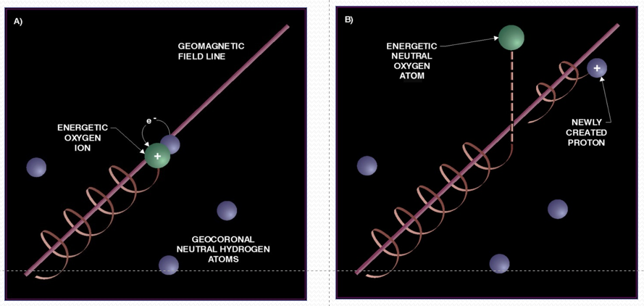
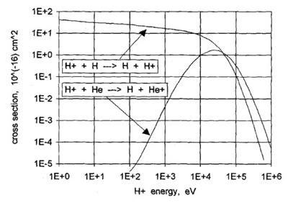
Remote sensing for Space Weather
Energetic Neutral Atom (ENA)
Geocorona Context
The geocorona, composed mostly of neutral hydrogen atoms (25/cm³ @ 10 R_{E}), surrounds Earth and extends up to 630,000 km
ENA Origin
ENAs form when energetic ions (H⁺, O⁺, He⁺) trapped in the magnetosphere capture electrons from geocoronal hydrogen atoms through charge-exchange collisions.
ENAs as Space Weather Tracers
During geomagnetic storms, ion density increases, enhancing ENA production
Resulting ENA fluxes: exceed 10⁵ particles / (cm² · s · sr · keV)
Why ENAs Matter:
ENAs carry the signature of trapped plasma populations, retaining original energy without being deflected by magnetic fields.
Useful for remote sensing of magnetospheric dynamics and storm-time processes.
Cross section energy dependence for proton charge exchange on hydrogen and helium atoms (Gruntman et al., 1997)
Notes:
Controllare il flusso che mi pare una cavolata!!!

Slide 7
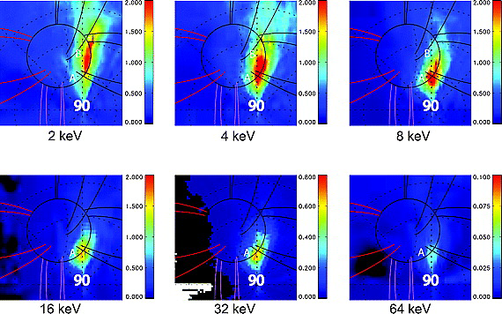
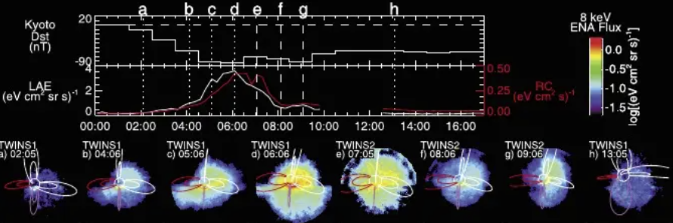
REMOTE SENSING BY ENA DETECTION AT THE EARTH: CURRENT STATUS
Example of high latitude ENA intensity from TWINS – storm event 11 Oct 2008
Bazell, D., E. C. Roelof, T. Sotirelis, P. C. Brandt, H. Nair, P. Valek, J. Goldstein, and D. McComas, “Comparison of TWINS images of low‐altitude emission of energetic neutral atoms with DMSP precipitating ion fluxes”, J. Geophys. Res., 115, A10204, 2010 (LAE)
Evolution of low-altitude and ring current ENA emissions from a moderate magnetospheric storm: Continuous and simultaneous TWINS observations
M. Fok. P. Valek 2010, Journal of Geophysical Research (LAE + RC)
Notes:
Ridurre il testo!!!

Slide 8
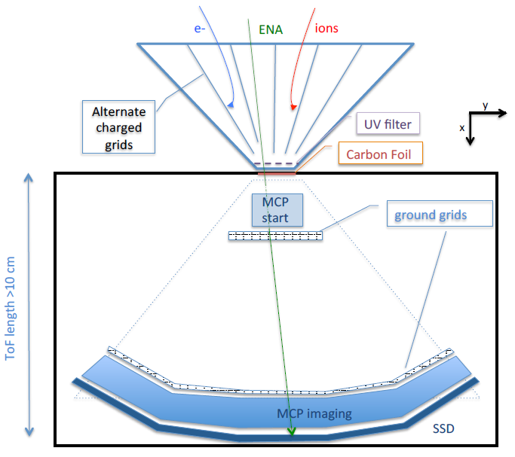
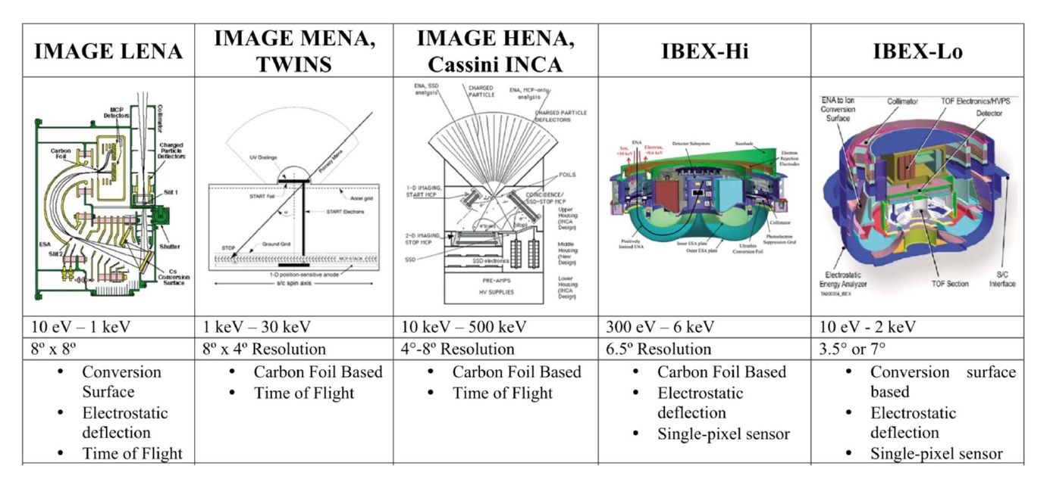
Current ENA detector
Sketch HERE!!
Notes:
DA SITEMARE

Slide 9
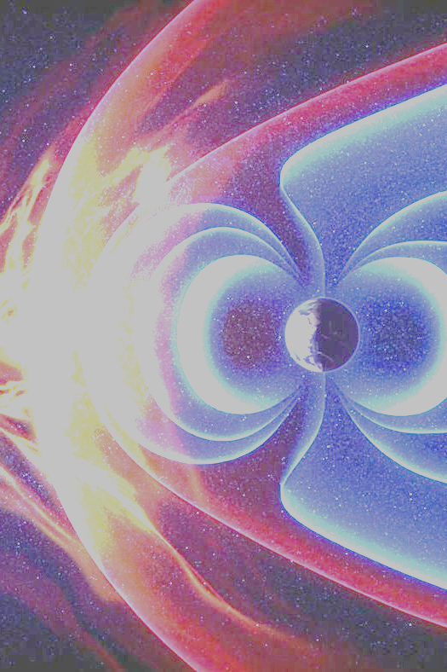
Space WEATher ENA Radiation Sensors (SWEATERS)
THE GOAL
Develop a novel class of detectors for charged and neutral atoms
in the 1–100 keV energy range
Broad Impact Across Fields
  Space sciences:
  ▸ Cosmic rays and magnetospheric dynamics
  ▸ Space weather monitoring
  Fundamental & applied research:
  ▸ Direct dark matter searches
  ▸ Plasma diagnostics (e.g. fusion)
  ▸ Micro-dosimetry in medicine and radiation science

Slide 10
SWEATERS Detector Concept
A “Gas Calorimeter” based on Micro-Pattern Gas Detector (MPGD) technique and a read-out system able to provide track reconstruction of the particles
The new detector must measure:
  Energy
  Direction
  Species
Employ well established HEP technologies in an innovative configuration
Low-cost fabrication together with the robustness of the electrode materials of MPGD make it extremely attractive for harsh environment (like a space mission)
Notes:
INSERIRE RIFERIMENTO AD ATOMI IONIZZANTI DI BASSA ENERGIA (DARK MATTER ….)

Slide 11
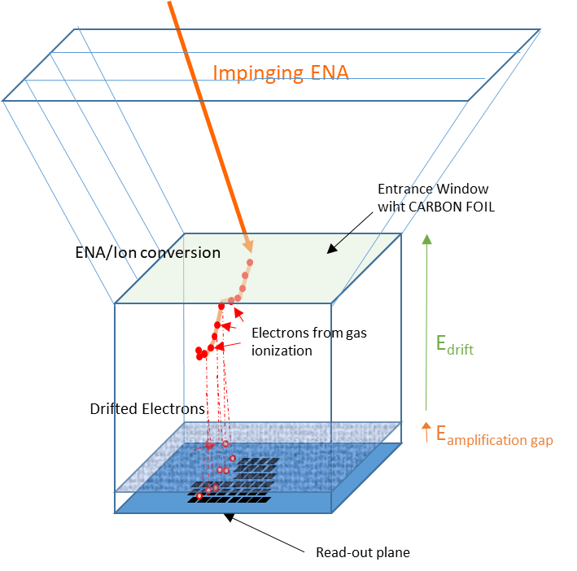
SWEATERS Detector Design
Starting Point
MPGD (which one?)
Ultra thin entrance window (gas cell sealing?)
micro-TPC (if tracks are long enough)
….
ENTRANCE
GAS CELL
READ-OUT PLANE

Slide 12
Low-Pressure Operation: A Space-Driven Constraint
Essential to reduce entrance window stress and simulate vacuum entry conditions
Mechanical design must ensure survival under:
  Differential pressure
  Launch vibrations
  Reliable sealing
Separate Development of Critical Items
Entrance Window: Design for minimal stress and maximum durability
Gas-cell: Focus on ion-gas interaction studies and optimization
Qualification Model (QM)
Each item developed independently
QM produced and tested separately before integration

Slide 13
Entrance Window Innovation
Low energy atom tracks in solid are few um’s long
It’s necessary a nanometer-scale thick window to contain the gas while preserving incident particle properties
Lowering gas pressure inside the Gas Cell minimizes differential stress on the EW, improving durability in vacuum
Really challenging!!!
Parameter | Requirement | Why?
Mechanical resistance to pressure differences | >100 mbar without any damage | Ensure gas containment and structural integrity
Energy loss during atom traversal | As low as possible, especially <5 keV | Preserve sensitivity at low energies
Energy dispersion | < 10% | Maintain good energy resolution
Angular dispersion | < 5° (up to 10° acceptable) | Enable accurate direction reconstruction
Lifetime under atomic flux | Years of operation at ≥ 10⁵ Hz/cm² | Ensure long-term performance under sustained flux
Charge state of exiting atom | Maximize ionized fraction (for both neutral and ionized input) | Improve detection efficiency
Secondary electron emission efficiency | As high as possible (for use in trigger/ToF systems) | Enable timing and triggering functions

Slide 14
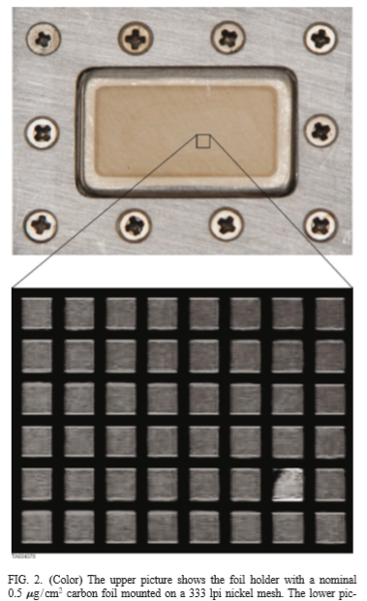
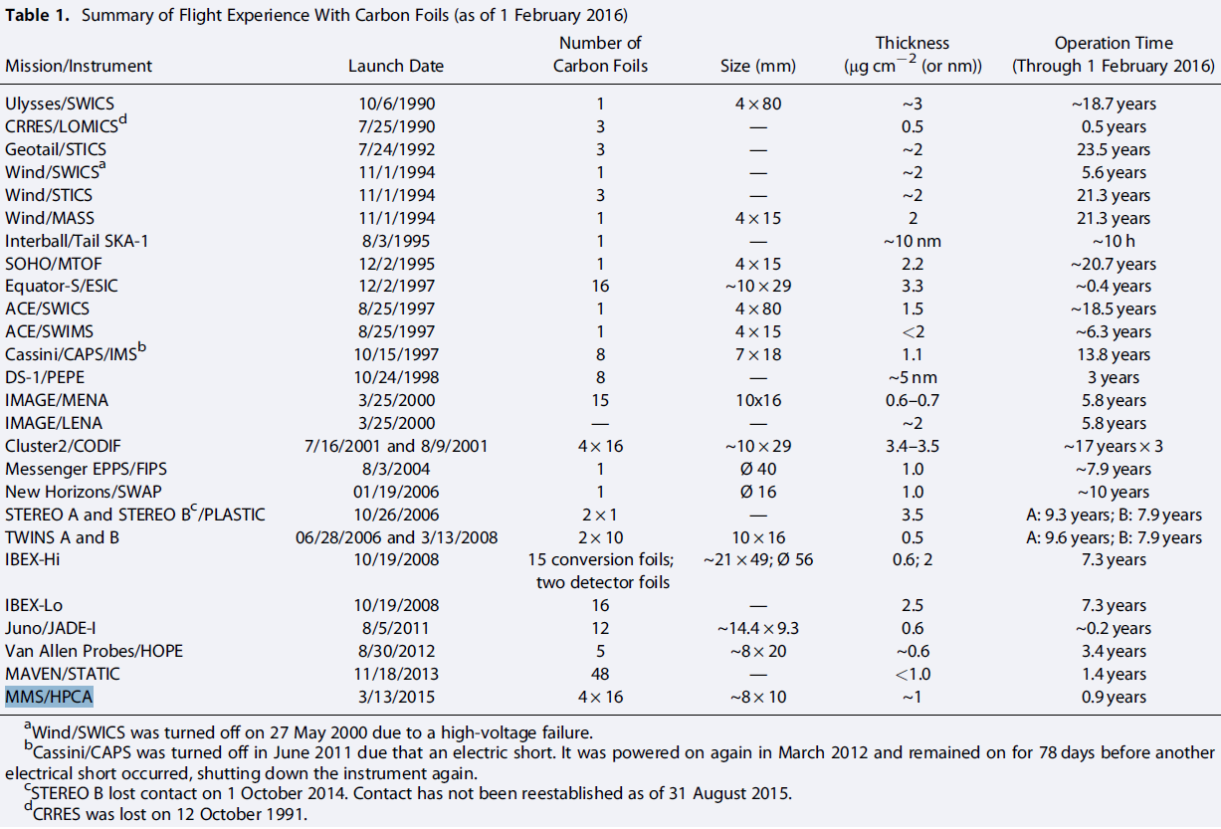
Baseline Material
Carbon Foil (TRL 9, but new usage)
Reliable and well-established for detecting ionized or neutral atoms
Typical thickness: 0.5–3.5 μg/cm² (approximately 3–17 nm)
Widely used in numerous past space missions → TRL 9!!!
DOI: 10.1002/2016JA022570
BUT the use as gas-tight seals like in SWEATERS poses durability challenges that must be addressed for long-term reliability.
Notes:
Charge state is necessary?

Slide 15
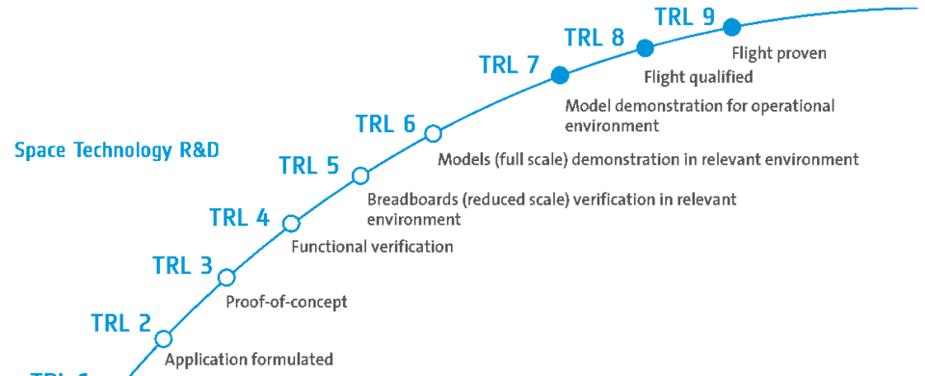
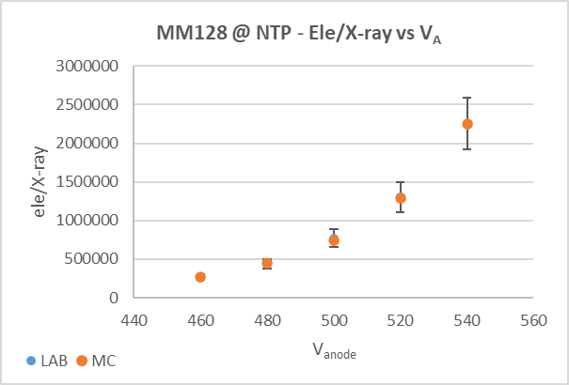
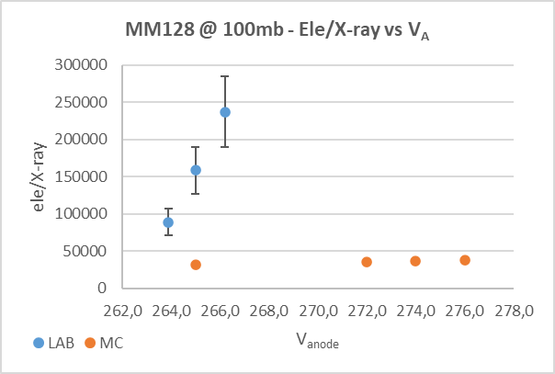
MICROMEGAS as the Chosen MPGD Tech
Technology | Gain Stability | Ion Feedback | Discharge Risk | Energy Resolution | Performance at Low Pressure
MICROMEGAS | Excellent | Minimal | Very Low | Good | High Gain
GEM | Good | Low | Low | Very Good | Moderate
THGEM | Moderate | High | Higher | Moderate | Good
MICROMEGAS: Proven on Earth, But never flown for low-energy atom detection in space
🔬 The Core Challenge: Incomplete Physics Knowledge
Uncertainty in low-energy atom–gas interactions
▸ Unknown energy thresholds and non-linear
responses
MICROMEGAS performance at low pressure
▸ Primary charge diffusion in drift region
▸ Stability and gain in avalanche region
Ion track properties
▸ Strongly dependent on gas composition
and pressure
We start from HERE
Overal GAIN | MC ≈ Lab @NTP | MC ≈ 1/5 Lab @100mbar

Slide 16
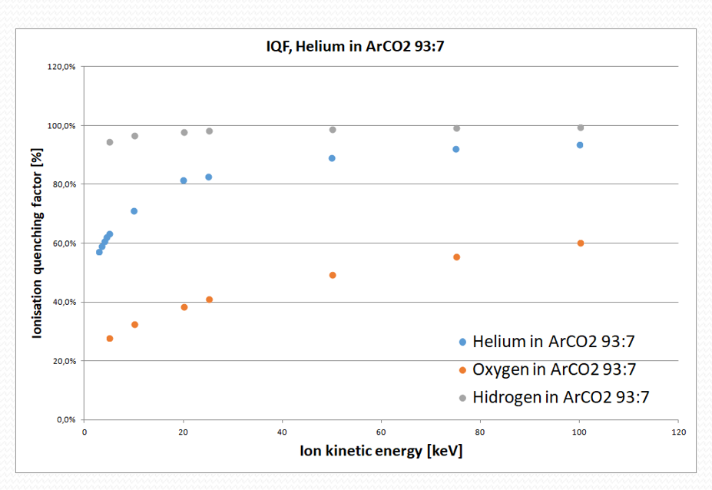
High-Energy vs Low-Energy Paradigm Shift
Ion energy loss in matter occurs via two main mechanisms:
🔹 Electronic (inelastic) losses
— Energy transferred to atomic electrons through ionization and excitation
🔹 Nuclear (elastic) losses
— Energy transferred to atomic nuclei via elastic collisions in the screened Coulomb field
— Leads to recoil motion, not ionization
Energy loss regimes:
High-energy ions
→ Electronic losses dominate
→ Described by the Bethe-Bloch formula
Low-energy ions
→ Nuclear losses become significant as ion slows down
→ Described by Lindhard theory
Lindhard Theory – Energy Partitioning
For an ion of kinetic energy Ei:
η → Energy to electrons (ionization + excitation)
ν → Energy to nuclei (atomic motion)
Total: Ei = η + ν, η is the detectable part, ν is quenched
Quenching Factor (QF)
QF = η / Ei
Fraction of energy visible to the detector
QF < 1 due to undetectable nuclear energy loss
Notes:
Different signal scales, drift times, gas behaviors

Slide 17
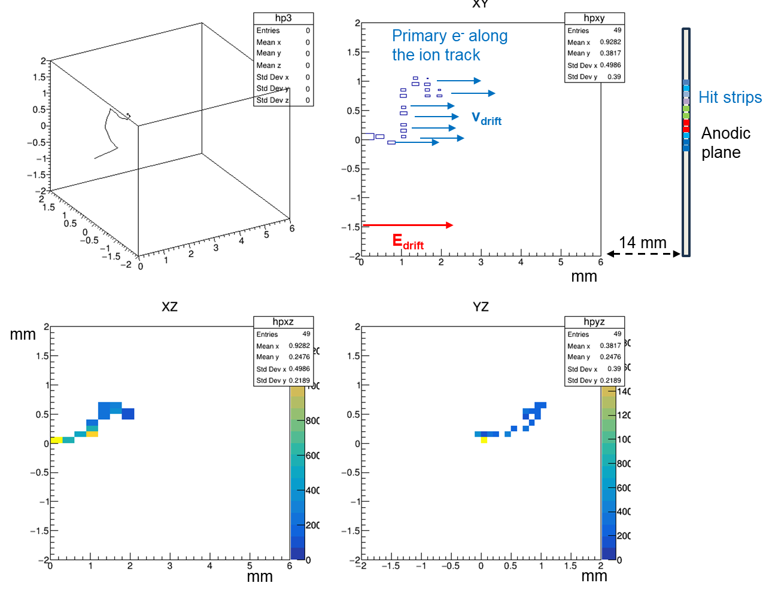
Ion tracks in low pressure gases
▸ Strongly dependent on pressure and atom mass
SRIM simulation: H⁺ 5 keV, 100 mbar Ar:CO2 (93:7)
Notes:
Questa meriterebbe una figura H+ keV range in funzione della pressione

Slide 18




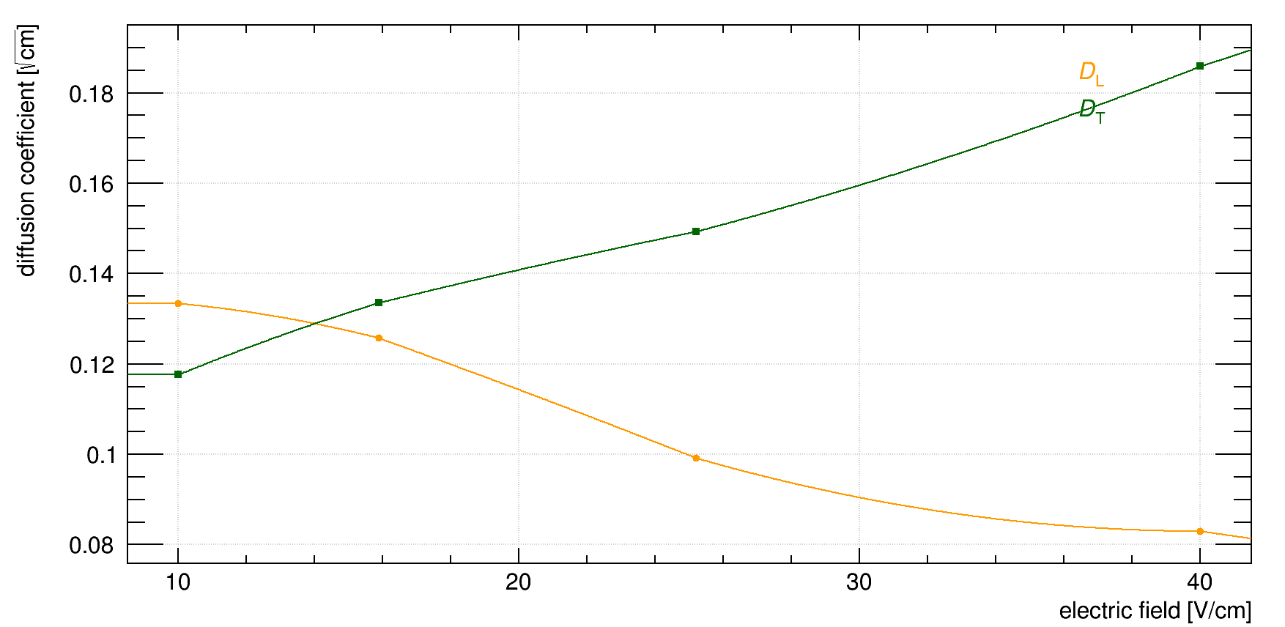
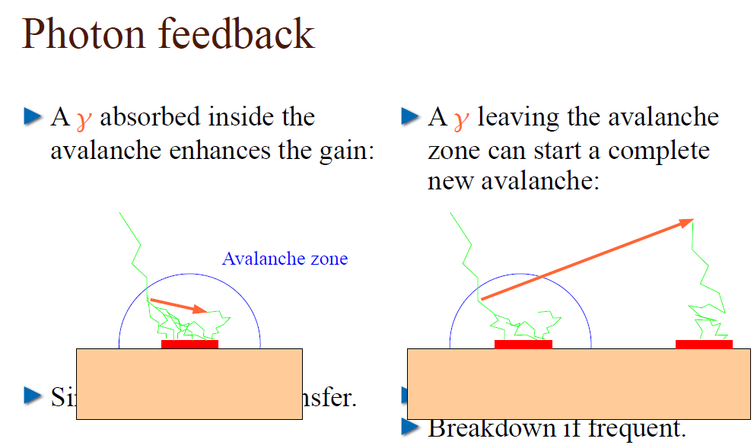
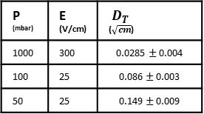
Operating MICROMEGAS at Low Pressure
What's Different?
Electron transport: The mean free path of electrons increases
At NTP in Argon where 𝑛=2.5×10²⁵ atoms/m³, 𝜎(𝐸) is the energy-dependent electron-argon cross-section (~10⁻²⁰ m² at 10 eV)
Diffusion: Transverse and longitudinal diffusion grow significantly at lower pressures, degrading timing and position resolution.
P (mbar) | E (V/cm) | $${ D}_{T}$$ ($\sqrt{cm}$)
1000 | 300 | $$\text{0.0285}±\text{0.004}$$
100 | 25 | $$\text{0.}\text{086}±\text{0.00}\text{3}$$
50 | 25 | $$\text{0.149}±\text{0.009}$$
Avalanche development: Avalanches become more extended and less confined, impacting spatial resolution and potentially increasing feedback.
    Gain stability: Achieving stable gain becomes more challenging. Special attention must be paid to mesh geometry, gas choice and field uniformity.
    Discharge probability: The risk of sparking can increase due to reduced quenching capacity of the low-density gas and longer avalanche paths
Notes:
Plot di Giuseppe??? Beh almeno iniziale guadagno
Come si calcola la distanza di drift (perché rad di cm?)

Slide 19
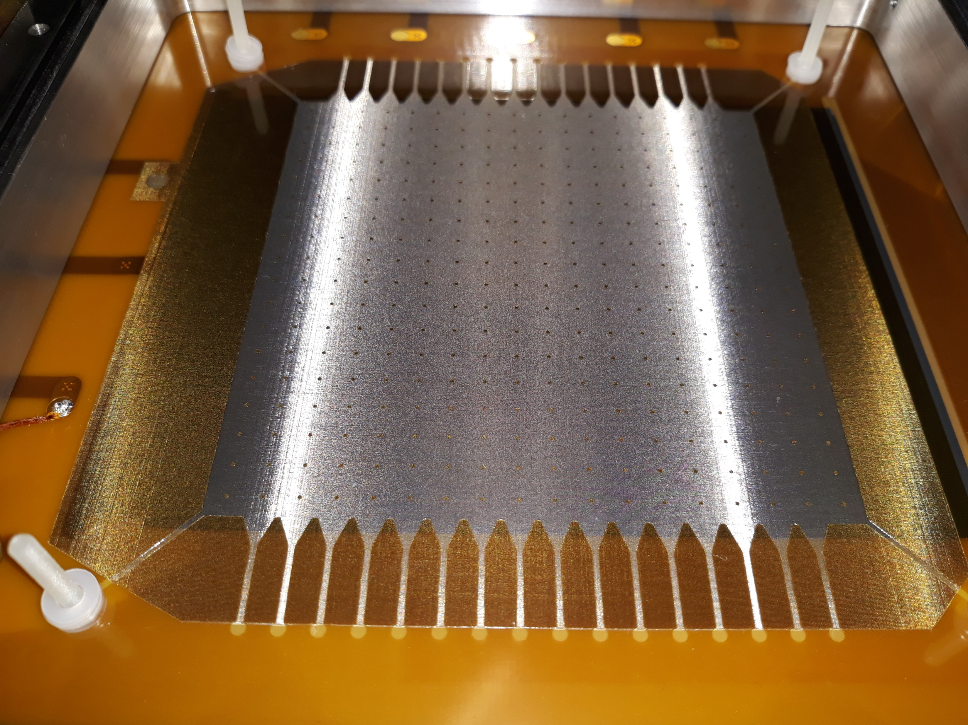
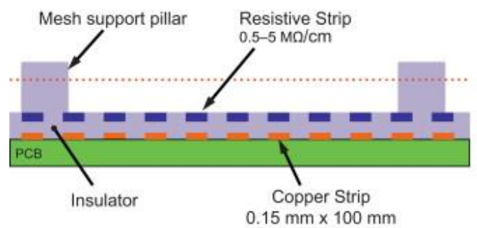
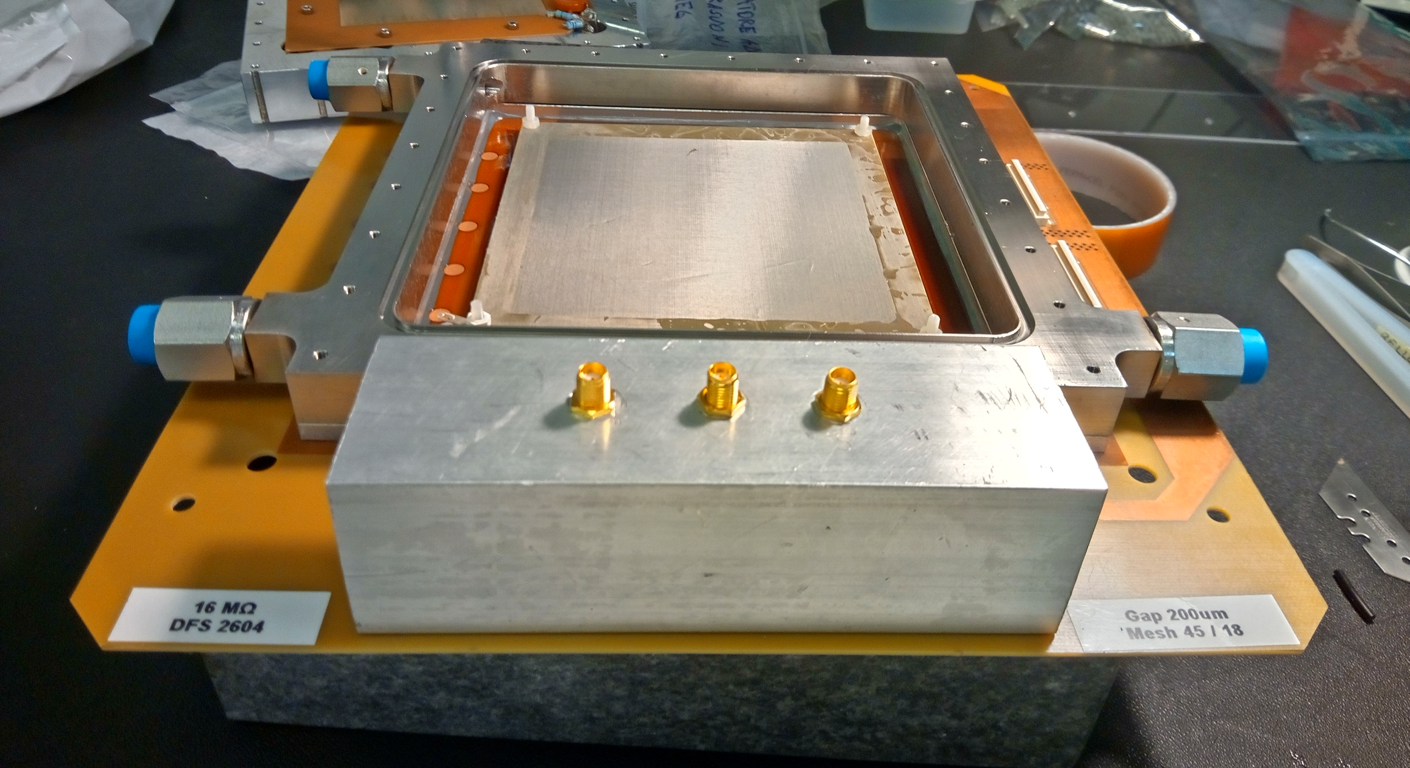
Design Must Anticipate Unknowns
Adaptive, testable, model-guided design approach
Started from a standard MICROMEGAS kit
(developed at CERN for the ATLAS NSW upgrade)
Transitioned from NTP to low-pressure operation
Minimal, critical modifications only:
Avalanche gap increased to 192 μm
→ One parameter change = major technological step
Drift height increased from 5 mm to 20 mm
→ To fully contain ion tracks
What remained unchanged:
Gas mixture
Materials inside the MICROMEGAS
Core technologies (e.g., bulk, DLC layers)
128 µm gap
192 µm gap

Slide 20
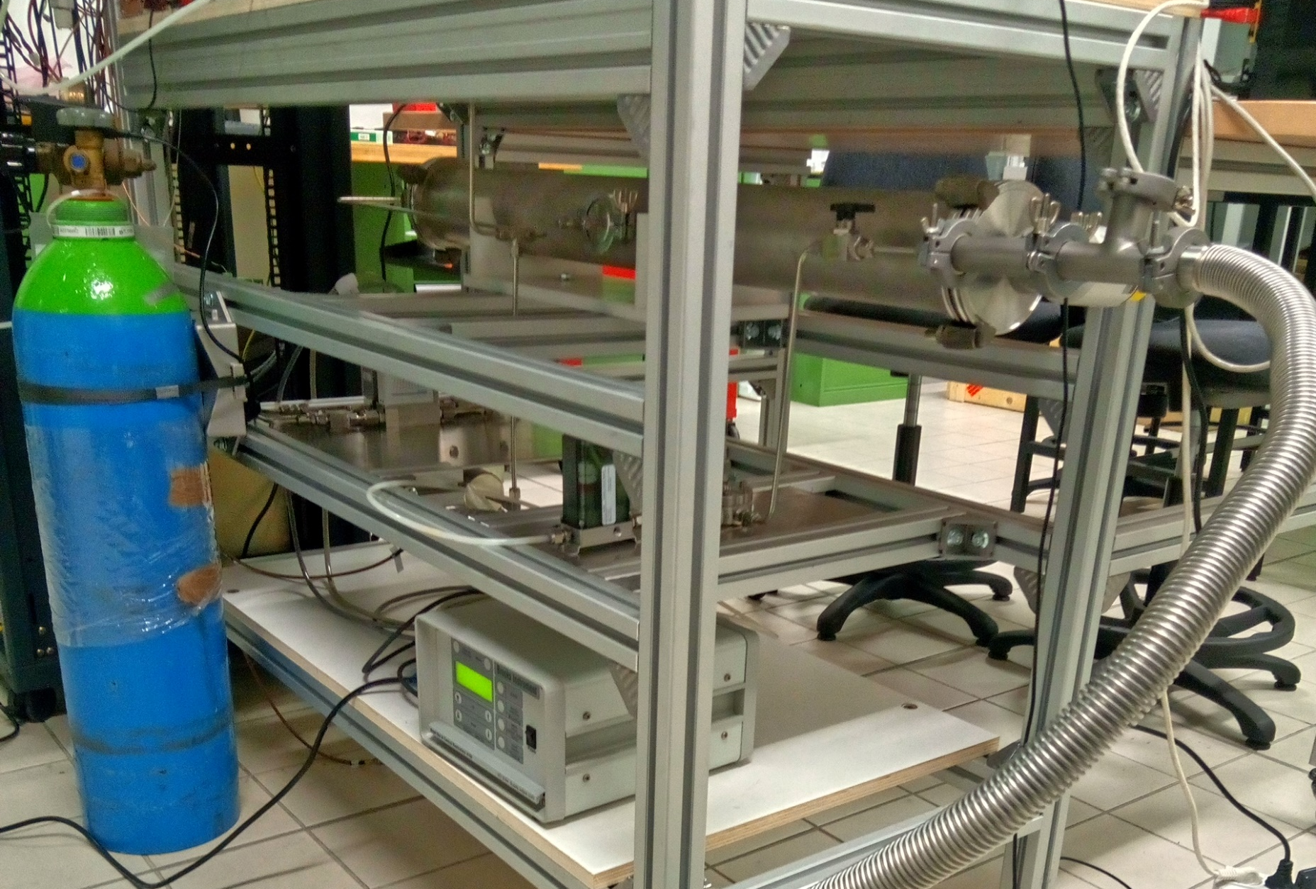
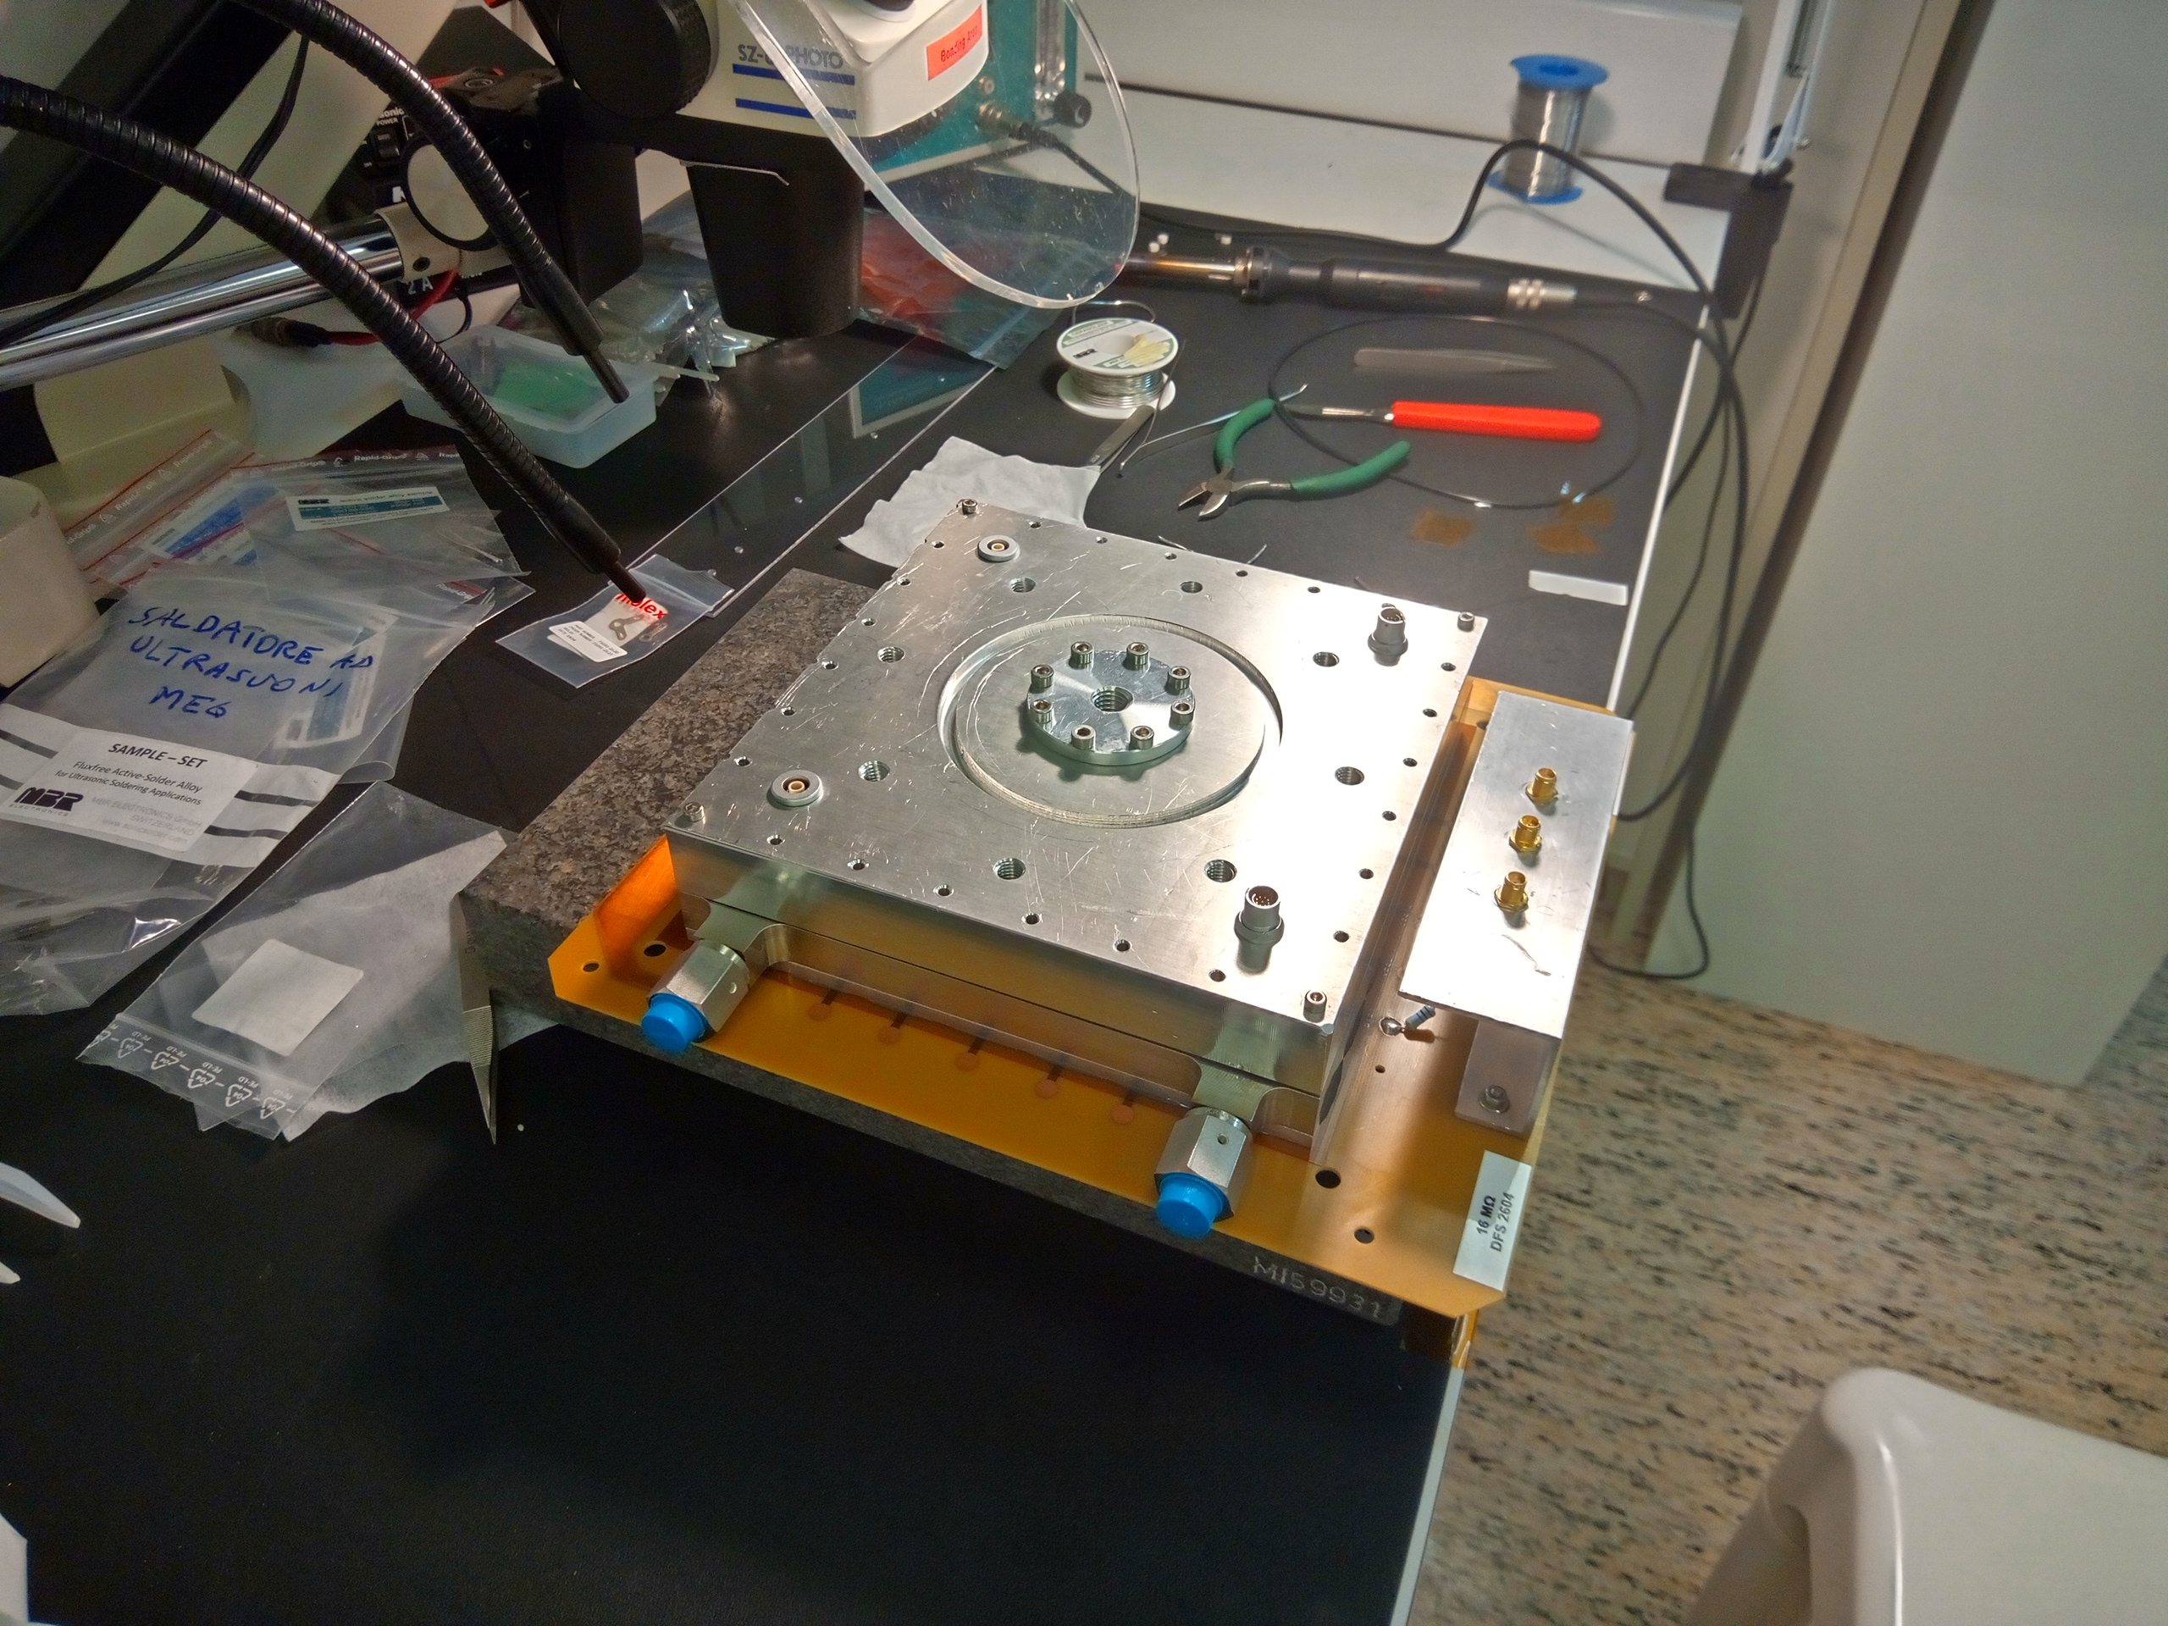
Enabling TRL Progression
Low-Leakage Frame and High-Purity Gas Handling
Why it matters
Detector performance is highly sensitive to oxygen contamination
→ Must be kept < 0.1% (ideally < 0.01%)
Gas Handling System Requirements
Ultra-high gas purity and mixture stability
Pressure stability within ±1 mbar
Fine flow control (few cc/min), independent of outlet conditions
Gas flow ≥ 40 cc/min ensures O₂ contamination stays below 0.01%
Main Mechanical Design Features
Reinforcement plate glued to PCB backside for stability
Two-part lateral frame:
  Lower part glued to PCB top layer for flatness and tight seal
  Upper part in stainless steel, with welded pipes & connectors
  Indium wire seal between the two frame parts
Swagelok VCR valves on gas inlet and outlet
Measured leak rate (fully assembled): < 0.9 × 10⁻⁵ mbar·l/s
Together, these developments enable controlled lab validation of detector performance—marking a key step from TRL 3 to TRL 4
Thanks to intensive R&D, the detector achieves stable, sealed low-pressure operation for hours—without any loss in performance

Slide 21
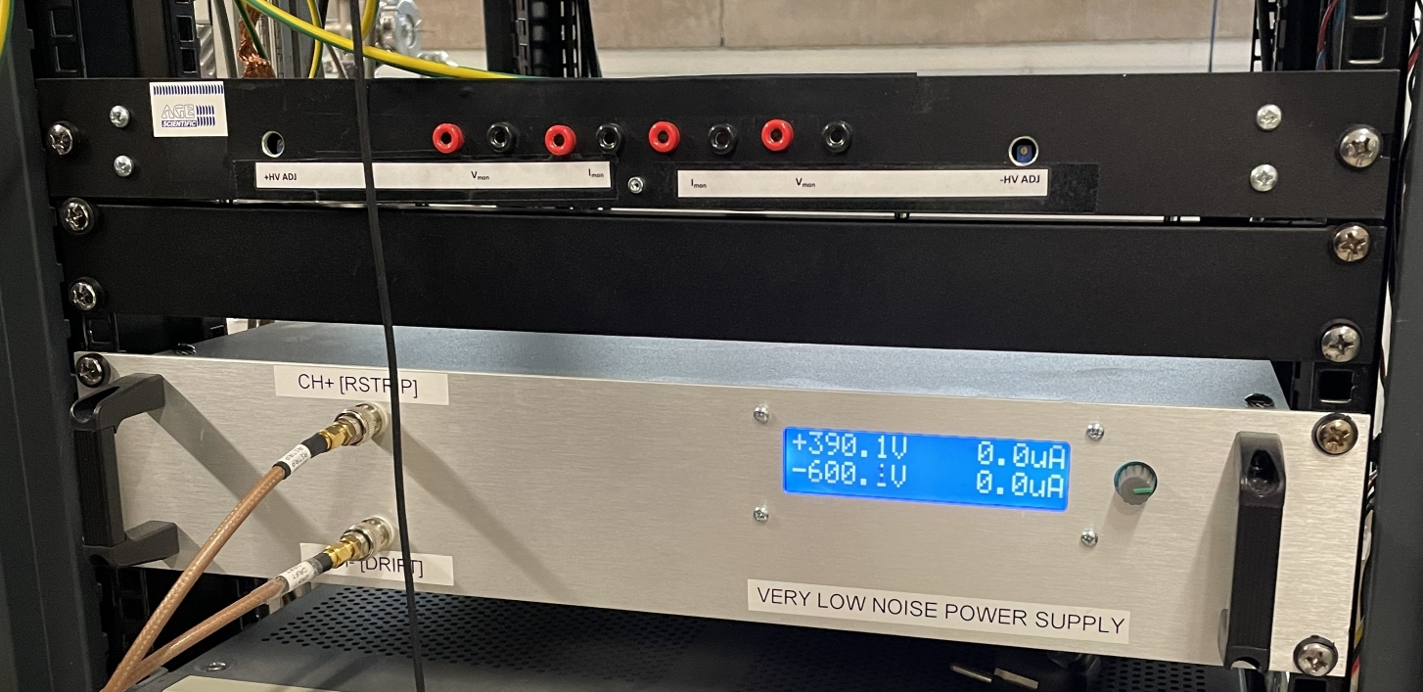
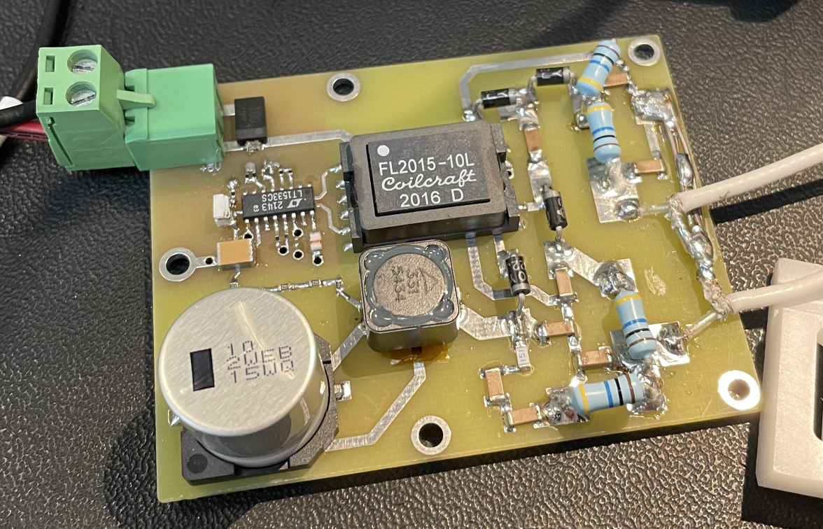
High Voltage system (HV) design and manufacturing
CUSTOM HV power supply
output voltages: 0-600 V (to be upgraded to 1500 V) in 0.1V steps
one positive and one negative channel
output current: 500 mA
output noise: < 5 mV pp between 0.1 and 10 Hz, <200 mV above 10 Hz
thermal drift: < 100 ppm/°C
power supply: 230V ac
Low-noise HV for balloon flight
Notes:
Portare dietro la MM da Pallone!!

Slide 22
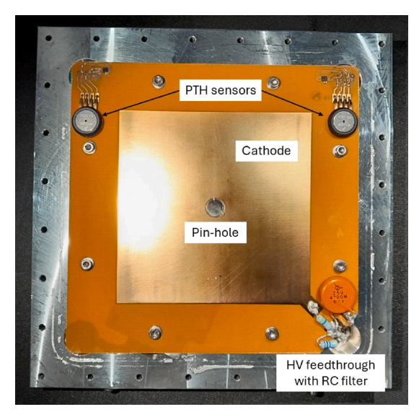
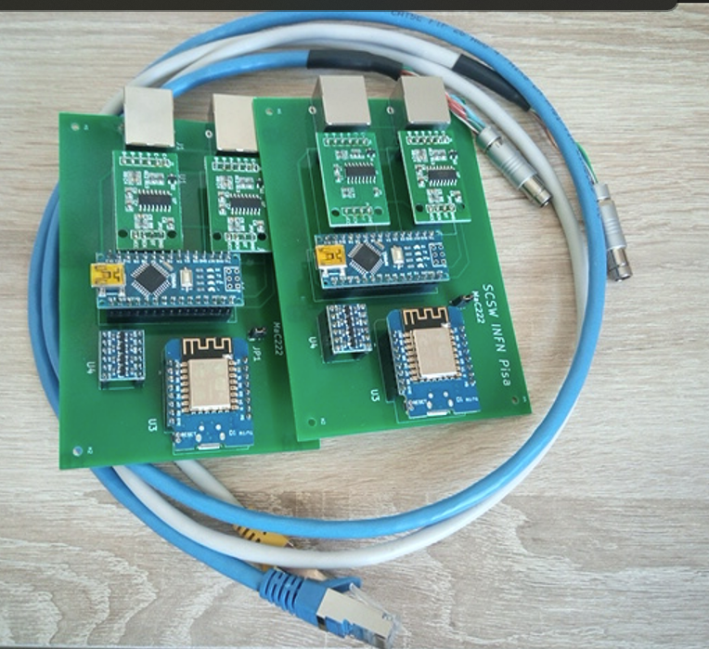
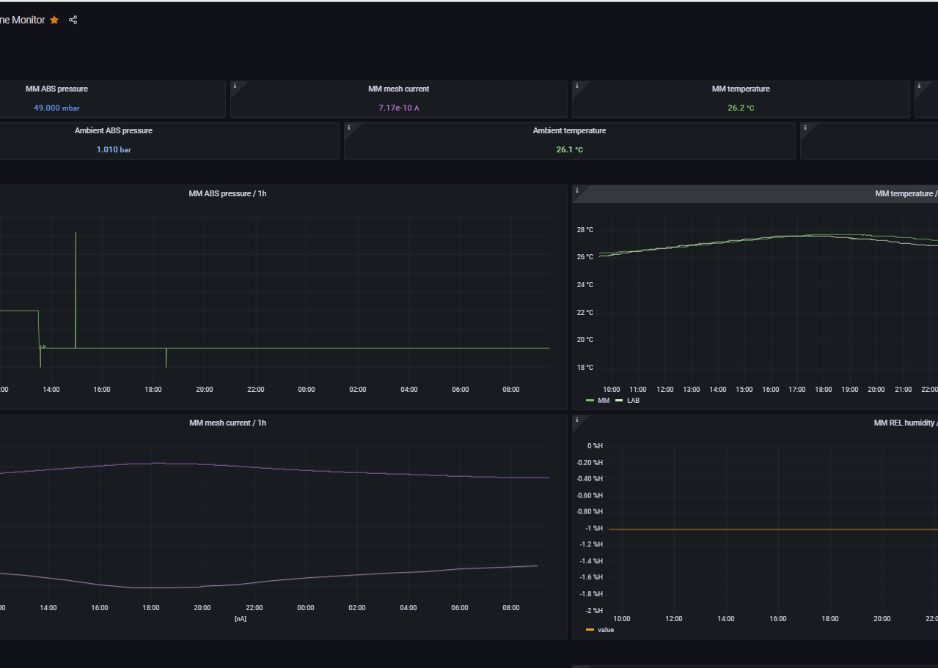
Detector slow-control system
REQUIREMENTS
Monitor PTH sensors inside the detector and in lab
Monitor Mesh current, pulse frequency, Anodic/cathodic voltage/currents
DEVELOPMENTS
CUSTOM INSTRUMENTED CATHODE for PTH measurement inside the gas cell
MQTTtoSerial Dongle to connect via WiFi all instruments equipped with an RS232 port
Data stored in DB (QT + SQLite + Grafana)

Slide 23
Boosting Detector Development
Dedicated Low-Energy Ion Beam Facility
A commercial SPUTTERING ION SOURCE is employed unconventionally—optimized for low current, high stability, and precise beam focusing over a long distance toward the detector under test.
Ion Source (IS)
Model: IG-5-C (Staib Instruments)
Energy Range: 200 eV – 5 keV
Directs ion beam to detector
He and H₂ ions (but also Ar, O2 …)
Vacuum System
Turbo Pump (TP) + Scroll Pump (SP) for Rough vacuum stage + turbo pump backing
Connected via DN 100 CF components
Achieves < 10⁻⁷ mbar with low vibrations
Main Chamber (MC)
Central node for all subsystems
Includes full-range pressure gauge for beam pipe pressure monitoring
will house future upgrades (neutral beam?)
Residual Gas Analyzer (RGA)
Monitors vacuum composition
Detects contaminants causing background/secondary beams
IS
MC
MM
TP
RGA
SP
1-2 m total length

Slide 24
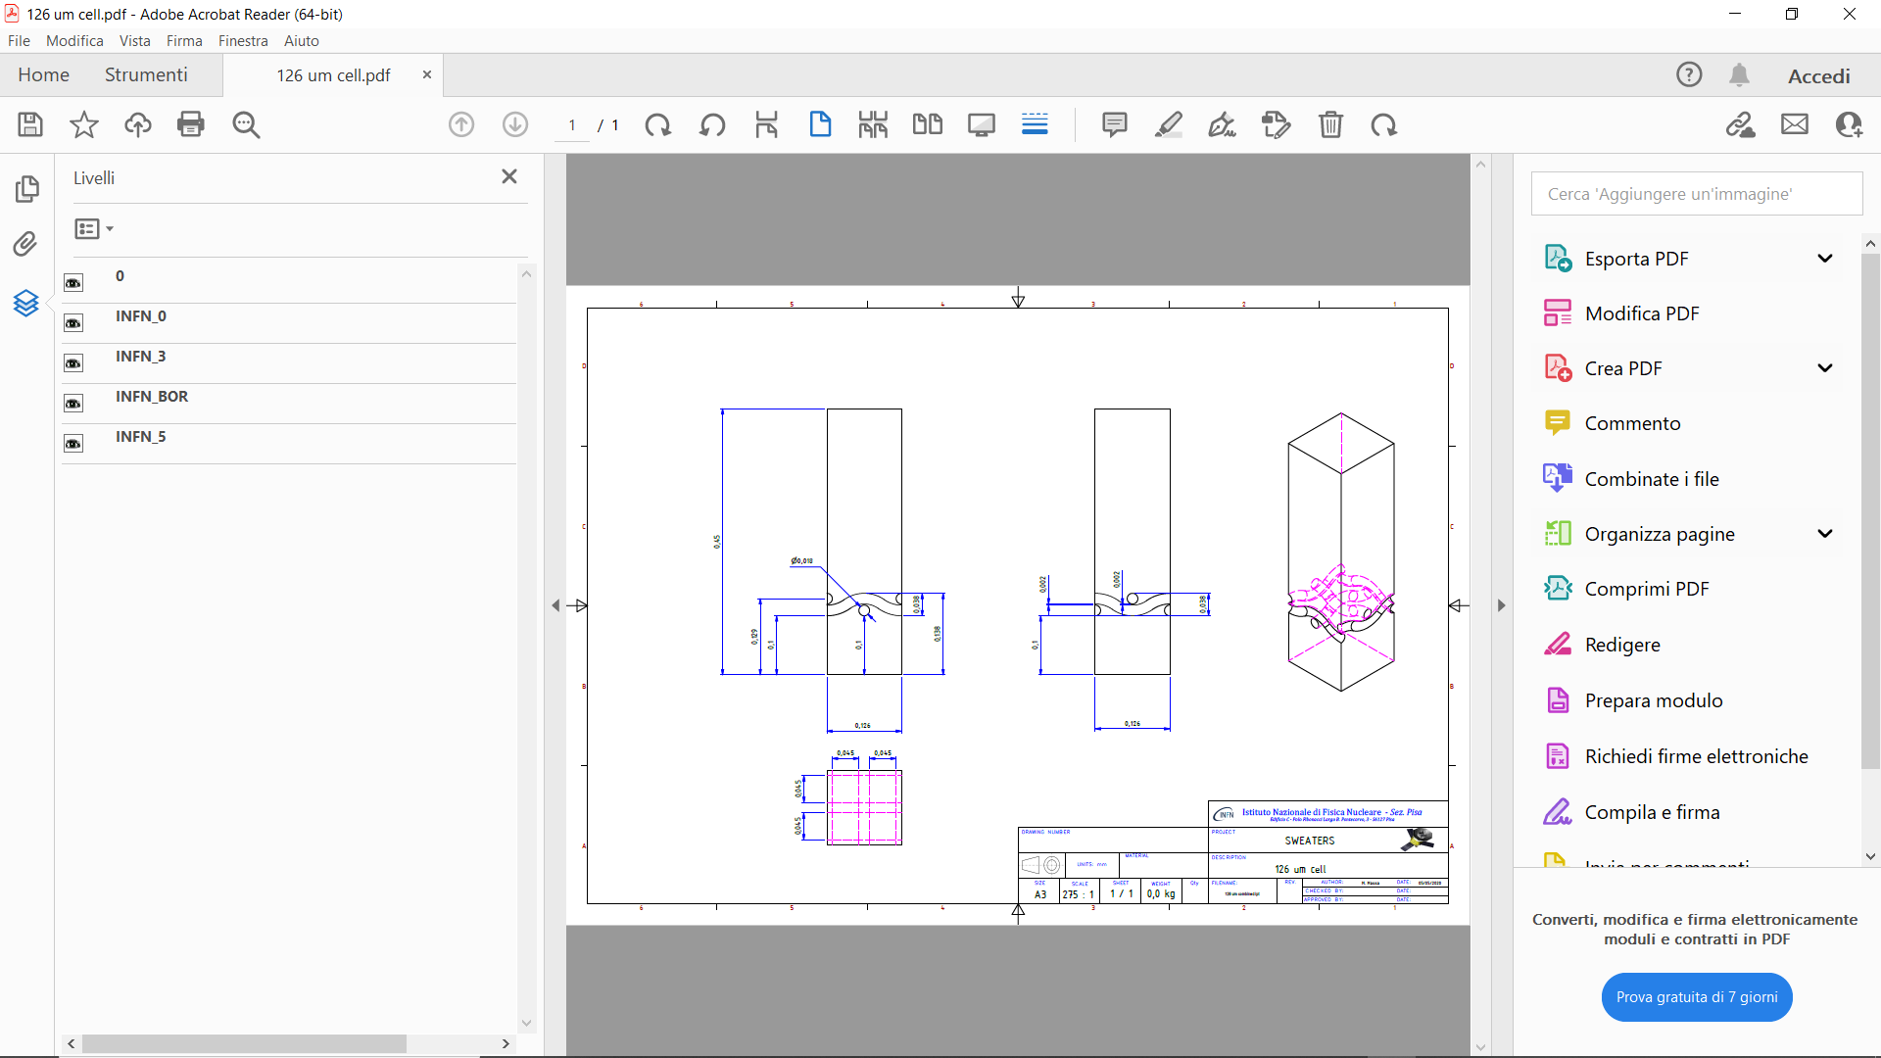
Detector Simulation
ENA Detector Simulation (EDSIM)
Robust simulations are essential to predict detector behavior, guide development, and validate performance—minimizing risk and enabling efficient TRL progression.
IN SWEATERS it’s important to:
Identify and quantify physical processes relevant to the overall gain, energy and tracking resolution
Quantify their relationships with gas mixture, pressure, temperature and avalanche gap
Make predictions for MICROMEGAS gaps up to 500um
Cathode
2cm
36um
Mesh
100-150um
Anode
MC Drift Region
Geant4 framework using fast simulators
  Degrad for x-rays (5.9 keV x-rays)
  SRIM for atoms
  Garfield++/Magboltz for electron drift
Electric field maps:
  Uniform field: 300V/cm @NTP, 25 V/cm @50-100mbar
MC Avalanche Region
Based on Garfield++ (AvalancheMicroscopic), Magboltz
Electric field maps
  ANSYS/ComponentAnsys123 with step ≈ 0.3 - 0.5um
Source
  primary electrons from Drift region at 400um from mesh

Slide 25
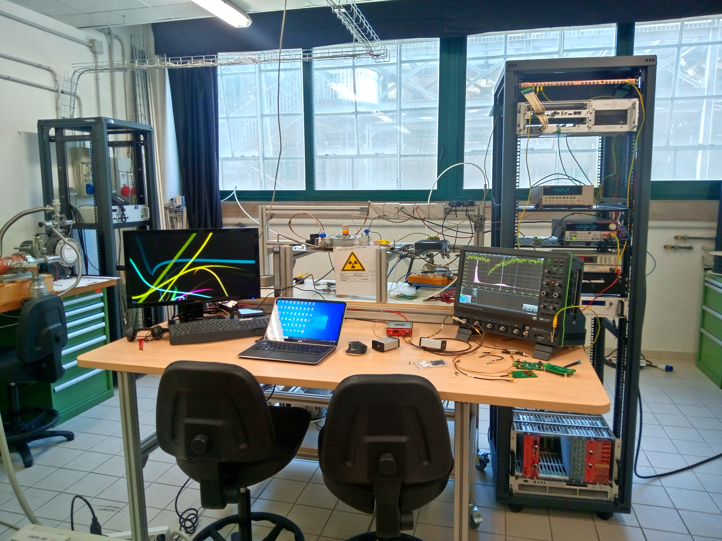
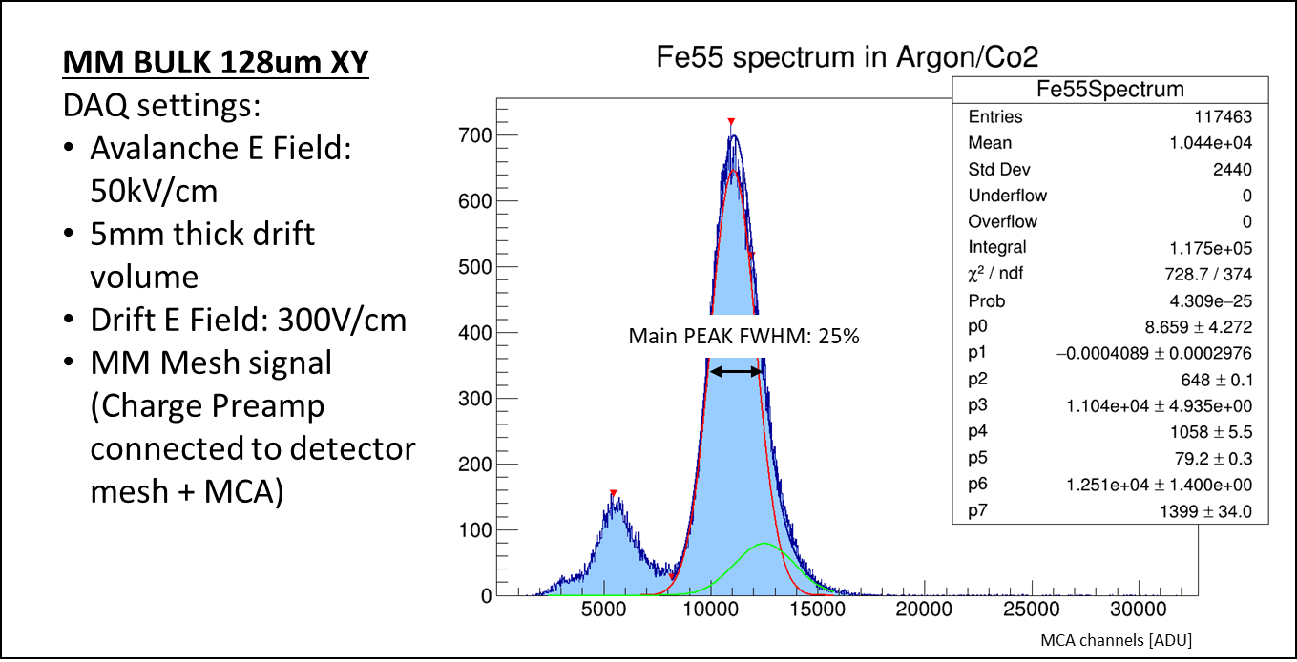
Experimental Campaign Goals
Understand MICROMEGAS performances at low pressure: gain, energy resolution, stability
Support Electronics and DAQ development
Low energy-gas interaction studies
Notes:
Inserire qualche dettaglio in più (sparisce l’escape peak, si valuta il noise a bassa pressione, si capire come devono essere fatti i grounding)

Slide 26
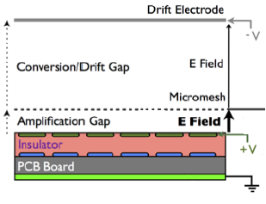
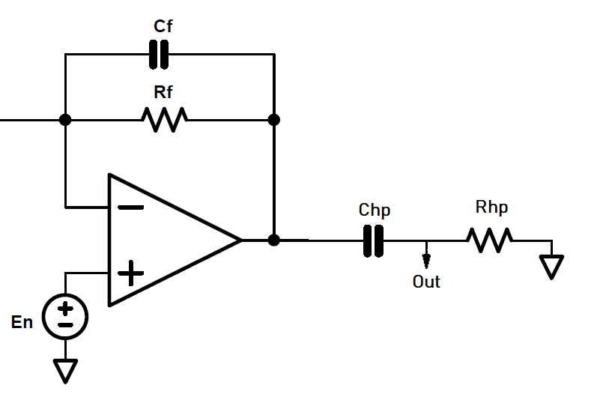
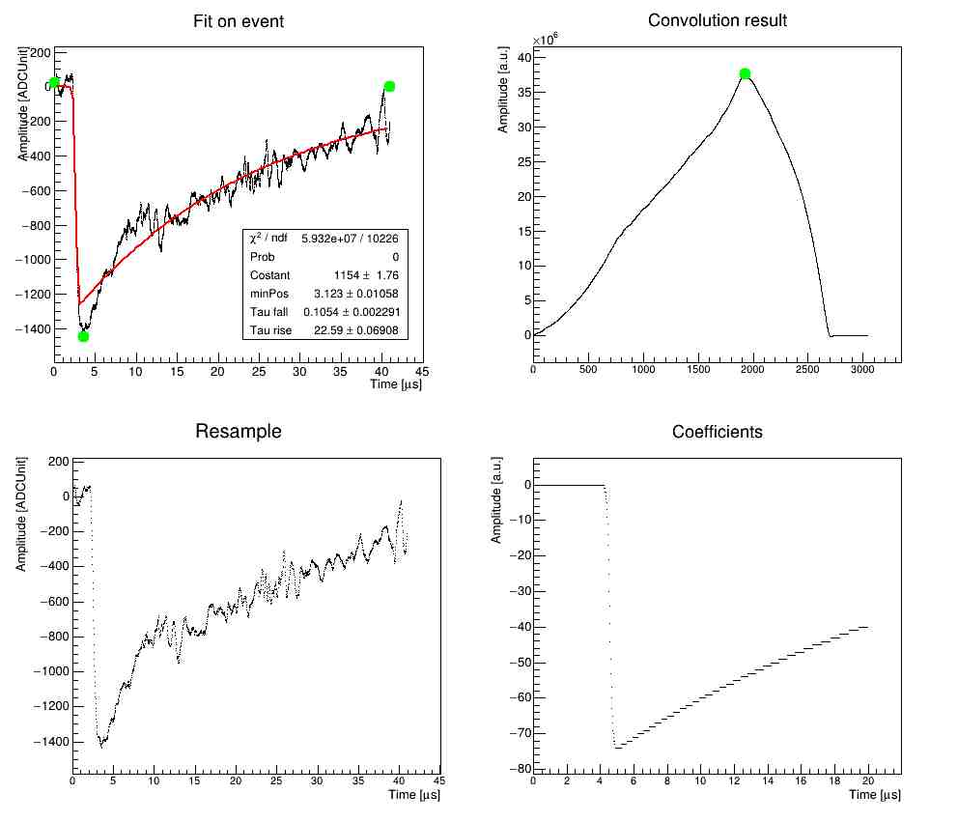
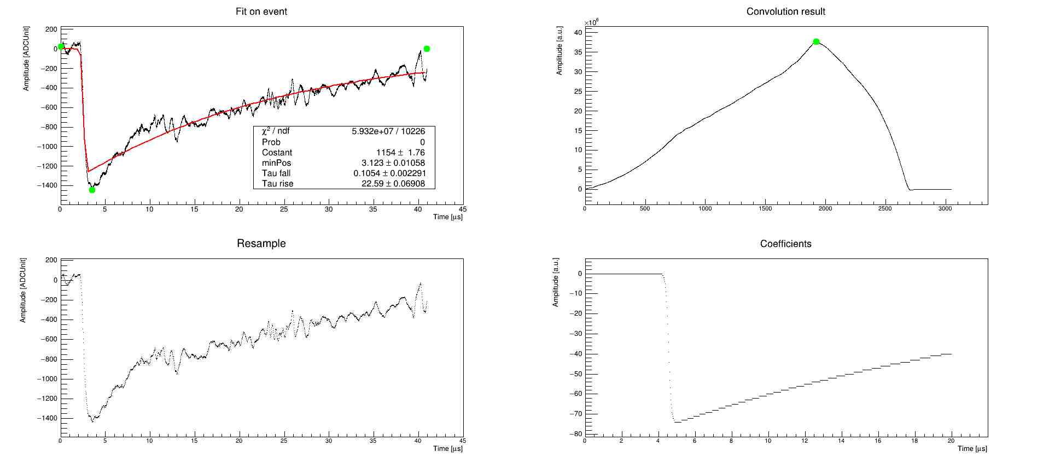
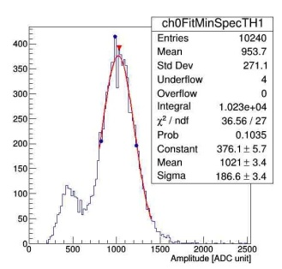
Micromesh energy measurement
Read out
chain
DAQ:
Oscilloscope
CAEN digitizer
Waveform analysis
Fit
Spectrum
Matched
filter

Slide 27
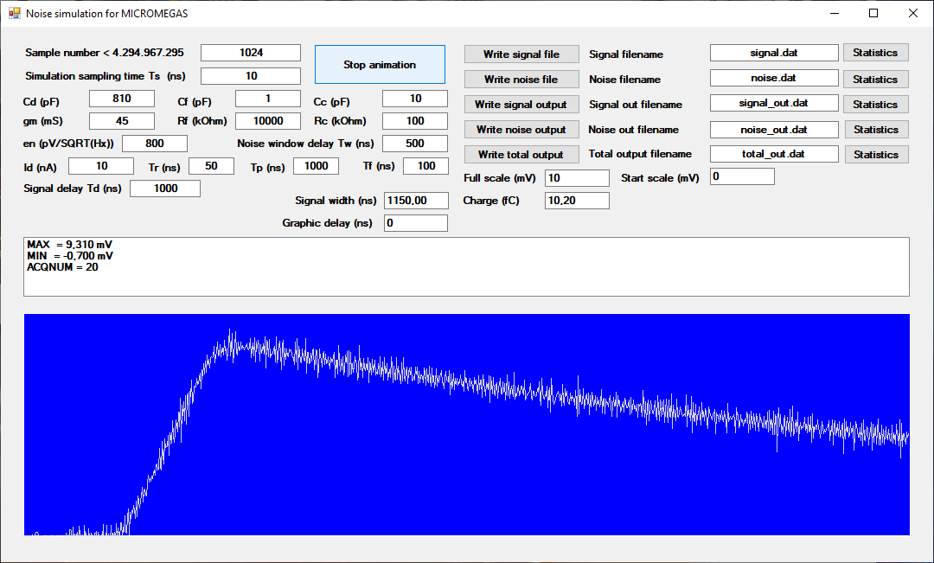
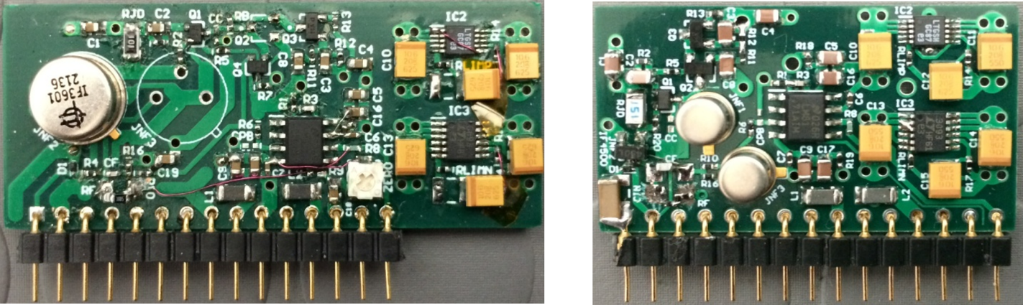
Mesh readout chain for energy measurements
Front-end electronics design and manufacturing
AMPLIFIER MAIN REQUIREMENTS
Low equivalent-noise-charge (ENC): < 1 fC for good S/N
Good input ESD protection
Commercial charge amplifiers (like CAEN A1422H with 400mV/MeV sensitivity) do not meet our requirements
OUR SOLUTION
Custom amplifier design and assembly
Design based on a time-domain software simulation
Current version ENC: < 0,65 fC (with a C_{INPUT} = 850 pF)
The amplifier design can be changed to meet different detector capacitances
The time domain simulator developed to design our charge amplifiers
First SWEATERS charge amplifier prototypes

Slide 28
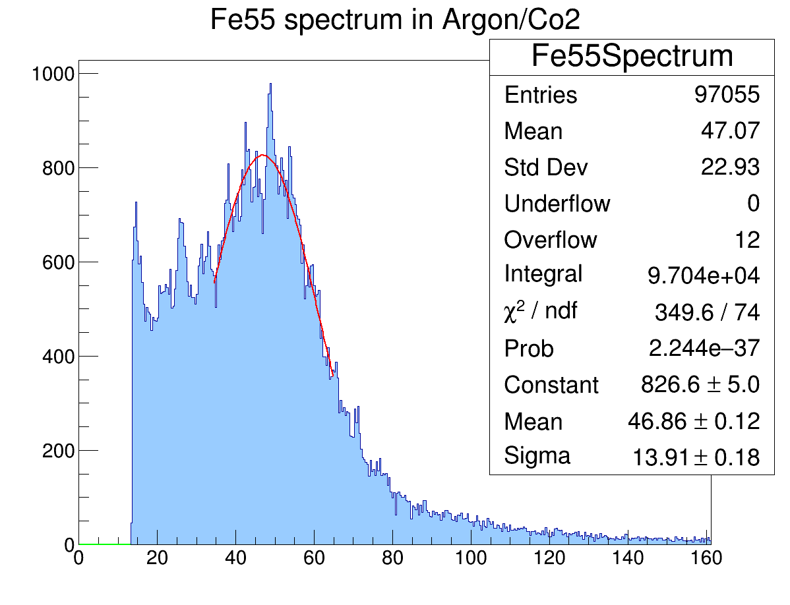
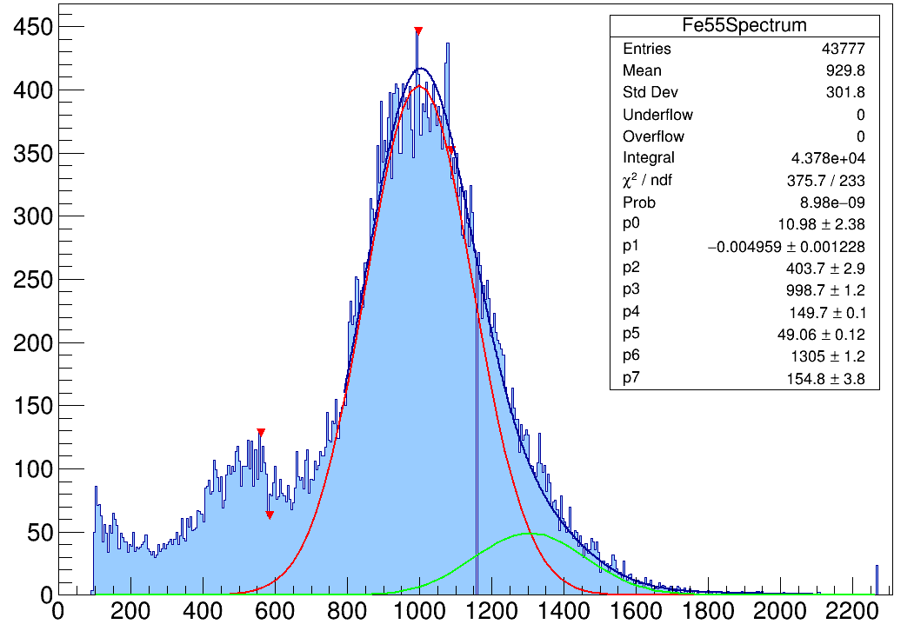
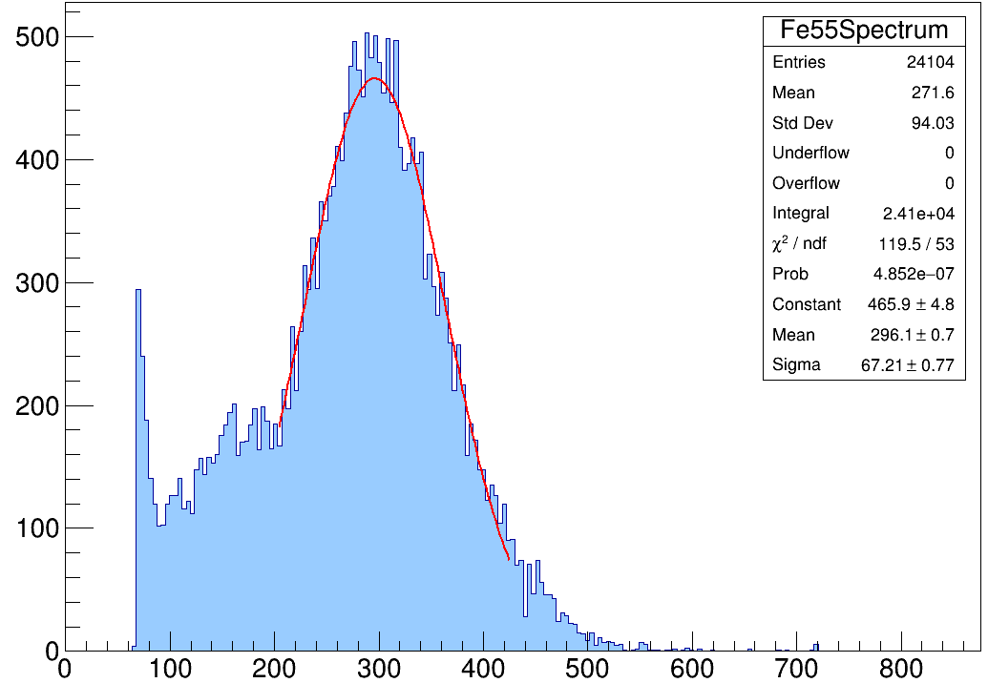
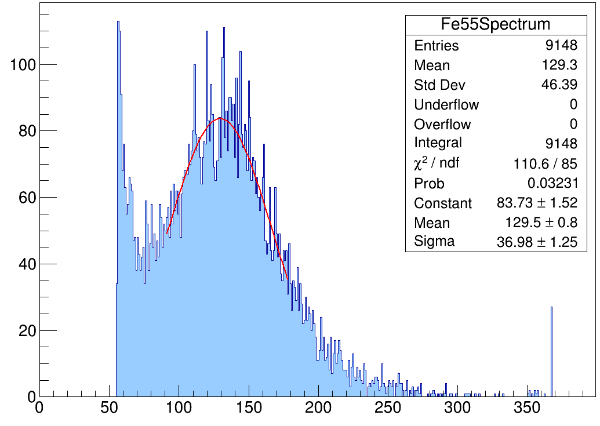
Technology selection and development
X-rays source test bench
X-ray sources: Mainly ⁵⁵Fe (5,9 keV) and ¹⁰⁹Cd (22 keV)
MM BULK 192µm XY
100 MBAR
DRIFT HEIGHT: 20 MM
FWHM: 70%
FWHM: 35%
MM BULK 128µm XY
100 MBAR
DRIFT HEIGHT: 5 MM
SIGNAL AMPLITUDE [MV]
SIGNAL AMPLITUDE [MV]
FWHM: 53%
FWHM: 67%
MM BULK 192µm XY
50 MBAR
DRIFT HEIGHT: 20 MM
MM BULK 192µm XY
30 MBAR
DRIFT HEIGHT: 20 MM
SIGNAL AMPLITUDE [MV]
SIGNAL AMPLITUDE [MV]
Notes:
Inserire qualche dettaglio in più (sparisce l’escape peak, si valuta il noise a bassa pressione, si capire come devono essere fatti i grounding)

Slide 29
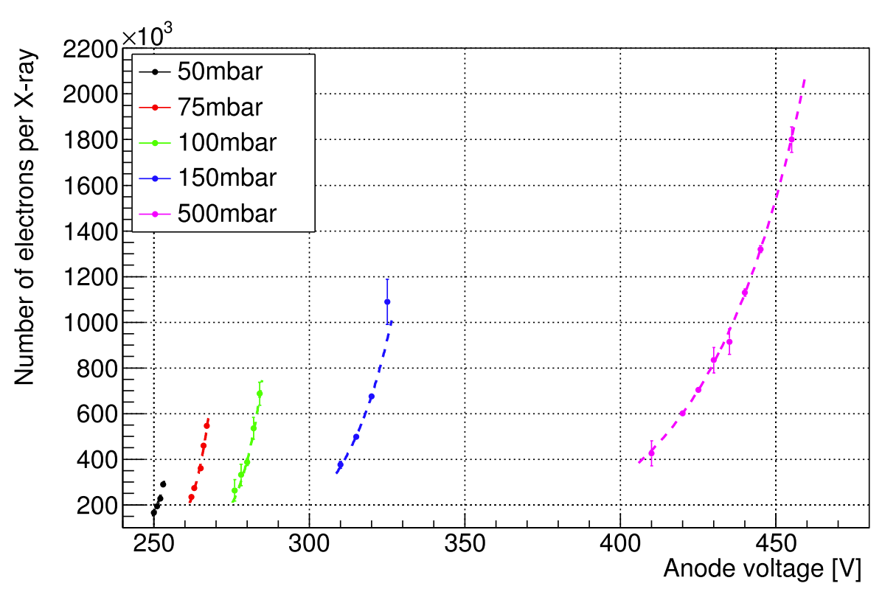
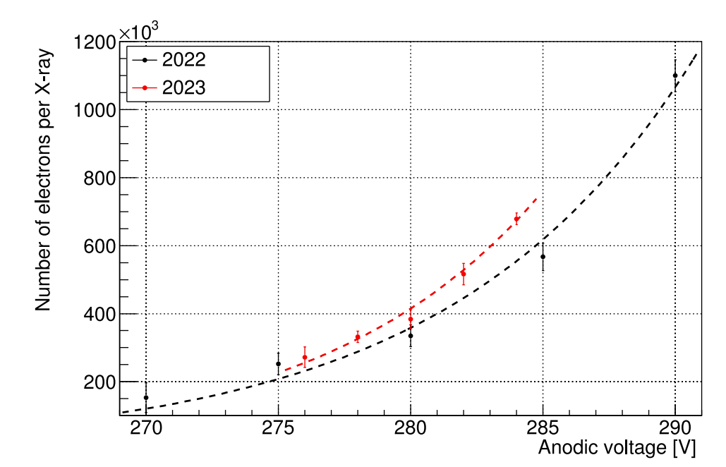


Representative Results
GAIN vs Pressure
Long term stability
Energy Resolution
Gas mixture changes
Parameters Explored: Gas type, pressure, drift/avalanche fields

Slide 30


Unexpected behaviuor
Gain Variation with Gas (Sealed Configuration)
Hydrogen main peak position at 75 mbar
A temperature-dependent gain variation was observed in SEALED DETECTOR — an effect not foreseen under NTP conditions.
The gain increase is likely due to avalanche feedback effects
The detector was operated without gas flow, as required for space qualification, allowing accurate tracking of intrinsic thermal dependencies.
This sensitivity could potentially be mitigated by increasing the amplification gap, offering a path toward temperature-resilient operation in sealed mode.
Notes:
Qui inserire il problema della definizione di «pressione assoluta» e di controllo dei sensori …. MISURE ASSOLUTE!!!

Slide 31

Accelerating Optimization via Simulation
New physical processes added to Garfield++

Slide 32

Accelerating Optimization via Simulation
MC vs LAB Data …. Now It WORKS!!!!

Slide 33
Ion Beam Testing
Ionization quenching factor measurements
Varying ion types, energies, gas pressure
He⁺
H₂⁺

Slide 34



Ion Beam Testing
Position and direction reconstruction
Custom mechanics arrangements
Analog preamplifiers + digitizer for a complete signal waveform analysis
Notes:
Slide sugli studi delle strip

Slide 35




Advancing Technology Readiness
Support Mechanics and Electronics
.
Define GAS Cell dimension and interfaces
Prove Sealing
Produce and test QM MICROMEGAS
First QM (Digitizer + picoammeter) with space qualified COTs
Notes:
Qui mettere immagine con i geantini

Slide 36




Advancing Technology Readiness
EDSIM Recent Updates
.
Include new geometries
Start studying acceptance
Insert data from the ULTRA-THIN material windows
Simulate Space Background
….
Notes:
Qui mettere immagine con i geantini

Slide 37
Potential Missions and Integration Scenarios
LEO, lunar orbiters, interplanetary probes

Slide 38
What We Learned About Designing for the Unknown
Design for flexibility: accommodate uncertainty in space environments
Go beyond the textbooks: test and validate where theory falls short
Broader relevance: approaches and tools extend to other low-energy detectors
Your questions are welcome!

Slide 39


MM for balloon
Temperature & pressure sensors
cathode
MESH charge amplifier
HV power supply from 5V
Il primo segnale!
MESH over the anode plane

