Slide 1
Micro Pattern Gaseous Detectors and their space applications
Lesson 1 — Experimental Physics Meets Space
Federico Pilo — INFN Sezione di Pisa
The XXXIII Bonaudi-Chiavassa International School on Particle Detectors
Cogne, 24 June 2025
Notes:
Title of the presentation
Subtitle: "Experimental Physics Meets Space — Technology and Constraints"
Your name, institution, date

Slide 2
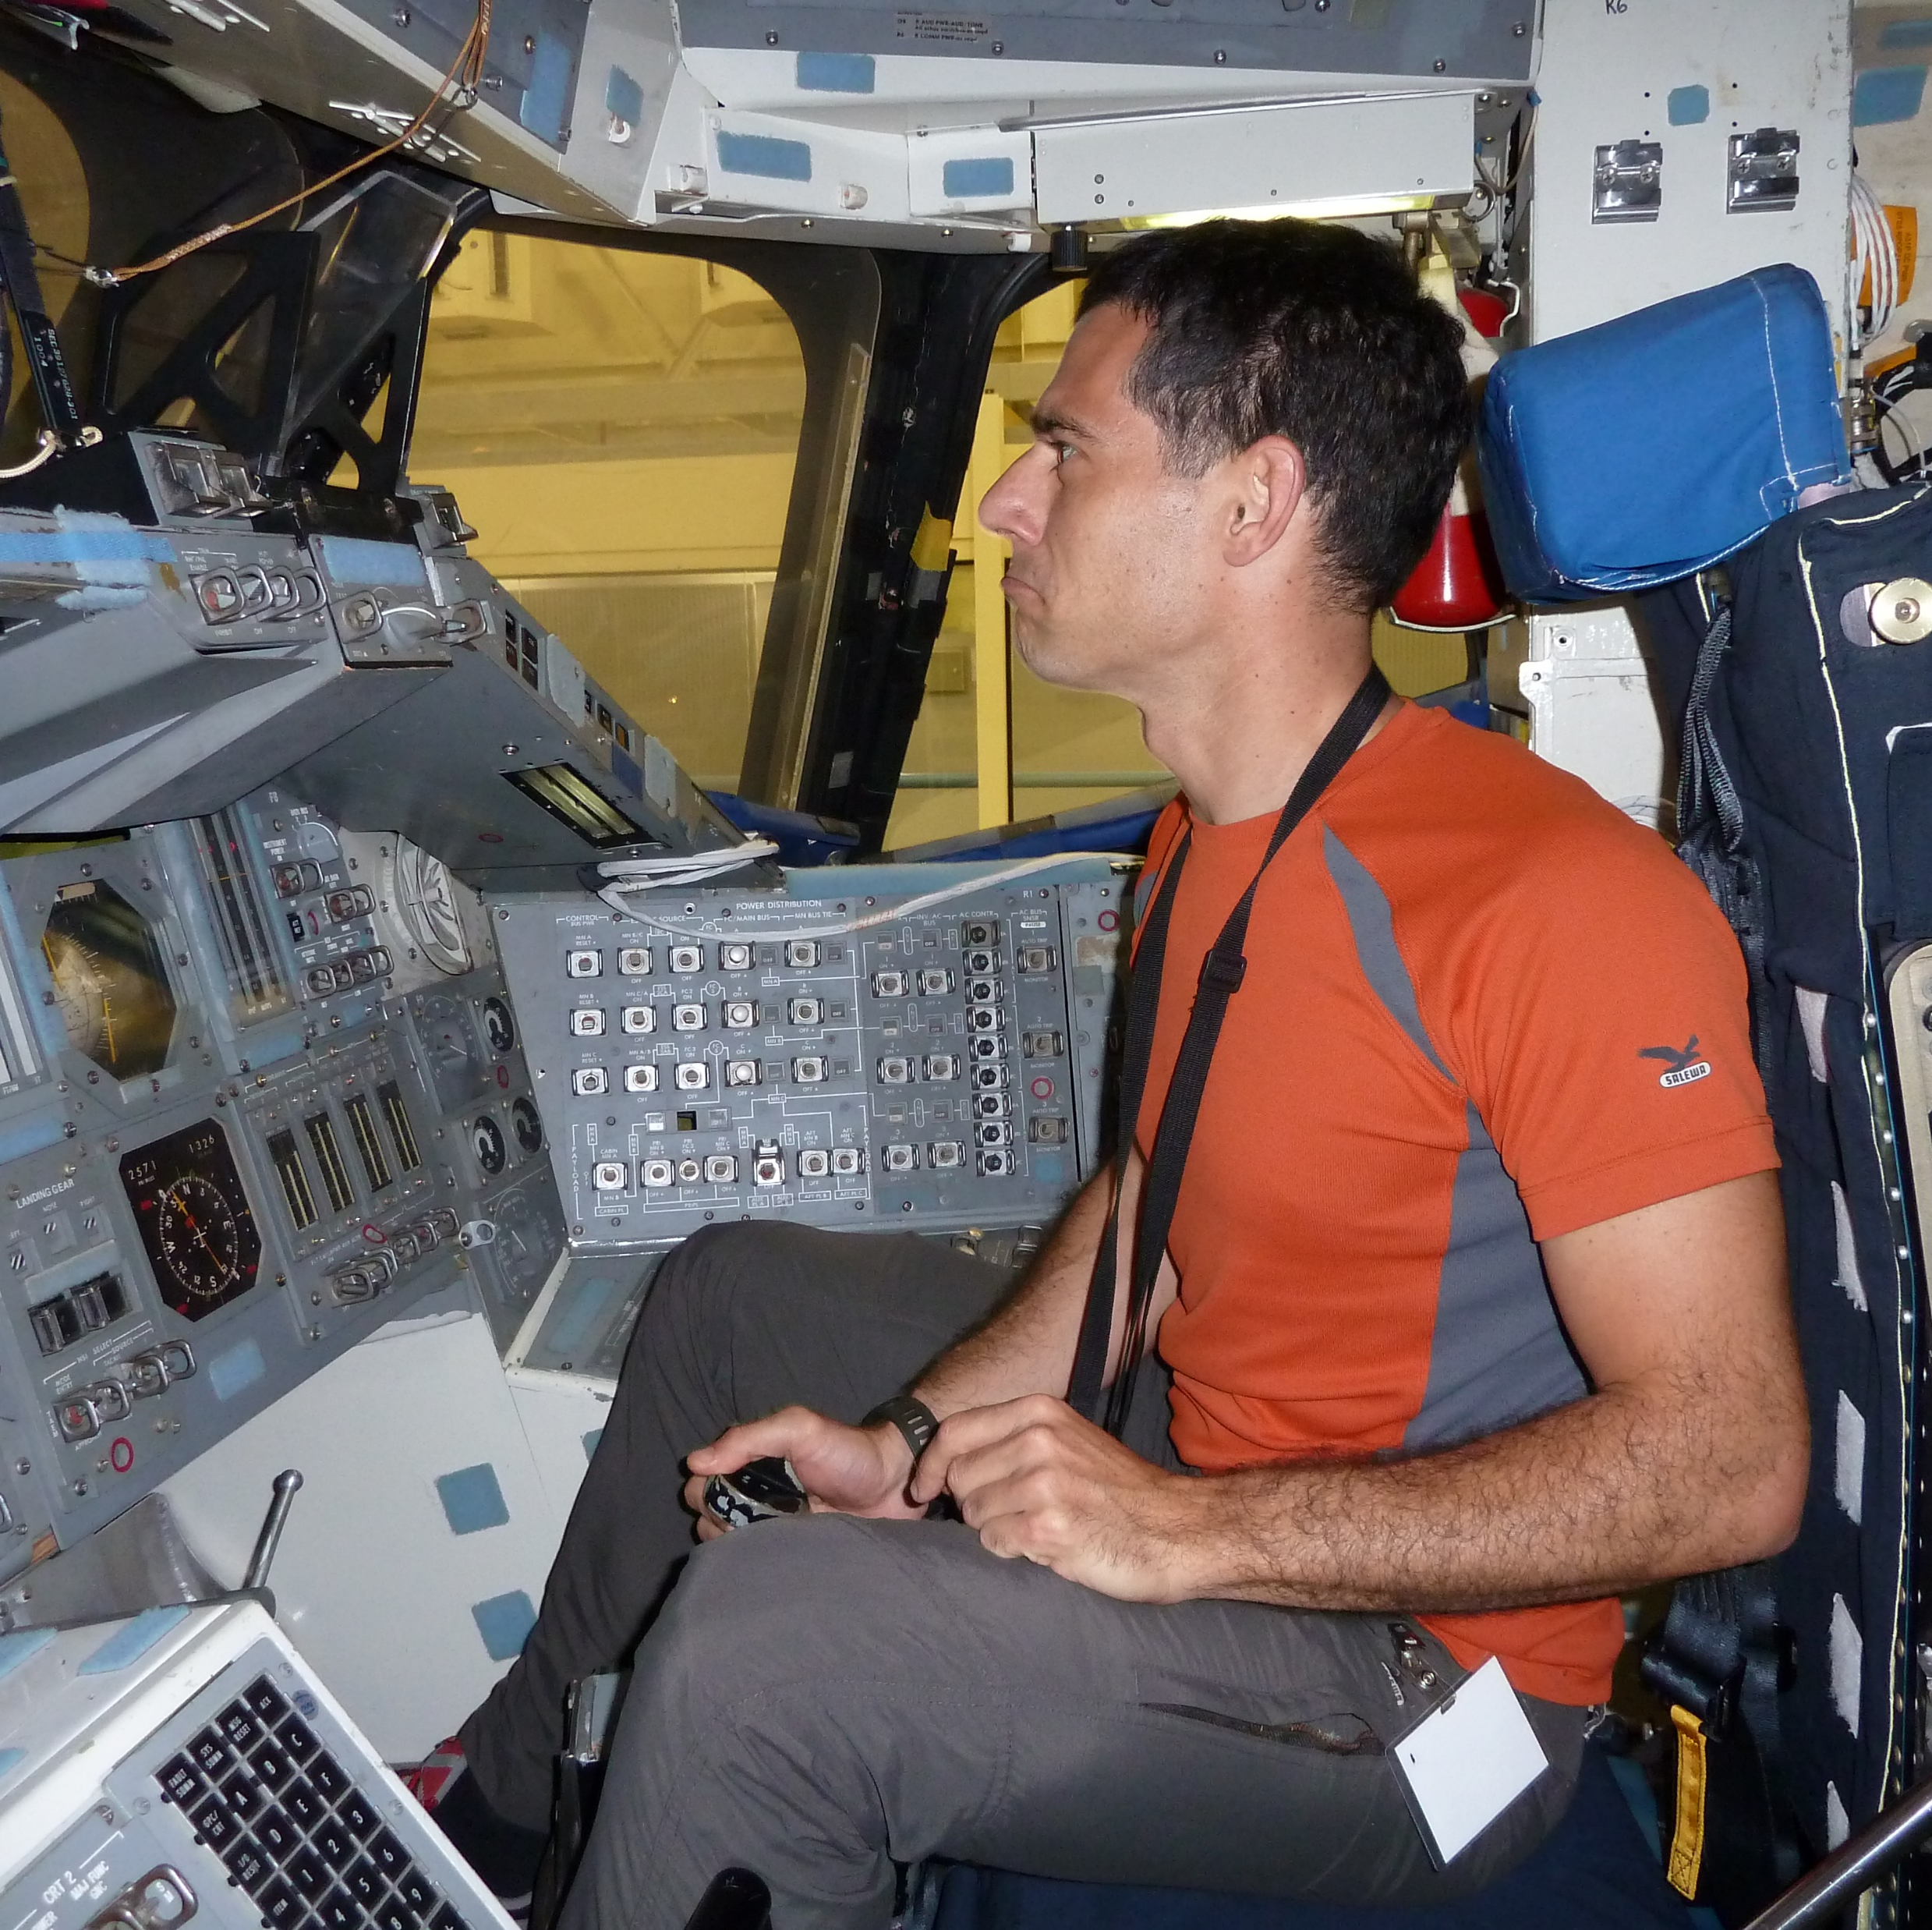

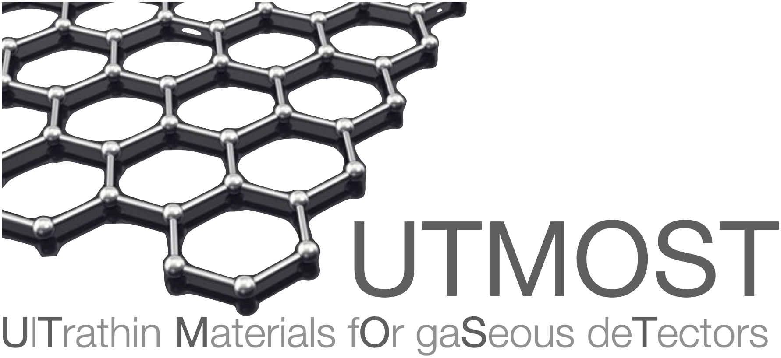







Federico Pilo
Researcher @ INFN Sezione di Pisa
Main research field: Development and construction of detectors for ionizing radiation, aimed at research in both the fields of astroparticle and cosmic ray physics, as well as planetary magnetospheres and, more generally, Space Weather.
AMS-02
EEE
Belle 2 / Dark Side
VIRGO/ET
SWEATERS
UTMOST
OCRA

Slide 3
Objectives of the session
Understand key differences between lab-based and space-based detector design
Learn fundamental principles and types of Micro Pattern Gaseous Detectors (MPGDs)
Analyze challenges and constraints in adapting MPGDs for space missions
Discover the invisible but essential work behind space qualification
Notes:
Understand the transition from lab to space instruments
Identify key experimental challenges (construction, testing, qualification)
Appreciate the unique constraints of designing for space

Slide 4
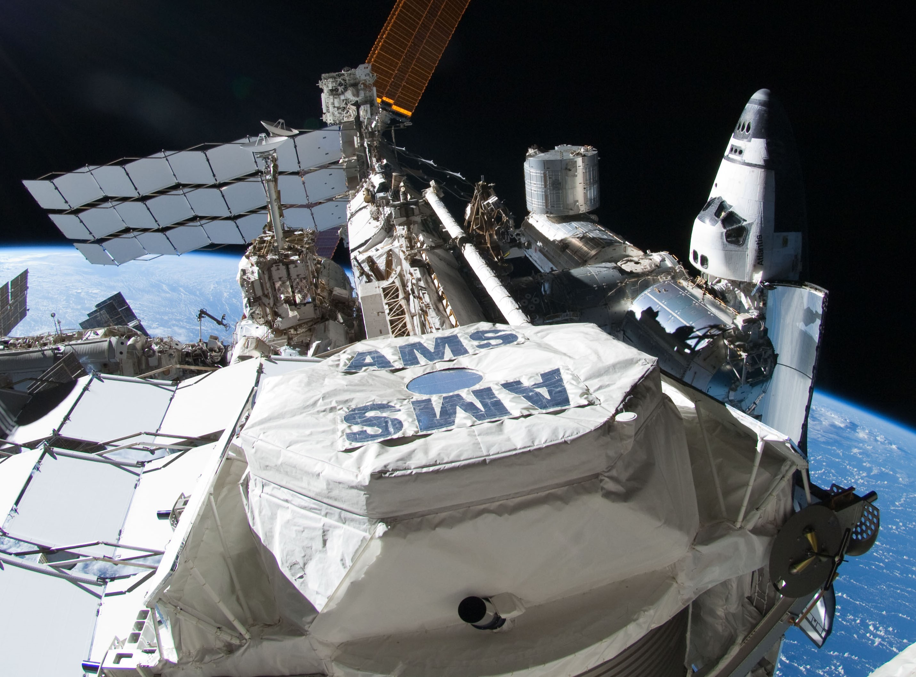




From Lab to Orbit
What Changes in Space-Based Design?
Strict constraints:
  Mass
  Volume
  Power
Must be autonomous and robust
Designed for zero maintenance
Requires redundancy for critical functions
Must survive launch, radiation, thermal cycles
If it breaks in orbit, it stays broken

Slide 5
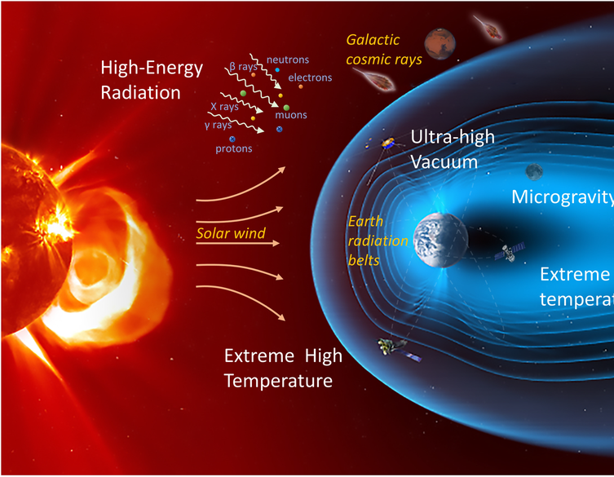
The Harsh Space Environment
What Makes Space Harsh?
Vacuum Conditions
No convection: heat transfer only via radiation
Outgassing and material degradation issues
Extreme Temperatures
Thermal cycling from −150 °C to +120 °C in LEO
Materials expand/contract → mechanical stress
Radiation Exposure
Cosmic rays, solar flares, trapped particles
Degrades electronics, causes bit flips, induces charging
Launch & Vibration Loads
Strong mechanical stress during ascent
Requires shock and vibration qualification
Microgravity
Fluid behavior changes
Affects mechanical supports, thermal flows
Atomic Oxygen (LEO-specific)
Corrodes surfaces
Particularly aggressive with polymers and thin films
Space is unforgiving. Every detail, from materials to layout to shielding, must be engineered with the environment in mind — because once it’s launched, there’s no second chance.
ESA/ATG medialab: https://sci.esa.int/web/smile/-/61516-cluster-and-xmm-newton-pave-the-way-for-smile
Notes:
Capire se mettere implications for detectors

Slide 6
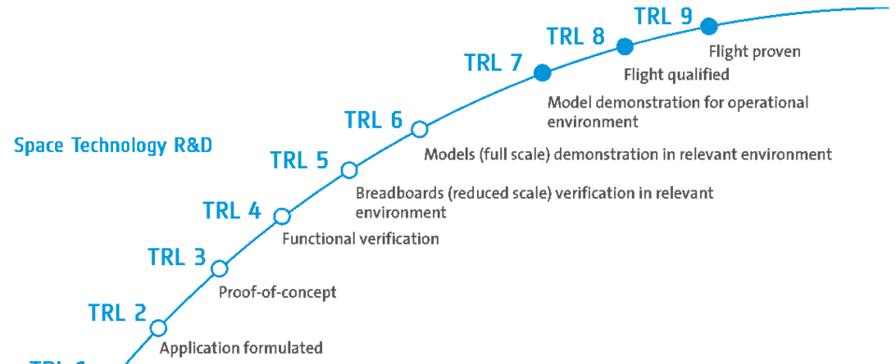
Technology Readiness Level (TRL)
When designing a scientific detector for space, you have to prove that it will survive and function reliably in the space environment
Space agencies (NASA, ESA, …) use the Technology Readiness Level (TRL) scale to structure development and reduce risk
Higher TRLs require not just proving performance but demonstrating it under the actual conditions of launch and space operation
Historically Space access was reserved for large missions with massive budgets, and testing even a small detector in orbit was practically impossible. But the landscape has changed.

Slide 7
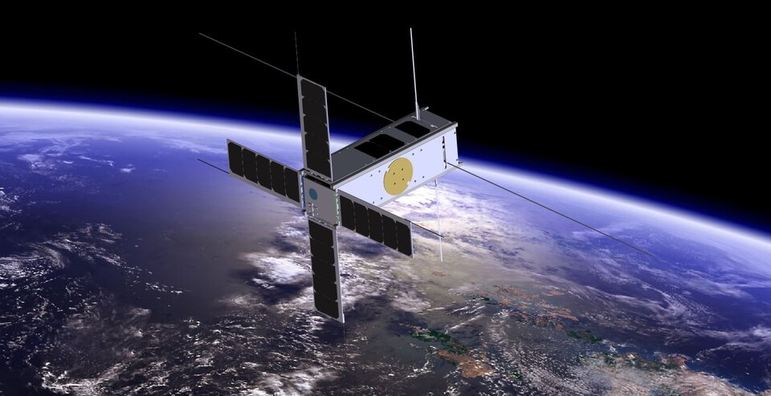
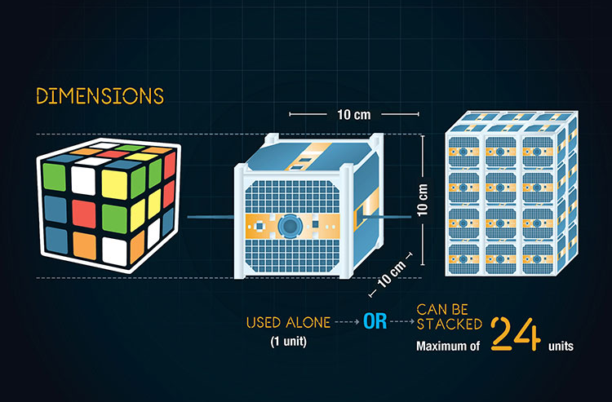
CUBESATS: a game changer
Today, CubeSats and nanosatellites offer a low-cost, fast-turnaround platforms for space qualification
Allow universities and research groups to bring early prototypes (TRL 4–6) into real space environments, shortening development cycles and validating critical technologies
From a “once-in-a-decade opportunity” to routine small-scale access!
CubeSats in a nutshell | Canadian Space Agency
Notes:
Mettere referenze nelle figure!

Slide 8
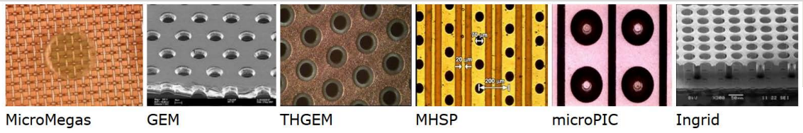
Introduction to MPGD
Definition: Micro-Pattern Gaseous Detectors (MPGDs)
Purpose: Detecting ionizing particles
Principle: Particle ionizes gas, creates electron-ion pairs
Advantages: high rate, resolution, radiation tolerance, low material budget
Micro Pattern Gas Detectors (MPGDs) are flexible and widespread devices. They play a crucial role in Energy Physics experiments, as well as for many other applications as medical, imaging, dosimetry. Large instrumented surfaces, high-rate capability, very good position resolution, radiation tolerance and low material budget are key features of MPGDs.
Different technologies and materials entering into this field are providing new possibilities for future detectors.

Slide 9
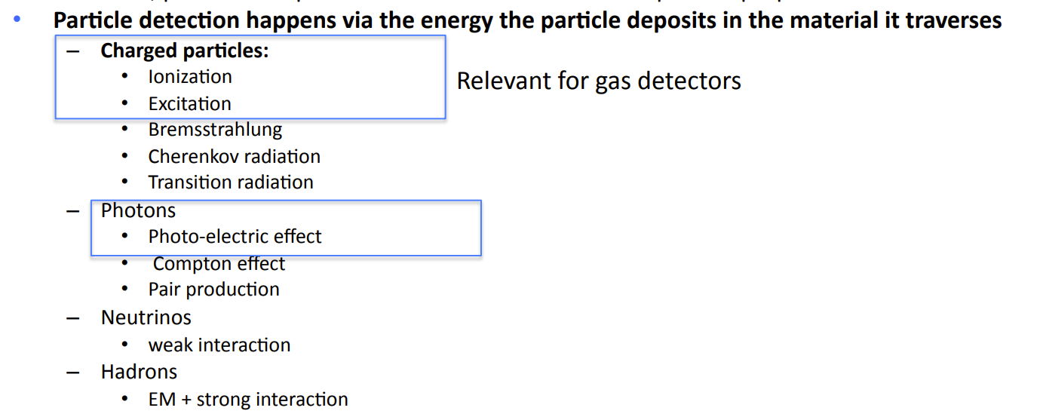
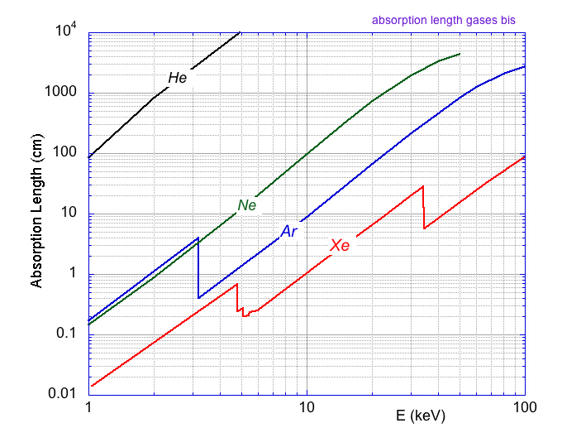
What are Gaseous Detectors?
Interaction and Ionization
Absorption Length in Gases at NTP
100 m
Photoelectric:
20 cm
E_{γ}
E_{γ} - E_{K,L,M..}
2 cm
The Binding energy depends strongly on target Z
^{e-}
3 mm
⁵⁵Fe 5.9 keV
Notes:
Integrare 8,9 e 10. Inserire 1 slide sulla parte di valanga

Slide 10
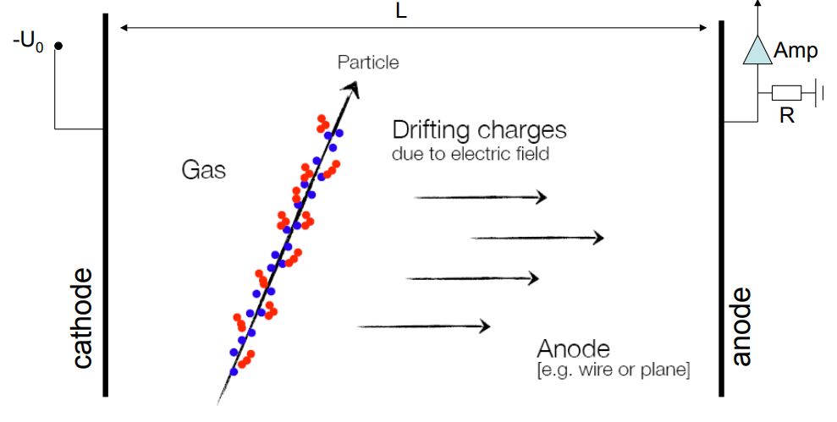
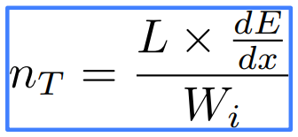
What are Gaseous Detectors?
Gas Ionization
100 m
Primary Ionization
Secondary Ionization (due to δ-rays)
W_{i} =Average energy to create e-ion pair (in Ar ≈26 eV)
n_{T} =Average number of e-ion pairs
Notes:
Integrare 8,9 e 10. Inserire 1 slide sulla parte di valanga

Slide 11
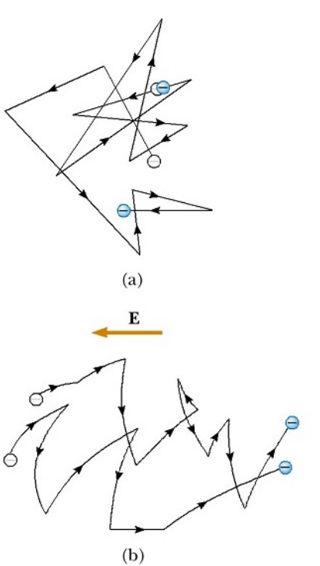
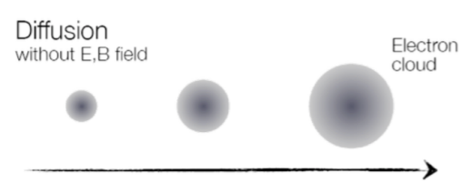
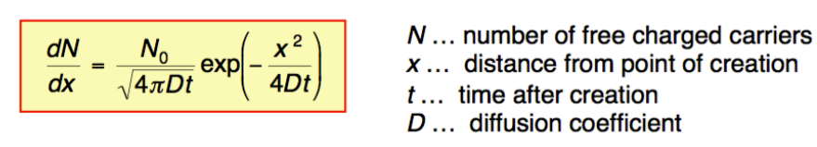
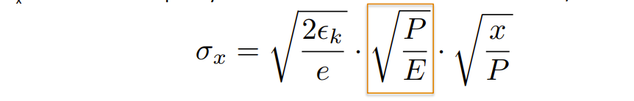
What are Gaseous Detectors?
Drift
The charger carrier distribution follow a gaussian distribution
When the electric field is applied, the e-ion pairs drifting along the electric field lines, is superimposed to the caothic thermal motion
Acceleration is interrupted by collision with gas atoms
This limits the drift velocity → mean drift velocity v_{D}!
D: Diffusion coefficient, depends on P and T
The width of the carrier distribution, σ_{x}, can be written explicitly as a function of the reduced electric field E/P
ε_{k} : characteristic energy, contain the T dependence
Notes:
Integrare 8,9 e 10. Inserire 1 slide sulla parte di valanga

Slide 12
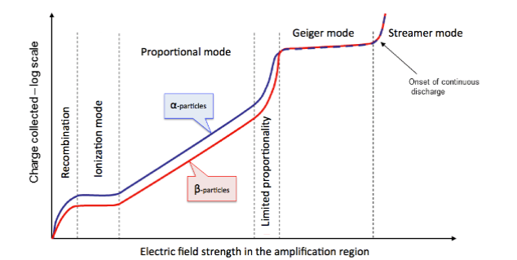
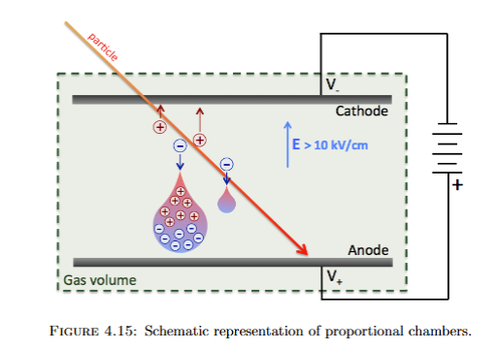
What are Gaseous Detectors?
Gas Multiplication
Schematic rapresentation of proportional chambers
In a uniform E-Field the number of electrons produced by N electrons traversing an interval 𝑑𝑥 is:
Townsend coefficient (α = 1/λ_{ion}) probability per unit length that an electron creates an additional electron
- α depends on the gas density!
Since the ionization cross section depends on the electron energy, in a NON uniform E-Field, α = α(x) depends on position in the detector:
Notes:
Integrare 8,9 e 10. Inserire 1 slide sulla parte di valanga

Slide 13

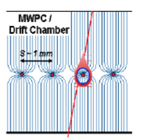
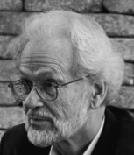
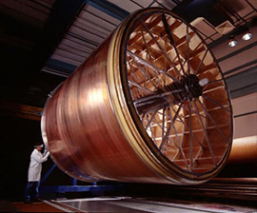
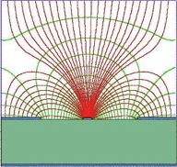
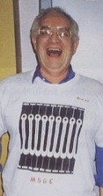
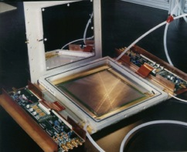

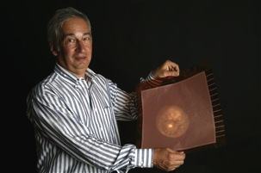
Birth of MPGD’s
MWPC
Multi-Wire Proportional Chamber
G. Charpak et al., 1968
TPC
Time Projection Chamber
D. R. Nygren et al., 1974
In the 90’s advances in microelectronics and photolithographic technology on flexible and standard PCB substrates favored the invention
First Micro Pattern Gaseous Detector (MPGD): Micro-strip Gas Counter (MSGC) Oed, 1988
Pitch size of a few hundred microns, an order of magnitude improvement in granularity over wire chambers (1 mm scale)
MSGC
Micro-Strip Gas Chamber
A. Oed, 1988
ANODE
CATHODE
200 µm
GEM
Gas Electron Multiplier
F. Sauli, 1997
MICROMEGAS
MICRO-MEsh GAseous Structure
I. Giomataris et al., 1996

Slide 14
Key Advantages of MPGDs
Granularity: Detailed and high-resolution detection
Excellent Time and Position Resolution: Precise detection
Stability and Radiation Hardness: Robust and reliable in high radiation environments
High Count Rate Capability: Suitable for high-energy physics experiments
Notes:
Mettere qualche ordine di grandezza e dei grafici!!

Slide 15
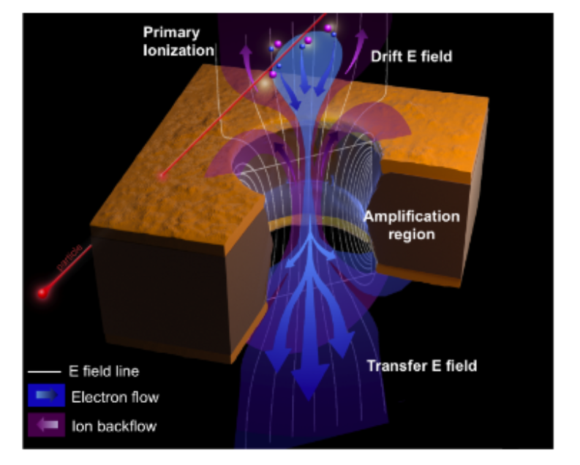
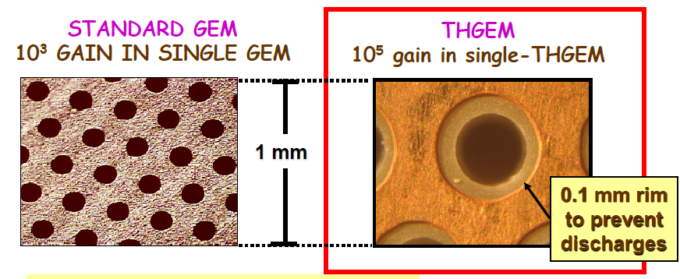
Types of MPGDs
GEM’s and THGEM’s
GEM
How it works:
A thin (50 um), metal-clad polymer foil chemically perforated by a high density of holes, typically 100/mm²
Large ΔV between the two sides of the foil creates a high field
Electrons released in the upper region, drift towards the holes acquiring enough energy to provoke ionizations
Large fraction of electrons are transferred into the lower section
Key advantages:
Full decoupling of amplification stage (GEM) and readout stage (PCB, anode)
Amplification and readout structures can be optimized independently
THGEM
L. Periale et al., NIM A478 (2002) 377.
High gas gain ~10⁵ (>10⁶) @ single (double) THGEM
Few-ns RMS time resolution
Sub-mm position resolution
MHz/mm2 rate capability
Cryogenic operation: OK
Gas: molecular and noble gases
Pressure: 1mbar - few bar

Slide 16
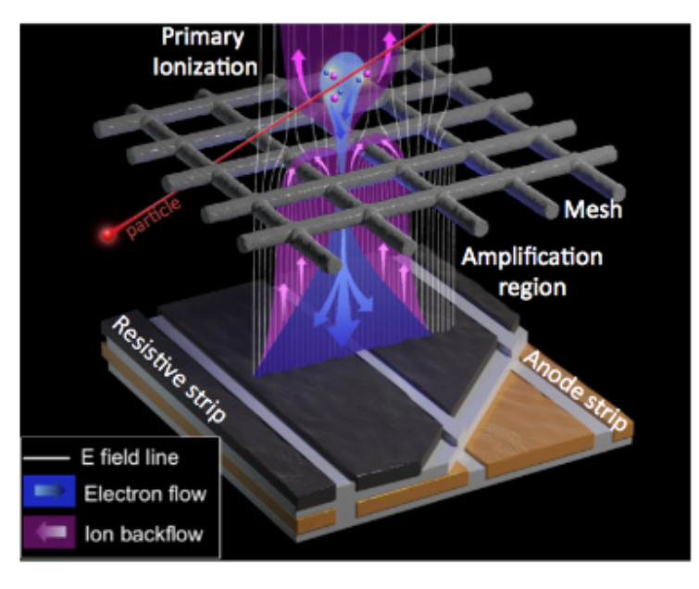
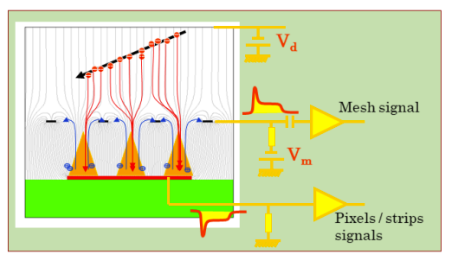
Types of MPGDs
MICROMEGAS
Multiplication takes place in high E field (~ 40 kV/cm) between the anode and the mesh
  High gain (up to 10⁵ or more)
  Single stage of amplification
  Fast signals (< 1 ns)
  Fast & natural ion collection
  Low ion backflow to the drift region
  Short recovery time (~150 ns) → High-rate capability (>MHz)
Signal is induced by both electron & ion movement towards the anode / micromesh
  Thin amplification gap (50-150 µm) → Small imperfections → no gain variations
Notes:
Controllare spessori delle GEM. Bilanciare meglio in modo che si capisca il comparison: mettere concetti e poi figure di merito

Slide 17
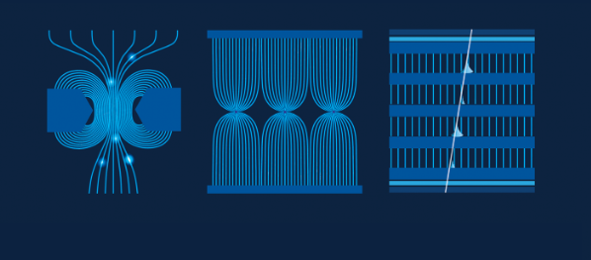
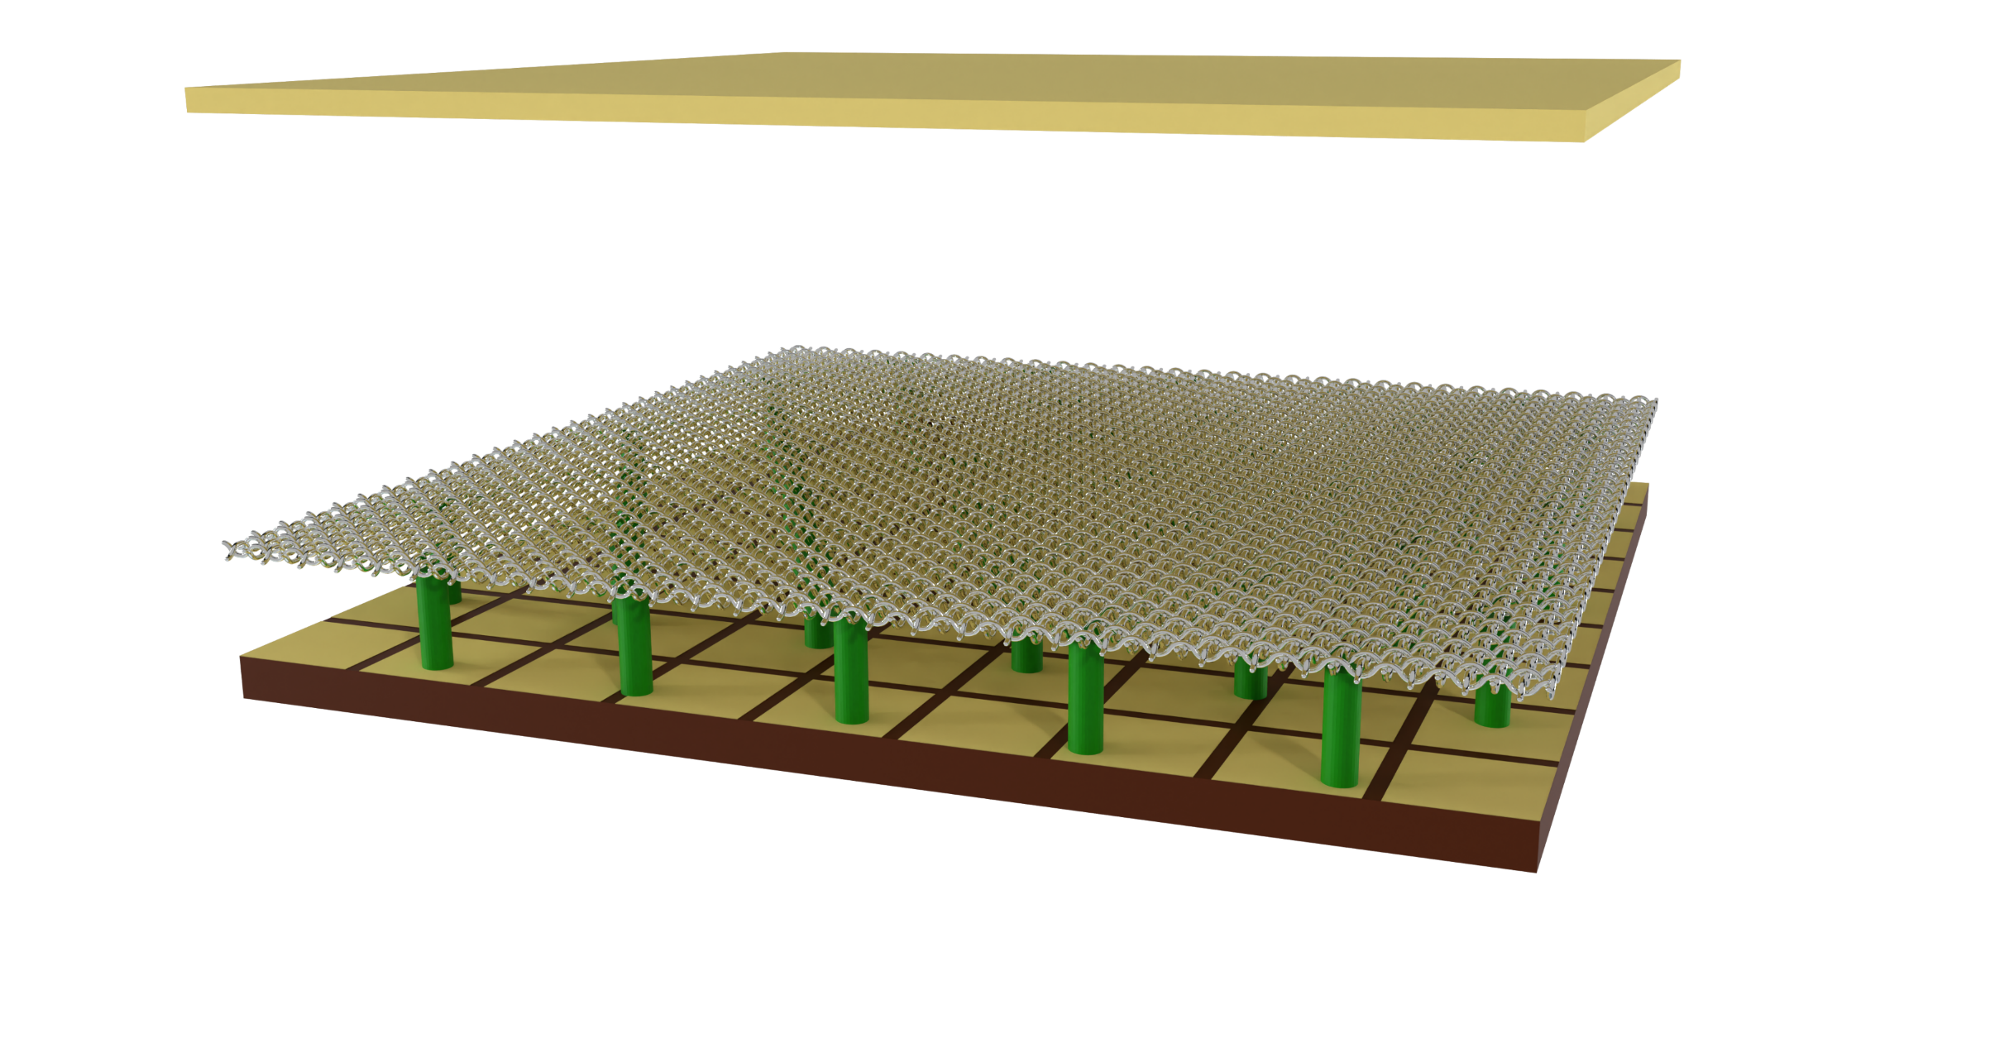
Micromegas
A. Cools PhD animation
Incident particle
Cathode
+
-
~ mm
Mesh
Anode
~ 100 µm
Pillars
Readout pads

Slide 18
Micromegas
A. Cools PhD animation
Incident particle
+
-
E
E ≈ 70 V/cm

Slide 19
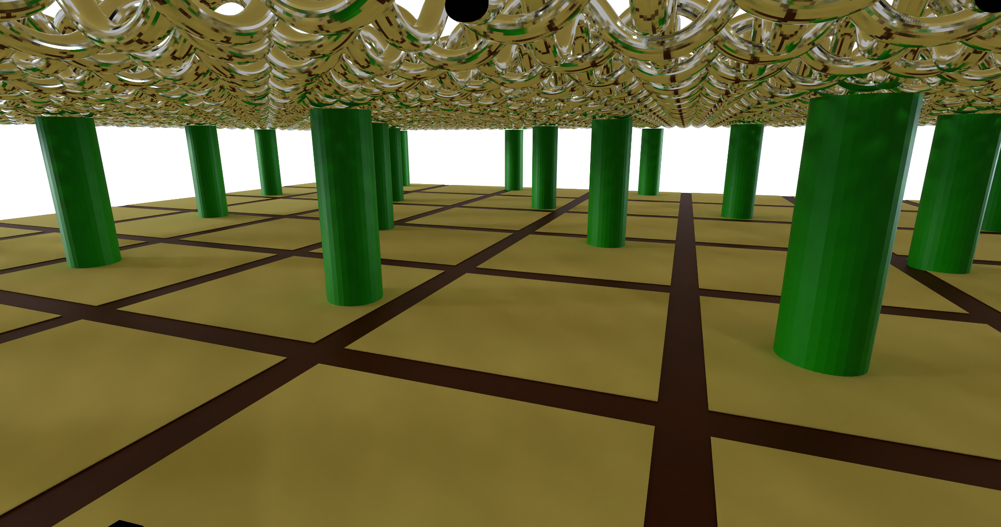
Micromegas
A. Cools PhD animation
e⁻
E ≈ 50 kV/cm
Electronics

Slide 20
Key Technological Evolutions in MICROMEGAS since 1996
🟦 Bulk Micromegas Technology (2006)
Introduced industrial-scale lamination of the mesh onto the anode PCB using photolithography and chemical etching
Impact: Improved robustness, mechanical stability, and large-area uniformity; enabled mass production
🟩 Resistive Micromegas
Integration of a resistive layer above the readout strips to suppress and quench discharges (sparks).
Impact: Enhanced spark tolerance, improved detector longevity and reliability — especially in high-rate environments
🟧 Microbulk Micromegas
Uses double-clad Kapton foils chemically etched to create mesh and amplification gap with extreme precision
Impact: Superior energy resolution, low background, and radiopurity; ideal for rare event searches (e.g., dark matter, axions, double-beta decay)
🔶 Floating Micromegas (ATLAS NSW Technology)
Mesh is not rigidly fixed but "floats" above a resistive anode, held electrostatically and by sparse pillars.
Impact: Enhanced spark protection, mechanical simplicity, and large-area modularity (used in ATLAS NSW upgrade, covering ~1280 m²)
🟥 Sub-mm and Tailored Amplification Gaps
Development of custom amplification gaps (down to 25–50 μm) using precision spacers or etching techniques
Impact: Tuned gain, reduced ion backflow, optimized performance for different particle types and energies
🟪 Large-Area and Modular Designs
Tiling techniques and robust mechanical assembly enabled large detection surfaces (up to ~2 m² per module)
Impact: Scalability for large experiments (e.g., T2K, COMPASS, ATLAS NSW)
🟫 Low-Pressure and Space-Ready Versions
Detectors optimized for operation in low-pressure gases (e.g., for space applications, ENA detection)
Impact: Enabled use in space- and balloon-borne instruments with minimal window stress and low mass
🟨 High-Precision Trackers
Micromegas with fine readout granularity (~100 µm pitch) and excellent spatial resolution (<50 µm)
Impact: Used in precision tracking and TPCs, often coupled with pixel ASICs (e.g., InGrid)
🔵 Integration with CMOS and Pixel Chips (InGrid)
Mesh is integrated directly over CMOS pixel chips (e.g., Timepix)
Impact: Ultra-fine imaging with 3D tracking and per-voxel energy deposition — ideal for rare event detection and vertexing
🟣 Radiopure and Ultra-Low Background Versions
Materials and assembly techniques optimized for ultra-low intrinsic radioactivity
Impact: Crucial for underground experiments (e.g., CAST, TREX-DM, PandaX-III)
Notes:
Capire meglio cosa mettere e cosa lasciare

Slide 21
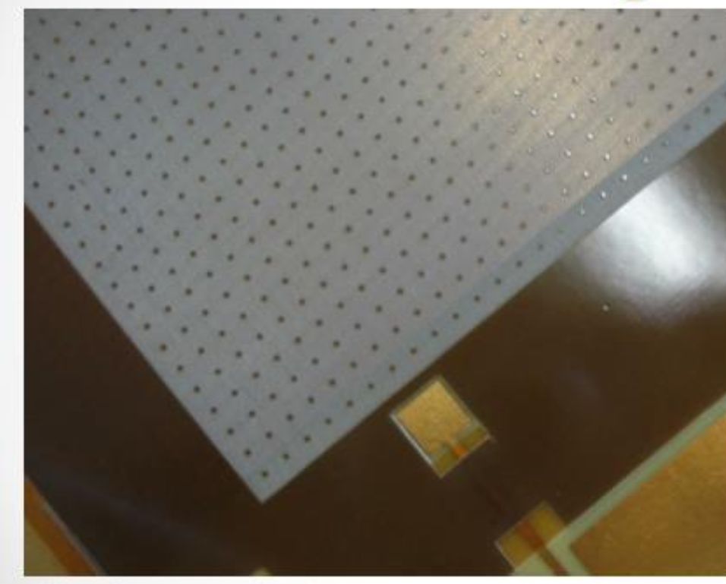
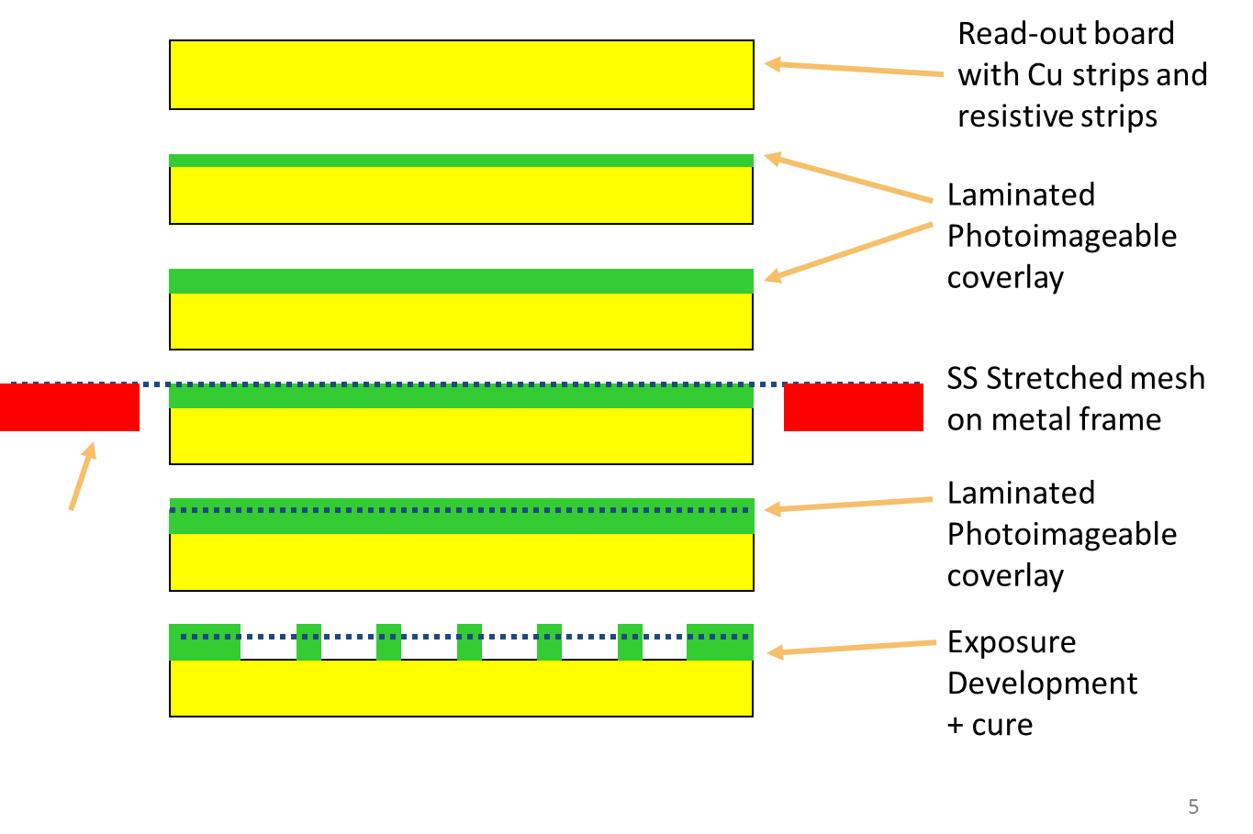
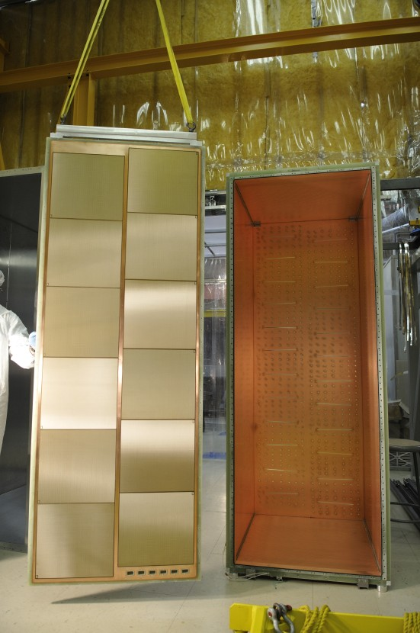
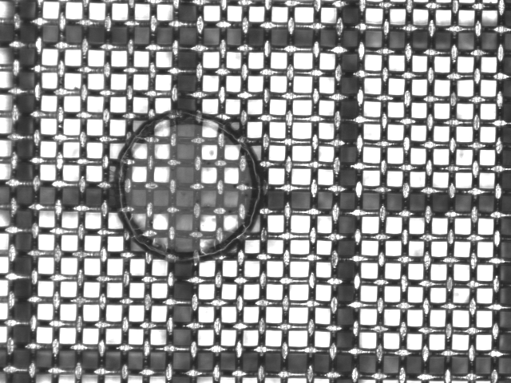
MPGD Technological Advancements
BULK MICROMEGAS
Integrated Design: Micromesh and readout plane laminated together using photolithography
Micromesh suspended above the readout anode by insulating pillars defining a uniform amplification gap
Typical Gap:50–150 μm
High Gain, Low Noise:Excellent signal-to-noise ratio even for single-particle or low-energy detection
All materials selected for:
  Vacuum and radiation compatibility
  Thermal stability
  Long-term mechanical integrity
Industrially reproducible
Microscopic view of the pillars integrated in the micromesh structure
T2K TPC , 1.8m x 0.8m plane
With 12 detectors
Notes:
Mettere la referenza e scrivere quanto necessario per T2K

Slide 22
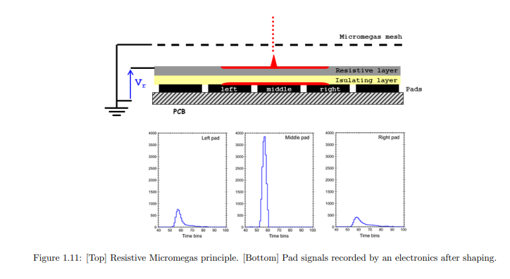
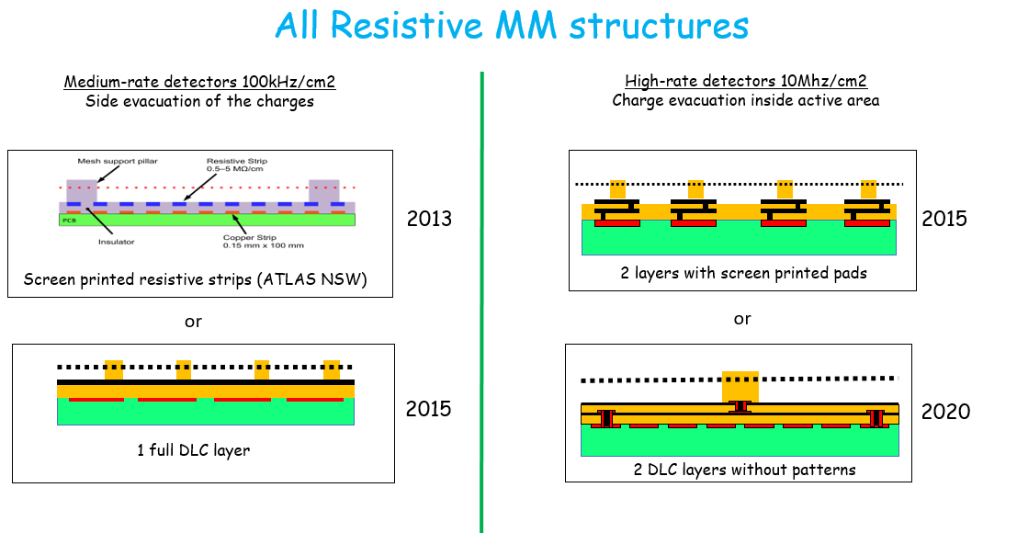
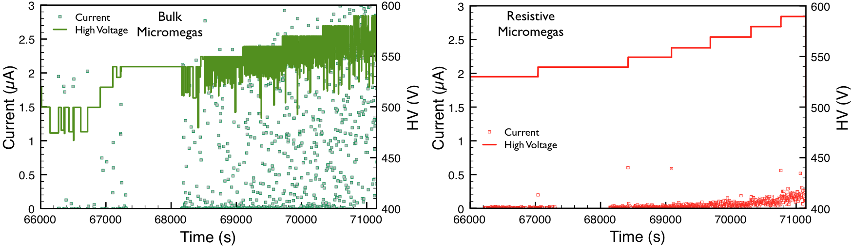
MPGD Technological Advancements
Resistive MICROMEGAS
A. Bellerive et al., eConf C050318 (2005) 0829
A resistive Micromegas incorporates a thin resistive layer between the amplification gap (mesh) and the readout strips
During a spark or discharge in the amplification gap, the resistive layer limits the current flowing to the readout electronics.
Benefits
Spark Protection: Drastically reduces energy released in sparks.
Improved Longevity: More robust under high radiation or intense particle flux.
Stable Performance: No dead time or degradation due to discharges.
Charge dispersion
Adopted in Major Experiments: Used in the ATLAS New Small Wheel (NSW) upgrade at the LHC.
David Attié, HDR, October 2022
David Attié, HDR, October 2022
M. Alviggi et al., e-print:2411.1702
Monitored HV (continuous line) and current (points) as a function of HV mesh under neutron irradiation, left a non-resistive micromegas; right a micromegas with resistive-strip protection layer (The Micromegas Project for the ATLAS Upgrade - Iakovidis, G. - arXiv:1310.0734)
Notes:
Mettere la referenza e scrivere quanto necessario per T2K

Slide 23
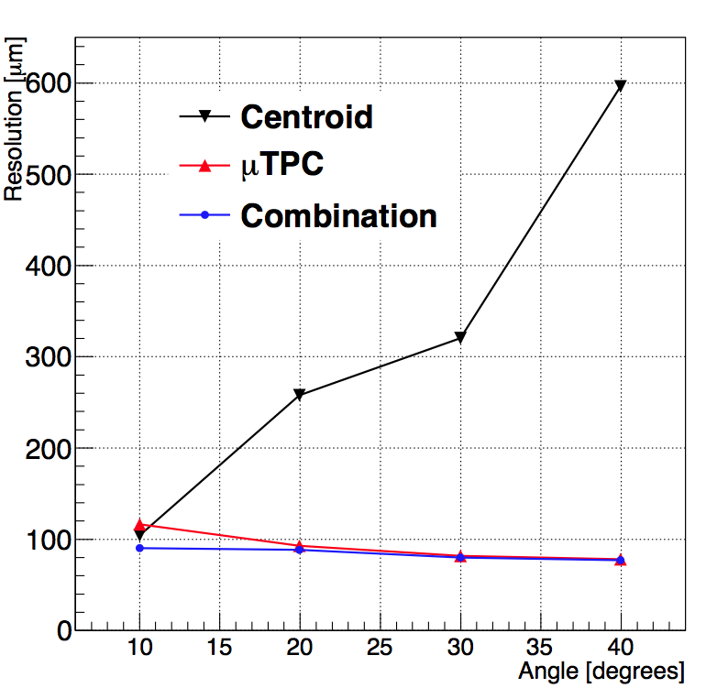
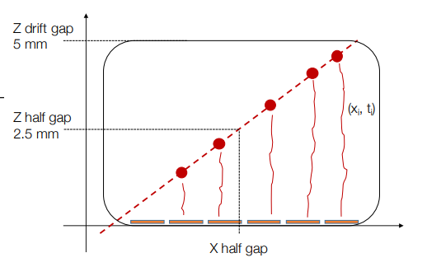
MPGD Technological Advancements
Micro TPC
JINST 10 (2015) C02026.
The time information of the hits can be used (together with the drift velocity) to identify the track path inside the gap
The MPGD chamber is used as a small TPC (i.e. micro -TPC).
At large incident angle or with strong magnetic field, the time measurement is way more precise than the charge centroid.
The spatial resolution versus the incident track angle with different reconstruction techniques.
The frontend electronics that can readout both the charge and time
Notes:
Mettere la referenza per l’esempio di sinistra

Slide 24
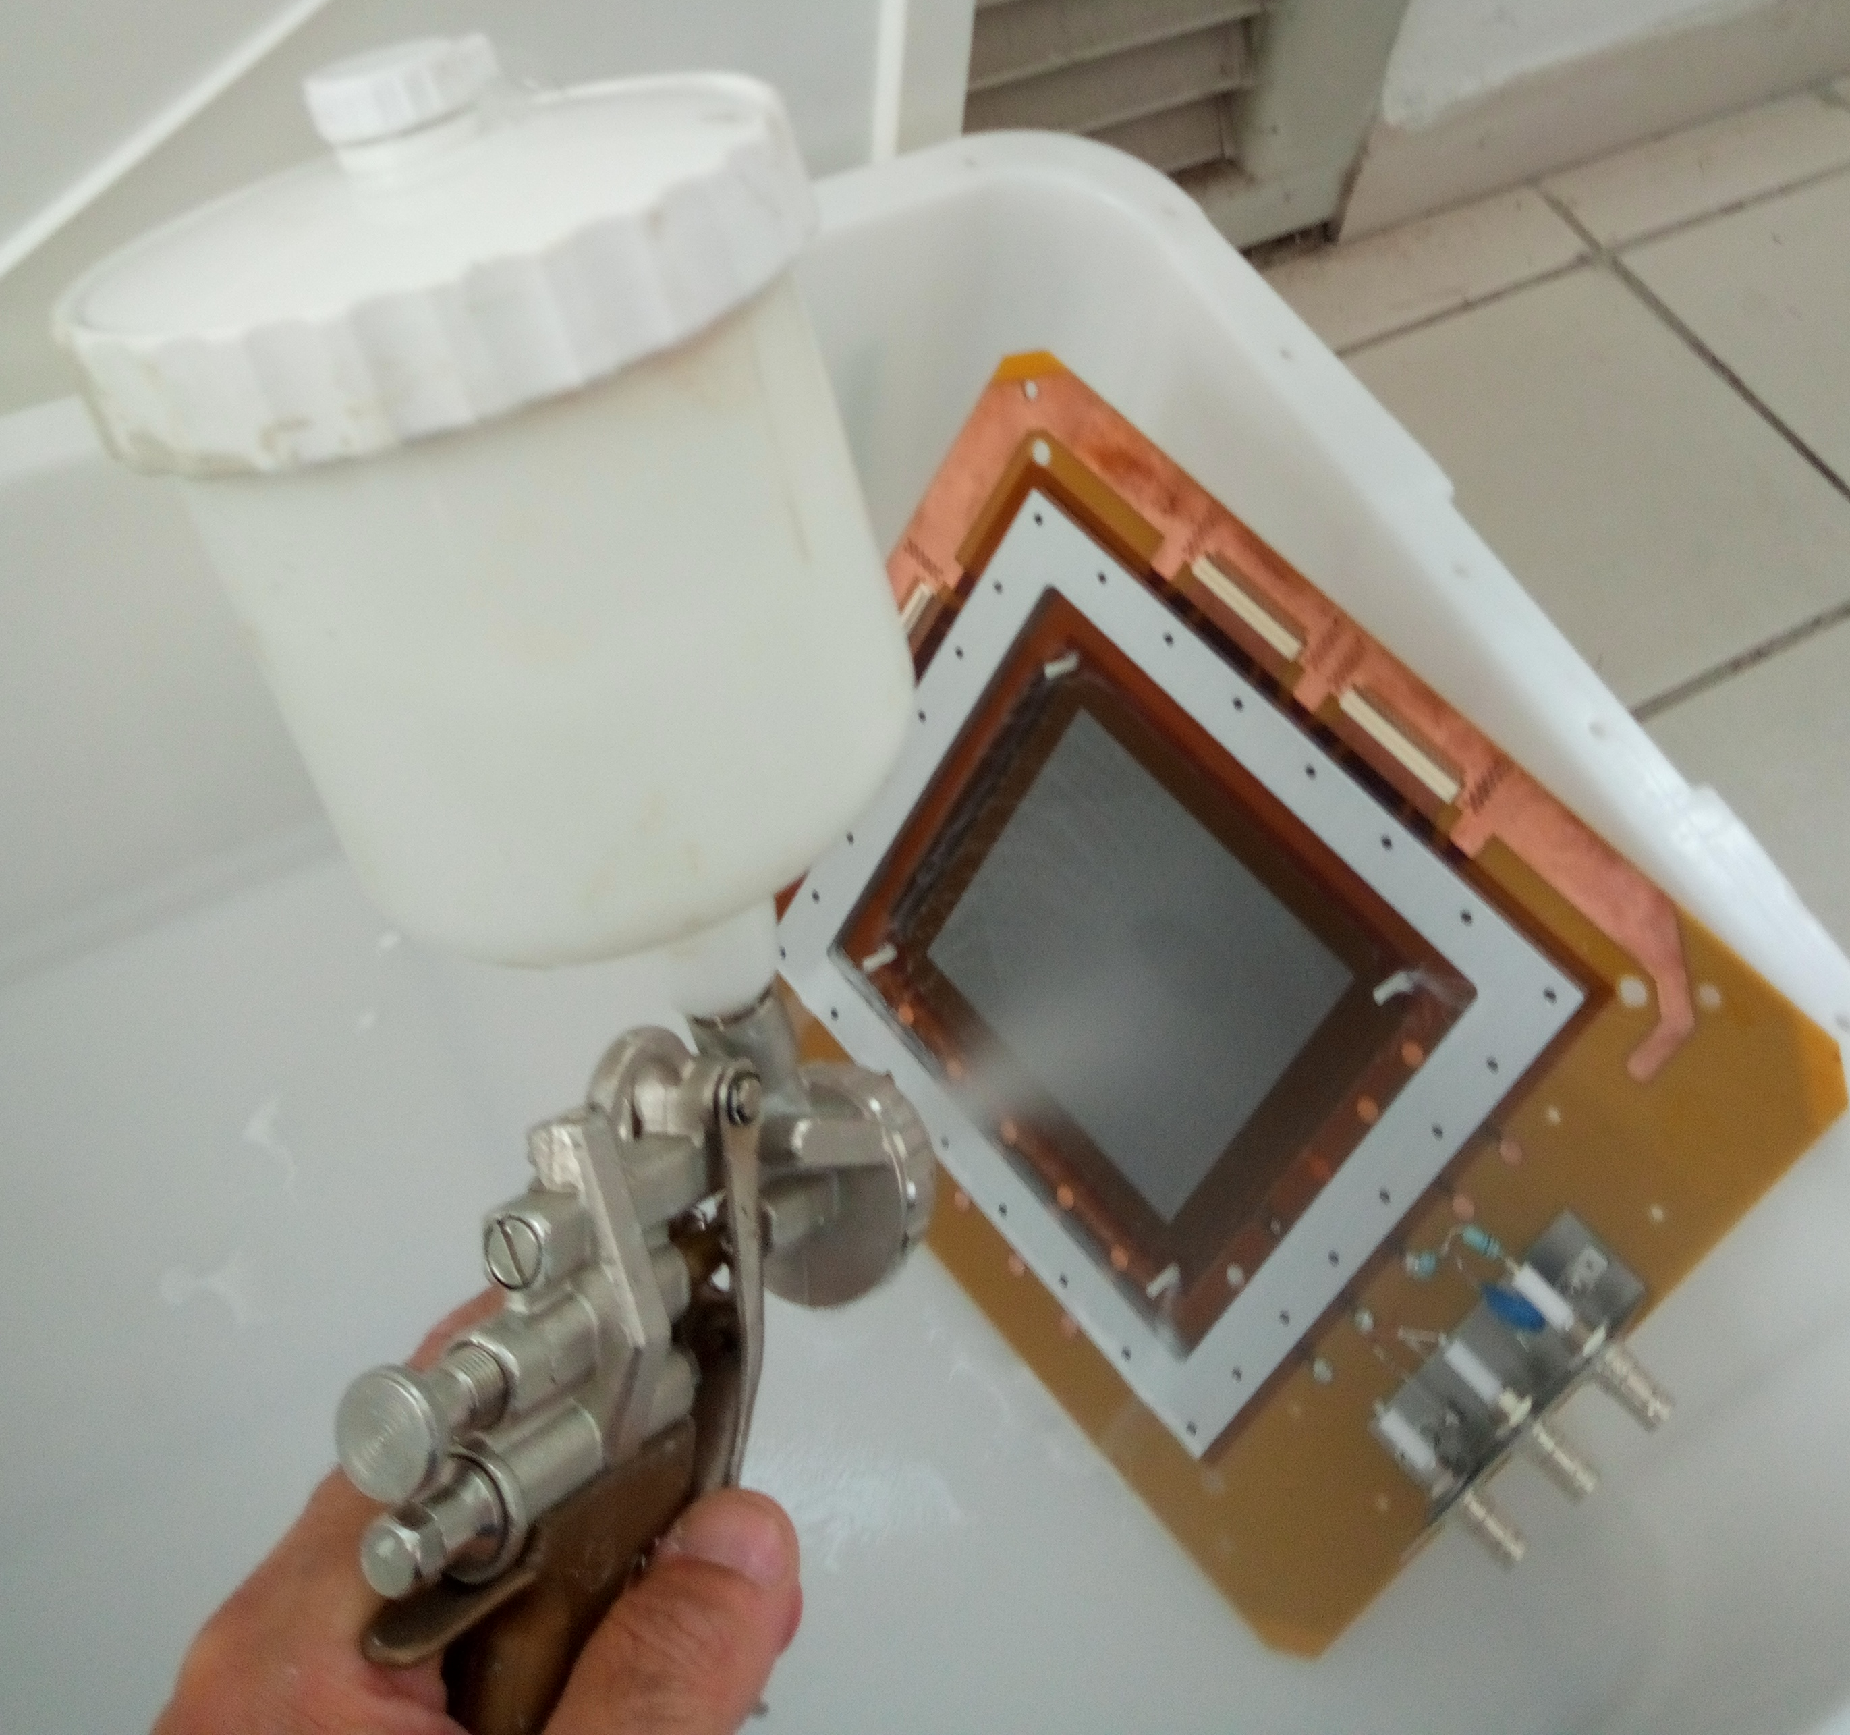
Challenges in MPGD Technologies: Already Complex on Earth
1. Spark Mitigation & Discharge Control
High-gain operation prone to discharges
Requires resistive layers and current-limiting designs
2. Radiation Hardness & Aging
Long-term stability under high radiation
Sensitive to gas impurities → needs clean operation
3. Large-Area Scalability
Uniformity in gain and geometry over big surfaces
Demands industrial-grade reproducibility
4. High-Rate Capability & Ion Backflow
Space charge effects and gain degradation
Needs field shaping & mesh optimization
5. Electronics Integration
Requires compact, fast, low-noise readout systems
Cooling and access are design constraints
6. 3D Tracking & Time Resolution
Micro-TPC mode needs precise timing and drift control → Fast electronics and calibration
7. Mechanical Precision & Assembly
Multi-layer assembly with micron tolerances
Especially relevant for curved or modular setups
8. Cost & Production Efficiency
Fine structures are expensive to produce at scale
Push for modularity and standardized components
9. Cross-Experiment Standardization
Lack of unified specs limits interoperability
Modular, flexible designs are a priority

Slide 25
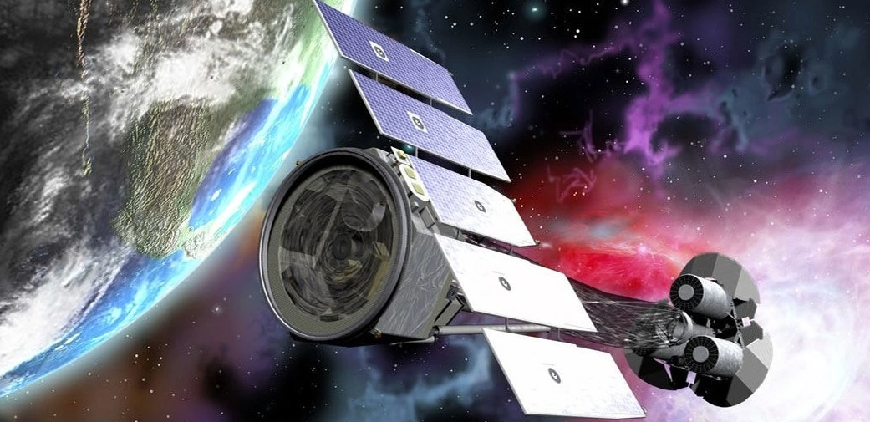
Why MPGDs for Space?
IXPE (Imaging X-ray Polarimetry Explorer)
Excellent for Very-Low Energy Particles
The low-density gas medium makes MPGDs ideal for detecting low-energy particles (keV range) that would be absorbed in denser materials like scintillators or semiconductors
Low Mass, Large Acceptance
Lightweight structure enables large sensitive areas with minimal impact on payload mass — crucial for space missions
Good Energy and Spatial Resolution
Suitable for applications like ENA imaging, X-ray polarimetry, and charged-particle tracking
Radiation Hardness
Inherently resistant to radiation damage, ensuring stable performance in high-radiation environments such as LEO or deep space
Flexible Geometry and Scalability
MPGDs can be customized in shape, size, and layout — ideal for constrained or unusual instrument designs
Lower Development and Production Costs
Compared to solid-state alternatives, MPGDs offer cost-effective solutions without compromising on performance
http://ixpe.iaps.inaf.it/index.html

Slide 26
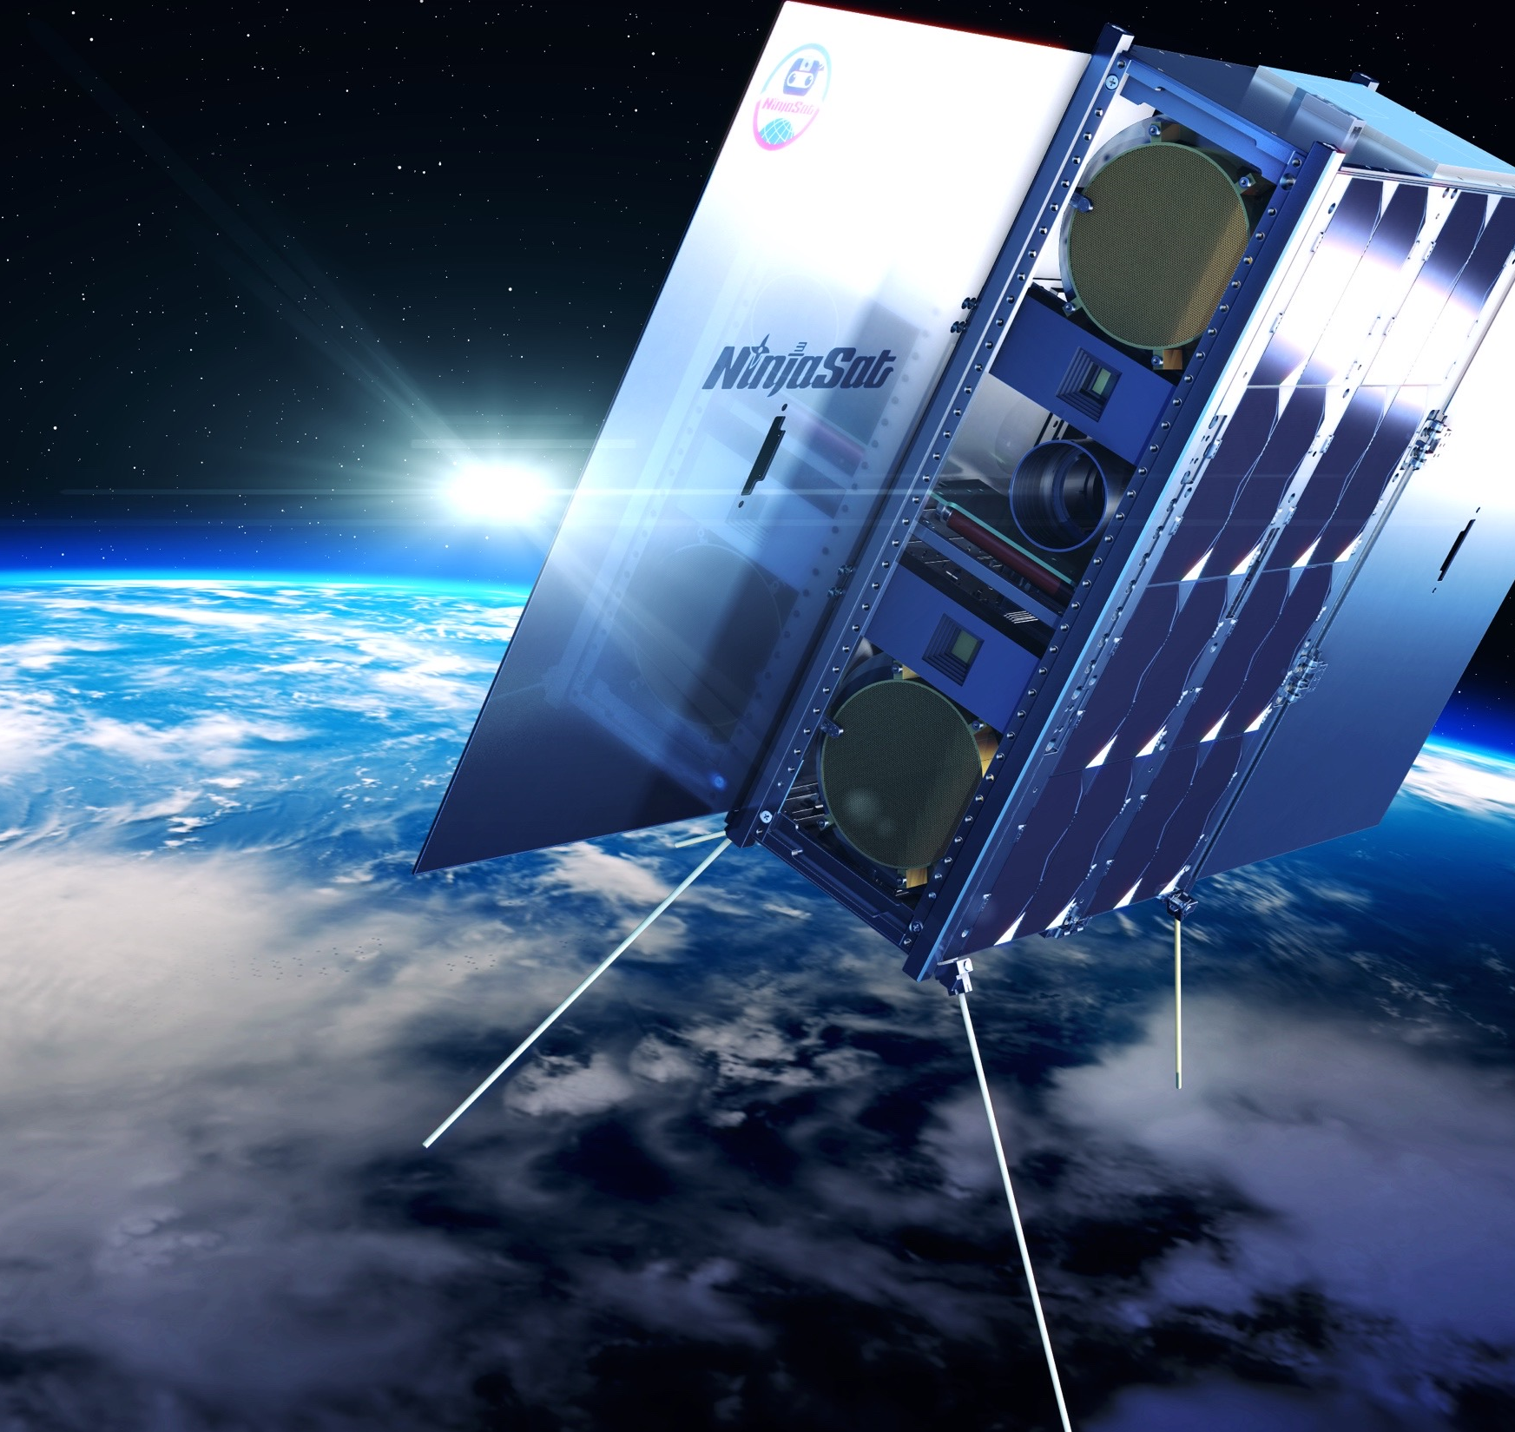
MPGD in Space: What's Really Different?
Gas leaks from a pressurized detector into the surrounding vacuum: even tiny leaks are fatal over time
Material selection: low-outgassing polymers and glues
Charging-up in vacuum/microgravity
Radiation: SEU and TID effects on front-end electronics
https://cosmic.riken.jp/ninjasat/

Slide 27
Gas sealing: maintaining purity over years
What makes sealing in space uniquely difficult?
The vacuum of space creates a huge pressure differential. Inside a spacecraft or system, pressures can be at normal atmospheric levels or even higher, while outside it’s near perfect vacuum. This difference stresses seals intensely.
Extreme temperatures—from hundreds of degrees below zero to intense heat—can cause materials to contract or expand, risking seal integrity. Materials that work well on Earth may become brittle or deform in space.
The space environment is filled with radiation and micrometeoroids, which can degrade sealing materials over time.
Some systems operate at cryogenic temperatures, such as those handling liquid hydrogen or oxygen, where seals must function reliably without leaks despite extreme cold.
Notes:
Mettere una figurina su CTE o modelli termici

Slide 28
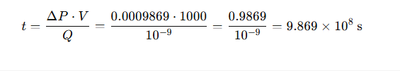
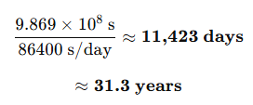
Gas sealing: maintaining purity over years
Leak rate
Leak rate is the measure of how much gas escapes (or enters) a sealed system over time due to imperfections in seals, welds, joints, or materials. Leak rate is influenced by the physical properties of the gas — especially its molecular mass and viscosity
Standard Unit (SI-based): Pa·m³/s (or atm·cc/s or mbar·l/s)
Given:
  Leak rate: Q = 10⁻⁹ atm·cc/s
  Pressure change: ΔP= 1 mbar = 0.001 bar = 0.0009869 atm
  Volume: V = 1 liter = 1000 cc
Using the formula:
Convert to days/years:

Slide 29
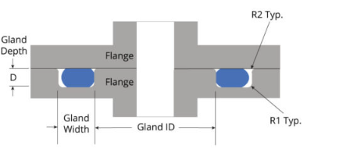
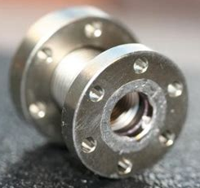
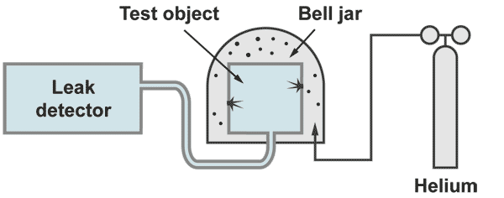
Gas sealing: maintaining purity over years
How are these challenges addressed?
Engineers develop specialized sealing technologies designed for space. These include advanced elastomers and metals that maintain flexibility and strength across temperature extremes.
Glass-to-metal seals provide vacuum-tight bonds essential for certain electronic and sensor interfaces.
Cryogenic seals require careful material selection and design to prevent leaks in extremely cold environments.
Valve designs often incorporate multiple sealing elements with backup layers to ensure redundancy.
Materials undergo rigorous testing for thermal cycling, radiation exposure, and mechanical stress to verify their long-term reliability.
Helium leak detection test
ASTM E1066 - Vacuum Within the Detector (Inside-Out Method)
This method involves placing a helium-filled hood or bag over the test object (which is under vacuum inside).
The helium tracer gas surrounds the object, and any helium leaking into the vacuum is detected using a Helium leak detector
Atmospheric helium concentration is only ~5 ppm (0.0005%). Very low background!!
Sensitivity: in the 10⁻⁸ to 10⁻¹¹ atm·cc/s range

Slide 30
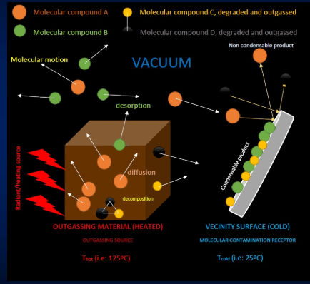
Material Constraints & Outgassing
What is Outgassing?
Release of volatile molecular compounds from a material (contained in it or adsorbed on the surface) due to the exposure to space vacuum environment.
It is the main effect provoqued by the extreme vacuum (from 10⁻⁵-10⁻⁷ mbar for low orbits, to <10⁻¹³ mbar in deepspace).
It is a process activated and accelerated with the increase o temperature.
Detrimental effects of outgassing on materials and components
Degradation of functional properties of materials (i.e: outgassing of functional additives)
Molecular or chemical contamination on component surfaces, affecting the performance (i.e: degradation of optical, thermal, electrical properties)
Perturbation of the spacecraft medium (i.e: voltage breakdowns, arcs, heat transfer problems)

Slide 31

Material Constraints & Outgassing
How to prevent Outgassing?
NASA developed screening tool to gauge a material’s
outgassing performance (ASTM E595 standard)
Use Low-Outgassing Materials
Select materials tested and certified for low outgassing.
Prefer metals, ceramics, and specially formulated space-grade polymers and adhesives with proven low volatile content.
Design Considerations
Minimize trapped volumes or cavities where outgassed molecules can accumulate. Use venting paths or purge systems to allow outgassed molecules to escape without contaminating sensitive surfaces.
Pre-Conditioning (Bake-Out)
Subject components and materials to vacuum baking at elevated temperatures before integration to drive off volatile compounds.
This reduces the amount of trapped gases that could later outgas in orbit.
Surface Treatments and Coatings
Apply low-outgassing coatings that can act as barriers.
Avoid Organic Contaminants
Limit or eliminate the use of organic compounds, greases, lubricants, and adhesives that tend to outgas more. Use inorganic or space-qualified alternatives when possible.
Proper Cleaning and Handling
Implement stringent cleaning protocols to remove surface contaminants that could outgas. Use cleanrooms and handle parts with gloves and protective measures to avoid introducing contaminants.

Slide 32


Gas Systems for space detectors
IXPE Gas Pixel Detector (GPD) Gas Filling
Detector; sealed Gas Pixel Detector (GPD, GEM technology based) Purpose: Detect X-ray photons with polarization sensitivity
Active area: ~15 mm × 15 mm
Gas volume: few cubic centimeters, sealed in a hermetic chamber
L. Baldini, et al., Astropart. Phys. 133 (2021) 102628, http://dx.doi.org/10.1016/j.astropartphys.2021.102628
Gas Filling Process (On Ground):
Detector is evacuated to ultra-high vacuum to remove contaminants
Gas mixture prepared with precise composition and pressure
Controlled filling into the GPD via dedicated gas lines and valves
Leak testing and pressure stabilization performed to ensure hermeticity
Detector sealed hermetically to maintain gas purity throughout mission duration
Key Points:
Sealed system avoids complexity and risks of in-orbit gas handling
Gas pressure and composition chosen to optimize detection efficiency and spatial resolution
Requires rigorous leak checks and stable gas composition control before launch

Slide 33


Gas Systems for space detectors
Circulating Gas System for AMS-02 TRD
Detector: Transition Radiation Detector (TRD) using straw tubes filled with a Xe-based gas mixture (Xe/CO₂ or Xe/CH₄) circulated continuously
Purpose: Detect high-energy charged particles by measuring transition radiation and ionization energy loss
Dimensions: Approx. 3 m × 3 m × 0.7 m - composed of 20 layers of straw tubes, totaling ~5248 straws
Gas Circulation System:
The TRD uses a closed-loop gas system onboard the ISS to minimize gas loss and allow long-duration operation without resupply.
Working gas: A xenon/CO₂ mixture is circulated to optimize transition radiation detection and proportional tube operation.
Gas compressors to recirculate the gas throughout the system.
Purifiers continuously remove oxygen, moisture, and outgassing byproducts, preserving detector performance and extending gas life.
Pressure, temperature, and flow rates are actively monitored. A dedicated control system autonomously manages gas circulation, purification cycles, and fault detection.
AMS-02 TRD Gas Slow Control System Specifications v 5.2
A. Bartoloni, B. Borgia, F. R. Spada INFN Sezione di Roma 1- Roma, Italy
Key Points:
Circulation allows for long mission duration with stable detector response
Requires redundant pumps and purification for reliability
System design considers microgravity environment and ISS safety standards

Slide 34

Electrostatic Charging in Space
Electrostatic charging occurs when spacecraft surfaces accumulate electrical charge due to interaction with the space environment, particularly plasma, energetic particles, and UV radiation
Why It Matters in Vacuum:
No atmosphere to dissipate charge—no natural path to neutralization
Dielectric materials and isolated surfaces retain charge longer
Higher risk of sudden Electrostatic Discharge (ESD)
Key Sources of Charging:
Plasma Environment: Low-energy electrons and ions in LEO and GEO.
Solar Radiation: Photoelectric effect on sunlit surfaces - When sunlight strikes spacecraft surfaces, electrons are ejected
High-Energy Particles: From solar storms or trapped radiation belts (Van Allen belts).
https://fluidcodes.com/news/simulate-to-mitigate-electrostatic-discharge-on-spacecraft/
Notes:
Qui capire meglio quali grafici mettere (https://api.pageplace.de/preview/DT0400.9781400839094_A24347742/preview-9781400839094_A24347742.pdf)
Slide Visual Suggestions
For the leak rate equation slide:
Include a simple graphic showing a sealed vessel in space, helium molecules leaking, a helium detector, etc.
For Electrostatic Charging, a 2-panel comparison:
Earth: charge dissipation
Space: floating charge accumulation

Slide 35




Electrostatic Charging in Space
Shu T. Lai, Fundamentals of Spacecraft Charging: Spacecraft Interactions with Space Plasmas , Princeton University Press, 2012.
Low Energy → Surface Charging: Non-conductive materials build charge differentially → possible discharges (ESD).
High Energy → Deep dielectric charging
High-energy particles penetrate and become trapped within spacecraft materials.
Typical electron and proton fluxes as a function of L-shell in the radiation belts.
The L-shell (or McIlwain L-parameter) denotes the magnetic field line’s distance from Earth’s center at the magnetic equator, measured in Earth radii (RE).
The number of each curve labeles the energy of the particles.
Notes:
Qui capire meglio quali grafici mettere (https://api.pageplace.de/preview/DT0400.9781400839094_A24347742/preview-9781400839094_A24347742.pdf)
Slide Visual Suggestions
For the leak rate equation slide:
Include a simple graphic showing a sealed vessel in space, helium molecules leaking, a helium detector, etc.
For Electrostatic Charging, a 2-panel comparison:
Earth: charge dissipation
Space: floating charge accumulation

Slide 36

Radiation Effects on Electronics: SEU and TID
SEE (Single Event Effect) | Disturbance to the normal operation caused by the passage of a single ion | Logic errors, corrupted data | Instantaneous
TID (Total Ionizing Dose) | Cumulative ionization damage | Parameter drift, degradation, failure | Months–Years
Aspect | Space Environment | High-Energy Physics (HEP)
Radiation Sources | Protons, electrons (solar wind, trapped), Galactic Cosmic Rays, SEPs | High-energy particles from collisions or beams
Particle Energy | Wide spectrum (keV – GeV), high flux variability | Typically, higher energy but localized and controllable
Shielding | Limited due to mass constraints | Often extensive, integrated in experimental design
SEU Concern | High — affects MCUs, FPGAs, front-end ASICs | Moderate — localized, managed with fast reset/recovery logic
TID Concern | Critical for long-duration missions (accumulates in orbit) | Less critical (experiments may be short-lived or accessible)
Mitigation Techniques | Rad-hard components, redundancy, watchdogs, EDAC | Custom ASICs, resets, frequent maintenance access
Notes:
Put out of the table the first two definitions (e forse levare la terza tabella lasciando solo ciò che rende differente da HEP)

Slide 37


Testing and Qualification: The Invisible Work
ECSS – European Cooperation for Space Standardisation
HARDWARE MODELS: used to structure design, testing, and validation phases to ensure quality and reliability before flight hardware is finalized
Breadboard
Conceptual or very early development (TRL 2-3)
Demonstration Model (DM)
Used to validate design choices, verify interfaces, and gain confidence before qualification
Mid-development (TRL 4-5)

Slide 38

Testing and Qualification: The Invisible Work
Instrument (parts) space flight testing
To space-qualify is to take a product, process, or material and test it in order to prove that it will withstand the environment of space flight.
Space qualification domains
Mechanical qualification: Vibration testing to see if the equipment can survive the vibrations during a rocket launch, or the shock when a satellite is released from its carrier.
Thermal qualification: In vacuum conditions to see if the equipment can survive in harsh cold and/or warm conditions in space.
Electro-magnetic qualification: To see if an equipment does not electro-magnetically disturb other equipment onboard the spacecraft, or, reversely, is not disturbed by any other neighbouring equipment.
Lifetime qualification: Tests to check if an equipment will remain operational throughout the projected duration of a mission, or, for mechanisms, will perform a sufficient number of operational cycles.

Slide 39


Testing and Qualification: The Invisible Work
Instrument (parts) space flight testing
A flight qualification can include a test in the actual desired environment.
Following ECSS and general aerospace standards;
Qualification tests (QT):
  Want to stress the hardware
  It doesn’t matter as much if it breaks
  On the Qualification Model (QM) or Proto-Flight Model (PFM)
  If successful, the design is “qualified” and can be used as the basis for building flight models.
Acceptance Test (AT):
  Want to check the hardware can survive but still function fully. Don’t want to break anything
  Confirm that the hardware is flight-ready, meets specs, and is free from manufacturing defects or damage.
  If passed, the unit is accepted for flight integration.
Recurring issues: micro-contacts, rigid connections, feedthroughs
Validation: how much can you really simulate on Earth?

Slide 40
Q&A / Discussion
What surprised you the most?
Any ideas for future space-based detectors?
NEXT lesson: From TRL 1 to TRL … – SWEATERS Case Study

Slide 41


Slide 42



Slide 43


MSGC
Performance
Intrinsic high-rate capability (>10⁶ Hz/mm²),
excellent spatial resolution (down to 30 μm),
multiparticle resolution (∼500 μm),
single photo-electron time resolution in the ns-range,
large sensitive area and dynamic range.
Limitations:
Destructive sparks,
time-dependent gain shifts (substrate polarization and charging up),
deterioration during sustained irradiation (“aging”).
Credit: Sauli « Gaseous Radiation Detectors »

Slide 44

MIRACLE Experience
MICROMEGAS on a Baloon
Notes:
Capire meglio cosa mettere e cosa lasciare

Slide 45


Slide 46
Electrostatic Charging in Space
Particle Type | Energy Range | Primary Source(s) | Charging-Related Effects
Electrons (low-energy) | eV – keV | Space plasma (LEO, GEO, solar wind) | Surface charging; differential charging
Electrons (high-energy) | 100 keV – MeV | Van Allen belts, magnetospheric substorms | Internal charging; deep dielectric penetration
Protons (low-energy) | keV – MeV | Solar wind, trapped plasma | Surface charging, sputtering, low-level ionization
Protons (high-energy) | MeV – GeV | Solar energetic particle (SEP) events, cosmic rays | Internal charging, SEEs*, deep material damage
Heavy ions (e.g. C, Fe) | MeV – GeV/nucleon | Galactic Cosmic Rays (GCRs), SEPs | Deep ionization, SEEs*, potential upsets or latch-up
Photoelectrons | ~1–10 eV | Emitted by spacecraft under solar UV | Affects net surface potential, alters sheath conditions
Secondary electrons | ~1–50 eV | Emitted when high-energy particles hit surfaces | Contribute to net charging behavior
Backscattered electrons | ~few eV – keV | Surface-particle interactions | Modify local potential, especially near insulators
Neutrals (e.g. gas molecules) | N/A (thermal) | Outgassing, propulsion, micrometeoroid impact | Can become ionized → secondary plasma effects
Dust grains | N/A (µm scale) | Debris, micrometeoroid fragmentation, lunar dust | Can acquire high charge; impact-induced ESDs possible

Slide 47
Radiation Effects on Electronics: SEU and TID
SEU (Single Event Upset) | Bit flip or transient error from a single particle | Logic errors, corrupted data | Instantaneous
TID (Total Ionizing Dose) | Cumulative ionization damage | Parameter drift, degradation, failure | Months–Years
Subsystem | SEU Sensitive | TID Sensitive | Notes
Front-End ASICs | Yes | Yes | Analog bias shifts, bit flips in config logic
FPGAs / MCUs | Yes | Yes | Critical for control & data path
Memory (SRAM/Flash) | Yes | Yes | Data corruption, program loss
Power Management | Sometimes | Yes | TID-induced threshold shifts, latch-ups
Notes:
Put out of the table the first two definitions (e forse levare la terza tabella lasciando solo ciò che rende differente da HEP)

