Slide 1
FCC Napoli – Next TB setup
Carlo Di Fraia – 07 MAR. 2025

Slide 2
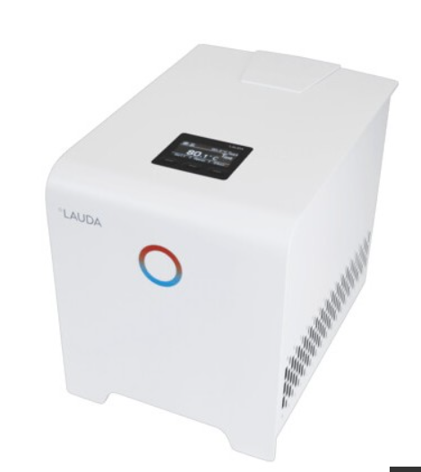
Chiller - Lauda L 250
Compact chiller for constant temperature applications from 4° to 80°C, with Peltier technology
Power 0.4 kW
Stability ± 0.1 K
Large OLED display
Pump pressure max 0.8 bar; pump flow rate 2.6 L/min
Tank volume max. 0.3 L
Dimensions (mm): 261×368 ×312
Heat transfer liquid: demineralized water
Datasheet

Slide 3
Chiller - Lauda L 250
Compact chiller for constant temperature applications from 4° to 80°C, with Peltier technology
Power 0.4 kW
Stability ± 0.1 K
Large OLED display
Pump pressure max 0.8 bar; pump flow rate 2.6 L/min
Tank volume max. 0.3 L
Dimensions (mm): 261×368 ×312
Heat transfer liquid: demineralized water
Datasheet

Slide 4
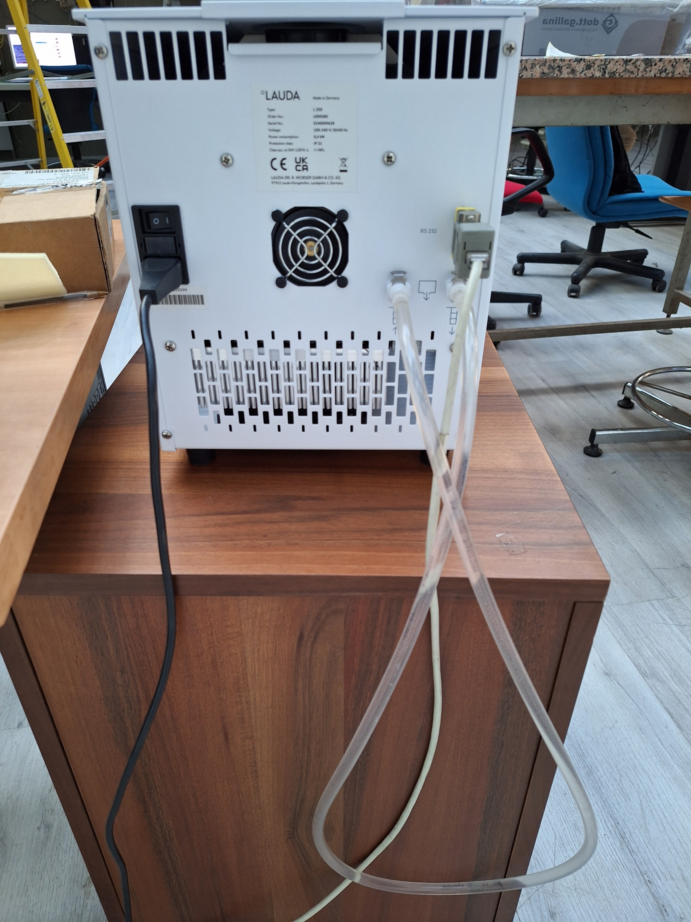
Chiller - Lauda L 250
Fully remote-controlled
Standard RS 232 interface
Preliminary tests:
Remote communication with the device perfectly working
Preliminary hydraulic tests positive (output short-circuited)
Next steps:
Integrate the chiller into the DAQ
Connect to the DarkBox hydraulic circuit and test the cooling effect

