Slide 1
TC report
Davide Fiorina – GSSI & INFN

Slide 2
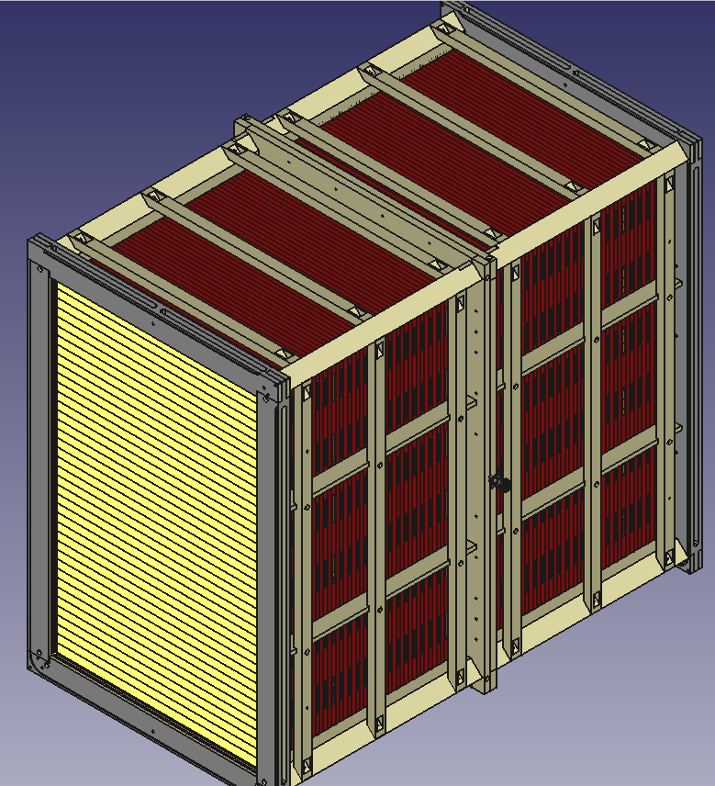
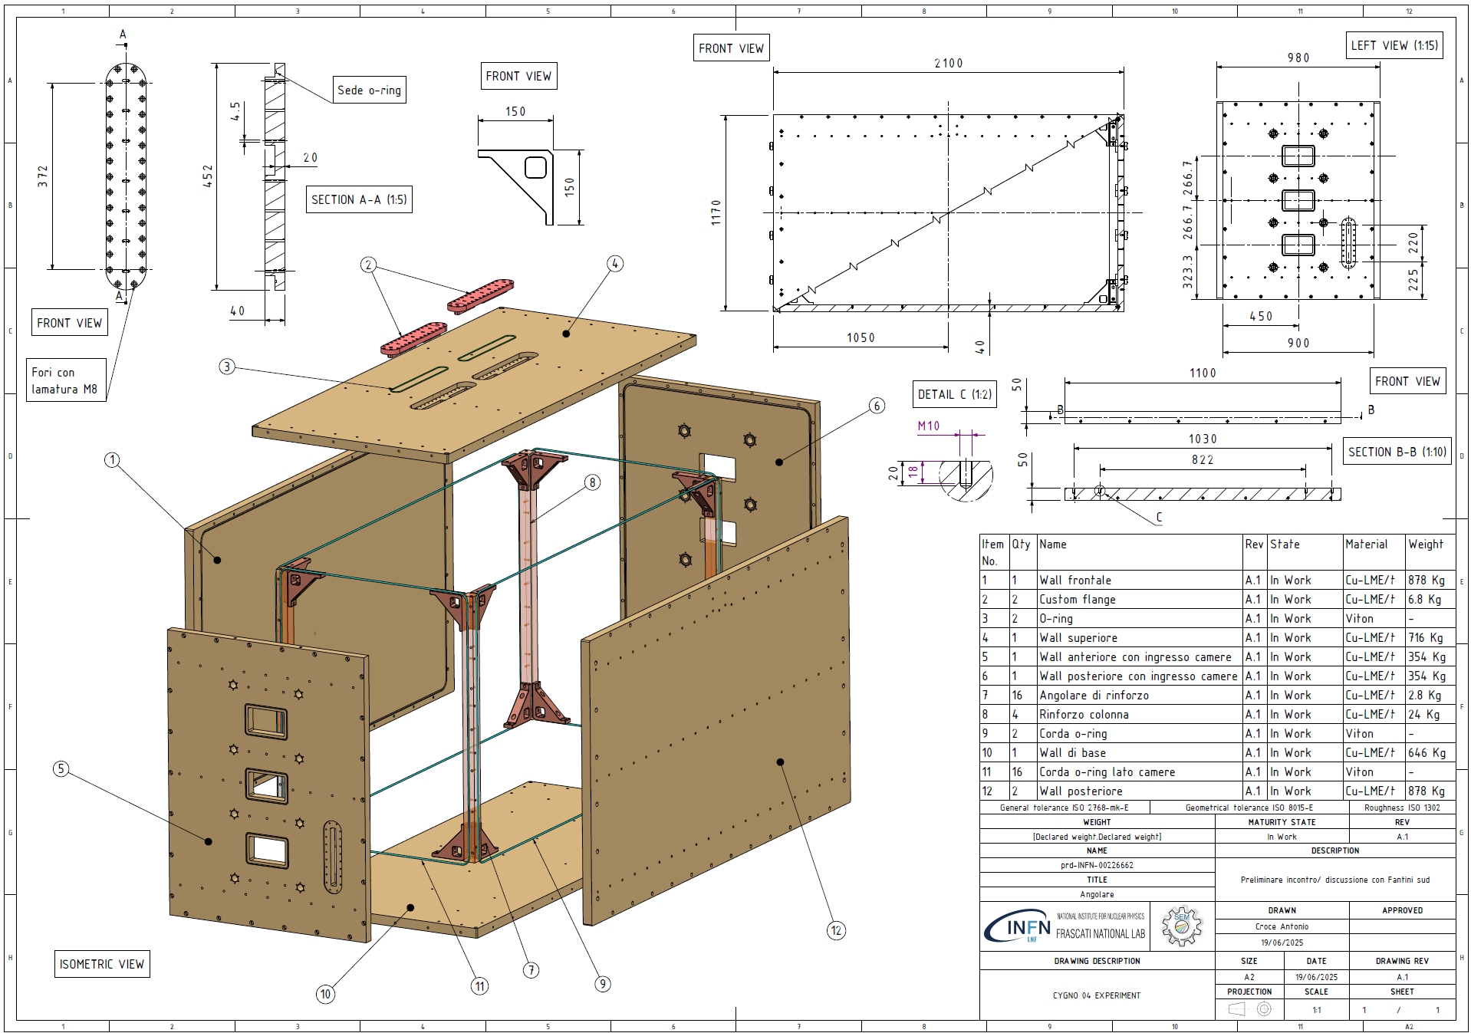
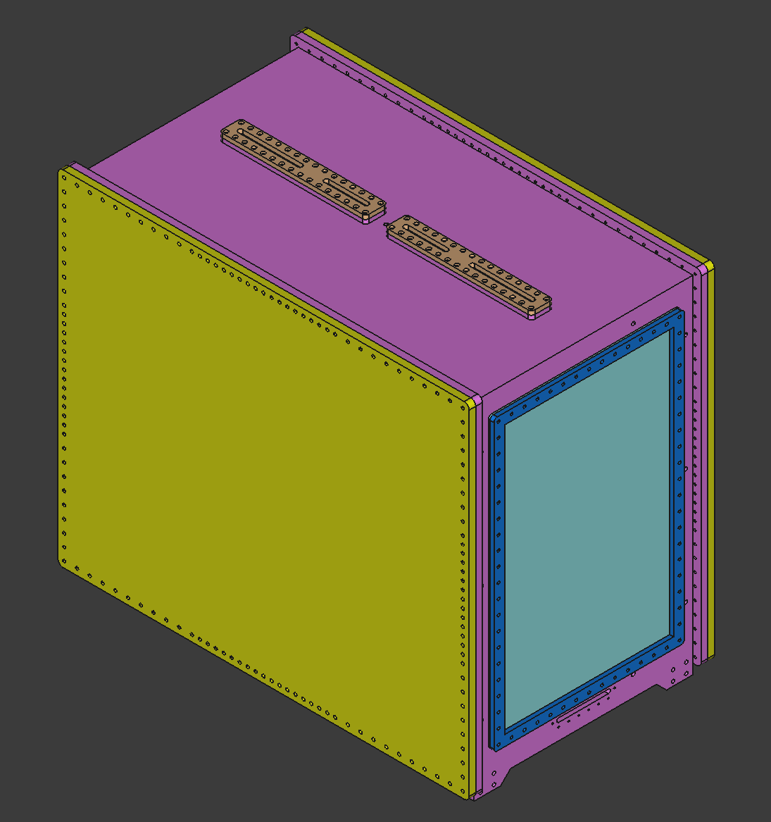
Status CYGNO04
Inner detector design frozen
Components procurement started
First version of the PMMA box
Already discussed with the company (Bussetti)
Small adjusted required and quote in a few days
Preliminary drawing of Copper vessel (frozen)
Sent to company (Fantini) for first review and quote
The company will take care of all the copper machining and possibly also LNGS installation
Working with Giovanni Maccarrone to have LN2 system to flush the copper vessel of CYGNO04

Slide 3
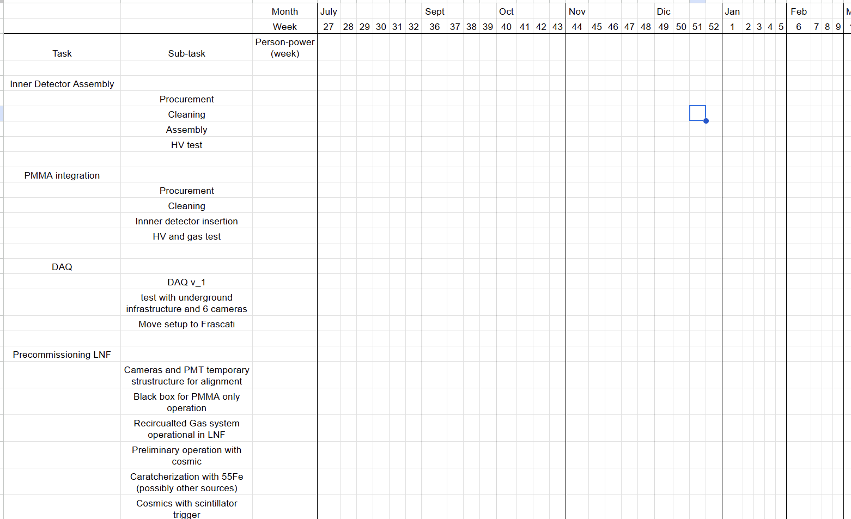
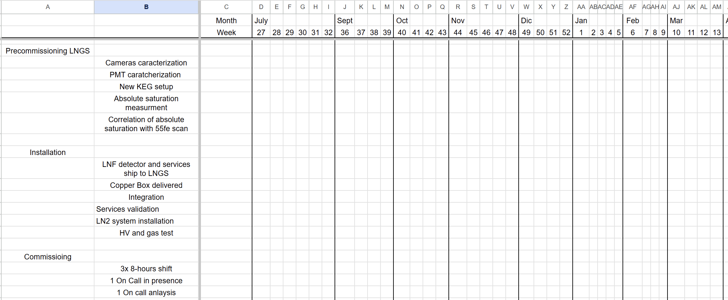
CYGNO04 task
As discussed in last week’s Joint WP meeting, the TC will provide a detailed set of tasks needed for CYGNO04
It is essential that all needed tasks are completed on schedule to ensure the construction, validation, and commissioning of CYGNO04.
Failure to provide the necessary support or delays in critical tasks may directly impact the detector timeline, physics results, and ultimately, the ability to produce publications.
Timely participation from all institutes is therefore not only requested but required for the success of the collaboration’s scientific goals.
Working with WPs conveners to fix tasks and effort needed
→ Prelimianry tasks to be discussed next GM

Slide 4
Appointments
Copper delivery end of July, Copper machining in October, LNGS delivery in November
Mid-September start of Inner Detector assembly
Begin October finish detector in PMMA, and Start of CYGNO04 precommissioning in LNF
End of the year detector installation underground
Beginning of 2026, start of commissioning
If you were hoping for a quiet year… well, surprise!

