Slide 1


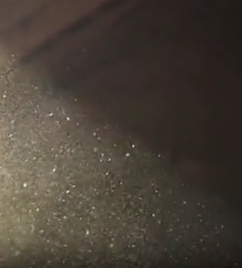


Cleanliness in ET
Piero Rapagnani
piero.rapagnani@roma1.infn.it
2025/03/03
3/3/2025

Slide 2
In a GW ITF, cleanliness is essential:
Particle impacts make suspension fibres explode
(e.g. https://tds.virgo-gw.eu/ql/?c=12352)
Particles on mirrors in high power cavities make absorption points, harming sensitivity and performance (e.g. P1900287-v2_Point_Absorbers_in_Advanced_LIGO__Appendix_version)
Dust increases stray light
(e.g.:https://agenda.infn.it/event/40538/contributions/243138/attachments/126242/186329/stray_light_GRASS2024.pdf)

Slide 3
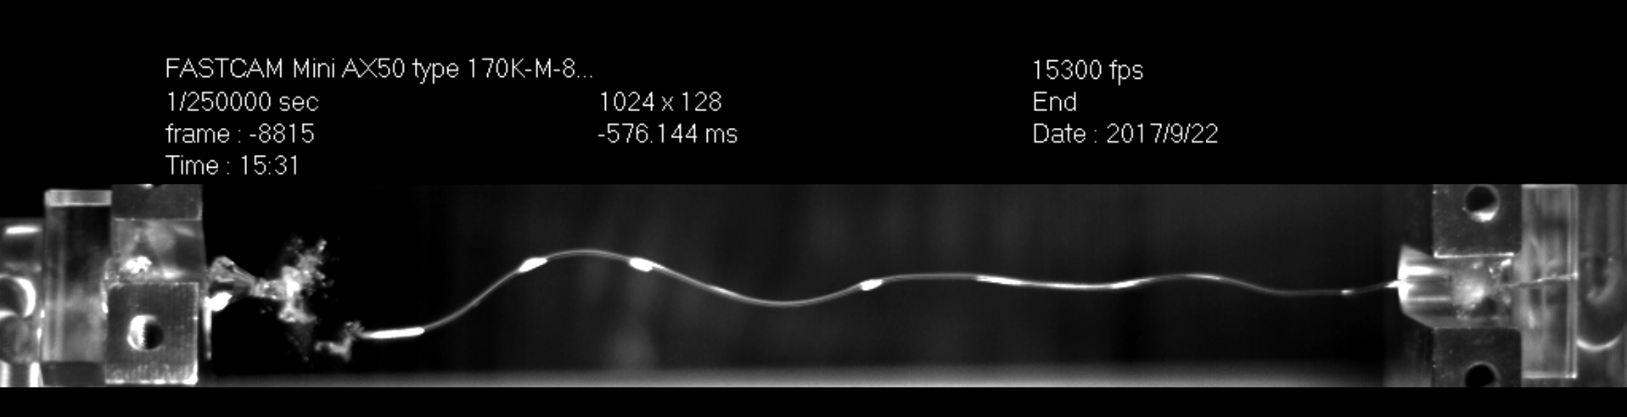
Fibre failure by particle impact
Fused silica fibres under tension are very sensitive to surface damage. A very small crack increases exponentially, causing the fused silica fibre to explode.
Probably, in ET-HF mirror suspensions fused silica fibers will have a tension higher than in current Advanced ITF
For ET-LF, also surface damages in crystalline fibres, in sapphire or silicon, cause failures, usually without an explosion

Slide 4
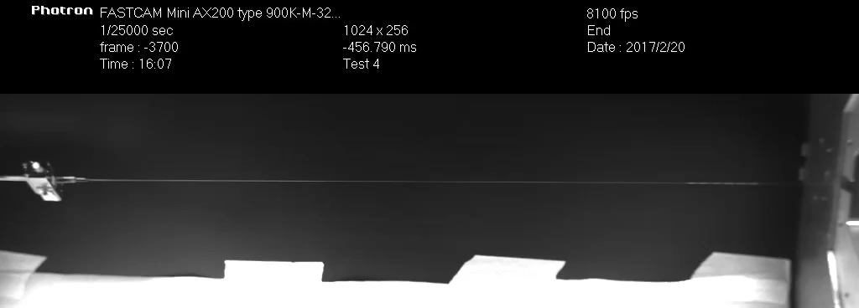
Fibre failure by particle impact

Slide 5
Fibre failure by particle impact
In the first assembly of Advanced Virgo, we had a long series of failures of fibres. This lead to an extensive study on possible causes, that were finally identified in particles coming from the primary scroll vacuum pumps (metal dust pieces >10 µm), accelerated during venting.
Salts with Na, Cl, K, and some Cu, but some with Fe and other with possible Mo (or S) traces, and many non-glass Si (with Mg or with Al); some Ti pieces
Possibly, electrostatic effect increased the cross section of the fibres w.r.t. these particles

Slide 6
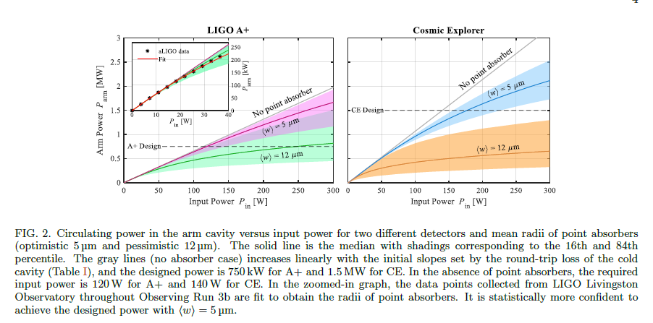
Absorption points on mirrors
Point Absorber Limits to Future Gravitational-Wave Detectors
LIGO Collaboration
arXiv:2109.08743v1 [physics.ins-det] 17 Sep 2021
https://doi.org/10.1103/PhysRevLett.127.241102
From the conclusions:
Our analysis of resonant field power in the cavity suggests that point absorbers of mean 5 μm radii will not prevent future gravitational wave detectors from achieving their design sensitivity.
Active research is being carried out to mitigate both the size and number of point absorbers on future optics.

Slide 7
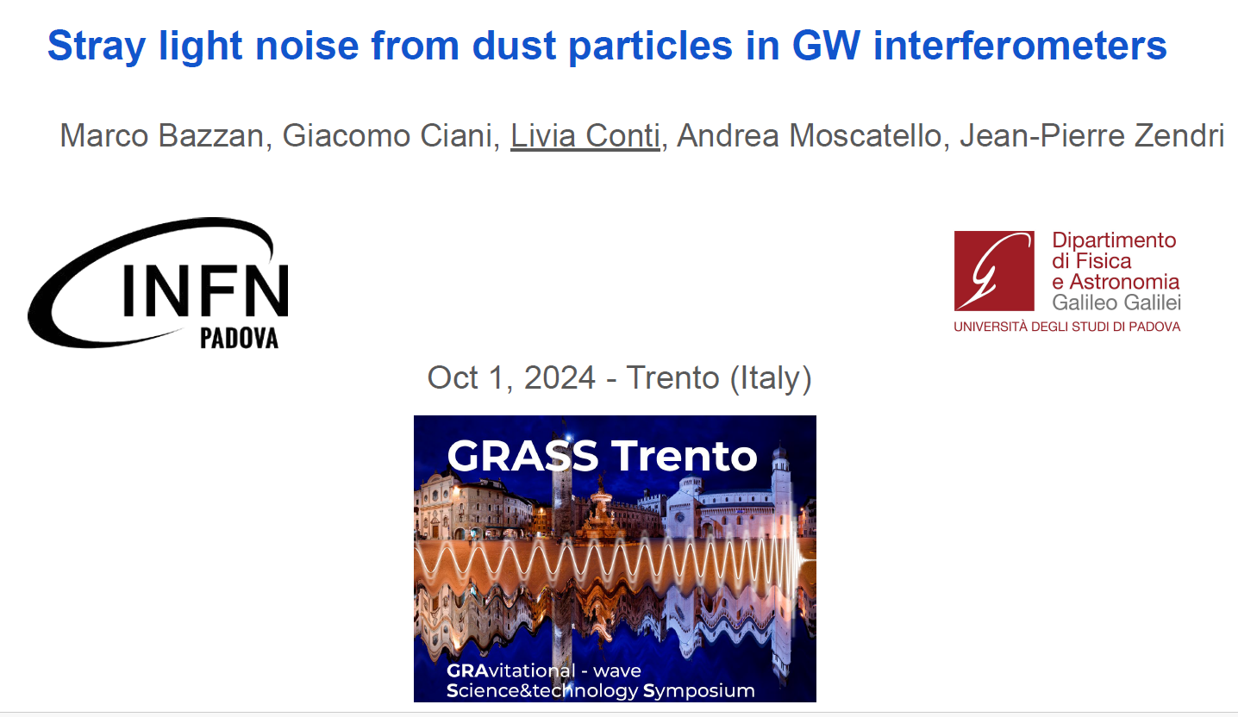
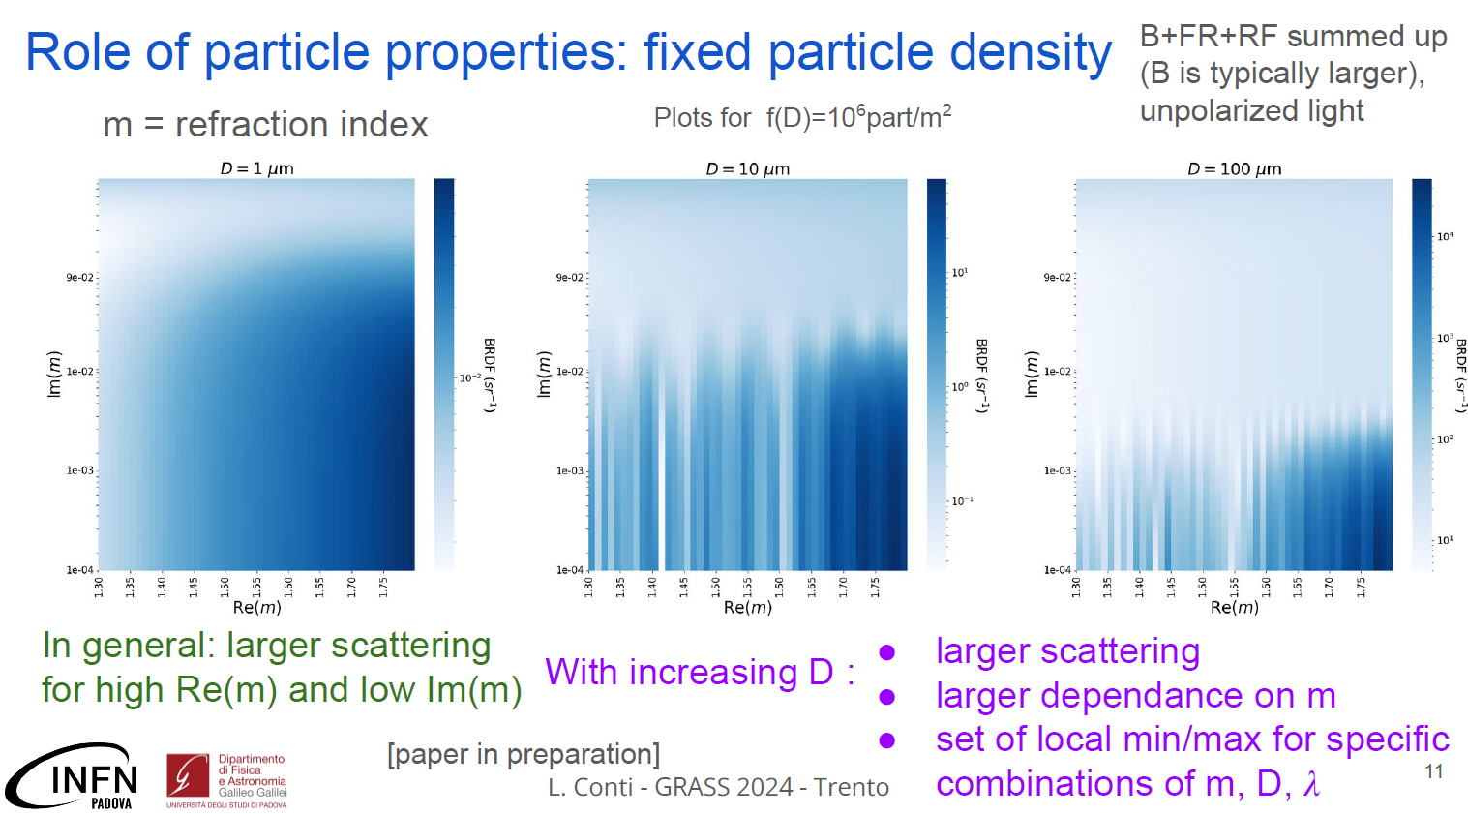
Stray Light Noise from Dust Particles
https://agenda.infn.it/event/40538/contributions/243138/attachments/126242/186329/stray_light_GRASS2024.pdf

Slide 8

In a GW ITF, cleanliness is essential:
Large Particles
Particle impacts make suspension fibres explode
(e.g. https://tds.virgo-gw.eu/ql/?c=12352)
Particles $\sim 10 μm$
Particles on mirrors in high power cavities make absorption points, harming sensitivity and performance (e.g. P1900287-v2_Point_Absorbers_in_Advanced_LIGO__Appendix_version)
Dust increases stray light
(e.g.:https://agenda.infn.it/event/40538/contributions/243138/attachments/126242/186329/stray_light_GRASS2024.pdf)
All Particles, depending on density?

Slide 9
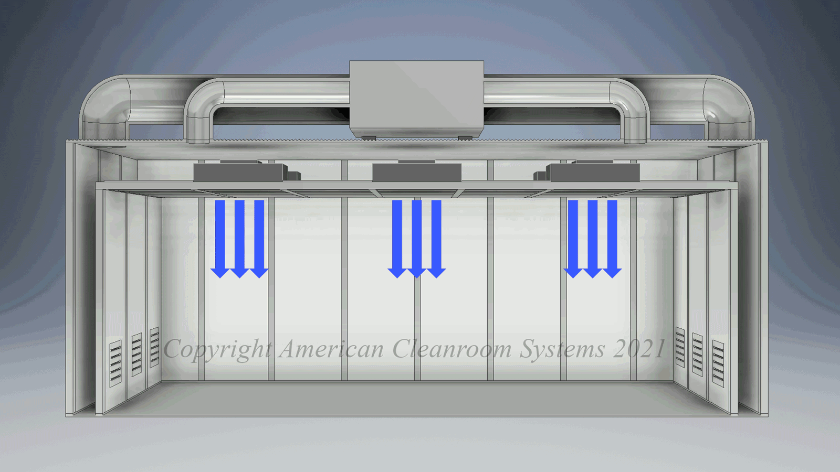
Main Clean Room Features and Classifications

Slide 10
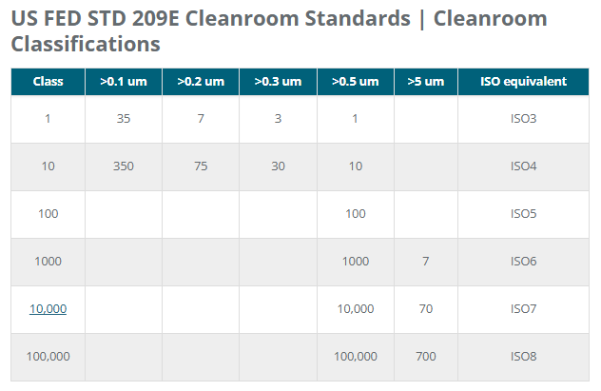

Slide 11
The ISO 1 specification for cleanrooms require less than 2 particles greater than 0.3 microns and no particles greater than 1.0 microns per cubic meter. An ISO 1 cleanroom typically has from 500-750 air changes per hour and typically utilizes ULPA filtration. Other common characteristics are 100% ULPA ceiling coverage and raised floors.It is the most clean of the cleanroom classification.
The ISO 2 specification for cleanrooms requires less than 11 particles greater than 0.3 microns and no particles greater than 1.0 microns per cubic meter. A IS0 2 cleanroom typically has 500-750 air changes per hour and typically utilizes ULPA filtration. Other common characteristics are 100% ULPA ceiling coverage and raised floors.It is the 2ndmost clean classification.
The ISO 3 specification for cleanrooms requires less than 102 particles greater than 0.3 microns and no more than 8 particles greater than 1.0 microns per cubic meter. A IS0 3 cleanroom typically has 500-750 air changes per hour and typically utilizes ULPA filtration. Other common characteristics are 100% ULPA ceiling coverage and raised floors.It is the 3rd most clean classification.
The ISO 4 specification for cleanrooms requires less than 1020 particles greater than 0.3 micronsand no more than 2 particles greater than 5.0 microns per cubic meter. An IS0 4 cleanroom typically has 500-600 air changes per hour and typically utilizes ULPA filtration. Other common characteristics are 100% ULPA ceiling coverage and raised floors.It is the 4th most clean classification.
The ISO 5 is a super clean cleanroom classification. A cleanroom must have less than 3,520 particles >0.5 micron per cubic meter and 250-300 HEPA filtered air changes per hour. The equivalent FED standard is class 100 or 100 particles per cubic foot. Common applications are semiconductor manufacturing and pharmaceutical filling rooms.
The ISO 6 is a very clean cleanroom classification. A cleanroom must have less than 35,200 particles >0.5 micron per cubic meter and 180 HEPA filtered air changes per hour. The equivalent FED standard is class 1000 or 1000 particles per cubic foot.
The ISO 7 is a common clean cleanroom classification. A cleanroom must have less than 352,000 particles >0.5 micron per cubic meter and 60HEPA filtered air changes per hour. The equivalent FED standard is class 10.000 or 10,000 particles per cubic foot. Common applications are pharmacy USP800 compounding rooms, electronics manufacturing and medical device manufacturing.
The ISO 8 is the least clean cleanroom classification. A cleanroom must have less than 35, 200,000 particles >0.5 micron per cubic meter and 20 HEPA filtered air changes per hour. By comparison a typical office space would be 5-10 times more dirty. The equivalent FED standard is class 100,000 or 100,000 particles per cubic foot. Common applications include plastic extrusion for medical devices, e-liquid manufacturing, and nutraceutical packaging.

Slide 12
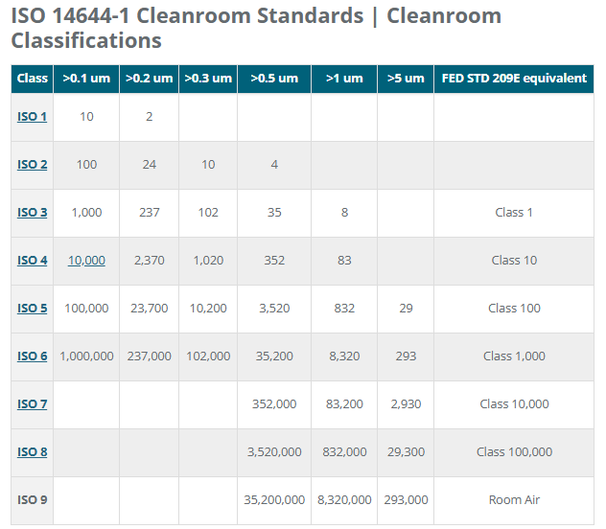

Slide 13
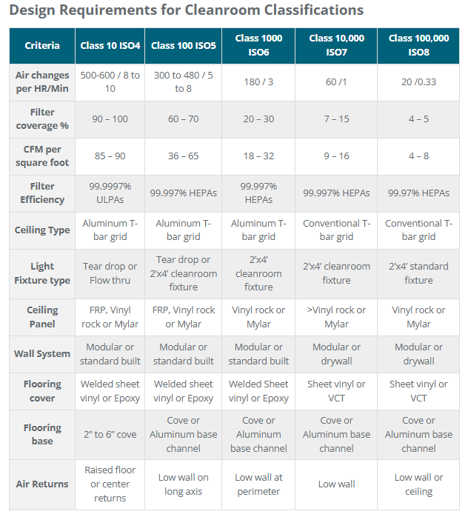
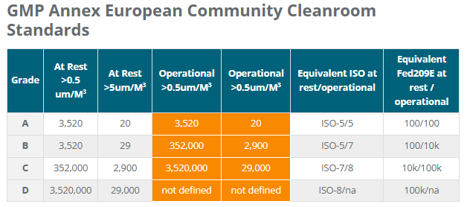
CFM: Cubic Foot per Minute
GMP: Good Manifacturing Practice

Slide 14
Cleanliness is not only a facility: Clean Rooms are useless without tight procedures followed with a scrupolous attitude. Indeed, a Cleanliness Chain from components production to integration into the ITF must be integrated in the design of all systems in the simplest and the most complete way possible (e.g: LIGO E1400258 Contamination Control; VIRGO VIR-0895A-17)
As an example, here is a typical clean assembly and integration procedure in Virgo:
ISO 7
Transport Area
ISO 7
Assembly Area
ISO 5
Demineralized water and isopropyl alchol ultrasound bath
Clean washing tunnel:
Demineralized water ISO 5 clean air flux
ISO 4
Pre-Cleaning Area
Tower
ISO 4

Slide 15
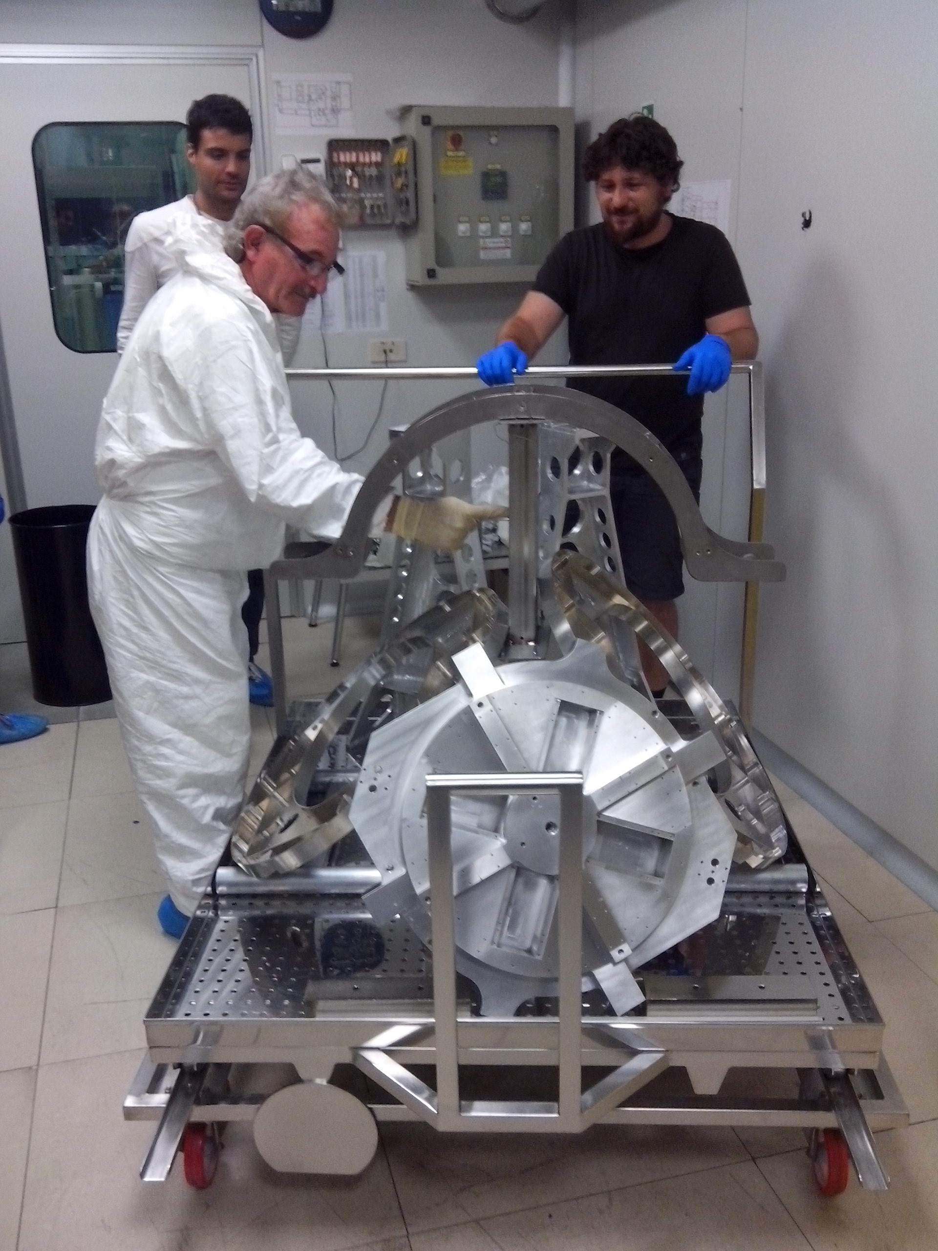
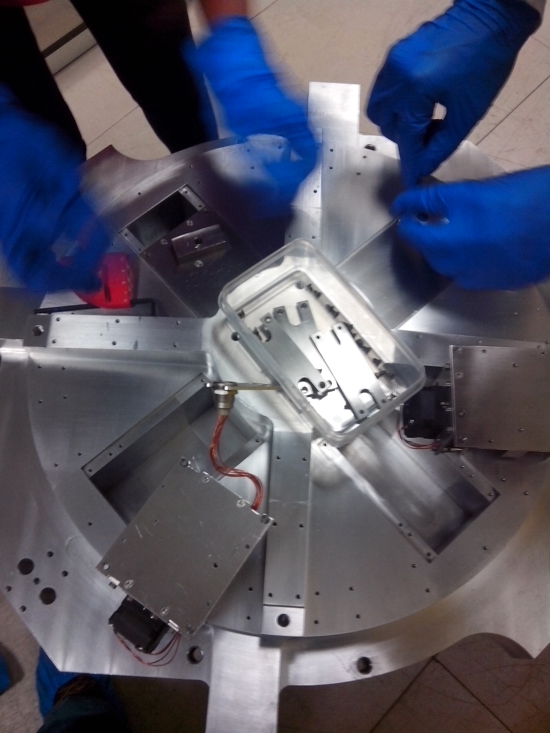
- Mechanical parts are cleaned at the machine shop with standard procedures (degrasing, pickling..)
ISO 7
Assembly Area
ISO 5
ISO 7
Demineralized water and isopropyl alchol ultrasound bath
ISO 4
Transport Area
Clean washing tunnel:
Demineralized water ISO 5 clean air flux
Pre-Cleaning Area
- Mechanical parts enter a ISO 7 Clean Room with large ultrasonic baths of demineralized water and isopropyl alcohol for further cleaning.
Tower
- All parts are hand checked for residual metal shavings, grease spots, and any other kind of residual pollution.
ISO 4

Slide 16
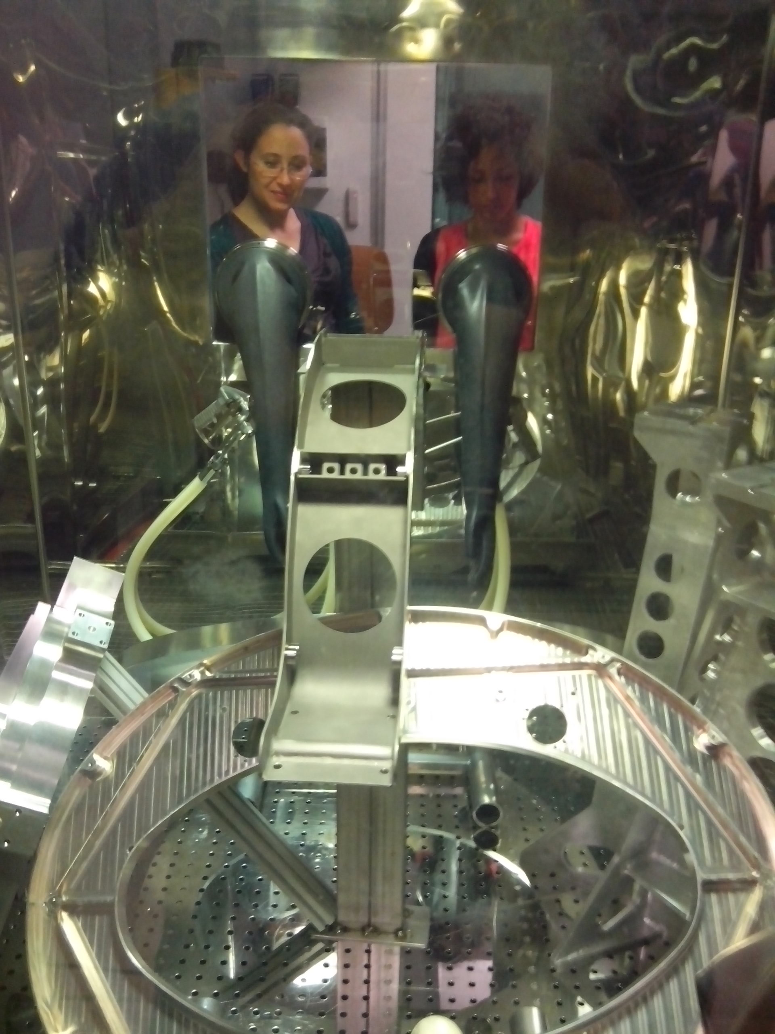
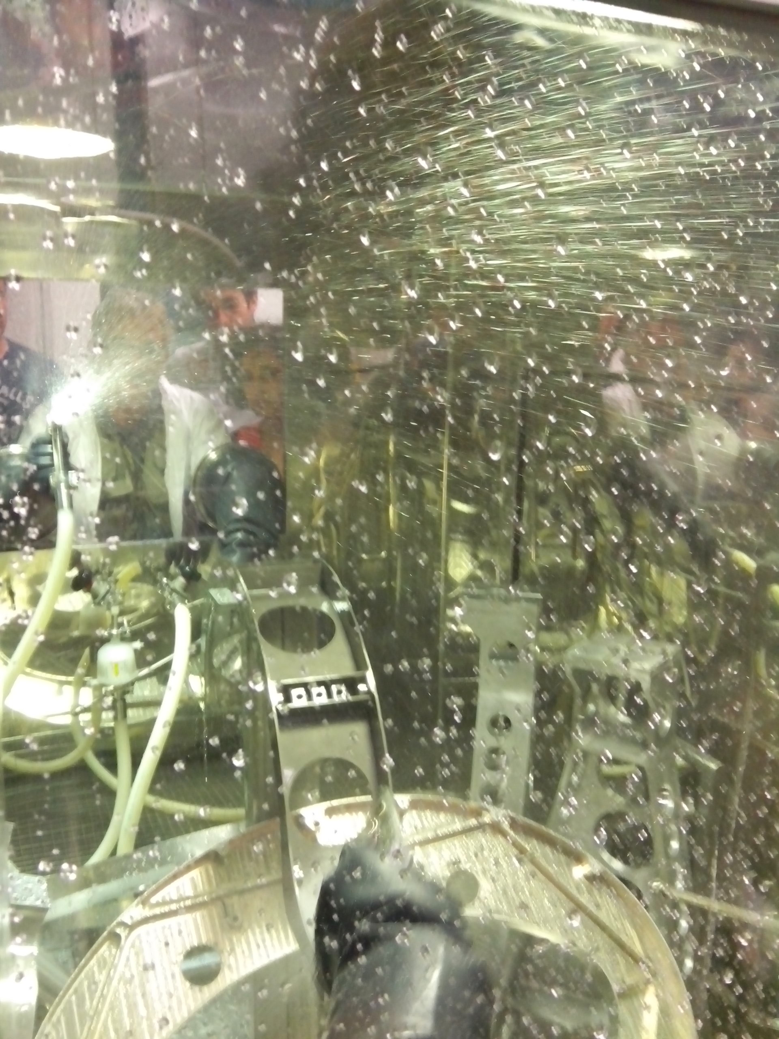
ISO 7
Assembly Area
ISO 5
ISO 7
Demineralized water and isopropyl alchol ultrasound bath
ISO 4
Transport Area
Clean washing tunnel:
Demineralized water ISO 5 clean air flux
Pre-Cleaning Area
Tower
ISO 4
- Parts are inserted in a special tunnel washing machine: one aperture is on the ISO 7 side, the other side opens on a ISO 5 Clean Room, where the mirror with its suspension will be assembled.
In the tunnel, all pieces are washed with demineralized water and ISO 5 clean air

Slide 17
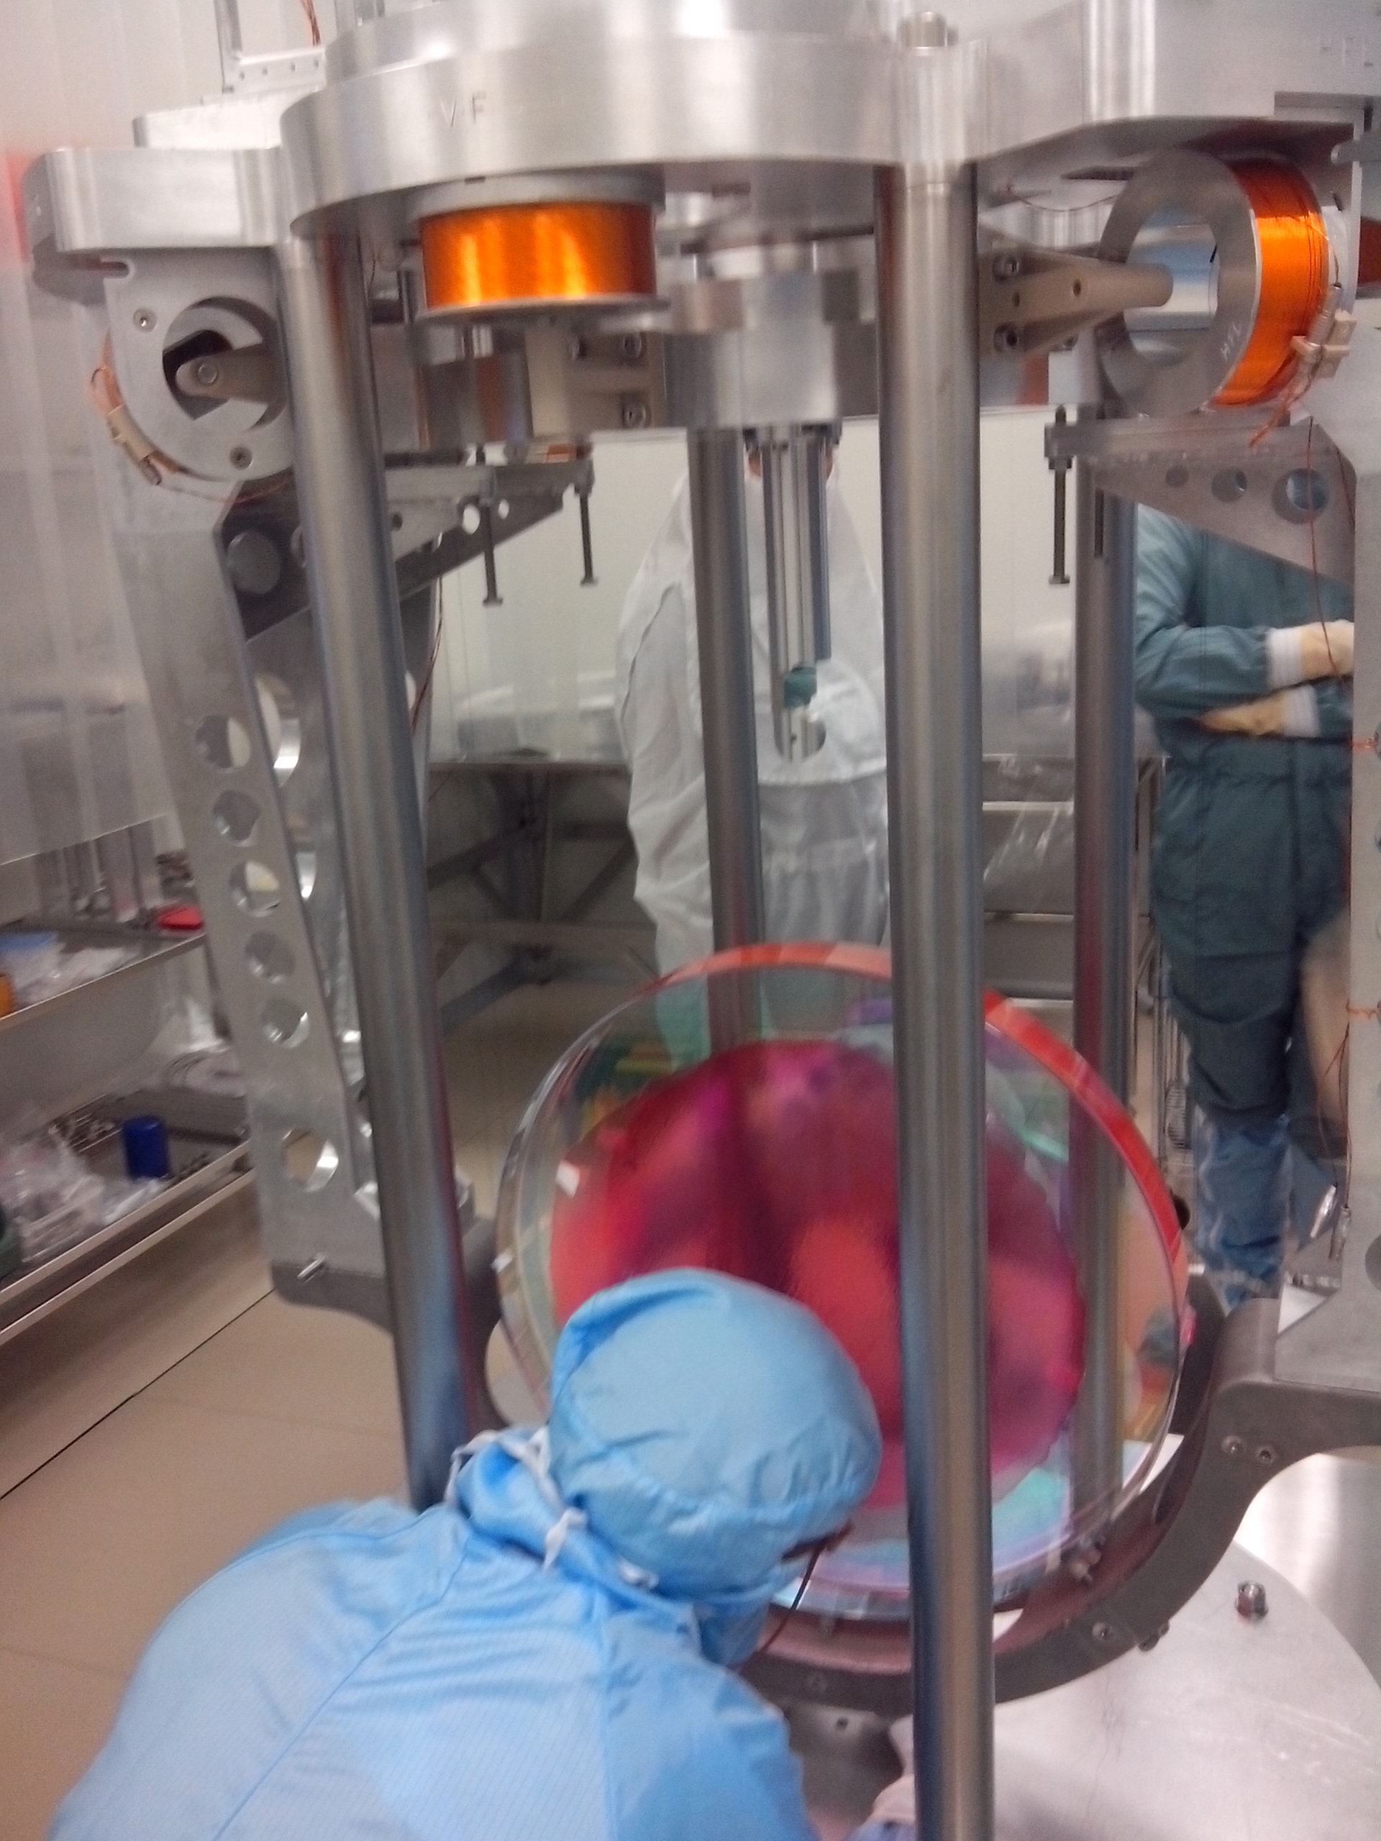
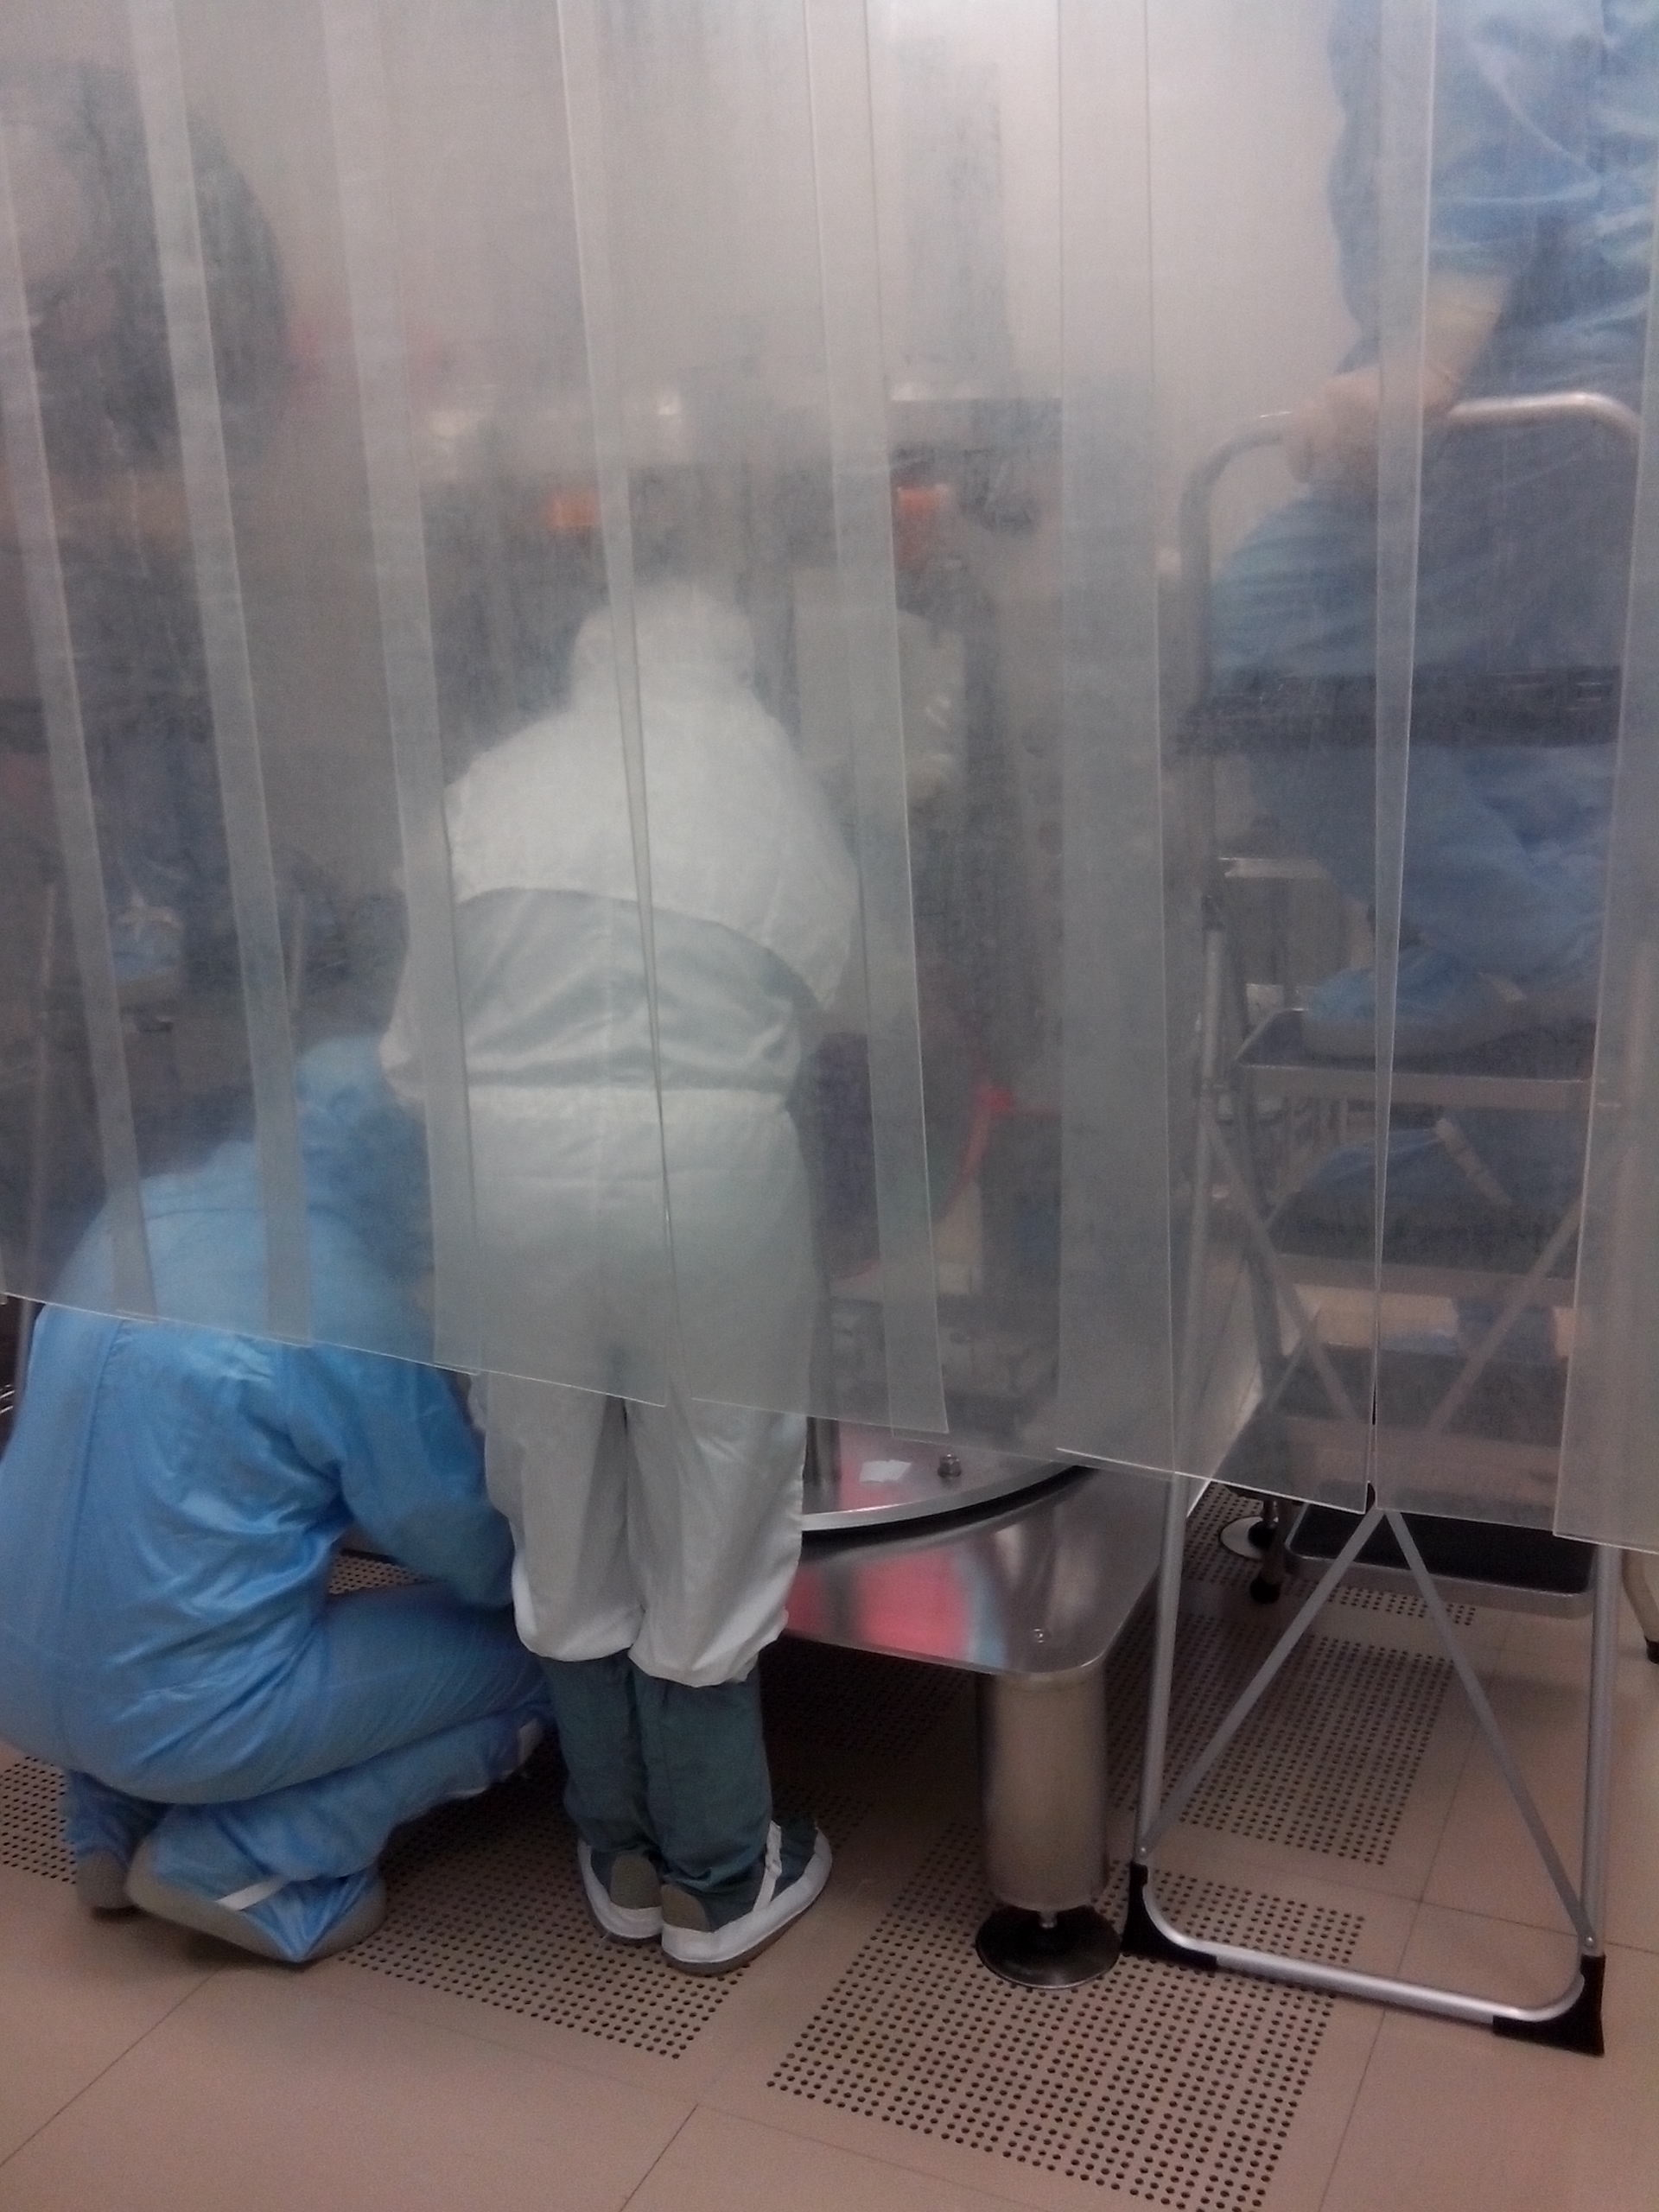
ISO 7
Assembly Area
ISO 5
ISO 7
Demineralized water and isopropyl alchol ultrasound bath
ISO 4
Transport Area
Clean washing tunnel:
Demineralized water ISO 5 clean air flux
Pre-Cleaning Area
Tower
ISO 4

Slide 18
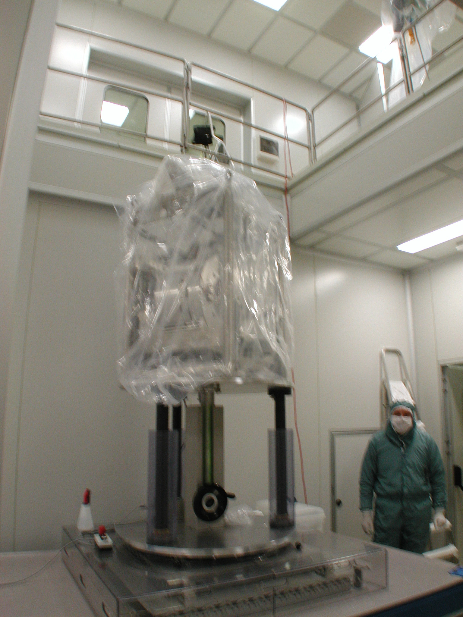
ISO 7
Assembly Area
ISO 5
ISO 7
Demineralized water and isopropyl alchol ultrasound bath
ISO 4
Transport Area
Clean washing tunnel:
Demineralized water ISO 5 clean air flux
Pre-Cleaning Area
- The payload is protected with multiple layers of clean plastic and transported under the tower for integration with the SA.
Tower
ISO 4
Usually, the protected payload transits in a ISO 7/ISO 6 clean room, arriving under the tower, where a flux of ISO 4 air is present.

Slide 19
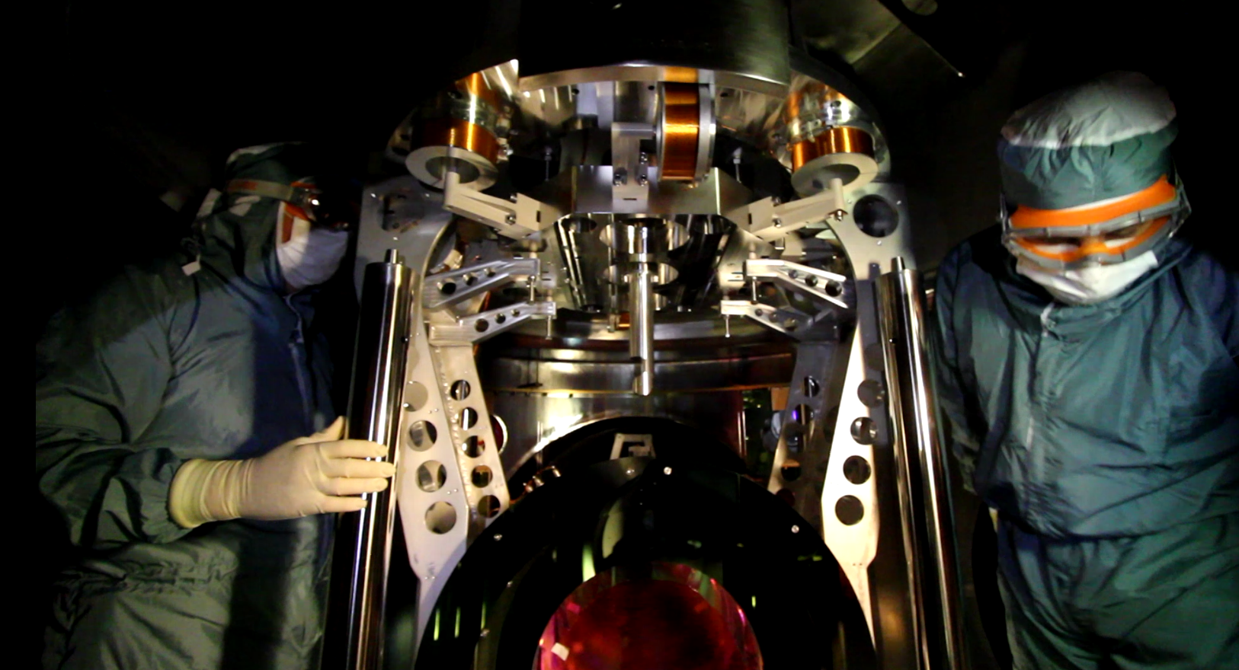
ISO 7
Assembly Area
ISO 5
ISO 7
Demineralized water and isopropyl alchol ultrasound bath
ISO 4
Transport Area
Clean washing tunnel:
Demineralized water ISO 5 clean air flux
Pre-Cleaning Area
Tower
ISO 4
Integration of the payload with the SA is carried out inside the tower, with a top-down ISO 4 air flux.
Operators are protected with three layers of clean garments

Slide 20
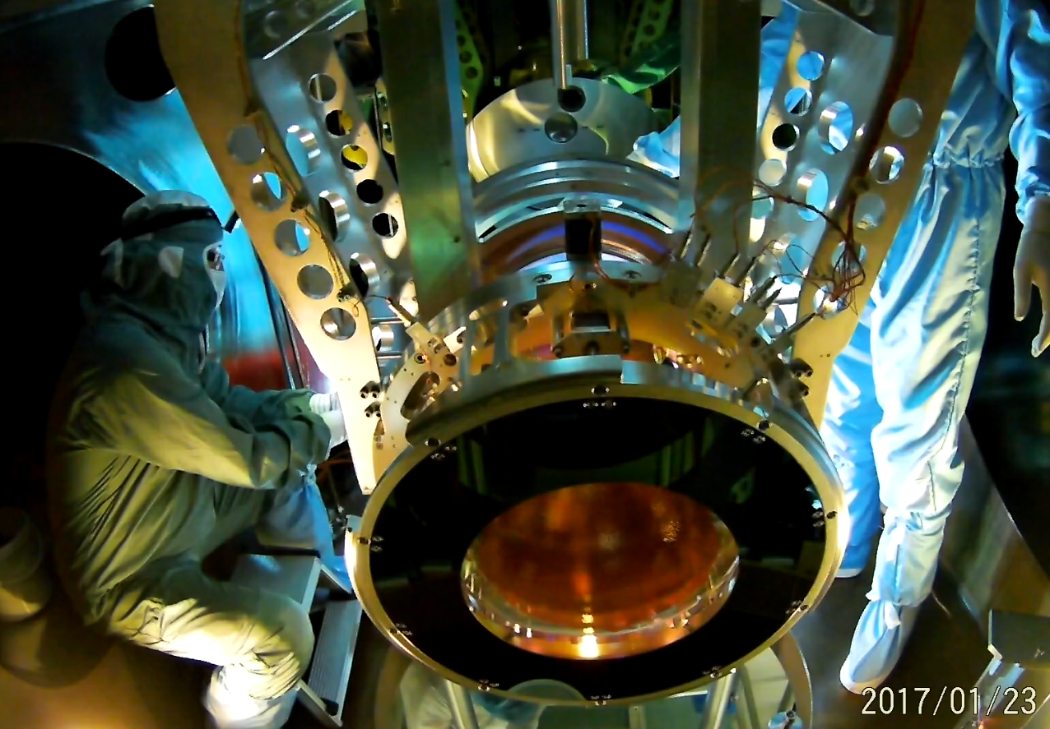
It is important to stress that during payload integration any action can cause a breaking of fibers or a pollution of the mirror.
Indeed, assembly operations which require tightening or untightening of bolts or screws must be reduced to a minimum: each operation of this kind can release dangerous metallic particles

Slide 21
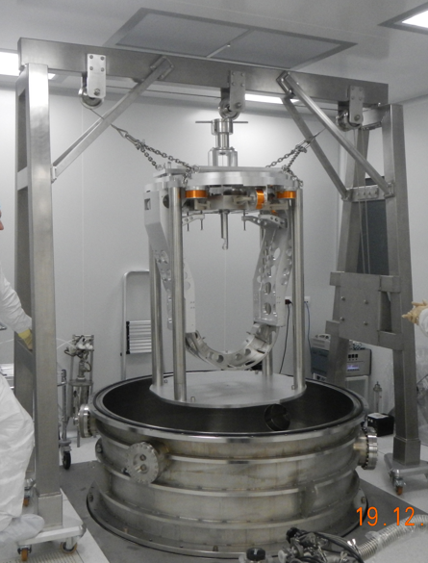
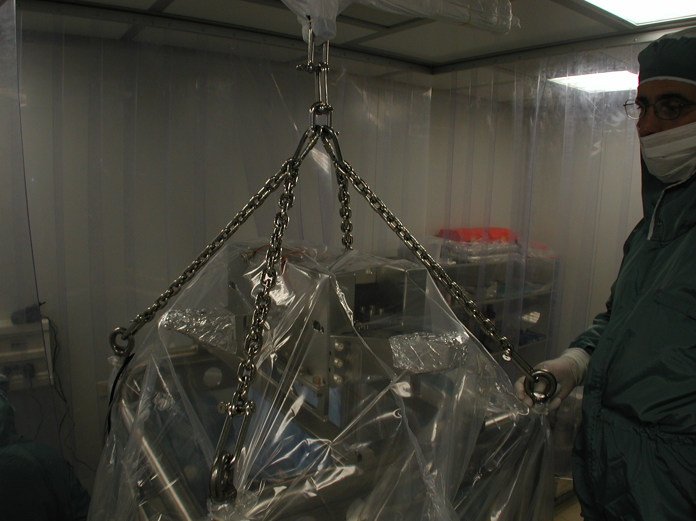
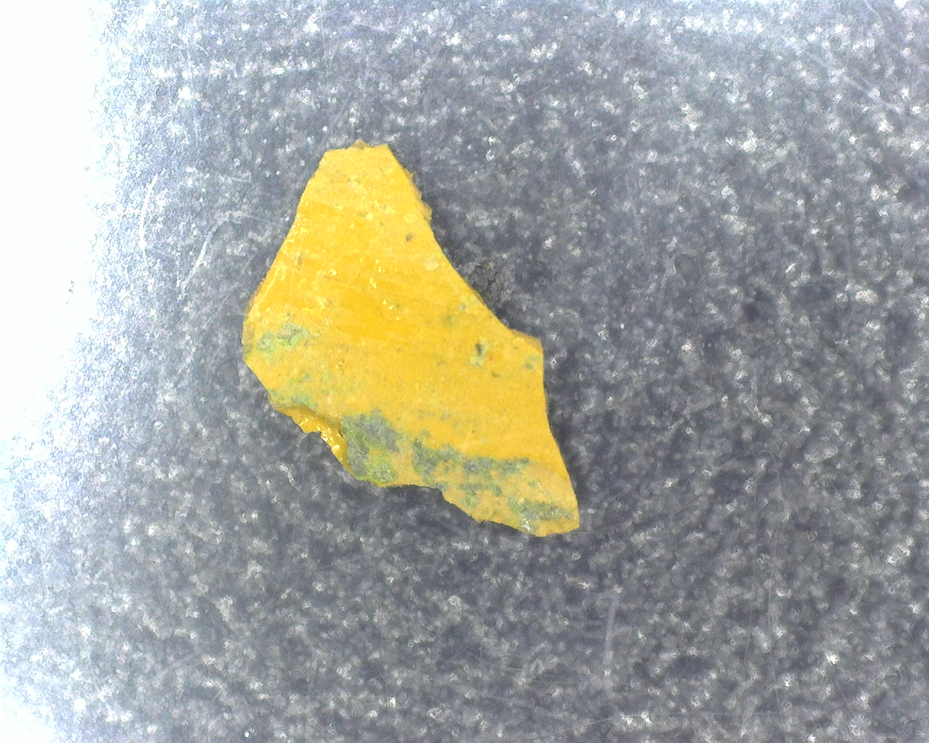
According to our experience, it is rather difficult to find and implement lifting gears with a good level of cleanliness: paint must be absent, grease also should be avoided stainless steel should be preferred to carbon steel, and so on. Moreover, metallic ropes and chains tend to release dangerous metallic particles
Paint debris from lifting crane
Lifting gear should be used only with a protected payload.
If it is necessary to operate a lifting gear close to an unprotected payload, at least a very efficient, clean flux of air should be used.

Slide 22
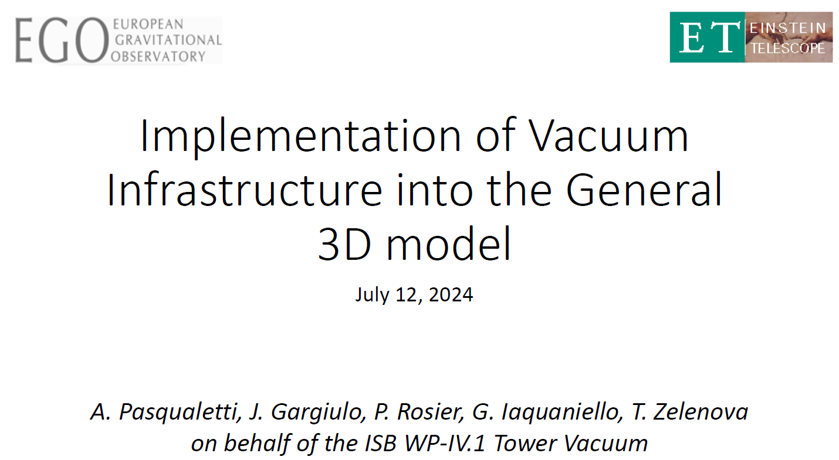
Proposal by the Vacuum Team

Slide 23
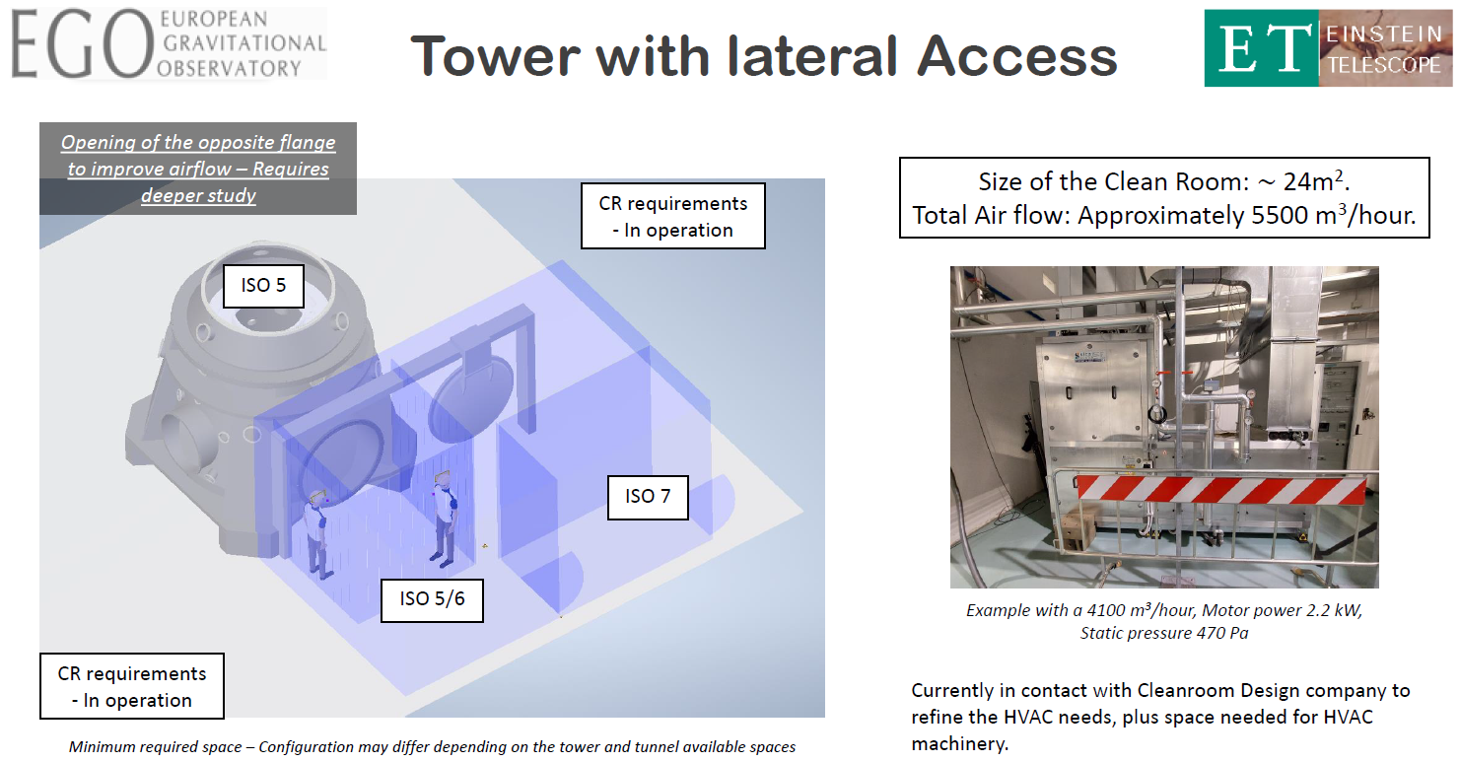

Slide 24
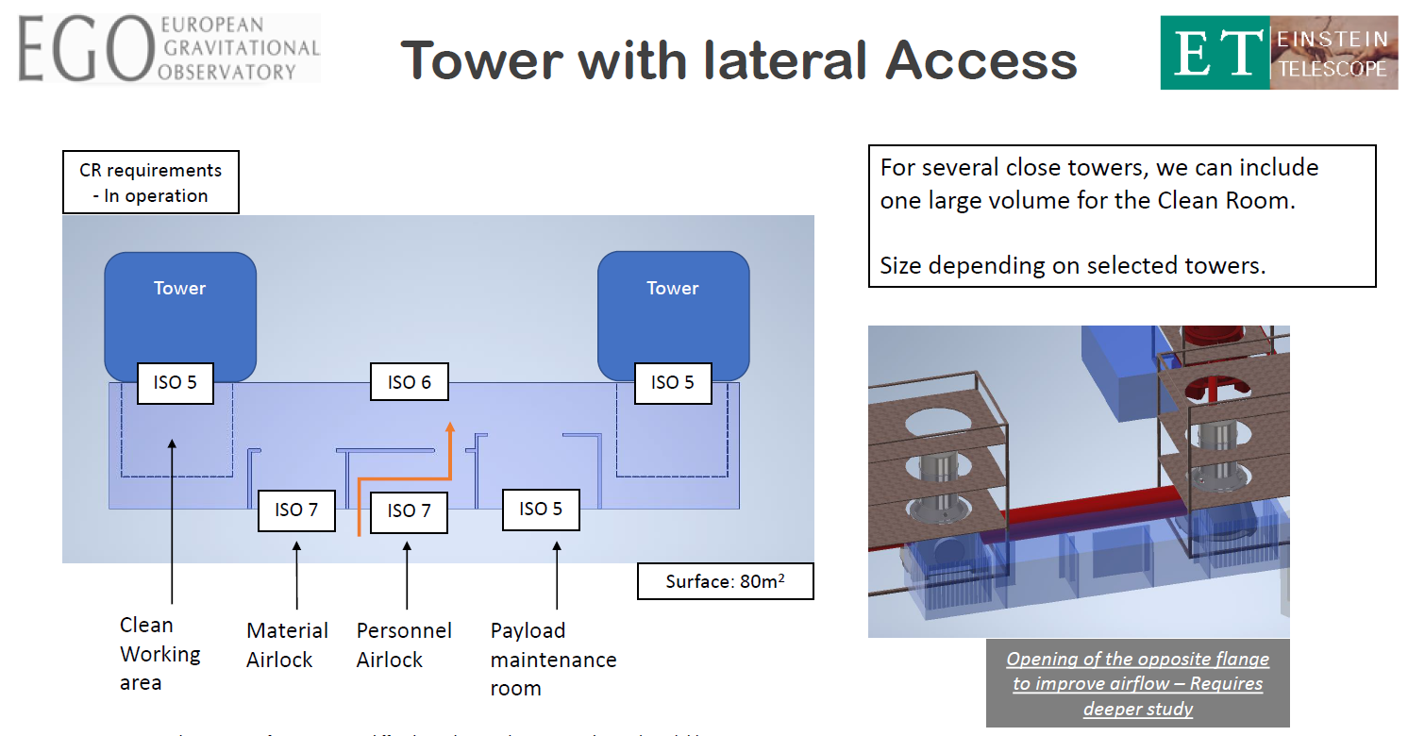

Slide 25
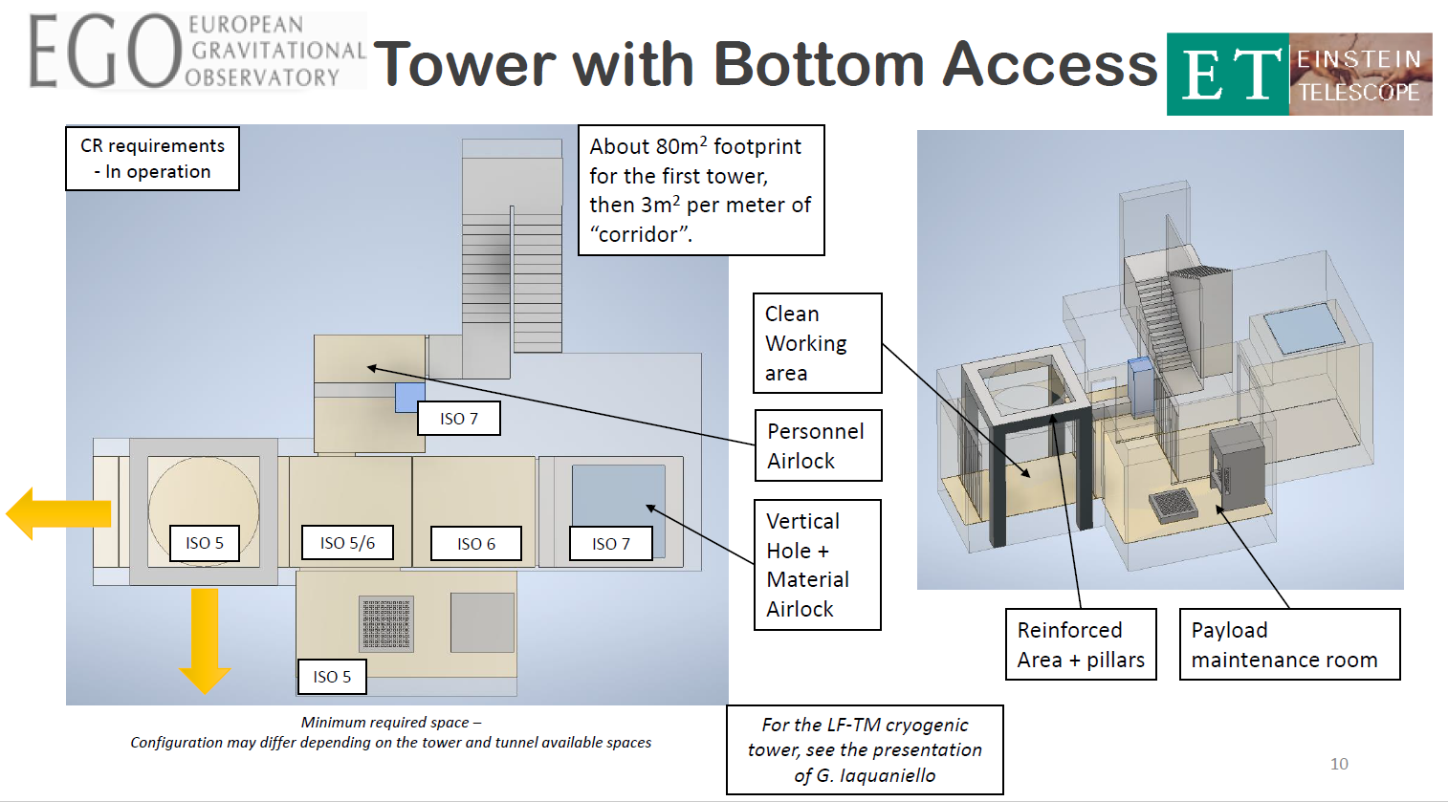

Slide 26
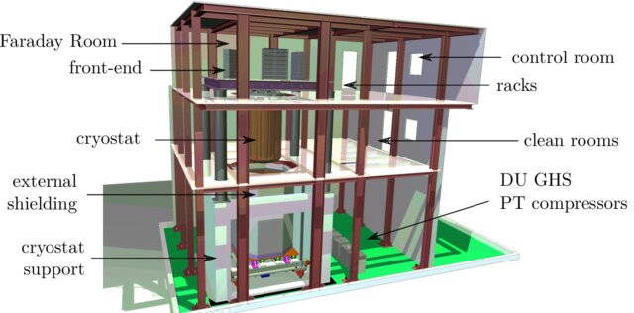
An Example of a High Level Clean Room in an underground experiment at LNGS:
CUORE Experiment (contact Angelo Cruciani)
https://cuore.lngs.infn.it/sites/default/files/PhD_Canonica.pdf

Slide 27
END

