Slide 1
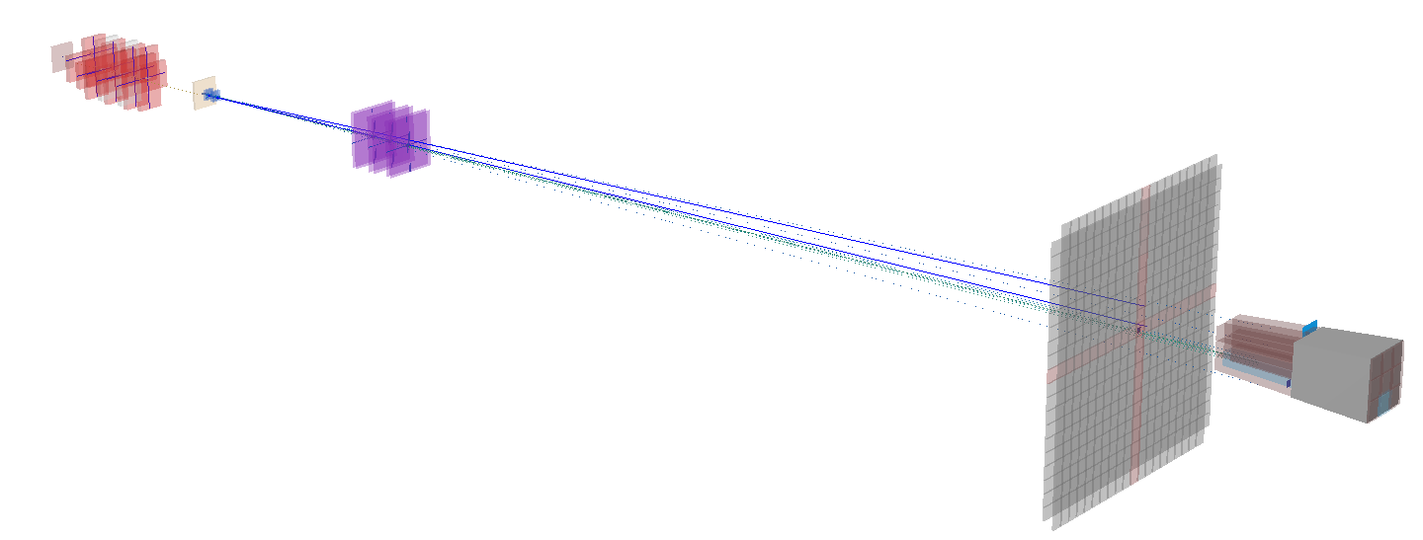
First attempt to study 𝛼-clustering fragmentation in GSI2021 data at 400 MeV/u
G. Battistoni, S. Muraro
INFN Milano

Slide 2
Introduction
At the Collaboration meeting in Naples, we reported the 1st MC study of multi-𝛼 tracking for the GSI2021 data concerning ¹⁶O fragmentation at 400 MeV/u, C target (GSI21PS_MC campaign), in view of the possibility of using global track reconstruction on real GS2021 experimental data:
https://agenda.infn.it/event/40055/contributions/233767/attachments/122536/179388/GBatt_AlphaGSI21.pdf
The GenFit reconstruction was used, implementing Event and Track selection cuts defined during the discussions in the Physics and Analysis group
Here we report about the 1st (overdue…) attempt to perform this reconstruction and analysis on the real data
Goal: start data analysis for 𝛼 -clustering with the electronic spectrometer beginning from the simplest case (no magnet) for ¹⁶O fragmentation (more interesting that ¹²C)

Slide 3
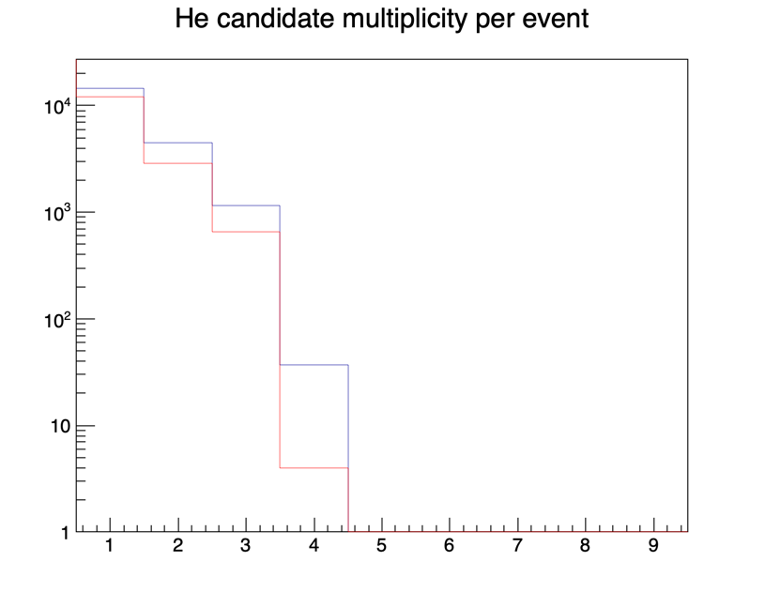
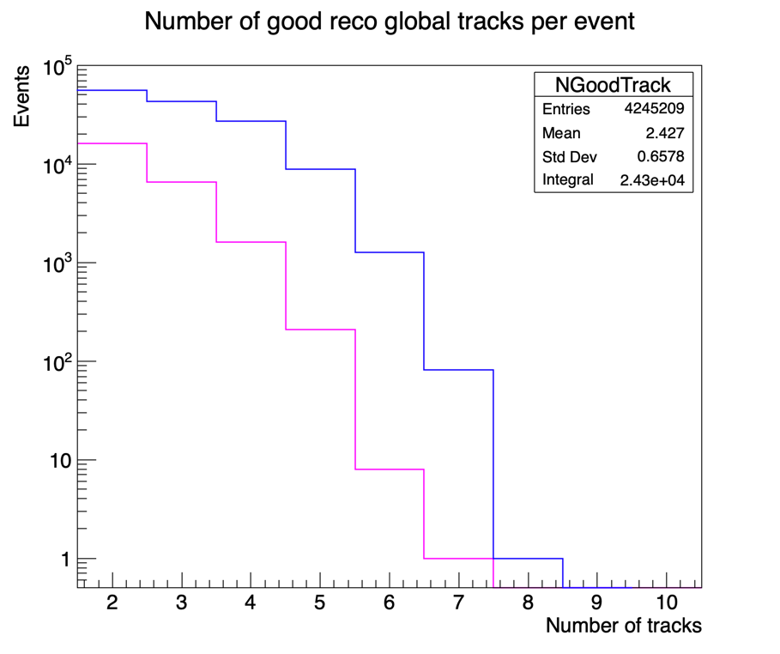
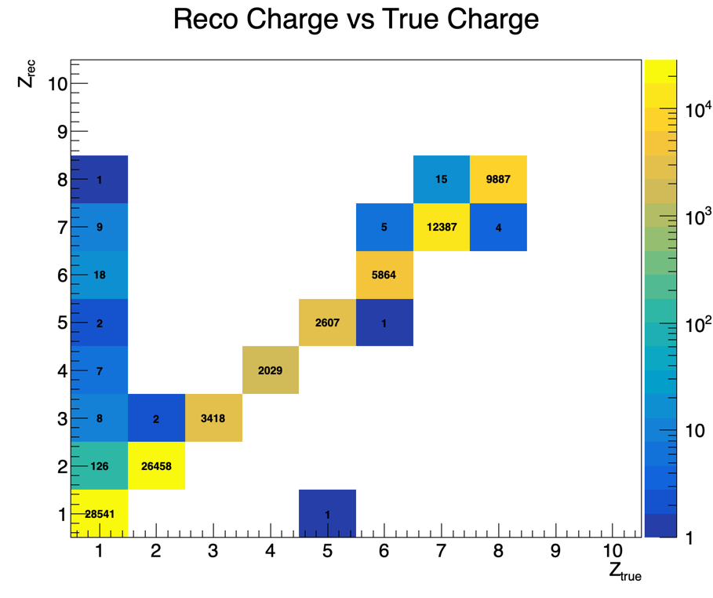
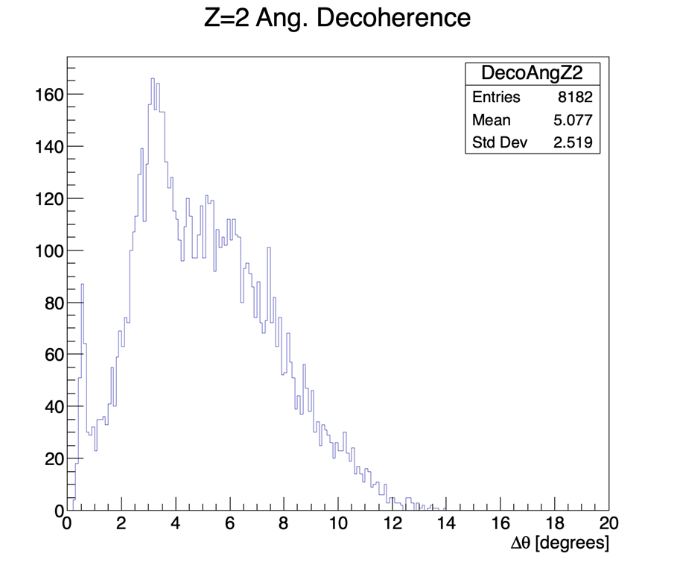
Summary of main results from MC study presented last year
5 10⁶ primary events
After event and track selection:
True Events
(N_{track}>1 at TW): 135 715
⁴He + ³He + …
True ⁴He
N_{Z=2} ≥ 2: 5685 event
of which 3542 are true ⁴He
Final Selected Events
Only 24 299 events left!
Z_{rec} = 2
8182 pairs selected
Z = 2 failed with <0.8% probabily

Slide 4
GSI2021 Run selection at 400 MeV/u
Run | Trigger type | n. events
4305 | Min. bias | 162110
4306 | Min. bias | 577120
4307 | Min. bias | 513365
4308 | Fragm. | 513391
4309 | Fragm. | 531838
4310 | Fragm. | 1012148
 | Total: | 3309972

Slide 5
Data Selection and Reconstruction
Following suggestions received by R.Z, M.T, Y.D, we excluded MSD (for the time being) from tracking: only VT + TW
New option: EnableBMVTmatch yes
Data reconstruction:
We have at first tried GenFit, both Standard and Linear: we failed to achieve a satisfactory results. Some results were presented at a physics meeting. Updated material on this is available here in the backup slides.
In a second attempt we used Straight Line Reconstruction achieving much better results. Here we present this approach

Slide 6
Straight Line Reconstruction: Event Selection
MSD were excluded from tracking by unsetting them in FootGlobal.par
Pile-up rejection: excluding events with more than one pulse in the SC acq. time window
1 BM track ⊗ ≥1 track with TW-point
Following experience from previous work by G. Ubaldi et al, we also ask for N_{track}≥2 to get rid of primary contamination

Slide 7
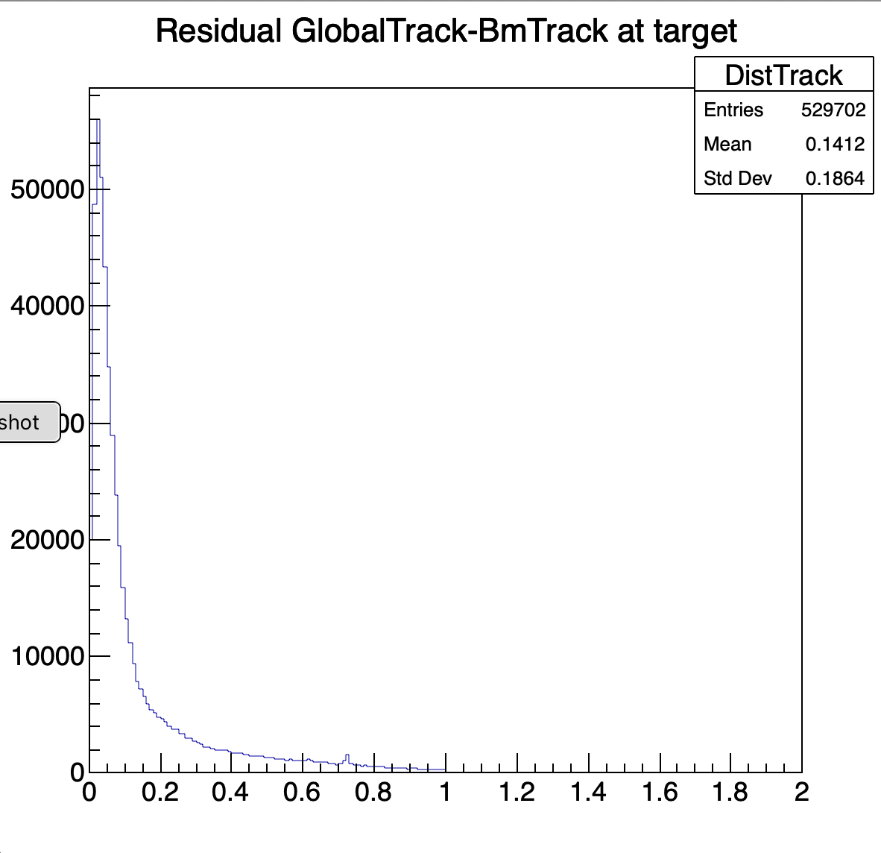
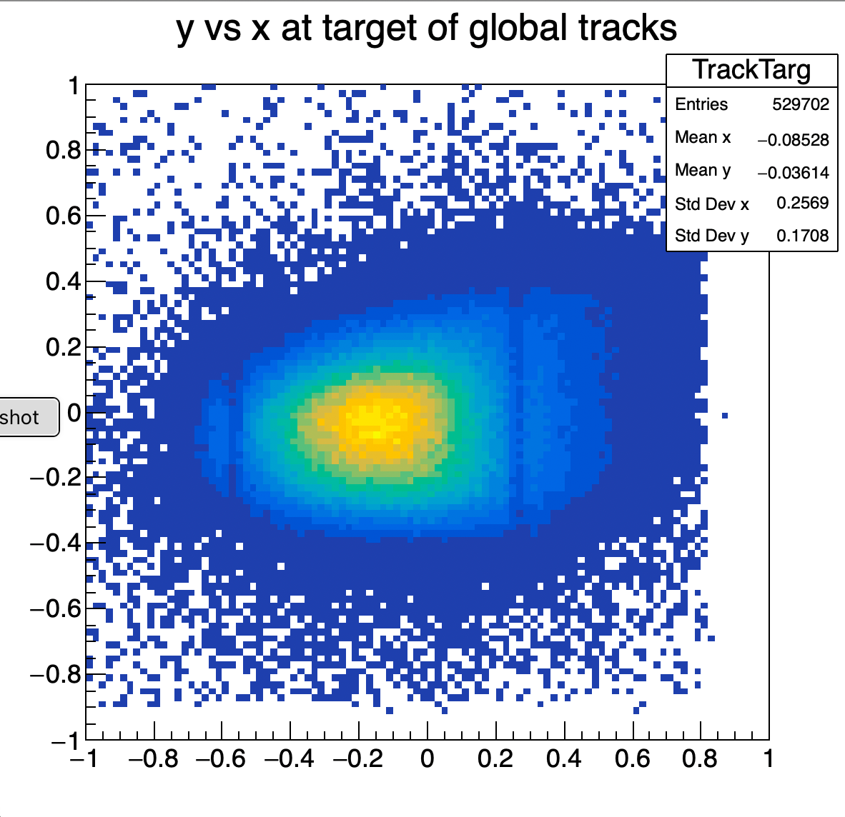
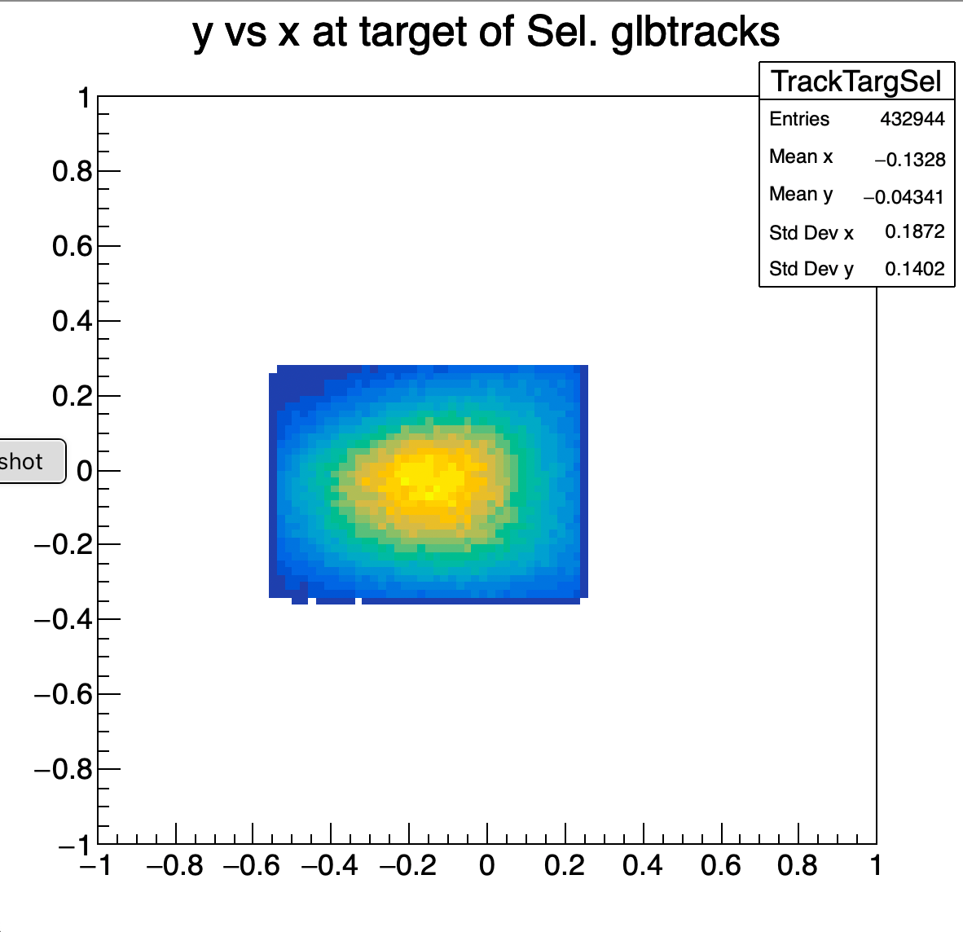
Track selection in the event
by default, after event selection, in each Global Track there are at least 3 VTX point and 1 TW point: tracks can have just 4 o 5 points in total
Selection on the matching between BM track and Global Track on the x-y plane at z=0 (center of target)
Selection on x-y position of primary beam at z=0
In Straight Line Reconstruction there is no available P(χ²) in Shoe to be used for track quality selection
Target
Global track
d
BM track
d < 0.15 cm

Slide 8
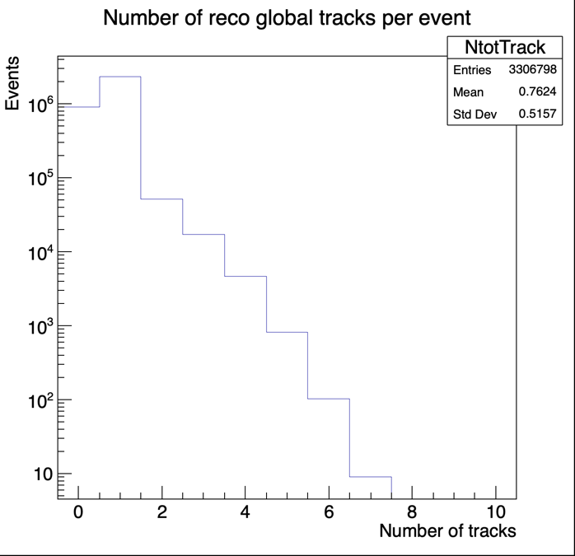
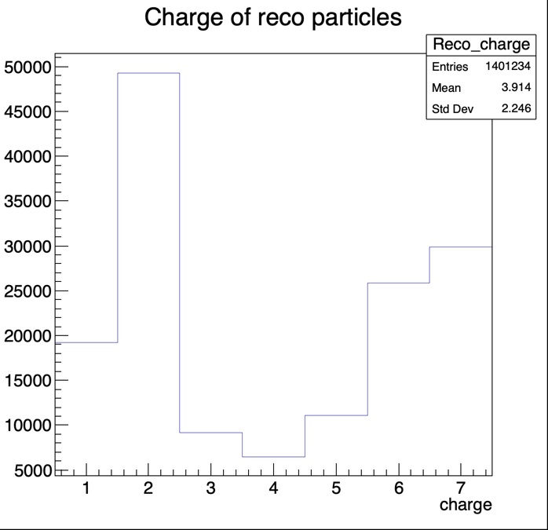
Straight Line Reconstruction
Exp. Data: all selected runs
Track multiplicity/event
All events

Slide 9
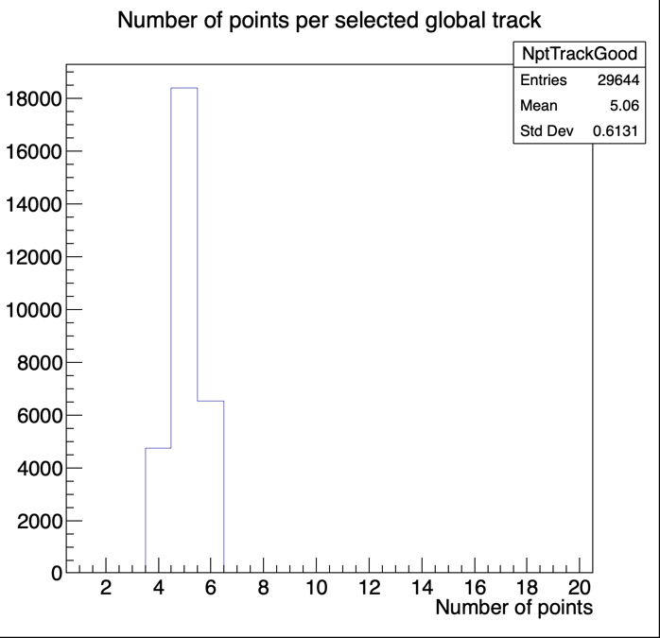
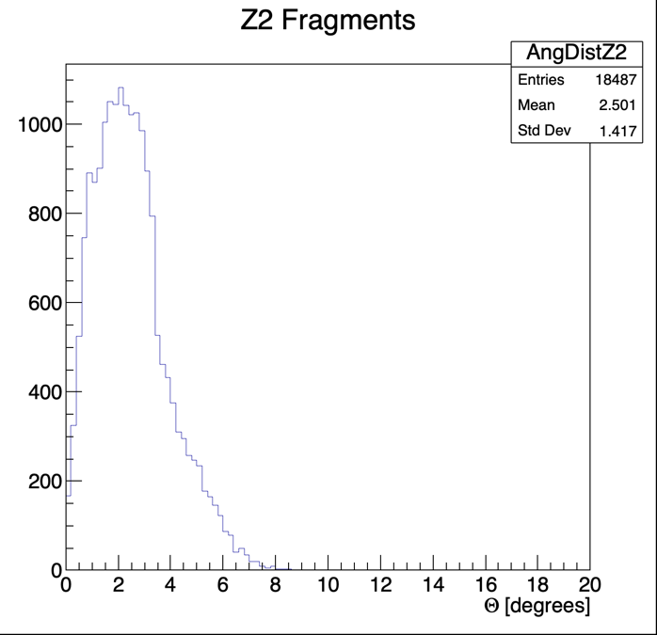
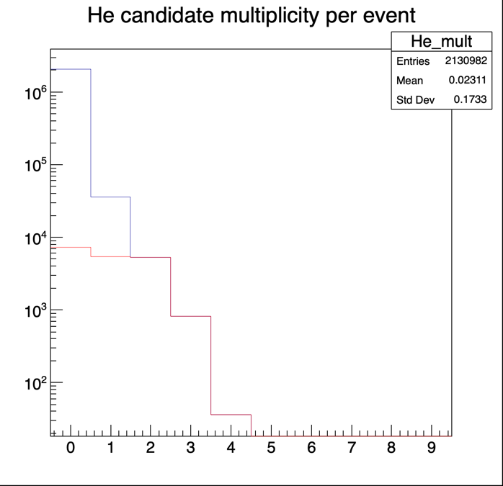
Straight Line Reconstruction with N_{track}≥2
Exp. Data: all selected runs
No. of points per selected track
Sometimes tracks have 6 points:
Calo is included as a point here
Angular distribution of Z=2 tracks
Multiplicity/event of Z=2 tracks
Final statistics:
Processed Events: 3306798 Rejected Events: 1175816 (35.6%) Events with 0 Tracks: 745337 (22.5%)
Total no. of Global Tracks: 2521223 (1.82 track/event)
Tracks with 1 TW point: 2105796 (83.5%) Tracks accepted after matching with BM target: 1401234 (66.5%)
Remaining tracks after N_{track}≥2 selection: 29644 (1.2%), of which Z=2 Tracks: 18487 (62.3% of accept. tracks)
Notes:
363587 N=0

Slide 10
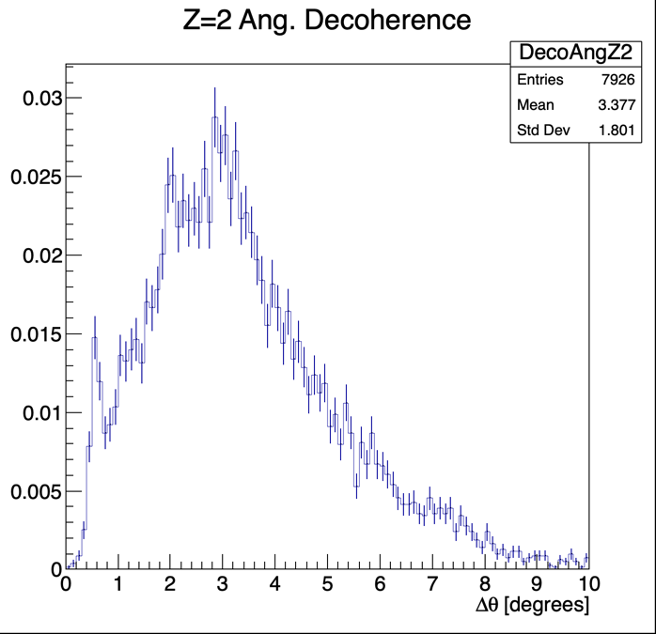
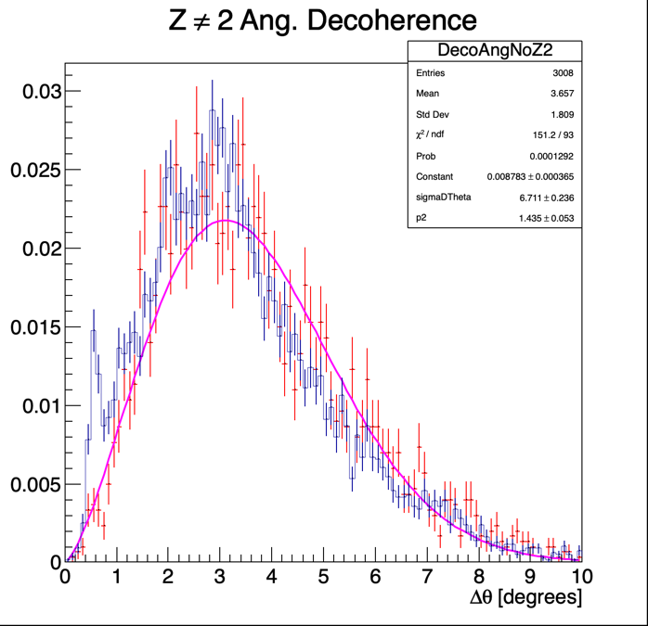
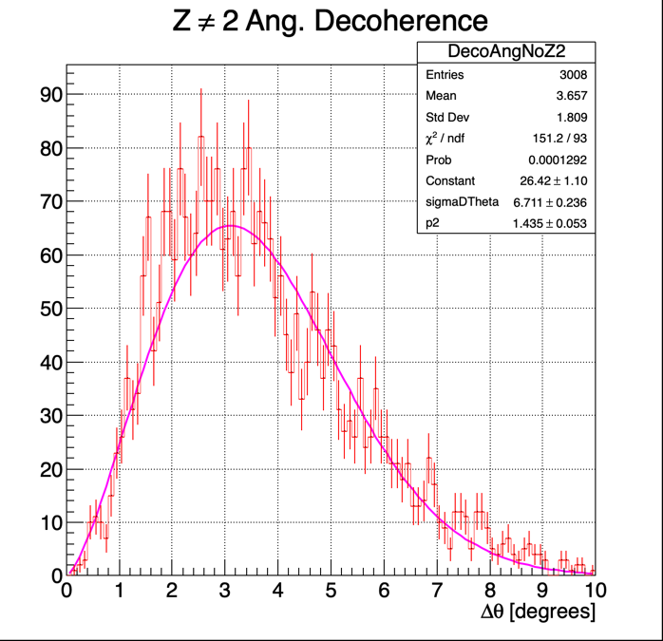
Present Results: angular separation of Z=2 tracks and search for ⁸Be peak
Exp. Data: all selected runs
Δθ for track pairs
with Z_{rec}=2
Δθ for track pairs
with Z_{rec}≠ 2
The attempted fit is just to guide the eye
Both normalized to Integral = 1

Slide 11
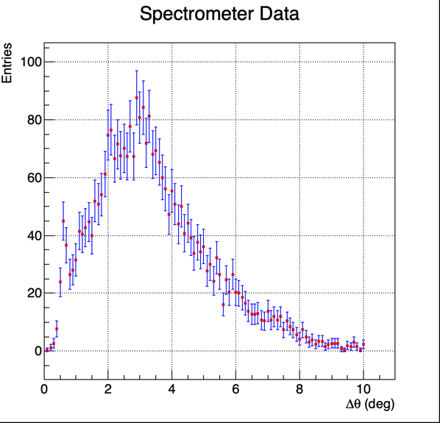
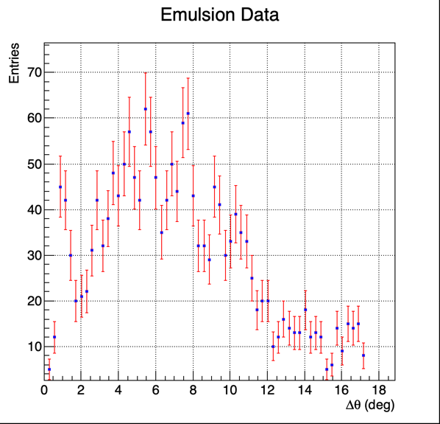
Comparison to Emulsion Data at 200 MeV/u
2 possible comments:
a) at 200 MeV/u you indeed expect a wider angular separation
b) in the electronic setup, small angular separations are penalized: superposition on the same TW bar

Slide 12
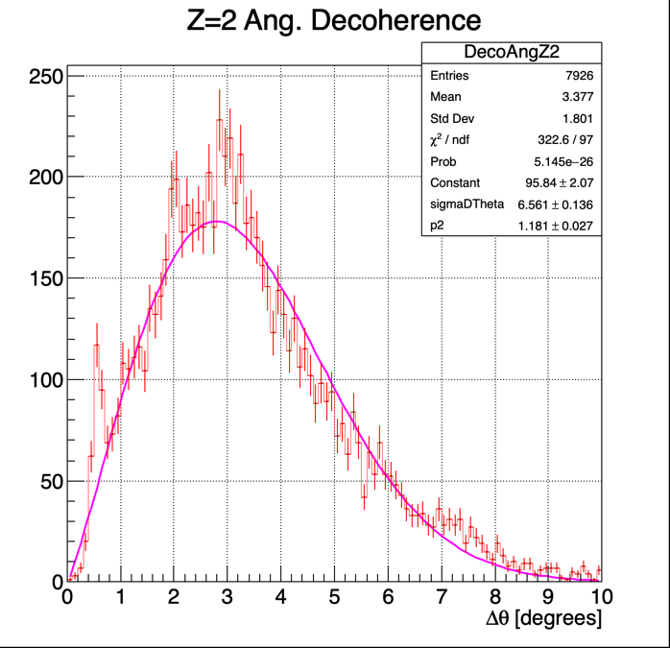
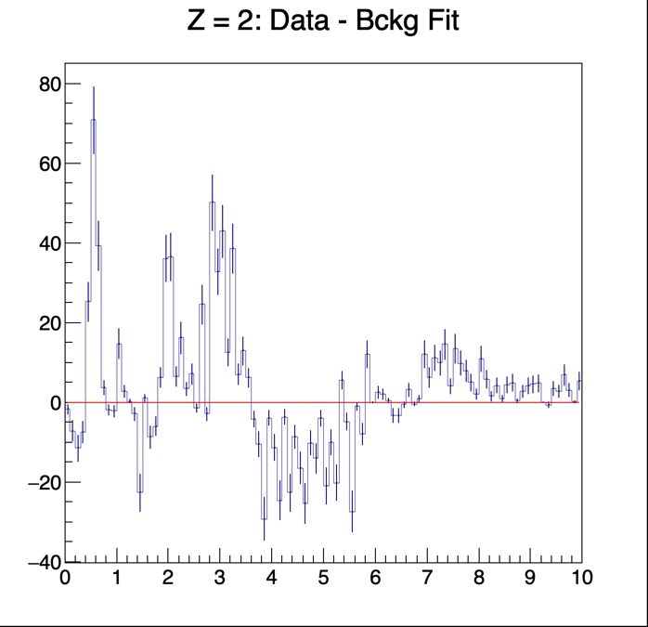
Observation of other possible structures and their interpretation
Data – Background Fit
These structures could reflect other very interesting nuclear physics processes (➔ including the higher excited levels of ⁸Be!!) , but, at the same time, they could also point to possible contaminations in the Z_{rec}=2 sample.

Slide 13
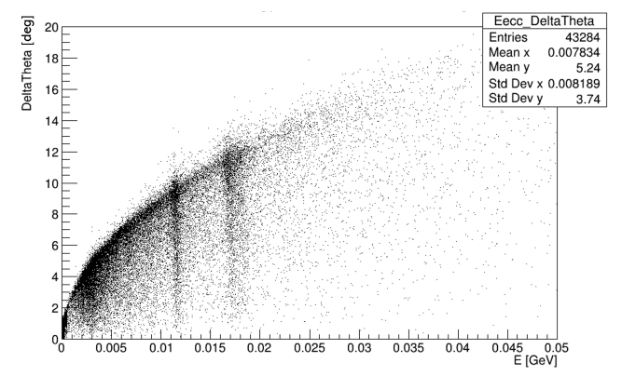
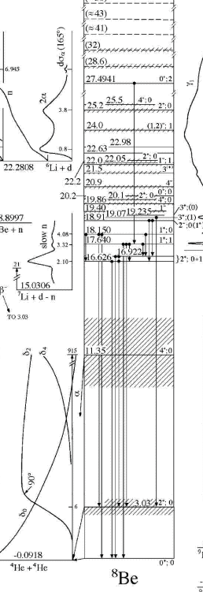
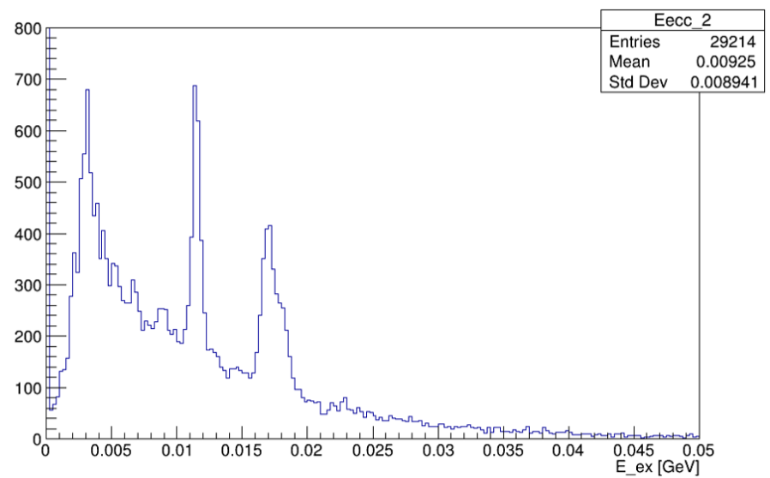
Δθ vs Excitation energy for ⁸Be
¹²C(α, ⁸Be)
MC Truth
¹²C + C @ 200 MeV/u
Extracted from
A. Caglioni’s talk at dec. 2023 meeting in Trento
3.03 MeV
11.4 MeV
∼17 MeV
92 KeV
Opening angle between α particles vs excitation energy in the the breakup of ⁸Be intermediate stage of ¹²C into 2 α particles (MC Truth analysis)
Sorry, we have not yet the same plot for ¹⁶O+C at 400 MeV

Slide 14
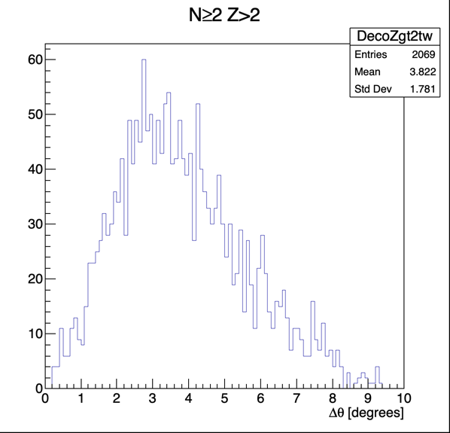
What we just learned from MC (MC truth)
GSI21PS_MC simulation campaign
The only distribution with no visible structures comes from the coupling of Z>2 particles
MC truth
Instead, important structures are predicted when considering the pairing of Z=2 and Z=1 particles

Slide 15
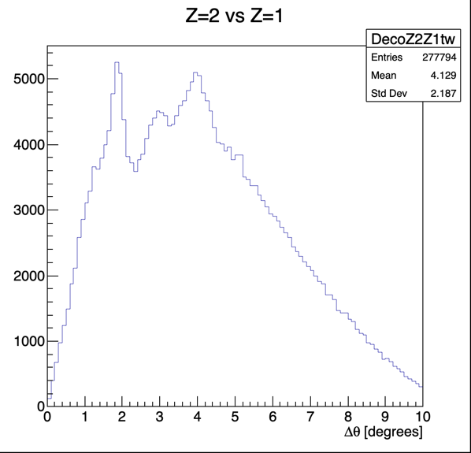
What we just learned from MC (MC truth)
GSI21PS_MC simulation campaign
Angular separation of Z=2 and Z=1 particles
MC truth
What are these structures?
➔ There are other nuclei exhibiting prompt decay similarly ton the ⁸Be case

Slide 16
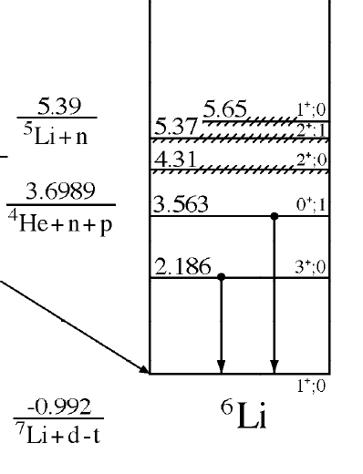
Interesting prompt decay cases:
⁴Li → ³He + p
⁵Li → ⁴He + p
⁶Li* → ⁴He + d
τ = 9.10 10⁻²³ s M(⁴Li) = 4.0255 u
τ = 3.04 10⁻²² s M(⁵Li) = 5.0109 u
τ = 7.6 10⁻²³ s M(⁶Li) = 5.6031 u
⁶Li is stable, but his excited levels can have a strong prompt decay:
M(⁶Li g.s.) = 5.6015 GeV/c² ; M(⁴He) + M(²H) = 5.6030 GeV/c² ➔ΔM = 1.47 MeV/c²
(excluding the 0⁺ 3.563 MeV level because of quantum numbers)

Slide 17
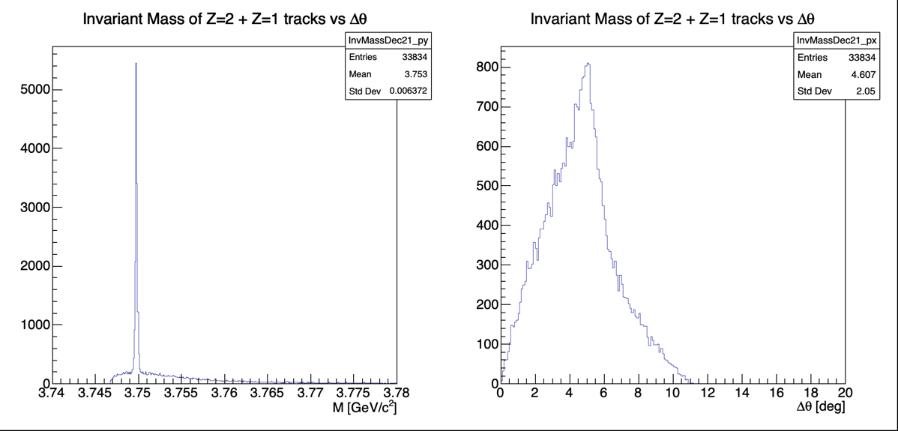
MC truth analysis: ⁴Li region
MC truth
Invariant mass of ³He + p
Δθ for ³He + p

Slide 18
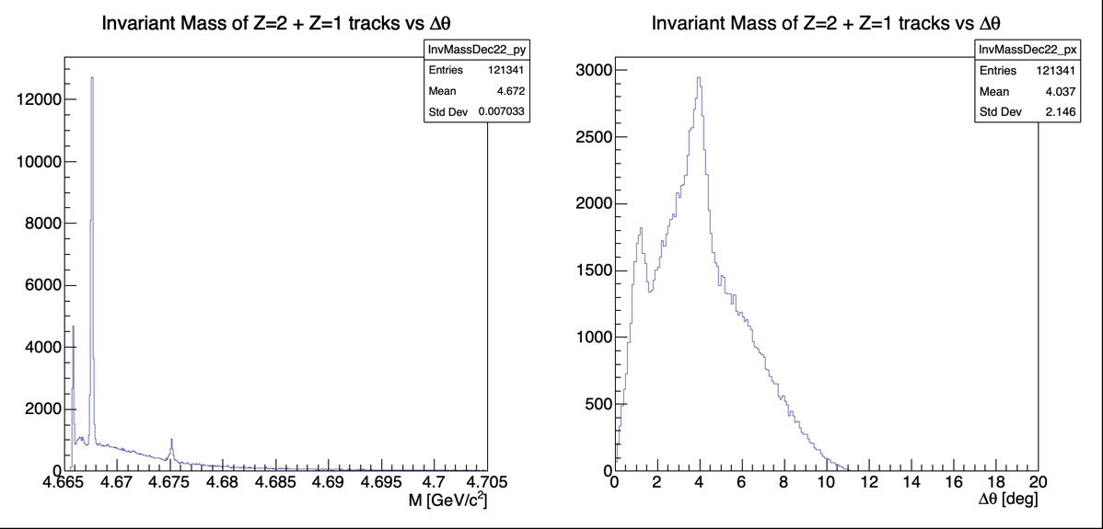
MC truth analysis: ⁵Li region
MC truth
Invariant mass of ⁴He + p
Δθ for ⁴He + p

Slide 19
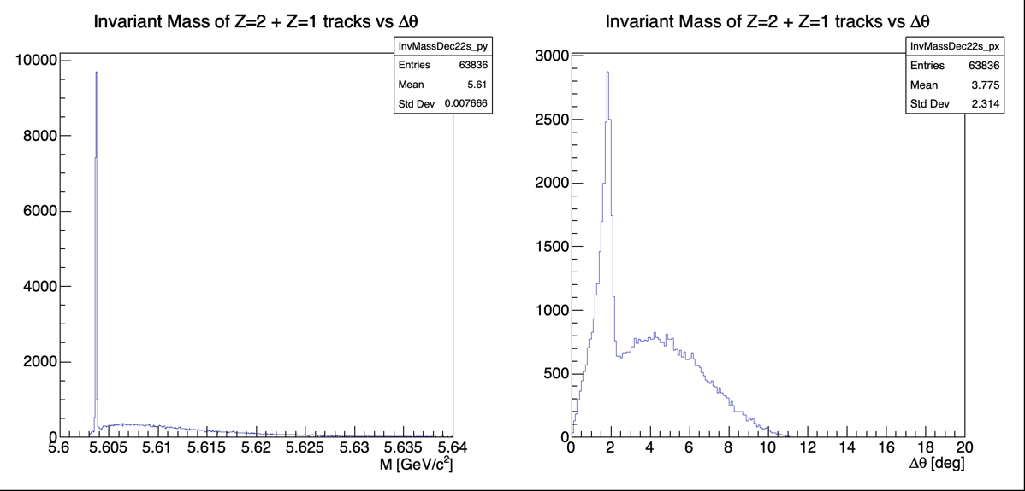
MC truth analysis: ⁶Li region
MC truth
Invariant mass of ⁴He + d
Δθ for ⁴He + d

Slide 20
Close to ⁶Li → ⁴H+d
but not exactly the same
MC truth
Close to ⁵Li → ³H+p
but not really the same…
This one is missing in the data!
(which is also interesting)
Data – Background Fit
All this is very preliminary, but also intriguing…
However, the Z=1 contamination hypothesis remains a plausible scenario

Slide 21
Comparison with reconstructed MC
Having switched to Straight Line Reconstruction, all the numbers presented in Naples are no more valid
We have reprocessed MC using Straight Line Rec. applying the same cuts used for exp. data
2 10⁶ events processed.
It immediately appears how this tracking is more efficient on MC than for real data:
Processed Events: 2000000 Rejected Events: 123061 (6.2%) Events with 0 Tracks: 213650 (10.7%)
Total no. of Global Tracks: 2220655 (1.5 track/event)
Tracks with 1 TW point: 2086994 (94%) Tracks accepted after matching with BM target: 1717282 (77%)
Remaining tracks after N_{track}≥2 selection: 90048 (4%), of which Z=2 Tracks: 37465 (41.6% of accepted tracks)

Slide 22
Comparison summary
Exp. data:
Processed Events: 3306798 Rejected Events: 1175816 (35.6%) Events with 0 Tracks: 745337 (22.5%)
Total no. of Global Tracks: 2521223 (1.82 track/event)
Tracks with 1 TW point: 2105796 (83.5%) Tracks accepted after matching with BM target: 1401234 (66.5%)
Remaining tracks after N_{track}≥2 selection: 29644 (1.2%), of which Z=2 Tracks: 18487 (62.3% of accept. tracks)
MC:
Processed Events: 2000000 Rejected Events: 123061 (6.2%) Events with 0 Tracks: 213650 (10.7%)
Total no. of Global Tracks: 2220655 (1.5 track/event)
Tracks with 1 TW point: 2086994 (94%) Tracks accepted after matching with BM target: 1717282 (77%)
Remaining tracks after N_{track}≥2 selection: 90048 (4%), of which Z=2 Tracks: 37465 (41.6% of accepted tracks)
Can we really compare MC to data?
This is not just a question about the nuclear physics model

Slide 23
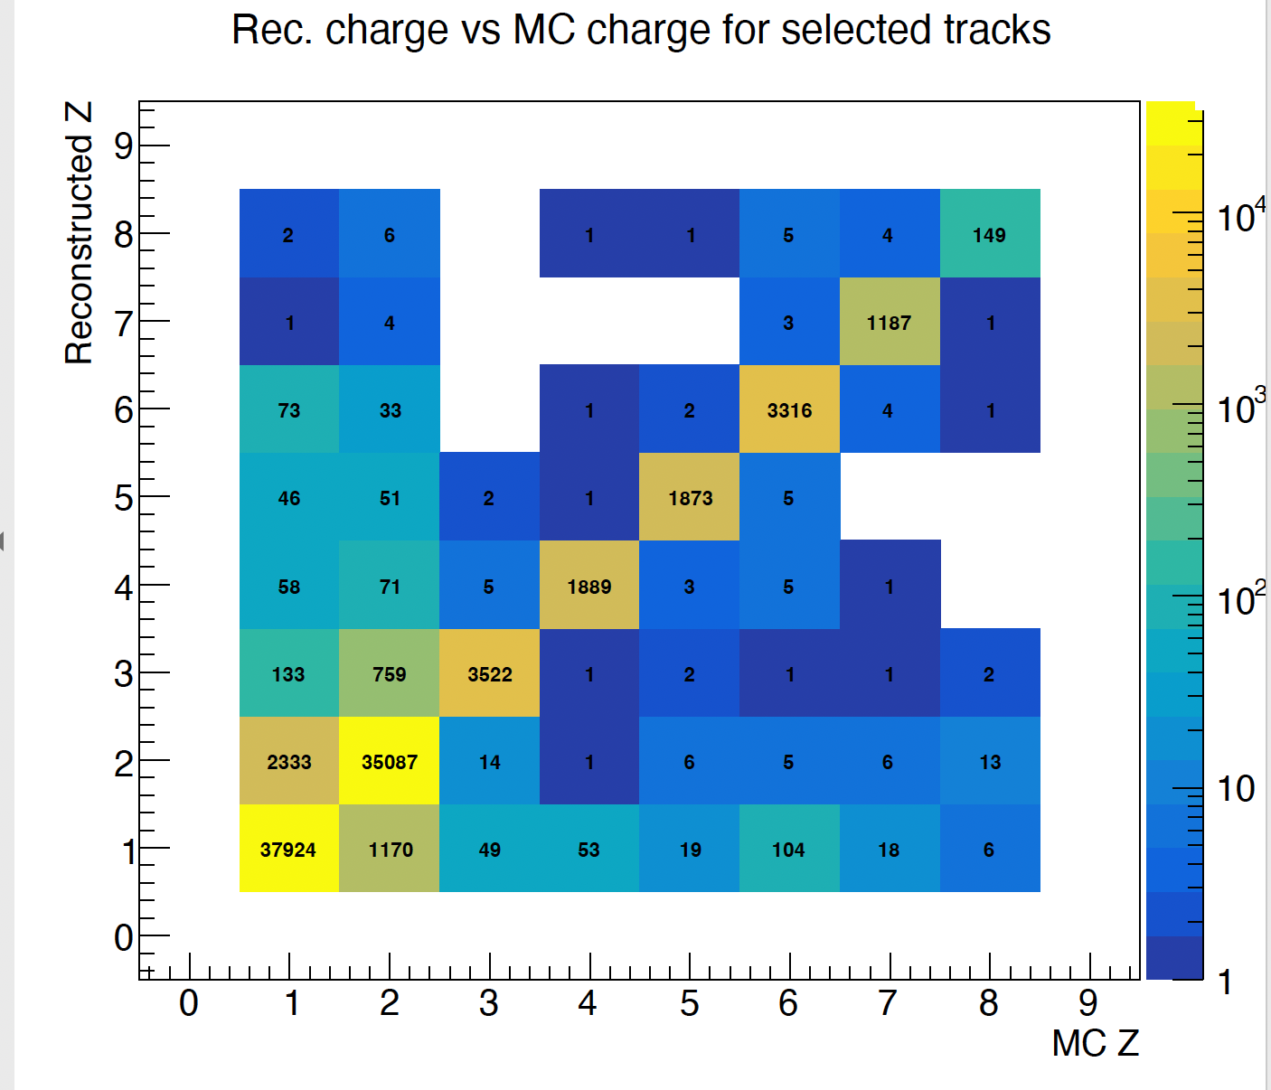
Comparison with reconstructed MC
Reconstructed Z vs True Z
This matrix is essentially diagonal, but the sample of Z=2 tracks has a contamination of Z=1 of the order of ~6.5%
It is unclear if we can trust this prediction: at present we are not including in MC the inefficiency of VT for Z=1 particles

Slide 24
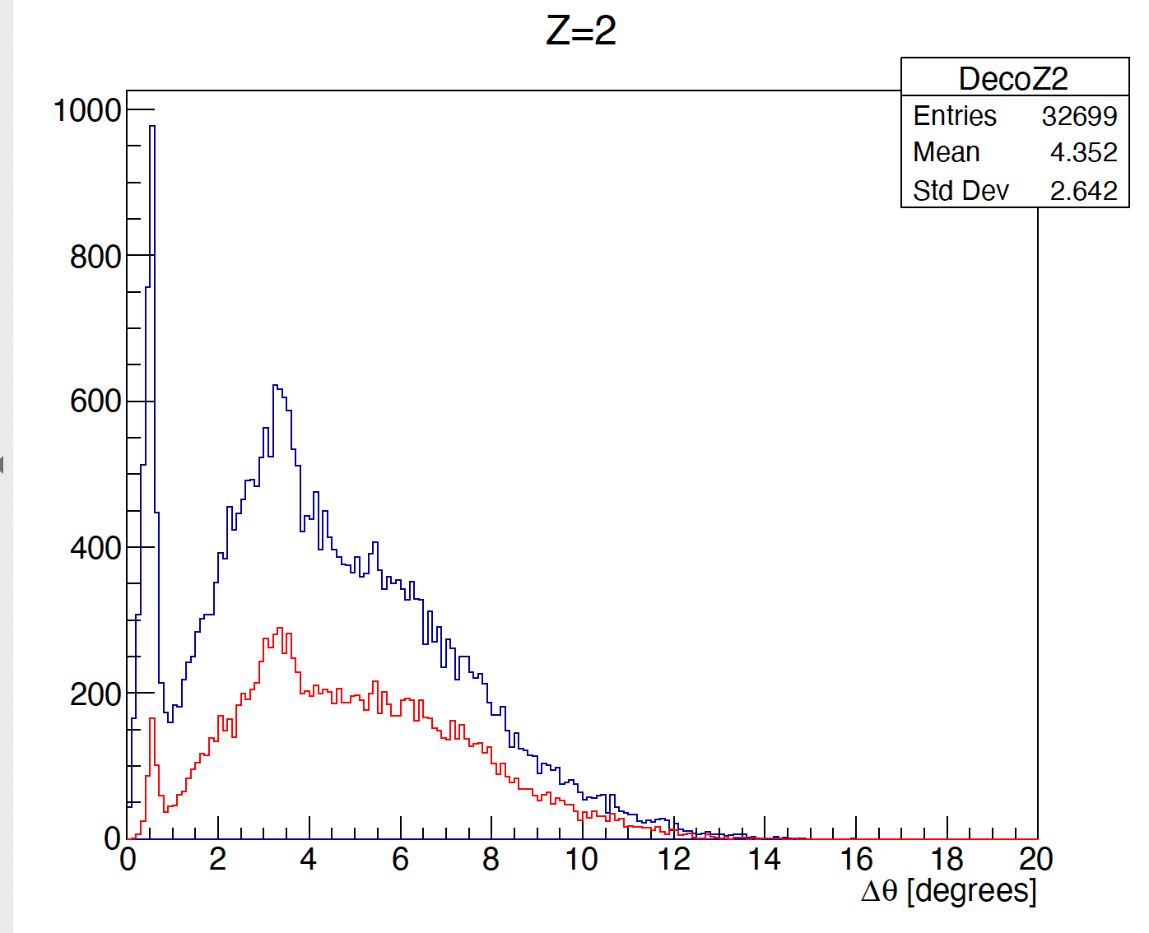
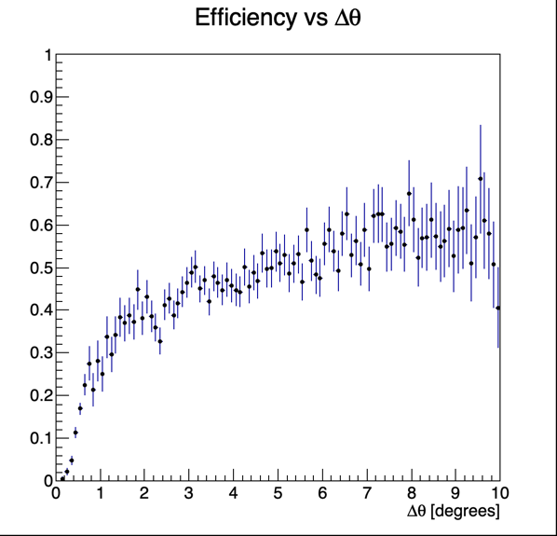
Comparison with reconstructed MC
Estimate of efficiency in the measurement of angular separation
MC truth: all the Z=2 tracks arriving at TW
Bin to bin ratio
MC reconstructed:
The ⁸Be_{g.s.} peak at small angular separation is strongly penalized
In this respect 400 MeV/u is worse than 200 MeV/u: narrower distributions

Slide 25
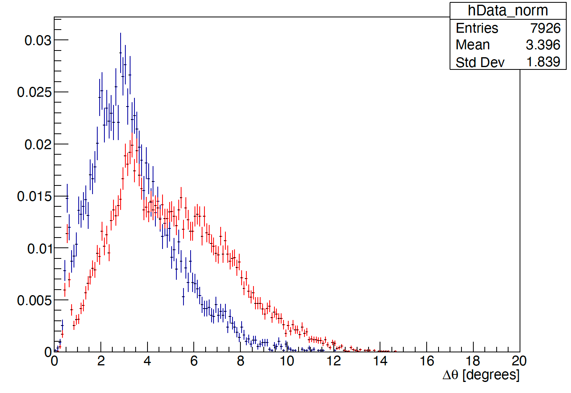
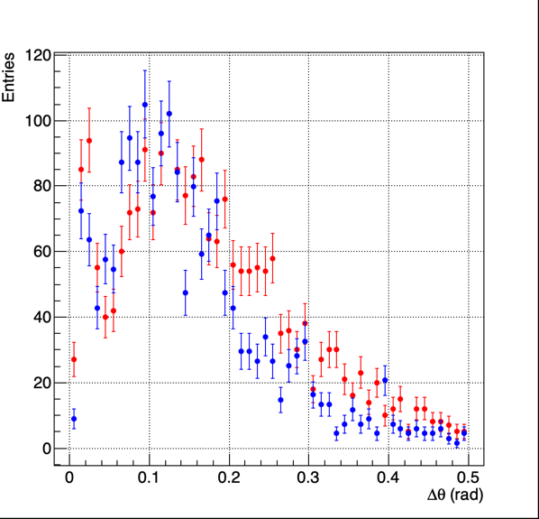
Comparison of data with reconstructed MC
There are strong differences between MC and data!
Exp data
In the case of emulsion data at 200 MeV/u MC prediction and exp. data were much closer:
Normalized to the same area
Reconstr. MC
Numbers taken from Naples slides dec. 2023, and approximately normalized to same integral
Exp,.Data
Reconstr. MC

Slide 26
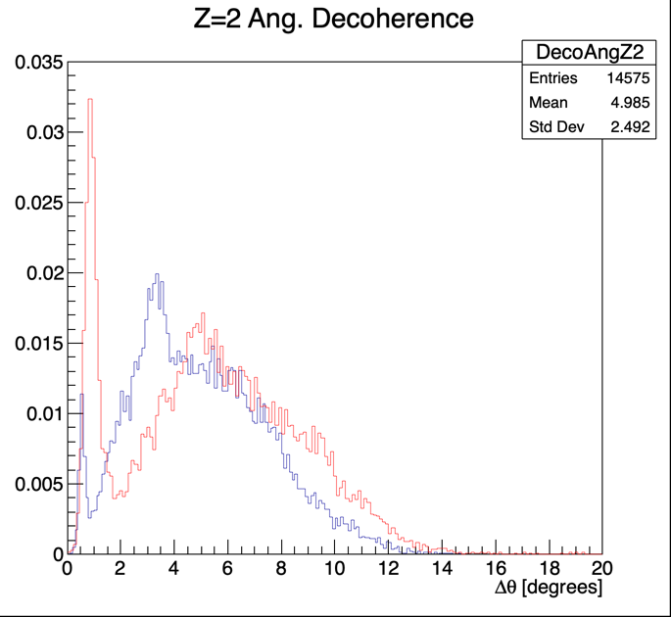
About energy and projectile in the MC
MC reconstructed:
this analysis 16O @ 400 MeV/u
Warning:
In FLUKA MC the ¹²C → 3 𝛼 fragmentation is already considered in detail with probability taken from existing data
This is not the case for ¹⁶O fragmentation
MC reconstructed:
¹²C @ 200 MeV/u
(see A. Caglioni, Trento 2023)

Slide 27
Conclusions
The analysis of GSI2021 data turned out to be not easy at all, and there is a penalty from large pile-up.
Apparently, there are problems in using GenFit. Straight Line Reconstruction seems to work better. The analysis strategy studied one year ago had to be totally rebuilt
There are still a lot of uncertainties that cannot be simply solved without additional information. For instance, the reliability of Z reconstruction and the amount of Z=1 contamination
MSD had to be taken away from reconstruction, for the time being. They could be very helpful in this situation
There are important disagreements in the comparison of data and MC, and there are surely differences with respect to the 200 MeV/u case:
At the moment it is unclear if there are issues in the physics model (which indeed might depend on energy) or if the simple reconstruction used in this analysis in faulty or introducing biases
It is however clear that there are instrumental inefficiencies at small angle separation which must be more evident when energy increases

Slide 28
Take home messages
Hints of other interesting nuclear physics processes are emerging. They must be taken into account for our future analyses!
The structures in Z1-Z2 correlation should be explored also with emulsions
It is anyway of fundamental important that both electronic spectrometer and emulsion analyze these phenomena at the same energy
This means that it’s probably necessary to analyze also GSI2021 data at 200 MeV/u (and run the simulation as well…)
For the electronic spectrometer: in order to understand better our systematics and to give answers to the many questions arising from GSI2021 data, it is ot the outmost importance to analyze ¹²C data taken with full detector and lower energy. Is CNAO2024 the most viable data set?

Slide 29
Backup Slides

Slide 30
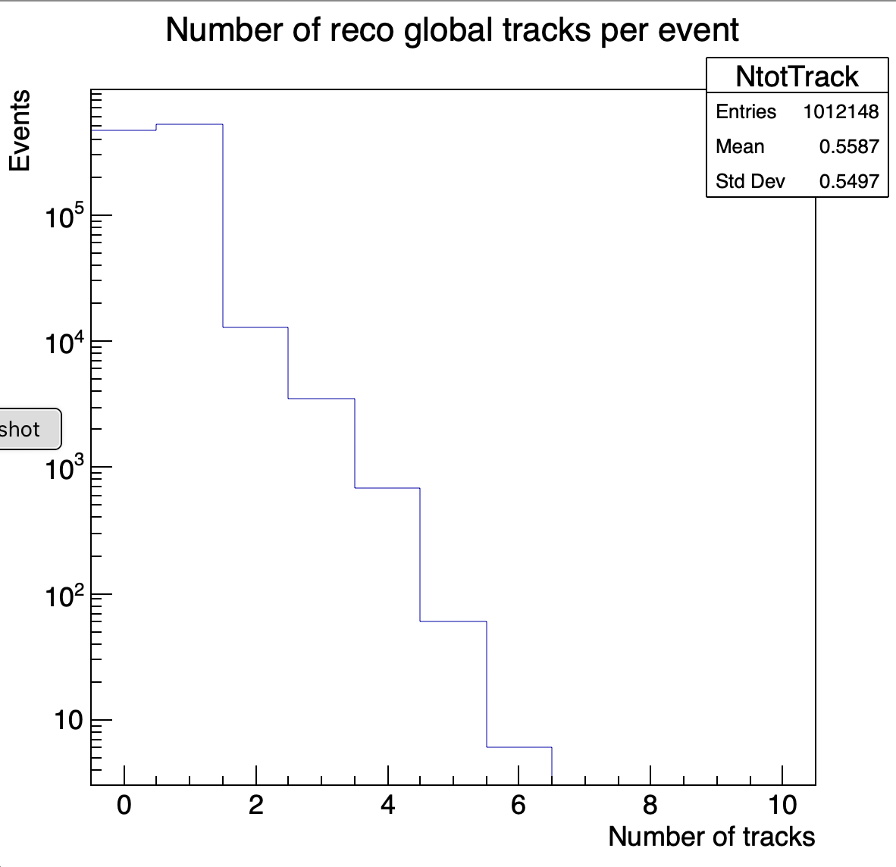
1) GenFit Reconstruction test with run 4310
No track selection!
Track multiplicity/event
468828 events with 0 reconstructed tracks
1 track: 526166 events
2 tracks: 12940 events
3 tracks: 3465 events
4 tracks: 682 events
5 tracks: 61 events
6 tracks: 6 events
In 1 track events there are
mainly non interacted primaries

Slide 31
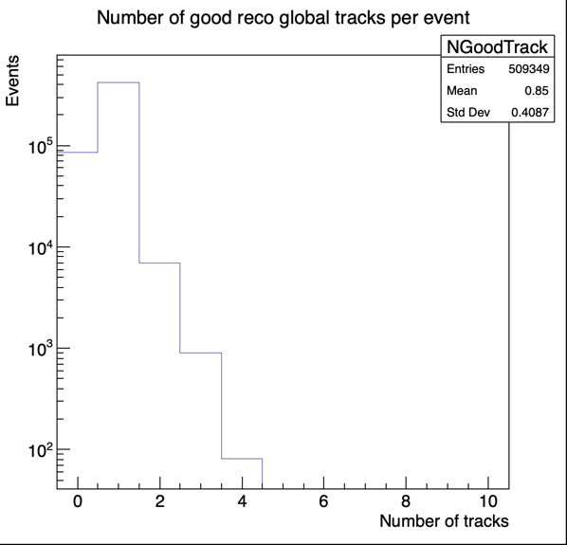
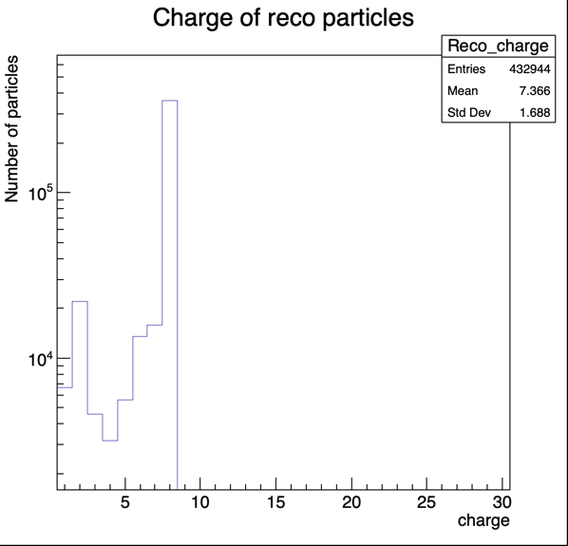
GenFit run 4310 after track selection
Track multiplicity/event
High multiplicities are killed

Slide 32
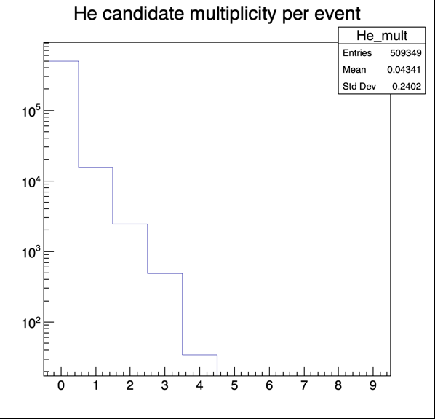
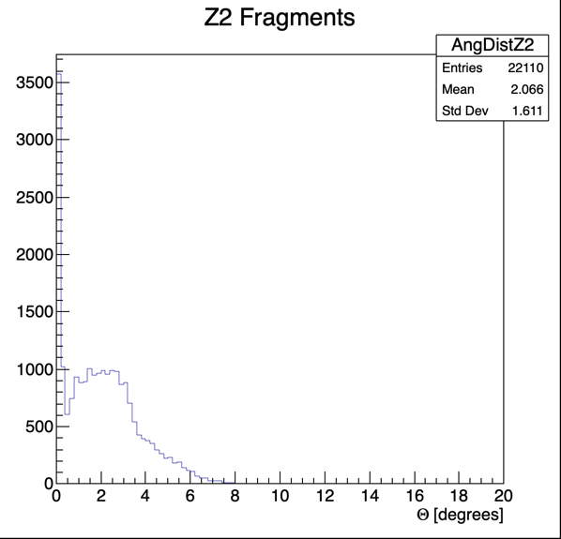
GenFit run 4310 after track selection
He(rec) multiplicity/event
Angular distribution of Z=2 tracks
High peak close to 0 degrees
Cuts are necessary

Slide 33
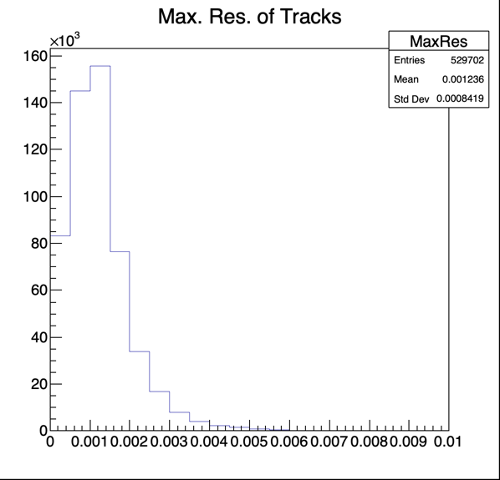
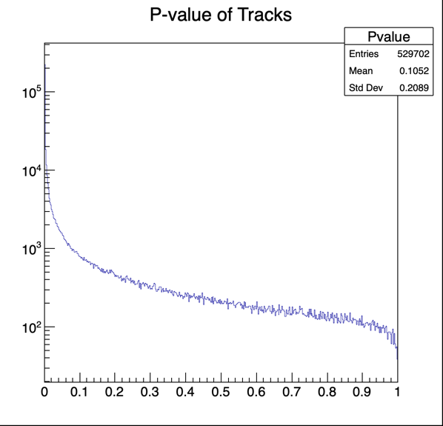
GenFit run 4310 after track selection
P(χ²)
Maximal residual between a Track Point and the Fitted position:
Seems a reasonable distribution

Slide 34
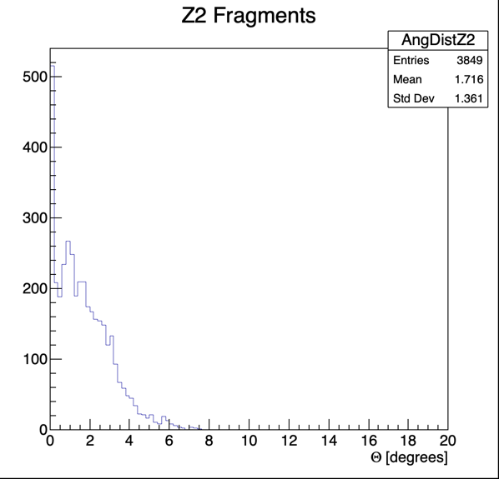
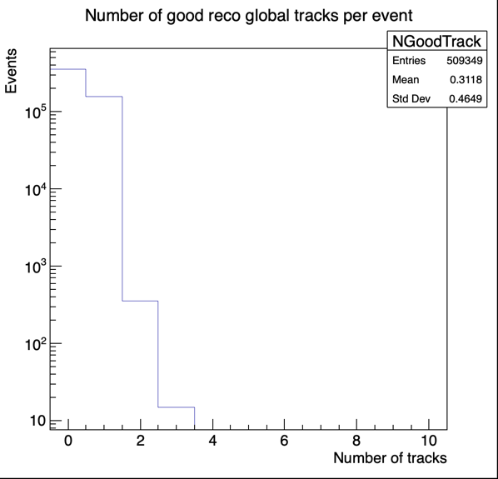
Attempting standard (loose) quality cuts
P(χ²) > 0.02
run 4310
Track Multiplicity/event
Angular distribution of Z=2 tracks
Events with Ntracks>1 are killed!
Number of events with Z=2 is also strongly reduced using the P-value cut

Slide 35
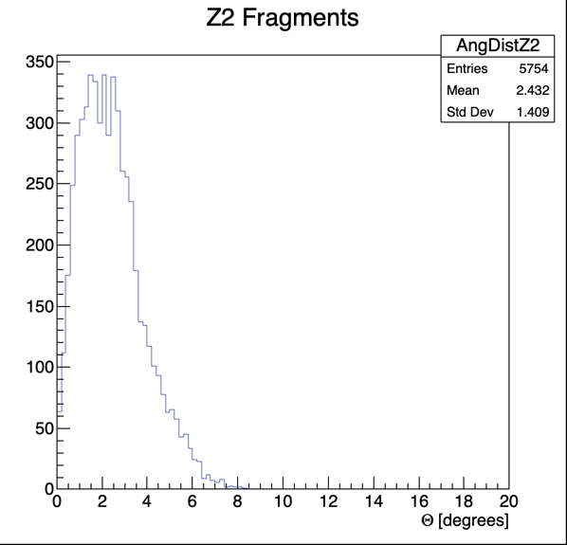
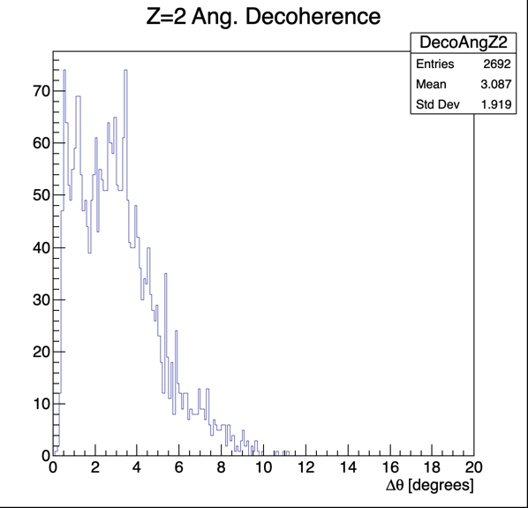
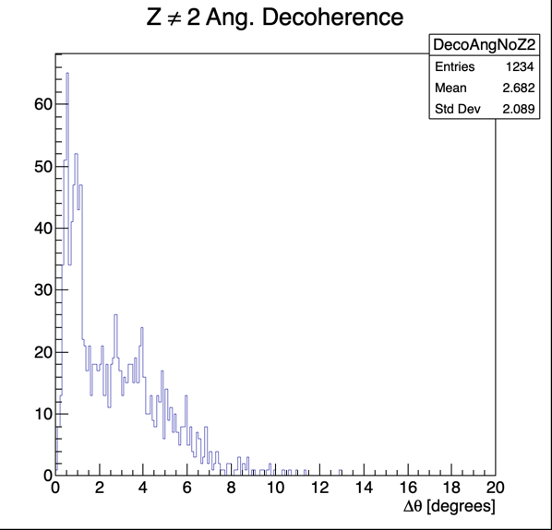
Dismissing cut on P(χ²) and requiring N_{track}≥2
run 4310
Angular separation of pairs of Z=2 tracks
Angular separation of pairs of Z != 2 tracks
Angular distribution of Z=2 tracks
Now seems clean
Weird distributions…

