Slide 1
Institute Board Meeting Report
Riccione, 28 May 2025

Slide 2
Agenda
Next data takings
Detector performance paper
Rotation of charges
FOOT award for Master theses or PhD theses?
New collaborators
Next meeting location
AoB

Slide 3
1. Next data takings; next requests
2025 CNAO 2025 (p, C), october-November (5-6 shifts)
+ one shift at the beginning of September for IT/VTX studies
2026 GSI ESA PAC
Setting FOOT on Mars:
Cross-Section Measurements for Space Radioprotection
Fragmentation of a ¹²C ion at 0.7 and 1.5 GeV/c
We asked to be at the beginning of an ESA allocated data period
→ It could mean also apr 26!
Plan B: CNAO

Slide 4
1.B Call MAECI
Main goal: accessing German infrastructures (FAIR-GSI explicitly mentioned)
Max cost: 400k€ for the italian party; 50% by MAECI, 50% by the hosting institute
No funding for the german infrastructure (!)
Duration: 3 years, from 01 jan 2026 to 31 dec 2028.
Non-staff positions can be funded; travel expances to Germany covered
Two possible German partners: GSI, Heidelber.
We’ll try to discuss with them if they are interested.

Slide 5
1.B Call MAECI
Main goal: accessing German infrastructures (FAIR-GSI explicitly mentioned)
Max cost: 400k€ for the italian party; 50% by MAECI, 50% by the hosting institute
No funding for the german infrastructure (!)
Duration: 3 years, from 01 jan 2026 to 31 dec 2028.
Non-staff positions can be funded; travel expances to Germany covered
Two possible German partners: GSI, Heidelberg.
We’ll try to discuss with them if they are interested.
«Two is better than one»
We might decide to make two diffent applications to double the success probabilities

Slide 6
2. Detector performance paper
We have two FOOT general papers:
- Conceptual design report … used for the FOOT starting
- «Measuring the impact of nuclear interaction in particle therapy and in radio
protection in space: the FOOT experiment”; mostly based on Monte Carlo studies
Proposal to have a «general performance paper» containing the summary of performances of each (sub) detector and the complete detectors (electronic & ECC)
We have already many performace informations on several detectors; some already published. Not a substitute for detailed sub detector performance papers; needed for analyses!!

Slide 7
2. Detector performance paper
We have two FOOT general papers:
- Conceptual design report … used for the FOOT starting
- «Measuring the impact of nuclear interaction in particle therapy and in radio
protection in space: the FOOT experiment”; mostly based on Monte Carlo studies
Proposal to have a «general performance paper» containing the summary of performances of each (sub) detector and the complete detectors (electronic & ECC)
We have already many performace informations on several detectors; some already published. Not a substitute for detailed sub detector performance papers; needed for analyses!!
Traini, Galati, Servoli already «volontiered…» for the organization.
Time scale: 80% of paper and performances ready for the end of the year

Slide 8
3. Rotation of charges
Physics Coordinator:
M. Toppi (jun 25)
Note that at the moment there is no «deputy» physics coordinator
Editorial Board:
A. Kraan (EB chair, jun 25), A. Lauria (jun 26), G. Traini (jun 25)
Software coordination:
Y. Dong (deputy, dec 26), A. Zarrella (deputy, dec 26)
Technical coordination:
M. Morrocchi (jun 26)
Spokesperson:
M. Villa (dec 26), P. Cerello (deputy)

Slide 9
3. Rotation of charges
Physics Coordinator:
M. Toppi (jun 25)
Note that at the moment there is no «deputy» physics coordinator
Editorial Board:
A. Kraan (EB chair, jun 25), A. Lauria (jun 26), G. Traini (jun 25)
Software coordination:
Y. Dong (deputy, dec 26), A. Zarrella (deputy, dec 26)
Technical coordination:
M. Morrocchi (jun 26)
Spokesperson:
M. Villa (dec 26), P. Cerello (deputy)
Jun 27
In the agenda
for the next
general meeting
Jun 27
Jun 27
A deputy is needed here already for CNAO 2025

Slide 10
4. FOOT award for Master theses or PhD theses?
We have seen very good Master theses and PhD theses
What about a FOOT award on these?
Price to pay: a small group of people
have to evaluate the theses every N years
(2-5 Master, 1-2 PhD per year)

Slide 11
4. FOOT award for Master theses or PhD theses?
We have seen very good Master theses and PhD theses
What about a FOOT award on these?
Price to pay: a small group of people
have to evaluate the theses every N years
(2-5 Master, 1-2 PhD per year)
The small group of people: The Editorial Board!
Organization, rules, «N» left to their wise decisions

Slide 12
5. Next General Meeting
Previous meetings
2025: Riccione (RN)
2024: Napoli, Cherasco (CN)
2023: Bergamo, Trento
2022: Strasbourg, Perugia
2021: online, CNAO
2020: online, online
2019: CNAO, Rome
2018: Elba, Borgomale (CN)
2017: Napoli, Bologna
2016: Milano

Slide 13
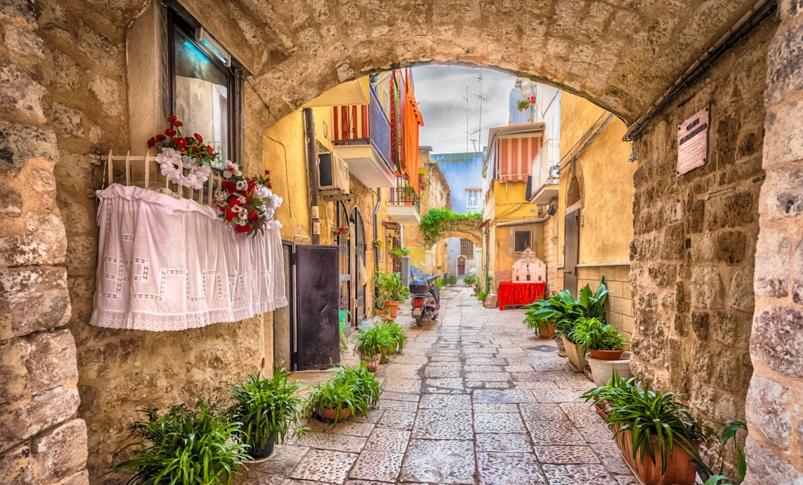
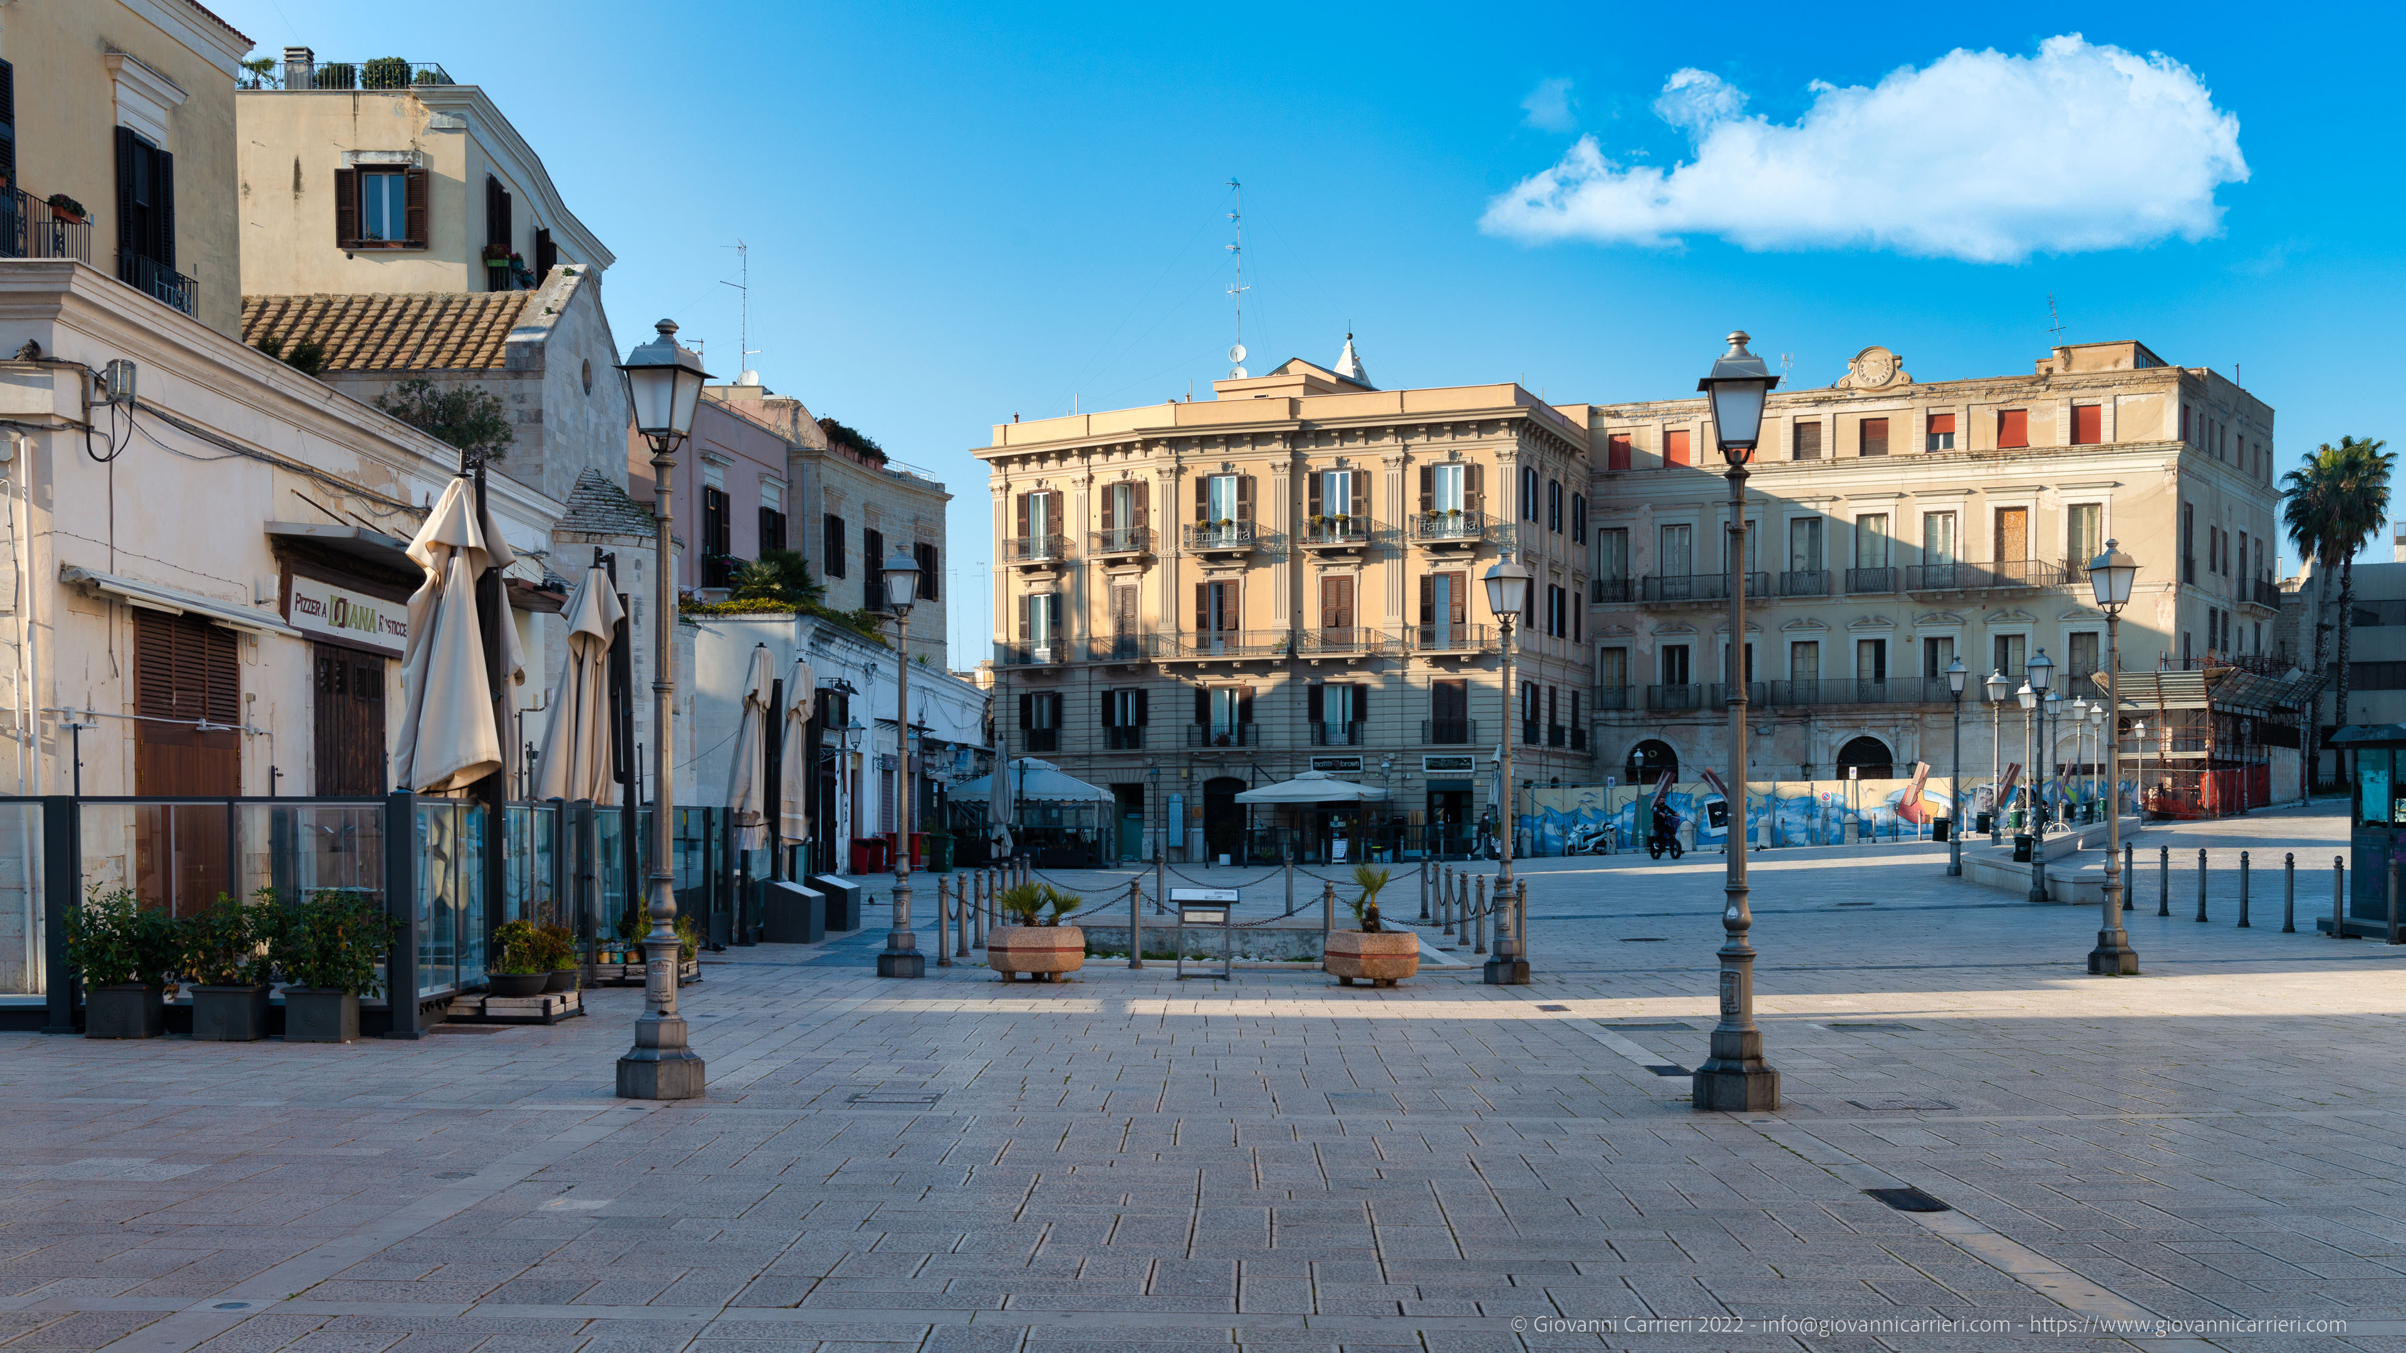
A trip to …..

Slide 14
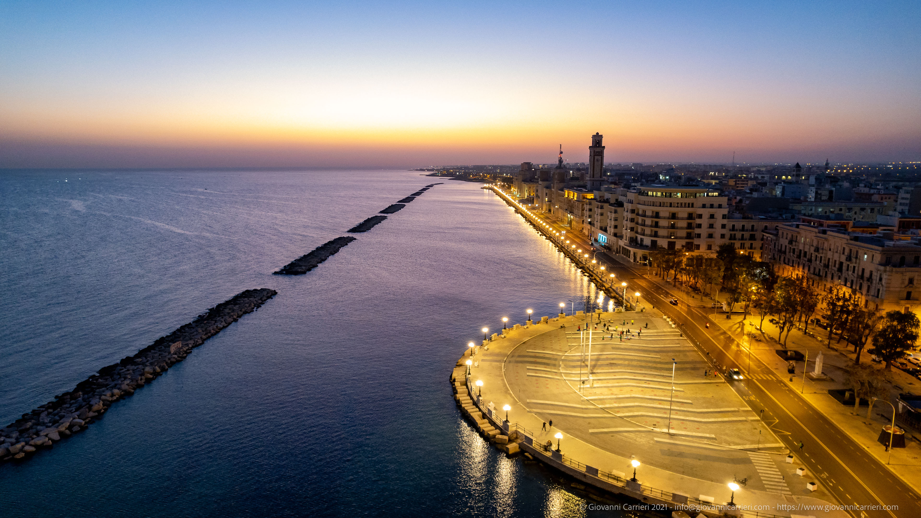
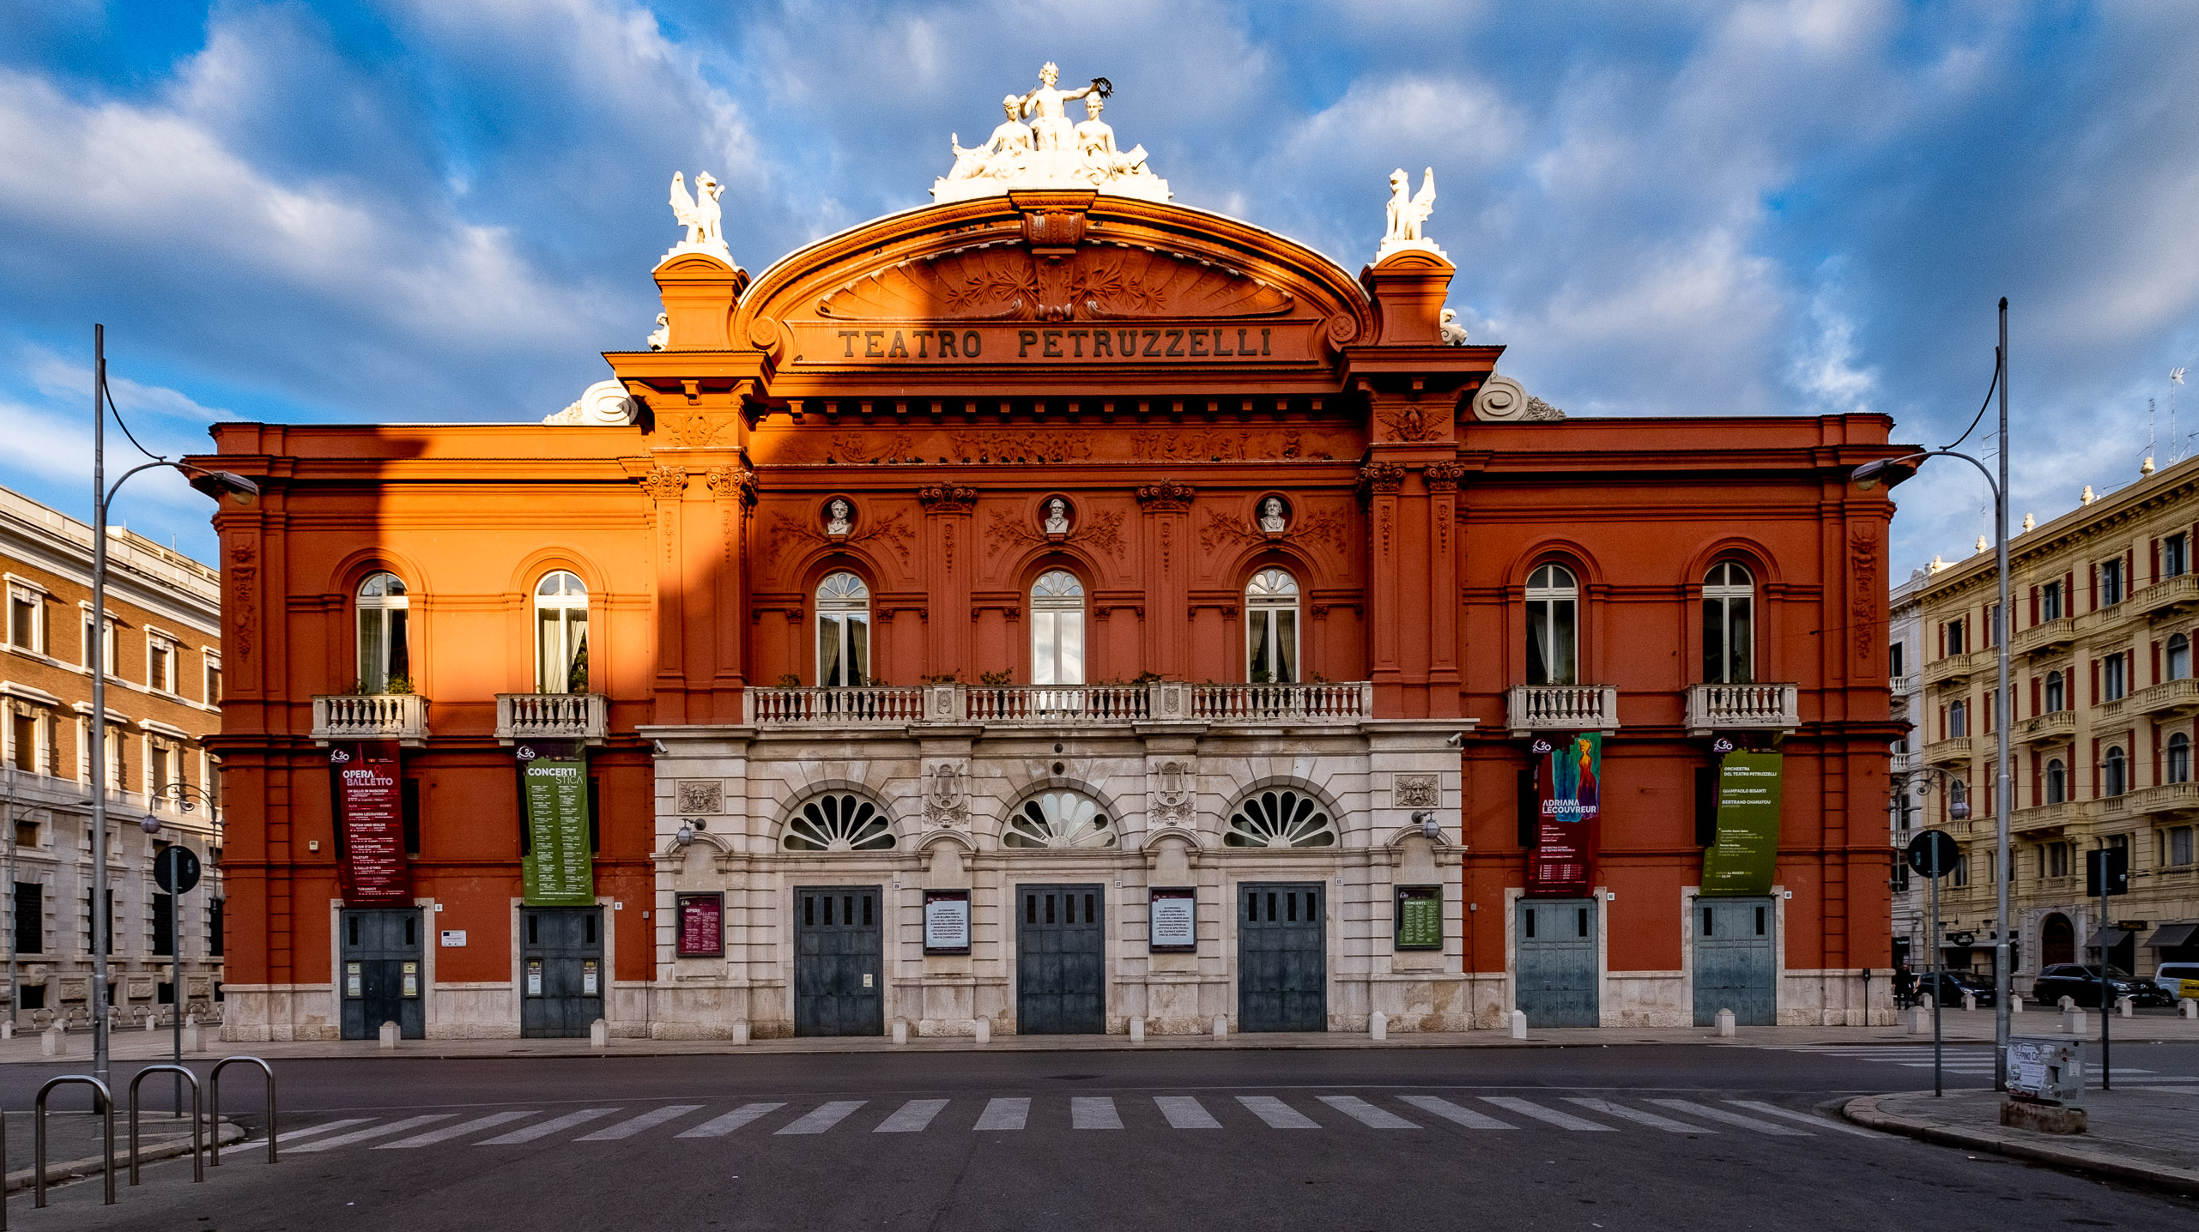
More hints…..

Slide 15
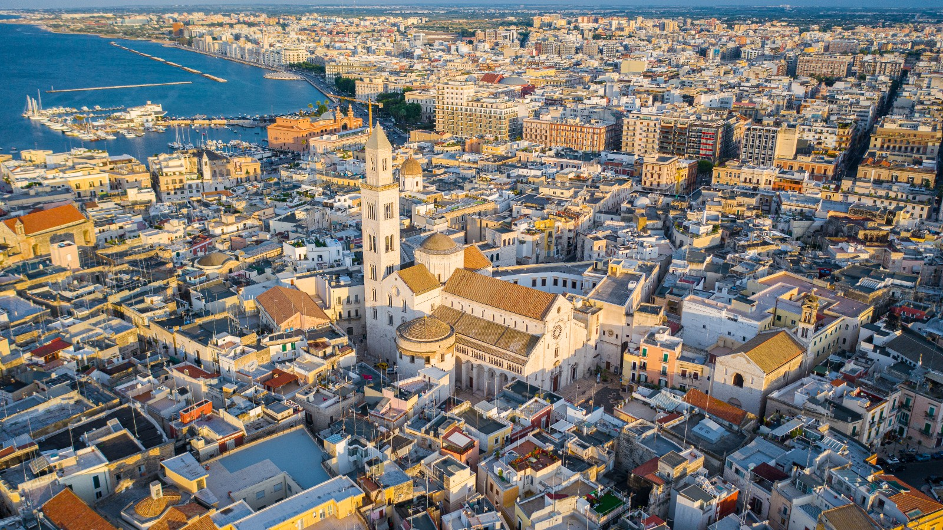
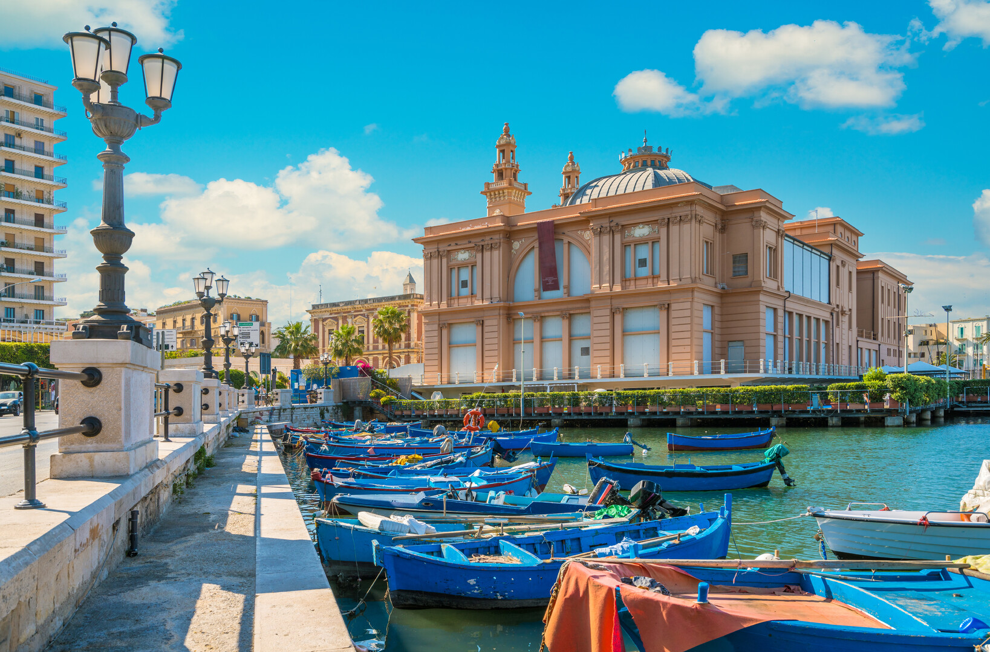
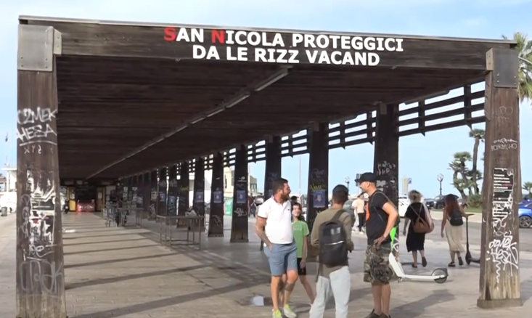
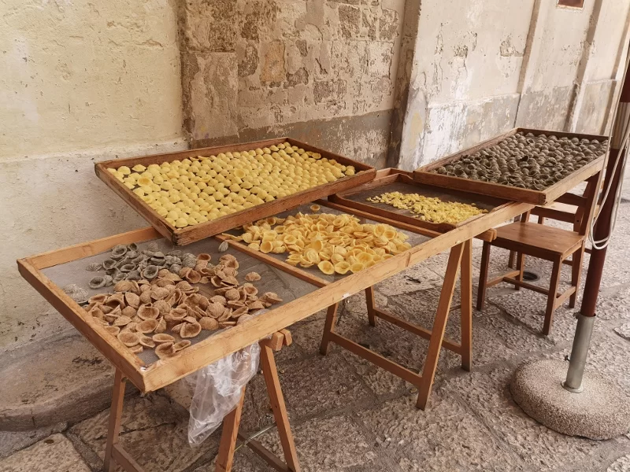
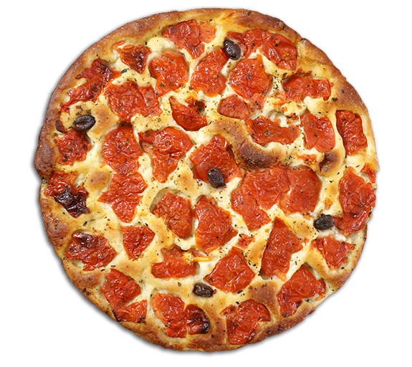
Next collaboration meeting in BARI
Courtesy of Giuliana

Slide 16
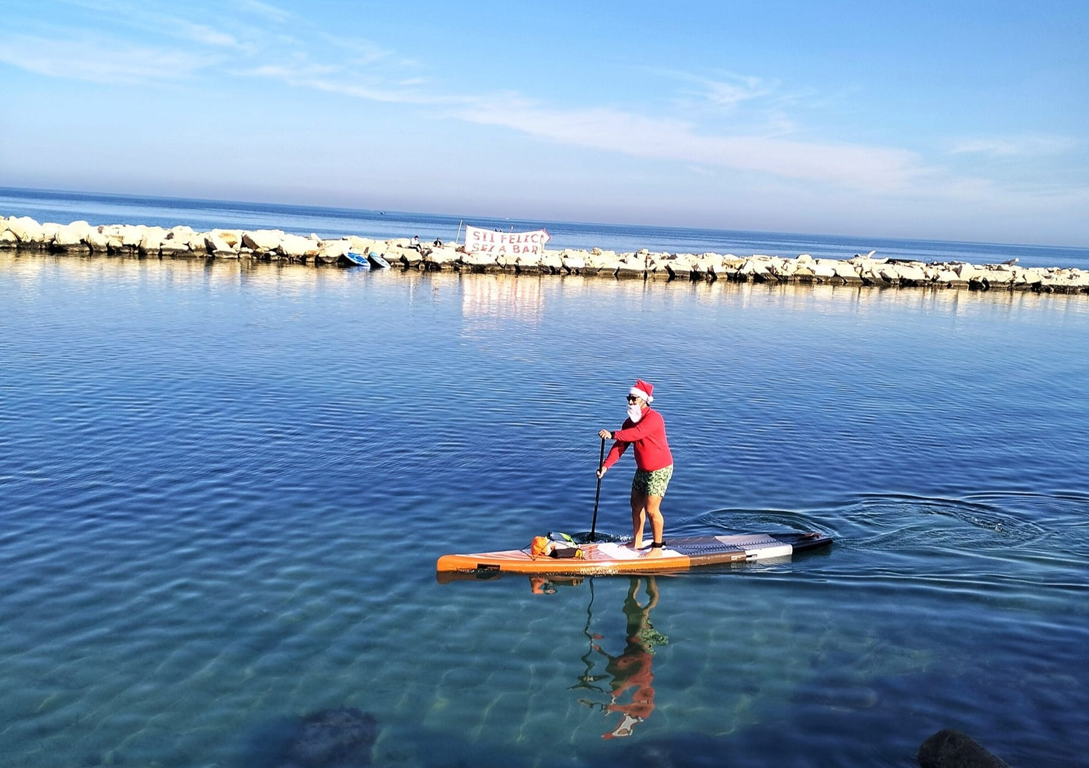
Three days between December 15th and 19th
WRITE DOWN ON YOUR CALENDAR!
Courtesy of Giuliana

Slide 17
Have a nice trip back! See you on zoom!

