Slide 1





Welcome to the
DarkSide
Masterclass
Part One
F.Carnesecchi, F.Coccetti, D.De Gruttola, M.Garbini, D.Hatzifotiadou, R.Nania, C.Pellegrino
University and INFN of Bologna
University and INFN of Salerno
Museo Storico della Fisica e Centro Studi e Ricerche Enrico Fermi Roma
Comic from: http://phdcomics.com/tv/?pl=thingsexplained
presented by Marzio De Napoli
Dipartimento di Fisica e Astronomia - Università di Catania
& INFN – Sezione di Catania
Istituto Istruzione Superiore Luigi Einaudi, Siracusa, 17 Marzo 2025

Slide 2
What is our universe made of ?
Notes:
Let the students answer to this question.
Starting form the first experience stuff (a chair, us,…) going to a planet or larger systems

Slide 3
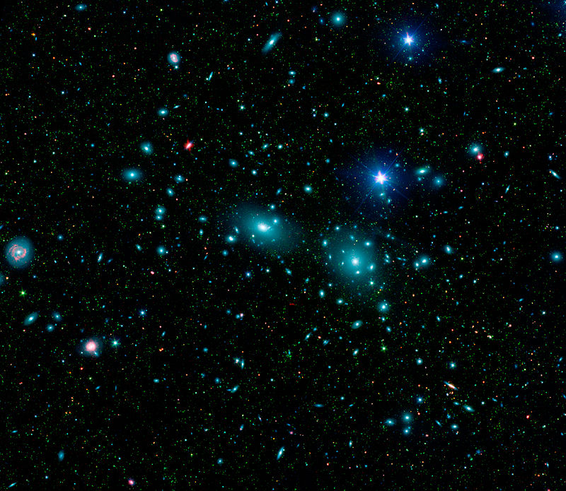

electrons
neutrons
Coma Cluster
protons
http://www.spitzer.caltech.edu/images/1803-ssc2007-10a1-Dwarf-Galaxies-in-the-Coma-Cluster
Notes:
On the left the Coma cluster (the cluster studied by Zwicky)
So earth, a galaxy, a cluster of galaxy, but the constituent of all this: p+n+e

Slide 4

Ordinary matter (gas,planets,stars,galaxies)
15%
http://phdcomics.com/tv/?pl=thingsexplained
Dark Matter
85%
«What we know is a drop, what we don't know is an ocean»
Isaac Newton
Notes:
Actually, all this represents just the 15% of all the matter in the Universe.
Moreover, in this 15% about 13.5% is made of intergalactic gas

Slide 5
Why the Dark Matter hypothesis ?

Slide 6
1933, Fritz Zwicky : first evidence of a mysterious mass he called “dark matter”, studying the velocity dispersion of a galaxy cluster (Coma Cluster)
1970, Vera Rubin : discovers further evidence of Dark Matter, studying the galaxy rotation curves
Notes:
Until 1970, not much credence on dark matter

Slide 7
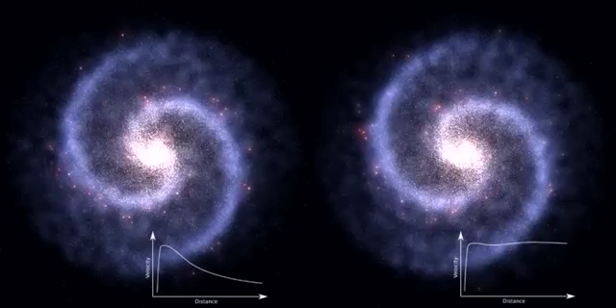
Galaxy without dark matter
Galaxy with the presence of dark matter
Notes:
A galaxy like the Milky way. Focus the attention first on the bulk of the galaxy (about the same behaviour) and then on the edge—> much faster for stars in the right one
On the right, what we observe→ can be explained with the hypothesis of a DM halo

Slide 8
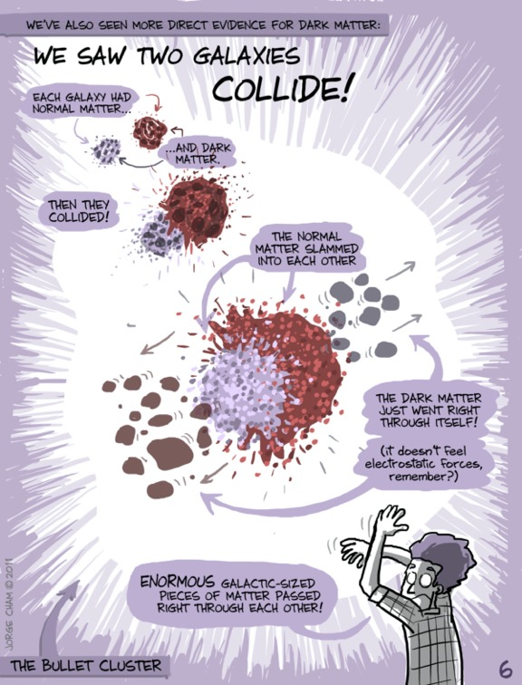
http://phdcomics.com/tv/?pl=thingsexplained
http://phdcomics.com/tv/?pl=thingsexplained
Notes:
Bullet cluster: 2 galaxy cluster that collided recently (in the galactic scale, ~ 100 millions years ago)
Red: ordinary matter (intergalactic gas)→ heated and slowed→ observed by X-Ray
Blu: DM (observed with gravitational lensing, a slide in the back up if needed)
Before collision: in the galaxy, the ordinary matter (visible) and the DM are in the same place
After collision : they are not coincident anymore
Moreover the ordinary matter shape is changed (shocked and slowed down) while the DM is not
Lection learned: This can be explained with DM and we also learned another characteristic of DM: it interacts weakly (both with itself and with ordinary matter)

Slide 9
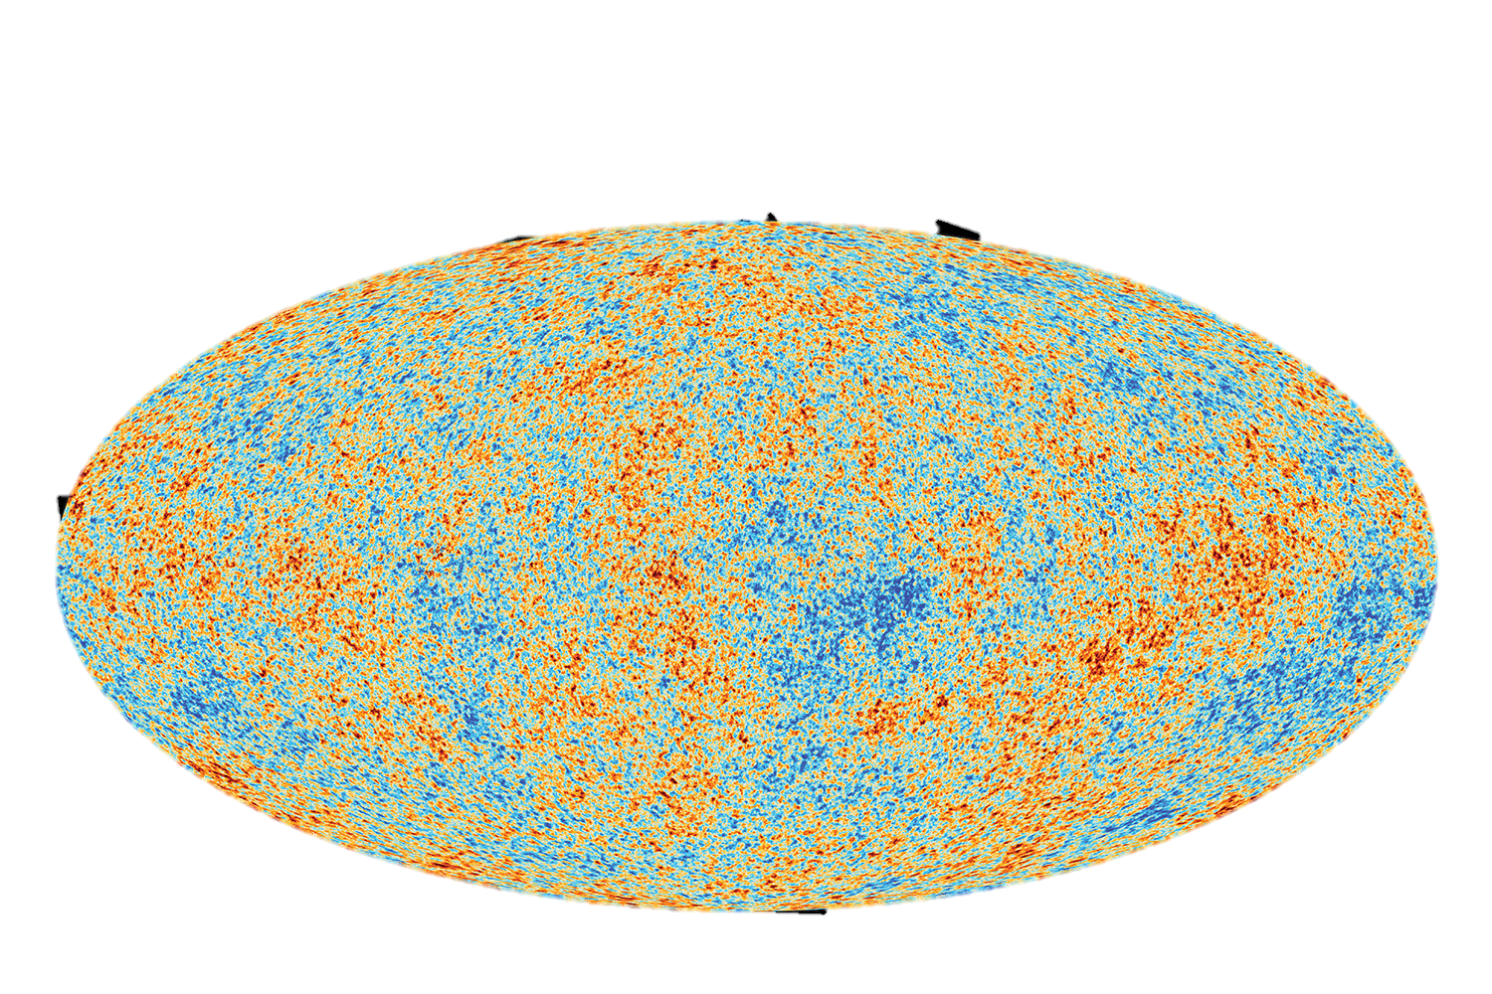
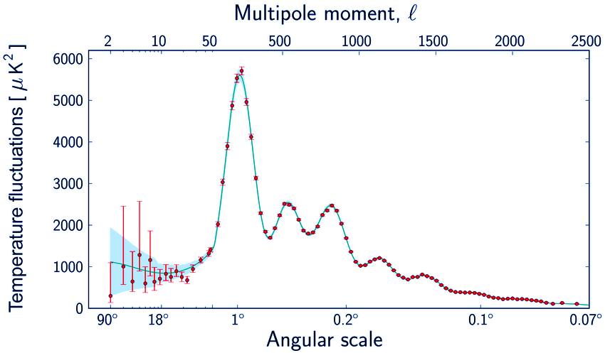
Cold spot
(high density)
Hot spot
(low density)
Angular width of all structure observed
Notes:
CMB (explain)
Very small temperature anisotropies of a few parts in 100,000 , anyway fundamental
These observed fluctuations can be explained only with a model which considers the presence of DM. Moreover, it must exist in the proportion of 1:6 (15%: 85%)

Slide 10
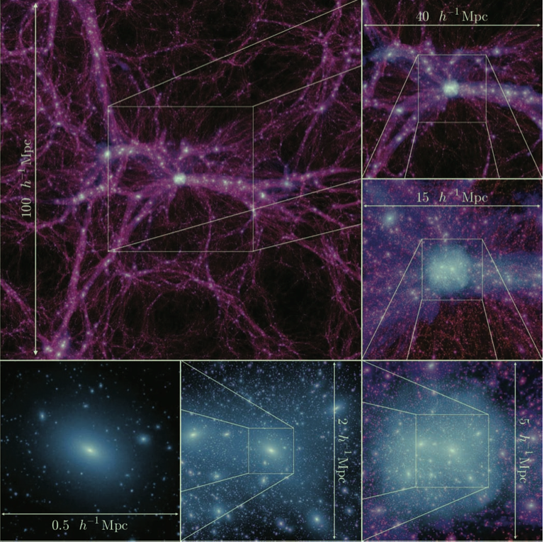
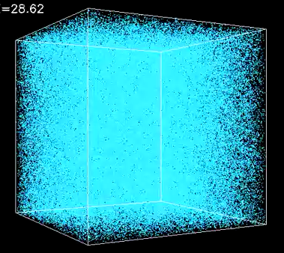
Notes:
Since the DM dominates the universe matter-> it had to lead the formation of the structure of the universe (galaxy, cluster of galaxy,…)
On the left, a simulation of the DM from the very early universe until now: at the beginning DM uniform in dots, then collapsing for gravitation, it forms these structures which are the stuff we call DM halos. At the end (image also reported in the figure) what we observe today (magnified, a galaxy)
These can be explained not only considering a DM but also with a Cold DM, which means that it should be ”slow “at the early universe, to have this bottom-up structure growing, that we observe today.

Slide 11
What is the Dark Matter ?

Slide 12

Dark Matter in popular culture
Often cited in media (books, comics, series,…)
Usually it is a source of some power or magical properties. Theories are generally quite various and far from reality

Slide 13
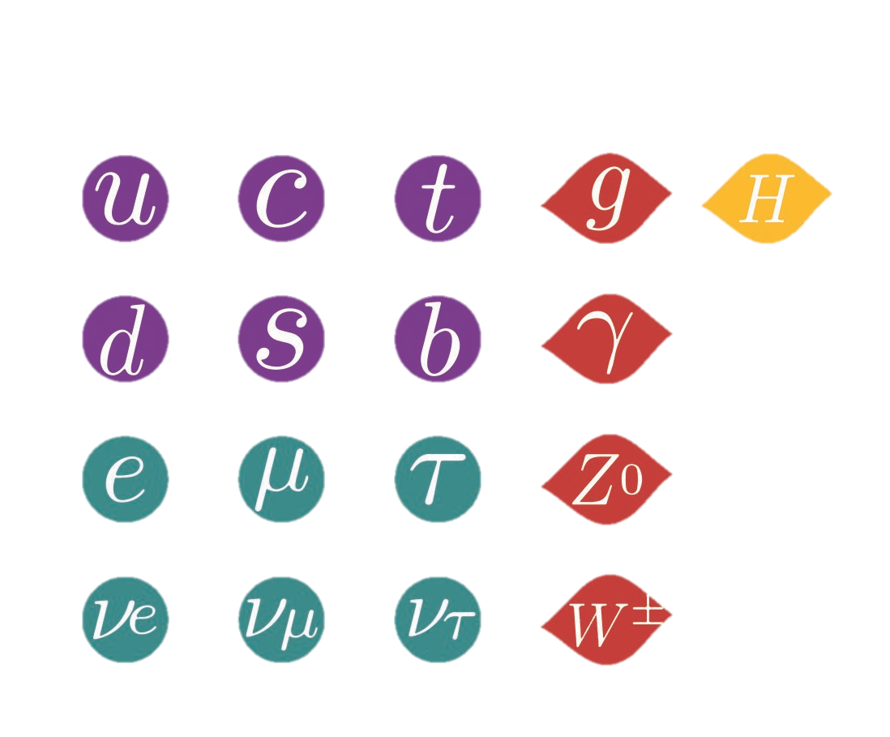
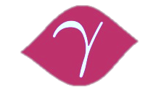
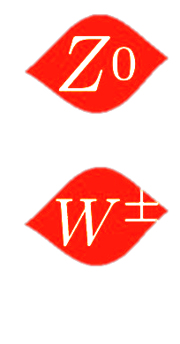
FERMIONS (matter particles)
BOSONS (force carriers)
Ordinary matter
Weak force
QUARKS
Strong force
up
charm
top
gluon
Higgs boson
Electromagnetic force
proton
down
strange
bottom
photon
neutron
LEPTONS
electron
muon
tau
Z boson
electron
neutrino
muon
neutrino
tau
neutrino
W boson
Notes:
First: what is the standard model—> fermions the constituent of all matter
To make the students understand→ ordinary matter constituents
Then explained the 4 forces (indicating the corresponding bosons), starting from the strongest to the weakest force (strong, electromagnetic, weak, gravitational) and then quickly, higgs force.
Then, the animation will, at your click, exclude candidates for dark matter, based on some considerations also related to the DM proof we have shown in these slides:
No strong force--> if yes we would already detected it a long time ago
No electromagnetic--> same reason and also DM is not charged--> no bright (dark...)
No higgs nor Z since DM is stable or at least with a lifetime comparable with the universe
No neutrinos since the DM is cold (slow, at the early universe) and if neutrino were the DM , it would be hot DM (since neutrino mass very small)
So, no candidate for DM from standard model.

Slide 14
Weakly Interacting Massive Particle
WIMPs satisfy all the better established DM characteristics:
They do not feel electromagnetic force (no charge)
They do not feel strong force (their interaction is not stronger than the weak forces)
Not ordinary matter (non-baryonic)
Stable (or extremely long lived, comparable with the Universe age)
Cold (slow, velocity not comparable with speed of light)
Massive
Notes:
Use this also like a summary

Slide 15
Backup

Slide 16
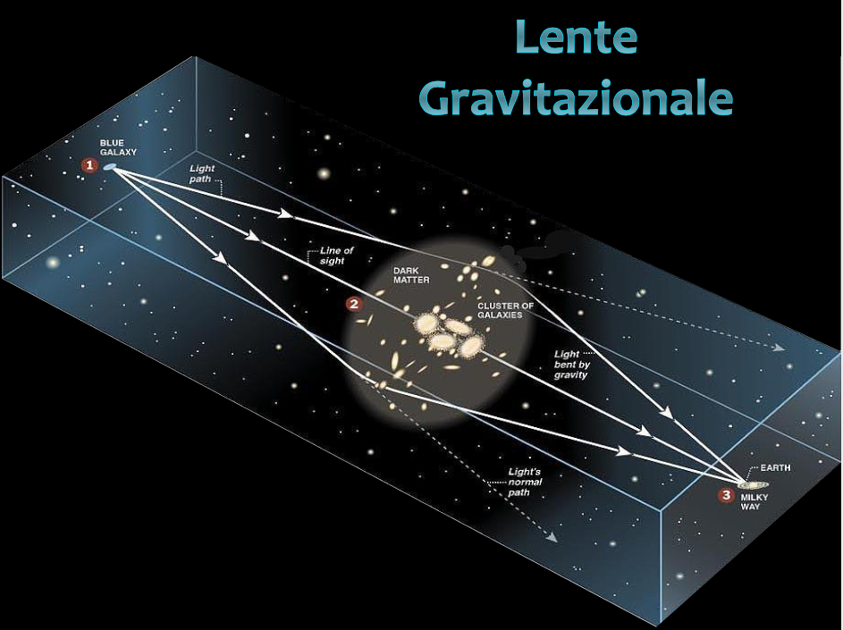
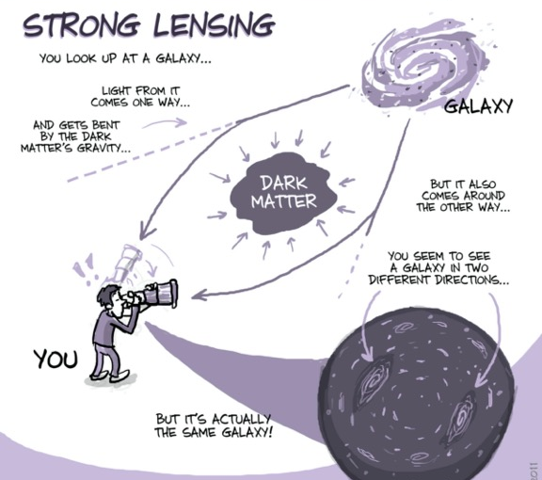
Gravitational lensing

