Slide 1


SS433 tens TeV resurgence twin beams by beta decay in flight of tens PeV neutron jet, see:
Proceedings to the 27th Workshop "What Comes Beyond the Standard Models" Bled, July 8-17, 2024 and in Daniele Fargion arxiv 2412.08011
arXiv:2504.17803
arXiv:2504.17803
arXiv:2504.17803
The understanding of microquasars in our galaxy is one of the frontiers of high energy astrophysics. Their models are based on a capturing mass Black Hole, with a nearby spiraling binary companion star. The companion star mass feeds the accretion disk around the Black Hole. This energy also fuels an orthogonal precessing X gamma jets. The spiral precessing tail of such microquasars, as the SS433 system, is due to an ultra-relativistic jet, spraying nucleons and electrons at relativistic speeds. The up-down jet is observable in radio, X, gamma spectra. Its long spirals are spread and diluted within a light-year distance. The source is inside the W50 supernova remnant nebula , whose asymmetry reflects the past and present role of the SS433 jet. Very recently HESS, HAWC discovered, surprisingly at a much far disconnected distance from the SS433, the resurgence of a twin gamma beam tail. Nearly 75 years light distance far away from the source. We show the frame of a possible model based on tens PeV jet whose beta decay in flight fit the TeV signals. CTAO might test soon this model.

Slide 2
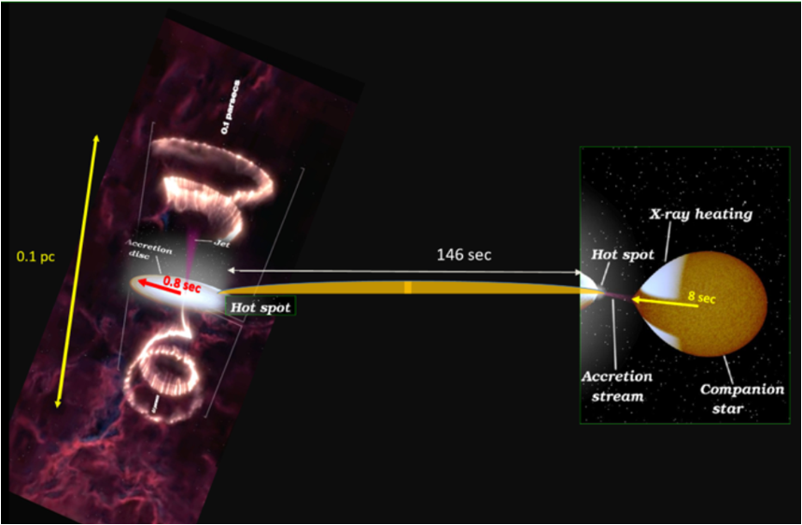
Nearby SS433 binary system

Slide 3
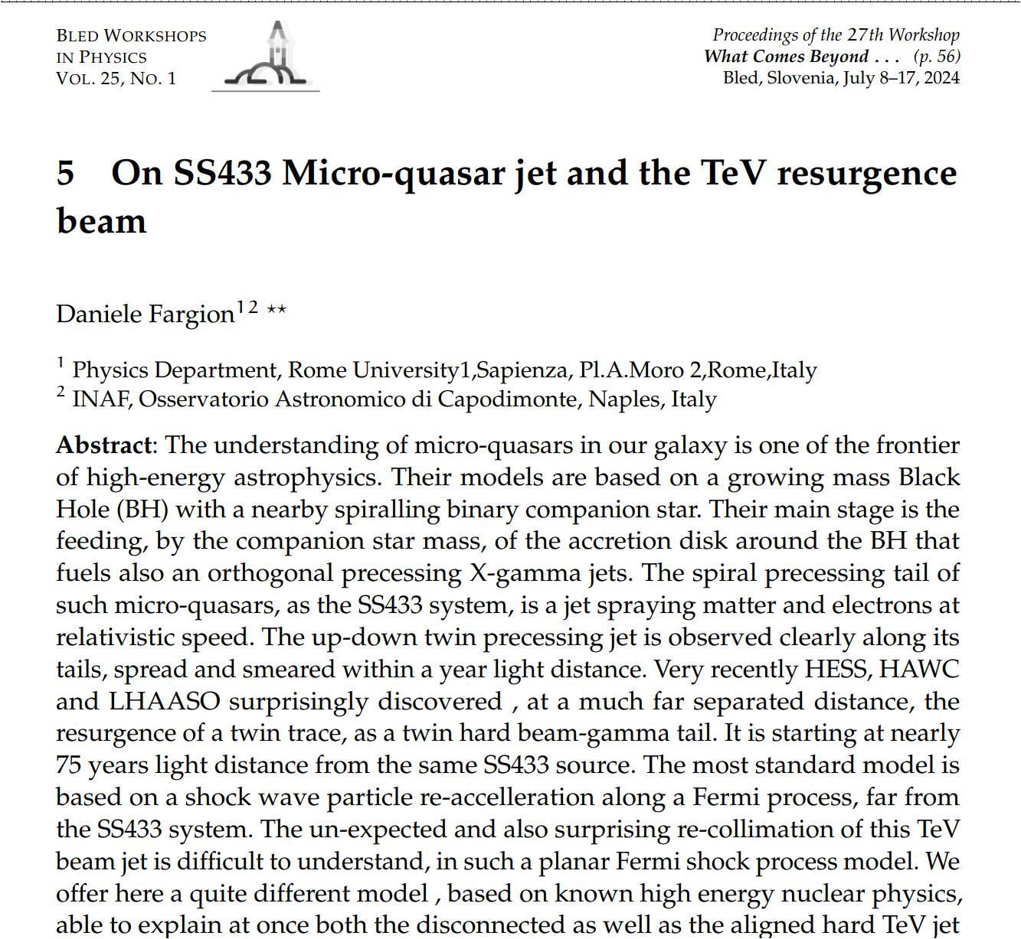
Bled, Slovenia July 2024
arXiv:2504.17803v1 [physics.gen-ph] 20 Apr 2025

Slide 4
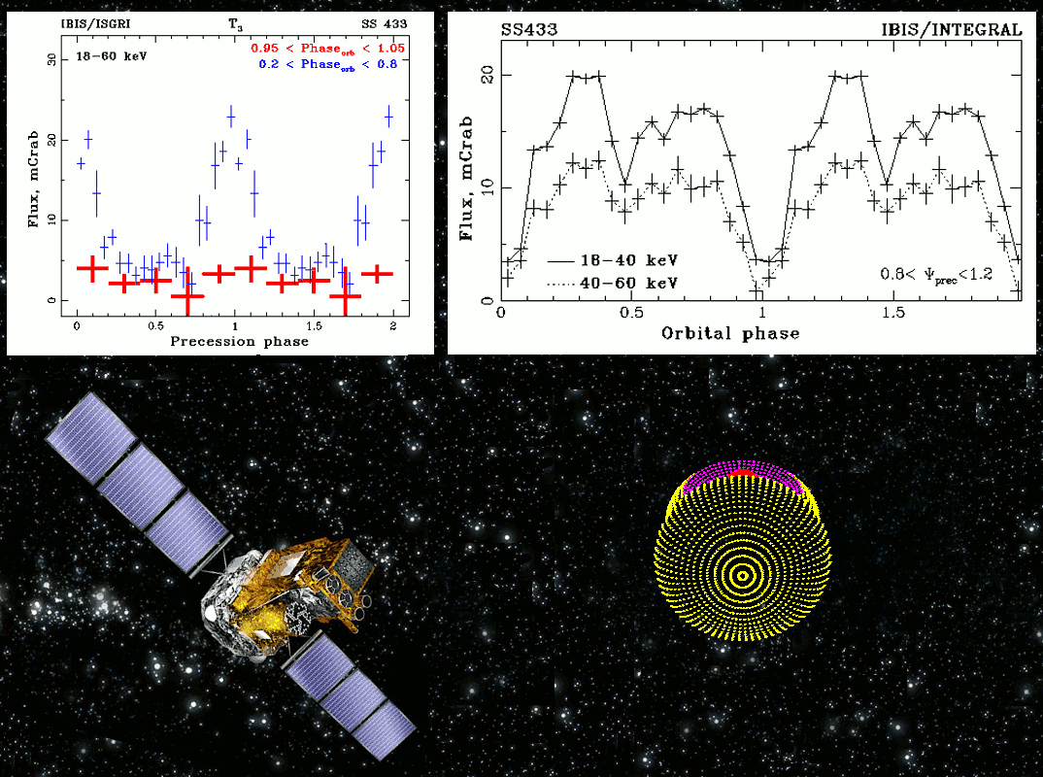
SS433 gif

Slide 5
How may, tens TeV gamma beam, resurge?
Tens TeV gamma hit on an external sheet (density and shell mass tuned): possible but rare.
Tens PeV neutron beta decay into tens TeV electron in flight

Slide 6
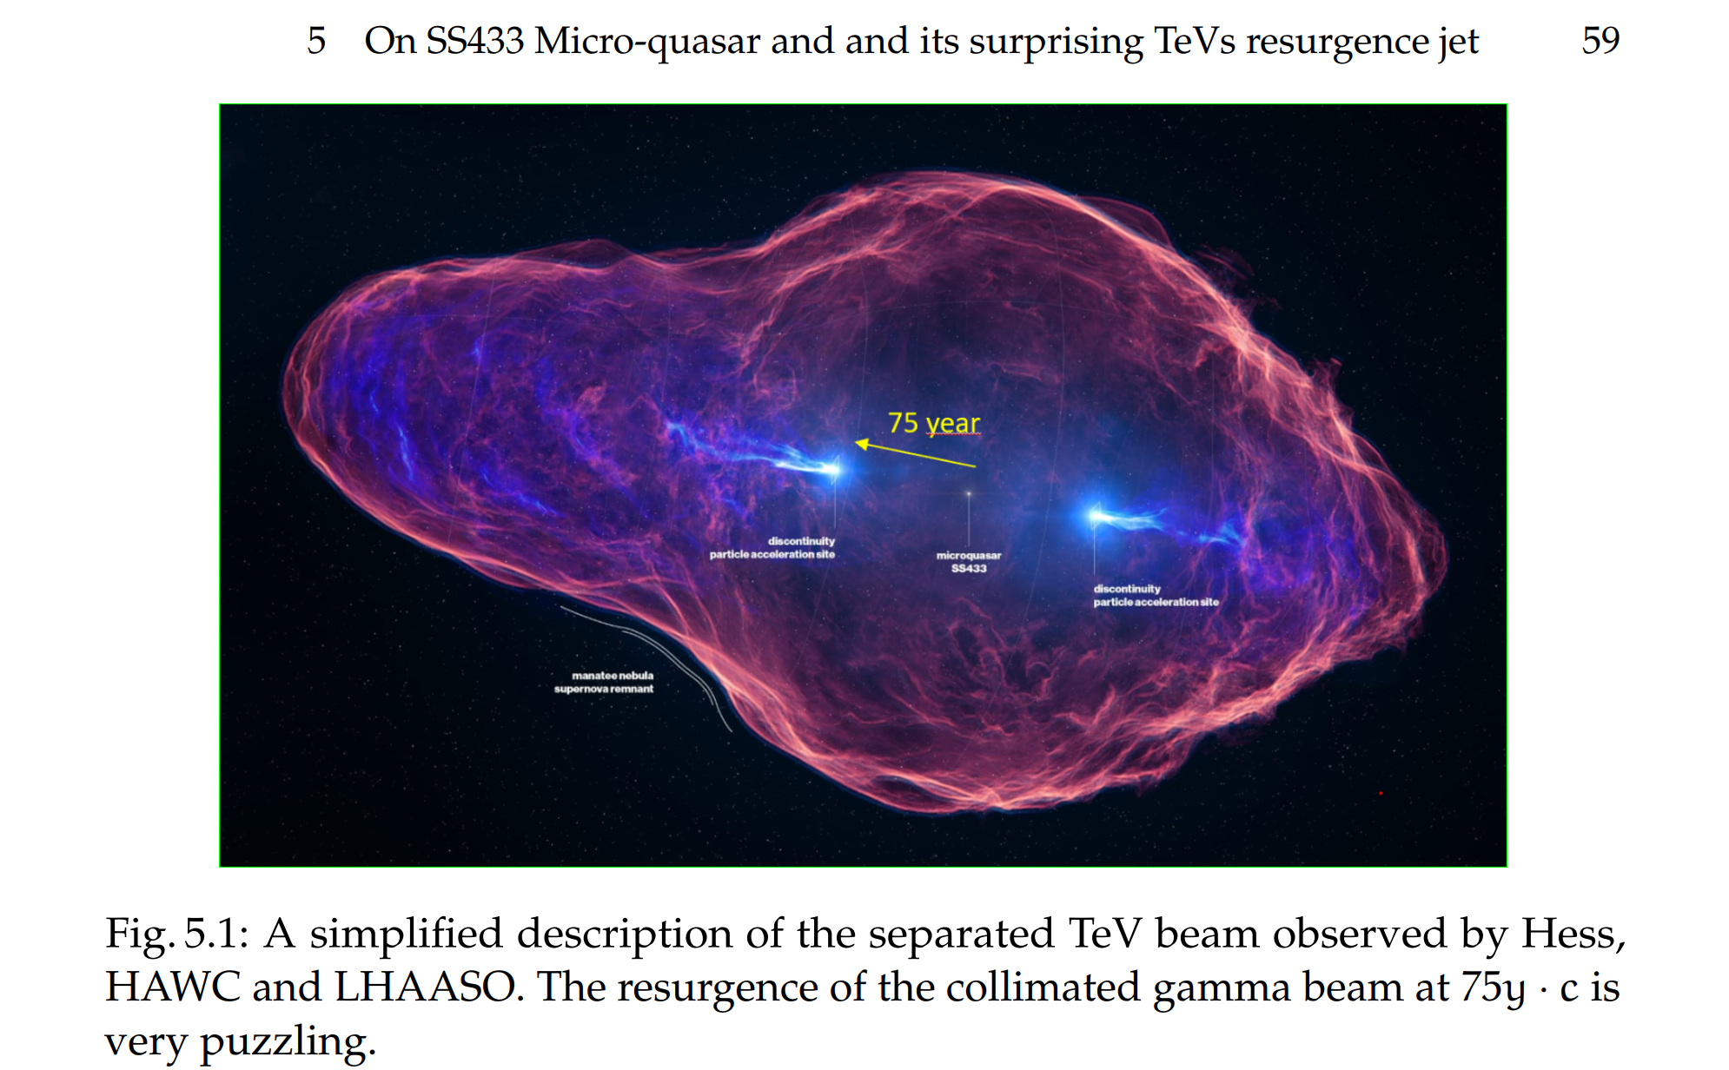
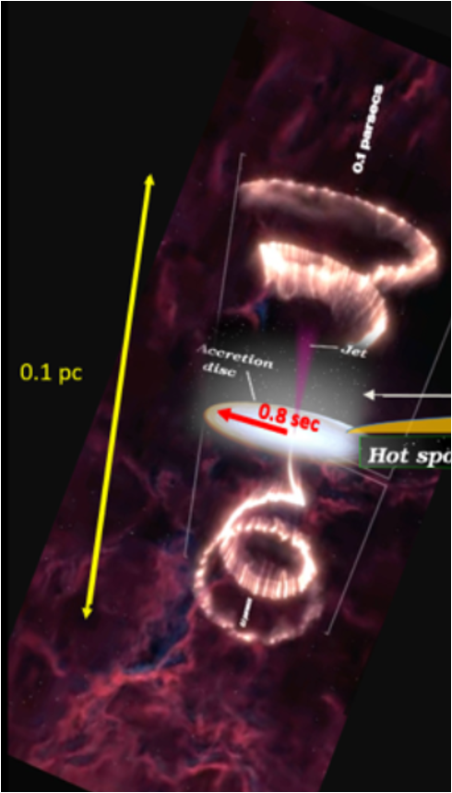
SS433 far distance TeV Jet resurgence

Slide 7
A puzzling far beam jet rise
The TeV beam appearance far from the source, was discovered this year, 2024, by the Cherenkov telescope array, Hess [2] and confirmed also by a large array, in Mexico, HAWC [3]. The presence and collimation at such far separated beam at far distances, is quite puzzling.

Slide 8
Present and our Models
Most models require surprising shock wave re-acceleration and their unexplained re-collimation. We shall not discuss them here.
We suggest the different possibility that a rarest , early, explosive flare episode in the micro-quasar may shine, at the same time, ultra-violet hot photons and ultra-relativistic energy (UHE) proton (or nuclei) in the jet.
Their (tens PeV proton) photo-nuclear scattering and interactioninside the binary system, could form also Delta ∆ resonances. The ∆ decay may feed pions but also ultra-relativistic neutrons. Such a phenomena has an analogy , (in cosmic volumes and in thermal big bang radiation), taking place between UHECR (Ultra High Energy Cosmic Ray) at hundred EeV energy and infrared cosmic black body photon at 2.7K° . The phenomena is well known under the author initials, as the ”GZK cut-off” in the maximal UHECR spectra .

Slide 9
How does any neutron Jet rise?
Only charge may be accelerated, by electro magnetic fields.
Protons may become neutron under any rich photon rain (or a long flight among cosmic radiation as GZK) above the Delta energy threshold
The need of a rich photon bath imply an early (nearly 80 years ago) a huge luminous flare in SS433, an explosion as a Nova, possibly due to a fast cannibal, planet-Bh, tidal capture anda collapse: by a few hours, or a day duration time.

Slide 10
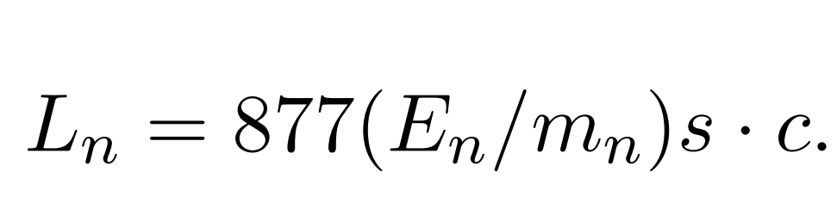
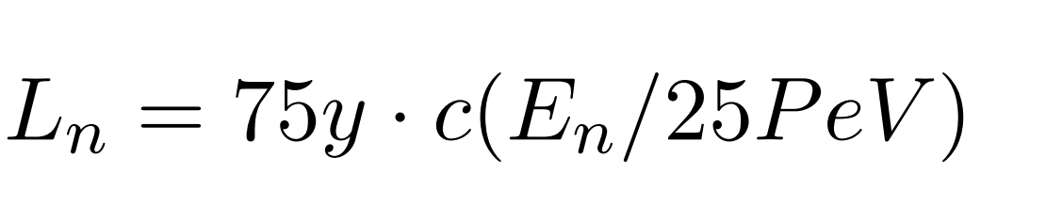
Neutron jet needed energy
To make resurge an hadronic neutron jet at nearly 75 years light distance , as the observed one,
we need a correlated energy connected to the neutron life time and its flight distance in relativistic limit; a distance tuned with the observed TeV resurgence:

Slide 11
How to define the photon flare energy?
Delta mass, m∆, has a value = 1232 MeV. This energy, defines the corresponding critical thermal photon energy Eγ, taking in account the needed tens PeV energy of the neutron jet. Therefore, also the tuned accretion disk temperature and its luminosity, necessary to take place for such a processes .

Slide 12
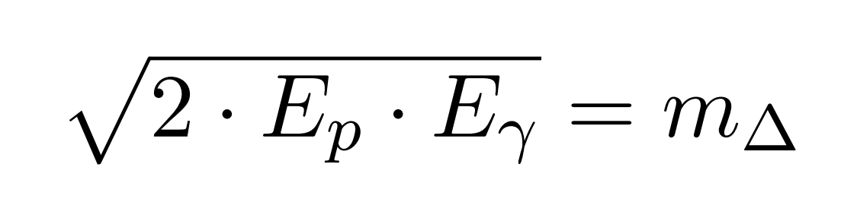
Delta production and decay for tens PeV nucleon energy
The neutron jet event is made by an UHE proton energy Ep (tens PeV one) scattering onto a hot thermal bath of photons Eγ , photon ejected suddenly from the BH accretion disk. Their ultra-relativistic approximation is:

Slide 13
The SS433 Flare temperature flare
The correlated photon energy (at the flare) to allow such a proton-pion , Delta resonance with a Ep = 25 PeV for a proton (and a later) neutron must be:
Eγ = (m∆) 2 / 2 Ep = 30.35eV /(Ep/(25P eV ))
This value must be corrected taking care of an additional small pion energy losses:

Slide 14
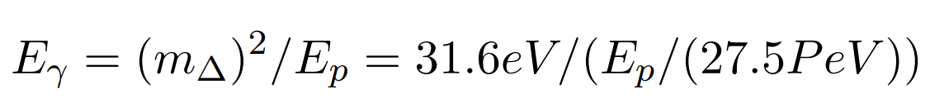
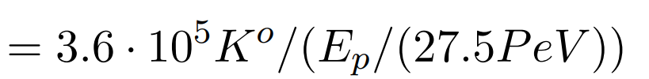
The final SS433 needed flare temperature
The pions absorb part of the primary proton energy. This energy loss is just at ten percent level. Consequently, for a final 25 PeV neutron, we must assume a primary proton at higher energy, nearly of 27.5 PeV. The interacting photon energy Eγ should also be tuned by the resonance mass m∆ by a little larger value:

Slide 15
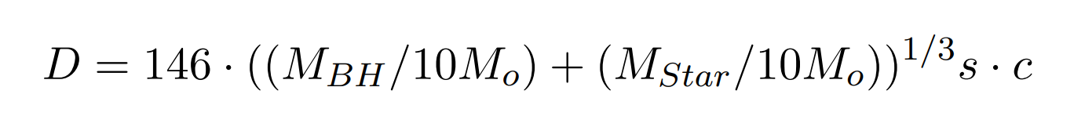
Where the proton jet and the flare meet and may create Delta and neutron beam?
This mutual distance D of the SS433 system may be re-calibrated , for any eventual binary masses , following the well known Keplerian (cubic root) law:
Let us assume for sake of simplicity that the accretion disk , in the figure assumed about 0.8s · c size, extends a little more. This is taking place , for a disk radius R disk = √ 2 · RSun . Because, as shown above, the disk flare temperature required for the resonance to arise is nearly 63 times the solar one, the corresponding peak flare luminosity LF lare should be (by scale Stephan Botzmann law), approximately, (63)^(4) times larger than our Sun., or

Slide 16
Disk flare distances for a neutron jet

Slide 17
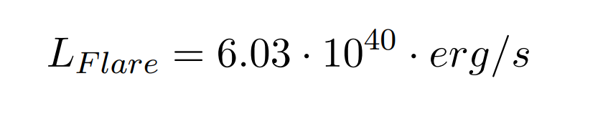
Needed flare luminosity and its duration
It should also remind here that this total flare power (considering the loss of energy in mass ejection and loss inside the BH) imply a much larger mass-energy rate waste, falling into the BH. We suggest an energy output (and a corresponding mass rate from the companion star to the BH) thousand times larger, as large as : (dM/dt)tot · c = 2 > 6.03 · 10 ^(43 )· erg/s .
This losses are not far from the usual SS433 observed ones, but they require a much brighter luminosity, near a Nova like , (dM/dt)N ova = > 10^(44) · erg/s , explosive event. The total duration of such a huge explosion may be of few hours or even, a very few days. For such a brief duration, the SS433 precessing jet (162 day period) , its deflection, could be considered frozen or negligible, pointing in a unique direction, as the occurred and observed separated TeV beam.

Slide 18
Is such a process efficent enough? Yes!
As we know, the maximal , peaked, cross section σ , for a photo-pion resonance, has a value as large as: σ∆ = 500b . Such a peaked cross-section explains the consequent, almost monochromatic, neutron beam energy.
Such a hot thermal photon bath, its number density , should allow an interaction probability above the threshold. This UV temperature considered above, emitted by a black body area, an ”over-Eddington” accretion disk, defines also the same photon number density at temperature T h=3.676·10^(5)K°, along the jet ultra-relativistic proton propagation fly: the main interaction distance nearby the disk, Dj could be comparable with the same accretion disk radius, leading to an approximated probability P for the photo-pion conversion into a Delta (and a consequent neutron beam creation) as follows: P = σ∆ · n(T) · Dj = 48 >> 1 …

Slide 19
Where are lost the proton jet component?
A Larmor radius for PeV proton and TeV electrons
As we had proposed above, tens PeV neutron decay, 75 yc far away, might become source of the observed , by beta decay,of a separated, 25 TeV gamma beam. We may inquire to the role of the twin proton secondaries of the ∆ decay at comparable energies. These 25 PeV energetic proton, contrary to neutron ones, are bent. Their Larmor radius Rp is constrained by the minimal galactic disk magnetic fields Bg , (at least , of a few micro Gauss) :

Slide 20
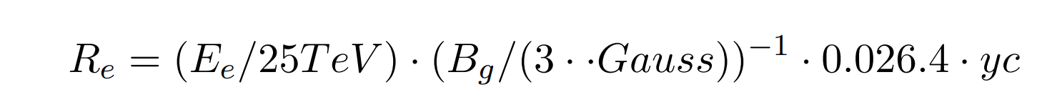
Proton jet smeared, electron at TeV along the neutrons
These spiral radius are nearly one third or less of the 75 TeV beam distance. Therefore these proton components are diffused and smeared: they cannot play any role into the separated TeV jet. Also the secondary electrons at nearly 25 TeV energy , the parasite secondaries traces of the neutron beta decay, are even more confined along the neutron beta trajectory, within a much smaller spirals of Larmor electron radius:
Therefore the electron role is not able to survive hundreds years light, in absence of the suggested primary 25 PeV energetic neutron beam. Electrons are the brillant parasite. Their ICS and synchrotron gamma are the observed traces.

Slide 21
Conclusions 1
A past flare in SS433, could be the source of a 25 PeV neutron jet , possibly explaining the puzzling separated twin, TeV , gamma beam at 75 years far distance. The unobservable PeV neutron flight show its presence and its beam resurgence as soon it decay at far distance and its electron may shine by synchrotron and ICS radiation. its collimation is an advantage respect the standard model of a schock wave processes . This ultra-relativistic beta decay imply also additional interesting consequences: An early trigger explosive event, nearly 75/80 years ago, as powerfull as a Nova star burst, for a duration of few hours or few days at SS433 system shine almost in a fixed direction (not along a conical precessing jet volume). This event occurrence is around the War World II end times. Such a Nova event ( to-day observed at a rate of a dozen a year), could have been escaped detection, at those post war times . Indeed the same nature of SS433 had been discovered much later, on 1977. It could be possible and worth-full to inspect such luminosity variability, in oldest astronomical photo-plate array in that direction and at those epochs, looking for such a variability signal.

Slide 22
Conclusion 2
The presence of such neutron PeV separated beam in SS433, may suggest also the search in other micro-quasars system elsewhere, for such disconnected signatures. Their statistics may define a corresponding neutrino spectra rate in PeV and hundred TeV energy range. The 25 PeV neutron beta decay and its primary 27 PeV proton-pion event, while on axis toward us , may shine both of a brightest prompt (1−2 ) PeV gamma burst but also of a secondary (electron and muon ones) neutrino at (0.2−0.5) PeV energy . Such a tuned energies are quite interesting , because they may reflect in the TeV PeV apparent energy dis-continuity, in neutrino spectra . Such spectra feature might be already hidden in the highest energy Ice-Cube neutrino data, assuming that their observed origin is really astrophysical and not , as some of us suggested, a charmed atmospheric noise.
Thank you for the attention

