Slide 1
Hundreds PeV tau neutrino induced air-shower D.Fargion
Recent Km3, ARCA 230313A, neutrino detector discover of a hundreds PeV event on February 2023 , if confirmed, it is very probably the UHE signature of UHECR secondary trace of UHECR by GZK cut off.
We show the expected rate of such neutrino induced air-shower by largest Telescope Array as CTAO while pointing downward the sea horizons.
Such proposal had been considered long time ago (> twenty years) by us, for Magic telescopes. Our estimates assumed the exact inner Earth density profile, and the best analytical model for UHE neutrino interaction in Earth cord at Earth (water or rock) edges. We show the rate and the noise for such fundamental, but rare, events and the preliminary test on UHECR events above the horizons.

Slide 2
The last news trigger: ARCA 230313A, the largest neutrino event ?

Slide 3
A two Hundreds PeV muon neutrino ?

Slide 4
Why UHE muon neutrino, are (as ARCA claimed) not atmospheric? A geometry argument

Slide 5
Why hundreds PeV tau airshower neutrino are an expected key tool in GZK neutrino? astronomy?

Slide 6
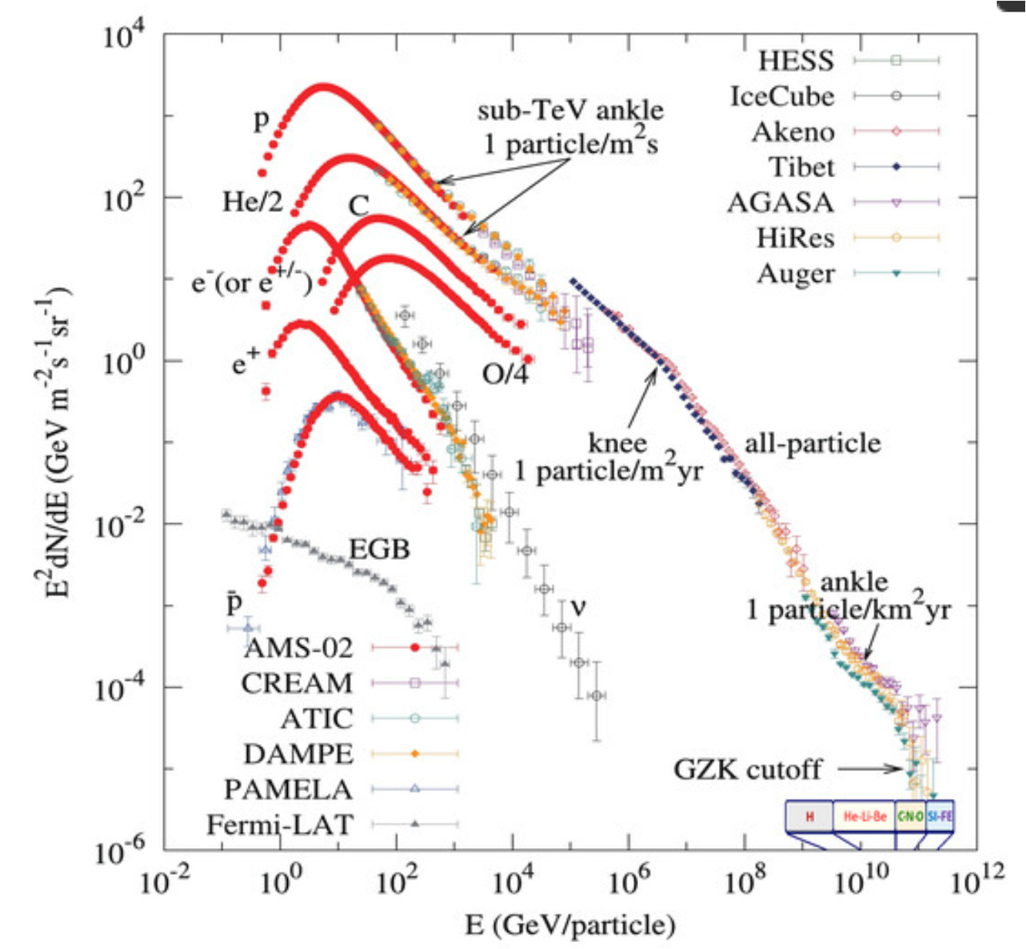
UHECR – GZK cut off by photon-pion opacity

Slide 7
UHECR- Delta resonance-> meson-pions→ gamma and neutrinos at hundreds PeV

Slide 8
All flavor oscillating by complete mixing

Slide 9
Neutrino Flavor Mixing

Slide 10
Neutrino mass- Flavor mixing-Tau guaranteed

Slide 11
Hundred PeV neutrino by Tau air-shower at horizons: A new Astronomy beyond the corner?

Slide 12
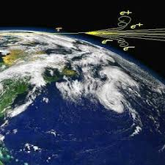
Recent and old estimate
Tau Air Showers from Earth
D. Fargion, P. G. De Sanctis Lucentini, M. De Santis, and M. Grossi
© 2004. The Astrophysical Journal, Volume 613, Number 2

Slide 14
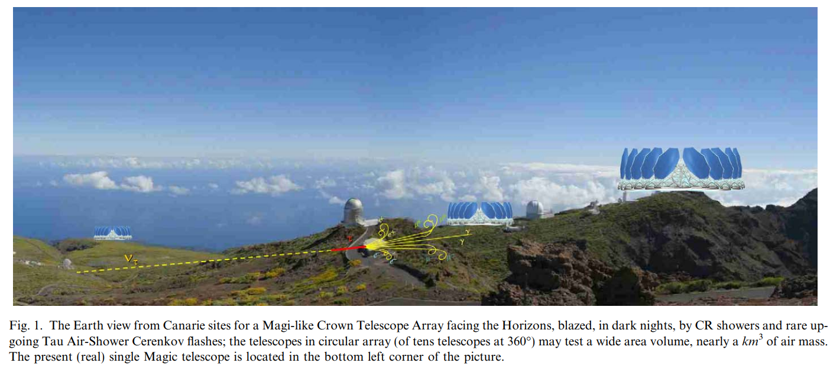
Crown array at top mountains

Slide 15
A 20 years old paper astro-ph/0505459 Neutrino Astronomy beyond and beneath the Horizons
21 May, 2005
40th Rencontres de Moriond on Very High Energy Phenomena in the Universe : La Thuile, Italy, March 12-19, 2005, 355-363
See also :
DF et all:
Cherenkov Flashes and Fluorescence Flares on Telescopes: New lights on UHECR Spectroscopy while unveiling Neutrinos Astronomy, 2008 NIMA

Slide 16
Tau airshower modes at high altitudes: gamma,electrons, muons (and their bending)

Slide 17
Tau airshower in deep Valley or at Horizons

Slide 18
Tau signature mostly hadronic

Slide 19
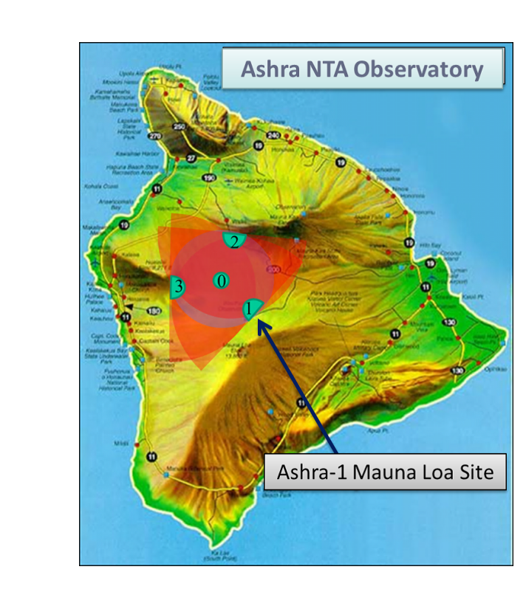
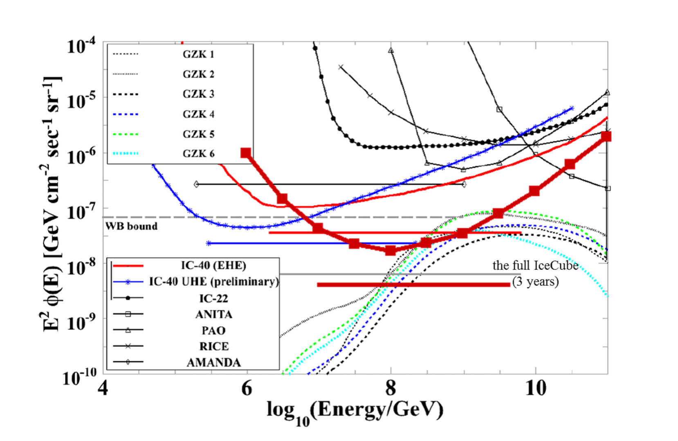
On-going: Many proposal for tau airshower ASHRA 2013(Taiwan), was looking «inside» it had better to look «outside» toward horizons. Beacon 2018 (USA),also to mountains and edges.

Slide 20
Future GRAND array, radio at mountains

Slide 21
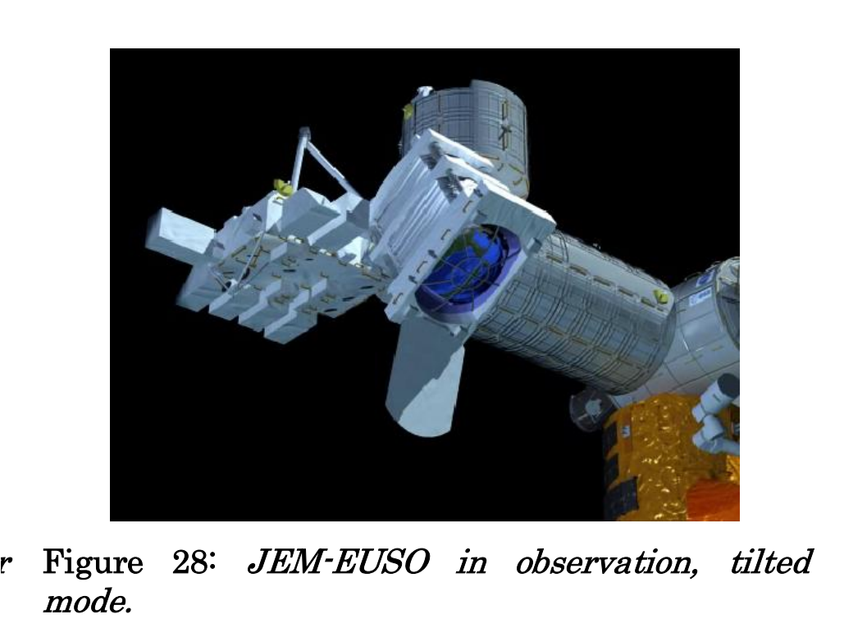
Future detection of tau airshower from the sky : POEMMA– JEM EUSO satellites and balloons
POEMMAToO_Oct_2_2020.pdf

Slide 22
Auger, 3000 kmsq ground array and fluorescence telescopes

Slide 23
CTAO and Magic telescopes array the ready detector to UHECR and Tau

Slide 24
Testing nearly horizontal UHECR airshowers at Horizons: a new Spetroscopy
The Magic and CTAO may test the presence of downward, nearly horizontal airshowers, in order to calibrate and verify possible future discover of Upward, nearly horizontal Tau airshowers.
The 2.2 hundred PeV tau induced airshower will be ideally observed from CTAO and MAGIC array, at several tens km distance

Slide 25
Rate for 10 eV/cmsq s in 3 years AUGER

Slide 26
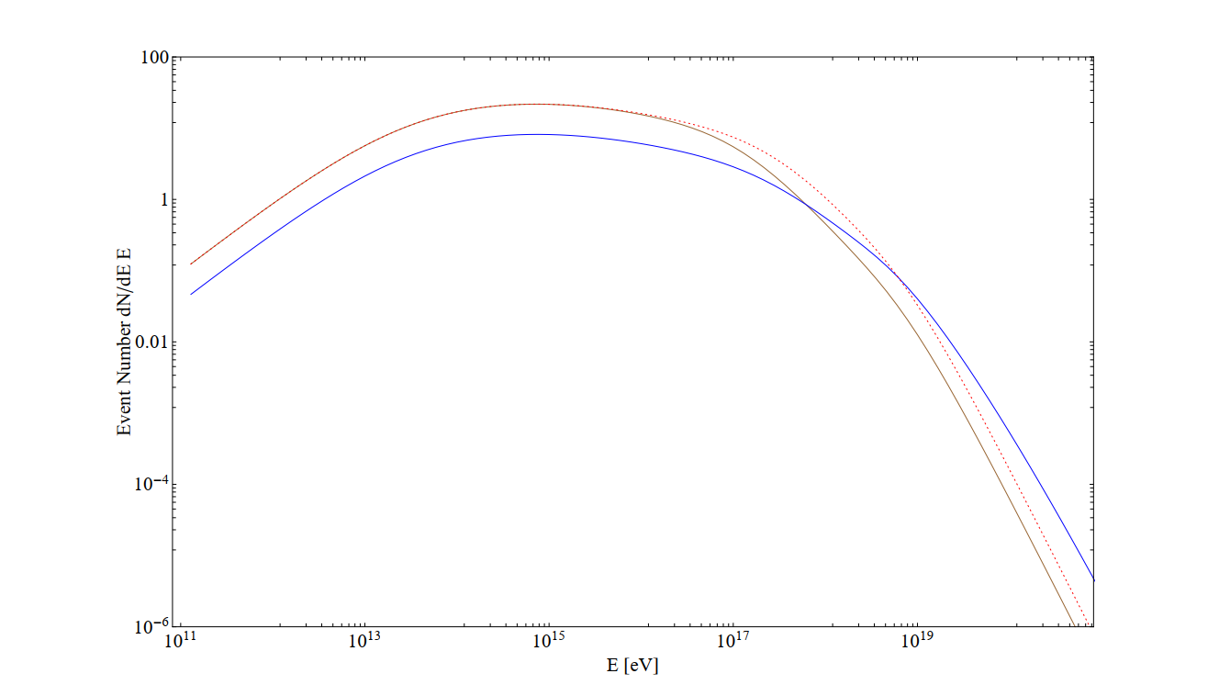
Nearly 2 event every 3 years at 10 eV/cmsq s (assuming ARCA detection) Or = 10 event every 3 years at 50 eV/cmq s Or= 70 events in AUGER , by 21 years recording Or = 3.3 Tau event each year in AUGER each year

Slide 27
AUGER DID not obtain any tau in 21 years (7 times longer) :: no tau event
Absent nearly 70 event expected in AUGER in 21 years record
CTAO observe at horizons an area 4 times smaller , at narrow solid angle ( 3.5 degree over 360 )
Each MAGIC detection rate is nearly, just 0.01 of AUGER. CTAO at least 70% times better.
2 MAGIC and 2 CTAO comparable at 5% AUGER detection rate or 0.15 event a year.

Slide 28
Hundred GeVs Muon decay in flight and muon bundle by UHECR at horizons are much easier test
Tau on Clouds: best opportunity
Atmospheric muon in vertical flight
Muon bundles by UHECR at horizons
Cherenkov lights by such UHECR airshowering
Tens-hundred GeV electron by muon decay at horizons: visible flashes at edges

Slide 29
Future inter-face detection on Tau detection via their muon events
More interesting detection by UHECR signal and their secondary muons.
Tens PeV UHECR easely observable at 80 degrees
They are downward along few degrees above the horizons
Several events each night or week , at tens PeV energy UHECR .
Only a wide crown array ( about 60 crown array as large as CTAO ones) will discover tau as AUGER , 3.3 a year

Slide 30
Conclusion
CTAO and Magic wider array, crown like, may search for UHECR and UHE neutrino at horizons: Tau flux is still rare, but UHECR at horizons are first useful benchmark to develope soon.
Tau rate, if found true, is a revolution, leading to a tau neutrino astronomy quite soon.
Horizontal muon by neutrino may be already tested , both by atmospheric and very rarely by astrophysic , via flashes onto clouds. THANK YOU

