Slide 1


Employability Skills for Phd Students - October 2025
Kirsten Williamson
Founder & CEO

Slide 2

Todays Learning Outcomes
Participants successfully completing this seminar will be able to:​
Understand what are employability skills and identify skills you have already, and those you might need to develop.
Examine your experience and make meaning of it through self-reflection.
Create an impactful summary of your skills and experience.
Demonstrate acquired skills in a professional interview setting.
Take immediate steps to create your own career pathway.

Slide 3

Employability Skills
Employability Skills can be defined as the transferable skills needed by an individual to make them ‘employable’. *
These skills are what employers believe
will equip the employee to carry out
their role to the best of their ability.
Employability depends on your knowledge,
skills and attitudes, how you use those
assets, and how you present them to employers.
*University of Exeter and STEMNet

Slide 4
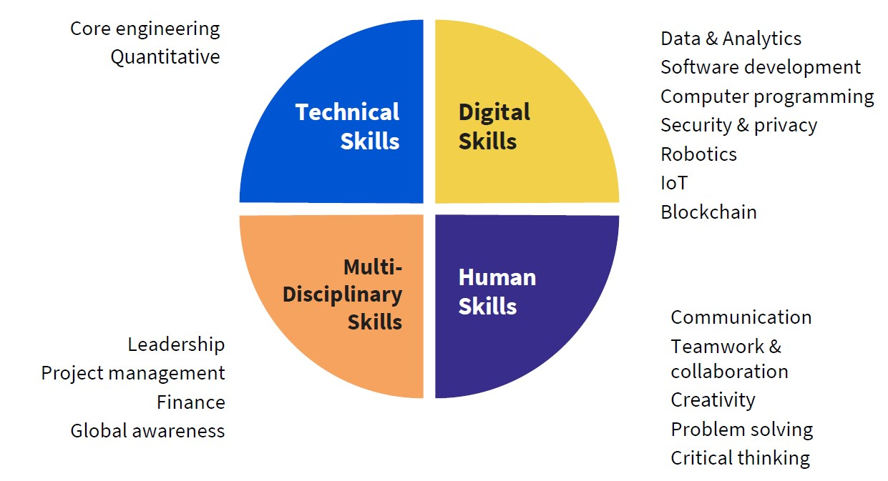
Today’s engineering and technology graduates need a multidimensional education
https://aerospaceglobalnews.com/news/airbus-is-looking-for-pi-shaped-engineers/
Sources: Burning Glass;
JWEL /MIT; NAE; WEF
AI and Big Data
Networks
Cybersecurity
Robotics
Digital Mindset
Leadership
Project Management
Talent Management
Environmental Stewardship
Critical or Analytical Thinking
Creative Thinking
Resilience
Flexibility and Agility
Curiosity
Lifelong Learning
Notes:
And employers are asking universities to fit more and more into a 3, 4 or 5 year programme, well beyond just the technical skills needed. How are universities supposed to fit it all in?
Employers expect 39% of key skills required in the job market will change by 2030.

Slide 5
Preparing for Employability
Work through the 5 steps below – in parallel than chronologically – to approach your career preparation and job search like a project. Make it fun, developmental and enjoyable.
Introspection – know yourself
Personal skills & self-reflection
CV preparation
Interview preparation
Extrospection – know your ecosystem

Slide 6
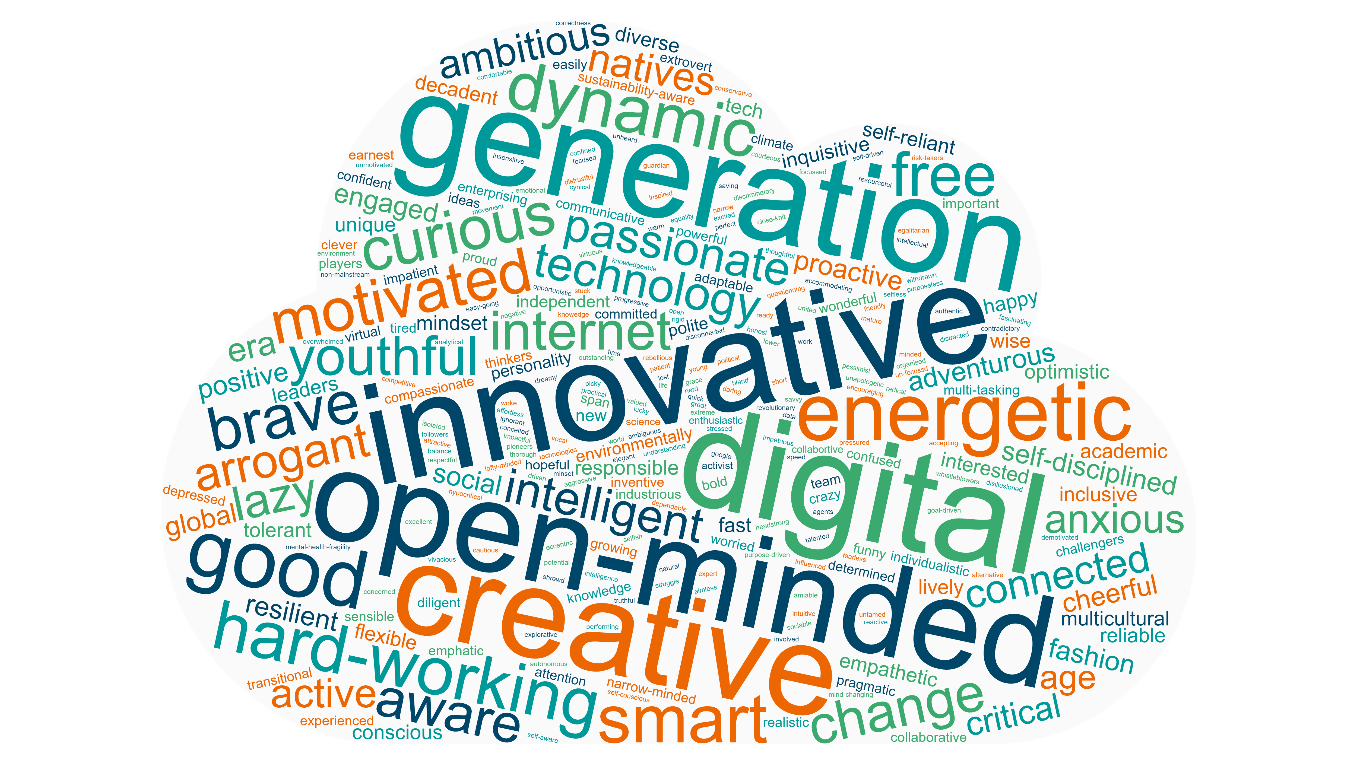
Everyone has their own unique skillset

Slide 7
“We do not learn from experience... we learn from reflecting on experience.”*
The critical importance of self-reflection
Try these to get started:
What happened today?
Why?
What did I learn from it?
What will I do differently tomorrow?
What emotions were triggered?
https://hbr.org/2022/03/dont-underestimate-the-power-of-self-reflection
*John Dewey

Slide 8
Presenting Skills - CV
CVs can look very different, there are a lot of useful points to pick up on this example which scored highly in the ‘AI CV checker’
Remember to use GenAI as a helpful tool but not the final answer > keep your own authentic language and profile.
Check in with your careers service on campus for help.

Slide 9
Preparing for Interview
Use ‘STARR’ to help you prepare examples from different times in your life and a range of experiences, e.g. your research, your research as a project, extracurricular activity, passions and hobbies, all kinds of work experience. Choose the examples that demonstrate the strongest evidence for the skill you want to describe.
Situation
Task
Action
Results
Relationships

Slide 10
Preparing for Interview - Practise
STARR
Situation
Task
Action
Results
Relationships
Tell me about your most significant achievement to date – a goal that you set for yourself.
Tell me about a time when you have achieved something with people different to yourself.
Tell me about a time when you have demonstrated resilience.

Slide 11
Preparing for Interview – Creative and Analytical Questions
Let’s talk about …
… Space Travel / AI / Genetic Engineering / Sport
P - Political
E - Economic
S - Societal
T - Technical
L - Legal
E - Environmental
Here’s a different kind of question, one we did not practice during the seminar. If you are asked to reflect on or discuss a topic in order to demonstrate your analytical skills, you can use this acronym ‘PESTLE’ to help you quickly come up with more ideas and a range of perspectives.
Here’s an alternative…
What are some of the considerations you would need to address if you were asked to mass produce your end of year design project?

Slide 12
Extrospection > Building up your market knowledge and your Ecosystem of contacts and information
Research
  Economic News (e.g. The FT)
  Trade and Academic associations in your field of interest
Networking
  Your university alumni
LinkedIn
  Following companies and organisations of interest

Slide 13
Preparing for employability - Recap
Introspection – know yourself
Personal skills & self-reflection
CV preparation
Interview preparation
Extrospection – know your ecosystem

Slide 14
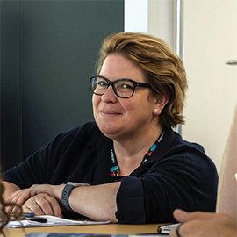

Good Luck!
Kirsten Williamson
Founder, The Global Learning Expedition
https://www.linkedin.com/in/kirstenwilliamson/

