Slide 1


Magnetometry: from single measurements to network of magnetometers
3rd General Meeting of COST Action COSMIC WISPers (CA21106)
9-12 September, 2025, Sofia, Bulgaria
Boyan Benev
Benev Science & Technology Ltd.
Institute of Astronomy and NAO,
Bulgarian Academy of Sciences

Slide 2
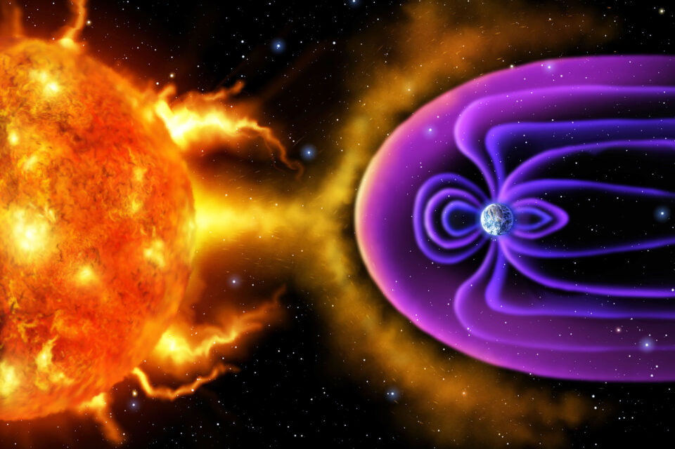
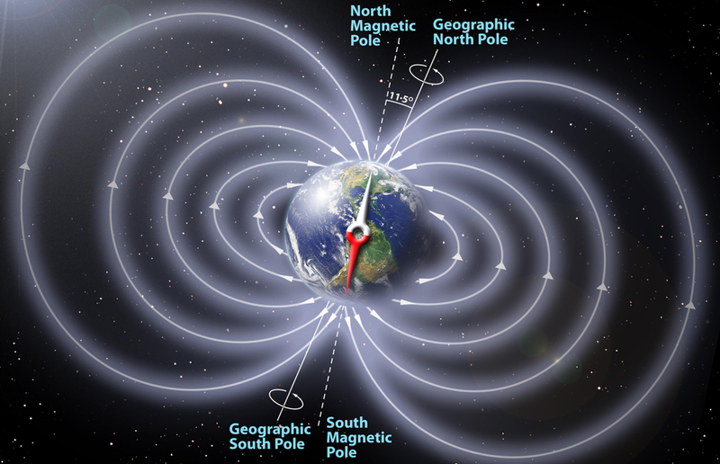
Earth’s Magnetic Field
Determines life on the planet and our civilization evolution.
Physics Magazine, American Physical Society

Slide 3
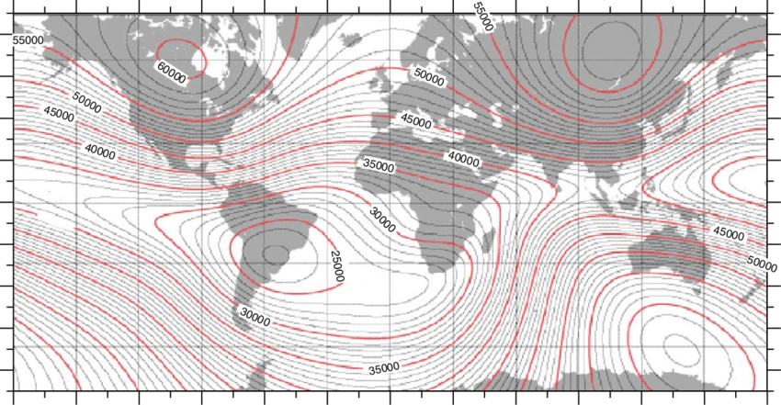
Geophysical (geological) and archeological surveys.
Perturbations are ~1nT in both cases!
M.A. Abdu et al. / Journal of Atmospheric and Solar-Terrestrial Physics 67 (2005) 1643–1657

Slide 4
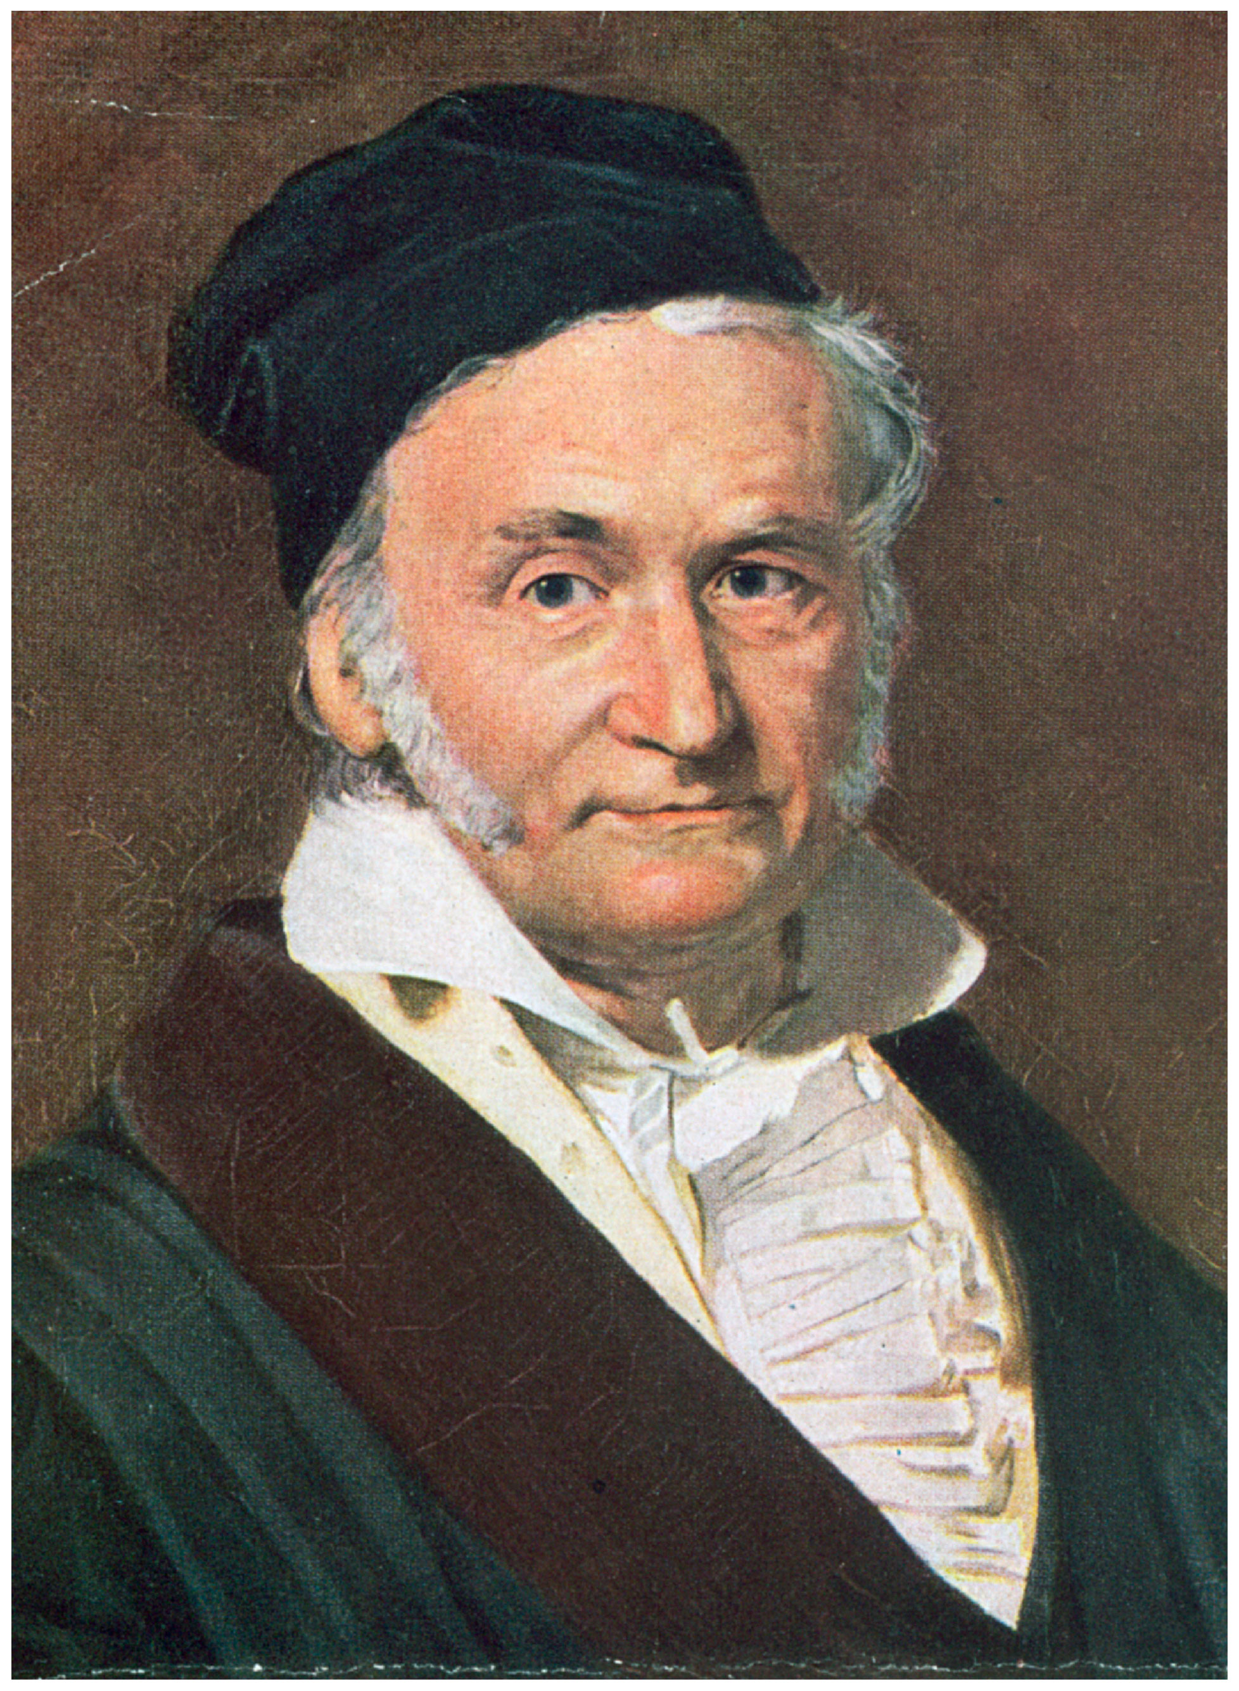
Measuring magnetic field
1833 – Carl Friedrich Gauss. First systematic study and measurement of the Earth’s magnetic field.
Two basic types – vector and scalar magnetometers.
Mechanical, electromagnetic, optical, quantum.
Magnetic needle, Rotating coil, Induction coil, Fluxgate, Hall effect, Magnetoresistive; Proton, Overhauser, Optical pumping.

Slide 5
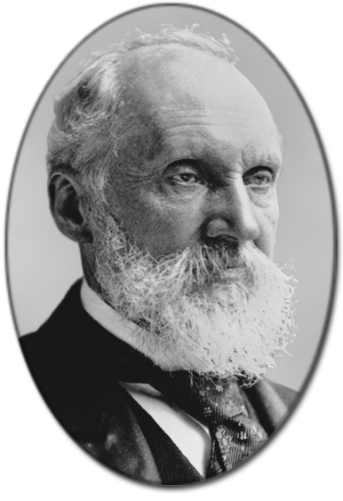
Magnetoresistance
1856 - William Thomson (Lord Kelvin). “Dependence of electrical resistance on the angle between the direction of electric current and direction of magnetization.”
Just to mansion: Giant magnetoresistance (GMR), Tunnel magnetoresistance (TMR), Colossal magnetoresistance (CMR), Extraordinary magnetoresistance (EMR), Anisotropic magnetoresistance (AMR).

Slide 6
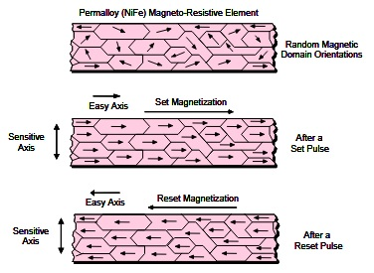
AMR Technology
Permalloy (NiFe) thin-film crystalline ferromagnetic layer structure.
Set/Reset function.
Honeywell International Inc. – www.magneticsensors.com

Slide 7
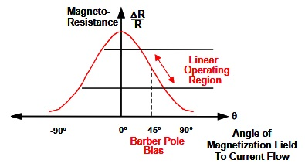
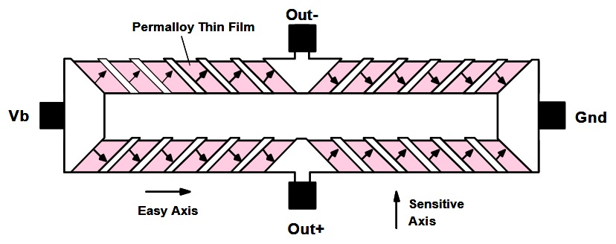
Linear region of operation.
Barber-pole configuration forming a Wheatstone bridge.
Honeywell International Inc. – www.magneticsensors.com
Honeywell International Inc. – www.magneticsensors.com

Slide 8
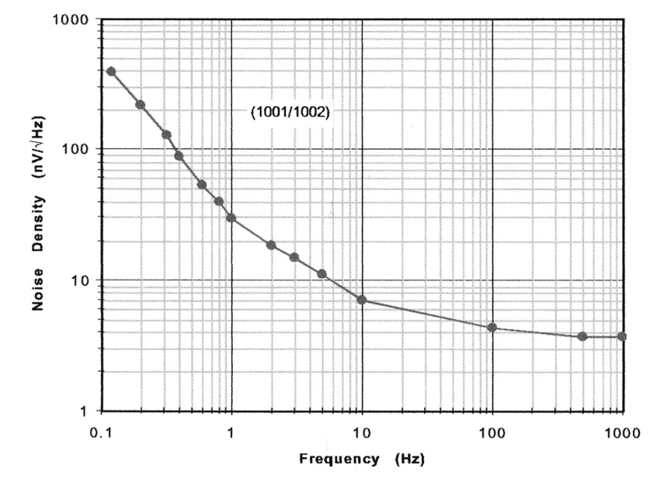
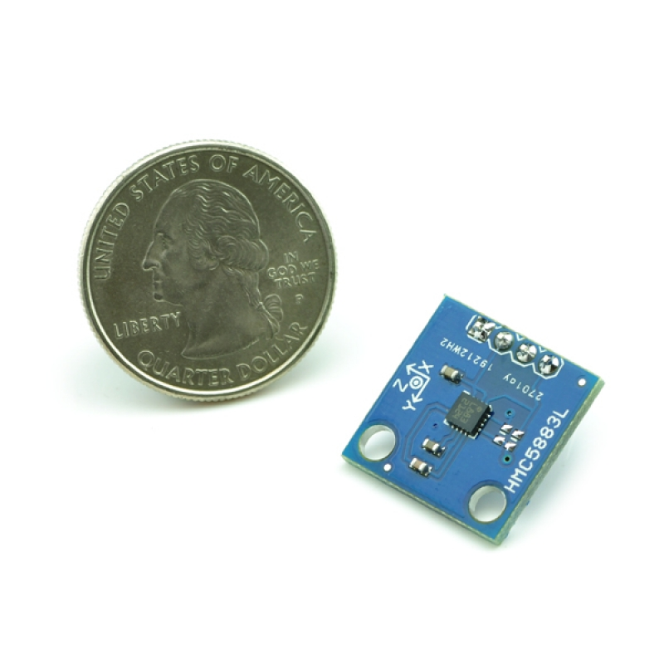
Why AMR?
The short answer is “Why not?”
RMS noise spectral density at 1 kHz – 12 pT/Sqrt(Hz).
Small energy demands!
Miniaturization.
Alternative to other technologies.
HMC1001/1002 RMS noise spectral density curve.
Honeywell International Inc. – www.magneticsensors.com

Slide 9
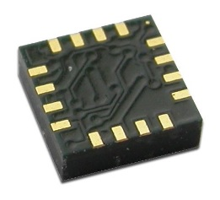
HMC5883L
(Honeywell International Inc.)
3-Axis Magnetoresistive Sensors in a tiny 3x3 mm SMD package.
Built-in Set/Reset and Offset circuits.
12-Bit ADC.
I²C Digital Interface.
Up to 160 Hz Output Rate.
Honeywell International Inc.
www.magneticsensors.com

Slide 10
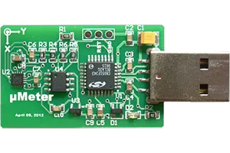
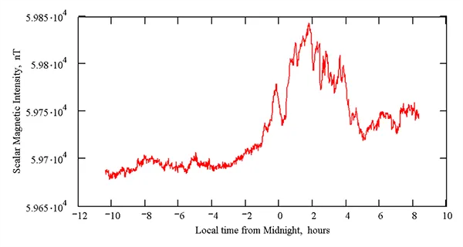
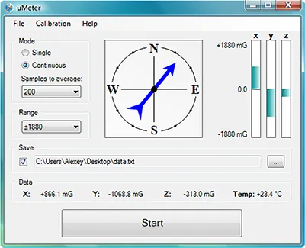
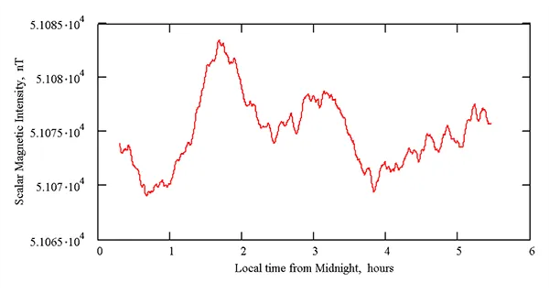
­µMeter
Our first successful experience using AMR sensor technology.
November 06-07, 2012, Cairns, Australia
* Absolute values are not correct.
March 20, 2013 in Stara Zagora, Bulgaria
* Absolute values are not correct.

Slide 11
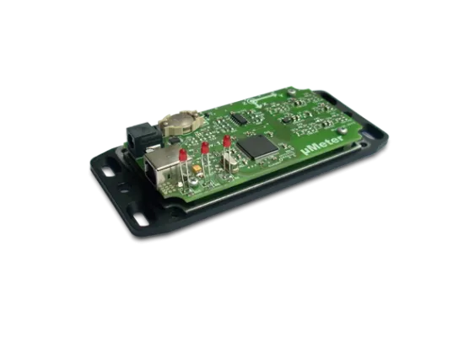
µMeter2
An improved version of µMeter magnetometer.
Autonomous recording system.
Multichannel AMR sensors.
USB control.
Independent battery-powered RTC.
Internal SD memory card data storage.
Cons: Strong temperature dependance of the measured data.

Slide 12
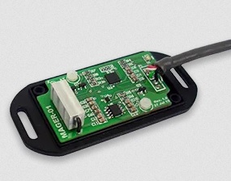
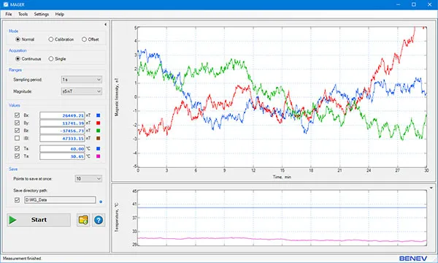
MAGER
Based on HMC5883L.
Internal temperature stabilization on magnetic sensor triad.
GUI Windows software with control over calibration process and temperature stabilization parameters.

Slide 13
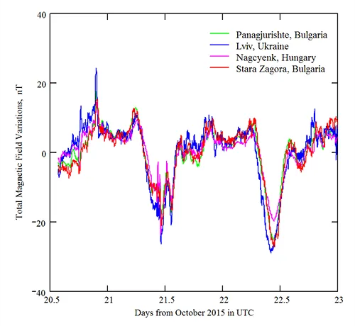
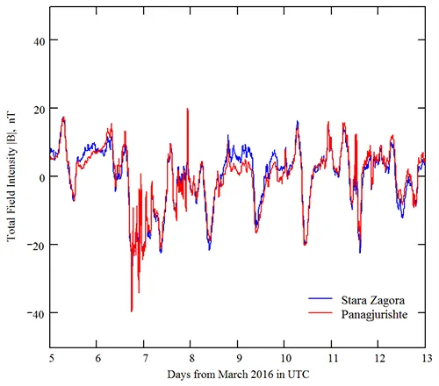
MAGER – First data
Stara Zagora geomagnetic data and one-minute data from three INTERMAGNET geomagnetic observatories. Our data are filtered using a 5-minute low-pass bidirectional filter. The series covers the period from October 20-23, 2015.
Comparison of the total geomagnetic field intensity between Stara Zagora data and minute data from INTERMAGNET geomagnetic observatory in Panagjurishte (PAG), Bulgaria, covering the period March 05-12, 2016. The Stara Zagora data are filtered using a 15-minute low-pass bidirectional filter.

Slide 14
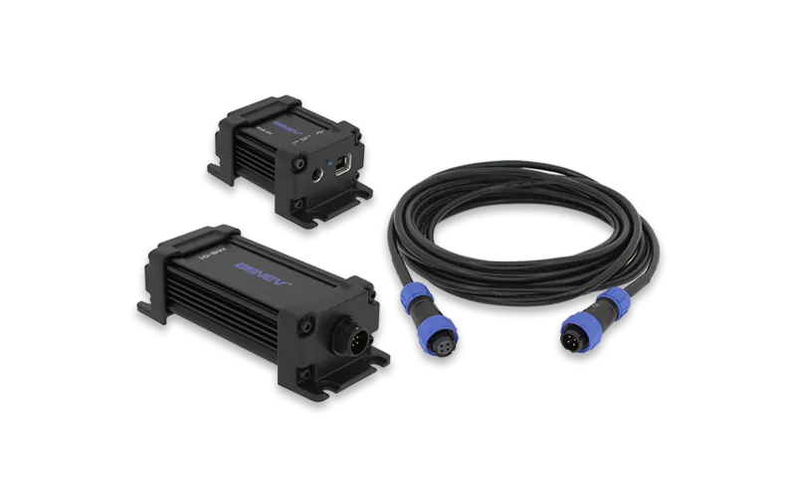
MG-01

Slide 15
Stating the task
Some facts:
Earth’s magnetic field ranges from 20000 nT in the equatorial zone to above 65000 nT near the magnetic poles. Magnetic storms are in the range from tens to hundreds of nT.
According to IAGA: Continuous and Irregular (impulsive) magnetic pulsations.

Slide 16
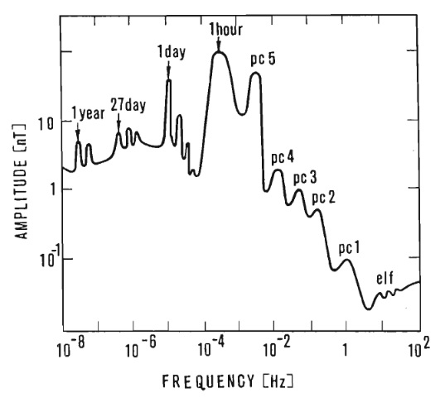
Pulsation | Period (s)
Pc 1 | 0.2 to 5
Pc 2 | 5 to 10
Pc 3 | 10 to 45
Pc 4 | 45 to 150
Pc 5 | 150 to 600
Pc 6 | Above 600
Pulsation | Period (s)
Pi 1 | 1 to 40
Pi 2 | 40 to 150
Pi 3 | Above 150
Amplitudes of natural variations of the horizontal component of geomagnetic field.
Jankowski and Sucksdorff, 1996

Slide 17
Basic requirements:
Geophysical and archeological surveys need accuracy better then 1 nT. Thus, we aim at least one order of magnitude better accuracy, SNR and temperature stability ~0.1 nT.
Absolute accuracy ~1 nT after calibration procedure.
Measuring range of ±70000 nT (10⁵ / 10⁻¹ = 10⁶ – six orders of magnitude!).
Sampling frequency from 10 Hz to DC.

Slide 18
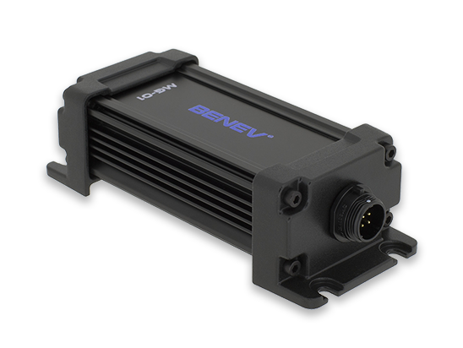
Basic configuration
Utilizes HMC1001 and HMC1002 from Honeywell International Inc.
Two basic parts: Sensor Head (SH) and Interface Module (IM).
Sensor Head – nonmagnetic. Consists of measuring sensors, Set/Reset circuit, temperature stabilization block, precise low-noise analog electronics, ADC, MCU and connects to the IM through isolated digital interface.

Slide 19
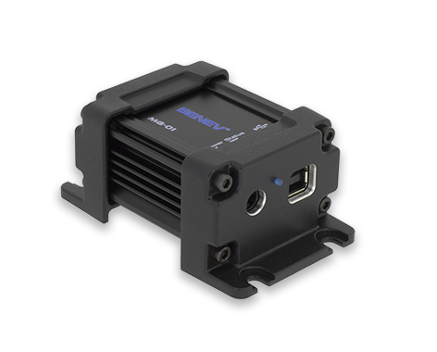
Interface Module supplies power to the SH and sends collected data to the PC through USB interface. It is implemented as USB HID device (no need of driver installation).

Slide 20
Working parameters
Parameter | Value
Range (on each axis) | ±75000 nT
Bandwidth (-3 dB) | DC ÷ 20 Hz
Sensitivity @ 1 S/s | 0.015 nT/ADU
Noise RMS spectral density @ 1 Hz | 0.05 nT/Sqrt(Hz)
SNR @ 1 S/s | 124 dB
ADC effective resolution @ 1 S/s | 20.5 bit
Max sampling rate | 10 S/s
Nominal power consumption | ~1 W
Supply voltage | DC 12 ÷ 24 V
Weight (SH + IM) | 360 g
www.BenevSciTech.com

Slide 21
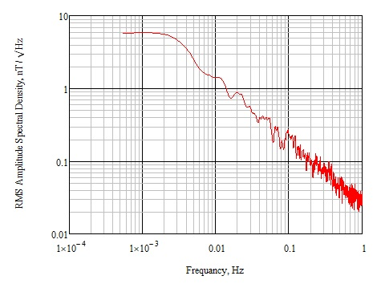
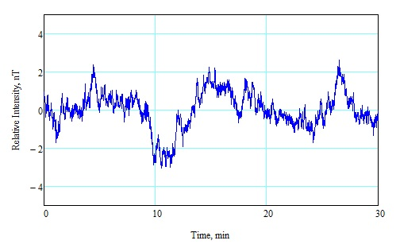
Noise figure
So small values of noise are only possible in the magnetic noise-free environment, faraway from big urban structures.

Slide 22
Temperature stabilization
Small aluminum block with build-in heating element is mounted on the magnetic sensors triad.
The block contacts with the sensor surface through thermo-conductive compound.
Heating element is a set of nonmagnetic resistors switched on and off by a build-in PWM controller.
The on board MCU controls the temperature implementing a PID algorithm. Magnetic measurements are taken during the off-state of the heating element.

Slide 23
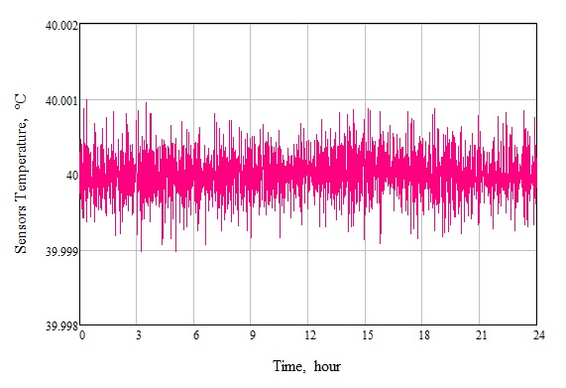
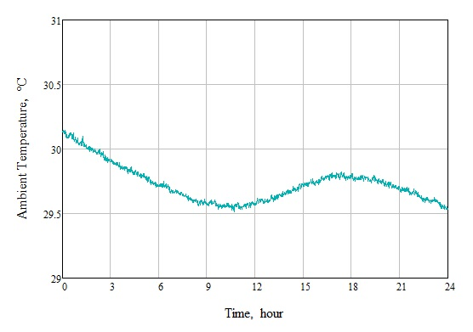
The installation location must be chosen so that there are minimal daily fluctuations in the ambient temperature!
Sensor temperature fluctuations during 24 hours.
Parameter | Value
Temperature accuracy @ 1 S/s (RMS) | 0.003 °C
Temperature coefficient | 0.35 nT/°C
Warm-up time | 10 ÷ 15 min
Ambient temperature variations during 24 hours.
www.BenevSciTech.com

Slide 24
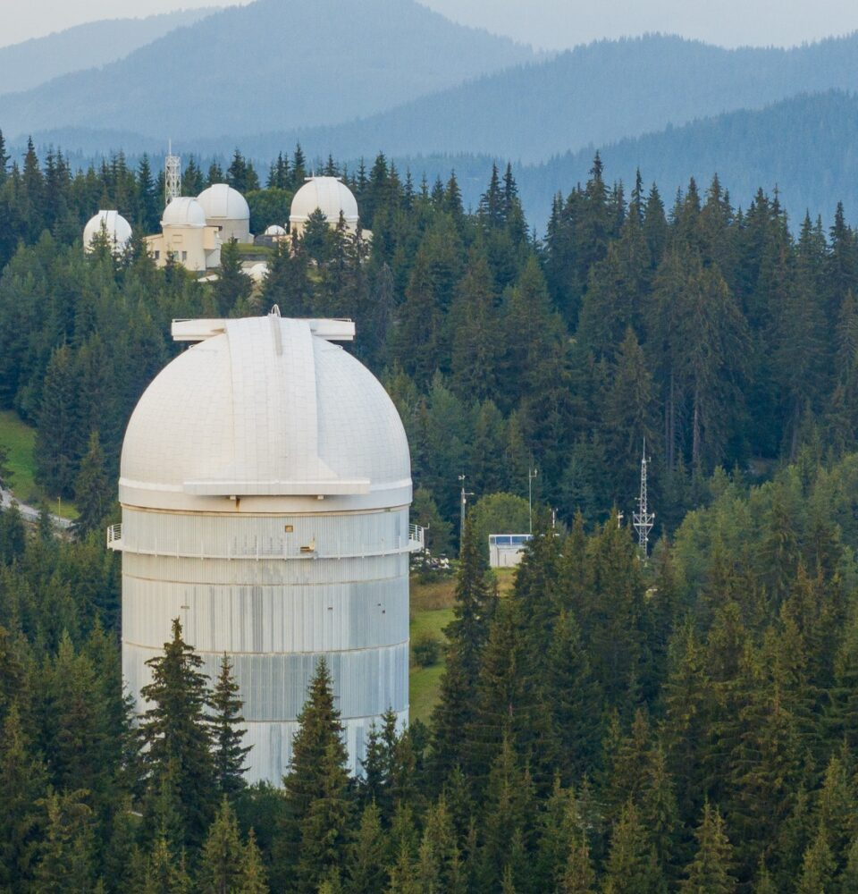
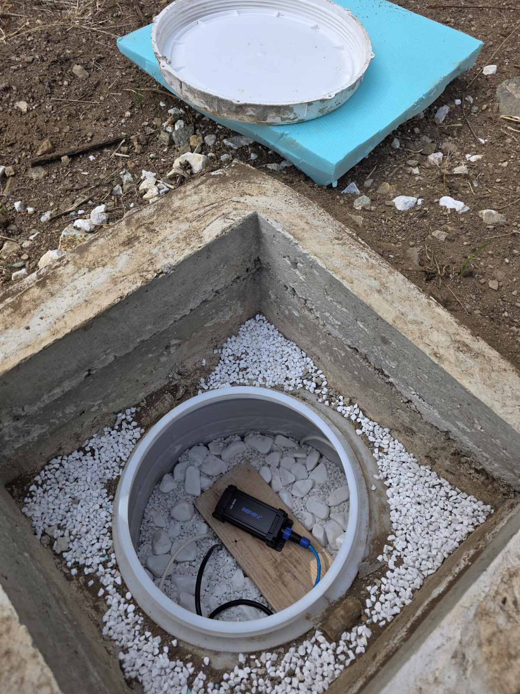
Installation
“IAGA Guide for Magnetic Measurements and Observatory Practice” by Jerzy Jankowski and Christian Sucksdorff.
A concrete shaft (without steel armature or any other ferromagnetic material) 1 m deep is poured out around a moisture protected plastic container. The shaft is buried in the ground on a shadow place in the nearby forest. The magnetometer is mounted on a wooden base lying on a stone bed on the bottom of the container. The shaft is covered by a thermo-isolated heavy ceramic plate. The closest buildings are about 100 m away.
This installation scheme ensures small enough fluctuations in the ambient temperature during the year.
NAO – Rozhen
41°41′36″N 24°44′20″E
1759 m

Slide 25
Calibration – Theory
Definitions:
“Comparison of measurement values delivered by a device under test with those of a calibration standard of known accuracy”. (Wikipedia)
“Operation that, under specified conditions, in a first step, establishes a relation between the quantity values with measurement uncertainties provided by measurement standards and corresponding indications with associated measurement uncertainties (of the calibrated instrument or secondary standard) and, in a second step, uses this information to establish a relation for obtaining a measurement result from an indication”. (BIPM)

Slide 26
“Finding the relation, to some degree of well-defined accuracy, between DUT output data and physical quantity”. (BB)
“Complete Triaxis Magnetometer Calibration in the Magnetic Domain” by Valérie Renaudin et al. (Journal of Sensors, 2010).
“New Method for Magnetometers Based Orientation Estimation” by Valérie Renaudin et al. (IEEE/ION PLANS, 2010).
(Why symmetrical matrix?)

Slide 27
Magnetometer error model:
Instrumentation errors.
  Scale factor – 3x3 square diagonal matrix S.
  Nonorthogonality and misalignment – 3x3 matrix M.
  Sensor offset – 3x1 vector b_{so}.
Magnetic deviation.
  Hard iron – 3x1 vector b_{hi}.
  Soft iron – 3x3 matrix A_{si}.
Random gaussian noise ε ∼ N(0, σ_{ε}²).

Slide 28
Let h represents error-free magnetic field and ĥ represents sensor triad readings. Then
ĥ = S * M * (A_{si}* h + b_{hi} ) + b_{so} + ε
Using combined 3x3 square matrix A = S * M * A_{si} and 3x1 vector b = S * M * b_{hi} + b_{so} , this represents a linear error model:
ĥ = A* h + b + ε => h = A⁻¹ * (ĥ - b - ε)
Our goal is to find A⁻¹ and b (12 unknown parameters).

Slide 29
Few aproaches are possible to the calibration procedure:
Using theoretical model of the Earth’s magnetic field, e.g. IGRF model.
Using another calibrated magnetometer as an in-situ secondary standard.
Using a Helmholz coil system. (https://benevscitech.com/en/coil-systems-magnetometers-calibration.html)
Using the absolute magnitude value of the local geomagnetic field with the reference to one of the nearby INTERMAGNET magnetic observatories.

Slide 30
Magnetic observatory in Panagyurishte (PAG), part of the INTERMAGNET network, as a reference point!
Rotating the magnetometer in 3D space:
h describes a sphere S_{Local} with radius H_{PAG} .
ĥ describes an ellipsoid E_{Local} (guaranteed by the linear error model).
Two-stage calibration process.
Find the Transform E_{Local} –> S_{Local} .
Find the Rotation S_{Local} –> S_{PAG} .

Slide 31
Calibration steps:
Rotating the magnetometer only in a small vicinity in 3D space around installation mounting point (±5 degrees at each Euler angle), thus ensuring strict linearity. Sampling period is 0.5 s or 1 s.
Using Levenberg-Marquardt optimization algorithm to find combined A⁻¹ and b. Thus, transforming the ellipsoid E_{Local} into a sphere S_{Local} with origin at P(0,0,0) and radius H_{PAG} .
Using INTERMAGNET (PAG) observational data and Levenberg-Marquardt algorithm or Kabsch algorithm (Wahba problem) to find the rotation transform S_{Local} –> S_{PAG} .
Whole calibration procedure takes only a few minutes!

Slide 32
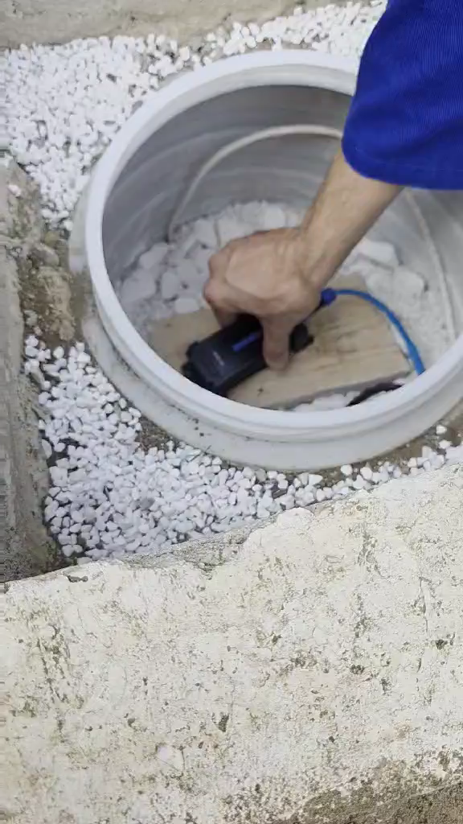

Slide 33
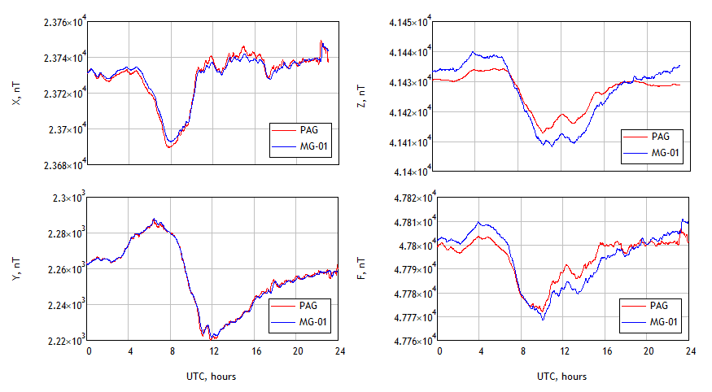
Calibration – Results
Earth’s magnetic field components comparison between PAG and MG-01 minute data after magnetometer calibration procedure. Data shown here depict daily geomagnetic variations on 31 August, 2025. The RMS deviations are: σX = 2.43 nT; σY = 1.11 nT; σZ = 4.20 nT; σF = 4.42 nT .

Slide 34
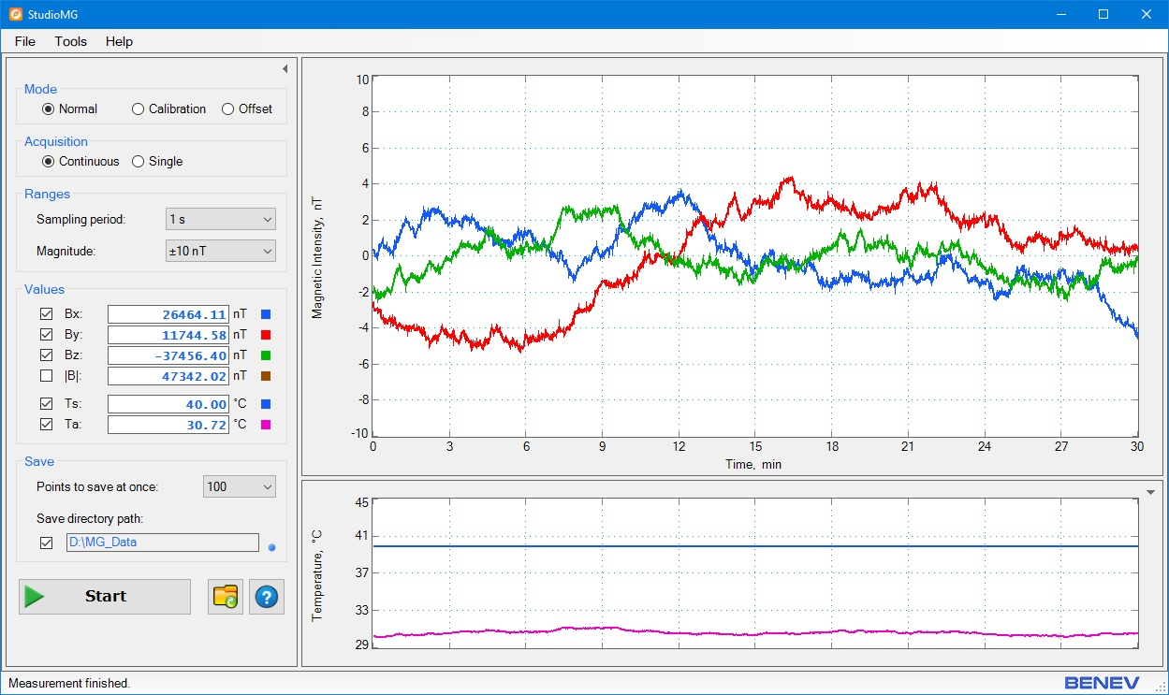
StudioMG (v1)

Slide 35
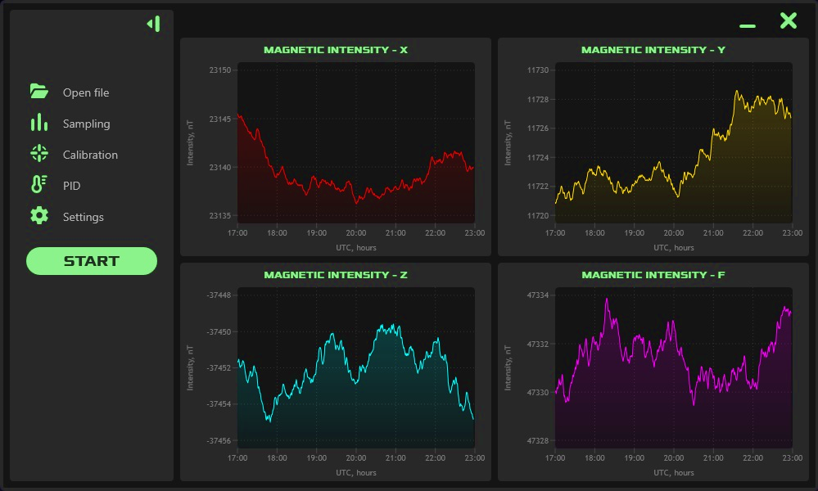
StudioMG (v2)

Slide 36
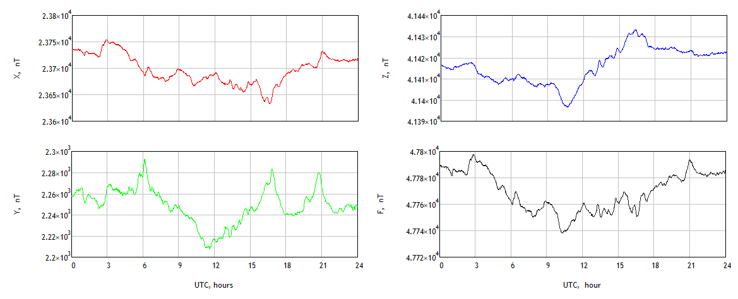
Observational data
09 August, 2025. Slight magnetic perturbations are observed.

Slide 37
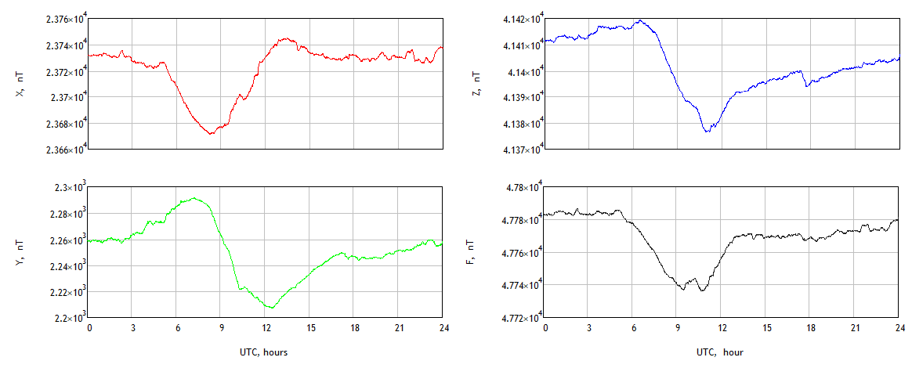
26 August, 2025. Quiet day with almost no perturbations.

Slide 38
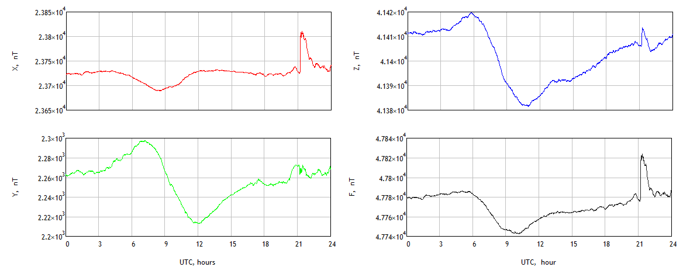
01 September, 2025. Magnetic perturbations start at 21:00 UTC.

Slide 39
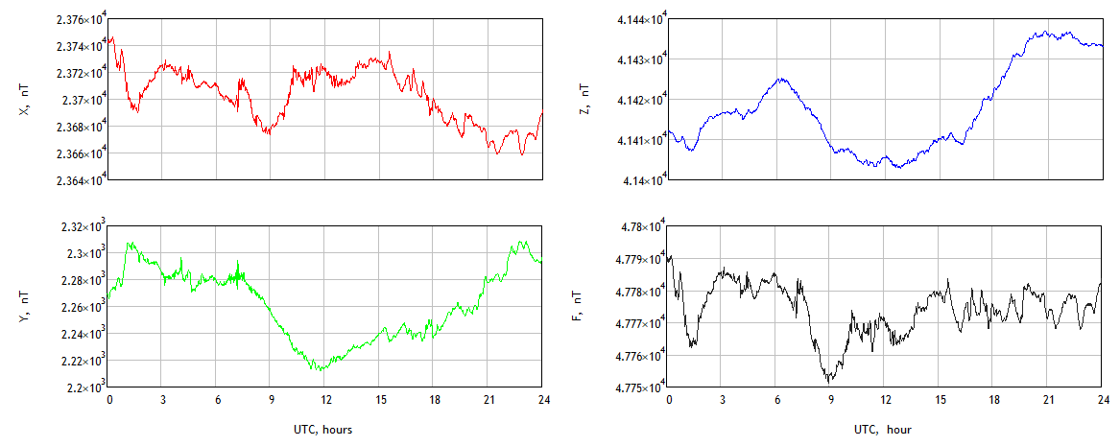
02 September, 2025. Evolution of the magnetic storm started on 01 September, 2025 at 21:00 UTC during the next 24 hours.

Slide 40
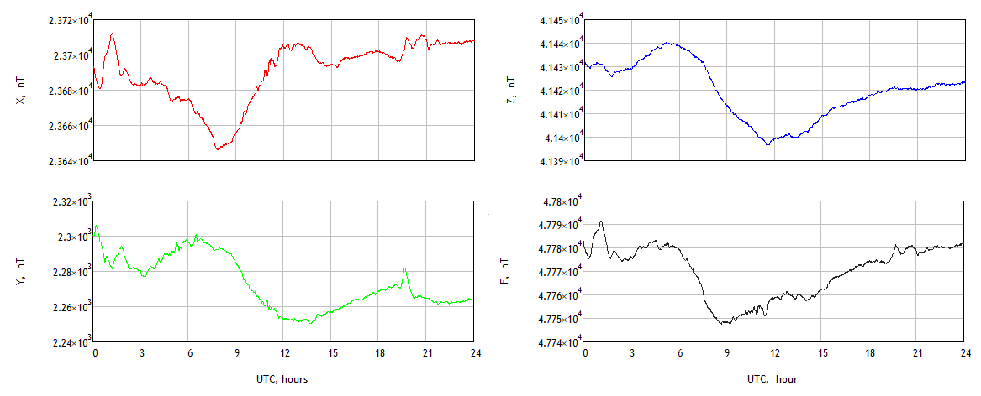
03 September, 2025. Magnetic perturbations decrease in amplitude.

Slide 41
Ideas and Perspectives
to the Future
RS-485 communication between SH and IM.
New software with fully automatic operation of recording raw data and filtered minute data.
Real-time online data archive with minute data in IAGA2002 INTERMAGNET Exchange Format and ImagCDF (NASA’s Common Data Format).
NAO Rozhen as part of INTERMAGNET.

Slide 42
Ring network (SATI).
Multi observational points network.
Satellite missions.
Drone (geophysical and archeological surveys).
Joint projects with Bulgarian Academy of Sciences and other research organizations.

Slide 43
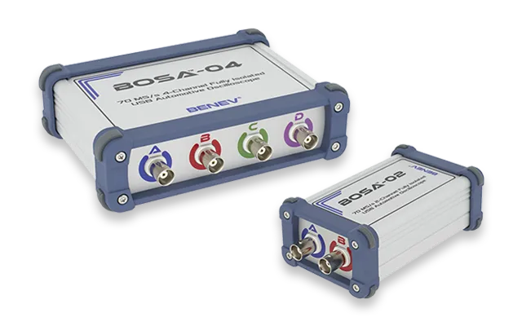
BOSA-02, BOSA-04
Automotive Diagnostic Oscilloscopes

Slide 44

GTR-01
Quantum Hardware Random Number Generator
Avalanche noise in the reverse-biased p-n junction as an entropy source.
Data output rate through a USB interface up to 2.2 Mb/s.
12-bit precise calibration with EEPROM values storage.
Statistical validation using NIST STS, TestU01, Diehard!

Slide 45

Thank You For Your Attention!
www.BenevSciTech.com

