Slide 1

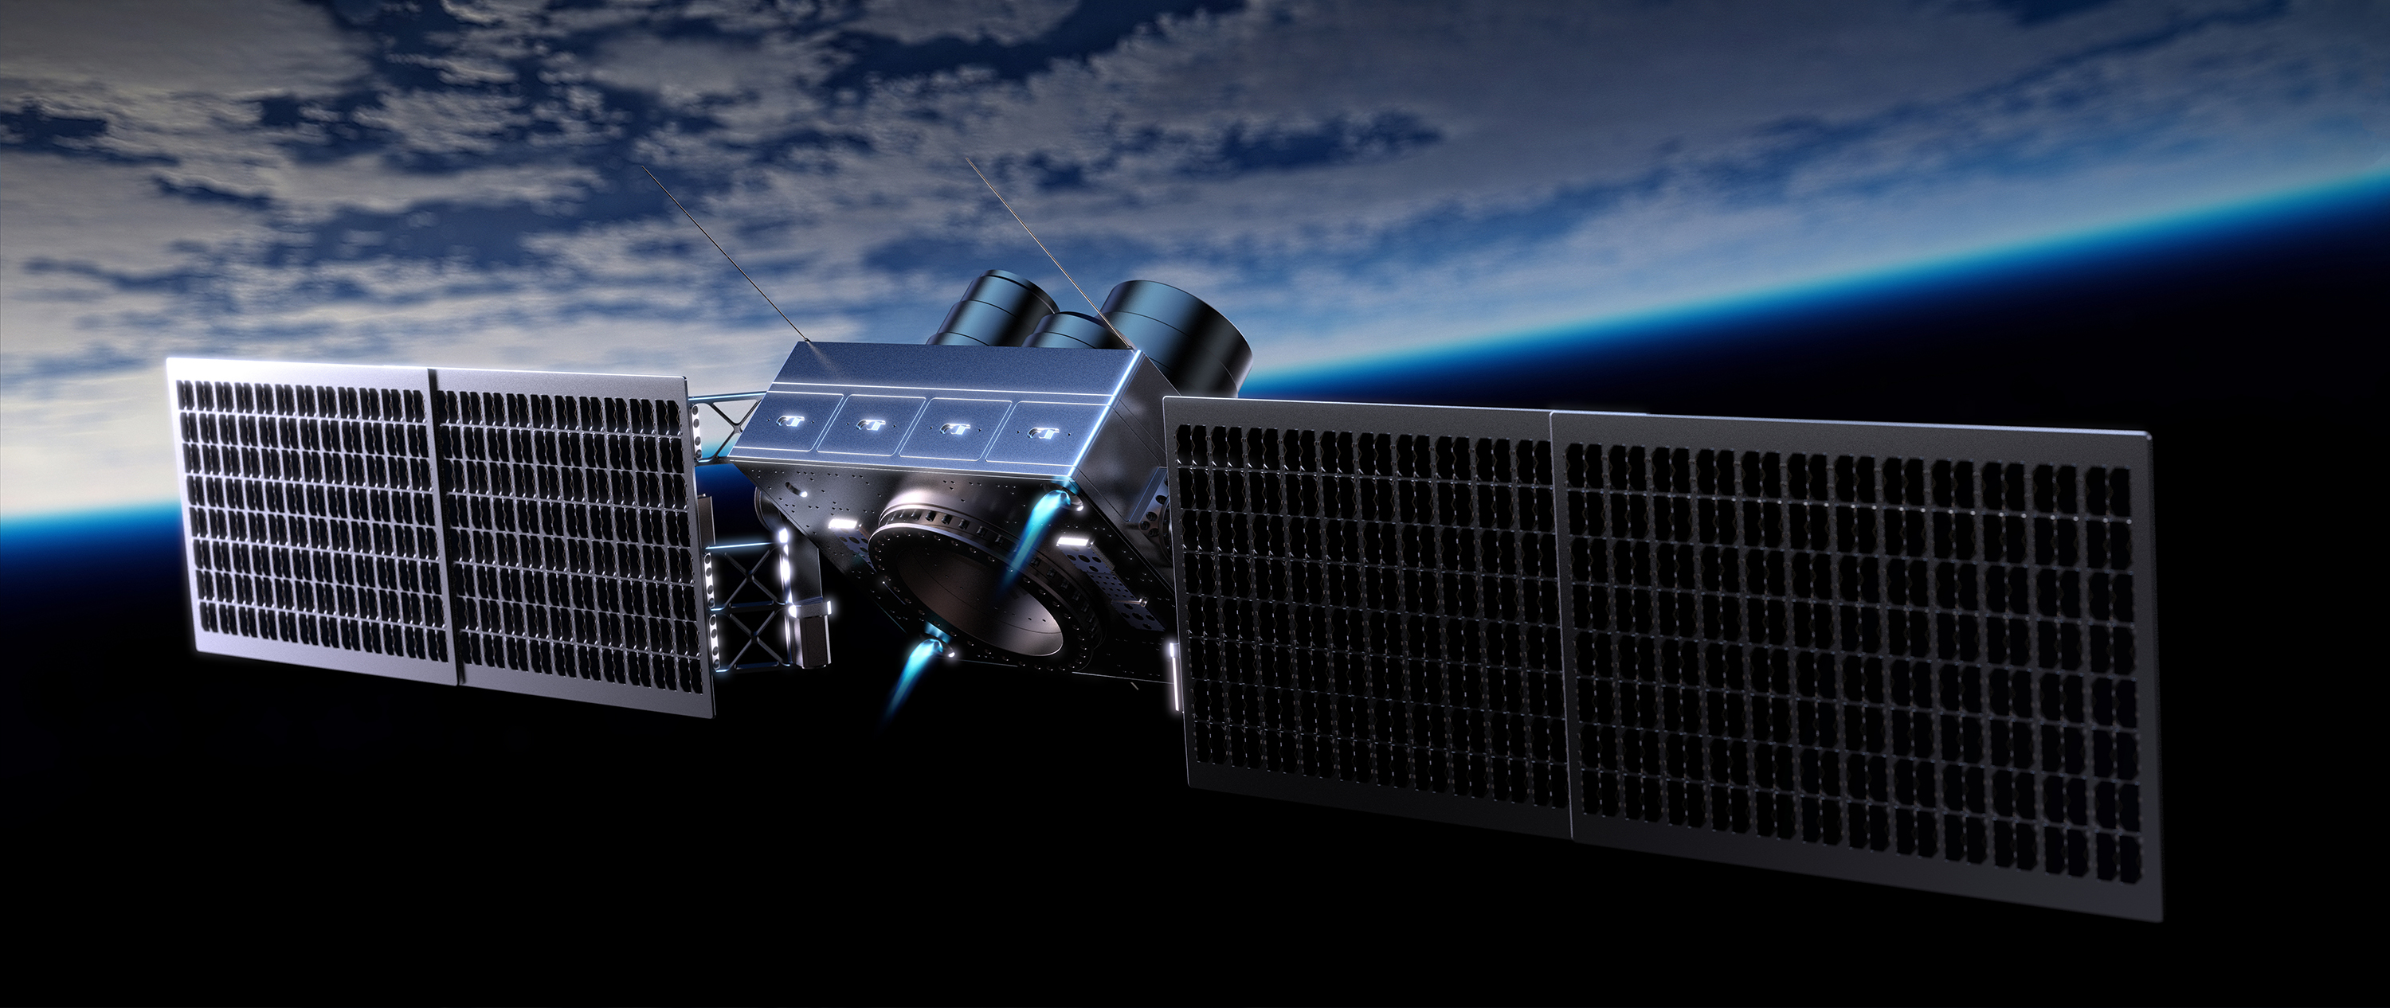
SATELLITES AND SPACE MISSIONS
THE ENDUROSAT STORY
Lubomir Toshev,
Principal Software Architect
Privileged and confidential

Slide 2
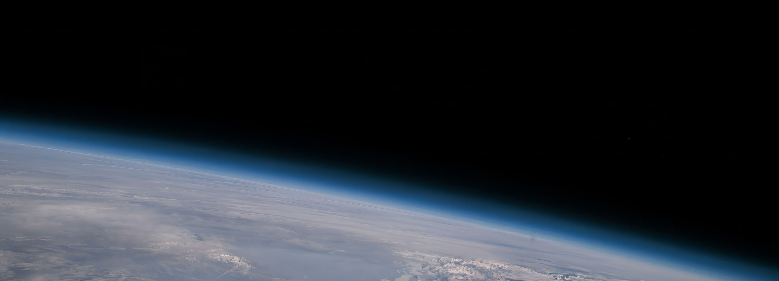
MAKING SPACE UNIVERSALLY ACCESSIBLE
Privileged and confidential

Slide 3
Fully in-house designed and manufactured
Components
2500+ modules in space
Nasa State of the art
900+ years Flight Heritage
2 weeks leed time
Satellite buses
Software flexible
Hight-performance
MicroSat & NanoSats
Space service
Complete Space Mission Cycle
We covered it all
Software suite
Advanced Operations
Fast & Secure data access
Privileged and confidential

Slide 4
First exploration missions + 200 customers signed
²⁰²⁴
2nd gen satellite tech developed + 100th space customer signed
First Small Satellite built & 3rd gen satellite tech developed
²⁰²²
²⁰²³
^{1st major space contracts won}
Company founded in an attic apartment
1st NanoSat built & Online Satellite Store launched
²⁰²⁰
²⁰²¹
Fixed-cost Space Service launched
²⁰¹⁸
²⁰¹⁶
²⁰¹⁹
²⁰¹⁵
²⁰¹⁷
^{50th space customer signed}
^{1st mission to space launched}
1st prototypes of satellite modules developed
Privileged and confidential

Slide 5
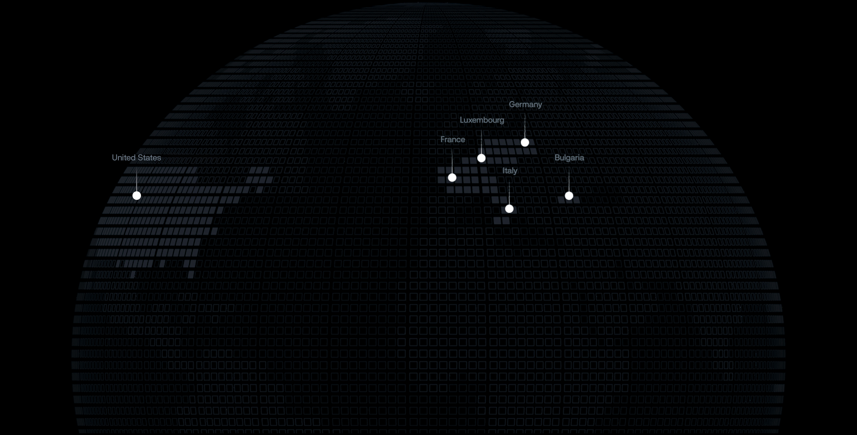



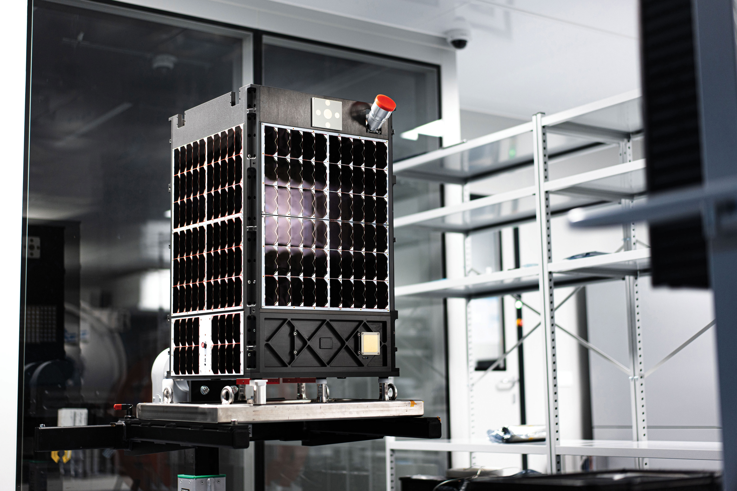
Company
Privileged and confidential

Slide 6


BOOTCAMP
^{70%}
^{MENTORS}
²⁰⁰⁺
^{HANDS-ON}
^{SPACE}
^{EDUCATION}
FROM RELEVANT SPACE INSTITUTIONS
ALUMNI WORKING IN HIGH TECH SECTORS
FIND OUT MORE: https://spaceedu.net
Privileged and confidential

Slide 7
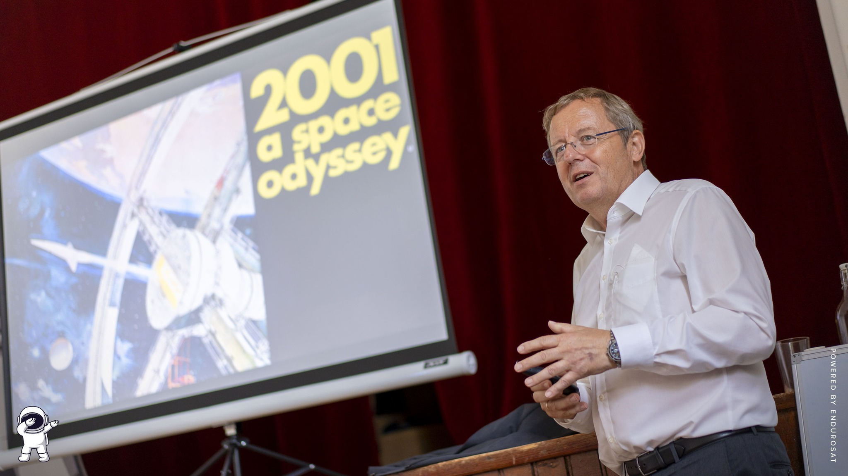
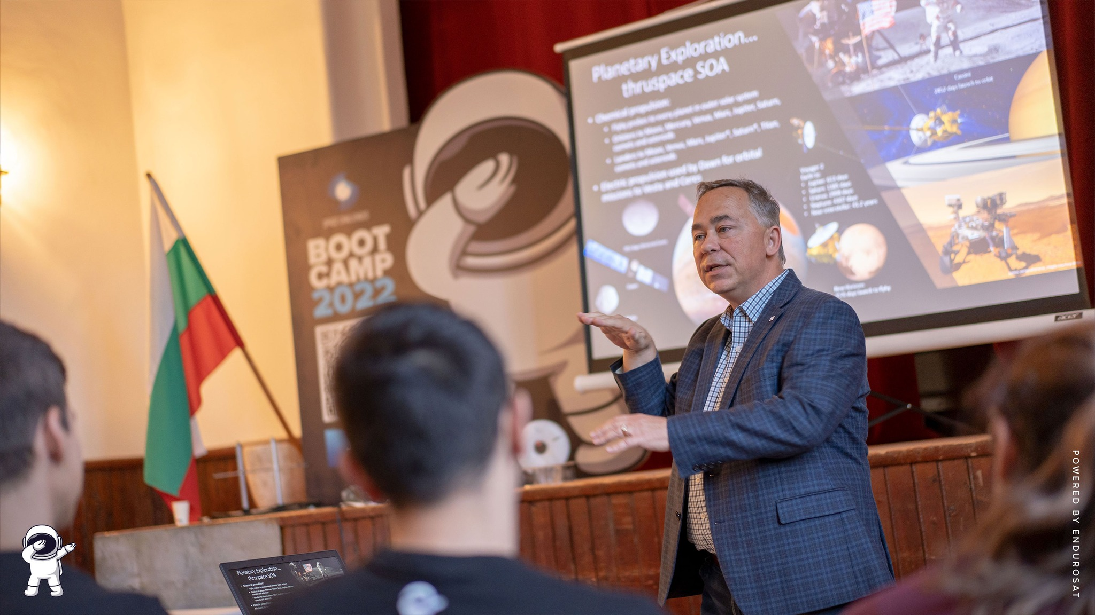
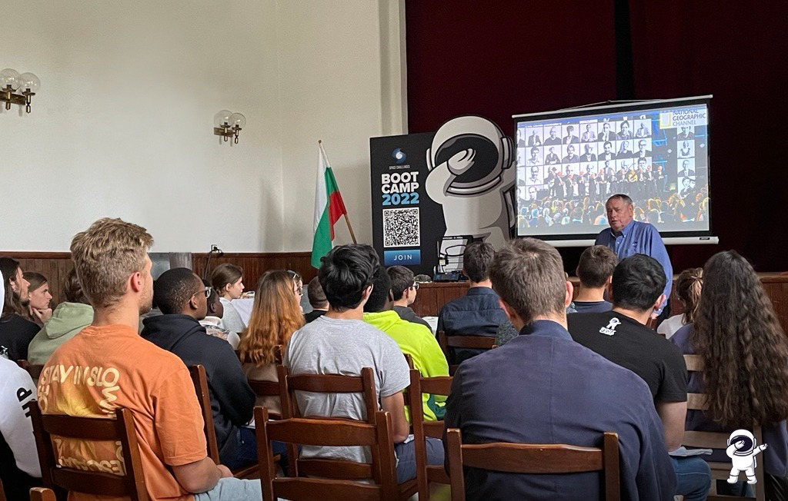
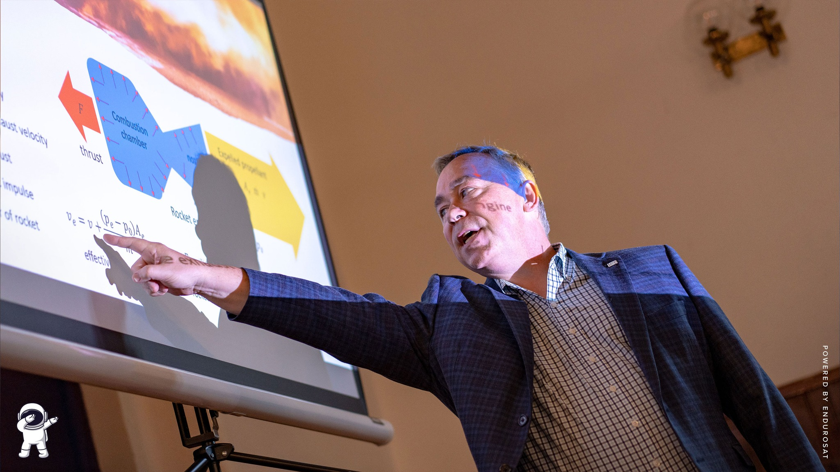
Privileged and confidential

Slide 8

MSC SPACE ENGINEERING
AND TECHNOLOGY
^{70%}
^{PARTNERS}
^{MENTORS}
^{HANDS-ON EDUCATION}
PARTNERING WITH 3 TOP UNIVERSITIES IN BULGARIA
FROM ENDUROSAT AND LEADING SPACE COMPANIES
FIND OUT MORE: https://newspacemasters.com
Privileged and confidential

Slide 9
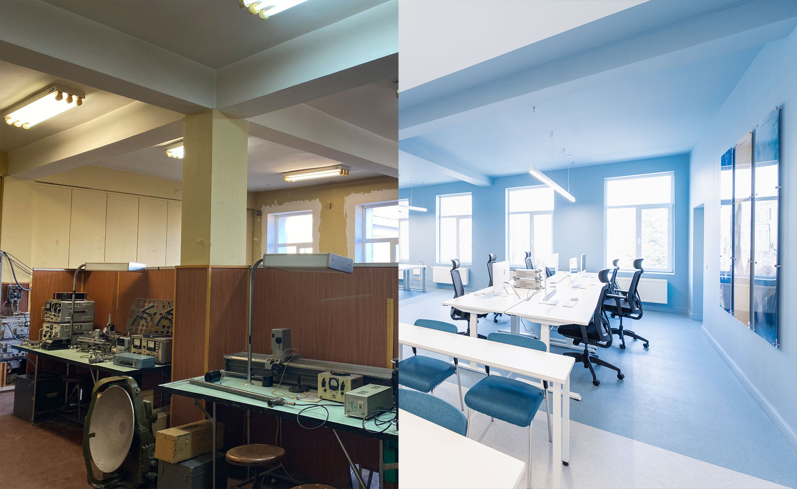
Privileged and confidential

Slide 10
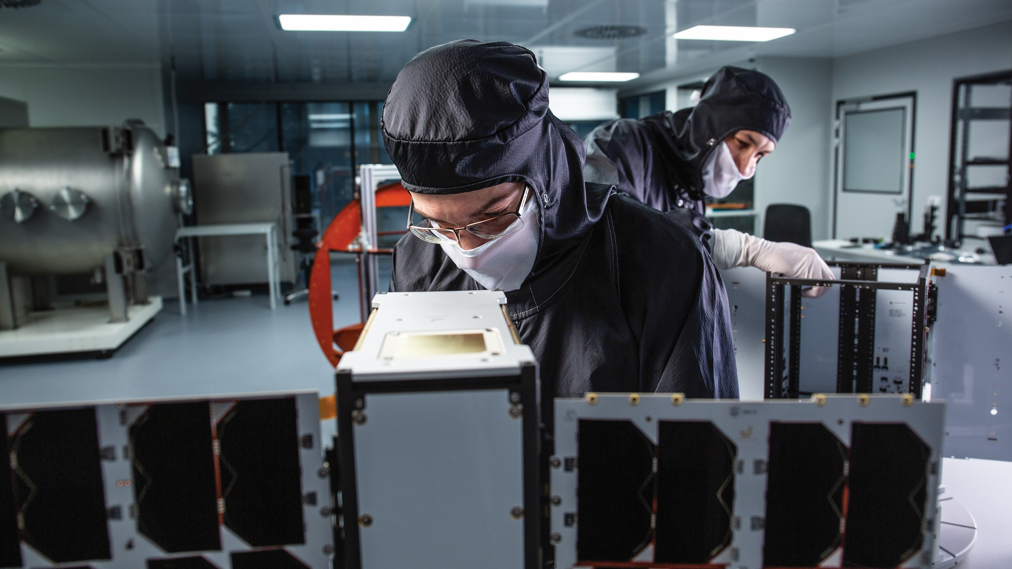
⁶⁰⁺
²⁰⁰⁺
^{DELIVERED SATELLITES}
^{TB DATA DOWNLINKED}
SOFTWARE-FLEXIBLE
SATELLITES
Privileged and confidential

Slide 11
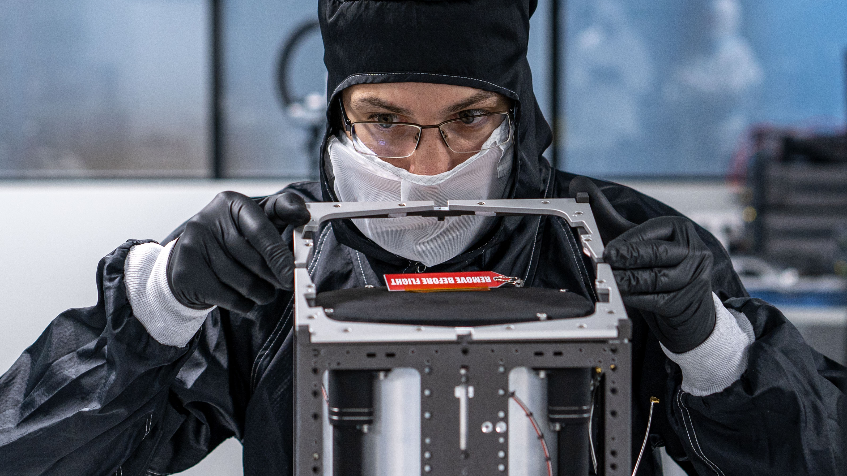
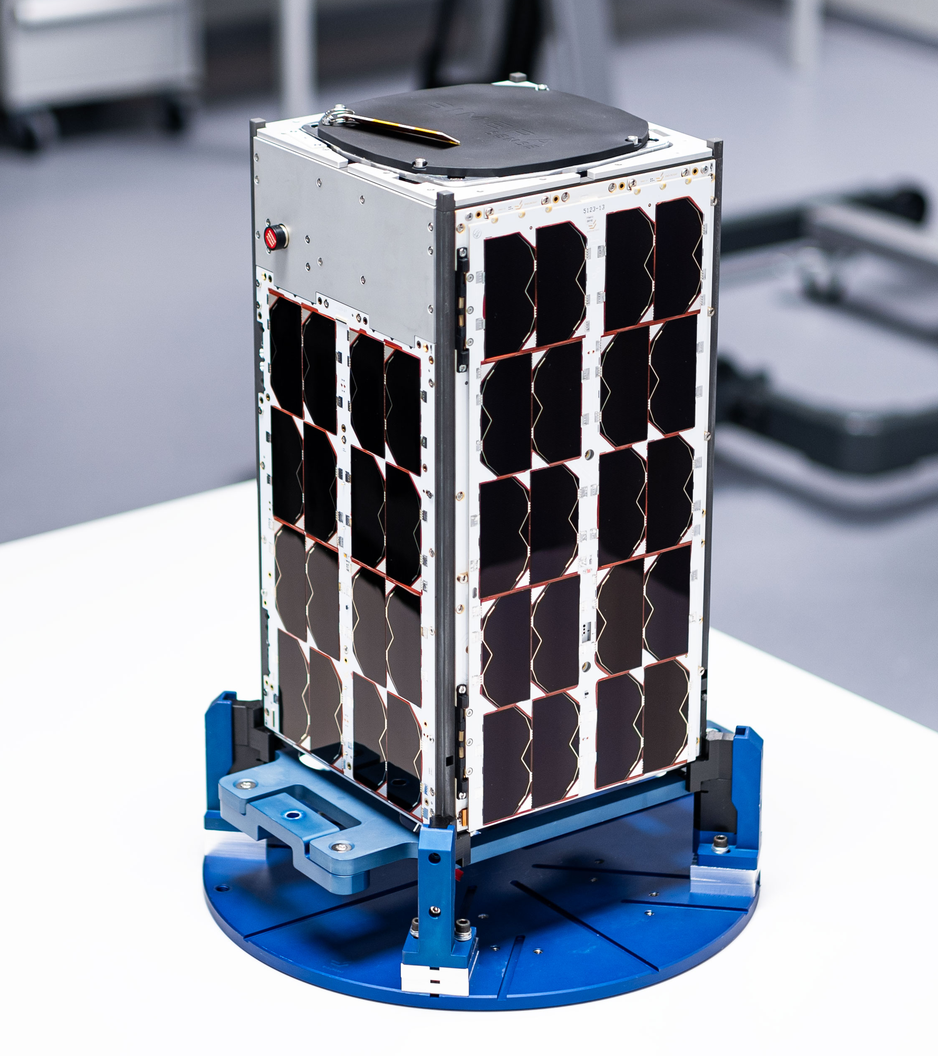
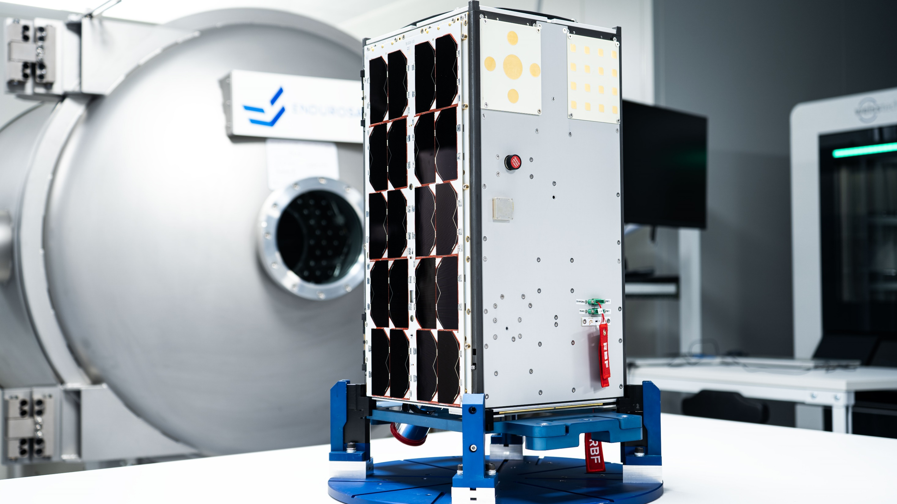
Privileged and confidential`

Slide 12
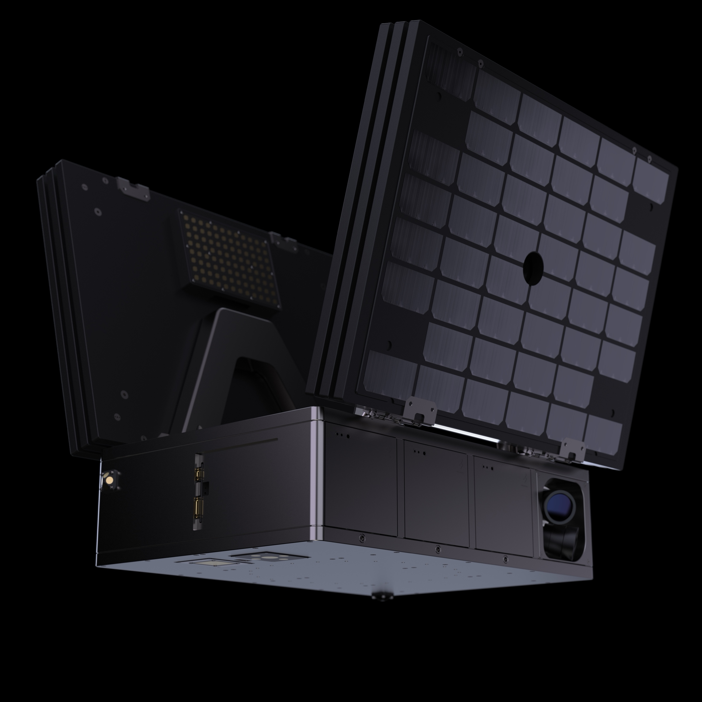
^{THE FRAME}
^{available payload volume}
^{ONBOARD GPU PROCESSING}
Average Payload Power Available
^{Available Payload Mass}
^{500 x 850 x 650 mm}
^{100 TOPS}
^{150-370 W}
^{80 kg}
Privileged and confidential

Slide 13
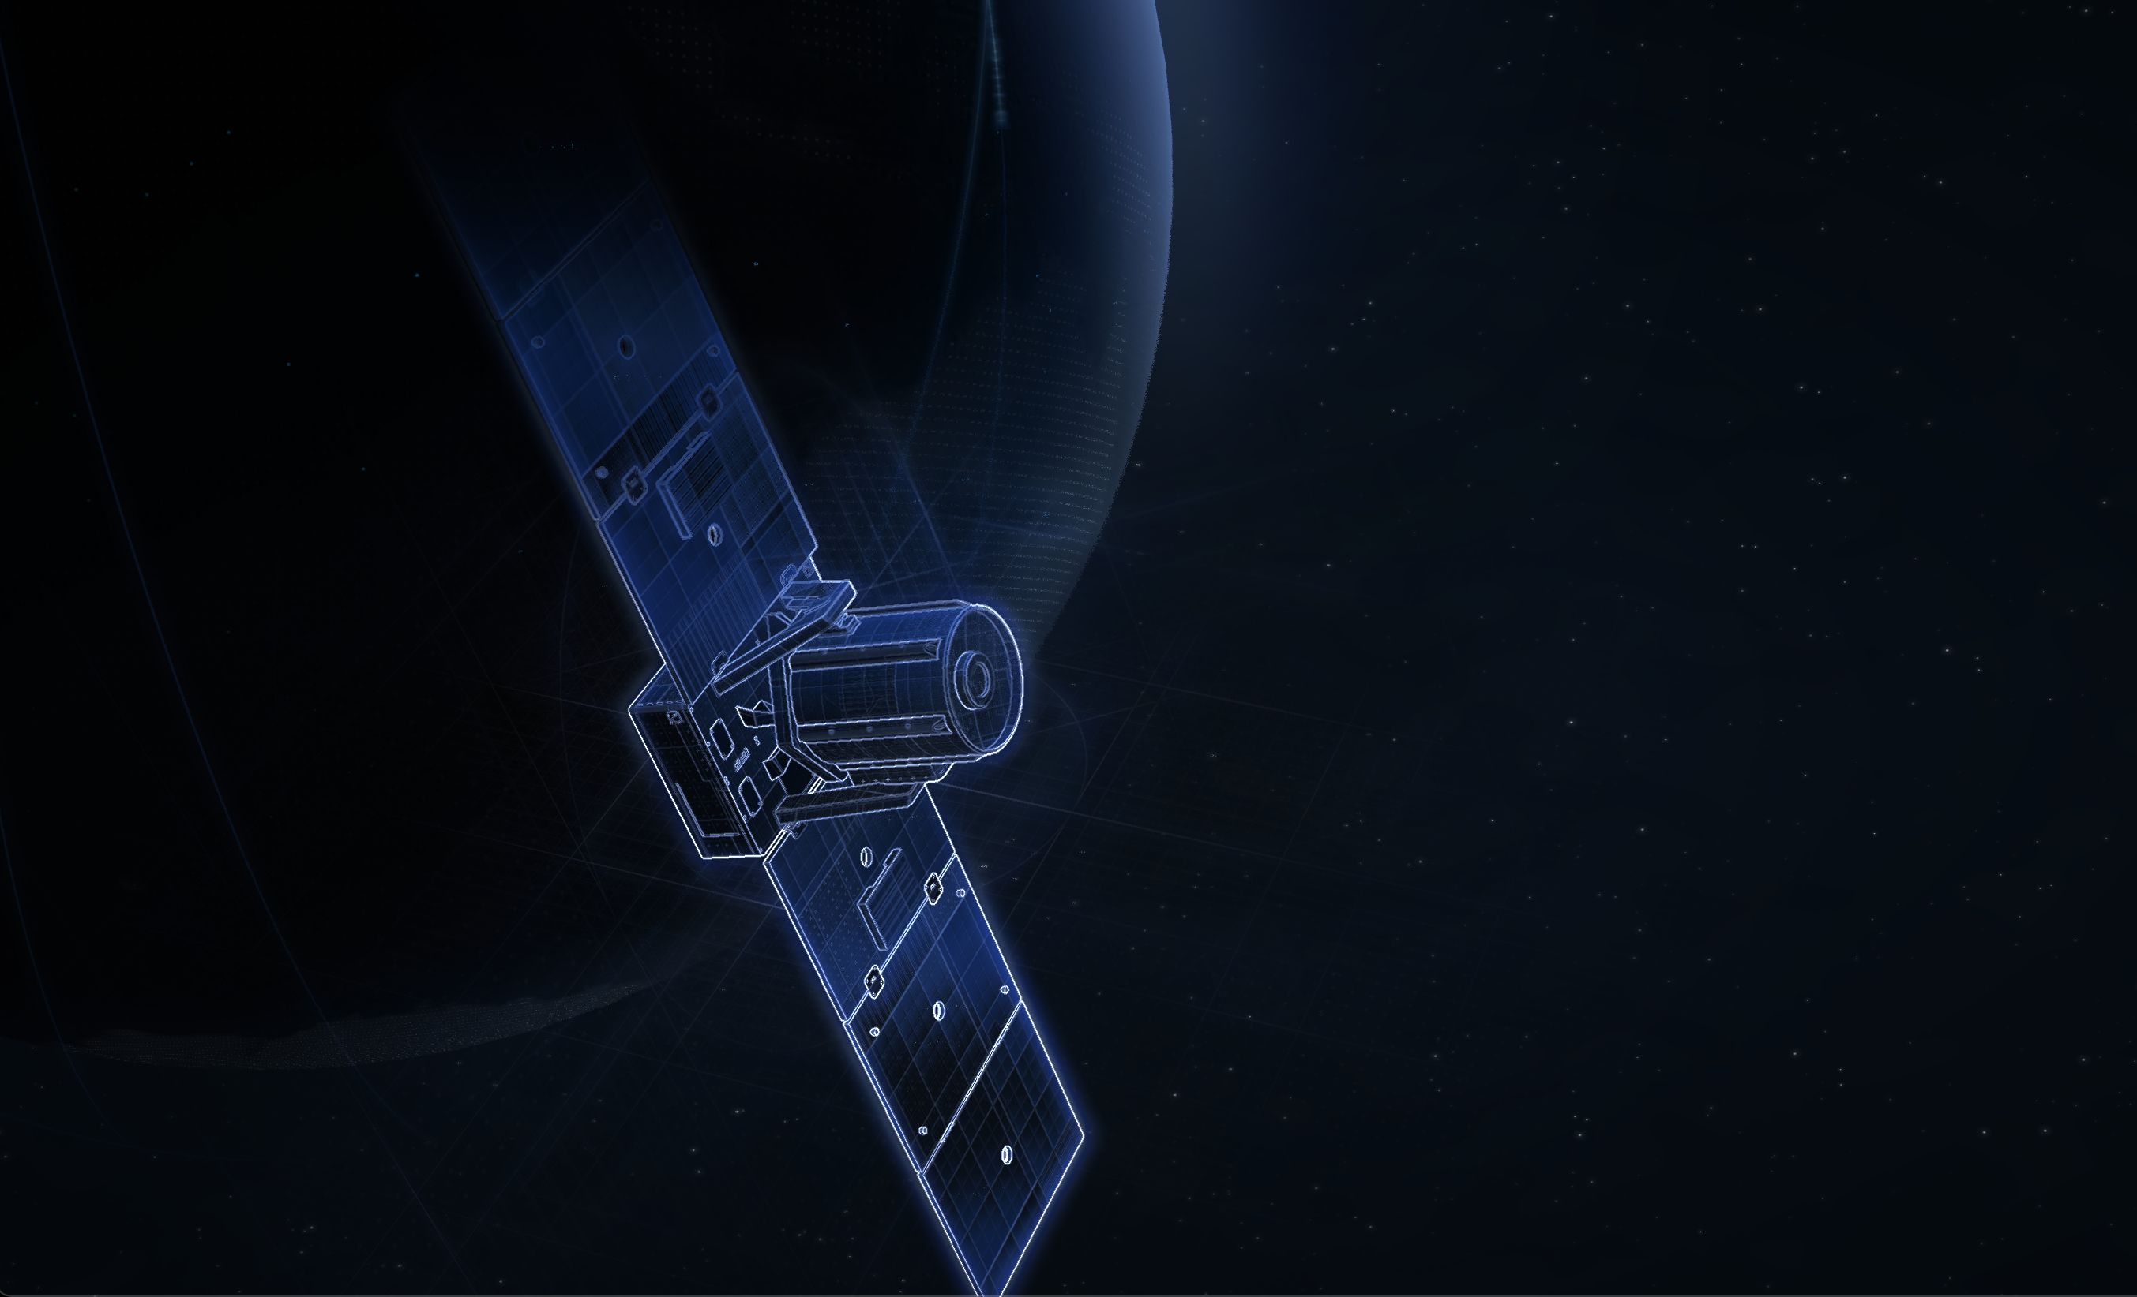
^{OPTICAL SENSING}
^{GSD AT 500 KM}
^{swath at 500 km}
^{deep space capable}
^{0.5 m}
^{4.16 KM}

Slide 14
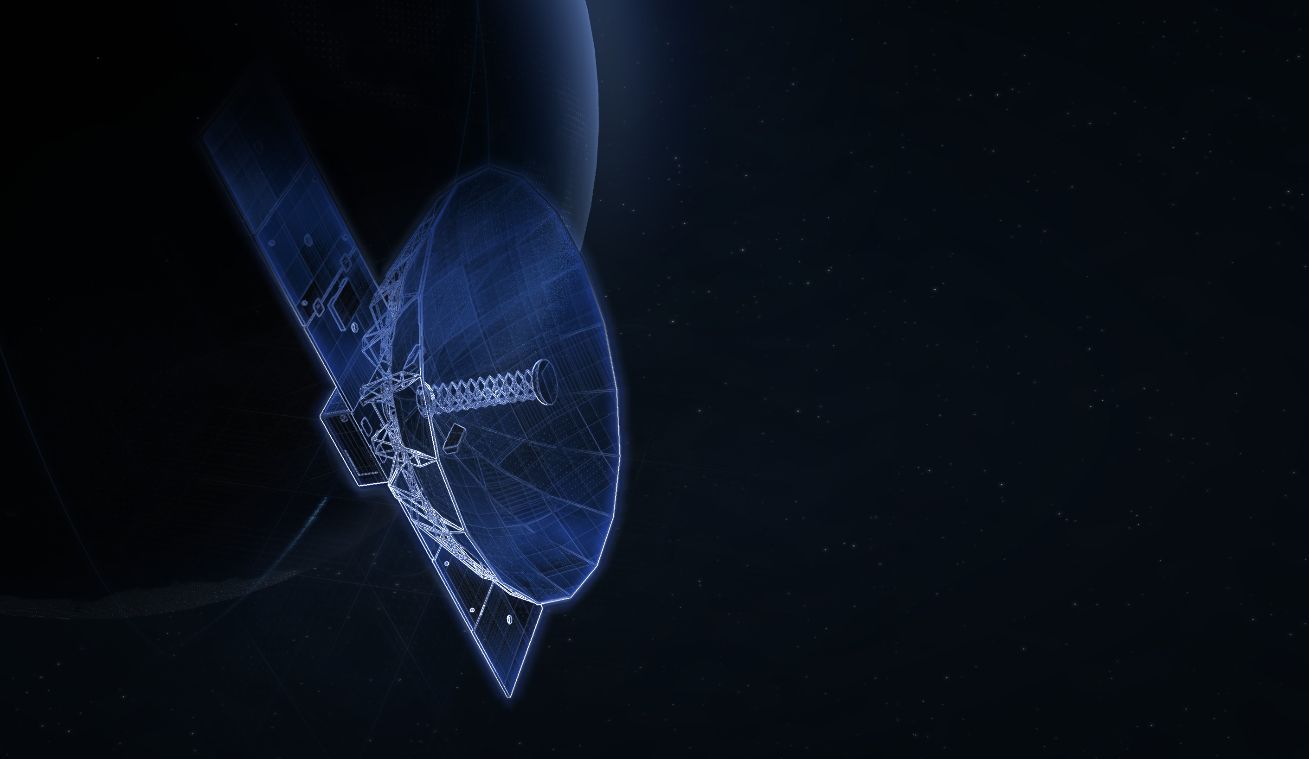
^{RADAR TELESCOPE}
^{GSD AT 500 KM}
^{swath at 500 km}
^{deep space capable}
^{0.5 m}
^{4.16 KM}

Slide 15
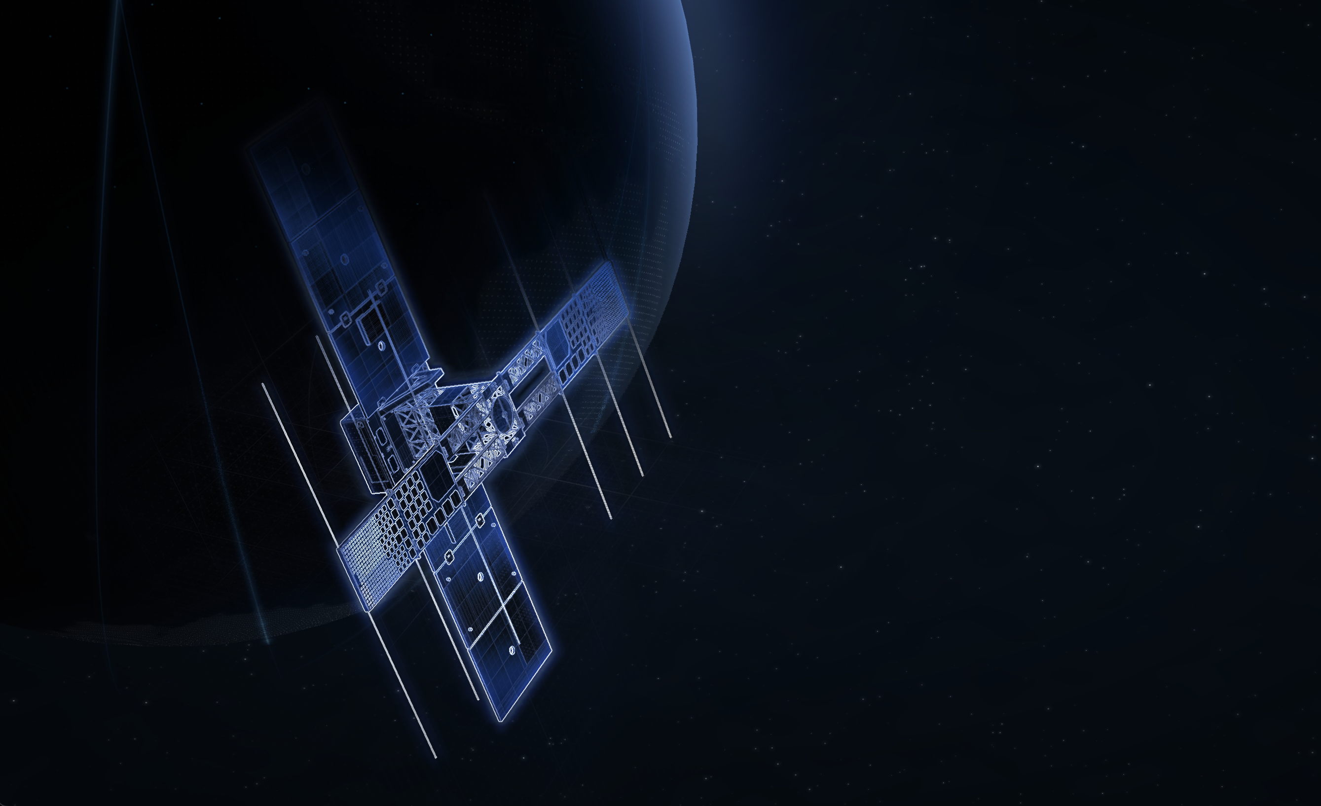
^{SIGNAL INTELLIGENCE}
^{Frequency band}
^{sensitivity}
Vhf, uhf, l, s, x, ku, k, ka bands
^{-100 dbm}

Slide 16

350+
SUCCESS
STORIES
Privileged and confidential

Slide 17
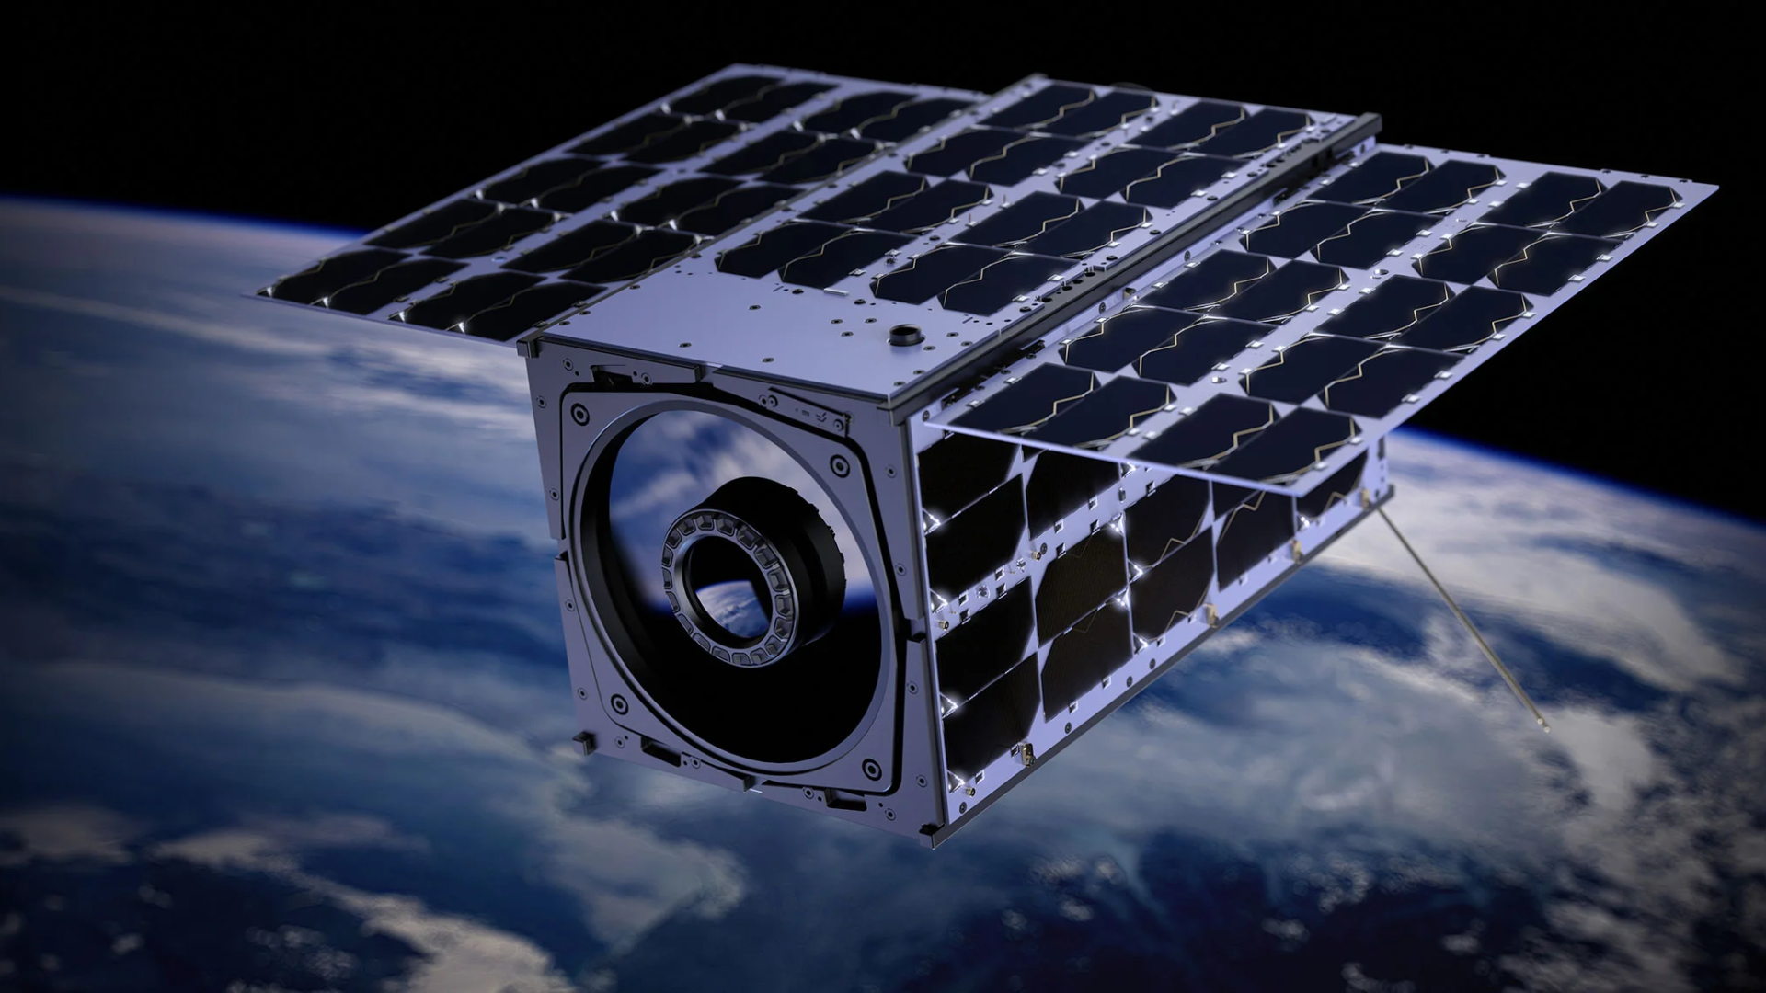
^{BALKAN-1}

Slide 18

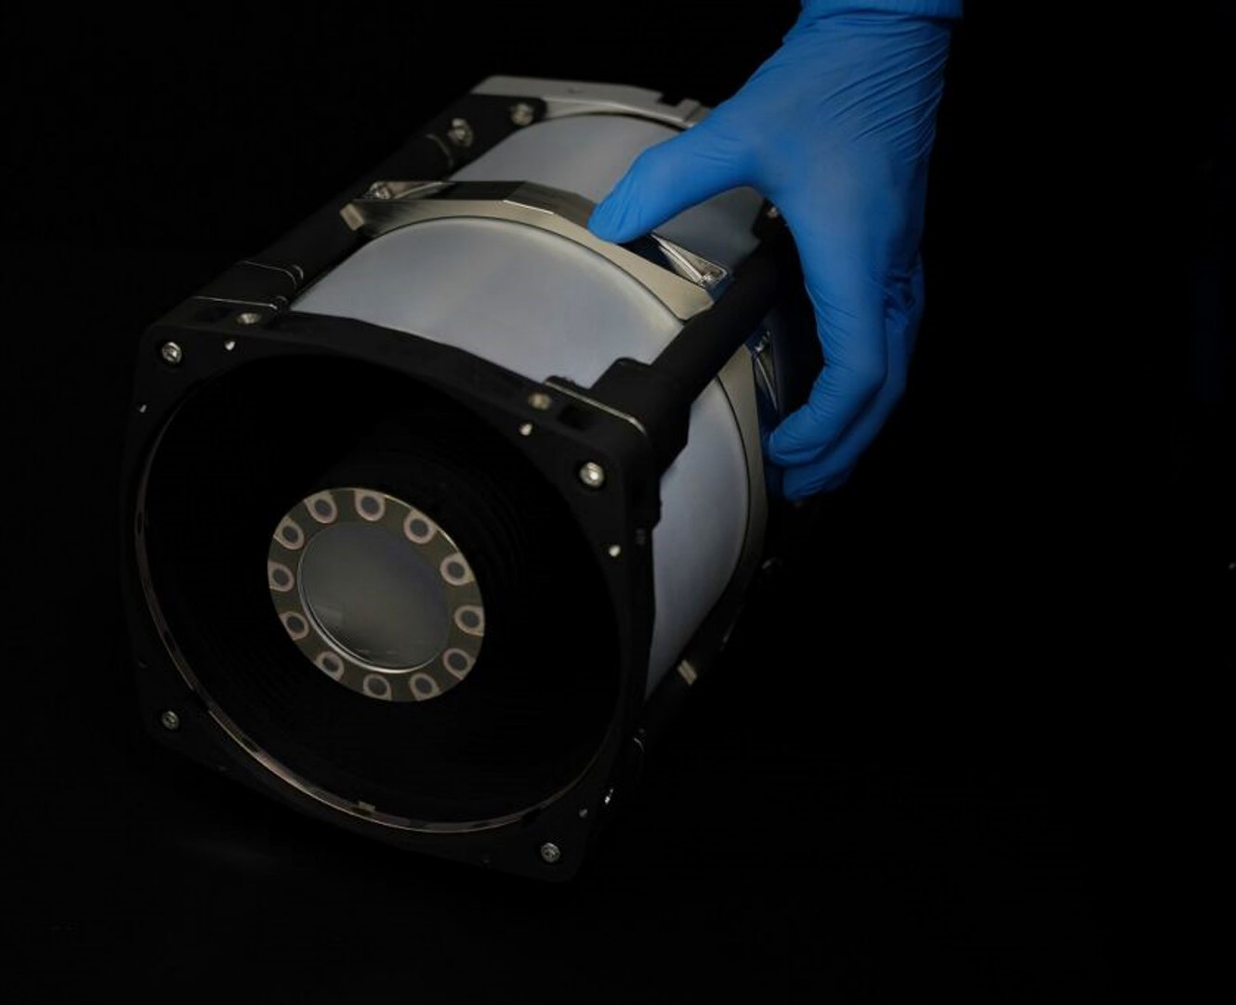
^{MULTISPECTRAL}
^{SENSOR}
^{resolution}
^{swath width}
^{spectral bands}
^{Spectral range}
^{1.5 m}
^{14 km}
7 multispectral + Panchromatic,
^{Wavelength: 450 – 900 nm}
Privileged and confidential

Slide 19
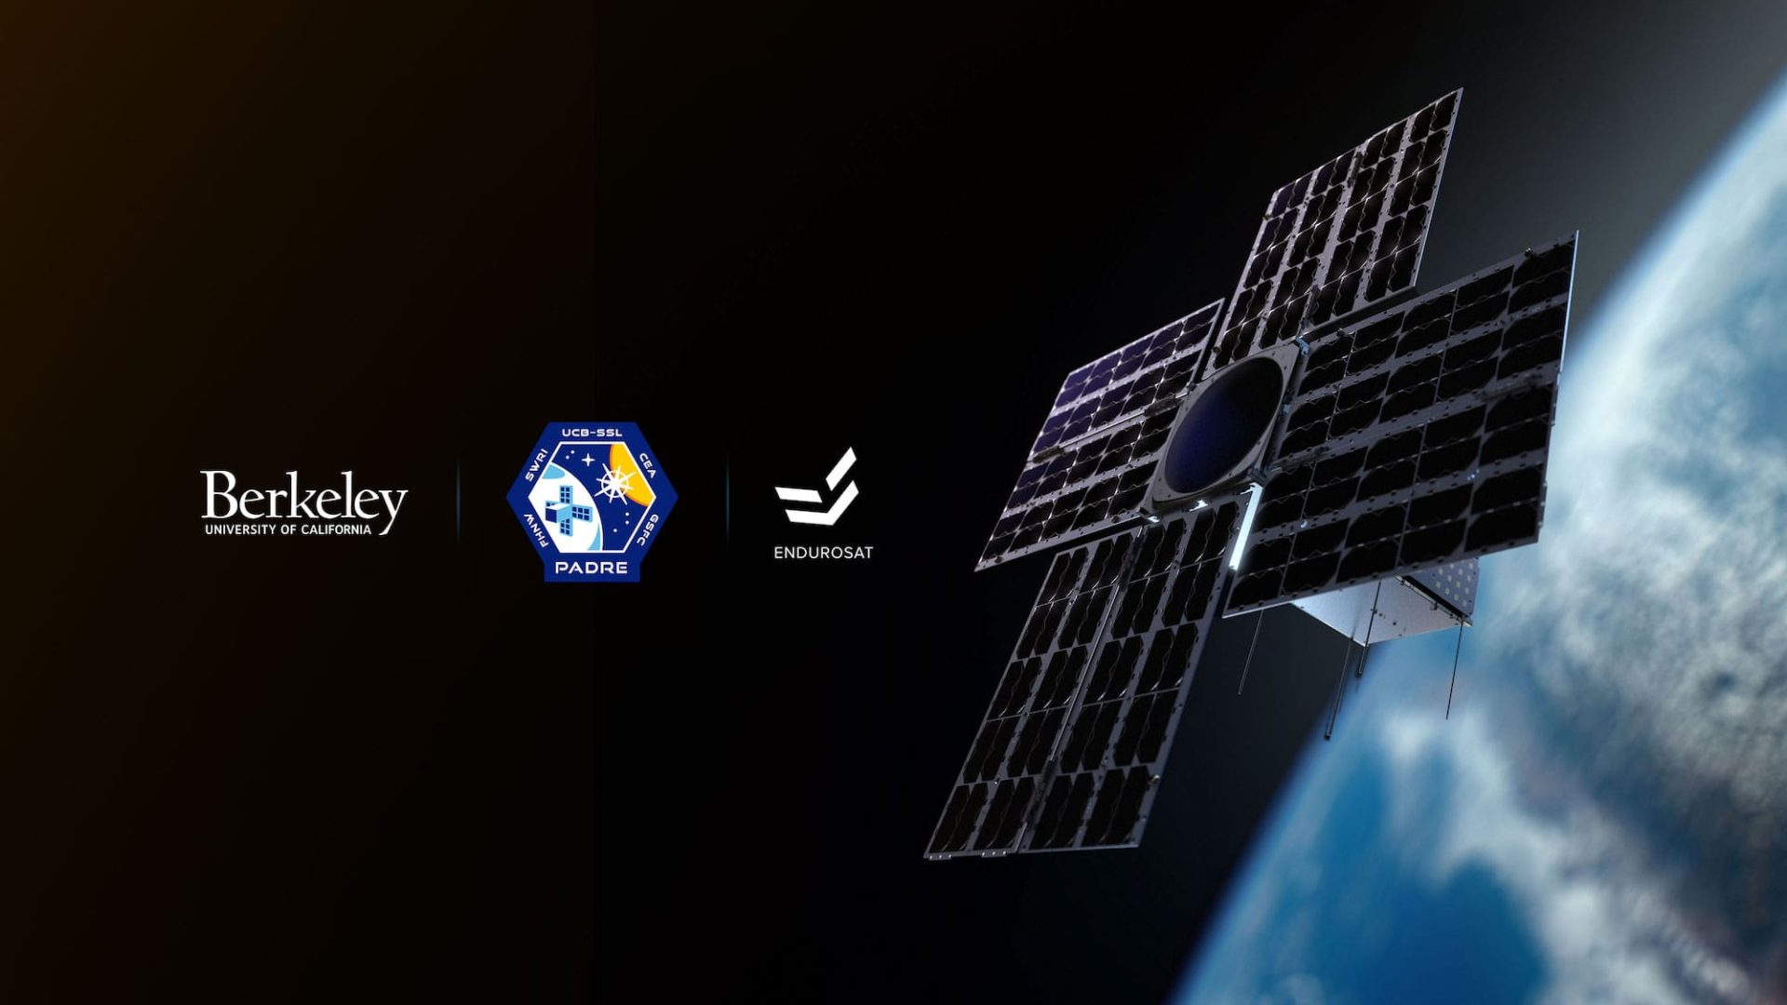
^{PADRE}
The Solar Polarization and Directivity X-Ray Experiment
Notes:
https://padre.ssl.berkeley.edu/blog/

Slide 20
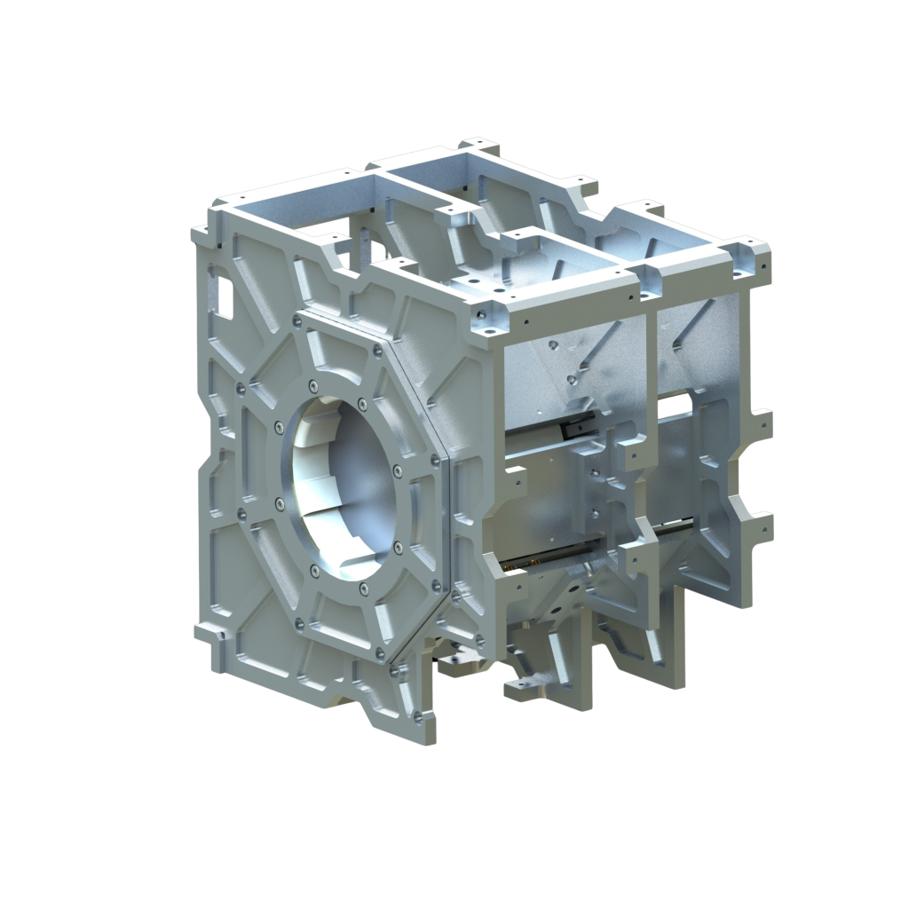
^{SHARP}
Solar Hard X-ray Polarimeter
Probes the polarization of non-thermal X-rays emitted during the impulsive phase of solar flares
Quantifies the degree of polarization with a Minimum Detectable Polarization (MDP) of 5% at a 99% confidence level

Slide 21
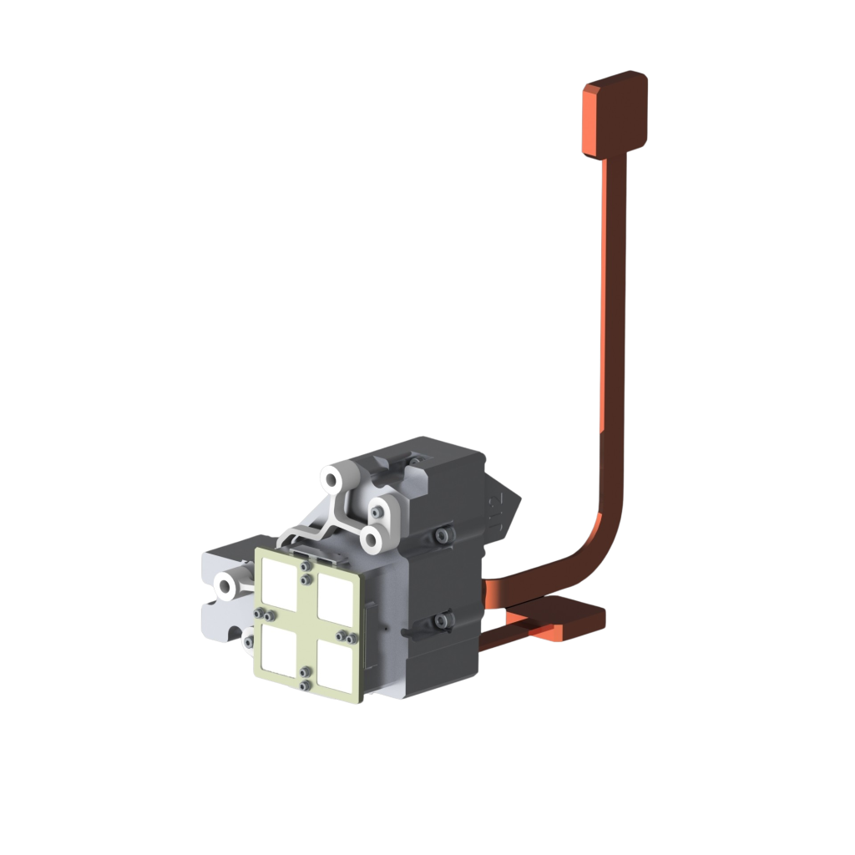
^{MeDDEA}
The Measuring Directivity to Determine Electron Anisotropy
Spare detectors from the Spectrometer/Telescope for Imaging X-rays (STIX)
Investigates the directivity of solar flare X-ray emissions
Advances our understanding of solar flare electron anisotropy

Slide 22

https://padre.ssl.berkeley.edu

Slide 23


Slide 24
T elescope
for O rbit
L ocus
I nterferometric
M onitoring
of our A stronomical
N eighbourhood

Slide 25
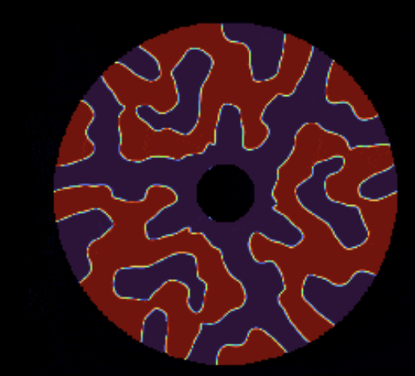
^{SCIENCE OBJECTIVES}
12.5cm space-based telescope
Record a ‘wobble’ signal in the separation of binary stars caused by the gravitational forces of a planet.
Observe a rocky planet around Alpha Centauri A or B without relying on a significantly larger and more expensive telescope.
By using a diffractive pupil optical mask to spread starlight into overlapping fringes, the separation measurement between binary stars becomes immune to telescope distortions in space.

Slide 26

https://toliman.space

Slide 27

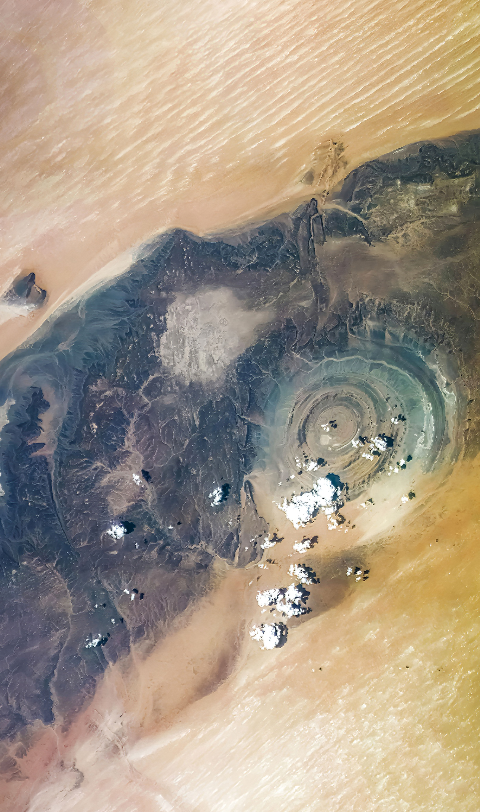
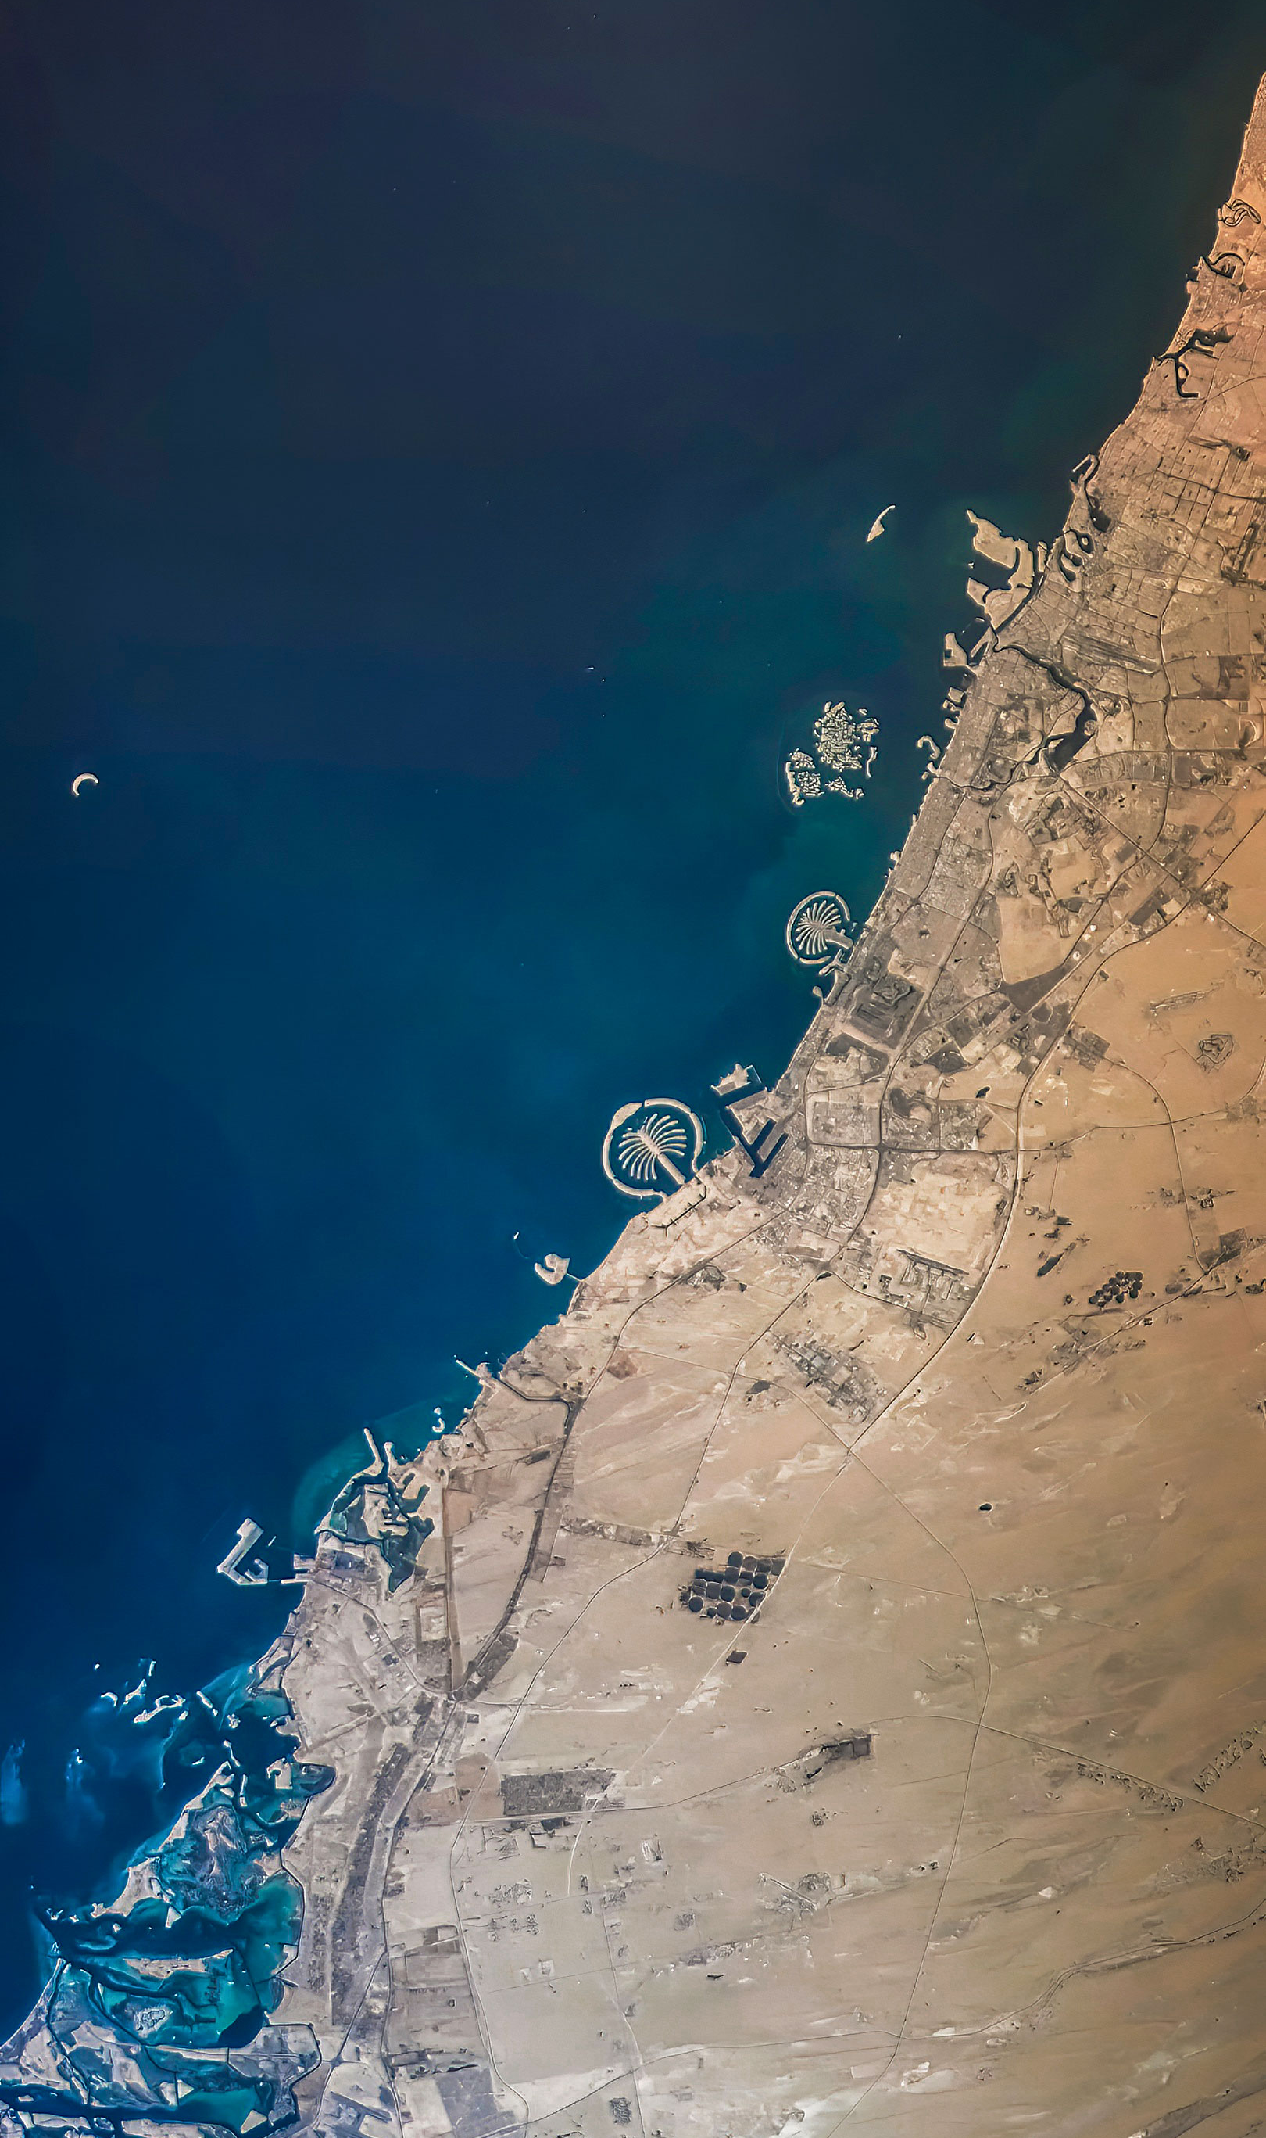
Captured by EnduroSat Satellites
ENDUROSAT.COM
Privileged and confidential
All photos and images contained in this presentation are exclusive property of EnduroSat AD, and are subject to copyright. As such, none of the images and photos may be directly or indirectly published, reproduced, copied, stored, manipulated, modified, sold, transmitted, redistributed, projected, used in any way, or redistributed in any medium without the explicit permission of EnduroSat AD.

