Slide 1
Impact of Cavities on the Detection of Quadratically Coupled Ultra-Light Dark Matter
Angus Macdonald
Based on arXiv:2507.16526 w/ Clare Burrage, Elisa Todarello, Michael Ross, Gray Rybka

Slide 2






Background
DM candidates exist over broad mass range
ULDM
WIMPs
PBHs
$$eV$$
$$GeV$$
$$TeV$$
$${\sim 10M}_{⊙}$$
ULDM Scalars
Predicted in physics beyond the SM
Treated as classical fields
$$φ_{H}\left(t\right)=φ_{∞}cos⁡(mt+δ)$$
$$ρ_{DM}=\frac{1}{2}m^{2}φ_{∞}^{2}$$
Notes:
Don't need to go into detail about which models for physics beyond the SM

Slide 3
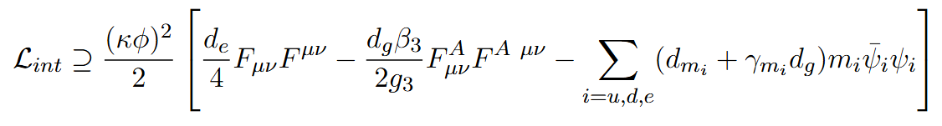
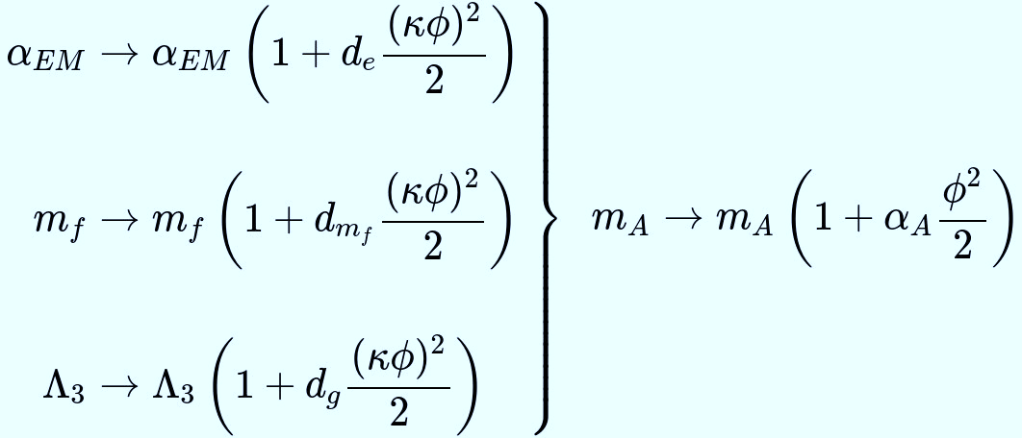
Scalar Coupling To Matter
Interactions induce shifts in fundamental constants:
Damour T, Donoghue JF. PRD. 2010 Oct 20;82(8).
Hees A, Minazzoli O, Savalle E, Stadnik YV, Wolf P. PRD. 2018 Sep 25;98(6)
Notes:
Just say – induces shifts in <Constants>. Don't list off which couplings give which shifts

Slide 4
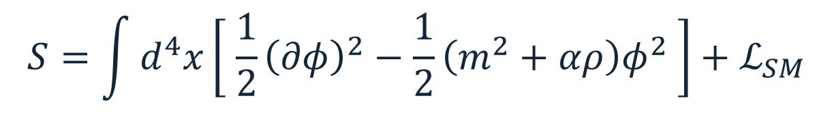



Scalar Coupling To Matter
Around non-relativistic matter:
$$S=\int{d^{4}x}\left[ \frac{1}{2}{\left(∂φ\right)}^{2}−\frac{1}{2}\left(m^{2}+αρ\right)φ^{2} \right]+ℒ_{SM}$$
Matter provides local shift in effective mass
$$□φ+\left(m^{2}+αρ\right)φ=0$$
Assume homogeneous solution away from matter
$$φ=φ_{H}\left(t\right)φ(x)$$
$$∇^{2}φ=ραφ$$
$$αφ^{2}≪1$$
Notes:
Mention tha alpha can be +ve or –ve. Say that effective mass may be tachionic

Slide 5
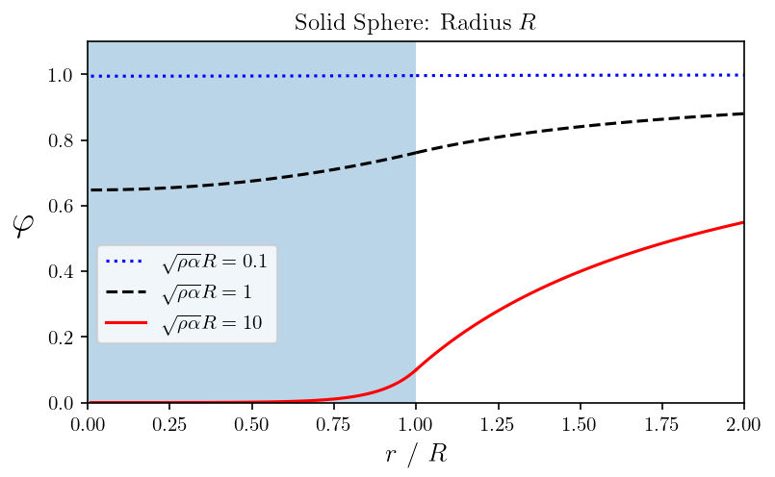
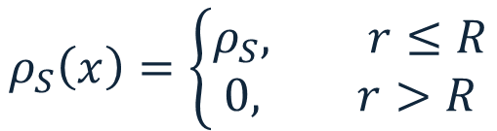


Matter Perturbs the Scalar Field
$$ρ_{S}\left(x\right)=\left\{\begin{aligned}ρ_{S}, r≤R \\ &0, r>R\end{aligned}\right.$$
Field gradients lead to fifth forces:
Negative $α$ result in more complicated behaviour
$$F_{5}=−\int{d^{3}x\frac{ρα}{2}∇φ^{2}}$$
$$F_{5}$$
Notes:
Ensure you properly describe figure.

Slide 6
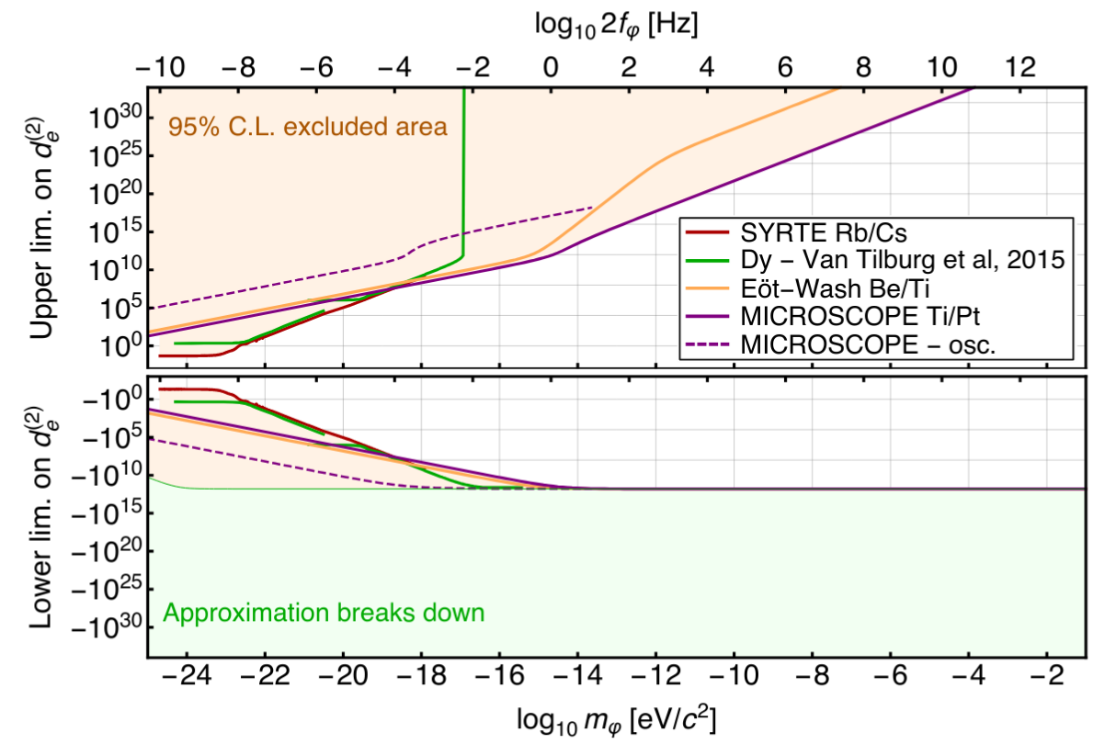
Existing Constraints
Tabletop scale experiments
  EP violation searches
  Atomic Clocks
Often assume idealised environments
Hees A, Minazzoli O, Savalle E, Stadnik YV, Wolf P. Violation of the equivalence principle from light scalar dark matter. Physical Review D. 2018 Sep 25;98(6)
Notes:
Don't go into too much detail about what each experiment is. Just say EP, sens. to 5ths and A. clocks.

Slide 7

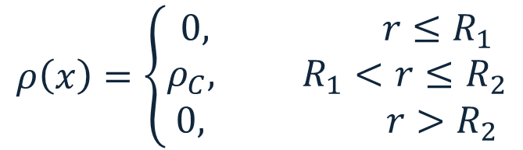

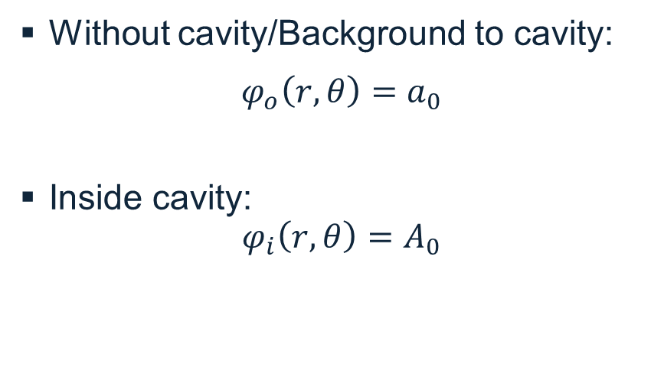


Cavities to Model Enclosed Environments
$$ρ\left(x\right)=\left\{\begin{aligned}0, r≤R_{1} \\ ρ_{C}, R_{1}<r≤R_{2} \\ &0, r>R_{2}\end{aligned}\right.$$
$$R_{2}$$
$$R_{1}$$
$$r$$
Without cavity/Background to cavity:
$$φ_{o}\left(r,θ\right)=a_{0}$$
Inside cavity:
$$φ_{i}\left(r,θ\right)=A_{0}$$
$$θ$$
Notes:
Edit to only menion constant component of field – for simplicity. Have linear component in backup.

Slide 8
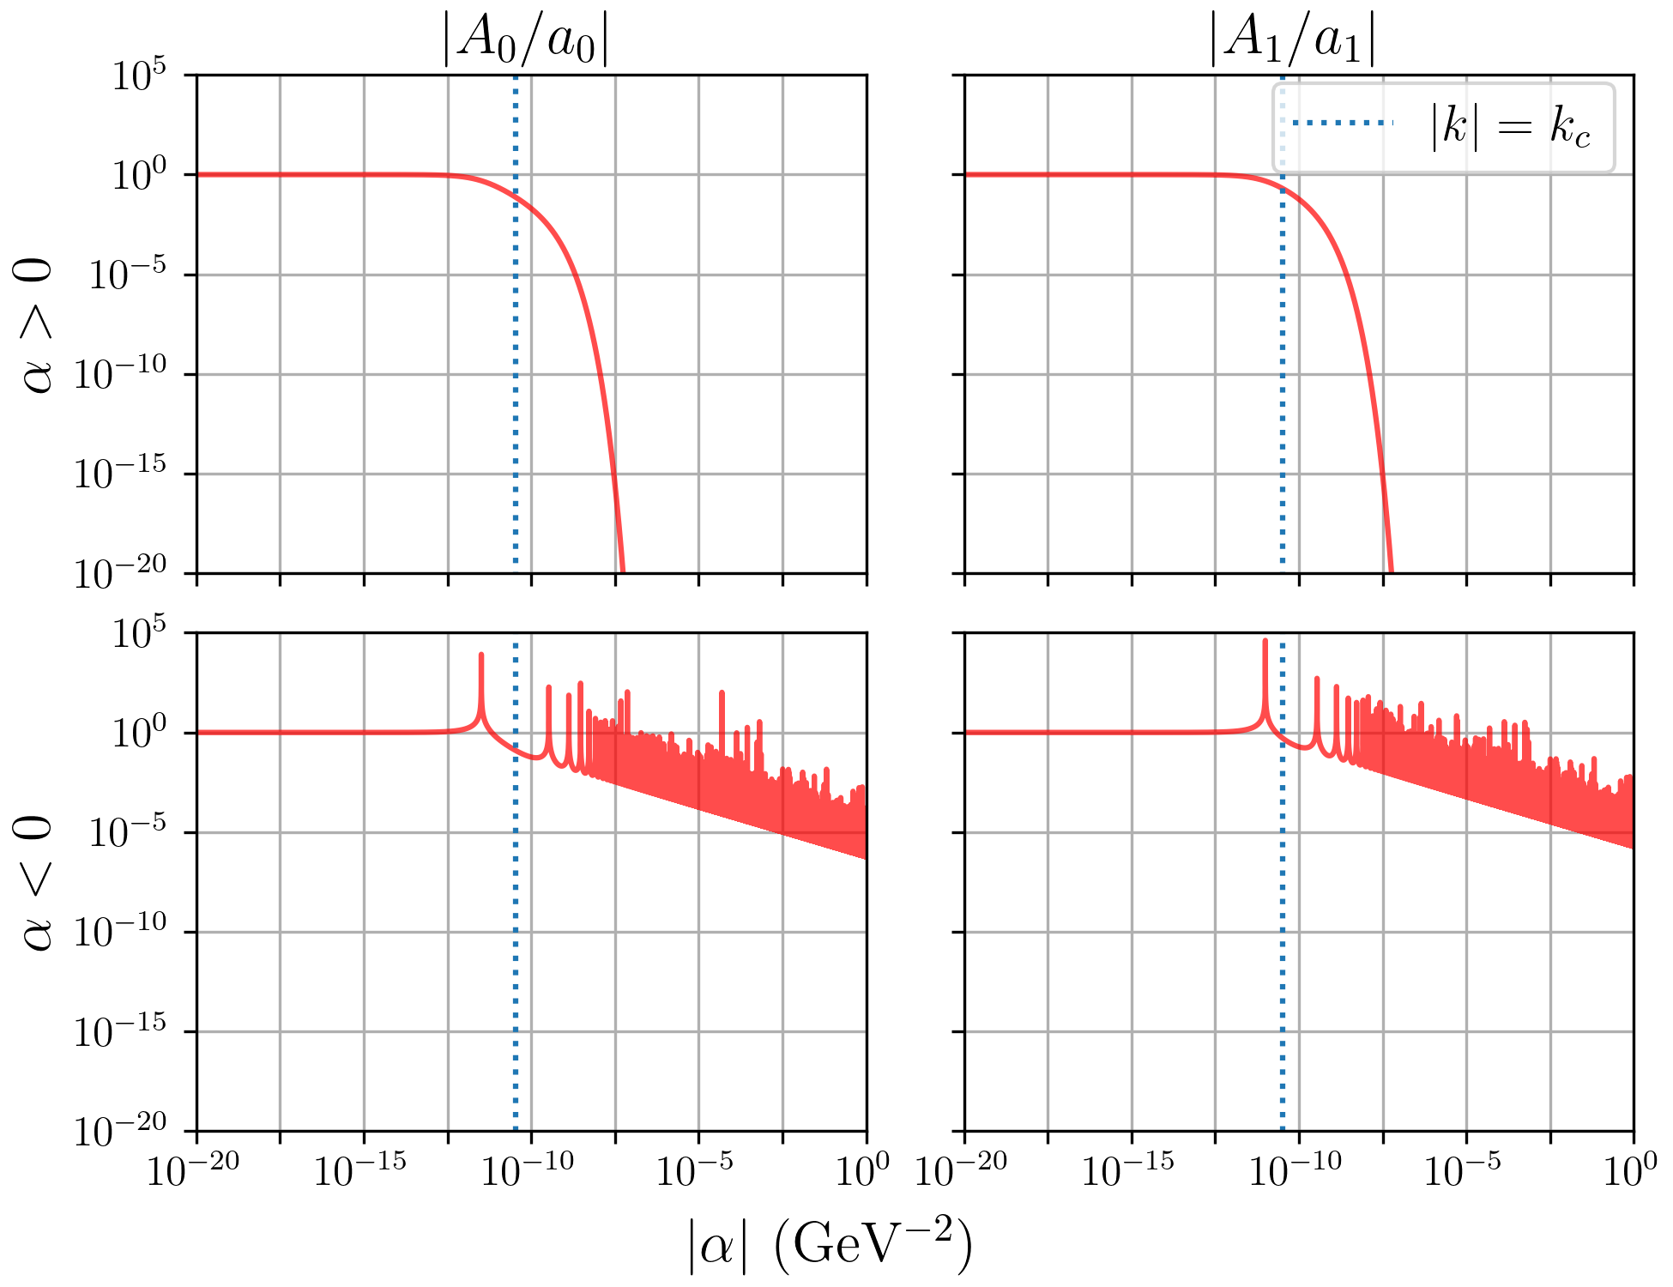
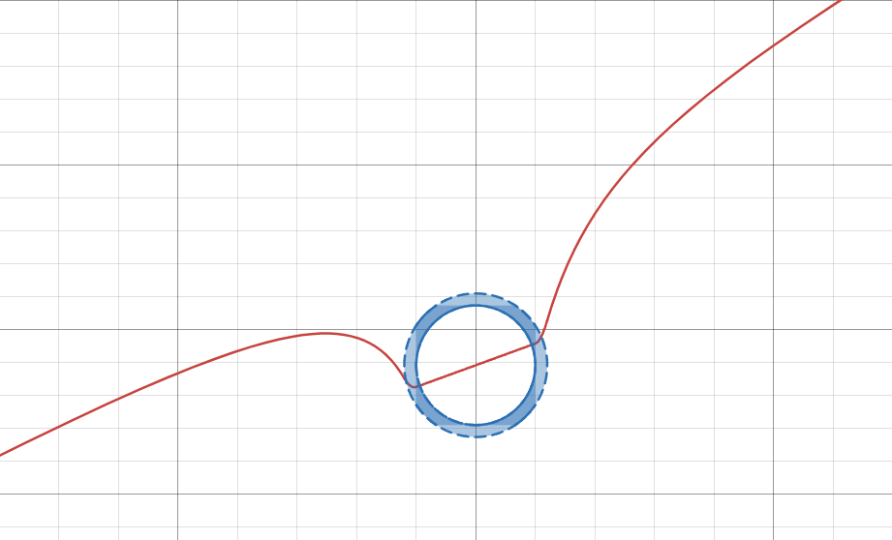
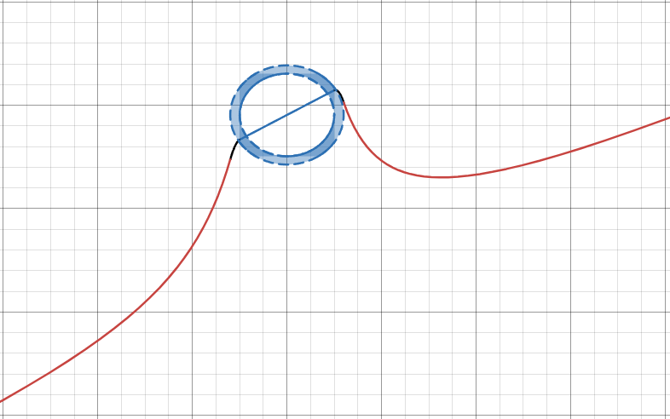
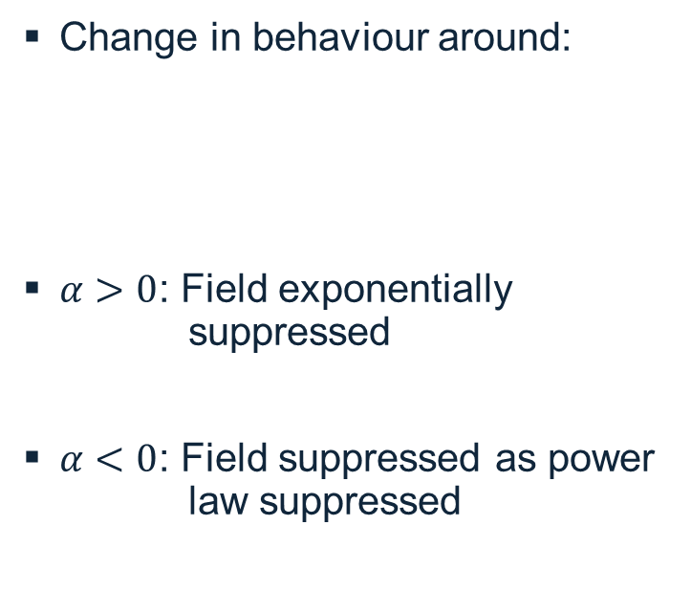

Impact of Cavity
Aluminium Cavity:
Internal Radius: 10 cm
Thickness: 1cm
$$\left|α\right|{=α}_{c}$$
Change in behaviour around:
$α>0$: Field exponentially suppressed
$α<0$: Field suppressed as power law suppressed
$$α_{C}=\frac{1}{ρ_{C}{\left(R_{2}−R_{1}\right)}^{2}}$$
Burrage C, A.M., Ross MP, Rybka G, Todarello E. Impact of cavities on the detection of quadratically coupled ultra-light dark matter
Notes:
Logarithmic vs linearly spaced – cannot show true height. Edit to only include constant component of field. Have linear in backup.

Slide 9
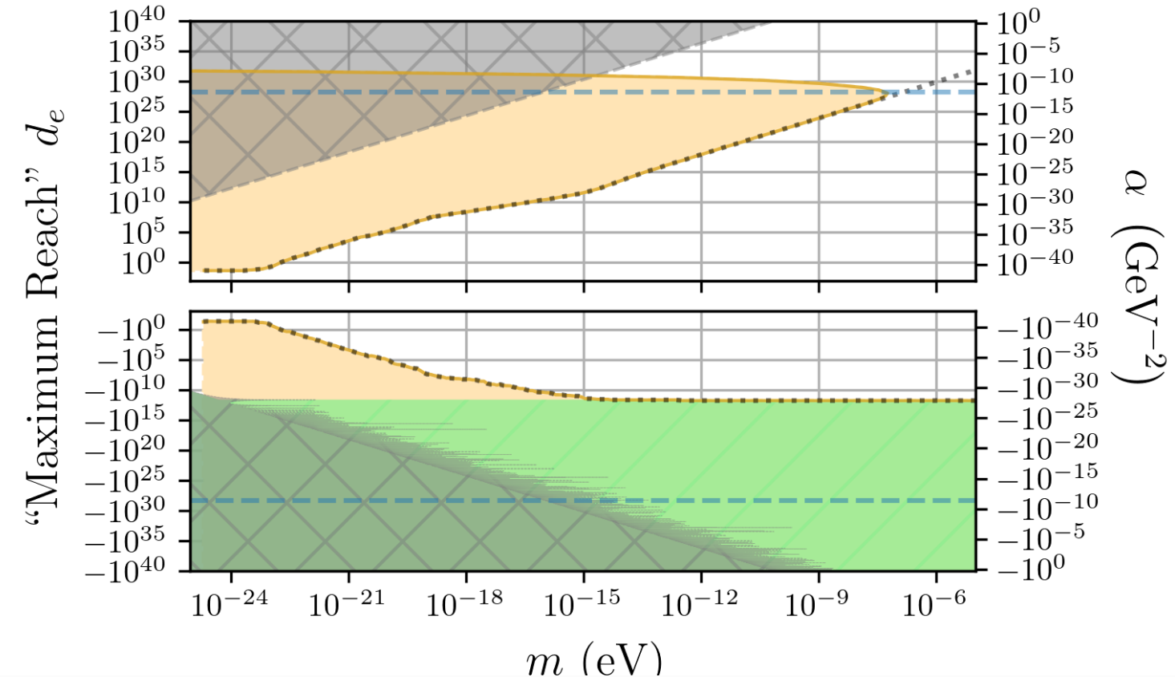
Example Rescaling of Constraints
Aluminium Cavity:
Internal Radius: 10 cm
Thickness: 1cm
Burrage C, A.M., Ross MP, Rybka G, Todarello E. Impact of cavities on the detection of quadratically coupled ultra-light dark matter
Notes:
Additionally, whilst the boundary of the original constraints lies well outside the region in which the quadratic model of interactions is invalid, cavity effects cause our re-mapped values to intersect with this region. Constraints here cannot be developed without a more comprehensive model of scalar interactions.

Slide 10
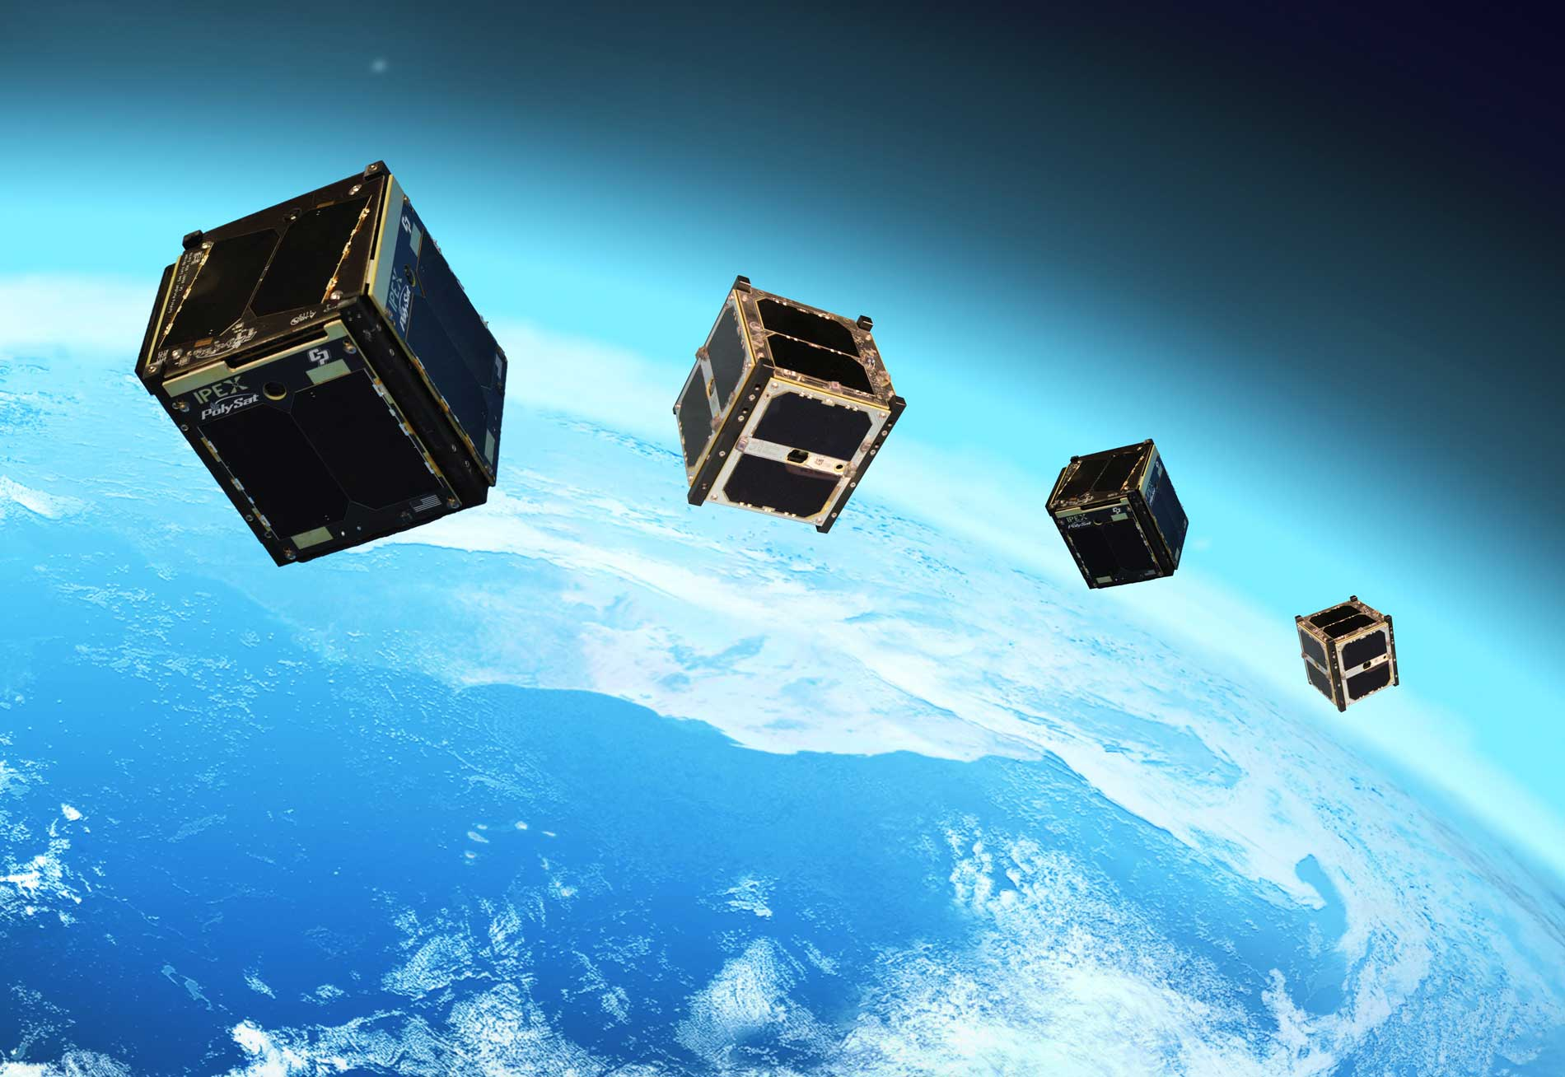
Mitigating Environmental Effects
CubeSats – minimise experimental environment
Use (differential) acceleration to constrain scalar properties
Image Credit: JPL
Notes:
Cheap
Form factor
Use satellite as test mass, rather than having the satellite contain test masses.
Vary geometry/composition of test masses

Slide 11
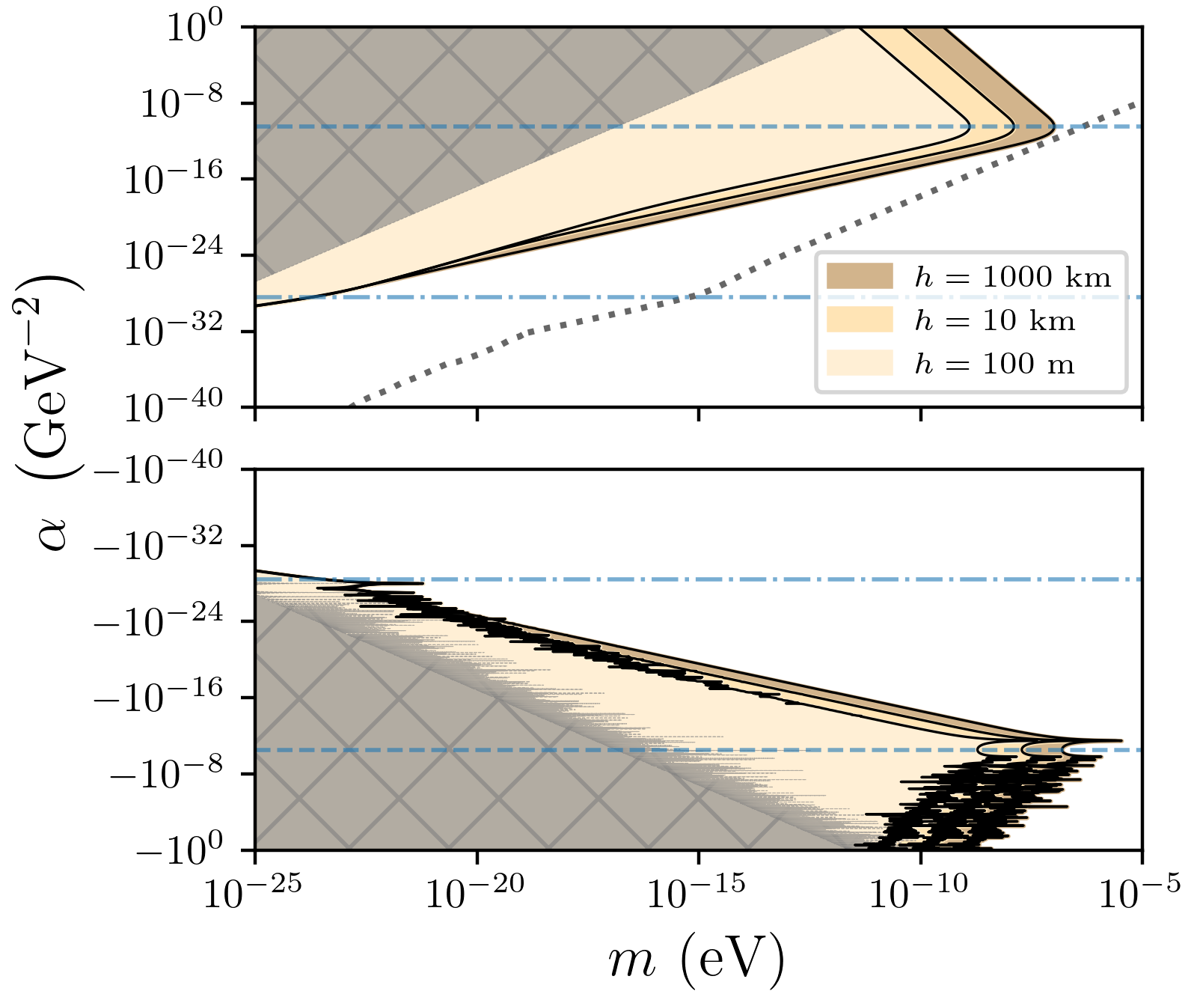

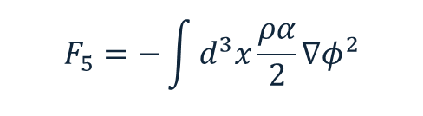
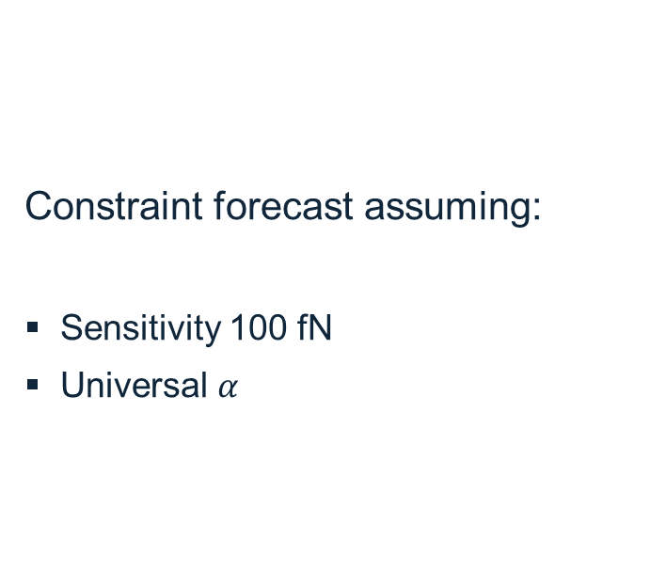

Differential Force on Cavities
Cavities:
Equal Mass: (~4 kg)
Internal Radius: 10 cm, 9cm
Thickness: 1cm , 2cm
$$α_{C}$$
Constraint forecast assuming:
Sensitivity 100 fN
Universal $α$
$$F_{5}=−\int{d^{3}x\frac{ρα}{2}∇φ^{2}}$$
$${−α}_{C}$$
Burrage C, A.M., Ross MP, Rybka G, Todarello E. Impact of cavities on the detection of quadratically coupled ultra-light dark matter
Notes:
Describe plot
Keeping external dimension of cavities the same
This has been conducted for universal ALPHA, ignoring composition dependence, as to be most general. Expect that reach of constraints, for models allowing composition dependent alpha, could extend constraints.
Old constraints cannot be trusted above the blue dashed line.
Turning point in force – should be present for previous constraints.
Different heights – find that at large alpha, experiment at R/2 above surface is preferred.

Slide 12
Summary
Ultra light scalar fields may describe dark matter
Interactions with standard model fields may be quadratic to leading order
Properties of these scalars can be constrained by laboratory scale experiments
Environmental conditions may suppress effects at strong couplings
Experiments may be designed to mitigate environmental effects

Slide 13


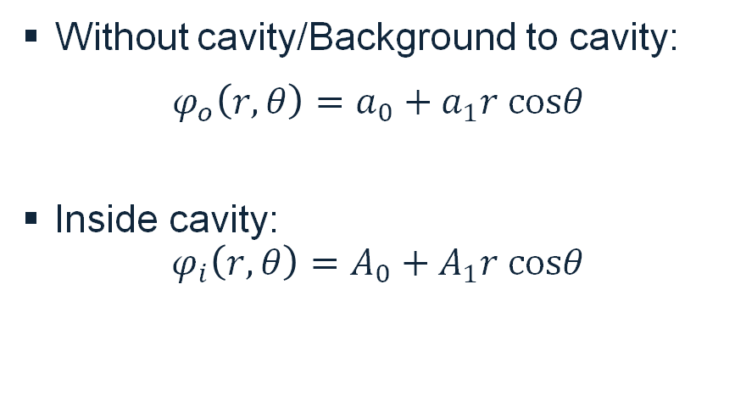


Cavities to Model Enclosed Environments
$$ρ\left(x\right)=\left\{\begin{aligned}0, r≤R_{1} \\ ρ_{C}, R_{1}<r≤R_{2} \\ &0, r>R_{2}\end{aligned}\right.$$
$$R_{2}$$
$$R_{1}$$
$$r$$
Without cavity/Background to cavity:
$$φ_{o}\left(r,θ\right)=a_{0}+a_{1}r cosθ$$
Inside cavity:
$$φ_{i}\left(r,θ\right)=A_{0}+A_{1}r cosθ$$
$$θ$$

Slide 14
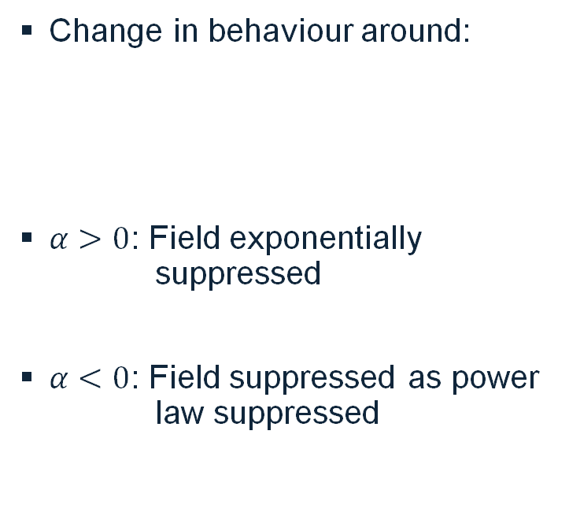

Impact of Cavity
Aluminium Cavity:
Internal Radius: 10 cm
Thickness: 1cm
$$\left|α\right|{=α}_{c}$$
Change in behaviour around:
$α>0$: Field exponentially suppressed
$α<0$: Field suppressed as power law suppressed
$$α_{C}=\frac{1}{ρ_{C}{\left(R_{2}−R_{1}\right)}^{2}}$$
Burrage C, A.M., Ross MP, Rybka G, Todarello E. Impact of cavities on the detection of quadratically coupled ultra-light dark matter
Notes:
Logarithmic vs linearly spaced – cannot show true height

Slide 40
Elements 1
These slides have elements to use in your slides if you are a confident PowerPoint user. Please ensure you respect the brand and identity guidelines.
Text box example – use this box for adding a text box to your slide. This box can be resized and edited easily.

Slide 41
Elements 2
Column 1 | Column 2 | Column 3
Row title | XX | XX▲
Row title | XX | XX▲
Row title | XX | XX -
Row title | XX | XX▲
Row title | XX | XX▼
A selection of hero images
have been compiled as part of Nottingham University’s image bank.
Text box example – use this box for adding a text box to your slide. This box can be resized and edited easily.

Slide 42
Elements 3
Series 1
Notes:
Colour should not be used to denote meaning without some alternative visual reference such as labels, texture, shapes or patterns. Nearly one-in-twenty people are colour blind, and there are many different types of colour blindness, not simply red-green or blue-yellow.
Contrast will be different for people with colour blindness. Charts may need particular attention. Colour sounds like an easy accessibility fix, but it is surprising how much we take for granted. If you are changing the colour of anything for a reason, think about accessibility – its easy to forget that some people may see things differently.
Well created charts make the information much easier to understand for everyone, not just those of us with colour blindness. Labels mean the viewer does not have to keep referring to the legend to interpret the data, which is good for everybody.

Slide 43
Elements 4
Timeline
Date here
Event
Date here
Event
Date here
Event
Date here
Event
Date here
Event

Slide 44
Elements – icons
Selecting an icon
To use a university icon,
copy and then paste your choice into the slide you wish to add it to. For a wider library of global icons, go to Insert, then icons and select your choice – format the icon using the guidance below.
Formatting an icon
To edit icon colour, click on the icon in its new location, go to shape fill in the Home tab (or right click icon to see the same option) keep to the Theme Colours (university palette) and ensure high contrast for accessibility.

Slide 45
Elements – map

