Slide 1
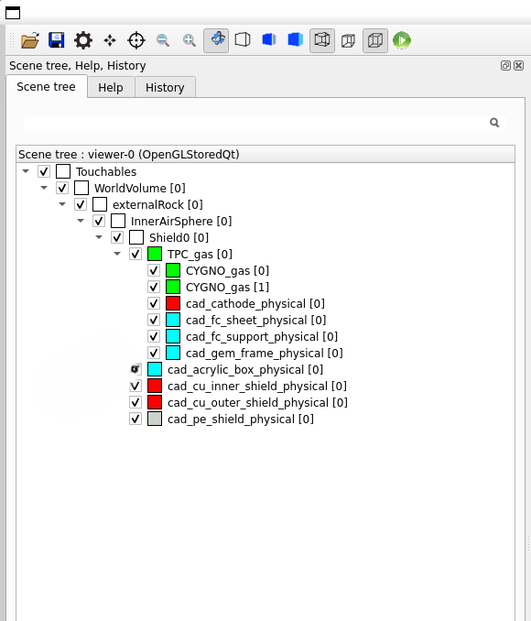
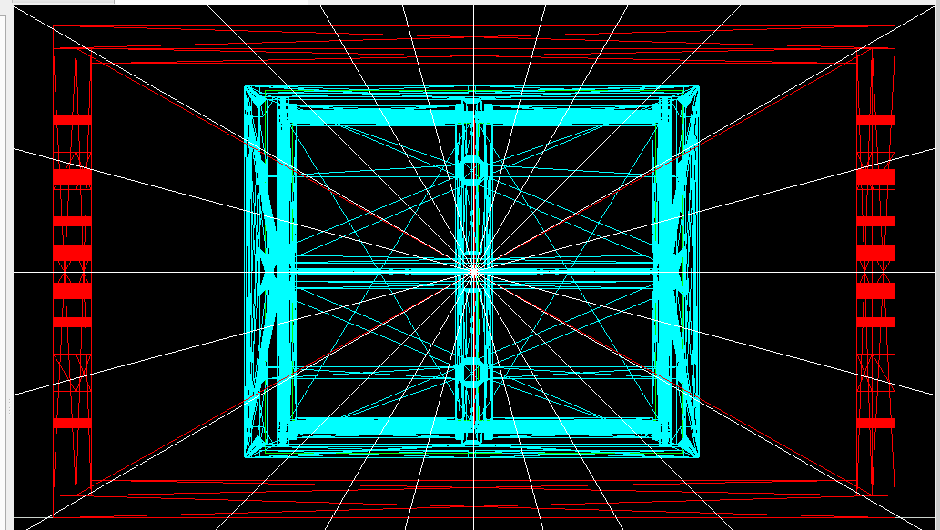
Source Calibration for CYGNO_04
CYGNO_04 Geometry v3
Source Fe55
Energy 5.9 keV
Activity 3.7 MBq
(25,55,0)cm
(-25,55,0)cm

Slide 2
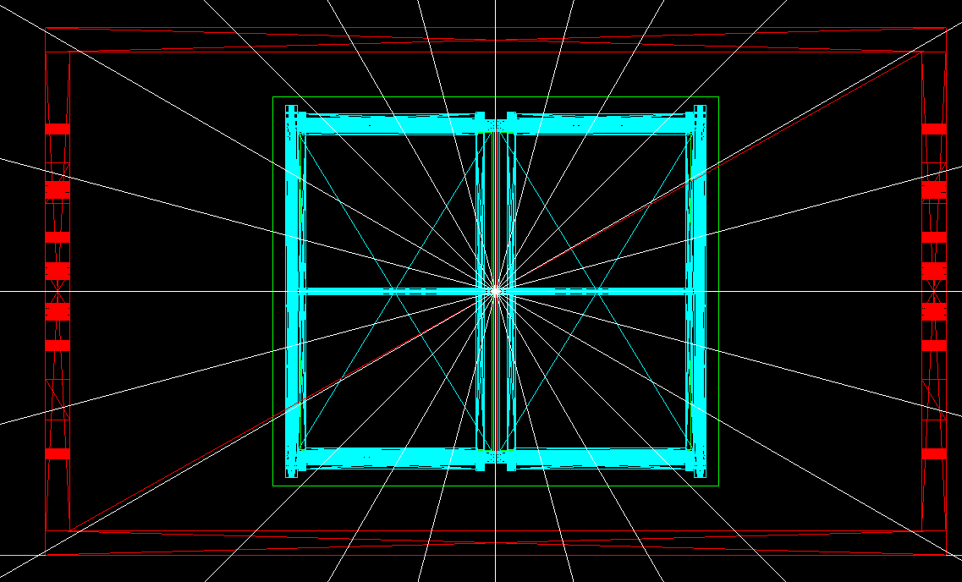
Source Calibration for CYGNO_04
Source Fe55
Energy 5.9 keV
Activity 3.7 MBq
(25,55,0)cm
(-25,55,0)cm
For the 55Fe, our task is to have:
On the COPPER
- 14 slits 62.5 mm apart each other;
4.5 x 14.5 mm² and 40 mm deep (the whole clean copper layer)
On the `PMMA
- 2 windows (1 per half volume)
80 x 402 mm² windows
This setup should allow 10 kHz of events (about 2 Hz/cm²)
Therefore, the existing cad-acrylic-box and inner cu are removed.
Next, to implement the proposed structure of Cu and PMMA to check the events rate.

Slide 3
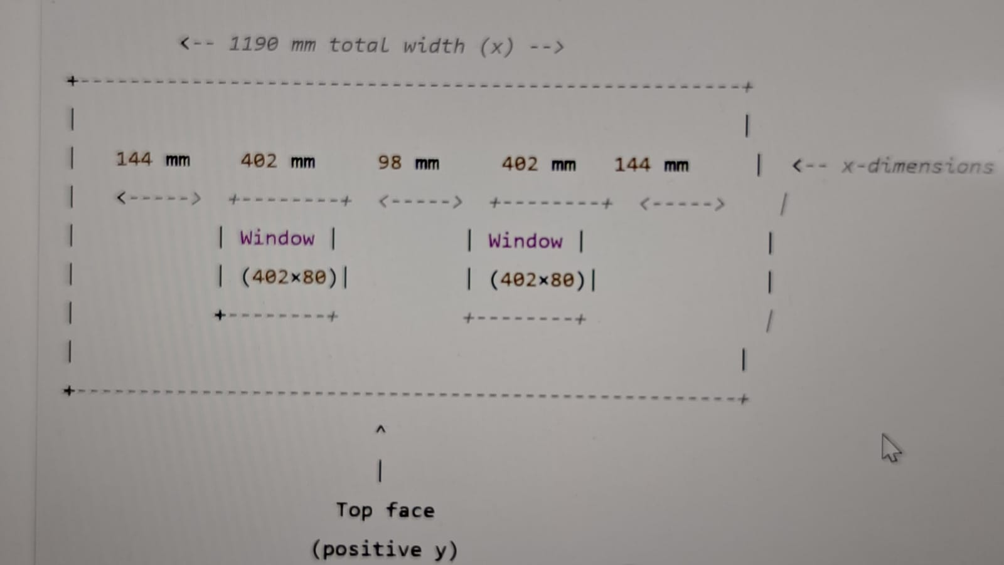
Source Calibration for CYGNO_04

Slide 4
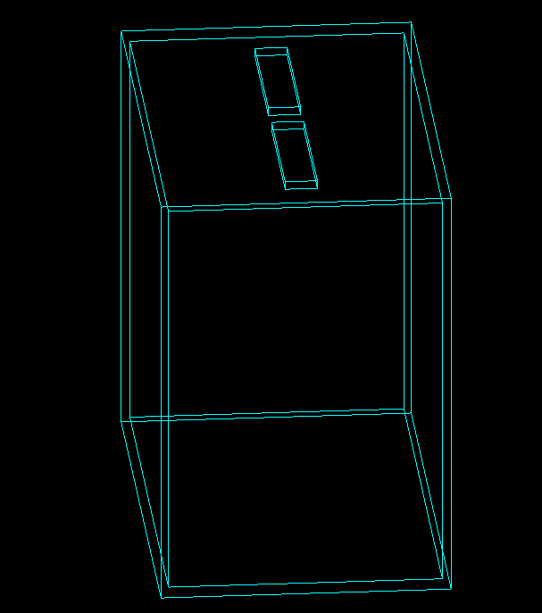
Source Calibration for CYGNO_04
144 mm
PMMA Box of size
1190 mm , 1040 mm, 720 mm.
Thickness of the PMMA is 20 mm
-2 windows (1 per half volume)
80 x 402 mm²
The windows are placed 98 mm apart each other and 144 mm from both sides of the box
98 mm
144 mm

Slide 5
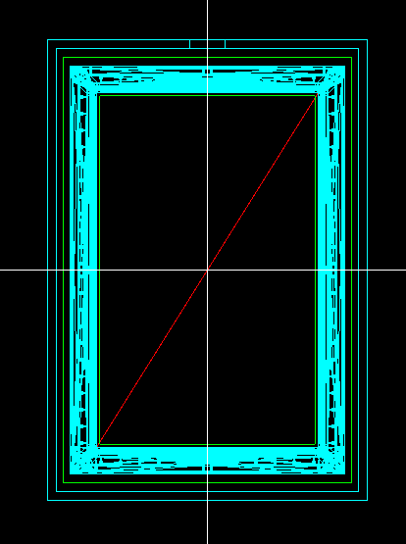
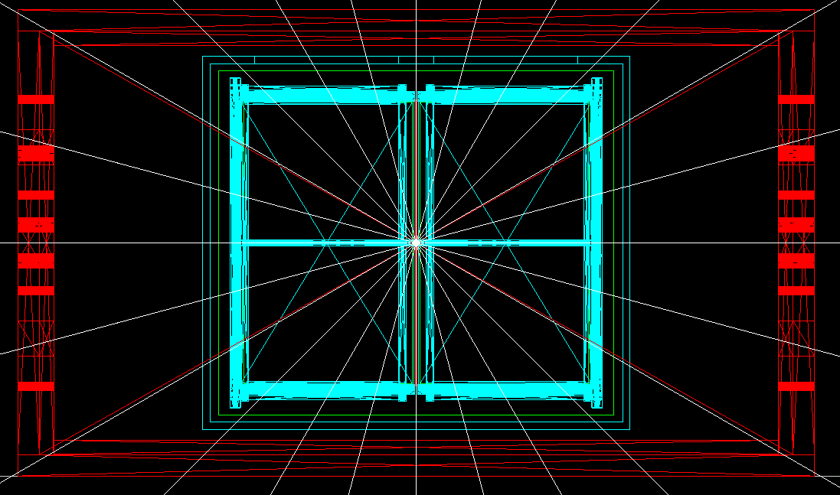
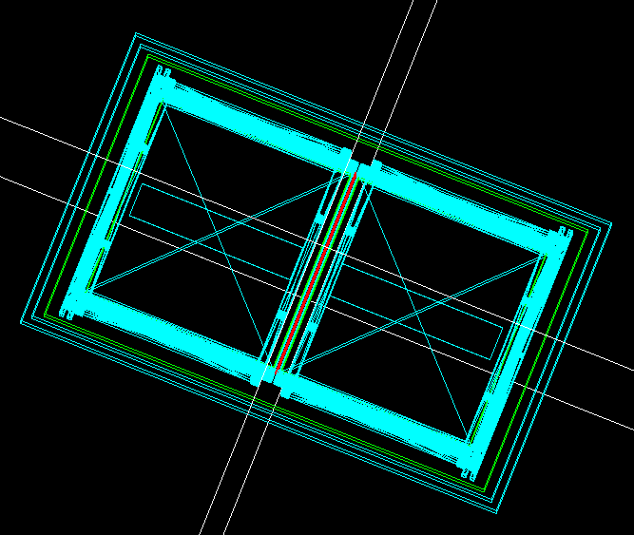
Source Calibration for CYGNO_04
These pictures confirm the alignment of the PMMA with the rest of the geometry without overlaps?
144 mm
Front view
98 mm
Side view
144 mm
Top view

Slide 6
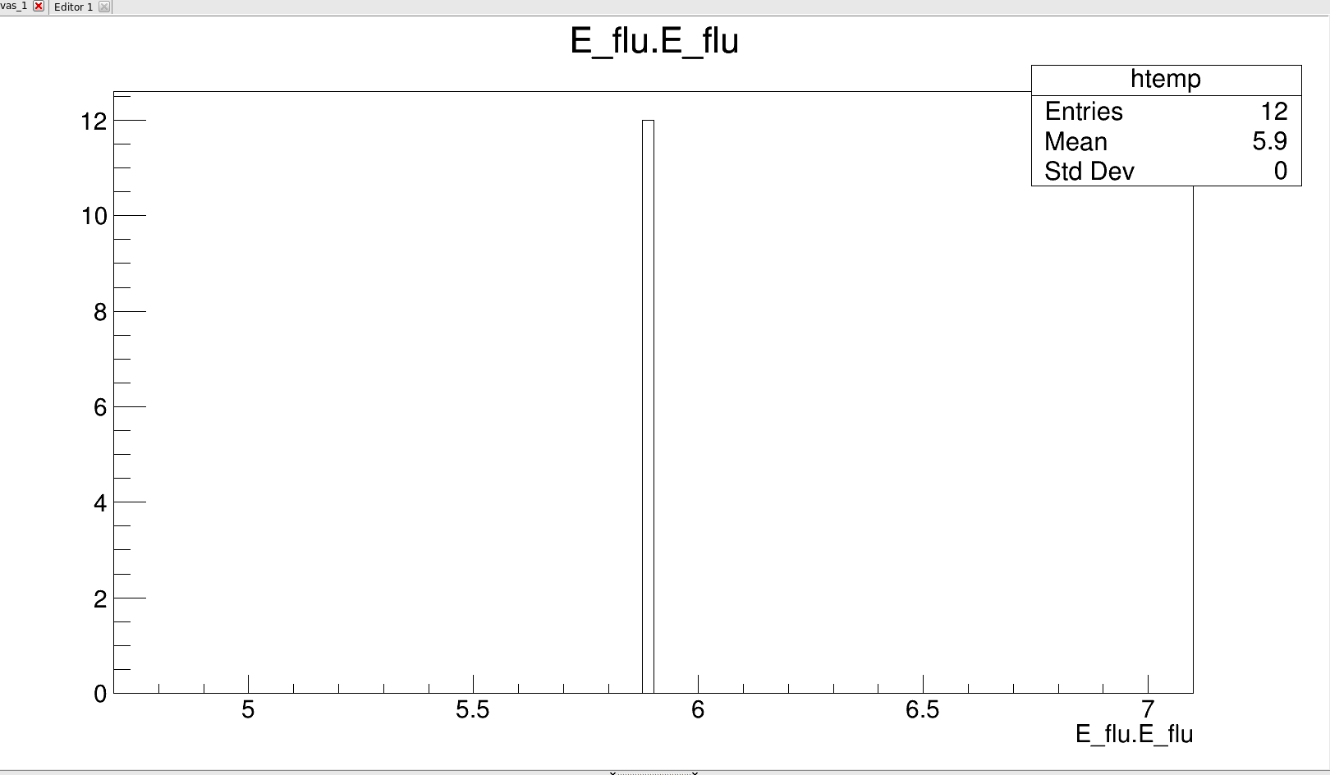
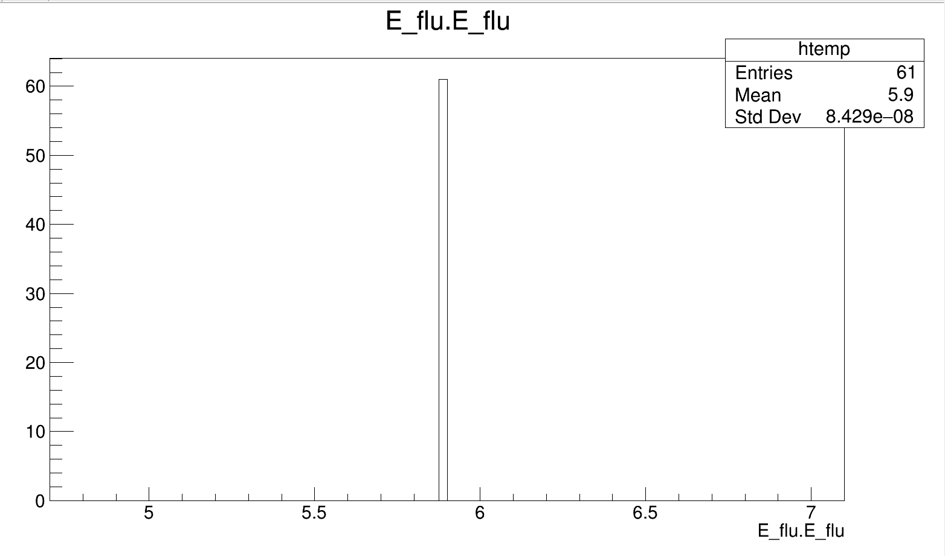
Source Calibration for CYGNO_04
Source: Gamma 5.9 keV
Number of events : 1000
Position: 25, 50, 0 cm (Isotropic direction)
PMMA without window
Source is placed above 20 mm thick PMMA
Source: Gamma 5.9 keV
Number of events : 1000
Position: 25, 50, 0 cm (Isotropic direction)
PMMA with window
Source is placed in window

