Slide 1



Exploring the radioactivity
Matteo Alberi
alberi@fe.infn.it
N. Irem Elek
lkenmr@unife.it
https://www.fe.infn.it/radioactivity

Slide 2









Who are we?

Slide 3

What is radioactivity?
Why is it important?
How do we measure it?

Slide 4



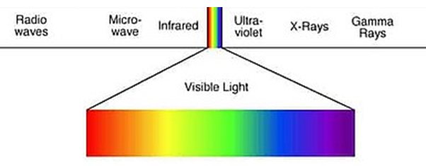
Approaching the nucleus
[E] = 1 eV = 1.6 10⁻¹⁹ J
~ 1 MeV
Proton
Charge | + 1.602 10⁻¹⁹ C
Mass | 1.6726 10⁻²⁷ kg
 | 938.272 MeV/c²
Radius | ~ 10⁻¹⁵ m
Spin | 1/2
Lifetime | > 2 10²⁹ yr
Neutron
Charge | /
Mass | 1.6749 10⁻²⁷ kg
 | 939.565 MeV/c²
Radius | ~ 10⁻¹⁵ m
Spin | 1/2
Lifetime | 881.5 s
Electron
Charge | - 1.602 10⁻¹⁹ C
Mass | 0.911 10⁻³⁰ kg
 | 0.511 MeV/c²
Distance e-nuc | ~ 10⁻¹⁰ m
Spin | 1/2
Lifetime | > 6.6 10²⁸ yr

Slide 5

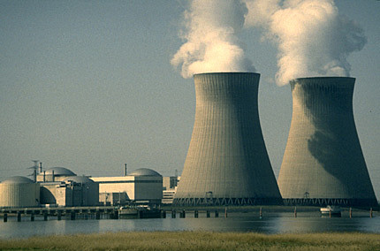
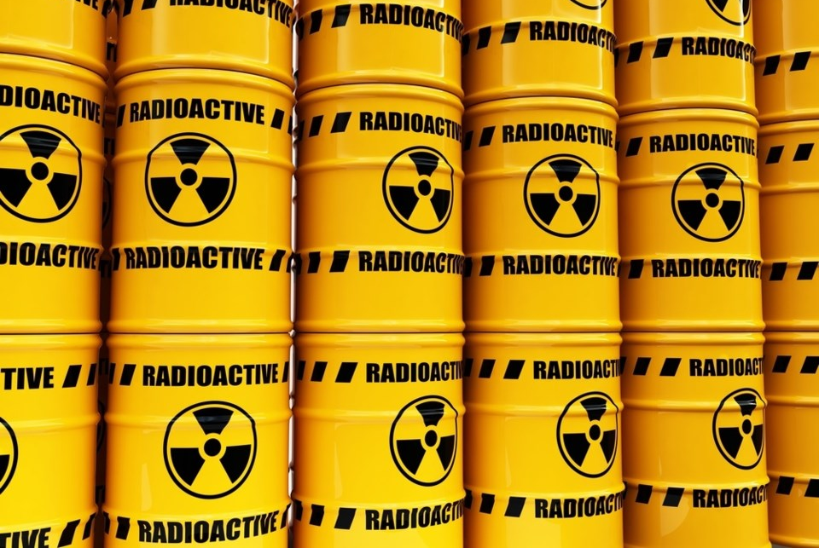

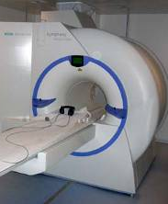
If I say "radioactivity", what do you think of?

Slide 6



Alfa decay
Radioactivity
Radioactivity is a natural physical phenomenon that occurs when the nucleus of an unstable atom reaches a new equilibrium state by emitting radiation
Beta decay
Gamma decay
1 Bq = 1 decay/s
Notes:
And this decay in which you emit from the nucleus an electron and anti-utrino again starting from this point reaching this new configuration. The new configuration is in term of stability is better than before. Sometime you can get also the emission of energy

Slide 7


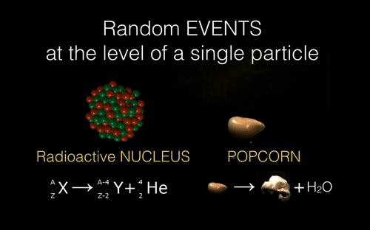
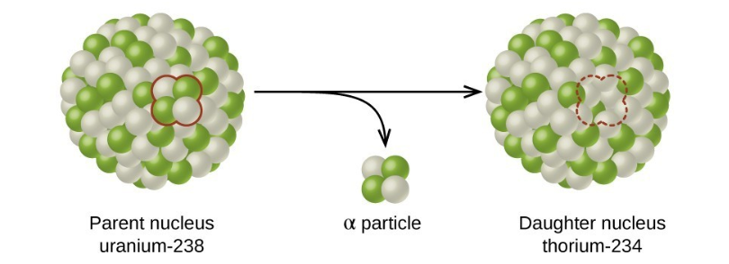

Slide 8
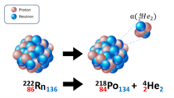
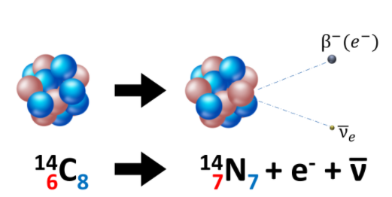
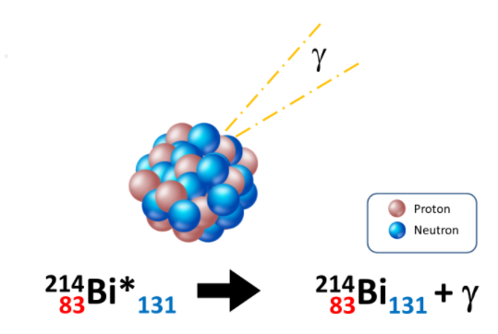
Alpha Decay (α-decay)
Typical of nuclides with a high number of both protons and neutrons
Occurs when atomic number Z > 83 and mass number A > 220
The nucleus emits an alpha particle (⁴₂He), reducing both Z and A
Beta Decay (β⁻-decay)
Characteristic of nuclei with an excess of neutrons compared to protons
To stabilize, the nucleus increases its number of protons
Emits a fast electron (β⁻ particle) and an anti-neutrino
Gamma Decay (γ-decay)
Emission of photons (γ) after an α or β decay
Atomic number Z and mass number A remain unchanged
The nucleus releases energy by emitting a gamma photon
Notes:
So basically you start with a nucleus with a number of proton and a total uh mass number is nuclear plus proton in the nucleus. Okay. And for some reason because it's not in equilibrium at certain moment it decide to decay. Okay. What's happen in this case? Two proton are released because number of Z is decreased by factor two. So basically you release two proton and two neutron which correspond to a nucleus . This is alpha decay. So if you imagine when this happen, when the atomic number is pretty high. So Z more than 80.
So uh beta decay basically Z improved by one. This means that we have more proton but the number of a doesn't change. So basically one neutron become a proton.

Slide 9
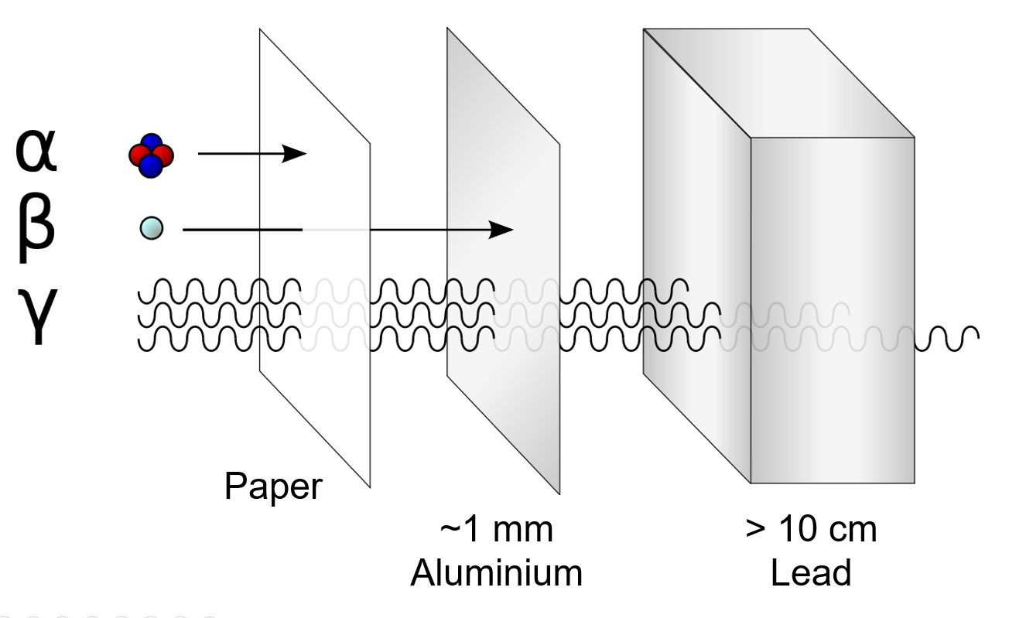
Penetration and Shielding
Penetration power
α stopped by paper
β penetrates paper but stopped by ~1 mm of aluminum
γ requires thick lead (>10 cm) or dense materials to be significantly attenuated

Slide 10

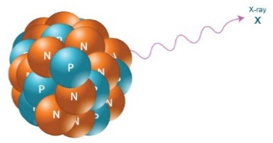
Radioactivity around us
Earth's radioactivity is due to naturally occurring radioactive elements with half-lives comparable to the age of the earth
Potassium-40 and some radioisotopes belonging to the decay chains of uranium and thorium emit γ rays with energy of the order of MeV and can be easily detected by spectroscopy γ
We can quantify the presence of radioactive elements using a scintillation detector
Element | Radioisotope | Isotopic abundance | Half-life | Typical abundance
Potassium | ⁴⁰K | 0.012% | 1.3 × 10⁹ year | 0.02 g/g [2%]
Uranium | ²³⁸U | 99.3 % | 4.5 × 10⁹ year | 3 µg/g [ppm]
Thorium | ²³²Th | 100 % | 14.1 × 10⁹ year | 10 µg/g [ppm]
γ

Slide 11
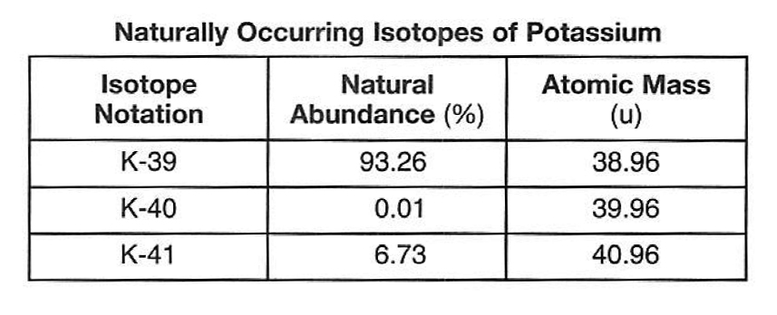

Potassium
Chemical properties
  Highly reactive alkali metal; reacts vigorously with water.
Physical properties
  Soft, silvery metal; low melting point (63.5 °C); excellent conductor of electricity.
Potassium-40 (⁴⁰K)
  A naturally occurring radioactive isotope of potassium
Source | K abundance (%)
Rocks | ~ 2
Banana | 0.36
Human body | 0.25
Tap water | 0.0001 – 0.0005

Slide 12
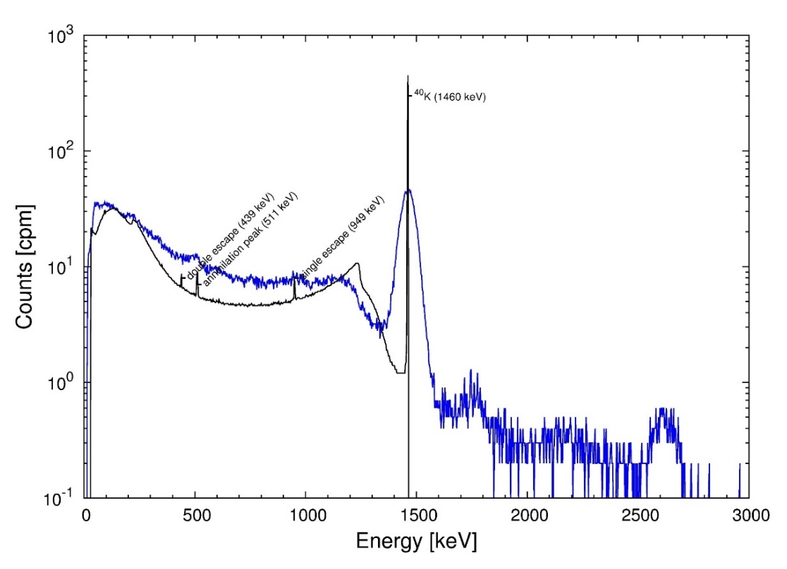
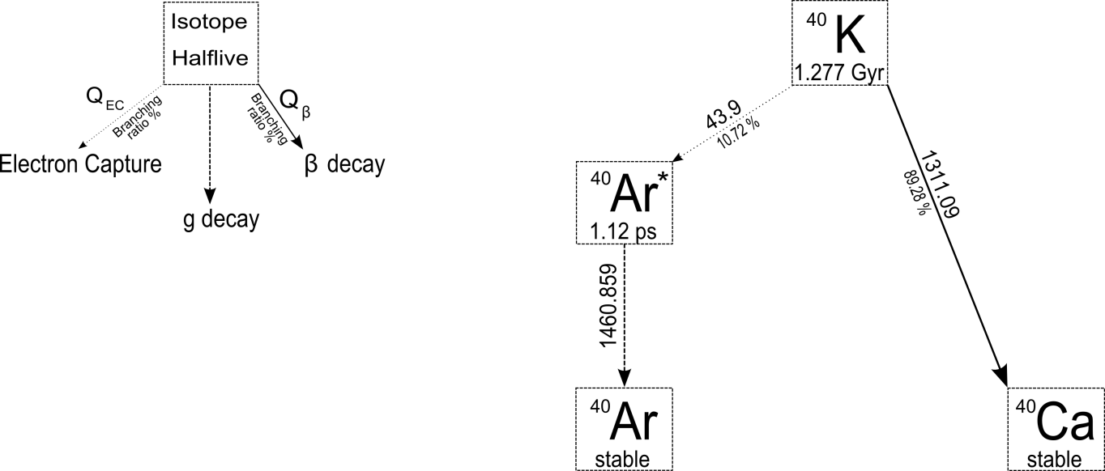

Potassium 40: decay and gamma spectrum
Electron capture (EC)
A nuclear process in which an inner orbital electron is captured by the nucleus, leading to the conversion of a proton into a neutron with the emission of an electron neutrino.
β⁻-decay
γ

Slide 13
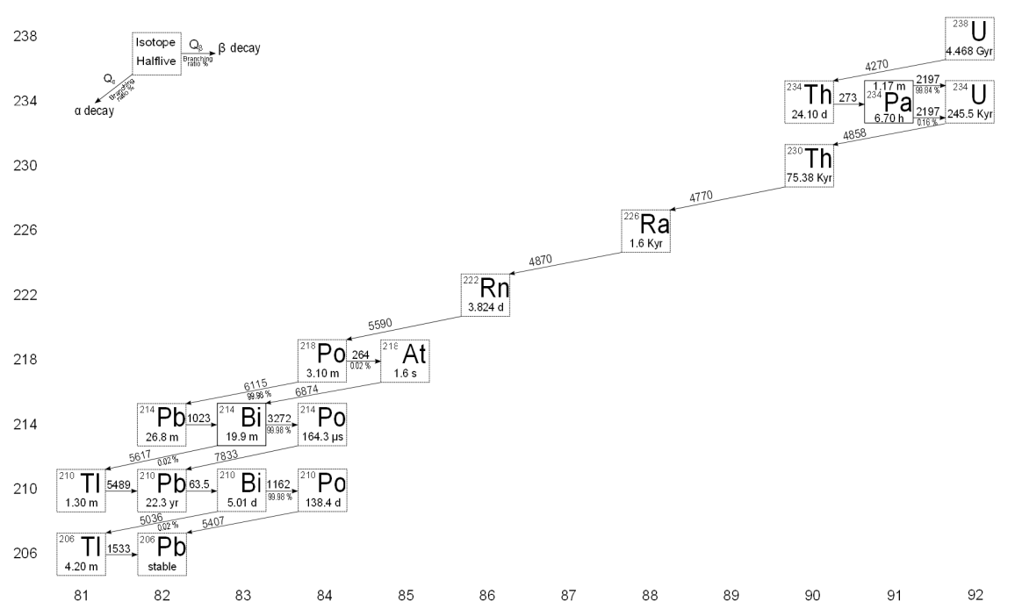

Uranium decay chain
γ
γ
γ

Slide 14
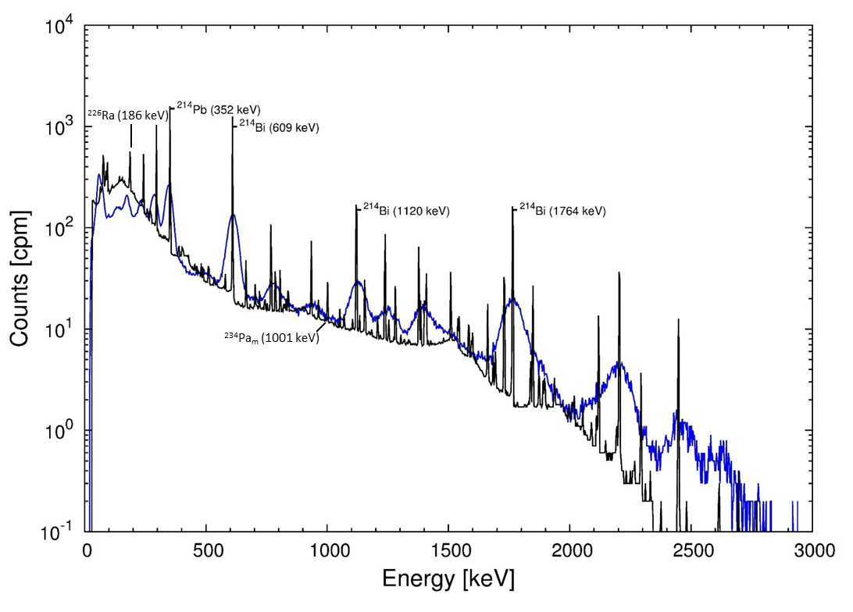

Uranium gamma spectrum

Slide 15
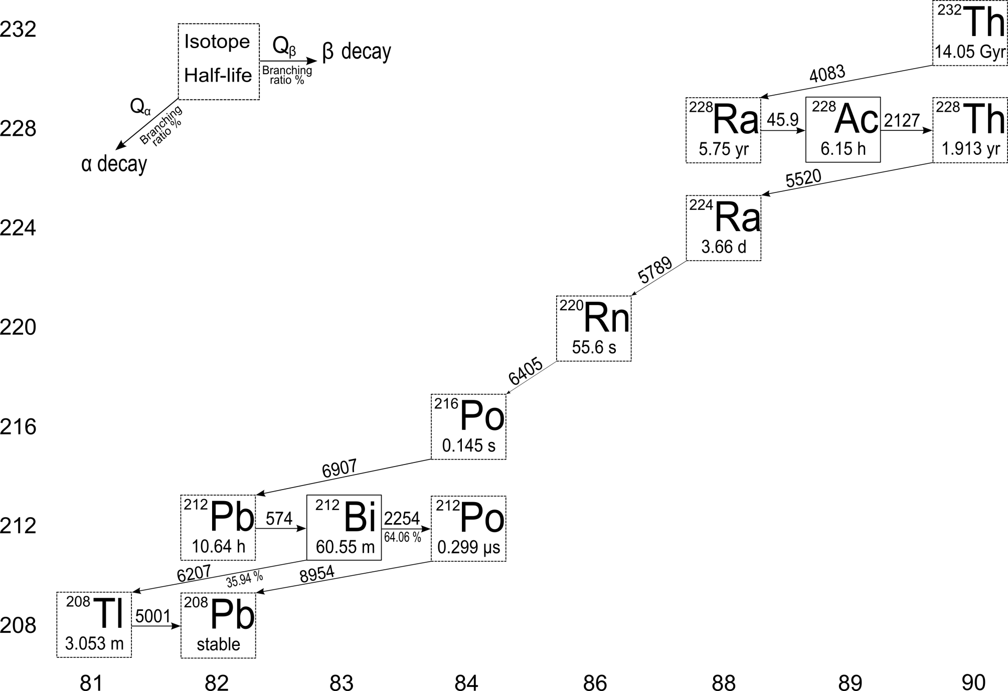
Thorium decay chain
γ
γ
γ
γ

Slide 16
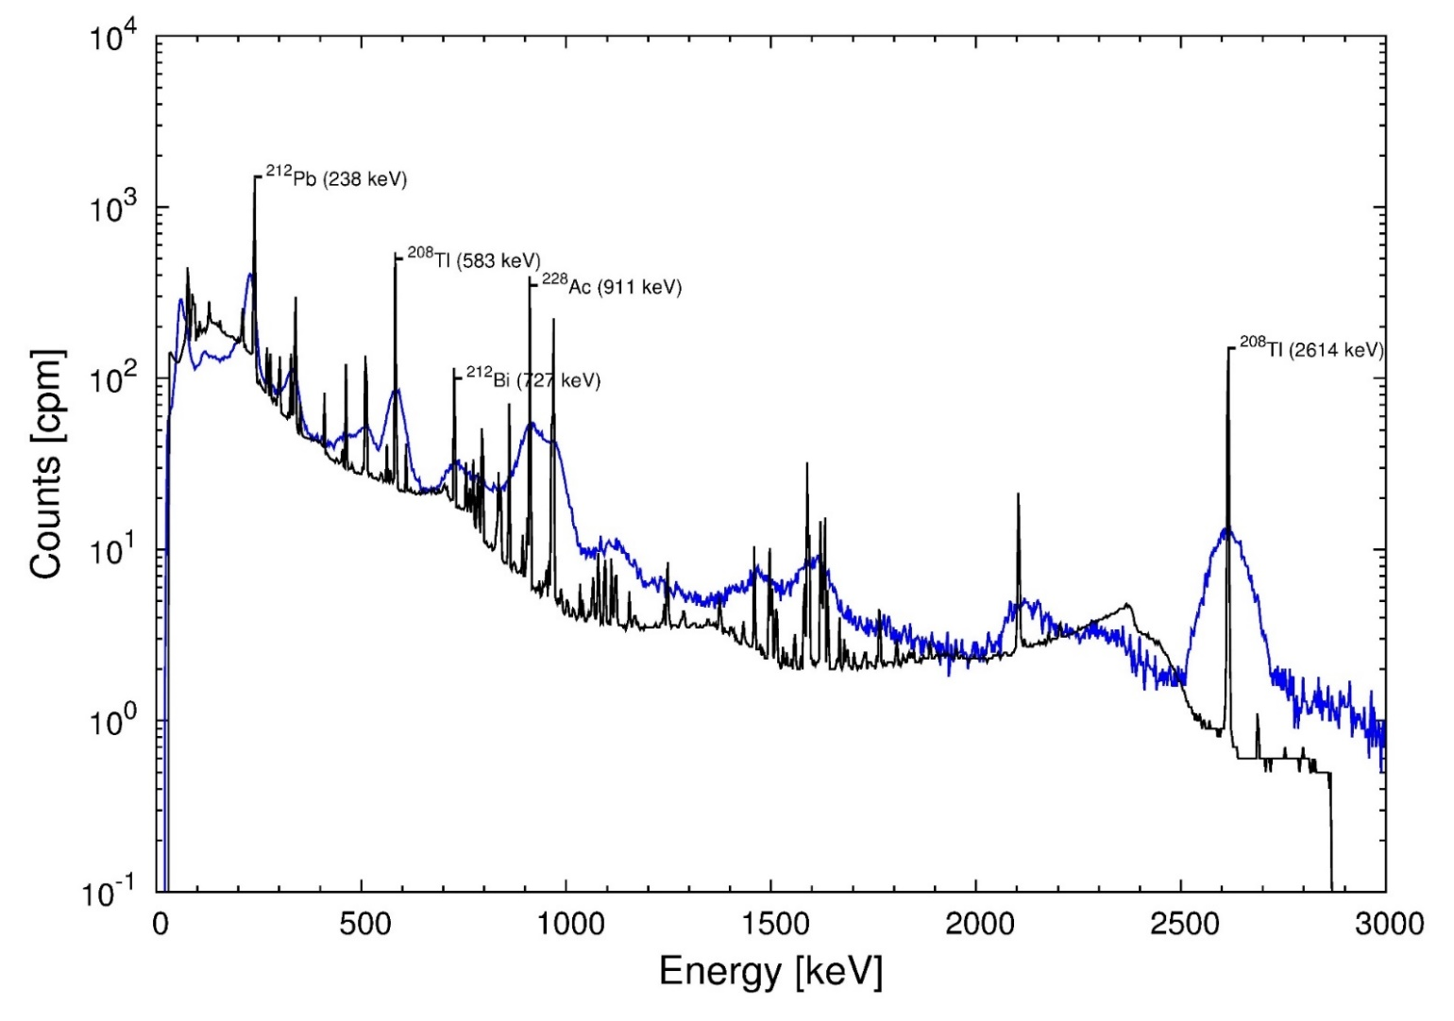
Thorium gamma spectrum

Slide 17

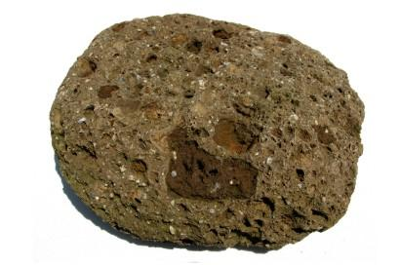
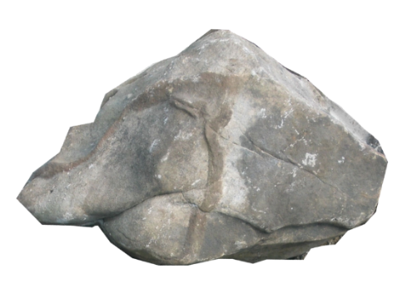
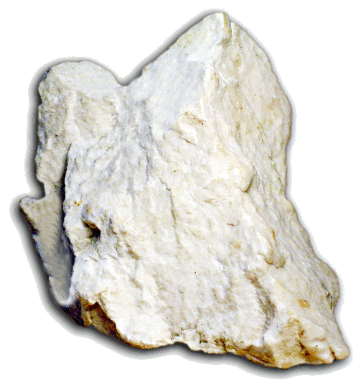
How radioactive are terrestrial rocks?
Granite (intrusive igneous rock)
Tuff (pyroclastic rock)
Granite: is an intrusive igneous rock (magmatic rock solidified within the earth's crust) composed mainly of quartz, feldspar and mica. These minerals may contain traces of radioactive elements
Tuff: it is a light volcanic rock formed by the compaction of volcanic ash and pyroclastic fragments. The presence of materials derived directly from volcanic eruptions can lead to increased radioactivity
Gypsum: it is an evaporitic sedimentary rock formed by the precipitation of calcium sulphate. Usually, it does not contain high levels of radioactive elements
Marble: it is a metamorphic rock derived from the recrystallization of limestone. Although it may contain traces of radioactive minerals, it generally has lower levels of radioactivity
~1000 Bq/kg
~1800 Bq/kg
Marble (limestone)
Gypsum (sedimentary)
~100 Bq/kg
~100 Bq/kg

Slide 18
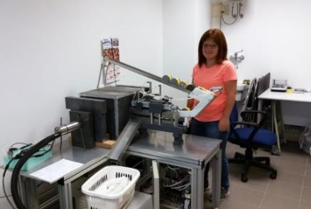
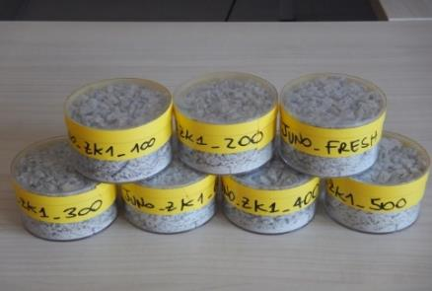
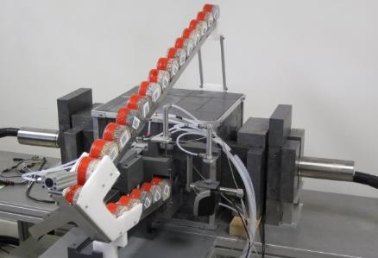
How can we measure the gamma radioactivity?
… in lab
~ 0.1 m

Slide 19

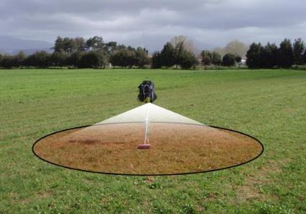
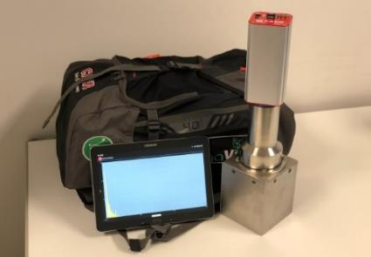
How can we measure the gamma radioactivity?
… in lab
… in situ
~ 0.1 m
~ 10 m

Slide 20

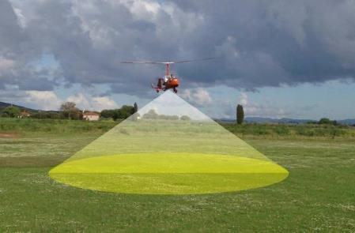
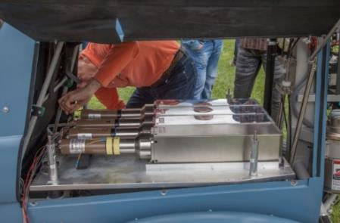
How can we measure the gamma radioactivity?
… in lab
… in situ
… airborne
~ 0.1 m
~ 10 m
~ 100 m

Slide 21
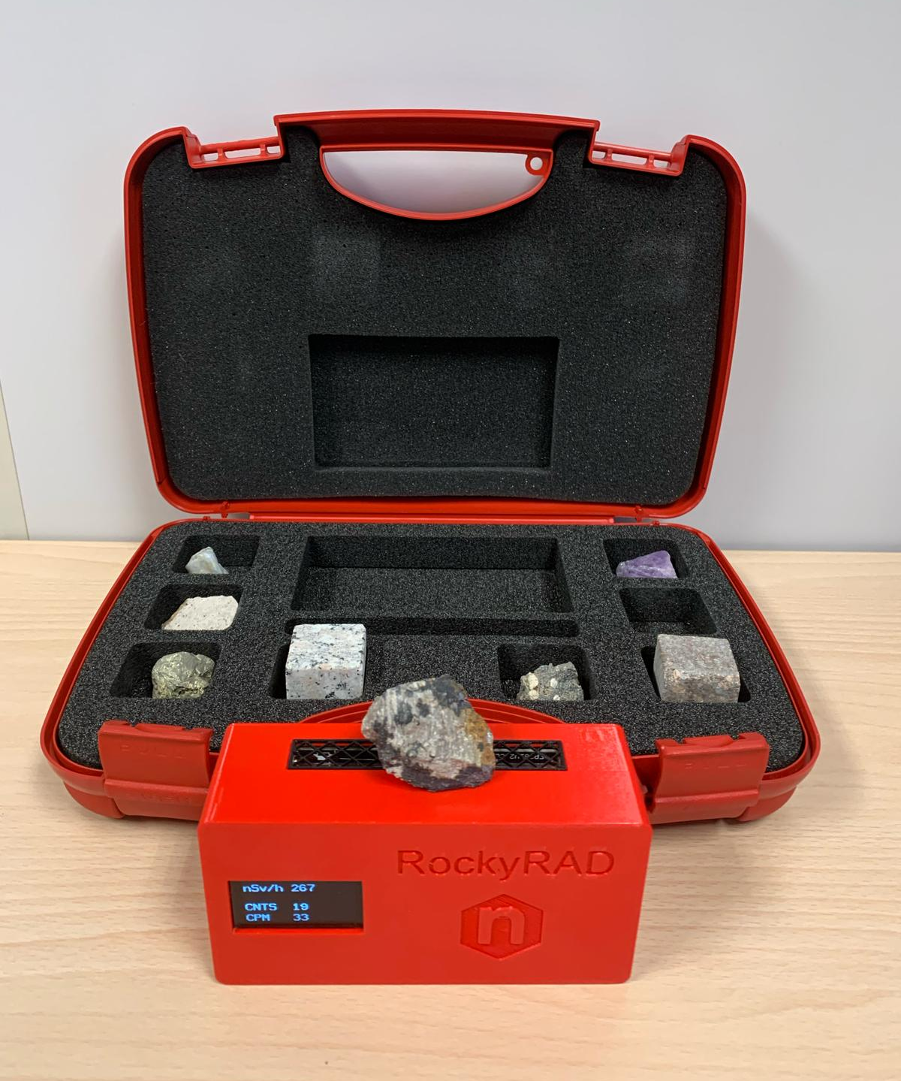
Introducing RockyRad
Detects β and γ radiation using a Geiger-Müller glass tube and displays real-time CPM (counts per minute) and ambient dose rate in nSv/h.
Connects to mobile devices via Bluetooth, with a dedicated Android app for real-time monitoring, data storage, and sharing.
Logged data can be exported in CSV format for easy analysis with external software.

Slide 22

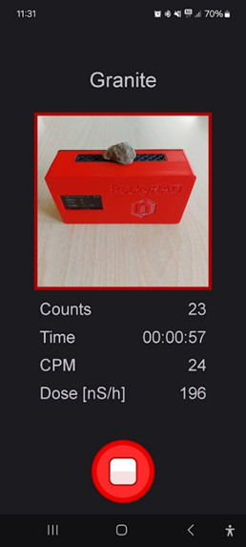

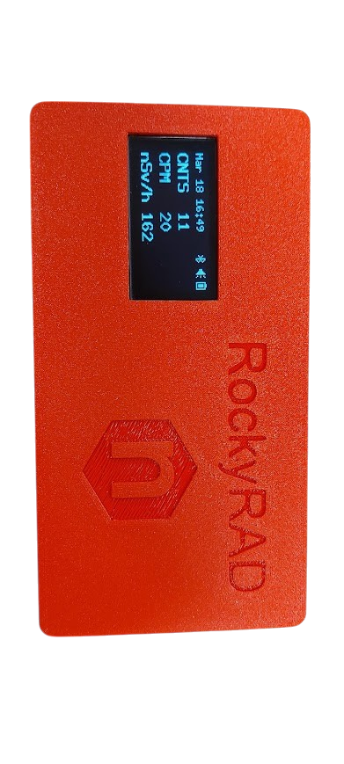
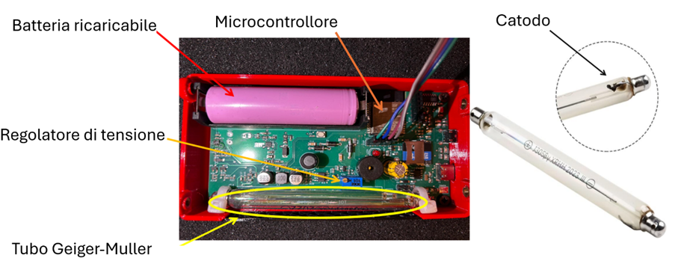
The RockyRad is a portable Geiger–Müller counter with a mobile interface to manage the Geiger counter acquisition. This detector is sensitive to both beta and gamma radiation, but it cannot discriminate between them.
​The RockyRad app provides, with a user-friendly interface, the real-time control over the measurement process. The user can specify measurement intervals and start new measurement. Following Bluetooth and Wi-Fi connection, users can use their phone to take a photo of the detector, set acquisition time.

Slide 23
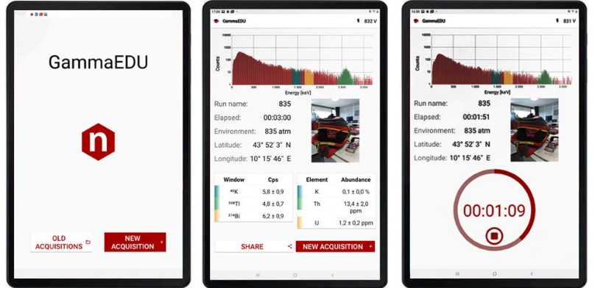

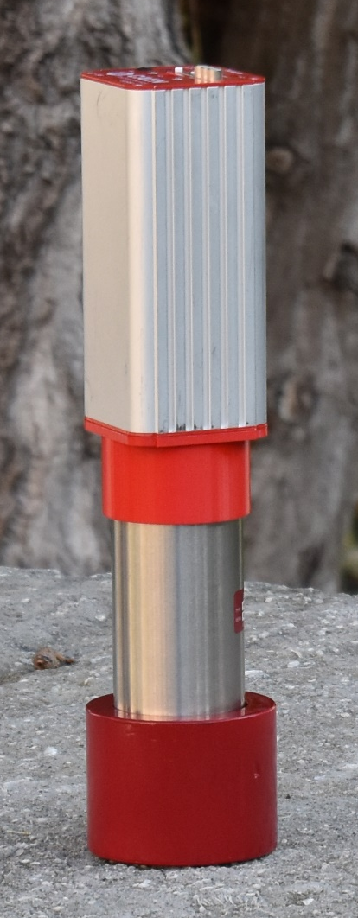
GammaEDU
https://www.caen.it/products/gamma-edu/

Slide 24

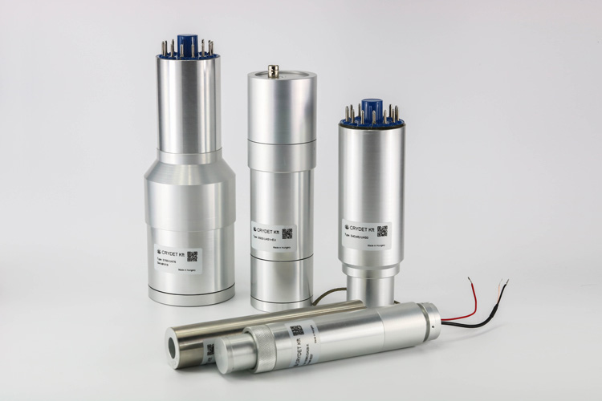
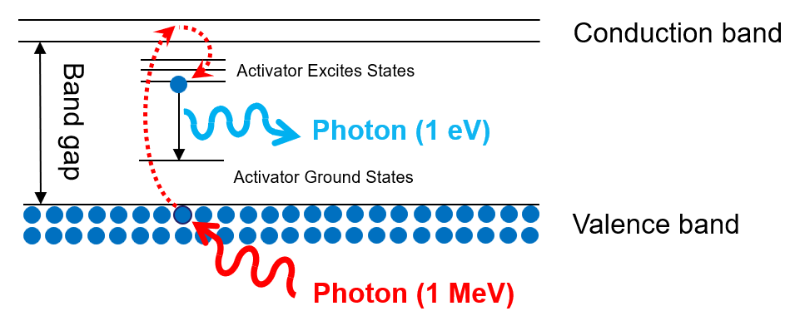
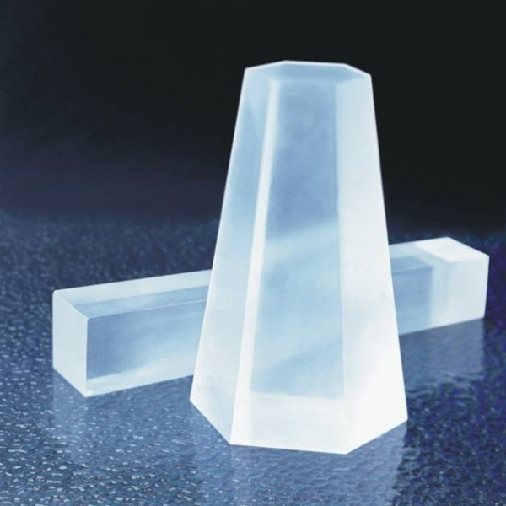
Detection of gamma radiation
Scintillation Detector (NaI(Tl)):
Sodium iodide crystal doped with thallium (0.2%) emits visible light flashes when gamma photons interact with it, enabling detection.
Scintillation Mechanism:
A gamma photon transfers energy to an electron, exciting it across the band gap. Upon returning to the ground state via activator levels, the electron emits a visible photon (~1 eV).
Material Properties:
NaI(Tl) is dense (3.7 g/cm³), transparent, efficient, but hygroscopic; its crystal structure defines the energy levels critical for scintillation performance.

Slide 25
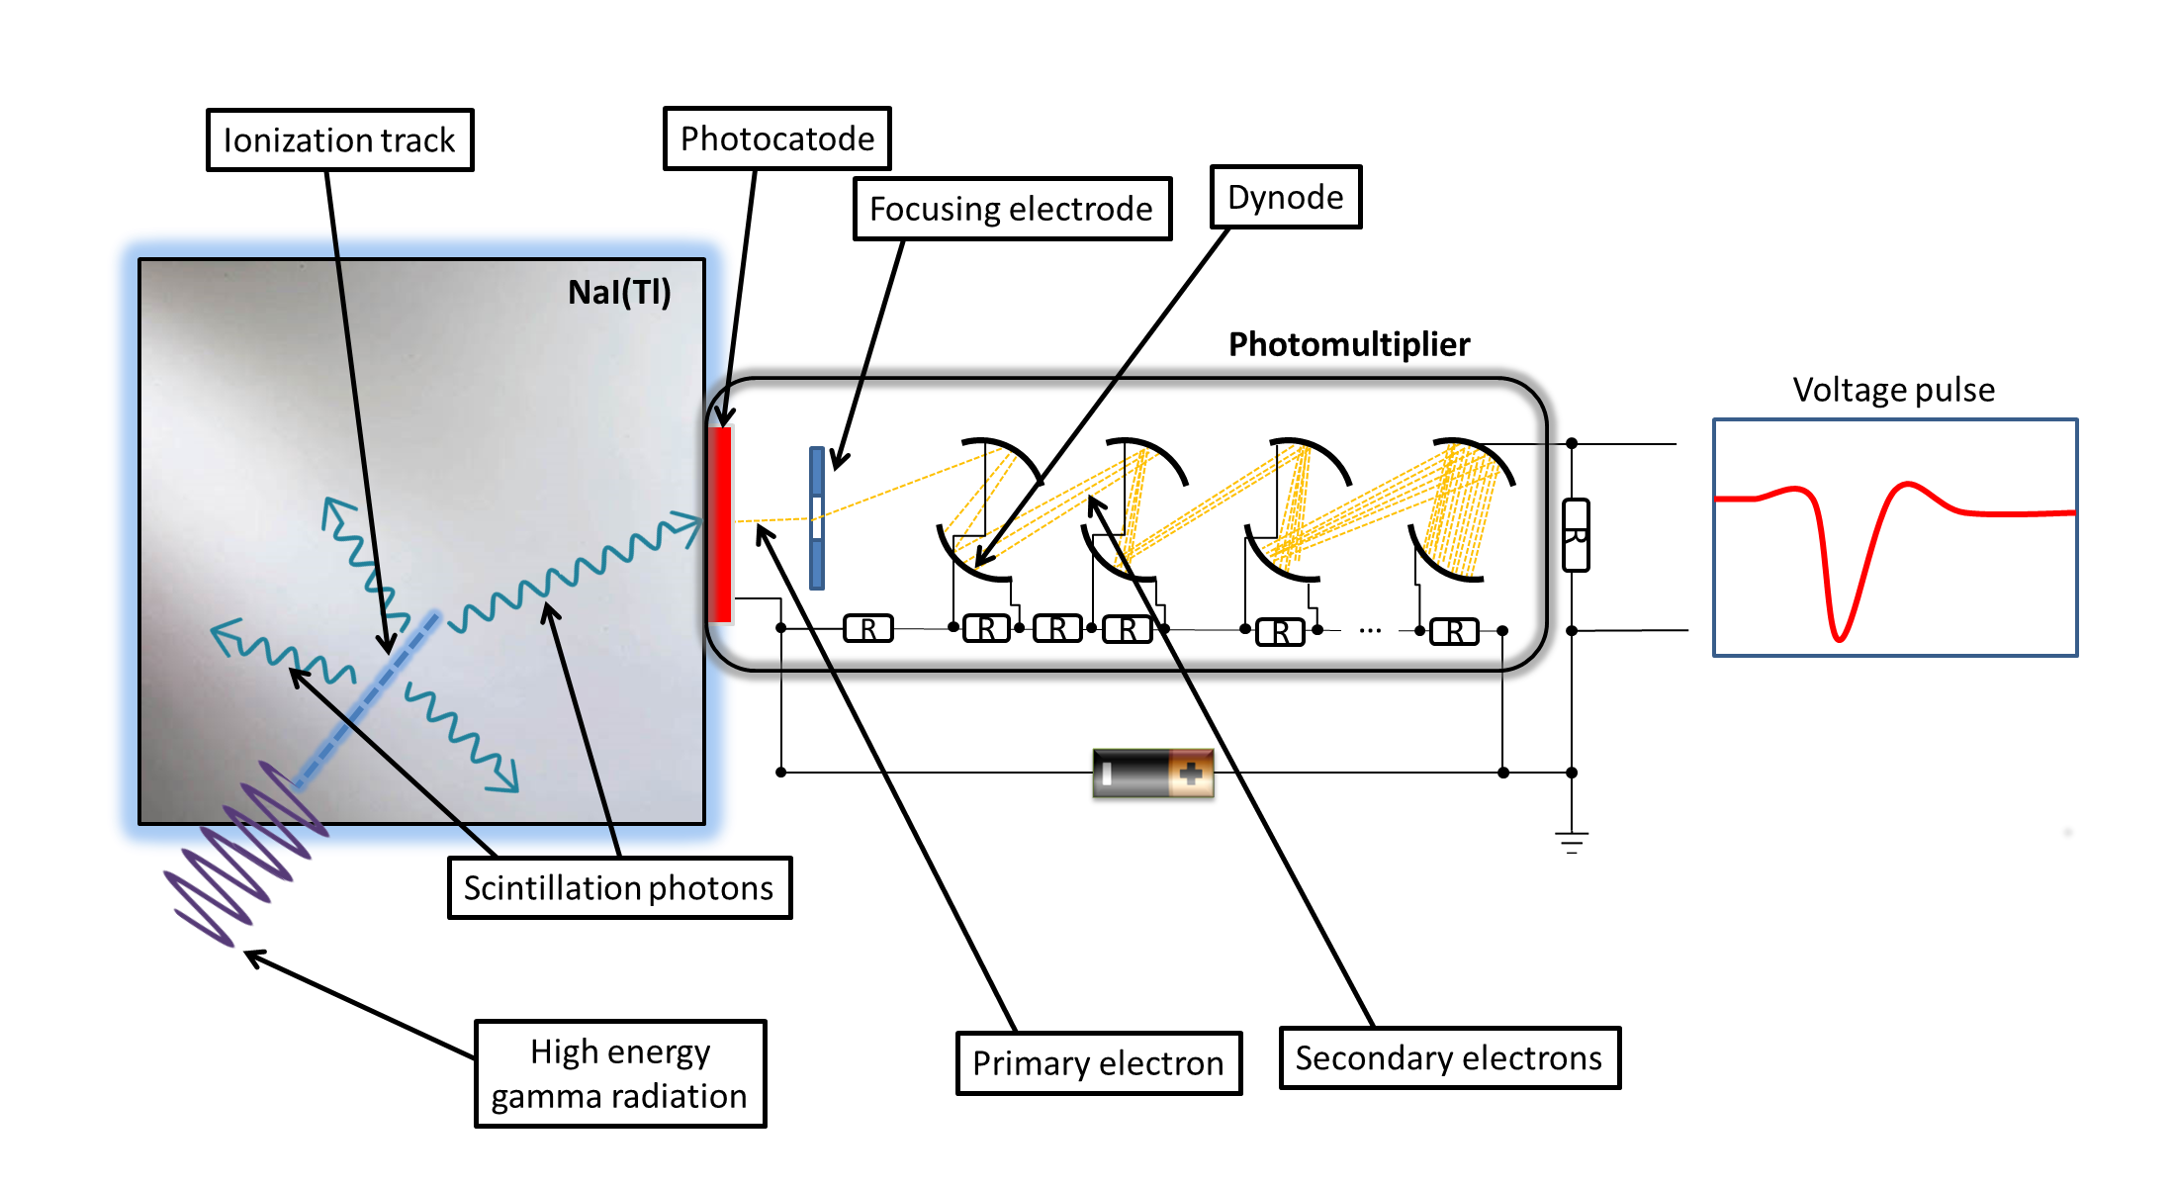
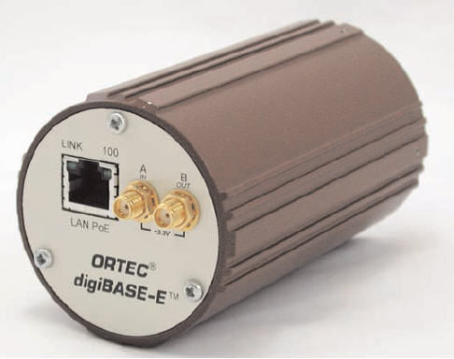
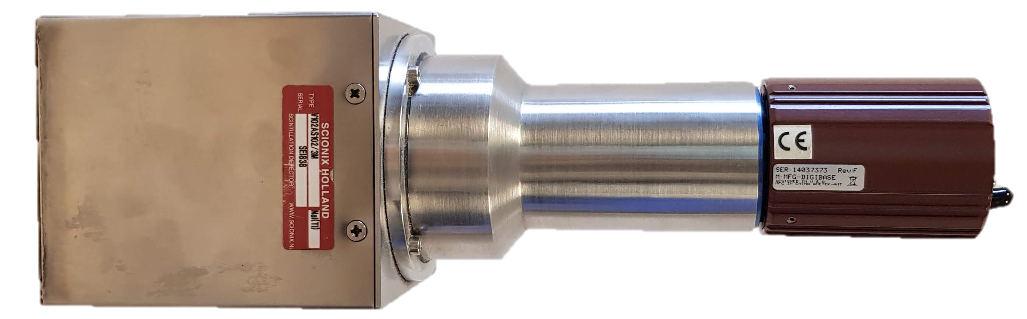
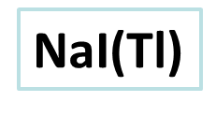

Schematic diagram of a scintillation detector
The intensity of the output current pulse is proportional to the energy of the incident photon
The MCA allows to convert the pulse obtained at the end of the charge amplification stage into a digital signal
MCA

Slide 26

We interpret the gamma spectrum
In a gamma spectrum we recognize the photopeaks, which correspond to the photons that arrive at the detector with energy equal to that with which they were emitted and that have deposited all the energy in the detector.
Photopeak
(⁴⁰K 1460 keV)
We know these energies from the physics of decay
Photopeak(²¹⁴Bi 1764 keV)
Photopeak
(²⁰⁸Tl 2614 keV)
Cosmic radiation

Slide 27
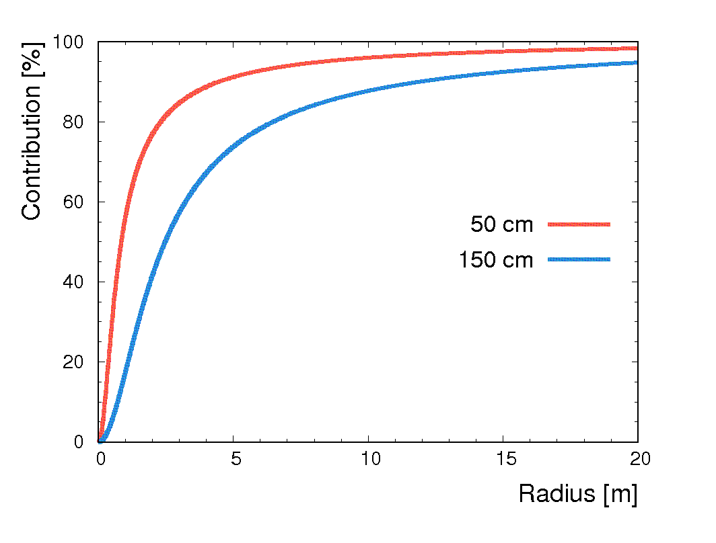
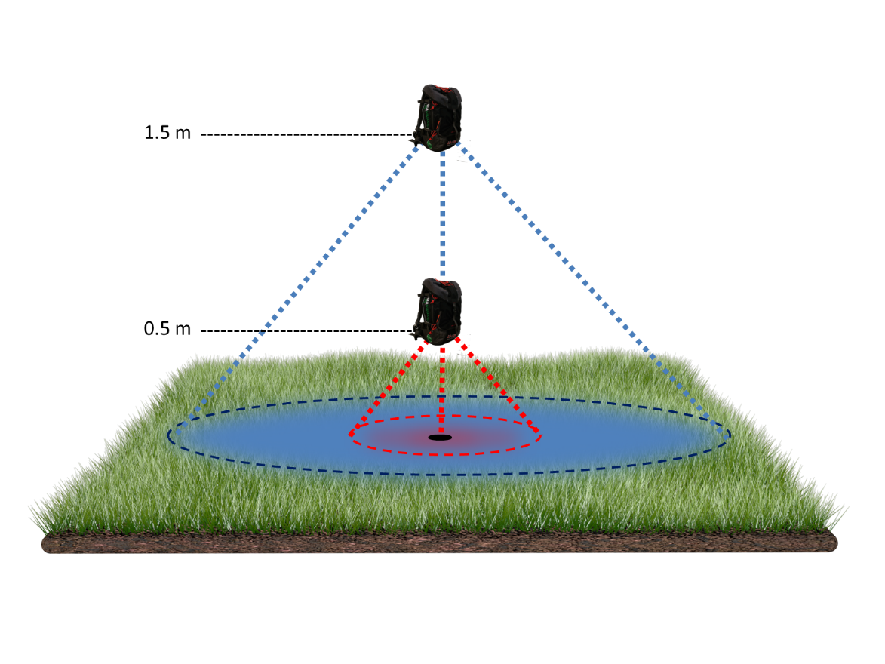
The field of view
If the detector is placed 5 cm above the ground, its field of view is 70 cm

Slide 28

Measurements must be made on an area at least 10 m away from artifacts

Slide 29
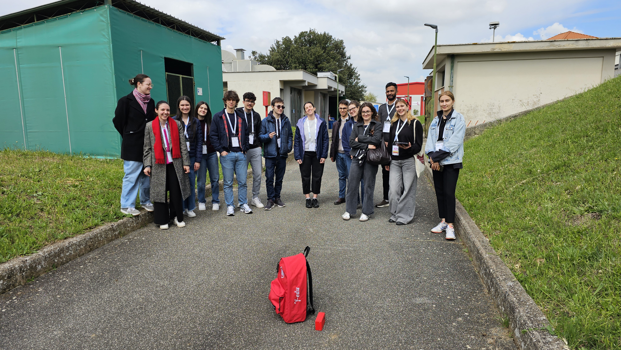
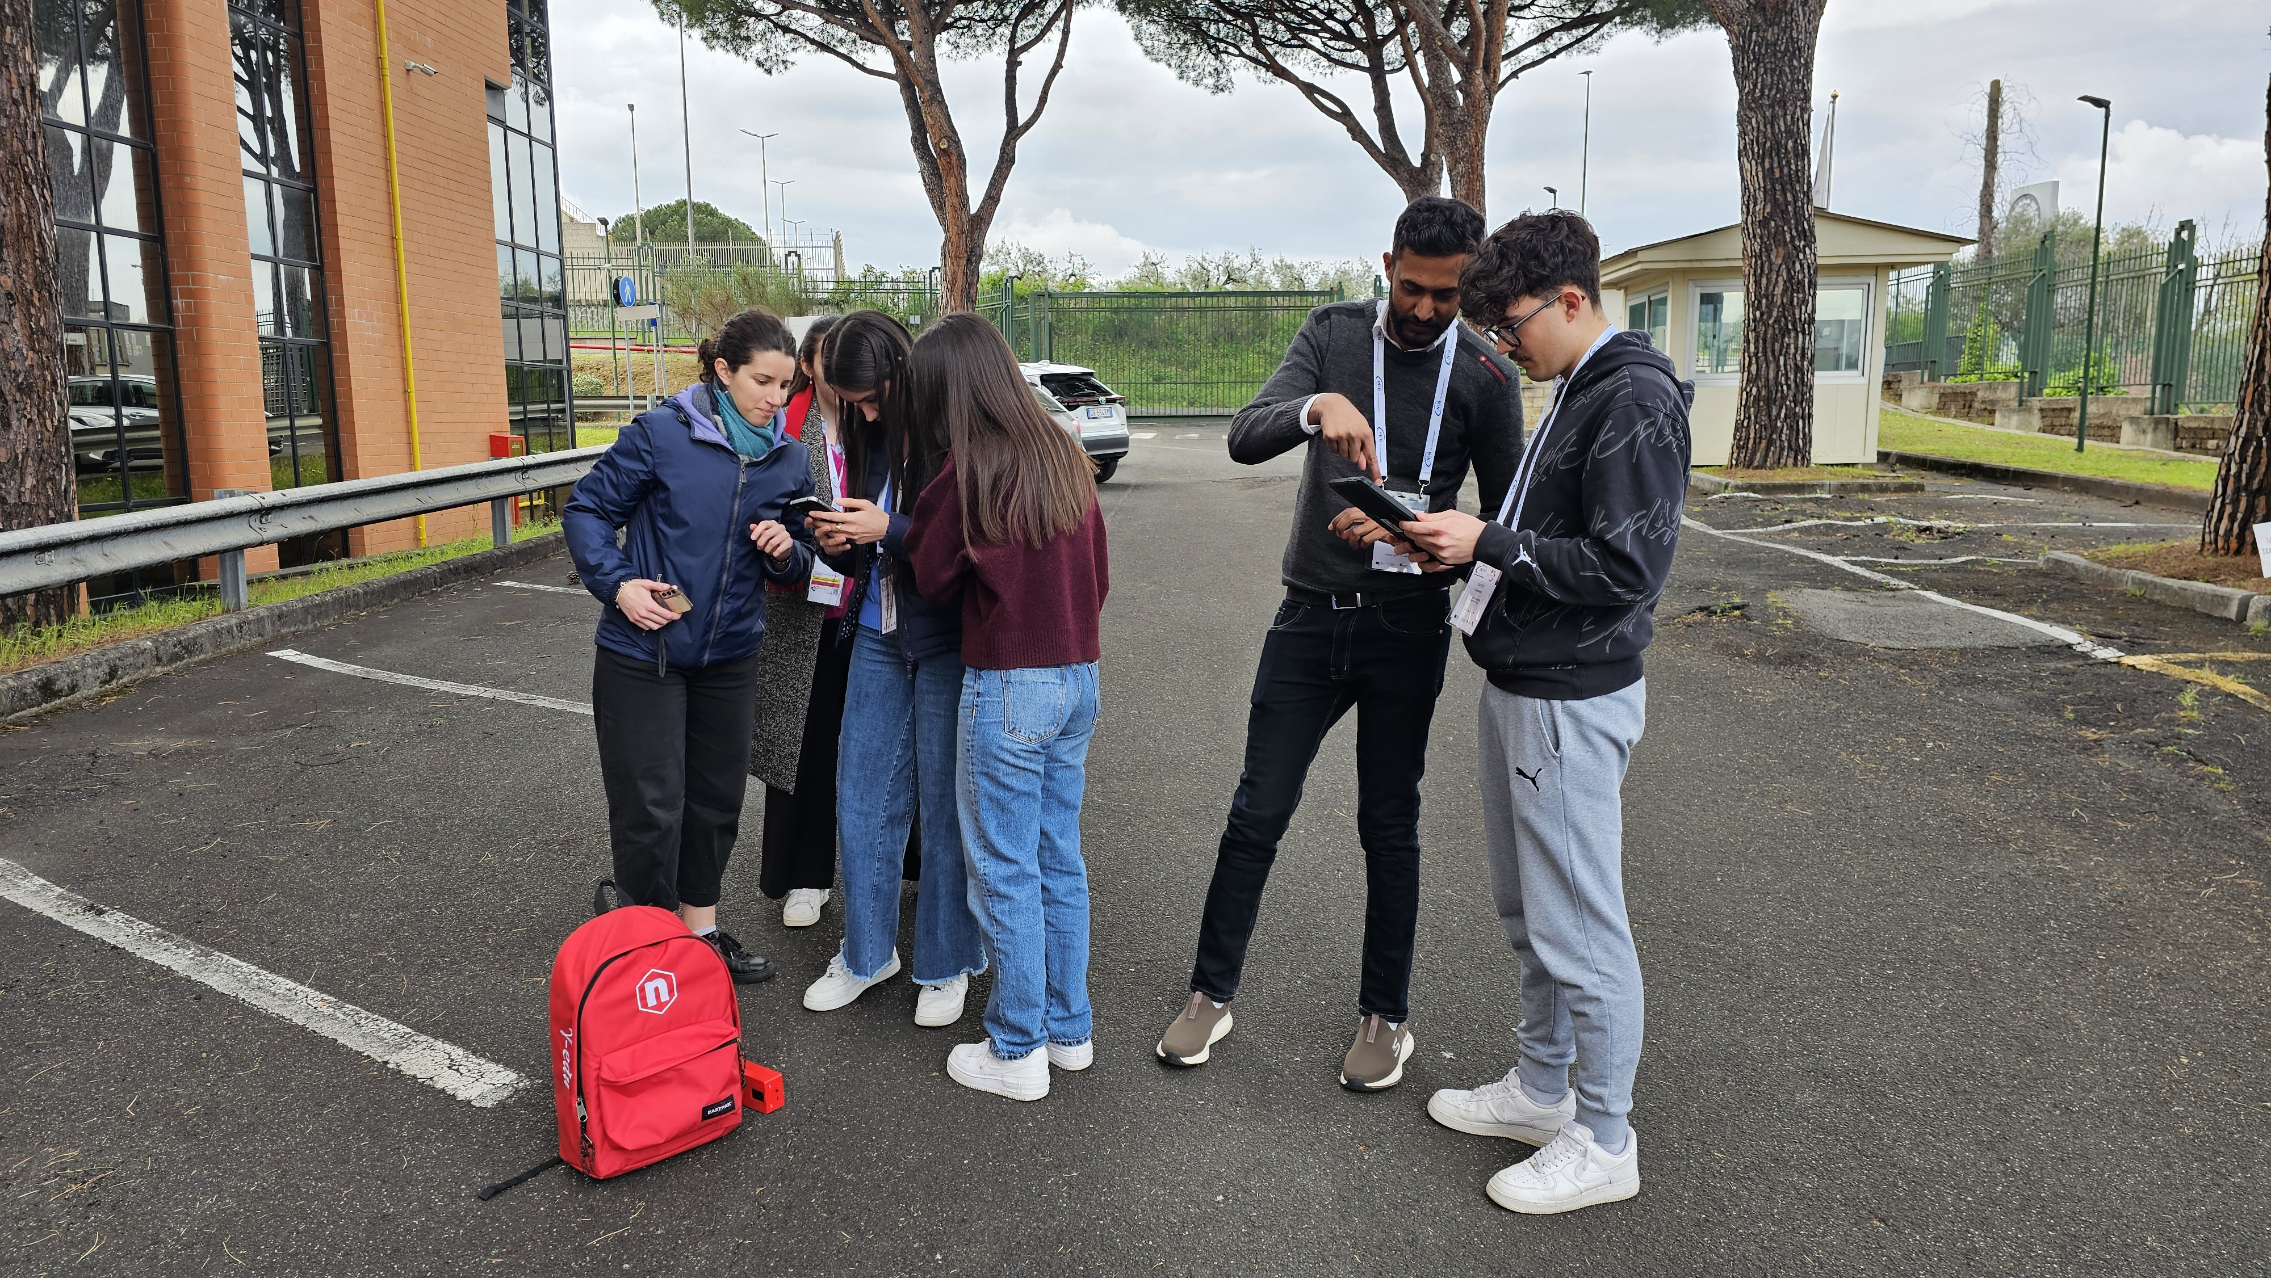
In-situ measurement
Frascati National Laboratories – April 2025

Slide 30
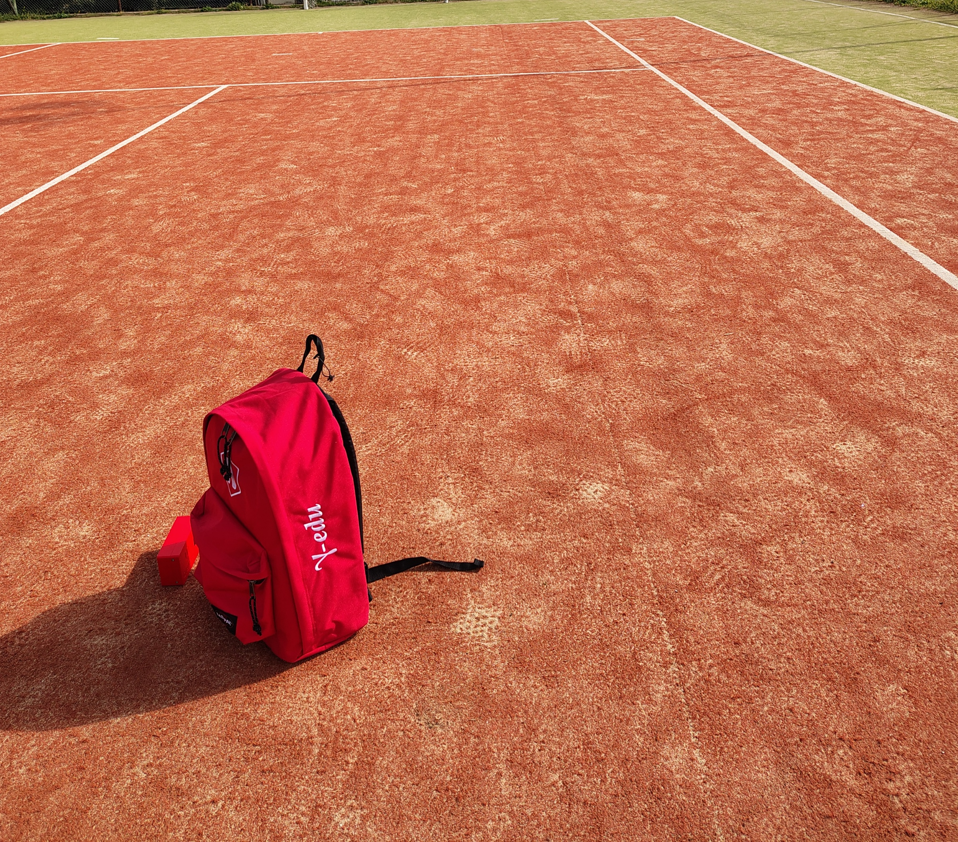
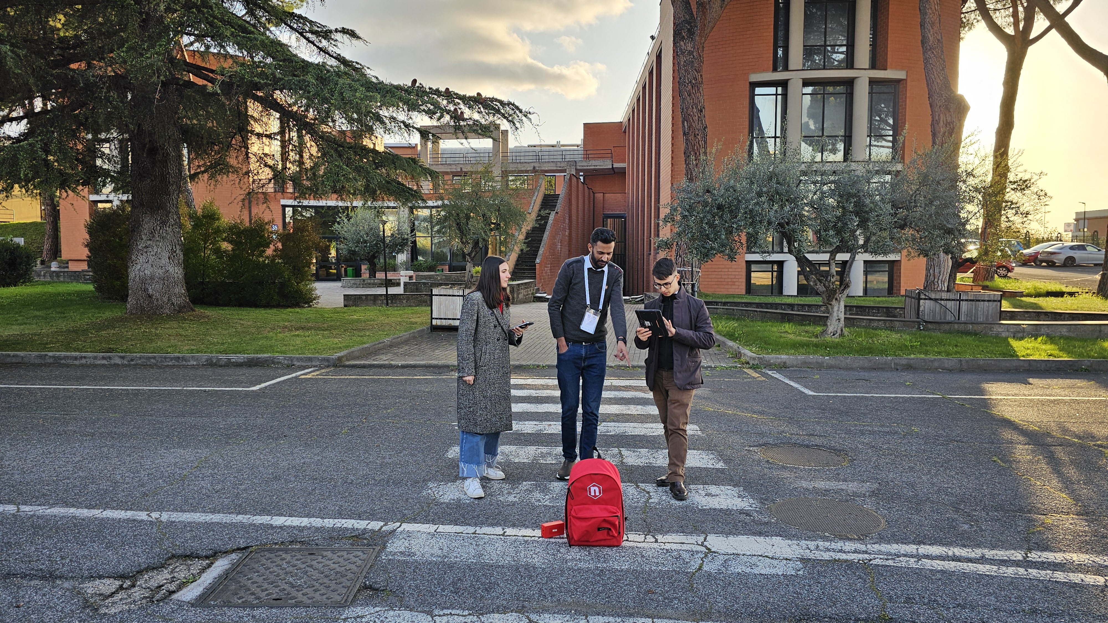
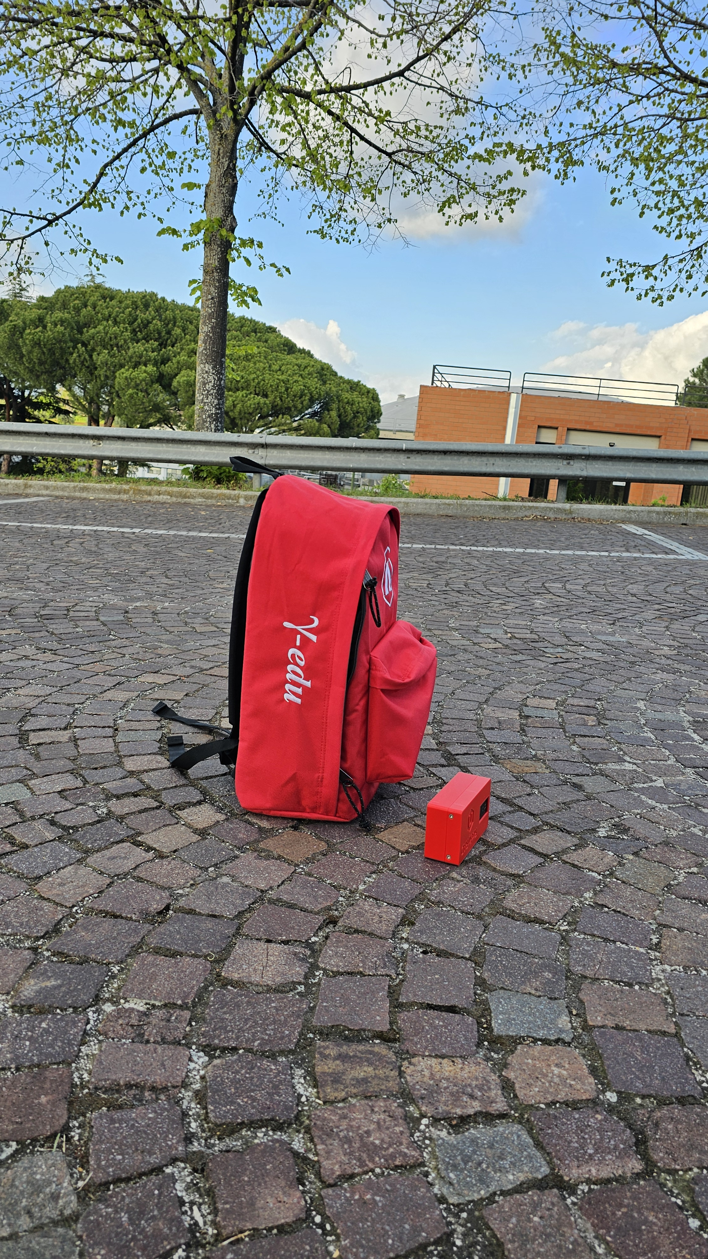

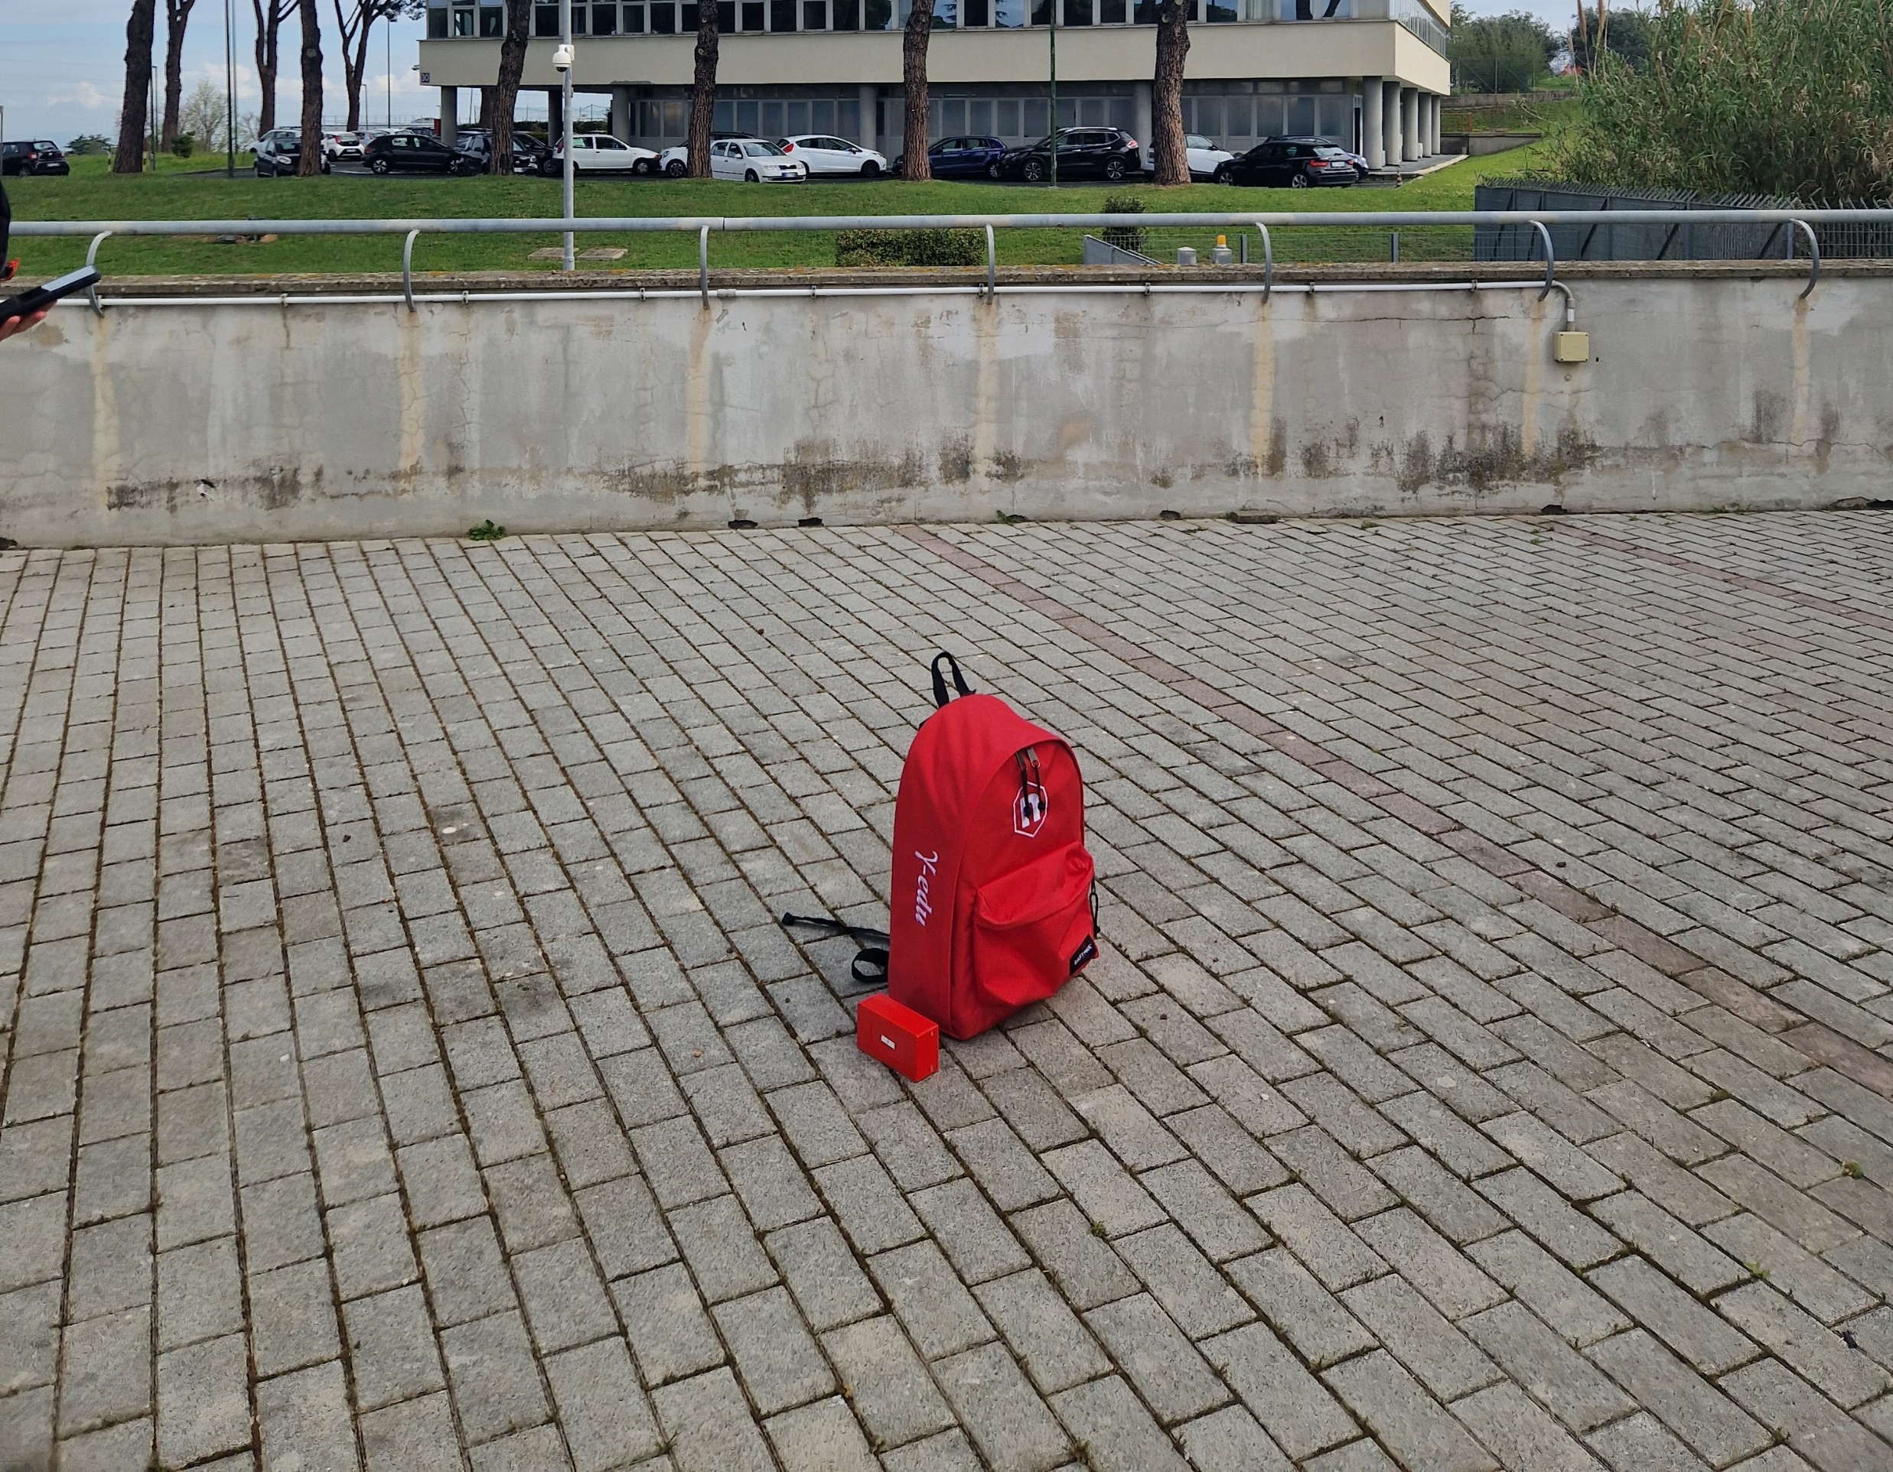
Frascati National Laboratories – April 2025

Slide 31
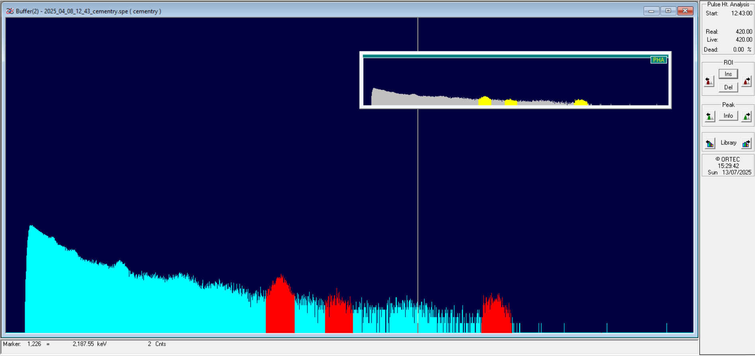
Cementry Sample;
K-40: 1.3 ±0.2 %
Bi-214: 3.6±0.9 1 ppm
Tl-208: 5.3±1.9 ppm

Slide 32







Let’s start to measurement!!
Acquire GPS coordinates
Take note of the surrounding environment
Take a photo of the measurement site
Set the acquisition time

Slide 33



Discover environmental radioactivity!
Interpretation of the characteristics of the gamma spectrum
The operator can acquire and analyze the gamma spectrum in real time to determine the abundance of K, U, and Th.

Slide 34






Share the results!
The KML file reports the measurement points, each assigned with the corresponding radionuclide abundances and an image of the acquisition site..
The file is ready to be viewed on Google Earth and shared
KML

Slide 35







GrassOlives
Take note of the surrounding environment
Take a photo of the measurement site
Set the acquisition time

Slide 36
Thank you for exploring Environmental Radioactivity with us!
We hope this presentation has sparked your interest in learning more about our incredible field. Keep asking questions, stay curious, ad enjoy discovering more about the world around you!!!

Slide 38





Principal interaction mechanisms of gamma-ray with matter
In the photoelectric effect, the incident photon completely transfers its energy to a bound electron, which is ejected from the atom.
The operating principle of a gamma-ray detector is based on the interaction of the incident photons with the detector material
  Photoelectric effect
  Compton scattering
  Pair production
The photoelectric effect dominates at low gamma energies
In the Compton scattering, the incident photon interacts with a bound electron resulting in the deflection of the photon. The photon transfers a portion of its energy to the recoiling electron.
In general, in pair production the energy is directly converted to matter.
threshold energy
(>1.02 MeV)
Annihilation
Compton scattering dominates at intermediate energies.
This interaction dominates at high energies.

Slide 39

Spectrometry with NaI(Tl) detectors
In a gamma spectrum we recognize the photopeaks, which correspond to the photons that interact with and deposit in the detector an energy equal to that which have been emitted from the unstable nucleus.
photopeak
(⁴⁰K 1460 keV)
Compton continuum
photopeak
(²¹⁴Bi 1764 keV)
photopeak
(²⁰⁸Tl 2614 keV)
Cosmic radiation

Slide 40

ɣ spectrum
Spectrum: a histogram of events classified according to the energy deposited
inside the detector
All photons, no matter how complex their mode of interaction, ultimately deposit all of their energy in the detector.
For a monoenergetic incident photon beam
Photopeak (full energy peak)
When Compton scattering events occur and the scattered photon generally may escape from the detector without further interaction, gives rise to the Compton continuum
1460.86 keV
Compton continuum
Channel/Energy

Slide 41



Energy calibration
A
A = (E_{Th} ,Ch_{Th} )
B = (E_{K} ,Ch_{K}, )
B
$$\frac{Ch−Ch_{K}}{Ch_{th}−Ch_{k}}=\frac{E−E_{k}}{E_{th}−E_{k}}$$
$$\frac{Ch−Ch_{K}}{Ch_{th}−Ch_{k}}=\frac{E−1460 keV}{\left(2614−1460\right)keV}$$
In order to understand which is the energy corresponding to a given acquisition channel, the spectrum must be “energetically calibrated", which means determining the linear relation existing between channel and energy on the basis of well known spectral structures

Slide 42
Interaction between radiation and the human body
The energy transferred per unit of mass by the ionizing radiation is called
dose D (Gy = Gray = J/kg).
To quantify the impact of ionizing radiation on the organisms it’s necessary to take into account the type of radiation and the radiosensitivity of the organs.
The equivalent dose H_{T} (Sv = Sievert = J/kg) measures the dose absorbed by the tissue T according to the "type" of radioactivity:
where w_{R} is a weighting factor dependent on the type of the radiation
Radiation | W_{R}
e ; γ ; X | 1
alpha | 20
The effective dose E (Sv = Sievert = J/kg) is the tissue-weighted sum of the equivalent doses in all specified tissues and organs of the human body and takes into account the different radiosensitivity of the irradiated organs:
Organs | w_{T}
Gonads | 0.20
Bone marrow, colon, stomach, lungs | 0.12
Bladder, breast, liver, esophagus, thyroid, other organs | 0.05
Skin, bone surfaces | 0.01
where w_{T} is the organs’ weighting factor

Slide 43
Mean effective dose absorbed in a year…
Mean effective dose absorbed by the population due to the "natural background": 2.400 µSv/year.
…and absorbed during a human life
Average exposure of the population to ionizing radiation *
Radon
Food and
water
Terrestrial
radiation
Medical
radiation
Cosmic rays
Human
activities
* UNSCEAR 2000 Report - United Nations Scientific Committee on the Effects of Atomic Radiation

Slide 44




Total effective dose (outdoor)
inhalation
cosmic radiaton
terrestrial radiation
ingestion
medical radiation
other

