Slide 1
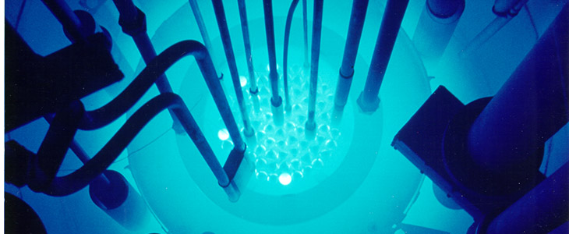
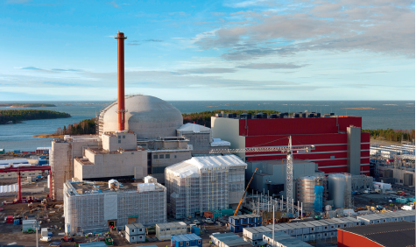
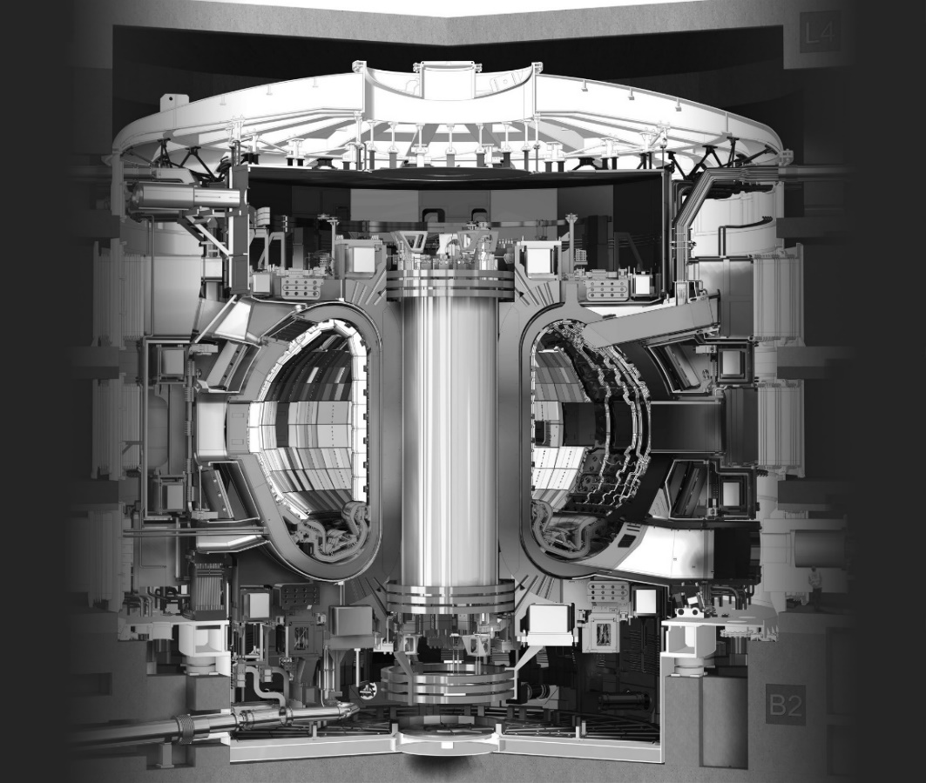
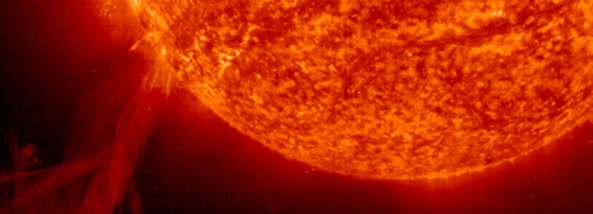
Nuclear Physics Applications to Energy
Marco Ripani
INFN Genova
INSPYRE –INFN Legnaro National Laboratories – July 14 – 18 , 2025
The views and opinions expressed herein do not necessarily reflect those of the ITER Organization.

Slide 2



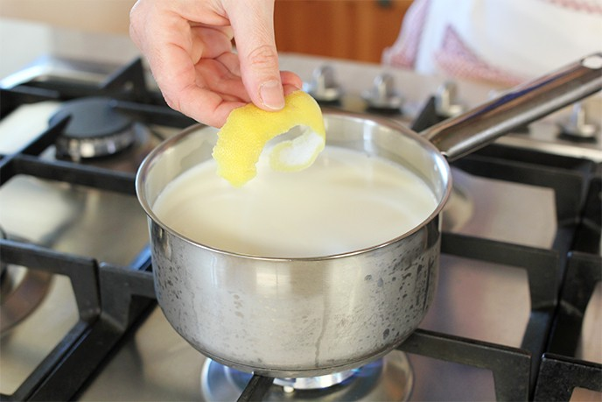
What is energy?
We are familiar with situations where we consume energy…

Slide 3
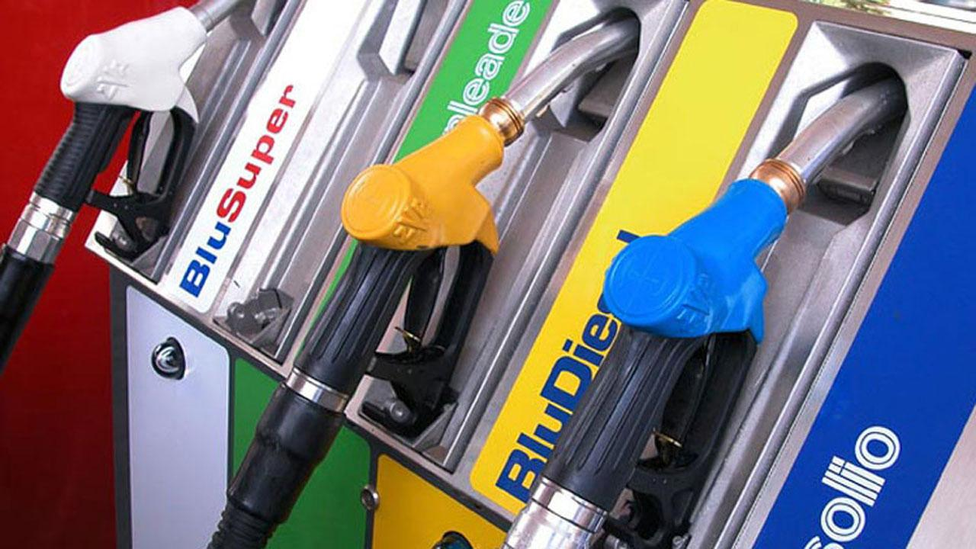
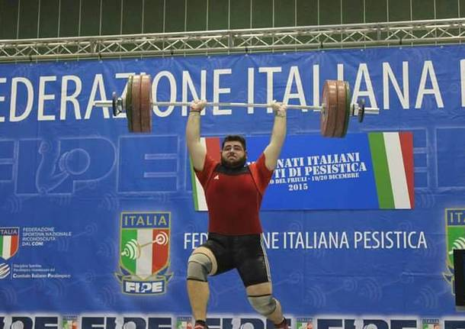

…or others in which energy is stored in some form

Slide 4

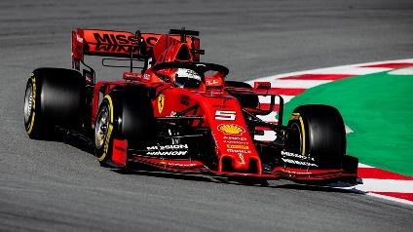




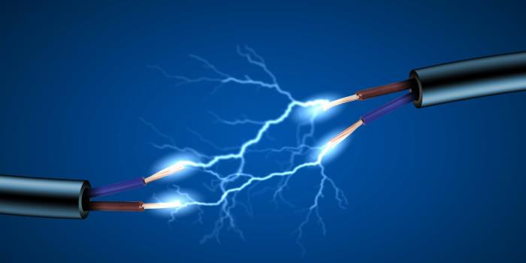

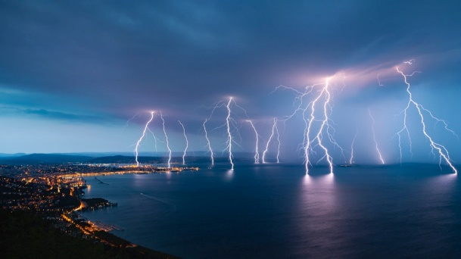
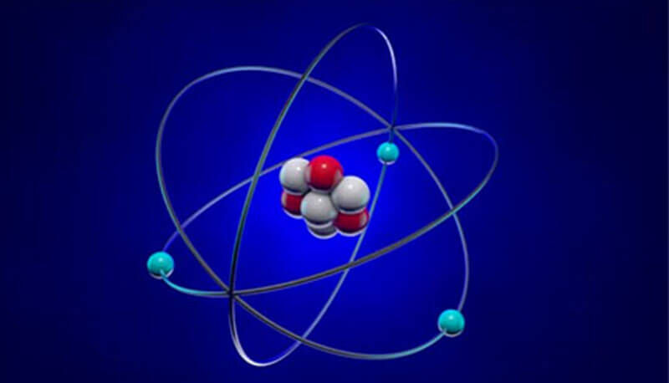
The forms of energy
Mechanical→Kinetic^{(*)}
Mechanical→Potential
Heat, too…
(thermal energy)
Electromagnetic
Chemical
(Potential)
Nuclear
(Potential)
(*) kinetic energy = energy of motion

Slide 5

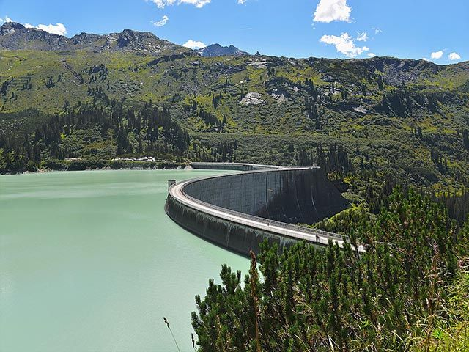
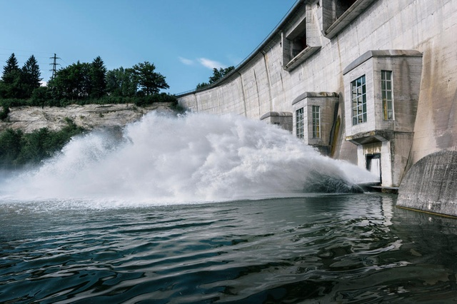
Energy transforms
From potential to kinetic…

Slide 6
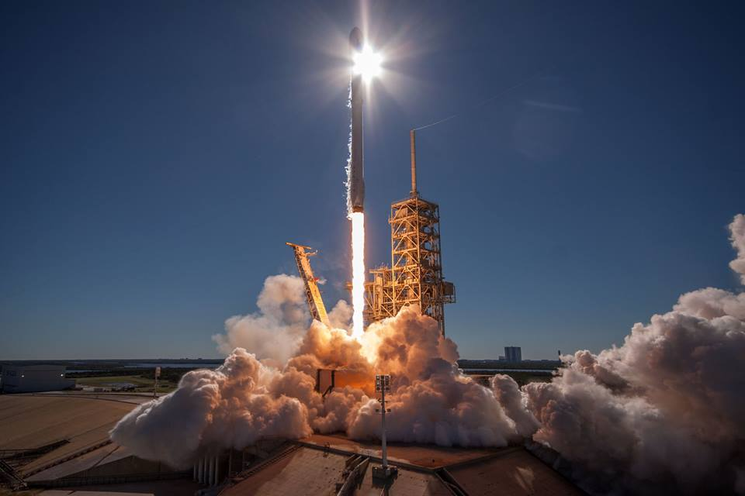


From chemical to kinetic (or mechanical) …

Slide 7

From chemical to kinetic (or mechanical) and electromagnetic (light)…

Slide 8
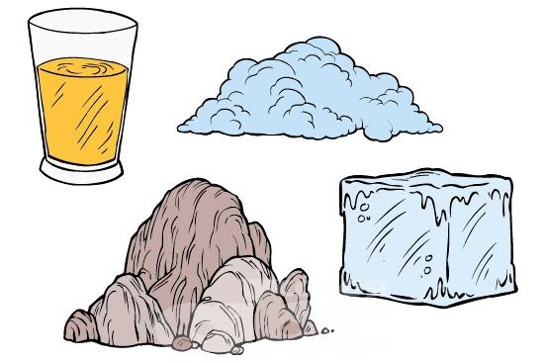

Matter under a magnifying glass

Slide 9

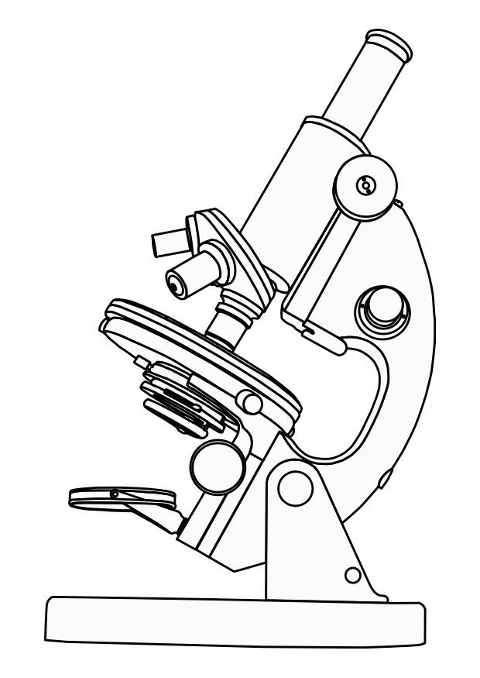
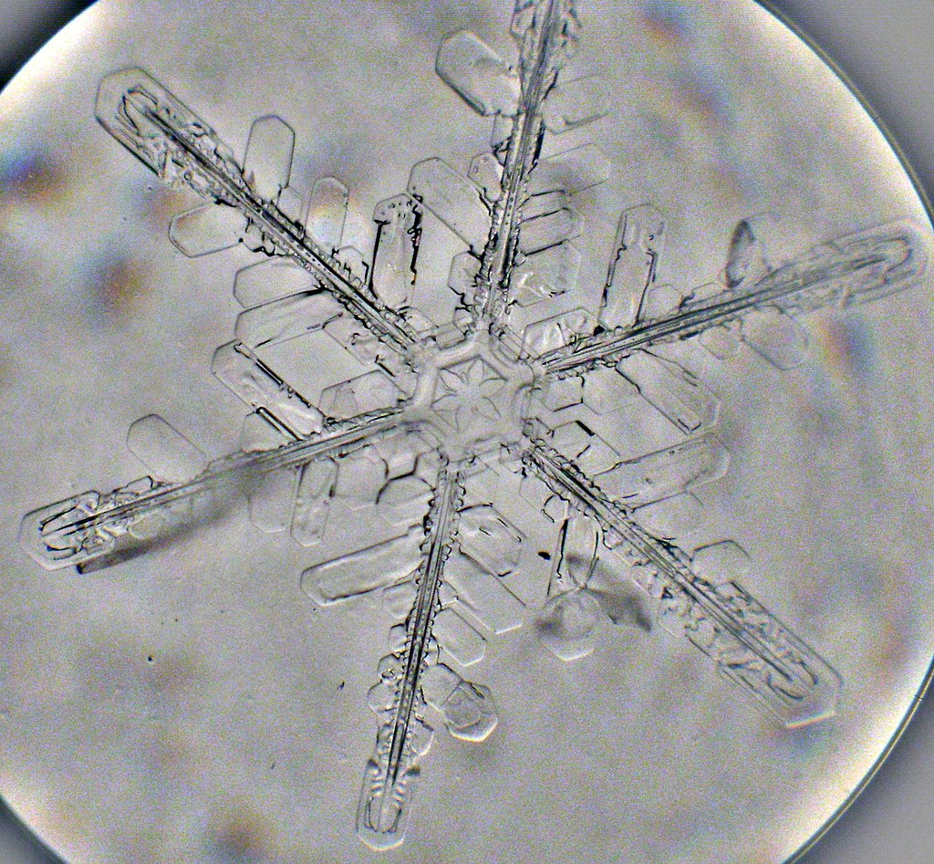
Snowflake
(from about 0,1 mm to a few mm)

Slide 10

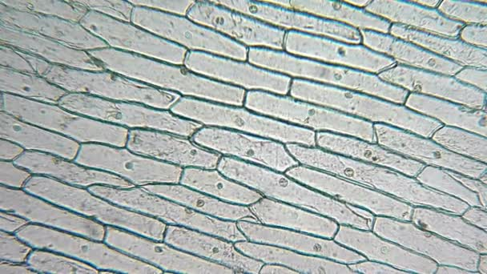
Onion cells
(about 0,01 mm)

Slide 11
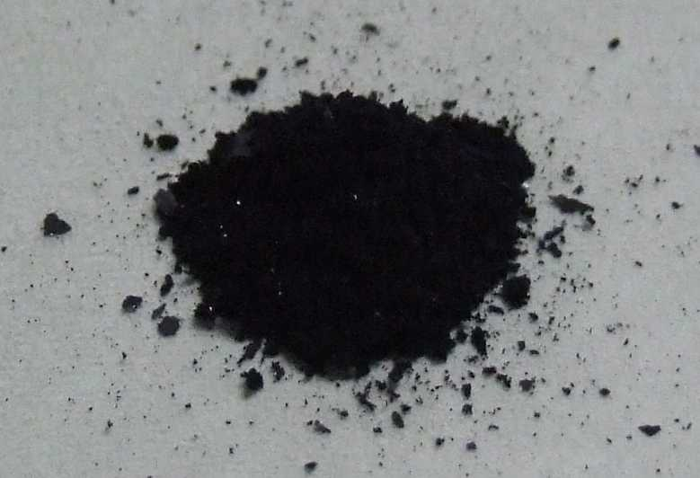
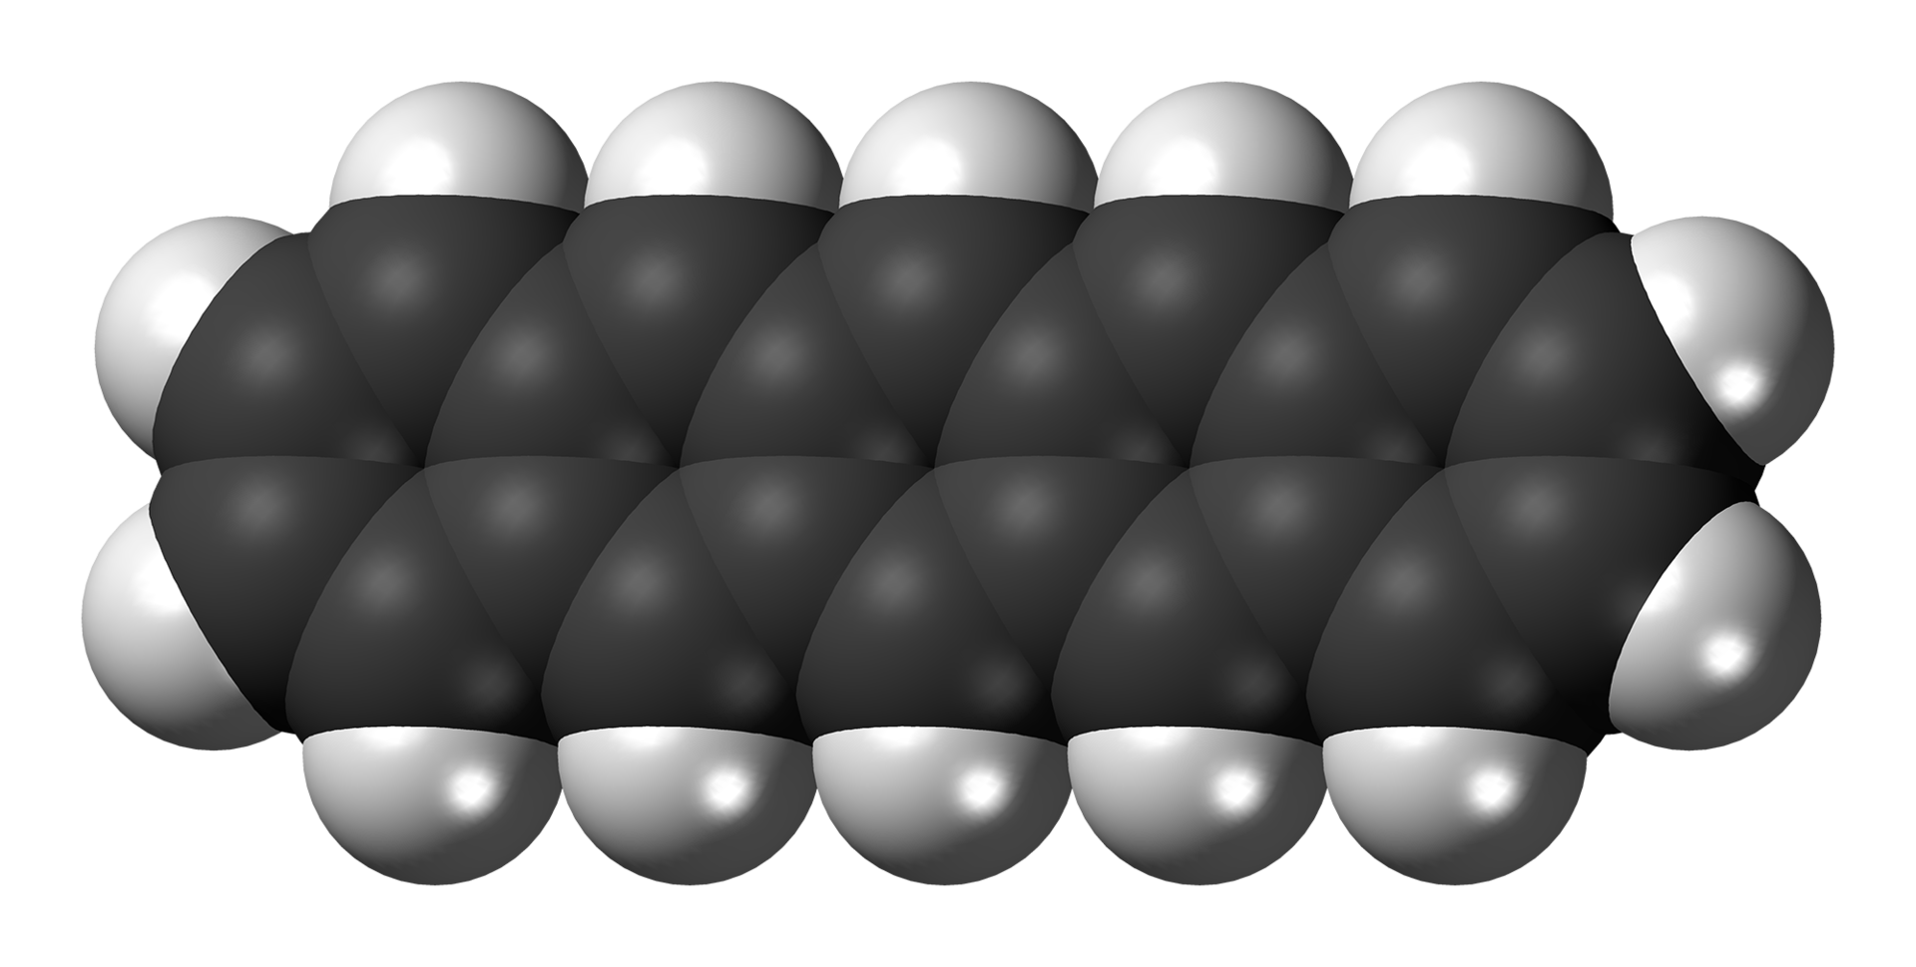
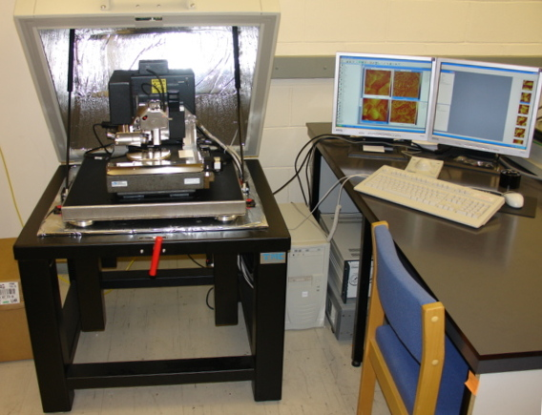
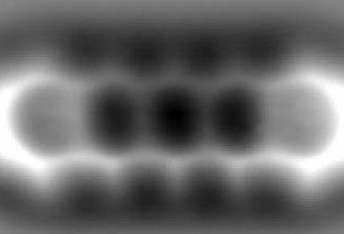
A pentacene sample…
H
C
Atomic force microscope
Pentacene atoms
(0,00000012-0,00000017 mm – a fraction of a millionth of a mm)

Slide 12

Atoms are very many…
In one liter of water there are 33 million billion billion molecules

Slide 13
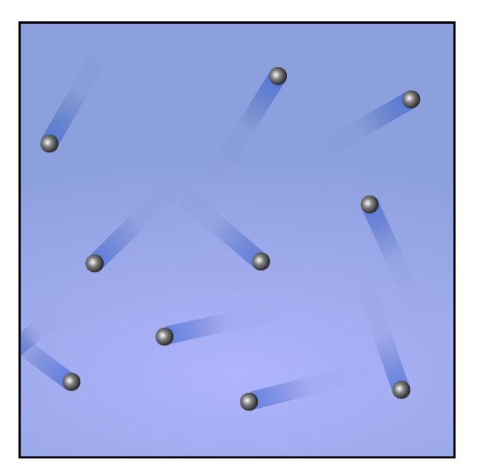
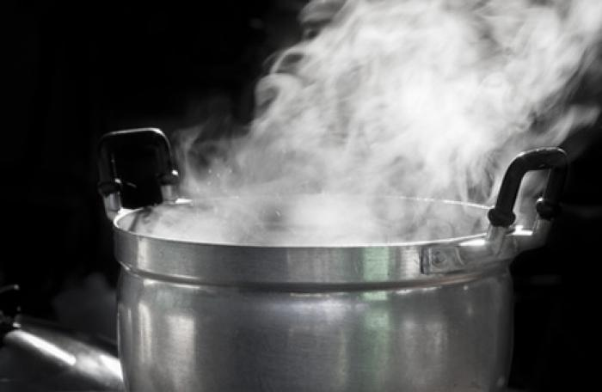
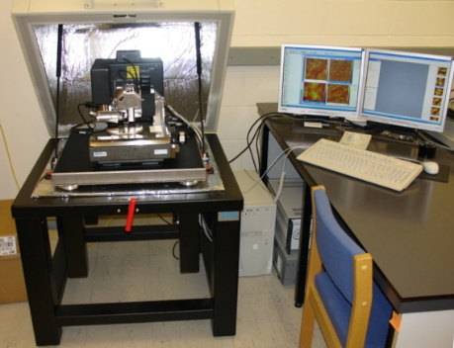
Heat
Water molecules in steam move and hit each other at a very high speed, about 500 meters per second (1,800 km/hour)
Heat is nothing but mechanical (kinetic) energy

Slide 14
The atom
What if we were able to see even smaller things?
Atomic nucleus
(about 0,000000000001 mm – one thousandth of a billionth of a mm)
“Orbiting” around are the electrons (negative electric charge)
Composed of protons (positive electric charge) and neutrons (no electric charge)
Simplest atom: Hydrogen → just one proton and no neutrons
The figure does not show the correct proportions: the nucleus is 100,000 times smaller than the atom!

Slide 15
The atomic nucleus
Protons (positive electric charge)
Neutrons (no electric charge)
Electric charges with the same sign repel each other
Neutrons act as the "glue" that holds the nucleus together (it's called «strong nuclear force»)
The larger the nucleus, the more neutrons it needs
For example, Oxygen has 8 protons and 8 neutrons
The most abundant type of Lead in nature has 82 protons and 126 neutrons
But there is also Lead with 124 and 125 neutrons → "isotopes“ → same chemical properties, different nuclei

Slide 16

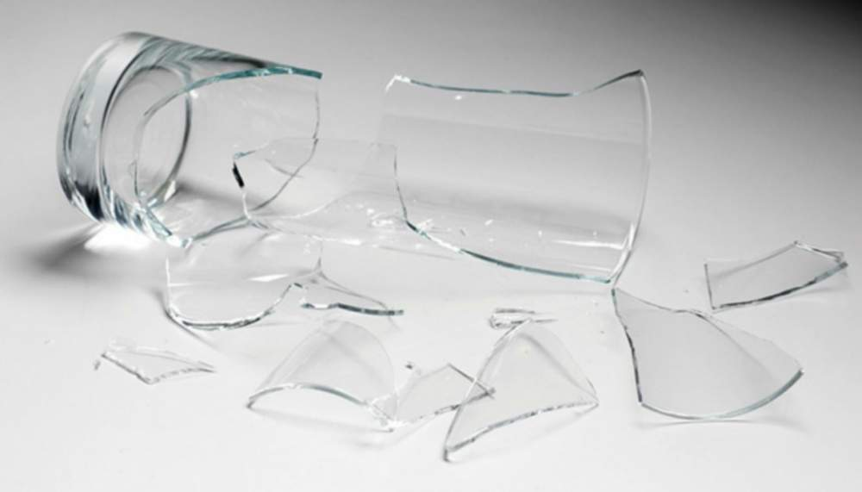
Radioactivity
Certain atomic nuclei are «unstable», that is, they tend to break up, releasing energy
Alpha (α) decay
Helium (2 p, 2 n)
Uranium 238 (92 protons, 146 neutrons)
Thorium 234 (90 protons, 144 neutrons)

Slide 17
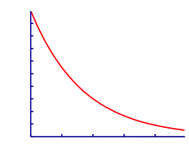




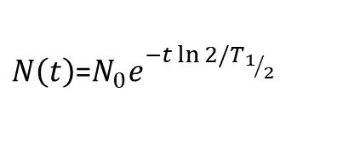
Elements and isotopes
There are many nuclear species
They are classified with two numbers:
Z = number of protons, which determines the chemistry
A = total number of nucleons (protons + neutrons)
Each radioactive substance has a characteristic time T_{1/2} in which its radioactivity is halved.
N(t)=Number of decaying nuclei
each nuclear species is uniquely determined by its A and Z
about 4400 known (A,Z) combinations (species)
about 250 stable (minimum energy: equilibrium)
the rest: radioactive (unstable)
$N\left(t\right)$=$N_{0}e^{−t\ln{2/T_{1/2}}}$
time
Some species decay in seconds...
...others in million (or even billion) years

Slide 18



The three main types of radioactivity
alpha
emission of an alpha particle (= helium nucleus)
beta
a neutron transforms into a proton (or a nucleus with N neutrons and Z protons transforms into a nucleus with N-1 neutrons and Z+1 protons, emitting an electron (beta particle) and an antineutrino
gamma
emission of a gamma ray (=photon, such as radio waves, microwaves, infrared, visible, ultraviolet, X-rays:
the only difference is the wavelength or, if you prefer, the energy)
Very often, alpha and beta radiation lead to the formation of nuclei in excited states which decay by gamma radiation
Radiation is part of our everyday life on earth

Slide 19
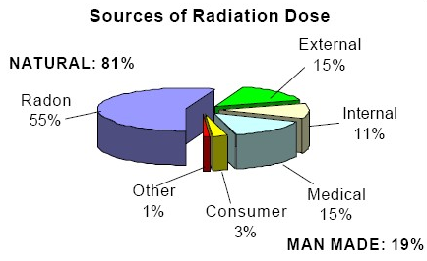
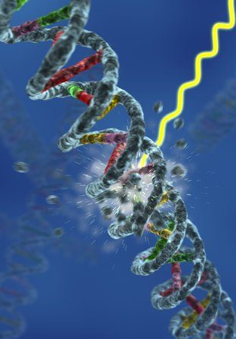

Radiation around us
they can break DNA and cause mutations
probably plays a role in evolution
From the sky: about 30 neutrons and 120 cosmic rays pass through our body per second
From air: about 10 atoms per second (Radon, Polonium, Bismuth, Lead) disintegrate in the lungs releasing alpha, beta, gamma
From diet: about 4500 atoms per second (Potassium-40) disintegrate in our body, releasing beta and gamma; also, about 2 atoms per second of natural uranium release alpha
From the ground and buildings: about 56,000 gamma per second pass through our body
≈ 6000 decays per second of Potassium-40 (⁴⁰K) per m³ of sea water

Slide 20

What are the biological effects of radioactivity ?

Slide 21
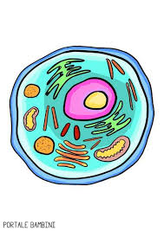
Biological effects of radioactivity
Radioactivity can be dangerous to the environment and humans due to cell damage (by direct exposure or by inhalation or ingestion)
Alpha decay (α)
Cell
Helium (2 p, 2 n)
Uranium 238 (92 protons, 146 neutrons)
Thorium 234 (90 protons, 144 neutroni)

Slide 22
Is it possible to break up a nucleus ?
proton
neutron
Some (radioactive) nuclei can split on their own, but many do not (stable) or do so with difficulty
We suppose that a certain force must be applied
Put another way, you will need to supply a certain amount of energy

Slide 23




Coulomb repulsion barrier (electrical repulsion)
Kinetic energy
Potential energy
proton
distance
neutron

Slide 24
Potential energy
Kinetic energy
I have to supply energy to overcome the barrier
If I can do that,
I will have produced nuclear energy
This process is called Nuclear Fission
distance

Slide 25


A special case, Uranium 235
Potential energy
If a neutron approaches this nucleus and is sucked in, it releases enough energy to jump the barrier very easily
The nucleus splits but more neutrons are also emitted
92 protons
distance
143 neutrons

Slide 26
Nuclear fission
neutron
Uranium-235
(92 protons, 143 neutrons)
I created a fission chain reaction
Natural uranium, as found in mines
→ 0.7 % U 235 + 99.3 % U 238
235 U splits even when it absorbs an almost a very slow neutron, while 238 U needs a very fast neutron, so the reaction is more difficult ➔ 235 is «fissile», 238 is not
The two fragments possess a lot of kinetic energy➔ transferred to atoms ➔ heat

Slide 27
How much energy is produced ?
And what are the reaction products ?
The mass of the two fragments plus the mass of the neutrons makes a little less than the mass of the initial uranium nucleus ➔ about a thousandth of the mass of the nucleus has been transformed into energy, according to Einstein's famous relationship
E = m c²
This energy is shared among
Kinetic energy of the two fragments
Kinetic energy of the 2-3 emitted neutrons
Gamma rays (electromagnetic energy)
antineutrinos (practically massless particles that pass through matter as if it were transparent)
The biggest part of the energy released by the fission process is converted into heat
Fission provides 20 to 50 million times more energy than a chemical reaction
With 1 gram of U-235, about 7,000 washing machines run for an hour
The same job would require almost 3 tons of coal

Slide 28
Neutron radiative capture
γ radiation
electron
antineutrino
β radiation
α radiation

Slide 29
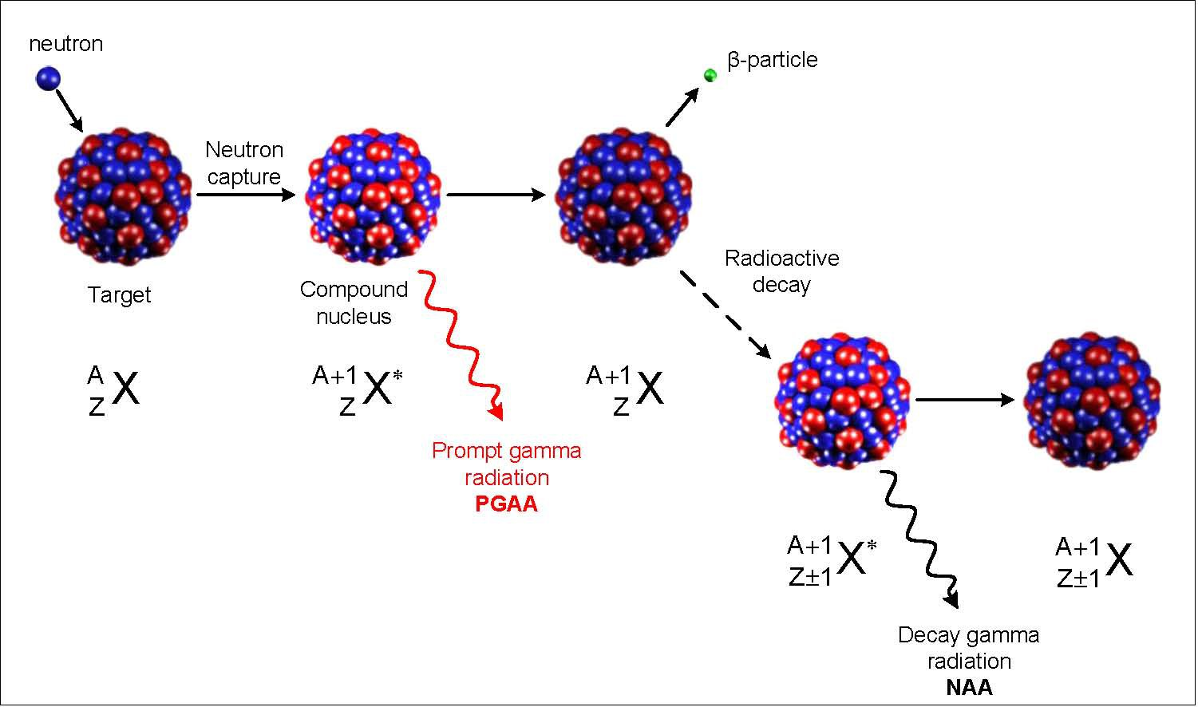
Nuclear energy and radioactive products
The two nuclei resulting from fission are called «fragments or fission products» → most of them are radioactive
Furthermore, we have seen that it is Uranium 235 that produces fission. Uranium 238 instead, with high probability absorbs the neutron, giving rise to a transformation chain that produces heavier elements, including Plutonium (that doesn’t exist in Nature)
However, plutonium can also give rise to fission, so it can be used as fuel
Other materials of the plant, subjected to the intense flux of neutrons, can also become radioactive (activation)
Example: Plutonium production from Uranium
n+ ²³⁸U → ²³⁹U + γ → ²³⁹Np + β + anti-ν → ²³⁹Pu + β + anti-ν
Other elements (Transuranics: elements heavier than Uranium) not existing in Nature are formed beyond Plutonium: the so-called Minor Actinides (Americium, Curium, etc.), typically with very long lives → they make handling and disposing of spent fuel more challenging
Example: ⁶⁰Co production in steel
n + ⁵⁹Co → ⁶⁰Co + γ → ⁶⁰Ni + β + anti-ν

Slide 30
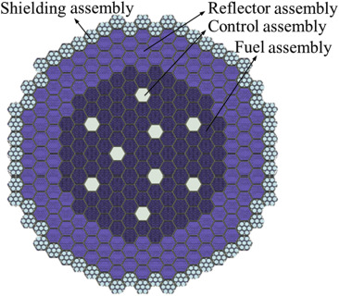
How it is built in practice
Fuel
Absorbing element
Fission 3
Neutron bounced back by"reflective" material
Fission 2
Loss
Fission 1
Absorption in other plant materials
Reactor «core»
Neutron from fission

Slide 32

The“thermal” reactor
Control rod (neutron absorbing material)
Lost neutron
Uranium rod
Uranium rod
Neutron
235
Absorption
238
In the thermal reactor, neutrons are slowed down to have maximum burn-up of fissile Uranium 235
235
235
Fission
Fissione
238
238
238
238
Absorption
238
Neutrons hit water molecules and slow down → fission more probable
Coolant (usually water)

Slide 33
The fast reactor
Control rod (e.g. Boron)
Escape
Fuel rod
Fuel rod
Capture
235
238
In the fast reactor, neutrons are not slowed down → possibility to produce and burn more Plutonium and also to burn other radioactive nuclei beyond Plutonium formed by neutron capture
235
238
Fission
Fission
Pu239
Fission
238
238
238
Capture
238
Scattering
Coolant: e.g. liquid metal, gas

Slide 34
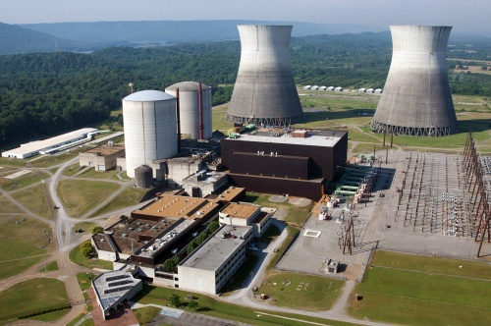
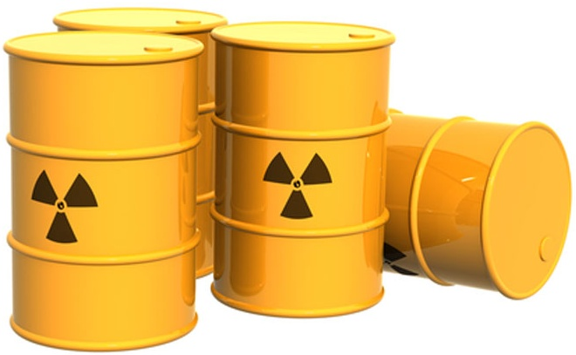
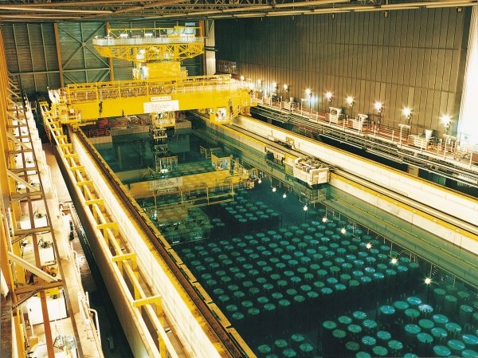
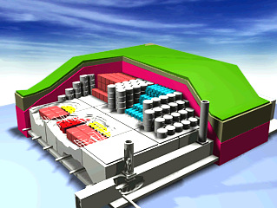
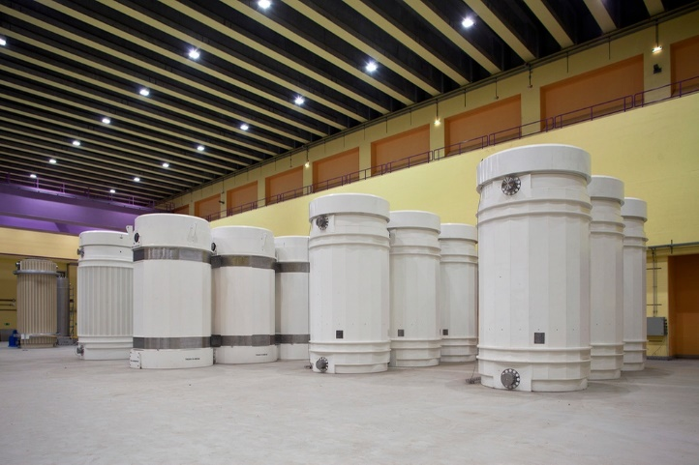
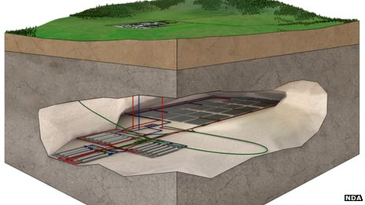
Radioactive waste production (from fission)
Nuclear power plants
Activated materials
Spent fuel
Cooling pools
Radioactive waste drums
casks
Surface repository
Geological repository

Slide 35
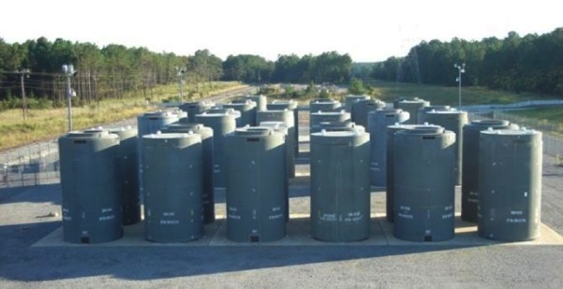
How much nuclear waste is there? And what to do with it?
In one year, a typical high power reactor produces about 1200 kg of radioactive substances in the fuel, of which 400 kg are radioactive for long periods, from a few hundred to a few hundred thousand years → they must be kept isolated
Therefore, the used fuel rods must be stored in safety for very long periods
when the plant is dismantled, the other activated materials must also be kept in isolation
Spent fuel casks
Some countries are already using or are planning to use underground repositories, to store the spent fuel and other highly activated components, and then close the access to the repository, letting the radioactivity run out on its own → after about 200,000 years the material is no longer dangerous
However, it is also possible to partially recycle the spent fuel → it can be treated to extract Uranium and Plutonium to be used a second time

Slide 36
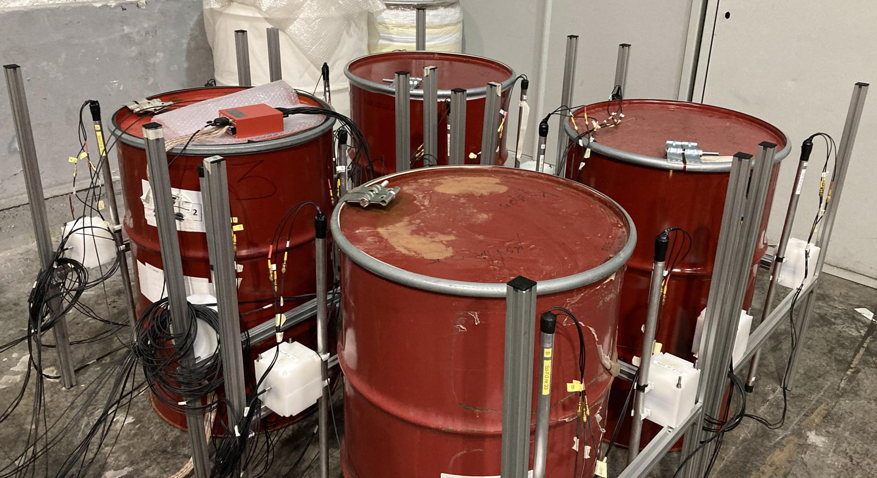
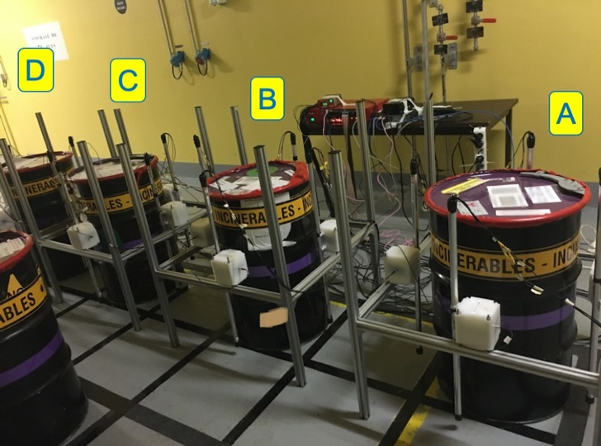
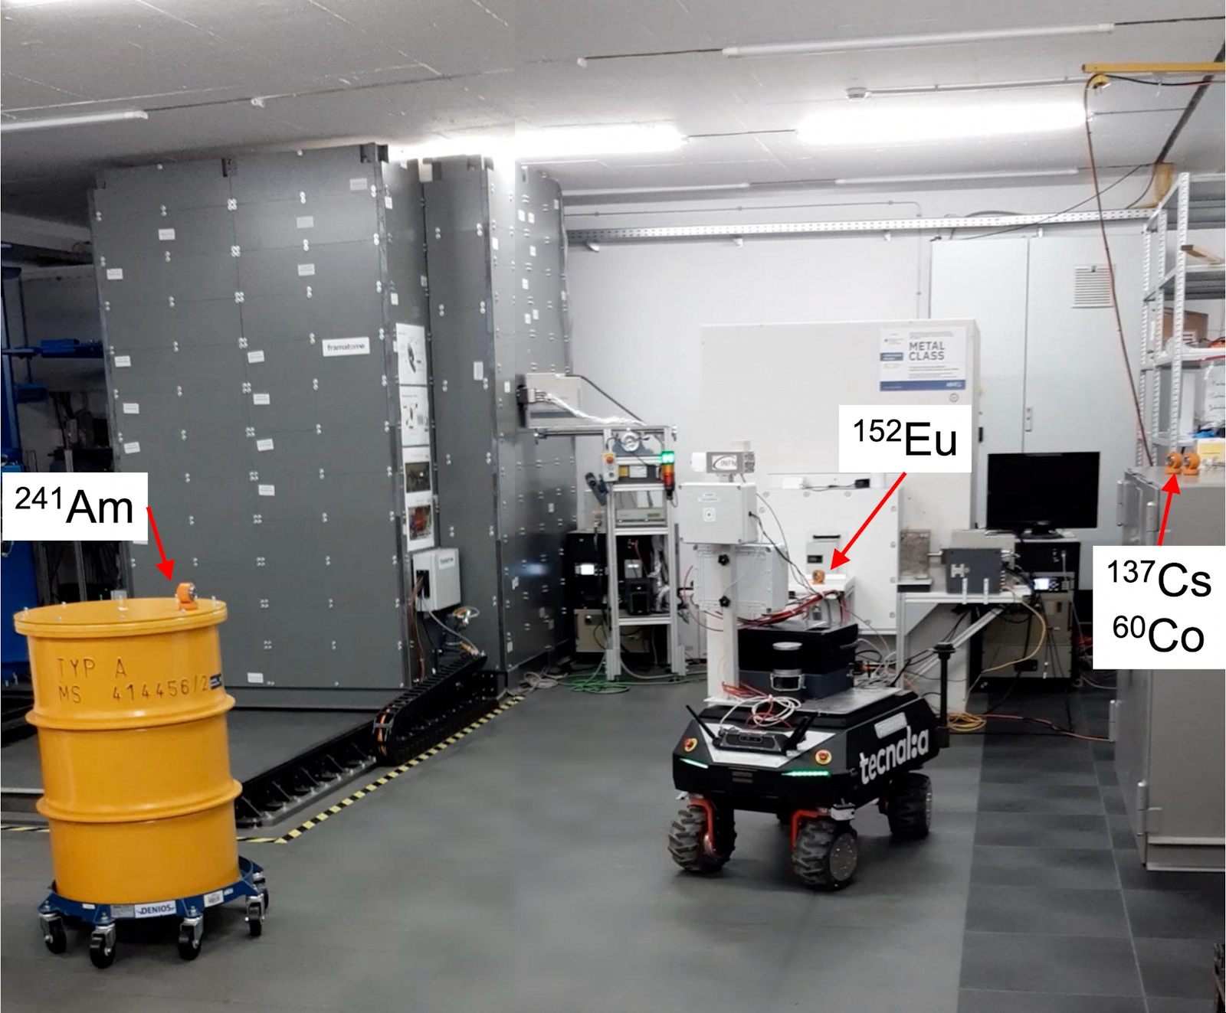
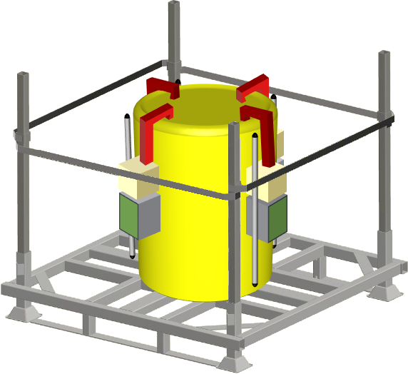
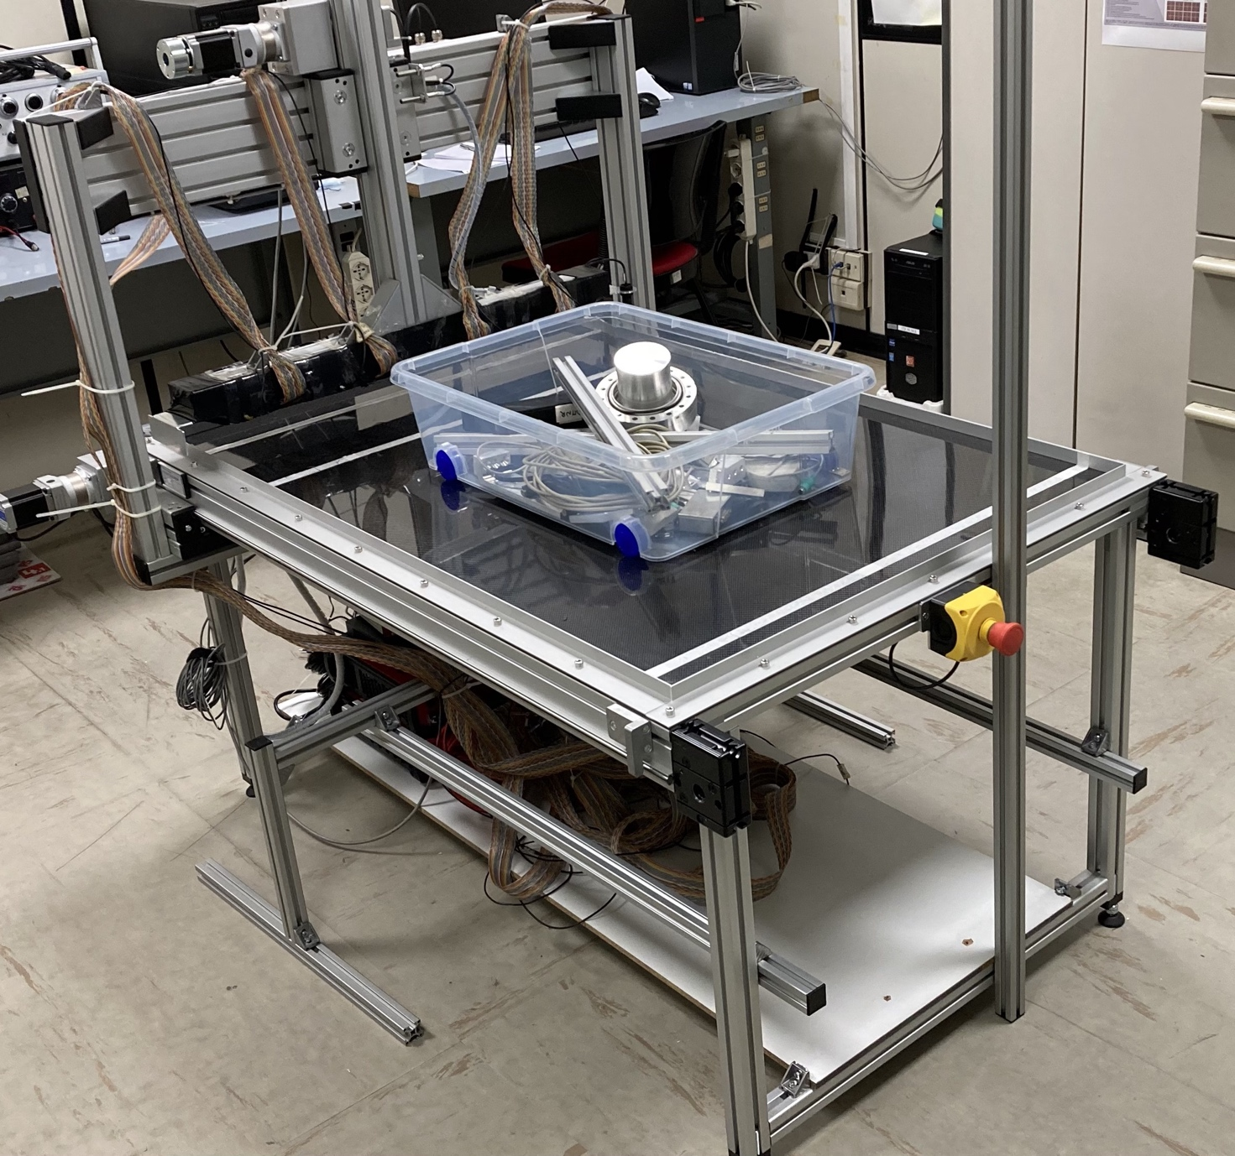

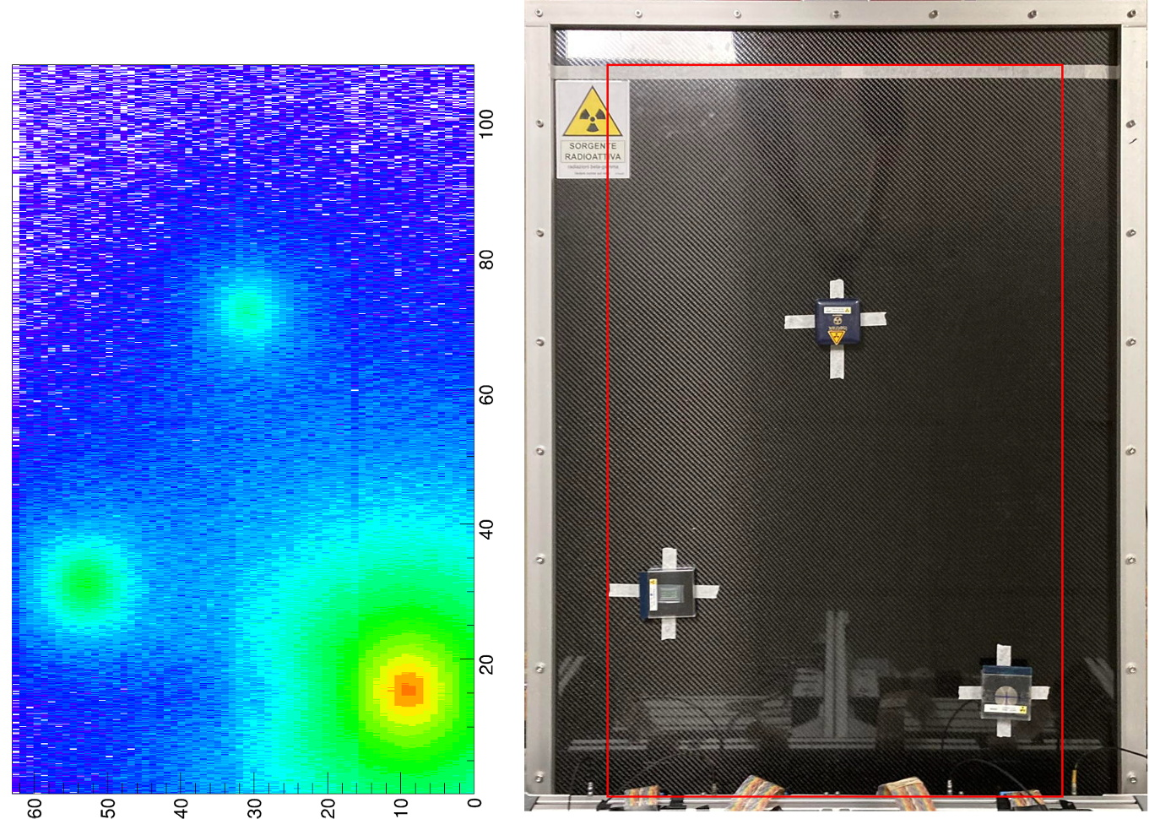
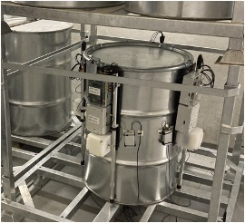
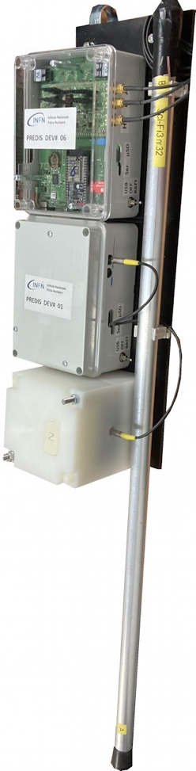
INFN contributions to monitoring radwaste

Slide 37
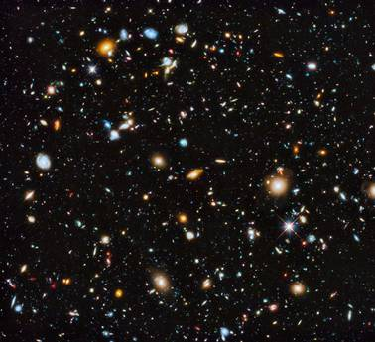

Nuclear Fusion
Deuterium (²H)
Tritium (³H)
This is called Nuclear Fusion: it is the mechanism at work in stars
(actually, not with D-T, the Sun works mainly with p+p→D+e⁺+ν)
Neutron
Helium (⁴He)
The neutrons have about 14 MeV kinetic energy ➔ transferred to water around the apparatus ➔ Heat
Helium nuclei have about 3 MeV ➔ they give some contribution to heating the plasma
Fusion does not produce directly radioactive fragments
(but Tritium is radioactive and neutrons activate structural materials)
→ It provides cleaner energy with respect to Fission
Currently we do not know how to build reactors capable of maintaining a stable regime for long enough
Ongoing research (JET, ITER, DEMO) is long term

Slide 38
Fusion reaction candidates
²H
³He+0.82 MeV
²H
³H+1.01 MeV
²H
n+2.45 MeV
²H
p+3.02 MeV
Q-value is sum of energy acquired by final nuclei → energy released in exoergic reactions
²H
⁴He+3.6 MeV
²H
⁴He+3.5 MeV
Deuterium-Tritium
has maximum probability to occur at the conditions that we can be able to reach in our fusion plants and provides a significant amount of energy
p+14.7 MeV
n+14.1 MeV
³He
³H

Slide 39
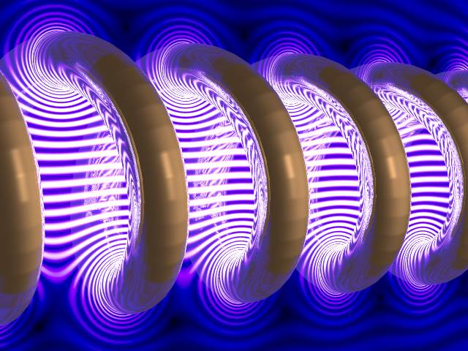

Conditions for Fusion
To make fusion happen, Coulomb repulsion between (positive) nuclei has to be overcome → necessary to reach VERY high temperatures → Deuterium-Tritium gas mixture must be heated to several million degrees
At such high temperatures, a plasma is created → a gas of electrons and nuclei (ions) moving independently
The plasma is so hot that it must be trapped (confined) such as to avoid touching the reactor walls → Confinement is achieved through magnetic fields
or the mixture can be compressed by using high power lasers («inertial» fusion)

Slide 40


The (magnetic) fusion reactor
Using a doughnut-shaped device works better (tokamak)
TOKAMAK
токамак, an acronym of either:
"тороидальная камера с магнитными катушками"
(toroidal'naya kamera s magnitnymi katushkami)
toroidal chamber with magnetic coils
or
"тороидальная камера с аксиальным магнитным полем"
(toroidal'naya kamera s aksial'nym magnitnym polem)
toroidal chamber with axial magnetic field
And here is a real one…

Slide 41


Slide 42

Heating the plasma
T_{plasma} in the tokamaks: ~100-150x10⁶ degree to trigger fusion D + T → ⁴He + n (*)
Plasms heating is obtained essentially by Ohm effect (but at lower temperatures as plasma resistance decreases with temperature), RadioFrequency (electron and ion Cyclotron Resonance) and injection of neutral atoms (Neutral Beam Injectors, NBI)
(*) The Chinese Experimental Advanced Superconducting Tokamak (EAST) established a new world record in 2021 by reaching a plasma temperature of 120 million degrees for 101 seconds and 160 million degrees for 20 seconds

Slide 43







The fusion roadmap: ITER
One of ITER’s goals is to get 10 times more fusion energy than the energy used to heat the plasma
Overall Project Schedule for new Baseline
Target dates:
Mar. | Oct. | Dec. | Dec. Sep. | Sep. | Sep. | Sep. | Sep.
2033 | 2034 | 2036 | 2038 2039 | 2041 | 2043 | 2045 | 2047
Assembly-I
IC-I
SRO
Assem IC
FPO-I
FPO-II
FPO-III FPO-IV FPO
^{s} Operation 16 Months
27 Months | bly-II 24 Months | -II 10 M | Operation 16 Months Maintenance | Operation 16 Months Maintenance | Operation 16 Months Maintenance | Operation 16 Month Maintenance
 |  |  | 8 Months | 8 Months | 8 Months | 8 Months
-V
DT-2
18
Months
IC: Integrated Commissioning SRO: Start of Research Operation FPO: Fusion Power Operation
Cryostat Closure
Full I_{p} & B_{T}
Q=10
>50s
Q=10
>300s
Full Field
Start DD
Divertor Plasma ^{operation}

Slide 44

Construction site today
16 Oct. 2024
Joint EPS-SIF International School on Energy 2025, 26 June 2025 ₇
IDM UID: E597RB
© 2022, ITER Organization

Slide 45



ITER: assembly in progress
Vacuum Vessel
Toroidal Field coils
Poloidal Field coils

Slide 46

The ITER divertor
Divertor: the fusion «exhaust», it absorbs gases that escape confinement and contaminants that accumulate during the fusion process
Situated at the bottom of the vacuum vessel
Extracts heat and ash produced by the fusion reaction, minimizes plasma contamination, and protects the surrounding walls from thermal loads
As the high-energy plasma particles strike the targets, their kinetic energy is transformed into heat and the heat is removed by active water cooling
Source: http://www.iter.org

Slide 47


The Divertor Tokamak Test (DTT) project in Frascati
Goal: test different options for the DEMO divertor
ITER will use a “traditional” approach which may not work in DEMO
in addition to the divertor, various possible solutions suitable for DEMO can be studied at DTT

Slide 48






New technologies for DTT at INFN: additive manufacturing (3D printing)
Prototype accelerator grids for DTT Neutral Beam Injector, 3D-printed in Copper-Chrome-Zirconium alloy

Slide 49




DTT@INFN: Electron Cyclotron Heating Mirrors and Ion Cyclotron Heating Antenna
Mirror in CuCrZr fully machined and provided with cooling connections
Improved curved antenna model
Mirror prototype
in AISI 316 steel
Maps of electric fields at the antenna

Slide 50


The challenge of materials
Reactor materials are subjected to a great deal of stress (neutron bombardment) → it is necessary to test them
IFMIF:
International Fusion Materials Irradiation Facility
The IFMIF project foresees a powerful deuteron accelerator (deuterons, 40 MeV and 125 mA → 5 MW beam power !) → Engineering Validation stage (EVEDA) going on at Rokkasho, Japan, with the goal to reach 9 MeV, 125 mA
The deuterons will hit a liquid lithium target, producing neutrons with intensity and energy spectrum similar to that of the fusion reactor, allowing to test certain materials (e.g. types of steel)
Europe will build DONES, with one accelerator

Slide 51





IFMIF and DONES@INFN
IFMIF RFQ: the supermodule (3.3 m)
RFQ
Construction
The prototype assembled in Japan

Slide 52
Summary
Radioactivity is a natural phenomenon and radioactive materials have been around us forever
Nuclear energy will still be one of the sources of low-emission «baseload» in many countries (including several new ones) for several years (and not only baseload, see small-scale reactors…)
There are solutions for the safe management of nuclear waste → they are also important for sectors other than energy (for instance, disposal of waste from the past and medical and industrial waste)
INFN applies its detector technologies to monitoring the radwaste
Fusion plants are at the center of a very intense experimental research program and could become a new source of energy around 2050
The fusion research program involves several challenges that require the development of many technologies, with a significant impact on industry
INFN gives a contribution to new experimental machines like DTT and applies accelerator technology to a powerful neutron source for material testing

