Slide 1

Microdosimetry in hadron therapy
Anna Bianchi
anna.bianchi@lnl.infn.it

Slide 2
Outline
Ionizing radiations
Medical Physics
Hadron Therapy
Dosimetry vs Microdosimetry
Microdosimetry
What can we do for the clinical improvement?
Research workflow

Slide 3
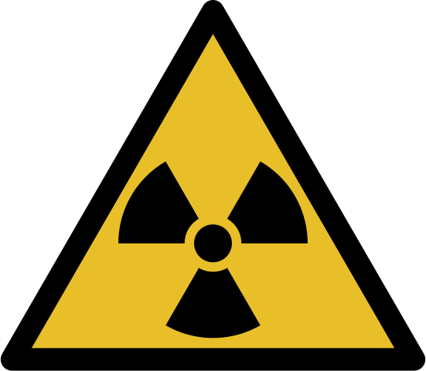
Ionizing Radiations
A brief recap

Slide 4

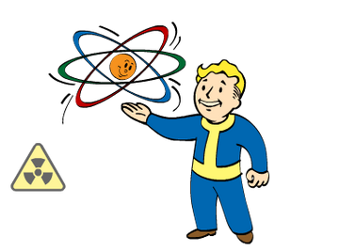
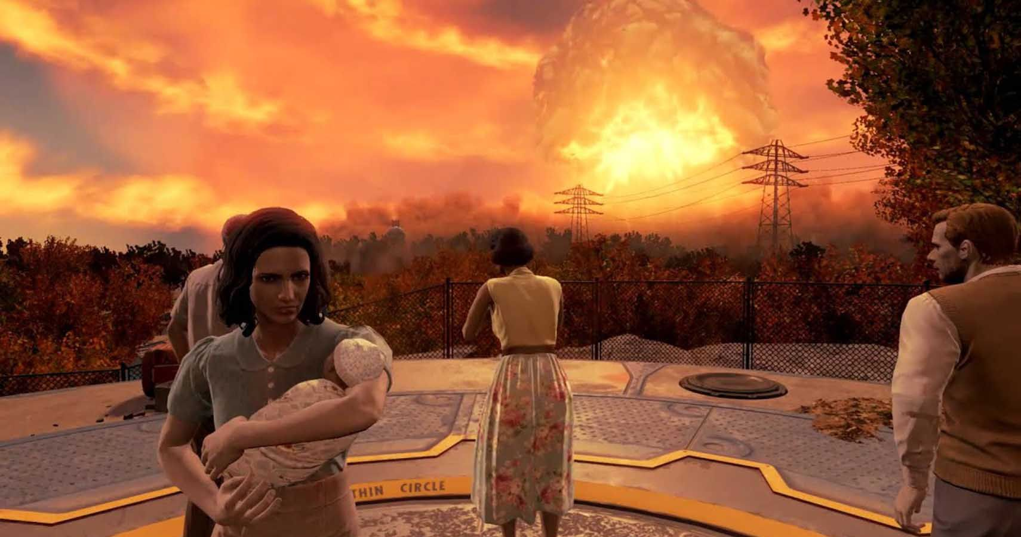
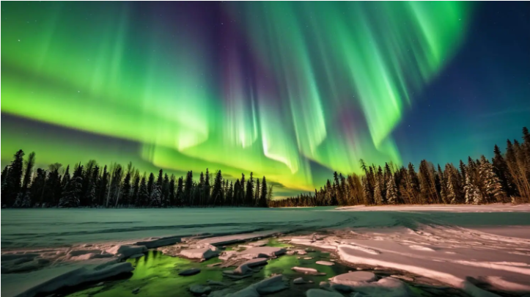


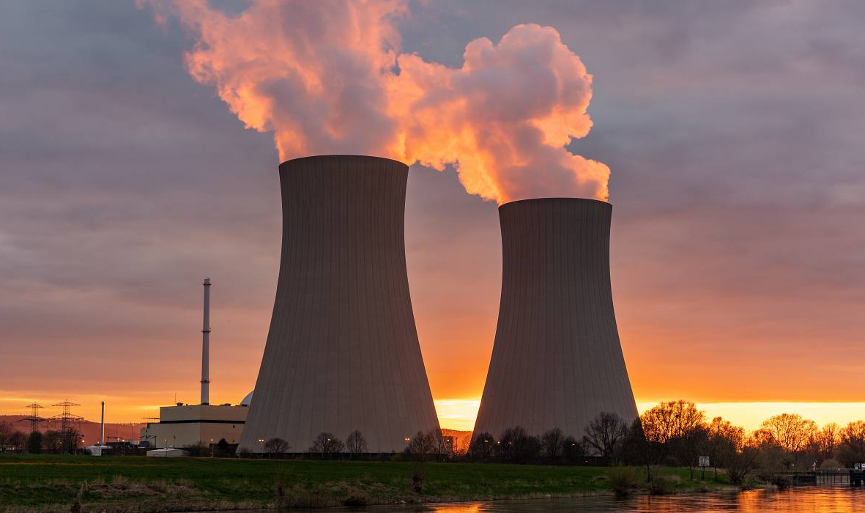
What comes to mind?

Slide 5
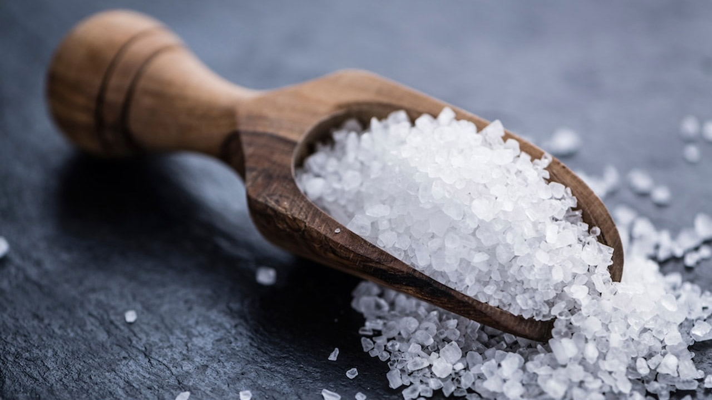
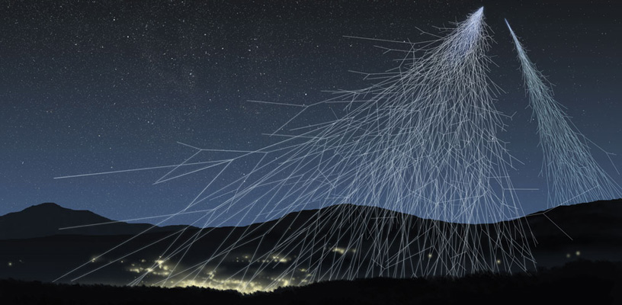

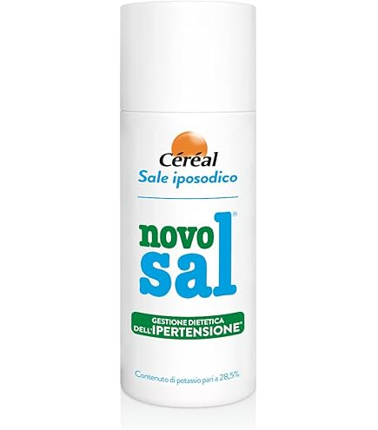
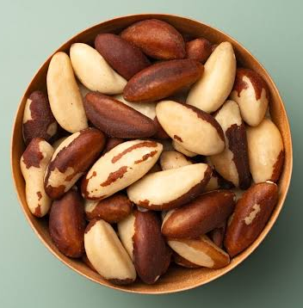
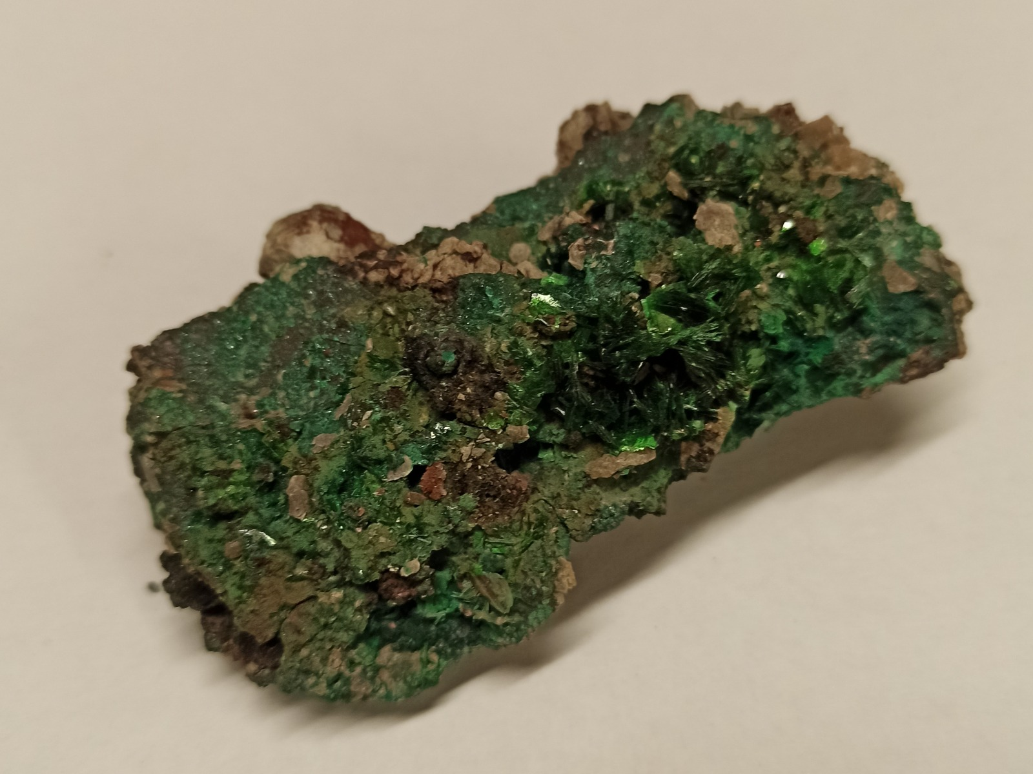
Radioactivity is everywhere…

Slide 6
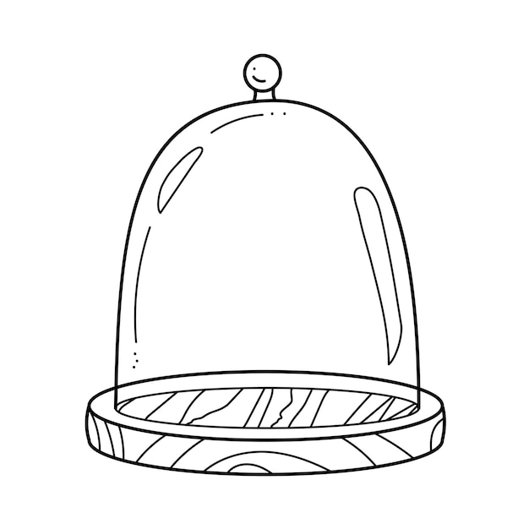


Small exposure to radiation…
contributes to fortifying the biological system
Similarly to exposures to bacteria

Slide 7
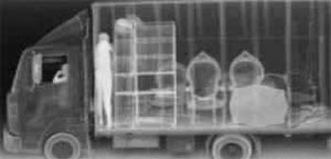

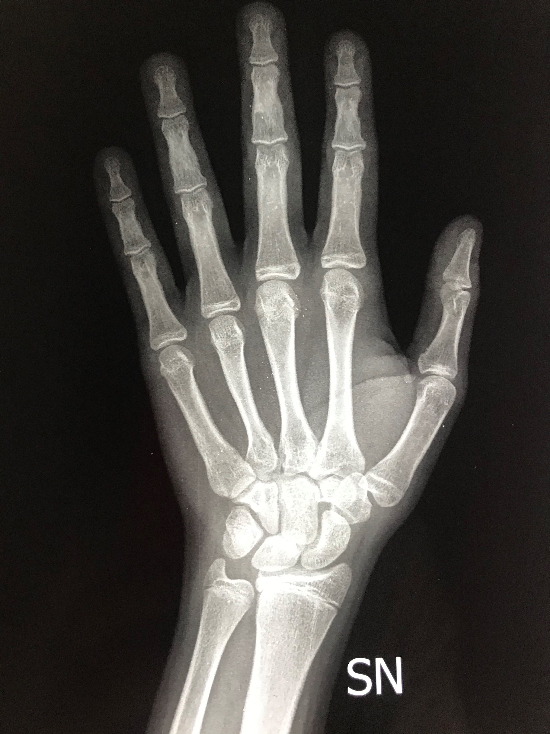
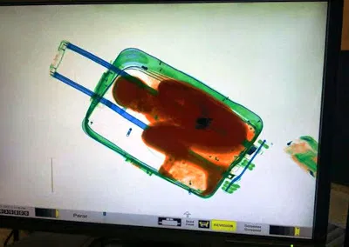
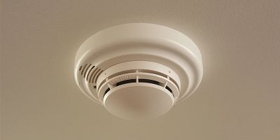
Artificial sources of ionizing radiation

Slide 8
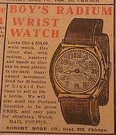
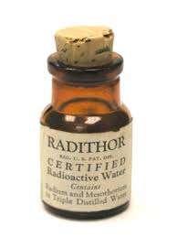
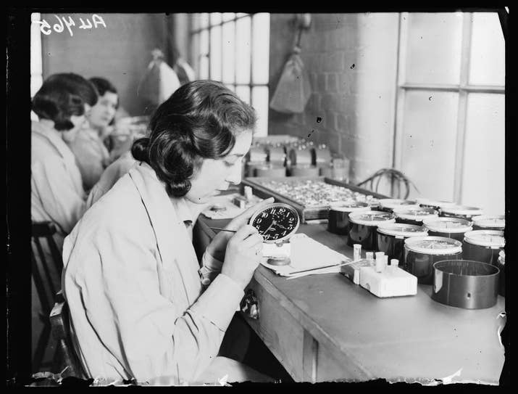
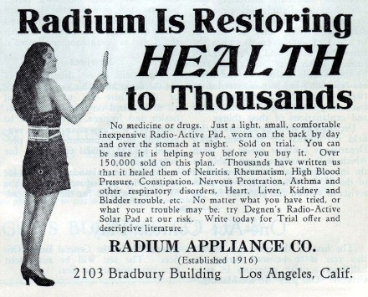
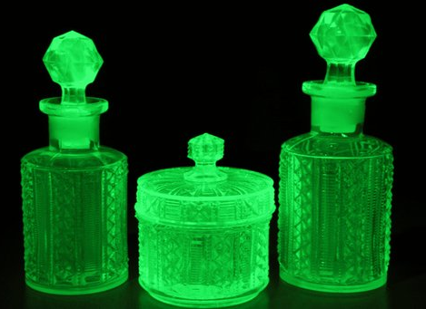
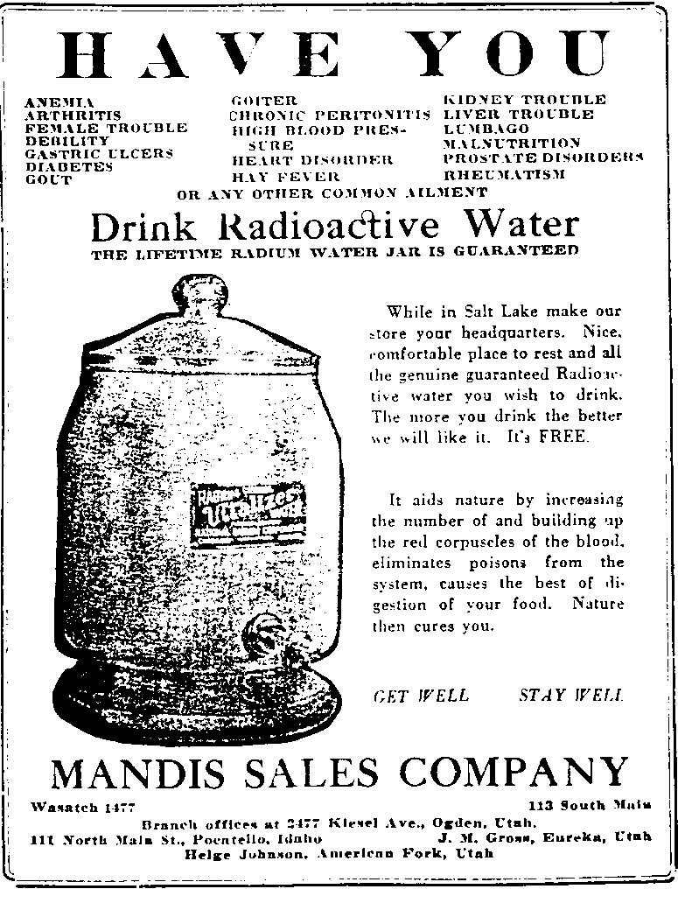
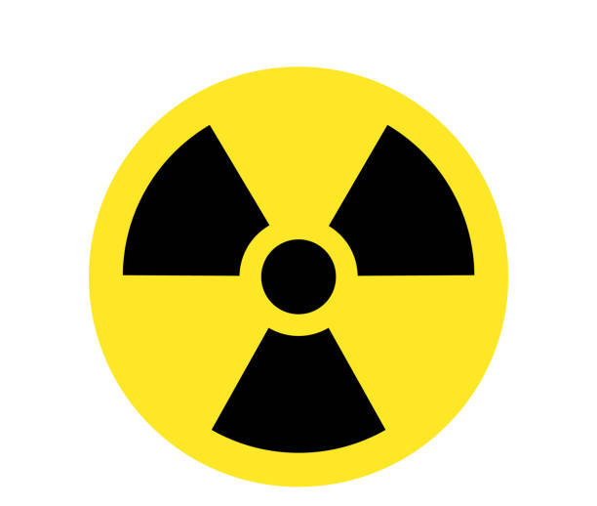
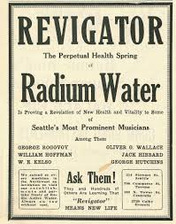

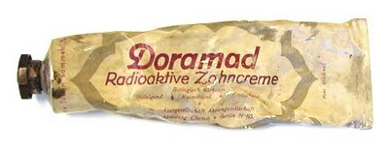
Curiosities from the past

Slide 9
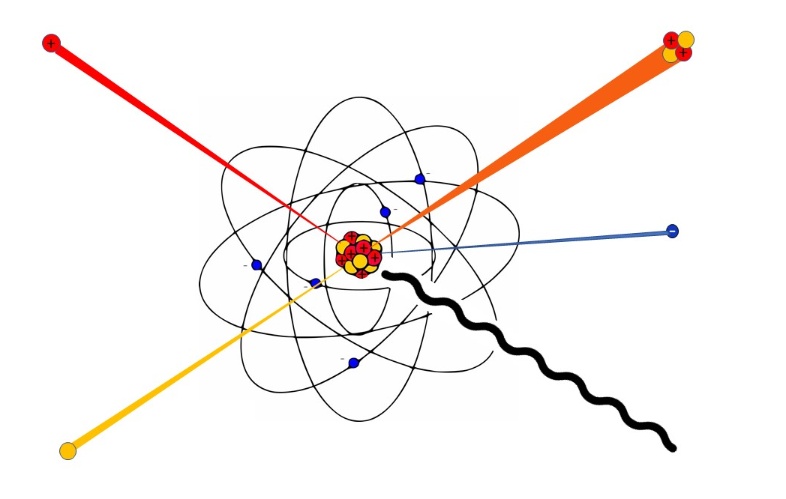
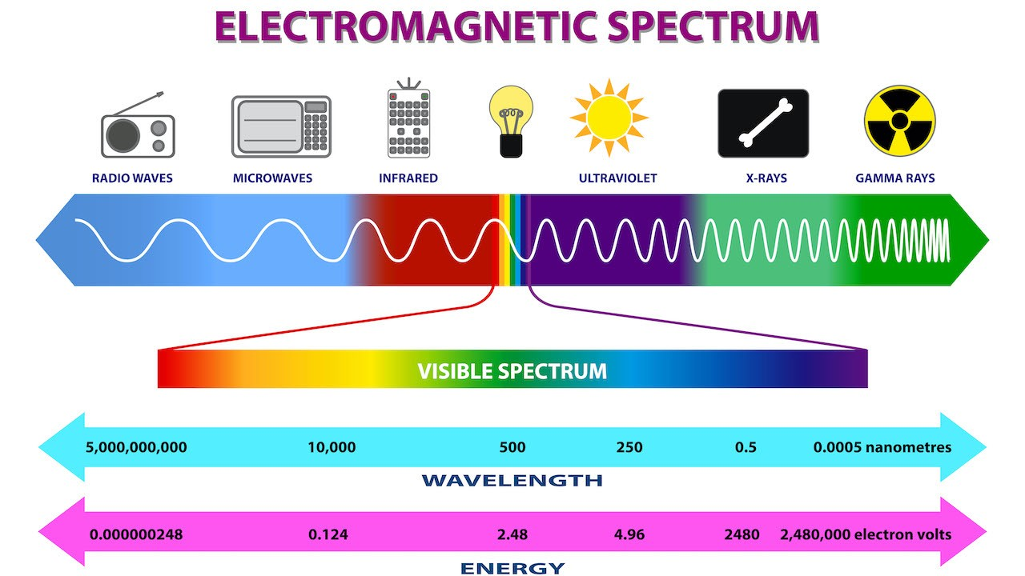
Different types of radiation
Electromagnetic
Alpha (⁴He)
Protons
Beta
Neutrons
Gamma-rays
Nuclear

Slide 10
Medical Physics
Small summary

Slide 11
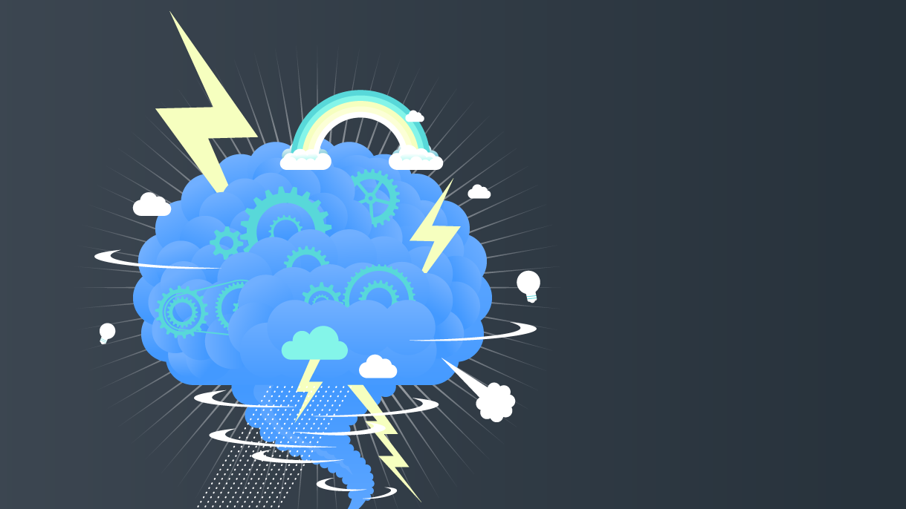
MEDICAL PHYSICS

Slide 12
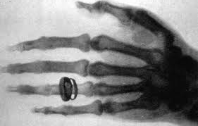

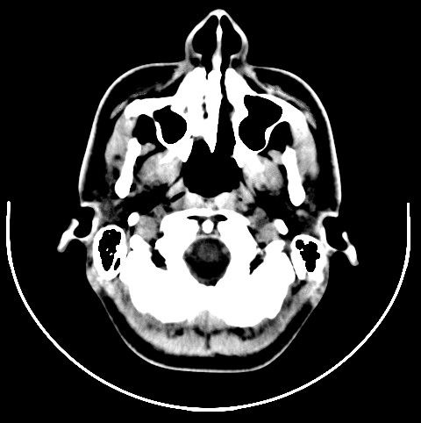
Ionizing radiation for imaging – from outside
Radiography
RX: 1895
TC: 1970

Slide 13
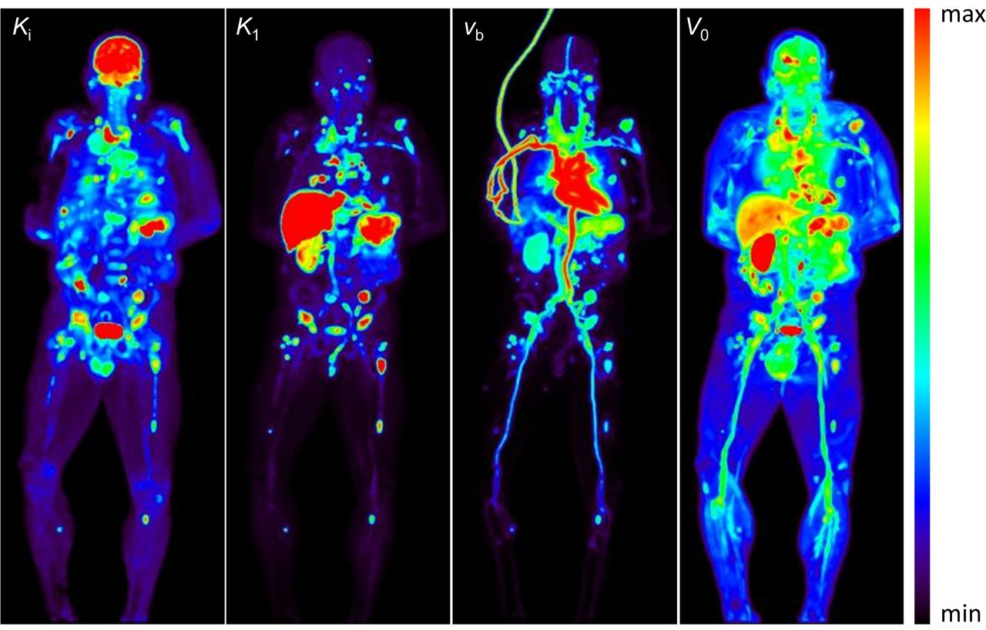

Ionizing radiation for imaging – from inside
Scintigraphy
SPECT
PET
Functional information

Slide 14
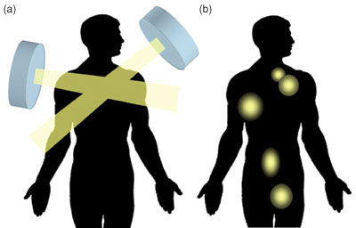
Ionizing radiation for therapy
External Radiotherapy
Internal Radiotherapy

Slide 15
hadronTHERAPY

Slide 16
IONIZING RADIATION -> DAMAGES

Slide 17
The enemy of my enemy is my friend

Slide 18



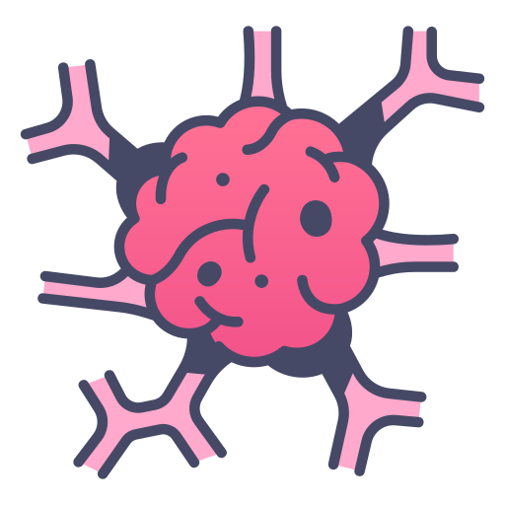
Target = tumour

Slide 19
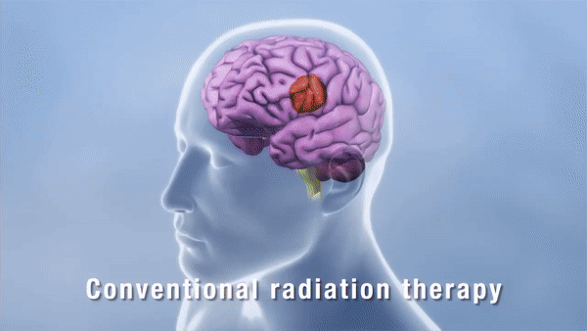
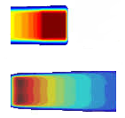
Radiotherapy vs hadrontherapy
Protons
Tumour
Photons

Slide 20
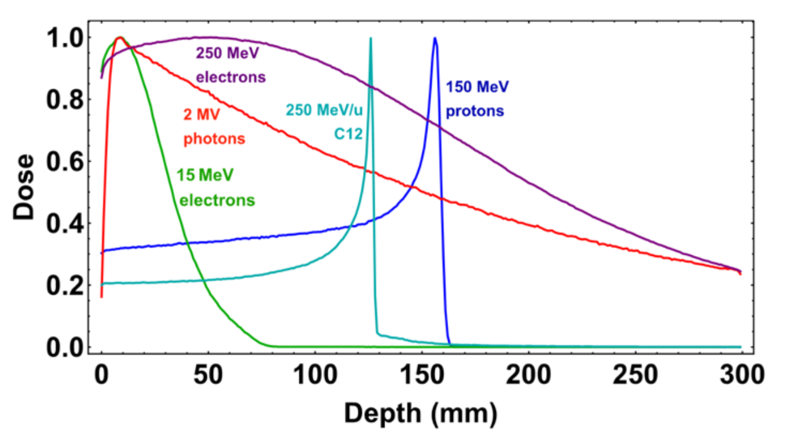
Physical advantages

Slide 21
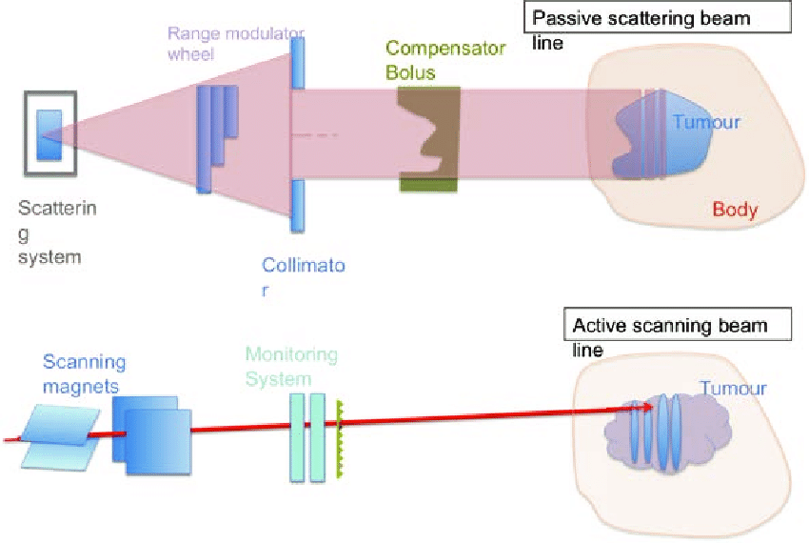
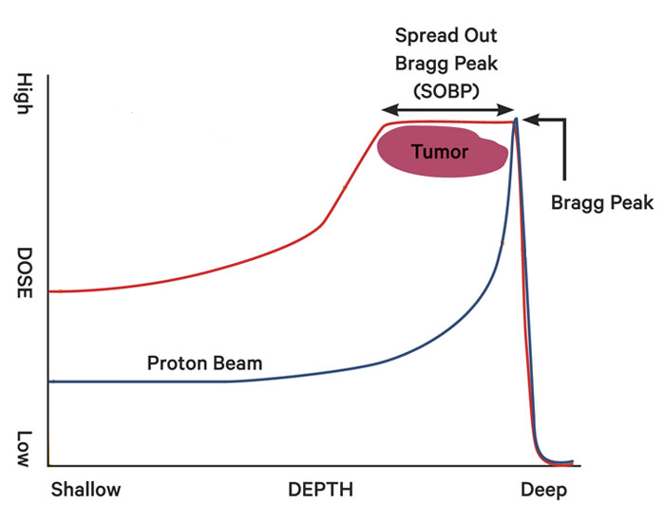
Hadrontherapy – beam delivery
SOBP
Passive
Active
Tumour

Slide 22
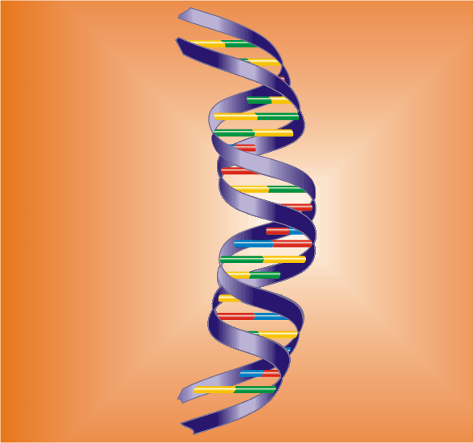
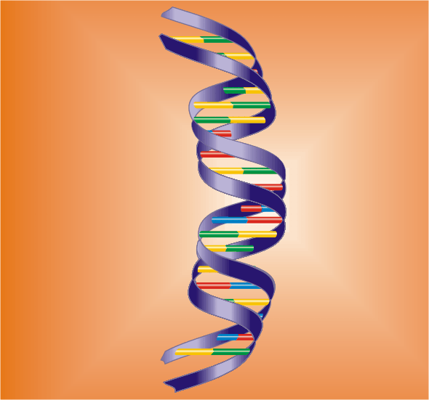
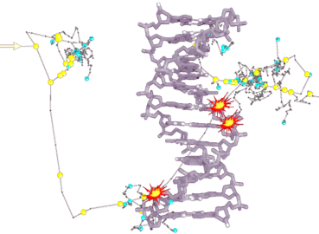
Biological advantages
Indirect damages
Simple direct damages
Complex direct damages

Slide 23
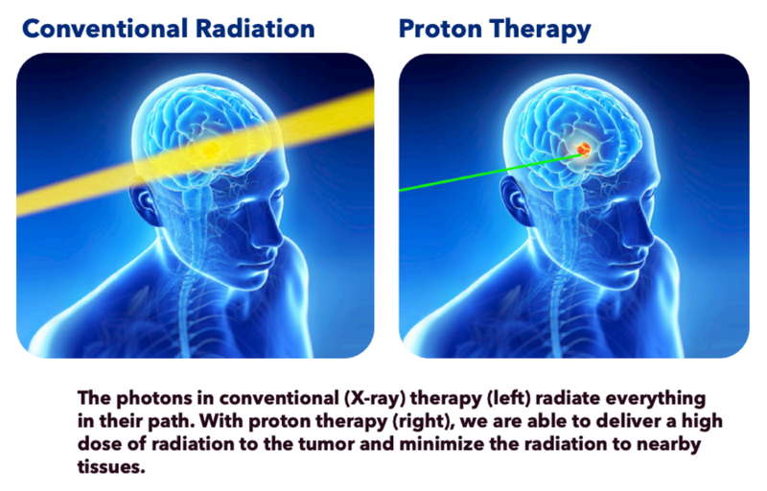
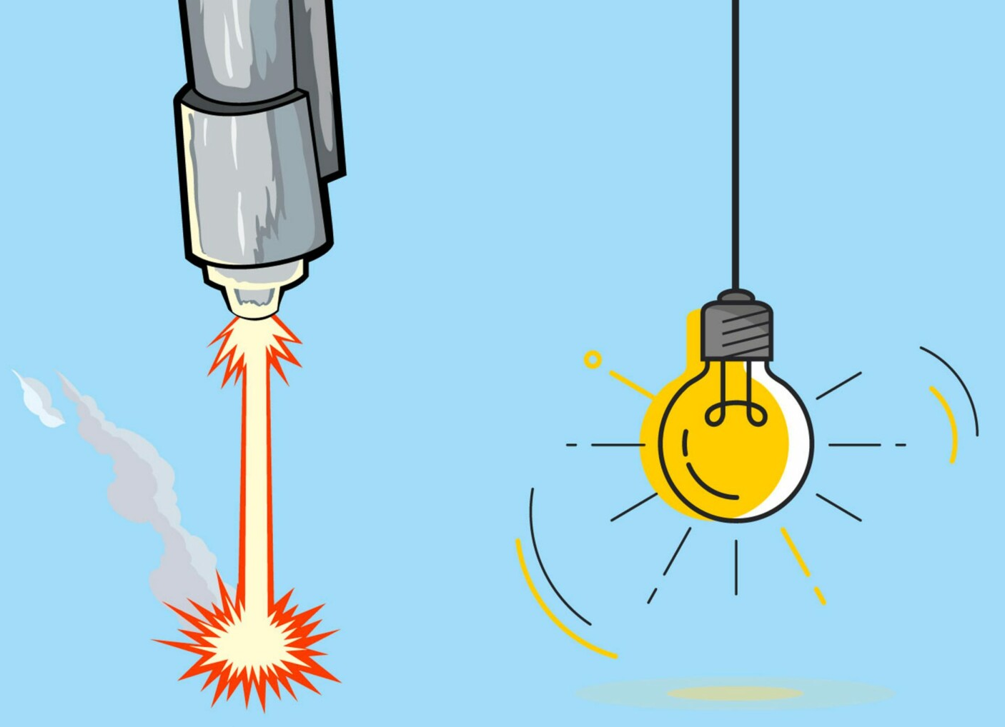
Advantages of hadrontherapy
Physics
Biology

Slide 24
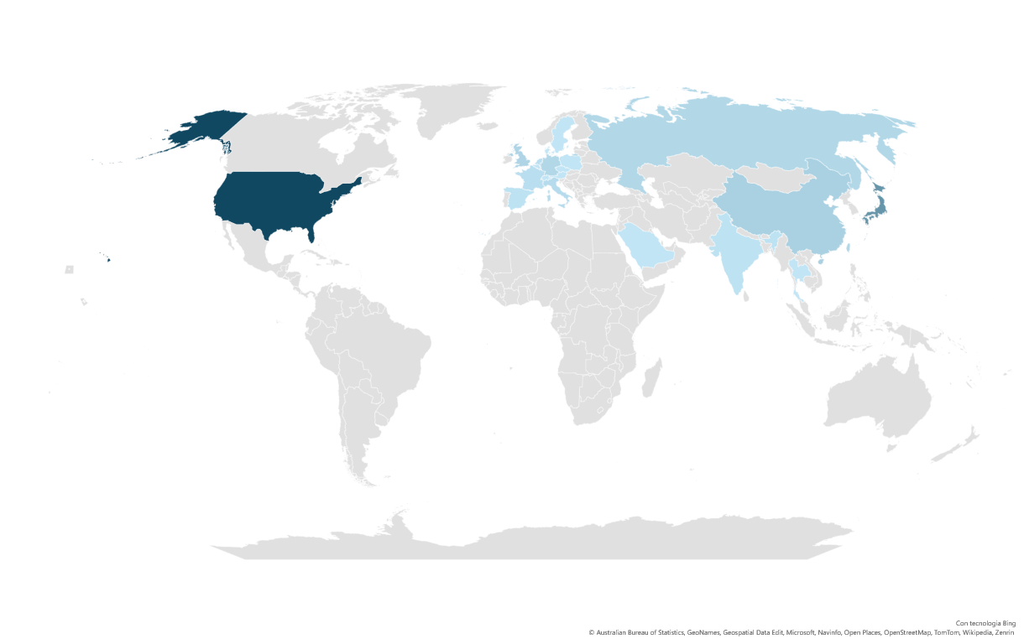
Hadrontherapy - diffusion
Total: 130 (15 with ¹²C)

Slide 25

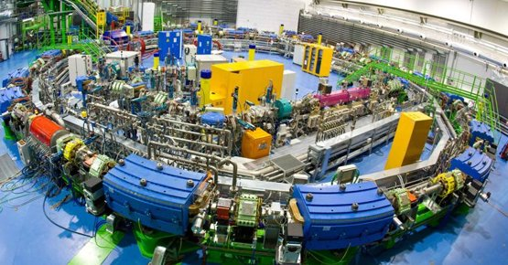
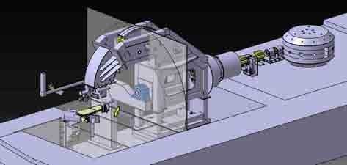
HAdroterapy - Italy
+ 2 centers under construction in Milan

Slide 26
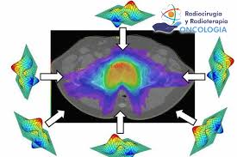
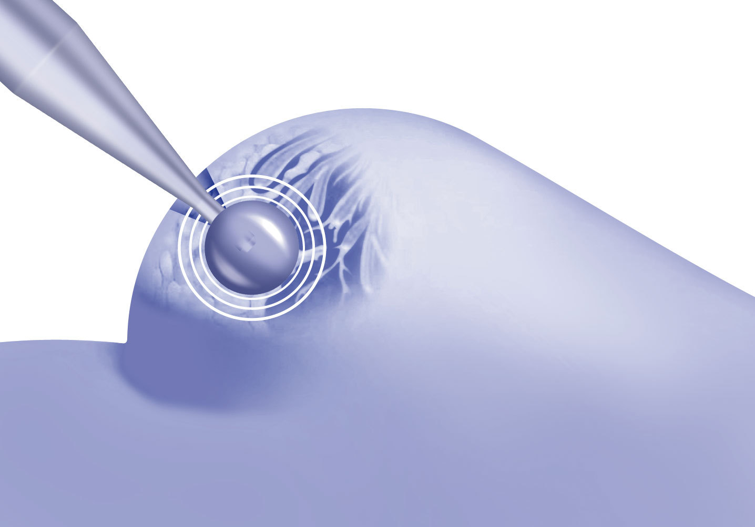
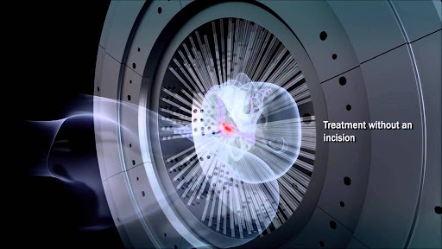
°Developments in radiotherapy
IORT
IMRT
Gamma
knife

Slide 27
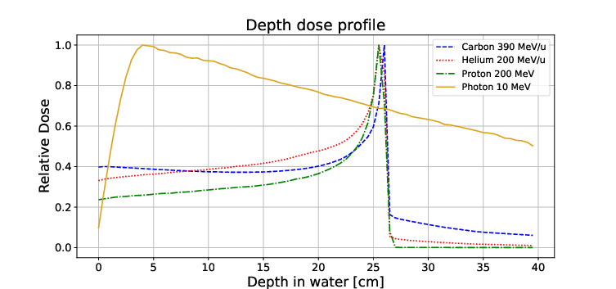
What ions can be used?

Slide 28

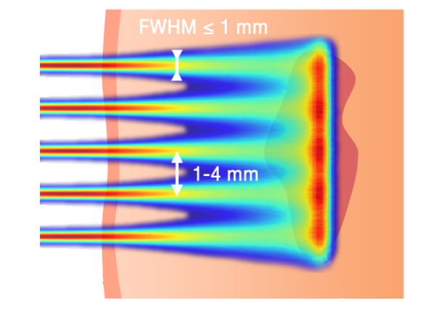
HAdrontherapy – new developments
Flash Radiotherapy
Mini-beam
Time
Space

Slide 29

Hybrid therapy: bnct

Slide 30

DOSimetry vs / microdosimetry
Absorbed dose and its limitations

Slide 31



Quantity
$$\text{Absorbed} \text{d}\text{ose}= \frac{\text{Deposited} \text{energy}}{\text{mass}}$$
Unit: gray [Gy]
$$1 Gy=1\frac{J}{kg}=0.00024\frac{kcal}{kg}$$

Slide 32





The absorbed dose is not enough
$$1 Gy=0.00024\frac{kcal}{kg}$$
100 Gy
0.024 kcal/kg
1.7 kcal
53 kcal
100Gy
@70kg
It’s not the energy that causes the damage!

Slide 33


quality
Same dose…
…different effects

Slide 34

quality
2.72-keV e⁻
5-MeV p
20-MeV α
60-MeV ¹²C

Slide 35
What is the effect on radiation on biological systems?
Indirect damages
Simple direct damages
Complex direct damages

Slide 36




The failure of absorbed dose
The surviving fraction of cells exposed to ionizing radiation decreases with increasing absorbed dose
Equal absorbed doses of different radiation types can produce different biological effects
Increasing LET
$LET=\frac{\text{d}E}{\text{d}x}$

Slide 37


The failure of LET
In spite of its complexities the LET concept can, at best, provide a crude characterization of the charged particle tracks that occur in the exposed medium.
Three features are essential in describing charged particle tracks:
The finite range of the particles and the change of LET along the track.
The lateral extension of the particle tracks due to the finite range of $δ$ rays.
The statistical fluctuation of energy loss along the particle track, often termed energy-loss straggling.

Slide 38

The Idea of Microdosimetry: to Measure the Lineal Energy as a Substitute of LET​
LET is related to the energy loss of an ionizing particle and lineal energy to the energy deposit in a target volume
$$y=\frac{ε_{s}}{\overline{l}}$$
d

Slide 39
microdosimetry

Slide 40

microdosimetry
Measurement of radiation quality
Biological effects of ionizing radiation

Slide 41
microdosimetry
Macroscopic dose the same -> 10 blue dots in each rectangle
BUT
Microscopic biological effect is different
1Gy – 60 MeV Protons
1Gy –Photons
1Gy – 150 MeV ¹²C

Slide 42
microdosimetry
Number of events = 10
Dosimetry
Mean number of ionizations =
=(2+3+1+4+2+2+4+5+3+4)/10 = 3

Slide 43

How can we measure what happens at the subcellular level?
$$d_{gas}$$
$$d_{bio}$$

Slide 44






Detector development @lnl – infn
Design and construction
Assembly and tests in ionizing radiation fields
1.0 mm sensor
Technical office and mechanical workshop
Engineered detectors for clinical application

Slide 45


Icru recommendation in 2023!!!
When microdosimetry has to be used
When the mean number of charged particles, including delta rays originating outside the site, interacting with the volume of interest is small, the stochastic nature of the radiation interactions should be considered. Such a situation will arise when the reciprocal of the particle fluence is comparable to or larger than the cross-sectional area of the volume of interest. In mixed radiation fields the fluence of the higher LET components should be considered.
Low ← z → High
$$\frac{1}{φ}>S$$
$$\frac{1}{φ}<S$$
S: cross-sectional area
φ: particle fluence
Microdosimetry is necessary
Conventional dosimetry is sufficient
ICRU = International Committee for Radiation Units

Slide 46
What can we do for the clinical improvement?
Proton therapy – an example

Slide 47

Treatment planning systems
B. Jones et al. / Clinical Oncology 30 (2018) 285e292

Slide 48


Proton therapy – rbe = 1.1
RBE=1.1

Slide 49
research workflow

Slide 50





Measurements and tests
catania
Nuclear reactor in pavia
trento

Slide 51

Data analysis

Slide 52




The outcome of the hard work: Conferences!

Slide 53




The outcome of the hard work: Conferences!

Slide 54


Slide 55





The outcome of the hard work: Conferences!

Slide 56



The outcome of the hard work: Conferences!

Slide 57




The outcome of the hard work: Conferences!

