Slide 1

Introduction to Particle Accelerators: History, Developments, Applications Antonio Palmieri
INFN-LNL
Accelerator Division
Accelerator Development Group
INSPYRE 2025 Legnaro, 14/07/2025

Slide 2
Preliminary Considerations
Main Accelerator Cathegories: an historical overview
Hints to applications
LNL Commitment in Last Generation Accelerators

Slide 3
Legnaro National Laboratories (LNL) of INFN
History:
Founded in 1961 as the Nuclear Research Center of the Veneto Region, they joined the INFN in 1968.
Mission:
Nuclear physics and nuclear astrophysics (nuclear spectroscopy, reaction dynamics), advanced technologies for nuclear and interdisciplinary physics applications, Technology transfer
Strengths:
Accelerator development, Radiation detectors, Surface technology
People
145 INFN staff (approximately 250 people work at LNL every day)

Slide 4
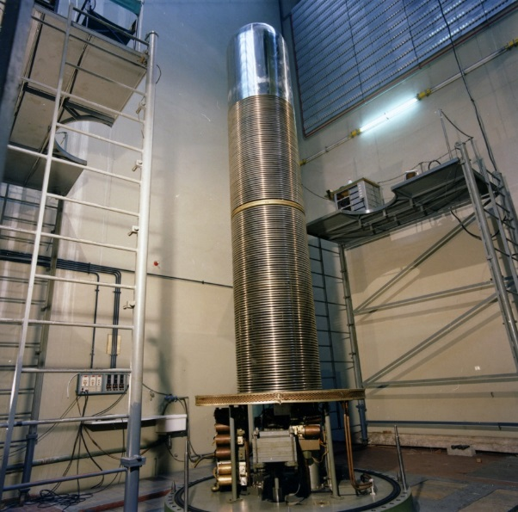
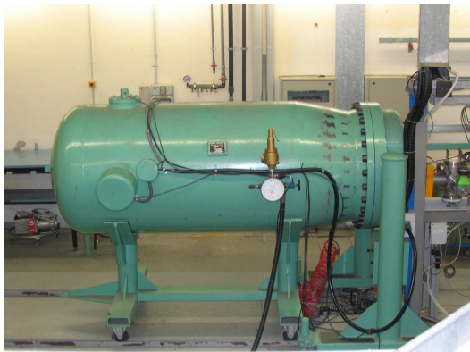
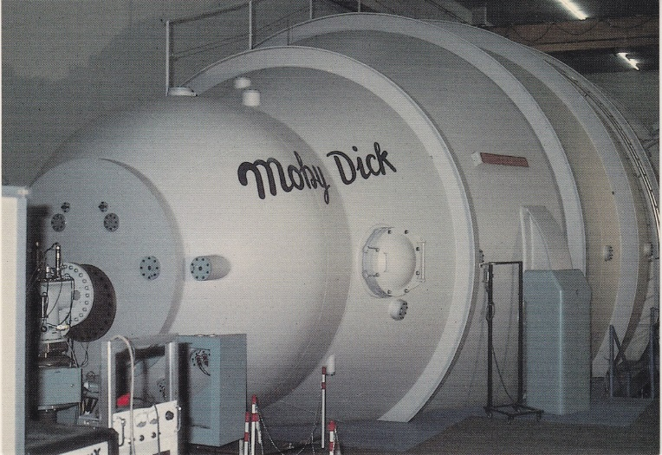
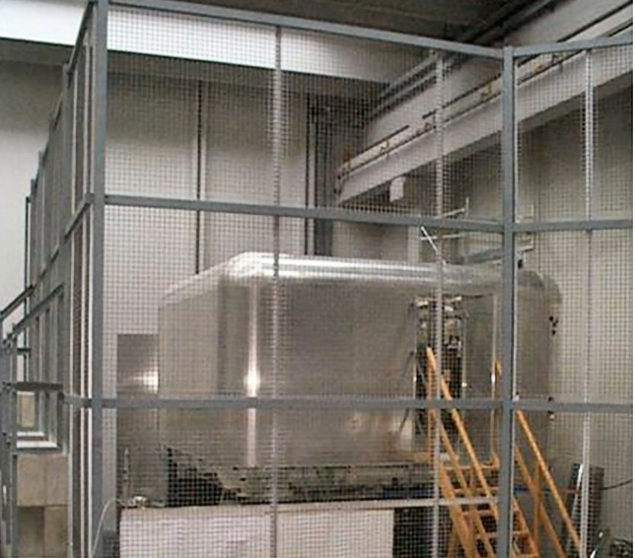
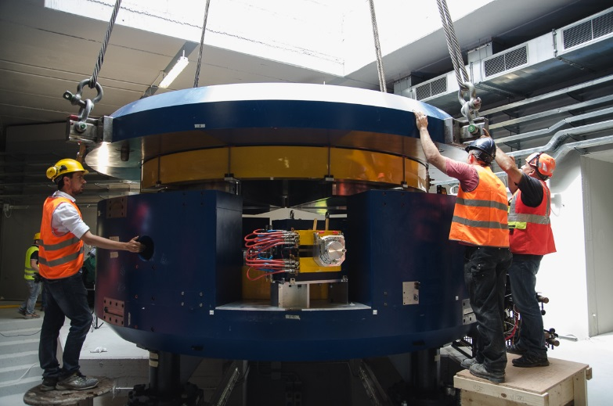
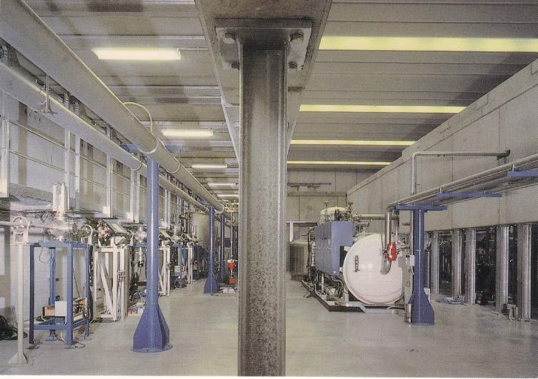
Accelerators at LNL:
3 electrostatic / 2 RF Linacs/
1 Cyclotron
CN (1961)
AN2000 (1971)
TANDEM (1981)
ALPI (1995)
PIAVE (2005)
SPES Cyclotron (2016)

Slide 5

What is a Particle Accelerator?
A Particle Accelerator is an Apparatus devoted to charged particle acceleration along a prefixed trajectory, with the aim of reaching a determined energy
Apparatus = > artificial and complex system
Charged particles => electrons, protons, ions, etc.
Acceleration along a prefixed trajectory => application of Electromagnetic Fields
The electric charge is a property of matter
We distinguish two types of electric charge positive charge and negative charge
Charges of the same [opposite] sign attract [repel] each other.
Types of accelerators
Linear or LINAC (the particle trajectory is (principally) along a rectilinear path)
Circular (the particle trajectory is a closed curve or a spiral).

Slide 6
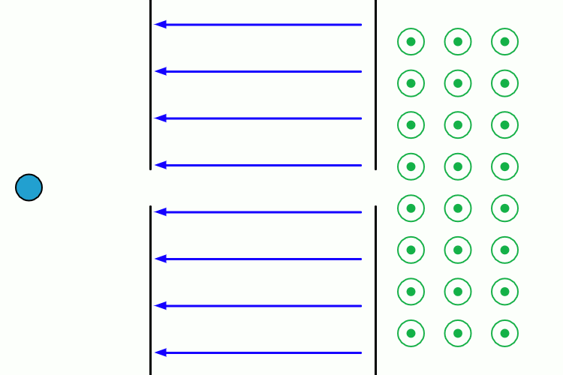
Motion of charged particle in a E and B field
There are two types of applied forces on a charged patrticle : electric force F_{e} and magnetic force F_{m} (Lorenz Force).
Electric force is parallel to the electric field.
The magnetic force is perpendicular both to particle velocity and magnetic field and is as high [low] as v and B are perpendicular [parallel].
Negative Charge
CampiMagnetic and electric fields have the right properties to determine the trajectory of a particle whose mass is m, that is
Keep the particle in motion on a fixed orbit
Reduce the divergence of the particle trajectoris (focusing)
Increase their energy (acceleration)
E field makes work on the charge and accelerates it, while B field does not.
E Field
B Field (entering in the sheet plane)

Slide 7
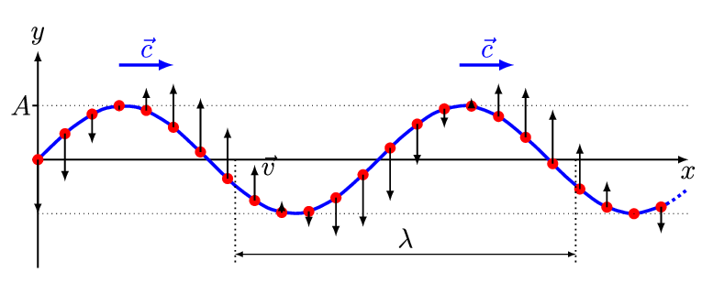
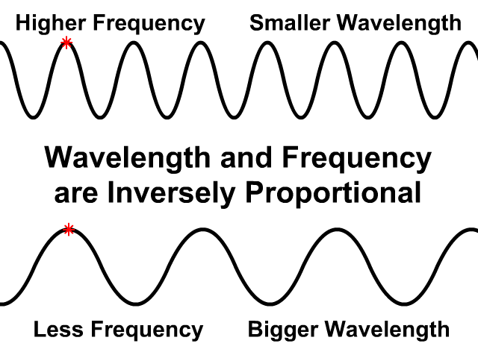
Electromagnetic Waves
James Clerk Maxwell (1831-1879) proposed a comprehensive theory of electrical and magnetic phenomena, which he summarized in 4 equations. They predict that the E field and the B field, when they vary over time, constitute a single entity (electromagnetic field), which propagates in a vacuum at the speed of light c = 299 779 245.8 m/s = 299 792.458 km/s in the form of waves (electromagnetic waves). An electromagnetic wave is determined by its fundamental parameters
The frequency f which is measured in Hz [1/s], which indicates how many oscillations the wave completes in a second
The wavelength λ, which is measured in meters [m], which indicates the distance between two crests (maxima of the wave)
The amplitude A, which tells us how intense the wave is. It depends on the physical quantity to which the wave is associated,
Frequency and wavelength are inversely proportional and their product is equal to the speed of light
For example for f=1MHz=10⁶Hz, then λ =300 m, for f=300 MHz λ =1m, f=1 GHz =10⁹Hz, λ =30 cm

Slide 8
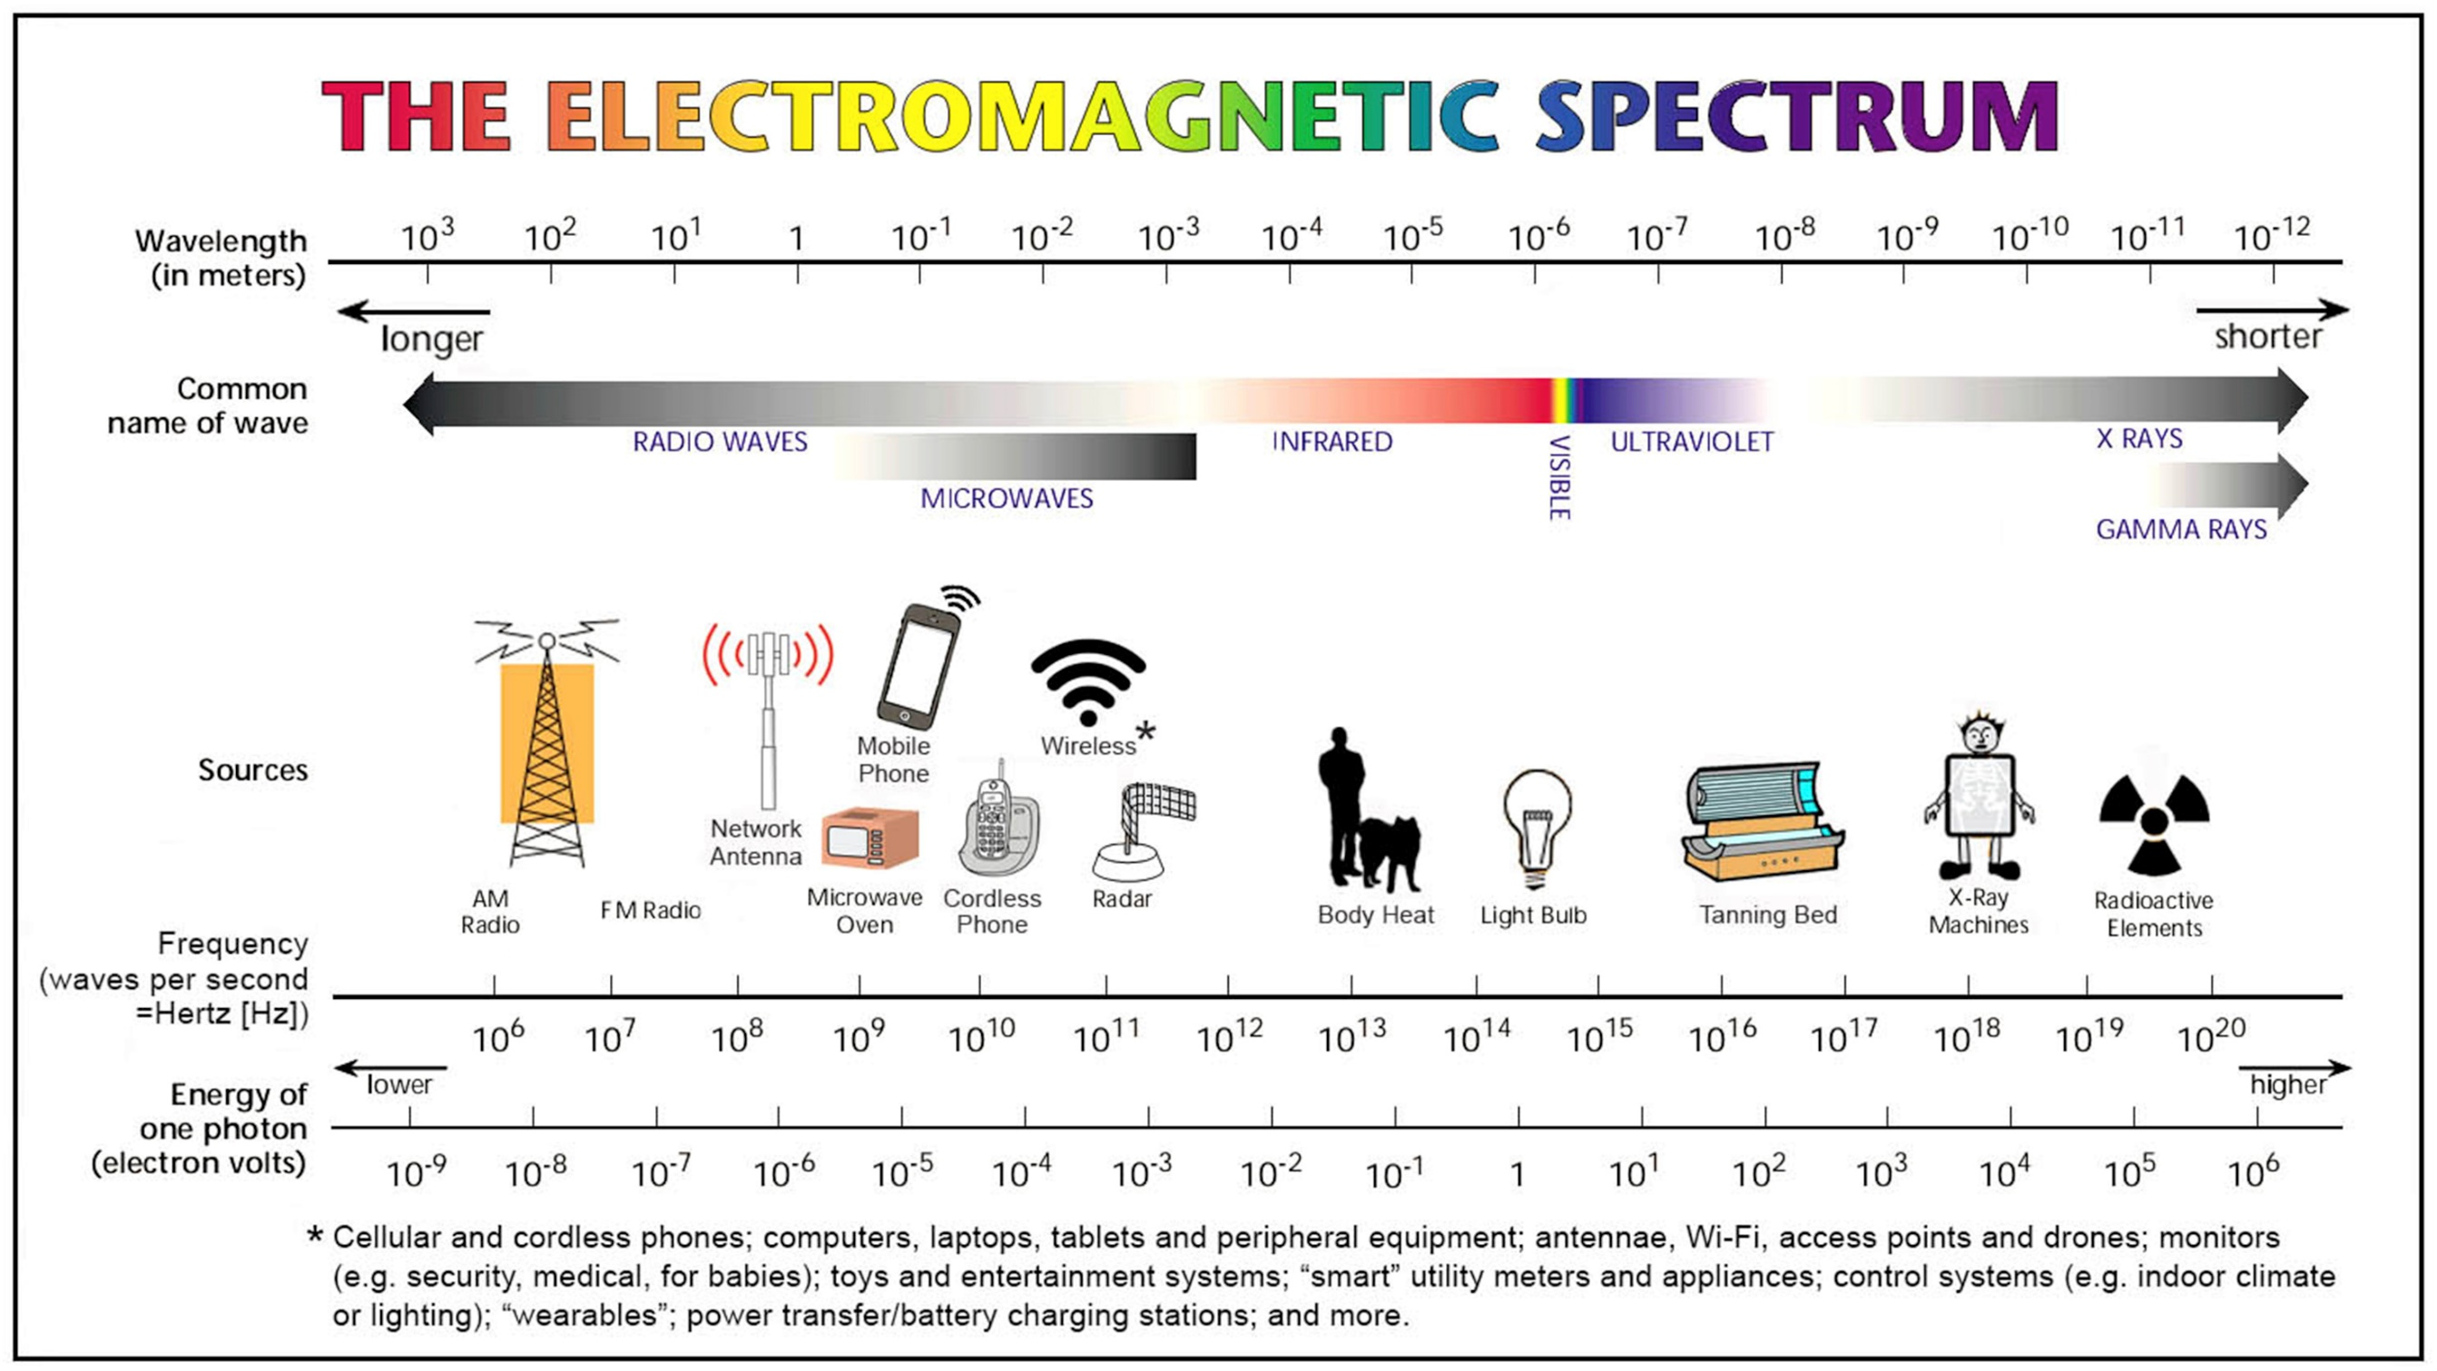

Slide 9
Energy and wavelength
The MKS unit of energy W is the joule (J). In particle physics, however, we normally use the electron volt (eV) and its multiples, kilo electron volts (1keV=10³eV) mega electron volt (1MeV=10⁶eV), Giga electron volt (1GeV=10⁹eV), Tera electron volt (1TeV=10¹²eV) etc. The electron volt is defined as the kinetic energy gained by one electron in falling through a potential difference V of 1 volt. Since
$$W=qV=charge x potential difference$$
and the magnitude of the electron charge is 1.602 × 10⁻¹⁹ C it follows that
Binding energies of atomic electrons are of order eV. Energy to remove a proton or neutron from the nucleus is of order of MeV. The German physicist Max Planck proposed that the exchange of energy between matter and radiation occurs for quanta, or discrete packets of energy. The fundamental concept of his theory was that a charged particle oscillating at the frequency ʋ could exchange energy with the environment only in the form of packets of magnitude E = hʋ h (Planck's constant) = 4.1 × 10⁻¹⁵ eV * s Therefore, in order to "see" physical phenomena in ever smaller scales of length, it is necessary to use ever greater energies.

Slide 10
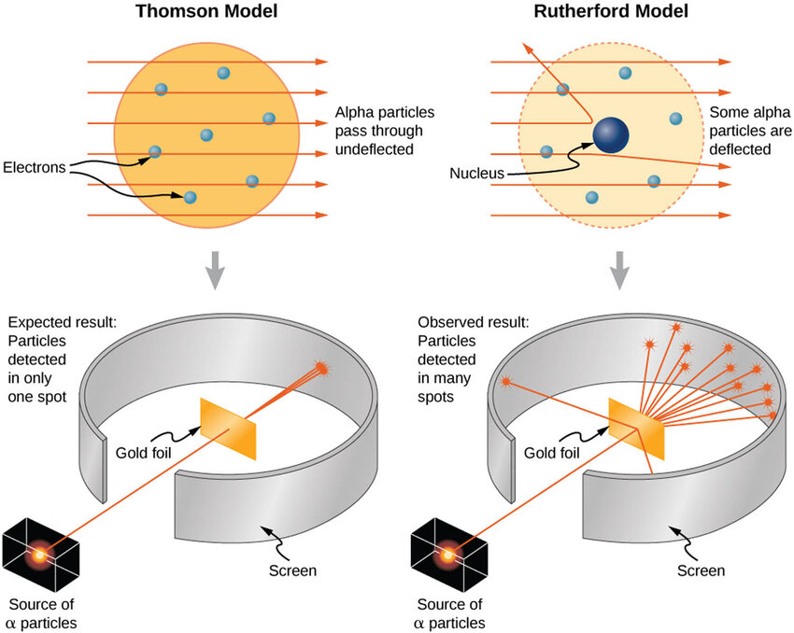
As all of it began
Ernest Rutherford discovered in 1910 that every atom has a nucleus, where the positive charge and most of its mass are concentrated. The experiment consisted of bombarding a very thin sheet of gold with alpha rays (which today we know to be the nuclei of helium, i.e. two protons bound to two neutrons) emitted by natural radioactive sources. After numerous shots fired at the layers of atoms of the gold sheet, carefully detected one by one on a screen, Rutherford was able to observe a significant number of deviations, so many as to justify the hypothesis that the atom had a planetary structure: at its center there was a positive nucleus surrounded by electrons orbiting around it.
He then called for "an abundant supply" of particles more energetic than those from natural sources. Thus, the first particle accelerators (1920s-1930s) were built to study the smallest constituents of matter, and this need drove the development of accelerators in the following decades as well.

Slide 11
Electrostatic Accelerators
The simplest idea for particle acceleration is to use an electrostatic electric field
Principle:
An electric field applied between two electrodes accelerates ions initially at rest via uniformly accelerated motion . The energy W delivered to the charge q depends on the intensity of the electric field E and the amount of electric charge of the particle to be accelerated.
+
L
-
The particle beams are accelerated in a vacuum chamber, with pressures ranging from 10⁻⁴ mbar to 10⁻¹² mbar (i.e. from one ten-millionth to one-millionth of a billionth of atmospheric pressure). However, the residual gas particles can be ionized and regions of intense electric field can cause this gas to become a conductor of electric currents, thus generating discharges. Furthermore, again due to the high electric fields, some electrons can be stripped away from the metal walls of the vacuum chamber. This limits the maximum energy obtainable to no more than 20-25 MeV
Ion +
E
-
+
W = q∙E∙L

Slide 12
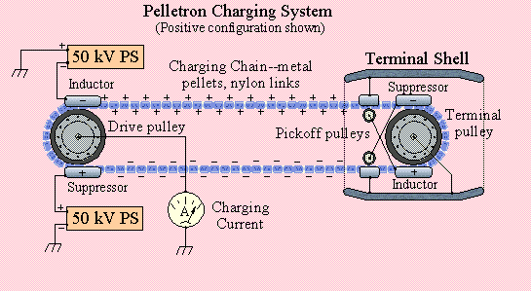
Van De Graaf and Pelletron Accelerators
(1929, Princeton, New Jersey)
Van de Graaf generator Scheme
The only way to increase breakdown voltage is to remove the continuous application of voltage, in other words to apply time-varying electric fields. This requires
-Sinusoidal (Radio-Frequency) generators
-Some synchronism
-slightly more complex accelerating structures

Slide 13
Limitation of Electrostatic machines
The particle beams are accelerated in a vacuum chamber, with pressures ranging from 10⁻⁴ mbar to 10⁻¹² mbar (i.e. from one ten millionth to one millionth of a billionth of the atmospheric pressure). However, the residual gas particles can be ionized (i.e. deprived of one or more electrons) and regions of intense electric field can cause this gas to become a conductor of electric currents, thus generating discharges. This limits the maximum obtainable energy to no more than 20-25 MeV.

Slide 14
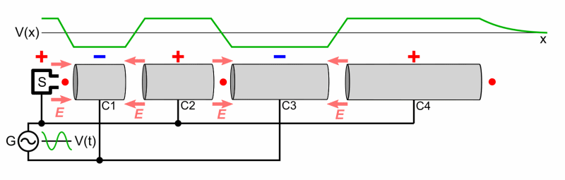
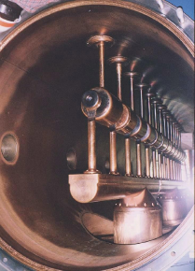
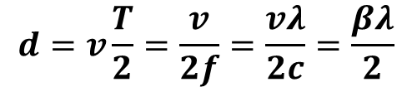

Wideröe Structure
V
Hollow Tubes
The voltage reverses every T seconds. For example, if the frequency f = 1MHz, then the inversion occurs every millionth of a second, so T = 1μs.
$$d$$
C
$$d=v\frac{T}{2}=\frac{v}{2f}=\frac{vλ}{2c}=\frac{βλ}{2}$$
The Wideröe structure (1928) was the first to be proposed to accelerate particles by applying a sinusoidal field. The hollow tubes, C1, C2, C3, C4 etc. are alternately connected to the two ends of a sinusoidal voltage generator. When ions enter an accelerating gap (space between two tubes) with velocity bc, if they have been injected "at the right time", they will find a voltage and therefore a field E that accelerates them. After crossing the gap, the particles will enter the hollow tubes which will shield them from the electric field. If now the distance between the centers of two consecutive gaps is equal to βλ / 2, then the particle, once it has reemerged from the hollow tube, will again find a voltage that accelerates it. On the other hand, the particles of ionized gas, not being in synchrony with the accelerating field, will undergo accelerations and decelerations, so on average they will not gain energy, and it will be more difficult for them to create discharges.
Notare che la lunghezza degli elettrodi cavi è di lunghezza
variabile, per tener conto dell’aumento di velocità degli ioni
accelerati. Se si usa un pre-iniettore le dimensioni diventano
simili.
Electrode at voltage V
Grounded cylinder
R. Wideröe

Slide 15
Ernest Orlando Lawrence
We notice that the distance between the centers of the accelerating gaps increases with the velocity of the particles. Therefore, as these particles are accelerated, the length of the tubes increases. At the time this solution was considered not very "practical", since only amplifiers capable of delivering power at frequencies up to about 10 MHz were available, clearly the distance d became considerable. For example, at f = 10 MHz the wavelength l is equal to 30 m, so to obtain a velocity equal to 1/10 of the speed of light c, d should be equal to 1.5 m. Furthermore, part of the electromagnetic energy associated with the sinusoidal electromagnetic field is lost through irradiation. Meanwhile ... in April 1929, Ernest Orlando Lawrence, a young physicist from the University of Berkeley, stumbled upon Wideroe's publication. Lawrence, although he was unable to read German, understood the working principle of Wideroe's machine, moreover…

Slide 16
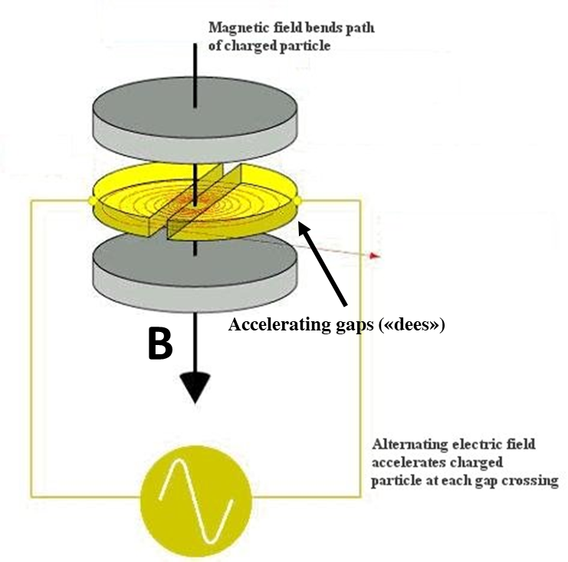
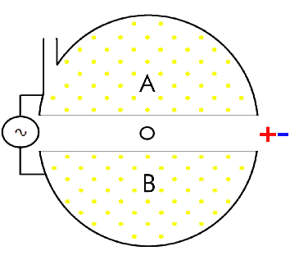
The Cyclotron
Lawrence realized that if the particles were accelerated in a circular path, the structure would certainly be more compact. For the trajectory to remain circular, the centrifugal force F_{C} and the Lorenz force F_{B} had to be equal. The angular velocity ω = v / R is the number of radians per second that the particle travels.
centrifugal force (directed towards the external)
Lorentz force (directed towards the internal)
The angular velocity does not depend on the radius, but only on the field B and on the charge / mass ratio q / m. The electric field applied between points A and B at a frequency equal to qB / (2πm) provides the necessary acceleration. This type of machine is called the Cyclotron

Slide 17
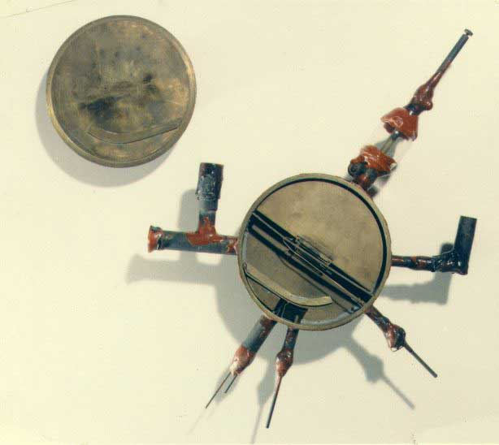
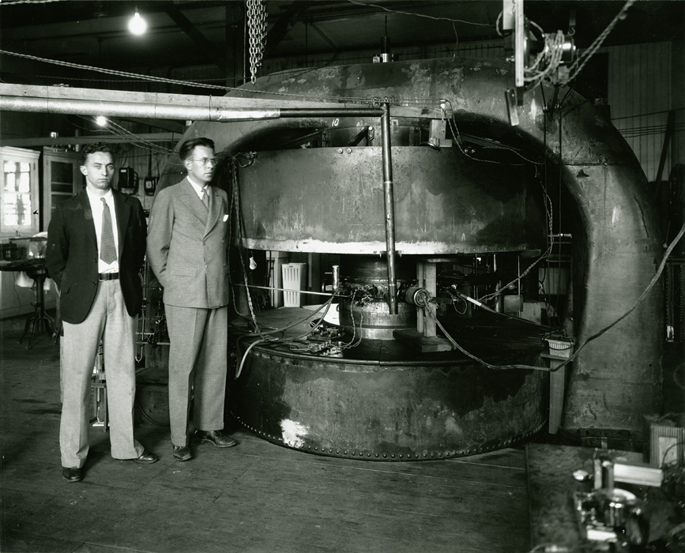
The Cyclotron (2)
First working Cyclotron Prototype
(E.O.Lawrence e M.S.Livingston, 1931, Berkeley, CA)
Diameter 4.5 inches (≈ 11.5 cm)
voltage= 1,800 volts
It accelerated H ions at 80 keV
27 inch Cyclotron (1932)

Slide 18
A modern cyclotron
750 μA 70 MeV, proton driver installed at LNL in 2016 for the SPES project

Slide 19
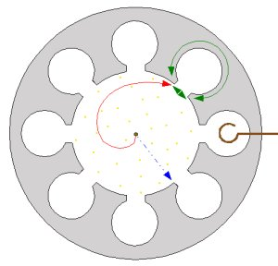
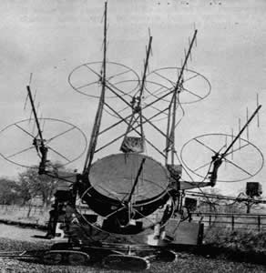
WWII (1939-1945) and its Technical Developments
The Second World War saw a notable development in radar technologies, with the advent of amplifiers at higher frequencies (to have greater resolution) and of greater power (to detect more distant objects), such as the Magnetron (but not only). At the time, the Magnetron was one of the best kept secrets of the British. Nowadays, Magnetron can be found in many homes, inside microwave ovens, since it is now the cheapest and easiest way to generate microwaves with high power. .
B- field directed out of the sheet plane
The electrons are trapped in these cavities, and when they oscillate they emit an electromagnetic wave
Antenna
Electron trajectories due to B field
Hot Cathode which emits electrons
The anodic block pf the first Magnetron (Randall and Boot)
A WWII Radar System
Grounded anode

Slide 20
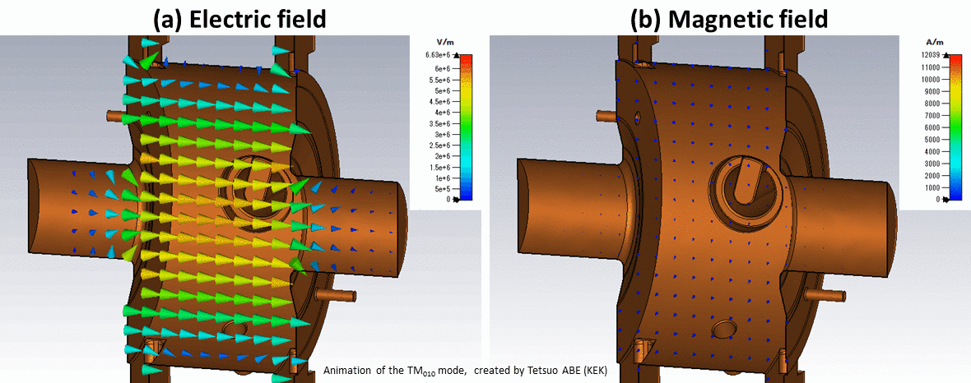
Alvarez DTL
.
After the end of World War II, some technologies used for radar were de-classified. As a result, new types of high frequency amplifiers (from 100 MHz to a few GHz) have become available.
Furthermore, in 1946 Luis Alvarez overcame the drawbacks of Wideroe Linac by including the Wideroe structure inside a large metal tube that formed an efficient cavity where the fields were confined and prevented from irradiation. This structure, called DTL (Drift Tube Linac), is widely used as an accelerator for protons and ions.
RF power coupling
Similarly to Wideroe's machine, the DTL alternates shielded tubes and accelerating gaps and exploits synchronism, but, in Wideroe's machine, the accelerating tubes are directly connected to the RF amplifier, so the machine can behave like an antenna and radiate.
In Alvarez's machine, the RF power injected into the cavity by means of an antenna establishes an electromagnetic field configuration that remains efficiently confined to the operating frequency. At different frequencies, the cavity tends to reflect the RF power back

Slide 21
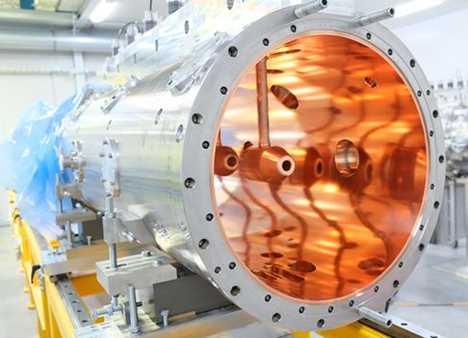
Alvarez DTL (2)
A modern DTL: the Tank 4 (of 5) of the DTL of the ESS project (https://europeanspallationsource.se/) designed, built and installed in Lund (Sweden) by INFN (Legnaro and Turin). The 5 tanks operate at 352.21 MHz, and accelerate protons from 3.6 MeV to 90 MeV
12m proton DTL built in 1947 in Berkeley, f = 200 MHz, Energy = 32 MeV, tank diameter 0.9 m

Slide 22
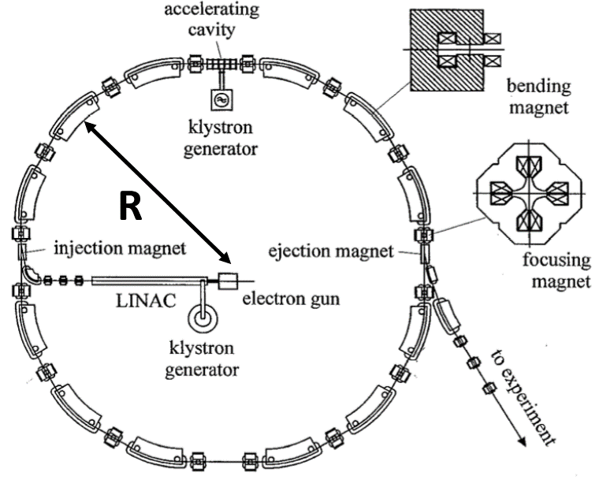
The Synchrotron (1945)
For Ernest Lawrence, the only limit for energy was the size of the magnet, but:
1) Starting from ~ 400MeV the production of cyclotrons becomes inconvenient and expensive
2) High energies => relativistic effects => ω no longer constant (since m increases with v according to Relativity). The particles get out of phase with the accelerating fields, and eventually there is no more acceleration.
Some of the problems of the cyclotron have been overcome in the Synchrotron.
the magnitude of B and the frequency f of the acceleration voltage are synchronized.
The particles are launched into the ring by a linear accelerator and bent into the ring by a series of magnets. At the accelerating element, the velocity v and therefore the energy of the particle increases.
There are some straight sections with many magnets to deflect particles in a practically circular path.
In order to have "stable" acceleration or to ensure that the particle always sees the same accelerating voltage in the cavity after one revolution, the revolution period (T_{riv}) must be an integer multiple (h) of the radio frequency period (T_{RF}) at each turn.
Both the magnitude of the magnetic field and the rf frequency are varied to maintain a synchronous particle at a constant orbit radius.
Synchrotrons are used to accelerate both ions and electrons, although electron machines are limited in energy by emission of synchrotron radiation.
The principle was invented by Vladimir Veksler in 1944. Edwin Mc Millan built the first electron synchrotron in 1945, coming up with the idea independently. The first proton synchrotron was designed by Sir Marcus Oliphant and built in 1952.

Slide 23
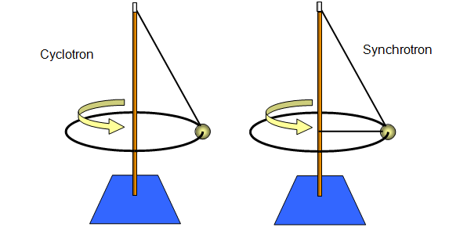
Mechanical Analogies
Cyclotron: the ball (particle) is held by a string (magnetic field) attached to the end of the stick: if the ball is hit forward regularly (accelerating field) every time it passes through the same position, it will tend to move further away from the stick, therefore it will travel a circle of greater radius.
Synchrotron: this time the ball is fixed rigidly vertically by a string, so that the radius it describes is always constant. In this case, as the ball is accelerated, what will vary will be the tension of this string (equivalent of the magnetic field).

Slide 24
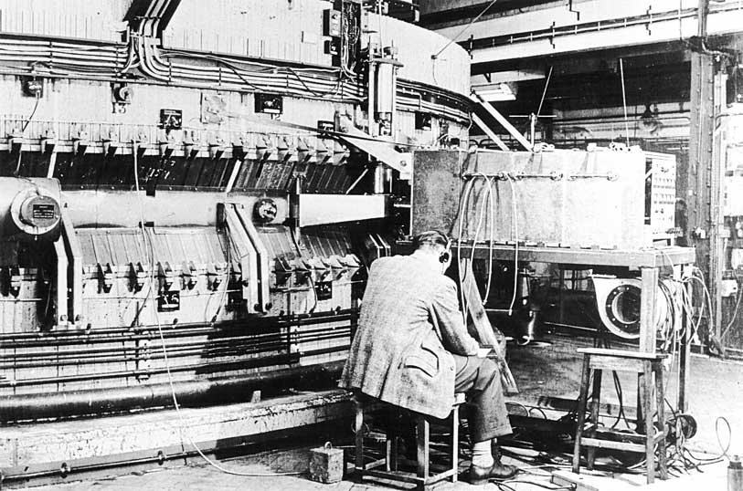
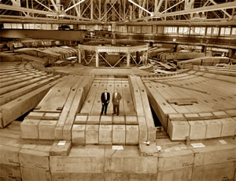
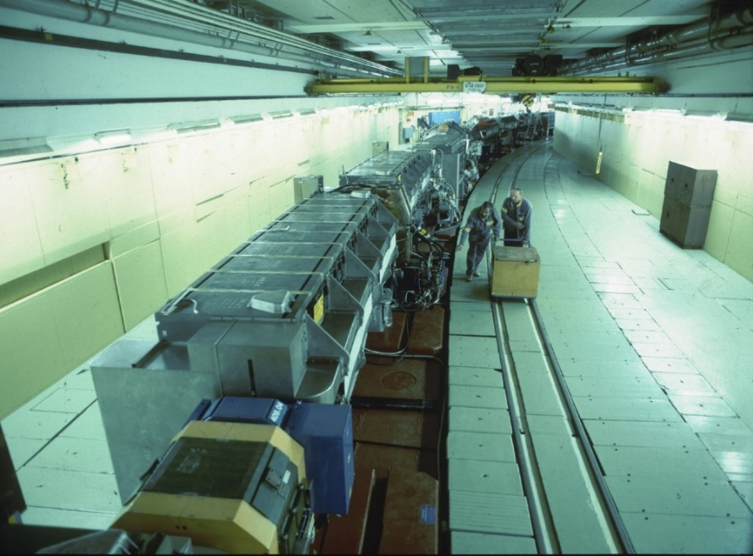
First Synchrotrons
Bevatron – Berkeley
1956 antiproton discovery (6.5 GeV energy)
1959 Nobel prize to
E. Segrè and O. Chamberlain
Although it was the first Proton Synchrotron to be planned, this 1 GeV machine at Birmingham University achieved its design goal only in 1953.
Scientists at CERN, Geneva, using Alternating -Gradient focusing built a Synchrotron capable of accelerating protons to 28 GeV called the Proton Synchrotron (PS).
Scientists at Dubna (USSR) build a Synchrotron capable of accelerating protons to 10GeV called the Synchrophasotron (1957).

Slide 25
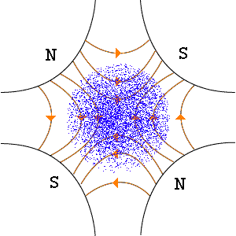
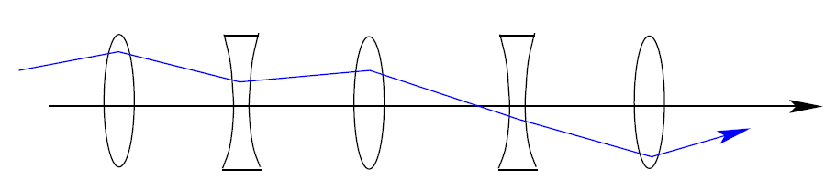
The Strong Focusing
x end y Lorentz force components acting on a positive charge entering on the sheet plane are:
The invention of strong focusing, in the early 1950’s, by Ernie Courant, Hartland Snyder and Stan Livingston, revolutionized accelerator design in that it allowed small openings (unlike the Bevatron, whose opening was large enough to contain a jeep, with its windshield down). Strong focusing or alternating-gradient focusing is the principle that the net effect on charged particle beam passing through alternating B field alternations is to make the beam converge
F_{x} = -g x
F_{y} = g y
If the particle is off-axis, the force increases linearly. Therefore the effect is focusing in the Horizontal plane, and defocusing on the vertical plane, but…
…Alternating focusing and defocusing lenses with drifts in between will together give total focusing effect in both planes (shown later). This the Strong Focusing Principle. The resulting structure is called the FODO.
Drift
Drift
Drift
Drift
Focusing
Focusing
Focusing
DeFocusing
DeFocusing

Slide 26
The Phase Stability
Edwin McMillan of UC Berkley, and V.I. Veksler (USSR) independently discovered Phase stability in 1945.
The Phase stability is the principle allowing a group of particles to travel in an accelerating structure in a stable way keeping synchronism with the accelerating fields.
The following is a simplified explanation of this principle in the case of linacs.
Let us consider a succession of accelerating gaps, for which the synchronism condition is fulfilled for a phase Φs (reference phase) . The P1 particle is called the stable reference particle. The particle N1 arrives earlier with respect to P1 and is subject to a lower accelerating field, while the particle M1 arrives later P and is subject to a higher accelerating field. Therefore, the effect of the accelerating voltage is to slow down N1 with respect to P and to accelerate M1 with respect to P. Eventually N1 and M1 will both get closer to P (bunching). To be more precise the particles will perform stable oscillation about the reference particle.
The opposite will occur the N2 and M2 particles about the P2 particles (unstable) .
Stable Phase
Unstable Phase
Strong focusing and phase stability are the foundations of all modern high-energy accelerators.

Slide 27

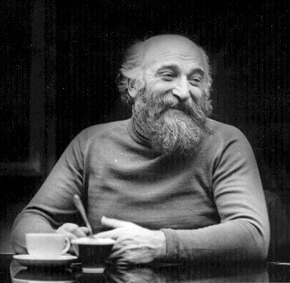
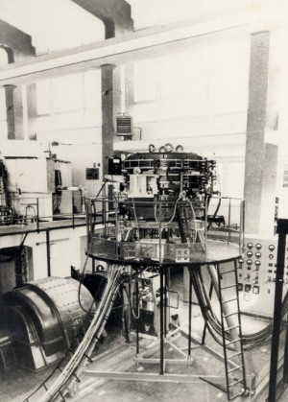
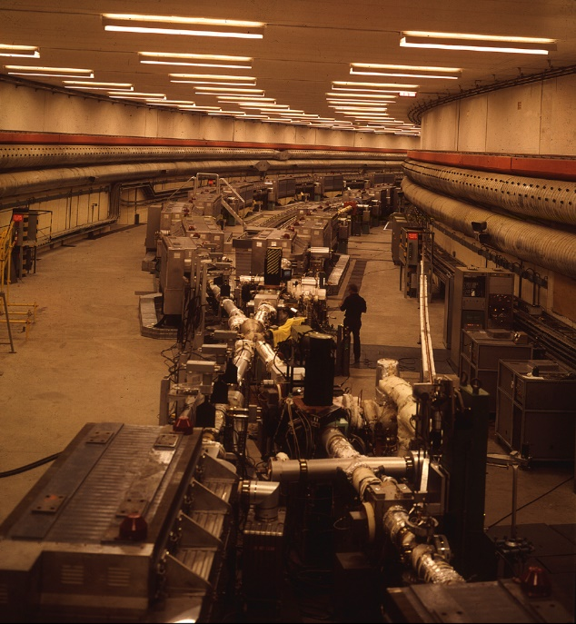
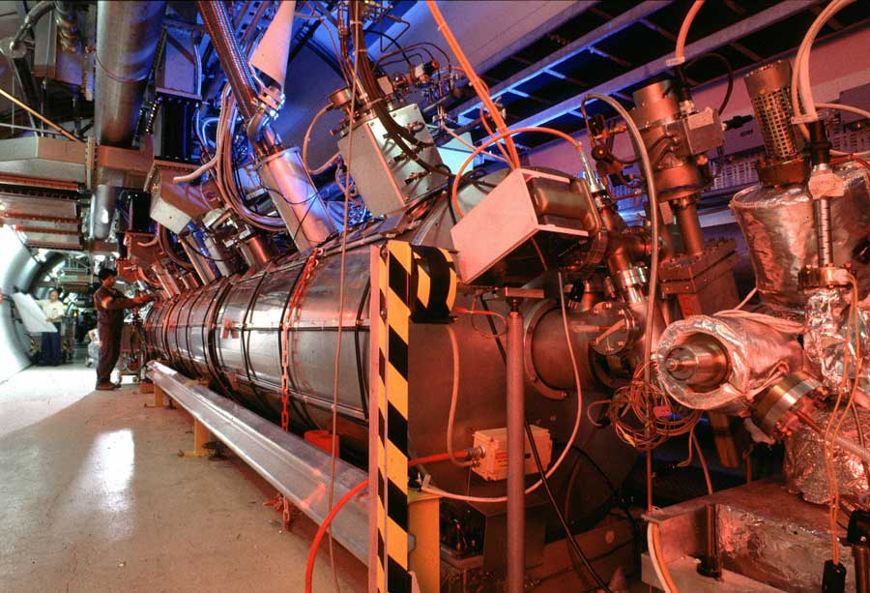

Colliders
In the 1950’s a number of places, MURA, Novosibirsk, CERN, Stanford, Frascati, and Orsay, developed the technology of colliding beams. Bruno Touschek, Gersh Budker and Don Kerst were the people who made this happen. Colliders are now the devices employed to reach the highest energies.
G. Budker (1918-1977)
1960-AdA (Anello di Accumulazione) was built at LNF Frascati, within a 1.5 m diameter electro-magnet where the radiofrequency field would accelerate the electron-positron beams up to 250 MeV.
The first proton-proton collider, the CERN Intersecting Storage Rings (ISR), during the 1970’s, operating at 26 GeV. See the massive rings and one of the intersection points.
Superconducting RF cavities at the CERN Large Electron Positron Collider (LEP), 208 GeV max energy. LEP operated between 1989 and 2000
B. Touschek(1921-1978)

Slide 28
The RFQ
At low energies, for protons (or ions), magnetic focusing is not very effective. In fact, in this case, since the velocity is low, to have a good focusing a large value of 𝑩 is needed, i.e. very large (and expensive) magnetic quadrupoles. So, in this case, the electric field, used for focusing, could work better (𝑭 = 𝑞𝑬). Suppose that the field in the four metal electrodes varies sinusoidally with time with frequency f. The particle will see this alternating polarity as the same effect as a FODO, since, in this case, the E field will give rise to the same forces as the magnetic quadrupole
In 1970 Kapchinskiy and Teplyakov (USSR) proposed to sinusoidally modulate the shape of the electrodes with a period equal to vλ/c: this creates a longitudinal component, therefore accelerating the electric field, with the same considerations on synchronism made previously. An RFQ (Radio Frequency Quadrupole) is therefore an electric quadrupole with modulated electrodes, which allows focusing and acceleration at the same time. Today in all modern Linacs an RFQ acts as the first accelerating stage.

Slide 29
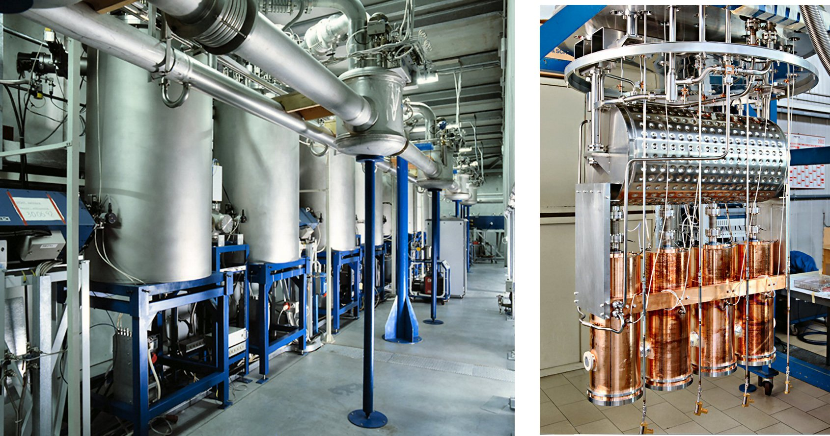
Supercondutcting Structures
Superconductivity (SC) is a physical phenomenon, explainable by quantum mechanics, in which certain materials, when cooled below a critical temperature Tc (typically below 10 K), have practically zero electrical resistance and expel the lines of force of the magnetic field. In this way it is possible to circulate currents and/or impart accelerating fields, without dissipating power in the form of heat. Since the late 1970s, superconducting materials (for example Niobium, with Tc = 8.4 K) have been used to construct the magnets and accelerating cavities, and today almost all high v/c accelerating sections use SC structures. At LNL, the ALPI linac (Linear Accelerator for Ions) has been installed and operating since the 1990s, which uses SC cavities at 80 and 160 MHz.
The first SC linac was built in Stanford (USA) in 1977. It accelerated electrons up to 50 MeV and was 27 m long.
Part of the SC ALPI linac at INFN-LNL: the cryostats and cryogenic lines can be seen
The inside of an ALPI chrysotate: 4 accelerating cavities are visible

Slide 30
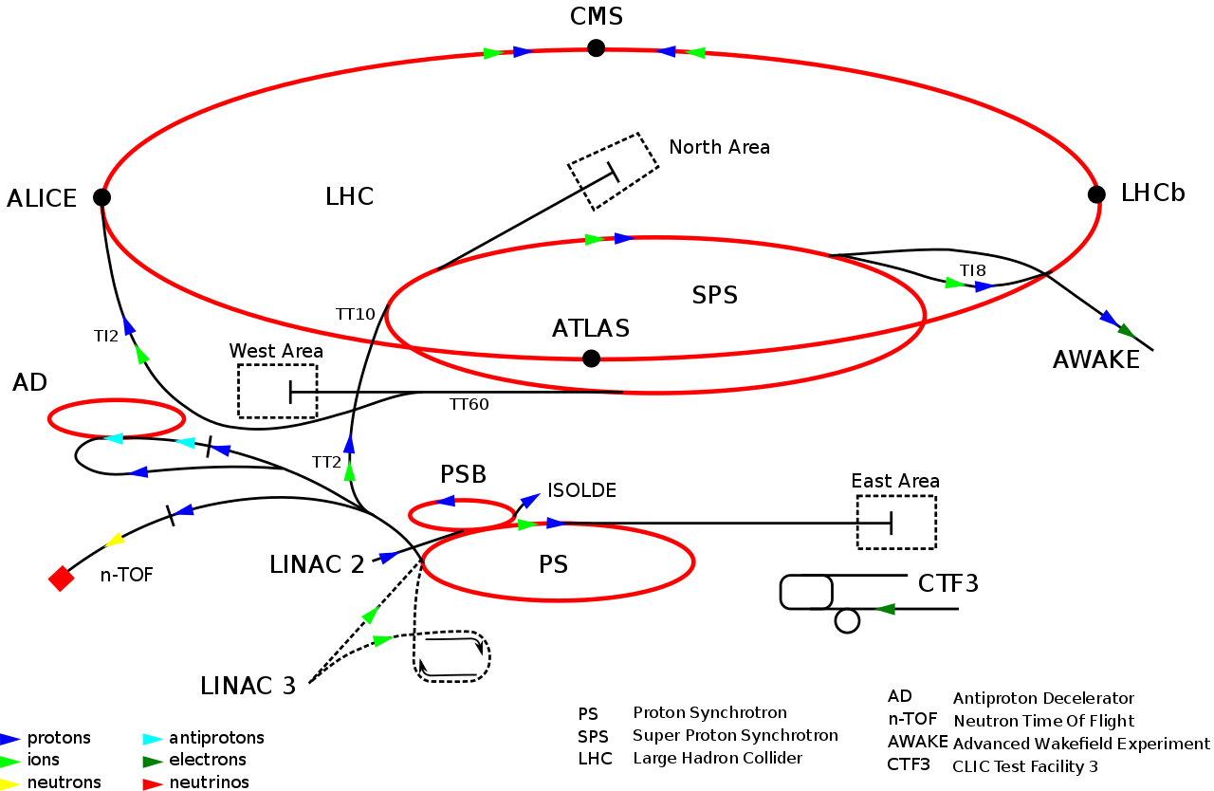
The biggest machine: LHC (CERN), 2008
LHC is responsible for accelerating protons from 450 GeV up to 7000 GeV to collide in the four experimental points
450 GeV protons injected into LHC from the SPS
PS injects into the SPS (Super Proton Synchrotron)
LINACS injects into the PS
The LHC (Large Hadron Collider) consists of a 27-kilometer ring of SC magnets with a number of SC accelerating structures to boost the energy of the particles along the way. Inside the accelerator, two high-energy particle beams travel at close to the speed of light before they are made to collide. The beams travel in opposite directions in separate beam pipes – two tubes kept at ultrahigh vacuum. They are guided around the accelerator ring by a strong magnetic field maintained by superconducting electromagnets.

Slide 31
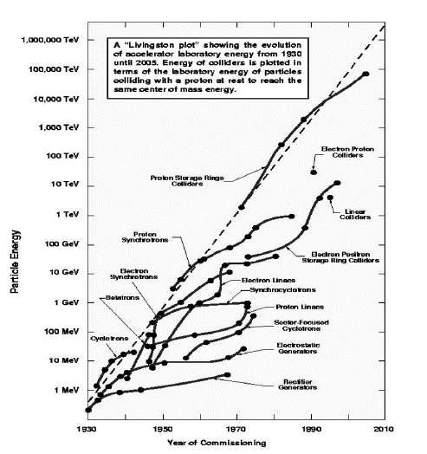
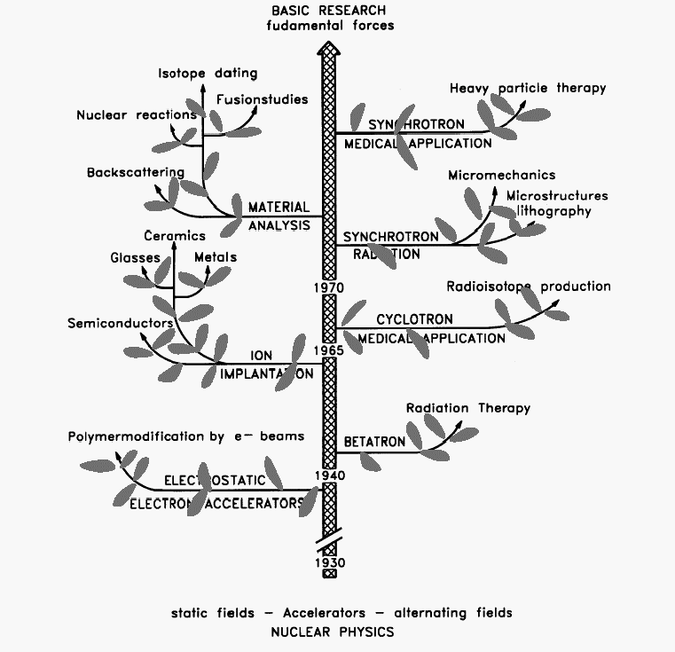
Livingstone plot
In 1950 Livingstone represented the energy of accelerators expressed on a semi-logarithmic scale as a function of the year of construction by observing linear growth. The increase in energy by a factor of 33 every decade is mainly due to discoveries and technological advances. The other applications then branched off from basic research.

Slide 32
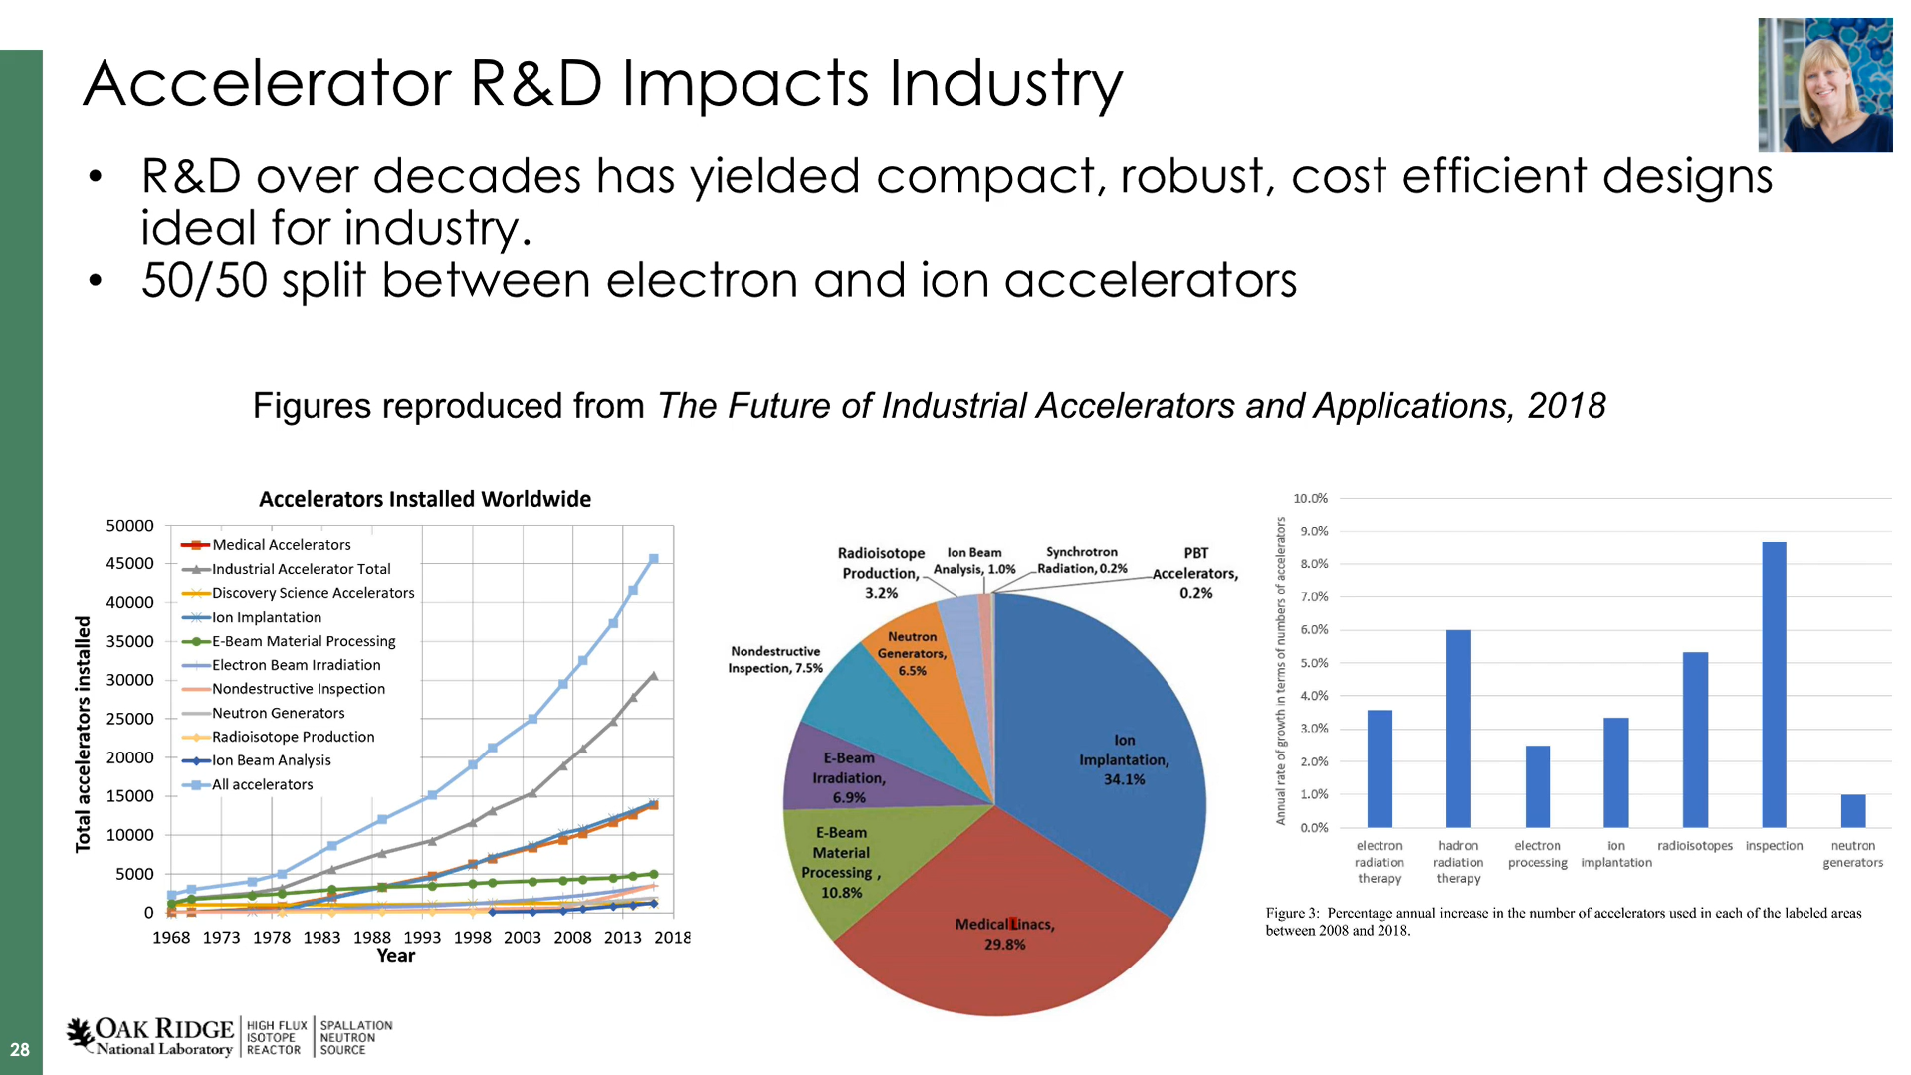
Make your own Accelerator!
The choice of the accelerating structure depends on the application, which also determines the most important parameters:
Energy
Beam Current
Kind of accelerated particle
PBT=Proton Beam Therapy
https://www.osti.gov/servlets/purl/1468902

Slide 33
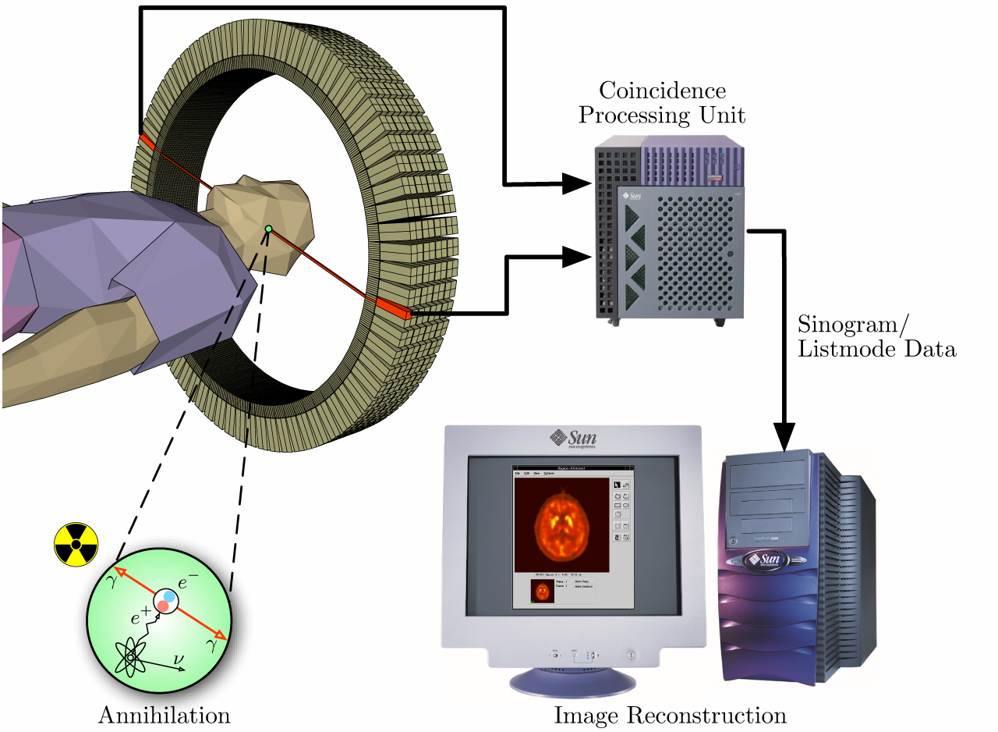
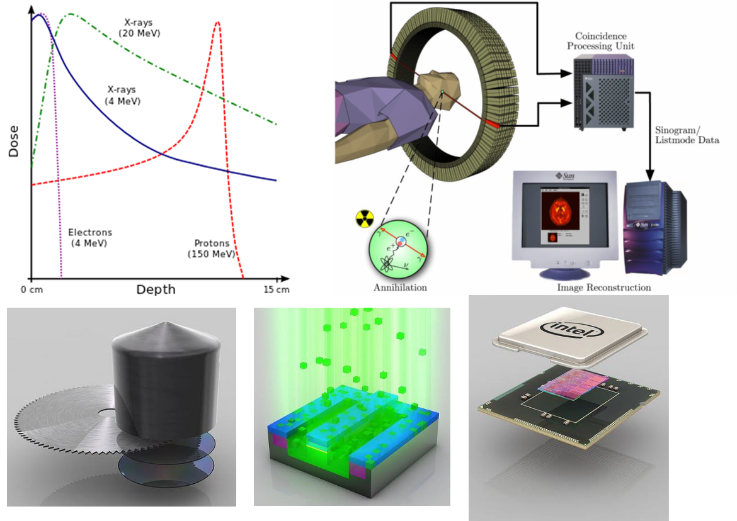
Accelerators in Medicine
Diagnosis
The production of the isotopes for PET (Positron Emission Tomography) is obtained via Cyclotrons for protons or deuterons at energies from 10 to 40 MeV then focused on a target.
Another diagnostic technique uses high fluxes of X-rays produced by synchrotron radiation (linear accelerators for electrons)
Therapy
X-rays or γ-rays are most commonly used in radiotherapy. In fact, with the synchrotron light produced by a circular accelerator for electrons, high flows are reached and often also higher energies and therefore higher penetration power.
Accelerators of 5, 20, 40 MeV are now industrially produced.
The major advances in cancer therapy have been achieved both by improving the diagnostic means of localizing malignant cells and by using particle beams with more penetrating power and greater energy loss in the tumor area (e.g. protons or C nuclei)
Increasingly used circular accelerators for protons or ions (12C), modulated in energy so as to have the maximum radiation at the depth of the tumor.

Slide 34

Accelerators in Industry
Ion Implantation
Electrostatic accelerators (energy of a few MeV, currents less than 10 mA) are used to deposit ions in semiconductors.
Sterilization
Electron beams for sterilization of medical devices (gloves, syringes, etc.)
Electron beams or X-rays obtained from food pasteurization accelerators
Food irradiation treatment is used:
– to reduce the microbial load in the food product and therefore reduce the health risks associated with certain products linked to the presence of pathogenic microorganisms
– to extend the shelf life of the products
– to prevent sprouting of potatoes, garlic and onions

Slide 35
Molecular, Cellular, Crystallographic Analysis (Synchrotron Light Rings)
Synchrotron radiation or synchrotron light is electromagnetic radiation generated by charged particles, usually electrons or positrons, which travel at velocities close to the speed of light and are forced by a magnetic field to move along a curved trajectory. The higher the speed of the particle, the shorter the wavelength of the emitted radiation and generally the emission peak occurs at X-ray lengths

Slide 36
AI and Accelerators
Accelerators are complex systems, composed of hundreds/thousands of parts. Their setup and optimization requires complex procedures, involving hundreds to thousands of parameters at a time.
Typically, humans cannot simultaneously manage such large parametric spaces, without relying on physical laws (which, by correlating the parameters, decrease the possible “dimensions”), or by tackling one parameter at a time, reducing the multidimensional space to many 1-dimensional problems.
In some cases, standard procedures may be impractical (incomplete models) or too slow.
Therefore, thanks to machine learning and deep learning techniques, AI is used for:
Optimization of particle beam transport
Predictive maintenance
Analysis of experimental data
Automatic control

Slide 37
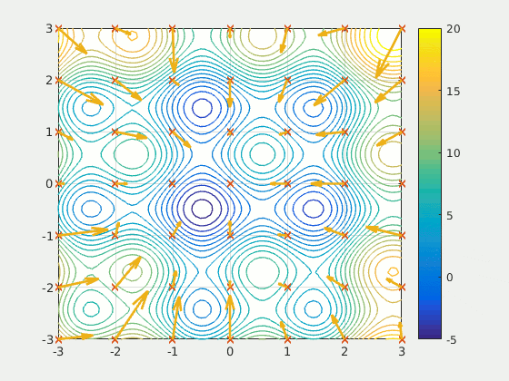
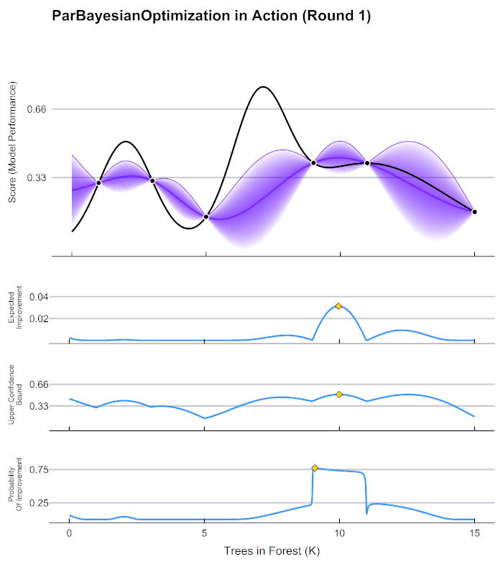
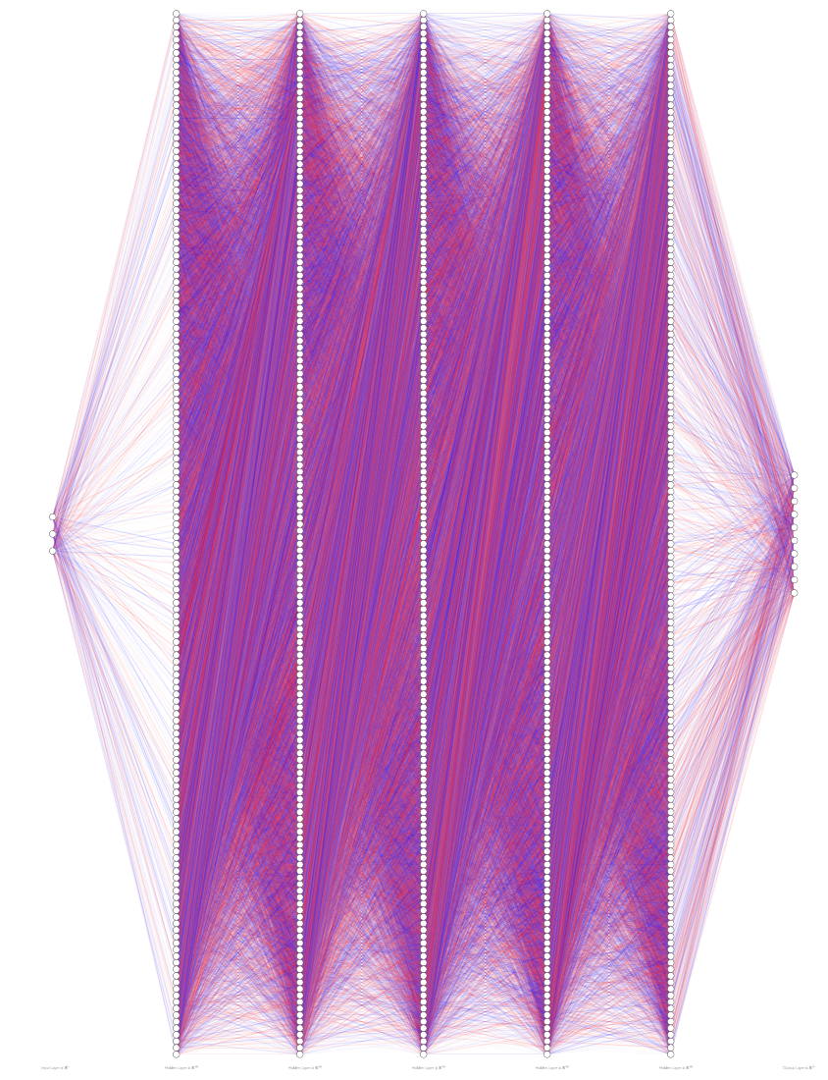
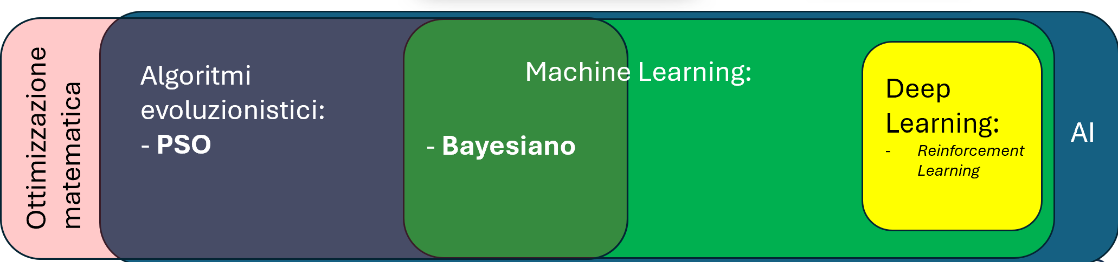
AI and Accelerators (2): a possible Classification
Hidden Layers
input
output
PSO (Particle Swarm Optimization), intelligenza di sciame
Neural Network
Bayes, Machine Learning
Input Layer: Contains neurons that receive the initial data (e.g., pixels of an image, numerical values, words of a text).
Hidden Layers: They are composed of artificial neurons connected to each other. Each neuron receives signals from the previous layer, processes them with weights and mathematical functions, and sends the result to the next layer. The more hidden layers there are, the more the network is able to recognize complex structures in the data.
Output Layer: Provides the final result, which can be a classification (e.g., "cat" or "dog") or a numerical value (e.g., a price prediction).

Slide 38
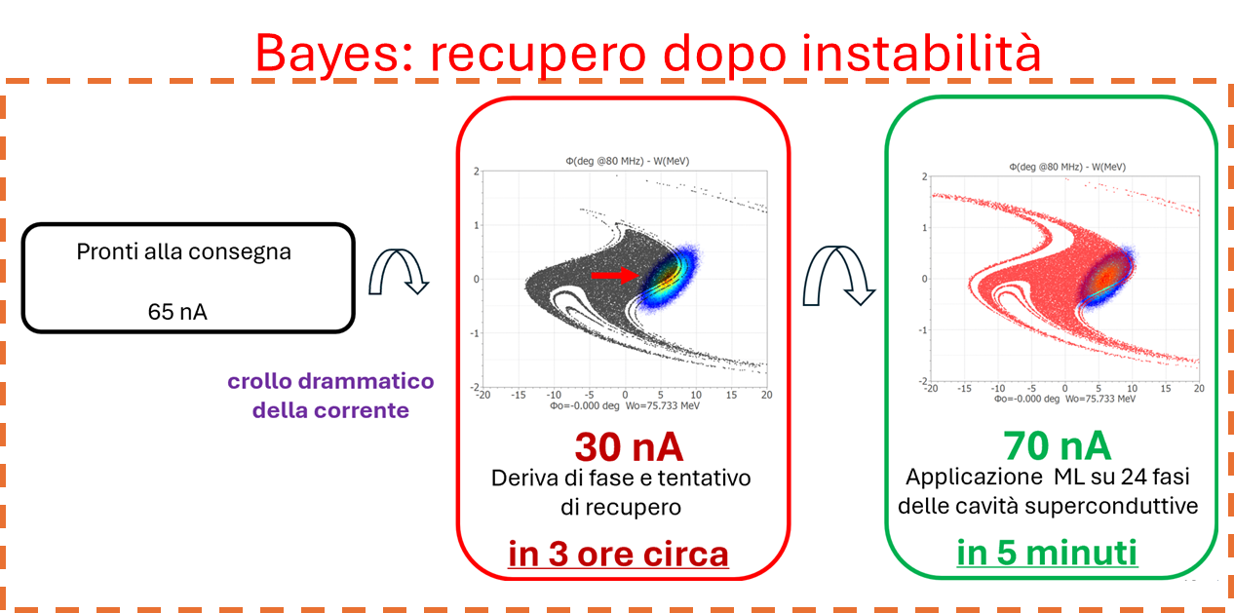
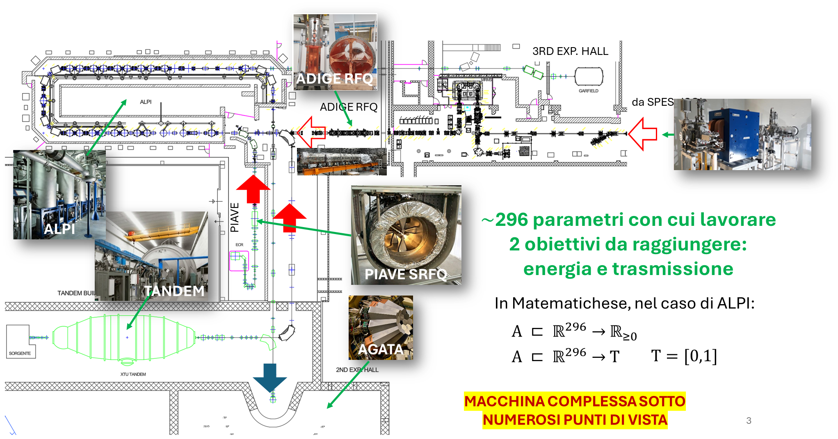
AI and Accelerators(3): application to LNL Accelerators
Ability to optimize and “move” in large parametric spaces, with speed.
Overall view of the problem to be solved and integration of the physical structure of the problem into mathematical structures.
Time gain and absolute values. In accelerators, these are transmission values ​​and setup/design times

Slide 39
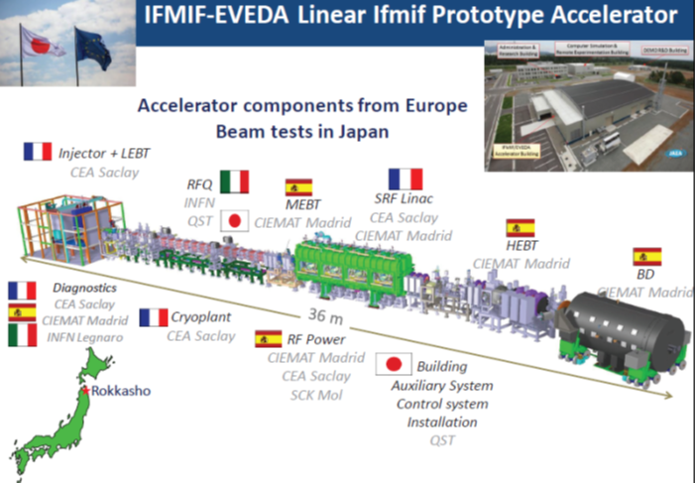
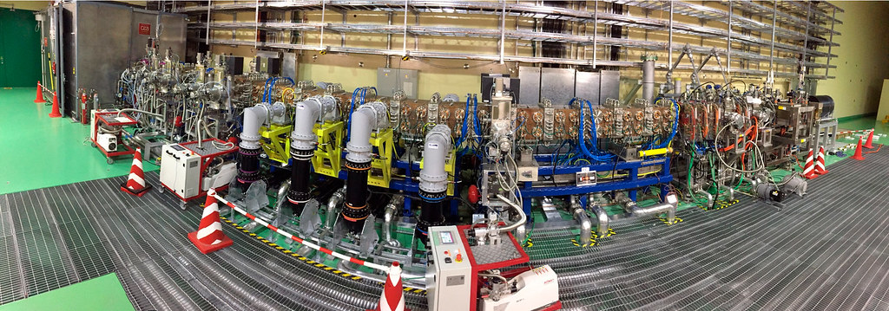
Legnaro Laboratories and their commitment to the latest generation Accelerators: The IFMIF-LIPAc project
The International Fusion Materials Irradiation Facility, (IFMIF), is a facility for testing candidate materials for use in fusion reactors. IFMIF must produce an extremely intense neutron flux, with energy characteristics similar to those that will occur in a fusion reactor. To generate this flux, two Deuteron Particle Accelerators in parallel are able to accelerate a current Ib=125 of D+ up to the energy W=40 MeV. The beam power Pb=Ib*W/q=125 mA*40 MeV*2=10MW.
The IFMIF prototype accelerator (LIPAc), which has a final energy of 9 MeV for a beam power of 1125 kW.
www.ifmif.org
Highlighted RFQ (INFN contribution to the project)

Slide 40
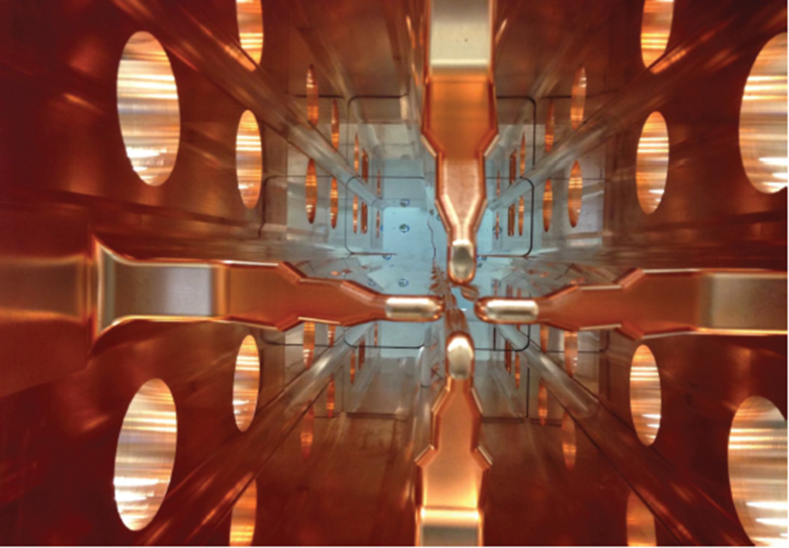

Legnaro Laboratories and their commitment to the latest generation Accelerators: The IFMIF-LIPAc project (2)
Highlighted RFQ (INFN contribution to the project)
RFQ of the IFMIF project (www.ifmif.org), 175 MHz, 125 mA of Deuterons, 5 MeV of final energy, 18 mechanical modules for a total length of 9.9 m and a RF power consumption of 1.25 MW (0.625 MW for the beam and 0.625 MW on copper), designed and installed by INFN (LNL-PD-To-Bo), currently under testing in Rokkasho (Japan). The RFQ is made of OFHC copper and steel, and must keep final mechanical tolerances of electrode positioning in the order of 0.1 mm

Slide 41

Legnaro Laboratories and their commitment to the latest generation Accelerators: The SPES project
The SPES Radio Frequency Quadrupole (RFQ) (https://www.lnl.infn.it/spes/) is the first stage of acceleration of the ion beams that will be further accelerated by the ALPI linac.
The RFQ accelerates these beams from an initial velocity equal to 0.35% of the speed of light to a final velocity equal to 3.6% of the speed of light
At the same time the RFQ divides the beam into "packets" and keeps it around the beam axis, so that ALPI can accelerate it efficiently.
Amplifier
RFQ
L’RFQ è installato in Area 2: si nota che è composto da 6 moduli

Slide 42




Legnaro Laboratories and their commitment to the latest generation Accelerators: The SPES project (2)
Assembly at the INFN Legnaro National Laboratories of one of the 6 modules of the SPES project RFQ, suitable for the acceleration of heavy ions for a charge-mass ratio between 3 and 7, beam current <1mA and operating at a frequency of 80 MHz. The electrodes are made of pure copper and the tank is made of copper-plated steel.

Slide 43



Legnaro Laboratories and their commitment to the latest generation Accelerators PNRR-ANTHEM project
The aim of the ANTHEM project (https://fondazioneanthem.it/) is to develop an innovative therapeutic solution, to obtain a therapy for those tumors that cannot be treated with conventional approaches. In particular, the main objective of the intervention is the creation of a BNCT structure in Caserta, using technologies, computer science and nuclear physics methods already available at INFN complemented by the biological and clinical skills of UNICAMP.
BNCT (Boron neutron capture therapy) Principle
Principle
Neutron Source: Proton Accelerator
The RFQ of the ANTHEM project, 352.2 MHz, 30 mA of Protons, 5 MeV of final energy, 6 mechanical modules for a total length of 7.13 m and an RF power consumption of 0.85 MW (0.15 MW for the beam and 0.7 MW on copper), powered by 8 solid state amplifiers.

Slide 44


A modern Linac: the ESS Accelerator in Lund (Sweden)
Rosso: strutture normalconduttive
Blu : strutture superconduttive
The European Spallation Source (ESS) (https://europeanspallationsource.se/) will be the most intense neutron source operating in the world. It is a pan-European infrastructure to accommodate a scientific community of about 5000 researchers. The low-energy neutron beams that will be made available will allow new experimental opportunities for real-time, in situ, in vivo measurements, including measurements of dynamic events on the nanometric scale. The Project, from a technical point of view, foresees the production of neutrons by the spallation reaction of protons on a rotating tungsten target. A proton pulse of energy 2.5 GeV, duration 2.86 ms and frequency 14 Hz will arrive on the target (current 50 mA, total power on the target 5 MW, instantaneous power 125 MW). The laboratory is located in Lund (Sweden). LNL (together with INFN Turin) are engaged in the design, installation and testing of the 5 DTL Tanks

Slide 45



DTL Installation and tests
1. MAT: DT assembly on module
2. TAT: Module connection
3. Tuning
4. Trolley e Cooling system
DTL3
DTL1
DTL4
The first Tank is installed in the tunnel after having done the tuning measurements and all the mechanical, vacuum and hydraulic tests.
Meanwhile, the other tanks, in the various "evolutionary" phases, are being assembled and tested.
 | Date
Tank1 | 18 Aug. 2021
Tank2 | 19 Dec. 2022
Tank3 | 11 Oct. 2022
Tank4 | 9 Sept. 2022
Tank5 | 25 Sept. 2023
The set of 5 tanks finally installed in the tunnel

Slide 46

Final Considerations
The design, construction and commissioning of a particle accelerator is a very versatile task and requires various skills. That includes physics, engineering (electrical/electronic, thermal, mechanical, fluid dynamics), material science, management skills etc.
Power Electronics
Material Science, Thermodynamics
Mechanical Engineering
Infrasturucture Engineering
Superconductivity and Cryogenics
Vacuum Technology
Circuit Design
Radio Frequency and Microwaves
Software Engineering
Control System Engineering
Baeam Dynamics/ beam optics
Electrodynamics
Plasma Physics
Administration and Accounting
Project Management

Slide 47

…and that is that.

