Slide 1
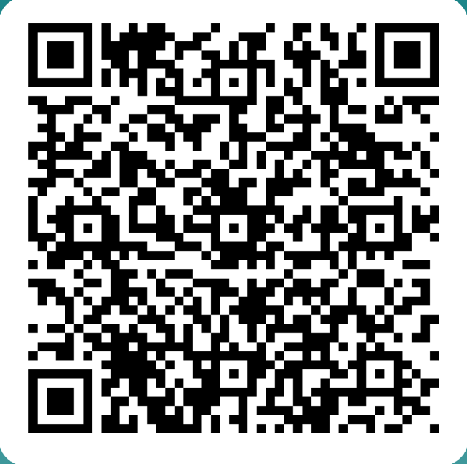
While waiting, please fill out this survey

Slide 3

Useful info
Attendance | Please use the INFN badge the check in and check out and report any delays and absences to the INSPYRE team (main method: mail to silvia.martin@lnl.infn.it and andrea.gozzelino@lnl.infn.it)
Canteen | Lunch break: around 1:10 pm (please stay in the canteen not more than 40 minutes). Please sign the list at the cashier’s desk and use the badge
Contacts | Silvia Martin: phone 440 or 665 Andrea Gozzelino: phone 346, office E-101
Useful phone numbers | Emergency phone number 888

Slide 4
Remarks
Please always wear your INSPYRE badge
Please use every day the INFN badge three times: morning, lunchtime, evening
Please check if you have filled out the "Information Notice on Processing of Personal Data by INFN" document

Slide 5
Share your experience @LNL
Social media: #INSPYRE2025

Slide 6
Group photo
Thursday, July 17 th 2025 morning
in Ceolin room/welcome center

Slide 7
Social event
Thursday, July 17 from 5:15 pm to 7:00 pm
in caffetteria area
Scienza per tutti game with cards

Slide 8
A simple rule
Ask, ask, and ask

Slide 9
andrea.gozzelino@lnl.infn.it and silvia.martin@lnl.infn.it
Doubts, communications, …

Slide 10
Safety @LNL
Injures in 2024 in Italy = 511.688
(1077 with death as conseguence)
We are ALL workers for INFN LNL !!!

Slide 11
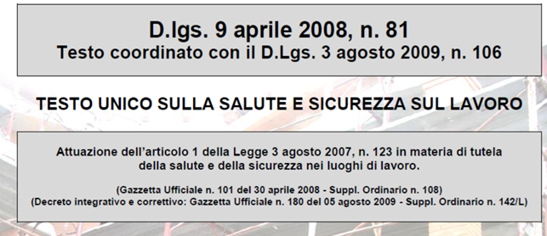
Safety @LNL
Our home is the most dangerous work space, but also in the labs there are risks!
We MUST follow the rule:

Slide 12
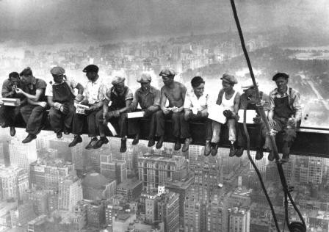
Safety @LNL
Lunch atop a Skyscraper - New York 1932

Slide 13
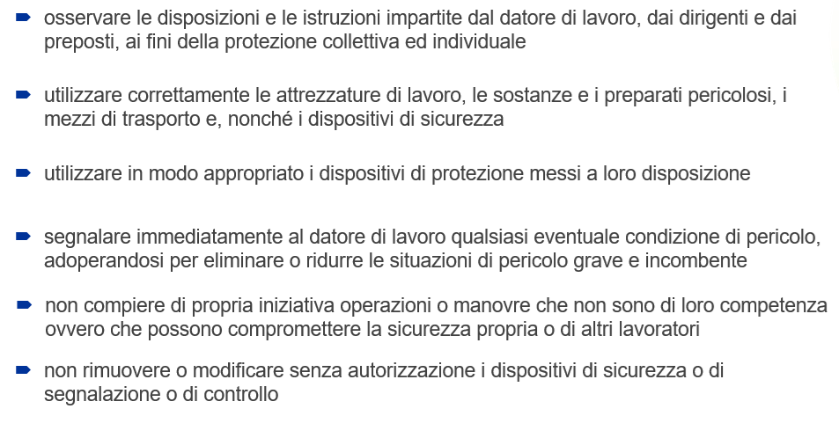
Safety @LNL
Tutor’s guidelines
A cable is a cable!
Gloves are gloves
I see a fire, I call 888
It seems hot, I do NOT touch!
I see a red light, but I switch OFF it to continue

Slide 14




















A) segnale di divieto:
Not to do
B) segnale di avvertimento:
Advise
C) segnale di prescrizione:
Take an action before
D) segnale di salvataggio o di soccorso:
Safety tools
E) segnale di informazione:
Info

Slide 15
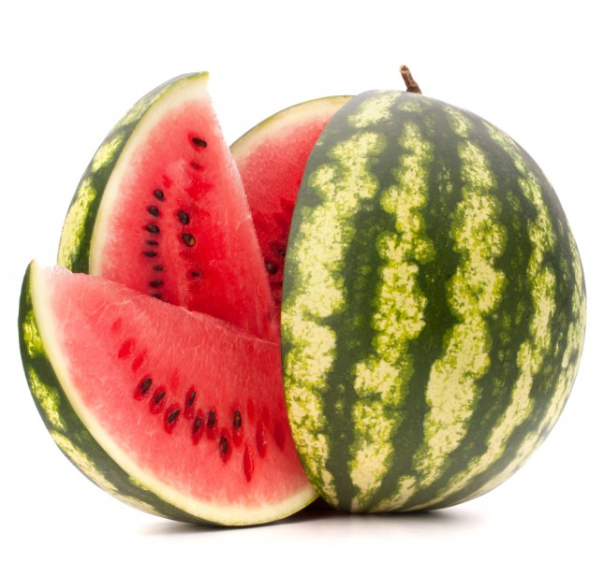
About the risk
Your feeling, your experience,
your guess, …

Slide 16
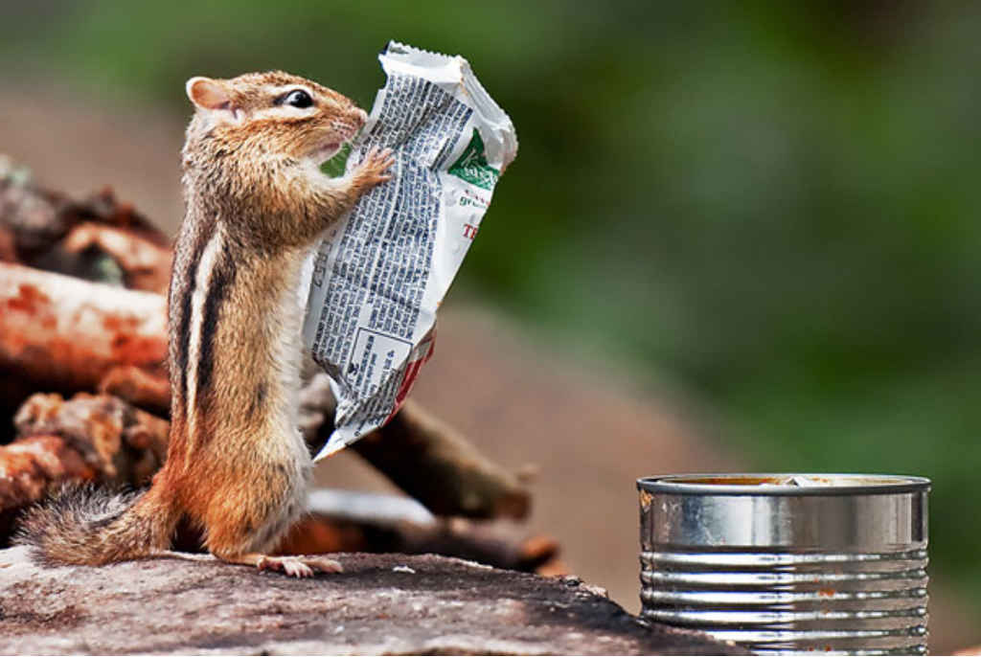
Instructions
Read documents

Slide 17
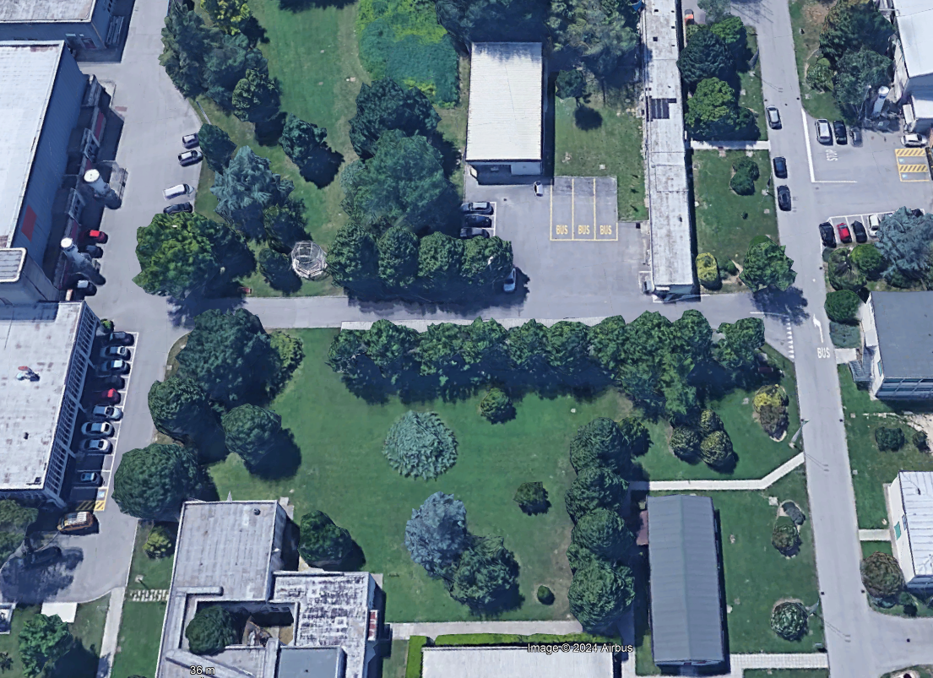
Assembly point

Slide 18
Ice breaking activity

Slide 19
1. Wait for the formation of the 4 teams
2. Everybody should write on a post-it 2 statements about themselves. Choose something interesting / fun / unexpected:
«I know by heart all the provinces in the Italian Lombardy region»
«I can bend my tongue in half»
Phase 1 – 10 minutes

Slide 20
1. Share your 2 statements with your team
2. Vote among the team which statement is the most interesting / fun / unexpected
Phase 2 – 15 minutes

Slide 21
1. Each team chooses one candidate as a representative for the final game
2. The representative comes to the desk and tell us the chosen statment
3. All teams vote for the best statement
Phase 3 – 10 minutes

Slide 22
And now…let’s form the groups!

Slide 23
Group 1
James Watson
Niels Bohr
Alan Turing
Maria Goeppert-Mayer
Sally Ride
Emmy Noether
Grace Hopper
Group 2
Stephen Hawking
Charles Darwin
Enrico Fermi
Valentina Tereshkova
Rosalind Franklin
Fabiola Gianotti
Hedy Lamarr

Slide 24
Group 3
Isaac Newton
James Clerk Maxwell
Richard Feynman
Ada Lovelace
Jocelyn Bell
Vera Rubin
Henrietta Leavitt
Group 4
Francis Crick
Galileo Galilei
Marie Curie
Lise Meitner
Chien-Shiung Wu
Andrea Ghez
Hertha Ayrton

Slide 25
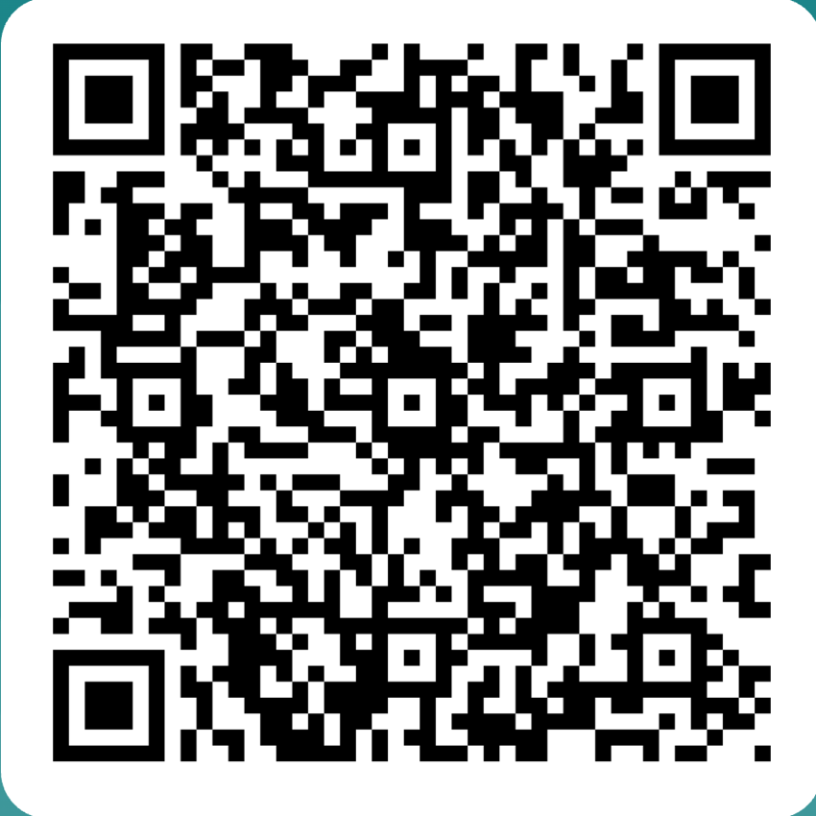
Final questionnaire

Slide 27

Thanks to

Slide 28
Thanks to
Matteo Albèri, Anna Bianchi, Giovanni Casini, Daniele Cesini, Davide Ford, Nedime İrem Elek, Antonio Palmieri, Sara Pirrone, Lorenzo Pranovi, Valentino Rigato, Marco Ripani, Carlo Roncolato

