Slide 1
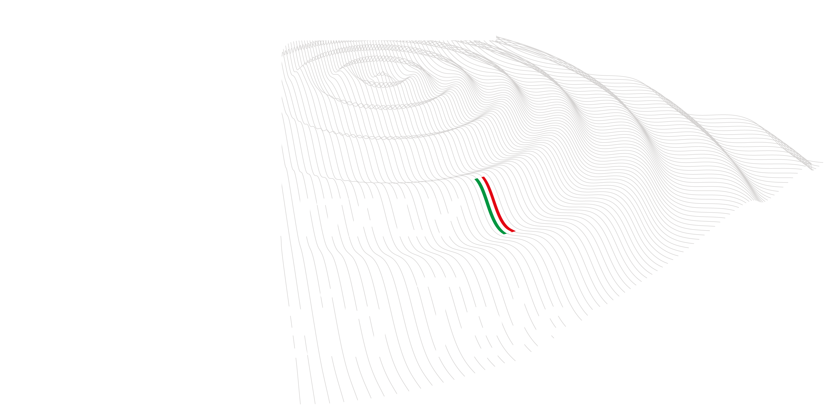
a plan for an applied physics and engineering laboratory for gravitational waves
E. Majorana
Sapienza Univ. di Roma
INFN Sezione di Roma
VanLong Hoang
Sapienza Università 4-04-2025
Missione 4 • Istruzione e Ricerca - ETIC

Slide 2
Missione 4 • Istruzione e Ricerca - ETIC

Slide 3
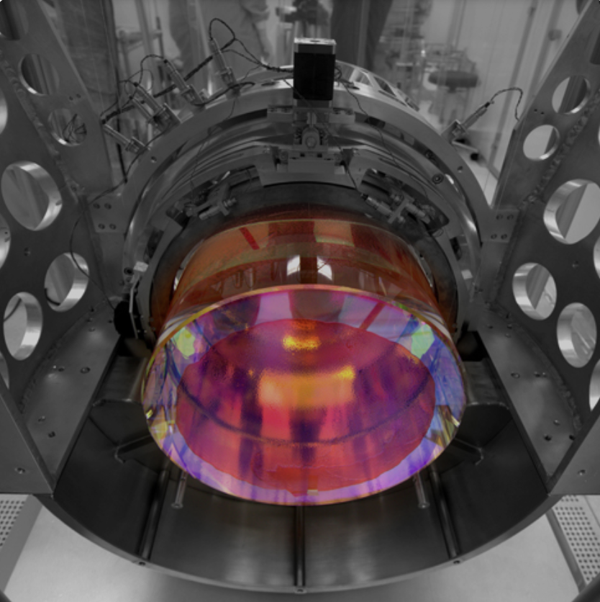
The mirrors are big objects
From the present ones 42 kg to the big ones 200 kg !
The position of the reflective surface fluctuates as a function of temperature and mechanical dissipation
WE MUST MITIGATE
THIS EFFECT
Missione 4 • Istruzione e Ricerca - ETIC

Slide 4
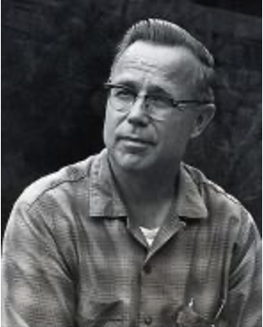
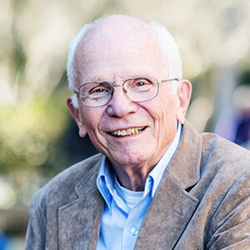
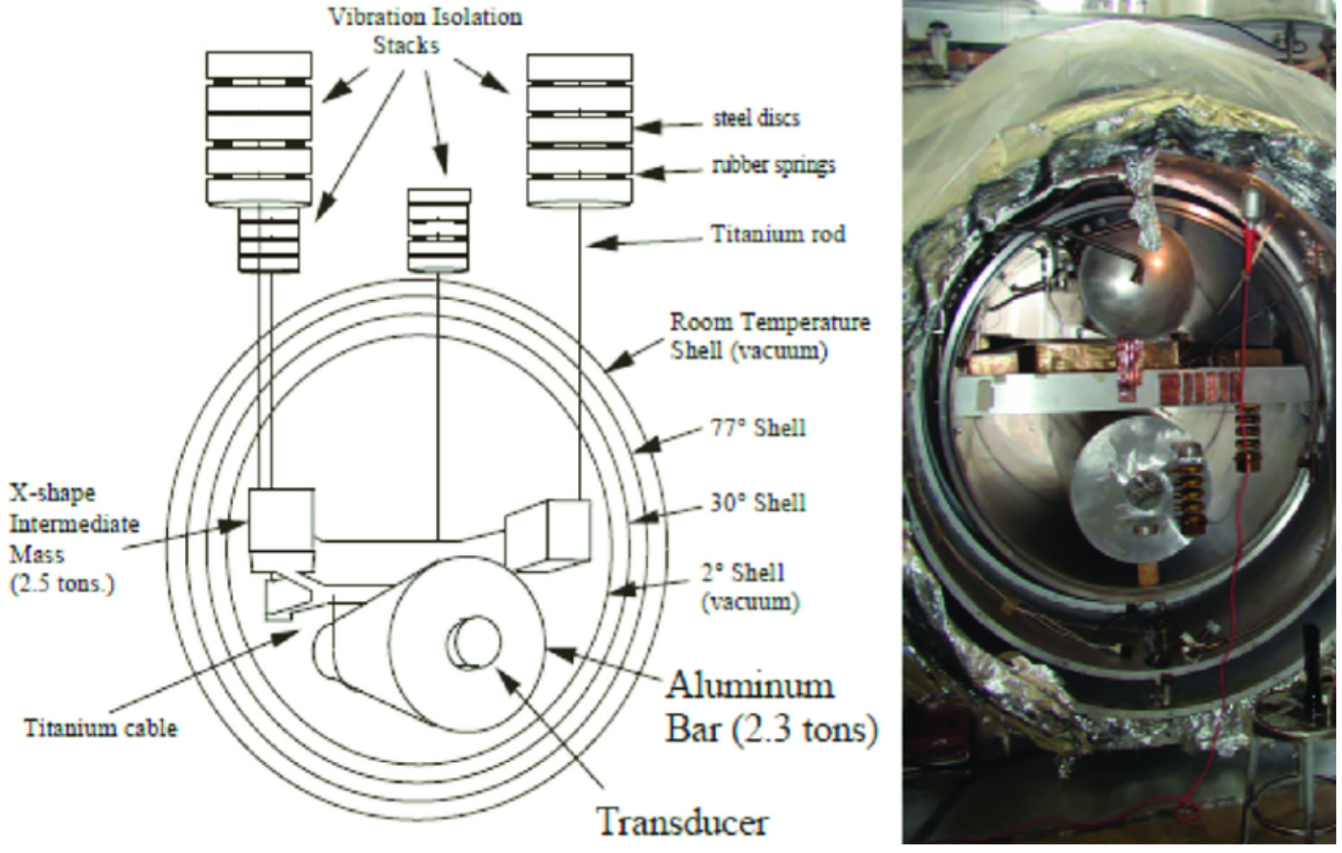
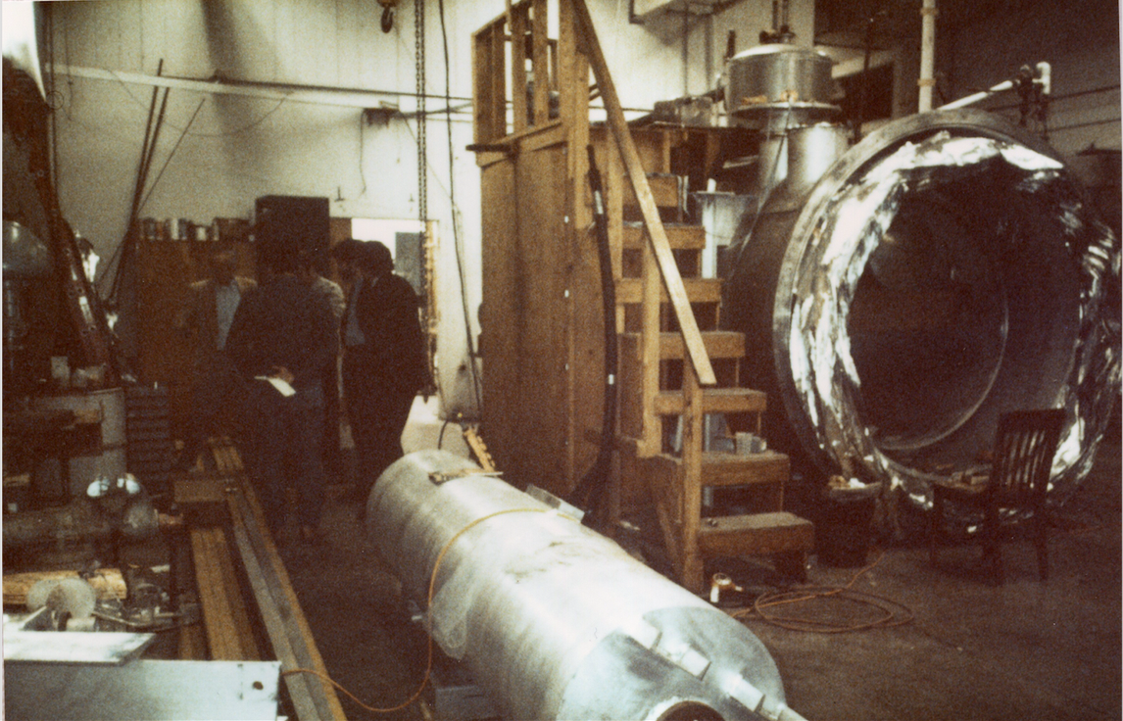
Cryogenics in physics: Fairbank’s theorem and Hamilton lemma
“Any experiment is better, if it is done at low temperature”
“Any experiment will be harder, if it is done at low temperature”
W. M. Fairbank
W. Hamilton
Missione 4 • Istruzione e Ricerca - ETIC

Slide 5
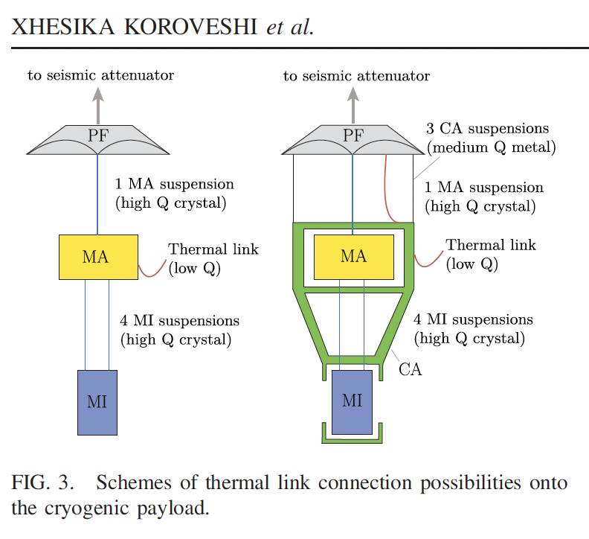
A “cold”payload
X. Koroveshi et al. PRD 108 (2023)
Missione 4 • Istruzione e Ricerca - ETIC

Slide 6
ARC, Amaldi Research Center heritage
ARC, is entitled to prof. E. Amaldi due to his visionary ability to envisage the progress of experimental fundamental physics, ranging from nuclear, to particle, cosmic ray, space, to neutrino and, finally, GW research.
In 2018, after the directional detection through LV network, the interdisciplinary excellence effort, pivoting on GW research, was funded at the Dep. of Physics of Sapienza Univ.
ARC excellence center at the Dep. of Physics of Sapienza Univ. concluded its 5-year funding term in 2022, ~750 k€ for apparatus, building provided by Sapienza (finally delivered in April 23)
ARC promotes FIVE interdisciplinary studies:
GW Data Analysis
MultiMessanger astrophysics
Quantum photonics
Surface Physics
Cryogenics for ET
Missione 4 • Istruzione e Ricerca - ETIC

Slide 7
ARC-ETCRYO
What do we want to study here ?
Viable Cryogenic payload solutions
Cooling large mass payloads through solid conduction
What is not included in the apparatus we are developing ?
Seismic Isolation. Due and crucial for actual ET design, modelling of payloads takes it into account. However, the mechanical and thermal performance of the suspensions embedded in the payload system, are not affected by Seismic Isolation system presence.
➔ Preserving the seismic isolation potentially provided by a superattenuator suspending the payload is the main constraint in cryogenic suspension system design.
Y
seismic suspension
cryogenics
Test mass payload
0.6 T
20 K
Missione 4 • Istruzione e Ricerca - ETIC

Slide 8
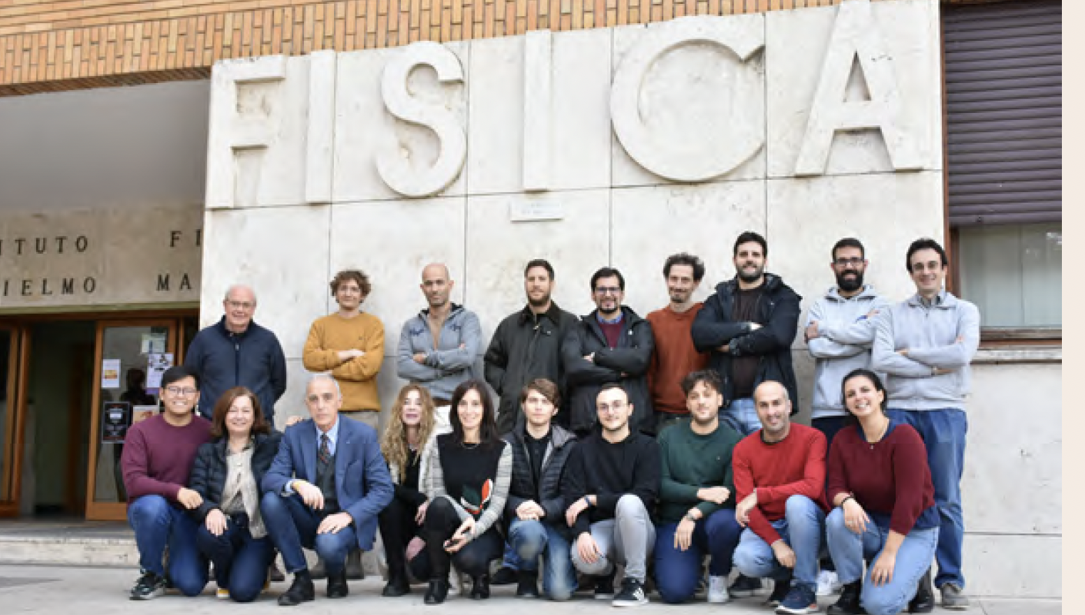
ETIC Project
WP1: Management
417.942€
WP2: Optics, Electronics and Photonics
12.266.676€
WP3: Vacuum and Cryogenics
5.228.165€
WP4: Suspensions and large interferometric facilities
10.511.601€
WP5: Computing & DAQ
1.108.177€
WP6: Sustainable Design
19.843.048€
WP7: Outreaching, Dissemination, training
623.320€
A. Grado WP coordinator
3 Operative Units in Rome
INFN-RM1@WP3: apparatus development budget (~4.2 M€) + 2 grants for fixed-term positions
UniSapienza-Fis@WP3: 2 grants for fixed term positions
UniSapienza-Ing@WP6, Sustainable Design
ET members subset in the local Research Unit
INFN | UniBO | UniCA | UniGE | UniNA | UniVanvitelli | UniPD
33.867.823.25 € | 186.574.23 € | 1.624.578.86 € | 989.113.35 € | 1.400.259.10 € | 281.035.50 € | 1.947.255.55 €
UniPG | UniPI | UniSapienza | UniRM2 | INAF | ASI | GSSI
5.079.557.50 € | 599.649.40 € | 1.550.135.75 € | 1.348.432.40 € | 407.316.90 € | 312.525.60 € | 404.674.00 €
Missione 4 • Istruzione e Ricerca - ETIC

Slide 9
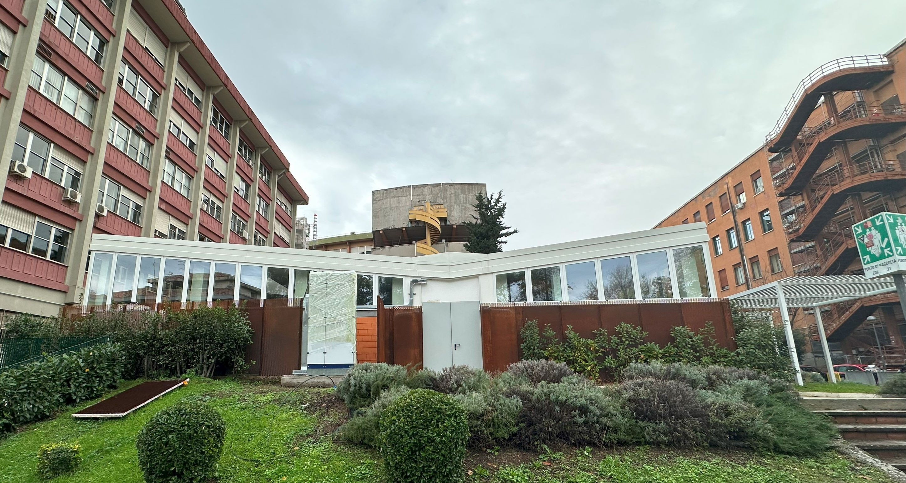
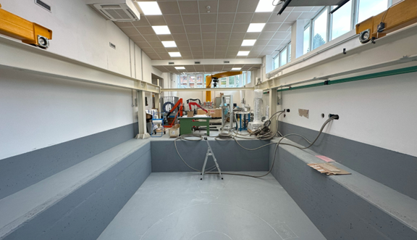
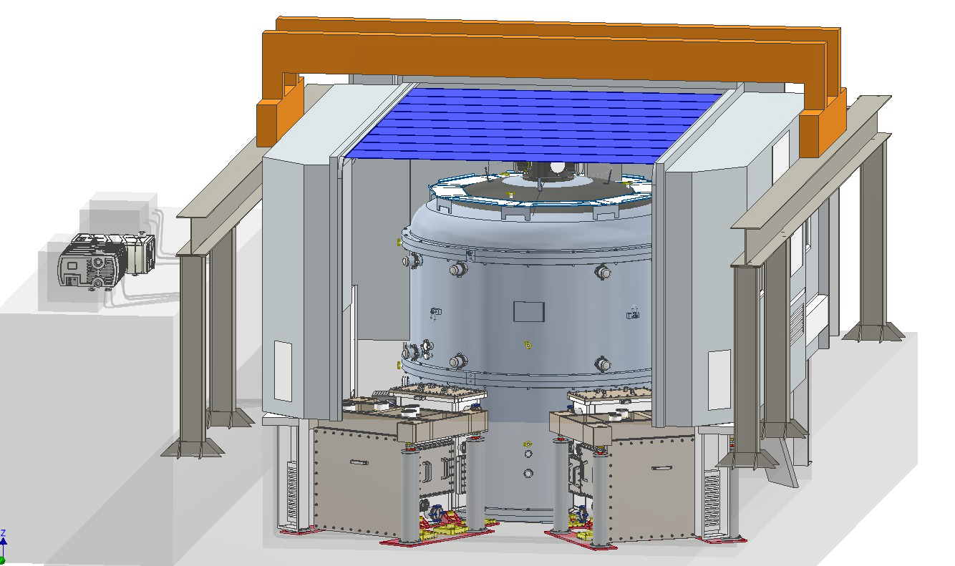
Opere Civili e impianti (adeguamento o ampliamento dei servizi)
Movimentazione
Camera pulita
Clean-booth
Cabina elettrica e comparto impianti esterno
Apparecchiature Acquisite
1° Linea di Refrigerazione con Camera di test (Fantini)
Pulse Tubes e compressori
Apparati progettati e costruiti ad hoc
2° linea di refrigerazione (04/2025)
Clean Booth (05/2025)
Criostato C75 (09/2025)
Prototipo Payload per sospensione in zaffiro (09/2025)
Lavorazioni speciali hi-tech
Coating ad alta emissività (DE) Lavorazioni speciali
campioni in zaffiro (JP, DE)
Link Termici (USA, JP)
Missione 4 • Istruzione e Ricerca

Slide 10
Missione 4 • Istruzione e Ricerca - ETIC

Slide 11
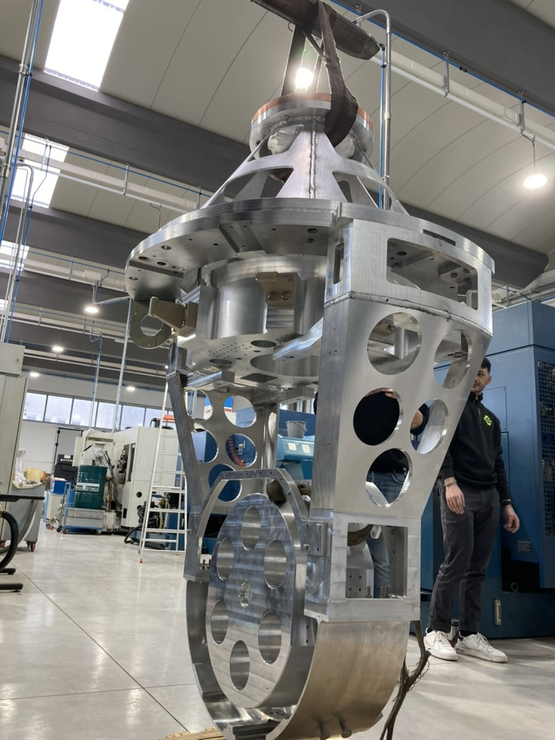
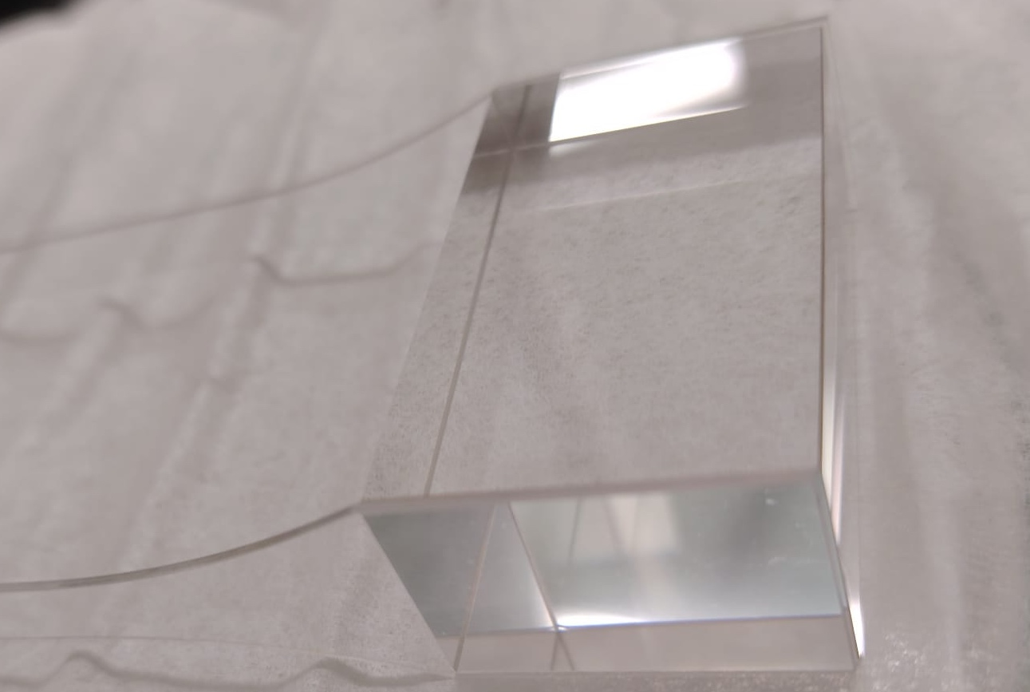
Missione 4 • Istruzione e Ricerca - ETIC

Slide 12
Missione 4 • Istruzione e Ricerca - ETIC

Slide 13
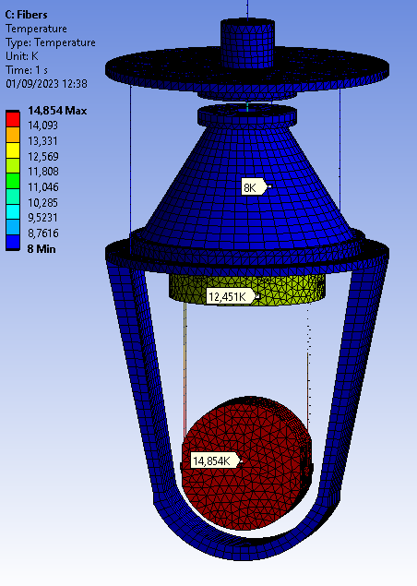
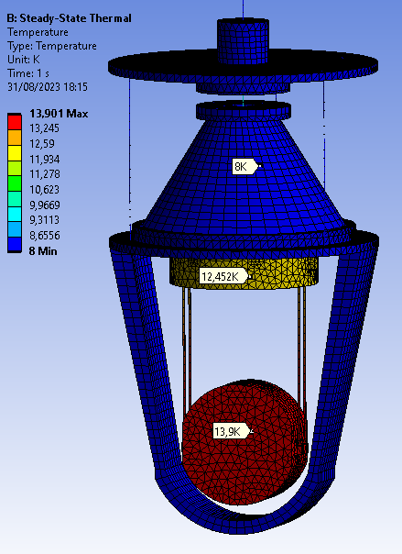
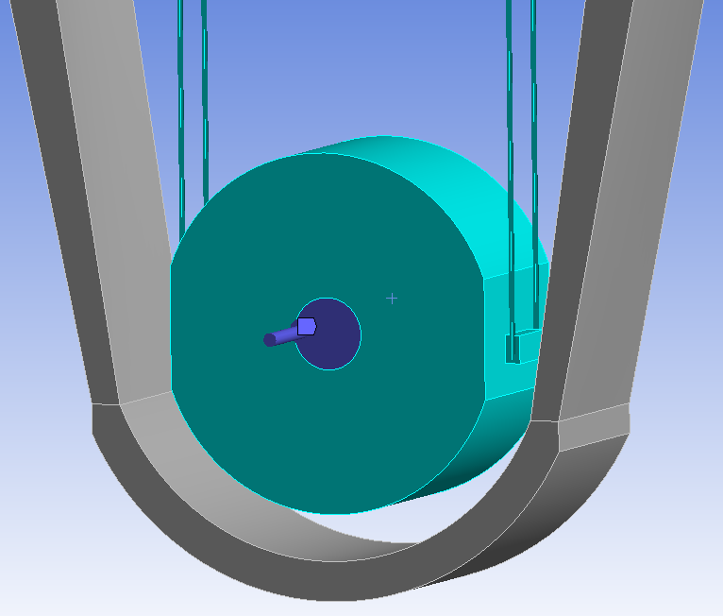
Suspensions: Steady-State Simulations for C75 payload
Sapphire Fibers
$Al_{2}O_{3}$Test Mass: 125 kg, 450 mm$∅$
PF-TM Sapphire wires: 5.4 mm $∅$, Length 800 mm
TestMass-MI Sapphire:
Fibers 2.2 mm $∅$, Length 700 mm
OR
Ribbons (thin) 6.5 mm $×$ 1 mm, Length 700 mm
Coldest Point 8K
Radiation component to 8K environment included.
High emissivity studies in Rome, dedicated to cryogenics ➔ Selection of the viable solution for both Prototype and ET cryostat ($ε=0.85)$ ~flat down to 100 K.
Sapphire Ribbons
$$P_{IN}=0.3W$$
Missione 4 • Istruzione e Ricerca - ETIC

Slide 14
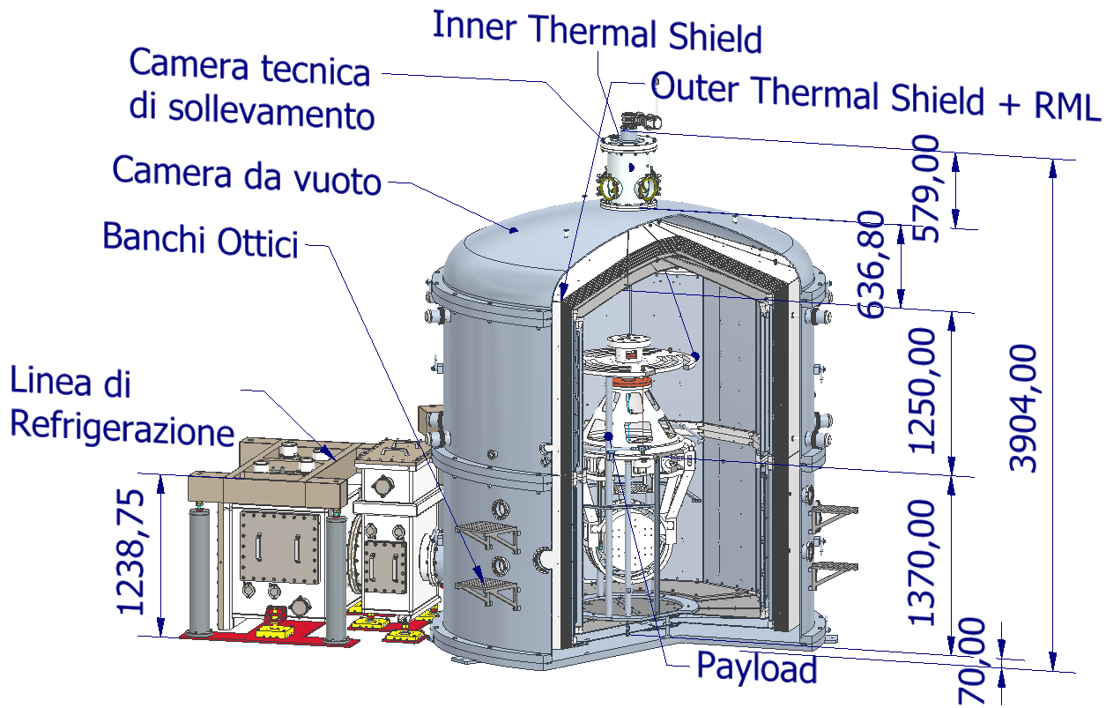
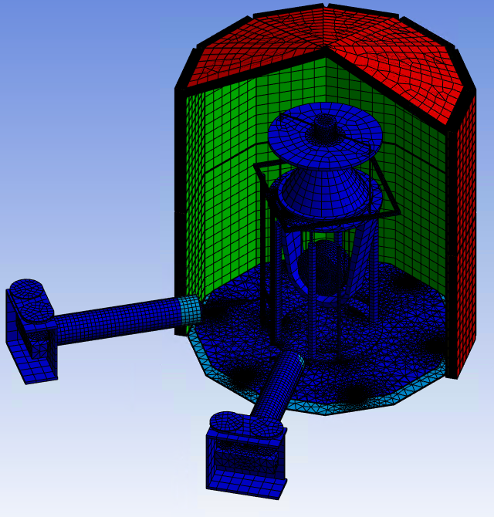
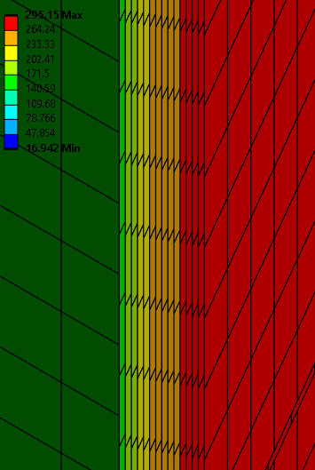
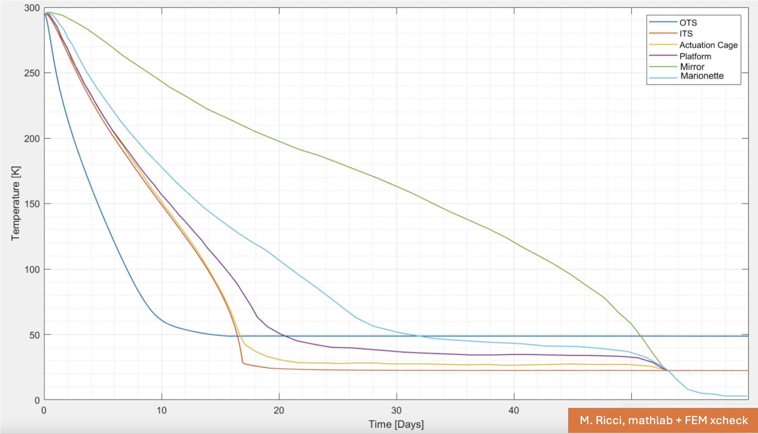
Thermal simulations
FIRST RML SYSTEM !
SBAI 2025

Slide 15
ARC-CRYOGENICS partner projects in the “Eistein Telescope galaxy”
PRIN LoVeC-ET (Low frequency Versus Cryogenics for ET), Majorana
PRIN payload prototype (including Silicon): partners: Sapienza, PG, URB TOV, INFN
KAGRA (a continuous collaborative exchange since some decades), we
discuss any cryogenic payload issue and solutions,
exchange on cryogenics, materials, technical noise, cryogenic/vacuum and sensing devices
KIT Karlsruhe Institute of Technology, Grohman
Current and Long-term plans for cryostats and payloads
ETIC-CAOS INFN, H. Vocca
Room Temperature developments for seismic attenuator interferometric facility
INFN Investment CSN5 at Napoli branch (L. Di Fiore)
EGO Vacuum & Cryogenics, A. Pasqualetti
Waiting for the ARC cryostat operation, we plan to use the facility at EGO
INFN Cuore and Cupid, Pirro and Cruciani
Directly involved in ETIC, they are spending significant and precious FTE with us
INFN LNGS, Spallino
Frost formation on cold surfaces
Missione 4 • Istruzione e Ricerca - ETIC

Slide 16
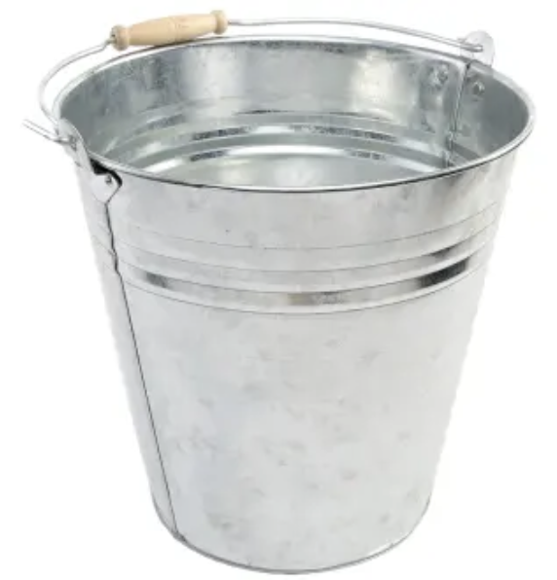
Manca ancora molto
seismic attenutor
Analyse carefully the target
cooling methods
underground infrastructure
test-mass Suspensions
Cryostats
materials
Experience with present detectors
Widening the collaboration and gathering financial resources
A “sustainanable” Technical Design
Development of experimental facilities and know-how identification
Aligning priorities and wisely schedule viable R&D milestones
Missione 4 • Istruzione e Ricerca - ETIC

Slide 17
Sinergie locali
Possiamo crescere in sinergia con altri settori di ricerca ricchi di esperienza presenti nel dipartimento, ma ciò è possibile solo seguendo da vicino le esperienze con gli attuali interferometri.
Stato dinamico delle test mass (TM)
Limiti di sensibilità del readout
Materiali a bassa dissipazione meccanica
Accoppiamento ottico tra le TestMass e readout interferoemetrico
Elettronica di Controllo
Sensoristica di vibrazione e rumore ambientale
Criogenia
I migliori specialisti del mondo non porteranno grossi contributi al TDR di ET in poco tempo senza utilizzare l’esperienza sul funzionamento degli attuali rivelatori.
Il momento per investire in questo settore e acquisire e consolidare rilevanza nella collaborazione è ORA
E’ necessario organizzare un network locale con I dipartimenti di ingegneria interessati alle tecnologie avanzate per ET con Fisica e INFN
Missione 4 • Istruzione e Ricerca - ETIC

Slide 18
Local synergies
Fruitful preliminary exchanges with
DIMA Mechanical and Aerospace Engineering Department
SBAI Basic and Applied Science Engineering Department
….
Fruitful preliminary exchanges with
Mechatronics and vibration control (seismic isolation systems and control)
Inertial sensor Sensor contamination at Low frequency (seismic isolation systems and control)
Fluid-dynamics studies (from technical issues related to detector cleanliness and residual vacuum to astrophysics)
Cryogenics (cryofluids and mechanical dynamics)
Electromagnetic pollution in underground environment (impact on sensing and actuation devices)
Special coatings dedicated to cryogenic payloads
Crystalline materials Sapphire and Silicon
…..
Missione 4 • Istruzione e Ricerca - ETIC

Slide 19
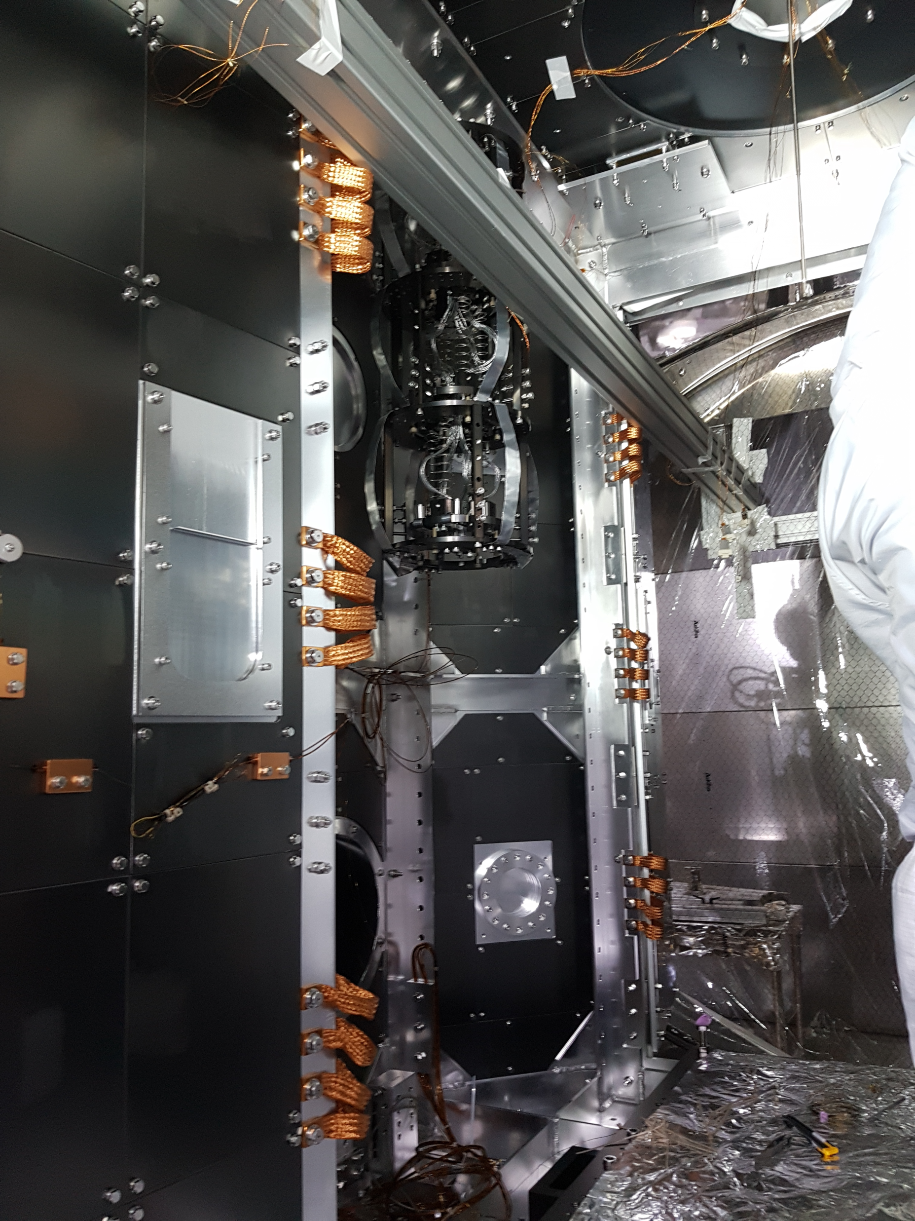
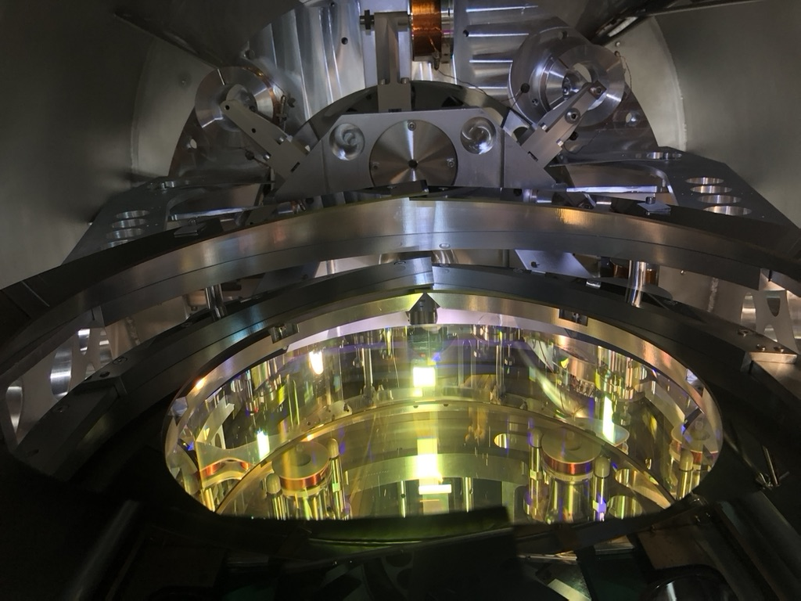
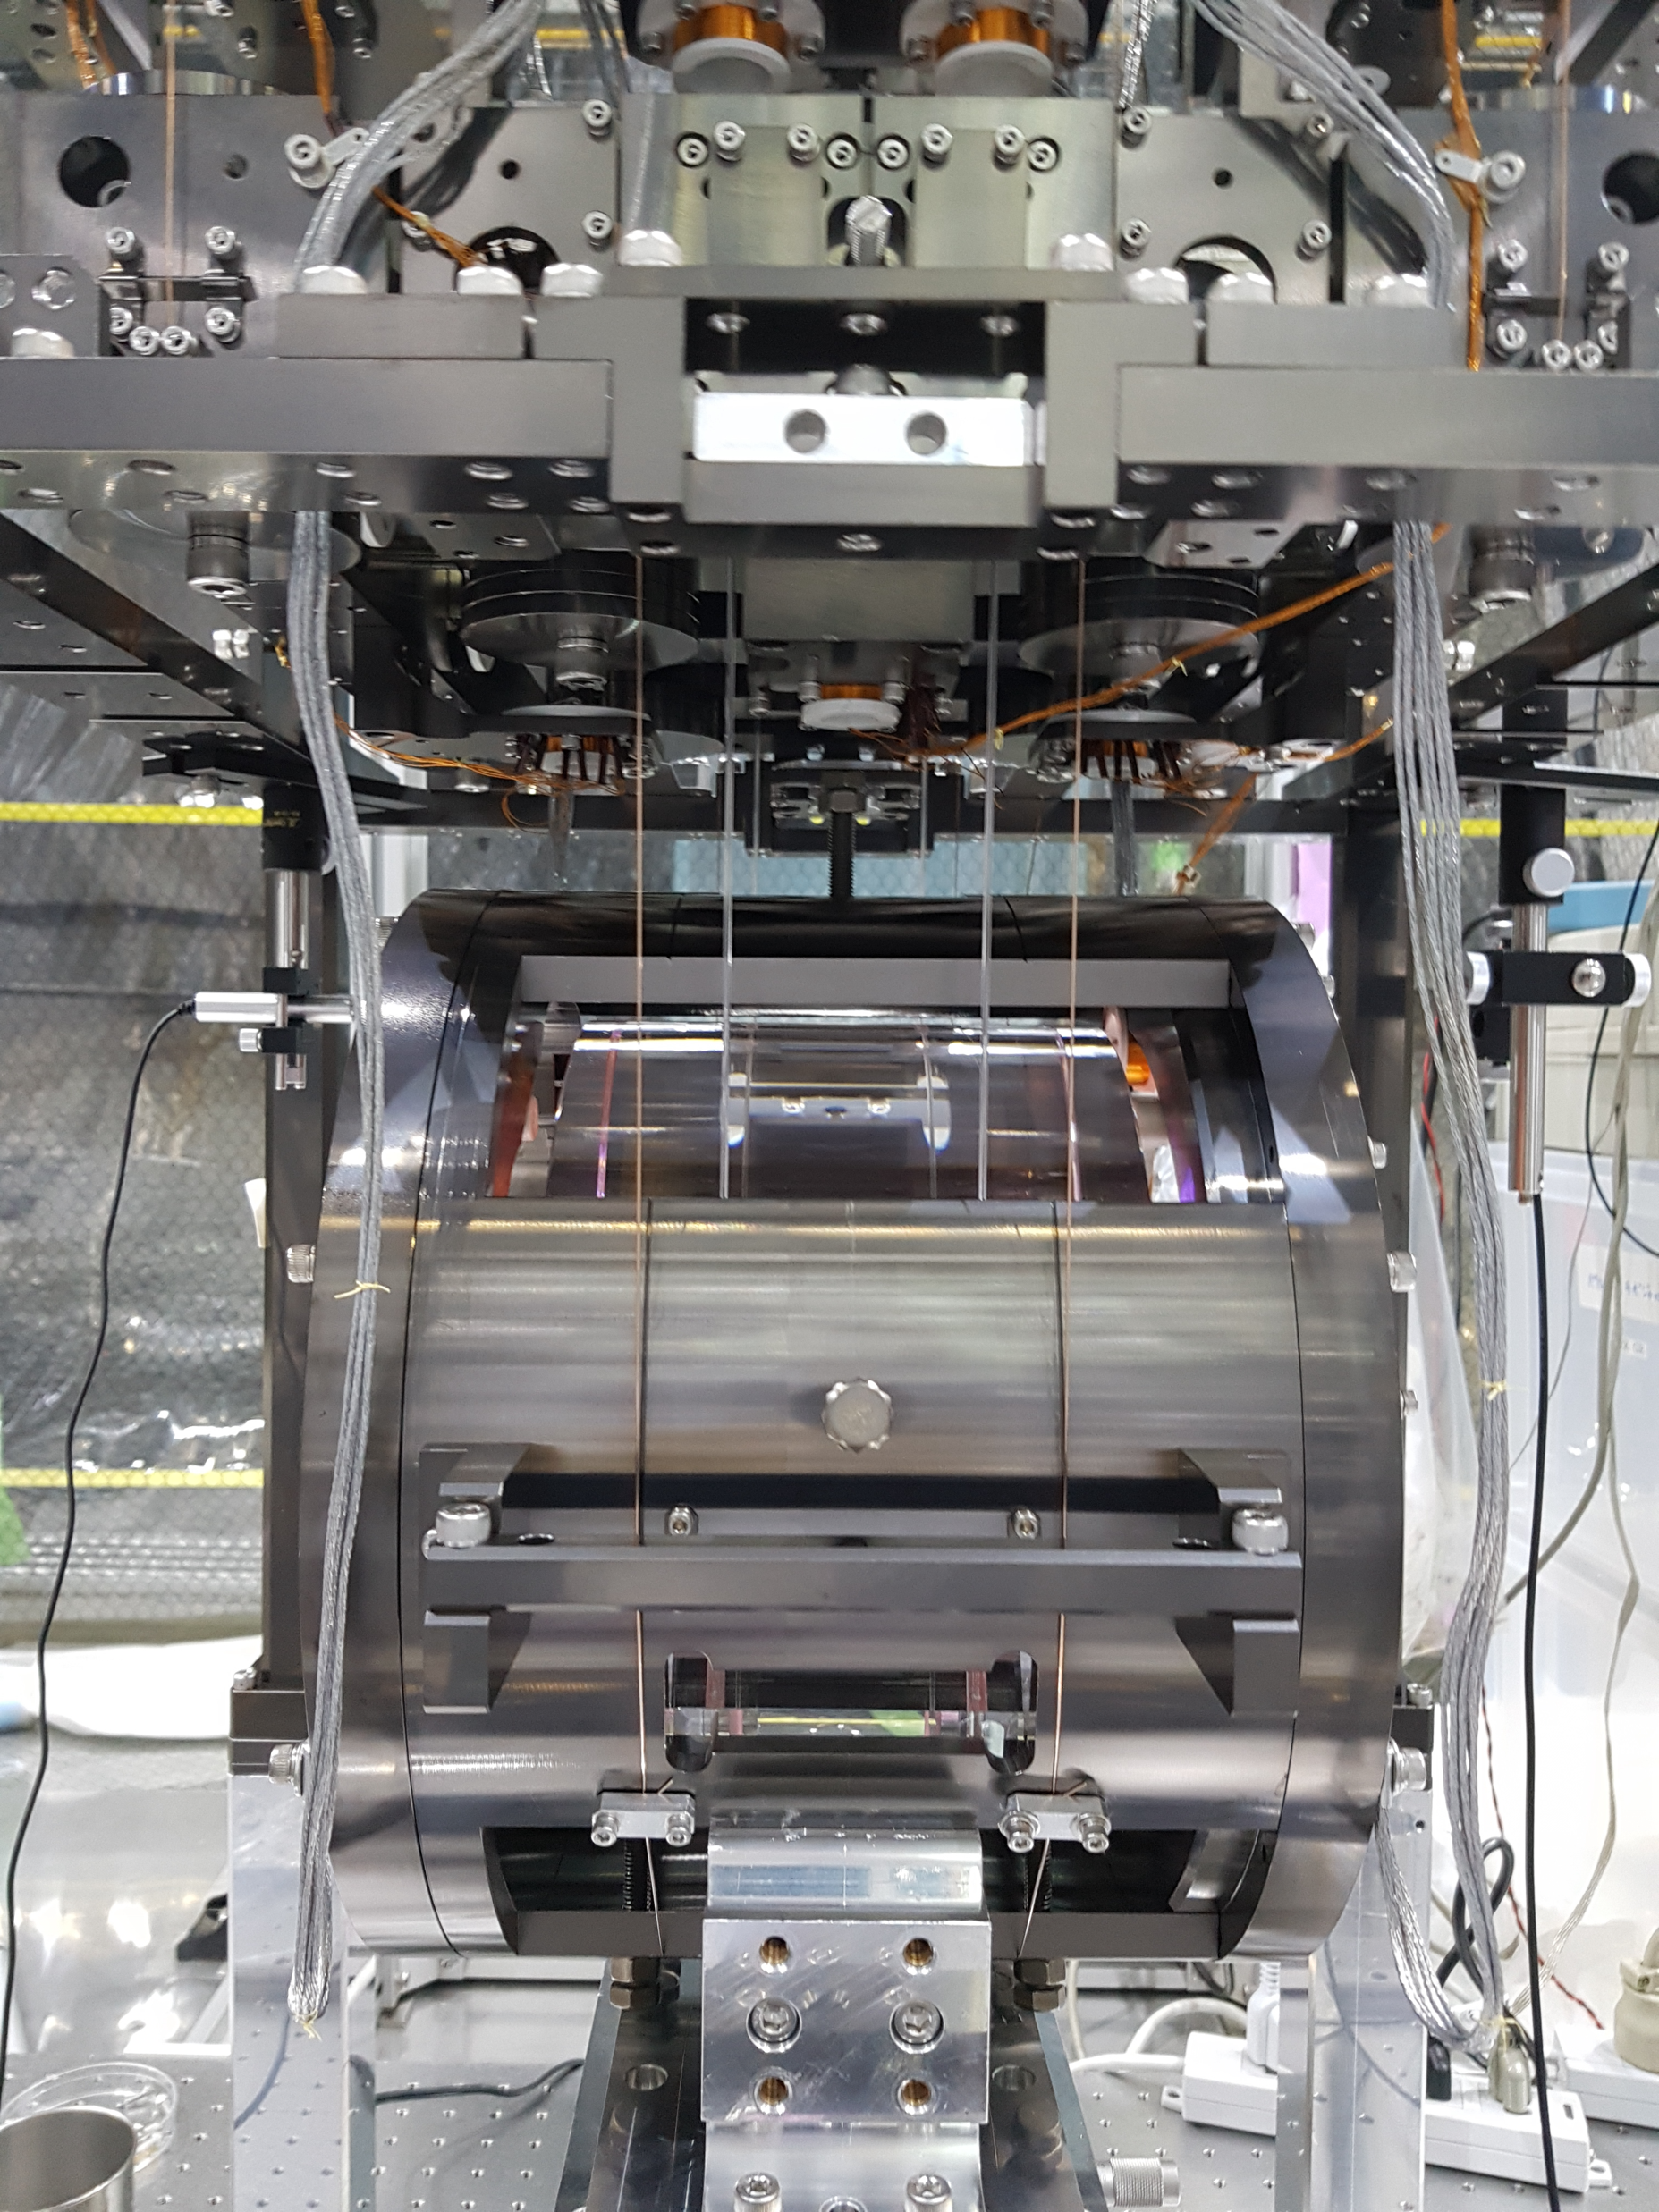
A special mention to
E. Benedetti,
Van Long Hoang, Benedetta Kalemi, Marco Orsini and
Marco Ricci
Challenges Pay

