Slide 1
Epic SVT preliminary F.E.analysis status
M. Benettoni, N. Bez, M. Turcato
Servizio Progettazione Meccanica
Feb. 2025

Slide 2
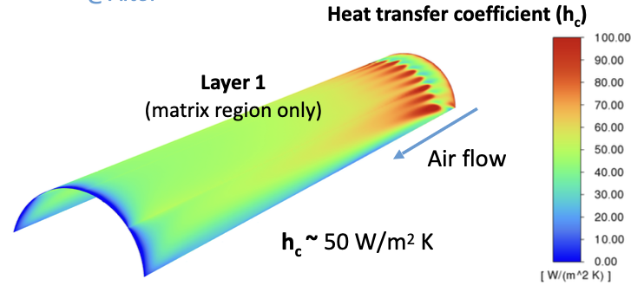
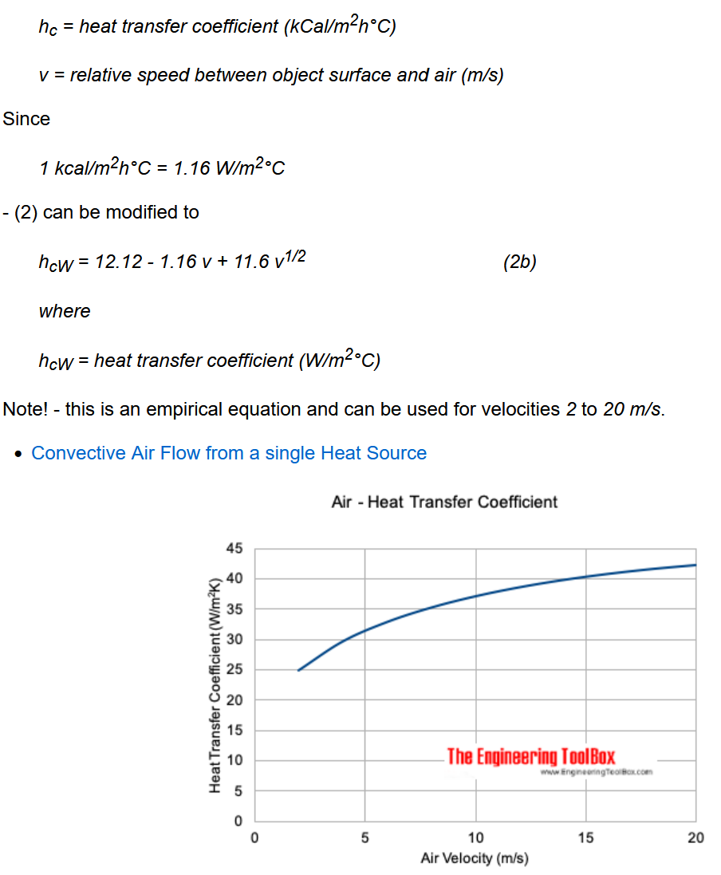

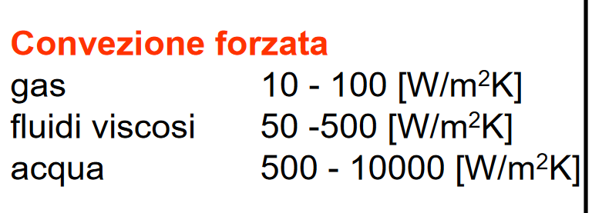
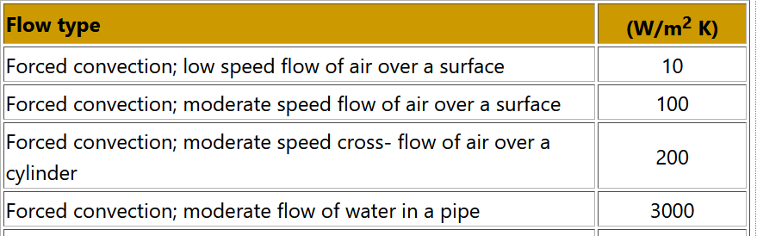
Preliminary heat trans. Coeff. estimate
Data from literature / web… : forced convection quoted to 10-100 W/m²K

Slide 3

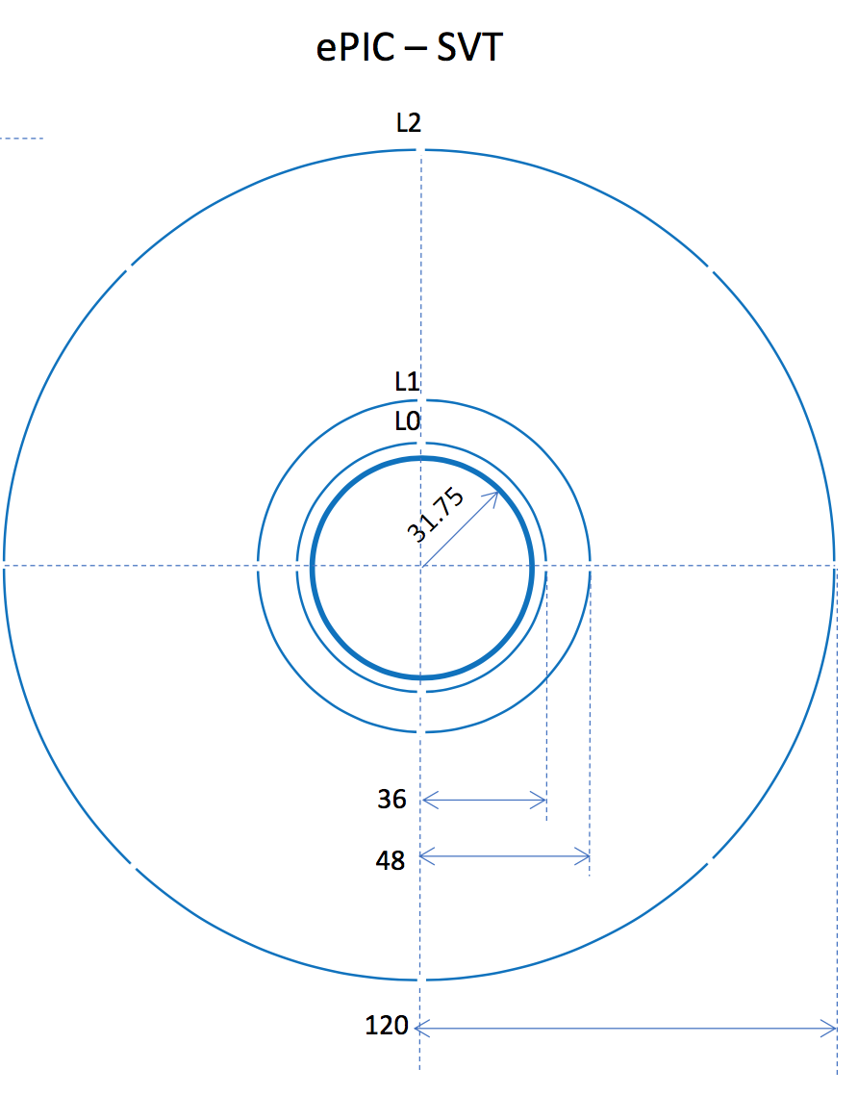
Rough calculation of L0&L1 temp esteem
Conservative? esteem assuming h.t.c. 25W/m2K, v=2.5 m/s
Ps=40 mW/cm2
Length ~ 26.6 cm
P/width = ~ 1 W/cm_width
Assuming htc 25 W/m2K = 0.0025 W/cm2K
Power from L0 + L1: Pw = 2 W/cm_width
A = 26.6 cm2 /sensor / cm_width
Dtemp = Pw /(hc 2A) ~ 15K
Dtemp is t_{sensor} vs t_{air} assuming both costant/uniform
Sensors to be ~ 15 K warmer than air (38K to ~ 4K for hc 10 to 100 W/m2K )
Air will get warmer along path depending on flow
E.g. with v=2.5 m/s
Flow 1.2 cm x 1 cm_width x 250 cm/s = 300 cm3/s/ cm_width
= 3 E-4 m3/s / cm_width : Q= 3.6 E-4 kg/s / cm_width
Air STP (Standard Temperature and Pressure): Cp 1006 J/Kg K , Ro 1.2 kg/m3
Dt air = Pw/QCp ~ 5.5 K from inlet to outlet @ 2.5 m/s
Expected warmest sensor area ~ 20.5K + air inlet temperature ….+ contingency …
(if no air dispersion, full flow, 25W/m2K, v=2.5 m/s on A=19.5 cm2 => ~5 l/s vs ~ 0.5 l full gap volume, ~ 10 V_exchange/s)
Not considered:
“4.5…(mm wide «border» ?) nella ‘’left end-cap’’, dove escono anche i dati e
si trova dal lato ‘hadron’, che consuma circa 800 mW/cm^2 … per che «larghezza»?

Slide 4
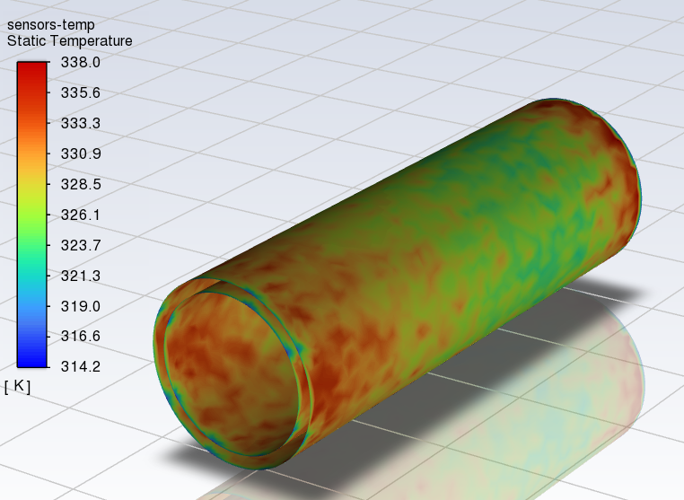
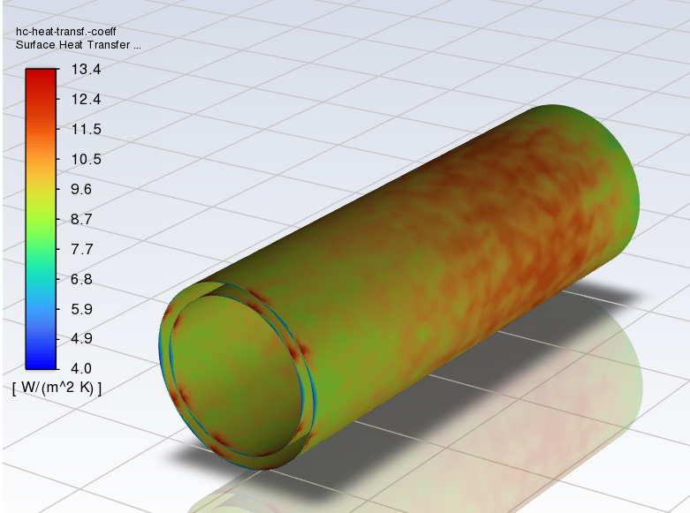
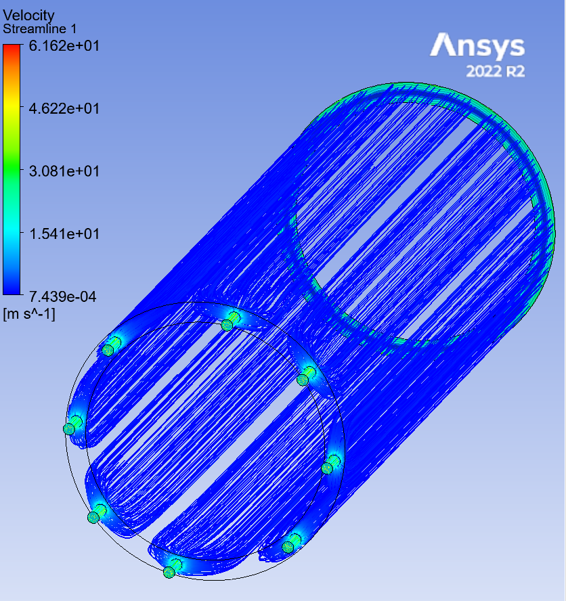
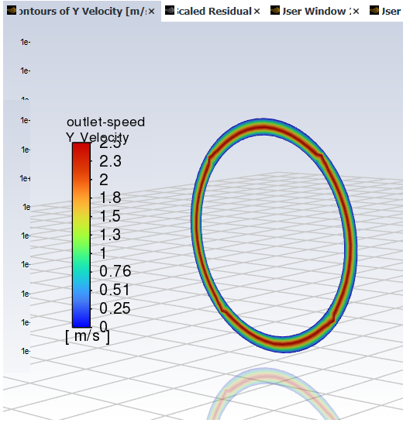
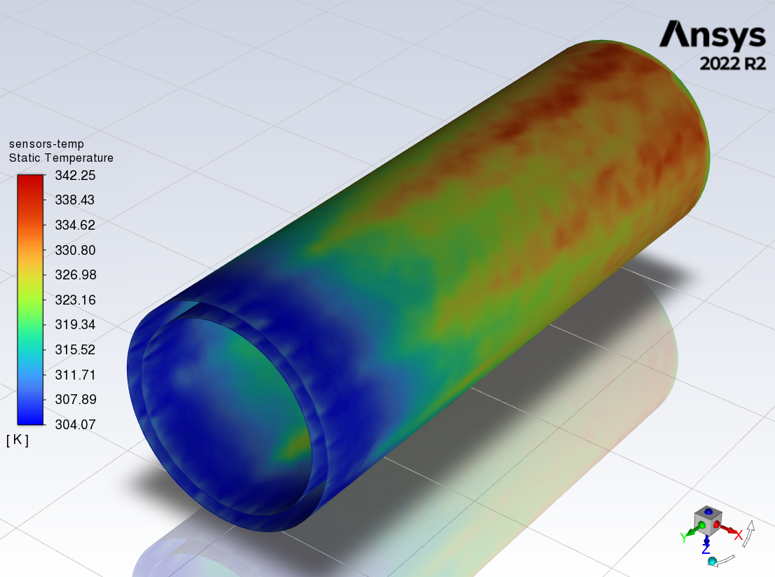
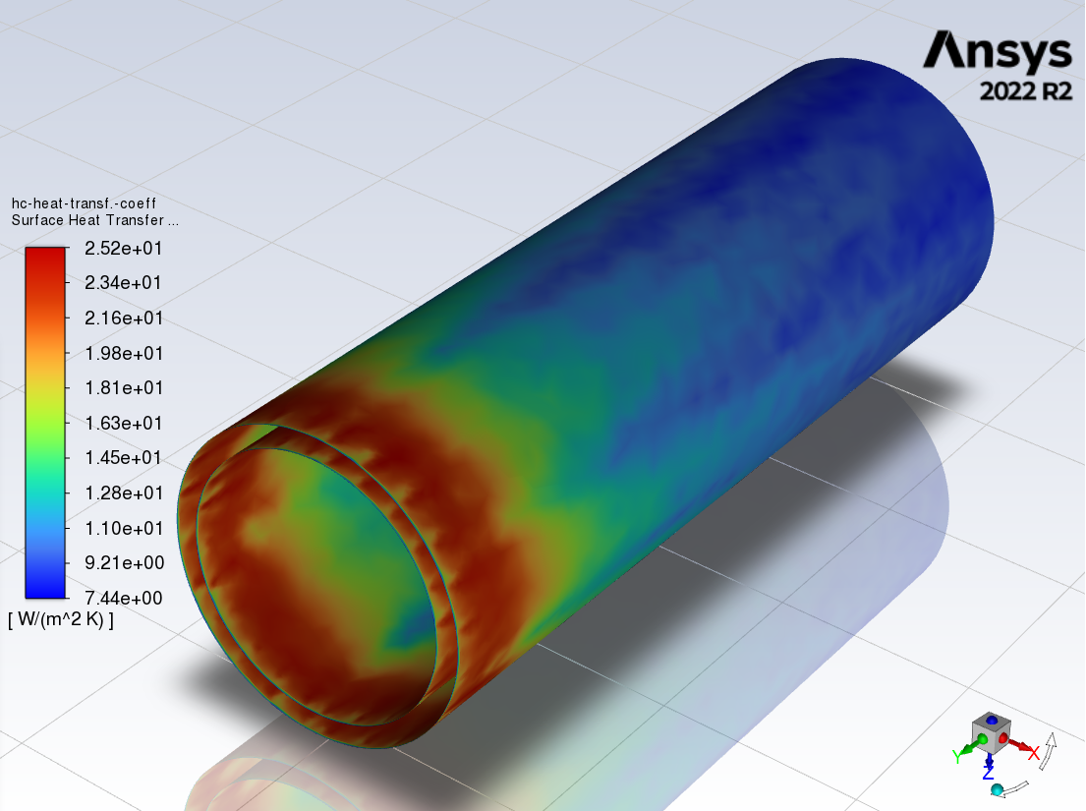
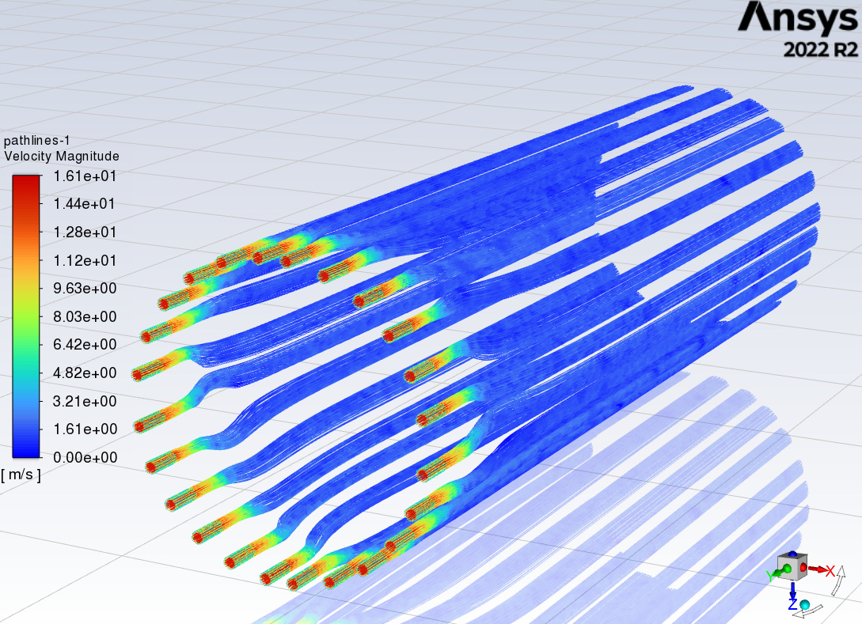
preliminary CFD simulations
First trials: localized inlets/nozzles, full section outlet @ 2.5 m/s
Inlet: array of 6x4 nozzles, 15m/s; outlet open, average speed 2 m/s; 40 mW/cm2 uniform on both surfaces
Spotted / dispersed color maps, strange patterns => cause: poor mesh => improved mesh (mesh inflation on surfaces)

Slide 5
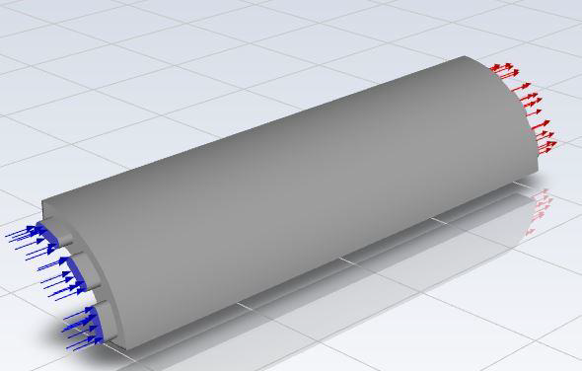
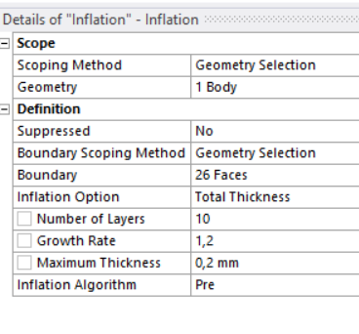
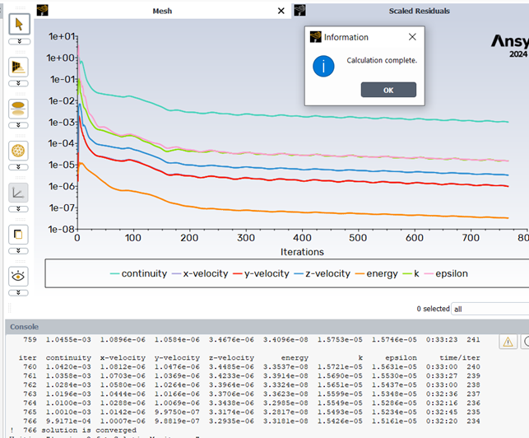
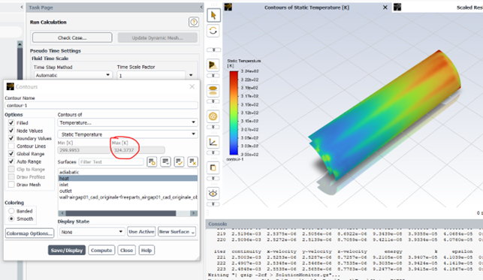
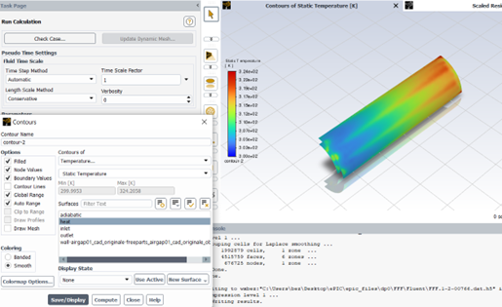
Improved preliminary CFD simulations and main parameters investigation
More realistic nozzles/inlets, added outlet opening, improved mesh (inflation, 10 layers, 0.2 mm max thickness),
v inlet @ 15 m/s, P = 400 W/m²
Additional investigation of results vs:
n. of iterations e.g. 233 vs 766 iterations (convergence reached) : no relevant difference in results
mesh sensitivity: n. and thickness of inflation layers : no relevant difference in results

Slide 6
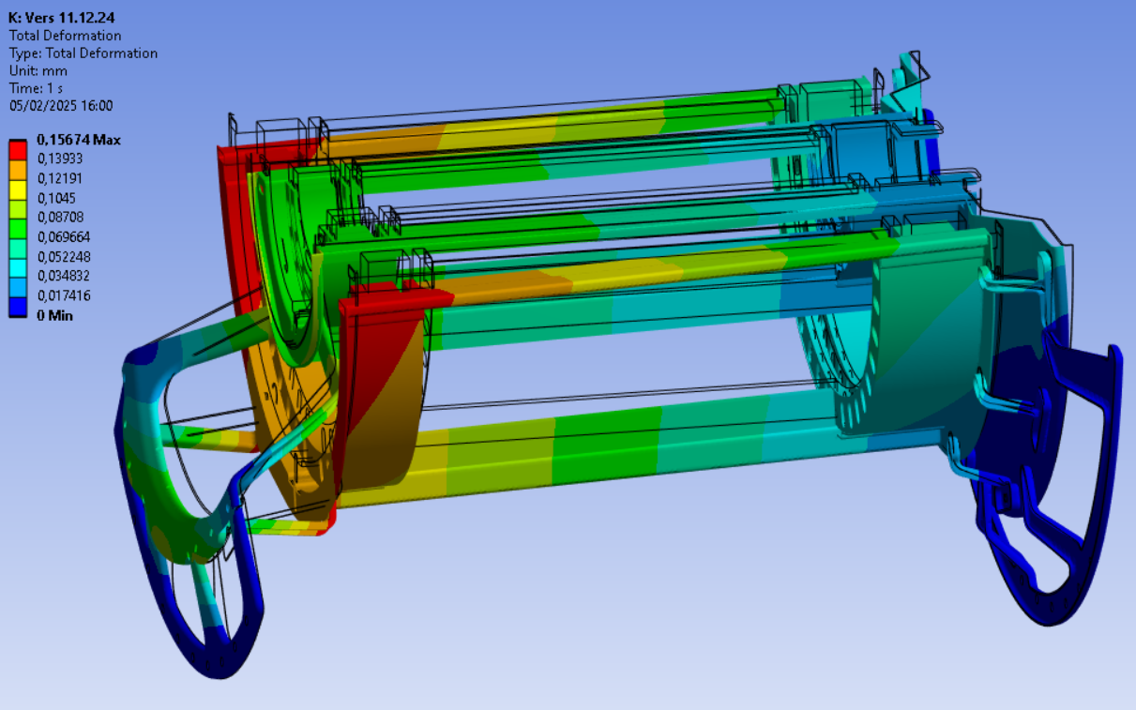
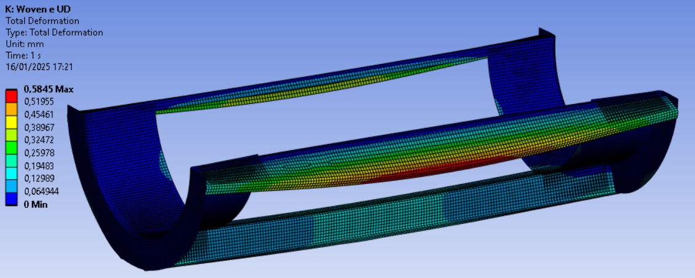
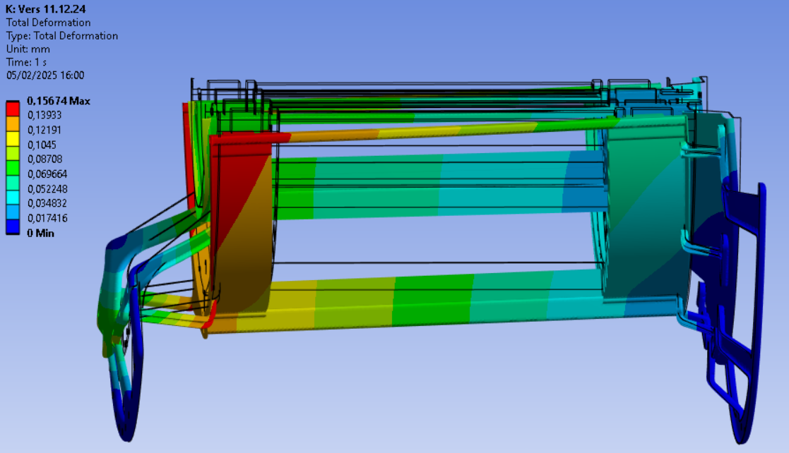
Preliminary static structural simulations
Initial attempt: uniform thickness 1 mm, Isotropic material E=50GPa, overall gravity load ~ 16N
(includes 50% contingency)
2nd iteration:
FEA of simplified L1 layer only, assuming:
Arcs composed by orthotropic CF woven E=61 GPa
Beams composed by unidirectional CF E_{l}=121 Gpa, E_{t}= 8.6 GPa
Shell elements thickness 0.2 mm on the “sensor half-cylinder”
Shell elements thickness 0.6 mm on the support “cones”
E.g. L2 supports to increase stifness …
Work in progress to refine geometry and FEA models to
minimize deformation / displacement of sensors, with minimal amount of structure mass

Slide 7
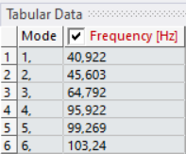
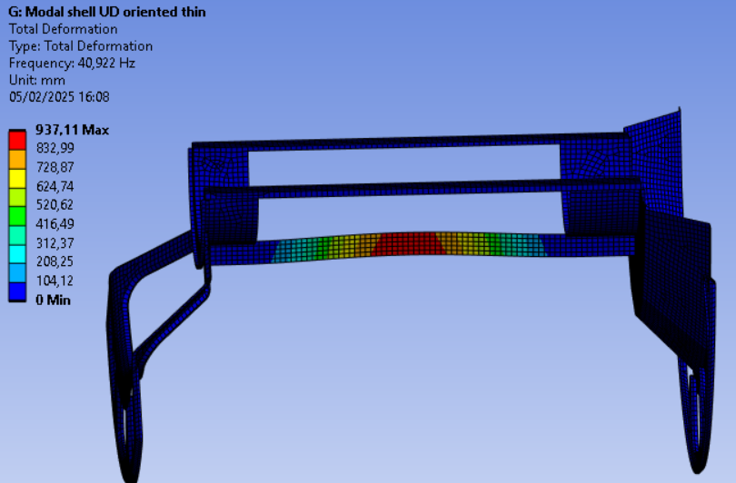
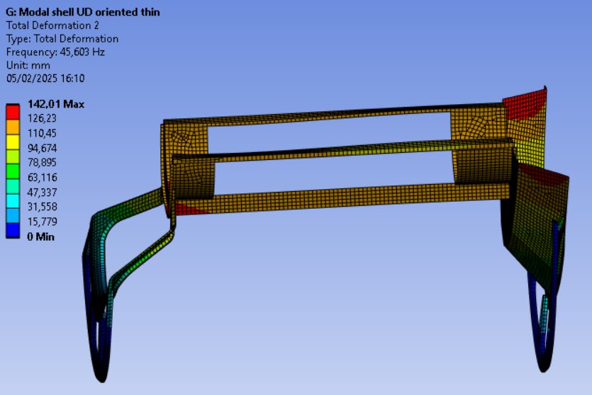
Preliminary modal simulations
Arcs composed by orthotropic CF woven E=61 GPa
Beams composed by unidirectional CF E_{l}=121 Gpa, E_{t}= 8.6 GPa
Shell elements thickness 0.4 mm on the “sensor half-cylinder”
Shell elements thickness 0.6 mm on the support “cones”
1st mode: bottom beam deflection … 2nd mode: axial oscillation (along Z)
Work in progress to refine geometry and FEA models to
design stiffer as possible structure, high natural frequencies, with minimal amount of structure mass

