Slide 1
DOM & DU tendering and assembly

Slide 2
Estimation of the total costs for the DU’s in m€.
Notes:
2
6-July-2010
Organizing future KM3net production

Slide 3
European public tendering;
-Tendering procedure necessary > 192 k€. (2011)
-Tendering can be done as a consortium
-Including preparation approximately 6 months, minimum 4 months.
-Delivery time has to be added!
Lowest price <-> economically best offer
????
3
Notes:
3

Slide 4
Mechanical parts;
Tendering procedure relatively simple, narrow constrains (drawings) and much competition. If the drawings are 100% clear the tendering procedure can be done on “lowest price”
-A total of 20 M€ of mechanical parts.
-All pure mechanical parts in one European public tendering document, a complete package divided in lots, each part 1 lot, possibility of obtaining an order for any amount of lots.
-Producing such a tender 4 times, starting with 10% (2 M€) of the total amount, subsequently another 3 tenders of 30 % (6 M€) of the total amount.
-Bigger amounts will not reduce the prices drastically.
-Estimated delivery time 2-3 months.
4
Notes:
4

Slide 5
Delivery of glass spheres;
Tendering procedure relatively simple, enough competition and production relatively easy to expand. If the requirements are completely clear the tendering procedure can be done on “lowest price”.
-A total of 3 M€ of glass spheres can be expected.
-Tendering procedure could be done by asking prices for batches of e.g. 4.000, 8.000 and 13.000 pieces.
-Conical holes to be decided.
5
Notes:
5

Slide 6
Delivery of the electronic boards;
Tendering procedure relatively simple, but more attention needed for quality of work at the producer and proof of this, also much competition, the tendering procedure can not be done on “lowest price” only.
A total of 35 M€ for electronic boards;
-6 M€ for the bare boards, probably to be tendered in one document with 6 lots and a small (5%) preproduction series.
-29 M€ for assembly and components, also 6 lots, probably better to divide in lots than to use different producers for one kind of board (so one producer for 12800 boards)
-Estimated delivery time 3 months for the boards and 3 months for assembly of a small (5%?) preproduction series.
6
Notes:
6

Slide 7
Delivery of the VEOC’s and BEOC’s;
Tendering procedure quite complicated due to lack of competition and high risk component.
It is under discussion if the VEOC’s should be made external or internal, BEOC’s probably should be produced externally.
If European public tendering is chosen for the VEOC, more firms should be contacted to interest them.
The for this kind of product high earning rates and lack of competition make this mandatory.
For the VEOC’s the aim should probably be only one external firm due to the special production line that has to be build for it.
For the BEOC tendering procedure could be done by asking prices for batches of e.g. 4.000, 8.000 and 13.000 pieces.
A total amount of 12 M€ for the VEOC’s can be expected if externally produced, another 5 M€ for the BEOC’s .
7
Notes:
7

Slide 8
Tendering procedure complicated due to lack of competition, the tendering procedure could be done by asking prices for batches of e.g. 100.000, 200.000 and 300.000 pieces. Afterwards the optimal combination of producers could be chosen (if there is more than one producer).
A total amount of 50 M€ for the PMT’s can be expected;
Delivery of the PMT’s;
8
Notes:
8

Slide 9
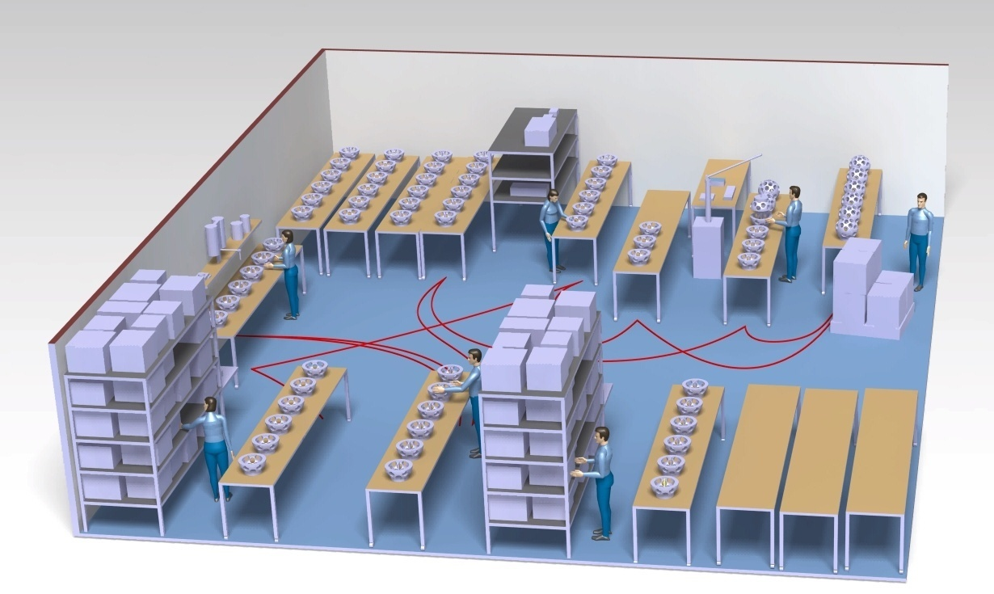
9
Notes:
9

Slide 10
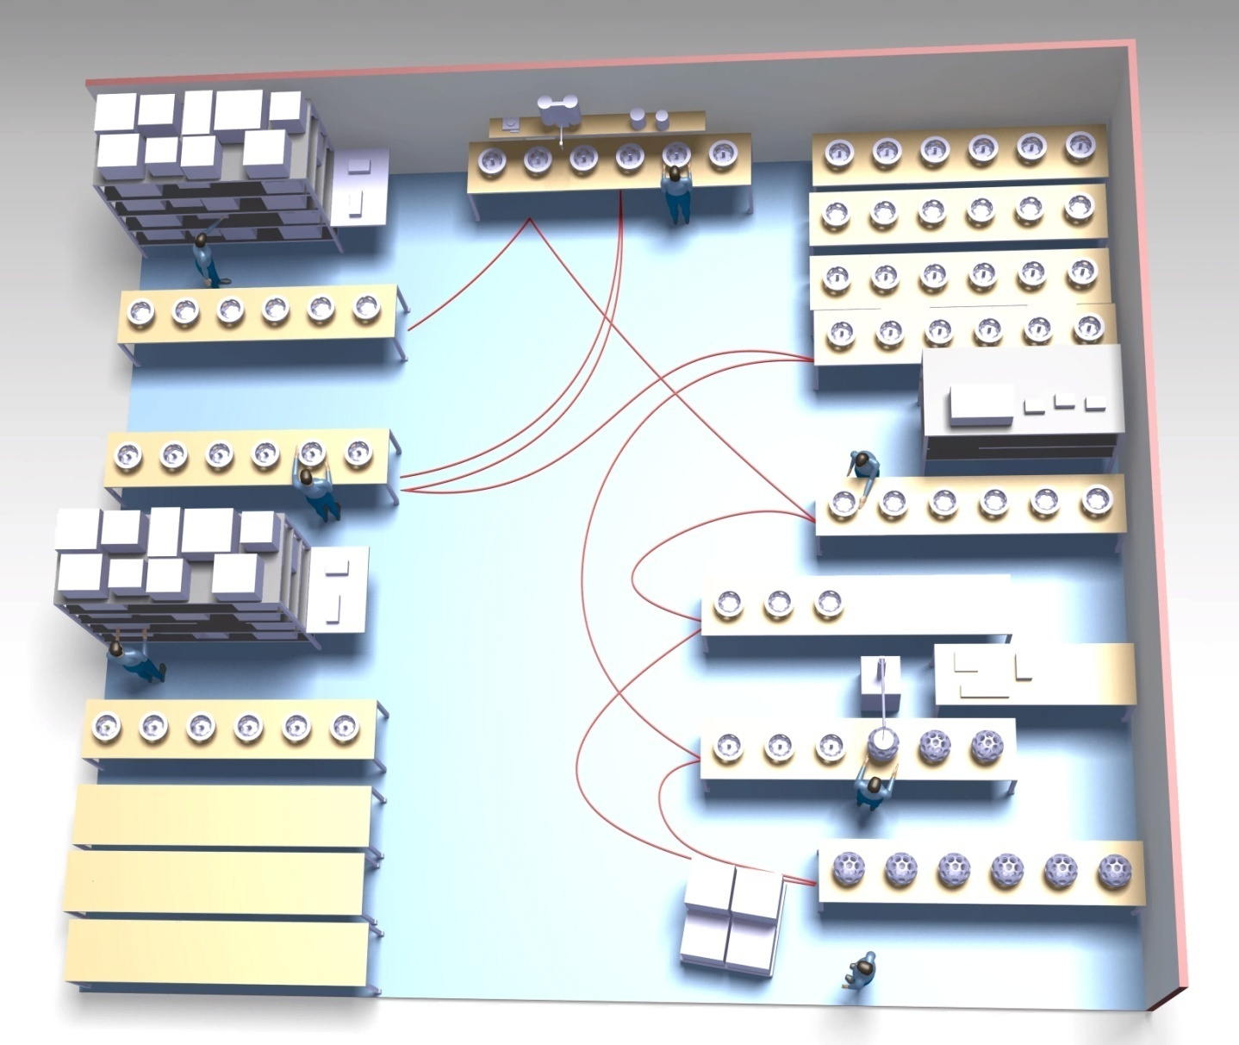
Gel-filling for top-and bottom hemisphere + test before filling.
Storage for components, sufficient for one day.
Storage-buffer for ready and partly ready products.
Assembly of bottom hemisphere, pmt’s with bases and signal collection board
Test setup for both top and bottom- hemispheres.
Two assembly-tables for top hemisphere, pmt’s and electronics.
Assembly of dom’s, simple end check.
Storage-buffer for empty (rolling) tables.
Packaging and transport.
Tasks: packaging, gel-filling and Functional test before filling.
10
Notes:
10

Slide 11
As an example; three sites to assemble OM’s, and one site that exclusively produces complete DU’s.
DOM production, 6 sites, per site;
-8 Fte
-250 m² production and testing.
-100 m² storage.
For DU production at 1 site;
-11 Fte
-1000 m² assembly and testing.
-storage (750 m²)
11
Notes:
11

Slide 12
“Reminder”
Total manpower needed (for production, assembly and
quality control at production);
60 fte during four years
A bit more specified on the next slide;
12
Notes:
12

Slide 13
Estimation of the assembly-hours in Fte years for the DU’s.
OM-assembly is incl. electronics.
5 Du’s ready
50 Du’s ready
140 Du’s ready
230 Du’s ready
320 Du’s ready
Fte.
Notes:
13
6-July-2010
Organizing future KM3net production

